Slide 1
Experimental considerations in searches for new physics with cold atoms
Matthew Jones
Durham University

Slide 2



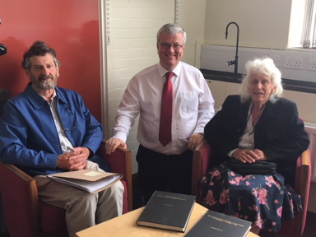

Acknowledgements
Matt Jones
Dr. Joseph Scott
David Carty
Joseph Scott
Funding: Frances and Rodney Stubbs
JS thesis https://etheses.durham.ac.uk/id/eprint/15616/?template=default

Slide 3
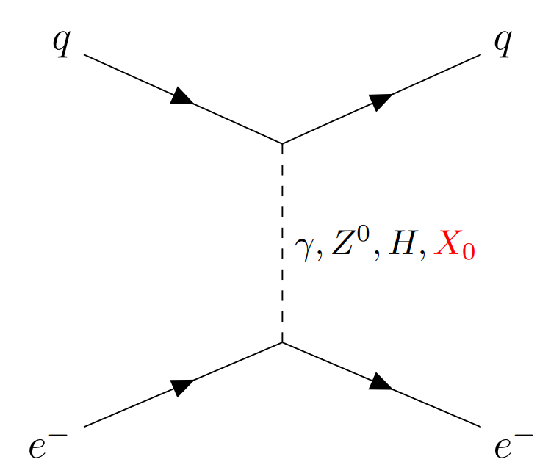
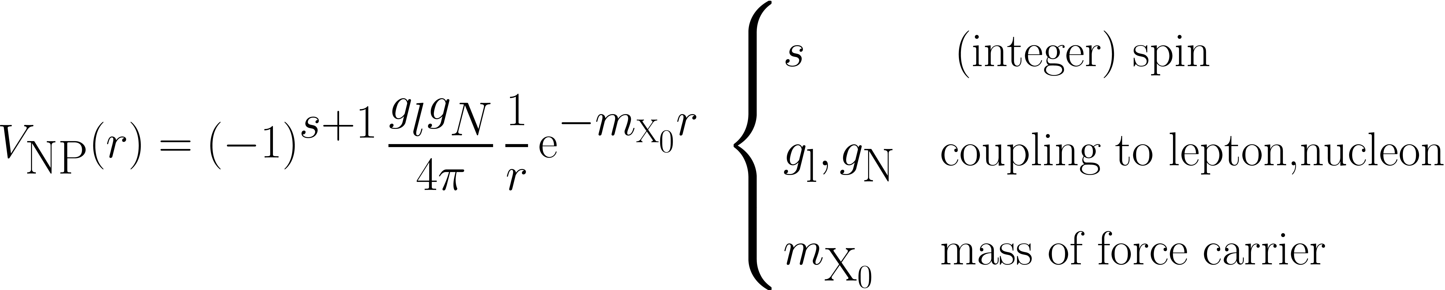
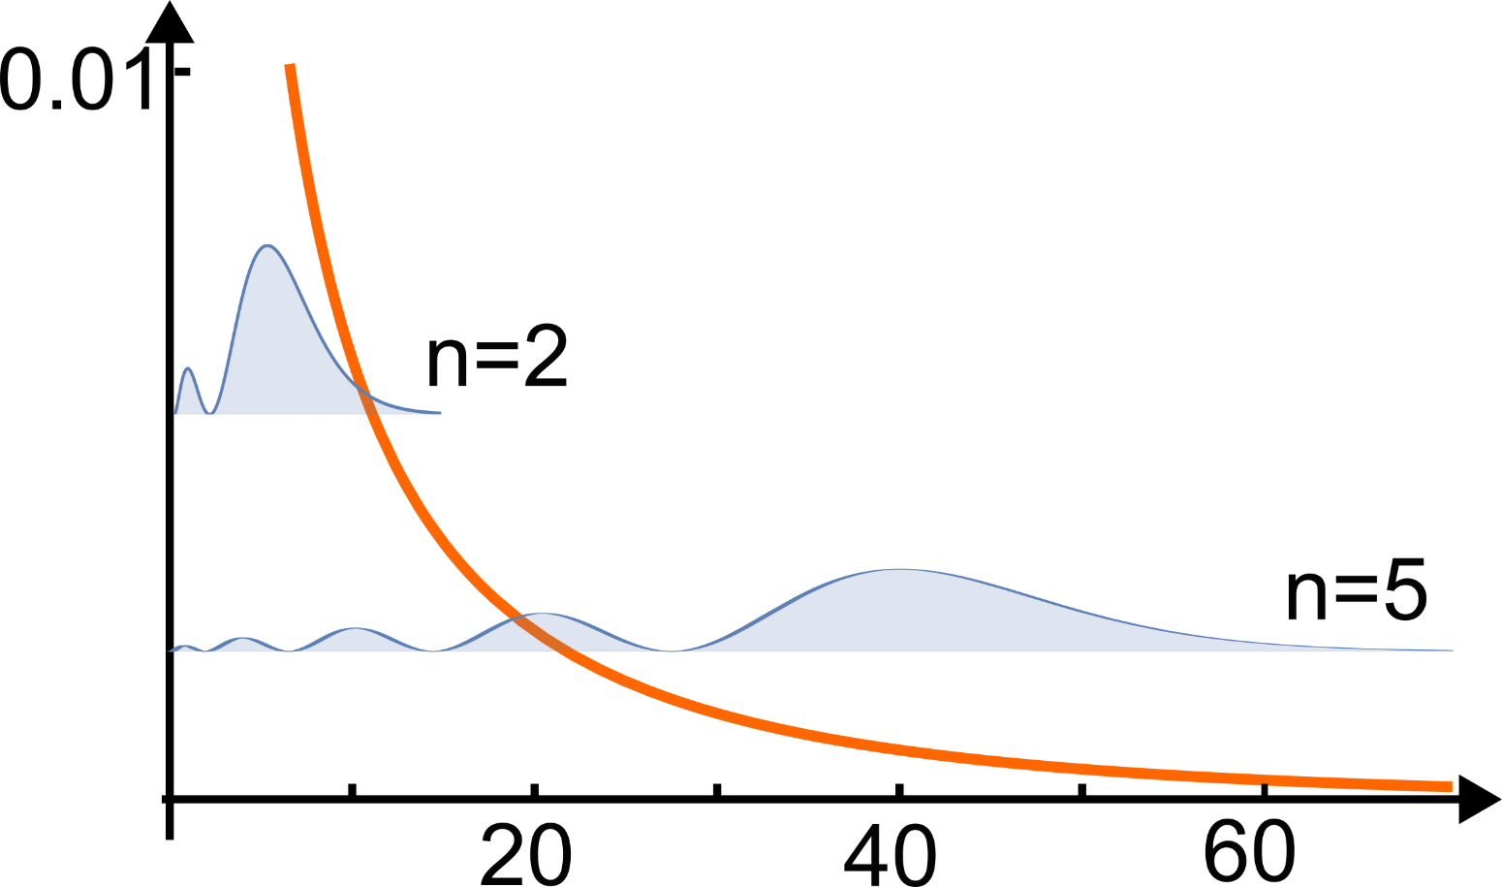

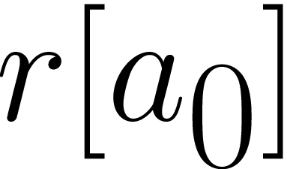
Motivation: testing the Standard Model
Theory: Robert Potvliege’s talk

Slide 4
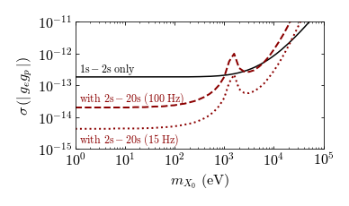
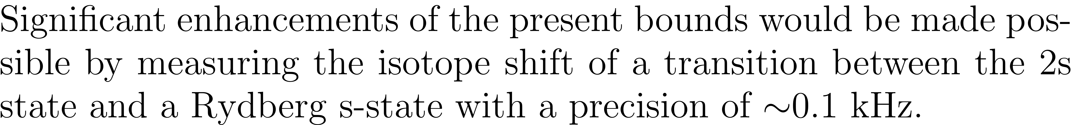
Hydrogen energy levels (1)
From Robert’s talk
Bounds based on the isotope shifts of two different transitions (gn = gp)
Phys. Rev. A 108, 032825 (2023), also Delaunay et al (2017)

Slide 5
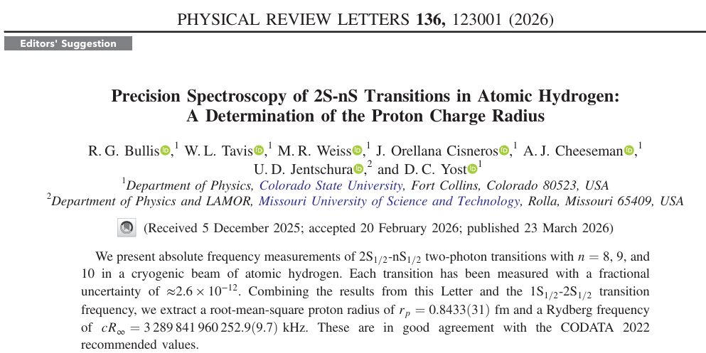
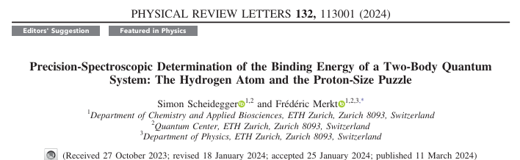


The state-of-the-art
Currently at 10 kHz

Slide 6
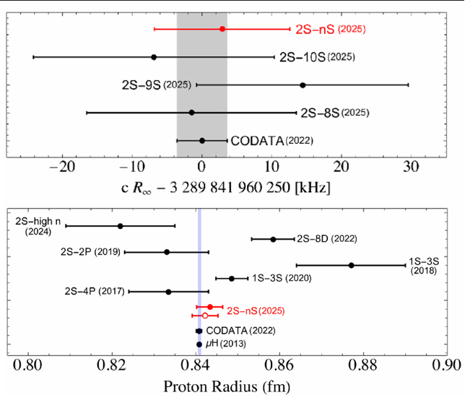
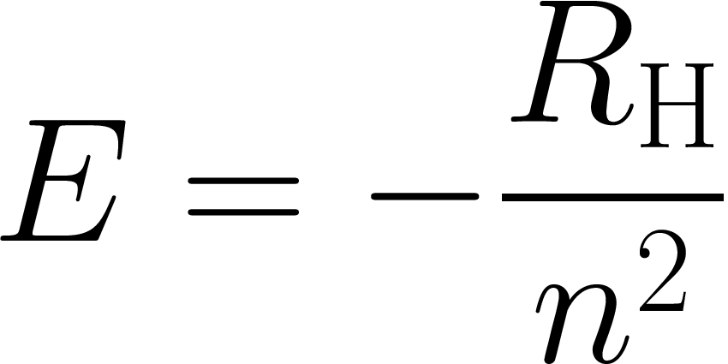





Systematics
Rydberg constant
From Bullis et al., PRL 136, 123001 (2006)
Proton radius
NB all of these values rely on H 1S-2S measurement
Parthey et al., Phys. Rev. lett. 107 203001 (2011)

Slide 7
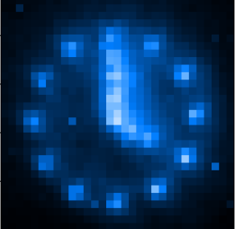
Outline
How can we gain three orders of magnitude in precision measurements of H and D atoms?
Current measurements
Spectroscopy with trapped atoms
Spectroscopy with trapped H/D atoms
Towards trapped hydrogen measurements

Slide 8
Current measurements

Slide 9
Energy levels and transitions
S
P
D
20
0 eV
3
2
1
-13.6 eV

Slide 10
Energy levels and transitions
S
P
D
20
0 eV
3
2
2P: τ≈1.6 ns
Lyman-α
121.567 nm
1
-13.6 eV

Slide 11
Energy levels and transitions
S
P
D
20
0 eV
3
2S: τ≈0.12 s
metastable
2
2P: τ≈1.6 ns
1
-13.6 eV

Slide 12
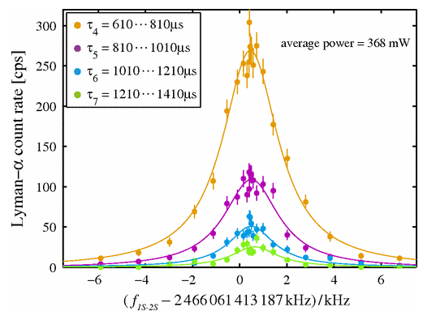

Energy levels and transitions
S
P
D
20
0 eV
3
2S: τ≈0.12 s
metastable
2
2P: τ≈1.6 ns
243 nm
243 nm
1
-13.6 eV
Line split by a factor of ~100
Parthey et al., Phys. Rev. lett. 107 203001 (2011)

Slide 13
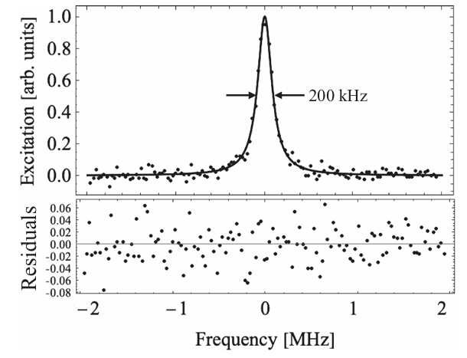
Energy levels and transitions
S
P
D
20
0 eV
3
759 nm
759 nm
2S: τ≈0.12 s
metastable
2
1
Bullis et al., Phys. Rev. Lett. 136 123001 (2026)

Slide 14
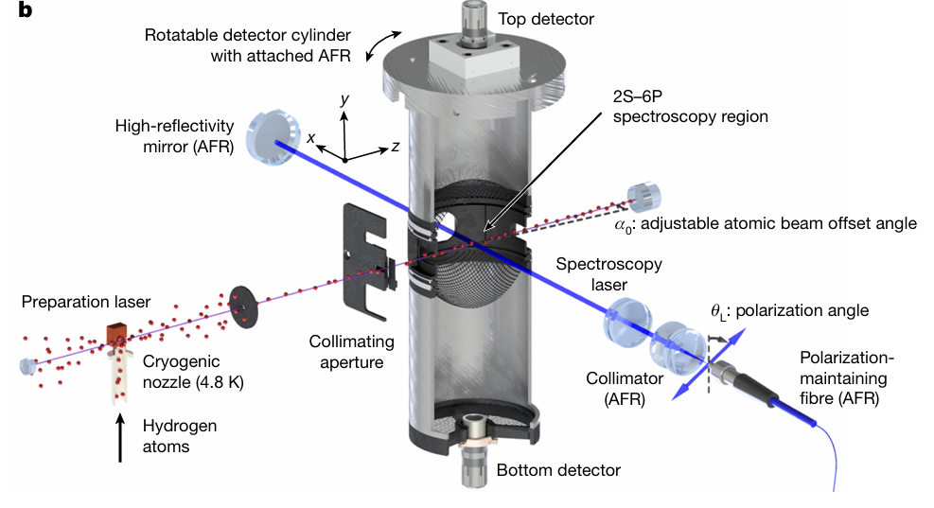
The current generation of experiments
Maisenbacher et al., Nature 650 845 (2026)

Slide 15
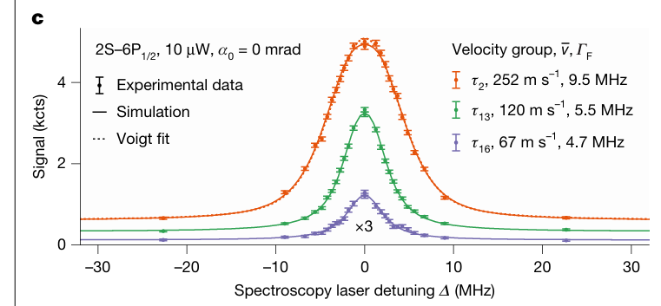
The current generation of experiments
Maisenbacher et al., Nature 650 845 (2026)

Slide 16
Velocity-dependent systematics
[systematic] shifts are also nonlinear due to the Gaussian beam intensity profile and the presence of many atomic trajectories, all of which sample slightly different ac Stark shifts
From Bullis et al., PRL 136, 123001 (2006)
Complex velocity-dependent lineshape models are required

Slide 17
Spectroscopy with cold trapped atoms

Slide 18
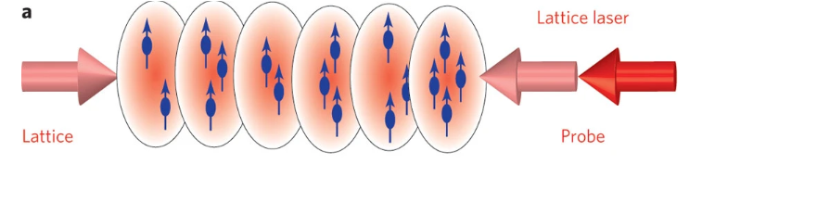
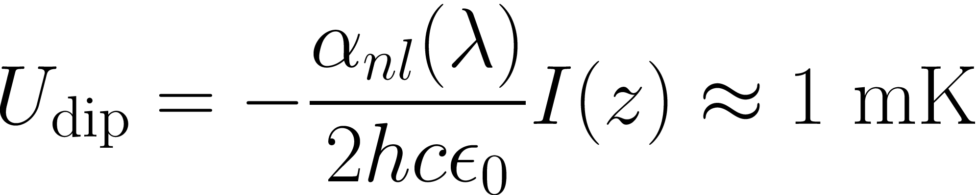


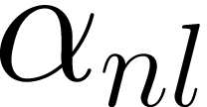





Lattice clocks – trapped atoms
H. Katori, Nat. Photonics 5, 203 (2011)

Slide 19

Lattice clocks – trapped atoms
H. Katori, Nat. Photonics 5, 203 (2011)

Slide 20
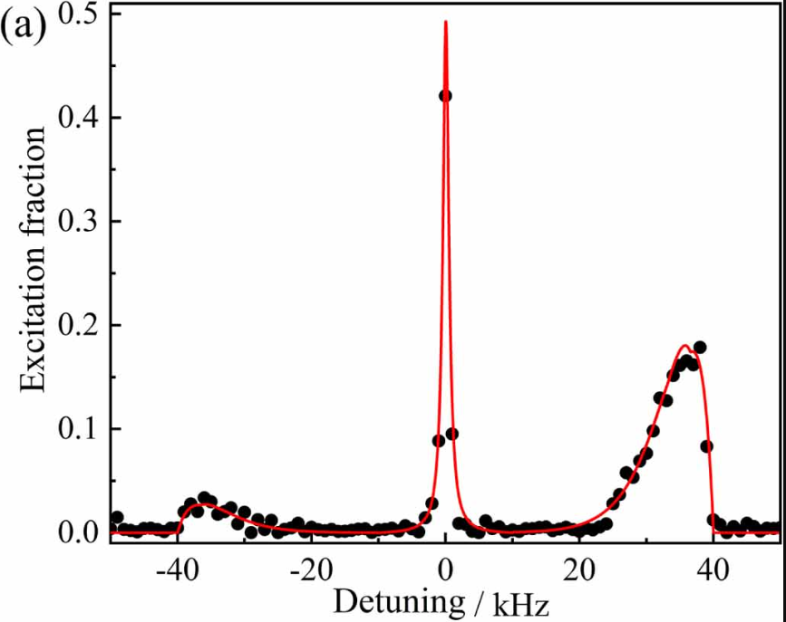


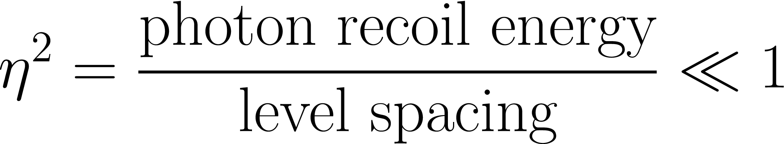
Lattice clocks – trapped atoms
Xiao-Tong Lu et al., Metrologica 62, 035007 (2025)
Carrier lineshape is independent* of velocity!
H. Katori, Nat. Photonics 5, 203 (2011)
Lamb-Dicke parameter

Slide 21
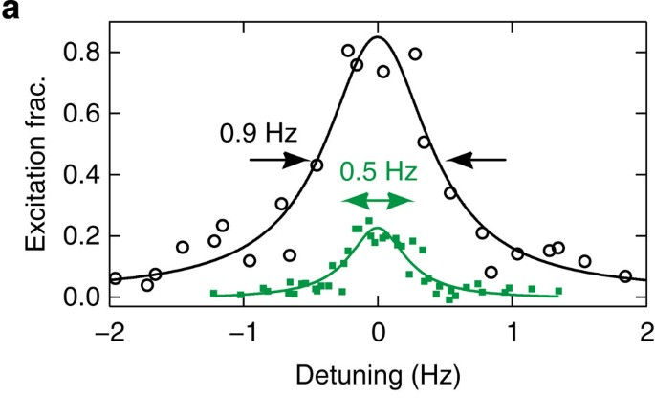
State-of-the-art
2 kHz
Nicholson et al., Nat. Commun. 6, 6896 (2015)
Accuracy and instability at 2 10^-18 level (0.001 Hz)
[Better than the SI second] 10^-16 level

Slide 22
Towards a H 1S-2S lattice clock
J. P. Scott et al., Metrologica 61, 025001 (2024)
J. P. Scott et al., J. Open Res. Softw. 14, 16 (2026)
See also
Amit et al., J. Phys. Conf. Series 2889,012027 (2024)
Amit et al., Phys. Rev. A 112 033101 (2025)

Slide 23
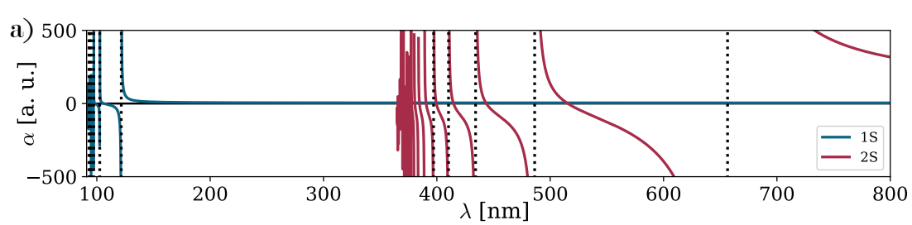
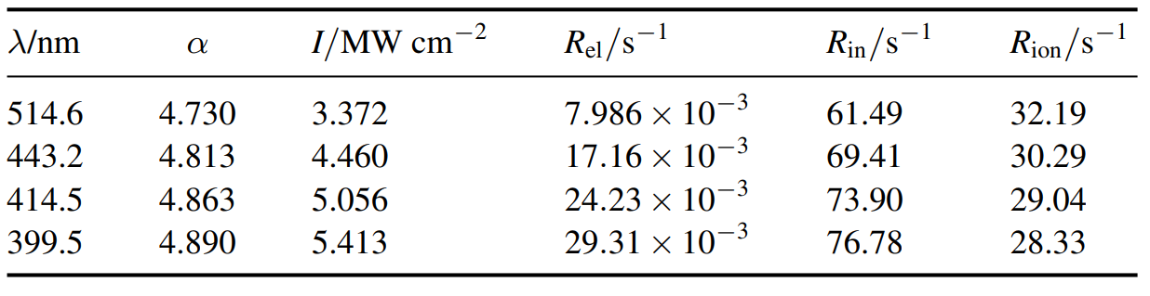

Magic wavelength
Calculated polarisabilities of 1S and 2S states using implicit summation method that included continuum (ca. 10%) [4]. Magic wavelengths for 1S – 2S transition where curves cross.
1S – 2P etc.
2S – 5P etc.
2S – 3P
2S – 4P
Low 1S polarizability means high lattice laser power is required.

Slide 24
Loss channels
S
P
D
20
0 eV
3
Inelastic scattering
2S: τ≈0.12 s
metastable
2
1

Slide 25
Loss channels
S
P
D
20
0 eV
3
Inelastic scattering
2. Two-photon ionization
2S: τ≈0.12 s
metastable
2
1

Slide 26
Loss channels
S
P
D
20
0 eV
3
Inelastic scattering
2. Two-photon ionization
2S: τ≈0.12 s
metastable
2
1

Slide 27
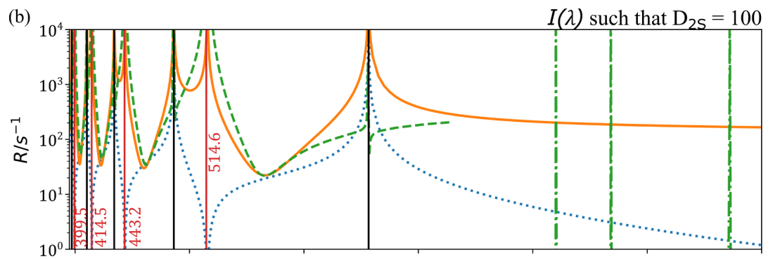
Broadening and loss
Elastic
Inelastic
2ph ion.
3ph ion.
Elastic and inelastic scattering rates, and two- and three-photon ionization rates versus wavelength for 2S atoms in a lattice with a depth of 100 times the recoil energy. Red vertical lines indicate the magic wavelengths. Reproduced from [C].
Much higher than radiative decay (lifetime) of 2S state => transition is strongly broadened

Slide 28
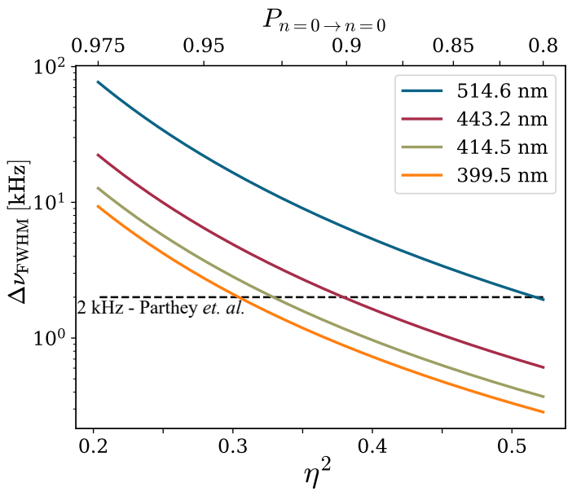
How bad is it (its bad)
Minimum achievable linewidth versus Lamb-Dicke parameter (bottom) and motional carrier strength (top) at the four different magic wavelengths. Dashed line indicates the state-of-the-art for beam measurements [6]. Reproduced from [7].

Slide 29
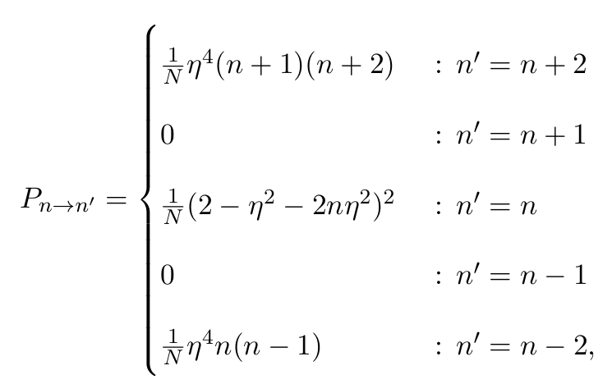
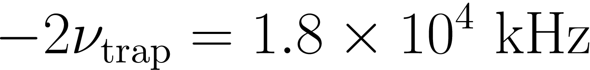

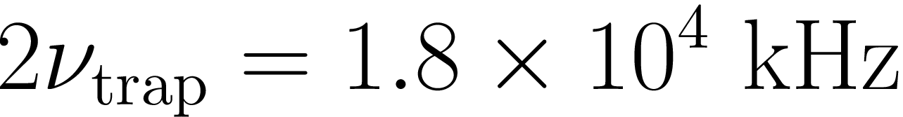
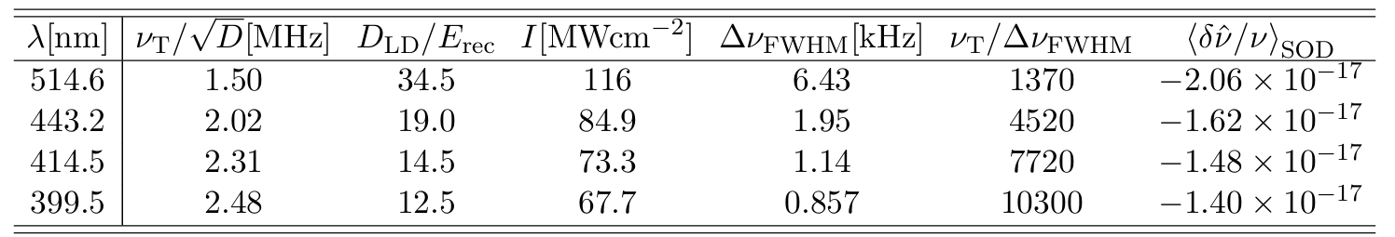
How bad is it (maybe not that bad)

Slide 30
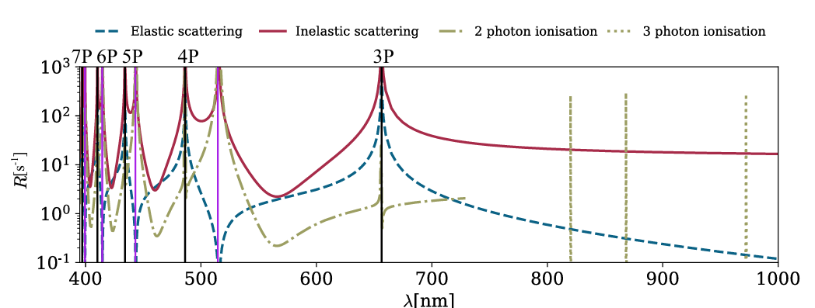
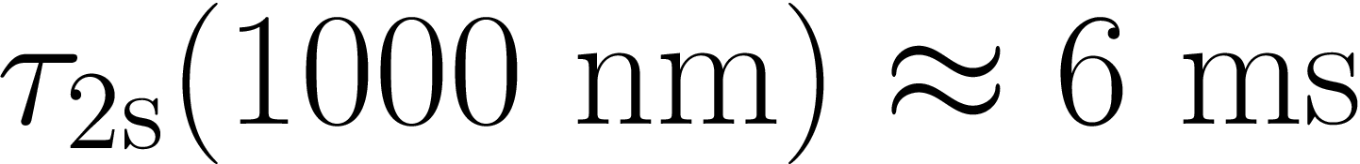
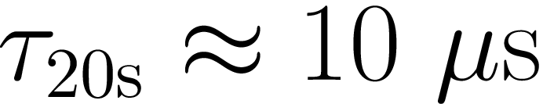
Other transitions

Slide 31
Summary
Losses mean a hydrogen lattice clock will not work as well as a “normal” lattice clock
1S-2S may still be improved due to elimination* of motional systematic errors
For 2S-nS transitions, a long-wavelength lattice could act as a reservoir of cold 2S atoms for spectroscopy

Slide 32
A route to trapped hydrogen

Slide 33
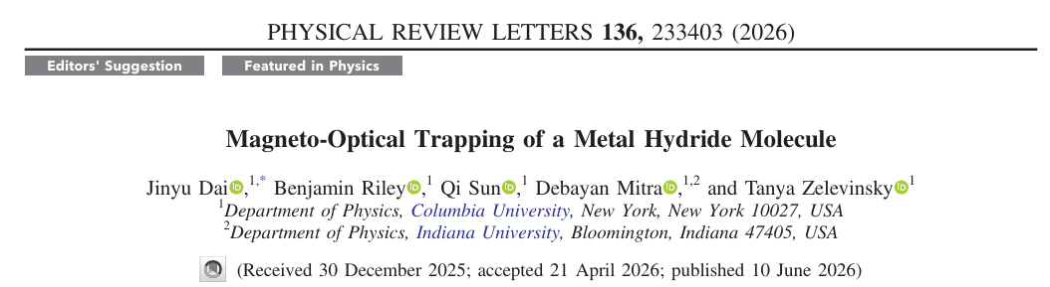
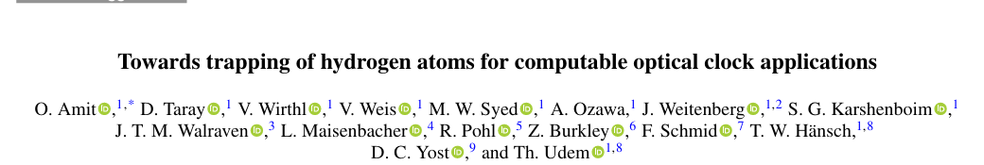
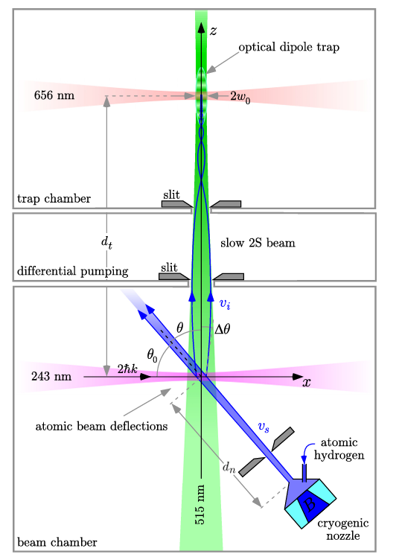

Some current approaches
Grasian collaboration
NB Alpha collaboration has laser-cooled and magnetically trapped antihydrogen

Slide 34

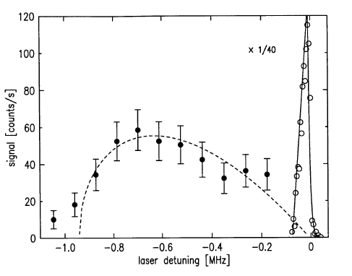
Hydrogen BEC revisted
Fried at al., Phys. Rev. Lett. 81, 3811 (1998)

Slide 35
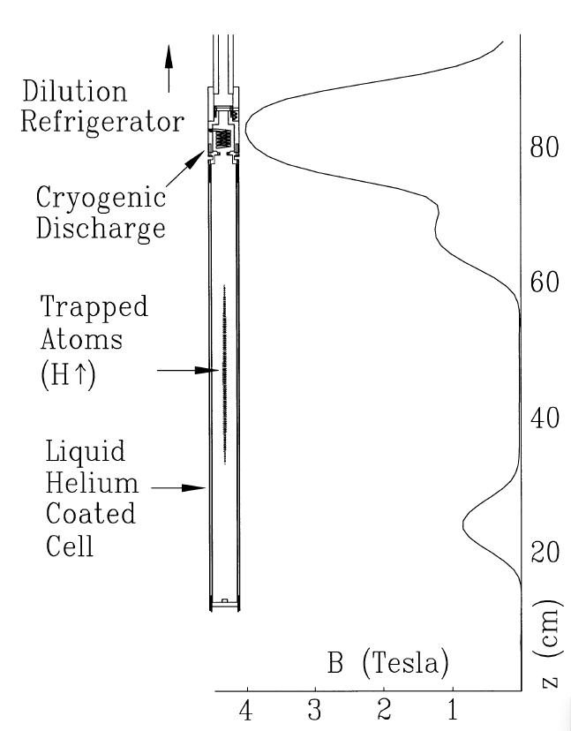
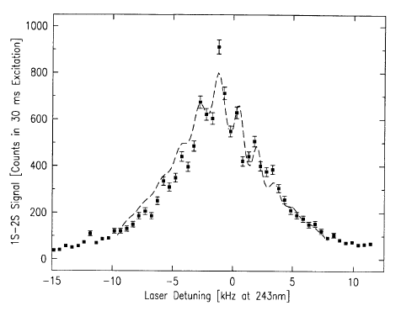
Hydrogen BEC re-visted

Slide 36
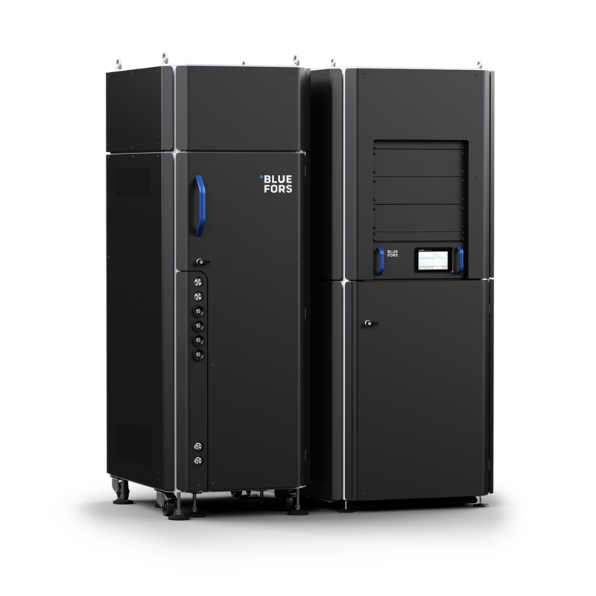
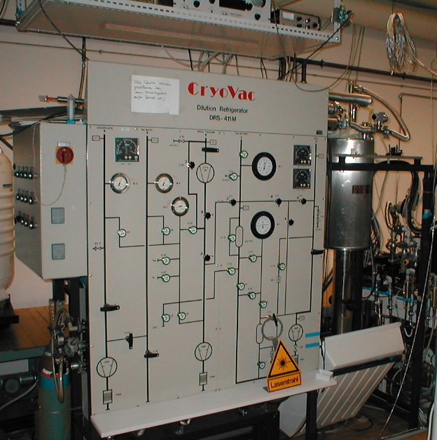
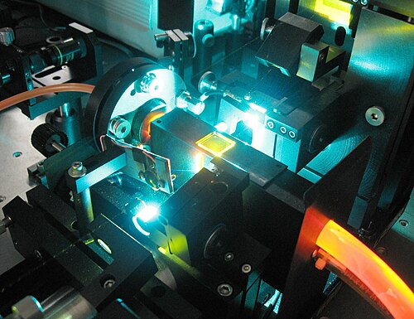
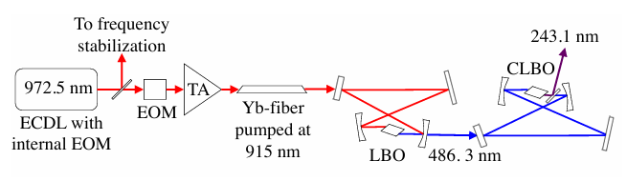
Hydrogen BEC re-visted
Bluefors
Wikipedia
Wikiwand
[1811.09874] Frequency-Stabilized Deep-UV Laser at 243.1 nm with 1.4 W output power

Slide 37
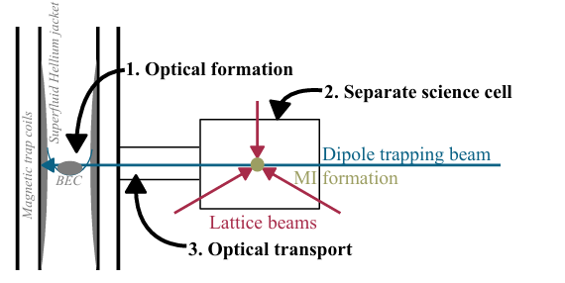
A possible experiment
For more details on Hydrogen Mott insulator see J. P. Scott PhD thesis
For experimental progress see Grasian collaboration Semakin et al., Eur. Phys J D 79 23 (2025)

Slide 38
Summary
A dramatic improvement in hydrogen spectroscopy is required
Cold trapped atoms are the way forward
The level structure of hydrogen makes these experiments very challenging.
BUT an experimentally proven route exists….
Next steps:
Investigate deuterium, evaluate possible systematic uncertainties
Get funding??

Slide 39
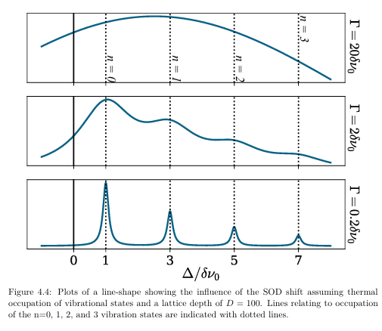
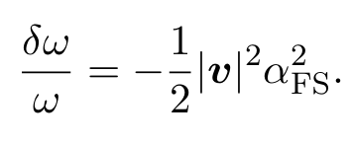
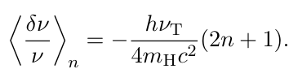
Second-order Doppler shift
Relativistic effect, equivalent to time dilation for moving atom
(δν0 ≈ O(10)mHz

Slide 40
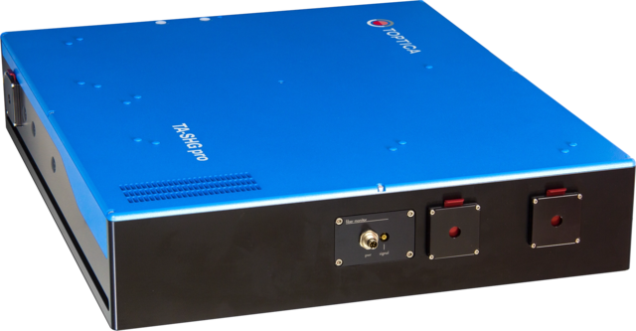
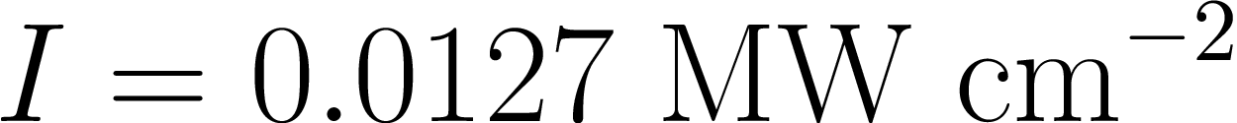
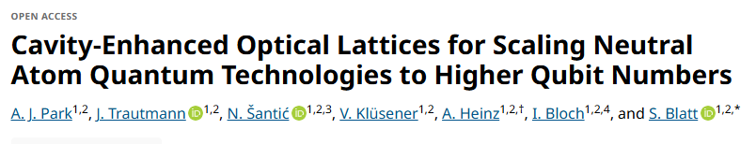
Power requirements
1 Watt available at 399.5
Assume 100 um lattice waist (1D)
Build-up cavity (5000) required….

