Slide 1
Bounds on the strength of a spin-independent fifth force:
Current reach of hydrogen and helium spectroscopy
Robert Potvliege
with Adair Nicolson, Matt Jones and Michael Spannowsky
Physics Department, Durham University, UK

Slide 2
Outline
General considerations
Bounds on gegp from hydrogen spectroscopy
Bounds on gegn from hydrogen, deuterium and helium spectroscopy
Outlook

Slide 3
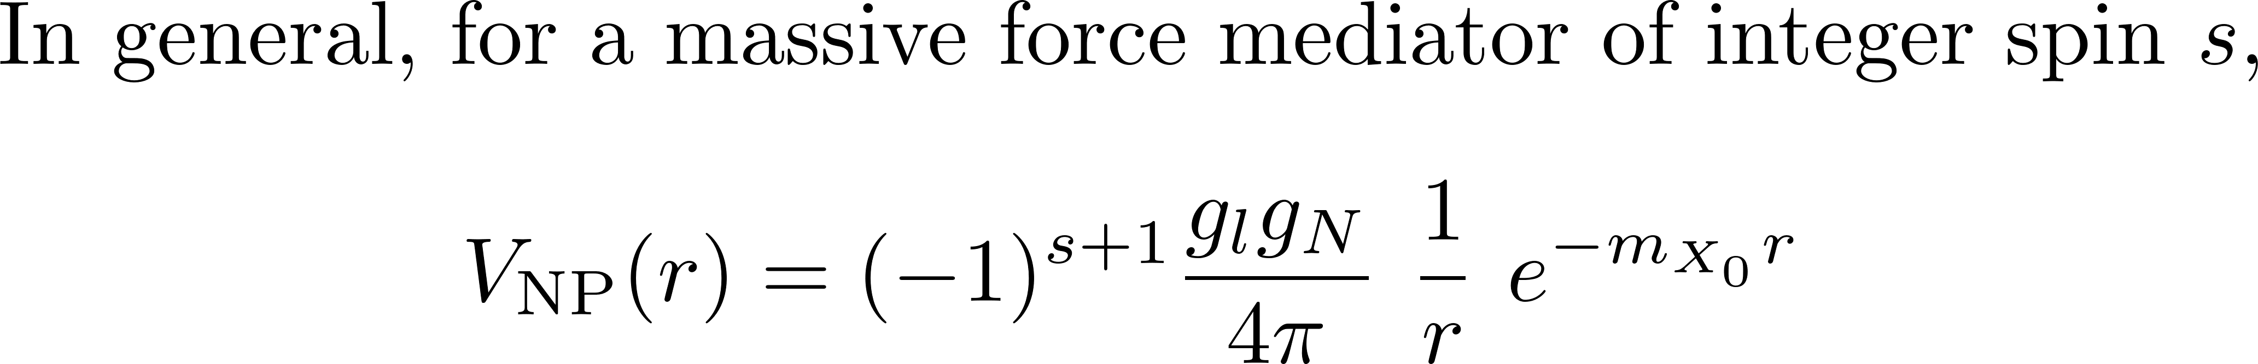
Type of new physics interaction considered here

Slide 4
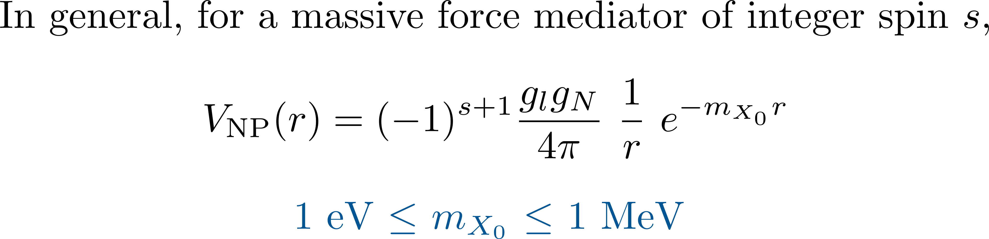
Type of new physics interaction considered here

Slide 5
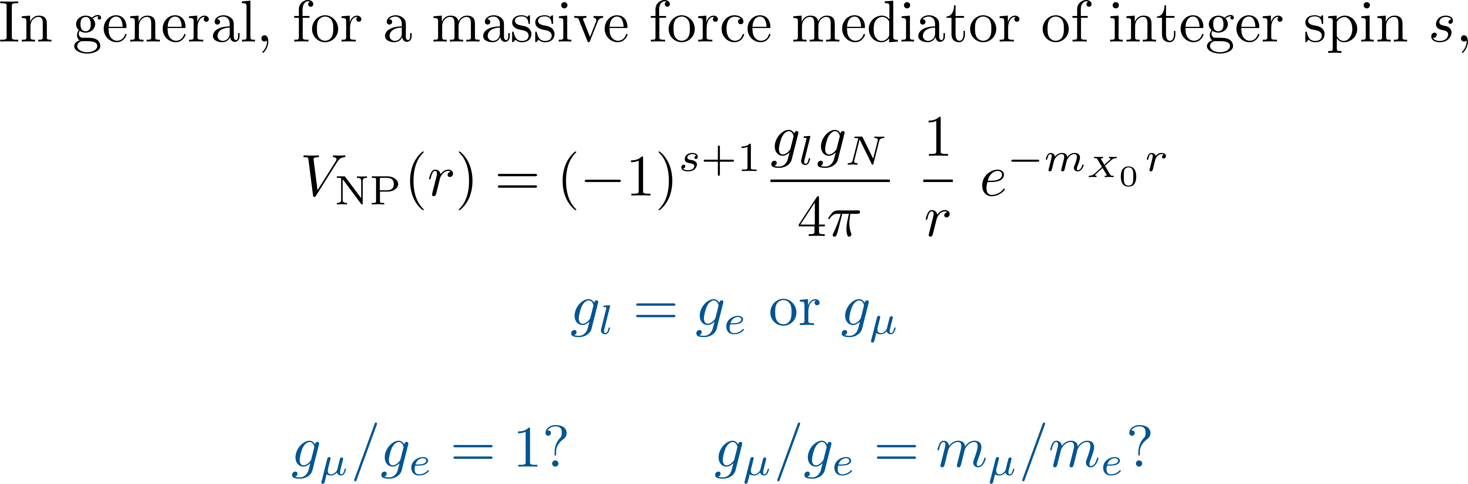

Type of new physics interaction considered here

Slide 6
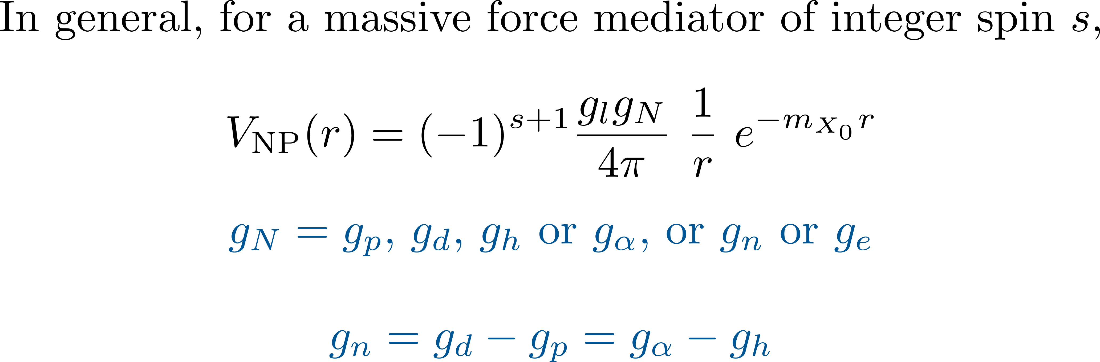
Type of new physics interaction considered here

Slide 7
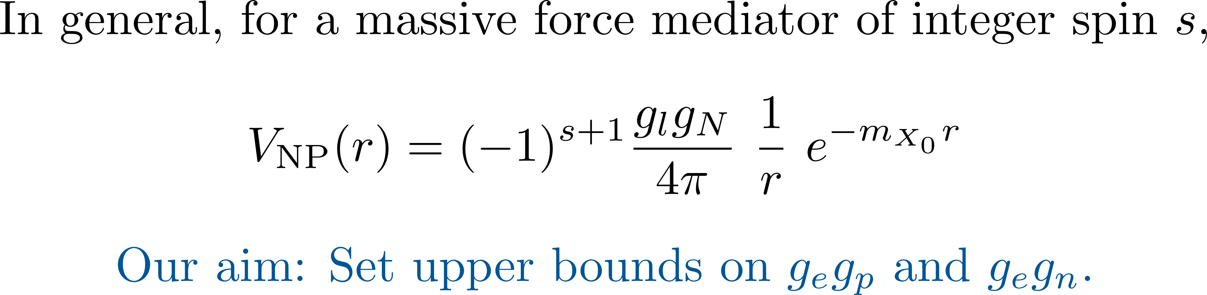
Type of new physics interaction considered here

Slide 8
Type of new physics interaction considered here
Using light atoms spectroscopic data in searching for such an interaction: E.g.,
Karshenboim [PRL 104, 220406 (2010) and PRD 82 073003 (2010)]
Jaekel and Roy [PRD 82, 125020 (2010)]
Brax and Burrage [PRD 83, 035020 (2011)]
Delaunay et al [PRD 96, 115002 (2017)]
Jentschura and Nandori [PRA 97, 042502 (2018)]
Jones et al [PRRes 2, 013244 (2020)]
Frugiuele and Peset [JHEP 05, 002 (2022)]
Delaunay et al [PRL 130, 121801 (2023)]
Potvliege et al [PRA 108, 052825 (2023)]
Potvliege [NJP 27, 045002 (2025)]

Slide 9
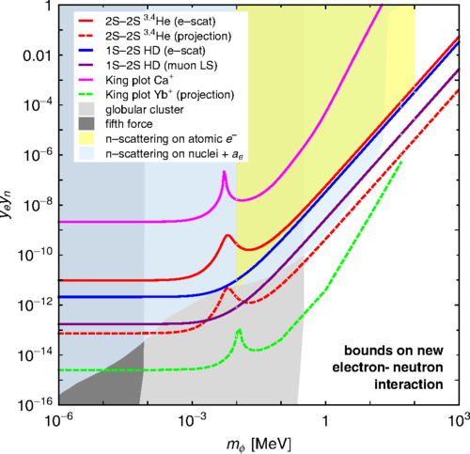
Bounds on gegn as of 2017
Bound from Casimir force measurements
From C Delaunay et al, Phys. Rev. D 96, 115002 (2017)

Slide 10
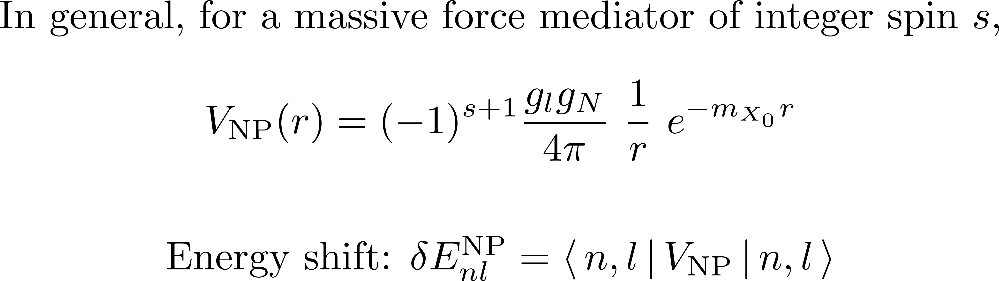
NP shifts

Slide 11
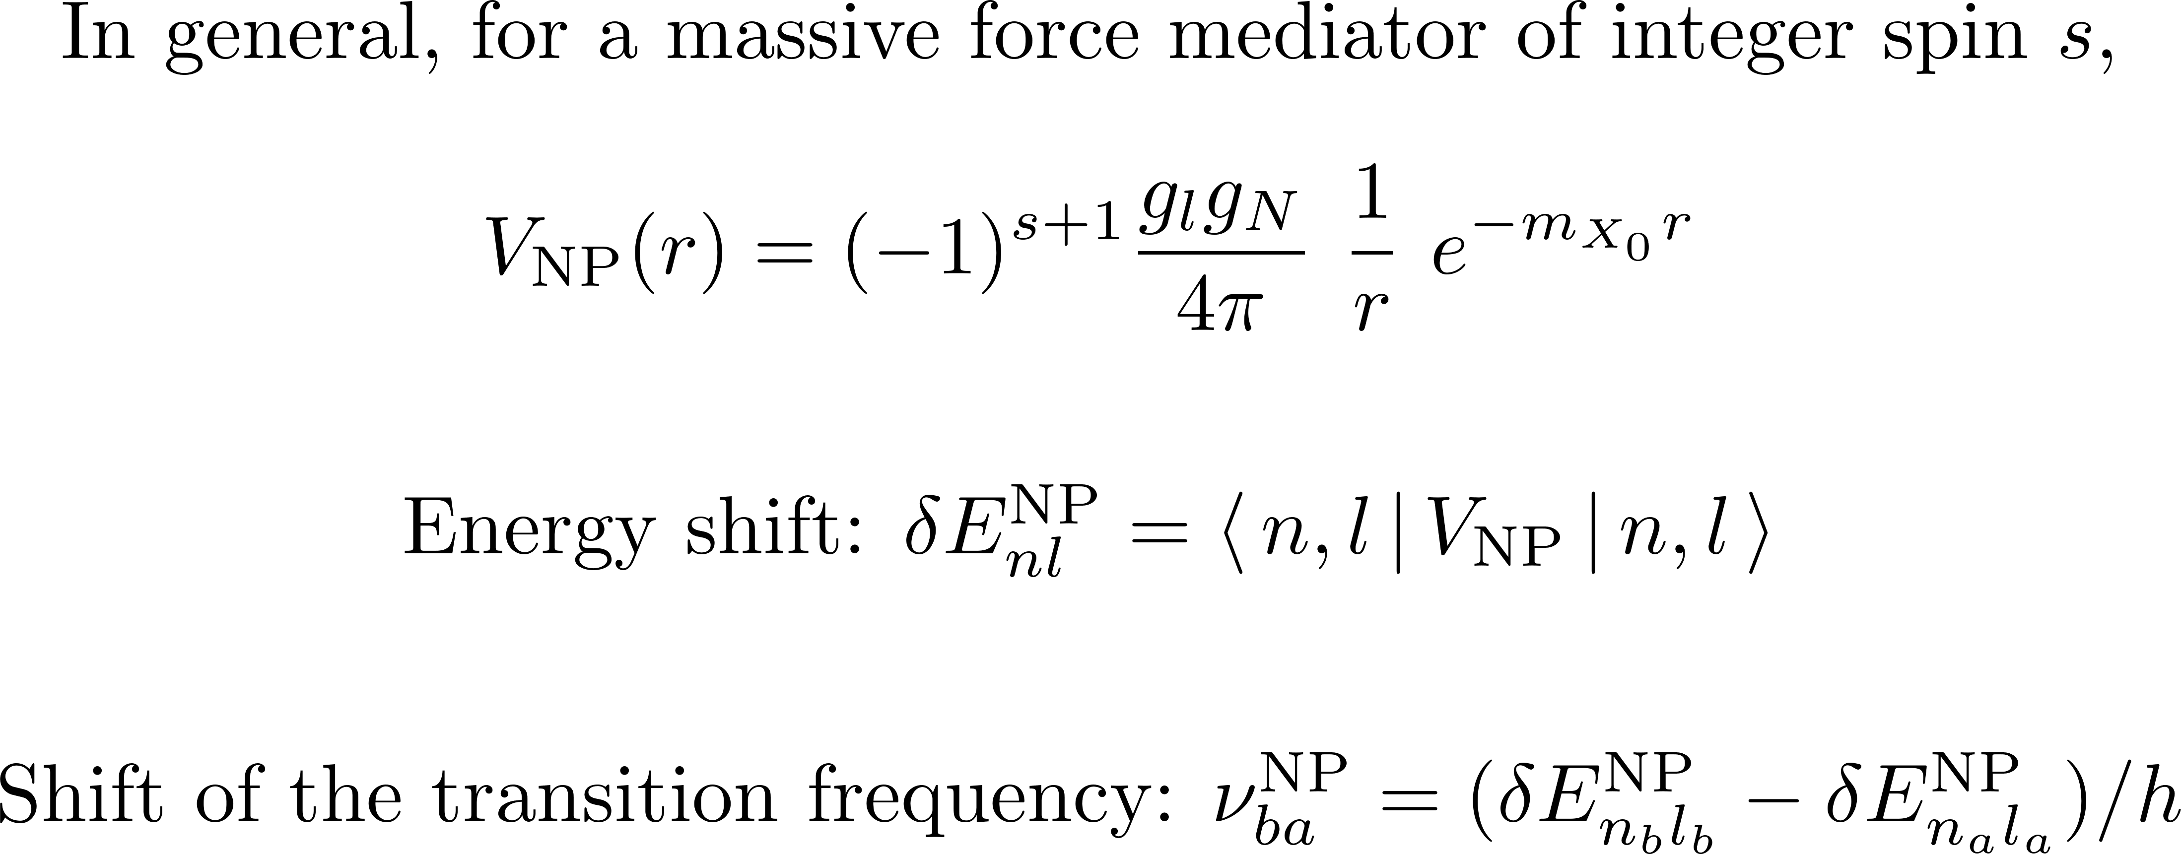
NP shifts

Slide 12
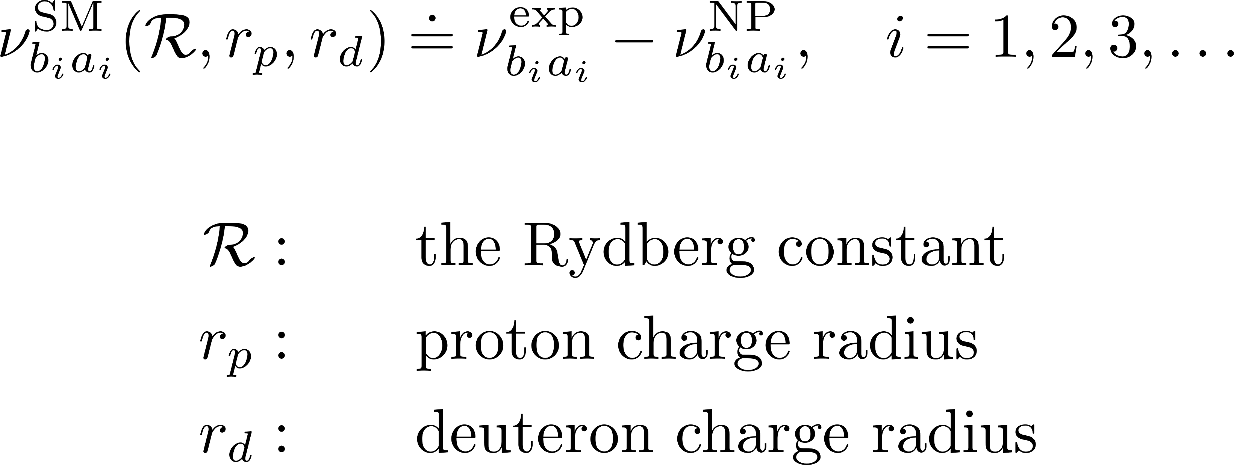
Chi-squared fitting to the standard model
How compatible is experiment with theory, assuming a NP interaction?

Slide 13
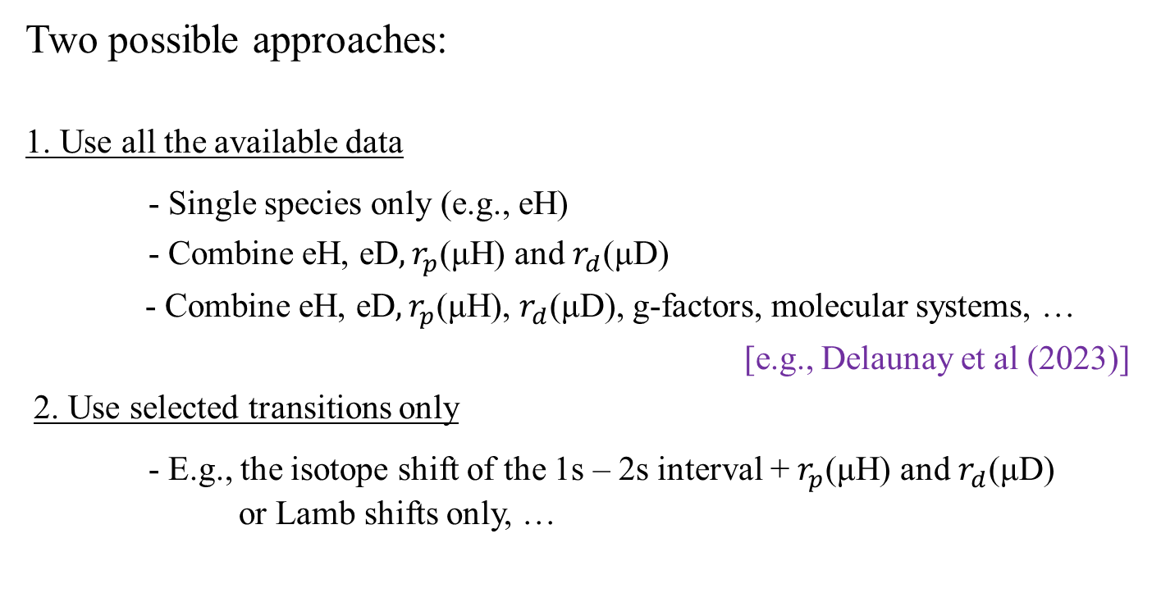
Chi-squared fitting to the standard model
Two possible approaches:
1. Use all the available data
- Single species only (e.g., eH)
- Combine eH, eD$, r_{p}$(μH) and $r_{d}$(μD)
- Combine eH, eD$, r_{p}$(μH), $r_{d}$(μD), g-factors, molecular systems, …
[e.g., Delaunay et al (2023)]
2. Use selected transitions only
- E.g., the isotope shift of the 1s – 2s interval + $r_{p}$(μH) and $r_{d}$(μD)
or Lamb shifts only, …

Slide 14
Chi-squared fitting to the standard model
1. Use all the available data
Pros: Use a number of independent measurements; broad range of transitions
Cons: Discrepancies in the data tend to make the bounds more stringent
for no good reasons; need to magnify the experimental errors; large
number of degrees of freedom may hide trends

Slide 15
Chi-squared fitting to the standard model
1. Use all the available data
Pros: Use a number of independent measurements; broad range of transitions
Cons: Discrepancies in the data tend to make the bounds more stringent
for no good reasons; need to magnify the experimental errors; large
number of degrees of freedom may hide trends
2. Use selected transitions only
Pros: Reduces discrepancies, focuses on the most precise data, may show interesting trends
Cons: Relies on the accuracy of a small number of measurements

Slide 16
Issue…
The data are often in significant tension with the predictions of the Standard Model or with each other…

Slide 17
Helium issues
Large differences between SM theory and experiment in the binding energy of several states
2 ³S state in helium-4: Δ = 0.477(52) MHz
2 ³S state in helium-3: Δ = 0.482(53) MHz
2 ³P state in helium-4: Δ = 0.444(17) MHz
[Clausen’s PhD thesis (2025)]

Slide 18
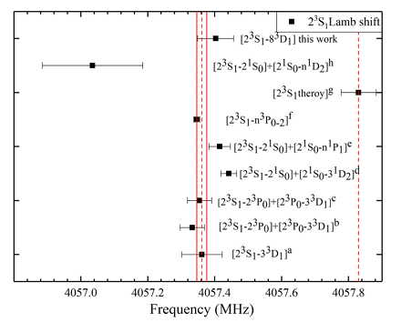
Helium issues
Large differences between SM theory and experiment in the binding energy of several states
2 ³S state in helium-4: Δ = 0.477(52) MHz
2 ³S state in helium-3: Δ = 0.482(53) MHz
2 ³P state in helium-4: Δ = 0.444(17) MHz
[Clausen’s PhD thesis (2025)]
[From Wu et al (2025)]

Slide 19
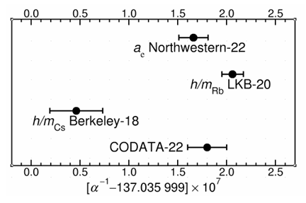
Electron anomalous magnetic moment issues
Large tensions in measured values of a key contribution to the fine structure constant
[CODATA2022]

Slide 20
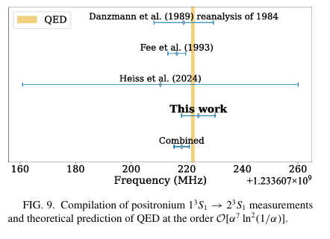
Positronium issues
Weak tensions between measured and theoretical transition frequencies
[de Sousa Borges et al (2026]

Slide 21
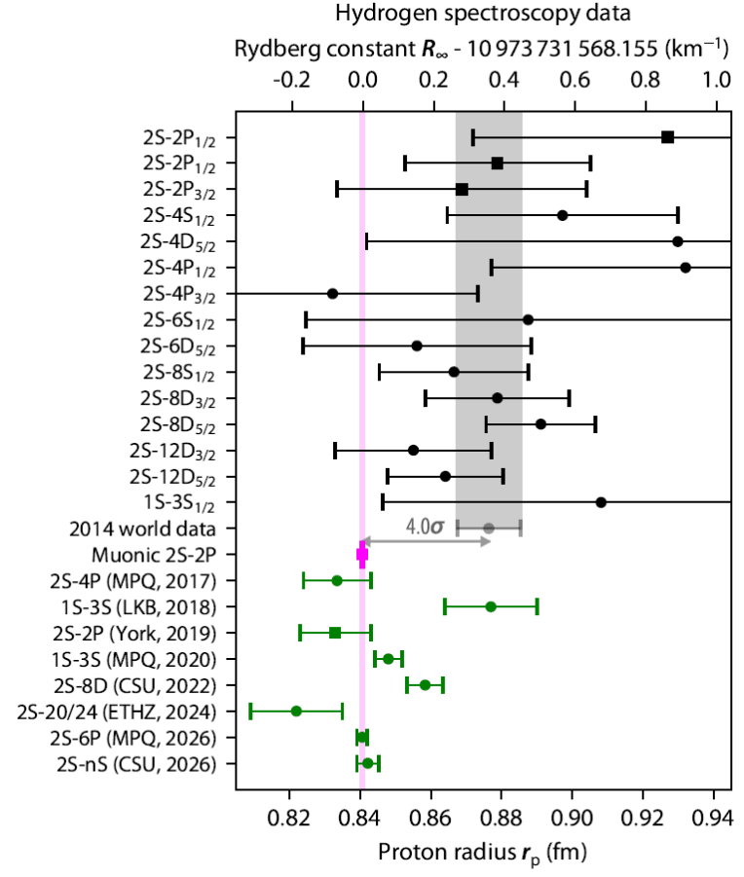
The proton radius issue
[Nature 650, 845 (2026)]
[PRL 136, 123001 (2026)]
[Submitted to Rep. Prog. Phys.]

Slide 22
Two issues of methodology…
1. Overall bounds or bounds for specific models? And which models?
2. Should we reduce any difference between experiment and SM theory to zero?

Slide 23
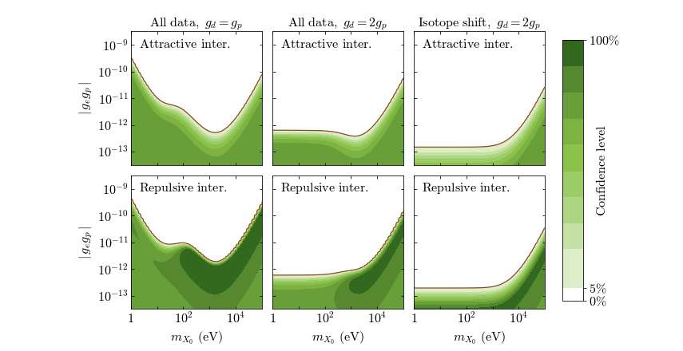
Two issues of methodology…
1. Overall bounds or bounds for specific models? And which models?
E.g., bounds on gegp based on eH, eD, µH and µD spectroscopy (gµ =ge)
[Phys. Rev. A 108, 032825 (2023)]

Slide 24
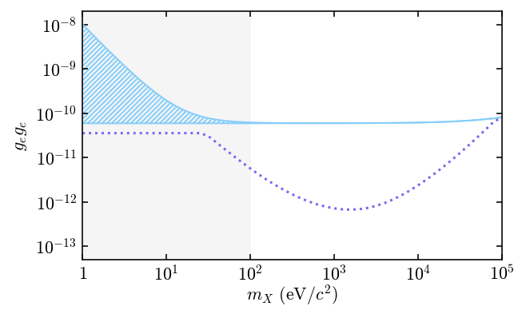
Two issues of methodology…
Bounds based on the anomalous magnetic moment of the electron
Overall bound
Possibly excluded by Casimir forces measurements
Bound assuming a “dark scalar photon” interaction

Slide 25
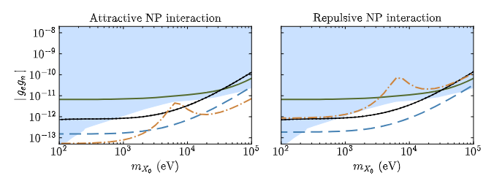
Two issues of methodology…
2. Should we reduce any difference between experiment and SM theory to zero?
E.g., the bounds on gegn based on the isotope shift of the 2 ³S – 2 ¹S interval of He
(dash-dotted curves) are strongly asymmetric…
[NJP 27, 045002 (2025)]

Slide 26
Bounds on gegp
Bounds on gegp from hydrogen spectroscopy

Slide 27
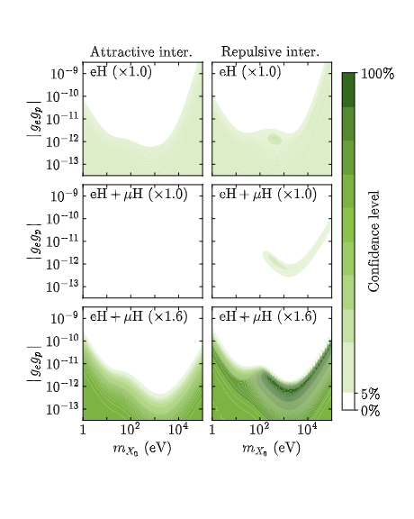
Bounds on gegp
Without µH
With µH
With µH, errors expanded by 60%
[PRA 108, 052825 (2023)]

Slide 28
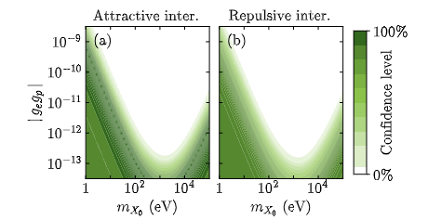
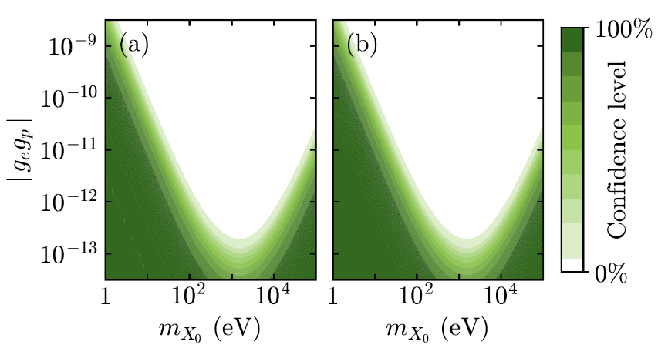
Bounds on gegp
Without µH
With µH
Only µH, eH(1s-2s) and eH(2s-6p)

Slide 29
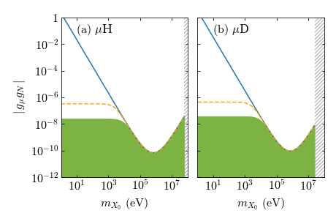
Sensitivity of the muonic species on NP
Dirac wave functions for the Uehling potential and the nucleus charge distribution
[PRA 108, 052825 (2023)]
See also Jaeckel and Roy (2010), Frugiuele and Peset (2022), Huang and Wang (arXiv 2026)

Slide 30
Sensitivity of the muonic species on NP
Dirac wave functions for the Uehling potential and the nucleus charge distribution
Non-relativistic wave functions for 1/r potential
Dirac wave functions for 1/r potential
[PRA 108, 052825 (2023)]
See also Jaeckel and Roy (2010), Frugiuele and Peset (2022), Huang and Wang (arXiv 2026)

Slide 31
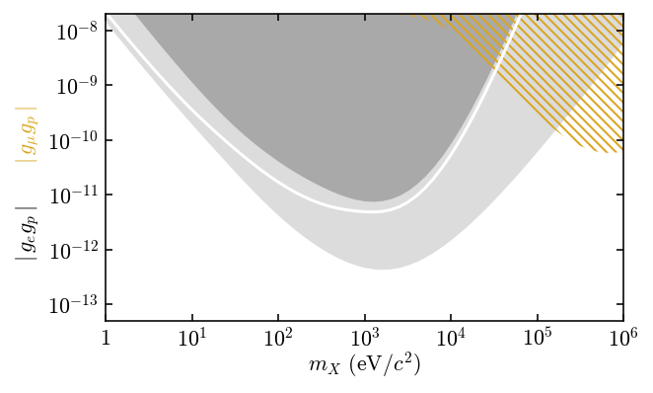
Bounds on gegp
Pre 2018 World eH data
2026 World eH data
Likely dependence on gegµ
2026 World eH + µH data

Slide 32
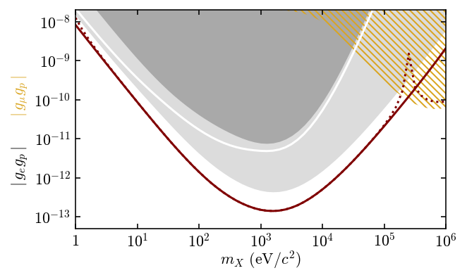
Bounds on gegp
The same with gµ = 207 ge
eH(1s-2s), eH(2s-6p) and µH with gµ = ge, no error magnification

Slide 33
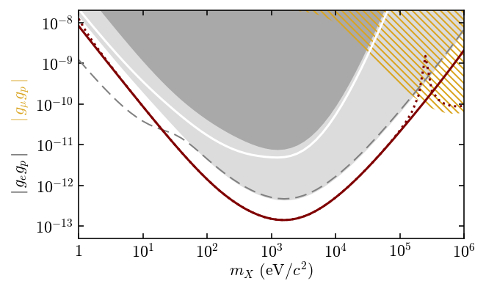
Bounds on gegp
2026 World eH data + provisional eH Rydberg data

Slide 34
Bounds on gegn
Bounds on gegn from hydrogen, deuterium and helium spectroscopy

Slide 35
Bounds on gegn
Bounds on gegn based on the isotope shift of the 2 ³S – 2 ¹S interval of He
(dash-dotted curves)
[NJP 27, 045002 (2025)]

Slide 36
Bounds on gegn
Excluded by neutron scattering data + anomalous magnetic moment of the electron
[Delaunay et al (2017)]

Slide 37
Bounds on gegn
Bounds from Ca isotope shift [Wilzewski et al (2025)]

Slide 38
Bounds on gegn
Black curves: bounds based on eH, eD, µH and µD for gµ = ge
Dashed blue curves: isotope shift bounds

Slide 39
Future prospects
Future developments…

Slide 40
Forthcoming measurements
In the next few years…
2s – ns transition frequencies in deuterium
2s – 6p transition frequency in deuterium
1s – 3s transition frequency in deuterium
1s – 3s transition frequency in hydrogen (higher precision)
Circular Rydberg transitions in hydrogen
1s – 2s transition frequency in He+
1s – 2s transition to 0.4 ppb in orthopositronium
.
.
.

Slide 41
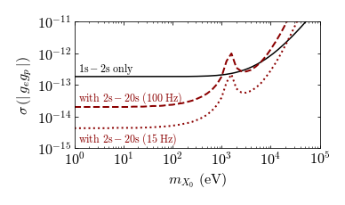
Reach of the isotope shift approach
Bounds based on the isotope shifts of two different transitions (gn = gp)
No µH or µD data
Phys. Rev. A 108, 032825 (2023), also Delaunay et al (2017)

Slide 42
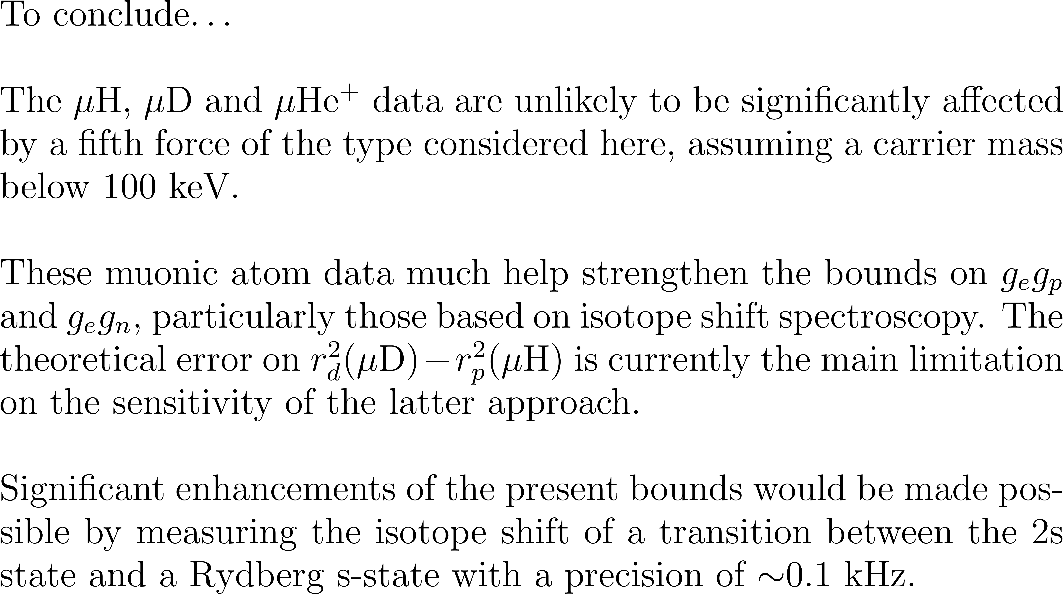
Conclusions

