Slide 1





ADMX, QSHS, and novel resonant techniques
Ed Daw, The University of Sheffield
High Precision Experiments for Dark Matter
Durham, 7th-9th September 2026
on behalf of Quantum Sensors for the Hidden Sector,
the University of Manchester
axion research group,
and the ADMX
collaboration

Slide 2
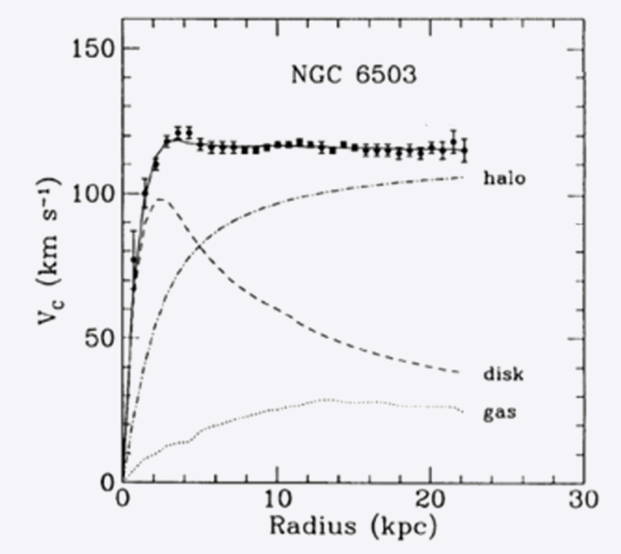
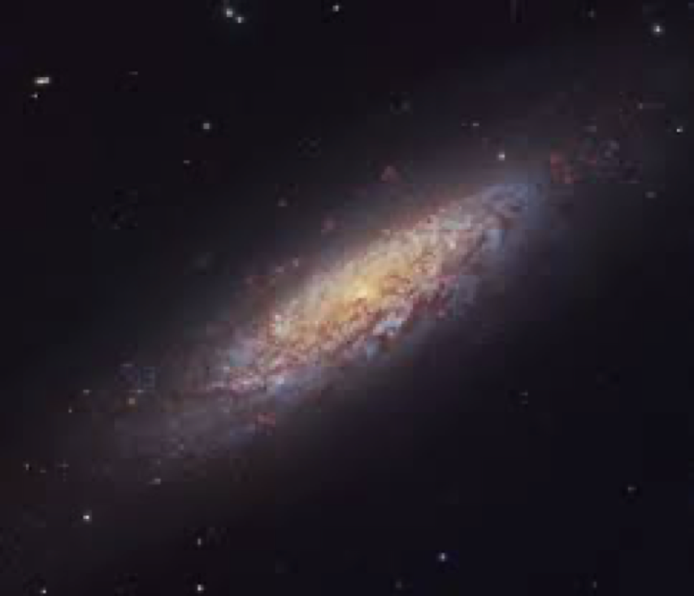

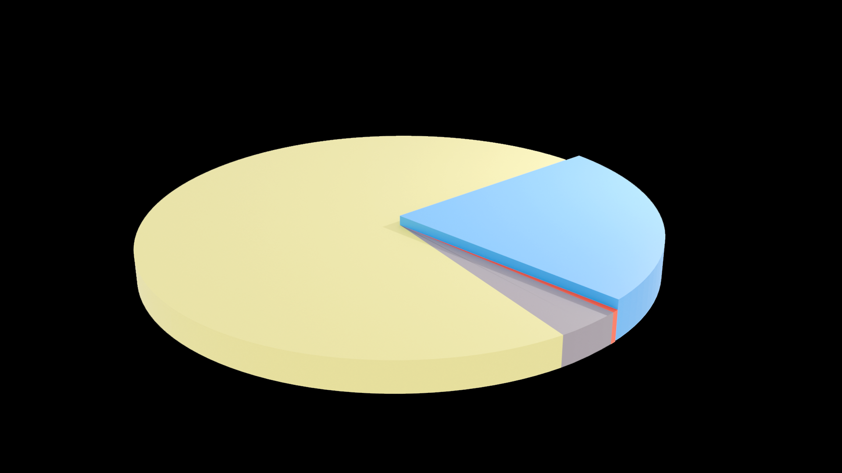


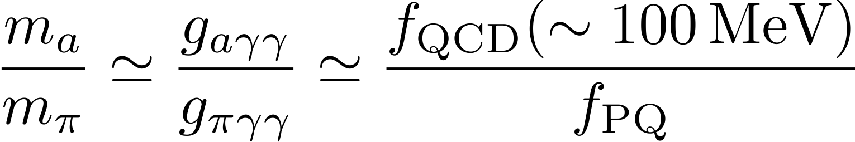

QCD Axions
Strong CP problem
Dark matter problem
Standard model symmetry group is:
QCD
Electroweak
EM
$$SU(3)$$
$$×$$
$$SU(2)$$
$$×$$
$$U(1)$$
$v_{rot}$ [DATA]
Non-Abelian
Non-Abelian
Abelian
CP Conserving?
CP
Violating
CP Conserving
Peccei Quinn mechanism:
CP conserved in QCD below a symmetry breaking energy scale
$$v_{rot}∝\frac{1}{\sqrt{r}}$$
Neutron electric
dipole moment
$${<10}^{−26} e −cm$$
Breaking of the Peccei Quinn symmetry yields axions
Other Nonluminous Matter:
Supermassive BHs 0.04%
Intergalactic Gas 3.6%
Neutrinos 0.1%
Dark Matter 23%
$$f$$
$$γ$$
$$a$$
$$f$$
$$g_{aγγ}∝m_{a}$$
Dark Energy 73 %
Luminous Matter:
Radiation 0.005%
Stars/Luminous Gas 0.4%
$$\overset{¯}{f}$$
$$γ$$
QCD axions are wave-like dark matter; at masses $𝒪(μeV)$, dark matter axions thermalized locally in our halo have de Broglie wavelengths of hundreds of metres

Slide 3
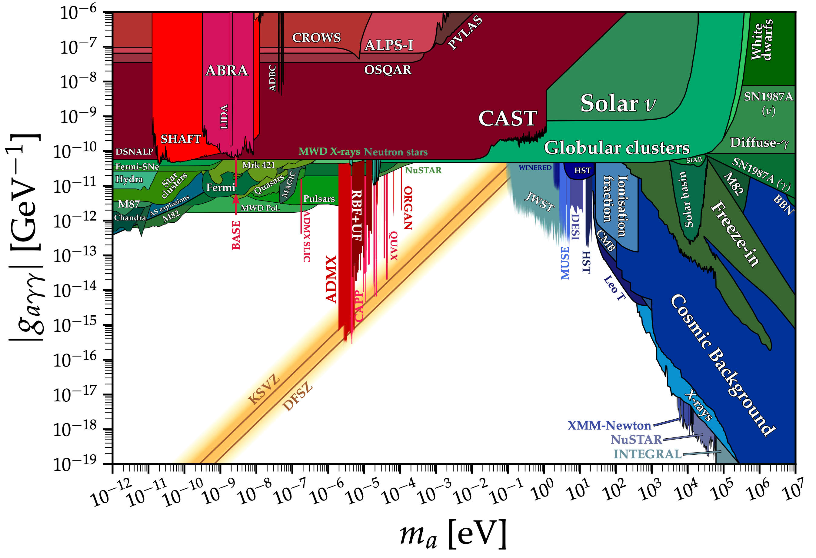

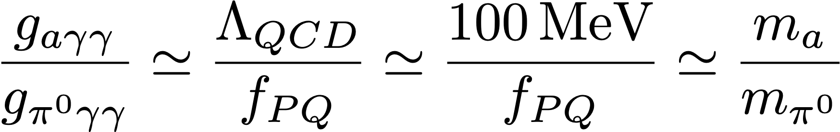
QCD AXION / ALP landscape
HAYSTAC
From Mixing
of the Axion and
the :

Slide 4
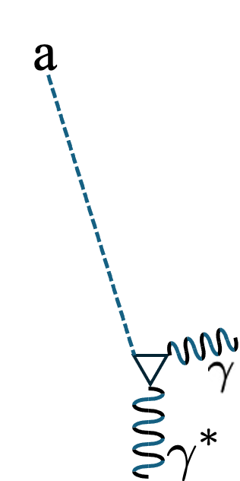
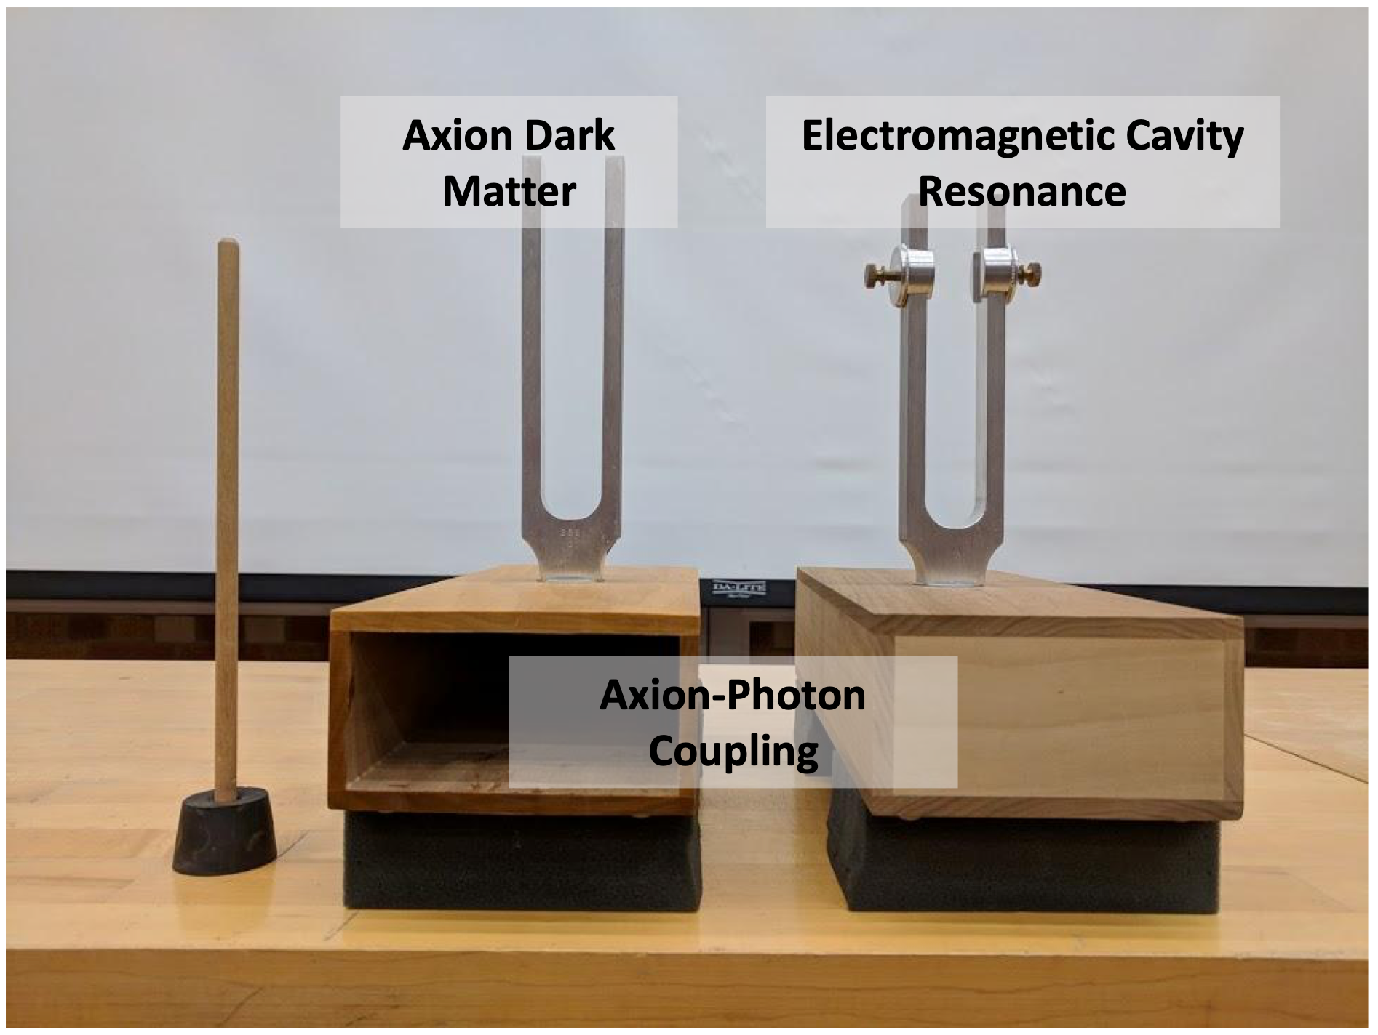
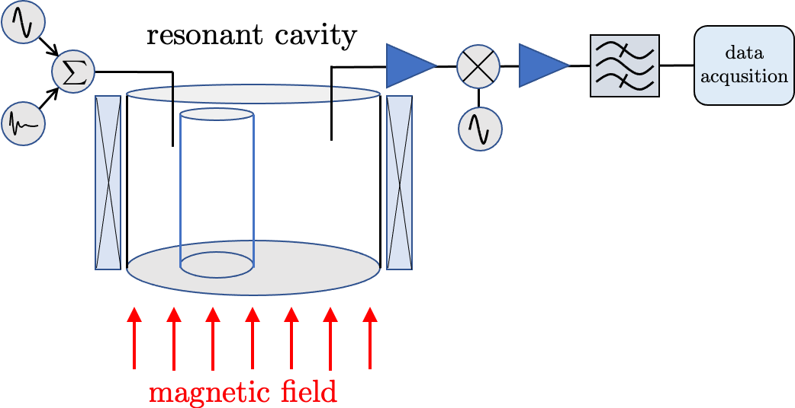
Resonant Axion Haloscopes
bandpass
filter
mixer
data
rate
about
20MHz
Power boosted by a factor of Q for axions resonating in a cavity TM mode.
Q typically about 30,000, so at 5GHz, line width about 200kHz, need to sample with at least 5MHz rate.
Require axions to be dark matter, and present locally.
Tuned experiment, slowing the search.
Only method so far to achieve sensitivity to QCD axions.

Slide 5
The Axion Dark Matter eXperiment (ADMX)
2023
2026
Collaborating Institutions:
University of Washington
Washington University St. Louis
University of Western Australia
University of Florida
University of Sheffield
University of Western Australia
Stanford University / SLAC
UC Berkeley
Fermilab
Pacific Northwest National Laboratory
Lawrence Livermore National Laboratory
Los Alamos National Laboratory

Slide 6
ADMX Design

Slide 7
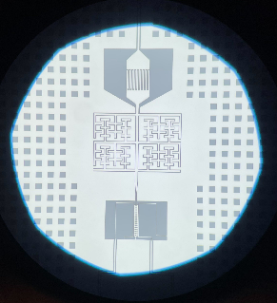
Superconducting Electronics
ADMX has relied on quantum sensing since 2010
Noise is minimized by cooling to millikelvin temperatures and using superconducting amplifiers operating at or near the standard quantum limit
Previous SQUIDs provided by
John Clarke (UC Berkeley)
JPA provided by
Siddiq Group at UC Berkeley (previous run)
Wash. U. St. Louis (current run)
TWPAs Under Test from Lincoln labs, JPL
M. Guzzetti, APS April 2023

Slide 8
ADMX Operations
The cavity is tuned every 100 seconds, during which power spectra are taken. Overlapping power spectra are examined for the characteristic axion signal shape appearing on-resonance.
The picture on the left shows how an axion signal would appear in the data. This is a synthetic signal.
We make several passes. Only signals that persist through all passes are candidate axions.

Slide 9
ADMX 2026
Plan: Extend reach down to DFSZ at below-nominal dark matter density
Method: Improve amplifiers to lower system noise temperature. Wash. U. St. Louis JPAs show lower noise than last year
Status: In data taking
1 – reach downward

Slide 10
ADMX sidecar
A smaller cavity mounted on top of the main ADMX 1 cavity. 166x110mm.
Large tuning rod, potentially tunable from 4 to 8GHz (17 to 34 micro eV)
Small volume, but useful for testing RF electronics due to tuning range.
QSHS manufactured and delivered the current copper ADMX sidecar cavity, and a second copper cavity for use by QSHS.
We also have an aluminium cavity for superconducting tests, with the same engineering configuration.

Slide 11
Signal power in a resonant cavity experiment
'ADMX – scale'
'QSHS and ADMX sidecar scale'
The loss in signal power going from 50cm diameter magnet bores and the corresponding cavities to 20cm diameter magnet bores and cavities is significant.
Ideally you want the best of both worlds – a large magnet that can probe a wide range
of axion masses, but in practice because the axion mass corresponds to a particular
length scale, it is hard to maintain sensitivity in higher mass searches even if you
can afford the large magnet that would be required.

Slide 12
ADMX 4-cavity system
Reach higher frequencies with multiple resonators
Maintain axion conversion volume with multiple cavities
Challenge: coherent signal combining between cavities

Slide 13
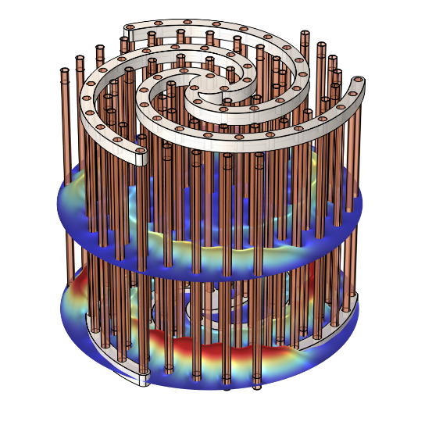
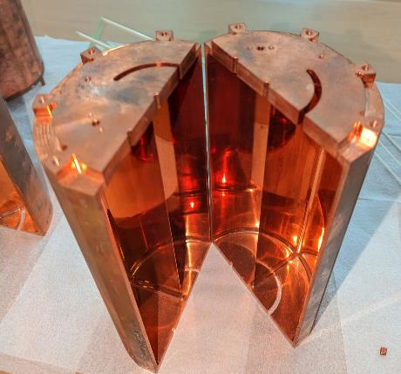
Sophisticated Resonators – Multiwavelength Cavities
Dividing single cavities or metamaterial structures captures similar volume gains to multiple cavities
Multiple periodic conductors allow the ALPHA “Plasma Haloscope” to have a multiwavelength volume
A. Millar Phys. Rev. D. 107 055103 (2023)
See also:
Lindahl et al. Phys. Rev. Applied 25, 024073 (2026)
“Pizza” Cavity is divided into subregions and read out coherently.
S. Youn, CAPP (2023)

Slide 14
Quantum Sensors for the Hidden Sector
UK collaboration funded by STFC in 2021 to develop low noise quantum electronics for application to axion searches. Works with ADMX.

Slide 15


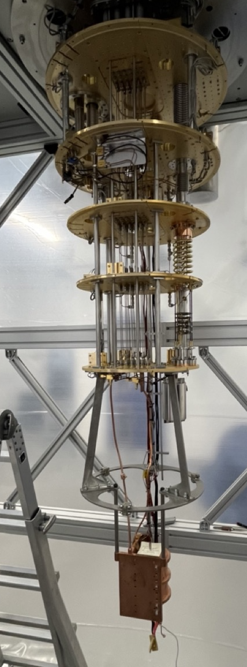
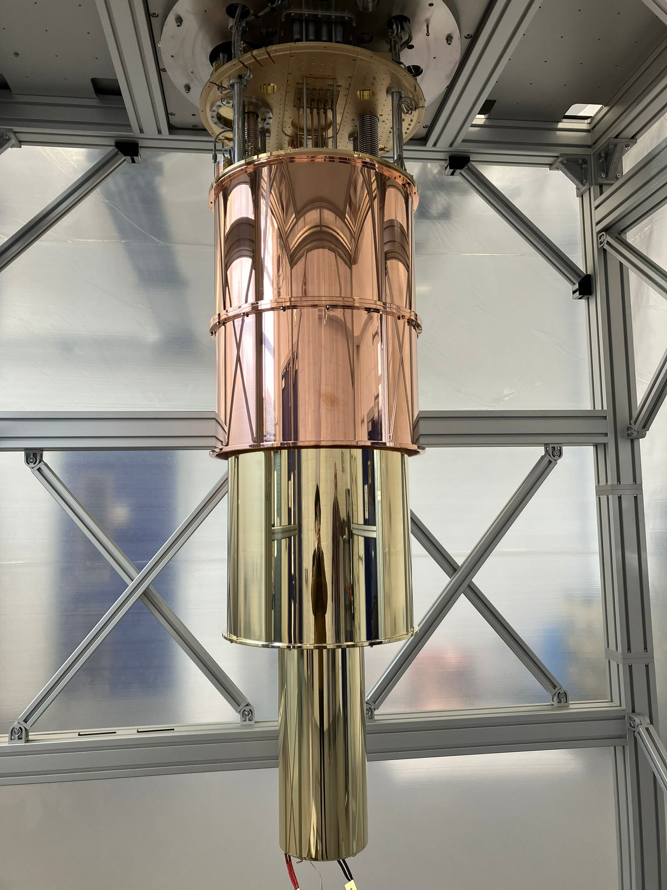
The Fridge
Data Acquisition: Room Temperature
Pulse Tube 1:
$$≈70 K$$
Pulse Tube 2:
$$≈4 K$$
Still Plate:
700 mK
Cold Plate:
100 mK
Mixing Chamber Plate:
8.5 mK
Tuneable 5 GHz Cavity
Cavity Temperature:
12 mK
Magnet Internal Bore:
18.5 cm
A Alsulami et al 2025 New J. Phys. 27 105002; arXiv: 2504.12257

Slide 16
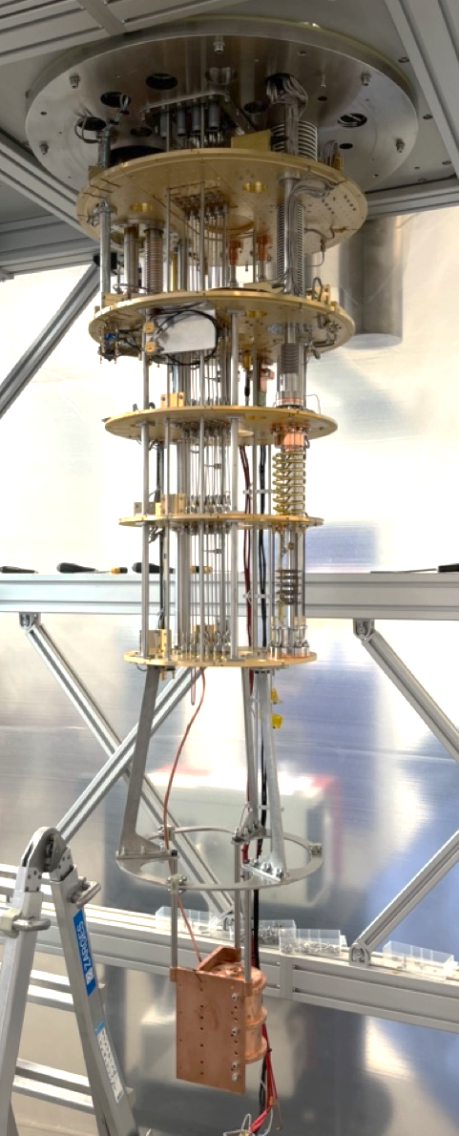
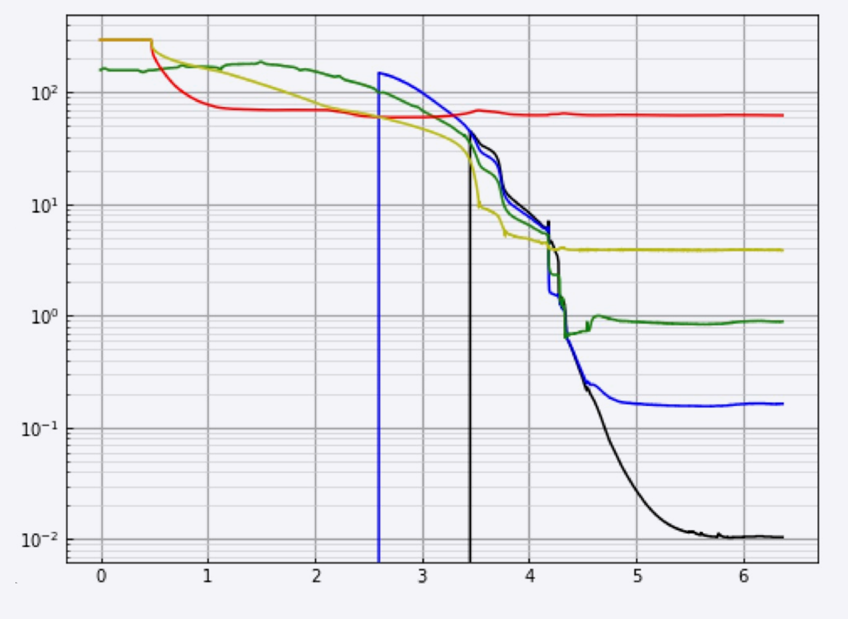
First Cavity Cooldown
Temperature (K)
Time offset (days)
Cavity temperature
sensor at 18mK

Slide 17

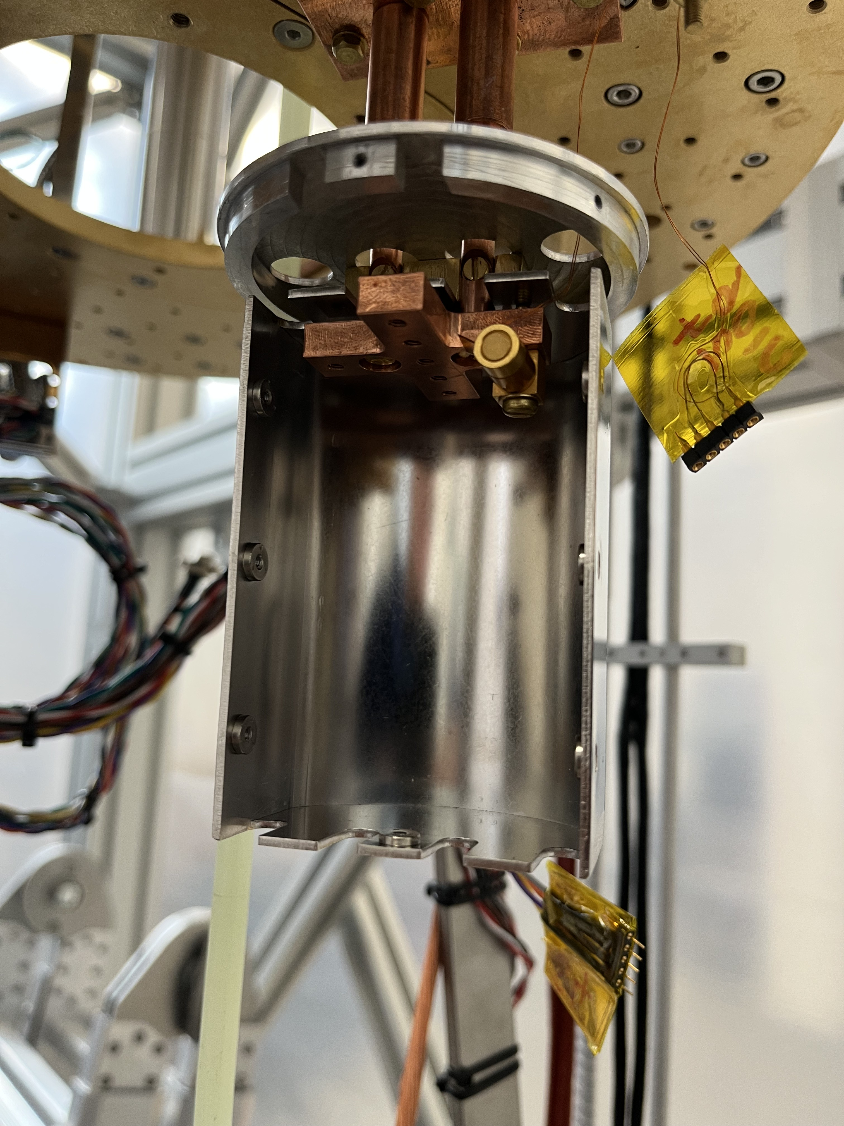
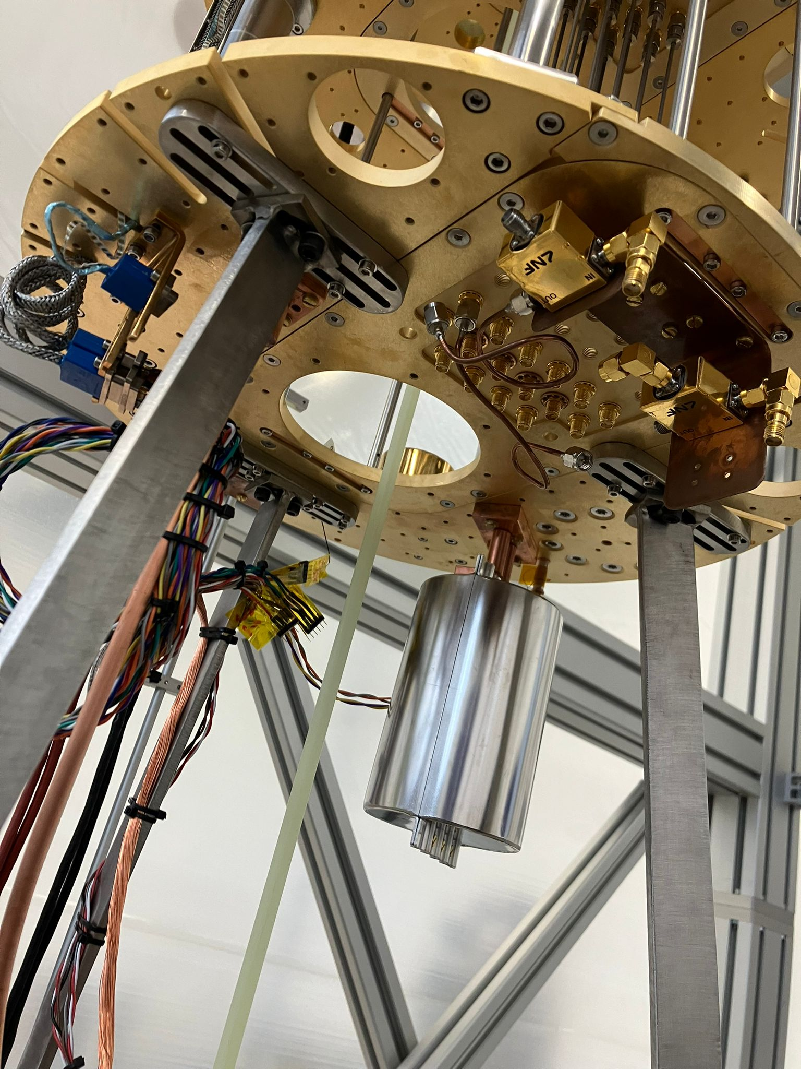
The Magnetic Field Shield
Field Shield
design,
Ed Laird
(Lancaster)
simulations
by
Paul Smith
(Sheffield)

Slide 18

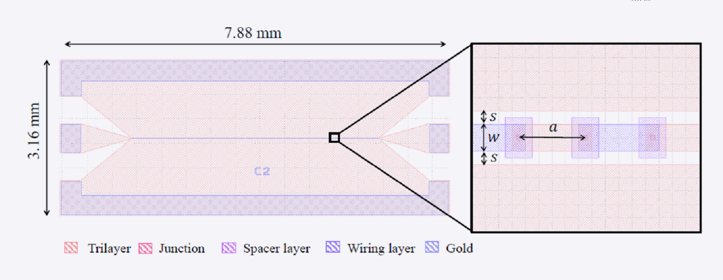

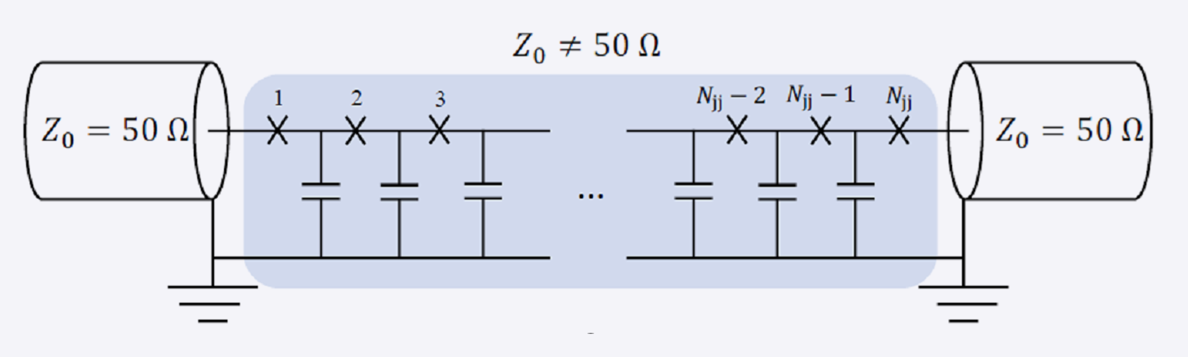
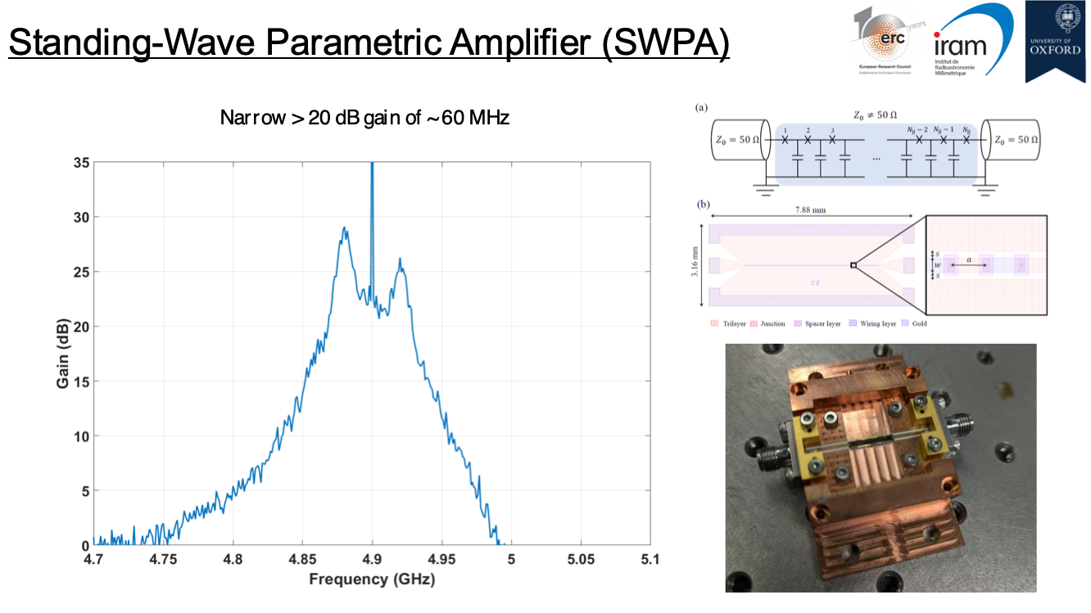
Standing Wave Parametric Amplifier (SWPA)
Boon Kok Tan, Javier Navarro Montilla
Over 20 dB gain over ~ 60 MHz optimal region

Slide 19
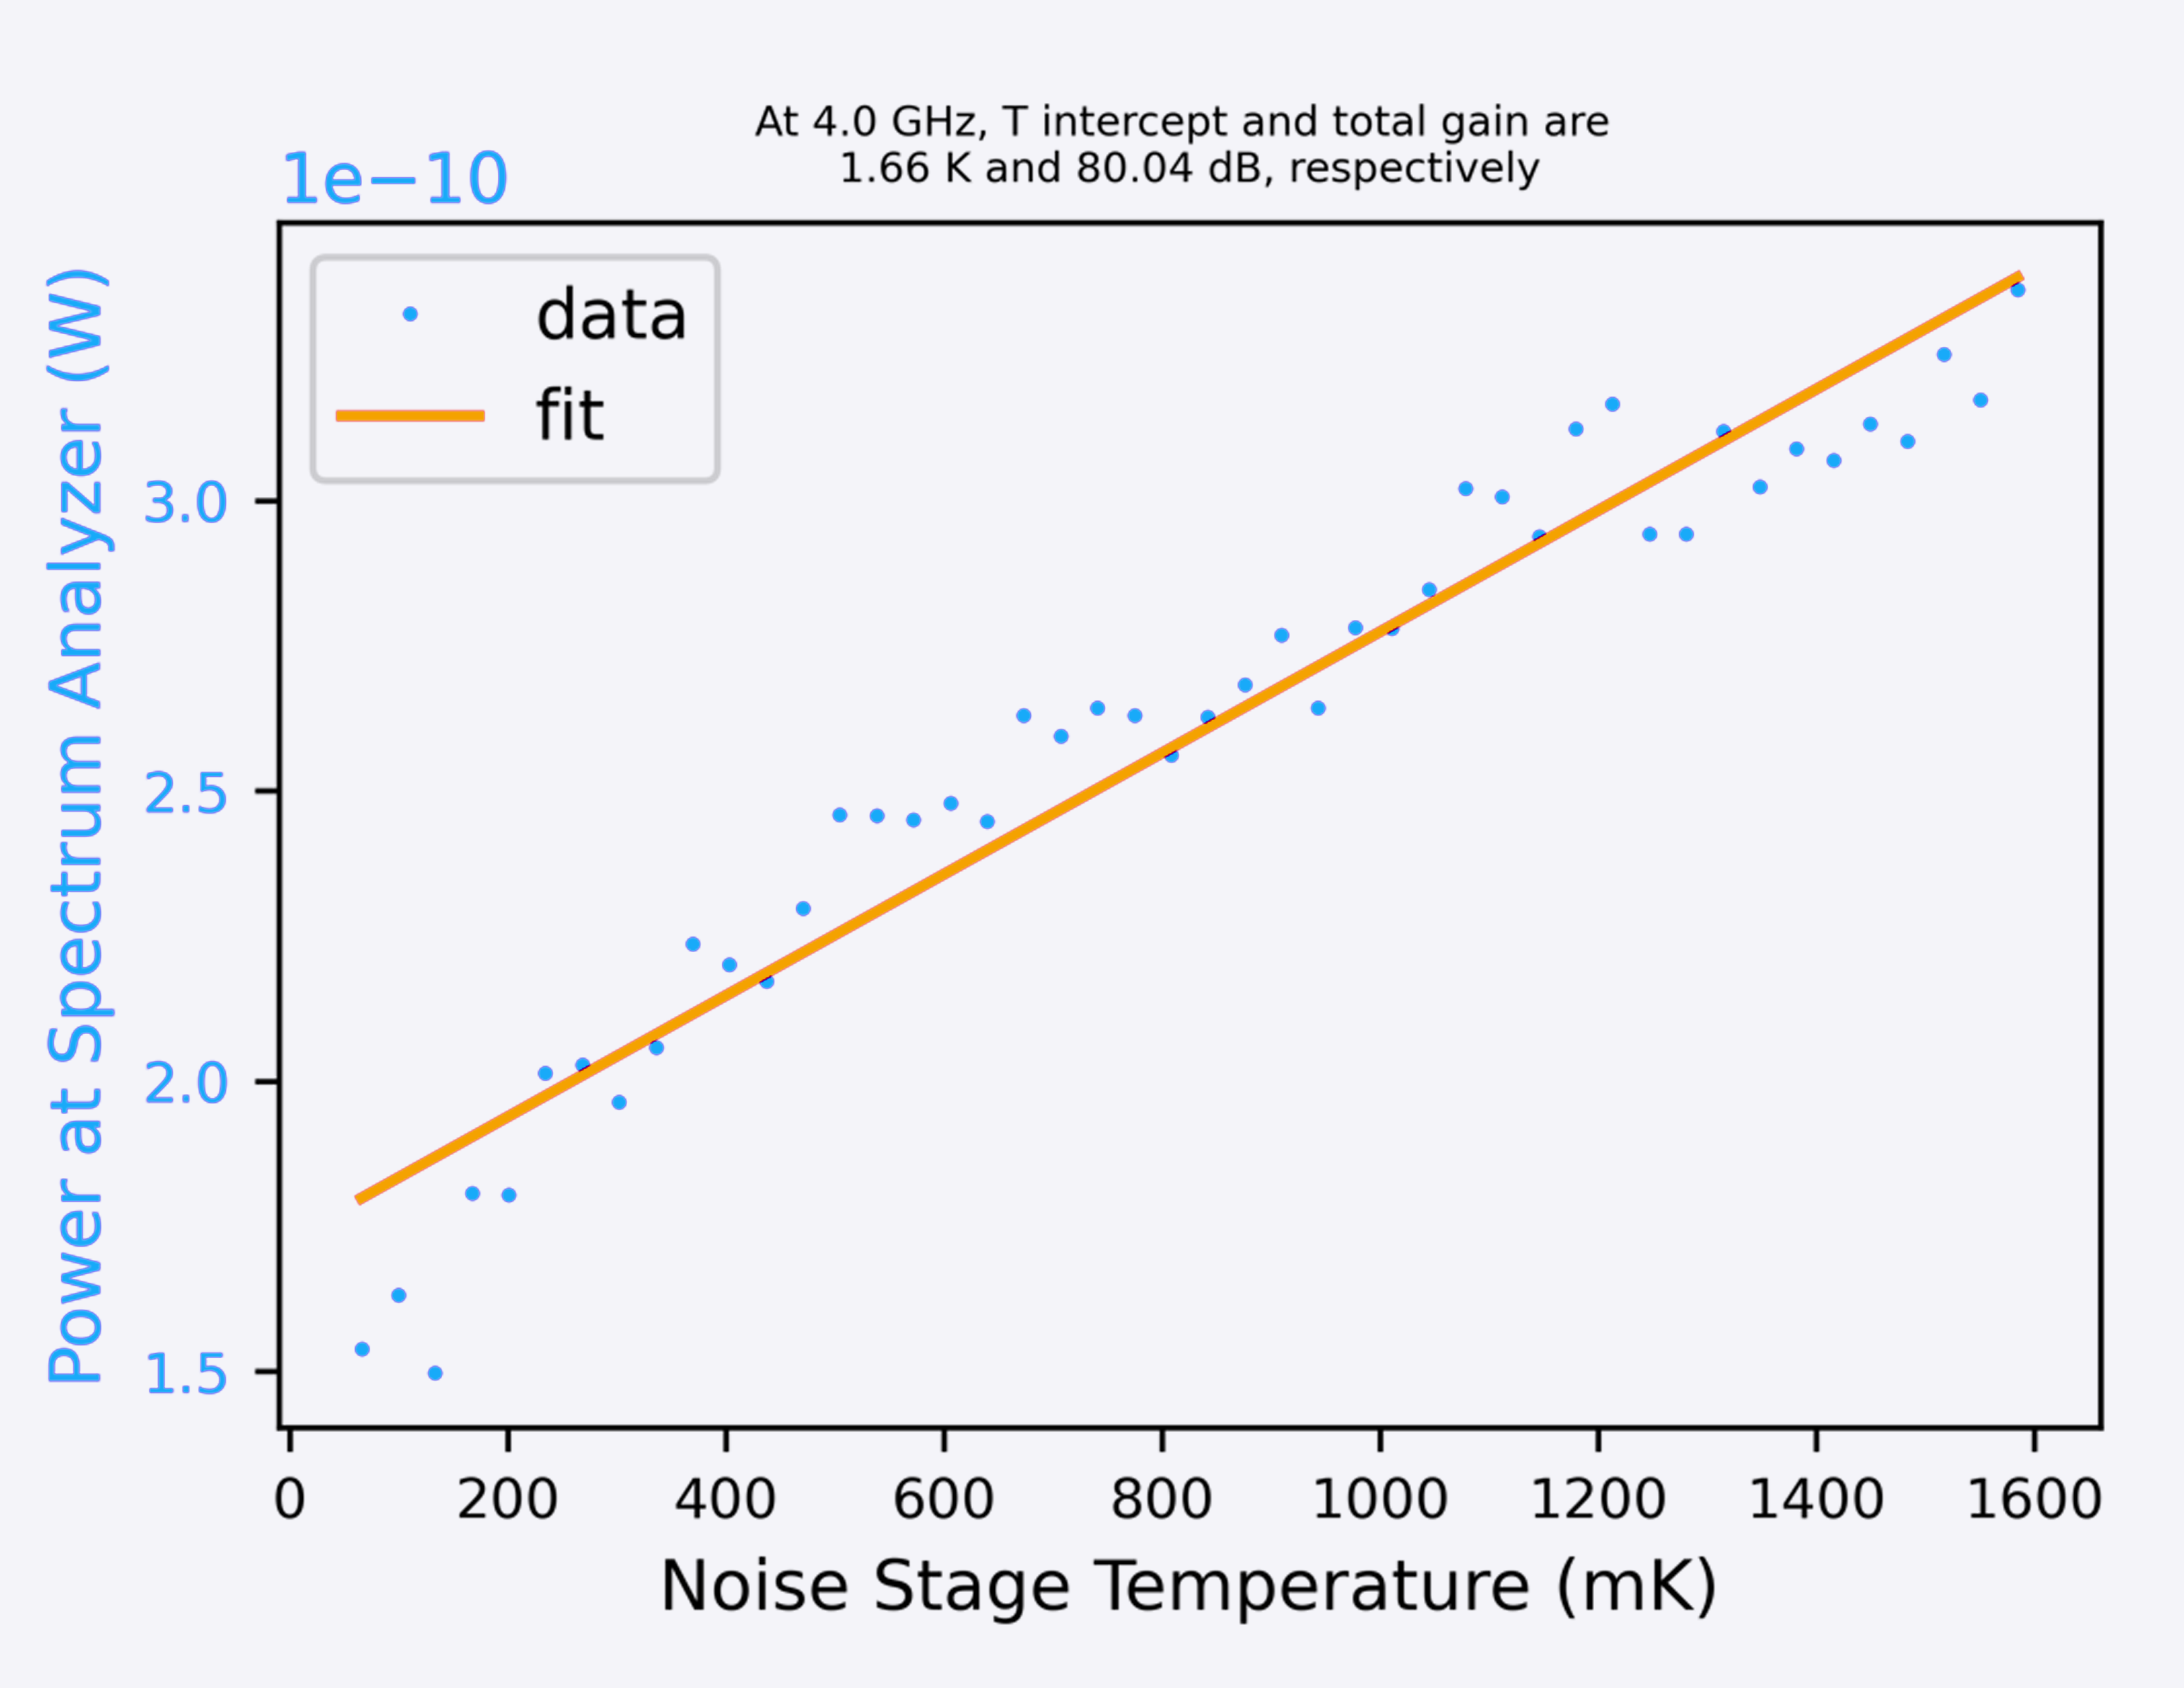
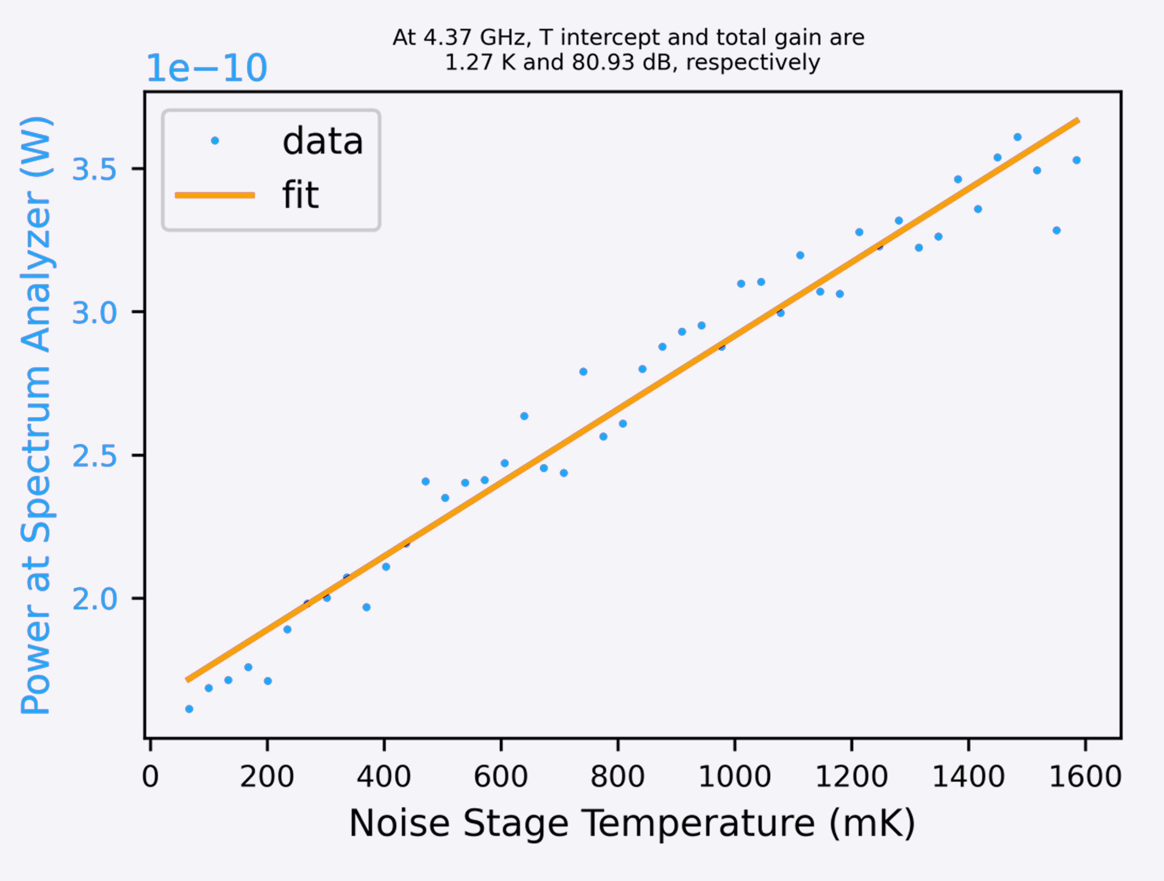
SNAIL JTWPA – Lancaster, VTT (Finland)
Joshoua Esmenda, Yuri Pashkin & Collaborators
4.0 GHz:
1.66 K Gain
80.04 dB T Intercept
4.37 GHz:
1.27 K Gain
80.93 dB T Intercept
Noise temperatures as low as 574 mK
4.0 GHz
4.37 GHz
Joshoua
Signal Frequency (GHz) | Bypass |  | Parameters 0 Pump=13 GHz, -61 dBm, BC = 670 uA
 | T_{bypass} (K) | G (dB) | T_{total} (K) | G (dB) | T_{TWPA} (K) | G_{TWPA} (dB)
4.00 | 9.3 | 69.34 | 1.91 | 79.05 | 0.915779 | 9.71
4.37 | 9.94 | 69.38 | 2.4 | 79.3 | 1.38752 | 9.92
5.00 | 8.75 | 68.62 | 1.85 | 80.18 | 1.239047 | 11.56
6.00 | 7.55 | 66.93 | 1.72 | 77.79 | 1.100635 | 10.86
6.20 | 7.94 | 66.79 | 1.95 | 76.85 | 1.166894 | 10.06
8.00 | 7.85 | 67.76 | 1.88 | 81.05 | 1.511981 | 13.29
 | Parameters 1 Pump=12.4 GHz, -61 dBm, BC = 695 uA |  |  |  | Parameters 2 Pump=12.4 GHz, -61 dBm, BC = 705 uA
 | T (K) | G (dB) | T_{TWPA} (K) | G_{TWPA} (dB) | T (K) | G (dB) | T_{TWPA} (K) | G_{TWPA} (dB)
 | 1.7 | 81.08 | 1.077007 | 11.74 | 1.66 | 80.04 | 0.868442 | 10.7
 | 1.27 | 80.93 | 0.574357 | 11.55 | 1.75 | 81.2 | 1.096288 | 11.82
 | 2.64 | 79.17 | 1.869082 | 10.55 | 2.13 | 80.51 | 1.56375 | 11.89
 | 1.85 | 75.81 | 0.872882 | 8.88 | 4.93 | 77.36 | 4.246172 | 10.43
 | NA | NA | NA | NA | NA | NA | NA | NA
 | 3.61 | 81.64 | 3.28873 | 13.88 | 4.58 | 79.71 | 4.078963 | 11.95
Signal Frequency (GHz)

Slide 20


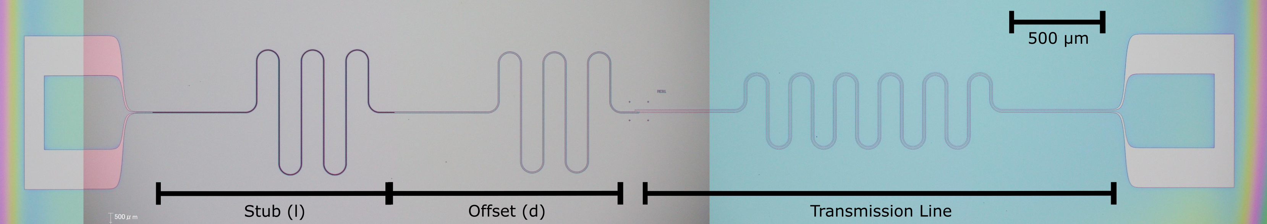
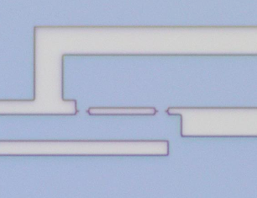
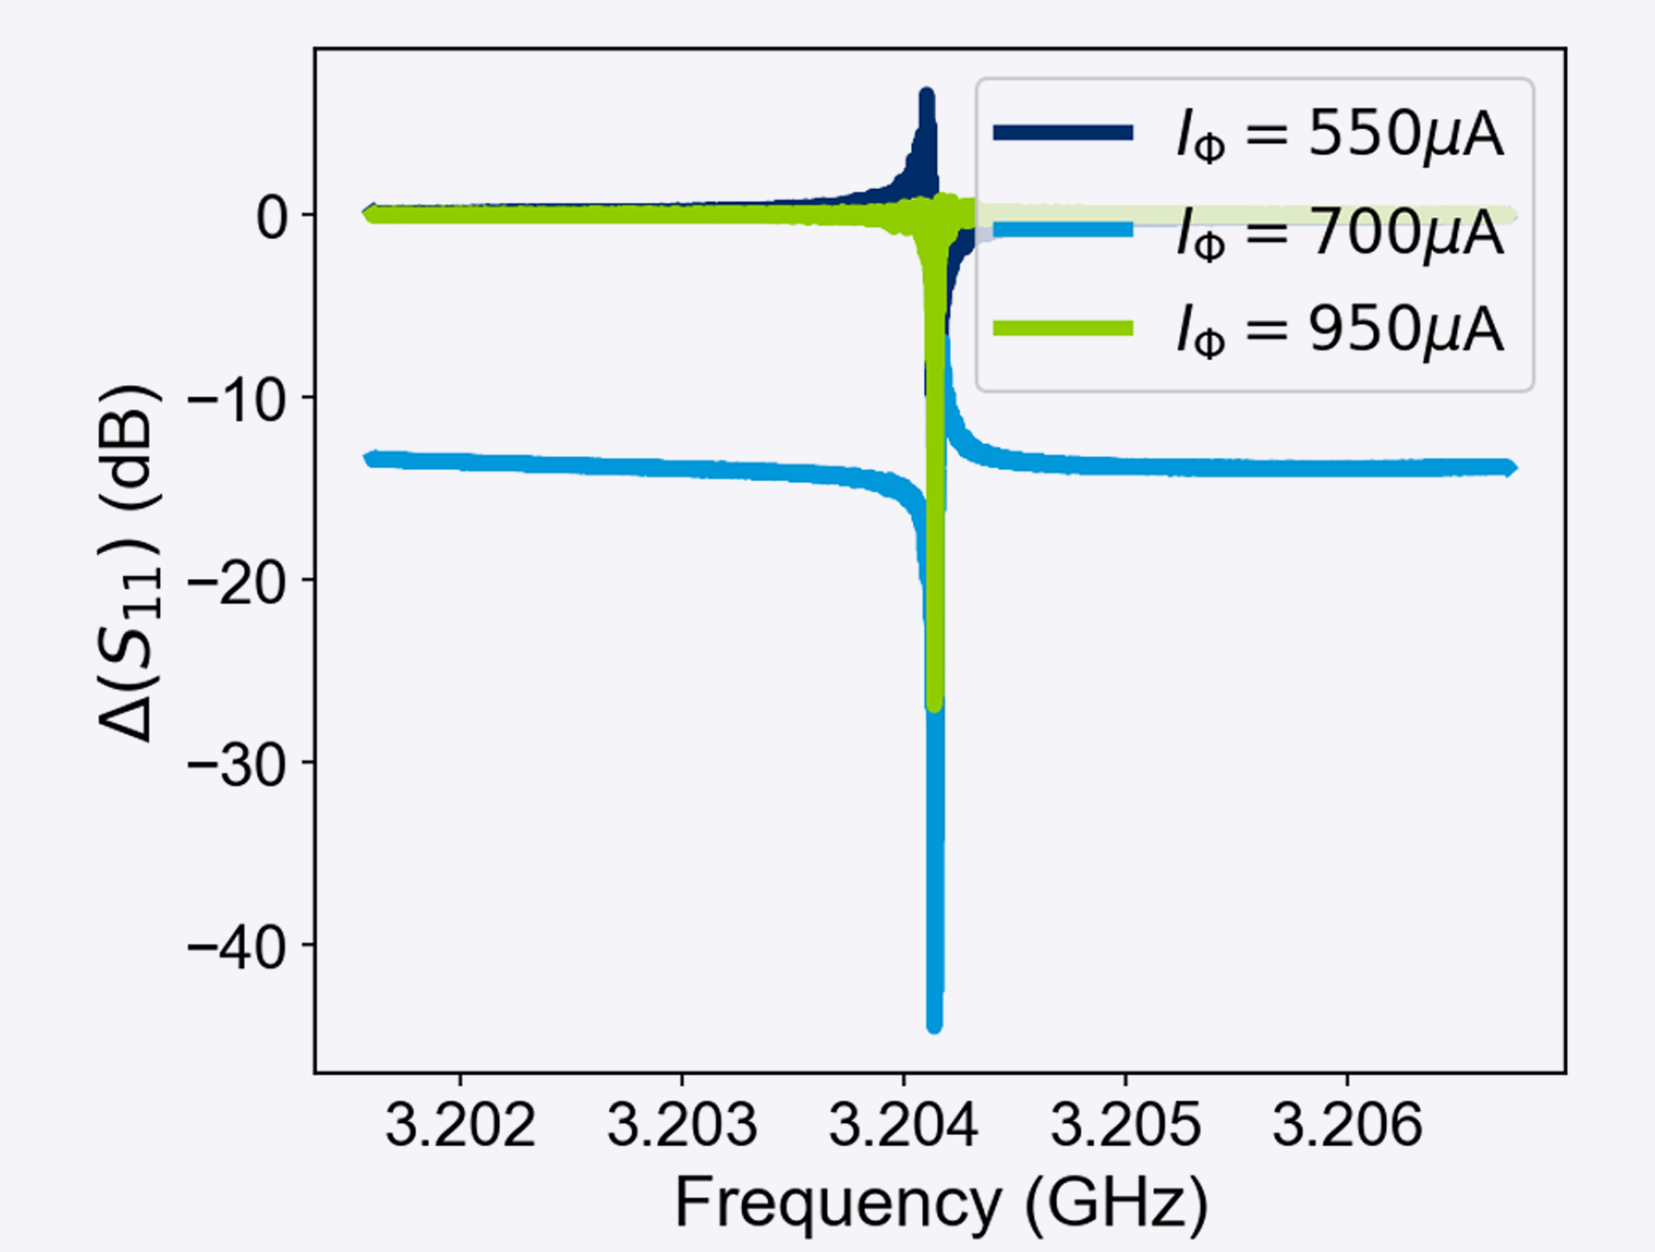
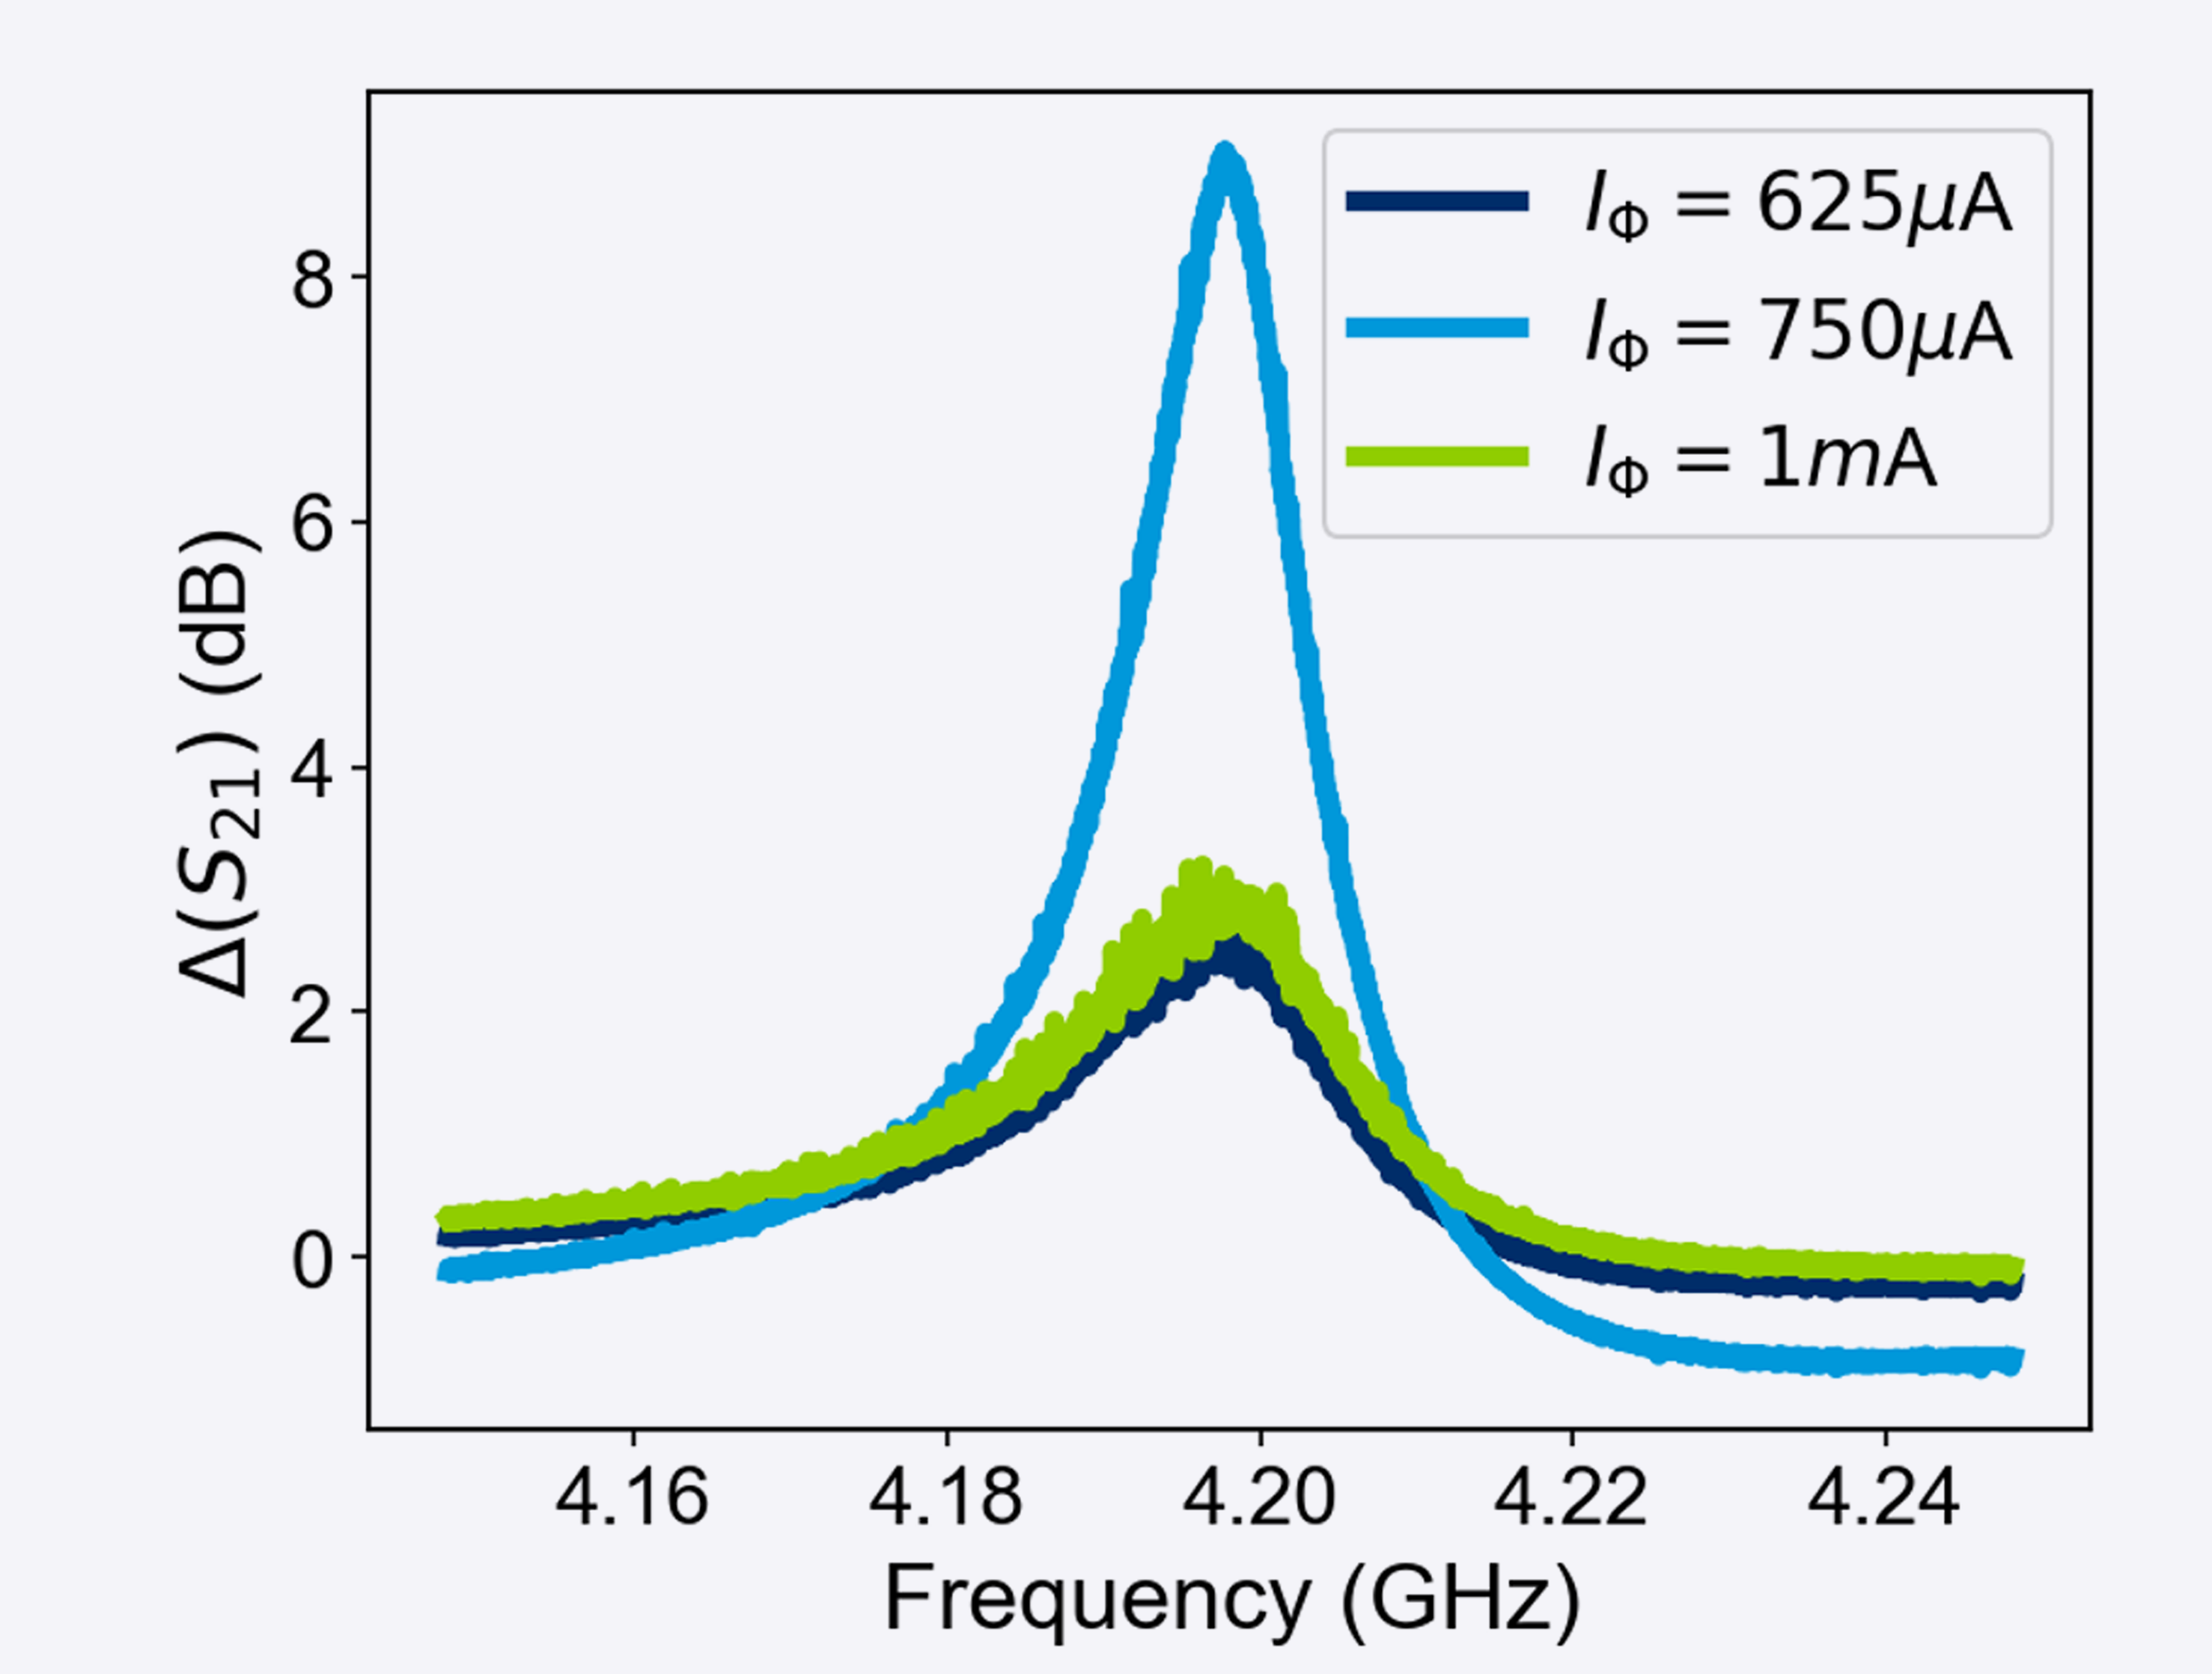
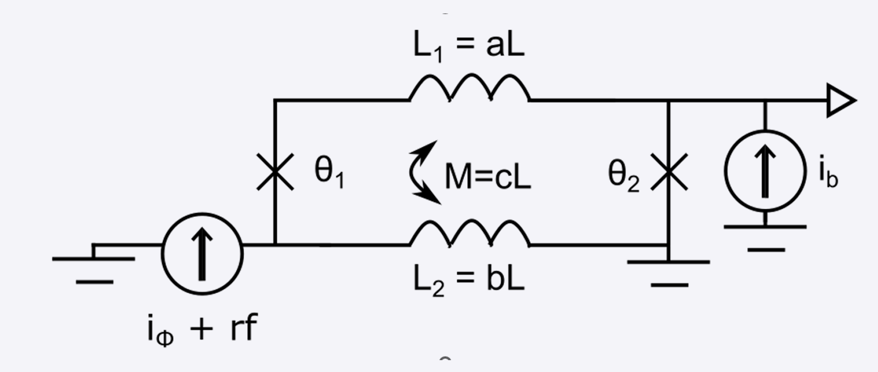
SLUG Loaded SQUID Amplifier
2 µm
1 µm
L = 3.1 pH
R = 5.8 Ω V_{Φ} = 0.14 mV/Φ₀
Ling Hao (NPL)
Gemma Chapman (NPL)
Ed Romans (UCL)
Thomas Godfrey (UCL)
T = 6.4 K
P_{in} = -40 dBm

Slide 21
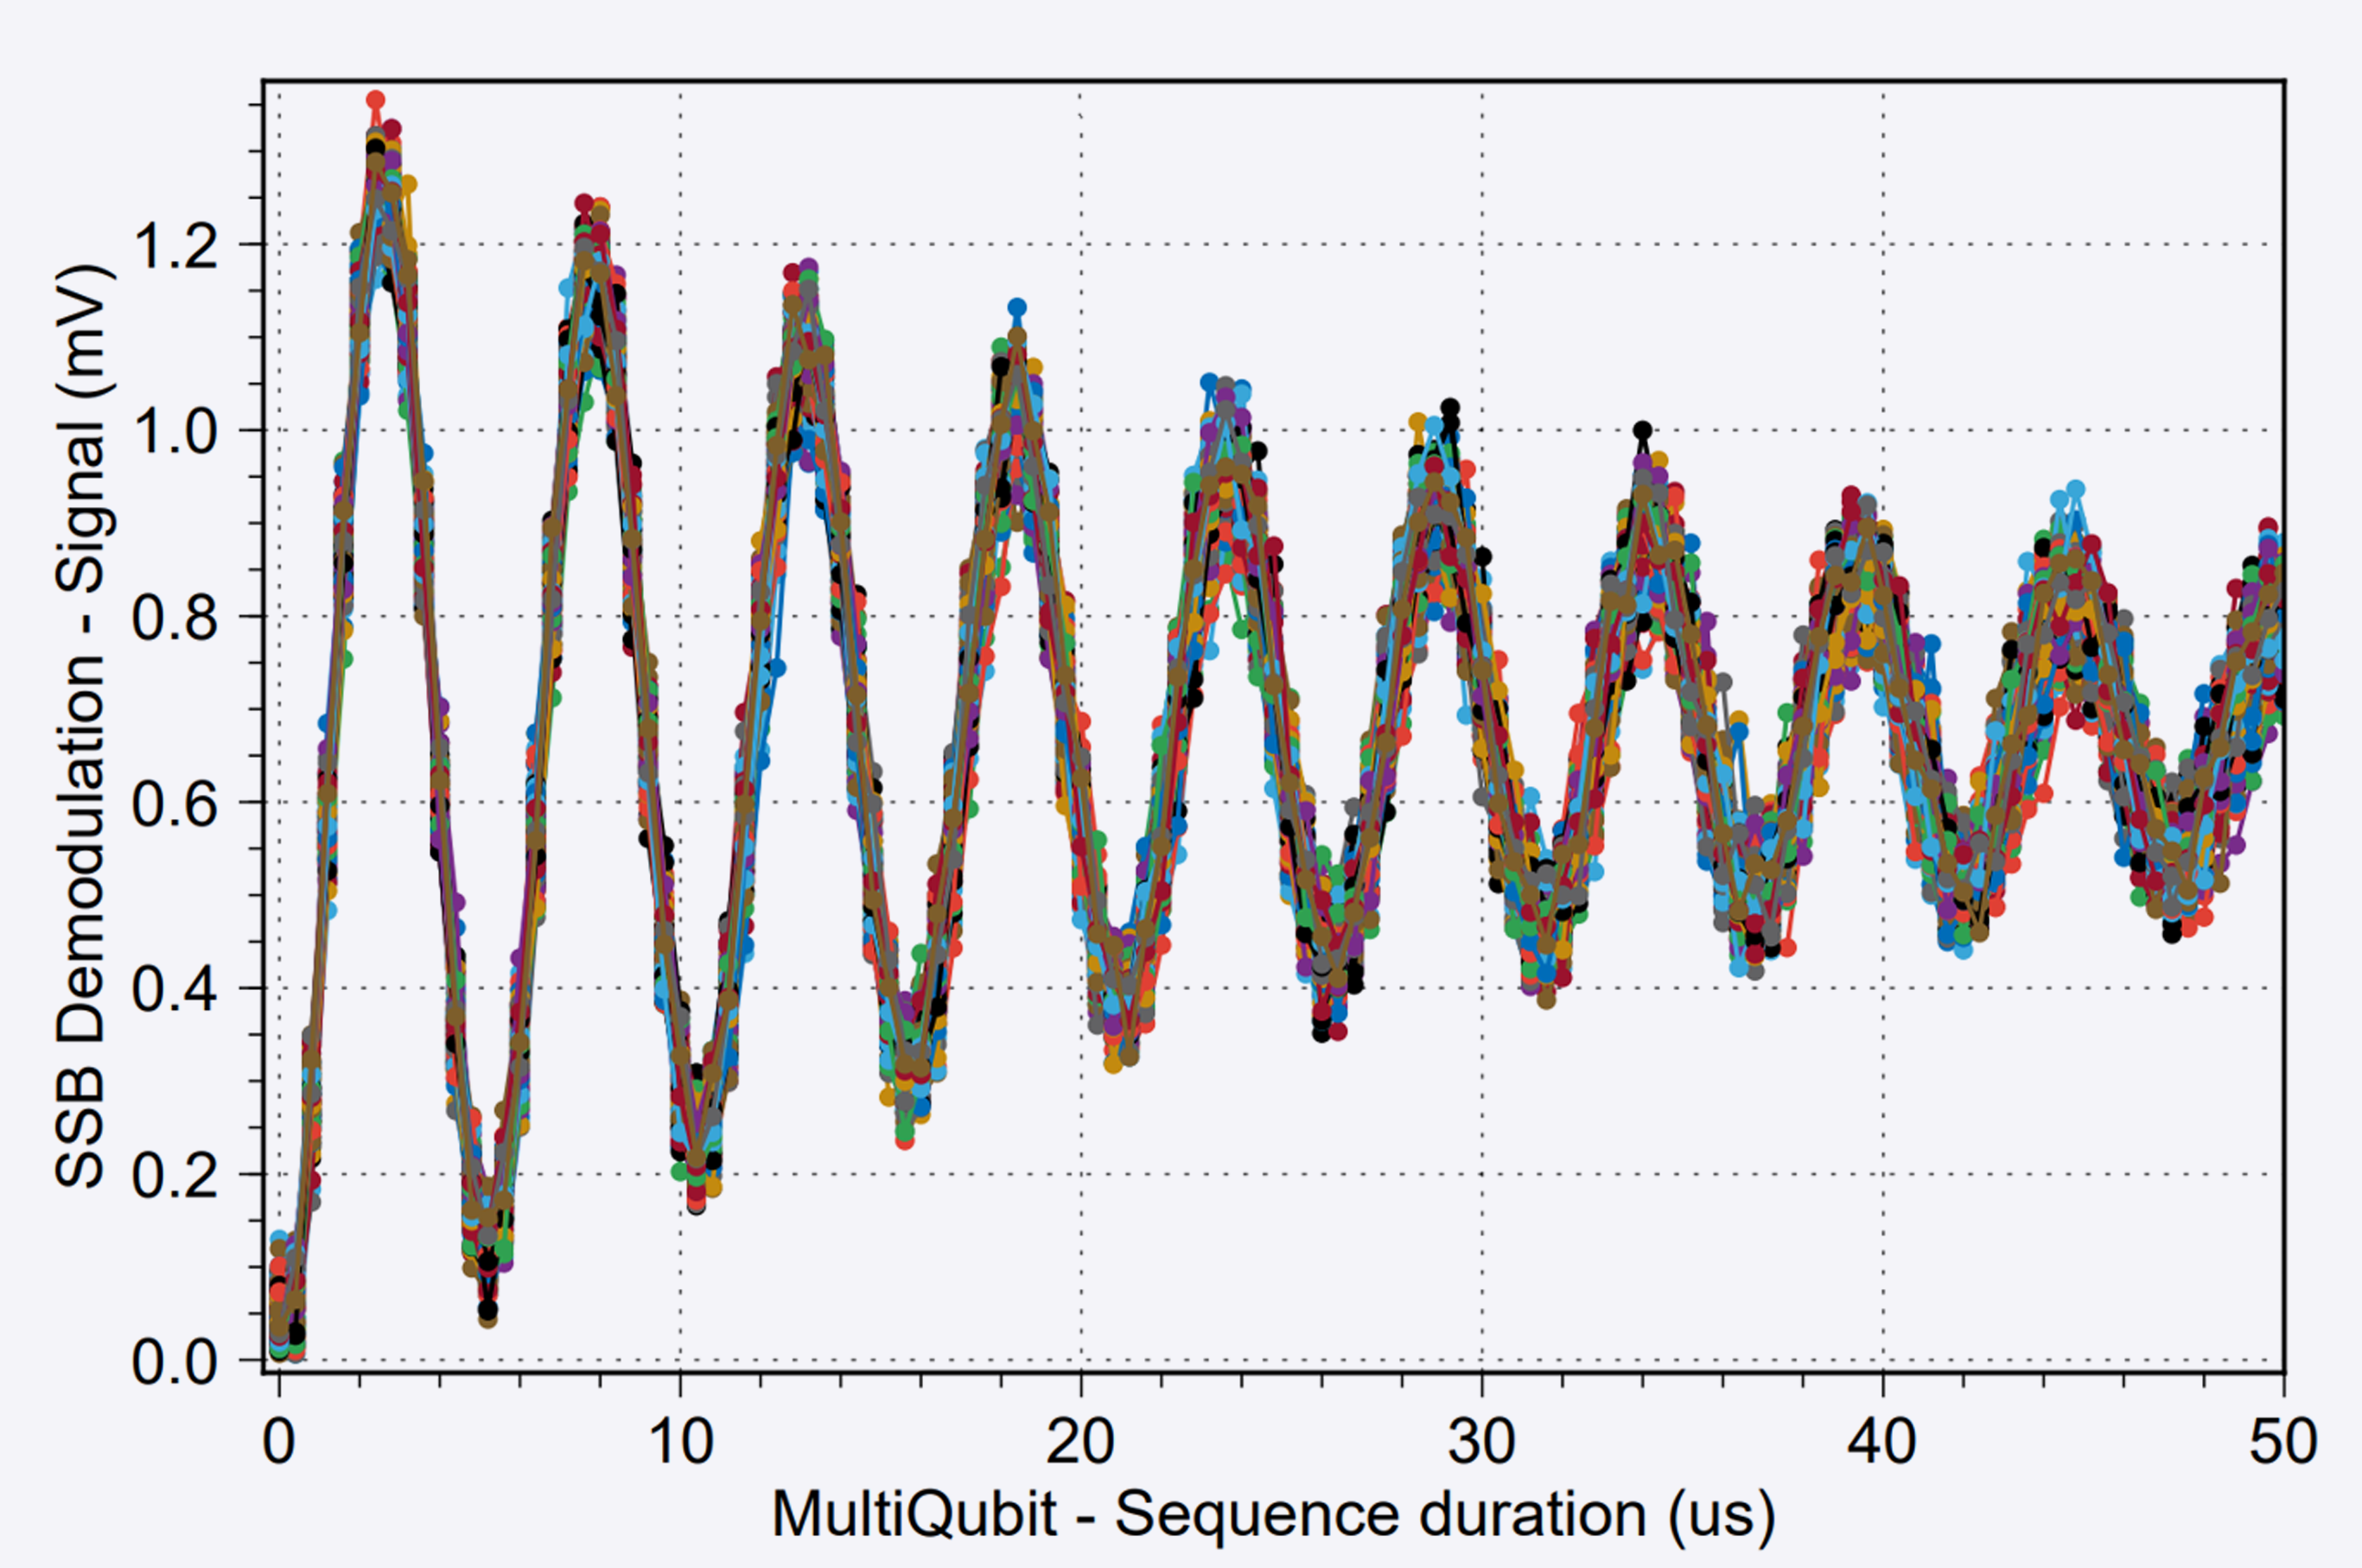
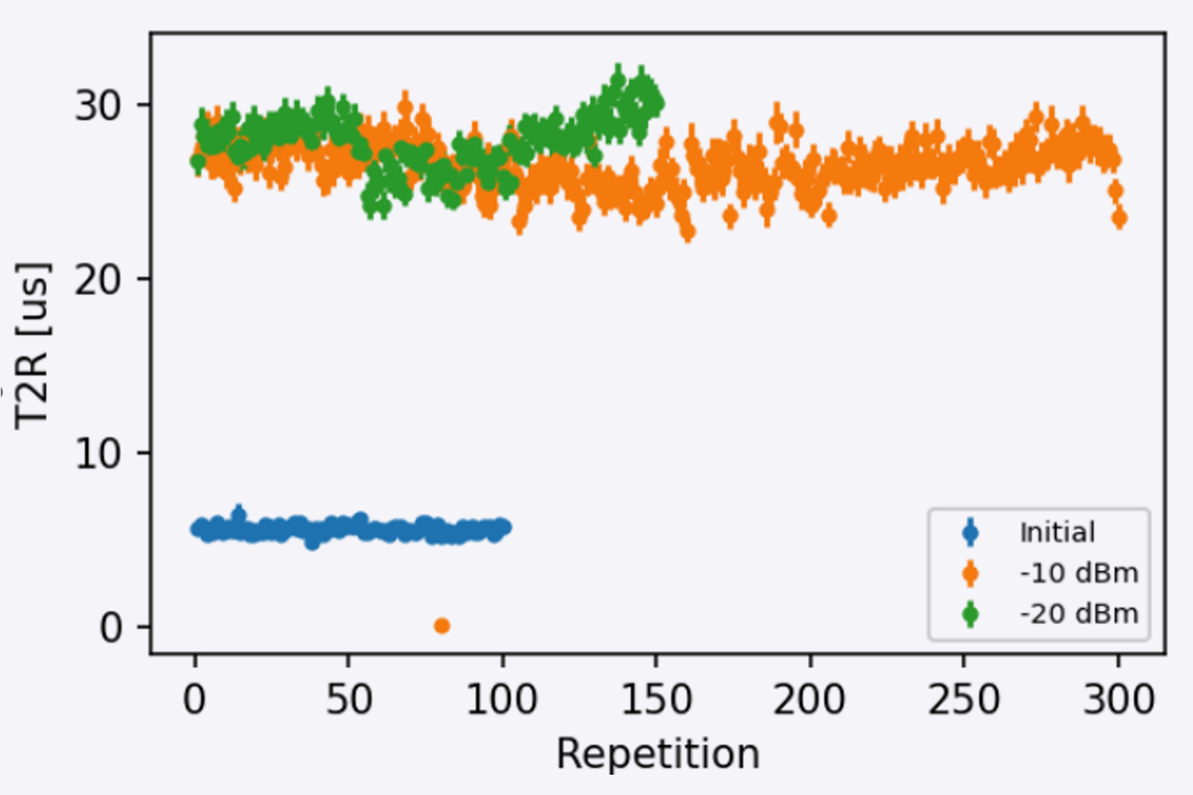
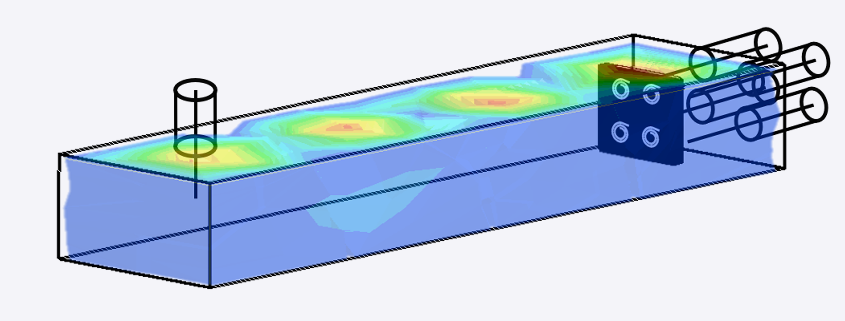
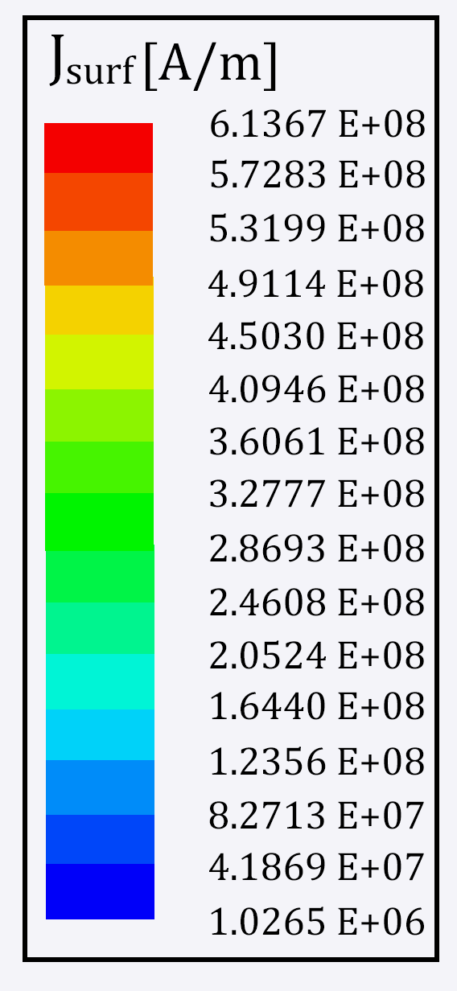
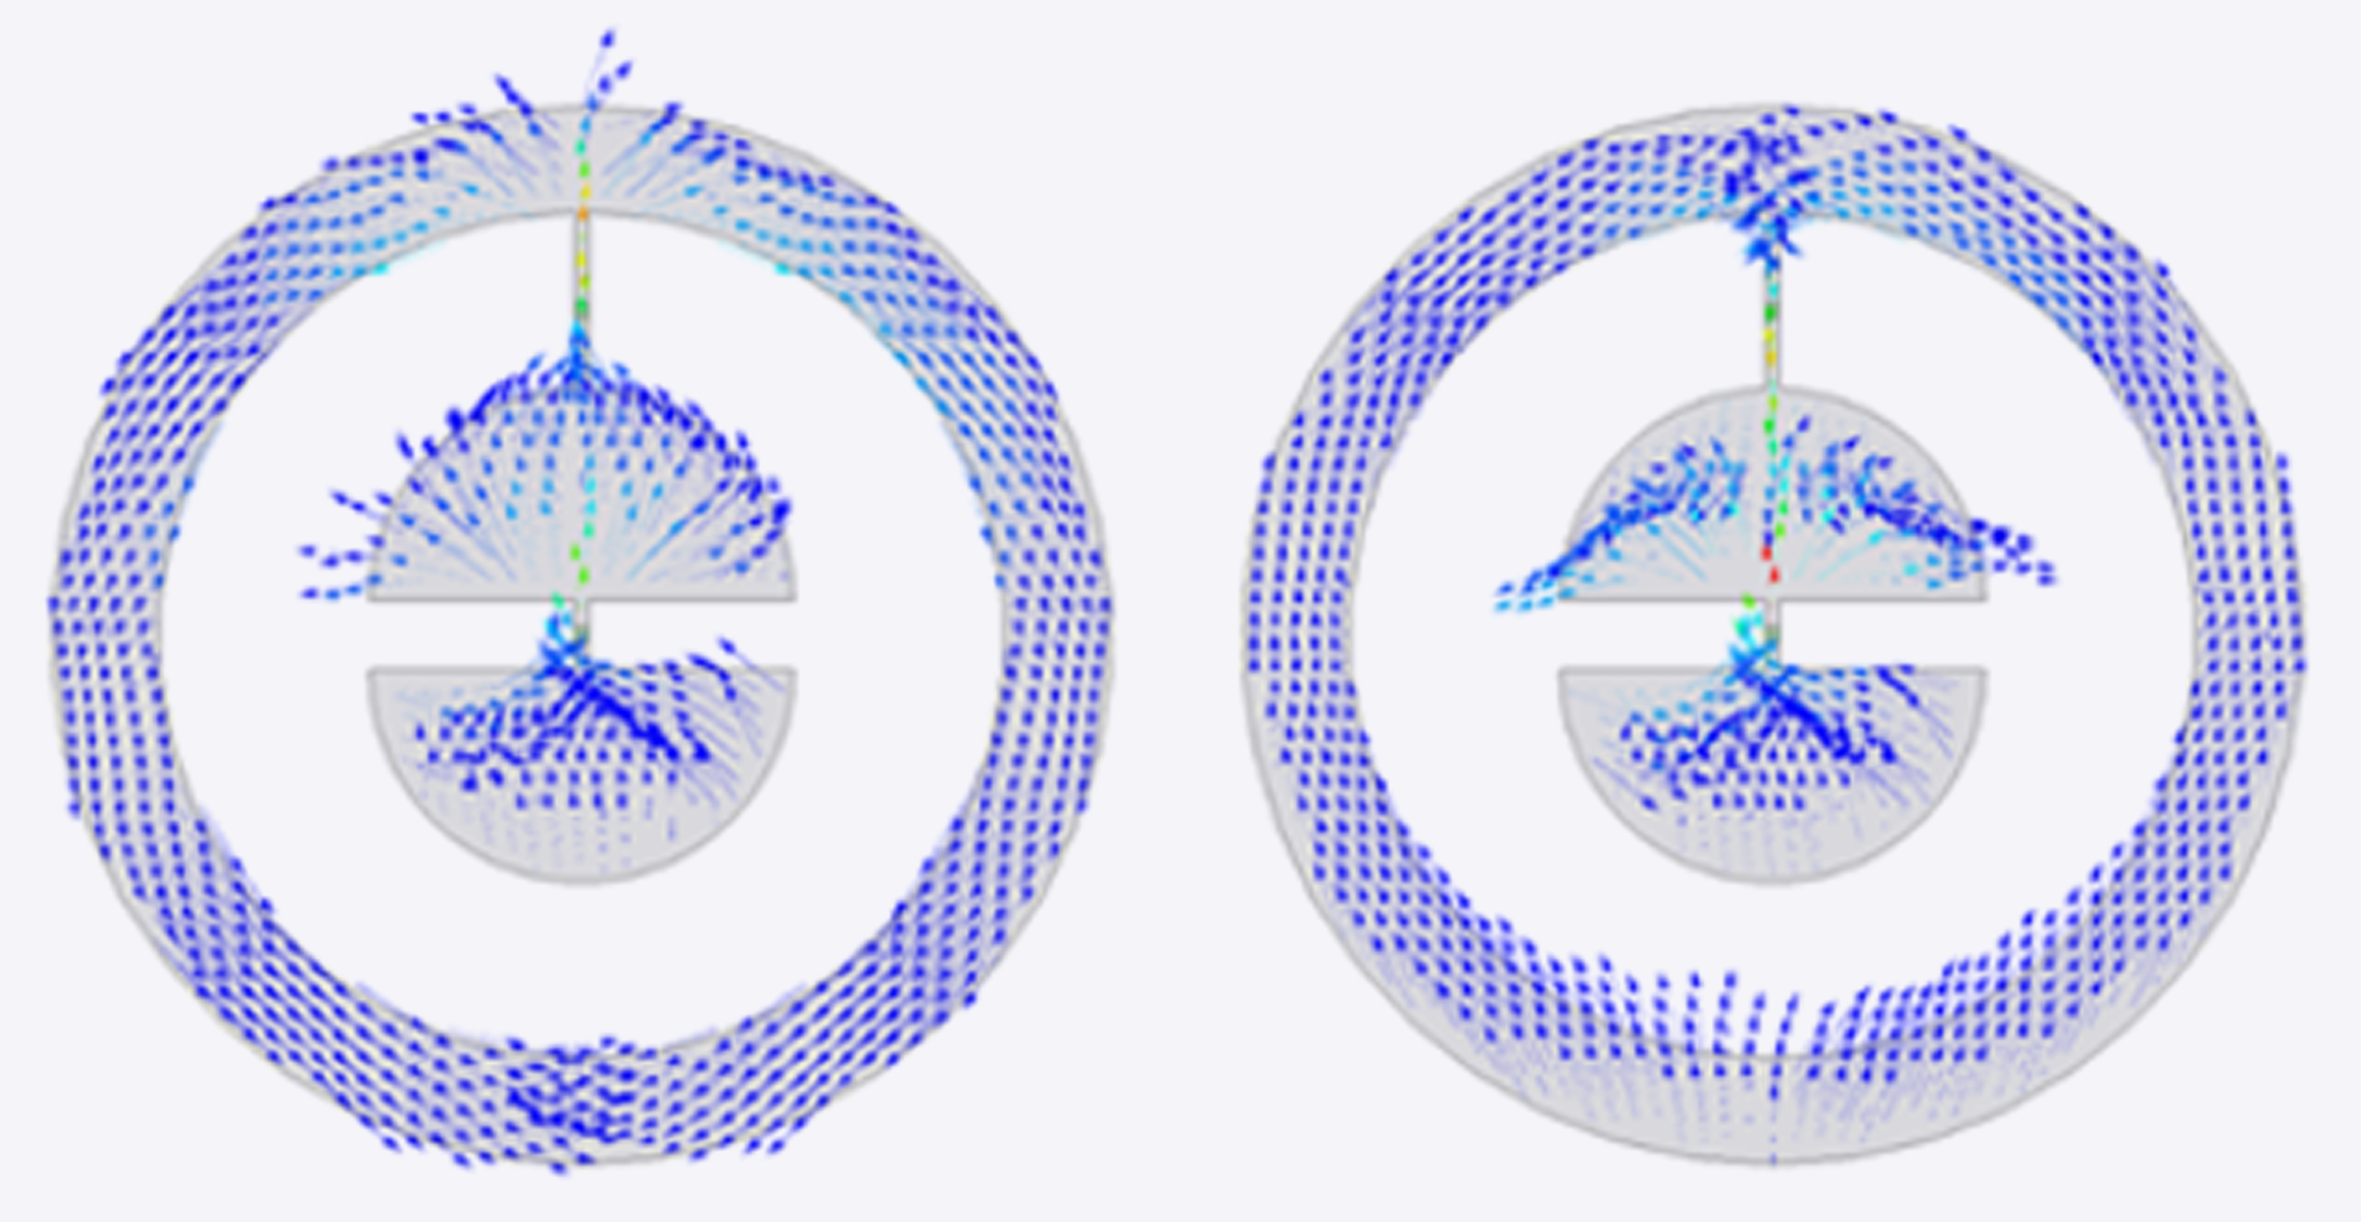
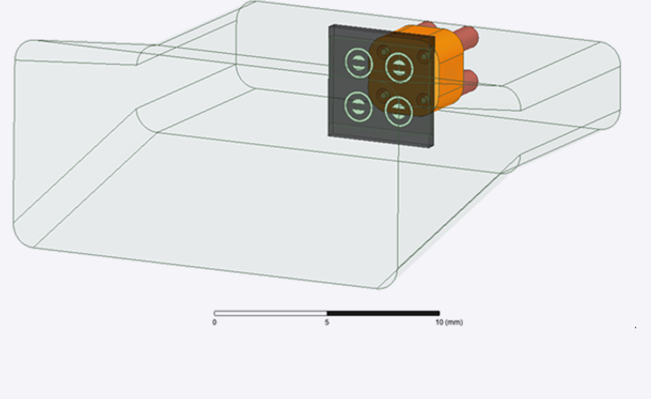
Qubit Sensor Development
Michele Piscatelli
Peter Leek
-20 dBm: Ramsey_x150
Coaxial Control Ports
Waveguide Input Port
Device
Low Frequency Port (4 GHz)
High Frequency Port (10 GHz)

Slide 22
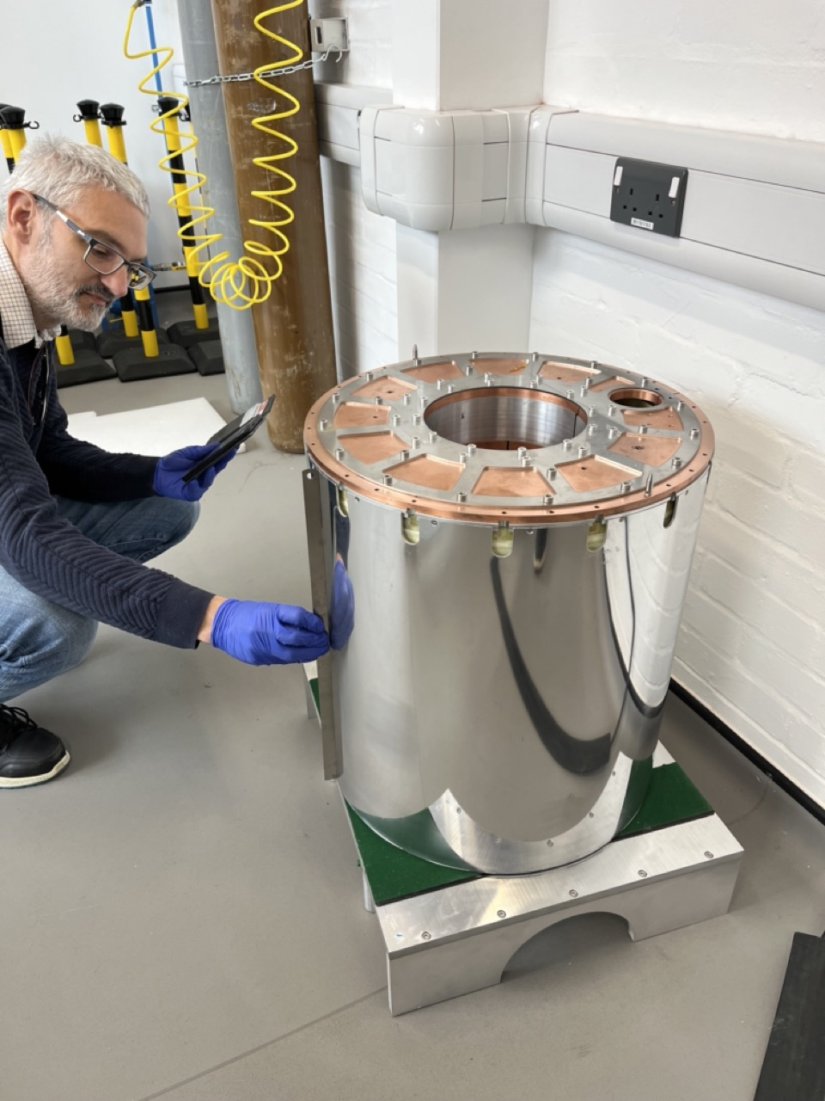
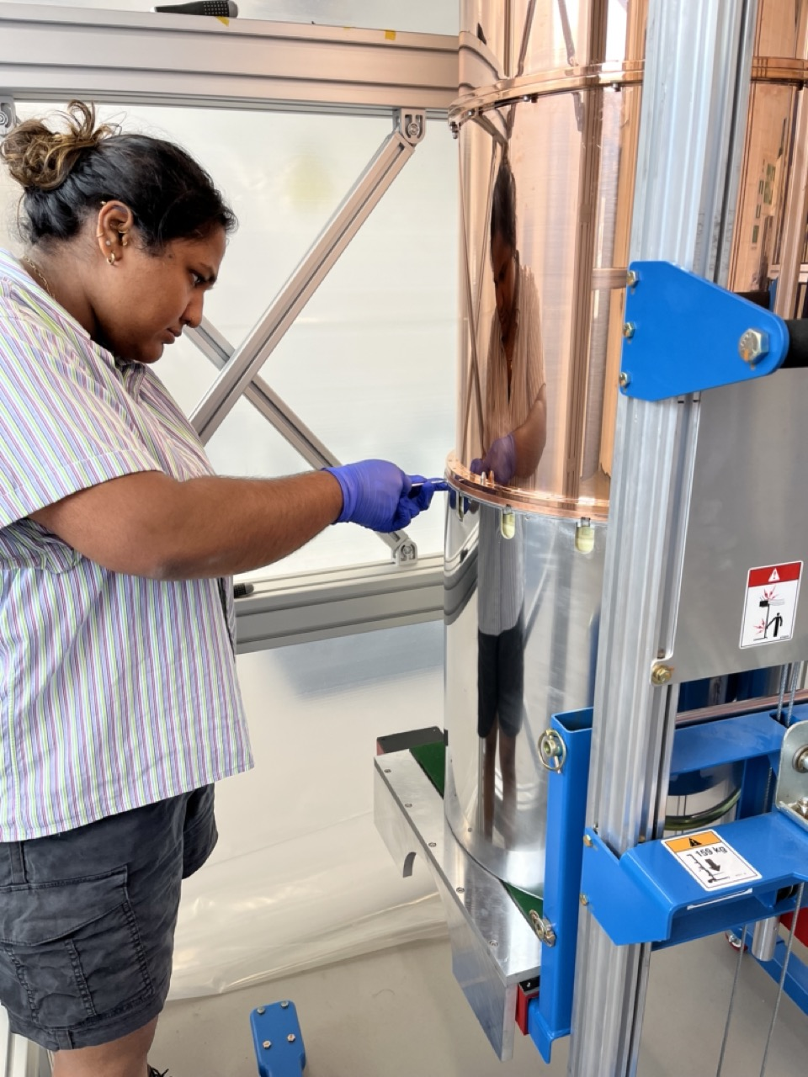
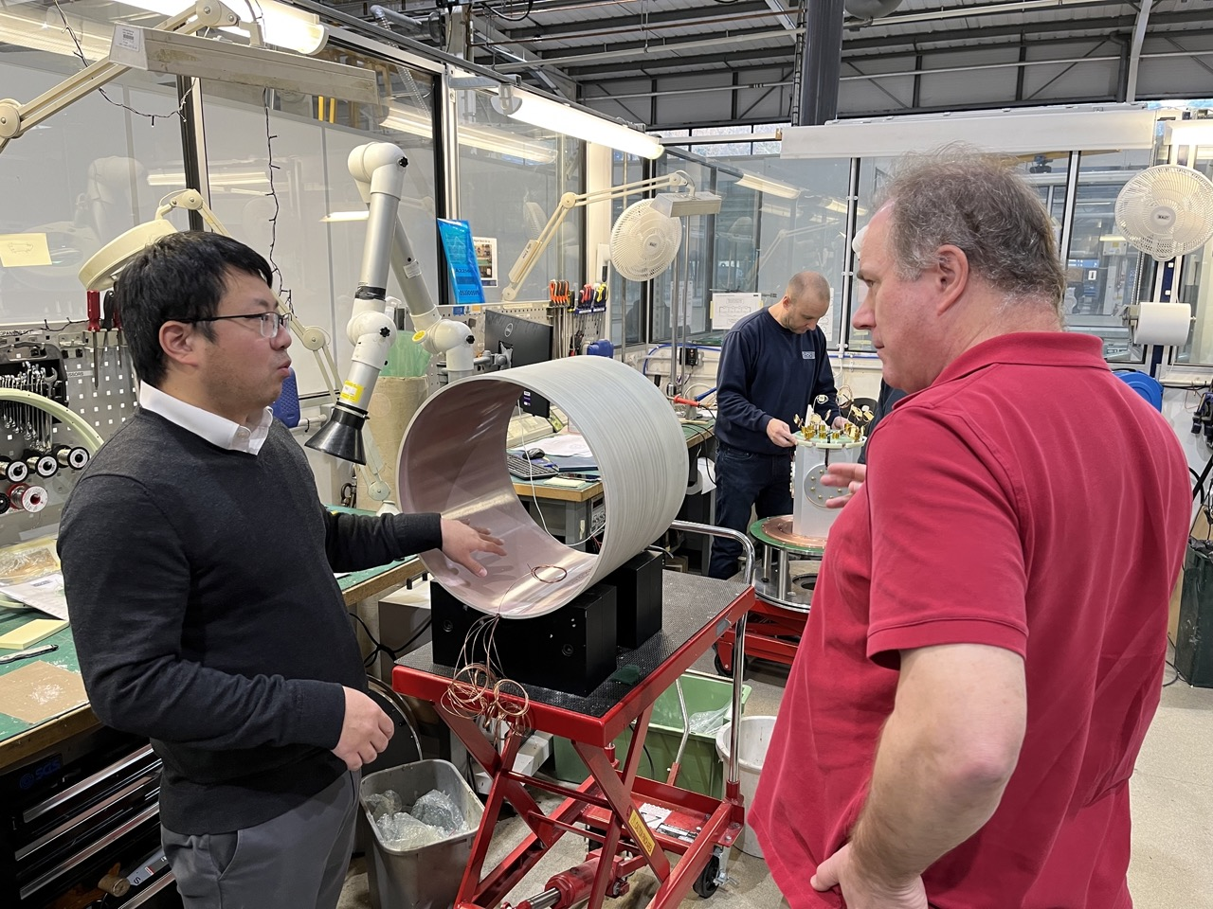
Magnet – Oxford Instruments
Outer shield NbTi winding is a formerless design.
3-coil superconducting magnet, Niobium Tin inner windings, Niobium Titanium
outer windings. Outer field cancellation coil reduces stray field below mixing chamber plate to <100G. Central magnetic field up to 8T, falls to <50G at the field shield.

Slide 23

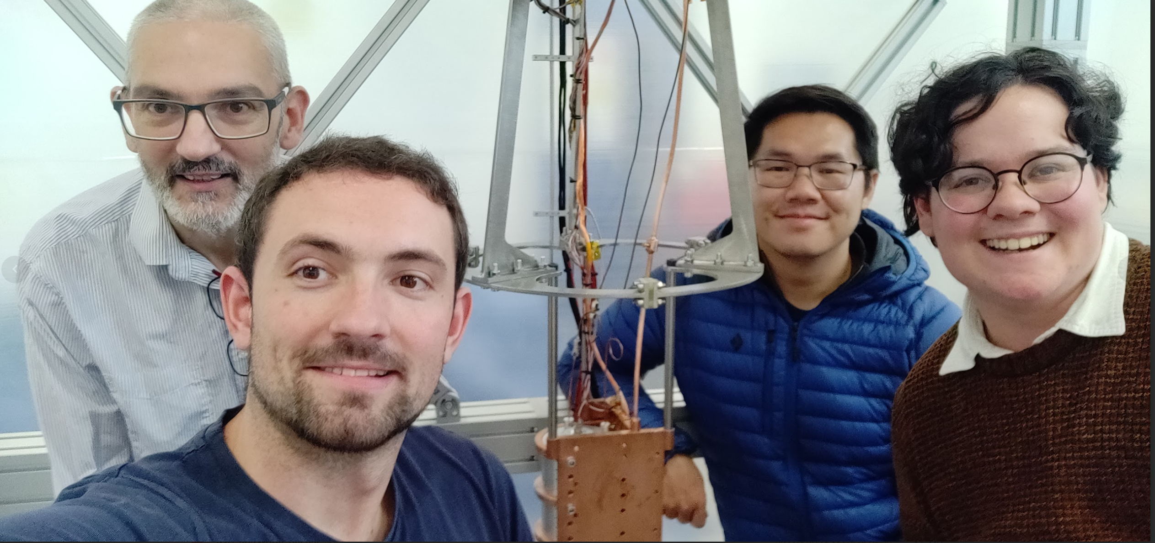
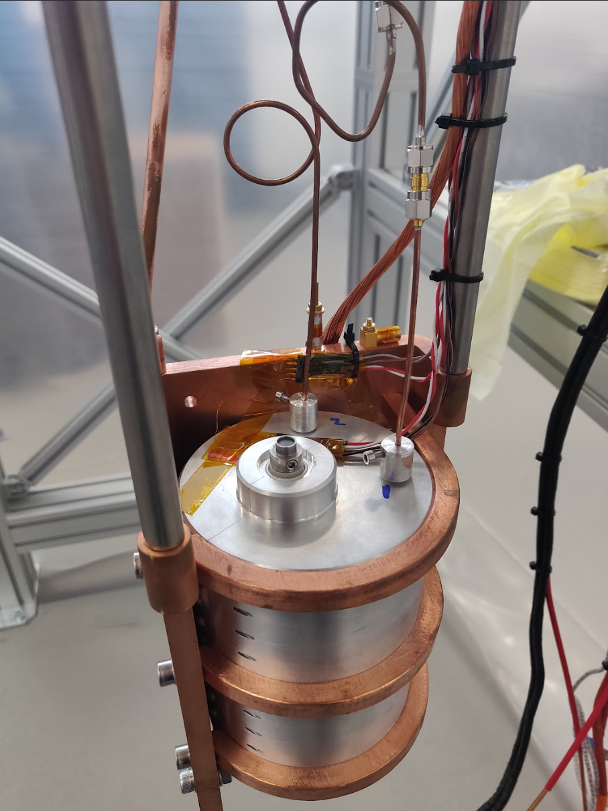
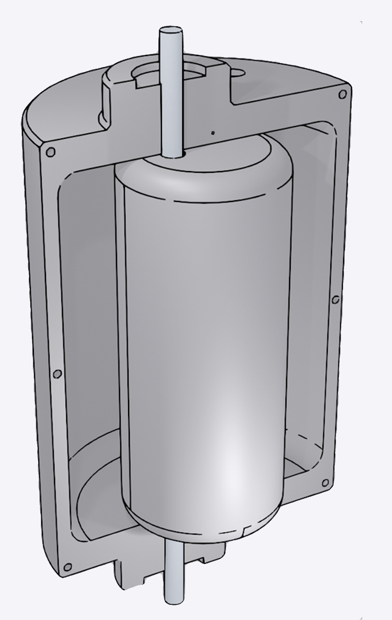
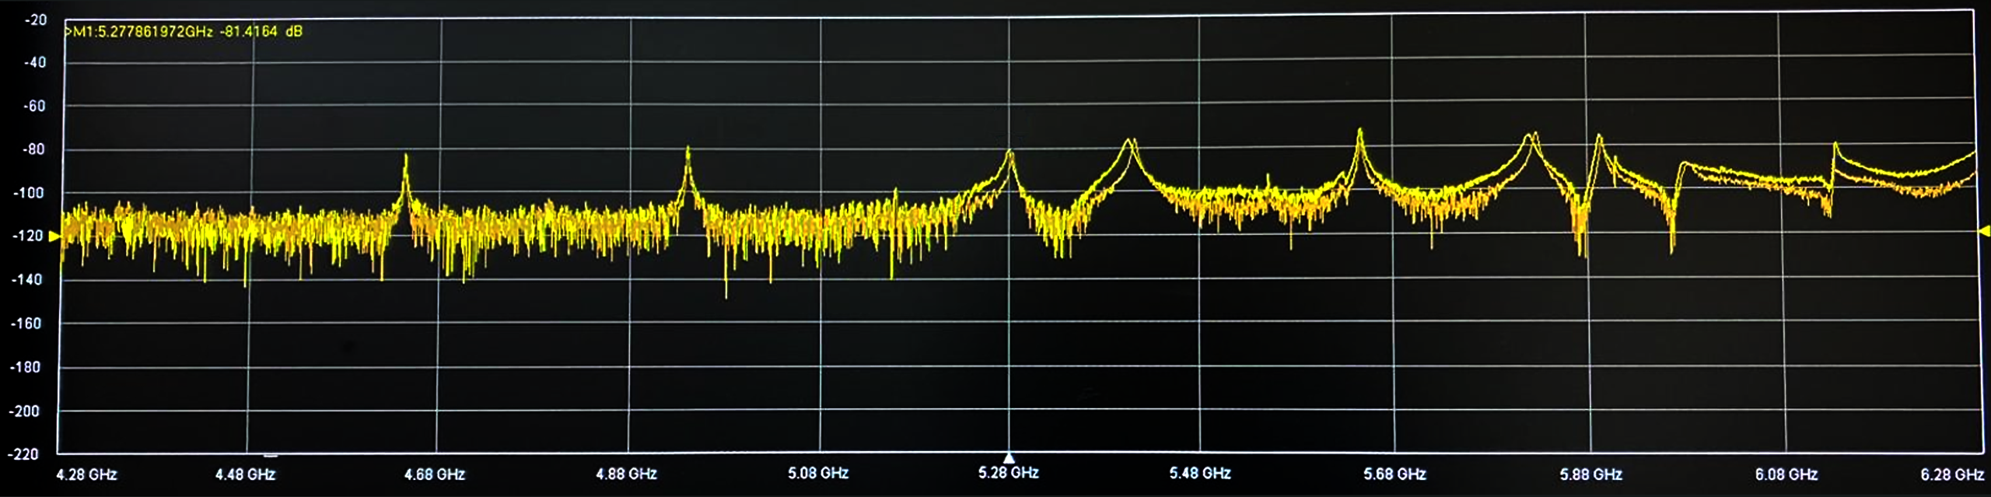
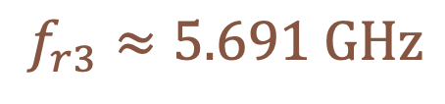
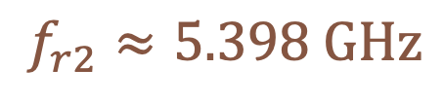
ADMX: Superconducting Magnet Test
Niobium Tin Tuning Rod Coating:
11 K Superconducting
Transition
Nick Du (Post Doc, LLNL ADMX), Paul Smith (Post Doc, Sheffield), Mitch Perry and Claude Mostyn (PhD Students, Sheffield)
$$f_{r4}≈5.820 GHz$$
$$f_{r5}≈5.897 GHz$$
Niobium Tuning Rod:
9 K SC Transition
Aluminium Cavity:
1 K SC Transition
VNA Spectrum, Before Cool
$$f_{r3}≈5.691 GHz$$
$$f_{r2}≈5.398 GHz$$
$$f_{r1}≈5.269 GHz$$

Slide 24
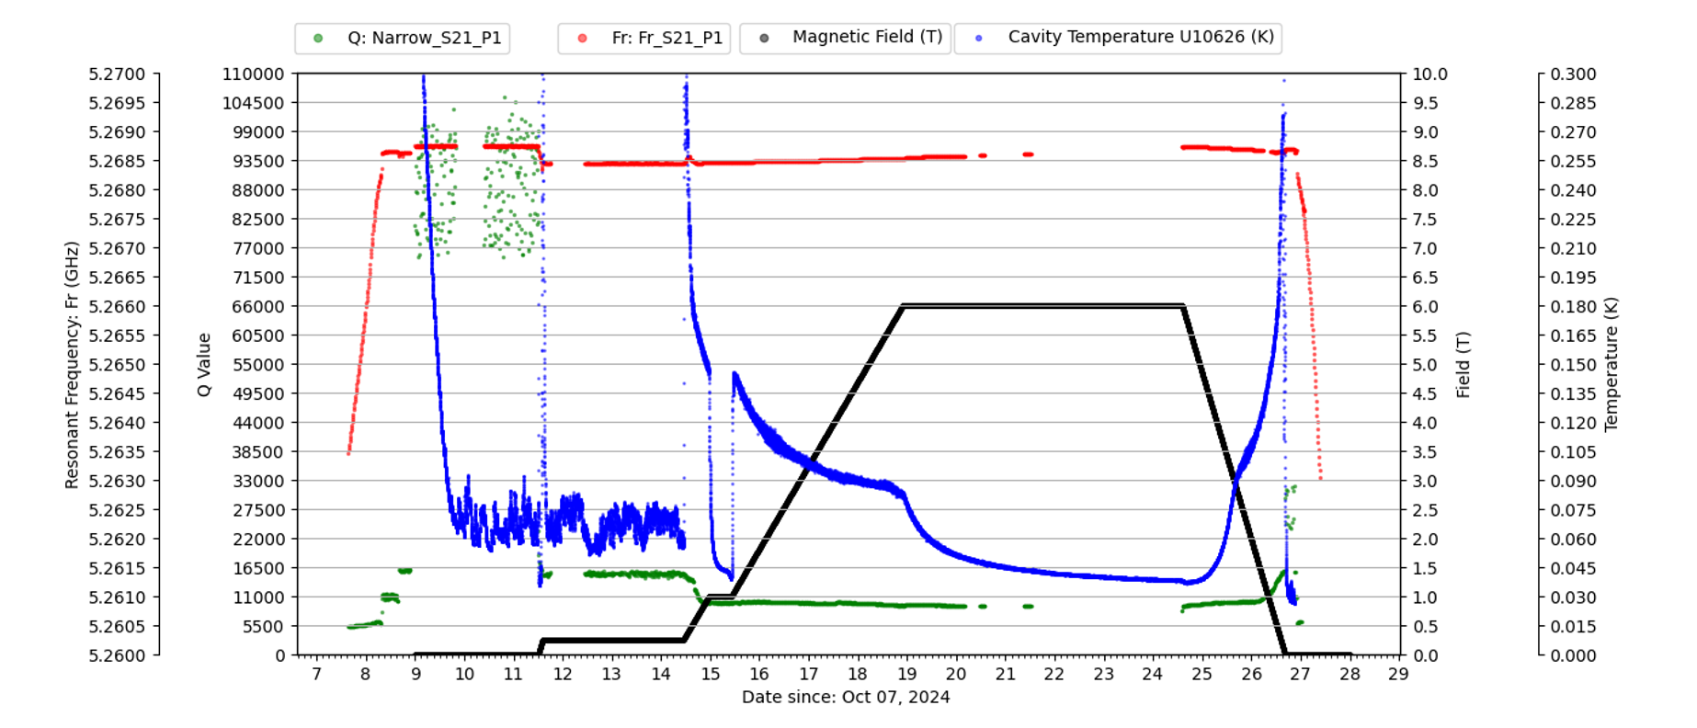
Joint tests with ADMX at QSHS of an aluminium cavity containing a
NbSn coated Niobium tuning rod.
Q steps up
again as Al
cavity walls
superconduct
PRELIMINARY
Q steps up again as Nb substrate in tuning rod starts superconducting
Q steps up as NbSn coating starts superconducting
Nothing superconducts yet

Slide 25
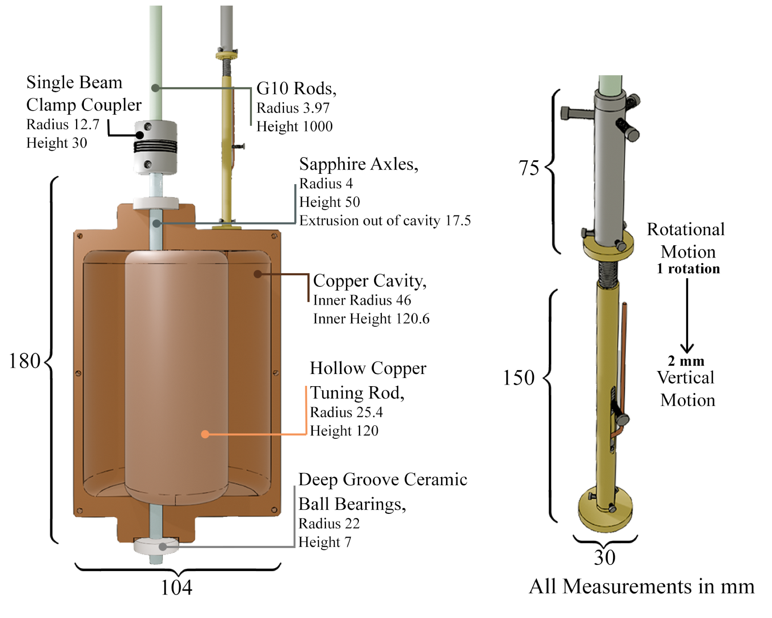
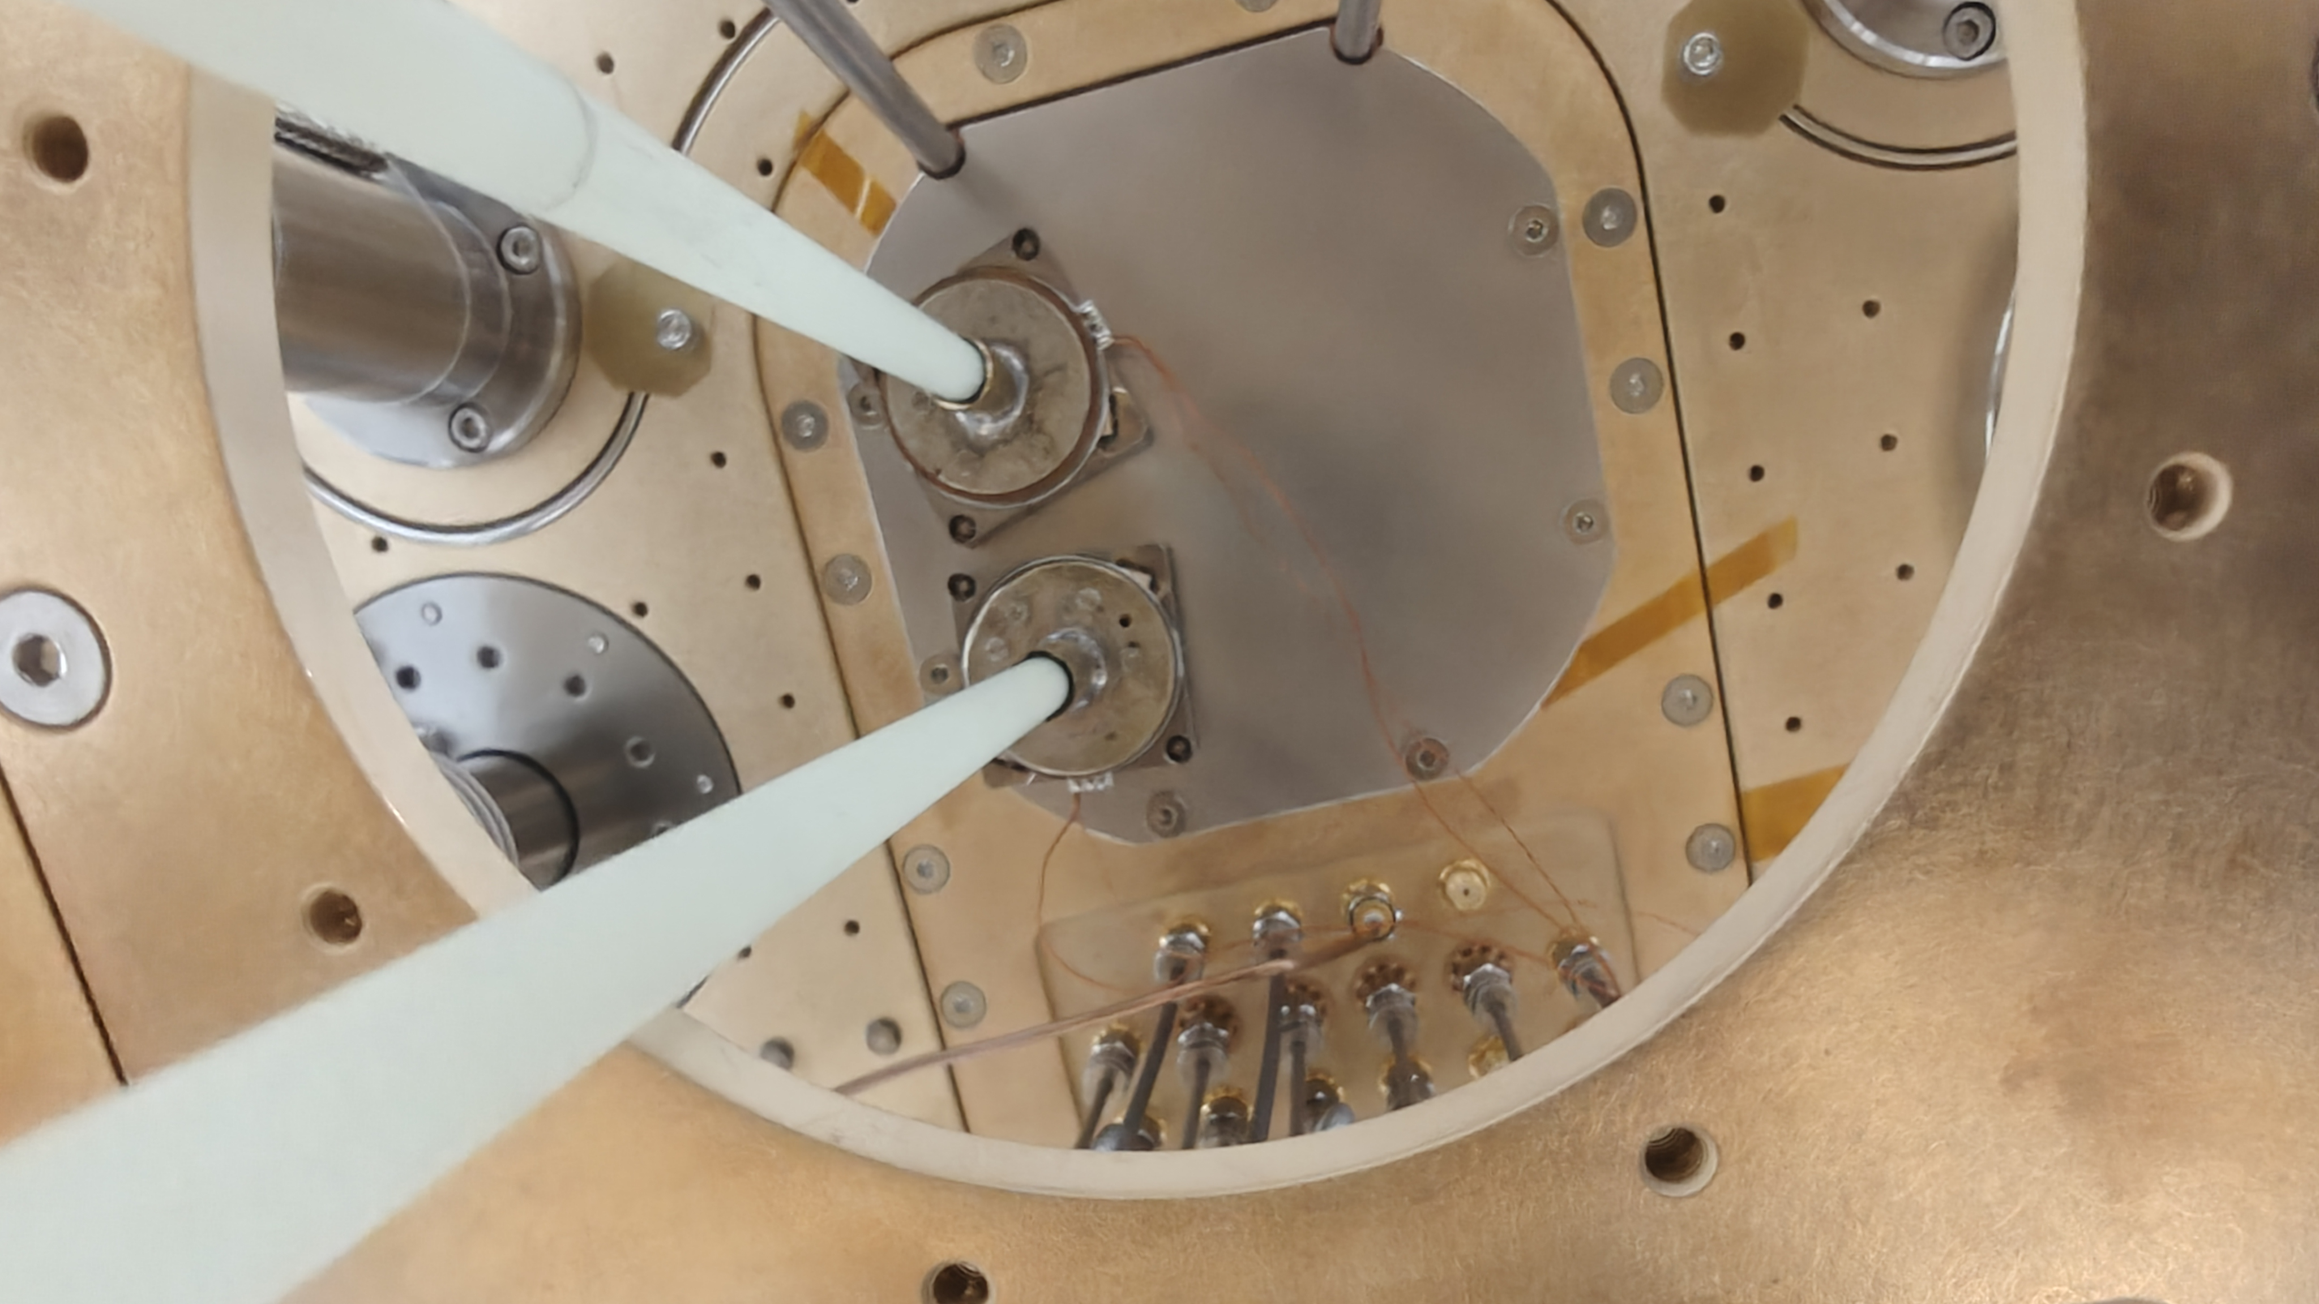
Cavity tuning
Direct drive of tuning rod rotation from attocube piezo drives at 4K.
Initially had problems with jamming, found to be caused by residual water ice in the insulation vacuum. Solved by flushing with dry nitrogen gas to half room pressure, then pump out, twice.
Further jamming problems still ongoing. Various ideas about cause
Piezos don't work well if you introduce helium gas.

Slide 26
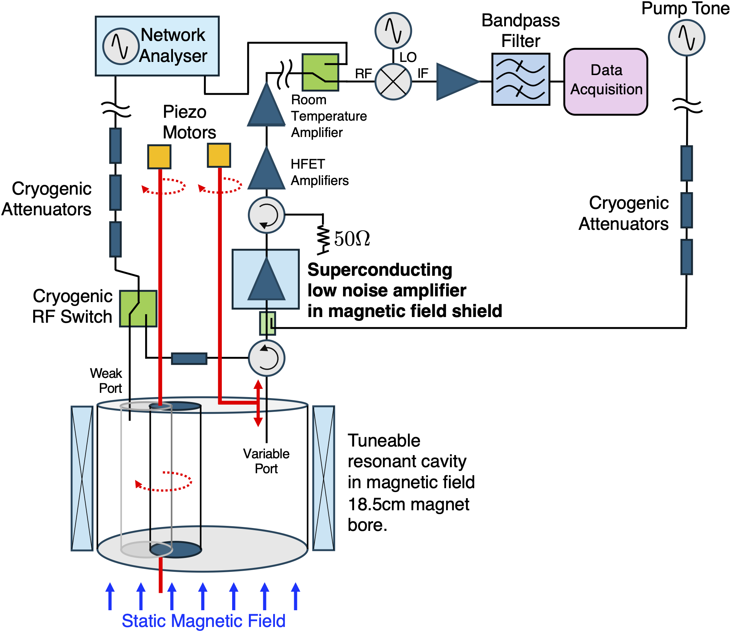
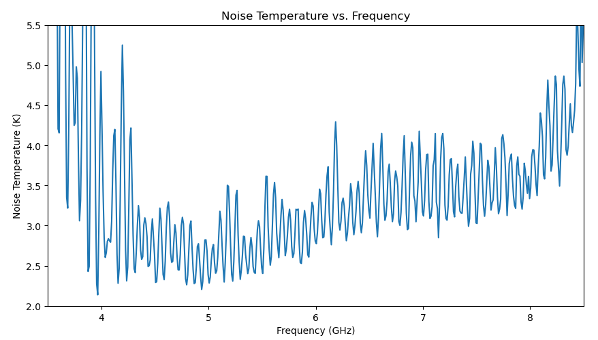
QSHS electronics
Two Low Noise Factory LNF-LNC4 8G cryogenic HFET amplifiers in series.
The lower of these is connected via a long superconducting coax that runs between the 4K plate and below the mixing chamber plate.
Room temperature amplifier was not installed for this test.
Oscillations will probably go away when we re-install the room temperature HFET amplifier

Slide 27
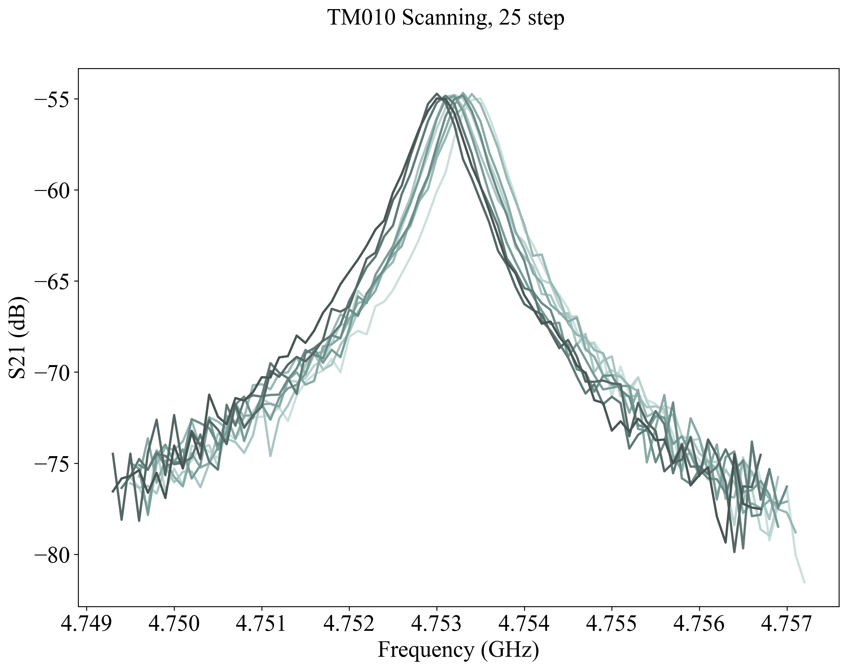
Tuning the cavity TM010 mode frequency
Using the attocube rotary drives to move the tuning rod.

Slide 28


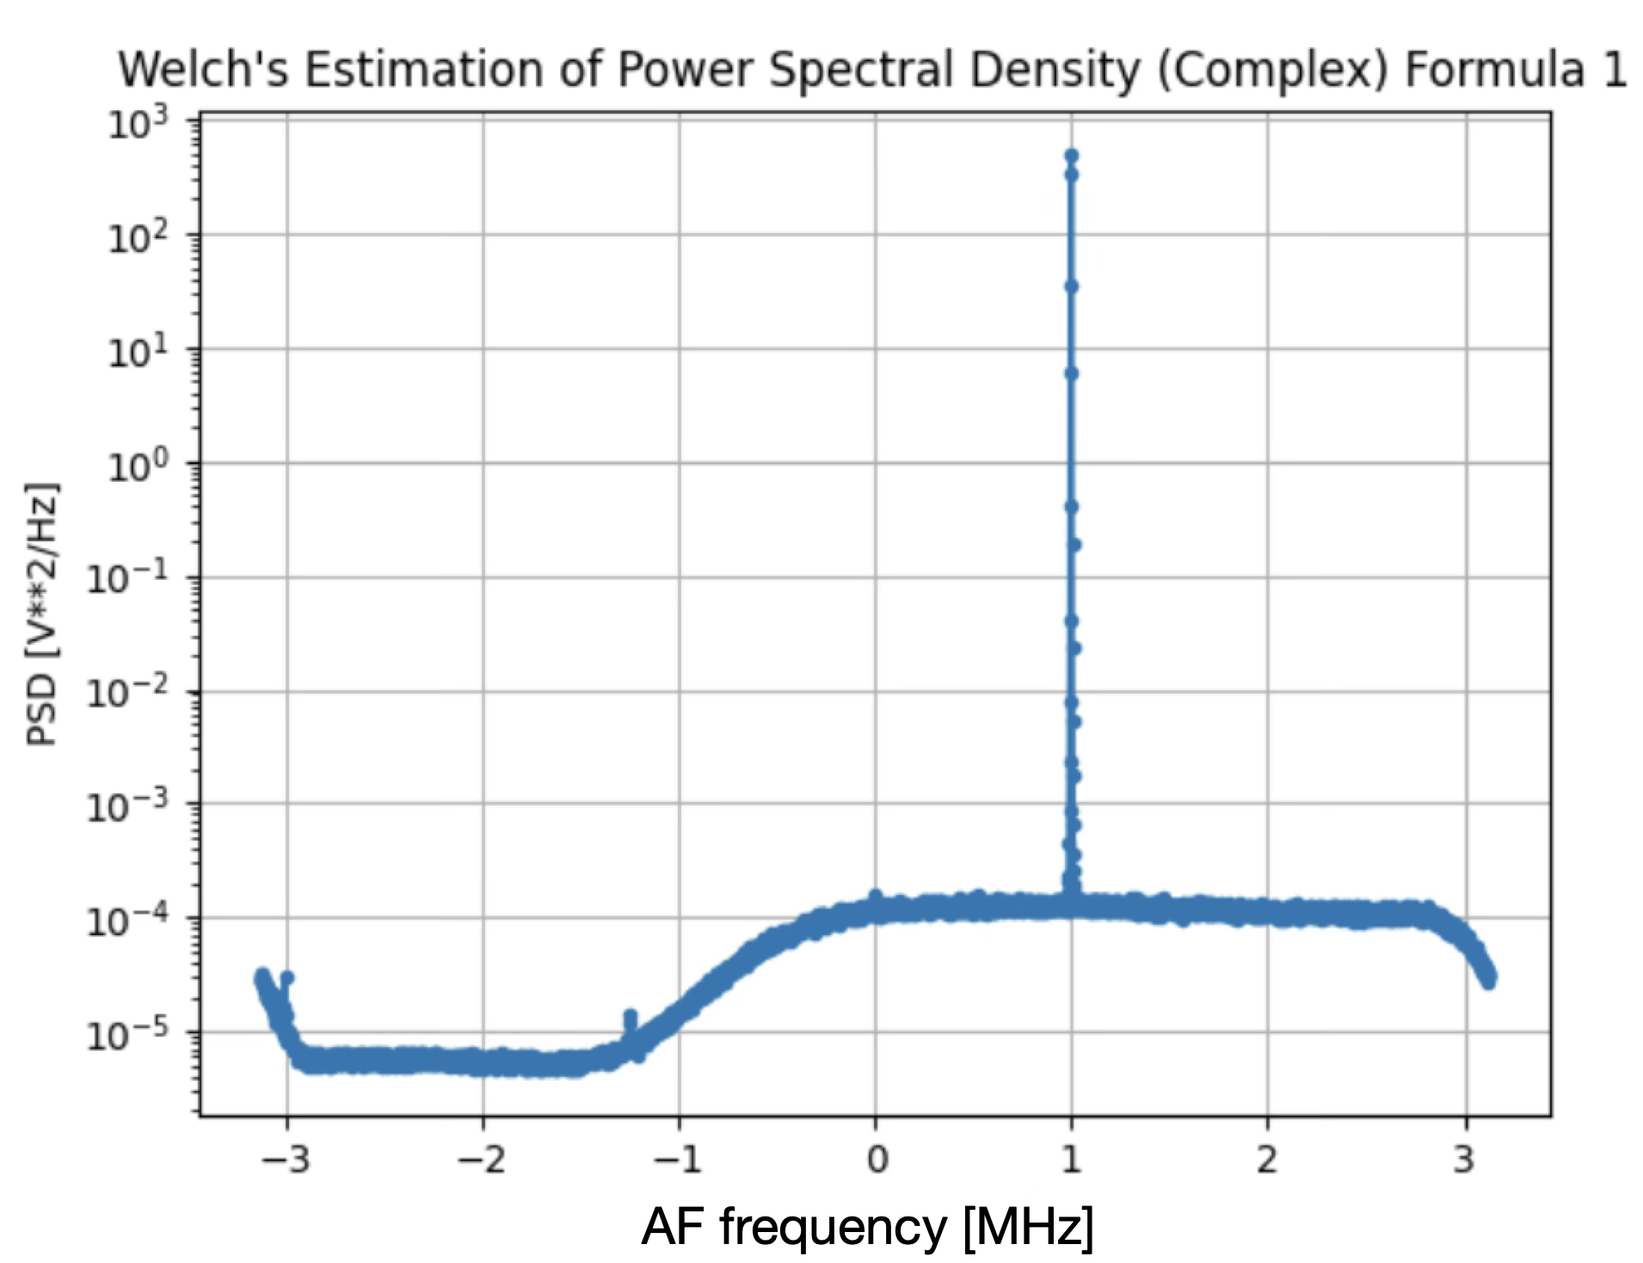
Double Heterodyne Receiver Chain Test
Injected signal
At 5 GHz
100MHz
digitiser,
AlazarTech
IN THE CRYOSTAT
Bandpass
Filter
20-23 MHz
HFET
amplifiers
2⁴
Data file
Local
Oscillator
4.9785 GHz
20MHz
Digital LO
In 2 quadratures
resonant cavity
at 60mK

Slide 29





Axions efforts at Manchester
Targeting high-frequency (30 GHz) domain
Pathfinder under construction:
→ successful preliminary test
coolings stable at 70 mK
→ first warm cavity characterization
→ DAQ completed
→ currently characterizing RF chain

Slide 30


Software & firmware tools
We are building a number of general routines to drive our hardware and perform quality control & data analysis. All public and citable at github.com/orgs/HALO-DM/
HW interfaces:
RAPID Real-time Acquisition Pipeline for IQ Data
ARTIC-FOX: Cryo interface
RED-FOX: VNA interface
Data analysis: FOX: Fourier-based Observation of aXions
off-line data analysis for haloscopes
→ configurable to read-in virtually any data format
Local data & QSHS data
If interested in contributing please email us!
Simulated spectra

Slide 31

Disadvantages of Standard Sikivie Resonators
The tuning rod can get stuck, so can the variable coupling antenna.
Trade-off between tuning range and quality factor / volume.
Lower limit mass set by the magnet bore.
Higher limit mass set by aspect ratio problems with cavities.
Only one useful mode. Three orders of magnitude in mass takes 100 years.
Resonant feedback
Standard electromagnetic resonant cavities have modes fixed by the conducting walls of the cavity. However, suppose you use an external circuit to create ‘custom’ charge distributions on the wall surfaces;
CAVITY
‘CAPACITOR’
NIM A, Volume 921, 21 March 2019, Pages 50-56

Slide 32
What you need for it to work
Potential advantages
No tuning rod or antenna. No moving parts in the cryostat.
Multiple parallel resonances. Search rate multiplies by mode count
High form factor almost independent of frequency
Regeneratively generated modes mean potential for very high Q values.
Frequency range less strongly constrained by magnet geometry
Electromagnetic structure capable of supporting high form factor electromagnetic field at microwave frequencies.
100 MHz bandwidth real-time feedback system with low noise
Digital filters that resonate in response to a sinusoidal drive.
Feedback control of loop gain and phase shift.
Understanding of the behaviour of such a system close to the standard quantum limit.

Slide 33


Feedback electronics
HFET
amplifiers
Bandpass
Filter
20-23 MHz
SOC
ADC
100MHz
Digital signal
processing
DAC
100MHz
Local
Oscillator
4.9785 GHz
Processor
Control
Local
Oscillator
4.9785 GHz
WARM
WARM
COLD
[Ethernet]
COLD
To
Cavity or
other RF
structure
From
Cavity or
other RF
structure

Slide 34


Radio frequency test results in the IF (intermediate frequency) band

Slide 35



Quality factor results
Each Q was set on the terminal, then measured on the network analyser. The highest measured Q was
at the setting of 8000, and was 7608, The width of this resonance was 2.3kHz.
Mixing up to RF frequencies of order 5GHz (using rubdium clock stabilised local oscillators and clocks
everywhere), the RF Q of this peak would be
This exceeds the Q of the axion signal due to its being thermalised in the halo, about a million. Next step
is to verify these results in RF tests.

Slide 36


RF structure for resonant feedback
Claude Mostyn, Final year Ph.D. student, Univ. of Sheffield
RG405 cable feeds for VNA
S parameter tests.
RG405 coaxial
Cable standoffs for feedback signal
Injection and readout
DRIVEN IN ANTIPHASE
Nylon support and spacer rods
Sidecar copper cavity
Square antenna patch
PTFE circuit board,
Ground plane on back,
Front a single square patch

Slide 37



E field map in cross section of cavity with the two square patches
driven sinusoidally in anti phase.
Claude Mostyn, Final year Ph.D. student, Univ. of Sheffield
2.36GHz
2.49GHz
2.84GHz

Slide 38

Form factor vs. drive frequency
Claude Mostyn, Final year Ph.D. student, Univ. of Sheffield
Free patch geometry resonance
TE111
TM010
TM011
Tentatively conclude that you can get form factors of above 0.4 over about 500MHz
of bandwidth. More work needs doing to understand exactly how the drive couples
to the cavity modes.

Slide 39
Conclusions
QSHS is a new UK axion search apparatus, funded by STFC.
We have a successful, multifaceted collaboration with ADMX.
We are currently commissioning our apparatus in tuned-cavity mode, similar cavity volume to ADMX sidecar, but physically colder.
Sheffield are collaborating with the Manchester group, who are developing apparatus for higher masses and have their own magnet and cryostat. A major effort is underway towards a uniform software / analysis framework.
Like other groups that have tried piezoelectric drives for the tuning rod and antenna insertion depth, QSHS have problems with mechanical jamming.
We are developing resonant feedback, which may solve these problems in an entirely different way.
Room temperature prototyping of resonant feedback is underway now, cryogenic test to follow.
ADMX want to try resonant feedback. We will work with ADMX to do a first test of resonant feedback in ADMX's hardware this year.

