Slide 1



Boson+jets measurements at the CDF experiment
Monica D’Onofrio
University of Liverpool
"Vector boson plus jets as a signal and background“
Durham, September 9th 2010

Slide 2
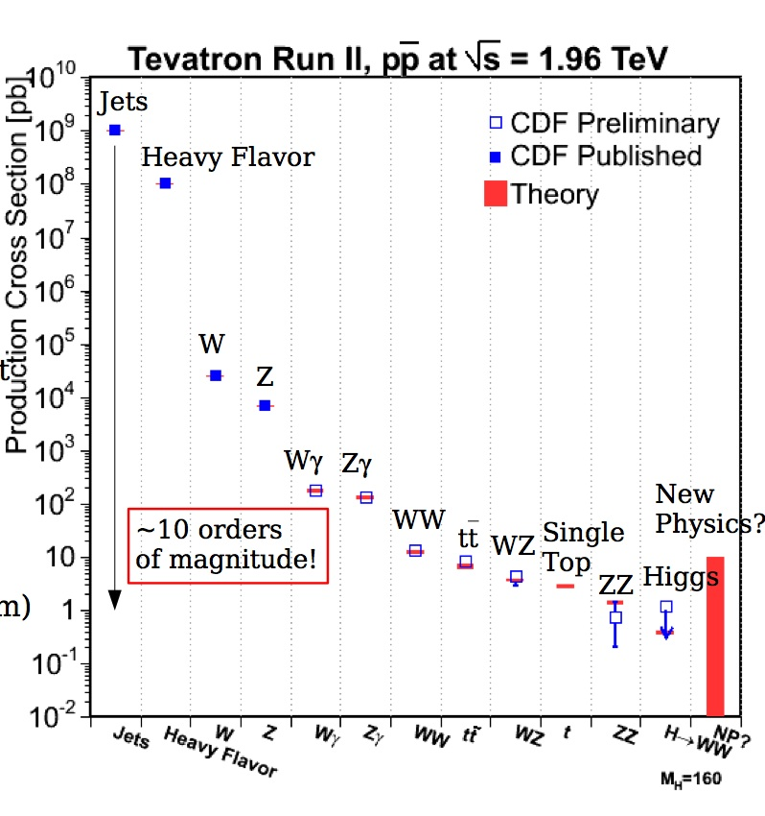
Introduction
Associated production of boson and jets is extensively studied at the Tevatron:
  As direct measurement:
    test of perturbative QCD at high Q²
    Sensitive to underlying events and hadronization modeling
    NLO prediction available
  As background for other SM processes and for most of the searches for physics beyond SM
    Top pair, single Top, DiBoson production
    SUSY searches
    Searches for 4th generation families
    SM and MSSM Higgs searches

Slide 3
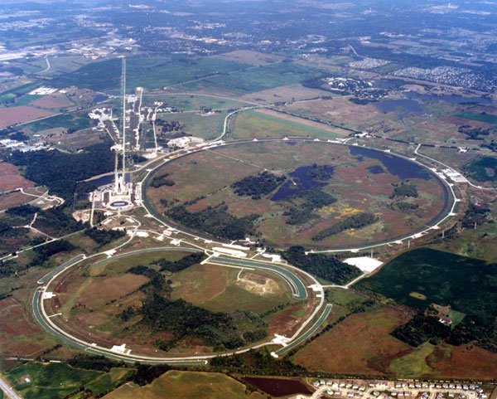
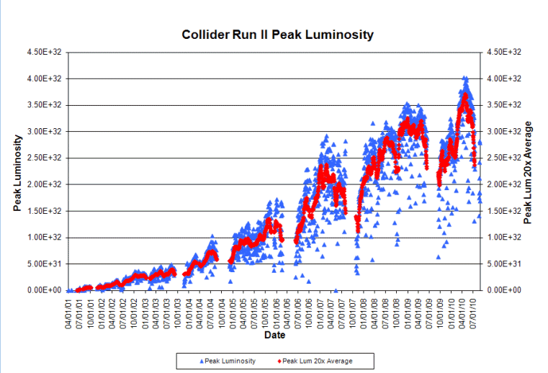
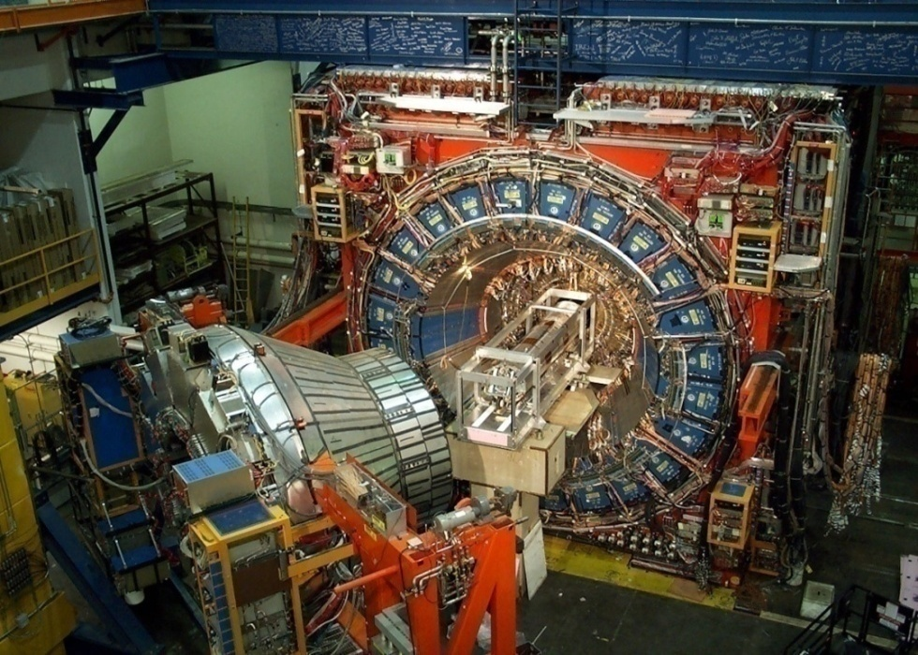
Tevatron and CDF
_
Fermilab
p
p
Proton-antiproton: √s = 1.96 TeV
Typical (peak) initial inst. Luminosity
→ ~ 3.5 (4.0)*10³² cm⁻² s⁻¹
Integrated Luminosity/week
→ ~ 70 pb⁻¹
CDF
DØ
Total Delivered Lumi: > 9 fb⁻¹
Peak luminosity
year: 2002 2010

Slide 4
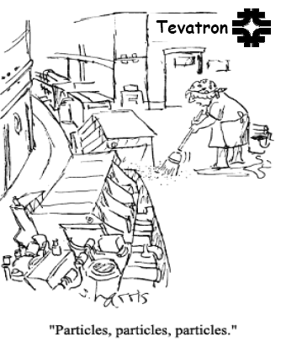
Outline
Comprehensive set of measurements carried out at the CDF experiment:
  γ+jets
  Inclusive W and Z measurements
  W→eν + jets
  Z→μμ + jets
  Z→ee + jets
  Z+P_{T} jet balance
Heavy Flavor final states will be discussed in the next talk

Slide 5
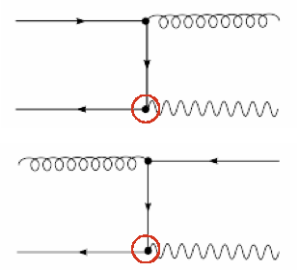
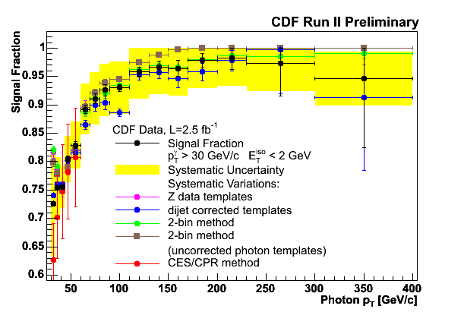
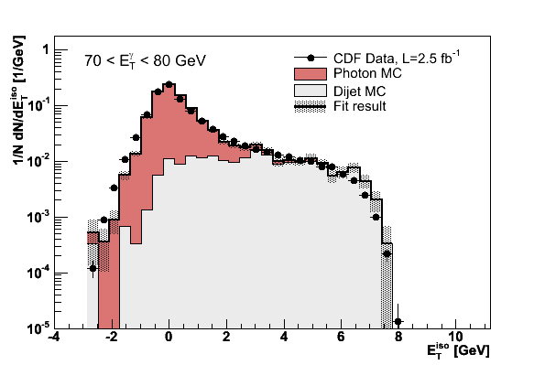
Inclusive photon cross section
Test of Next-to-Leading Order (NLO) perturbative QCD
Probing distances ~10⁻¹⁹ m, constrains PDF at high-x
Sensitive to new physics at high p_{T}
Advantages over pure QCD:
  Well known QED vertex
  Better energy resolution (EM cal)
Photon purity
Event Selection
γ: |η| < 1.0, Isolation<2.0 GeV, E_{T}>30 GeV
MET/E_{T} < 0.8 to reject cosmic bkg
Main background:
γ from light meson decay (30% at low E_{T})
Rejected with Iso cut, residual bkg estimated
using tail of Iso distribution (templates)
γ purity from 70% to 98% as function of E_{T}
Used several methods, differences accounted for as systematic uncertainties
  13% → 5% as function of E_{T}
Notes:
The isolation template in the MC is sensitive to
small imperfections in the simulation of the
underlying event, shower shape and pile-up
Variations in the template shape and/or fitting
range only change the signal fraction by ~2%

Slide 6
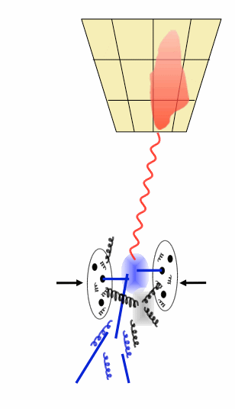
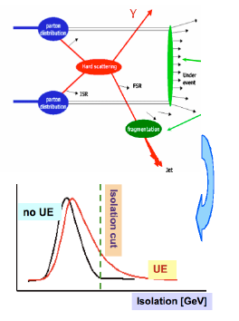
Unfolding and non pQCD effects
Measurements compared to NLO pQCD predictions by JETPHOX
  PDF CTEQ6.1M
  Fragmentation Functions BFGll
  Dynamic ren., fact., fragm. scales: μ_{R} = μ_{F} = μ_{f} = E_{T}^{γ}
→ Data unfolded back to hadron level
  Use PYTHIA Tune A to correct for acceptance, efficiency and resolution effects : unfolding factors
γ
jet
NLO predictions corrected for non-perturbative QCD contributions from UE and fragmentation
  decrease the cross section due to their contribution to the energy in Iso cone
  estimate corrections using MC samples with UE ON/OFF and comparing PYTHIA Tune A vs DW
C_{HAD} = 0.91 ± 0.03

Slide 7
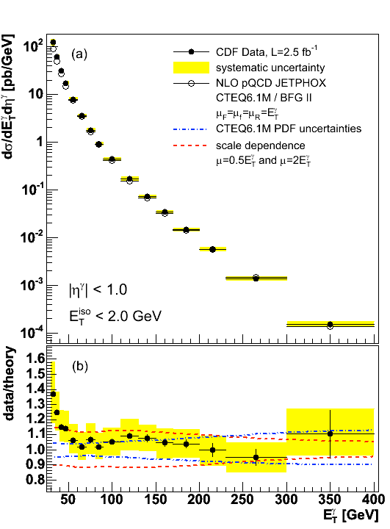
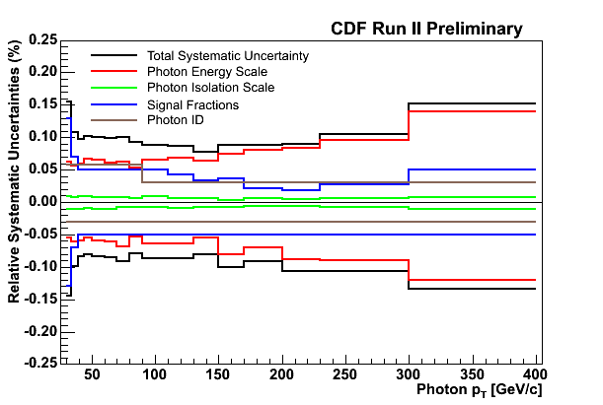
Results
Good agreement between data and theory for E_{T}>50 GeV
Differences at low E_{T} already seen in previous measurements at collider
Systematics uncertainty dominated by photon purity at low E_{T}, energy scale at high E_{T} : 10% → 15% in measured range

Slide 8
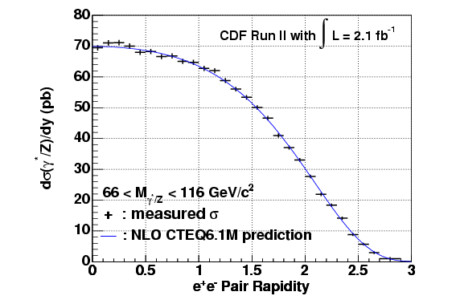
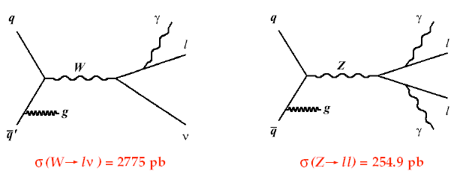
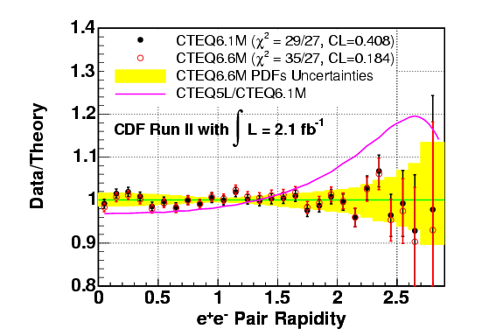

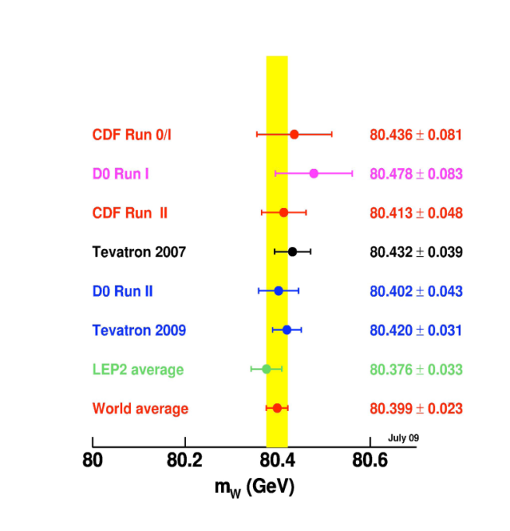
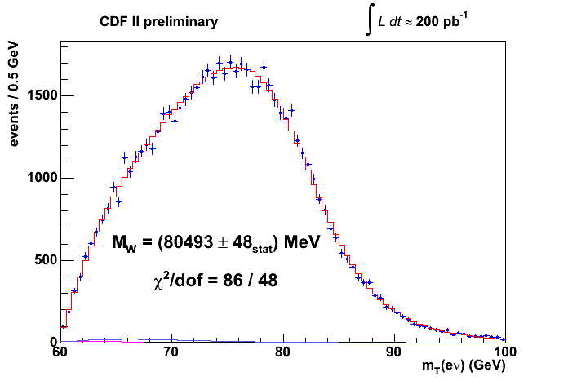
Inclusive W/Z
dσ(Z)/dY
Very accurate measurements of W and Z masses and inclusive cross sections
world’s most precise single measurements!
Large statistics to study jet production in association with W/Z
M_{W} = 80413±48 MeV
Γ_{W} = 2032±73 MeV
Next round CDF @ 2fb⁻¹
expect <30 MeV uncertainty !
Notes:
Fraction of data and theory prediction II.
NLO calculation with NLO CTEQ6.1 PDF and NLO CTEQ6.6 PDF theory predictions used.
Theory prediction scaled to total cross section from data.
The statistic and systematic uncertainties are considered.
Yellow error band shows the CTEQ6.6M PDFs uncertainty. (CL = 90 %)

Slide 9
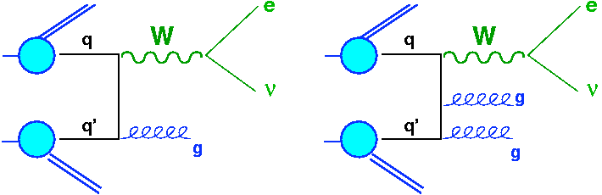
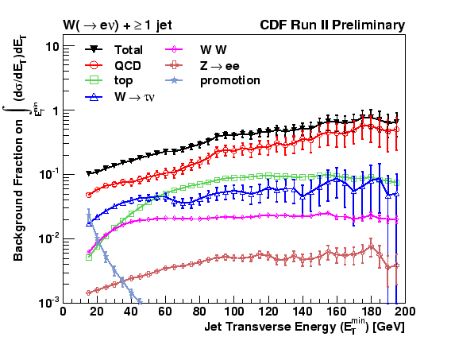
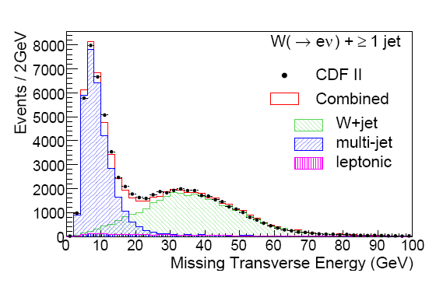
W→ev + jets
Event selection
E_{T}^{ele} >20 GeV
MET>30 GeV
m_{T}(W) > 20 GeV/c²
E_{T}^{jet} >15 GeV, |η|<2.0, R=0.4
ΔR(e,jet)>0.52
+PS
Main background
QCD (fake electrons):
data-driven → estimated in CR with electron cut reversed - “anti-electron” method
W→τν, Z→ee : use MC simulation (PYTHIA and ALPGEN+PYTHIA)
bkg normalization → from data:
Fit MET distribution with templates (MC for non-QCD, data in CR for QCD)

Slide 10
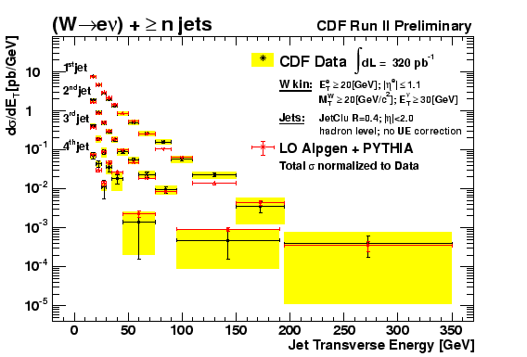
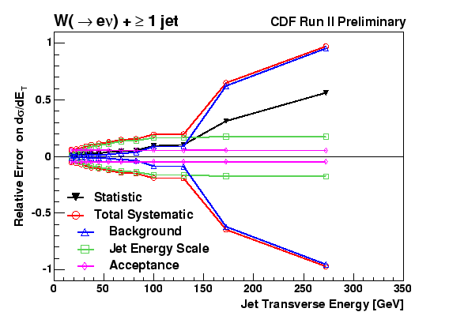
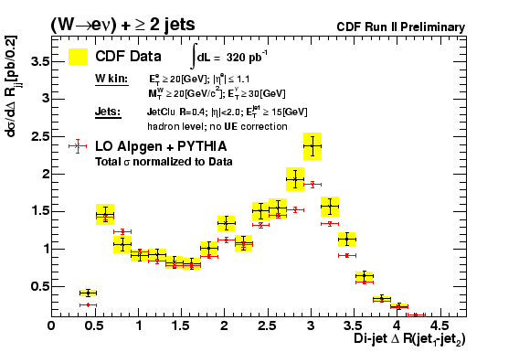
Results
Data compared unfolded to hadron level and compared to different matrix elements + parton shower predictions
Study also jet correlations (Ex. ΔR(j1-j2))
Systematic uncertainties dominated by Jet Energy Scale and bkg subtraction (at high E_{T})

Slide 11
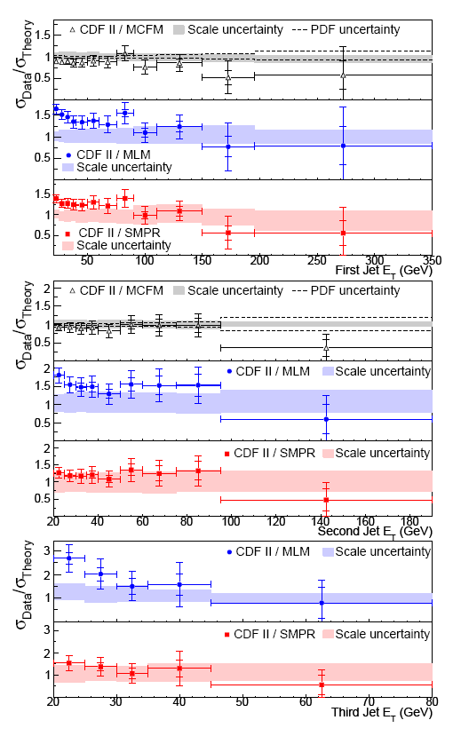
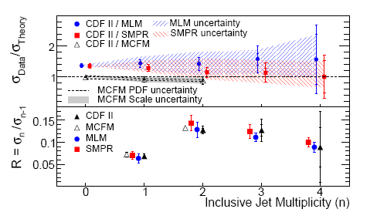
Comparison with NLO and LO+PS MC predictions
Consider NLO and ME+PS tools:
MCFM cross sections not corrected for UE and hadronization effects
  Impact ~ 10%
Total and differential cross sections as function of 1st, 2nd and 3rd jet considered
MLM : ALPGEN v2.12 (LO) + Herwig v6.5 + MLM + CTEQ5L
SMPR: MadGraph v4 (LO) + Pythia v6.3 + CKKW + CTEQ6L1
MCFM: NLO, no showering + CTEQ6.1M

Slide 12
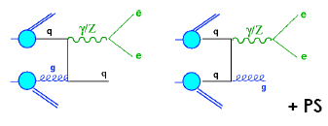
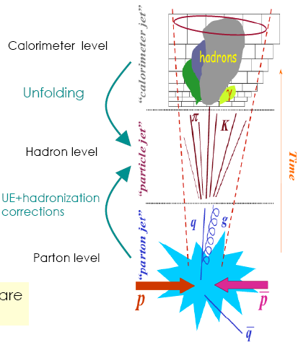
Z→ll + jets
No real MET in the events
At CDF, two measurements:
  Z→ ee + jets
  Z → μμ + jets
Cross sections measured as a function of jet p_{T} and jet Y
Z→ ee
E_{T}^{ele} >25 GeV
|η|<1 (central),
1.2<|η|<2.8 (forward)
M_{ee} in [66-116] GeV/c²
Jet selection
MidPoint R=0.7
p_{T}^{jet} >30 GeV/c, |Y|<2.1
ΔR (e/μ – jet) > 0.7
Z→ μμ
p_{T}^{muon} >25 GeV
|η|<1
M_{μμ} in [66-116] GeV/c²
Measurements unfolded back to hadron level

Slide 13
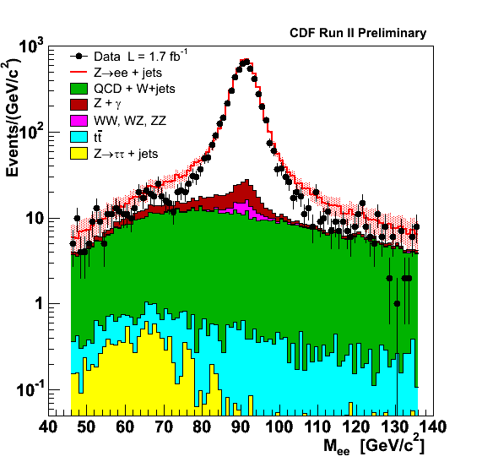
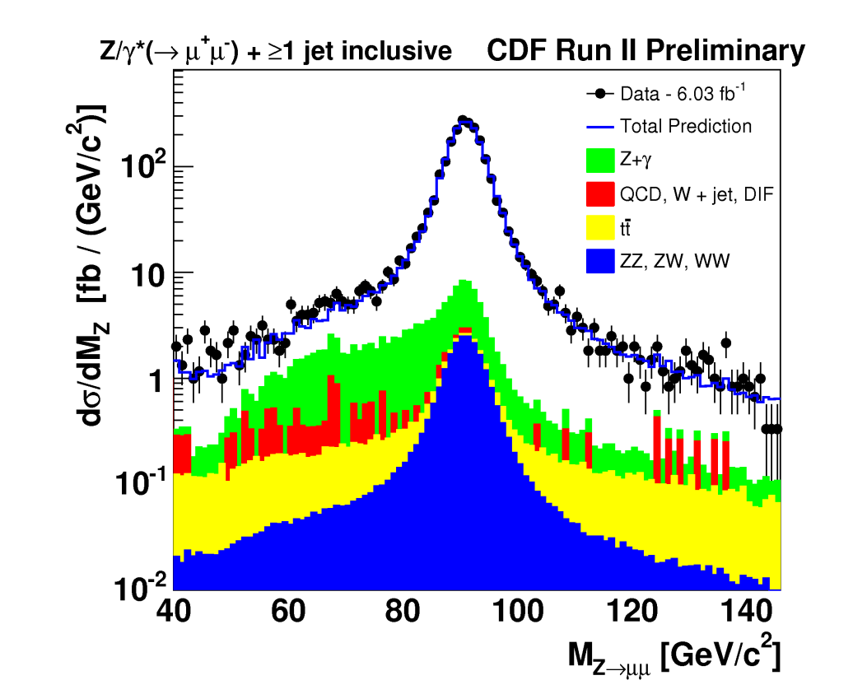
Background estimation
Main background: QCD and W+jets
  Data driven estimation (electron and muon fakes):
    Ele-channel: fake electron probability estimated in dijet samples
    Muon channel: same charge tracks
  Others (Z→ττ, Z+γ, top production, diboson): from MC PYTHIA
  Overall bkg checked in side bands (±20 GeV/c² outside Z range)
Total background: 5-10% depending on lepton mode and jet multiplicity

Slide 14
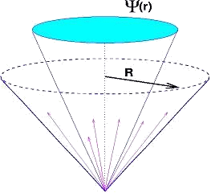
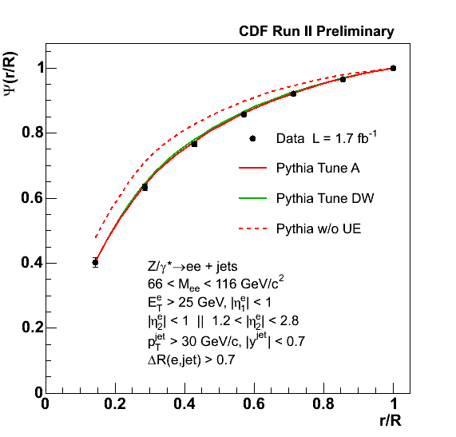
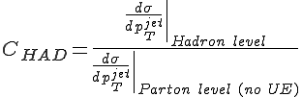
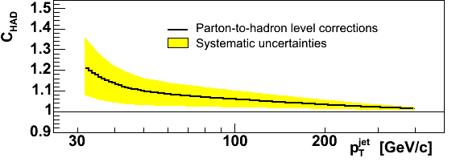
NLO and non pQCD corrections
Data unfolded back to hadron level
Theory comparison: use MCFM
  NLO predictions up to 2 jets in final state
  CTEQ6.1M PDF
  Renorm, fact. scale: μ₀ = M²(Z) + p²_{T}(Z)
  Parton level cross section corrected for UE and hadronization effects:
    PYTHIA Tune A UE ON/OFF and Tune A/Tune DW
Rely on good modeling of the Underlying Event (dominant
contribution) and fragmentation into hadrons in the MC.
Observables sensitive to the UE (Jet shapes and Energy flow) measured to ensure a good modeling by the MC.

Slide 15
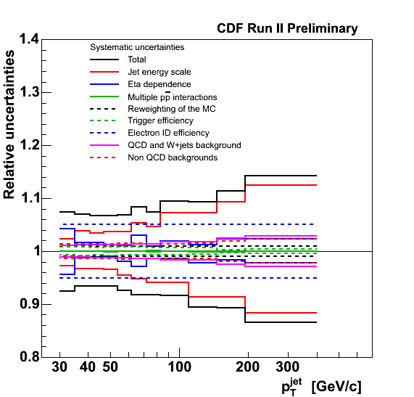
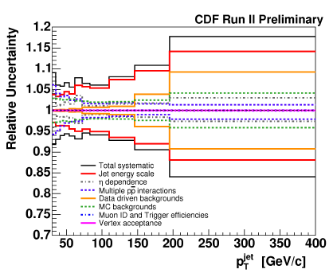
Systematic uncertainties
Dominated by jet energy scale uncertainties:
  8%(5% ) → 18% (15%) for electron (muon) channel as function of jet p_{T}. Flat in jet rapidity.
  Uncertainties on electron ID efficiency conservative ~ 5% (~1% for muon )
Z→ee+≥1 jet
Z→μμ+≥1 jet

Slide 16
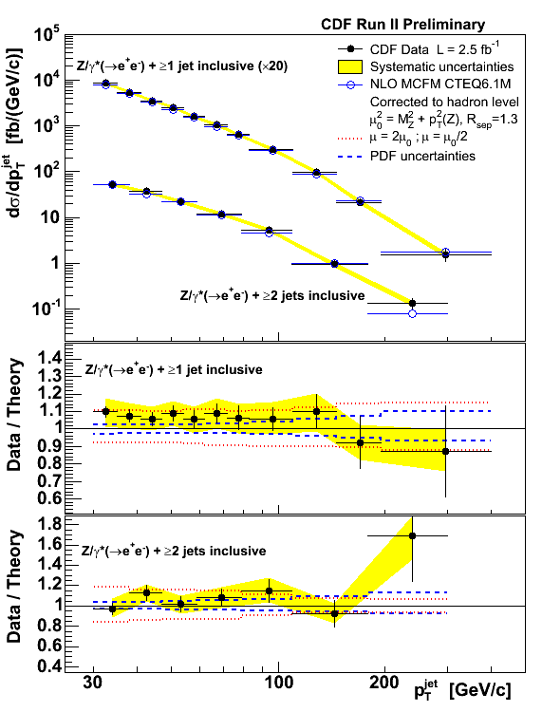
Results Z→ee + jets
Good agreement between data and NLO predictions (after UE/had corrections)
Uncertainties on MCFM theoretical calculation:
  PDF uncertainties: hessian method, 3-10%
  Renorm/fact scale: 10-15%
  Non p-QCD factors: up to 8% at low p_{T}

Slide 17
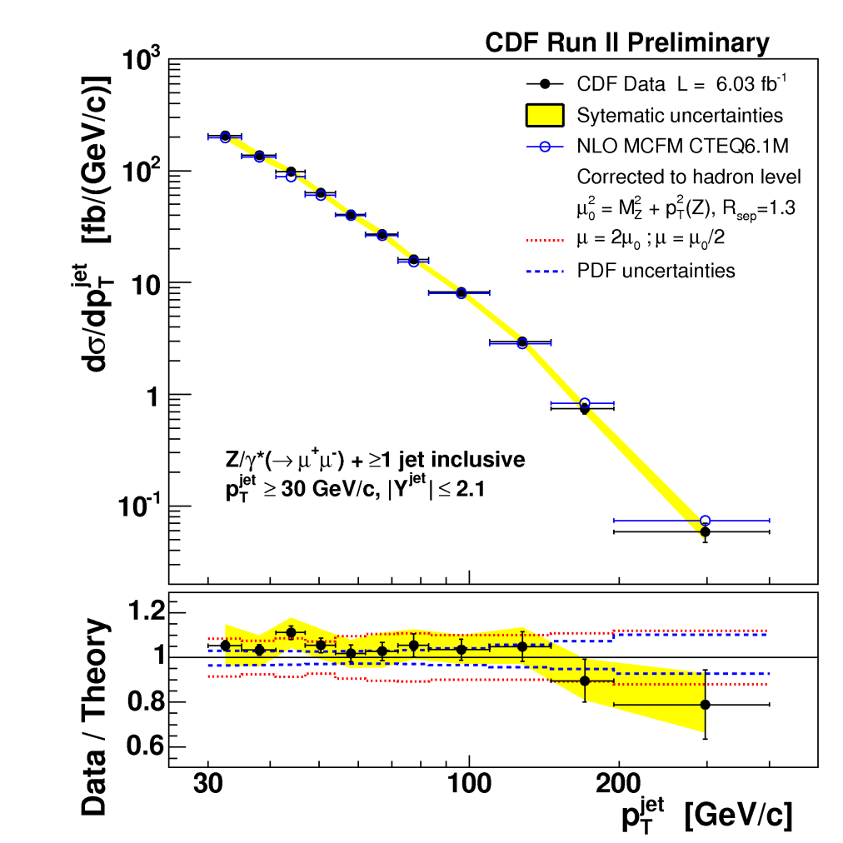
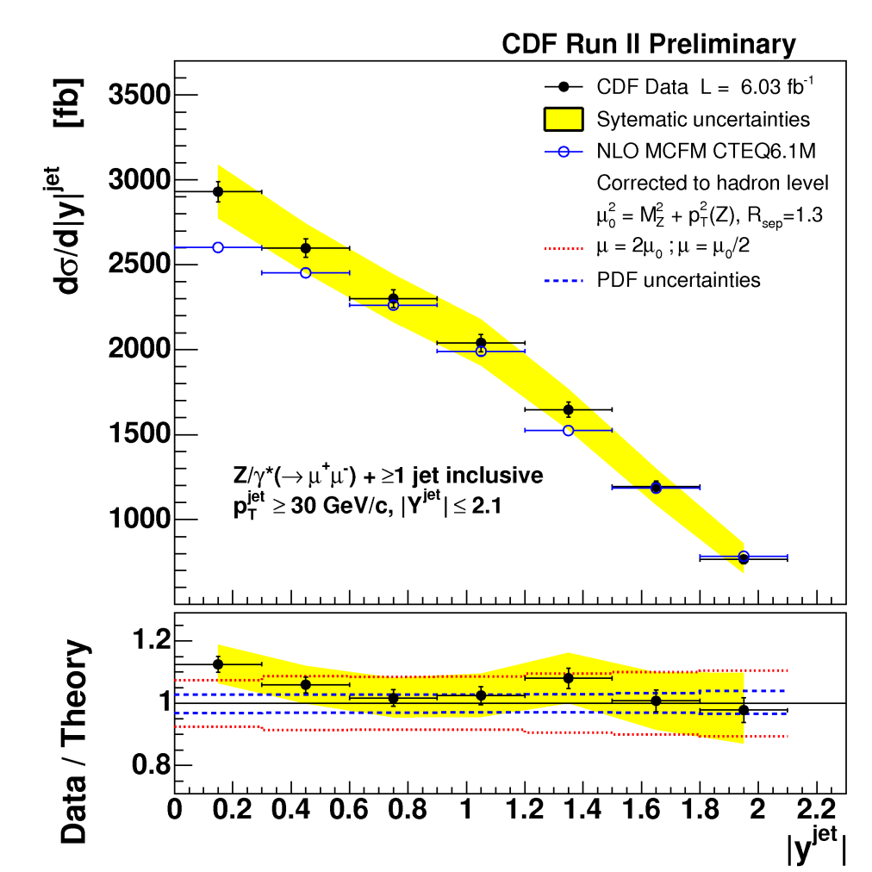
Results Z→μμ + jets
Good agreement between data and NLO predictions
Events with at least 1 jet : jet p_{T} and Y

Slide 18
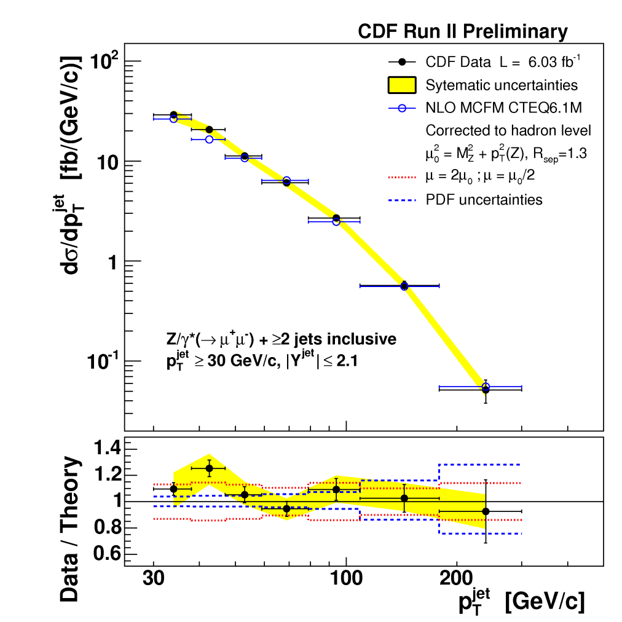
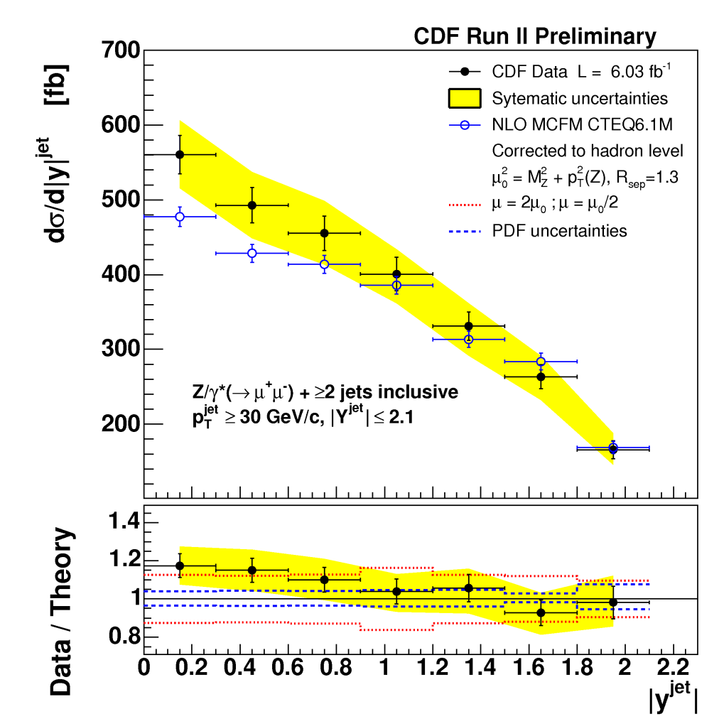
Results Z→μμ + jets (II)
Events with at least 2 jets: jet p_{T} and Y

Slide 19
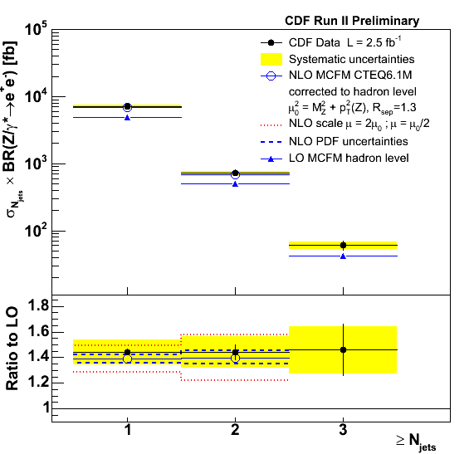
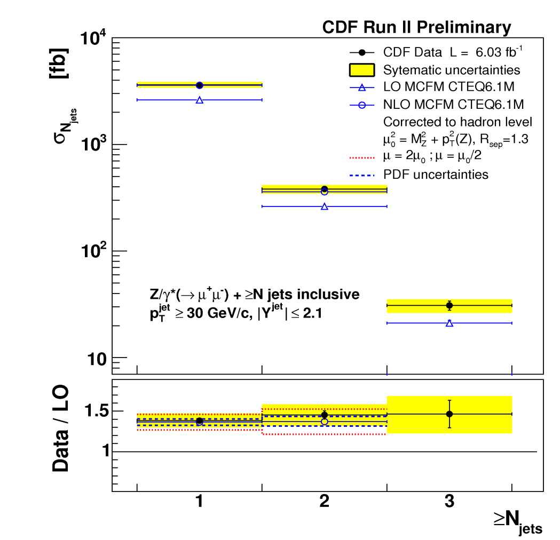
Jet Multiplicity in Z+jets events
K-factor NLO/LO rather flat as function of N jet, around 1.4
~15% more jets due to non pQCD effects
Z→ee + jets
Z→μμ + jets

Slide 20
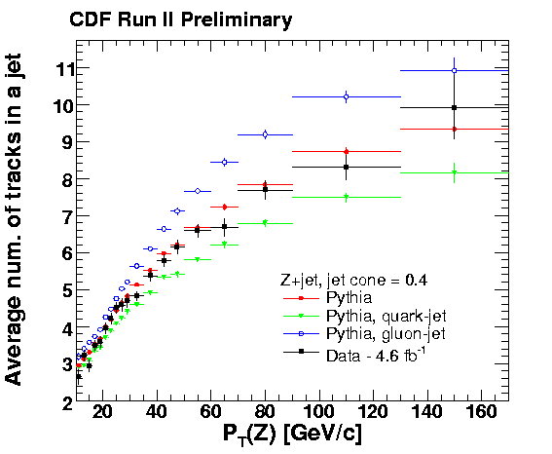
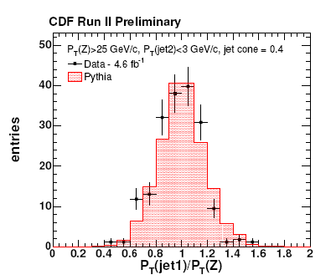
Z+jet p_{T} balance
Z+jets samples have enough
statistics to be used for jet studies
  Uncertainties on JES
  Test of QCD jet modeling
  Check quark-gluon composition in MC:
→ PYTHIA describes in-cone hadronizationand fragmentation accurately
Event selection
•80 < M(Z) < 100 GeV (ee and μμ)
•JETCLU clustering (R = 0.4, 0.7, and 1.0)
•PT( jet1 ) > 8 GeV , 0.2 < |η(jet1)| < 0.8
•Pt (jet2) < 8 GeV
•|Δφ(Z –jet1)| > 3.0 rad.
•P_{T}(Z) > 25 GeV (to avoid soft, poorly measured jets)
P_{T} balance:
< p_{T}(jet1)/p_{T}(Z)>
Good agreement if
pT(jet2)<3 GeV
[perfect 2-body system]

Slide 21
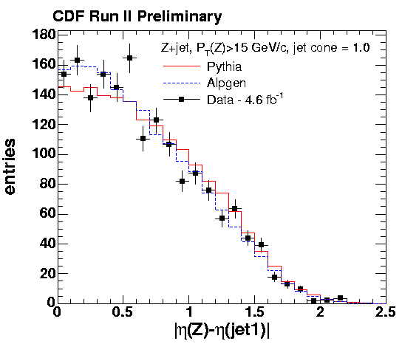
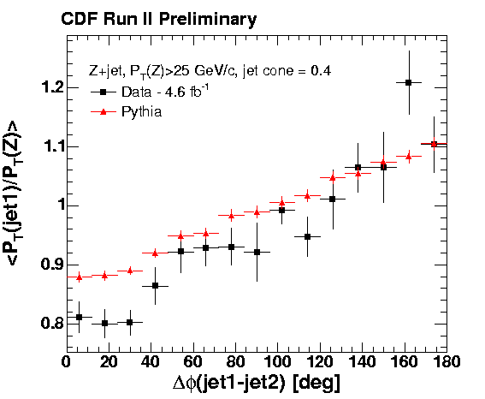
Pythia and ALPGEN modeling
Kinematic properties depends on ME and PDF
PYTHIA and ALPGEN model contributions from qg→Zq and qqbar→Zg diagrams correctly
  Look at rapidity correlations
  Use same UE, same PDF (CTEQ5L),
  same showering in both MC samples
out-of cone radiation.
• PYTHIA (Tune AW) underestimated the amount of out-of-cone radiation (large-angle FSR)
Main uncertainty in hadronic jets energy
•Discrepancy smaller with larger jet cone sizes.

Slide 22
Summary and conclusion
Boson+jets are fundamental to test pQCD, underlying Event
and new LO ME calculations + Parton Shower Monte Carlo
generators.
Measurements on γ+jets, W+jets and Z+jets production shown.
  γ+jets cross section:
    Compared to NLO predictions
  W+jets cross section:
    compared to NLO predictions and ME+PS Monte Carlo
  Z+jets cross section:
    Compared to NLO pQCD calculations.
    pT , Y and Jet multiplicity distributions in inclusive Z+jets production.
    Non-pQCD corrections are sizeable (~15% more jets).
  Z+jets samples used for JES studies
Heavy flavor cross sections measurement in next talk

Slide 23
Back-up slides

Slide 24
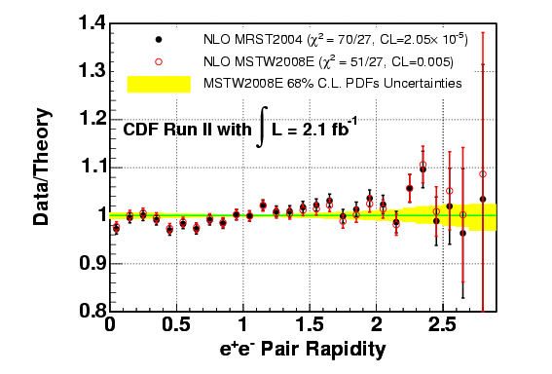
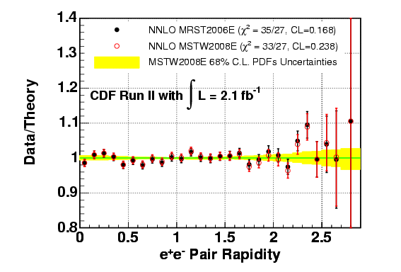
Z-Rapidity
Fraction of data and theory prediction.
→ NLO calculation with NLO MRST PDF(2004) and NLO calculation with NLO
MSTW PDFs(2008) theory predictions used.
→ NNLO calculation with NNLO MRST PDF(2006) and NNLO MSTW PDFs(2008) theory predictions used.
Theory prediction scaled to total cross section from data. Statistic and systematic uncertainties are considered.
Yellow error band shows the MSTW2008 PDFs uncertainty. (CL = 68 %)

Slide 25
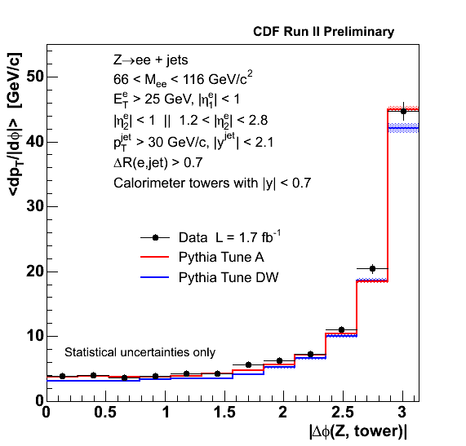
Energy Flow
As already seen, the jet is described accurately.
Also very good agreement in the region away from the jet dominated by the Underlying Event.
Both Tune A and Tune DW describe the energy flow in the data.
Z⁰ φ=0
transverse plane
calorimeter
towers
Dominated by the Underlying Event

Slide 26
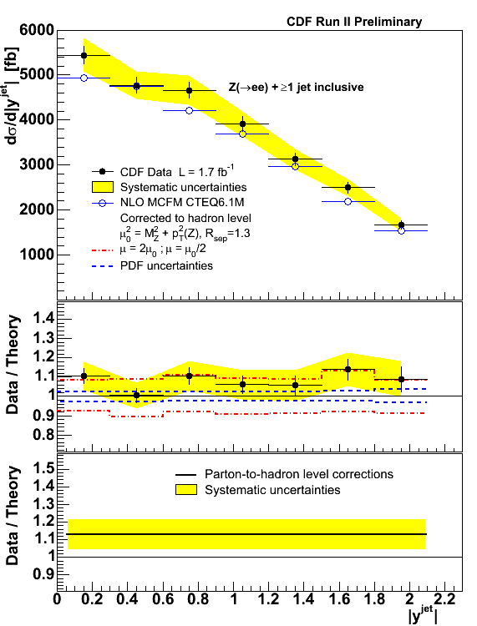

Rapidity distributions Z→ee+jets

Slide 27



Z(→ee)+jets Data/MC comparison (II)
Angular distribution (ΔR) jet1-jet2
Pythia 6.216, Herwig 6.504, Alpgen v2.1+Pythia 6.325 Tune BW

Slide 28


Z(→ee)+jets Data/MC comparison
Jet shapes (differential): data compared to Pythia and Herwig (various tunings)

Slide 29

MC generators: PYTHIA Standalone and ALPGEN+PYTHIA

