Slide 1

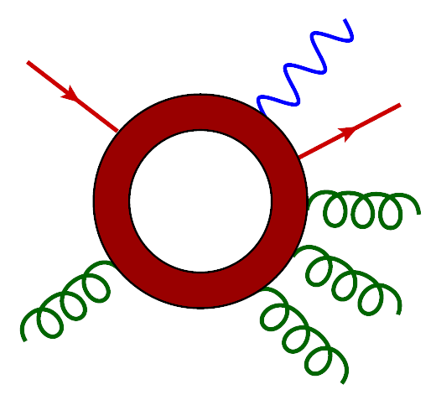
Status of NLO Calculations for V + Jets
Lance Dixon (CERN & SLAC)
& for the BlackHat collaboration
C. Berger, Z. Bern, LD, F. Febres Cordero, D. Forde,
T. Gleisberg, H. Ita, D. Kosower, D. Maître
IPPP Durham Topical Workshop on
V + Jets as Signal or Background
9 September 2010

Slide 2
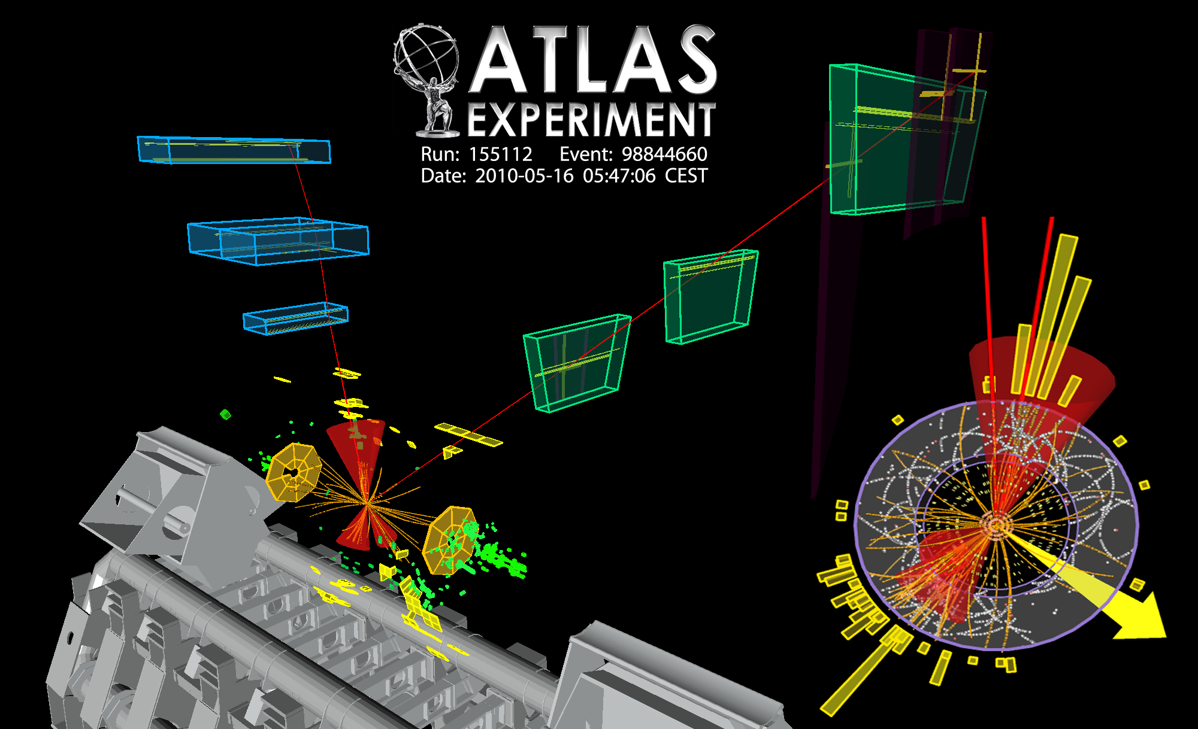
W + 3 jets candidate(s) already seen at LHC

Slide 3
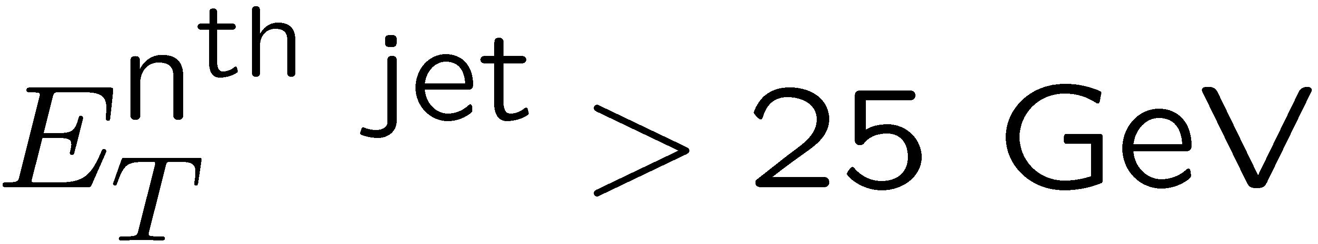
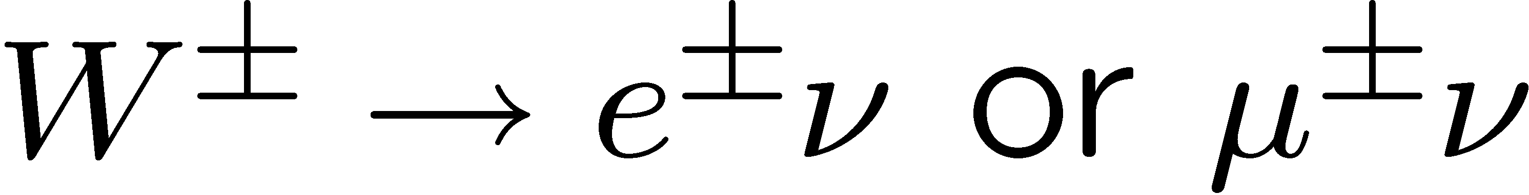
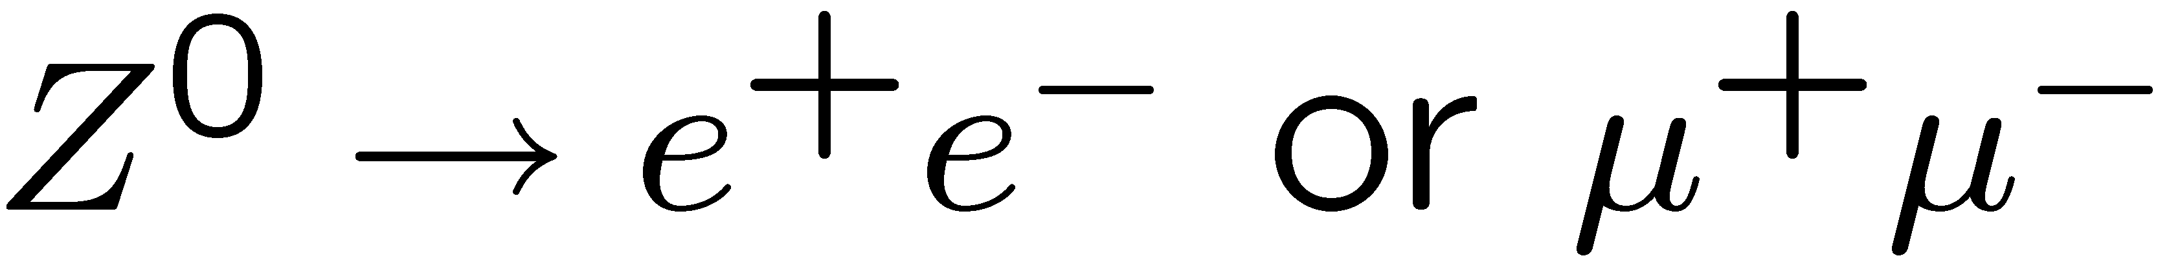
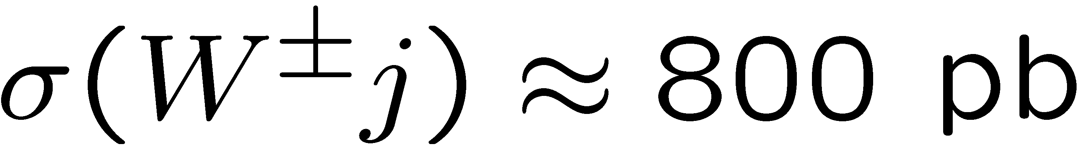
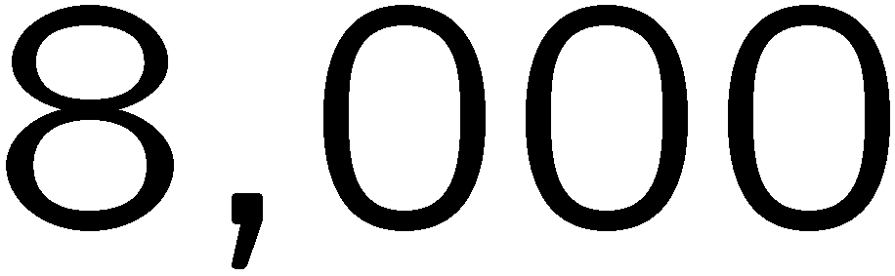
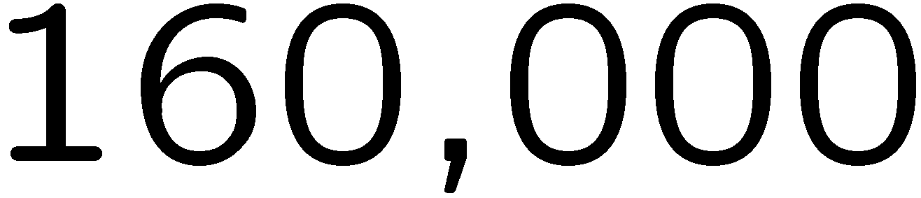
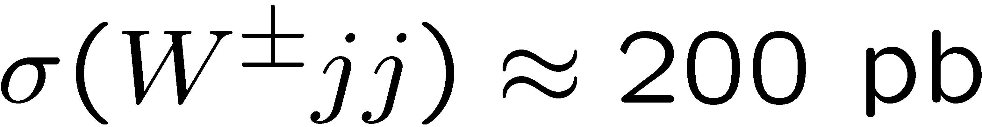
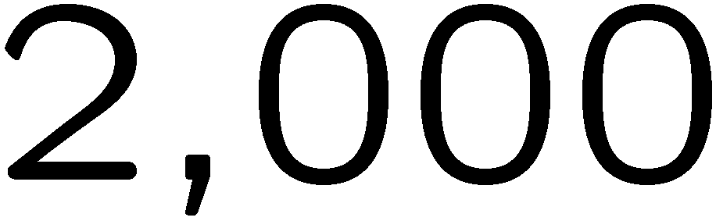
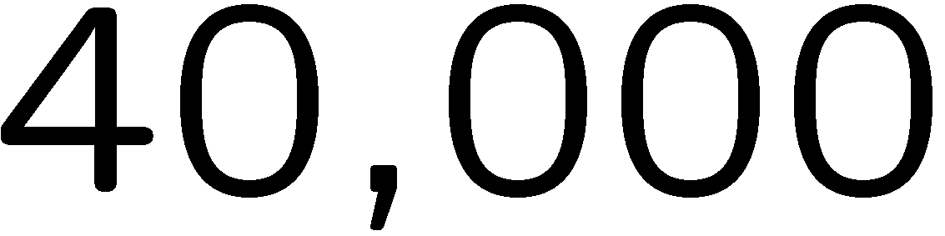
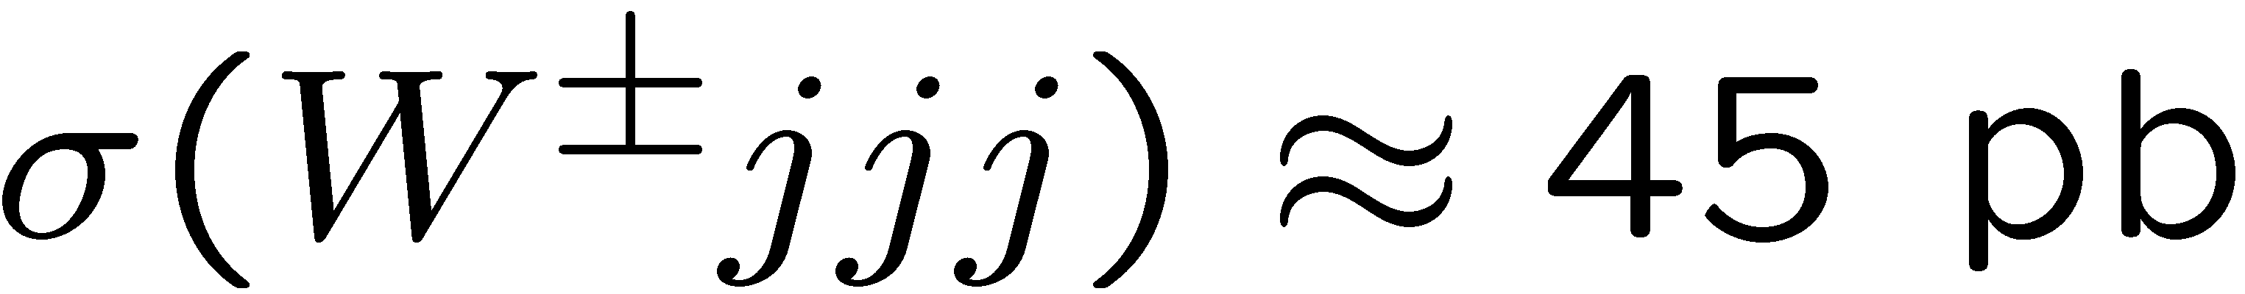
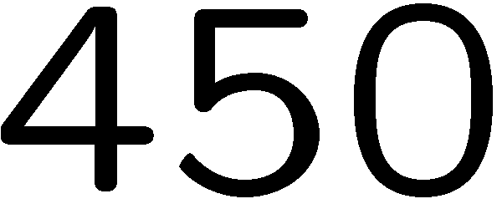
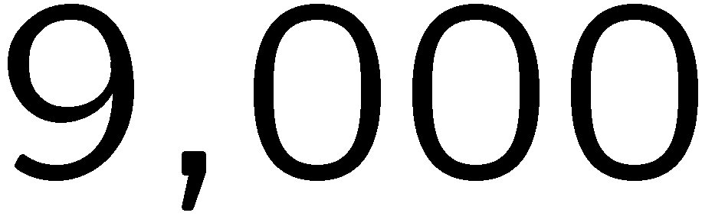
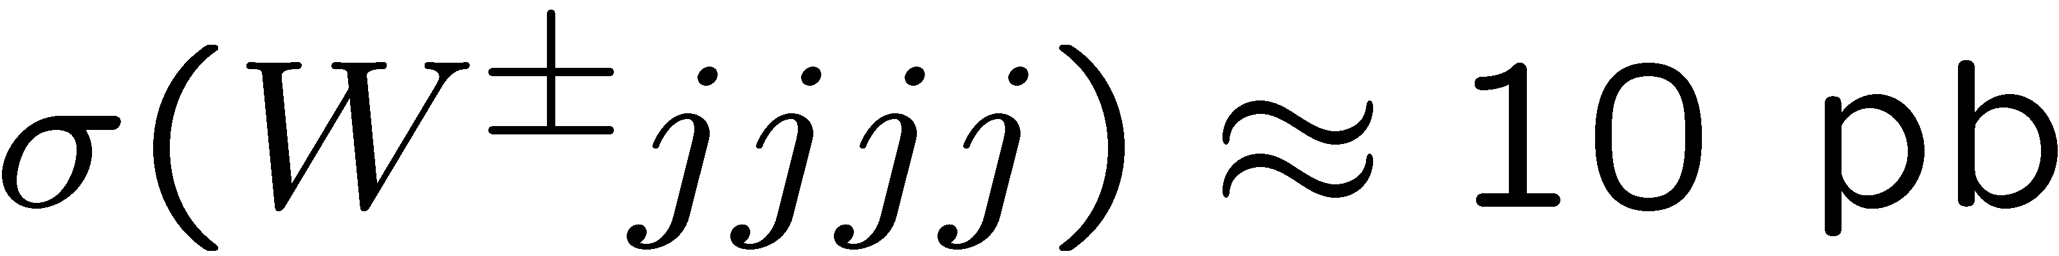
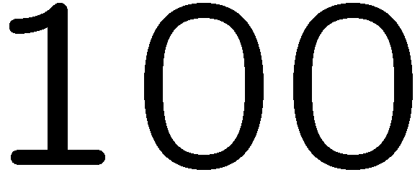

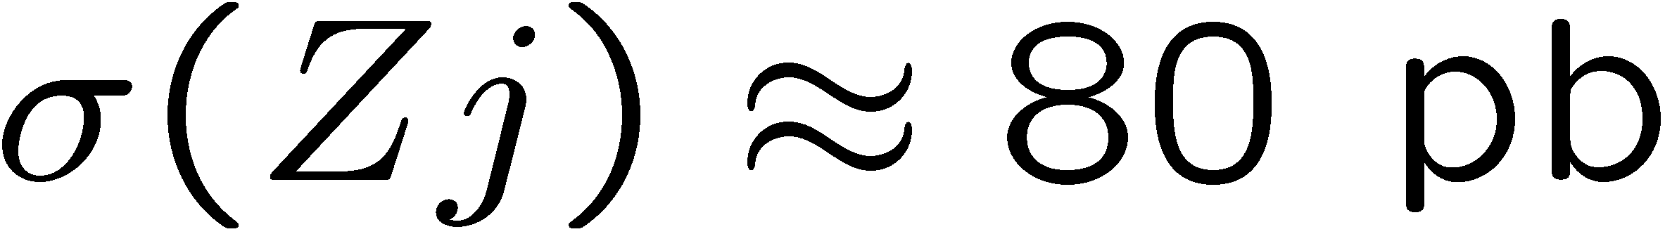
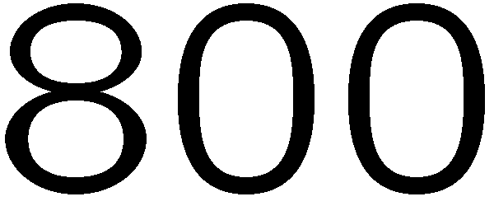
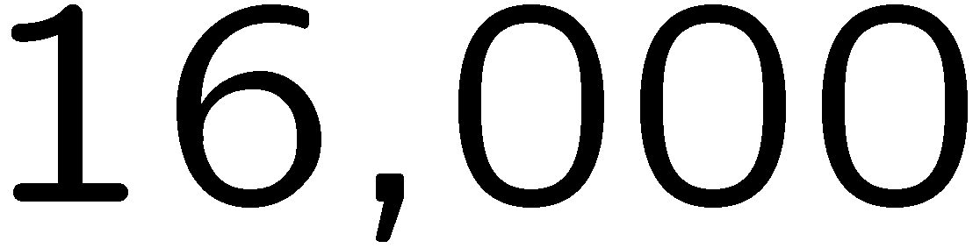
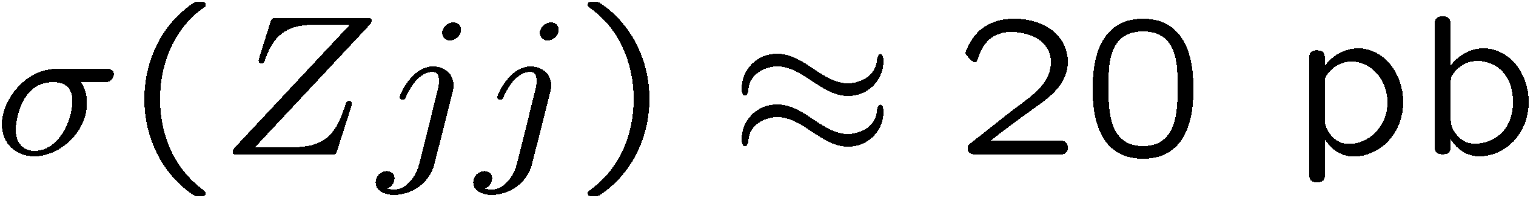
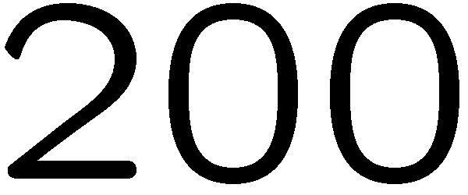
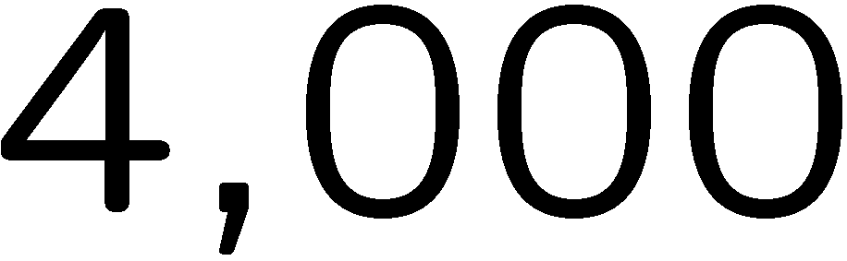
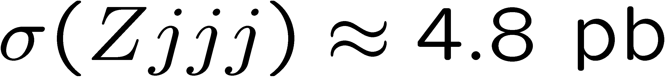
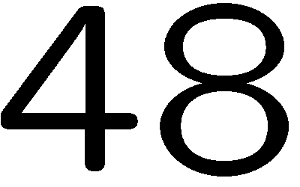
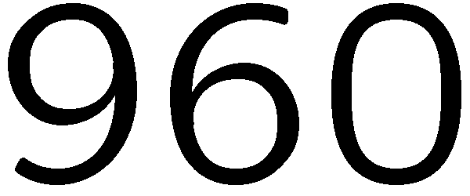
Numbers of V + jets events at 7 TeV
W⁺ + W⁻ . Includes branching ratio for decay to one flavor lepton,
standard cuts on: jet (anti-k_{T}, R=0.4)
rapidity, lepton, missing E_{T}

Slide 4
How best to control
SM backgrounds?
Get the best theoretical prediction you can, whether
  Basic Monte Carlo [PYTHIA, HERWIG, Sherpa, …]
  LO QCD parton level
  LO QCD matched to parton showers [MadGraph/MadEvent, ALPGEN/PYTHIA, Sherpa, …]
  NLO QCD at parton level
  NLO matched to parton showers [MC@NLO, POWHEG, SHERPA,…]
  NNLO inclusive at parton level
  NNLO with flexible cuts at parton level
Increasing availability →
Increasing accuracy →
Take ratios whenever possible
- QCD effects cancel when event kinematics are similar
- Closely related to “data driven” strategies

Slide 5
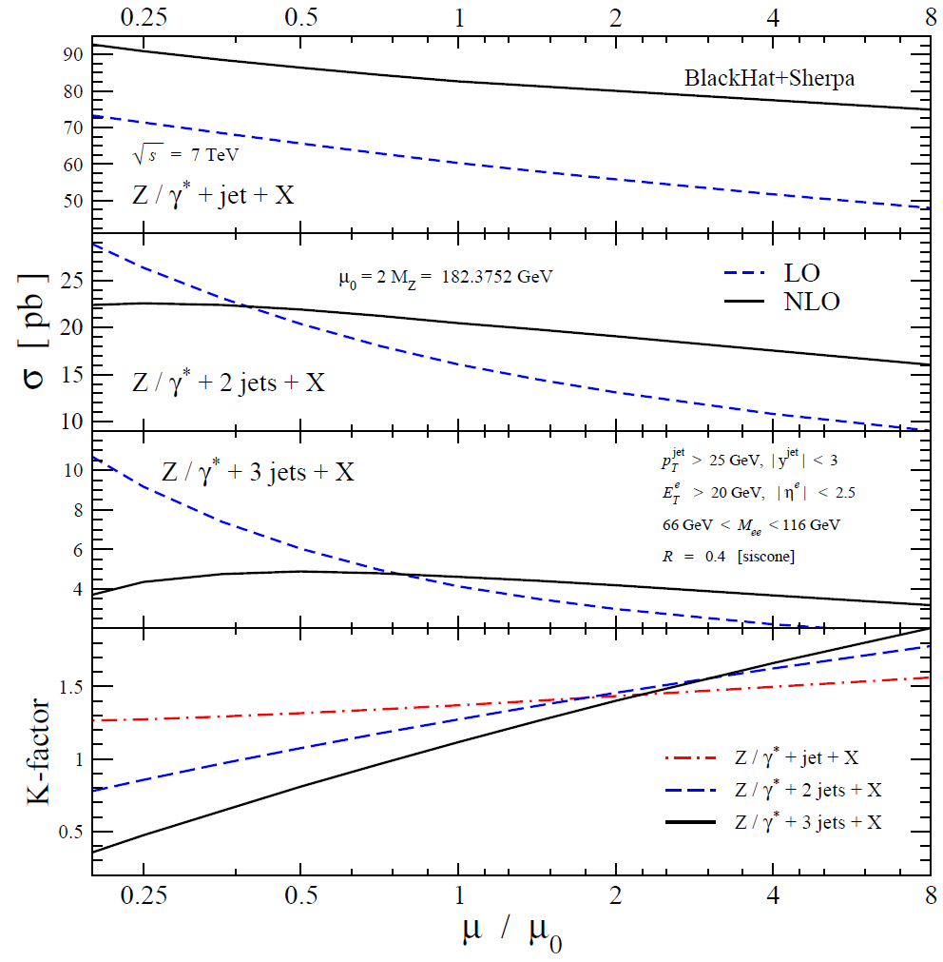
LO uncertainty increases with n_{jets}
Example of
Z + 1,2,3 jets
at LHC@7 TeV
Uncertainty much
smaller at NLO:
~ 50% → ~ 15-20%
NLO required
for quantitative
control of multi-jet
final states
Berger et al.,1005.3728

Slide 6
Good news
Dramatic advances recently in NLO predictions for complex final states, including, but not limited to, V + jets.

Slide 7
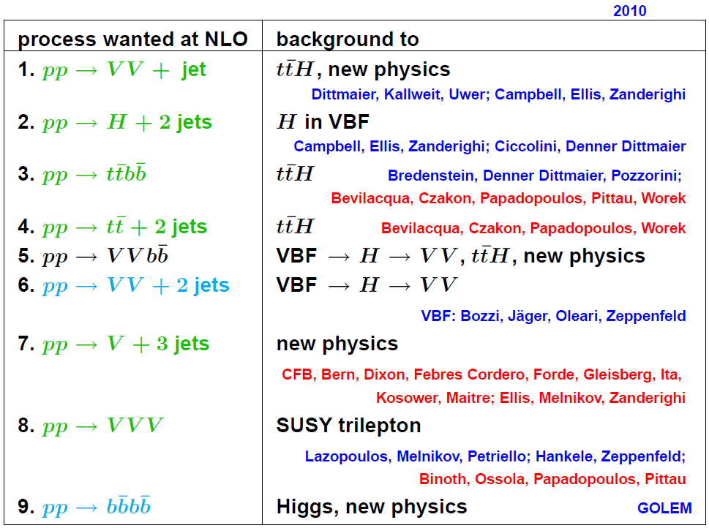
The Les Houches Wish List (2010)
Feynman
diagram
methods
now joined
by
unitarity
based
methods
Berger
courtesy of
C. Berger

Slide 8
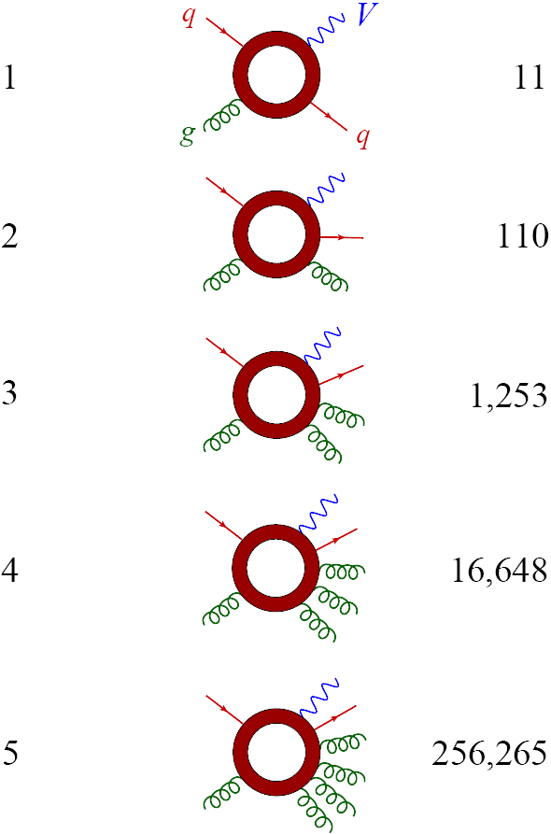
Computational Issues at one loop
For V + n jets (maximum number of external gluons only)
# of jets
# 1-loop Feynman diagrams
On-shell methods,
exploiting analyticity,
can be more efficient,
especially for multi-gluon
+ quark processes

Slide 9
Several Recent Implementations of On-Shell Methods for 1-Loop Amplitudes
Method for
Rational part:
CutTools: Ossola, Papadopolous, Pittau, 0711.3596
NLO WWW, WWZ, ... Binoth+OPP, 0804.0350
NLO ttbb, tt + 2 jets Bevilacqua, Czakon,
Papadopoulos, Pittau, Worek, 0907.4723; 1002.4009
specialized
Feynman
rules
_ _ _
Rocket: Giele, Zanderighi, 0805.2152
Ellis, Giele, Kunszt, Melnikov, Zanderighi, 0810.2762
NLO W + 3 jets in large N_{c} approx./extrapolation
EMZ, 0901.4101, 0906.1445; Melnikov, Zanderighi, 0910.3671
D-dim’l
unitarity
D-dim’l
unitarity
+ on-shell
recursion
SAMURAI: Mastrolia, Ossola, Reiter, Tramontano, 1006.0710
Blackhat: Berger, Bern, LD, Febres Cordero, Forde, H. Ita,
D. Kosower, D. Maître; T. Gleisberg,
0803.4180, 0808.0941, 0907.1984, 0912.4927, 1004.1659
+ Sherpa → NLO production of W,Z + 3 (4) jets

Slide 10
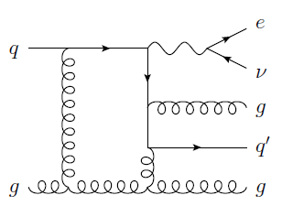
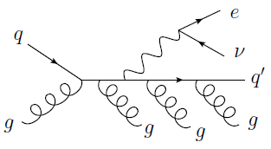
Besides virtual corrections,
also need real emission
Infrared
singularities
cancel
General subtraction methods for integrating real-emission contributions developed in mid-1990s
Frixione, Kunszt, Signer, hep-ph/9512328;
Catani, Seymour, hep-ph/9602277, hep-ph/9605323
Recently automated by several groups
Gleisberg, Krauss, 0709.2881;
Seymour, Tevlin, 0803.2231;
Hasegawa, Moch, Uwer, 0807.3701;
Frederix, Gehrmann, Greiner, 0808.2128;
Czakon, Papadopoulos, Worek, 0905.0883;
Frederix, Frixione, Maltoni, Stelzer, 0908.4272

Slide 11
W,Z + 2 jets at NLO
Benchmark code is MCFM (public)
Based on analytic formulae for virtual corrections → code runs (relatively) fast!
Campbell, Ellis,
hep-ph/0202176
Bern, LD, Kosower,
hep-ph/9708239
Predictions agree well with Tevatron data – to within 10% – after applying nonperturbative corrections for splashout + underlying event
CDF: 0711.3717 (Z), 0711.4044 (W)
D0 (Z): 0808.1296, 0903.1748,
0907.4286
+ updates for ICHEP 2010
+ talks at this workshop!
Jet algorithm used not the same in
  experiment (IR unsafe mid-point cone), vs.
  theory (“MCFM midpoint” is actually a type of IR safe seedless cone)
Salam, 0906.1833

Slide 12
W + n jets Data
Tevatron
CDF, 0711.4044 [hep-ex]
n = 1
NLO parton level
(MCFM)
LO matched to parton shower MC with different
schemes
n = 2
n = 3
only LO
available
in 2007

Slide 13
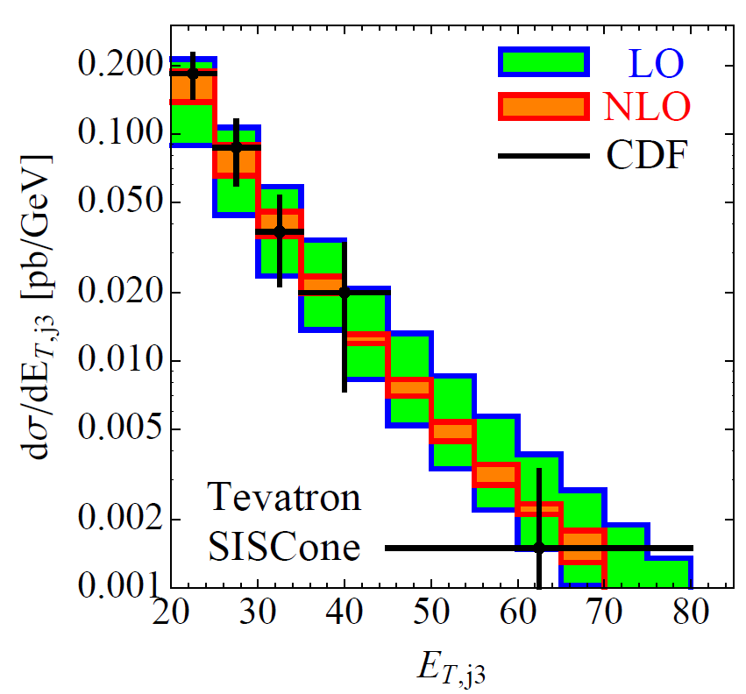
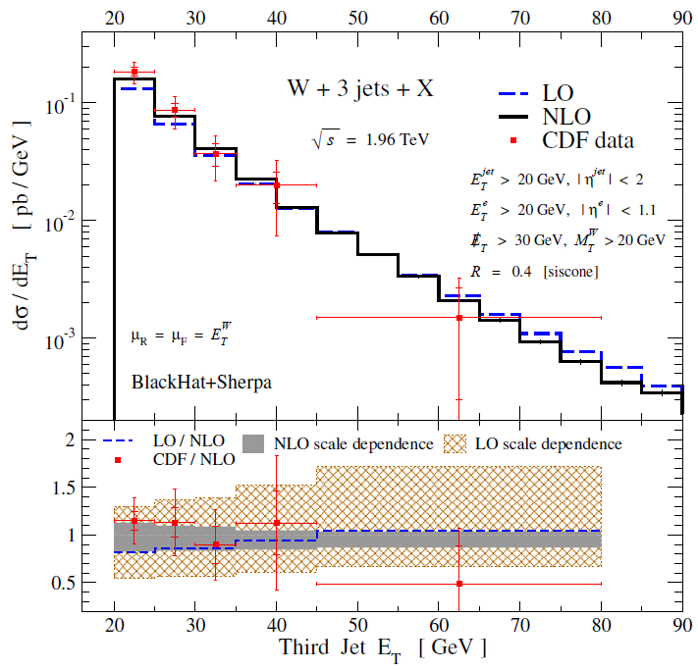
W + 3 jets at NLO at Tevatron
Ellis, Melnikov, Zanderighi, 0906.1445
Berger et al., 0907.1984
Rocket
Leading-color adjustment procedure
Exact treatment of color

Slide 14

W + 3 jets at LHC at NLO
LHC has much greater dynamic range
Many events with jet E_{T}s >> M_{W}
Must carefully choose appropriate renormalization + factorization scale
Scale we used at the Tevatron,
also used in several other LO studies,
is not a good choice:
NLO cross section can even dive negative!

Slide 15
More Appropriate Scale Choices
Q: What’s going on?
A: Powerful jets and wimpy Ws
If (a) dominates, then
is OK
But if (b) dominates, then the scale E_{T}^{W} is too low.
Looking at large E_{T} for the 2nd jet forces configuration (b).
Better: total (partonic) transverse energy
(or fixed fraction of it, or sum in quadrature?); gets large properly for both (a) and (b)
Bauer, Lange
0905.4739
Another reasonable scale is invariant mass of the n jets

Slide 16
Compare Two Scale Choices
logs not properly
cancelled for
large jet E_{T}
– LO/NLO quite flat,
also for many other observables

Slide 17
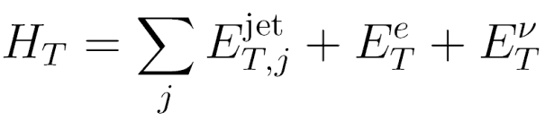
Total Transverse Energy H_{T} at LHC
often used in supersymmetry searches
0907.1984
flat LO/NLO ratio
due to good
choice of
scale μ = H_{T}

Slide 18
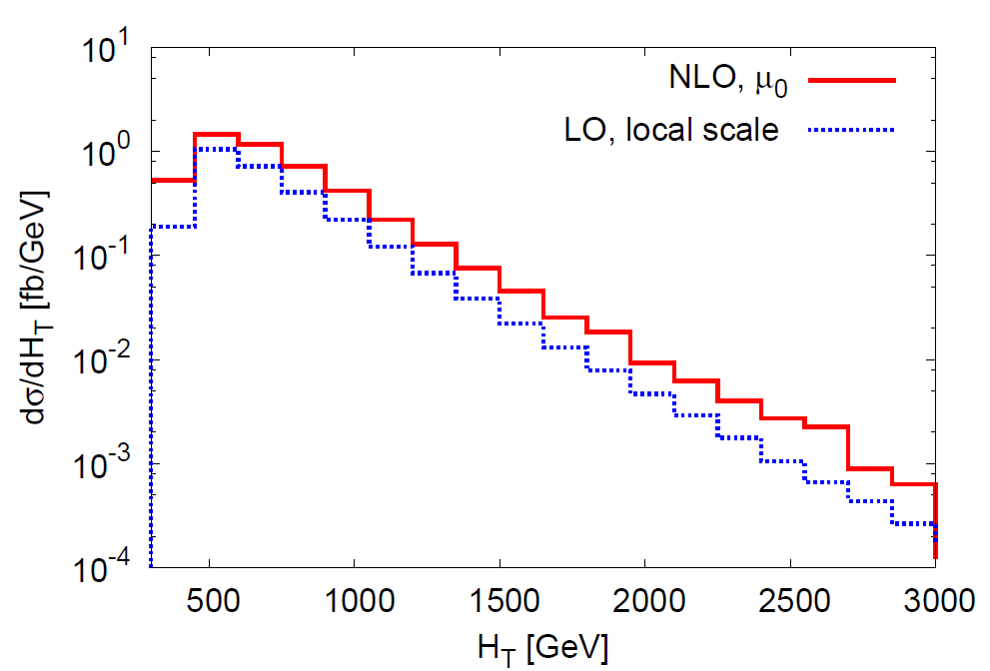
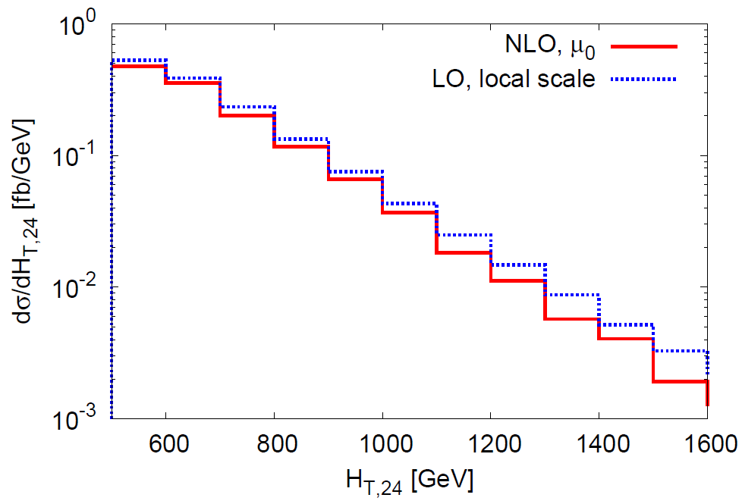
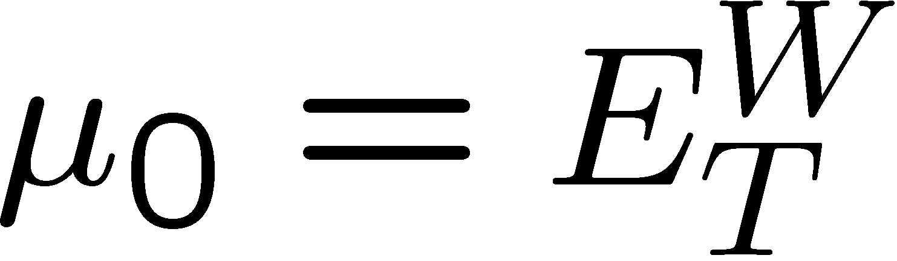
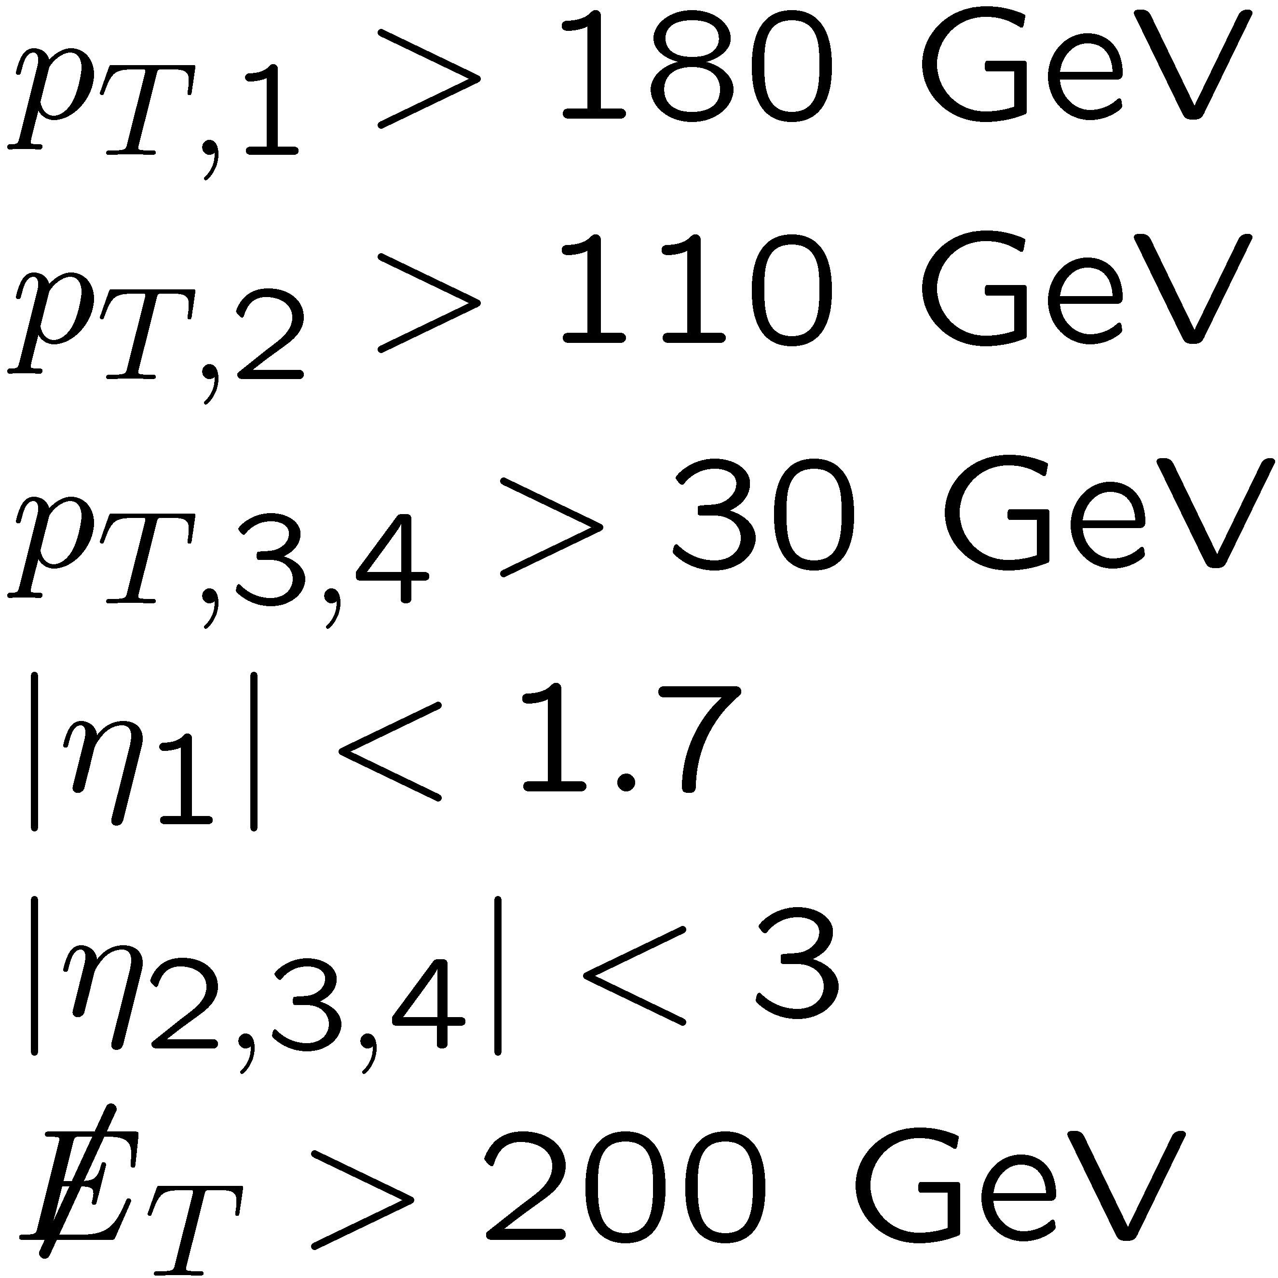
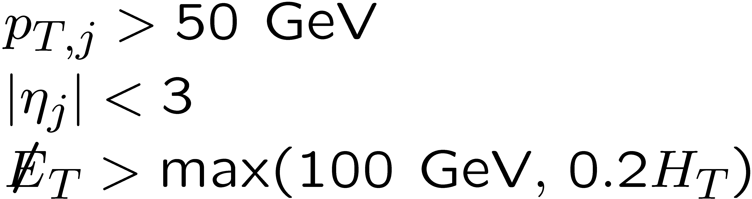
V + jets as SUSY background
Melnikov, Zanderighi, 0910.3671
Study of W(→ τν_{τ} → hν_{τ}ν_{τ}) + 3 jets,
as background to MET + 4 jets SUSY searches
ATLAS + CMS SUSY search cuts (circa 2009), lead to very different K factors
Would be good to understand why
ATLAS SUSY cuts
CMS SUSY cuts

Slide 19
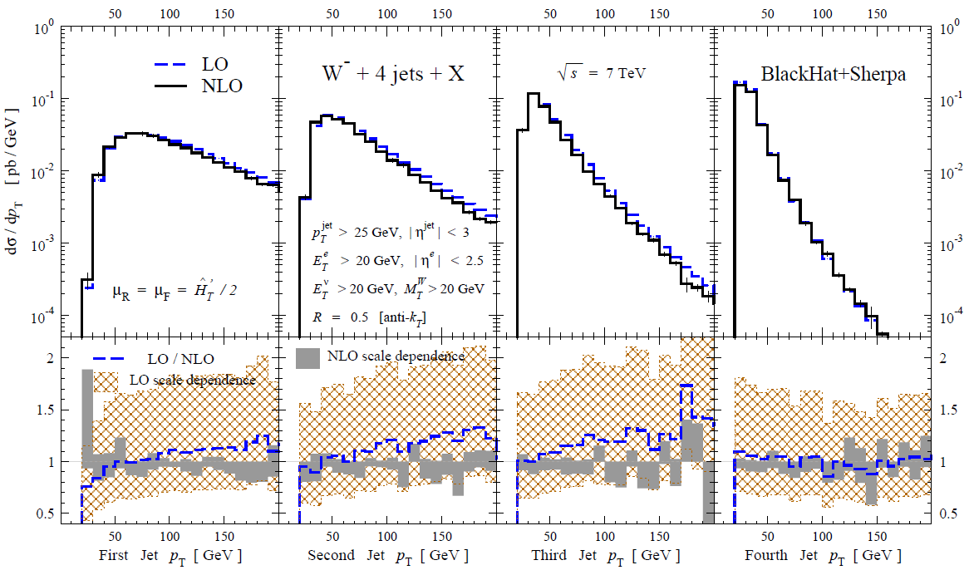
NLO W + 4 jets now under control
C. Berger
et al.,
1009.nnnn
Preliminary
Virtual terms: leading-color (including quark loops); omitted terms only ~ few %

Slide 20

NLO Parton-Level vs. Shower MCs
Recent advances on Les Houches NLO Wish List all at parton level: no parton shower, no hadronization, no underlying event.
Methods for matching NLO parton-level results to parton showers, maintaining NLO accuracy
  MC@NLO Frixione, Webber (2002), ...
  POWHEG Nason (2004); Frixione, Nason, Oleari (2007); ...
  POWHEG in SHERPA Höche, Krauss, Schönherr, Siegert, 1008.5339
  GenEvA Bauer, Tackmann, Thaler (2008)
However, none is yet implemented for final states with multiple light-quark & gluon jets
NLO parton-level predictions generally give best normalizations for total cross sections (unless NNLO available!), and distributions away from shower-dominated regions.
Right kinds of ratios will be considerably less sensitive to shower + nonperturbative effects

Slide 21
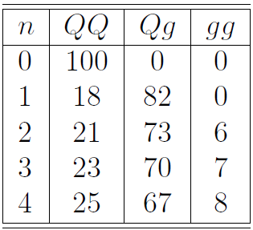
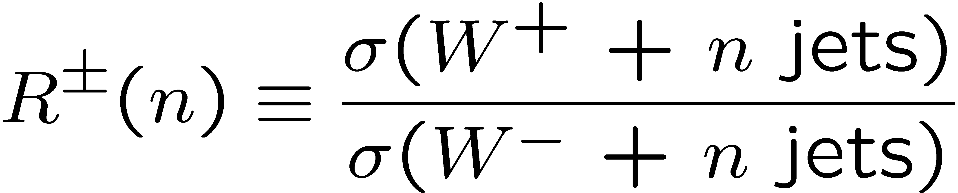
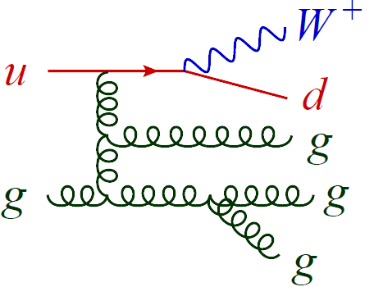
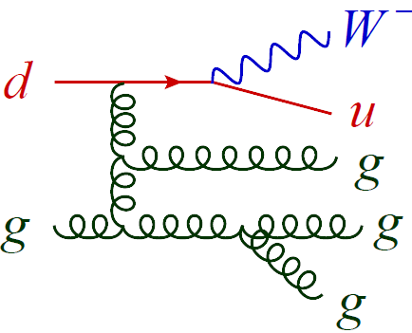
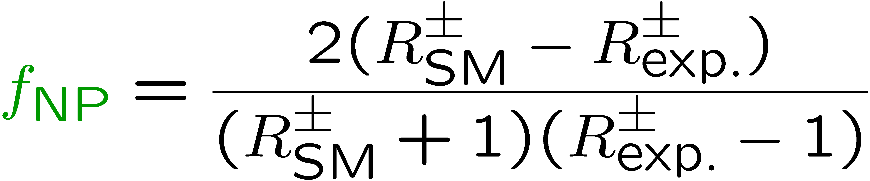
Simple yet robust ratio: W⁺ to W⁻
Kom, Stirling, 1004.3404.
Very small experimental systematics
(N)NLO QCD corrections quite small, 2% or less
→ Intrinsic theoretical uncertainty very small.
PDF uncertainty also ~1-2%. Driven by PDF ratio
u(x)/d(x)
in well-measured valence region of moderate x.
Sensitive to new physics (or Higgs, or top quark pairs)
that produces W± symmetrically
Fraction of new physics in sample is:

Slide 22
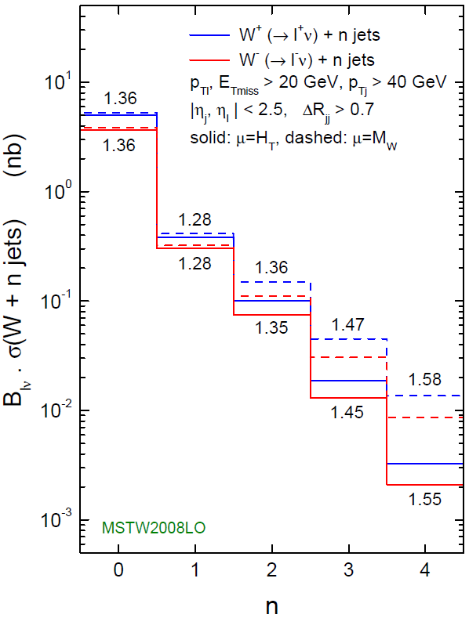
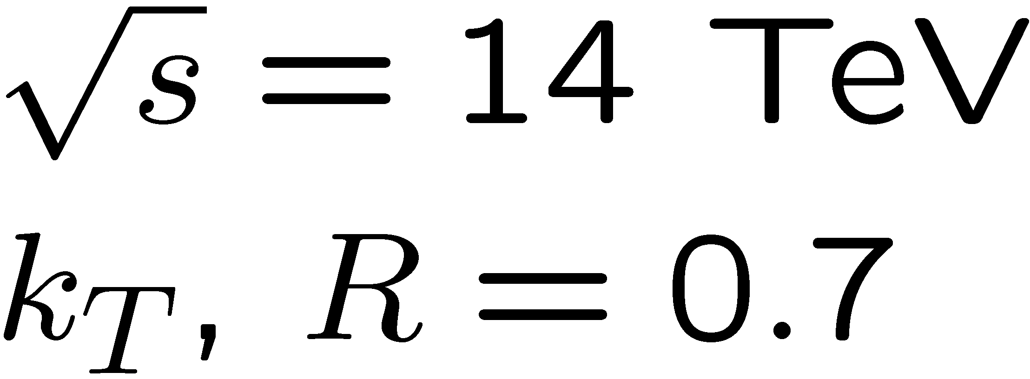
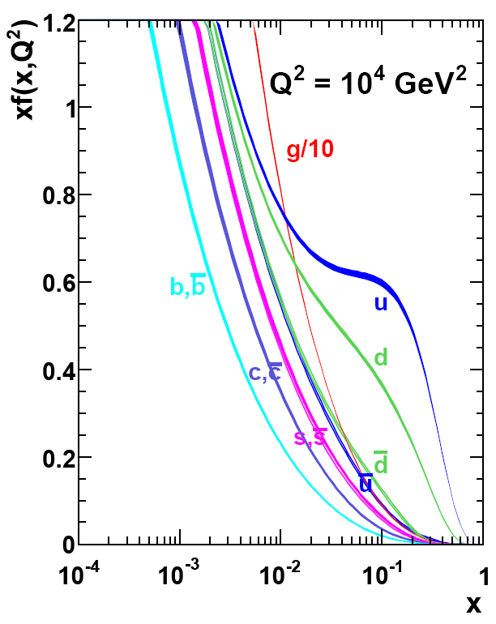
W⁺ to W⁻ ratio at LO
Kom, Stirling, 1004.3404.
Huge scale dependence at LO
cancels in ratio
Increases with n due to increasing x
MSTW2008

Slide 23
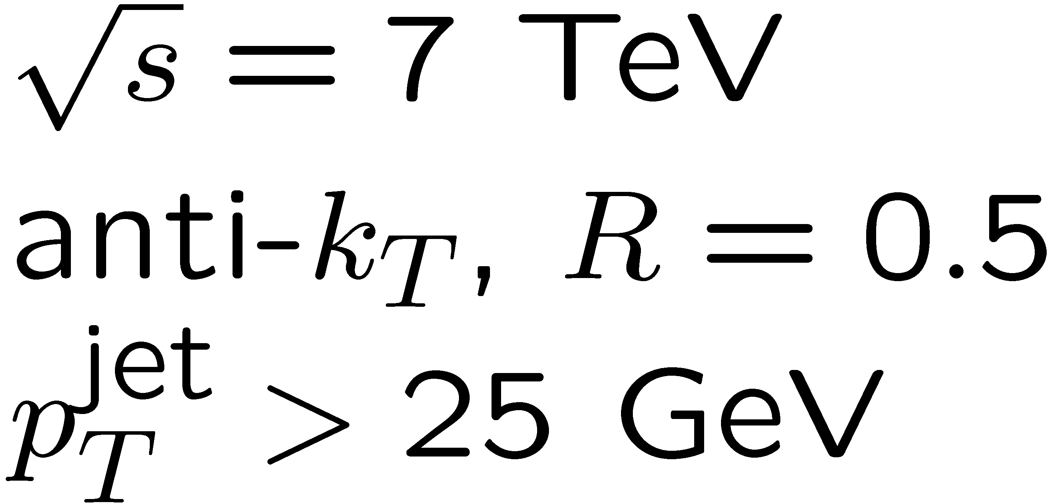
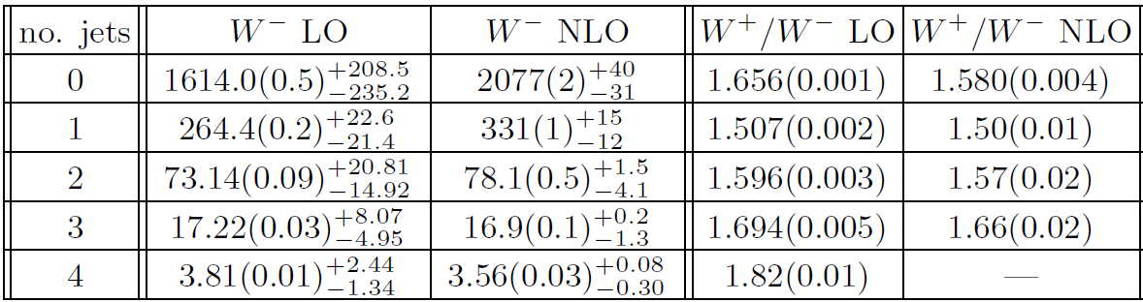
W⁺ to W⁻ ratio at NLO
Berger et al. [BlackHat+SHERPA ]1009.nnnn
Moderate scale dependence at NLO
again cancels in ratio
Increases with n due to increasing x, but a little more slowly than at LO.
W + 4 jets results Preliminary; NLO W⁺ + 4 still being completed

Slide 24
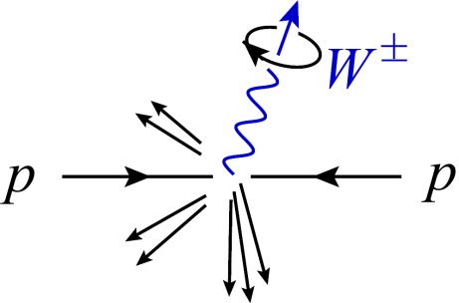
W polarization fractions at moderate p_{T}
BlackHat+Sherpa
0912.4927
Strong left-handed polarization for W⁺ and W⁻
Increases slowly with W boson p_{T} and with number of jets, due to increasing parton x
Very stable against QCD corrections

Slide 25

W polarization analyzed by leptonic decay
ν_{L}
_{L}
_
ν_{R}
_{R}
_{L}
_{L}
Left-handed polarization translates into:
- larger p_{T} for ν_{L} (missing E_{T}) in W⁺ events
- larger p_{T} for e_{L} in W⁻ events
SU(2)_{L} pure V-A → 100% analyzing power

Slide 26




W^{+/-} + 3 jets: lepton p_{T} ratios
NLO LO

Slide 27


Top quark pairs very different
Main production channels are C invariant:
Semi-leptonic decay involves (partially) left-handed W⁺
But charge conjugate decay involves (same degree) right-handed W⁻
→ electron and positron have almost identical p_{T} distributions
→ Nice handle on separating W + jets from semileptonic top pairs

Slide 28







Semi-leptonic tops vs. W + 3 jets

Slide 29




What about new physics?
Whether e⁺ looks like e⁻ depends on production channels involved
For example supersymmetry: Depends on whether
initial quarks are correlated with final leptons:
(at Ο(α_{s}²))

Slide 30

W polarization even large at Tevatron
Preliminary
LO

Slide 31

W /Z ratios
Like W⁺/W⁻ ratio, stable against perturbative nonperturbative QCD effects, since M_{W} ≈ M_{Z}
Like W⁺/W⁻ ratio, in inclusive case (n = 0) it’s a precision observable, computable at NNLO, also including experimental cuts
Perhaps not quite as clean experimentally as W⁺/W⁻, because W and Z selections are not identical, top background is different
MSTW

Slide 32


W /Z ratios (cont.)
Like W⁺/W⁻ ratio, now computable at NLO for up to 3 associated jets [BlackHat+Sherpa]
Use ratio, plus measurement of W (→lν) + n jets to calibrate Z(→νν) + n jets bkgd to MET+jets searches [CMS analysis note]
Much better statistics than Z(→l⁺l⁻) + n jets
NLO
W + 3 jets Z + 3 jets
vs. Tevatron data
D0
CDF

Slide 33



NLO Z + 3 jets
Very similar to W + 3 jets
Additional closed fermion loop graphs, not present in W case
But analogous contributions in W/Z + 2 jets case
known to be very small. So drop them.
Also more identical-fermion channels, and γ* sitting under the Z → a bit more computationally intensive than W case.
Initial results [1004.1659] for Tevatron, CDF and D0 cuts.
Plan to compute NLO W/Z + 1,2,3 jets for 7 TeV LHC, allowing detailed study of W/Z ratio as function of kinematics

Slide 34
One last ratio: Jet production ratio
“Folk theorem” – sometimes referred to as “Berends scaling”:
Ellis, Kleiss, Stirling, PLB 154, 435 (1985); Berends, Giele, Kuijf, Kleiss, Stirling, PLB 224, 237 (1989); Berends, Kuijf, Tausk, Giele, NPB 357, 32 (1991); Abouzaid, Frisch, hep-ph/0303088; D0, hep-ex/0205019; CDF, hep-ex/0312008
Adding one more jet reduces the cross section by a constant factor (which depends on jet definition), i.e. uniform jet emission probability r.
Using W + n jets at NLO for n=1,2,3,4 we can test this scaling at NLO parton level.

Slide 35

Jet-production ratios for W + n jets at LHC
These ratios are not as stable in perturbation theory as W+/W- or W/Z.
But more stable than σ(W + n jets).
W + 4 jets Preliminary

Slide 36

P_{T}(Z) distribution in Z + n jets at Tevatron
jet production ratio
certainly not uniform
bin by bin in P_{T}(Z)

Slide 37
Conclusions
Large V + jets backgrounds at LHC need NLO to control normalizations, but Feynman diagrams often too slow.
“On-shell” approaches exploiting analyticity, implemented numerically in BlackHat, Rocket, … now producing NLO results for W/Z + 1,2,3 jets, also [new] W⁽⁻⁾ + 4 jets
(as well as many other important processes)
These NLO results are still at parton level, not embedded in a shower Monte Carlo
Best use may be via ratios – aids to data-driven analysis of backgrounds.
W⁺/W⁻ ratio nontrivial, well-determined, sensitive to new physics
Left-handed W polarization is surprisingly large and very stable, leading to further charge-asymmetric effects in W + n jets
Time to see how these predictions stand up against the first fb⁻¹

Slide 38









Origin of W polarization at LHC:
Simplest case – LO W + 1 jet
SU(2)_{L} + valence quark dominance
_
d
W + 2,3 jets is more complex still
dominate due to PDFs

Slide 39

Polarization very similar for 1, 2 or 3 jets
LO
C. Berger et al.
to appear

Slide 40




Polarization at moderate p_{T,W} very stable vs. jet p_{T} cut
LO
14 TeV
C. Berger et al.
to appear

Slide 41


Jet Separations vs. Sherpa shower
Les Houches 2009
SM and NLO working
group report,
1003.1241
vs. LO parton level
0907.1984

