Slide 1
LHC Upgrade Planning
Roger Bailey
CERN

Slide 2
Instantaneous luminosity
“Thus, to achieve high luminosity, all one has to do is make (lots of) high population bunches of low emittance to collide at high frequency at locations where the beam optics provides as low values of the amplitude functions as possible.” PDG 2005, chapter 25
Nearly all the parameters are variable (and not independent)
  Number of bunches per beam k_{b}
  Number of particles per bunch Ν
  Normalised emittance ε_{n}
  Relativistic factor (E/m₀) γ
  Beta function at the IP β *
  Crossing angle factor F
    Full crossing angle θ_{c}
    Bunch length σ_{z}
    Transverse beam size at the IP σ*
Total Intensity
Beam Brightness
Energy
Interaction Region

Slide 3
LHC performance drivers
Total Intensity
Beam Brightness
Collimation
Injector chain
Electron cloud effect
Machine protection
Nominal
Initial
Energy
Interconnects
Training
Machine protection
Interaction region (β*, F)
Optics
Aperture
Machine protection

Slide 4
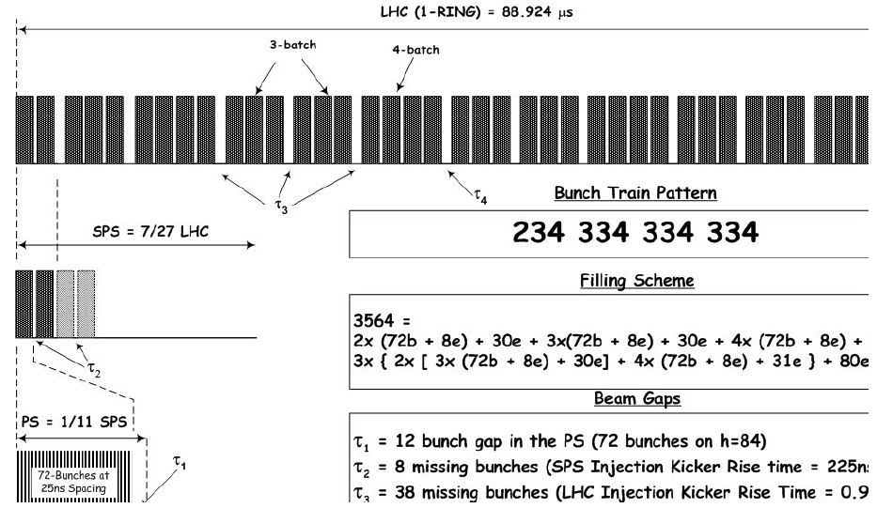
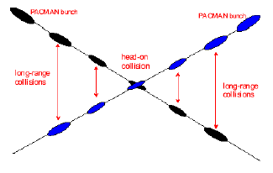
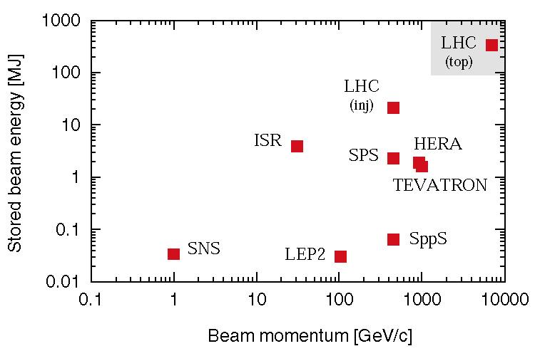
LHC nominal performance
Nominal settings
Beam energy (TeV) | 7.0
Number of particles per bunch | 1.15 10¹¹
Number of bunches per beam | 2808
Crossing angle (μrad) | 285
Norm transverse emittance (μm rad) | 3.75
Bunch length (cm) | 7.55
Beta function at IP 1, 2, 5, 8 (m) | 0.55,10,0.55,10
Derived parameters
Luminosity in IP 1 & 5 (cm⁻² s⁻¹) | 10³⁴
Luminosity in IP 2 & 8 (cm⁻² s⁻¹)* | ~5 10³²
Transverse beam size at IP 1 & 5 (μm) | 16.7
Transverse beam size at IP 2 & 8 (μm) | 70.9
Stored energy per beam (MJ) | 362
* Luminosity in IP 2 and 8 optimized as needed

Slide 5
Initial stage
We start near the origin in all 3 dimensions !
  Energy
    Determined by hardware
    Operational choice would have been below nominal
    Run at highest energy safely possible
  Intensity
    Injector complex can deliver nominal beams (25ns 50ns and 75ns)
    Limited by equipment safety and operational efficiency
    Start low and simple
  Interaction region
    Ultimately determined by hardware (strengths and apertures)
    Operational choice but limited by energy
    Start simple and modest

Slide 6
Evolution of target energy during commissioning
When
Why
All main magnets commissioned for 7TeV operation before installation
Detraining found when hardware commissioning sectors in 2008
  Easy to get to 5TeV
  Harder to get to 6TeV or higher
Machine wide investigations following S34 incident showed problem with spices
Machine wide investigations following S34 incident showed problem with stabilizers
Commissioning of new QPS system
  Breakdown at operational voltage
    connector quality
  Obliged to run at lower voltage
    OK for 2kA
  Need to change connectors
7 TeV
2002-2007
Design
12 kA
5 TeV
Summer 2008
Detraining
9 kA
Late 2008
Splices
3.5 TeV
Summer 2009
Stabilizers
6 kA
1.18 TeV
October 2009
nQPS
2 kA
450 GeV

Slide 7
The way back
When
What
Train magnets
  Should be easy to get to 6TeV
  6.5 TeV should be in reach
  7 TeV will take time
Fix stabilizers for 12kA
Complete pressure relief system
Fix connectors
Commission nQPS system
Commission circuits to 6kA
7 TeV
2014 ?
Training
6.5 TeV
2013
Stabilizers
2011
3.5 TeV
6 kA
2010
nQPS
1.18 TeV
2009
2 kA
450 GeV

Slide 8
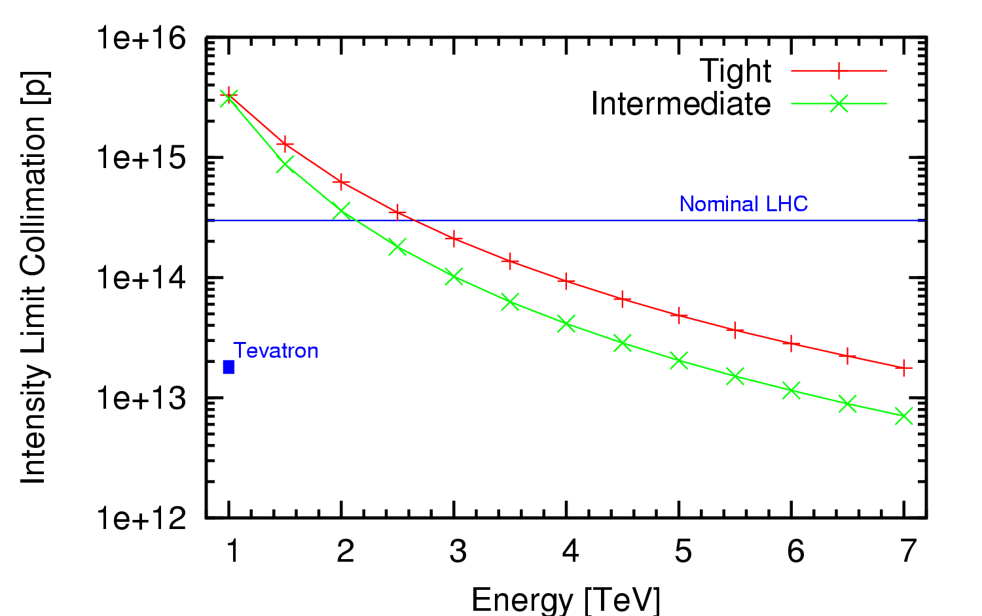
LHC Intensity limits 2010 2011
Collimation system conceived as a staged system
0.2%/s assumed
First stage to allow 40% of nominal intensity at 7TeV
  Under certain assumptions
    LHC lifetimes and loss rates
    0.1%/s assumed (0.2h lifetime)
    Ideal cleaning
  Imperfections bring this down
    Deformed jaws
    Tilt & offset & gap errors
    Machine alignment
  Machine stability
    Tight settings a challenge early
    Intermediate settings make use of aperture to relax tolerances
Fix I_{max} to 6 10¹³ protons per beam at 3.5TeV
(about 20% nominal intensity)
30MJ stored beam energy

Slide 9
Higher intensities
With experience assume that we can
  Move to tight settings
  Achieve 0.1% loss rates
  Get the imperfection factor down
    Should allow to push to higher intensities at 3.5 TeV
Then need to install something more
  Collimators in the cold regions of the machine in 2012
    Using “missing magnet” space in the dispersion suppressors
    Requires moving magnets in LSS3 and LSS7 (24 magnets each)
  Phase II collimators install in 2015 or so

Slide 10
β* and F in 2010 2011
Lower energy means bigger beams
  Less aperture margin
  Higher β*
> 150 bunches requires crossing angle
  Requires more aperture
  Higher β*
Targets for 3.5TeV
  2m no crossing angle
  3m with crossing angle

Slide 11
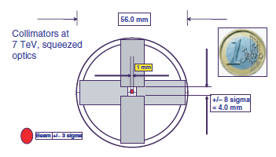
β* evolution
As energy increases, lower β* gets easier
The squeeze is always going to be challenging
  Changing optics with dangerous beams
  Follow / anticipate with collimators
  Particularly tricky below 1m
With experience, should be easier, but still …

Slide 12
Early beam operation
2009 | 2010 | 2011
Repair of Sector 34 | 1.18 TeV | nQPS 6kA | 3.5 TeV I_{safe} < I < 0.2 I_{nom} β* > 2 m | Ions |  | 3.5 TeV ~ 0.2 I_{nom} β* ~ 2 m | Ions
No Beam | B |  | Beam |  | Beam
Energy limited to 3.5 TeV
2010
  Intensity carefully increased to collimation limit
  β* pushed as low as possible
  Target luminosity 10³² cm⁻²s⁻¹
2011
  Run at established limits
  Target integrated luminosity 1 fb⁻¹
Energy | TeV | 3.50 | 3.50 | 3.50 | 3.50
Bunch intensity | 1.E+10 | 10.0 | 10.0 | 10.0 | 10.0
Bunches per beam |  | 4 | 24 | 432 | 792
Emittance | µm | 3.75 | 3.75 | 3.75 | 3.75
β* | m | 3.50 | 3.50 | 3.50 | 3.50
Luminosity 1 and 5 | cm-2 s-1 | 1.0E+30 | 6.1E+30 | 1.1E+32 | 2.0E+32
Total inel X section | cm2 | 6.0E-26 | 6.0E-26 | 6.0E-26 | 6.0E-26
Event rate | Hz | 6.1E+04 | 3.7E+05 | 6.5E+06 | 1.2E+07
Event rate / Xing | Hz | 1.4 | 1.4 | 1.3 | 1.3
Protons |  | 4.0E+11 | 2.4E+12 | 4.3E+13 | 7.9E+13
% nominal |  | 0.1 | 0.7 | 13.4 | 24.5
Current | mA | 0.7 | 4.3 | 77.7 | 142.5
Stored energy | MJ | 0.2 | 1.3 | 24.2 | 44.4
Beam size 1 and 5 | um | 59.3 | 59.3 | 59.3 | 59.3
40% efficiency for physics → 10⁶ seconds collisions per month
10⁶ seconds @ <L> of 10³² cm⁻² s⁻¹ → 100 pb⁻¹

Slide 13
Overall strategy beyond 2011 (dates provisional)
2010 | 2011 | 2012 | 2013 | 2014 | 2015 | 2016 | 2017 | 2018 | 2019 | 2020 | 2021 | 2022 | 2023 | 2024 | 2025 | 2026 | 2027 | 2028 | 2029 | 2030 | 2031 | 2032 | 2033 | 2034 | 2035 | etc.
Energy3.5TeV |  |  | Increase Beam Energy to 7TeV |  |  |  |  |  |  |  |  |  |  |  |  |  |  |  |  |  | Increase Beam Energy to 16.5 TeV
β∗ of 2m |  |  | Decrease β∗ to 0.55m |  |  |  |  |  |  |  | New interaction region (β∗to 0.2m, luminosity leveling)
20% of I_{nom} |  |  | Increase k_{b} to 2808 |  |  |  | Increase beam brightness
Initial |  |  | Nominal |  |  |  | Ultimate |  |  |  | HL-LHC |  |  |  |  |  |  |  |  |  | HE-LHC
10³² |  |  | 10³⁴ |  |  |  | 2.3 10³⁴ |  |  |  | 5 10³⁴ |  |  |  |  |  |  |  |  |  | 2 10³⁴
1 fb⁻¹ |  |  | ≤ 50 fb⁻¹/yr |  |  |  | ≤ 100 fb⁻¹/yr |  |  |  | ≤ 200 fb⁻¹/yr |  |  |  |  |  |  |  |  |  | ≤ 100 fb⁻¹/yr

Slide 14
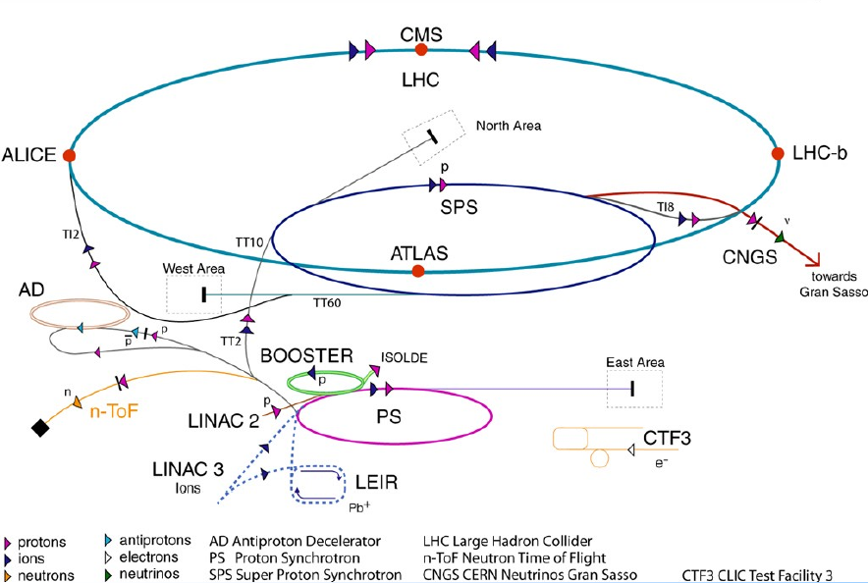
Present accelerator complex
1976
1972
LHC beam route
LINAC2
BOOSTER
PS
SPS
1959

Slide 15
Injector chain
The present accelerators are getting old (PS is 50 years old…) and they operate far beyond their initial design parameters
Luminosity depends directly upon beam brightness N/ε*
Brightness is limited by space charge at low energy in the injectors
Need to increase the injection energy in the injection synchrotrons

Slide 16
Injector chain
Scenario 1 (pre 2010)
  Replace old machines
  Consolidate SPS
  Realistic planning 2020
Scenario 2 (2010)
  Consolidate all machines
  Upgrade PSB energy
  Realistic planning 2015
50 MeV
Linac2
Linac4
50 MeV
Linac2
Linac4
160 MeV
160 MeV
1.4 GeV
PSB
LP-SPL
2 GeV
PSB+
4 GeV
26 GeV
PS
PS2
26 GeV
PS
50 GeV
Output energy
Output energy
450 GeV
SPS
450 GeV
SPS
LHC /
sLHC
LHC /
sLHC
7 TeV
7 TeV

Slide 17
Intensity Limits
Reminder design = 1.15 (for 10³⁴); Ultimate = 1.7 (for 2.3x10³⁴)
Intensity Limitations (10¹¹ protons per bunch)
 | Present | SPL-PS2 | 2GeV in PS
Linac2/LINAC4 | 4.0 | 4.0 | 4.0
PSB or SPL | 3.6 | 4.0 | 3.6
PS or PS2 | 1.7 | 4.0 | 3.0
SPS | 1.2 | >1.7? | >1.7?
LHC | 1.7-2.3? | 1.7-2.3? | 1.7-2.3?
Conclusion from (or just after) Chamonix workshop in February 2010:
We continue (as planned) and finish the study for LP-SPL/PS2
Study in parallel the PS Booster energy upgrade
Decision can be taken when we have the results of these studies and experience with the LHC operation

Slide 18
High Luminosity Interaction Regions
Original idea was a phased upgrade
Phase I goals and scope reproduced below
  Goals of the upgrade:
  flexibility & performance; improve spares count; cope with radiation damage; enable focusing of the beams to β*=0.3 m in IP1 and IP5
  Scope of the project:
    Upgrade of ATLAS and CMS interaction regions: Interfaces between LHC and experiments remain unchanged.
    Cryogenic cooling capacity and other infrastructure in IR1 and IR5 remain unchanged and will be used to full potential.
    Replace present triplets with wide aperture quadrupoles based on the LHC dipole (Nb-Ti) cables cooled at 1.9 K.
    Upgrade D1 separation dipole, TAS and other beam-line equipment (also TAN) so as to be compatible with the inner triplets.
    Modify matching sections (D2-Q4, Q5, Q6) to improve optics flexibility, and introduce other equipment to the extent possible.

Slide 19
Reconsidered at Chamonix 2010
Tough Questions asked by SM to task force:
Will the phase 1 upgrade produce an increase in useful integrated luminosity?
    Installation time and recomissioning a new machine afterwards
Do we have the resources to complete on a time scale which is reasonable with respect to phase 2?
Key preliminary findings (report forthcoming)
  Can expect 1.2 to 1.35 better luminosity with present limitations
      30 cm β∗ is more difficult than 55 cm of the present LHC. Better solution found with β∗ = 40 cm offering a 3 sigma margin per beam (which was part of the initial goal) but only 1.2 gain in lumi over nominal. Today we are limited by a single element. IR upgrade will use all the margins in the whole ring.
  Radiation damage not an issue till 2020 with evolution now expected
  In any case the Triplet cannot be built before 2016 at best (resources)

Slide 20
New study under way
High Gradient/Large Aperture Quads, with B_{peak} 13-15 T. Higher field quadrupoles translate in higher gradient/shorter length or larger aperture/same length or a mix. US-LARP engaged to produce proof by 2013. Construction is 1 year more than Nb-Ti : by 2018 is a reasonable assumption. β∗ as small as 22 cm are possible with a factor ∼2.5 in luminosity by itself, if coupled with a mechanism to compensate the geometrical reduction
Crab Cavities: this is the best candidate for exploiting small β∗ (for β∗ around nominal only +15%). However it should be underlined that today Crab Cavities are not validated for LHC , not even conceptually: the issue of machine protection should be addressed with priority
  Early Separation Scheme could be an alternative (or a complement)
SC links to replace at the surface elecronic equipment today in the tunnel and exposed to high radiation
New Cryoplants in IP1 & IP5: for power AND to make independent Arc- IR:
2.8 kW @ 1.8 K scales as 5.2 kW @ 2 K (for 1 set of cold compressor)

Slide 21
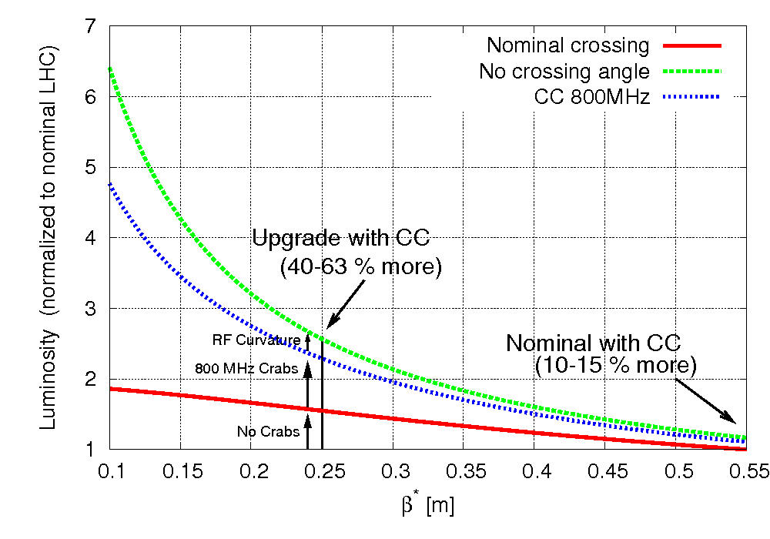
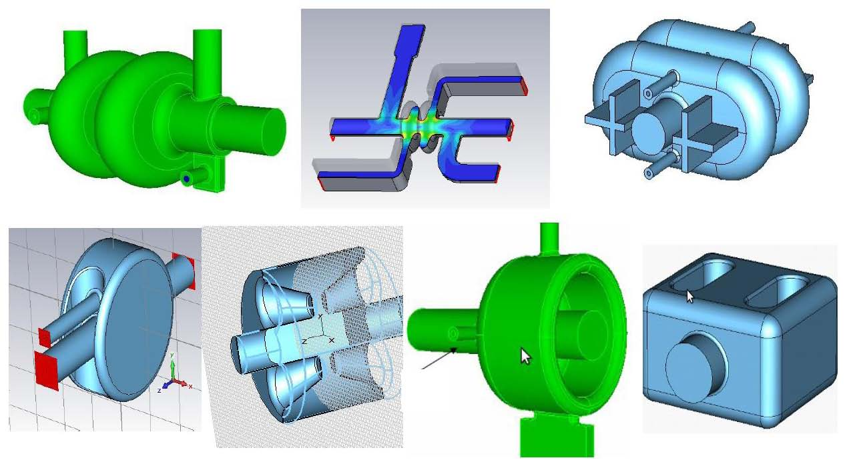
Crab cavities for exploiting low β∗
θ_{c}
Rossi@SLHC Public Event
21

Slide 22
MTP “Observations from the DG”
Thus, the MTP assumes the feasibility of the energy upgrade of the PS Booster and does not include the start of the LP-SPL and PS2 construction as of 2013
In order to optimize the strategy towards the HL-LHC, with the goal of maximizing the integrated luminosity useful for physics, Management has set up a task force. A preliminary recommendation from this task force is to delay the inner triplet replacement to a single HL-LHC upgrade around 2020.

Slide 23
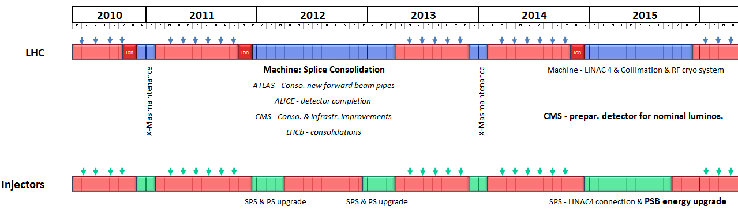
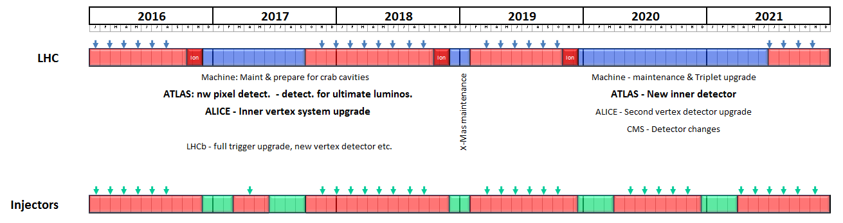
Preliminary route to achieving all this – Plan A
Provisional

Slide 24
2012 shutdown activities (provisional)
LHC
  12-15 months foreseen for the interconnection consolidation and hardware commissioning for 7TeV
  In the shadow, some R2E (Radiation to Electronics) project work, to be defined
  Collimation project – phase 2 in IR3 ; 3 options are being envisaged
  In the shadow, performed by experiments:
    ATLAS: consolidation and installation of a new forward beam pipe
    ALICE: commissioning of TID and some calorimeter modules
    CMS: works on the infrastructure and consolidation
    LHCB: improvements, exchange of the bigger part of the conical beam pipe
Injectors
  SPS and PS upgrade activities will be performed in 2 shut-downs of 15 weeks, at the end of 2011 and 2012

Slide 25
2015 shutdown activities (provisional)
LHC
  The length driven by CMS consolidation.
    CMS requests 12 months to consolidate the calorimeter, forward pixel tracker, needed for better performance at nominal luminosity
  In the shadow:
    The full maintenance of all the equipments (machine and experiments) will be performed
    The completion of the collimation project – phase 2
    The installation of a separate cryogenic system for the RF (which could be postponed in 2017)
Injectors
  A shutdown of 9 months
  Connect LINAC4 to PSB
  Upgrade the PS booster, for 2-GeV operation
    These activities can be postponed to 2017 if necessary

Slide 26
2017 shutdown activities (provisional)
LHC
  Shutdown driven by the activities in the experiments and especially in ATLAS and ALICE. 10 months
    ATLAS; insert the new pixel layer. In parallel various systems will be upgraded and the LV1 will be sharpened
    ALICE; installation of a smaller beam pipe and a new vertex detector. The outer detector will be upgraded in shorter shutdowns (Christmas breaks)
    LHCb; rebuild the vertex detector and increase the readout rate
  In the shadow, full machine maintenance as well as the preparation of magnets for crab cavities in IR4
Injectors
  2 x 3.5 months
  consolidations and upgrades

Slide 27
2020 shutdown activities (provisional)
LHC
  Machine
    New Inner Triplets and the crab cavities to be installed. 18 months
  CMS, ATLAS; Inner detector trackers to be replaced. Possibly a major upgrade of all the front-end and back-end electronics and the online computing systems
  ALICE; upgrade its second vertex detector
Injectors
  During the 2020-2021 shutdown the injectors will run in a “normal mode”, with 3.5months shutdowns at the end of 2019 and 2020

Slide 28
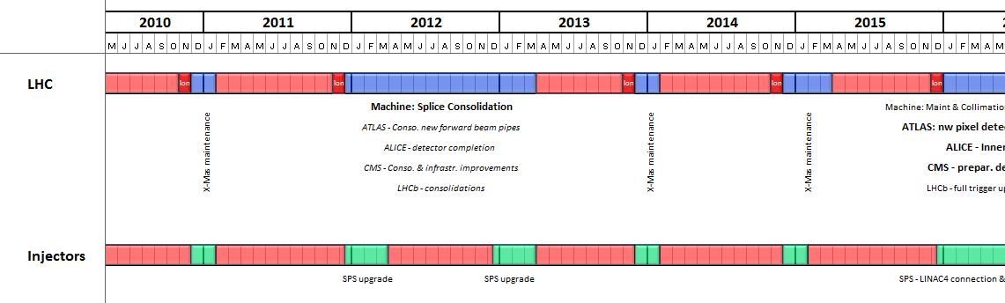
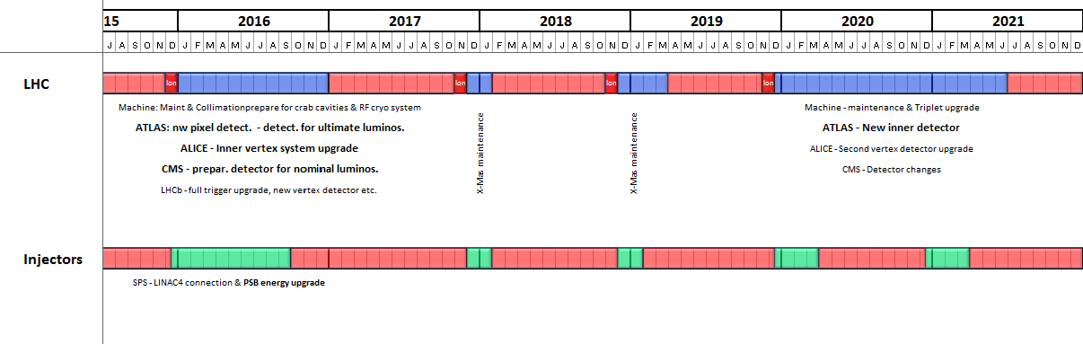
Preliminary route to achieving all this – Plan B
Provisional

Slide 29
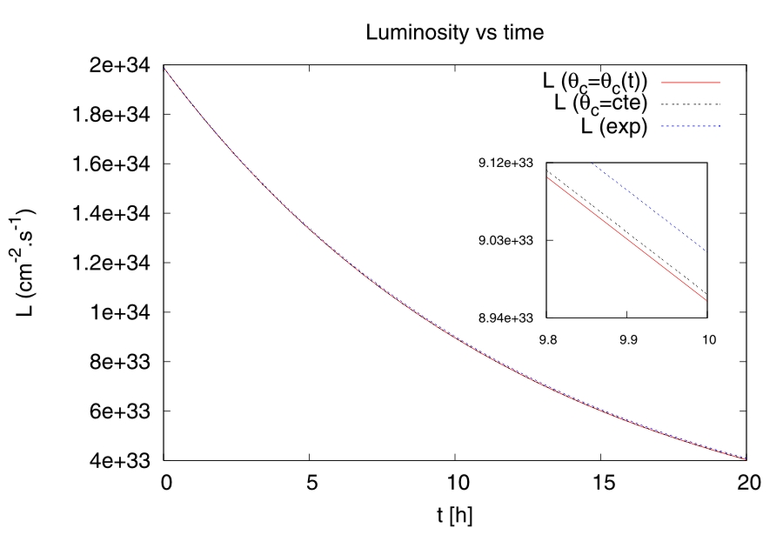
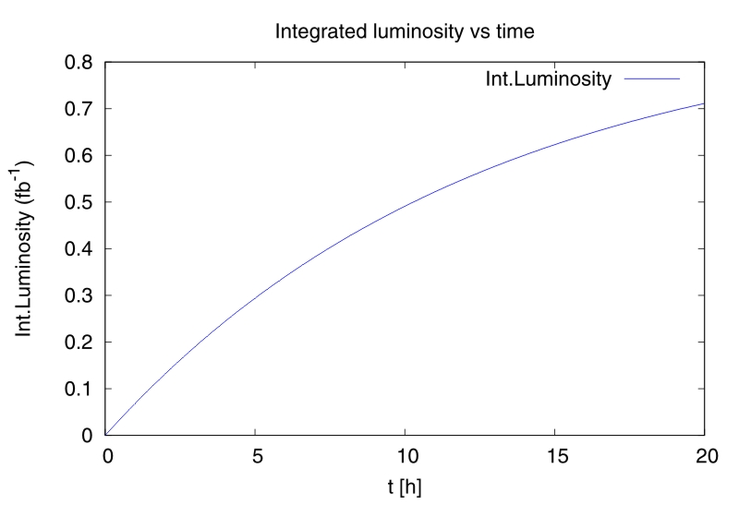
HE-LHC
“First Thoughts on a Higher-Energy LHC”
Ralph Assmann, Roger Bailey, Oliver Brüning, Octavio Dominguez Sanchez, Gijs de Rijk, Miguel Jimenez, Steve Myers, Lucio Rossi, Laurent Tavian, Ezio Todesco, Frank Zimmermann
Abstract:
We report preliminary considerations for a higher-energy LHC (“HE-LHC”) with about 16.5 TeV beam energy and 20-T dipole magnets. In particular we sketch the proposed principal parameters, luminosity optimization schemes, the new HE-LHC injector, the magnets required, cryogenics system, collimation issues, and requirements from the vacuum system.
Table of Contents:
Parameters
Luminosity optimization
Injector
Magnets
Cryogenics studies
Vacuum system
Collimation issues

Slide 30
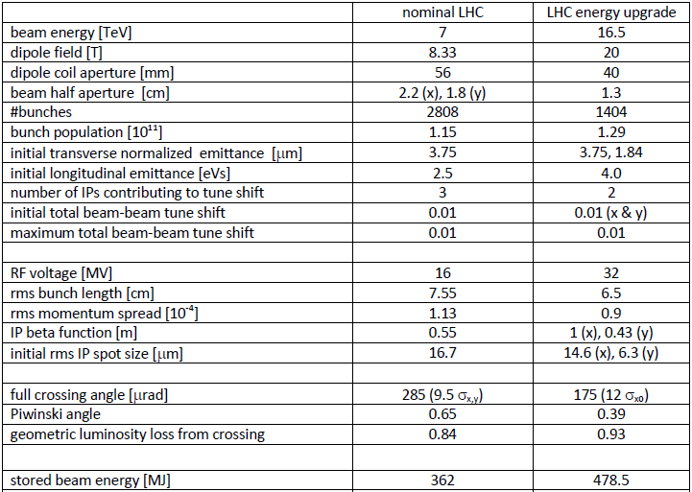
HE-LHC
Provisional parameter list for LHC energy upgrade at 33 TeV centre-of-mass energy

Slide 31
LHeC
2 options on the table
  Ring-Ring
    e-p and e-A (A=Pb, Ar, …) collisions, limited possibilities for polarized e
    More “conventional” solution, like HERA, no difficulties of principle at first sight but constrained by existing LHC in tunnel
    Steady progress with detailed design
  Linac-Ring
    e-p and e-A (A=Pb, Ar, …) collisions, polarized e from source, poorer Luminosity/Power
    No previous collider like this (at present)
    Comparisons of layouts

Slide 32
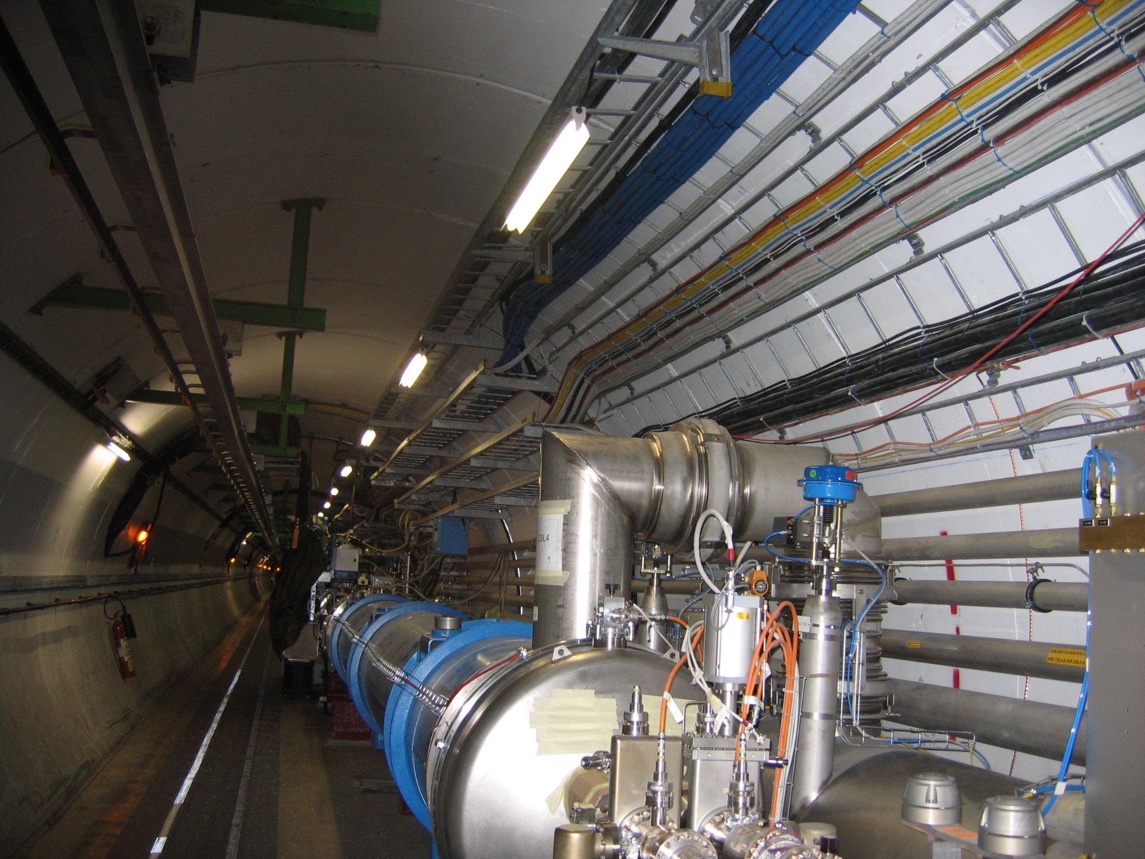
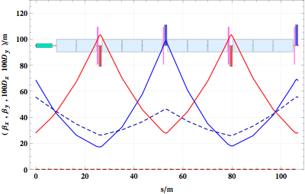
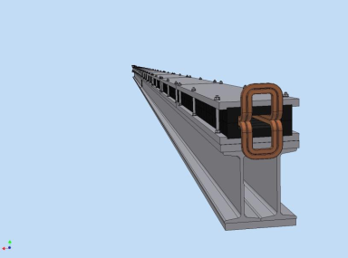
Ring-Ring
No interference with LHC
Meets design parameters
Synchrotron radiation energy loss < 50 MW (maximum dipole filling)
2 quadrupolesfamilies
Reasonable sextupole strength and length
Dedicated injector at 10GeV

Slide 33
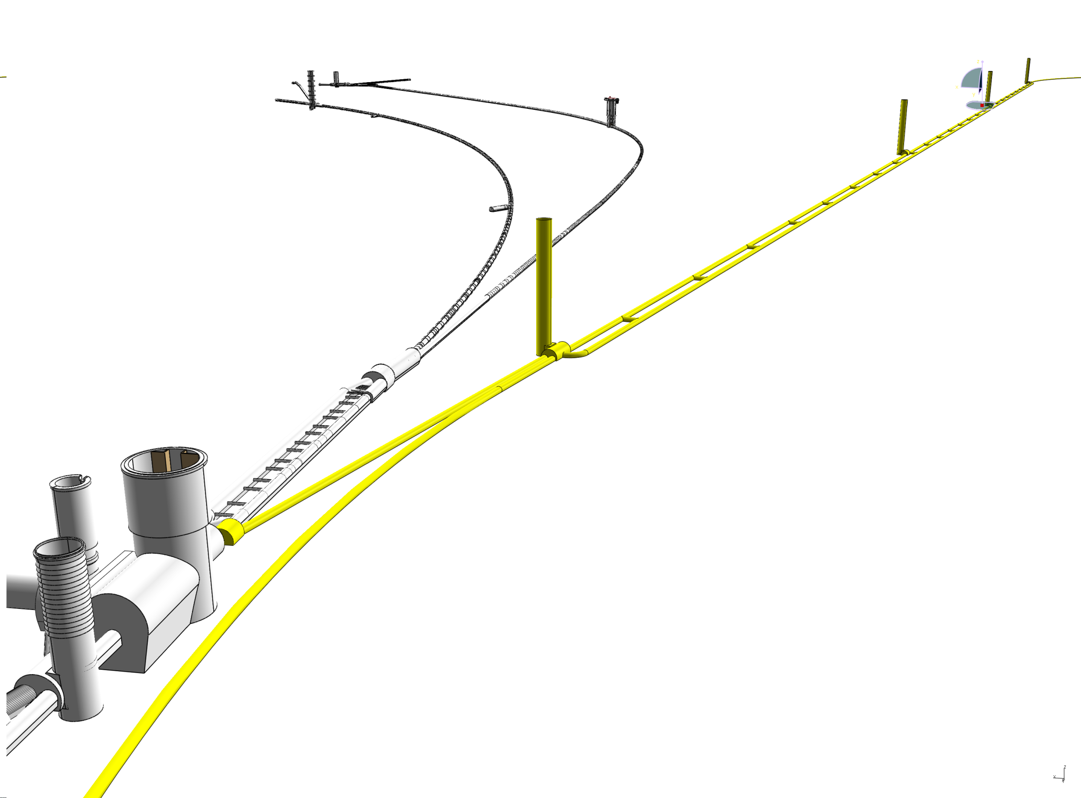
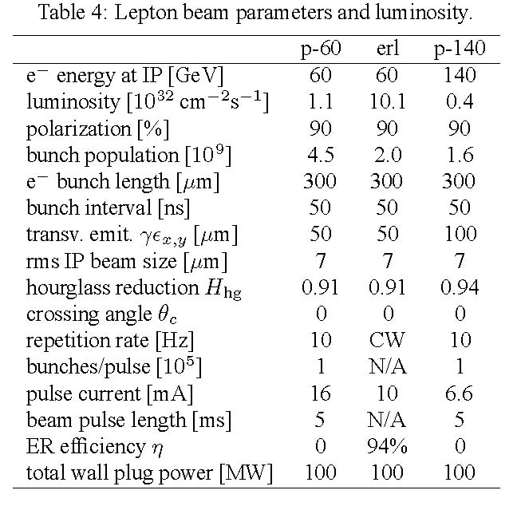
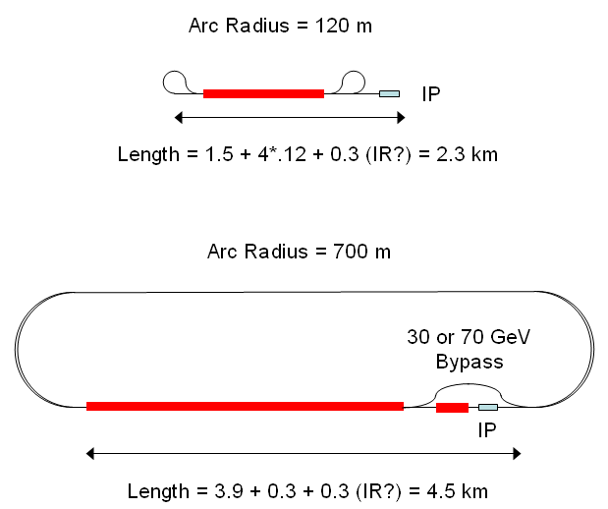
Linac-Ring

Slide 34
Summary
Clear goals for 2010 and 2011
Route to nominal pretty clear (E, k_{b}, β∗)
  Needs collimation upgrade
Pragmatic upgrade of the injectors for around 2016
  Linac 4, upgraded booster
Single upgrade of the HL IRs around 2020
Planning will be finalised during second half of 2010
  Strategy meeting July 7th
  Ongoing HL-LHC task force (Chamonix if not before)
  Ongoing HE-LHC study group (Chamonix if not before)
  Ongoing LHeC machine study group (CDR Q4 2010)

