Slide 1
PPAN perspective and the Science Roadmap
Jordan Nash PPAN Chair

Slide 2
A PPAN Roadmap as input to an STFC roadmap
We are producing an overall roadmap of PPAN science
Use this as a document to put in front of policy makers
highlight opportunities
There will be future spending reviews
Outline our scientific strategy
Much of the work for this has already been done by APs
They have produced excellent documents in consultation with the communities
We wanted to use these as the starting point
We want to put the information in a uniform format
We asked their help in doing this

Slide 3
Advisory Panel Reports
Panels identified major scientific challenges, the facilities which could attack these, and some idea of timescales - roadmaps

Slide 4
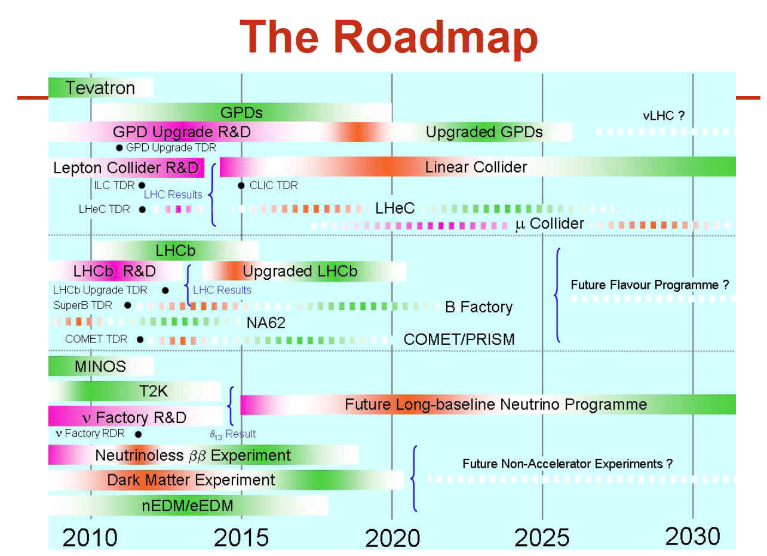
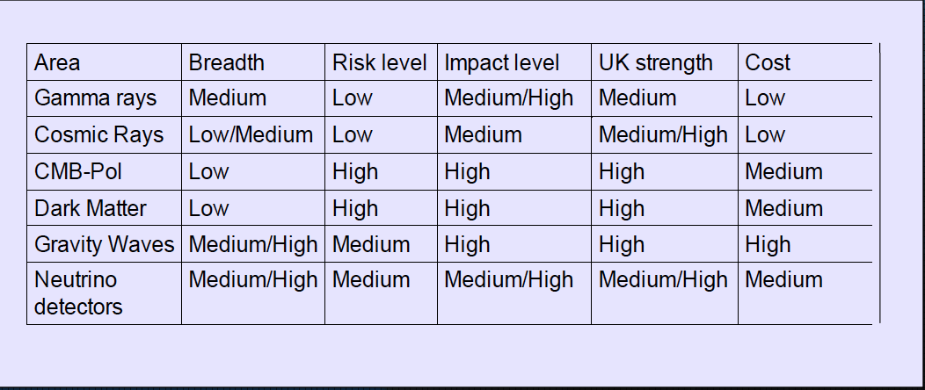
Advisory Panel reports – Roadmaps

Slide 5
Key elements of the roadmap
The key science questions/themes
About 3-4 for each Advisory Panel
PPAN synthesized distilled
The facilities/experiments/activities for answering these questions
A timeline over the next 20 years of how these could be/will be available
This is often a matrix
The enabling technologies
Any key decision points
Science driven
Funding driven (perhaps external partners)
Technology driven

Slide 6
What we asked the APs to provide
A one page summary
Science questions identified – this is the key to identify
Timeline of facilities/opportunities – potential ways to answer the questions
A few paragraphs of description on the timeline elements

Slide 7
Science Roadmap – the Plan
Advisory Panels to distil reports to 1 page formatted summary
by end of May
PPAN to produce draft PPAN science roadmap
by end July
STFC to produce draft overall science roadmap
by September
Consultation with community (via APs) on draft science roadmap
end September – end November
Victoria Wright PPAN 24th March 2010

Slide 8
Advisory Panel questions
The advisory panels provided 18 key questions to PPAN
Many of these questions overlapped
PPAN looked at all of these and condensed these into a smaller set of questions
Identified the overlaps

Slide 9
FUAP Questions
What is the nature of dark matter and dark energy?
When did the first stars, black holes and galaxies form?
Do our laws of physics work under extreme conditions in the Universe?
How do galaxies evolve?

Slide 10
NUAP Questions
How do the Sun and other stars affect their planetary environments?
What controls the properties and evolution of stars, including the Sun?
How are stars born and how do planetary systems in which life may emerge, form and evolve?
What fundamental processes operate in astrophysical sources, including the Solar System?

Slide 11
PAAP Questions
What is the origin and composition of the universe?
What is the nature of space-time?
What is the role of high energy particles in astrophysical environments?
What happens to the laws of physics in extreme environments?

Slide 12
PPAP Questions
What are the elementary constituents of the Universe that were produced in the Big Bang?
Can the forces between elementary particles be understood in a unified framework?
What unknown properties of particles and forces drove the evolution of the Universe from the Big Bang to its present state?
Why is there more visible matter than antimatter in the Universe and what is the origin of this asymmetry?

Slide 13
NPAP Questions
What are the Origins of the Elements?
What is the Nature of Nuclear and Hadronic Matter?

Slide 14
PPAN Mission Statement
The PPAN programme is to understand and explore…
Constituents
Forces
Fabric
Origin and evolution of our universe
and our place in it!

Slide 15
Questions
Likely to be 4 “Big questions” from PPAN as input to the STFC exercise
They are being wordsmithed, but are likely to cover
Origin and Evolution of the universe
Planetary systems and life
Constituents of universe, fabric, and their interactions
Physics in extreme conditions

Slide 16
Roadmaps
We received 5 roadmaps
Varied style and quantity of content
Don’t want to get caught in the “either your project is on this map, or it is not in the picture” trap
Identify science questions we want to answer
Possible facility/facility classes which can provide answers
Timelines/decision points which influence choices of facilities

Slide 17
PPAP Roadmap

Slide 18
NUAP Roadmap

Slide 19
PAAP Roadmap

Slide 20
NPAP Roadmap

Slide 21
FUAP Roadmap - 1

Slide 22
FUAP roadmap - 2

Slide 23
PPAN Roadmap
For next PPAN (in two weeks) meeting, will work to synthesize the roadmaps
Try and produce a single side of paper which identifies science opportunities in the next two decades which answer our science questions.
We will feed this back for comments

Slide 24
Future Spending Reviews
We have all seen the budget and can read the newspapers.
It is clear the pain we have been feeling in the Science Programme is not yet over
Likely that we will be asked once again to prioritize the science we do.
We probably will have to make even deeper cuts into our highest priority activities
But we have to find some way to keep future activities possible.
Perhaps how the grants are awarded and “ring-fenced” needs to be discussed (Mark will be discussing)
Much will depend on how the numbers actually are settled on in the CSR – lots of variables (STFC/UKSA/Facilities/Subscriptions…)

