Slide 1
IPPP: Past, Present and Future
Durham 14 September 2010 Public Talk for the Steering Committee
Valya Khoze

Slide 2
1. IPPP 2000-2005
In 2000 PPARC decided to fund a dedicated Institute to strengthen and coordinate Particle Physics Phenomenology research in the UK.
IPPP was created as a partnership between Durham University and PPARC.
Durham Physics (1999): Alan Martin, James Stirling, Mike Pennington,
Nigel Glover, Chris Maxwell, Valya Khoze, Adrian Signer
University committed 4 new permanent staff positions at £3.2M
Steve Abel , Patricia Ball, Georg Weiglein and Sacha Davidson
Research Council provided a 10-year grant £8.3M for
postdoctoral positions, support staff, budget for Workshops and Visitors
University, DTI and Ogden Trust together provided £6.6M for a new building to house the Institute.
James Stirling (first IPPP Director) and Nigel Glover (Deputy Director)

Slide 3
2. IPPP 2005-2010
Nigel Glover (IPPP Director)
Georg Weiglein and then Peter Richardson (Deputy Director)
In 2008 partnership between Durham University and STFC was renewed for a second 10-year period:
STFC provided a new 10-year grant of £16.7M
University committed to:
3 new permanent academic staff positions
£1M of research support and increased research space (new building)
In Feb 2010 PPAN accepted the assessment of the Particle Physics Advisory Panel that IPPP has been a particularly successful contributor in this field and re-confirmed the ranking alpha4.
In order to ``preserve the breadth in the overall programme the project funding was reduced by 10% (re-indexation) ‘’.
£16.7M -> £15.9M

Slide 4
3. IPPP 2010 -> Future
Valya Khoze (IPPP Director ) Frank Krauss (Deputy Director)
IPPP Members and the Steering Committee
IPPP Objectives
Responsibilities
What do we provide (IPPP Statistics)
Research Publications and Research Highlights
Workshops/Conferences past and present
Experimental Support
Hiring Strategy
Preparing for Mid-term Review 30.09.2012
Preparing for the next grant renewal; long-term future of IPPP

Slide 5
Making Introductions
IPPP Members
Steering Committee Members
So that we can get to know each other better and to enable closer
cooperation and interactions between IPPP and the Steering Committee also
going beyond the bi-annual official meetings. We welcome your input and ideas.
We want to make IPPP and the Steering Committee feel closer and
(if you agree with what you and we have here)
we would like you to act as our ambassadors in the wider community.

Slide 6
Co-I IPPP Academic Staff : Sept. 2010
Steve Abel
Professor
IPPP/Maths
BSM, String-ph
Patricia Ball
Professor
IPPP/Phys
B-Physics
Nigel Glover
Professor
IPPP/Phys
QCD, SM
Gudrun Heinrich
STFC F./ Lecturer
IPPP/Phys
QCD, SM
Joerg Jaeckel
Lecturer
IPPP/Phys
BSM, ALPs
Valya Khoze
Professor
Director
BSM, SYM-th
Frank Krauss
Reader
Deputy Director
Monte Carlo
Chris Maxwell
Senior Lecturer
IPPP/Phys
QCD, SM
Silvia Pascoli
Reader
IPPP/Phys
Neutrinos
Peter Richardson
Professor
IPPP/Phys
Monte Carlo
Adrian Signer
Senior Lecturer
IPPP/Phys
QCD, IR-effects

Slide 7
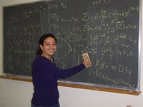
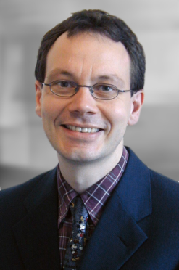
IPPP Academic Staff : New in 2010/11
Celine Boehm
Lecturer (1.1.2011)
IPPP/Phys
Dark Matter, Astro-Particle
← LAPTH Annecy
Thorsten Feldmann
Lecturer (1.1.2011)
IPPP/Phys
B-phys, flavour
← TU Munich
New Candidate
Lecturer
IPPP/Phys
QCD, SM
Offer made 09.2010 and
being considered by the candidate

Slide 8
non-Co-I Professorial Staff
Ruth Gregory
Professor
CPT Maths/Phys
Valery Khoze
Professorial
Fellow
IPPP/Phys
Alan Martin
Emeritus
Professor
IPPP/Phys
Visiting Professors
Currently 15 Visiting Professors at IPPP drawn from leading experts in the field
IPPP Associates
10 members of UK permanent academic staff awarded IPPP Associateships each year. Each Associateship has a value of up to £4000 per annum and is funded by Durham University, through the IPPP. Aim is to support particle physics phenomenology research in the UK. Visits to IPPP, research collaborrations, contributions to Workshop organisation… More later today

Slide 9
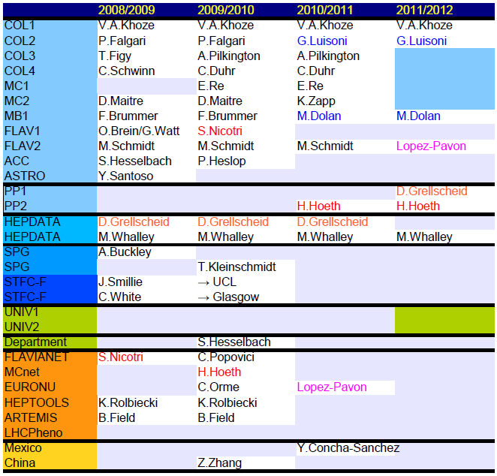
PDRA Research Staff
In 2009/10 we had
19 Research Associates
working at the IPPP
funded either directly
by the IPPP grant (10)
or by other grants
or networks.
Will return to
this TABLE
when discussing Hiring Strategy

Slide 10
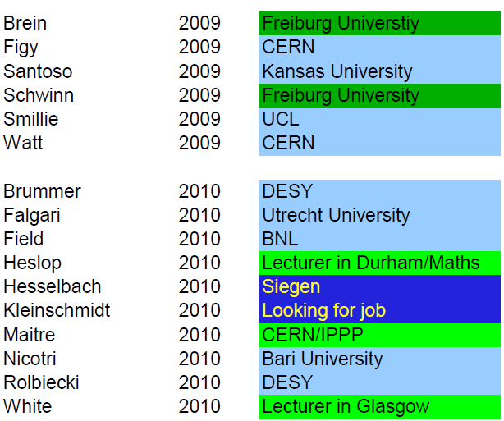
Research Staff: Destinations
Of IPPP-funded postdocs since 2000, over 95% go on to positions in particle physics

Slide 11
PhD Students
Currently there are around 30 Postgraduate Students working at the IPPP and supervised by IPPP academic staff.
Funded through EU RTNs or
Overseas Funding Agencies

Slide 12
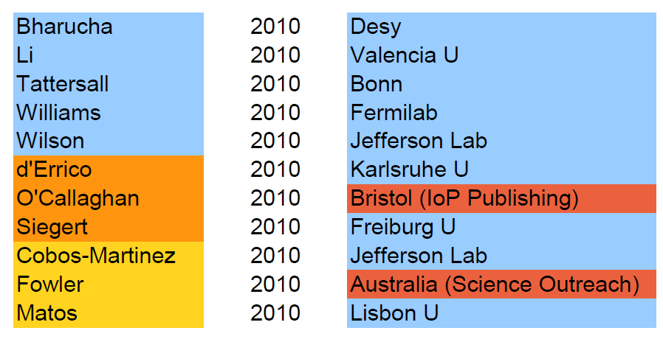
PhD Students: Destinations
Since 2000, over 60% of PhD students trained by us go on to research positions in particle physics.
This year:

Slide 13
Steering Committee 2009-2010
Prof Jon Butterworth (Chair) University College London Until 30 September 2010
Dr Ulrik Egede Imperial College London Until 30 September 2010
Prof Beate Heinemann UC Berkeley Until 30 September 2011
Prof Norman McCubbin STFC Until 30 September 2011
Prof Mike Seymour CERN and U Manchester Until 30 September 2011
Dr Claire Shepherd-Themistocleous STFC Until 30 September 2010
Professor Dan Tovey University of Sheffield Until 30 September 2010
Prof Nigel Glover (Director) IPPP Durham University ex officio
Dr Peter Richardson (Deputy) IPPP Durham University ex officio
Professor Patricia Ball IPPP Durham University Until 30 September 2010
Mrs Deborah Miller STFC (SPO) in attendance
Mrs Linda Wilkinson IPPP in attendance

Slide 14
Steering Committee 2010
Prof Jon Butterworth (Chair) University College London Until 30 September 2010
Prof Lance Dixon SLAC and CERN Until 30 September 2013
Dr Ulrik Egede Imperial College London Until 30 September 2010
Prof Graham Ross Oxford Until 30 September 2013
Prof Beate Heinemann UC Berkeley Until 30 September 2011
Prof Norman McCubbin STFC Until 30 September 2011
Prof Mike Seymour CERN and U Manchester Until 30 September 2011
Dr Claire Shepherd-Themistocleous STFC Until 30 September 2010
Professor Dan Tovey University of Sheffield Until 30 September 2010
Prof Valya Khoze (Director) IPPP Durham University ex officio
Dr Frank Krauss (Deputy) IPPP Durham University ex officio
Professor Patricia Ball IPPP Durham University Until 30 September 2010
Dr Katharine Schofield STFC (Science Prog. Repr.) in attendance
Mrs Linda Wilkinson IPPP in attendance

Slide 15
How does a UK-based World-class Phenomenology centre contribute to the development of particle physics? (or science and technology more generally)
Objectives:
1. Perform internationally excellent research in particle phenomenology
2. Provide a critical mass of competence across all areas of particle theory with emphasis on connecting theory with experiments
3. Engage with UK and International PP community to help shape future programme providing leadership, vision and strategic advice
4. Attract and retain the best people
Responsibilities:
1. Strong two-way interaction so that UK can play an even more pivotal role in experimental programme at CERN and elsewhere:
a) respond to new theoretical developments - explore experimental implications
b) respond quickly to requests from UK experimenters
2. Active programme of Workshops and focused meetings on timely subjects.
3. Enhance the visibility and role of UK groups within the global community
4. Training and opportunities for research students.
5. Contribute to public understanding of science

Slide 16
What do we provide IPPP Statistics
Workshops
Publications and Research Highlights ….
Since its creation in 2000 the IPPP has
published more than 800 scientific papers
organised or co-organised 145 meetings or workshops, ~ half of which have been in Durham
produced ~ 40 PhD's in particle physics phenomenology
95% of postdocs and 60% of PhD students go on to research positions in particle physics

Slide 17
IPPP Publications
YEAR IPPP-papers top-cited papers
IPPP/ all papers in hep-ph
2005 72 26/347
2006 79 29/289
2007 89 10/211
2008 85 3/122
2009 86 10/211
2010 65 (up to Sept) 0/1

Slide 18
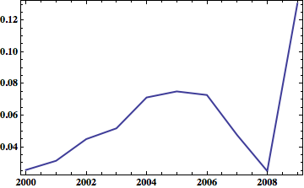
IPPP Publications
IPPP top-cited papers/ all top-cited hep-ph
IPPP
DESY
IAS
blue is IPPP, purple is IAS and yellow DESY

Slide 19
IPPP Workshops
IPPP organises, co-organises or sponsors
close to 20 workshops a year (100th meeting was in 2007)
including Annual Theory Meetings and
Young Experimentalists and Theorists Institute
total of 18 workshops 6 in Durham
2009 23 8
2008 16 6
2007 19 7
2006 15 8
http://www.ippp.dur.ac.uk/Workshops/

Slide 20
YETI 2010 : dark world, cosmology, LHC Workshops-2010 Part I
Durham 12 January - 14 January 2010 Higgs-Maxwell Meeting: Particle Physics and Cosmology
Royal Society of Edinburgh 10 February 2010 Theory Experiment Interplay at the LHC Workshop Royal Holloway, University of London 8 April - 9 April 2010 Numbers, Periods and Quantum Field Theory Durham 15 April - 17 April 2010 Exploring the Origin of Mass: A New Dawn Durham 21 April - 24 April 2010
Amplitudes 2010 Queen Mary, University of London 4 May - 7 May 2010
BOOST2010 Oxford 22 June - 25 June 2010
CKM2010: 6th International Workshop on the CKM Unitarity Triangle Warwick University 6 September - 10 September 2010 Vector boson plus jets as a signal and background Durham 8 September - 10 September 2010

Slide 21
Lattice meets Phenomenology Workshops-2010 Part II Durham 15 September - 17 September 2010
CERN Theory Institute: Neutrino Theory, Models, and Experimental perspectives CERN 13 September - 22 September 2010 Working Group on Radiative Corrections and MC Generators for Low Energies Liverpool 18 September - 19 September 2010 LHC first results and outlook Cosener's House, Abingdon 20 September - 21 September 2010 QCD in the LHC Era: A Meeting in Honour of Bryan Webber Emmanuel College, Cambridge 22 September - 22 September 2010
Soft Gluons and New Physics at the LHC
Manchester 1 November - 2 November 2010
MPI@LHC 2010: 2nd Int Workshop on Multiple Partonic Interactions at the LHC Glasgow 29 November - 3 December 2010
Forward Physics at the LHC Manchester 12 December - 14 December 2010 Annual Theory Meeting Durham 16 December - 18 December 2010

Slide 22
Research Highlights

Slide 23
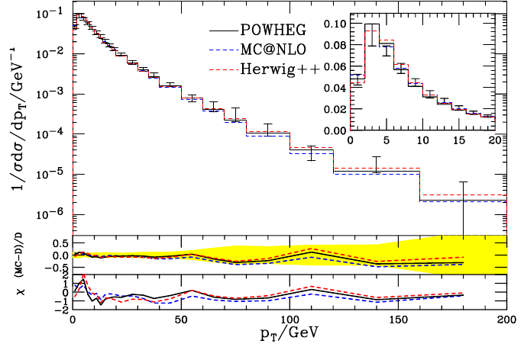
Monte Carlo: Herwig++
Various processes with Powheg method (NLO accuracy) in current release:Z, W, H, ZH, WH
Under construction: VBF, ZZ, ZW, WW
CKKW published (in e+e-collisions), hadronic collision in preparation.
W-pt spectrum (Powheg) (Tevatron, D0, Run I)‏
Powheg is a way to incorporate
NLO effects for total rates

Slide 24
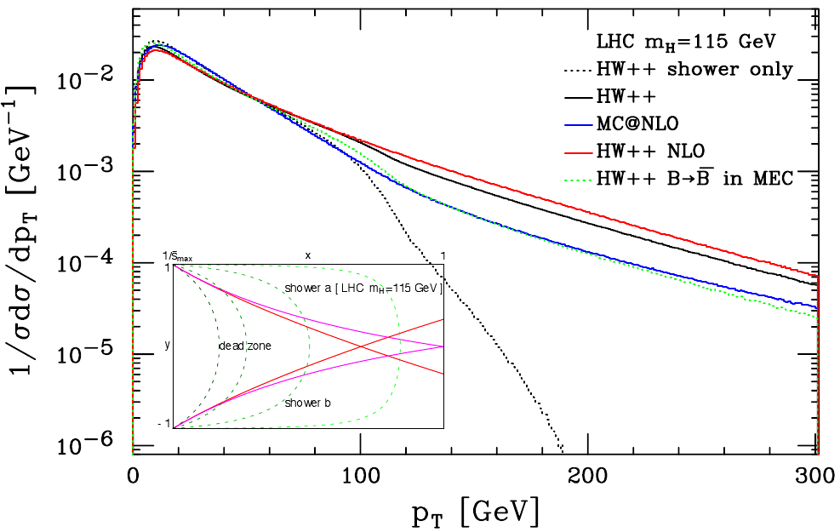
Monte Carlo: Herwig++
Various processes with Powheg method (NLO accuracy) in current release:Z, W, H, ZH, WH
Under construction: VBF, ZZ, ZW, WW
CKKW published (in e+e-collisions), hadronic collision in preparation.
H-pt spectrum (Powheg) (Study for LHC, at 14 TeV)‏
Powheg is a way to incorporate
NLO effects for total rates

Slide 25
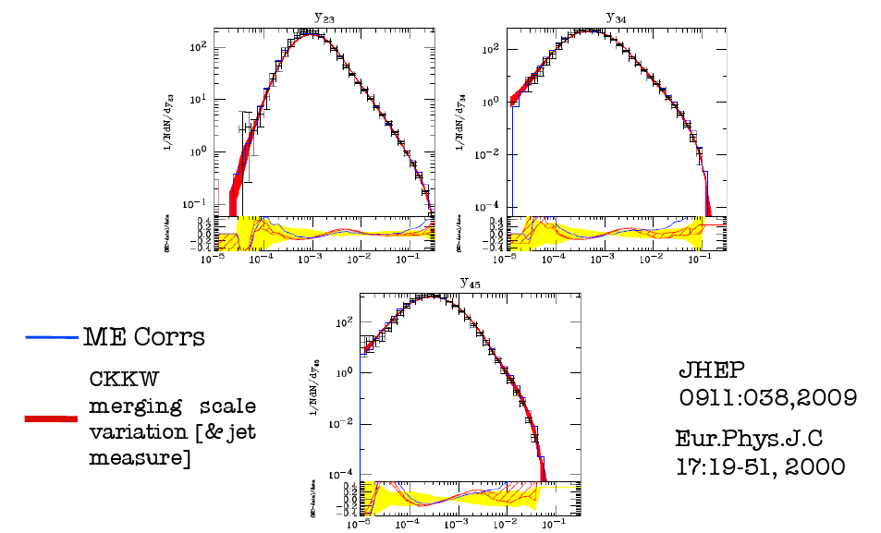
Monte Carlo: CKKW in Herwig++
CKKW is a way to incorporate
NLO effects for jets

Slide 26
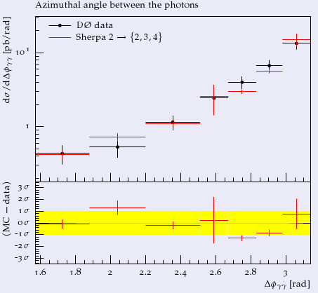
Monte Carlo: Sherpa
CKKW method (better accuracy for many jets) fully automated, QED*QCD included.
Recent progress: Powheg method automated for simple processes
Combination of Powheg and CKKW methods achieved
Diphoton production (D0, Tevatron Run II)‏

Slide 27
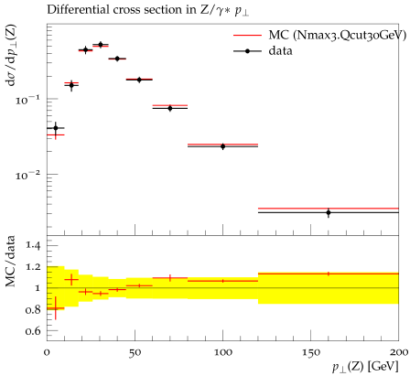
Monte Carlo: Sherpa
CKKW method (better accuracy for many jets) fully automated, QED*QCD included.
Recent progress: Powheg method automated for simple processes
Combination of Powheg and CKKW methods achieved
Z-pt vs. data (CDF, Tevatron Run II)‏

Slide 28
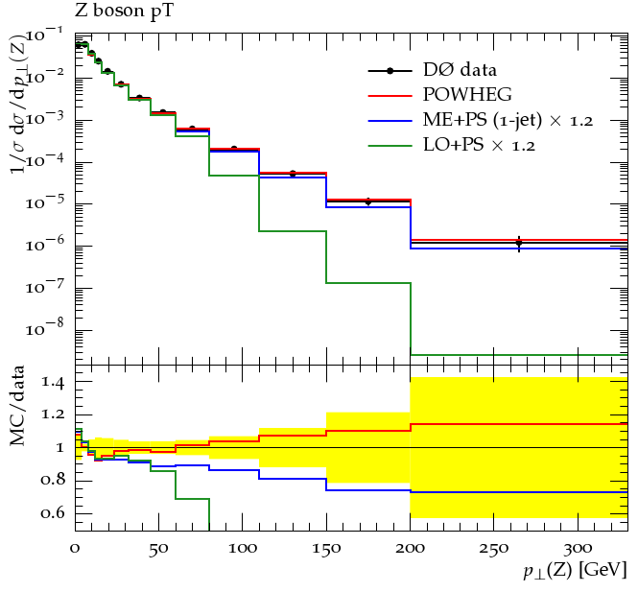
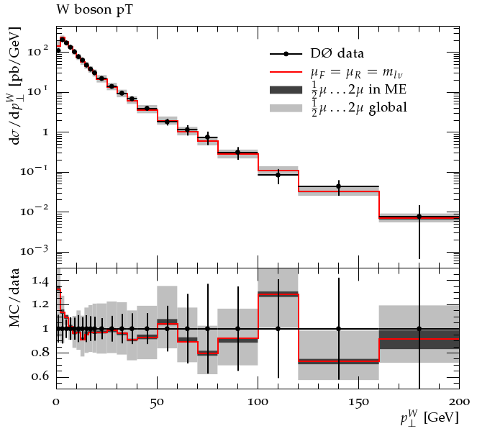
Automation of Powheg in Sherpa

Slide 29
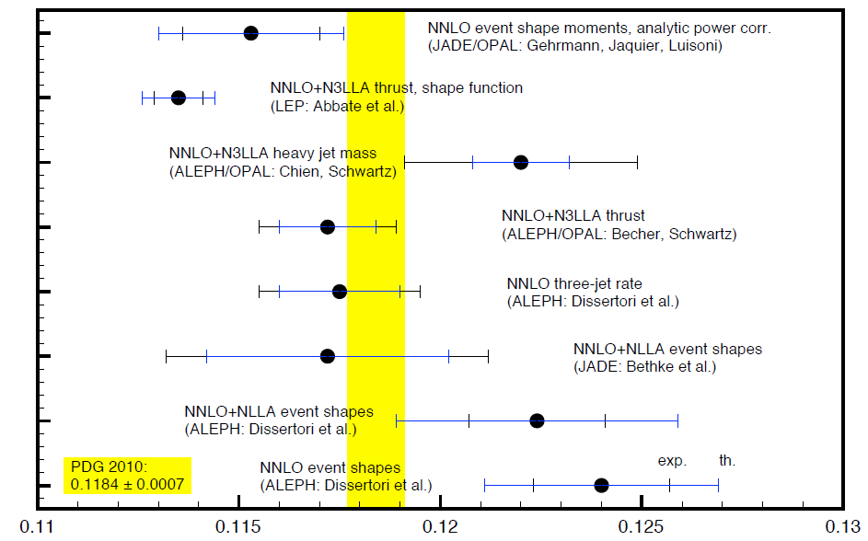
Determination of the strong coupling constant at NNLO
in QCD from 3-jet rate in e+e- annihilation at LEP
O(alpha^3)
Compilation of recent alpha_s determinations:
Dissertori, Gehrmann-De-Ridder, Gehrmann, N. Glover, G. Heinrich, Stenzel PRL’10

Slide 30
Maitre + Berger, Bern, Dixon, Febres Cordero, Forde, Ita, Kosower, Gleisberg
Collaboration with SLAC and UCLA through exchange of Maitre and Gleisberg

Slide 31
W/Z + 3 jets and W+4 jets with BlackHat + Sherpa
BlackHat
Automates computation of virtual one-loop amplitudes for QCD processes
C++ framework
Uses new progress in the unitarity techniques, spinor formalism, complex momenta
Cut containing part: 4 Dimensional
Rational part:
One- loop recursion (reuse of lower point results )
Rational extraction using D-dim unitarity
SHERPA
Provides
Efficient phase space integration
Event generation
Analysis framework
Automated dipole subtraction for the real part
(and much more)
Is written in C++
Gleisberg, Hoeche, Krauss, Schoenherr, Schumann,
Siegert, Winter
Berger, Bern, Dixon, Febres Cordero, Forde, Gleisberg, Ita, Kosower, Maitre

Slide 32
Soft-hadron interactions and diffraction
1. Developed multi-pomeron models for soft hadron interactions and their application to the description of the proton-proton data in the Tevatron-LHC energy range and to the HERA diffractive data V.A. Khoze, A.D. Martin, M.G. Ryskin.
Implementation of the new theoretical models into MCs
F. Krauss, K.Zapp, V.A. Khoze, A.D. Martin, M.G. Ryskin.
2. Theoretical study of central diffractive production of dijets, diphotons and resonance states, from quarkonia to the Higgs bosons L. Harland-Lang, V.A.Khoze, A.D.Martin, M.G.Ryskin and W.J. Stirling. Application to the Tevatron, RHIC and LHC .
This activity has already initiated a series of new measurements at the Tevatron, and more results from the LHC and RHIC are about to come.

Slide 33
MSTW Parton distributions
A. Martin, J. Stirling, R. Thorne, G. Watt
MSTW 2008 partons
Long term Durham activity, still going strong
Uncertainties on alpha(S) in global PDF analyses
arXiv:0905.3531
Parton distributions for the LHC
arXiv:0901.0002
http://projects.hepforge.org/mstwpdf/
Longstanding collaboration with UCL and now Cambridge
reinforced by arrival of Graeme Watt in March 09

Slide 34
MSTW Parton distributions
A. Martin, J. Stirling, R. Thorne, G. Watt
Long term Durham activity, still going strong
Uncertainties on alpha(S) in global PDF analyses
arXiv:0905.3531
Parton distributions for the LHC
arXiv:0901.0002
from the news:
Hottest paper in Physics in 2010
The physics paper with the highest percentage increase in citations in 2010 as determined by ScienceWatch.com is `Parton distributions for the LHC' written by IPPP scientist Alan Martin together with his collaborators James Stirling, Robert Thorne and Graeme Watt. ScienceWatch tracked the citations in Essential Science IndicatorsSM from Thomson Reuters from the first bimonthly period of 2010 to the second bimonthly period of 2010 and identified 1762 `hot' papers. The hottest paper in the physics category is "Parton distributions for the LHC", Eur.Phys.J.C63:189-285,2009 which now has nearly 200 citations.
Longstanding collaboration with UCL and now Cambridge
reinforced by arrival of Graeme Watt in March 09

Slide 35
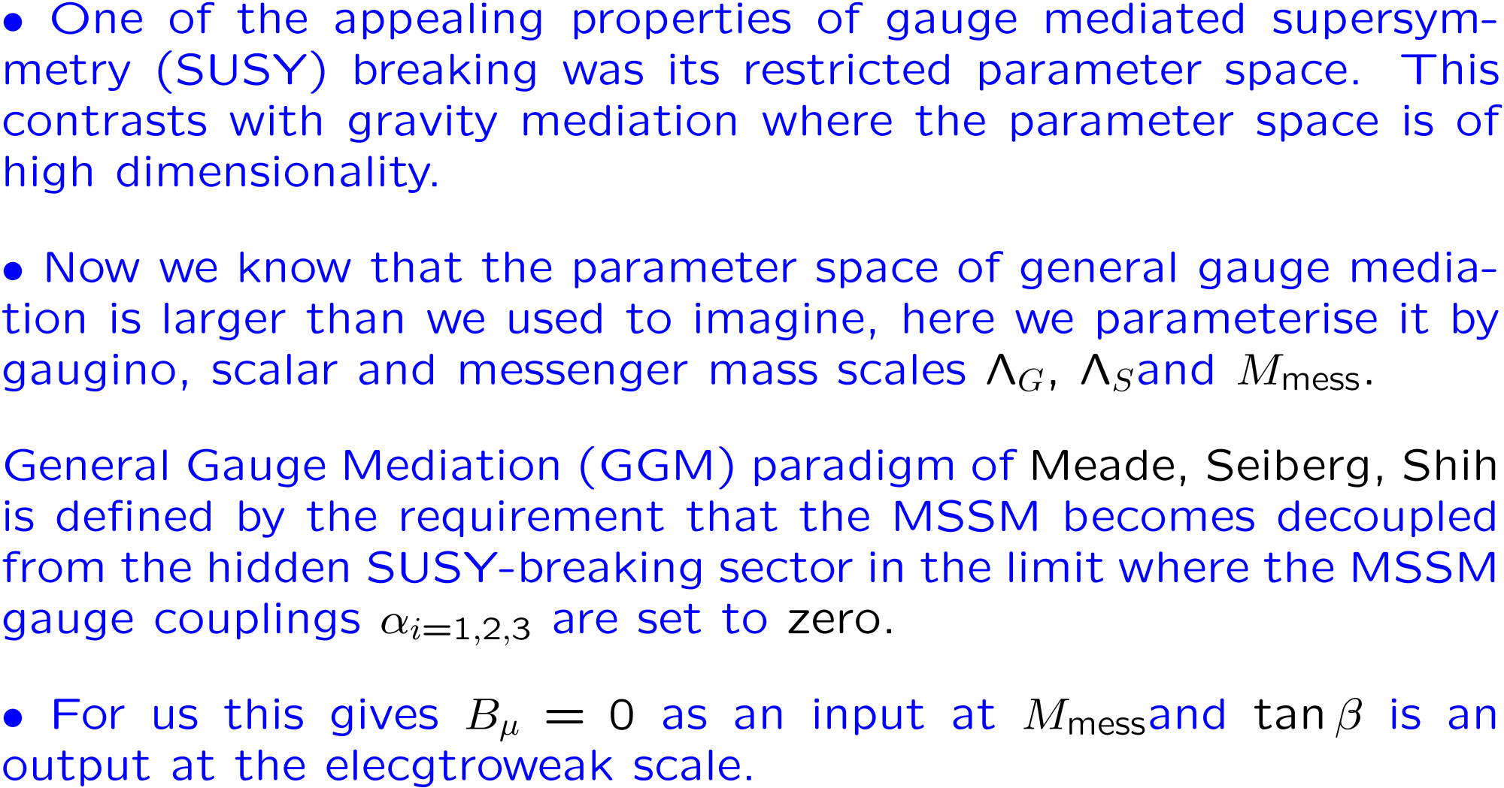
GGM SUSY breaking
1. LHC applications 2. LHC@7TeV applications
S. Abel, M. Dolan J. Jaeckel and V.V. Khoze JHEP ArXiv 0910.2674 and 1009.1164

Slide 36
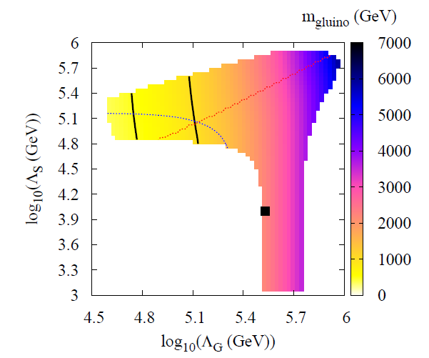
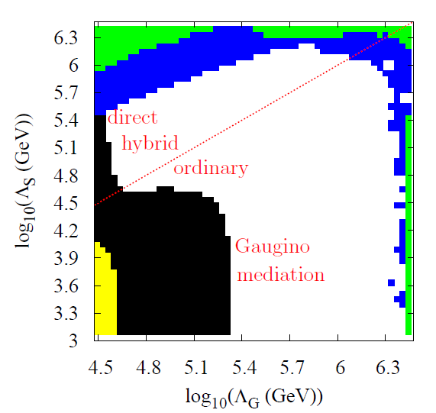
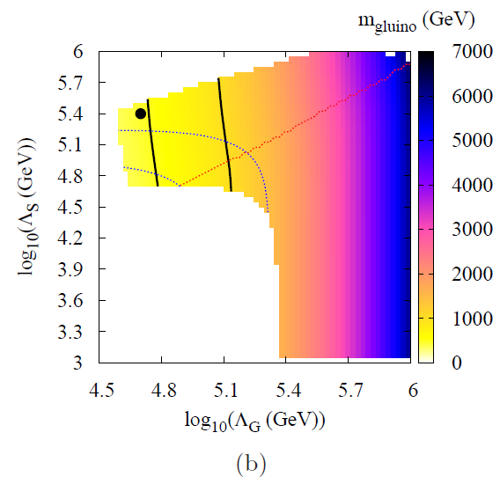
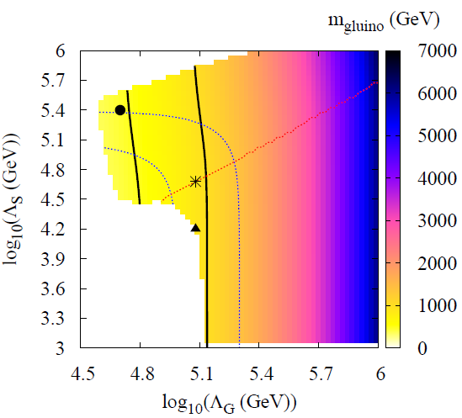
S. Abel, M. Dolan J. Jaeckel and V.V. Khoze 1009.1164
Detailed discussion of patterns
4 benchmark
points
NLSPs NNLSPs
Full spectrum
decays
cross-sections

Slide 37
Neutrino Physics
Low energy neutrino factory E. Fernandez Martinez, T. Li, S. Pascoli and O. Mena
Improvement of the low energy neutrino factory PRD 81 (2010) 073010
New setup for long baseline neutrino oscillations studies. The low energy neutrino factory uses neutrinos from low energy (~4 GeV) muon decays and searches for theta_13, CP-violation and
the type of neutrino mass hierarchy.
This new study shows that this setup is an
excellent reach comparable to the
high energy neutrino factory for CP-violation.
Values of the CP-violating phase delta for which it is possible to
establish CP-violation at 3-sigma for a given value of sin² 2 theta13.
It tells how well the experiment performs in determining CPV.
The LENF are the green line for a TASD detector and the blue region
is for a Liquid Argon magnetised detector, where the two boundaries
correspond to optimistic and conservative choices for the parameters
of the detector.

Slide 38
Neutrino Physics
Neutrino masses in BSM models Y. Farzan, S. Pascoli and M.A. Schmidt,
A Leptophilic Model Explaining Neutrino Masses and Dark Matter, arXiv:1005.5323
Dark matter (DM) nonzero neutrino masses may be the consequence of the same new extension of the Standard Model.
Need: SM sector, New (hidden) Sector and Z_2 symmetry.
lightest particle of the new sector is stable and can constitute the dark matter.
The canonical seesaw mechanism is forbidden and neutrino masses emerge at loop level.
The relevant scale can be at the electroweak scale and lead to a rich phenomenology in colliders, in lepton flavour violating rare decays and in direct and indirect dark matter searches, making the model testable in the coming future.
.

Slide 39
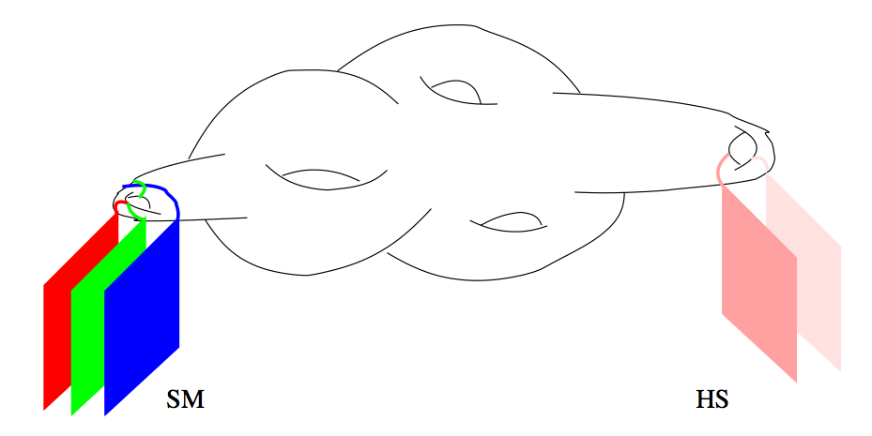
Fundamental Physics @ Low Energies @ IPPP
Good Physics Case for Axions, WIMPs and WISPs
explore `The Low Energy Frontier’
Low energy experiments can test energy scales much higher than accelerators
Complementary!
May provide information on
hidden sectors and thereby
into the underlying
fundamental theory

Slide 40
FP @ Low Energies @ IPPP
S. Abel, F. Bruemmer, J. Jaeckel, V.V. Khoze, S. Roy
Investigate possibilities to test
models of fundamental physics (e.g. string theory) @ LE
(e.g. do they predict light particles?)
(JHEP 0911:027,2009; JHEP 0906:037,2009; JHEP 0807:124,2008)
Develop and study phenomenological test models
(in the lab but also in astro and cosmo)
(arXiv:1002.0329 [hep-ph]; JCAP 0911:002,2009)
Use existing high precision measurements to obtain constraints
(1008.3536 [hep-ph]; Phys.Rev.Lett.103:080402,2009)
Suggestions for future new and improved experiments in direct collaboration with experimentalists
(1009.1519 [hep-ph]; JINST 4:P11013,2009; Phys.Lett.B659:509-514,2008)

Slide 41
NNLO Scattering Amplitudes in N=4 SYM
Recent computations at two loops for any number n of external particles in special kinematics.
A. Brandhuber, P. Heslop, V.V. Khoze, Travaglini JHEP 1001:050,2010
V. Del Duca, C. Duhr, V. Smirnov JHEP 1009:015,2010 n = 8 (special kinematics)
P. Heslop, V.V. Khoze arXiv:1007.1805 any n (special kinematics)
Dramatic simplifications of the two-loop result for planar MHV scattering amplitudes in N=4 SYM obtained via a computation of Wilson loops with polygonal contours. All polylogarithmic functions cancell and only products of logarithms remain.

Slide 42
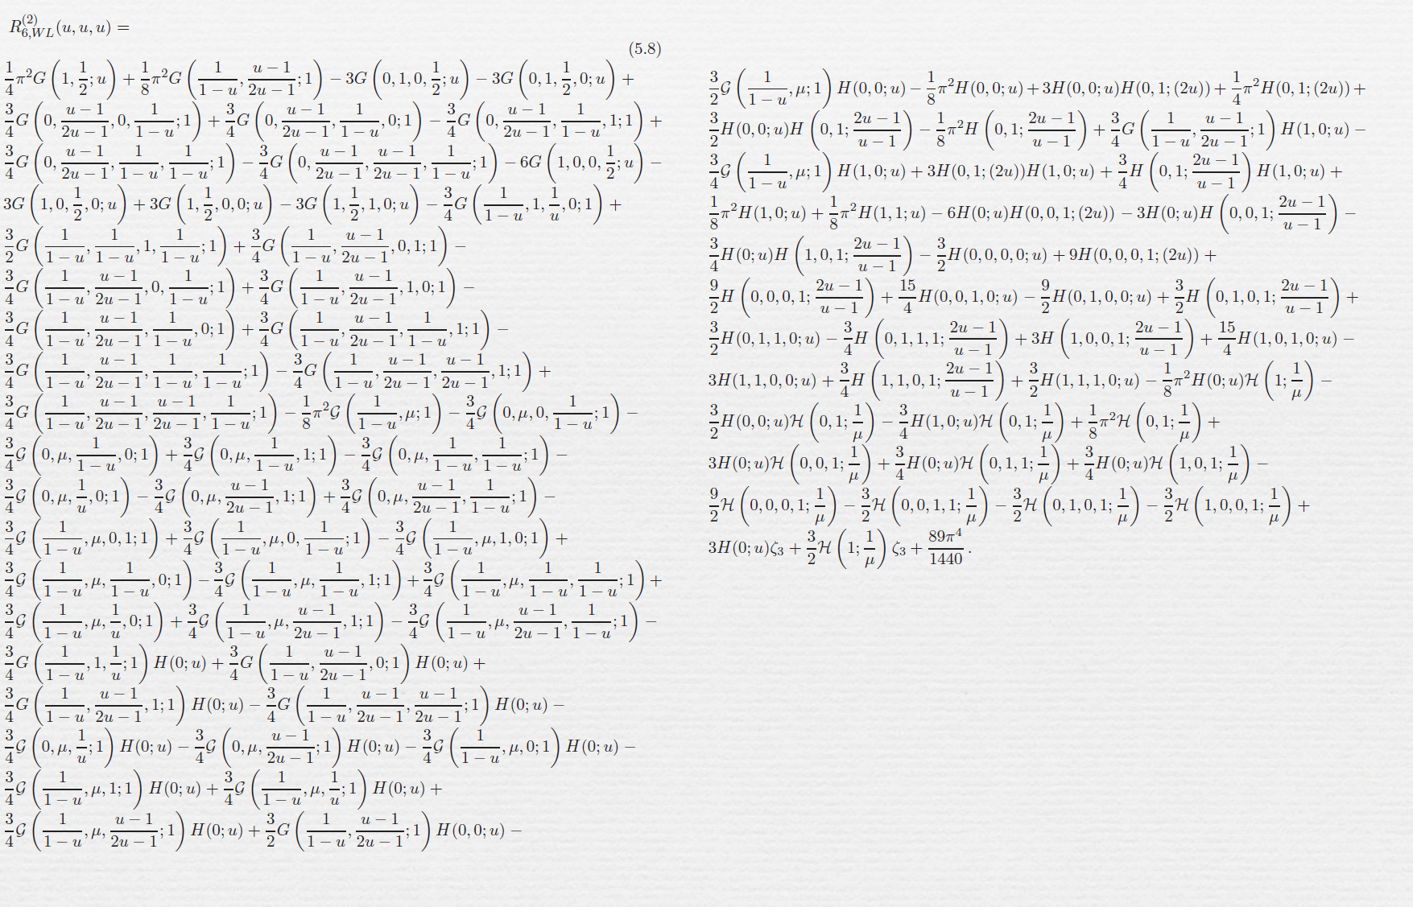
This is how the simplest 6-point 2-loop MHV amplitude in the simplified kinematics (u1=u2=u3) looked in March 2010:
more precisely Amplitude = exp [BDS +R]
And this is R (u1=u2=u3) for n=6 Del-Duca-Duhr-Smirnov JHEP 1005:084,2010
Now at n-points (in a different kinematics):

Slide 44
Hiring Strategy
Attract and retain the best people at all levels
Academic staff: currently 11 people in place + 2 + 1:
Latest Lecturer appointments: interviews held on 17.05.2009
2 positions filled and 1 position will be filled:
Standard Model field – reinforced and
Astro-Particle/Dark Matter field - new
Celine Boehm
Lecturer (1.1.2011)
Dark Matter, Astro-Particle
Thorsten Feldmann
Lecturer (1.1.2011)
Flavour Phsics
New Offer
Lecturer (1.10.2010)
Higher Orders QCD, SM

Slide 45
Hiring Strategy
Academic staff:
aim 11+ 3 + 2 (or more precisely 10 + 3 +3)
New round of Lecturer appointments
Advertise now – deadline December/January to start in 2011/12.
3 Lecturer up to Reader-level positions:
2 in Beyond-the-Standard-Model including Higgs
1 in any area of phenomenology (replacement for Patricia Ball)
After the last round: BSM area requires reinforcement
Higgs physics area requires strategic action

Slide 46
Hiring Strategy: Postdoctoral Research Staff:

Slide 47
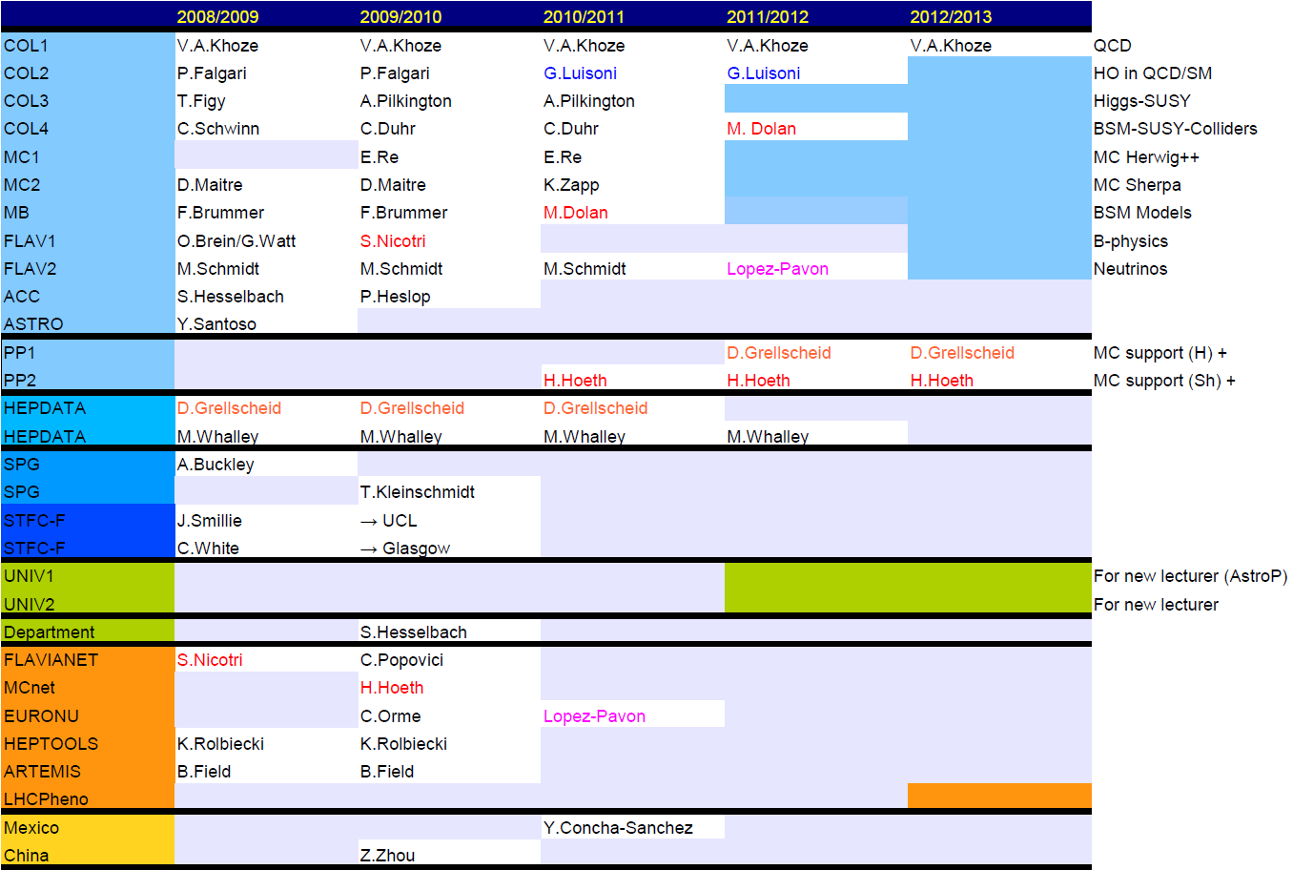
Hiring Strategy: Postdoctoral Research Staff:

Slide 48
IPPP 2010 -> Future
IPPP Members and the Steering Committee
IPPP Objectives
Responsibilities
What do we provide (IPPP Statistics)
Research Publications and Highlights
Workshops past and present
Experimental Support
Hiring Strategy
Preparing for Mid-term Review 30.09.2012
and for the next grant renewal and long-term future of IPPP

Slide 49
The LHC era
The next decade is of crucial importance for particle physics
IPPP has a key role to play

Slide 50
Extra Slides

Slide 51
Steering Com: Terms of Reference
a) To oversee the research programme of the Institute providing strategic guidance as appropriate.
b) To ensure that the Institute provides leadership and is responsive to the needs of the UK particle physics community.
c) To advise on the programme of workshops and other meetings.
d) To advise the Director on the IPPP associateship programme and the award of the Associateships.
e) To nominate new Directors for approval by the University and STFC.
f) To appoint from among its external membership a representative, normally the Chair, to serve on the University Appointment Committee for all permanent academic staff positions within the Institute's remit.
g) To report to the University and to STFC, as required, on the progress of the Institute.
h) Normally to meet twice a year, with at least one meeting at the IPPP.

Slide 52
Steering Com: Membership
a) Ex-officio: The Director and Deputy Director of the IPPP.
b) One member elected by the staff of the IPPP from among their number.
c) Normally six external members representing the UK experimental and theoretical particle physics community, with a majority representing the experimental side.
d) Normally two members representing the international experimental and theoretical particle physics community.
e) A representative of the STFC Science Programme Office in attendance.
f) One of the UK external members to act as Chair for an initial period of three years, renewable for a further three years. The choice of Chair to be approved by STFC.
g) External members to serve for three years, and to be eligible for extension for a maximum of two additional years (unless appointed as Chair)
h) New members to be decided by the Steering Committee following the STFC procedures for nominations to committees.

