Slide 1
Calorimetry at the LHC
Introduction
Overview
  Some basics
ATLAS
  Design
  Performance
CMS
  Design
  Performance
LHCb
ALICE
Summary

Slide 2

Introduction
What is a calorimeter (in HEP):
A device that absorbs (a substantial fraction of) the energy, E₀, of an incident
particle, producing a signal with amplitude ∝ E₀.
Energy is absorbed via a cascade process, producing n secondary particles, thus
⟨n⟩ ∝ E₀ and the containment depth grows only logarithmically: L_{C}(E₀) ∝ log(E₀).
In the limiting case that the energy resolution is dominated by
fluctuations on the detected signal:
Thus the relative energy resolution improves with increasing energy.
The combination of logarithmic scaling in size and improving relative energy
resolution with increasing energy makes calorimetry particularly powerful in
experiments at the energy frontier.
Calorimetry is essential for measuring neutral particles and E_{T}.

Slide 3
Challenges of calorimetry at LHC
For the general purpose detectors:
High rate capability (25 ns bunch spacing)
Fine granularity (minimize ‘pile-up’ and optimize isolation cuts)
Good energy resolution, especially at high energy (search for narrow resonances)
Hermetic and uniform coverage down to small angles wrt the beam
Long term stability
Strong resistance to radiation damage
Use of technologies lending themselves to industrial-scale construction
Affordable cost
In practice, the above requirements may impose conflicting constraints, resulting in
compromises.
For example, very high electromagnetic energy resolution and very high hadronic resolution
are in general incompatible.

Slide 4
Hadron calorimetry basics
The absorber depth required to contain hadron showers is ≈10λ_{Ι} (150 cm for Cu).
Several processes contribute to hadron energy dissipation, eg in Pb:
Thus in general, the hadronic component of a
hadron shower produces a smaller signal than
the em component: e/h > 1
F_{π°} ~ 1/3 at low energies, increasing with energy
F_{π°} ~ a log(E)
(since em component ‘freezes out’)
Nuclear break-up (invisible) 42%
Charged particle ionisation 43%
Neutrons with T_{N} ~ 1 MeV 12%
Photons with E_{γ} ~ 1 MeV 3%
If e/h ≠ 1 : - response with energy is non-linear
- fluctuations on F_{π°} contribute to σ_{E} /E
Furthermore, since the fluctuations are non-Gaussian, σ_{E} /E scales more weakly than 1/√ E
“Compensating” calorimeters improve hadronic energy resolution by using design strategies to achieve e/h ~ 1. E.g. the ZEUS ²³⁸U/scintillator sampling calorimeter. However, such designs give only modest e/γ resolution. Neither ATLAS nor CMS have chosen this approach: For ATLAS: e/h ~ 1.3
For CMS: e/h ~ 1.4 for HCAL and e ~1.6 for ECAL

Slide 5
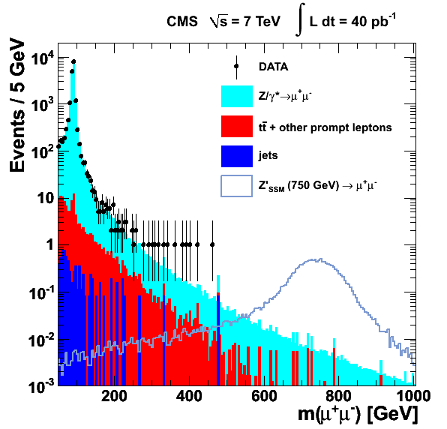
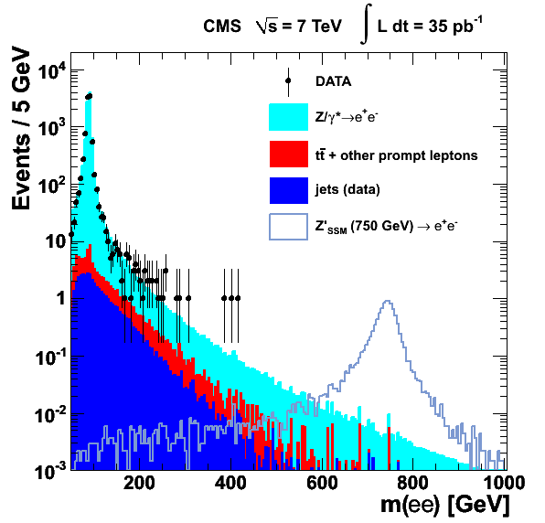
The power of calorimetry (1)
Search for resonances in dilepton mass distributions
fwhm ≈ 130 GeV
fwhm ≈ 43 GeV

Slide 6
The power of calorimetry (2)
Search for resonances in dijet mass distributions
Simulation of dijet mass distributions from a narrow 1.2 TeV resonance, for 3 different combinations of jet type.

Slide 7
The ATLAS calorimeter
Pseudorapidity coverage |η| < 4.9
No azimuthal cracks/discontinuities
em calorimeters:
Barrel |η| < 1.475
Endcaps 1.475 < |η| < 3.2
Lead/liquid argon sampling
‘accordion’ structure
hadron calorimeters:
Central region |η| < 1.7
iron/scintillator tiles
Endcaps 1.5 < |η| < 3.2
copper/liquid argon sampling
flat-plate absorber
Forward calorimeters:
(combined ECAL/HCAL)
3.1 < |η| < 4.9
copper/liquid argon (em section)
tungsten/liquid argon (hadron section)
with tubular copper electrode structure
Main features:
Fine transverse granularity with up to 7 segments in depth
(~ 190 000 readout channels).
Allows measurement of em and hadronic shower shapes.
Barrel ECAL is behind the coil of the central s/c solenoid, within the magnet cryostat.
Non-compensating: e/π signal ratio is ~1.3.

Slide 8
Liquid argon accordion calorimeter
Triangular current pulse
Signal after bipolar shaping
Sampling at 25 ns intervals
Motivation for emphasis on LAr/sampling calorimetry:
Intrinsic linearity
Stability over time
Radiation tolerance
Fine segmentation (transverse/depth)
Fast bipolar shaping overcomes the potential
disadvantage of long drift time (450 ns in the barrel)
0 200 400 600 Time (ns)

Slide 9
ATLAS LAr test beam performance(1)
Relative energy resolution for electrons
σ_{E}/E
E_{beam} (GeV)

Slide 10
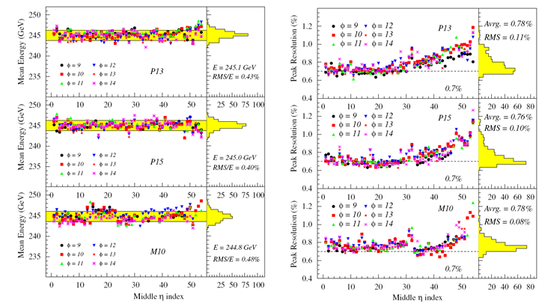
ATLAS LAr test beam performance(2)
250
250
1.2
240
0.8
0.7%
250
1.2
Mean Energy (GeV)
Peak Resolution (%)
240
0.8
RMS/E = 0.40%
Mean = 0.76%
250
1.2
240
0.8
Middle η index
Mean energy response (left) and relative peak energy resolution (right) at 245 GeV, for specific η locations in three Barrel modules, as a function of the middle cell η index.

Slide 11
ATLAS electron performance
|σ_{data}| = 1.73 ± 0.08 GeV
|σ_{MC}| = 1.49 ± 0.02 GeV
J/ψ → ee
|η_{ee}| < 2.47
Z → ee
|σ_{data}| = 2.96 ± 0.1 GeV
|σ_{MC}| = 2.32 ± 0.03 GeV
|η_{e1}| < 2.47
2.47 < |η_{e2}| < 4.9
Excellent resolution (1.9% @ Z) and linearity down to very low p_{T}
Z → ee

Slide 12
ATLAS jet energy resolution
σ(E_{T}) = 0.48√ΣE_{T}
- Jet momentum resolution measured in situ
with dijets using bisector technique
- Advanced calibrations improve resolution
by 10-30%
- Monte Carlo agrees with data within 10%
σ(p_{T})/p_{T}
The Global Cell Weighting (GCW) uses cell weights based on the cell energy density to compensate for the different calorimeter response to hadronic (low energy density) and electromagnetic energy depositions.
Diff % (Data-MC)
(p_{T1} + p_{T2} /2 (GeV)

Slide 13
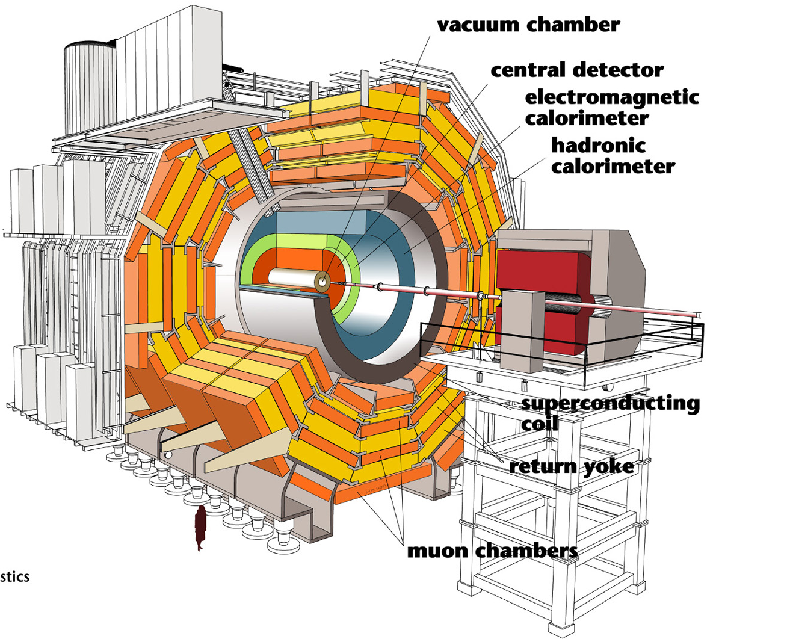
CMS cut-away view

Slide 14
The CMS calorimeters
CMS Calorimeter (ECAL+HCAL) is hermetic: Depth > 10 λ at all η, no projective gaps
HCAL HB: 0.0 < |η| < 1.4 Brass Absorber (50 mm) + Scintillator tiles (3.7 mm) Photodetector - HPD
HE: 1.3 < |η| < 3.0 Brass Absorber (80 mm) + Scintillator tiles (3.7 mm) Photodetector – HPD
HO: 0.0 < |η| < 1.3 Scintillator tiles (10 mm) Outside of solenoid Photodetector – HPD
HF: 2.9 < |η| < 5.2 Iron Absorber + Quartz fibres Photodetector – PMT

Slide 15
CMS HCAL Barrel
HPD
Light produced in the scintillators is captured in wavelength shifting fibres and transported through clear fibres to Hybrid Photo Detectors (HPD)
Splice
WLS fibre
Mirror
Optical cable
Inspecting scintillator tiles
Clear fibre
Tile
Half of the HCAL barrel being inserted in the solenoid
End view of the HCAL during construction

Slide 16
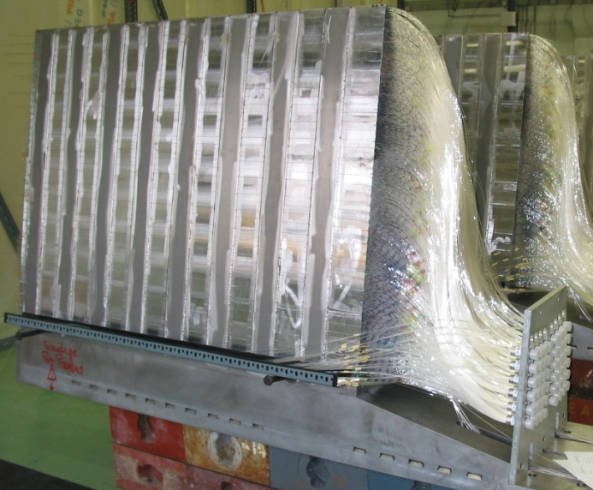
CMS HCAL endcap & forward sections
Workers in Murmansk with brass from decommissioned shells of the Russian Northern Fleet
A forward HCAL wedge during assembly, showing quartz fibres bundles
Two sets of fibres, read out separately.
Half run full depth of the absorber (165 cm ≈10λ_{I}).
Half start at depth of 22 cm.
Thus possible to distinguish between:
- e/γ showers
(most of energy in first 22 cm)
- hadron showers
(equal signals in both sections).
A partially assembled HCAL endcap mounted on a magnet pole piece

Slide 17
The CMS ECAL
Lead tungstate
(X₀ = 0.89 cm, R_{M} = 2.1 cm)
~ 11 m³, 90 t
ECAL
Preshower: 1.65 < |η| < 2.6
(Improved π⁰/γ discrimination)
2 orthogonal planes of Si strips
Behind 2 X₀ and 1 X₀ Pb resp.
Strip pitch: 1.9 mm (63 mm long)
1.4x10⁵ channels
Barrel: |η| < 1.48
36 Super Modules
61200 crystals (2 x 2 x 23 cm³)
Photodetector: APD
Endcaps: 1.48 < |η| < 3.0
4 Dees
14648 crystals (3 x 3 x 22 cm³)
Photodetector: VPT

Slide 18
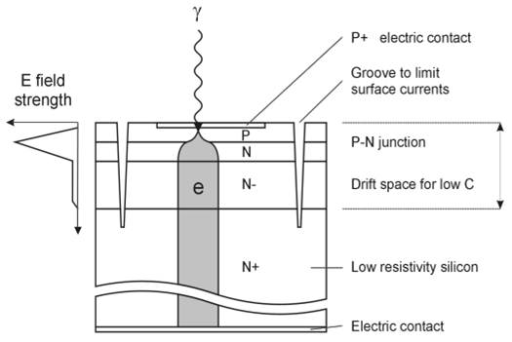
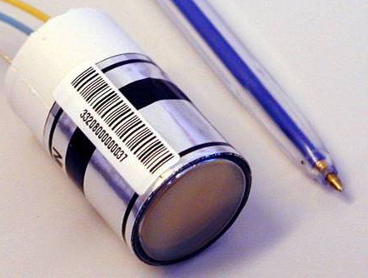
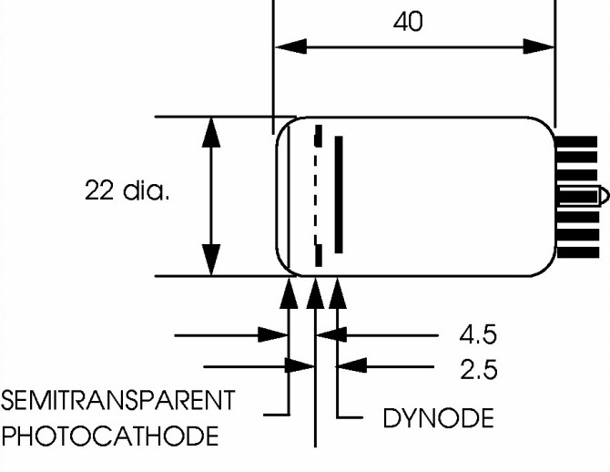
The CMS ECAL photodetectors
Half barrel of 18 supermodules installed in CMS
Montage of 2 half-endcaps without front covers
φ = 26.5 mm
d_{eff} ~6μm
40μm
MESH ANODE
Barrel: Avalanche photodiodes (APD)
Two 5 x 5 mm² APDs/crystal
Gain: 50 QE: ~75% @ λ_{peak}= 420 nm
Temperature dependence: - 2.4 %/ºC
Endcaps: Vacuum phototriodes (VPT)
Radiation-resistant UV glass window)
- Active area ~ 280 mm²
Gain ~10 (B=4T) Q.E.~ 20% (420 nm)

Slide 19
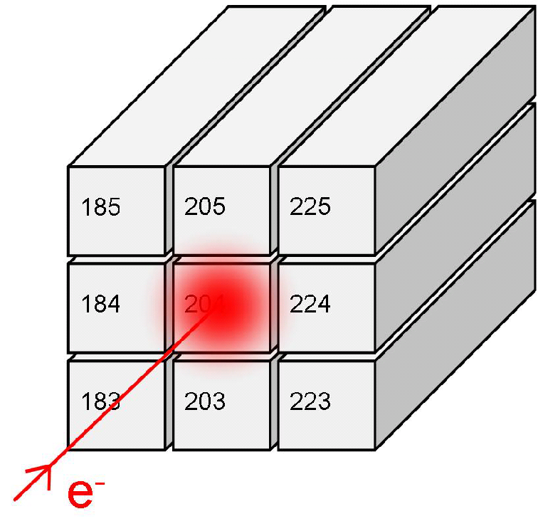
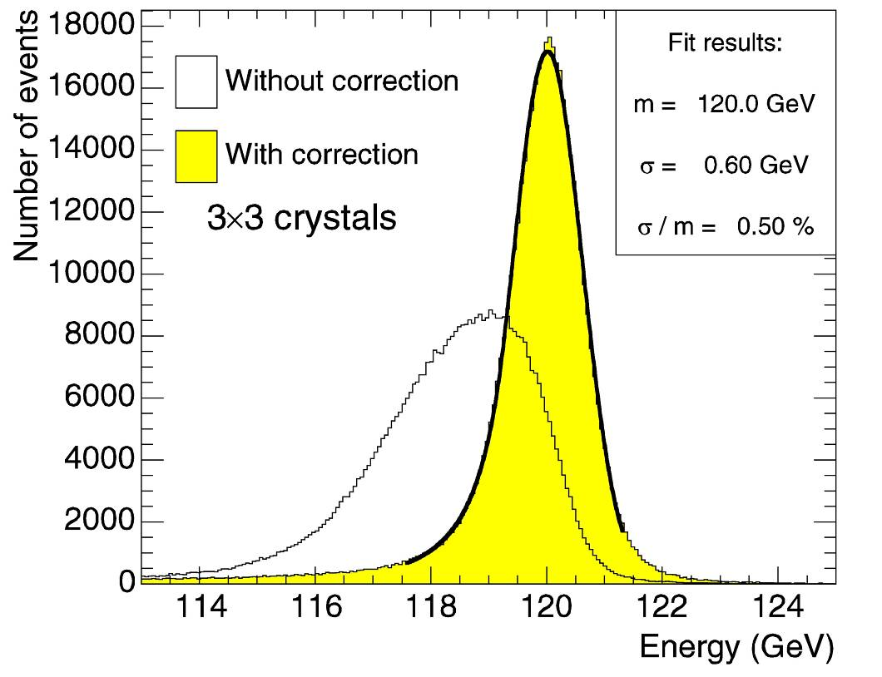
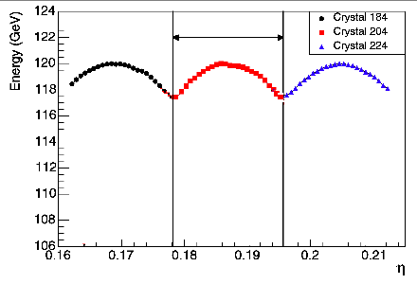
CMS ECAL test beam performance
22 mm
(3 x 3) around Crystal 184
(3 x 3) around Crystal 204
(3 x 3) around Crystal 224
Resolution goal
of 0.5%
at high energy
achieved
4x4 mm² central region
position (η )
Response correction with information
from crystals alone(works for γ)

Slide 20
CMS ECAL performance at LHC
Invariant mass distributions for
Z → ee in barrel
Top:
Full sample.
Bottom:
non-showering/
non-showering
(low-bremss.)
Fit with BW for Z
+ CB function.
σ_{CB} ~ 1 GeV
for NS/NS.
Indicative of expected mass resolution for low mass H → γγ
(unconverted γ)
Barrel
σ_{CB} = 1.70±0.09 GeV
Endcaps
σ_{CB} = 0.99±0.19 GeV
Crystal inter-calibration precision from weighted mean of pre-calibrations: (test beam + lab LY/gain + cosmic rays), + in situ: ‘φ-symmetry’, beam-dump muons, and π⁰/η → γγ

Slide 21
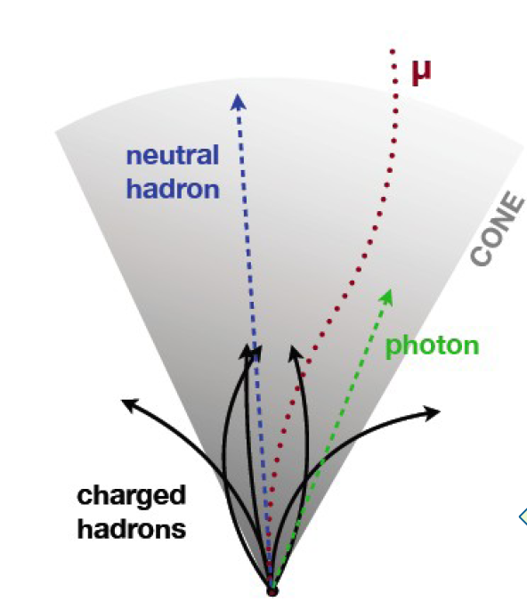
Particle flow calorimetry in CMS
CMS has:
a strong magnetic field (3.8 T)
excellent tracking resolution
ECAL with excellent energy resolution
and fine transverse granularity (R_{M} = 2.1 cm)
~ 10%
Energy distribution in typical jet
~ 25%
Therefore measure:
charged particles in Tracker
photons in ECAL
neutral particles in HCAL
~ 65%
Charged hadrons~ 65%
Photons~ 25%
Neutral hadrons~ 10%

Slide 22
Missing E_{T} measurement in CMS
Particle flow
Calorimeter
Calorimeter
Particle flow

Slide 23
CMS: Jet transverse momentum resolution
● Dijet Asymmetry
 Photon + Jet
Calorimeter
Calorimeter + tracks
Particle flow

Slide 24
The LHCb Calorimeters
Four sub-detectors:
ECAL
HCAL
Scintillator Pad Detector SPD
Preshower PS
Solid angle coverage 300x250 mrad
Fast trigger on energetic e/γ/πº/η
ECAL
HCAL

Slide 25
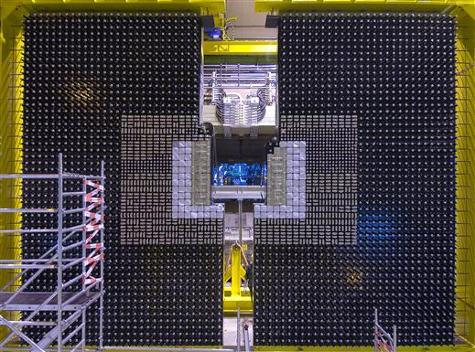
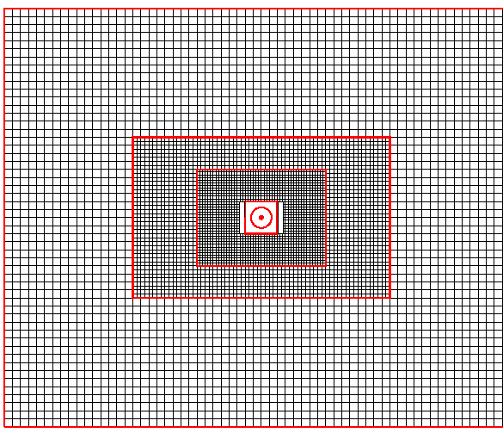
The LHCb ECAL
The shashlik wall during assembly, looking upstream
Subdivision into inner, middle and outer modules
3312 modules: ~12 x 12 cm²
9/4/1 cells/module → 6016 channels
630 cm
776 cm
Inner shashlik module with
9 cells
432 mm (25 X₀)
phototube
66 times
WLS fibres
Volume ratio Pb:Sc = 2:4
Moliere radius: 3.5 cm
Scintillator
Lead

Slide 26
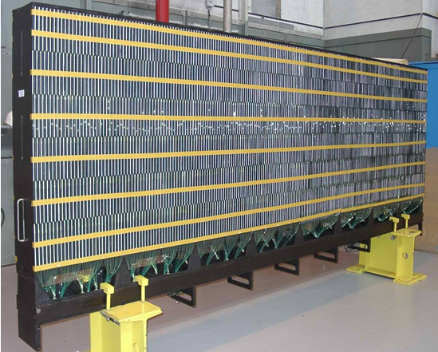
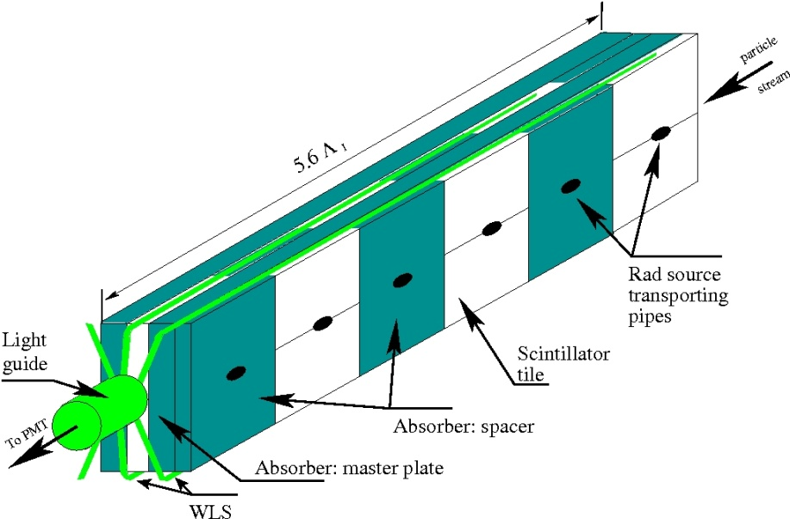
The LHCb HCAL
Mostly used for triggering
One quadrant
Inner/Outer sections
Cell size: ~13x13 cm² / 26x26 cm²
1488 Channels
Particle direction
26x2 Large horizontal modules
Same design as ATLAS TileCal:
- interleaved Sc tiles / Fe plates
parallel to beam axis
Volume ratio Fe:Sc = 5.58:1
Energy resolution (beam tests): σ_{E}/E = (69±5)%/√E ⊕ (9±2)%
5.6λ
Calibration-source pipes
Light guide
Scintillator tile
Absorber: spacer
Absorber: master plate
To PMT
WLS fibre

Slide 27
LHCb Calorimeter performance
HCAL
Inner section
ECAL energy resolution with electron test beam
HCAL
Outer section
Reconstructed π⁰/η → γγ

Slide 28
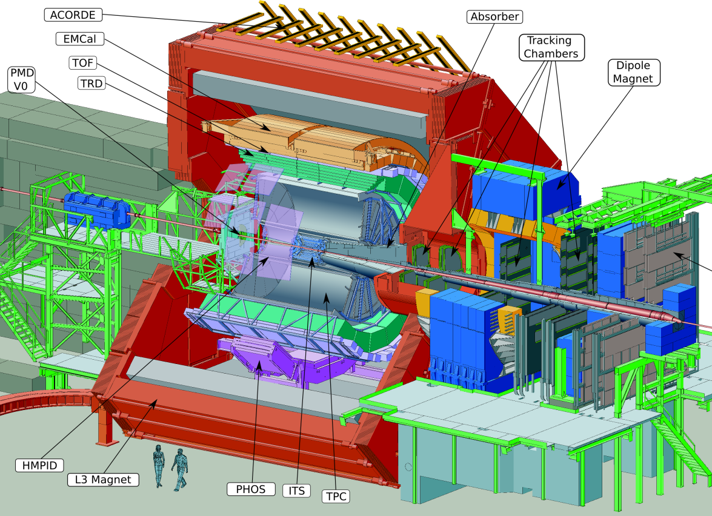
The ALICE Calorimeters
Two electromagnetic calorimeters
with complementary roles
EMCal
Illustration of photon-jet physics in ALICE using the TPC for charged particle tracking, and the PHOS and EMCAL to measure photons and jets respectively
PHOS
EMCal
PHOS

Slide 29
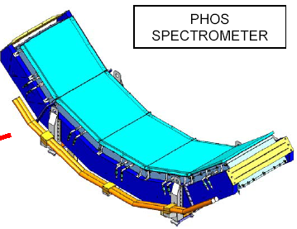
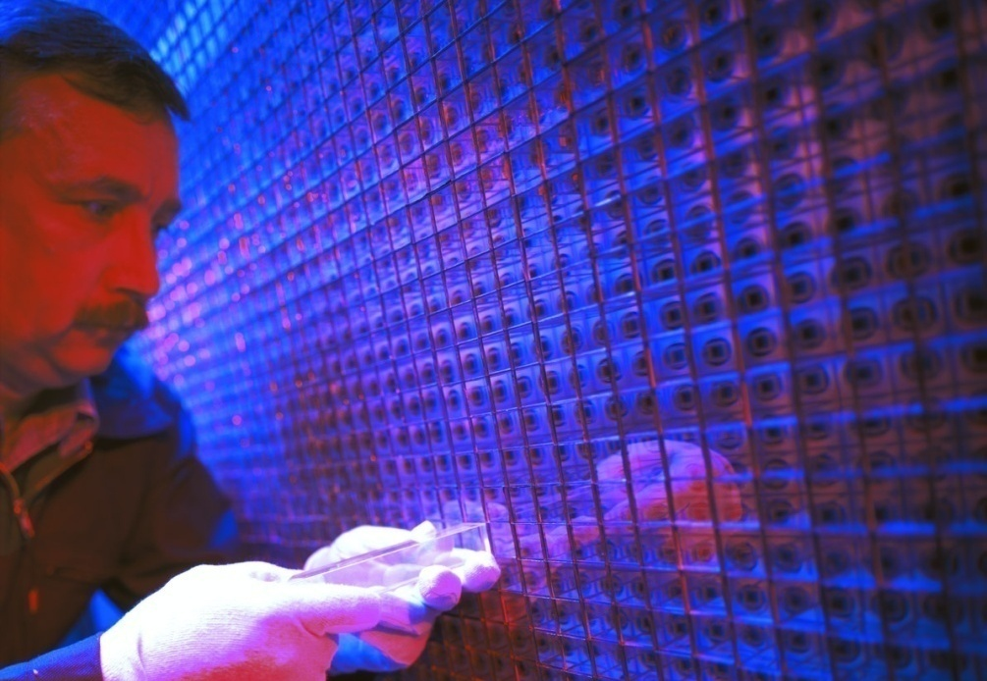
ALICE PHOS (Photon Spectrometer)
PHOS designed to measure:
light mesons
thermal radiated photons
direct photons recoiling against jets
(together with EMCal and TPC)
Requires:
good σ_{E}/E at few hundreds of MeV
(Thermal photons (1 < Eγ < 10 GeV)
fine granularity
(demanding heavy ion environment)
→ PbWO₄ crystals + APDs
(operated at -25^{O}C to increase LY by 3x)
Full PHOS:
- 100^{O} in φ,
- 0.13 < η < +0.13).
- 5 identical modules, of 56 x 64 crystals
(17920 crystals in total),
- dimensions 22 x 22 x 180 mm³
- APD (5 x 5 mm²) covers 5% of rear face.
Currently installed:
- 3 modules (260^{O} < φ < 320^{O})

Slide 30
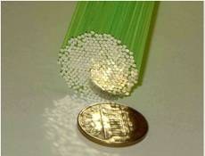
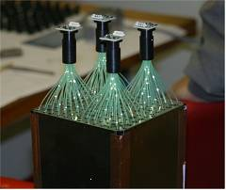
ALICE EMCal
EMCal designed to measure:
em showers up to 250 GeV
jets up to 200 GeV
(together with theTPC)
→ Shashlik modules + APDs
77 layers: Pb (1.4 mm) / Sc (1.7 mm)
(24.6 cm / 20.1 X₀, R_{M} = 3.2 cm)
4 Towers/module – each 6x 6 cm²
5 x 5 mm² APD, gain =30
Full EMCal:
- 10 full supermodules of 24 x 48 Towers
- 2 1/3-size supermodules of 8 x 48 Towers
→12 288 towers total
428 cm from beam (0.8 X₀ in front)
Total coverage: 107^{O} in φ, |η| < 0.7
4 SM installed for 2010 run
EMCal completed in 2010/11 shutdown

Slide 31
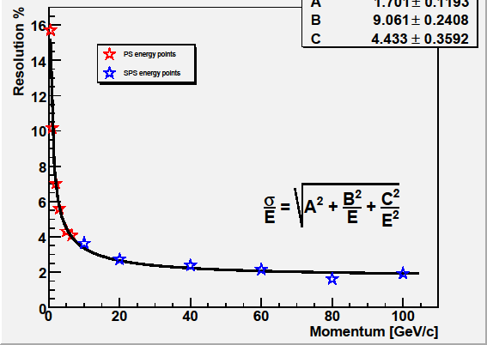
ALICE EMCal & PHOS performance
Energy resolution in test beam
γγ invariant mass – 2010 LHC run
m₀ = 135.2 MeV
σ = 6.4 MeV
PHOS
PHOS
p_{T} > 6 GeV/c
m₀ = 135.3 MeV
σ = 9.5 MeV
EMCal
EMCal
5 < p_{T} < 6 GeV/c

Slide 32
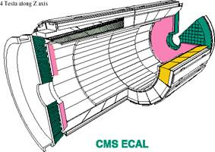

Summary
The design and construction of the calorimeters for the LHC experiments
have posed challenges on an unprecedented scale.
Overcoming these challenges required extensive R&D programmes,
leading to important detector innovations.
A variety of technologies have been chosen by the four main experiments,
tailored to meet particular physics needs.
All the detectors have been implemented successfully and have met,
or are close to, meeting their design goals.
Now for the discoveries!
STFC
RAL

Slide 33
Spares

Slide 34
Anomalous APD signals

Slide 35
Electron energy resolution

Slide 36
CMS Tracker material budget
Material budget in units of radiation length as a function of pseudorapidity η for the
different sub-detectors (left) and broken down into the functional contributions (right).

Slide 37
ATLAS Inner Detector material budget
Material distribution (X₀, λ) at the exit of the ID envelope, including the services and thermal enclosures. The distribution is shown as a function of |η| and averaged over φ. The breakdown indicates the contributions of external services and of individual sub-detectors, including services in their active volume.

Slide 38
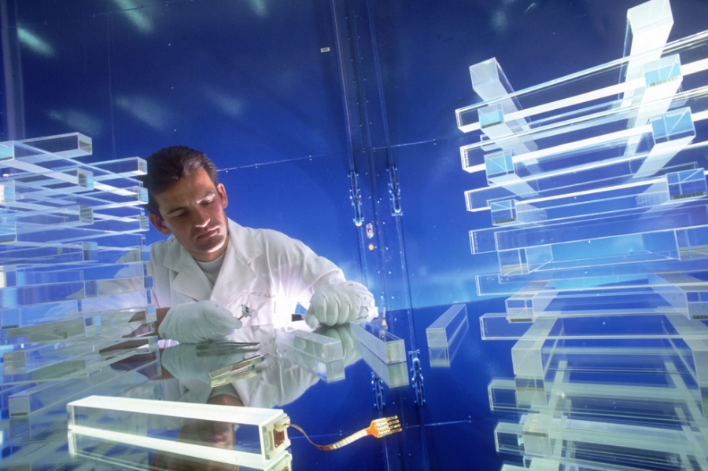
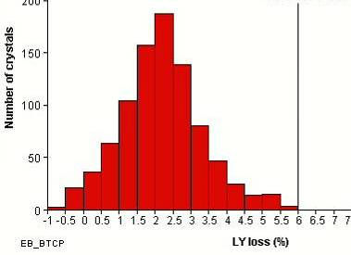
Lead tungstate properties
Fast light emission: ~80% in 25 ns
Peak emission ~425 nm (visible region)
Short radiation length: X₀ = 0.89 cm
Small Molière radius: R_{M} = 2.10 cm
Radiation resistant to very high doses
Light loss is characterised by
‘induced absorption’
8
0
Dynamic equilibrium between formation/annealing
of colour centres under irradiation at room temp
→ Light loss depends on dose-rate
CMS specification requires: μ₄₂₀ < 1.5 m⁻¹
(Under uniform (lateral) ⁶⁰Co irradiation at > 30 Gy/hr)
Under LHC-like conditions for the Barrel (~ 0.15 Gy/hr)
→ Light yield loss ≾ 6%
7
0
6
0
T(%)
5
0
- emission
4
0
3
0
i
n
i
t
i
a
l
2
0
a
f
t
e
r
i
r
r
a
d
i
a
t
i
o
n
1
0
0
3
0
0
3
5
0
4
0
0
4
5
0
5
0
0
5
5
0
6
0
0
6
5
0
7
0
0
w
a
v
e
l
e
n
g
t
h
(
n
m
)
Temp dependence ~2.2%/^{O}C
Stabilise to ≤ 0.05^{O}C
Low light yield (1.3% NaI)
Photodetectors with
gain in magnetic field
ΔT
Power-on/
Power-off
0 5
Light Yield Loss (%)

Slide 39
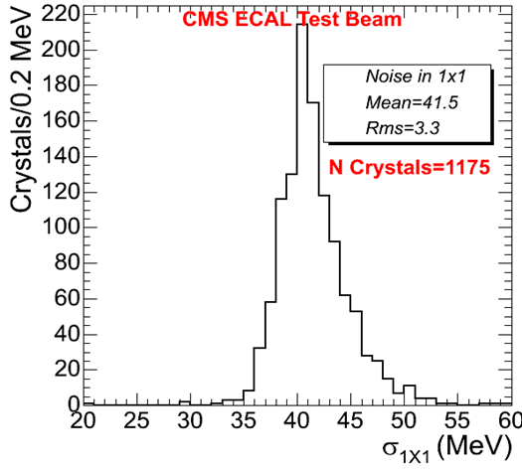
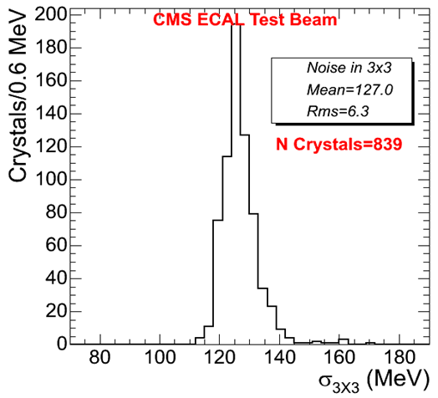
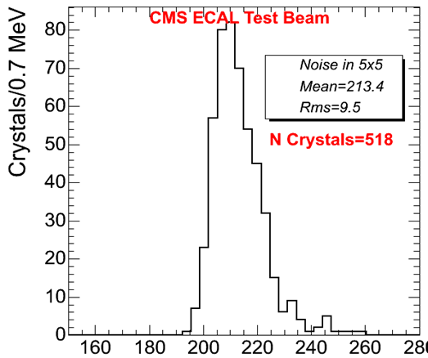
On-detector electronics
Front End card
(FE)
VFE x 5
Noise measured
in Test Beam
With dynamic
pedestal sampling:
Cluster noise
scales as √n for
clusters summed
over n channels
Mean = 41.5 MeV
Σ1x1
FE
Trigger
Sums
Data
MB
Trigger Tower (TT)
Very Front End card (VFE)
Trigger primitives computed on the detector
Command & control via token ring
Modularity: Trigger Tower (25 channels in Barrel)
5 VFE Boards (5 channels each) / 1 FE Board
1 Fibre sends trig primitives (every bunch Xing)
1 Fibre sends data (on Level1 accept)
LVR
Mean = 127 MeV
Σ 3x3
Σ 5x5
HV
x12
2
12 bits
Mean = 213 MeV
1
Logic
x6
12 bit ADC
0
2 bits
MGPA
x1
APD/VPT
VFE architecture for single channel
Energy Equivalence (MeV)

Slide 40
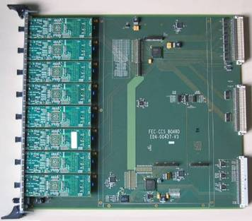
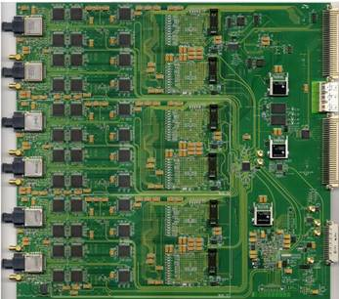
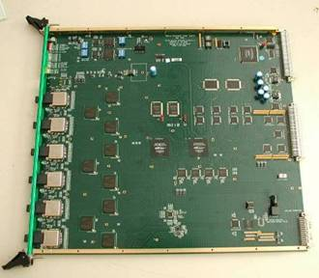
Off-Detector electronics
Clock & Control System (CCS)
Trigger Concentrator Card (TCC)
Data Concentrator Card (DCC)

Slide 41
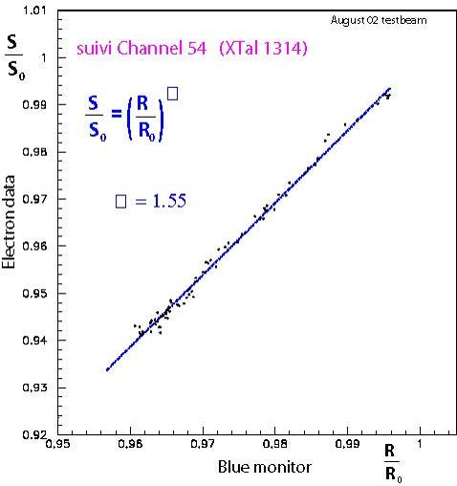
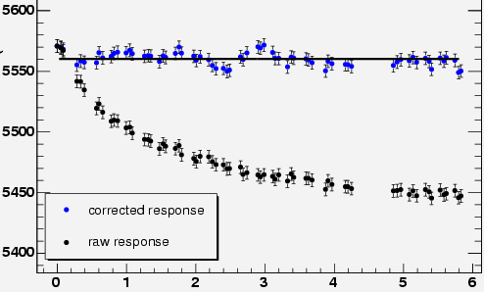
Laser light monitoring
During LHC cycles the ECAL response will vary, depending on irradiation conditions
Changes in crystal transparency will be monitored with a laser allowing the ECAL response to be corrected
Simulation of crystal
transparency evolution
at LHC (L = 2 x 10³³cm⁻²s⁻¹)
- based on test beam
irradiation results
Electron signal (test beam)
440 nm
796 nm
Laser signal
Test beam data
ADC
Laser light is injected into each crystal through
optical fibres (normalised with PN diodes to 0.1 %)
Blue light tracks response, infrared provides a check
The laser is pulsed during the LHC ‘abort gap’
An optical switch directs light to one
half-supermodule or one quarter-Dee in turn
A complete monitoring cycle takes ~ 20 minutes
χ²/ndf =73.9/68
Corrected response
Raw response
Time (hours)

