Slide 1
Parton Distribution Functions
James Stirling
Cambridge University
introduction and overview
current status of pdf determinatons
impact on and of LHC measurements
summary - issues and outlook
including work in collaboration with
Alan Martin, Robert Thorne and Graeme Watt

Slide 2
1
introduction and overview

Slide 3
parton distribution functions
introduced by Feynman (1969) in the parton model, to explain Bjorken scaling in deep inelastic scattering data; interpretation as probability distributions
according to the QCD factorisation theorem for inclusive hard scattering processes, universal distributions containing long-distance structure of hadrons; related to parton model distributions at leading order, but with logarithmic scaling violations (DGLAP)
key ingredients for Tevatron and LHC phenomenology

Slide 4
for example, in Deep Inelastic Scattering
Q²
C
y,μ²
where the scale dependence of the parton distributions is calculable in QCD perturbation theory
f_{i/p}
Dokshitzer
Gribov
Lipatov
Altarelli
Parisi
… and f_{i}(x,μ₀²) determined from
lattice QCD (in principle)
fits to data (in practice)

Slide 5
how pdfs are obtained*
choose a factorisation scheme (e.g. MS), an order in perturbation theory (LO, NLO, NNLO) and a ‘starting scale’ Q₀ where pQCD applies (e.g. 1-2 GeV)
parametrise the quark and gluon distributions at Q_{0,}, e.g.
solve DGLAP equations to obtain the pdfs at any x and scale Q > Q₀ ; fit data for parameters {A_{i},a_{i}, …α_{S}}
approximate the exact solutions (e.g. interpolation grids, expansions in polynomials etc) for ease of use; thus the output ‘global fits’ are available ‘off the shelf”, e.g.
SUBROUTINE PDF(X,Q,U,UBAR,D,DBAR,…,BBAR,GLU)
input | output
*traditional method

Slide 7
2
current status of pdf determinations

Slide 8
the pdf industry
many groups now extracting pdfs from ‘global’ data analyses (MSTW, CTEQ, NNPDF, HERAPDF, …)
broad agreement, but differences due to
choice of data sets (including cuts and corrections)
treatment of data errors
definition of ‘best fit’ and ‘uncertainty’
treatment of heavy quarks (s,c,b)
order of perturbation theory
parameterisation at Q₀
theoretical assumptions (if any) about:
flavour symmetries
x→0,1 behaviour
…
HERA-DIS
FT-DIS
Drell-Yan
Tevatron jets
Tevatron W,Z
other

Slide 9
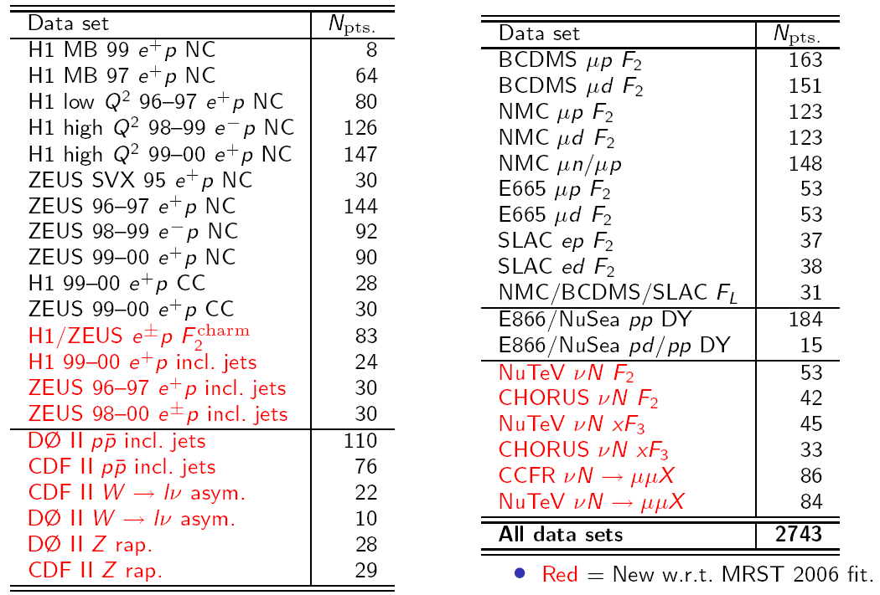
examples of data sets used in fits*
red font = new wrt MRST2006 fit
*MSTW2008

Slide 10
recent global or quasi-global pdf fits
pdfs | authors | arXiv
ABKM | S. Alekhin, J. Blümlein, S. Klein, S. Moch, and others | 1105.5349, 1104.0469, 1101.5261, 1007.3657, …
CTEQ | H.-L. Lai, M. Guzzi, J. Huston, Z. Li, P. Nadolsky, J. Pumplin, C.-P. Yuan, and others | 1007.2241, 1004.4624, 0910.4183, 0904.2424, 0802.0007, …
GJR | M. Glück, P. Jimenez-Delgado, E. Reya, and others | 1006.5890, 0909.1711, 0810.4274, …
HERAPDF | H1 and ZEUS collaborations (A.M. Cooper-Sarkar et al.) | 1006.4471, 0906.1108, …
MSTW | A.D. Martin, W.J. Stirling, R.S. Thorne, G. Watt | 1006.2753, 0905.3531, 0901.0002, …
NNPDF | R. Ball, L. Del Debbio, S. Forte, A. Guffanti, J. Latorre, J. Rojo, M. Ubiali, and others | 1108.1758, 1107.2652, 1103.2369, 1101.1300, 1012.0836, 1005.0397, …

Slide 11
 | MSTW08 | CT10(W) | NNPDF2.5 | HERAPDF 1.0/1.5 | ABKM09 | GJR08
HERA DIS | ✓ | ✓ | ✓ | ✓ | ✓ | ✓
F-T DIS | ✓ | ✓ | ✓ | ✗ | ✓ | ✓
F-T DY | ✓ | ✓ | ✓ | ✗ | ✓ | ✓
TEV W,Z | ✓ | ✓ | ✓ | ✗ | ✗ | ✗
TEV jets | ✓ | ✓ | ✓ | ✗ | ✗ | ✓
GM-VFNS | ✓ | ✓ | ✓ | ✓ | ✓ | ✗
NNLO | ✓ | (✗) | ✓ | ✓ | ✓ | ✓
Note:
each set comes with its own unique α_{S}(M_{Z}²) value (and uncertainty), correlated with the pdfs
including Tevatron jet data tends to give a harder high-x gluon
CT10W gives higher weight to Tevatron W asymmetry data
CT10, NNPDF2.n, HERAPDF1.n use recent combined HERA SF data
ABKM have recent versions including various Tevatron jet sets
no publication yet for HERAPDF1.5

Slide 12
LO vs NLO vs NNLO?
in the MSTW2008 fit
3066/2598 (LO)
χ² _{global} /dof = 2543/2699 (NLO)
2480/2615 (NNLO)
LO evolution too slow at small x; NNLO fit marginally better than NLO
Note:
an important ingredient missing in the full NNLO global pdf fit is the NNLO correction to the Tevatron high E_{T} jet cross section
LO can be improved (e.g. LO*) for MCs by adding K-factors, relaxing momentum conservation, etc.

Slide 13
comparison of gluons extracted from LO, NLO, NNLO global fits
large positive P_{qg} contributions at small x lead to smaller gluons at higher order
beyond LO, clear positivity issue at small x,Q² , and this is reflected in predictions e.g. for (the physical quantity) F_{L}

Slide 14
Nadolsky, July 2011, PDF4LHC

Slide 15
dynamical partons?
... evolve perturbatively from a low starting scale: μ₀² = 0.5 GeV²
Gluck, Jimenez-Delgado, Reya, arXiv:0709.0614

Slide 16
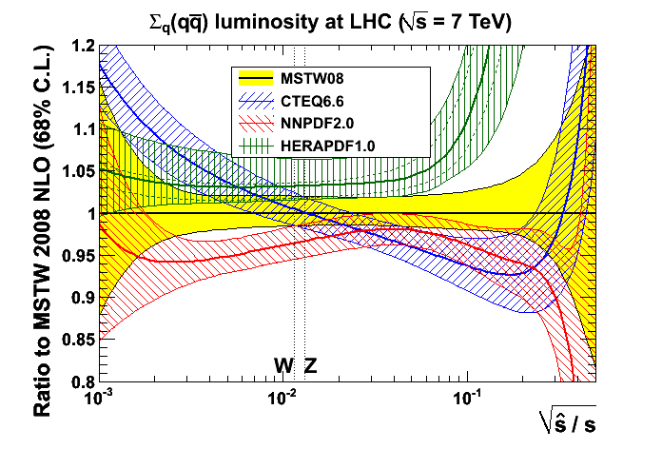
we note convergence of pdfs!
plots from Graeme Watt
2010
2011
... although still some differences with ABKM, GJR, HERAPDF

Slide 17
pdf uncertainties
all groups produce ‘pdfs with errors’
typically, 20-40 ‘error’ sets based on a ‘best fit’ set to reflect ±1σ variation of all the parameters* {A_{i},a_{i},…,α_{S}} inherent in the fit
these reflect the uncertainties on the data used in the global fit (e.g. δF₂ ≈ ±3% → δu ≈ ±3%)
however, there are also systematic pdf uncertainties reflecting theoretical assumptions/prejudices in the way the global fit is set up and performed (see earlier slide)
* e.g.

Slide 18
determination of best fit and uncertainties
MSTW08 ― 28 parameters, 20 eigenvectors. Due to slight incompatibility of different sets (and perhaps to some extent parametrisation inflexibility) use ‘dynamical tolerance’ with inflated Δχ² of 5 - 20 for eigenvectors ; also study variation with m_{c}, m_{b}, α_{S}
CT10 ― 26 eigenvectors. Inflated Δχ²~40 for 1 sigma for eigenvectors (no normalization uncertainties in CTEQ6.6, cf. CT10)
HERAPDF2.0 ― 10 eigenvectors, use Δχ²=1. Additional model and parametrisation uncertainties
ABKM09 ― 21 parton parameters, use Δχ²=1 ; also variation with m_{c}, m_{b}, α_{S}
GJR08 ― 12 varying parton parameters (out of 20). Use Δχ²=20. Impose strong theory (‘dynamical parton’) constraint on input form of pdfs.
Note: NNPDF create many replicas of data and obtain PDF replicas in each case by fitting to training set and comparing to validation set → uncertainty determined by spread of replicas. Direct relationship to χ² in global fit not trivial.

Slide 19
determination of best fit and uncertainties contd.
NNPDF and MSTW (due to extra parameters) have more complicated shape for gluon at smaller x and bigger small-x uncertainty
choice of parametrisation leads to bigger very high-x gluon uncertainty for CTEQ
different theory assumptions in strange quark pdf leads to vastly different uncertainties ― MSTW small, NNPDF large; feeds into other ‘light’ quarks
perhaps surprisingly all get rather similar uncertainties for pdfs and predicted cross sections ― see later

Slide 20
example: MSTW2008(NLO) vs. CTEQ6.6
Note:
CTEQ error bands comparable with MSTW 90%cl set (different definition of tolerance)
CTEQ light quarks and gluons slightly larger at small x because of imposition of positivity on gluon at Q₀²
CTEQ gluons slightly larger at large x - only Run 1 jet data in fit
→ implications for ‘precision’ LHC cross sections (later)

Slide 21
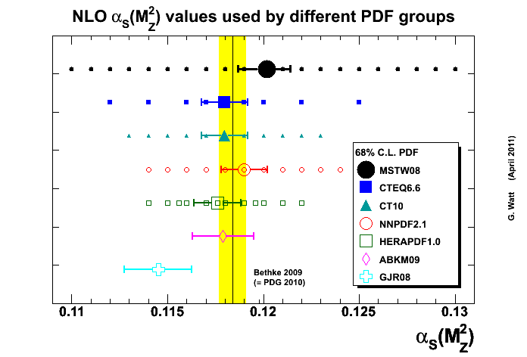
pdfs and α_{S}(M_{Z}²)
MSTW08, ABKM09 and GJR08: α_{S}(M_{Z}²) values and uncertainty determined by global fit
NNLO value about 0.003 − 0.004 lower than NLO value, e.g. for MSTW08
CTEQ, NNPDF, HERAPDF choose standard values and uncertainties
world average (PDG 2010)
note that the pdfs and α_{S} are correlated!
e.g. gluon – α_{S} anticorrelation at small x and quark – α_{S} anticorrelation at large x

Slide 22
α_{S} - pdf correlations
care needed when assessing impact of varying α_{S} on cross sections ~ (α_{S} )^{n}
MSTW: arXiv:0905.3531

Slide 23
pdf + α_{S} uncertainties in jet cross sections

Slide 24
3
impact of and on LHC cross sections
a small selection of recent ATLAS, CMS and LHCb data plots will be shown – see talks by Mario Campanelli, Greg Heath and Claire Shepherd-Themistocleous for more details

Slide 25
proton
proton
M
x₁P
x₂P
benchmarks
benchmarks

Slide 26
parton luminosity functions
a quick and easy way to assess the mass, collider energy and pdf dependence of production cross sections
a
√s X
b
i.e. all the mass and energy dependence is contained in the X-independent parton luminosity function in [ ]
useful combinations are
and also useful for assessing the uncertainty on cross sections due to uncertainties in the pdfs

Slide 27
SS
VS
more such luminosity plots available at www.hep.phy.cam.ac.uk/~wjs/plots/plots.html

Slide 29
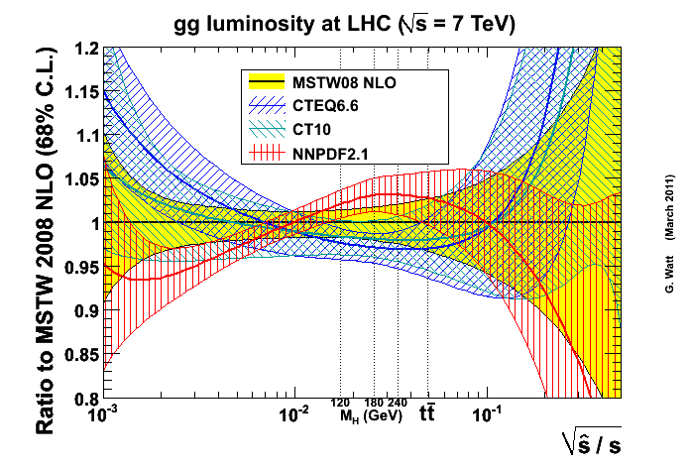
parton luminosity comparisons
positivity constraint on input gluon
Run 1 vs. Run 2 Tevatron jet data
momentum sum rule
luminosity and cross section plots from Graeme Watt, available at projects.hepforge.org/mstwpdf/pdf4lhc and discussed in arXiv:1106.5788

Slide 30
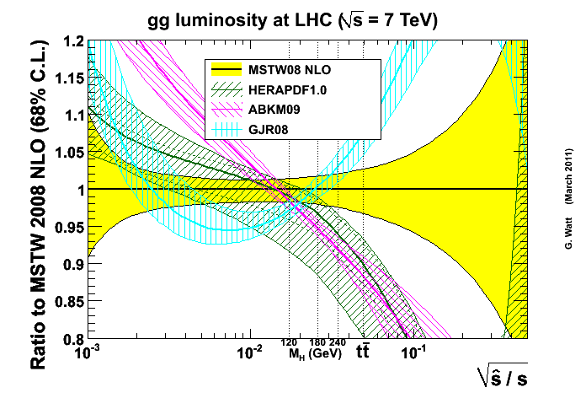
restricted parametrisation
no Tevatron jet data in fit

Slide 31
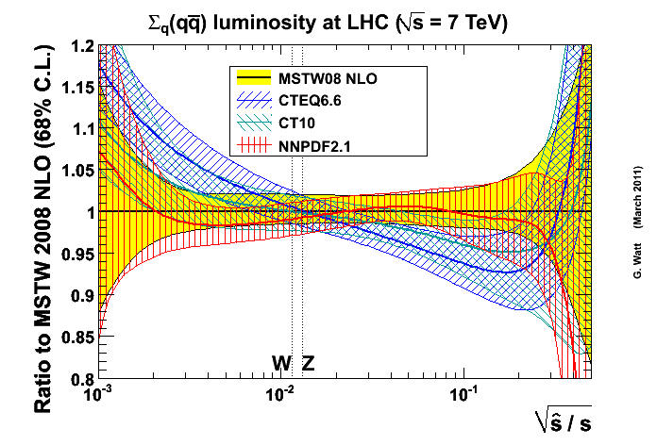
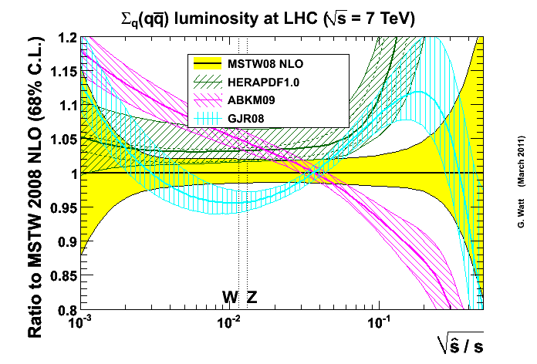

Slide 32
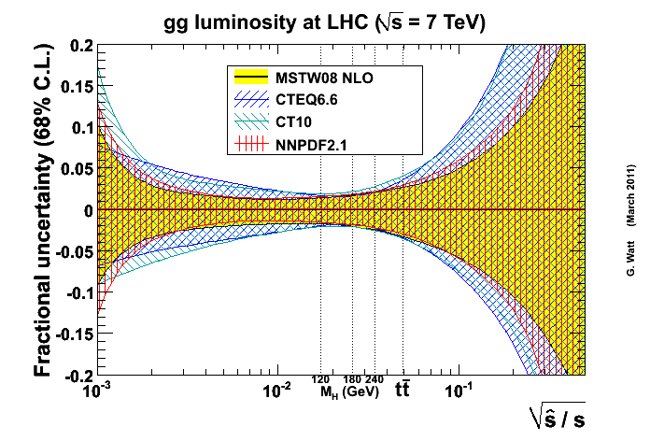
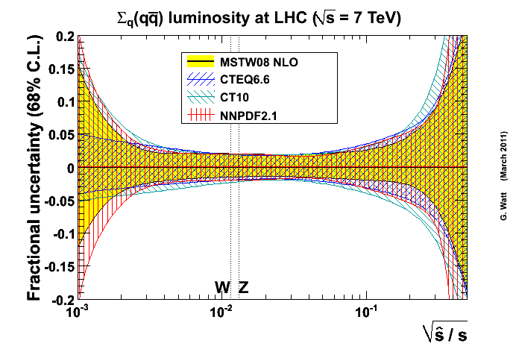
fractional uncertainty
remarkably similar considering the different definitions of pdf uncertainties used by the 3 groups!

Slide 33
W, Z

Slide 34
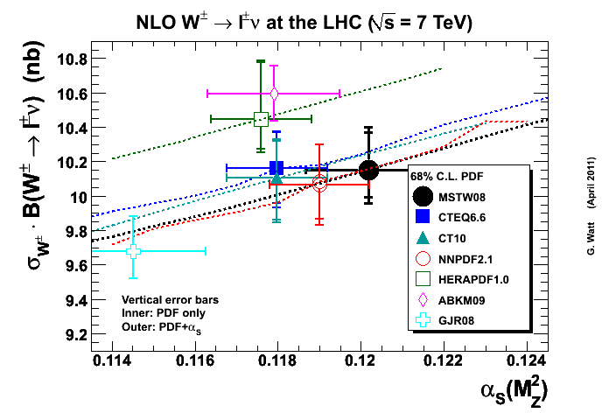
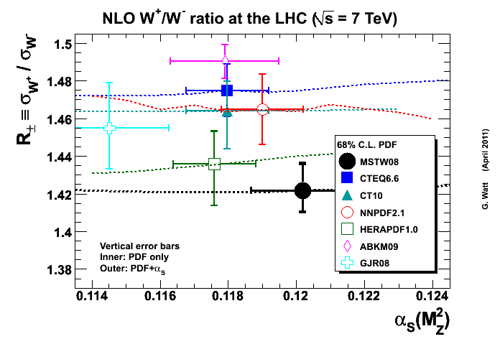
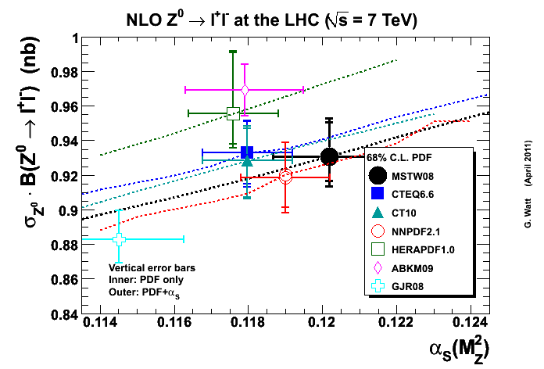
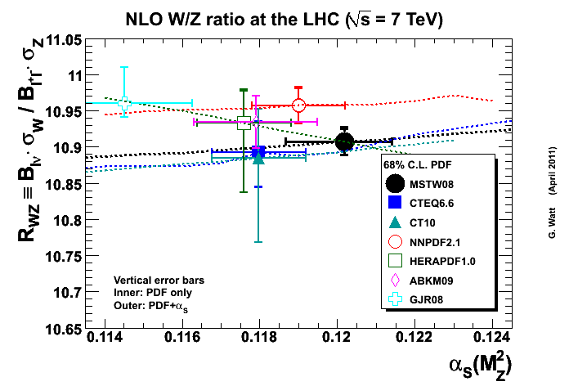
benchmark W,Z cross section predictions
±3%
G. Watt, arXiv:1106.5788 [hep-ph]

Slide 35
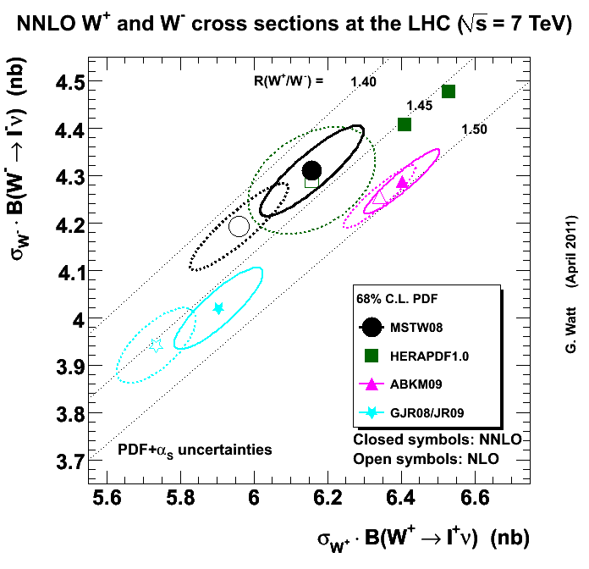
predictions for σ(W) 7 TeV LHC: NLO vs. NNLO

Slide 36
impact of sea quarks on the NLO W charge asymmetry ratio at 7 TeV:
pdfs | R(W⁺/W⁻)
{udg} only | 1.53
{udscbg} = MSTW08 | 1.42 ± 0.02
{udscbg}_{sea} only | 0.99
{udscbg}_{sym.sea} only | 1.00
at LHC, ~30% of W and Z total cross sections involves s,c,b quarks

Slide 37
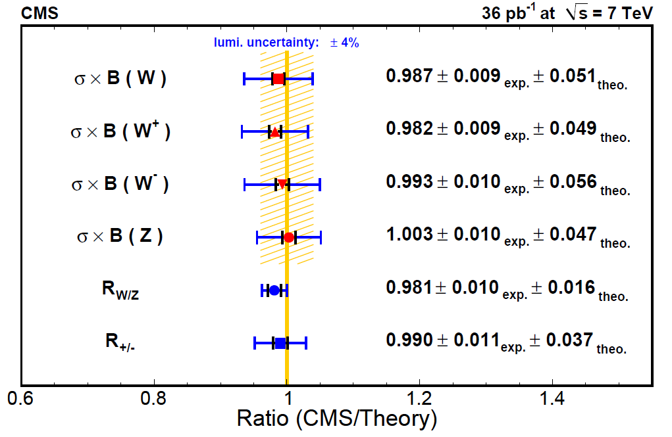
fiducial
total

Slide 38
W→lν rapidity asymmetry
l±
W
very sensitive to pdfs
particularly near y=0
complex interplay of u_{V}, d_{V}, Sea, V ± A decay
at W level ...

Slide 39
including leptonic decay ...
at small η_{l}, proportional to u_{V} - d_{V} as before
at medium η_{l}, dominated by helicity-favoured
d ubar → W⁻ → l⁻ν
hence A_{l} → - 1
at large η_{l}, dominated by helicity-unfavoured
u dbar → W⁺ → l⁺ν
hence A_{l} → + 1
p_{Tmin} controls the degree of ‘forwardness’
complex interplay of u_{V}, d_{V}, Sea, V ± A decay
at W level ...
pdf
constraint

Slide 40
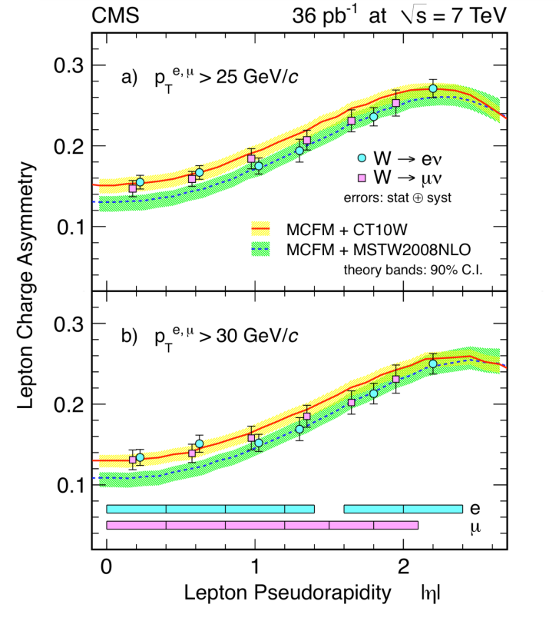

Slide 41
CMS-PAS-EWK-11-005

Slide 42
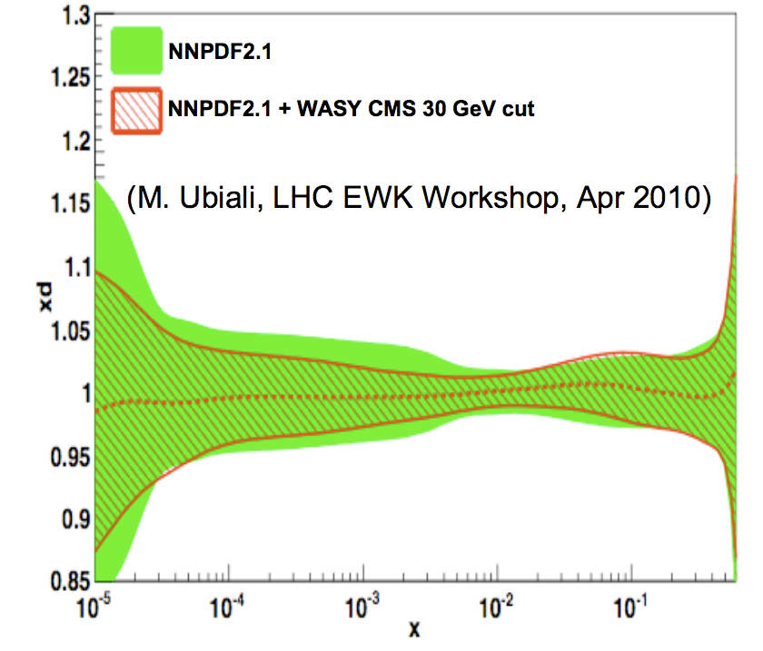
using LHC lepton asymmetry data to constrain the d-quark pdf

Slide 43
using LHC Z (also W) rapidity data to constrain the quark pdfs

Slide 44
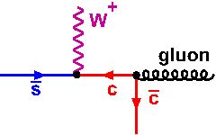
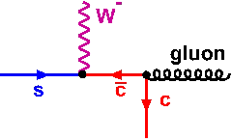
probing heavy quark pdfs?
take advantage of (a) qg dominates W,Z + jet production, (b) heavy quark suppression becomes weaker at high Q², small x, (c) ability to tag c,b jets
CMS: “W production in association with c jets” (CMS-PAS-EWK-11-013)
sbar / s
sbar + s
Z
differences at level of exptl.
systematic error!
Also: Z + c as a measure of charm pdf?

Slide 45
strange quarks in NNPDF, MSTW, CTEQ
s + sbar
s - sbar
Note:
MSTW: assume u,d,s quarks have same x^{δ} behaviour as x → 0

Slide 46
Higgs

Slide 47
Harlander,Kilgore
Anastasiou, Melnikov
Ravindran, Smith, van Neerven
…
only scale variation uncertainty shown
central values calculated for a fixed set pdfs with a fixed value of α_{S}(M_{Z})

Slide 48
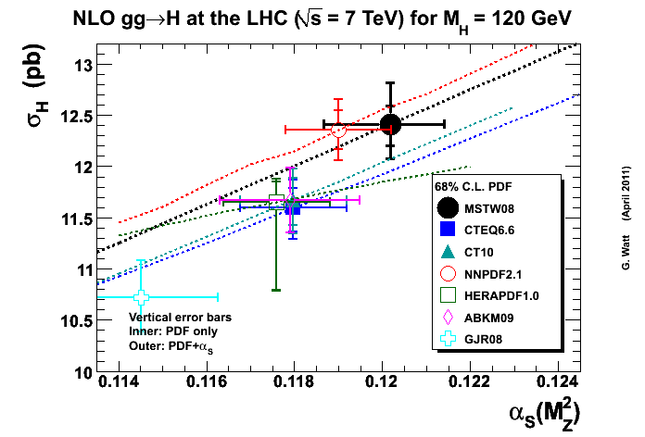
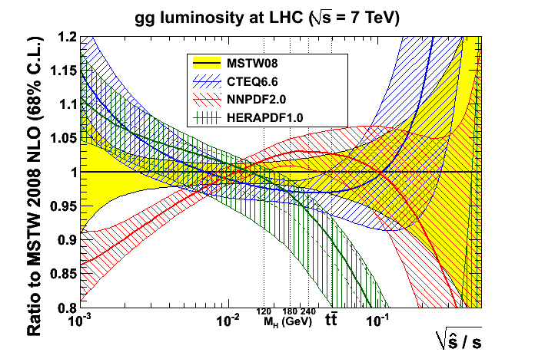
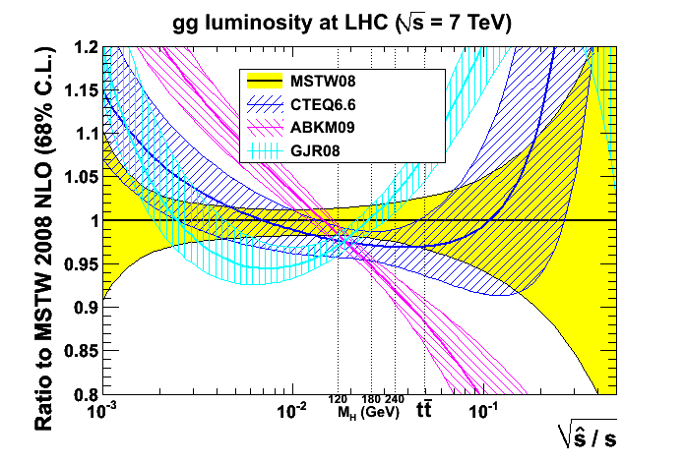
benchmark Higgs cross sections
… differences from both pdfs AND α_{S} !

Slide 49
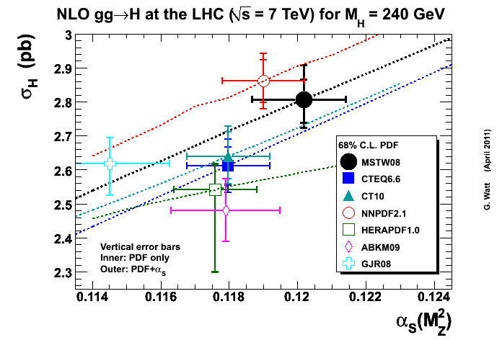

Slide 50
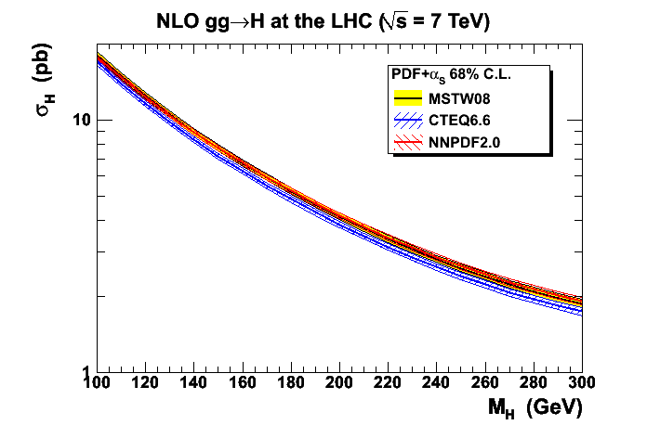
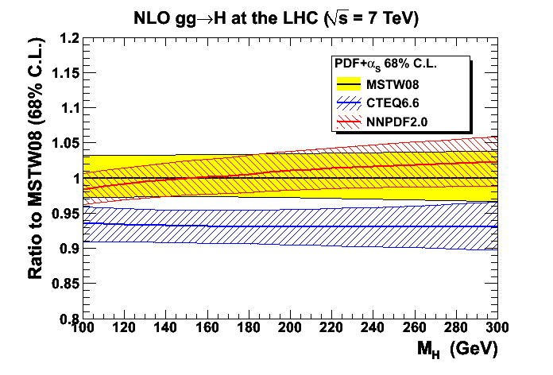
Note: (i) for MSTW08, uncertainty band similar at NNLO
(ii) everything here is at fixed scale μ=M_{H} !
How to define an overall ‘best theory prediction’? See prescription in "Handbook of LHC Higgs Cross Sections: 1. Inclusive Observables", arXiv:1101.0593
NLO
“Other PDF sets, GJR08, ABKM09, and HERAPDF1.0 are useful for more conservative or extensive evaluations of the uncertainty.”

Slide 51
top

Slide 52
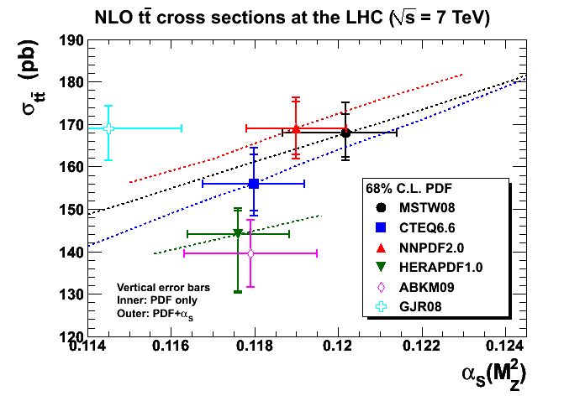
benchmark top cross sections

Slide 53
NNLO approximations to σ(tt)
}
NNLO~
Ben Pecjak, EPS2011
MSTW2008, m_{top} = 173.1 GeV , m_{top}/2 < μ_{F} = μ_{R} < 2 m_{top}
errors are 90%cl PDF + scale
variation between different pdf sets generally larger...

Slide 54
a high top cross section disfavours a soft high-x gluon pdf

Slide 55
can we use the top cross section to cross-calibrate the gg→ Higgs cross section?
(both are α_{S}² * g * g dominated)
i.e. is the pdf uncertainty on the H/tt ratio smaller than on the individual H cross section?
Heavy Higgs → YES
Light Higgs → NO

Slide 56
jets
so far, no obvious problems for pdfs...

Slide 57
Note:
theory = NLOJet++ MC = NLO pQCD + non. pert. corrections
tendency for POWHEG (also based on NLO pQCD) to give steeper slope?

Slide 58
comparison with different pdfs (CMS)

Slide 59
4
summary: issues and outlook

Slide 60
issues and outlook
continuing convergence between the various pdf sets; more NNLO sets becoming available; residual differences in central values largely understood
outstanding issues include:
combined HERA data not yet in all fits (although preliminary MSTW studies exist)
difficulty of reconciling Run II Tevatron W asymmetry data
proper assessment of uncertainties due to treatment of heavy quark flavours (definition and variation of m_{c,b}, GM-VFNS optimal but not uniquely defined)
influence of [α_{S} ln(1/x)]^{n} beyond-NNLO contributions?
‘QED pdfs’ (nothing since MRST 2004; now needed for precision EW)
‘overall best’ theory prediction and uncertainty?! - average / envelope of CTEQ/NNPDF/MSTW 68%cl has been advocated, e.g. for σ(Higgs) predictions

Slide 61
issues and outlook contd.
LHC data now at point of being able to discriminate between pdfs:
small-x u_{V} and d_{V} can now be fine-tuned using W → lepton asymmetry data
Z rapidity distribution fine-tunes d distribution
top cross section begins to resolves hard/soft gluon issue
... and is correlated with jet cross sections
W,Z + c jet may be able to provide new information on s, c pdfs
expect new fits including LHC data from all global fitters soon!

Slide 62
extra slides

Slide 63
Massimiliano Grazzini (2010)

Slide 64
Massimiliano Grazzini (2010)

Slide 65
heavy quarks: charm, bottom, …
considered sufficiently massive to allow pQCD treatment:
distinguish two regimes:
(i) include full m_{H} dependence to get correct threshold behaviour
(ii) treat as ~massless partons to resum α_{S}^{n}log^{n}(Q²/m_{H}²) via DGLAP
FFNS: OK for (i) only ZM-VFNS: OK for (ii) only
consistent GM(=general mass)-VFNS now available (e.g. ACOT(χ), RT, BMSN,…) which interpolates smoothly between the two regimes
Aivazis, Collins, Olness,Tung; Roberts, Thorne; Buza, Matiounine, Smith, Migneron, van Neerven, …
Note:
the definition of these is tricky and non-unique (ambiguity in assignment of O(m_{H}²//Q²) contributions), and the implementation of improved treatment (e.g. in going from MRST2004→MRST 2006 or CTEQ 6.1→6.5) can have a big effect on light partons
the true uncertainty on e.g. LHC predictions coming from ambiguities in the heavy quark treatment has yet to be quantified

Slide 66
charm and bottom structure functions
MSTW 2008 uses fixed values of m_{c} = 1.4 GeV and m_{b} = 4.75 GeV in a GM-VFNS
subsequently studied the sensitivity of the fit to these values, and impact on LHC cross sections

Slide 67
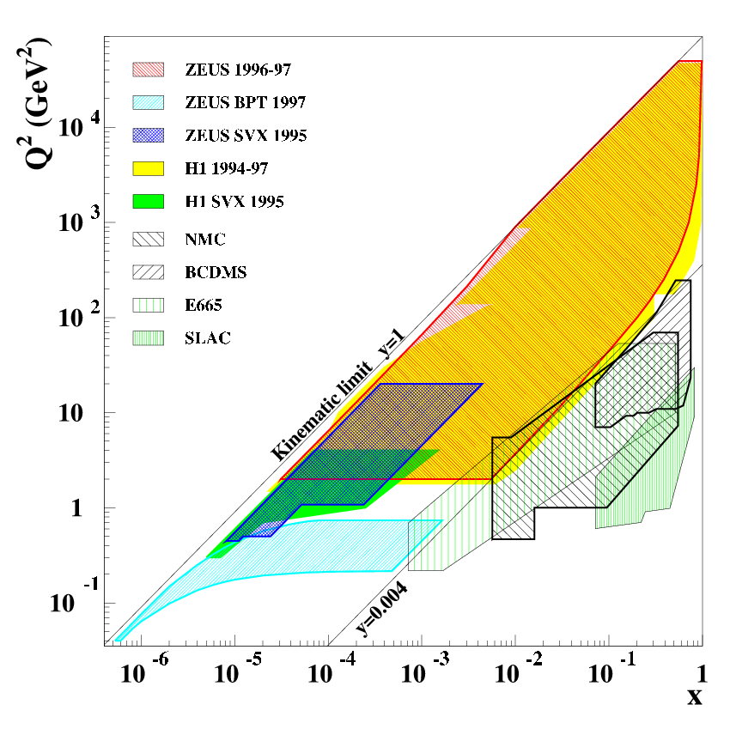
summary of DIS data
+ neutrino FT DIS data
Note: must impose cuts on DIS data to ensure validity of leading-twist DGLAP formalism in analyses to determine pdfs, typically:
Q² > 2 - 4 GeV²
W² = (1-x)/x Q² > 10 - 15 GeV²

Slide 68
improved LO pdfs
conventional wisdom is to match pQCD order of pdfs with that of MEs
but, in practice,
σ_{LO} = PDFs(LO) ⊗ ME(LO) can be different from σ_{NLO} = PDFs(NLO) ⊗ ME(NLO), in both shape and normalisation
LO pdfs have very poor χ² in (LO) global fit (no surprise: NLO corrections at large and small x are significant and preferred by the data)
momentum conservation limits how much additional glue can be added to LO partons to compensate for missing NLO pQCD corrections (e.g. to get correct evolution rate of small-x quarks)
therefore relax momentum conservation and redo LO fit; study the impact of this on χ², partons and cross sections
e.g. Thorne & Shertsnev 2007: LO* partons
χ²: 3066/2235 → 2691/2235, momentum conservation: 100% → 113%

Slide 69
τ transverse momentum distribution in H → τ τ production at LHC
comparison of gluons at high Q²

Slide 70
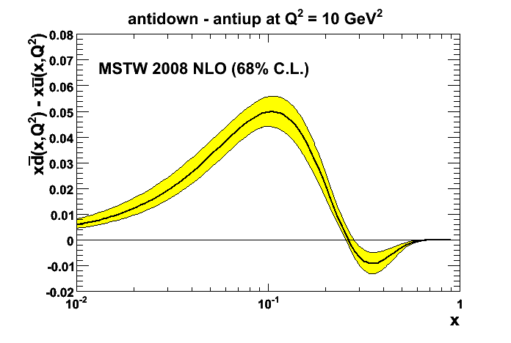
sea quarks
the sea presumably arises when ‘primordial‘ valence quarks emit gluons which in turn split into quark-antiquark pairs, with suppressed splitting into heavier quark pairs
so we naively expect
but why such a big d-u asymmetry? Meson cloud, Pauli exclusion, …?
The ratio of Drell-Yan cross sections for pp,pn → μ⁺μ⁻ + X provides a measure of the difference between the u and d sea quark distributions

Slide 71
strange
earliest pdf fits had SU(3) symmetry:
later relaxed to include (constant) strange suppression (cf. fragmentation):
with κ = 0.4 – 0.5
nowadays, dimuon production in υN DIS (CCFR, NuTeV) allows ‘direct’ determination:
in the range 0.01 < x < 0.4
data seem to slightly prefer
theoretical explanation?!

Slide 72
MSTW

Slide 73
MSTW

Slide 74
CT09G fit to Run I and Run II jet data simultaneously, find much harder gluon (with more flexible parameterisation)
… harder than valence quarks?!

Slide 75
F_{L}
an independent measurement of the small-x gluon
a test of the assumptions in the DGLAP LT pQCD analysis of small-x F₂
higher–order ln(1/x) and higher-twist contributions could be important

Slide 77
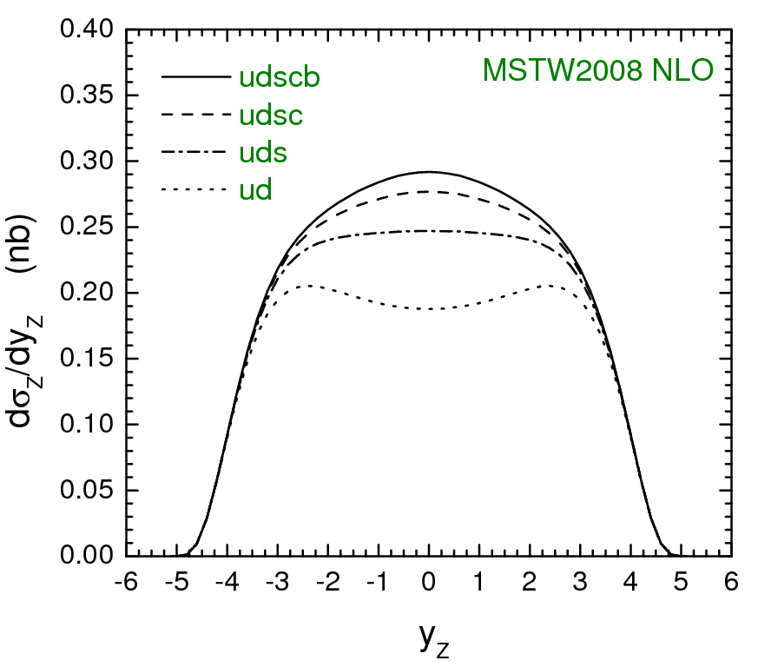
LHC (14 TeV)

Slide 78
LHCb
→ detect forward, low p_{T} muons from

