Slide 1
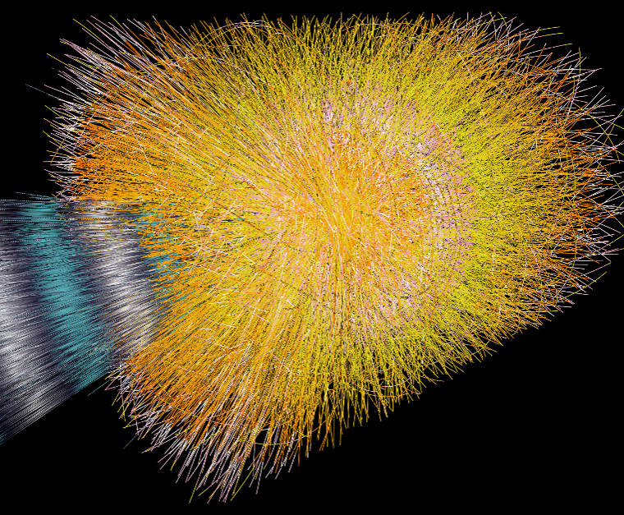

Heavy Ions at LHC
R. Lietava
The University of Birmingham

Slide 2
Outlook
QGP
Event characterisation
Soft probes
  Multiplicity, Transverse energy, Energy density
  Flow and correlations
Hard Probes
  Quarkonia
  Jet quenching
    High pt suppression (h⁻,D0,J/ψ,γ,Z,...)
    Reconstructed jets
Summary
Notes:
After motivation I will briefly remind you alice detector
My goal in this seminar is
To describe what kind of physics we wannt and can do
- and to less extent to give you the ctp status

Slide 3
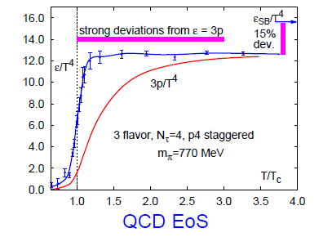
Quark Gluon Plasma
Latice QCD: transition hadrons -> quarks and gluons
QGP is not ideal gas !
Relativistic Heavy Ion Collider (RHIC):
  Macroscopic liquid:
    System size > mean free path
    System lifetime > relaxation time
  Perfect: shear viscosity/entropy ~ 0
LHC :
  System is hotter, denser, bigger
  Abundant production of hard probes
g_{B}=8_{c}*2_{s}=16
g_{F}=3_{f}*3_{c}*2_{s}*2_{a}=36

Slide 4


LHC Heavy Ion Program
LHC Heavy Ion Data-taking
Design: Pb + Pb at √s_{NN} = 5.5 TeV
(1 month per year)
Nov. 2010: Pb + Pb at √s_{NN} = 2.76 TeV
LHC Collider Detectors
  ATLAS
  CMS
  ALICE

Slide 5
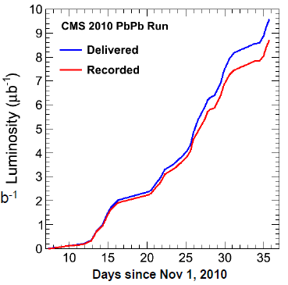
Pb–Pb Luminosity
B.Wyslouch, CMS, EPIC2011
Delivered integrated
luminosity ~ 9 μb⁻¹
Luminosity achieved
L = 2–3 x 10²⁵ cm⁻²s⁻¹
ATLAS very similar to CMS
ALICE recorded ~ 50%
due to TPC dead time

Slide 6
Heavy Ion Collision Centrality
Controls the volume and shape of the system
Multiplicity and energy of produced particles
are correlated with geometry of collisions.
Measured distribution:
Track multiplicity
Transverse energy
Forward energy
Variables:
impact parameter
participants
collisions
percentile of x section
Participants (10)
_{=>} _{Collisions (18)}
b
y
Plane perpendicular
to beam direction
Beam direction
x

Slide 7
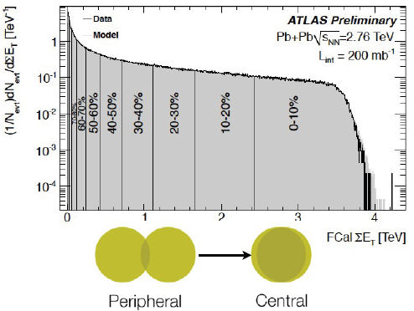
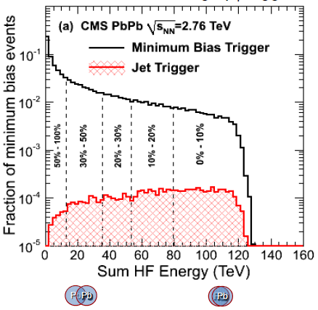
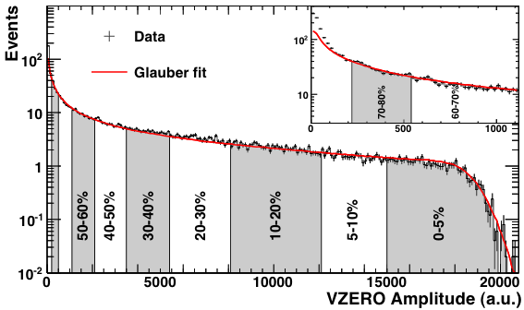
Centrality selection
ALICE
S.White, ATLAS, EPIC2011
B.Wyslouch, CMS,EPIC2011
M.Nicassio, ALICE, EPIC2011
Notes:
CMS and ATLAS calos

Slide 8
Soft Probes
Charged particle multiplicity , E_{T}, ε
Transverse momentum spectra
Radial flow
Anisotropic flow

Slide 9
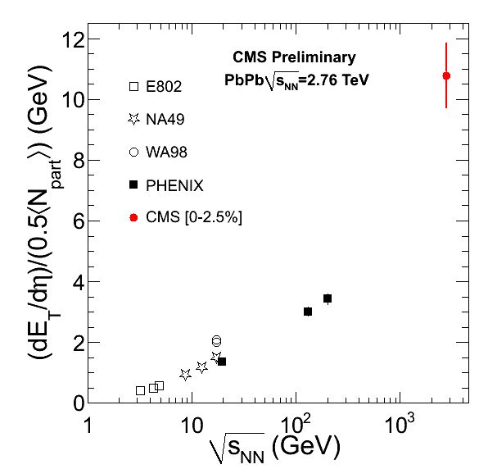
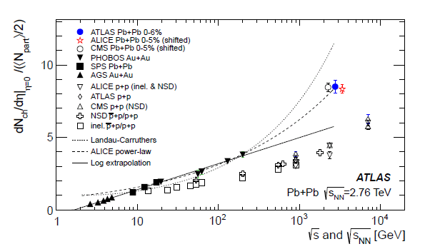
Multiplicity, E_{T} and ε
Particle Production and Energy density ε:
  Produced Particles:dN_{ch}/dη ≈ 1600 ± 76 (syst)
    ≈ 30,000 particles in total, ≈ 400 times pp !
    somewhat on high side of expectations (tuned to RHIC)
    growth with energy faster in AA
  Energy density ε > 3 x RHIC (fixed τ_{0,})
  Temperature + 30%
CMS, QM2011

Slide 10
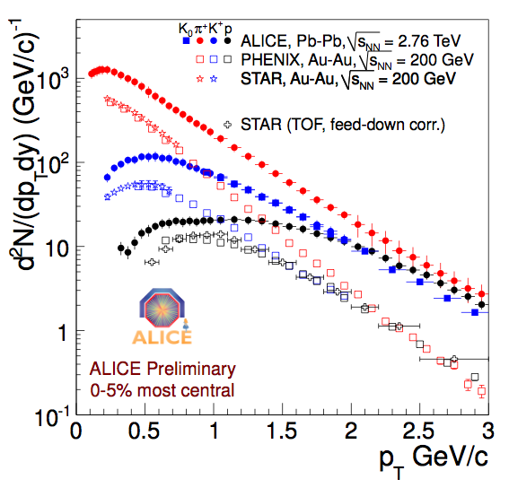
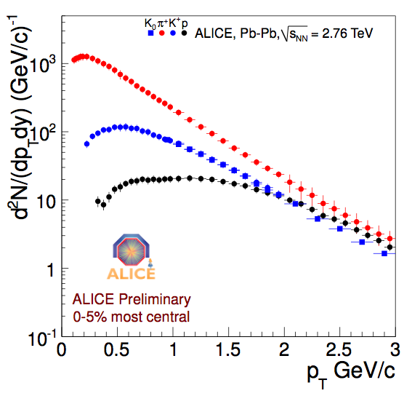
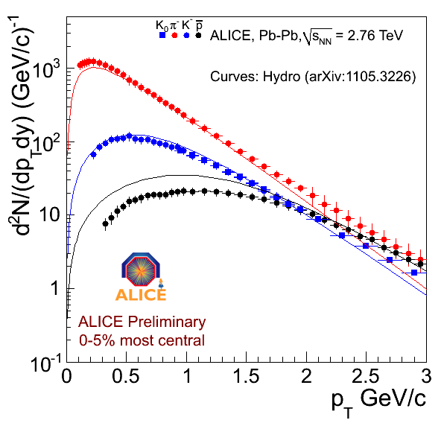
Charged particle spectra
Radial Flow
K, π, p spectra 0-5% central collisions
Very clear flattening and higher tails at √sNN=2.76 TeV
Quantify with blastwave parameter studies: radial flow β=v₀/c and freezout temperature T_{fo}
β= 0.66
T_{fo}~110 MeV
L.Barnby , ALICE, EPIC2011

Slide 11
Anisotropic Flow
Fourier expansion in azimuthal distribution:
φ – azimuthal angle
In non-central collisions
participant area is not azimuthally
symmetric: system evolution transfer
this anisotropy from
coordinate space to momentum space
φ
ψ₂
v₁ - direct flow
v₂ - elliptic flow, dominant for system
symmetric wrt Collision Plane
Collision Plane :
- Defined by Beam and Impact Parameter

Slide 12
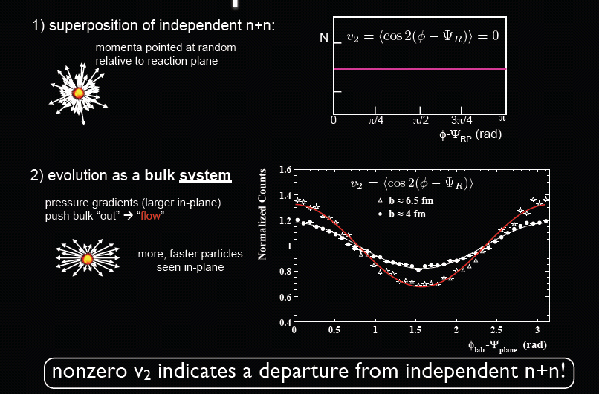
Elliptic flow - v₂
Adopted from R.Snellings

Slide 13
Physics of elliptic flow
Elliptic flow depends on:
Initial conditions
Fluid properties
  Equation of state
  Shear viscosity
Shear viscosity:
Small viscosity η => large cross section σ => strongly interacting fluid

Slide 14
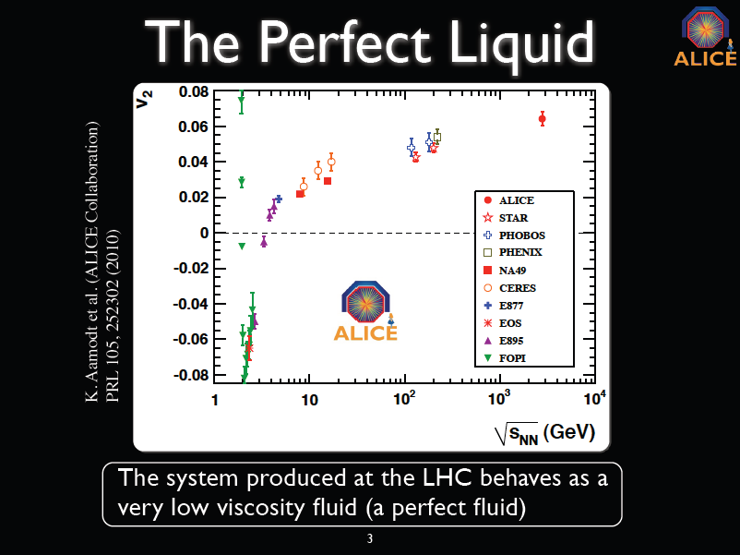
R.Snellings, ALICE

Slide 15
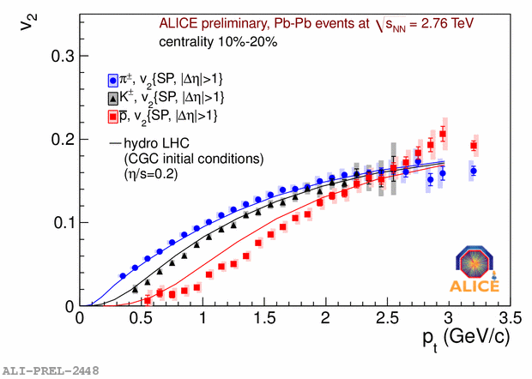
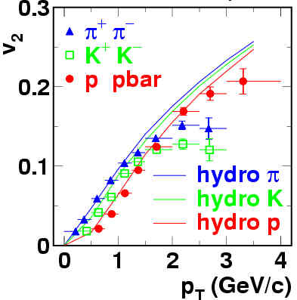

Hydrodynamics and v₂
comparison of identified particles v₂(p_{T}) with hydro prediction – mass splitting described
  (calculation by C Shen et al.: arXiv:1105.3226 [nucl-th])
  Protons are to be understood

Slide 16
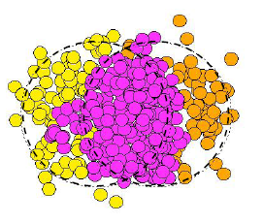
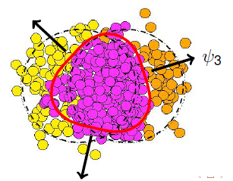
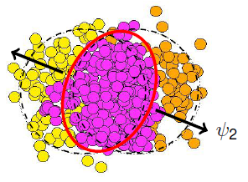
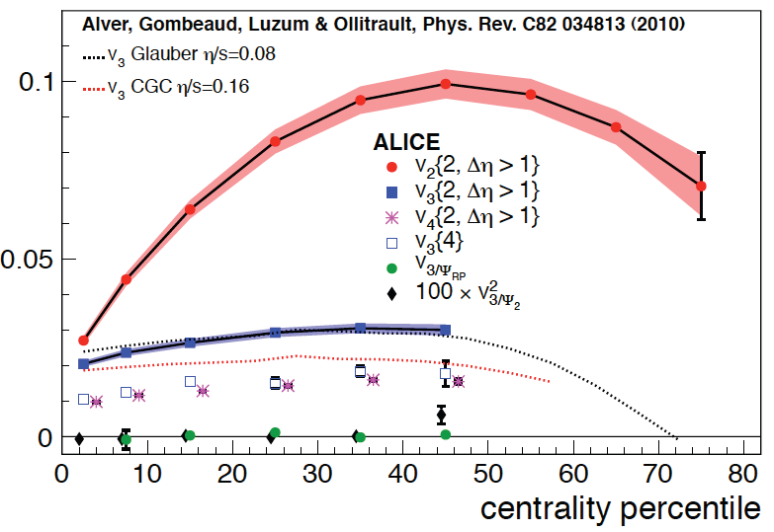
Fluctuations → v₃
“ideal” shape of participants’ overlap is ~ elliptic
  in particular: no odd harmonics expected
  participants’ plane coincides with event plane
but fluctuations in initial conditions:
  participants plane != event plane
  v₃ (“triangular”) harmonic appears
  [B Alver & G Roland, PRC81 (2010) 054905]
and indeed, v3 != 0 !
v₃ has weaker centrality dependence than v₂
Matt Luzum (QM 2011)
v₂
v₃
ALICE: PRL 107 (2011) 032301

Slide 17
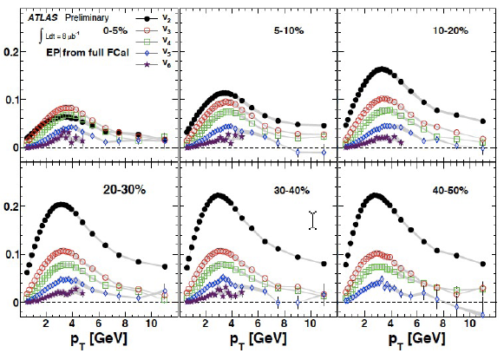
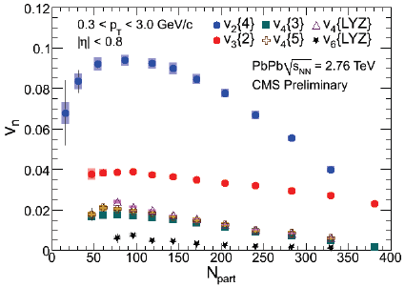
Higher harmonics
S.White, ATLAS, EPIC2011
v_{n+1} < v_{n}
v_{n+1} less centrality
dependent than v_{n}
M.Issah, CMS, EPIC2011
v_{n} – information on viscosity, n > 2

Slide 18
2 Particle Correlations and Flow
Fourier expansion in azimuthal distribution:
If flow dominates than:
φ_{T}
Flow Fourier coefficients
φ_{A}

Slide 19
Flow vs Non-Flow Correlations
Compare single calculated values with global fit
To some extent, a good fit suggests flow-type correlations, while a poor fit implies non-flow effects
v₂ to v₅ factorize until p_{T} ~ 3-4 GeV/c, then jet-like correlations dominate
v₁ factorization problematic (influence of away-side jet)
Jan Fiete Grosse-Oetringhaus – ALICE

Slide 20
Anisotropic Flow Summary
Centrality and p_{t} dependences of various v_{n} constraint
  initial conditions (CGC vs Glauber)
  viscosity – η/s
There is no hydro calculation (yet) describing simultaneously data on v₂ and v₃ ,….
2 particle correlations consistent with flow for p_{T}<3-4 GeV/c

Slide 21

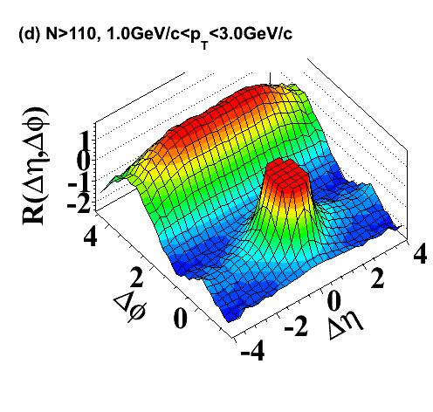
Speaking of which…
Full Fourier decomposition of the CMS pp ridge?

Slide 22
The nuclear modification factor
quantify departure from binary scaling in AA
  ratio of yield in AA versus reference collisions
e.g.: reference is pp → R_{AA}
…or peripheral AA → R_{CP} (“central to peripheral”)

Slide 23
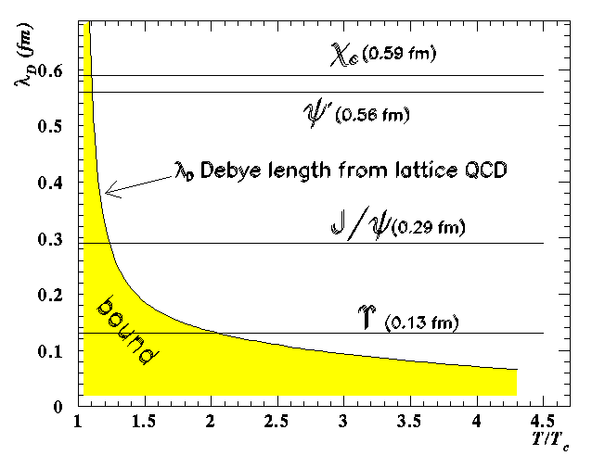
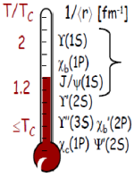
Quarkonia suppression
In the plasma phase the interaction potential is expected to be screened beyond the Debye length λ_{D} (analogous to e.m. Debye screening):
Charmonium (cc) and bottonium (bb) states with r > λ_{D} will not bind; their production will be suppressed
Recombination of cc and bb regenerates quarkonia

Slide 24
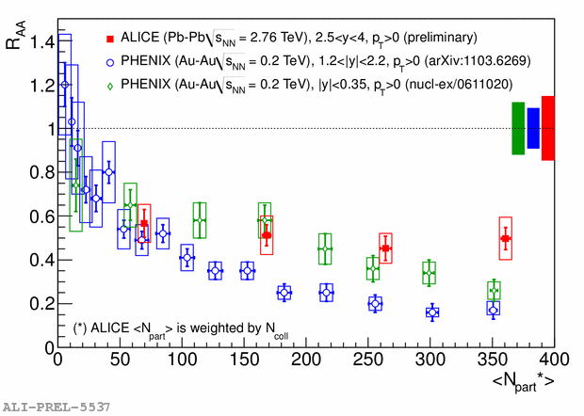
J/ψ @ LHC: forward y, low p_{T}
LHC: 2.5 < y < 4, p_{T} > 0 (ALICE)
Less suppression than RHIC:
1.2 < y < 2.2, p_{T} > 0 (PHENIX)
As suppressed as RHIC: |y| < 0.35. pT > 0 (PHENIX)
Recombination ?
Ginés Martínez – ALICE (QM2011)

Slide 25
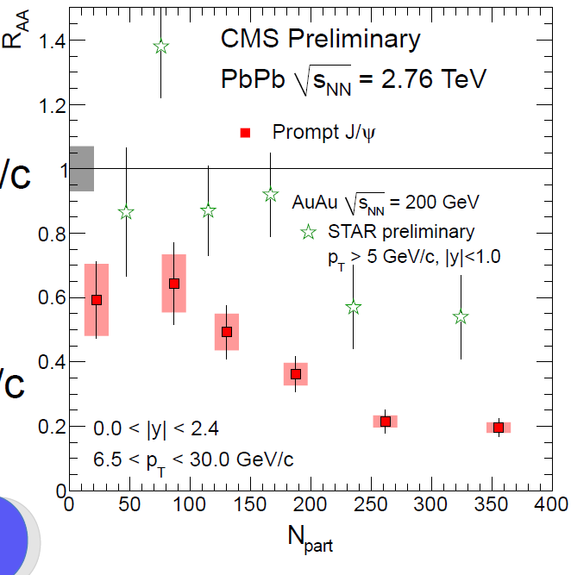
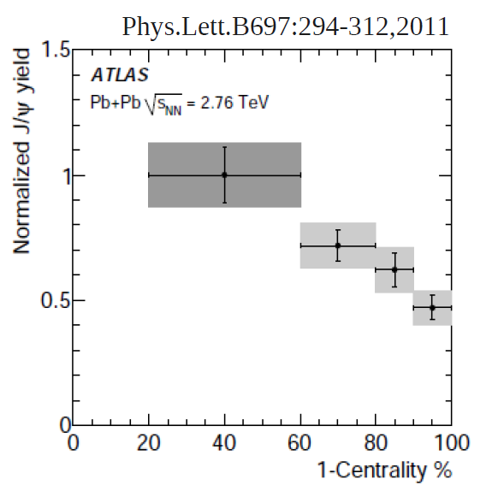
J/ψ @ LHC: central y, high p_{T}
LHC: |y| < 2.4, p_{T} > 6.5 GeV/c (CMS) prompt J/ψ
more suppressed than RHIC:
|y| < 1. pT > 5 GeV/c (STAR)
inclusive J/ ψ
CMS: PAS HIN-10-006
ATLAS: PLB 697 (2011) 294

Slide 26
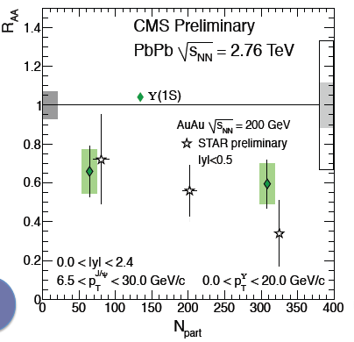

Υ(1S) suppression
CMS: PAS HIN-10-006

Slide 27
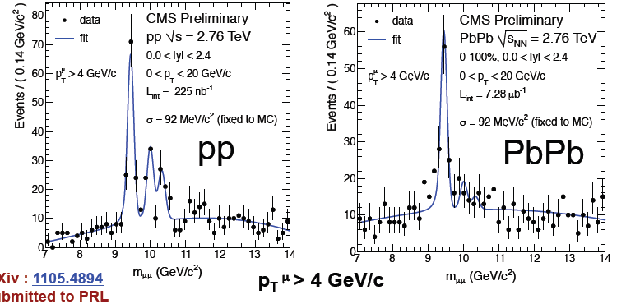

Υ(2S+3S) suppression
additional suppression for Υ(2S+3S) w.r.t. Υ(1S) ?
CMS: arXiv: 1105.4894

Slide 28
Quarkonia Summary
Υ and J/ψ suppressed by same amount ?
Suppression depends on y and pt
the future runs should allow us to establish quantitatively the complete quarkonium suppression(/recombination?) pattern
  high statistic measurements
  open flavour baseline / contamination
  pA baseline

Slide 29
Jets in medium
h
Fragmentation
Leading hadron
c
radiated
gluons
radiated
gluons
a
p_{a} = x_{a} P
b
d
p_{b} = –x_{b} P
heavy nucleus
heavy nucleus
Key prediction: jets are quenched
collisional energy loss (Bjorken)
radiative energy loss (Wang and Gyulassy)
J.D. Bjorken Fermilab preprint PUB-82/59-THY (August 1982).
X.-N. Wang and M. Gyulassy, Phys. Rev. Lett. 68 (1992) 1480

Slide 30
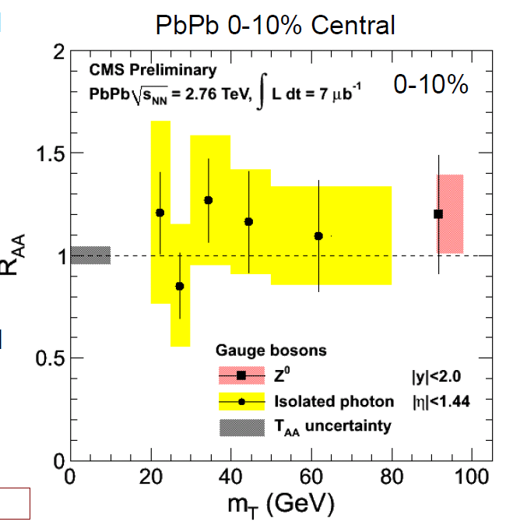
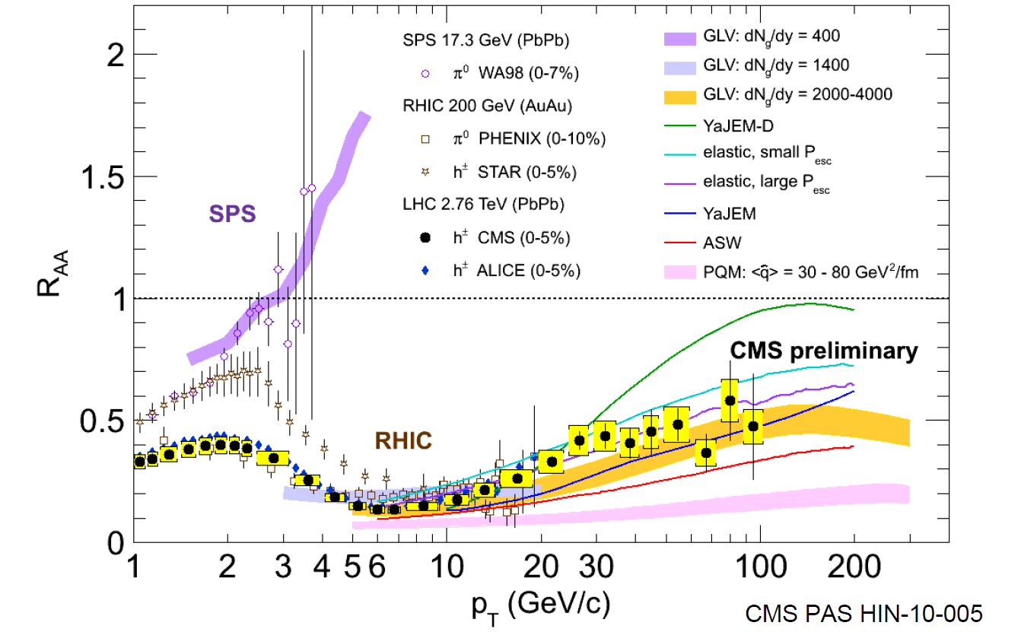
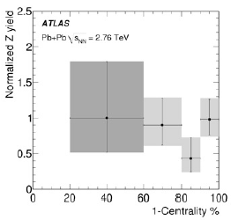
R_{AA} at LHC
Non colour probes
R_{AA}(p_{T}) for charged particles
produced in 0-5% centrality range
  minimum (~ 0.14) for p_{T} ~ 6-7 GeV/c
  then slow increase at high p_{T}
  still significant suppression
  p_{T} ~ 100 GeV/c !
essential quantitative constraint for
parton energy loss models!
NOT suppressed

Slide 31
Jet quenching
Jet quenching = Energy loss of fast parton in matter
  jet(parton) E -> jet E’ (=E-ΔE) + soft gluons (ΔE)
  modified jet fragmentation function f(z) (= number & energy distribution of hadrons) via matter induced gluon radiation/scattering
QCD energy loss ΔE =f(m) x c_{q} x q x L² x f(E) depends on:
  q : 'transport coefficient ' = property of medium (QGP >> nuclear matter)
  L: size of medium (~ L²)
  c_{q}: parton type (gluon > quark)
  f(m) : quark mass (light q > heavy Q)
  f(E) : jet energy (ΔE = constant or ~ ln(E))
1) How much energy is lost ?
measure 'hard' fragments
2) Where (and how) is it lost ?
3) Shows expected scaling ?
beams of
hard probes
QGP

Slide 32
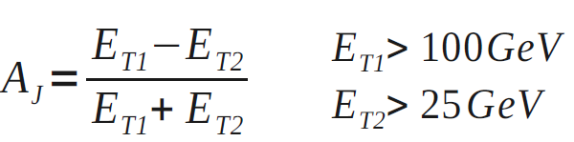
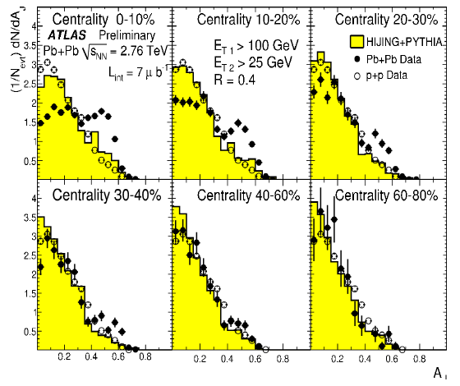
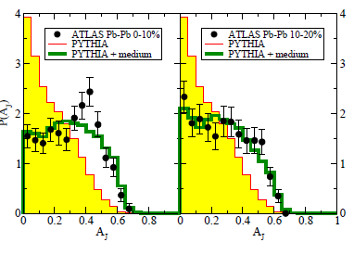
How much is lost ?
imbalance quantified by the di-jet asymmetry variable A_{J} :
with increasing centrality:
enhancement of asymmetric di-jets with respect to pp
& HIJING + PYTHIA simulation
ΔE~20 GeV
Consistent with RHIC
Qin,Muleer:Phys.Rev.Lett. 106 (2011) 162302
ATLAS: PRL105 (2010) 252303

Slide 33
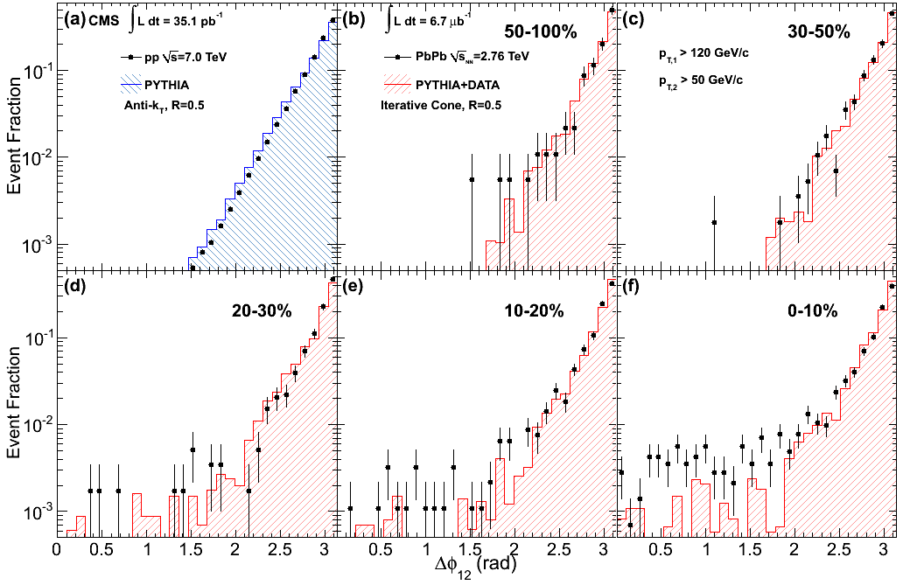
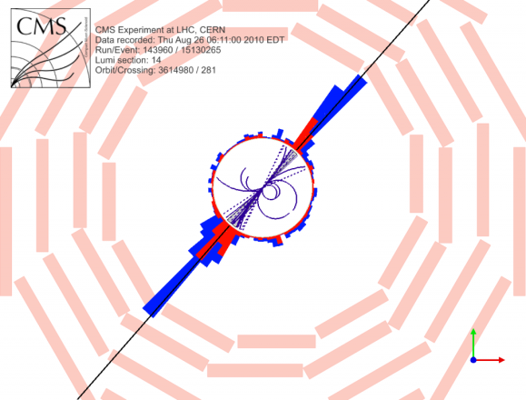
Where is it lost ?
No visible angular decorrelation in Δφ wrt pp collisions!
→ large imbalance effect on jet energy, but very little effect on jet direction!
ΔΦ₁₂
CMS: arXiv:1102.1957

Slide 34
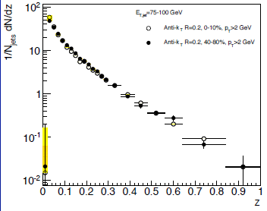
How is it lost ?
Jet fragmentation function
distribution of the momenta of the fragments along the jet axis
distribution is very similar in central and peripheral events
  although quenching is very different…
apparently no effect from quenching inside the jet cone…
central
peripheral
Brian Cole – ATLAS (QM2011)

Slide 35
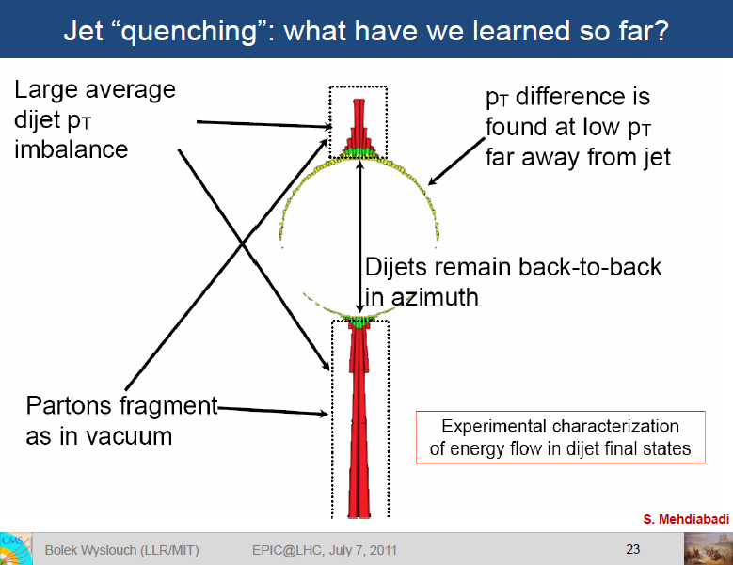
B.Wyslouch, CMS, EPIC2011

Slide 36
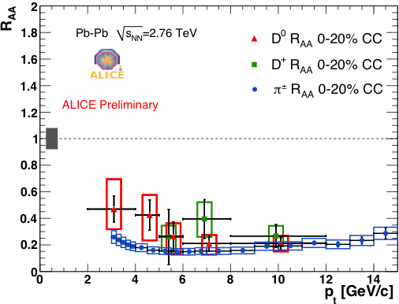
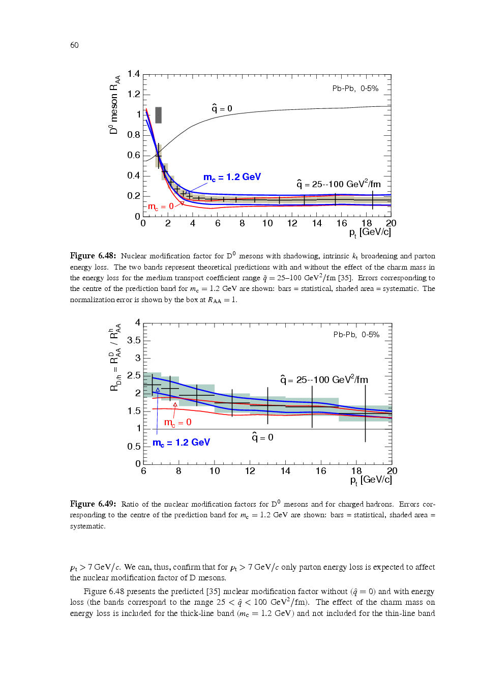
Mass & Colour Charge Dependence
Measure Heavy Quarks (c,b) versus π (gluon fragmentation dominates π at LHC)
D-Meson suppression / π suppression
Colour Charge + Mass
Colour Charge
Charm Mesons R_{AA}
(π⁺ + π⁻) R_{AA}
N Armesto et al., PRD 71 (2005) 054027
- R_{AA} prompt charm ≈ R_{AA} pions for p_{T} > 5-6 GeV
expected difference factor 2 @ 8 GeV
- R_{AA} charm > R_{AA} π for p_{T} < 5 GeV ?
jet quenching
ΔE ~ f(m) x c_{q} x q x L² x f(E)
^
Needs better statistics & quantitative comparison with other models

Slide 37
Summary
Journey started ~35 years ago: QGP was presumed
QGP observed at LHC:
  Collective flow
    Strongly interacting liquid – hydro works
    Estimate of viscosity ?
  Jet quenching
    Back to back jets strongly suppressed
    Dynamic of quenching ?
  Quarkonia dissolution versus recombination ?
  Heavy flavour: Are heavy quarks really suppressed as much as light quarks and gluons ?
HI SM Model describing simultaneously all observables !
The journey to terra incognita of heavy ions continues!

Slide 38
Back up

Slide 39
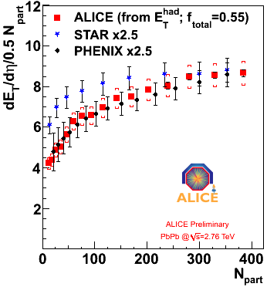
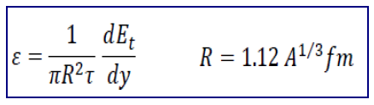
Energy density
Transverse energy density per participant pair: 2.5 x RHIC
Consistent with 20% increase in <pt>
B.Wyslouch, CMS, EPIC2011
CMS, QM2011
J.Harris, ALICE, EPIC2011
Bjorken energy density x time: 2.8 x for 5% of most central collisions

Slide 40
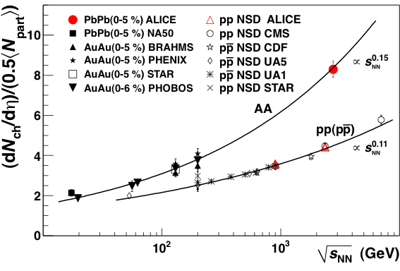
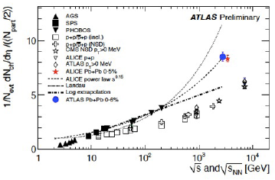
Energy dependence
growing faster then pp
2.2 compared to RHIC
1.9 compared to pp
S.White, ATLAS,EPIC2011
M.Nicassio, ALICE, EPIC2011
Agreement among experiments

Slide 41
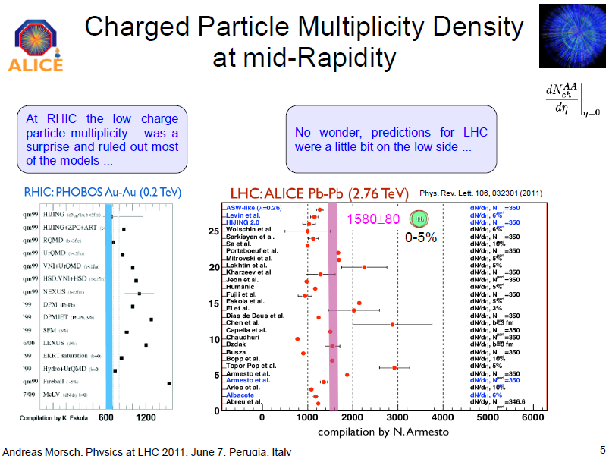

Slide 42
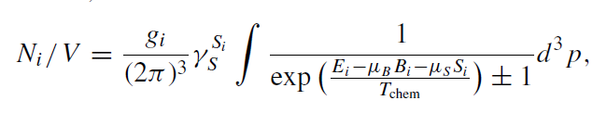
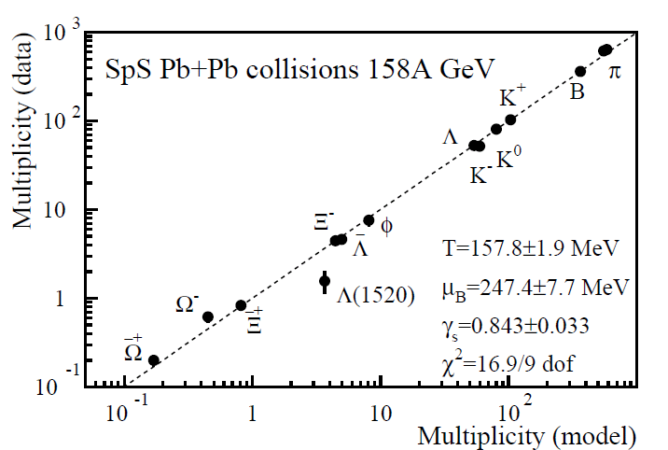
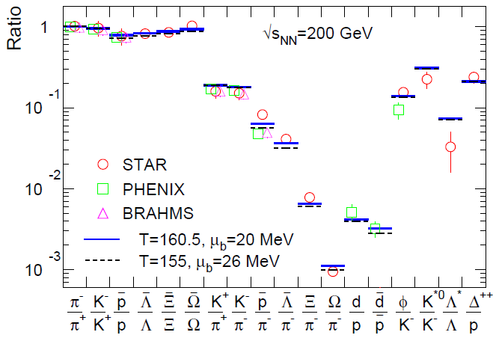
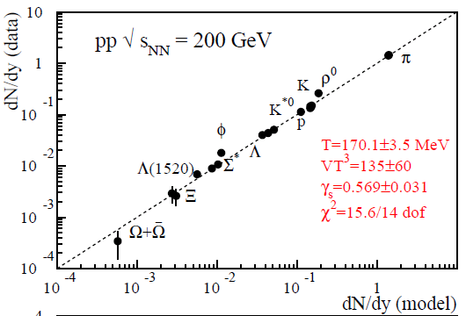
Particle ratios
In general well described (~10%) by statistical (thermal) model
  P(m) ~ e^{-(m/T)}
  T Temperature
  μ_{b} Baryo-chemical potential
  γ_{s} Strangeness suppression
T_{ch}: 160-170 MeV γ_{s} : 0.9-1 (AA), 0.5-0.6 (pp)
SPS Pb-Pb
RHIC Au-Au
RHIC pp

Slide 43

Thermal model at LHC
pp: 900 GeV & 7 TeV
pp:
Thermal fit rather poor
Pb-Pb:
- K/π grows slightly from pp value
p/π ≈ like pp
p/π off by factor > 1.5
from thermal predictions !
but very compatible with RHIC !!
Before we can conclude anything
we need more particle species..

Slide 44

Physics of elliptic flow
Adopted from R.Snellings

Slide 45


Direct flow
QM2011

Slide 46

Structures in (Δη,Δφ)
near side jet peak
two shoulders
on away side
(at 120° and 240 °)
aka “the Mach cone”
long range structure
in η on near side
aka “the ridge”
ATLAS-CONF-2011-074

Slide 47

Andrew Adare – ALICE

Slide 48

Di-jet imbalance
Pb-Pb events with large di-jet imbalance observed at the LHC
recoiling jet strongly quenched!
CMS: arXiv:1102.1957

Slide 49

Jet nuclear modification factor
substantial suppression of jet production
  in central Pb-Pb wrt binary-scaled peripheral
out to very large jet energies!
Brian Cole – ATLAS (QM2011)

Slide 50

Where does the energy end up?
nice analysis by CMS using reconstructed tracks:
→ momentum difference is balanced by low momentum particles outside of the jet cone
CMS: arXiv:1102.1957

Slide 51


Z and W from ATLAS
S.White, ATLAS, EPIC 2011
Z and W yields consistent with binary collision scaling

Slide 52

AdS / CFT in a Picture
Graviton with
5-momentum k in bulk satisfies k•k = 0 → described by 4 numbers
Those 4 numbers describe virtual gauge quanta on 4-d boundary
( Adopted from S. Brodsky figure )

Slide 53


