Slide 1
MICE, Uni-Geneva
and the transnational access to MICE (MICE-TNA)

Slide 2
MICE activities by University of Geneva
DAQ/trigger responsibility
-- Edda Gschwendtner (2003-2005)
Jean-Sebastien Graulich (2005-06/2011) « JSG »
Yordan Karadhzov (03/2011 -- )
-- students: Vassil Verguilov (2006-now)
-- MICE DAQ (and VW Golf 1800 GLI 7313 TZ 01 aka ‘the shed’ or ‘the whale’)
transported in summer 2007 to RAL
2. JSG was « online coordinator » since summer 2009-2011 (now Linda Coney)
3. also contributed to TOF
4. now EMR construction and tests in collaboration with Como/Trieste
(see presentation by Davide)
5. Field mapping (with CERN)
6. Also MICE spokesperson (lots of travel, committees, boards, meetings)

Slide 3
MICE Operations Manager
Experienced physicist resident at RAL
On call 24/24
Daily duties (tour), weekly duties (MICE hall and MICO meetings)
Prepares running requests and paperwork for running the experiment
Coordination of activities in the experiment on daily basis
Especially important when data taking!
-- authority on safety by delegation of Project Manager (Andy Nichols)
-- delegation of physics objectives of experiment from Spokesperson (ABlondel)
1 Month at a time
2009: Graulich (UNIGE), Tsenov (Sofia), Cecchet (Pavia) → 3 Months
2010: Graulich (UNIGE), Tsenov (Sofia) ➔ 2 Months
2011: Blondel (Unige), Vankova (Sofia), Cecchet (Pavia), Karadhzov (UNIGE) ➔ 4 Months
25% of MOM time from TNA-supported physicists!

Slide 4
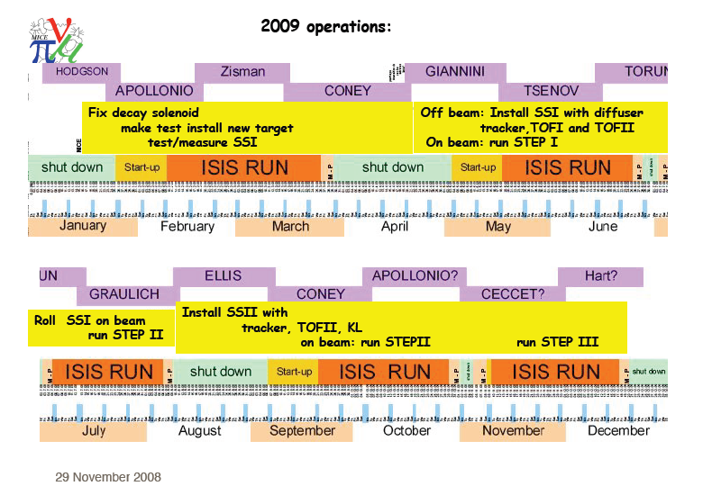

Slide 5
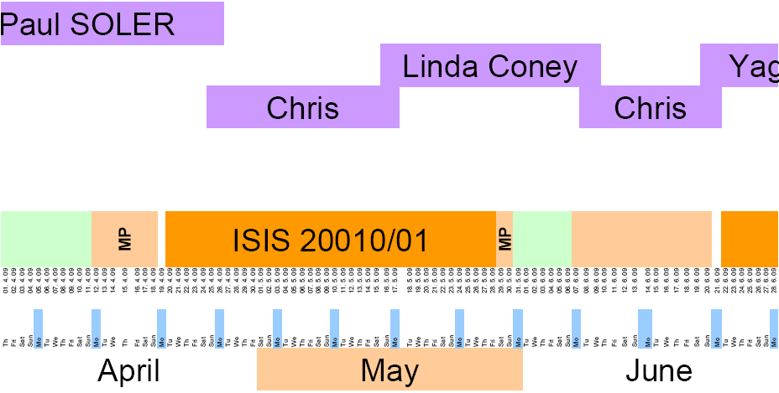
THANKS to all MOMs

Slide 7
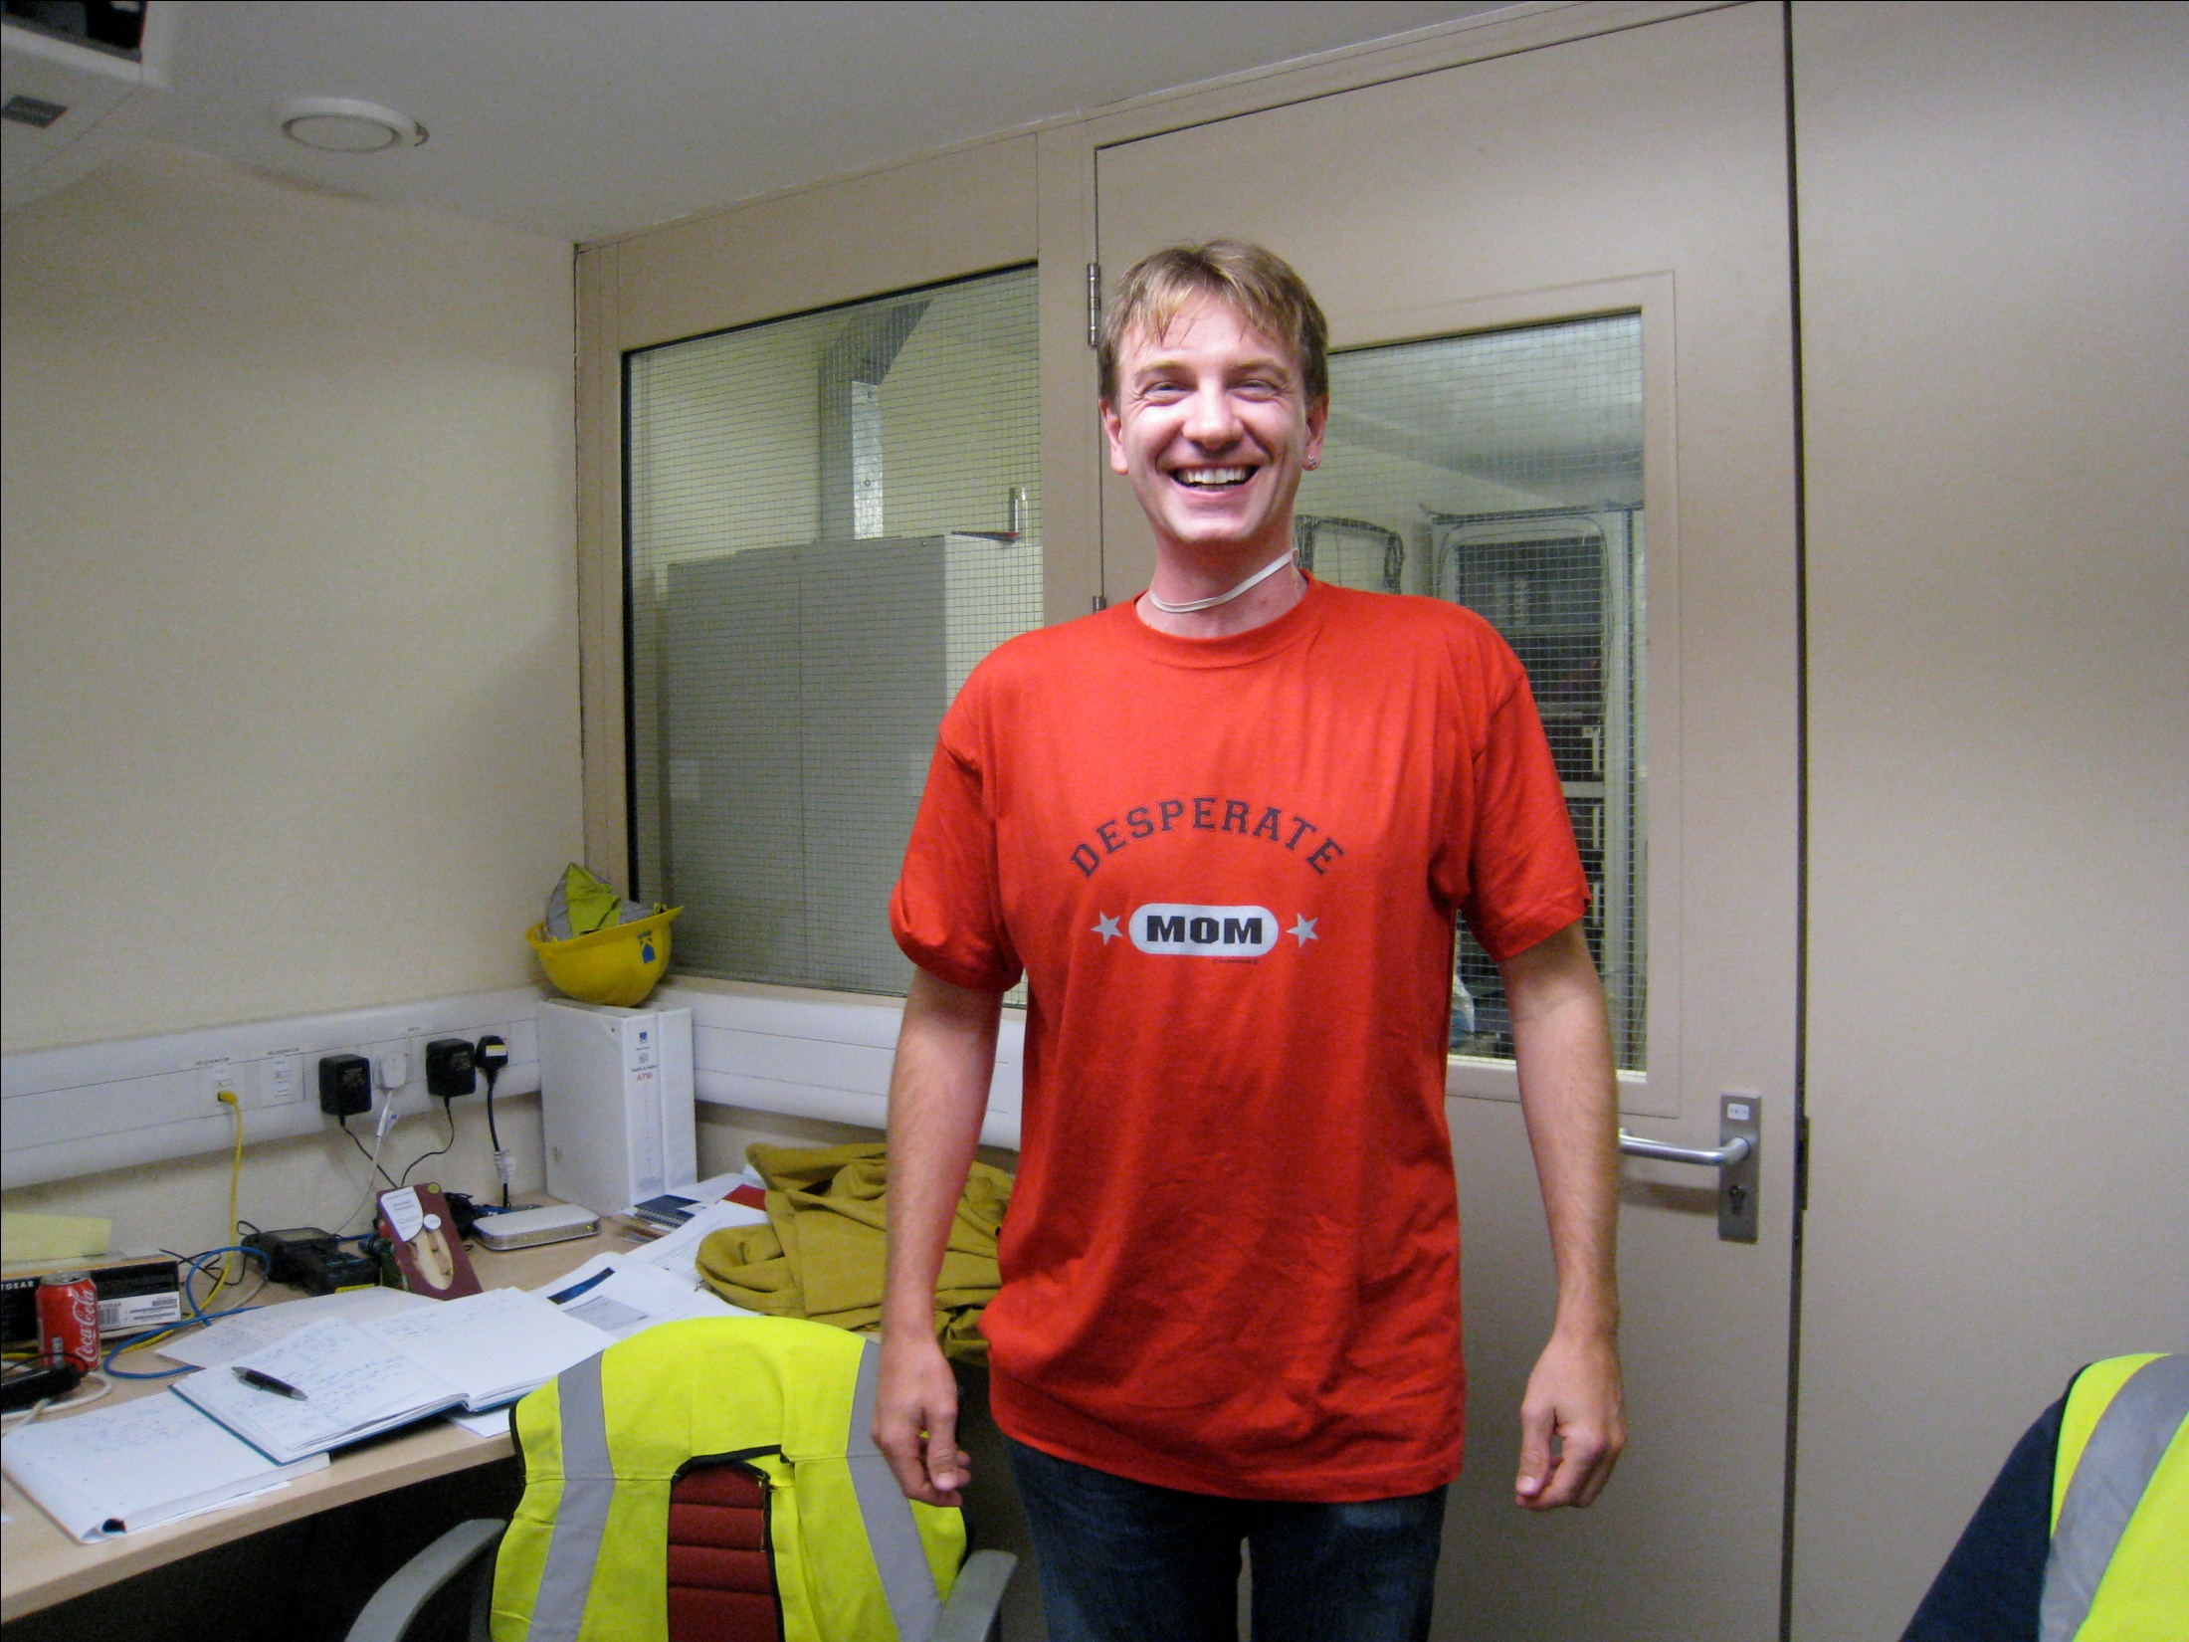
JSG

Slide 8
DAQ / online responsibility (JSG) until June 2011
1 Week / month at RAL
Organization of MICE control room and
implementation of MICE DAQ system
Organization of Controls and monitoring and relationship with DAQ
Organized review of MICE DAQ and controls
Made bid for funding of MICE online farm and installation at RAL
➔ online data reconstruction
Yordan has taken over DAQ/trigger part, Linda Coney the online groupe coordination

Slide 9
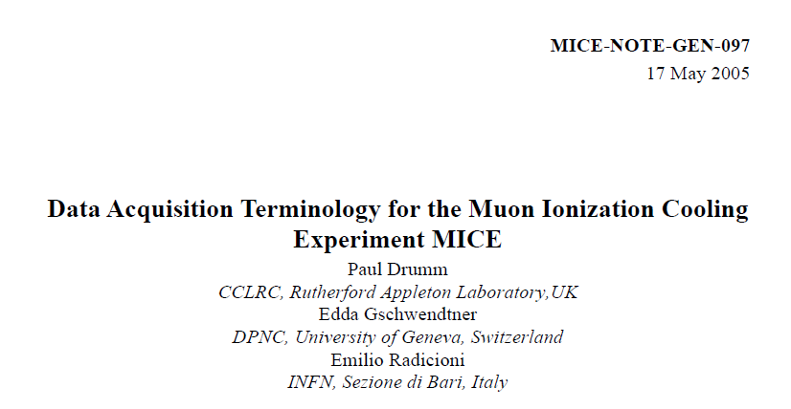


Slide 10
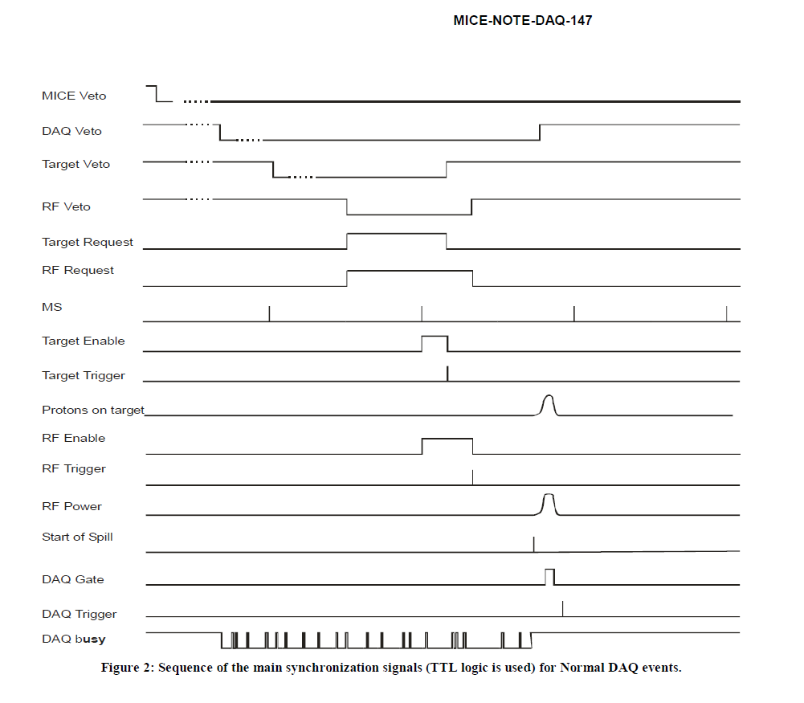

Slide 11
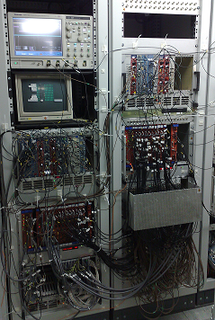
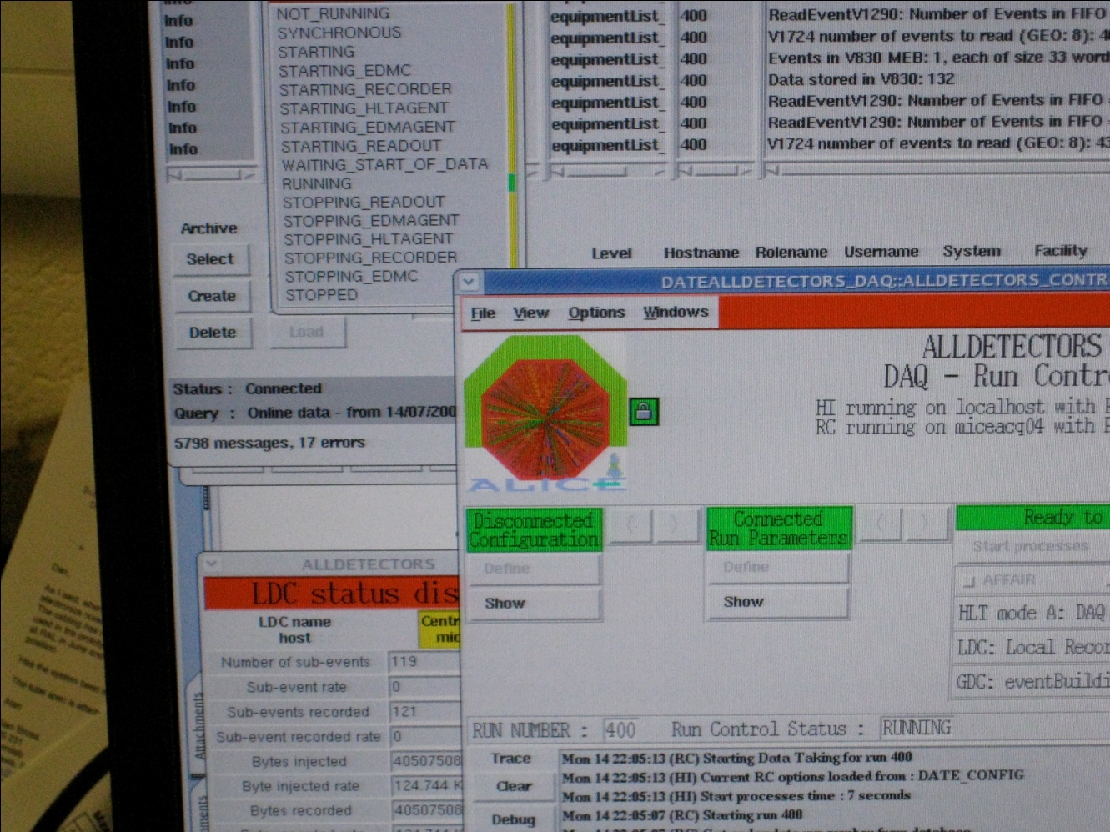
⬅MICE trigger, scalers, gates pulsers, etc…
MICE DAQ

Slide 12
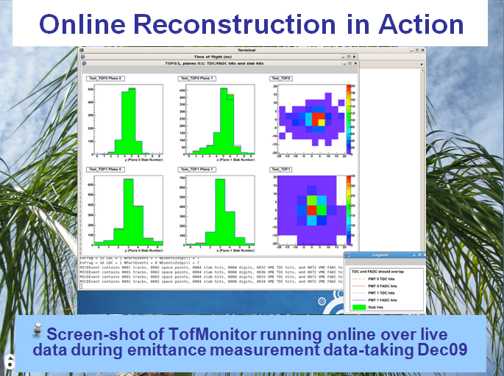

Slide 13
MICE data taking
5 ISIS user runs per year
typically
-- one week of run up+ machine physics 50/64 ~ 1Hz
-- 30-37 days of ‘user run’ 50 Hz
-- Few days of Machine physics
One long shut down (8 months) every ~4 years.
Last one in second half of 2010.
Next one in second half of 2014.
Data taking periods important to MICE:
-- 2008: first beams; no decay solenoid; started with GVA counters,
then CKOV/TOF/KL
-- 2009: no decay solenoid until october
-- a few runs with decay solenoid in the fall 2009, first TOF calibration
-- repairs to decay solenoid until may2010
-- main step I run in July 2010, first measurements of emittance.

Slide 14


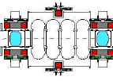

MICE SCHEDULE
update October 2011
μ
Run date:
STEP I
Completed
EMR run Q2 2012
STEP IV
Q4 2012
and 2013
Under construction:
STEP V
STEP VI

Slide 15
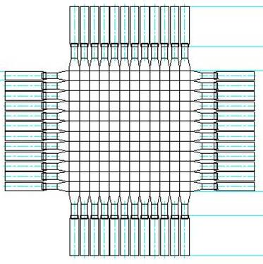
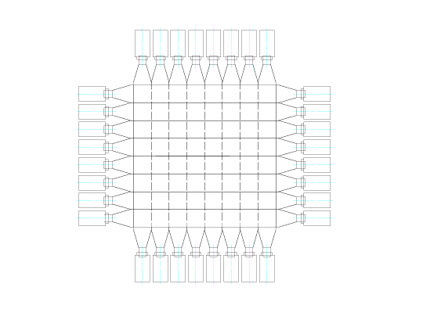
How MICE Measures ε in Step 1
(t0,x0,y0)
(t1,x1,y1)
TOF0
TOF1
Use TOF0 and TOF1 to determine phase space parameters of the muon beam
0.40 m
0.42 m
Momentum-dependent
matrix relates
(t0,x0,y0,t1,x1,y1)
(t1,p,x1,x’1,y1,y’1)
solved by iteration
Tof-0
Tof-1
10 x 4cm scintillator
σ_{x,y} = 1.15 cm
σ_{t} = 50 ps
7 x 6cm bars
σ_{x,y} = 1.73 cm
σ_{t} = 50 ps

Slide 16
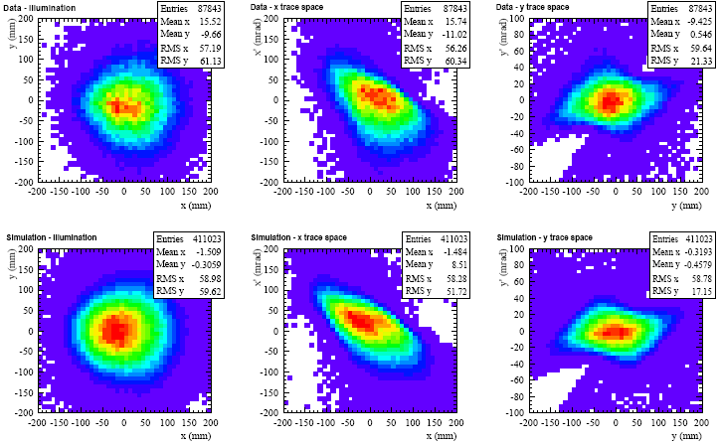
Emittance Measurement Result: Data vs MC
Reconstructed transverse phase space of the baseline MICE beam ➔ would give beam of 200MeV/c in MICE absorber
6mm emittance in first tracker
y (mm) vs x (mm)
x′ (mrad) vs x (mm)
y′ (mrad) vs y (mm)
Data
MC

Slide 17
MICE STEP I
Superb data taking end 2009 and summer 2010!
GOALS ACHIEVED
See presentation by M. Rayner at FAC in Jan 2011
Rates limited by beam loss induced in ISIS.

Slide 18
muon rates
-- required muon rate is ~50/200 per pulse without (stepI-IV)/with (StepV-VI) RF
-- limitation is irradiation in ISIS due to beam losses induced by MICE target
measured in Volts on Beam Line Monitors
-- observed rates in MICE 2010 (6mm beam)
5 TOF1/ms/V_BLM for μ⁻ beam,
30 TOF1/ms/V_BLM for μ⁺ beam
following a series of dedicated irradiation runs and measurements of activation
ISIS allowed us to run routinely at 2V and even tried up to 10V.
We are within range for STEPS I-IV ,
routinely running with 150 pions or 50 muons per pulse
further studies on how to get more muons per losses are ongoing
(beam bump, timing, faster dip, etc..)

Slide 19
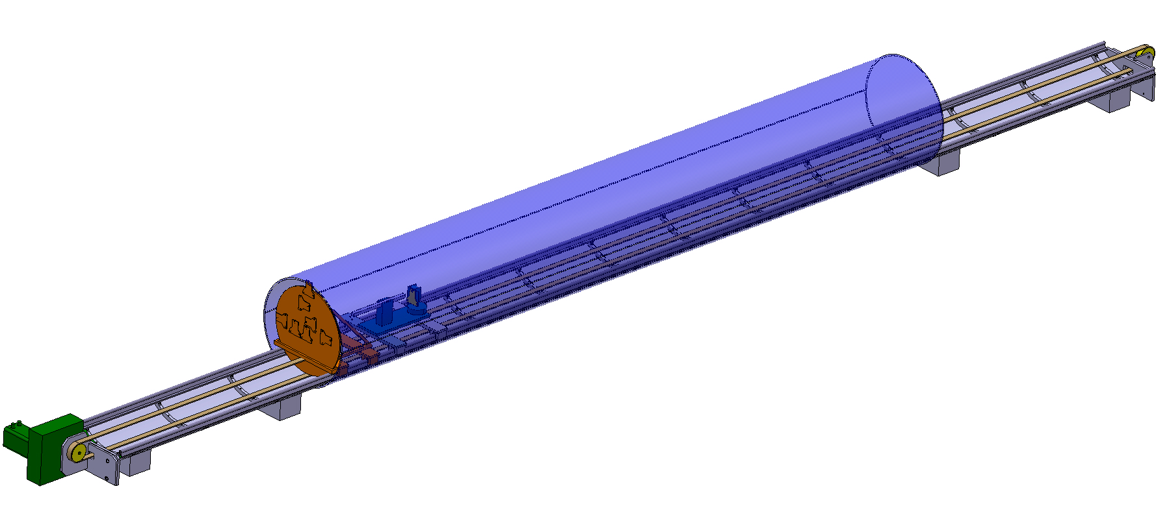
FIELD MAPPING
UNIGE + CERN F. Bergsma, P.-A. Giudici
Revolving disc
step size 5 degree
supports
No support inside magnet
independent of magnet shape
supports

Slide 20
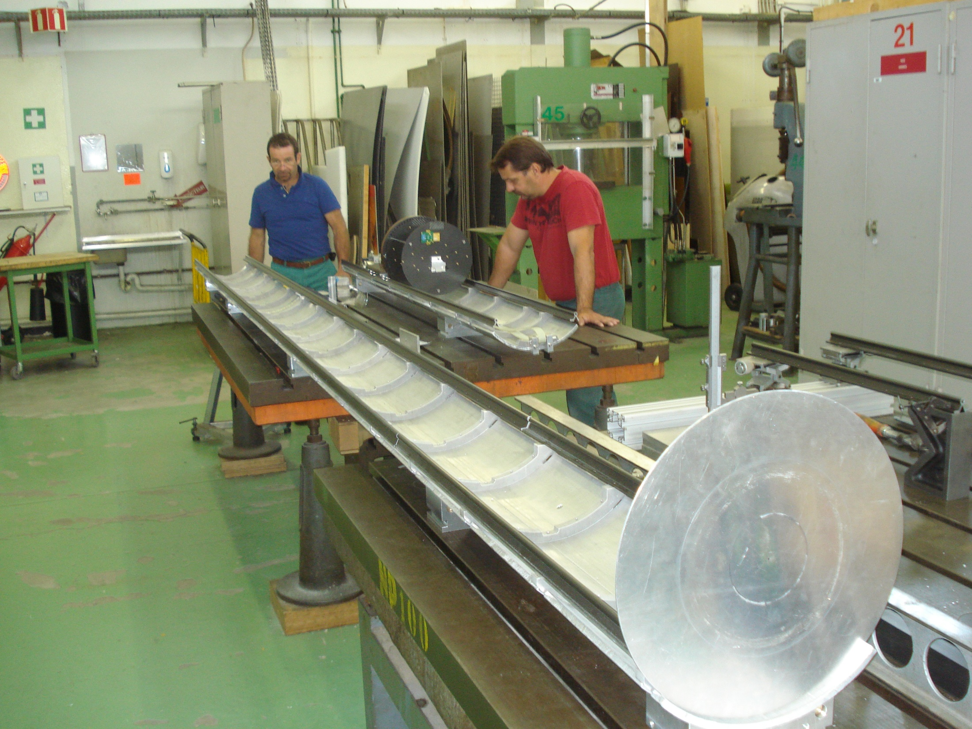
2 m
Cradles need rectification
cradles
5 m
400 mm

Slide 21
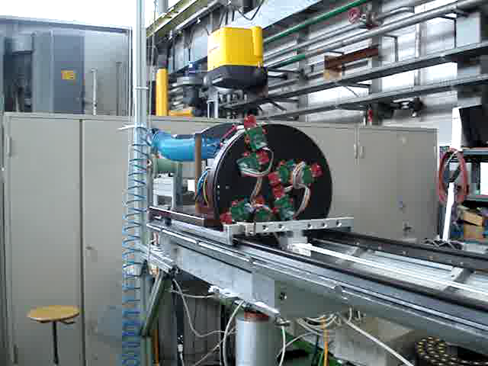

Slide 22
ISIS running 2012-2013
Typical year consists of 5 ISIS ‘user runs’ of ~35 days each + run-ups, MP.
5 more periods April 2013 to April 2014
additional step IV running + Step V installation (priority)
Next Long Shut Down envisaged: Aug. 2014 to February 2015
New target, Step I
full EMR run
Step IV
Installation +
Field mapping
Maybe some step IV
Step IV:
empty/LH2/(LHe)
no absorber
flat LiH
LiH wedge
+ reserve

Slide 23
Estimated visits in 2012 → April 2013 for UNIGE + CERN
Run in February-March 4 people 2 weeks
EMR installation May 2012 1 engineer + 2 technicians 1 week
physicists 2x4weeks
Field mappings 4x 2weeks
MOM 4 weeks
Running dec. 2012- April 2013 est 8-12 weeks
Spokesperson 15 weeks
Total estimate: 58 weeks or
300-350 days (including CERN field mapping)

Slide 24
Conclusions
MICE TNA program has been extremely useful for MICE
Beneficiaries have provided :
-- 25% of MOM time
-- allows smooth presence of DAQ, Online, TOF, KL all critical to the experiment
-- so far a significant part of MICE experiment hardware …and results!
Upcoming
-- MICE EMR (also a prototype for future neutrino detectors)
-- Magnetic measurements
-- MICE step IV data taking (~1 year starting dec 2012)

