Slide 1
Searches for dilepton resonances (CMS)
Sam Harper (RAL/STFC)
13/01/12
BSM 4 LHC UK- Durham
further information can be found:
https://twiki.cern.ch/twiki/bin/view/CMSPublic/PhysicsResultsEXO

Slide 2
Introduction
a di-lepton is a very clean final state for a hadron collider
easily identifiable final state with low backgrounds
for ee + µµ, tau is different story
has a handy calibration point: Z⁰
can study selection efficiency, cross-check luminosity and calibrate calorimeter energy and tracker p_{T} scales
broad sensitivity to a wealth of new physics scenarios
Z's, Technicolor, SUSY, Little Higgs, Large Extra Dimensions (ADD), Universal Extra Dimensions, Warped Extra Dimensions
all of the above can show up as an excess in the di-lepton mass spectrum

Slide 3
Analysis Strategy
search is are inclusive and model independent
just look for an excess above a background
search assumes a ‘narrow’ resonance
no specific topological cuts beyond basic ones
challenges:
understanding behaviour of electrons and muons at high p_{T}
particularly challenging for eles as there is no abundant high p_{T} source
analysis is very reliant on MC at high energies for backgrounds and signal studies, this must be proven to model well
understanding SM backgrounds at high mass
looking at the tails is always a challenge
data driven methods are a must
in general, main Z’ challenge is not finding the Z’ but proving you didn’t throw it away when you don’t find it

Slide 4
Triggering: Electrons
Z’ analysis lives and dies by the trigger
Main trigger: two EM clusters with E_{T} > 33 GeV matched to hits in the two inner most tracker layers, with loose cuts on longitudinal and lateral showershape
Efficiency: >99% for two offline selected electrons
High E_{T} thresholds allow a loose trigger to be used
requires offline cut of 35 GeV (barrel), 40 GeV (endcap)
Loose trigger lowers chance of something going wrong and allows for a more flexible analysis
Safety trigger: 200 GeV supercluster
No cuts beyond spike killing
Only e/gamma trigger in CMS without a H/E cut
Just incase things arent as we expect…

Slide 5
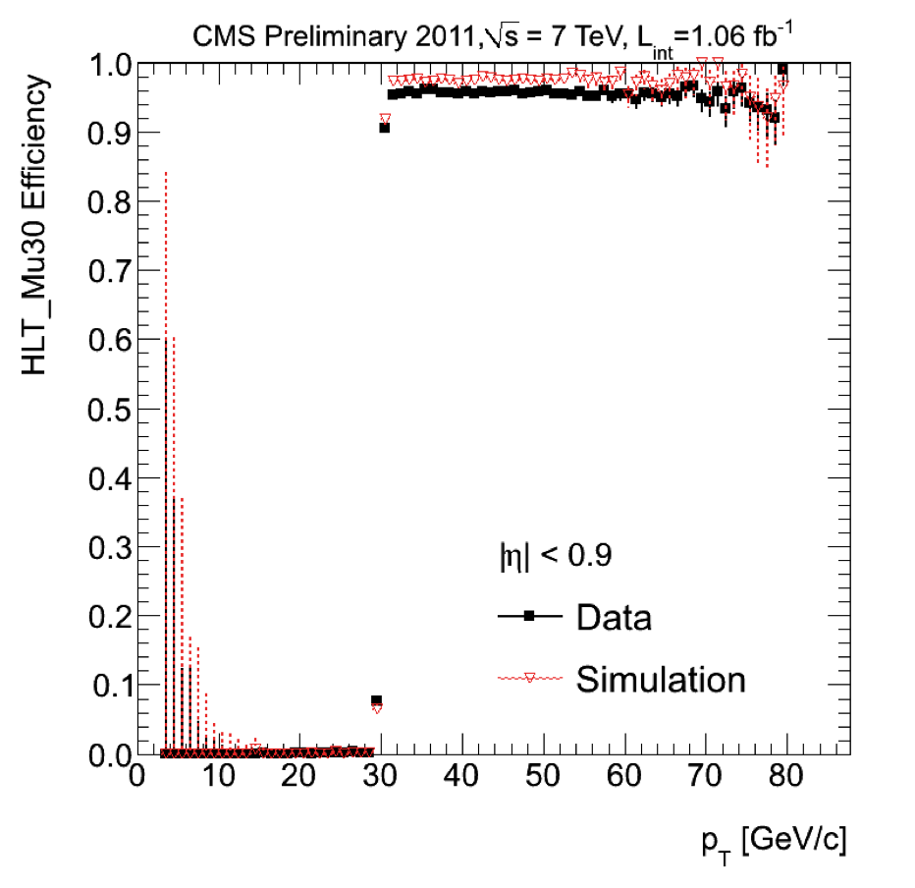
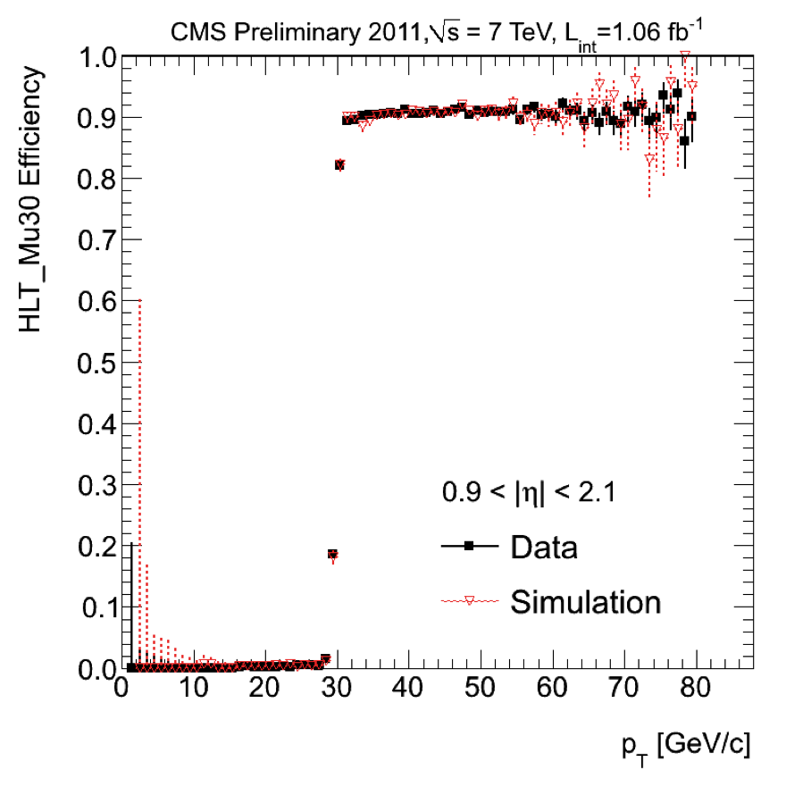
Triggering: Muons
Main trigger: single muon trigger at 30 GeV
offline cut: 35 GeV/c
should hold around 30-40 GeV next year
90-95% efficient, mainly from L1
Prefer high threshold single muon trigger to lower threshold double muon trigger

Slide 6
Object ID
both eles/mu use simple cut based ID
designed to be well modelled in MC
electron separated out into barrel (|η|<1.442) and endcap (1.56<|η|<2.5) regions
muons do not have this gap and are divided into (|η|<0.9) and (0.9|η|<2.4)
cuts tuned on MC and sideband regions
electron cuts were chosen in 2009!
efficiencies estimated by MC corrected by a scale factor measured at Z peak
muon eff const in p_{T}
ele eff const after ~100 GeV
Corrected MC Eff past 100 GeV
 | central | forward
ele | 89±2 | 84±3
mu | 96.4±0.2 | 96.0±0.03
MC eff scale factor
 | central | forward
ele | 1.008±0.011 | 1.017±0.01
mu | 0.999±0.003 | 0.983±0.05
comment on pile up
muon + ele ID PU safe at high p_{T}
muon only uses tracker isolation
eles: leakage into ele cone dominates PU contribution >100 GeV

Slide 7
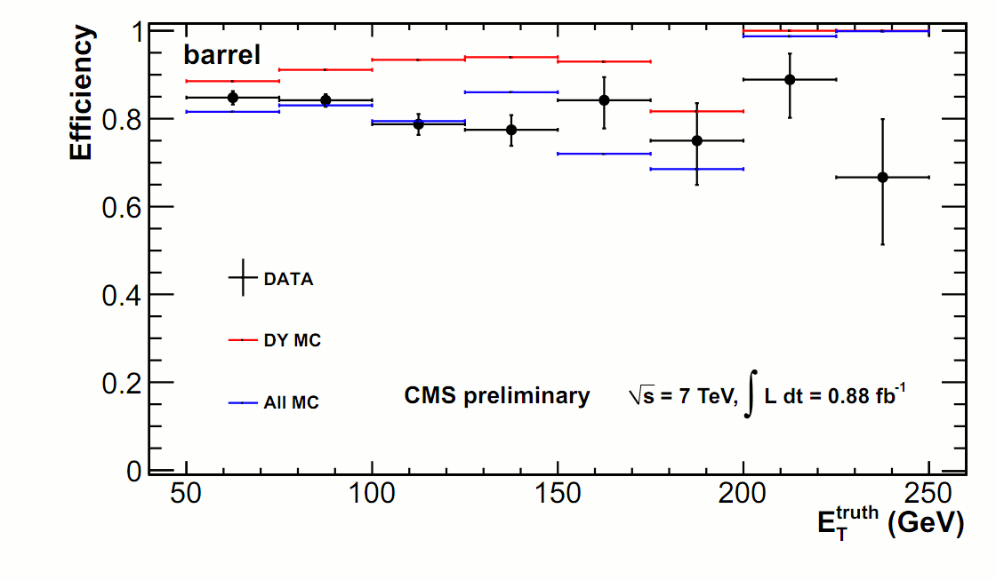
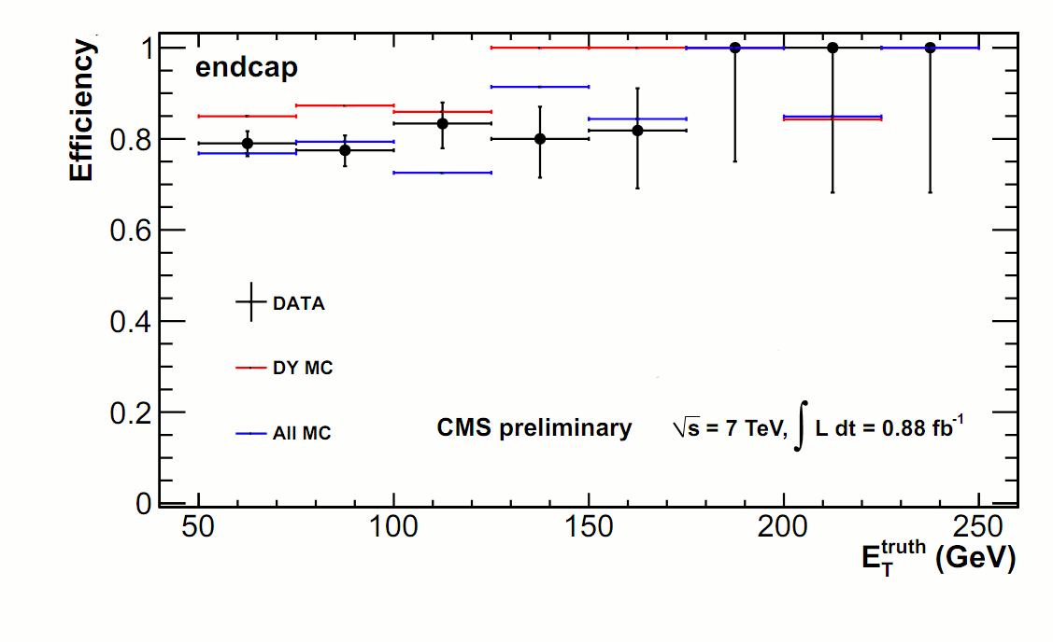
Electron Selection at High Mass
we know MC works well at Z peak but does it work at TeV
need to check data/MC agreement vs E_{T}
use tag&probe off the Z peak
challenging to measure the efficiency off the Z peak
statistics are low
w+jets becomes significant
Simulation tracks data vs energy
know this within few %
can trust MC extrapolations at high mass!

Slide 8
Backgrounds to New Physics
Principle backgrounds are:
SM Drell-Yan: γ*/Z-> l⁺l⁻
shape taken from Monte Carlo
normalisation taken from Z peak in data
t-tbar:
where tt goes to e+e-, mu+mu-
est. from MC, cross-checked in data
also includes Z->ττ, WW, WZ
Jet Background:
di-jet, W+jet events where the jets are misidentified as electrons/muons
Cosmic Ray Background:
muons from cosmic rays
estimated <0.1 event after vertex and angular difference requirements
common to both channels
only significant in ee channel, known to 40% from data driven fake rate method
only a concern in μμ channel

Slide 9
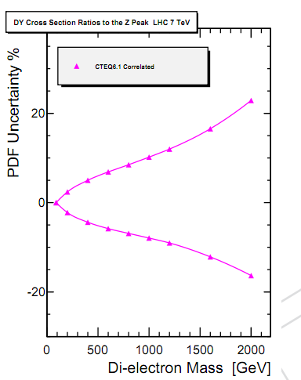
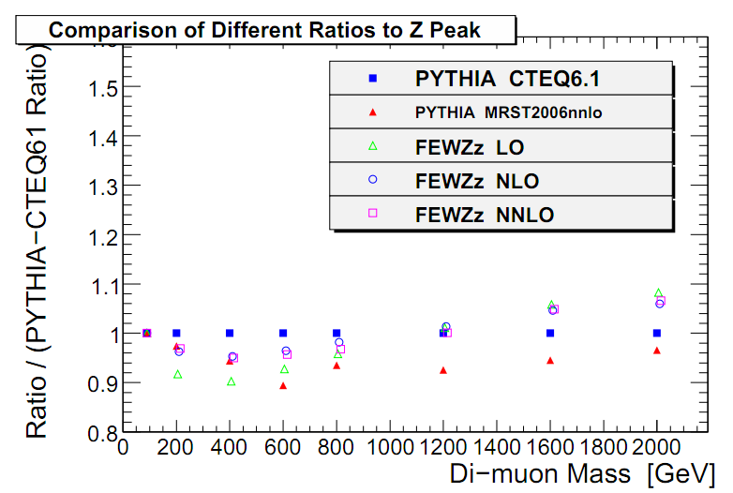
SM Drell-Yan
largest SM background to new physics
new physics may interfer, this is currently ignored
estimate using pythia normalised to the data in 60-120 GeV region
removes luminosity uncertainty
main uncertainties are due to PDF and NNLO effects
PDF uncertainties dominate
range from 6% at 0.5 TeV to 20% at 1 TeV

Slide 10
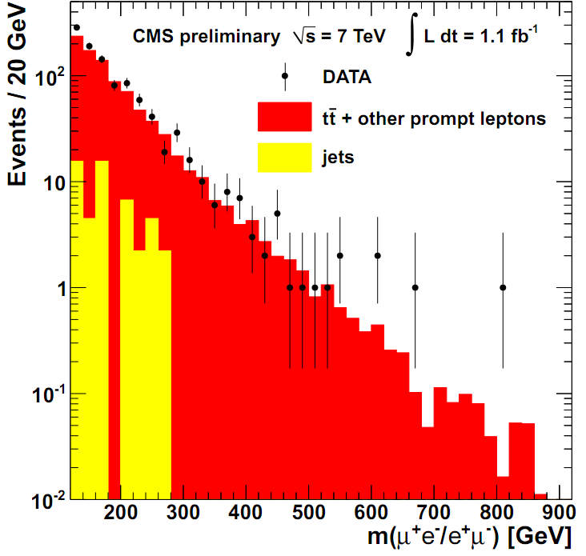
ttbar background
biggest (non Drell-Yan) bkg
need to ensure understand high mass tails
estimate from MC verified by the “e-μ” method
exploit that e-mu mass spectrum is 2x the ee mass spectrum
also includes similar processes such as WW,WZ, tau tau, single top
good agreement with prediction
for M>200 GeV
 | est using e-mu | observed
electrons | 139±8 | 124±20
muons | 194±15 | 171±22
work on going to re-inteprate this plot in terms of limits on X->emu (eg RPV Susy)

Slide 11
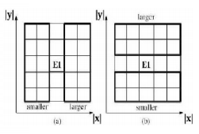
Understanding Energy/ p_{T} Scale
calibration point: Z, order magnitude away from signal region
how do we know our ECAL energy scale out there -> missing crystal method
remove centre crystal from the cluster
use surrounding crystals to estimate energy of centre crystal
these crystals are at energies we know the calibration is good
accuracy: about 2% scale with a 40% RMS
muons use cosmics to set scale
easier to understand in central region, forward regions where less new physics is expected to present

Slide 12
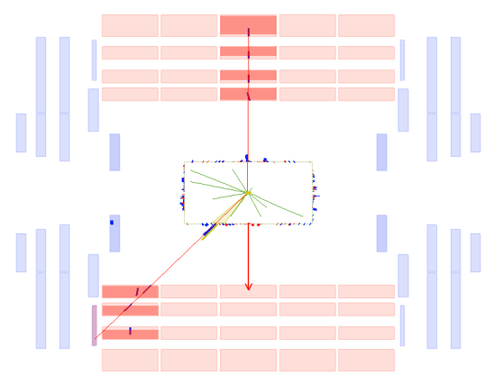
2011 Turn on: first 20 pb⁻¹
1017 GeV muon pair detected
SM bkg >900 GeV: ~0.05 events
was a nice start to the year but of course 1 event is meaningless on its own, need to wait for more

Slide 13
2011 Turn on: first 20 pb⁻¹
2 and a half hours later….

Slide 14
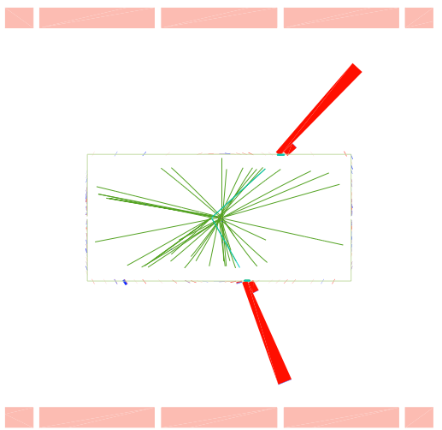
2011 Turn on: first 20 pb⁻¹
950 GeV electron pair appears
given CDF had 1 ee event at 970 GeV, Z’ physics suddenly becomes pretty interesting…

Slide 15
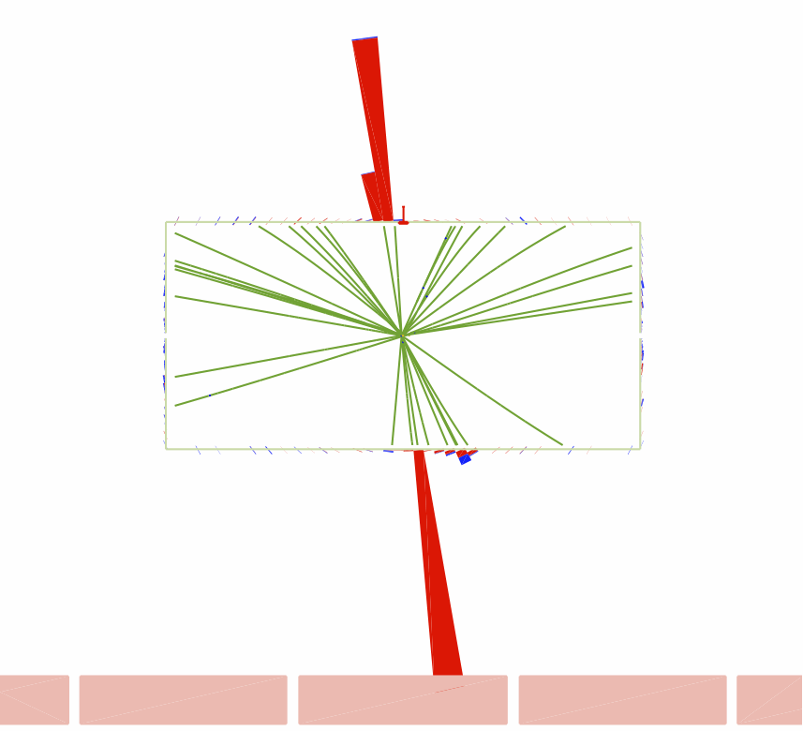
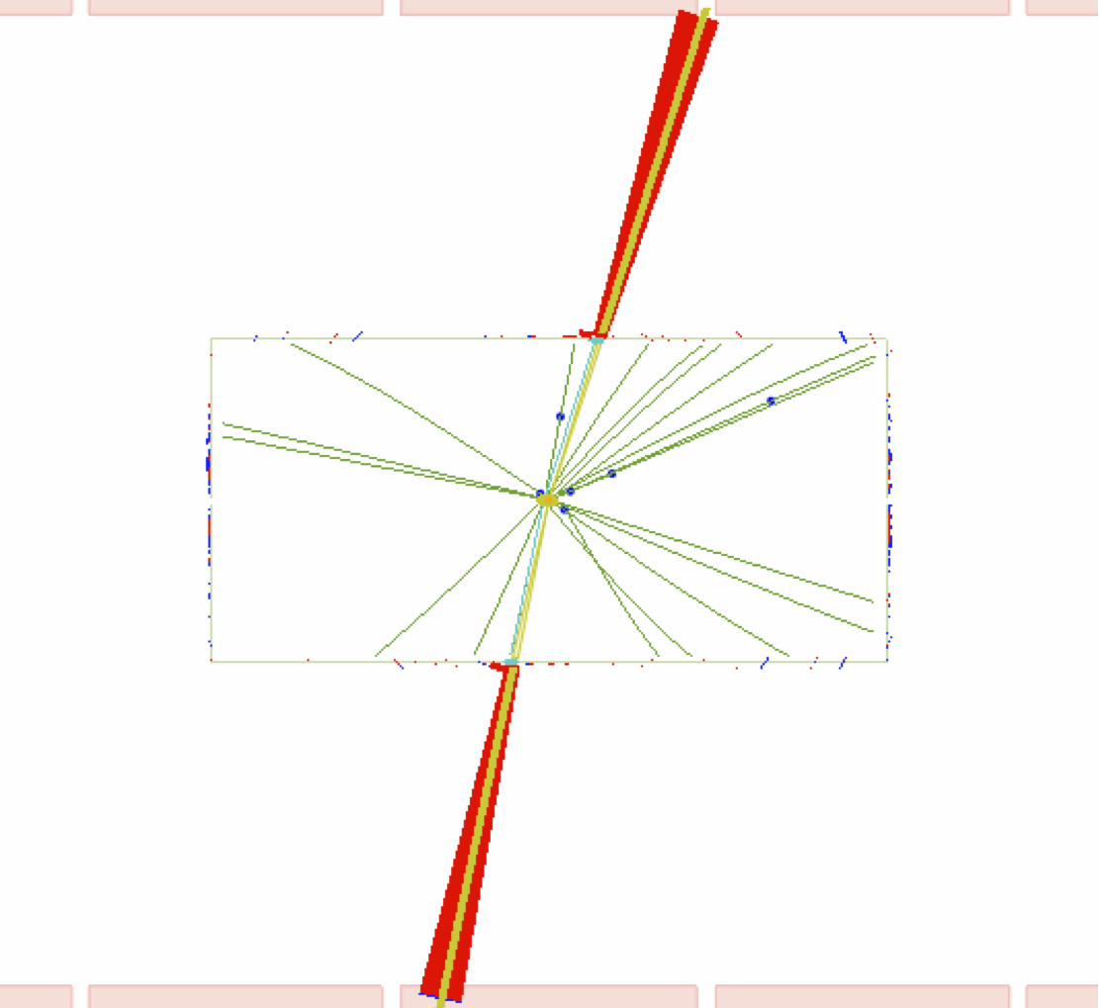
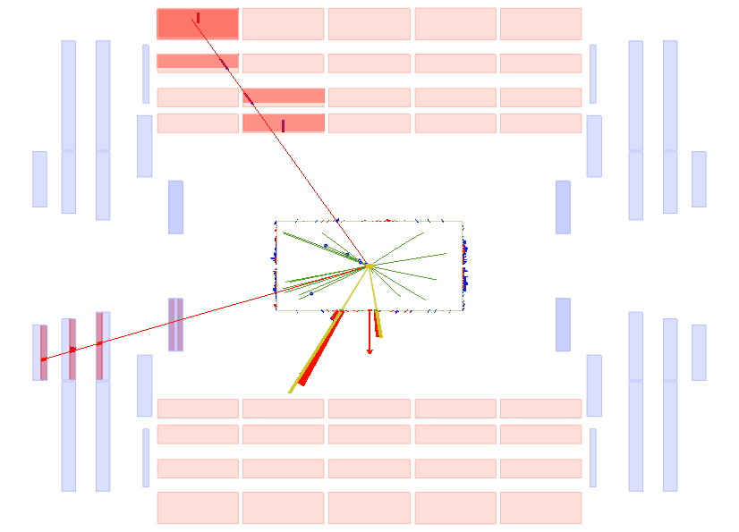
First 0.5fb⁻¹
two more electron pairs
M = 971, 930 GeV,
one muon pair,
M = 1026 GeV
ATLAS also had an electron candidate there too…
Z’ physics was getting very exciting indeed
and then nothing ☹
damn statistics…

Slide 16
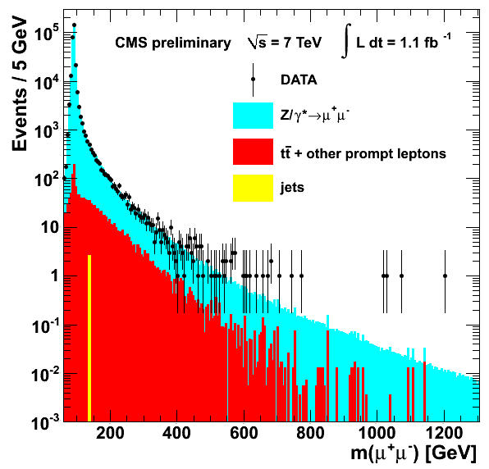
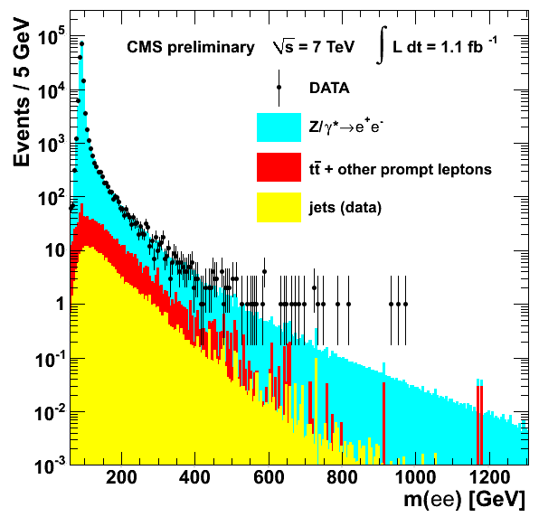
Results
search strategy:
excess with mass >200 GeV
inclusive search: mass of 2 leptons |η|<2.5, no cuts on MET / other activity in event
p_{T} > 35 GeV (40 GeV endcap electrons)
no OS required eles / OS required muons
at 1 TeV:
ele: Acc x Eff: ~64%, resolution 1.7%
improvable but not by much
muons: Acc x Eff: ~80%, resolution 7%
no magic bullet to improve sensitivity
so if no excess hint in 2011, a long time before any discovery could occur at same √s
most significant excess:
970 GeV with Z (1sided σ)=2.1
to observe such excess somewhere between 600-1800: Z = 0.2

Slide 17
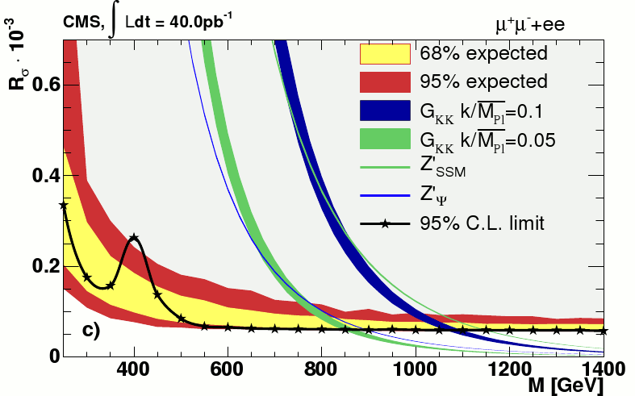
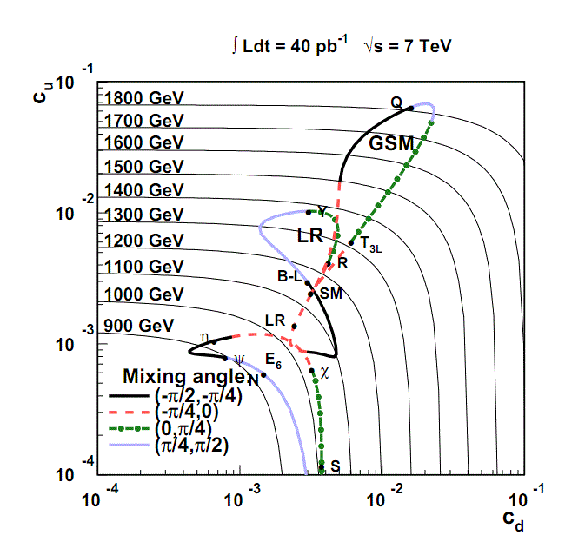
Limits
limits are slightly different to normal
σ.Br (Z’->ee) / σ.Br (Z/γ*->ee)
Z’ cross-section in window of ±40% of onshell mass
Z cross-section in range 60-120 GeV
was designed when we thought we wouldn’t understand our lumi
revisit in 2012...
for some benchmark models convert this σ.Br limit to mass limit
has very little meaning theory wise
convert limits on σ.Br to c_{u} c_{d} limits
not done for 1.1fb PAS but planned for paper
Model | Mass Limit (GeV)
 | ee | μμ | ee+μμ
Z’_{SSM} | 1730 | 1780 | 1940
Z’_{ψ} | 1440 | 1440 | 1620

Slide 18
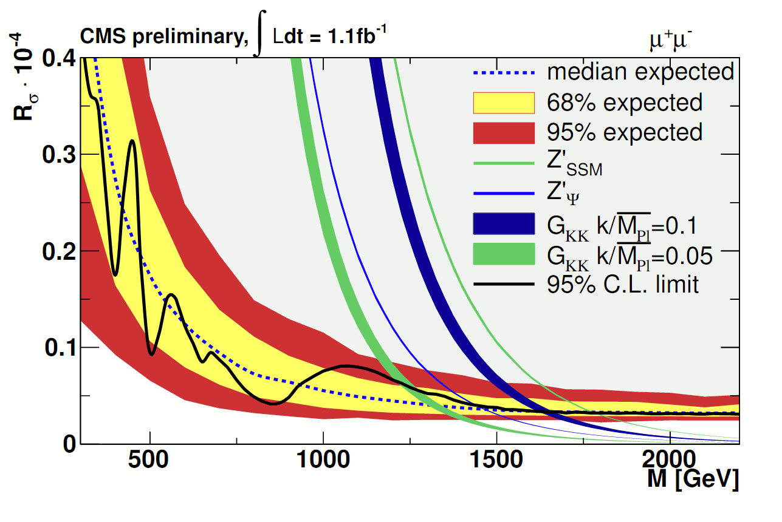
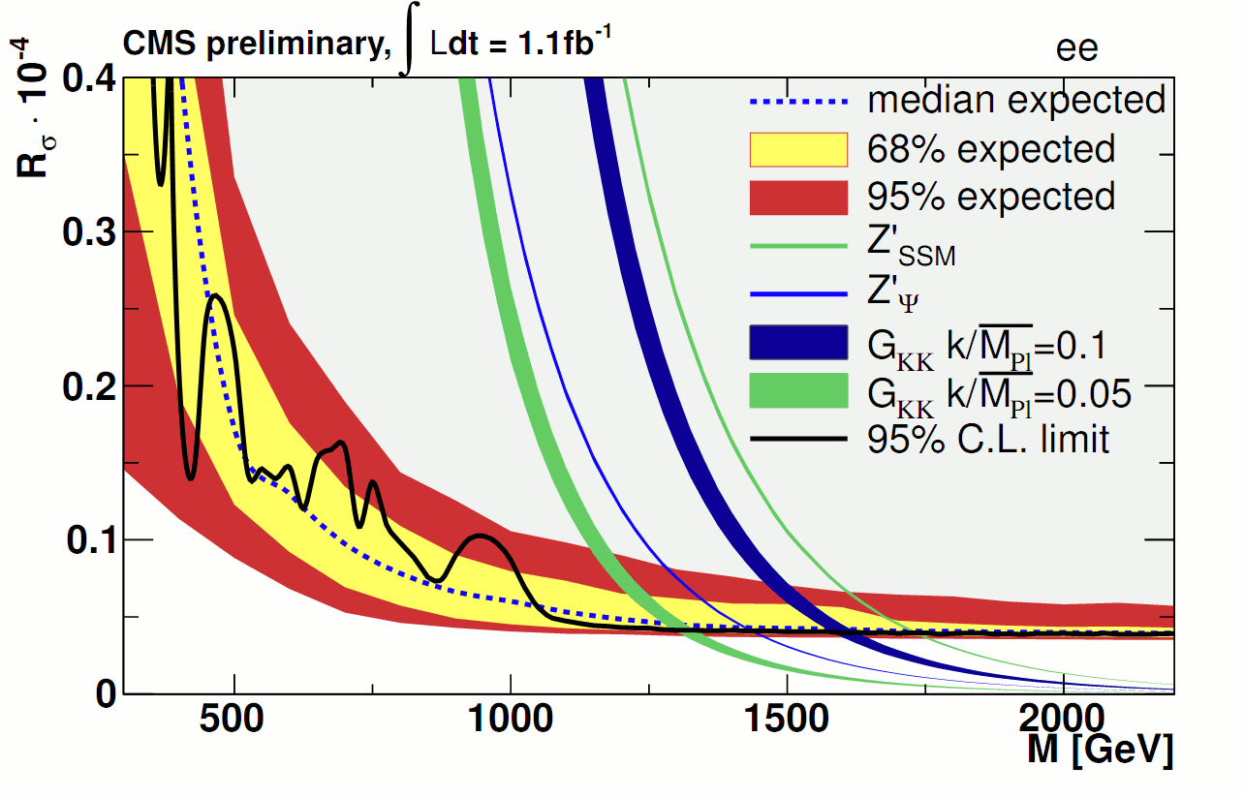
Channel Comparison at 1 TeV
at 1 TeV:
ele: Acc x Eff: ~64%, resolution 1.7%
muons: Acc x Eff: ~80%, resolution 7%
Expected limits:
5fb⁻¹ muons , 6fb⁻¹ electrons
Example Discovery:
background inside ±1.5σ at TeV:
electrons: ~0.4 events
muons: ~1.6 events
so if we have 5 events electrons, 6 events muons above background:
p-value ele: 4E-6 (6 data events)
p-value muon: 3E-4 (8 data events)
muons give better limits, electrons better at discovery

Slide 19
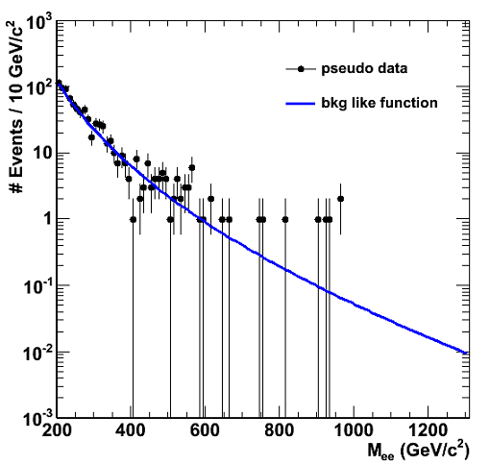
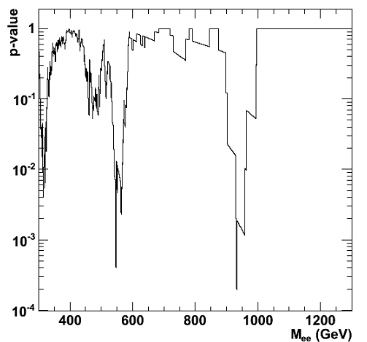
Bumps in the Night
TOY EXPERIMENT GENERATED FROM SMOOTH EXAMPLE BKG FUNC
The great thing about a Z’ search is that you will usally get a a >2 sigma local excess due to the mass range searched!
always exciting but I’m beginning to get a little jaded ;)
test using toy experiment generated using smooth bkg function similar to 1.1fb⁻¹ analysis:
gives a rough idea of effect and you can try it a home folks ☺
from toy expect p-value in range 0.005-0.055 somewhere in mass range

Slide 20
Other Channels

Slide 21
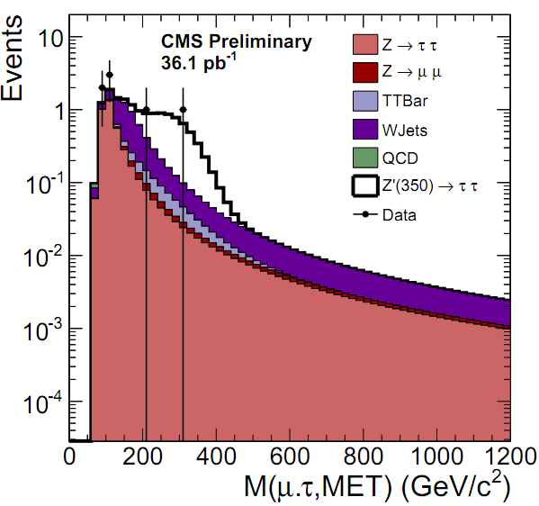
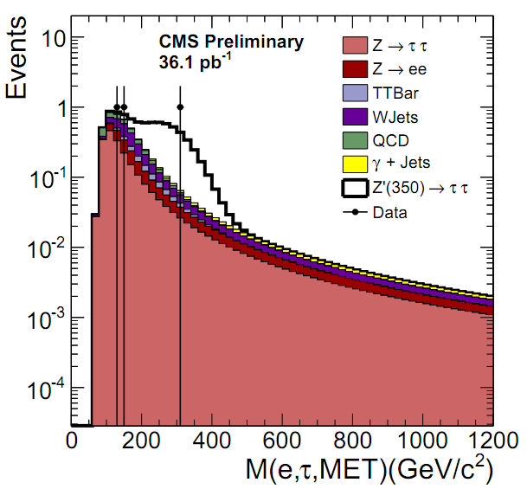
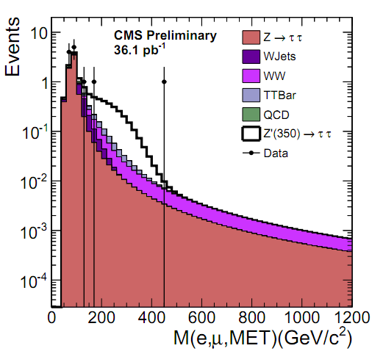
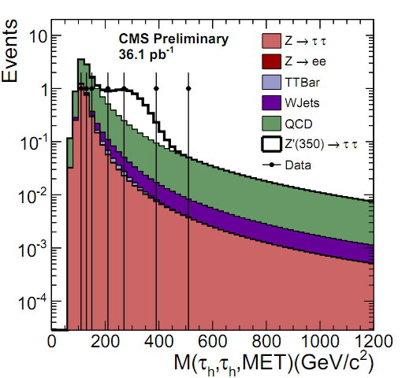
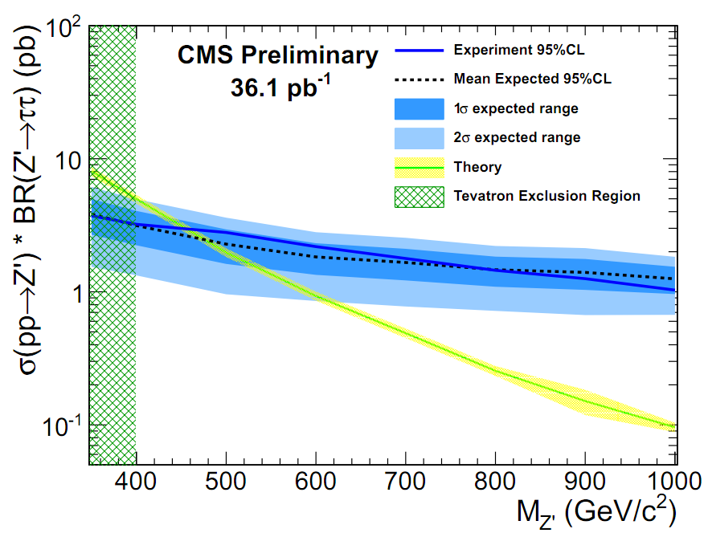
Z’->ττ
EXO-10-022
only 2010 result out
2011 result coming out very soon!
low backgrounds but complicated final state
acceptance: of order ~15% at 1 TeV over all channels (ee/μμ is ~70-80%)
MET in final state means Z’ is wide, signal will not be as clear cut as in light leptons

Slide 22
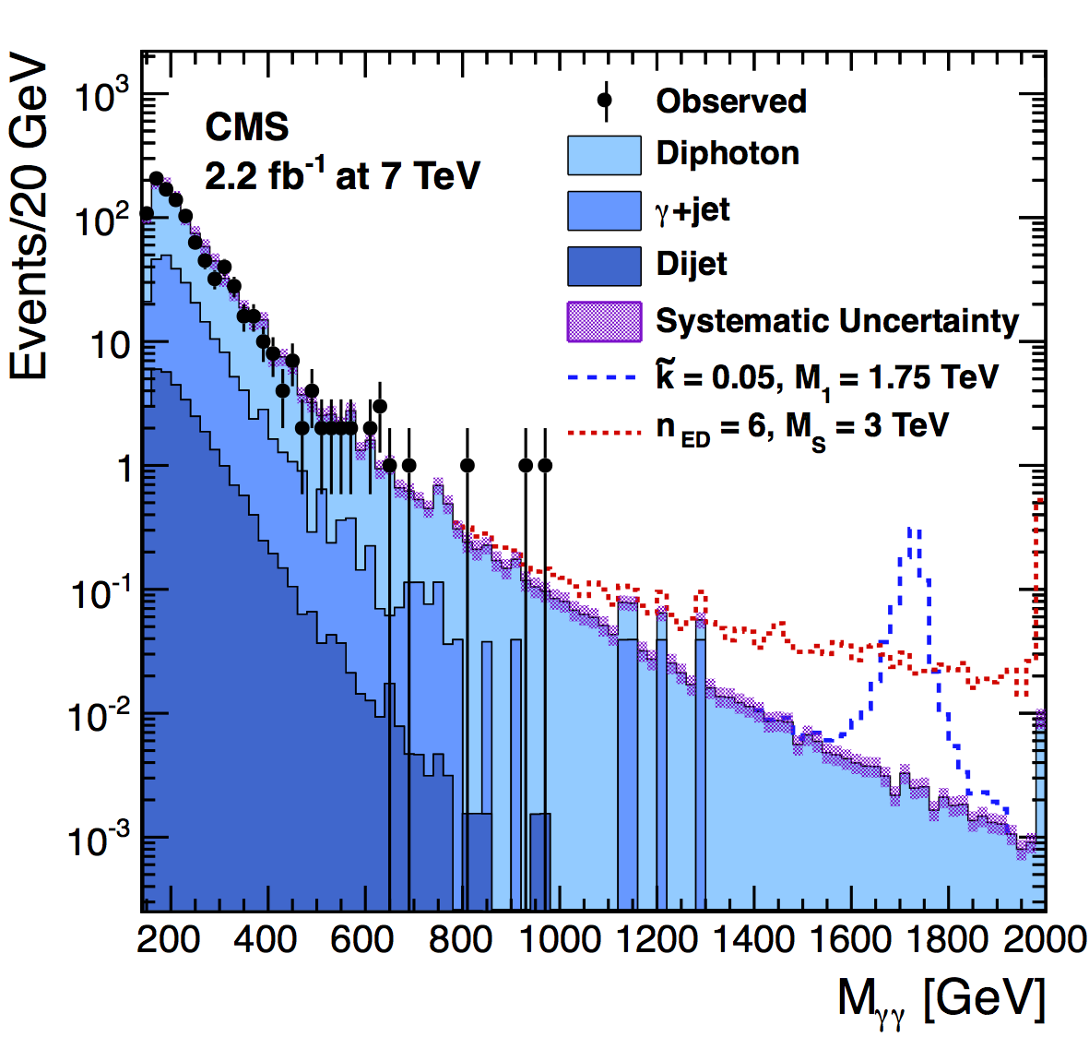
Di-Photon
arXiv:1112.0688, submitted to PRL
favoured channel for ED
factor 2 high BR to photons over eles/muons
requires two photons with E_{T} > 70 GeV, |η|<1.44
data driven background estimates of jet background
di-photon background from pythia reweighted by mass dependent NLO k-factor from DIPHOX+GAMMA2MC
searches for both warped (resonant) and ADD (non-resonant) scenarios
RS Graviton Mass Limits (TeV)
k/M_{pl} | γγ (1.1fb⁻¹) | γγ (2.2fb⁻¹) | ee + μμ
0.01 | 0.77 | 0.86 | -
0.05 | 1.41 | 1.50 | 1.45
0.10 | 1.74 | 1.84 | 1.78

Slide 23
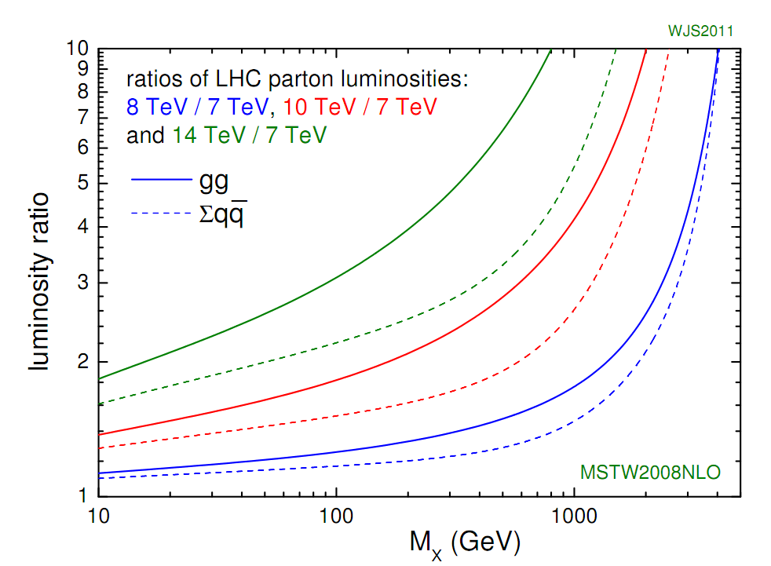
2012 Outlook
Currently LHC plans to deliver 10-16fb⁻¹ at √s=8 TeV
Z’ is big part of case for increase in energy
benefit really felt at high mass
Energy gives x1.4-1.8 at 1 TeV, x2-2.5 at 2 TeV, x10 at 3 TeV
7->8 gives us extra 10 fb⁻¹ at 2 TeV even if you throw away 7 TeV data
100-400 GeV higher reach
James Stirling
past 2 TeV: factor 30 jump compared to public result
equivalent to 2010 ->2011 jump at TeV
factor 6 compared to analysed but not public data
large phase space till to explore!

Slide 24
2012 Outlook: Limits
mass limits in TeV
 | current | 2012 (7 TeV) | 2012 (8 TeV)
Z’ SSM | 1.9 | 2.5 | 2.8
Z’ ψ | 1.6 | 2.2 | 2.4
RS G (K/M_{pl}=0.01) | 1.8 | 2.2 | 2.6
almost a TeV jump in reach in 2012!
a lot of phase space to explore ☺

Slide 25
Summary
no significant evidence of a new neutral boson found despite excitement early on
excellent dry run of our discovery procedures
near future:
Z’->ττ coming out very soon
Z’->ee/μμ 5fb⁻¹ result aiming for Moriond
this time next year:
effectively factor 30 data compaired to public result expected
CMS has several robust and mature analyses ready to quickly take advantage of whatever surprise nature has in store for us
2012: the year of the Z’
(I say this every year, one year I have to be right ☺)

Slide 26
backups

Slide 27
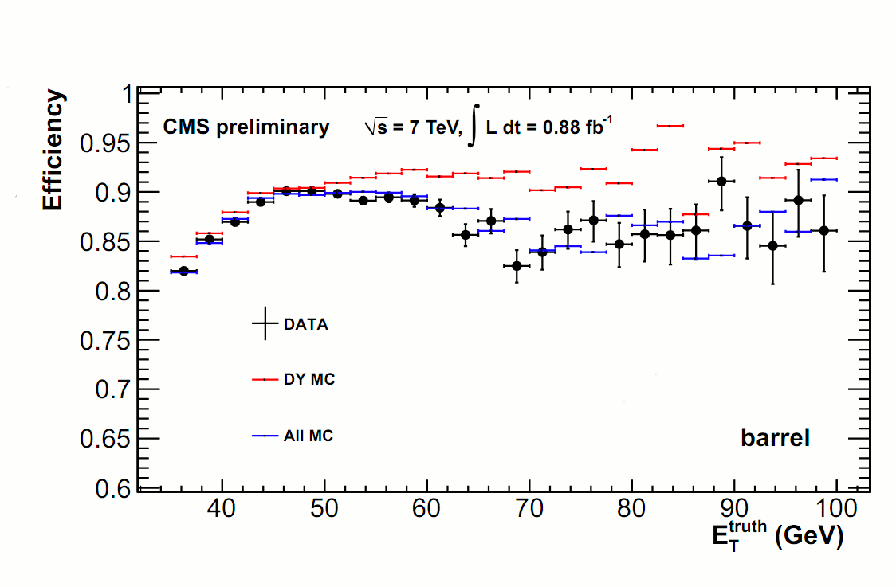
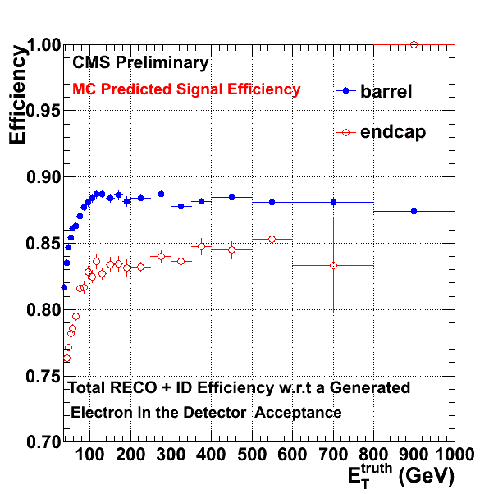
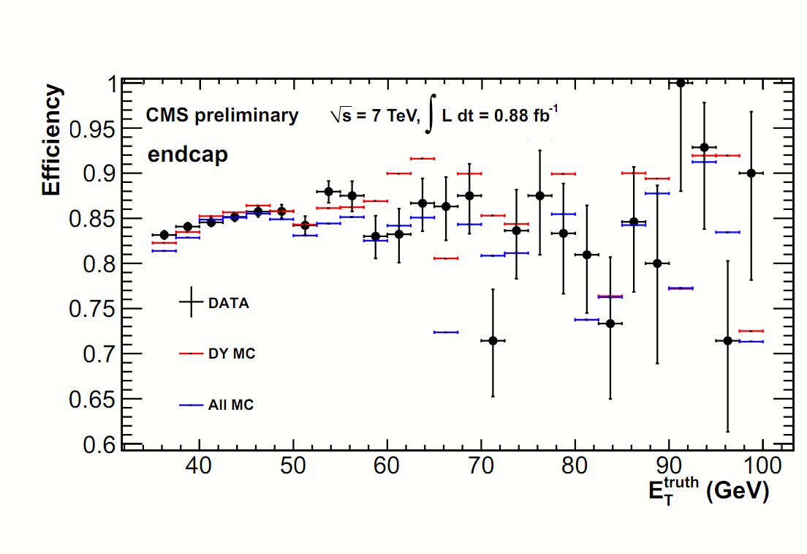
Electron Efficiencies

Slide 28
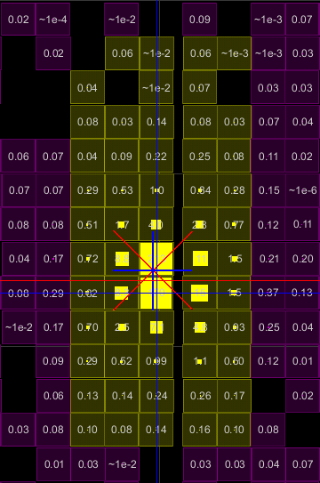
Electron Selection
selection unchanged since pre-LHC 2010 startup (trumph of simulation!)
selection is unbiased!
shower-shape consistent with that of an electron
EB: 93% of its energy in in 2 crystal strip in η, or 83% in 1 crystal strip
EE: RMS of η width of shower < 0.66 crystal
well matched prompt track in η/ϕ
avoid variables using tracker curvature
little hadronic energy in 0.15 cone
hadronic energy behind ele < 5% of ecal energy
isolated in 0.3 cone:
sum pt of tracks < 7.5 (EB), 15 (EE) GeV/c
only consider tracks come from electron vertex, PU safe
calorimeter energy:
barrel: < 2.0+0.03 E_{T} GeV
endcap: < 2.5 + 0.03 E_{T} GeV, <0.5 GeV HcalDepth2
each crystal is 0.0175x0.0175 in η/ϕ
noise/underlying event term
leakage of ele energy into isol cone (dominates at high energy, PU effect reduced)

Slide 29
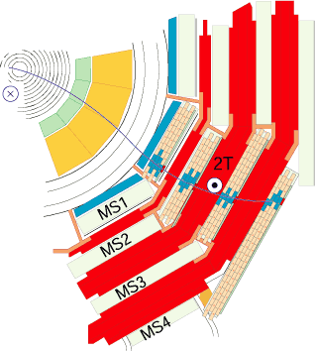
Selection: Muons
reconstruction:
reconstruct separately as tracks in
silicon tracker
muon detectors
match and fit simultaneously to form a “global muon”
selection:
10 hits in si tracker
p_{T} > 35 GeV/c
isolated in the tracker
PU safe
global fit χ² < 10
1 hit in the pixel system
hits in two muon stations
d₀ < 0.2 wr.t prim vert
ID: 95% efficient,efficiencies stable vs p_{T}

Slide 30
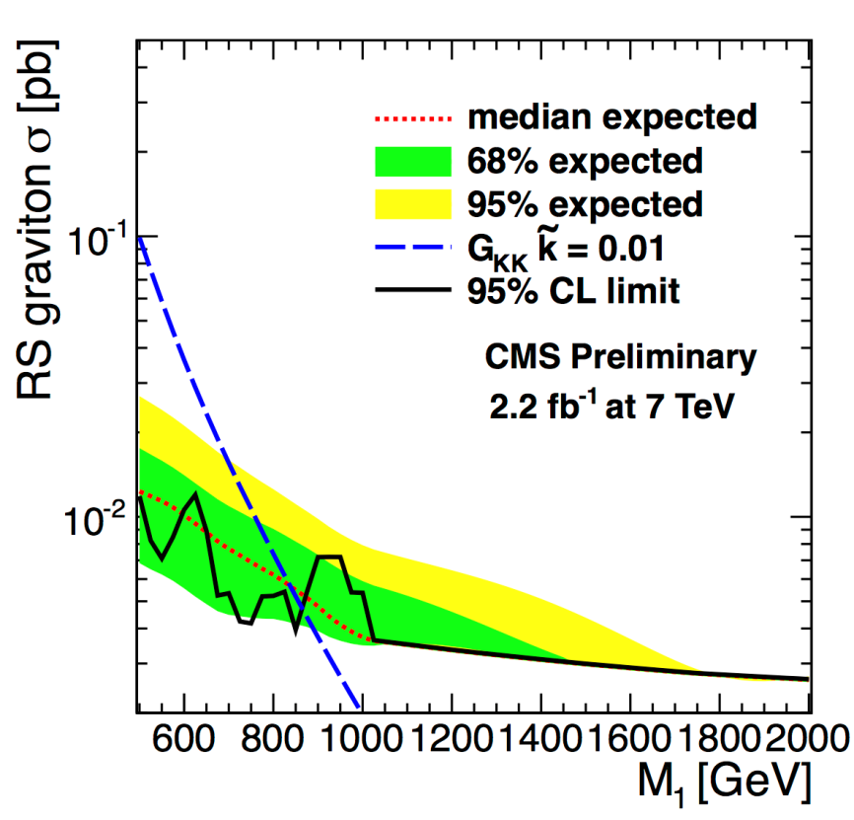
Di-Photon Resonances

Slide 31
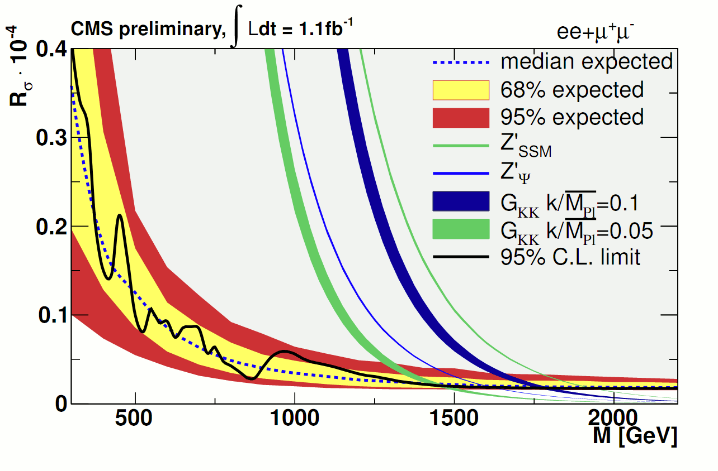
Z’->ee / µµ
limits are set using Bayesian unbinned likelihood in window of ±40% of resonance mass
roostats implementation
limits are ratio of Z’/Z σ.Br
reduces PDF uncertainties and removes luminosity dependence
muons have better expected limits due to higher acceptance but worse obs. due to 1.2 TeV muon event
Model | Mass Limit (GeV)
 | ee | μμ | ee+μμ
Z’_{SSM} | 1730 | 1780 | 1940
Z’_{ψ} | 1440 | 1440 | 1620

Slide 32
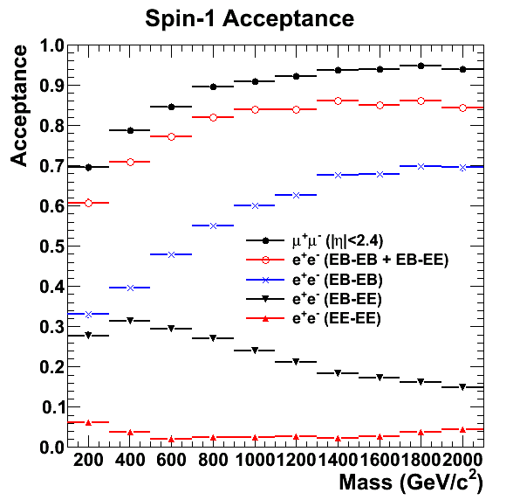
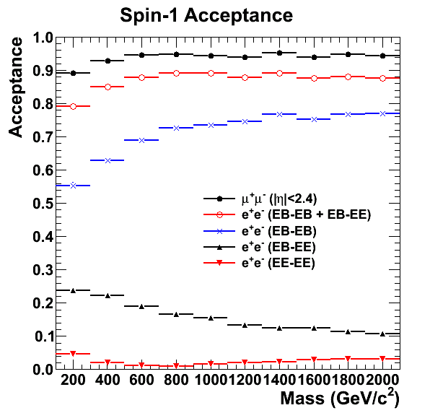
Signal Acceptance
Spin-1
Spin-2
high acceptance: ~80-90% at high mass
muons beat eles due to gap between barrel and endcap
endcap-endcap channel has small accept but large bkg
ignored in ele channel

Slide 33
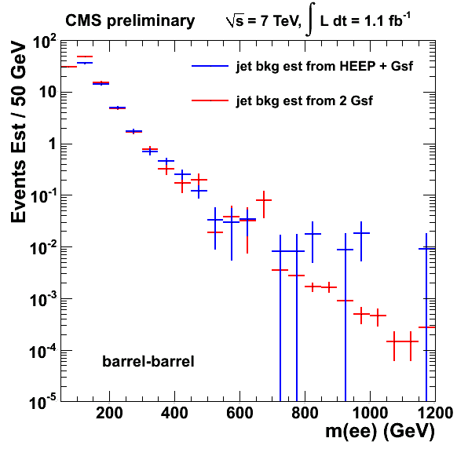
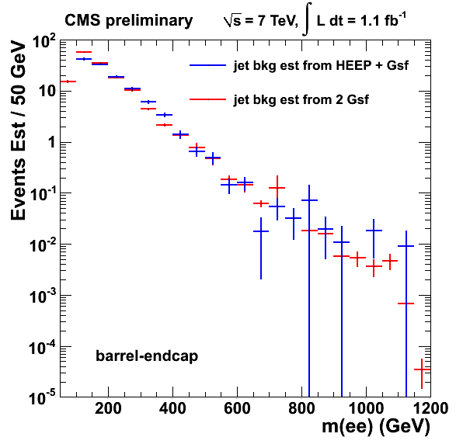
Jet Background
important in barrel-endcap region, less so in barrel-barrel
estimated using fake rate method
select events with 1 and only 1 loose electron
fraction of events remaining after applying selection = fake rate
can start from tight+loose or from 2 loose:
apply fakerate either once or twice
starting from 1 tight+ loose means contaminated by Zs
starting from 2 loose means you don’t include W+jet
closure test compare results
agreement within systematic uncertainty of 40% of method

Slide 34
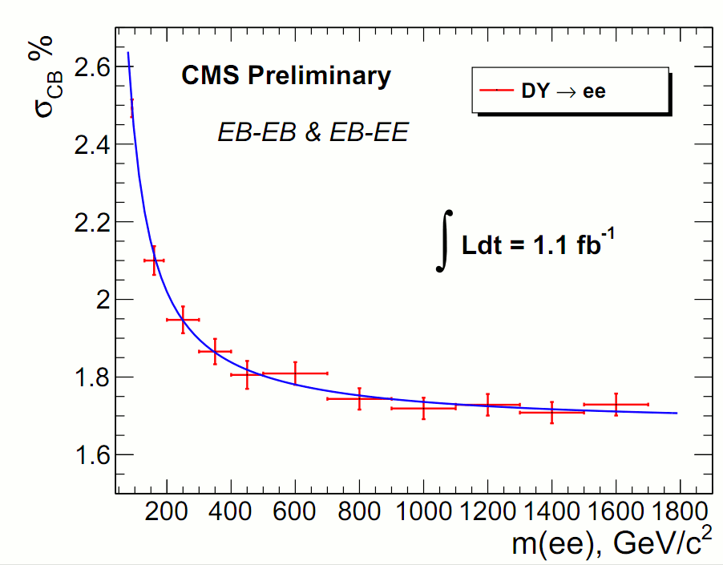
Resolution

Slide 35
35pb⁻¹ to 1.1fb⁻¹
Z’->ee/µµ exclusion from 0.05pb to 0.002pb
large jump in sensitivity
thanks LHC for the lumi!

Slide 36
Comparisons to ATLAS
only two important numbers: accxeff and resolution
backgrounds are small and are dominated by SM DY which is irreducible
both analyses are similar and straightforward
analyses equal in electrons, CMS far superior for muons
CMS will always set better limits
however muons don’t help that much for discovery past 1 TeV
large resolution means larger SM DY background washes out gain in acceptance over electrons
 | acc (ele) | res (ele) | acc (mu) | res (mu)
CMS | 64% | 1.7% | 80% | 7%
ATLAS | 65%* | ~1% | 40%* | 15%
*ATLAS accxeff quoted at 1.5 TeV but should be similar at 1 TeV
Z’ SSM limits
Model | Mass Limit (GeV)
 | ee | μμ | ee+μμ
CMS | 1730 | 1780 | 1940
ATLAS | 1700 | 1610 | 1830

