Slide 1
Neutrino Detectors
Gary Barker
(University of Warwick)
PPAP, Uni. Birmingham , 18-09-12

Slide 2
Requirements of the detectors
To have sensitivity to mass hierarchy and δ_{CP} in a single experiment will require:
Target mass at least as big as T2K/SuperK and Nova
To record neutrino interactions over a spread of energies (Wide Band Beam)
Excellent reconstruction of kinematics (esp. E_{ν})
Clean ν_{e} CC reconstruction (i.e. small ν_{μ} CC and NC backgrounds)
Ideally with charge reconstruction ability:
Essential for a Neutrino factory beam to discriminate ν_{μ}/anti− ν_{μ} (Golden Channel)
Unfolding the ν_{μ}/anti− ν_{μ} components of a conventional beam
For a Particle Astrophysics/nucleon decay/geo-neutrino programme:
Low threshold physics (< few tens MeV ): core collapse SNe, diffuse SNe remnants, thermonuclear solar neutrinos, geo-neutrinos...

Slide 3
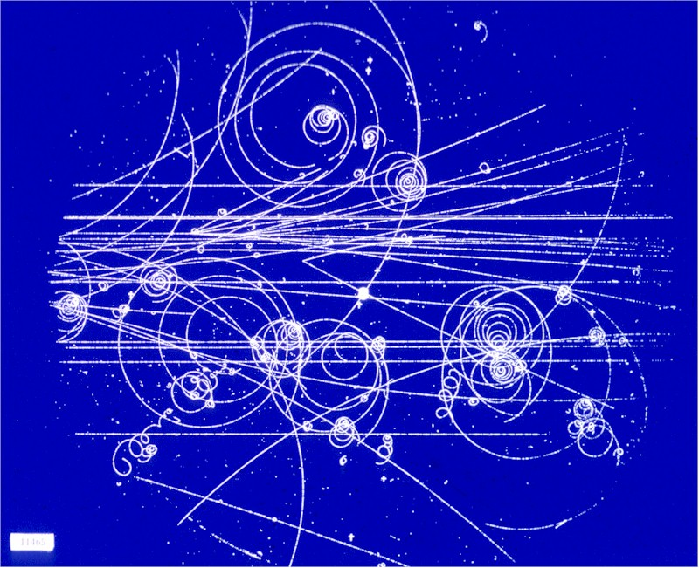
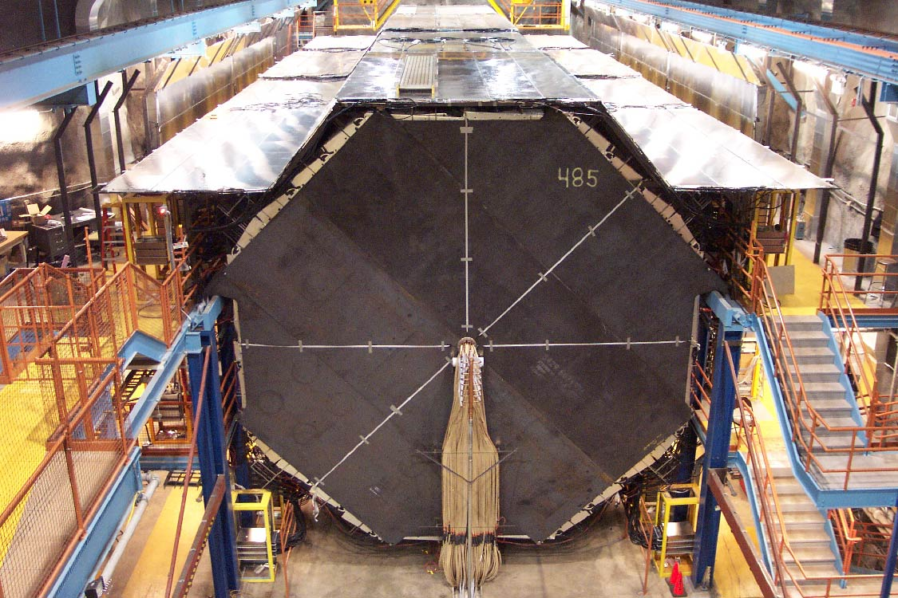
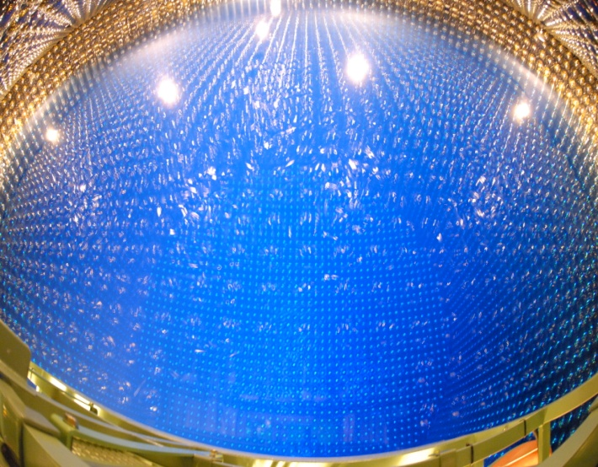
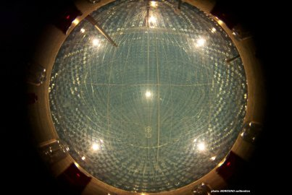
Main Technology Choices
Iron/scintillator sandwich tracking calorimeter
Liquid argon
MINOS
Water Cherenkov
Liquid scintillator
SUPERKAMIOKANDE
BOREXINO

Slide 4
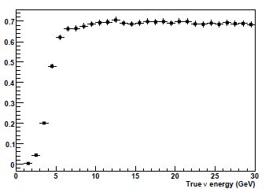
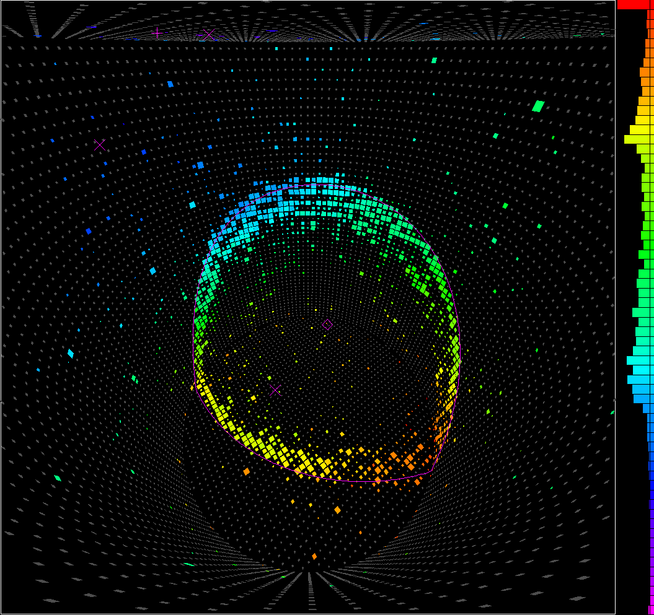
Pros and Cons
Liquid argon
Iron/scintillator sandwich tracking calorimeter
For:
True 3D imaging with pixel size ~ (3mmx3mmx0.3mm)
High granularity dE/dx (PID)
Total absorption cal. (e’s)
Relatively low energy threshold
Charge and scintillation light readout
Against: Scale-up issues?
For: Little R&D needed, optimised for Golden channel at a high energy NF
Against: Relatively high thresholds, no electron ID
Glasgow/Valencia
Glasgow/Valencia
Signal efficiency
“wrong-sign” muons
Water Cherenkov
Liquid scintillator
For:
Excellent e-muon separation
Against:
Reconstruction: only a low E_{ν} option (<OGeV)
Cherenkov threshold e.g.
Size: maybe 1Mton (x20 SuperK)
For:
Very low thresholds possible (200 p.e./MeV)
Well matched to low-energy programme
Against:
Reconstruction: similar issues to H2O at high energy, directional information difficult

Slide 5
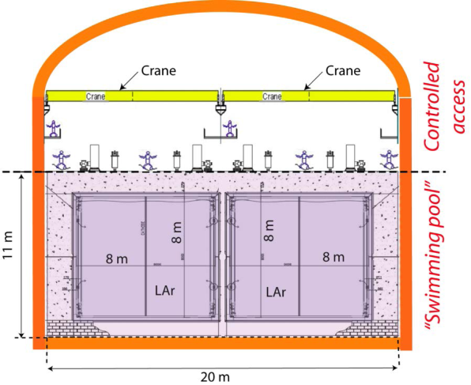
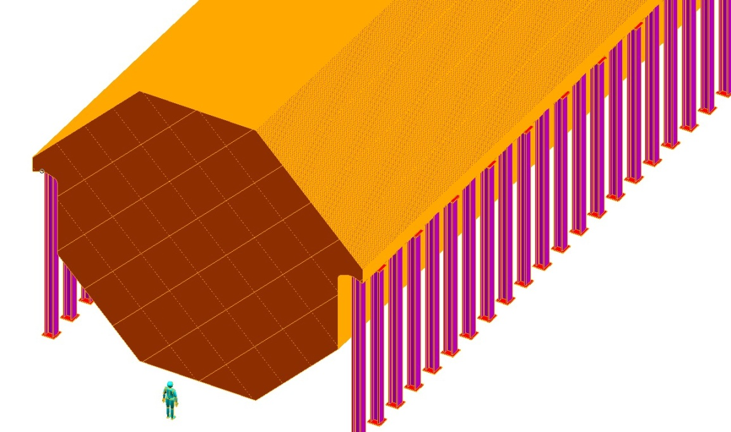
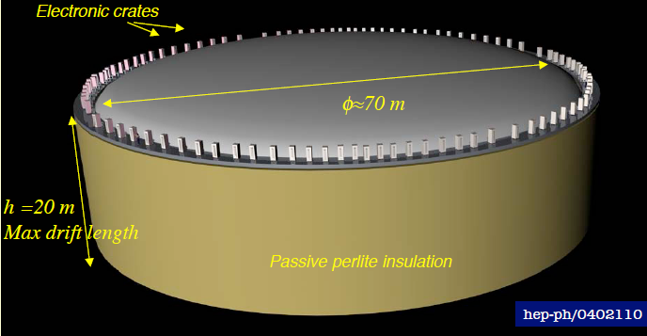
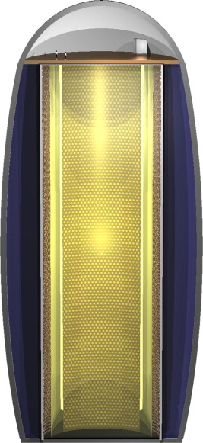
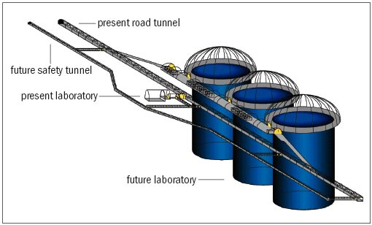
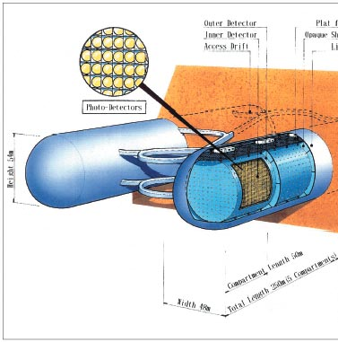
Options Worldwide
MIND: x9 MINOS @ NF
LAr: single tank (20m drift) vs modular approach (4m maximum drift )
40m x14m x 14m, B=1T
x10⁶ ton-scale water-Cherenkov detectors
Memphis in Europe
LENA: 70kt liquid scintillator (100m x 30m) with active veto for direct cosmics and fast spallation neutrons
HyperK in Japan

Slide 6
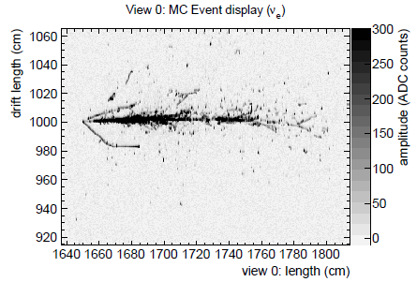
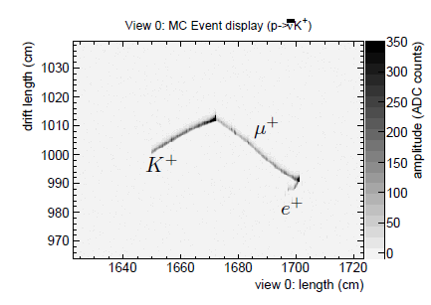
LAr TPC
UK focus has been on a LAr TPC as being the most able to provide a physics program across a broad spectrum of neutrino physics
Superb oscillation physics capability to measure oscillations as a function of energy and for ν/anti-ν separately to break MH/δ_{CP} degeneracies in a single experiment (6: 1 mass advantage c.f. Water Cherenkov)
Nucleon decay lifetime sensitivities >10³⁴ years:
  * multi-prong channels:
  * kaon channels :
(Order -of- magnitude improvement in efficiency for same background over SuperK)
Supernova burst neutrinos (for galactic event, expect O10k neutrinos/10secs for 20kt) ; sensitivity to remnant supernova neutrinos (all ν-flavours visible)

Slide 7
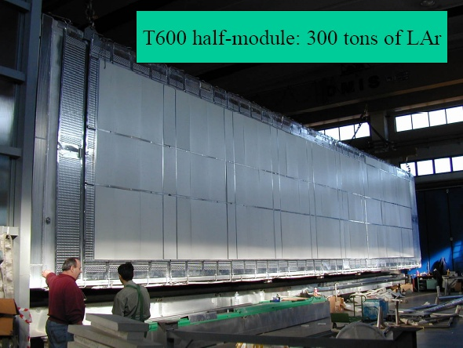
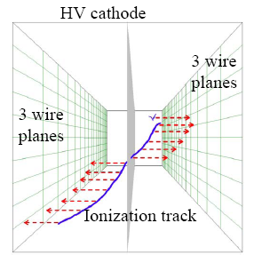
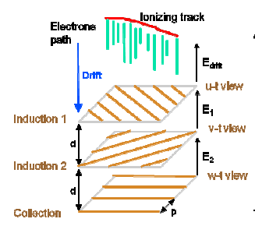
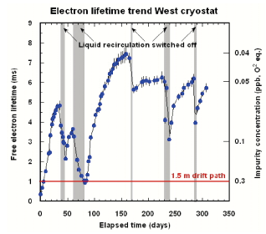
Current State of the Art: ICARUS
Jim Strait (Project Director for LBNE):`R&D for an ICARUS-style detector complete – what remains are engineering issues’

Slide 8
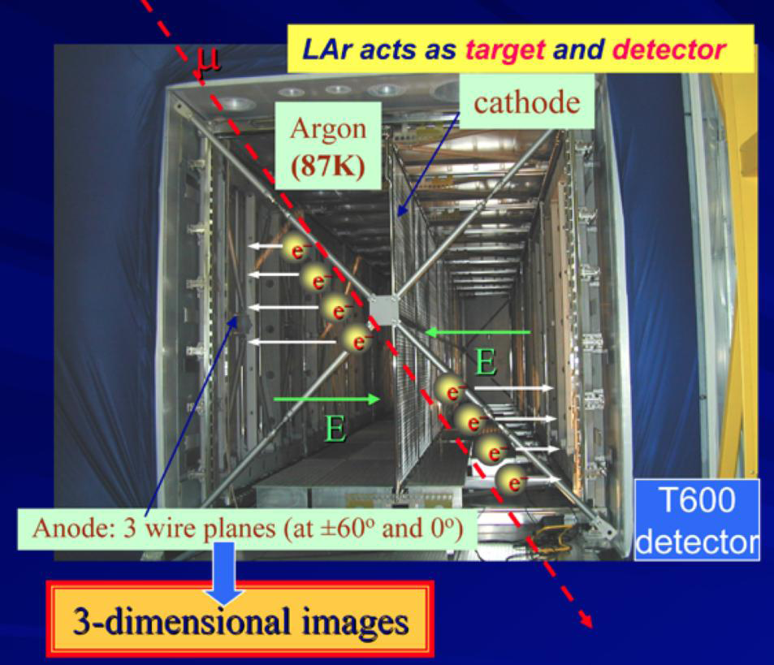
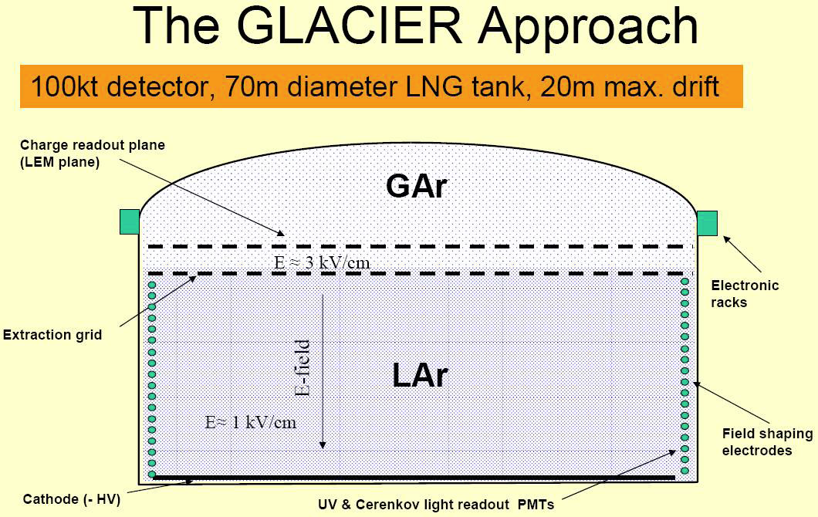
LAr: Readout Technology
Two main options
Single phase e.g. ICARUS
Double phase

Slide 9
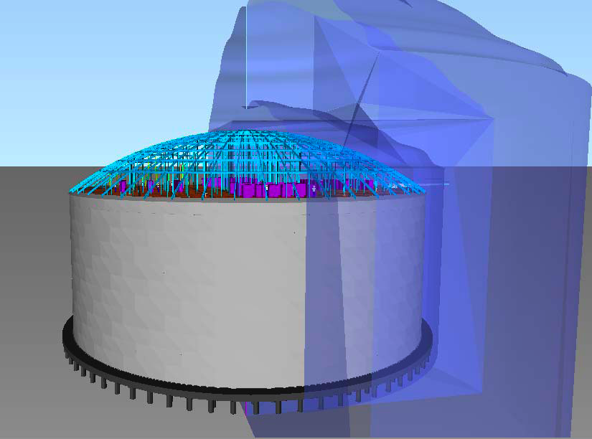
Challenges Towards a Large LAr TPC
LAr purity
Drift field
DAQ/trigger/electronics
2-phase charge readout and
light readout
Near Detectors
Engineering
Event reconstruction
UK activity (to varying degrees) in all these areas mainly through participation in Euro design studies: EuroNu, IDS-NF, LAGUNA, LAGUNA-LBNO, ASPERA....

Slide 10
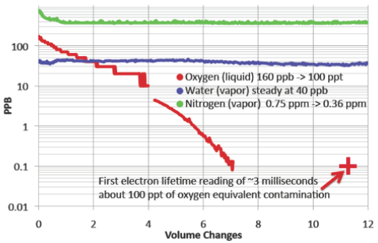
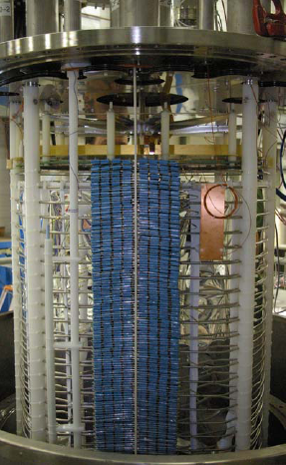
UK Focus: Purity/Field
Long drift distances in LAr(>10m) demand low electronegative impurities:
LAPD@FNAL (30t LAr volume , non-evacuated dewar) recently demonstrated 3ms electron lifetime (100 ppt oxygen equiv.)
In right ball-park: 10ms gives 20m attenuation length (for drift of 1 kV/cm)
Liverpool /ETHZ tests @CERN demonstrate `piston effect’ and impurity effect on e-lifetime studies (K. Mavrokoridis et al. JINST 6 P08003)
HV feed-throughs of ~a few MV can be avoided by internal HV generation (Cockcroft-Walton voltage multiplier)
ArDM experiment@CERN has demonstrated 1kV/cm over 1.2m (5m demonstration underway – ARGONTUBE@Bern)

Slide 11
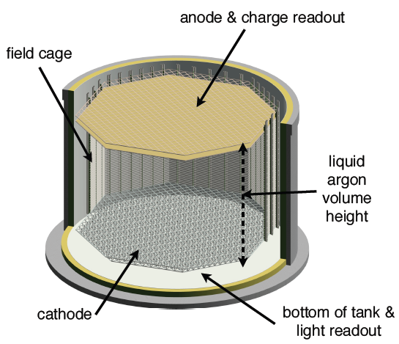
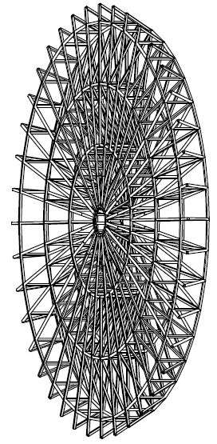
UK Focus: Engineering Solutions
UK companies* are playing a lead role in defining engineering solutions for a large LAr TPC through LAGUNA-LBNO:
  Tank design: based on industrial LNG tank with stainless steel or membrane options
  Non-standard roof : must support field cage inside and electronics from above, feed-throughs etc
  Delivery of argon underground/ventillation
  Underground risk assessment
Green light for a given project would trigger rapid engineering progress – the UK could be at forefront of this
Technodyne
* Technodyne International Ltd in collaboration with Alan Auld Ltd, Ryhal Engineering

Slide 12
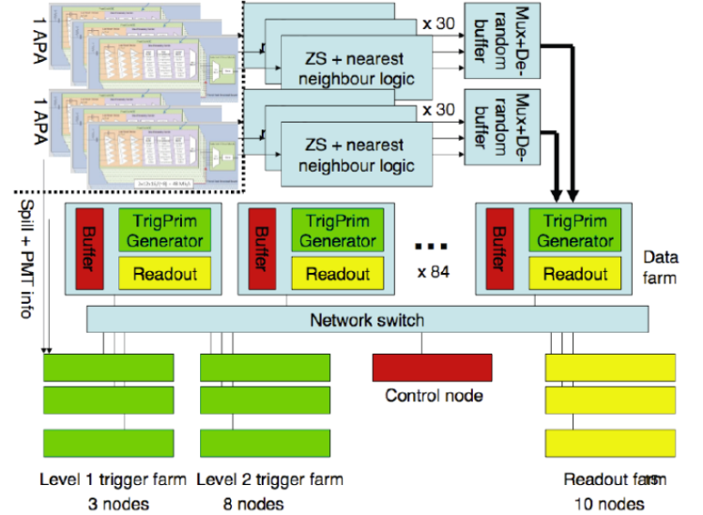
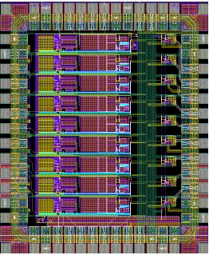
UK Focus: Electronics/DAQ
Expertise and experience (LHC, MINOS, T2K,..)
Some conceptual design work already starting:
  Generic DAQ concept for LAr (Proposed by UCL, Manchester for LBNE testbeam)
  Triggering on events with high background environment e.g. surface LAr detectors at LBNE (Oxford group)
Interesting progress in integrating more of the electronics chain (amplifier+digitiser) into dedicated CMOS ASICS running in the liquid volume itself (French and US groups)
Real international need for solutions that could put UK in strong position for future involvement
0.35 μm CMOS amp. working at cryogenic temps. (IPNL, Lyon)

Slide 13
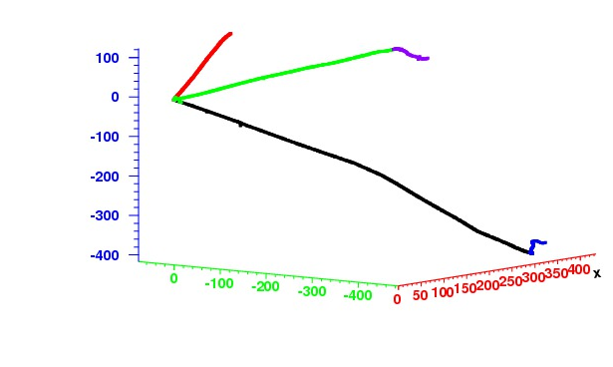
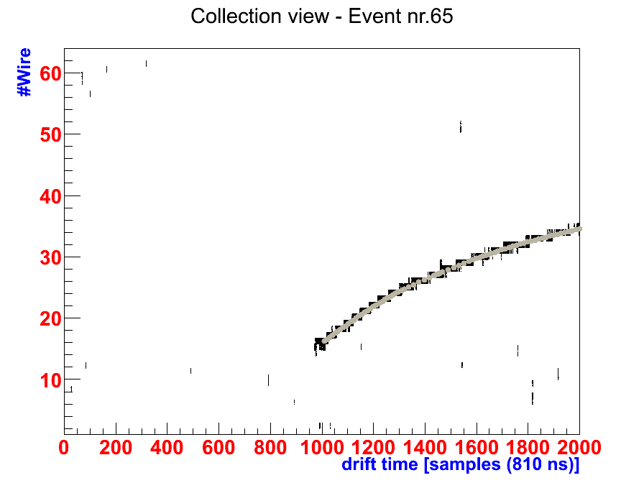
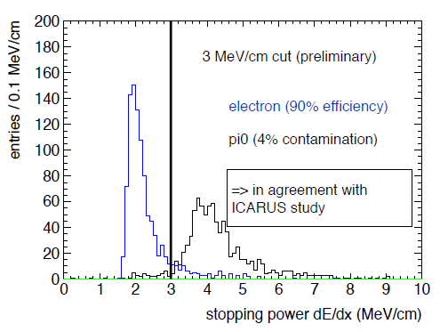
UK Focus: Reconstruction
True automatic event reconstruction only recently seriously developed:
Neutrino event topology reconstruction (cellular automaton, principle curves), e-mag/hadron shower separation (Warwick)
First application to ARGONTUBE data – measure diffusion constants over 5m drift (Warwick)
Electron/pi0 separation using dE/dx ; energy resolution; hit simulation (QMUL/ETHZ)
Cambridge starting to apply particle flow algorithms for LBNE LAr studies
Sheffield leading cosmic background studies @ LBNE
LAr simulation
ARGONTUBE data

Slide 14
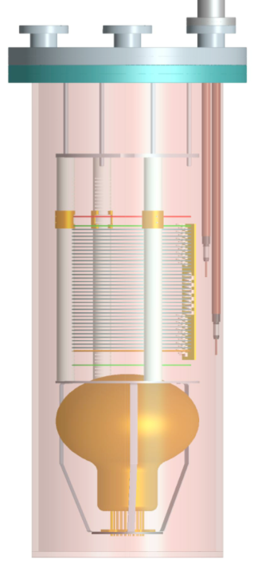
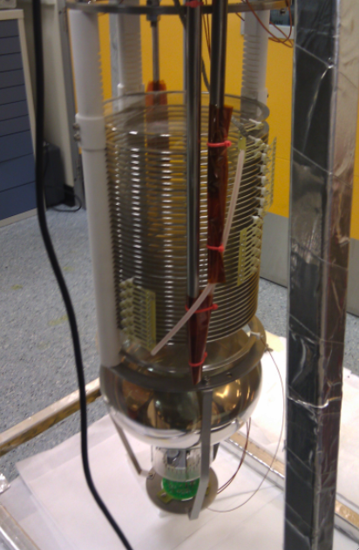
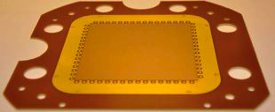
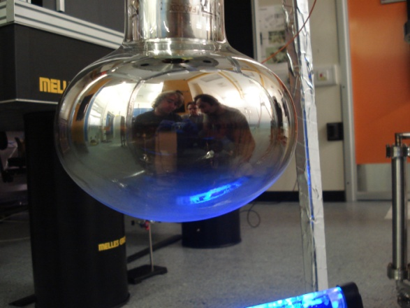
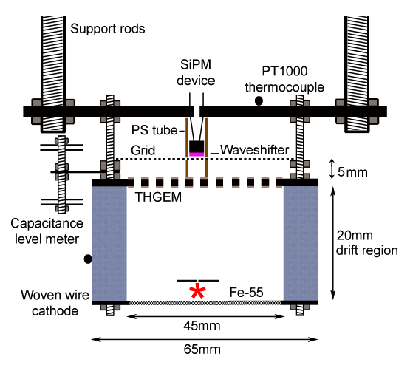
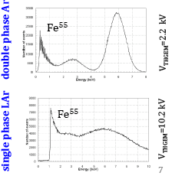
UK Focus: Readout R&D
Liverpool LAr test-stand (40l) working with CEA-Saclay to investigate bulk MicroMegas for charge amplification
Prompt light important for t₀/triggering. Liverpool /Sheffield WLS coatings for PMT’s (128nm->430nm).
Warwick and Sheffield have investigated possibility of using secondary scintillation emission from TGEM in single phase experiment
P K Lightfoot et al., JINST 4:P04002,2009

Slide 15
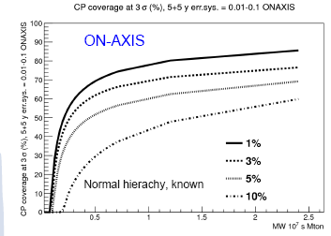
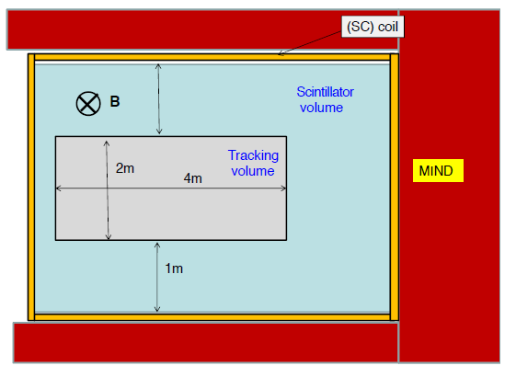
UK Focus:Near Detectors
Used to constrain (un-oscillated) event rate at far detector in LBL experiments
Essential to control beam flux systematics at 5% or better for δ_{CP}-reach in any of the future LBL projects
UK experience e.g. T2K ND280 (ECAL, DAQ, engineering) and Glasgow have studied for a Neutrino Factory
Hybrid design under consideration: 10- bar argon gas TPC surrounded by scintillator bars (readout as in T2K) to contain showers + 0.5T B-field
A. Longhin @nuTURN
Near detector concept for LBNO

Slide 16
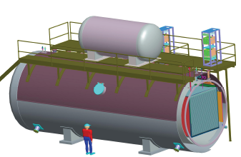
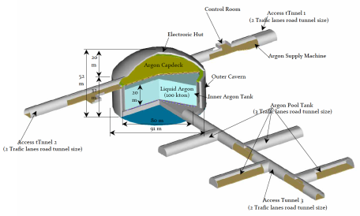
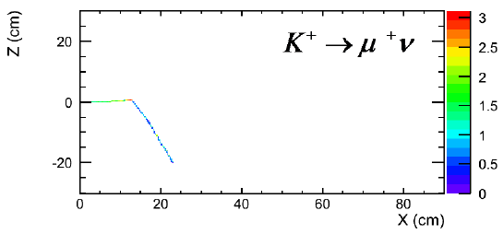
Short-term opportunities (1)
MicroBooNE
US: MicroBooNE (low E cross sections, MiniBooNE anomaly+R&D) leading onto LBNE 10kt (or even 5kt+5kt) ?
Japan: prototype work in 340MeV/c kaon beamline @ JPARC (reconstruction work) leading onto large detector at Okinoshima?
100kt Lar @ Okinoshima
AIDA(Euro Integrating Activity Project): Test beam infrastructure (tagged electrons and muons with charge ID) at CERN for neutrino detector prototyping : MiniMIND, DAQ (Glasgow, Liverpool,Oxford, Sheffield)

Slide 17
Short term Opportunities (2) LAGUNA-LBNO R&D@CERN
A 6x6x6 m³ (300 t) prototype is proposed to be constructed and operated in the CERN North Area
To demonstrate feasibility, optimise technologies and evaluate physics performance of the double-phase TPC concept on a large scale
Charged particle test beams will be available to collect the first-ever large, controlled, data set to measure calorimetry and PID performance and to validate /develop further our simulation and reconstruction
To be positioned in the EHN1 (North Area Hall) - design work already started in GS division for extension of the building
Start of construction expected next year
Ideal facility for R&D and preparation of the full LAGUNA-LBNO proposal and of interest to other options using LAr e.g. LBNE, Okinoshima.

Slide 18
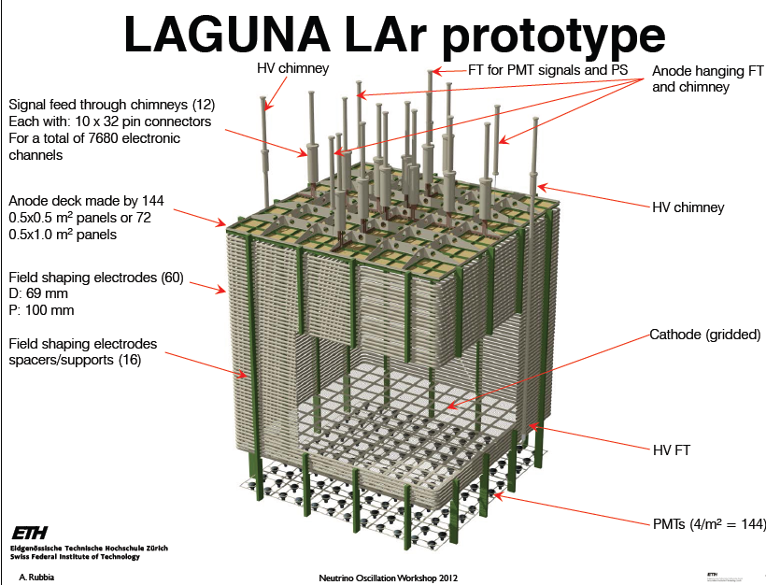

Slide 19
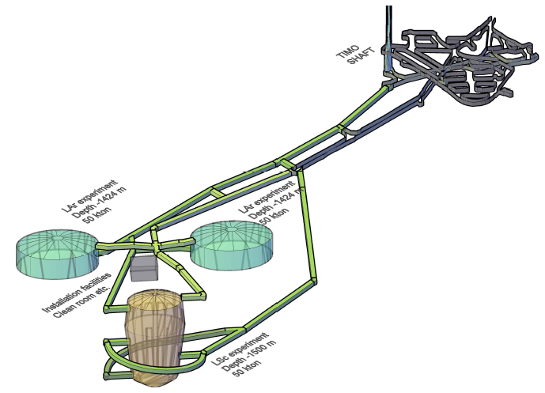
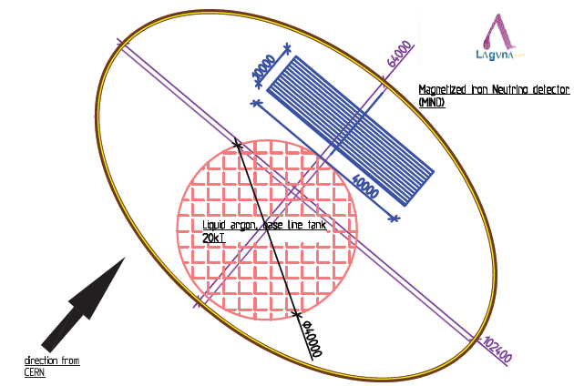
Closing Remarks
Next project choice clearly still in flux ......
UK focus has been on LAr and groups have managed, with minimal funding, to start laying foundations for contributions to a future project
Many areas of R&D are common to all of the detector technology options : e.g. DAQ, underground engineering, near detectors,...
Staged solutions involving gradual build-up of detector mass are the favoured strategy (LAGUNA-LBNO, LBNE)
Final detector implementations may involve hybrid solutions combining the best from different technologies e.g.:
LAGUNA-LBNO far detector
GLACIER+LENA installation @ Pyhasalmi to cover high+low E physics programme

Slide 20
Thanks to...
Kostas Mavrokoridis, Andre Rubbia, Neil Spooner, Lee Thompson, Christos Touramanis,....

