Slide 1
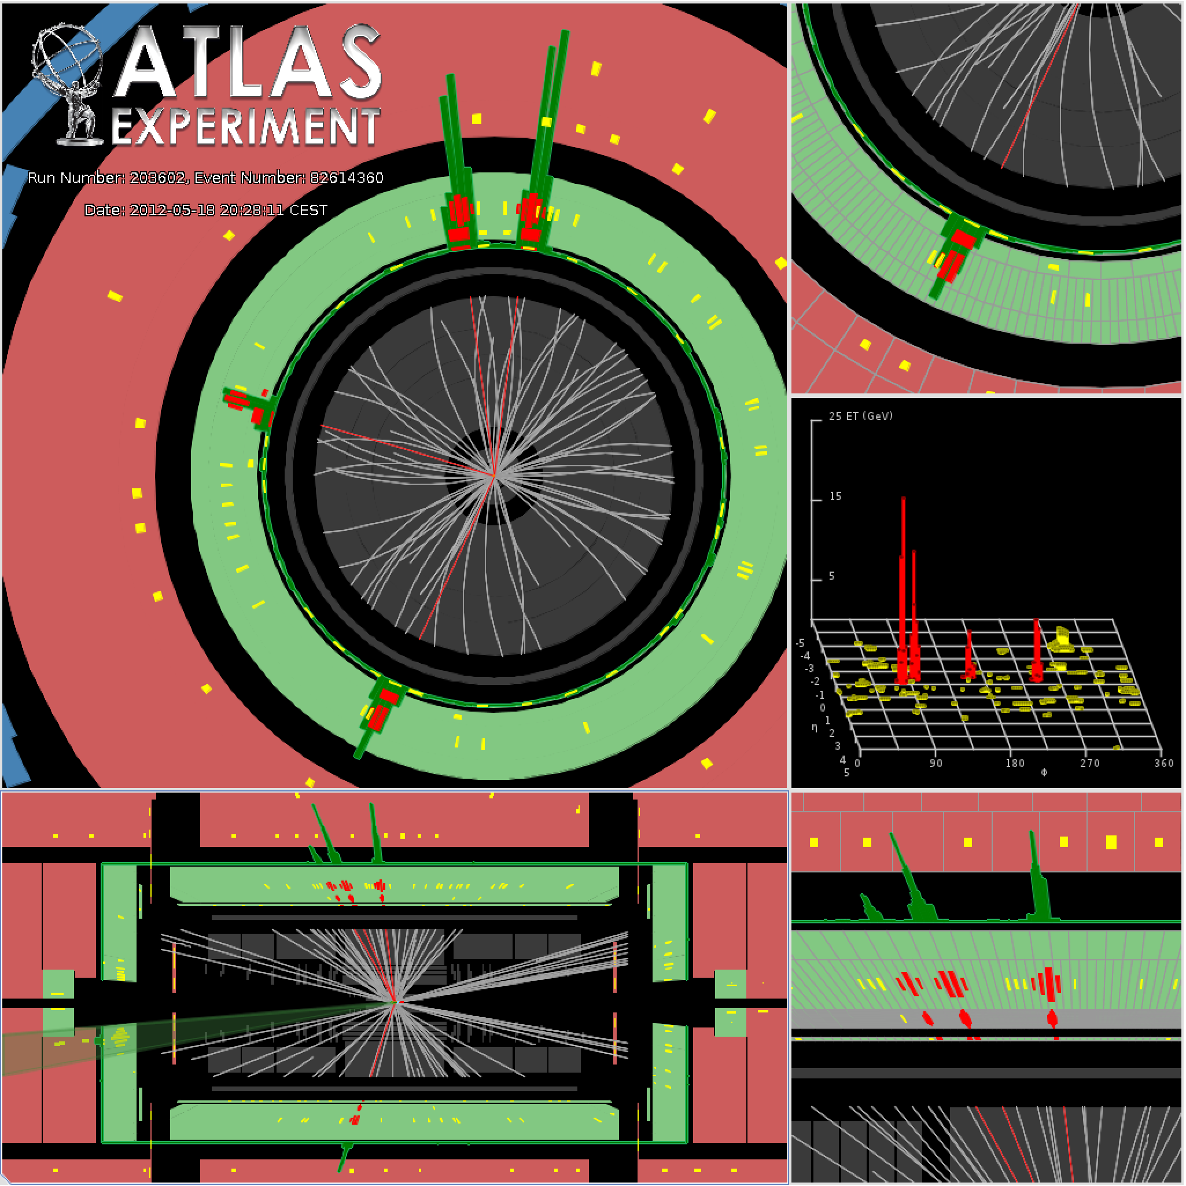
ESPP12: Energy Frontier Report
Dan Tovey
University of Sheffield

Slide 2
Energy Frontier Session
http://indico.cern.ch/conferenceDisplay.py?confId=182232

Slide 7
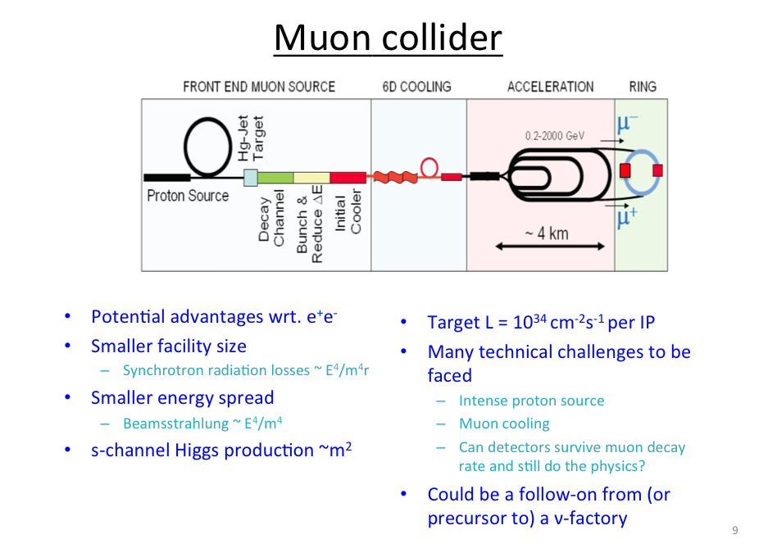
Wyatt

Slide 8
Wyatt

Slide 9
Wyatt

Slide 10
Wyatt

Slide 11
Wyatt

Slide 12
Wyatt

Slide 13
Japan / Asia

Slide 14
Yamauchi

Slide 15
Yamauchi

Slide 16
USA / Americas

Slide 20
Energy Frontier Summary

Slide 23
Personal Impressions
Top priority for future EF programme has to be building and exploiting HL-LHC and experiments
Consensus in both EF and accelerator discussion sessions
Must not jeopardise this when selling future facilities to FAs etc.
Big questions relate to next generation EF machine:
Historically consensus for lepton collider
Strong support expressed in EF and accelerator discussion sessions
When should the community ‘press the button’?
What is the science case at that point?
Cannot decouple this from money
E.g. Japan volunteers large fraction of cost of 250 GeV ILC
Have to pursue strategy which stands the best chance of success
Must not jeopardise CERN subscription
Way forward must therefore be part of CERN strategy

Slide 24
Viewpoints
Viewpoint 1:
Discovery of the ‘Higgs’ gives us a unique opportunity which we must exploit while still timely. Case must be made for an upgradeable 250 GeV Higgs factory with all speed.
Viewpoint 2:
LHC physics programme is just beginning. We still do not know the nature or mass scale of any new physics which might appear. Without this information we risk building a facility which can explore the Higgs (and top) sector(s) but do little else. We should wait until LHC14 results (or even later) before deciding next step / technology.

Slide 25
Discuss ….

Slide 26
Accelerator Summary
Nakada

