Slide 1
Particle Physics Theory
Town Meeting 2012
Professor John Womersley
Science and Technology Facilities Council
19th December 2012

Slide 2
Outline
Updates on STFC and on the programme
Looking forward to the next Spending Review

Slide 3
New STFC senior management structure
JOHN WOMERSLEY
Chief Executive
Grahame Blair
Executive
Director, Programmes
ANDREW TAYLOR
Executive
Director, National Laboratories
GORDON STEWART
Executive
Director, Corporate Services
JANE TIRARD
Executive
Director, Finance
TIM BESTWICK
Executive
Director, Business and Innovation
SHARON COSGROVE
Executive
Director, Strategy and Communication
Astronomy
Particle Physics
Nuclear Phys
Science Board
ESRF, ILL
Diamond
Futures
External Innov.
Public engagement
Education and Training
ING, JAC
SUSAN SMITH
Head of DL
ISIS
CLF
RAL Space
Technology
(UKATC, NPG)
ASTeC
PPD
Scientific Computing
HR
Safety, Health and Environment
Legal Services
Estates
Corporate ICT
Financial Accounting
Financial Management
Governance
Business Development
Innovation
Campus Development
Strategy
Performance
Planning
Communications
International

Slide 4
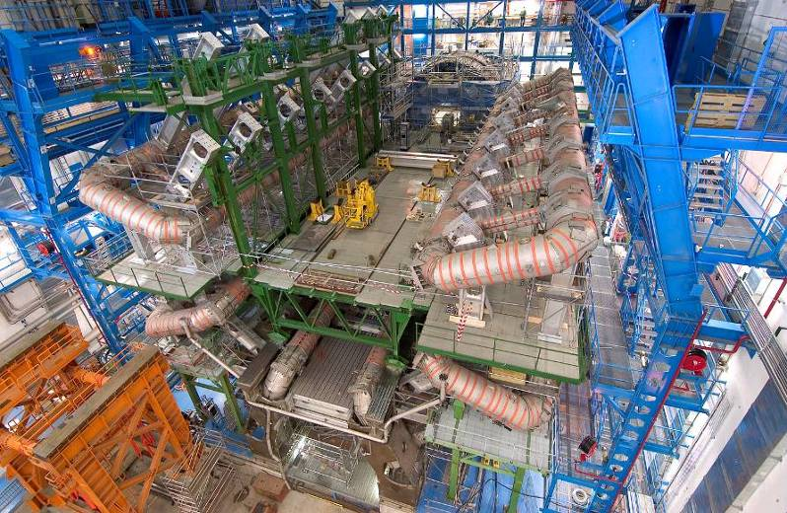
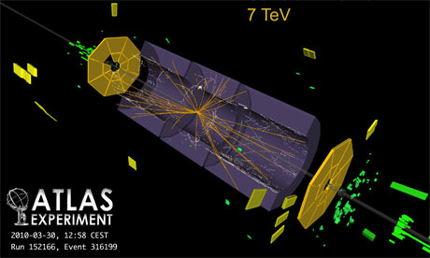
Particle Physics
Our highest priority in particle physics is the exploitation of the Large Hadron Collider at CERN.
  ATLAS, CMS and LHCb (and ALICE) experiments
  GridPP
The ATLAS and CMS upgrades are highest priority projects
Exploring neutrino mass and mixing with T2K and SuperNEMO

Slide 5
LHC
The LHC delivered over 23fb⁻¹ at 8 TeV in 2012
  - data analysis and Grid computing resources were able to keep pace
These data have started to shed light on some of the big science questions, including placing challenging limits on physics beyond the standard model.
Latest physics updates:
  Higgs results now 6-7σ, generally all consistent with SM (but still some puzzling features)
  ATLAS excludes spin-2 hypothesis at 91% CL
  LHCb observes B_{S} → μμ decay at rate compatible with SM

Slide 6
LHC next steps
Next steps
  Heavy ion run
  Long Shutdown 1 Feb 2013 – Dec 2014, possibly 2 years
  Machine restart in 2015 at 13 TeV
Proposals for the UK participation in the Phase 1 construction and Phase 2 R&D for the ATLAS and CMS upgrade programmes being considered in 2012.
  Collaborations asked to consider a number of de-scope options
  PPRP will present its recommendations to Science Board at its December meeting
Future participation in the LHCb upgrade will be decided as part of Programmatic Review
  meanwhile, UK groups have some modest bridging funding to remain engaged with the upgrade R&D programme

Slide 7
Neutrino Physics
The international T2K project at JPARC in Japan, in which the UK holds key leadership roles, is a world leading experiment for the study of neutrino oscillations
  Accelerator, beamline and experiment restored following 2011 earthquake, and experiment began taking data again in Q1 2012.
  presented new results on electron neutrino appearance from muon neutrinos at 2012 Neutrino conference in Kyoto
  first single experimental indication that θ₁₃ is non-zero and large with a 2.5 σ level of significance
We are supporting the Demonstrator phase of the SuperNEMO project, a UK-France led experiment to search for neutrinoless double-beta decay
  Aim is to demonstrate required sensitivity before a final decision on participation in the detector construction project.

Slide 8
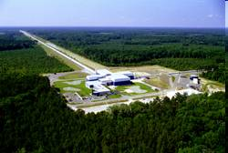

Particle Astrophysics
In the coming decade we expect to directly detect, for the first time, gravitational waves from distant cosmic phenomena
  Exploitation of ground-based Gravitational Wave Detectors
  Advanced LIGO
Opportunity to fund future activity in direct detection of dark matter and high energy gamma rays at a modest level
  focused R&D

Slide 9
Particle Astrophysics
Science Board has recommended funding for a 3 year R&D programme towards Cherenkov Telescope Array (CTA) observatory in high energy gamma
  - places the UK in a strong position to lead the high-energy component of CTA in the construction phase and ensure future access to data for the UK scientific community
Science Board also endorsed Dark Matter as a strategically important area of research for the UK
  - SB sub-group worked with Community to develop a coordinated strategy for UK involvement
  - DM-UK collaboration submitted revised project R&D proposal to STFC aligned to strategy agreed by Science Board which has now been approved.

Slide 10
Advanced LIGO
The LIGO international collaboration have been considering relocating one of the AdLIGO interferometers in the US to India to extend the scientific reach of the detector array.
Strong science case has now been supported by the outcome of an intensive feasibility study that meets the necessary short-term requirements for the LIGO-India project to move forward.

Slide 11
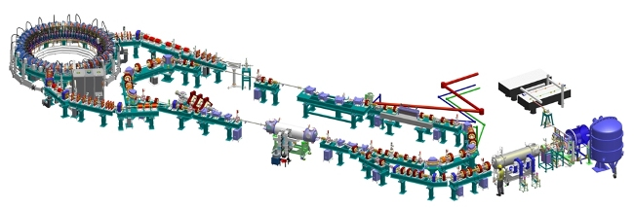
Accelerator R&D
The Accelerator Strategy Board continues to provide strategic programme advice
  Set out the strategy, programme and future funding level for electron, laser-plasma and proton accelerator R&D
  Review STFC’s accelerator R&D programme over 2011 and 2012
  Good progress continues to be made

Slide 12
Accelerator R&D
In 2011, STFC reviewed accelerator proposals for MICE, FETS and Target Studies and core support for the John Adams Institute
The mid-term review of the Cockcroft Institute and a review the science programme managed by STFC’s accelerator department, ASTEC, took place in 2012.
  In particular, wanted to understand the synergies and benefits of co-location as well as fit with STFC strategy
The outcome of the reviews was reported to the Science Board meeting in December 2012.
These reviews complete the evaluation of STFC’s accelerator R&D programme.
Outcomes will be fed into the ASB’s work on developing the Accelerator Roadmap

Slide 13
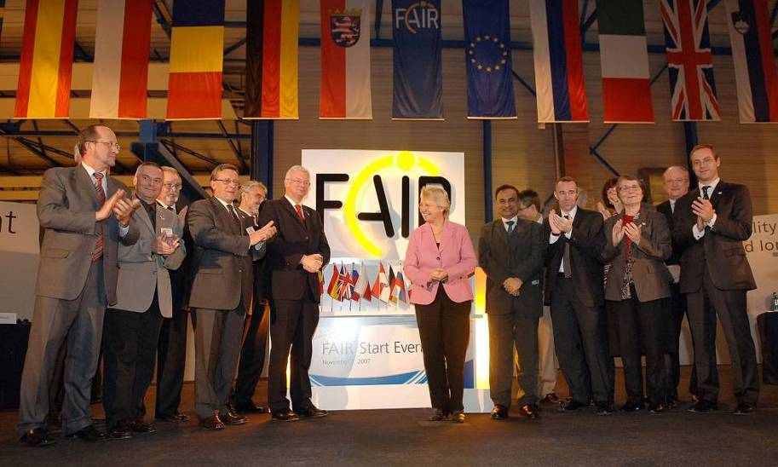
Nuclear Physics
A new generation of facilities offering beams of highly unstable ions promises breakthroughs in understanding the behaviour and origin of hadrons and nuclei
UK groups have won time on a range of international facilities and lead many international physics programmes at facilities such as Isolde, Jyvaskyla, GSI, MaxLab, GANIL and JLAB, and continue to play a key role in the LHC ALICE project at CERN
Our highest priority in nuclear physics is to participate in the NuSTAR experiment at the Facility for Antiproton and Ion Research, the new European laboratory being constructed at GSI in Darmstadt

Slide 14
Nuclear Physics
A number of new opportunities have been under consideration by the NP community. These include:
  future UK contributions to the Jefferson Lab upgrade in US,
  future ISOL facilities (ISOLDE), and
  upgrades for the ALICE, AGATA and NuSTAR detectors.
SoIs for three of these proposals are being submitted to Science Board for consideration in April
The NP advisory panel is also embarking on an update to its community roadmap. This update, together with the supporting SoIs, will provide an important input to the programmatic review.

Slide 15
FAIR
The FAIR Council has created an Associate Partner status and has invited the UK to consider such status.
The NP community and Science Board considered that it would be in the UK’s strategic interests to be an Associate member of FAIR
Financial costs of ~£600k pa (0.5% of operating costs)
UK’s status would be valid until 3 years after the start of operation i.e. to 2020 on current schedules.
STFC Council has now endorsed this approach which will be taken forward during the coming year.

Slide 16
Consolidated Grants
Existing standard and rolling grant mechanisms have now been replaced by a single consolidated grant scheme
  Not a major change for Particle Physics
  Continued support for core posts and R&D and early stage technology development in universities
2011 PPGP Theory grants round was one of the first to use consolidated grants mechanism
  Some points of clarification needed but overall has worked well
  the next Particle Physics Theory Grants round is now underway.
Wakeham re-investment will help us to maintain support for this round, though funding remains tight

Slide 17
Consolidated Grants
The 2012 PPGP Experiment grants round, which underpins the UK’s particle physics research and exploitation programme, completed. Grants announced October 2012
Strategic guidance from PPAN on need for some additional small scale activities to keep options for the future and some vitality in the programme
  Flexibility for Grants Panel used to award a small amount of FTE and travel to new activities (or existing activities currently not supported by STFC) where a strong science case made
Coordinated the consolidated grants round with the ATLAS and CMS upgrade proposals.
Sharp reduction in STFC capital allocation post-CSR means capital for grants will be limited by available funding
    options to manage impact of reduced capital being considered

Slide 18
STFC Innovations
STFC External Innovations has made 5 awards under the CLASP Security Call and all projects are about to start.
The current CLASP Environment call is part way through taking advice from DEFRA, NERC and the Environment Agency to set and assess priority areas
The 2013 CLASP call theme is under discussion and is expected to be announced early next year
Notes:
CLASP Environment Call:
22 Expressions of Interest, shortlisted to 11 full applications who will present their projects in person to the CLASP panel on 19th and 20th Feb 2013

Slide 19
STFC Innovations
IPS Fellowships
co-funded technology transfer staff to support knowledge exchange from STFC’s research base
There are now 5 IPS Fellows in post
The cohort now has critical mass and meets regularly to share best practice and facilitate new collaborations between their institutes.

Slide 20
Education and Training
Departmental studentship quota allocations for 2012 and 2013 have now been announced
ETCC is commencing a light touch review of the algorithm
Ernest Rutherford Fellowships-sifting and interviews to be held in Jan-Feb 2013, expect to make 12 awards.
Funding for Student Enhancement Programme (STEP) started on 1 April
CASE Awards- closed in Oct 2012, expect to make 5 awards in Feb 2013
Notes:
OK
Looking in particular at the impact of changes in the levels of academic time and PDRAs funded in recent grants rounds
Next round of Fellowships closed Sept 2012, sifting and interviewing during Jan-Feb 2013. Grant funding has been awarded and will start on 1 Jan 2013
Feedback for STEP has been positive from departments with awards already completed

Slide 21
ResearchFish e-Val Update
e-Val Pilot study – July 2010
Data collection – Feb-May 2011
Data used for reporting during 2011/12
Panel review of system/questions – November 2011
Revisions to system – Jan-Sept 2012
User testing of revised ResearchFish system – Oct 2012
Second data collection – starts Jan 2013
Submission deadline – end Mar 2013

Slide 22
Programmatic Review 2013
Overseen by Science Board with community input through the advisory panels
The goal is not to shrink the programme or to fit within a reduced budget
  This is a process to optimise our science programme
  Includes both identification of future opportunities and realisation of where science productivity may have passed its peak
  Will include consideration of issues such as fraction of spend on grants vs. projects vs. students
Best position ourselves for next CSR

Slide 23
Terms of Reference
Evaluate the recent, current, and likely future scientific excellence, operational effectiveness, and impact of the scientific aspects of each of STFC's programmes;
Identify any aspects of STFC's programmes that are less well-matched to the Council's strategy and to make recommendations concerning the future of these activities;
Consider future programme opportunities and make recommendations on how these could be taken forward;
Evaluate the balance of STFC's programmes and to recommend a future research portfolio

Slide 24
Advisory Panels
Membership of the Particle Physics, Nuclear Physics and Particle Astrophysics Advisory Panels have all be revised.
AP’s have completed updated roadmaps and submitted these as part of the Programmatic Review.
  Each panel undertook an extensive consultation exercise with their communities, which included community town meetings as well written submissions.
  Panel reports were considered by the PPAN Sub-Group at its meeting in November.
More on Programmatic Review later

Slide 25
Outline
Updates on STFC and on the programme
Looking forward to the next Spending Review

Slide 26
The next two years
We have a reasonably well-defined (and sustainable) science programme and priorities for 2013-15
  We should look for imaginative and affordable ways to broaden it where we can
  Take advantage of additional capital opportunities (e.g. for DIRAC in 2011-12)
We need to deliver on our commitments to government from the 2010 Comprehensive Spending Review
  Maintain the quality of the UK’s science base
  Deliver excellent science with high impact

Slide 27
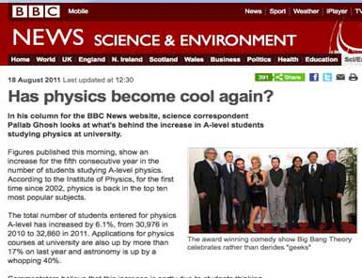
Impact!
The Higgs discovery
Reached 12 million on UK TV
14 million on UK radio
1200 stories in UK broadcast media over 24 hours
Mentioned every 1.1 seconds on Twitter at the peak of the excitement
  8 of 10 ‘trending’ topics were Higgs-related
Almost 4,500 articles printed globally

Slide 28
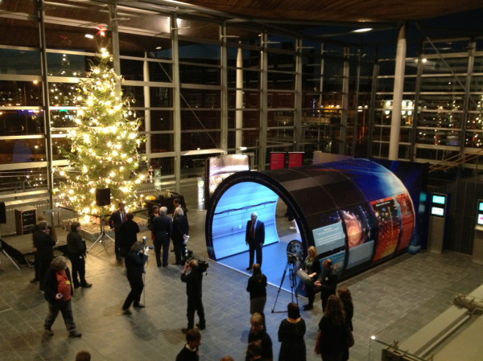
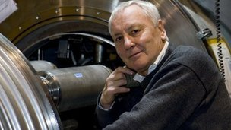
Very high level of public interest in fundamental physics
  STFC is supporting an ongoing communications programme throughout the UK
Applications for physics courses at university in 2012 are up 8.3% - despite overall decrease (8.7%) in applications

Slide 29
And more broadly, STFC has
Stabilised and turned around management and finances
Turned around stakeholder relations
Collaboration with other Councils and TSB
Major Projects delivered
  E-infrastructure, Catapult, ELI,…
Scientific Successes
  Higgs, SKA, KMOS, first light with DES, Diamond 10th anniversary…
Continued momentum
  ESA at Harwell

Slide 30

And yet…

Slide 31

National economic context
  Sharp deterioration in public finances over the summer
  National debt £1.1 trillion predicted to rise to £1.4 trillion by 2014
  Bank of England cut growth forecast
  ONS data shows that public borrowing has exceeded official estimates for every month this year
  Budget deficit up on last year

Slide 32
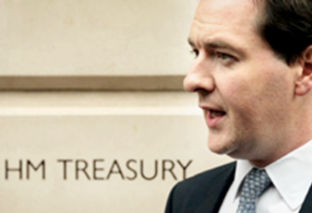

Chancellor’s autumn statement
  Additional budget cuts of 1-2% across government
  Science Ringfence exempted
  Additional £600M of capital investment in research
  Vince Cable earlier called on the Chancellor to drop plans for spending cuts in science

Slide 33

Comprehensive Spending Review
Consensus now that there will not be a full CSR until after the election
Means some mechanism needed to set spending levels for 2015/16 and probably 2016/17
  a simple “roll-over” of one/two more years flat cash?
  Perhaps worse than that:
  HMT very nervous about commitments beyond the current CSR period (e.g. E-ELT)
We’re therefore planning for a “spending review”
starting in spring 2013

Slide 34
Flat cash = loss of purchasing power
Equivalent loss of purchasing power
£m
Modelled 2 more years flat cash: results are not pretty
  Pressure from electricity prices, inflation, new programme
  (e.g. Diamond beamlines, open access publishing…)
  Take us beyond the “tipping point” from 2010 CSR
  Results have gone to BIS

Slide 35
Why does government support science?
£
Government
Science
Technological innovation, skills
Understanding of the Universe

Slide 36

Impact Report 2012
  Impacts from across STFC, grant programmes, campuses, labs….
  £3bn saved by deferring decommissioning and replacement of two nuclear power stations, enabled by research at ISIS
  £500-£700m economic benefit realised by Oxford Instruments and e2v over 40 years of collaboration and engagement with STFC and its university research communities
  46.5m estimated total audience reached by STFC Public Engagement schemes since 2006
Notes:
Annual requirement from BIS - ministerial launch expected
26m people reached by TV and radio coverage of Higgs announcement
£3bn saved by deferring decommissioning and replacement of two nuclear power stations, due to research at ISIS enabling 5-year life extensions to be made
£500-£700m economic benefit realised by Oxford Instruments and e2v over 40 years of collaboration and engagement with STFC and its university research communities
$1m investment from Space Florida in STFC spin-out Cella Energy
£25bn forecast annual revenue generated through successful exploitation of high performance computing
90 new jobs created at Sci-Tech Daresbury and Harwell Oxford Campuses
93% percentage of STFC PhD graduates in employment
8.3% increase in applications to physics degree courses
46.5m estimated total audience reached by STFC Public Engagement schemes since 2006

Slide 37
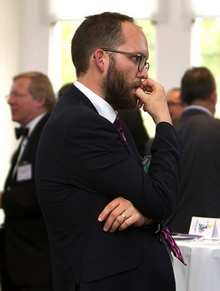
Triennial Review of Research Councils
Cabinet Office process; “politically driven”
Ceri Smith (Director Labour Markets) is lead reviewer, day to day lead will be Richard Ney (Deputy Director - Finance & Corporate Services)
Andrew Whitty (CEO GSK) expert help
RCUK working group has developed briefing for BIS
Review starts in early 2013 scheduled for 3 months - now expected to last 6 months
Will review all seven councils at once
Notes:
Two phases to the review
Phase I
identifies and examines the key functions
considers whether the functions are needed
if so examines how the functions might best be delivered
report to ‘challenge panel’ and then Ministers
If the current delivery model is ok then
Phase II
examines whether the body’s control and governance arrangements are in accordance with the recognised principles of good corporate governance

Slide 38
Ceri’s very initial ideas on the scope of the review are:
  Examine each RC and how organised
  Look at international comparators and reasons why different - NSF, NIH etc
  Talk to very wide range of stakeholders
  (not clear how he intends to do this)
  Economic analysis of potential delivery models
  'Institutes'
  'Theology and politics' in the area - Haldane principle, etc
  Analysis of impact
  Governance good practice - interested in role of the public
  Research spend in context of other research funding
  And yes, will include the question of 1 vs. 7 research councils
Notes:
Our strategy for the Triennial Review
Fully support RCUK in managing the Triennial Review to secure improvement for UK science
Support harmonisation (only) where it makes sense
Articulate our distinctiveness and the significant improvements and achievements since the last review
Subtly flag up potential items for change
Offer up changes that reduce cost / increase efficiency
Identify governance arrangements to deliver improvement and make matters more transparent or accountable
Secure new responsibilities with good strategic fit

Slide 39

2012 was an outstanding year for
particle physics
We have an excellent story to tell
High level of government support
BUT challenging economic climate
Spending review likely in 2013
What do we need from you?
Impact examples (e.g. studies for the REF)
Consistent, national message of broad support for science
(no shooting inwards please)
Most of all: we need to sell the excellence and importance of fundamental science

Slide 40


