Slide 1
Introduction to the Programmatic Review
Jon Butterworth, UCL
(Most slides from Victoria Wright,
Head of Science Strategy, STFC)

Slide 2
Why Review the Programme?
STFC runs a managed programme of activities
For the UK to remain world-leading, we need to regularly assess quality, effectiveness and impact
We also need to ensure our programme continues to meet our strategic goals

Slide 3
Purpose of the Programmatic Review
To assess the quality of STFC’s programmes in terms of science, operational effectiveness, and impact;
To inform STFC’s future strategic and financial planning;
To define appropriate research areas and recommend a research portfolio and planning timeline for STFC support to those research areas.
To do this we need to
Prioritise projects / science areas
Optimise science and impact for a range of financial scenarios
Ensure there is balance in the programme

Slide 4
Terms of Reference for the Review
To define research areas that are consistent with STFC’s strategic aims
To evaluate whether each of STFC's current programmes is well-matched to the Council’s strategy
To evaluate the recent, current, and likely future scientific excellence, operational effectiveness, and impact of the scientific aspects of each of STFC's programmes
To identify any aspects of STFC's programmes that are less well-matched to the Council's strategy and to make recommendations concerning the future of these activities
To consider future programme opportunities and, if appropriate, to make recommendations on how these could be taken forward
To evaluate the balance of STFC's programmes and to recommend a future research portfolio

Slide 5
Who will do the review?
Science Board is leading the review and has set up four sub-groups to do the detailed assessment
Particle Physics, Astronomy and Nuclear Physics Sub-Group (chair Jon Butterworth)
Large Facilities Sub-Group (chair Olwyn Byron)
Impact Sub-Group (chair Bob Warwick)
Technology Sub-Group (chair Ken Long)

Slide 6
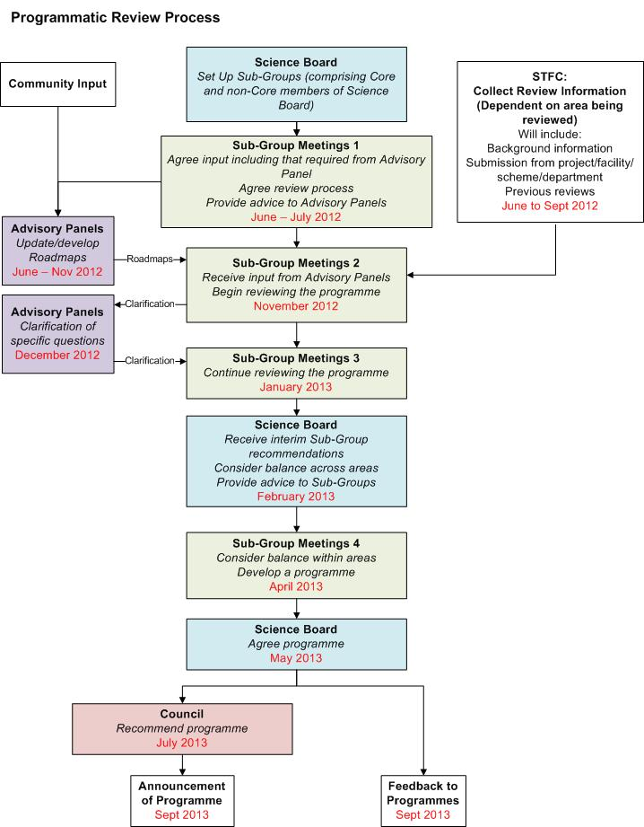
Timescale for the Review

Slide 7
Where we are now
All subgroups have met
PPAN-SG has has two in-person and one phone meeting
In the most recent meeting (Nov 20) we received reports and had discussions with the advisory groups
Particle Physics, Astronomy, Solar System, Nuclear Physics, Astroparticle Physics
We went through the submitted proformas, making preliminary prioritisations, comments, and identifying missing material
We saw, but did not yet discuss in detail, reports from STFC departments, and reports on computing and accelerator science.

Slide 8
Planned outputs
Discuss in PPAN-SG and agreed by Science Board last week:
A few pages “contextual document” with prioritisation statements about general areas, balance of programme etc
Alpha-rankings of funded projects
Strategic guidance to grants panels on “exploitation” activities/projects which are under their review
Future (5-10 year) roadmaps with different financial scenario plans/options
These will come go to Science Board along with the reports from the other SGs to allow construction of an overall programme.

Slide 9
Questions?

