Slide 1
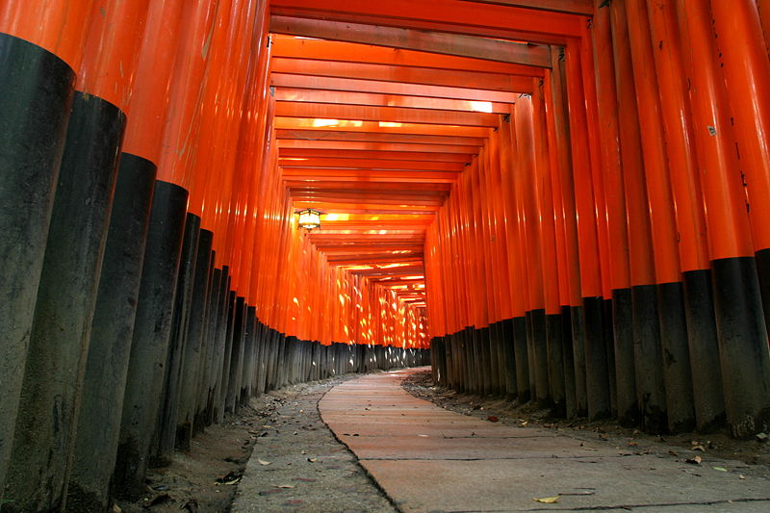
Neutrino Physics In the Coming Years
Higgs-Maxwell
Edinburgh
February 13th, 2013
Dave Wark
Imperial College London/RAL

Slide 2
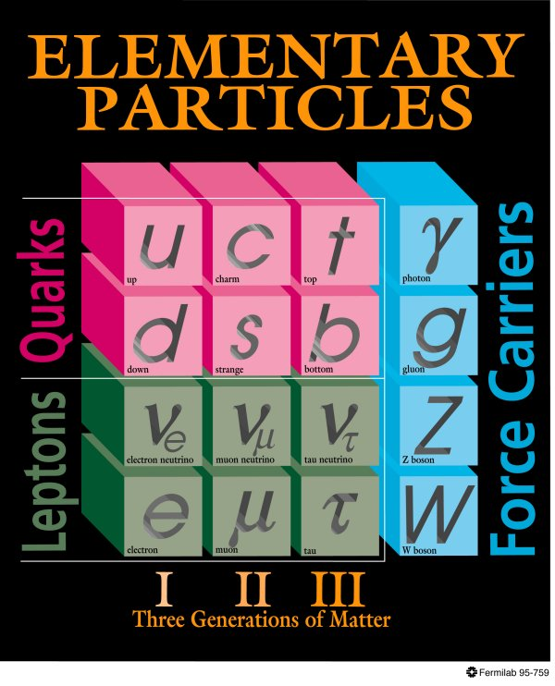
The Standard Model (~1981)
Neutrinos in the 1981 Standard:
  Three neutrinos with a conserved lepton flavour number.
  Massless.
  Strictly Left-handed.
?
??
?
??
???
H
Higgs

Slide 3
The Standard Model (~now)
Neutrinos in the 1981 Standard:
  Three neutrinos with a conserved lepton flavour number.
  Massless.
  Strictly Left-handed.
?
??
?
??
???
H
Higgs

Slide 4
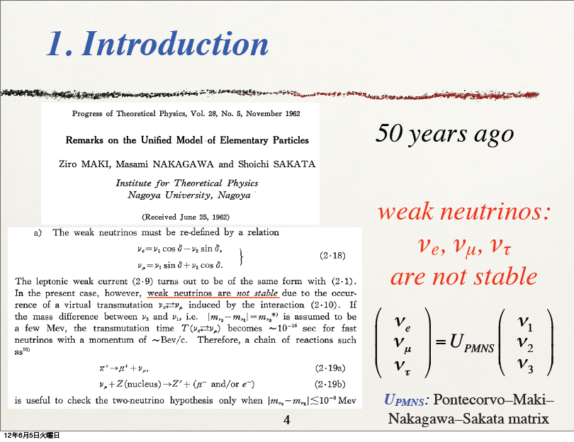
A Historic Anniversary…
From Nakaya-san’s talk at Nu2012

Slide 5
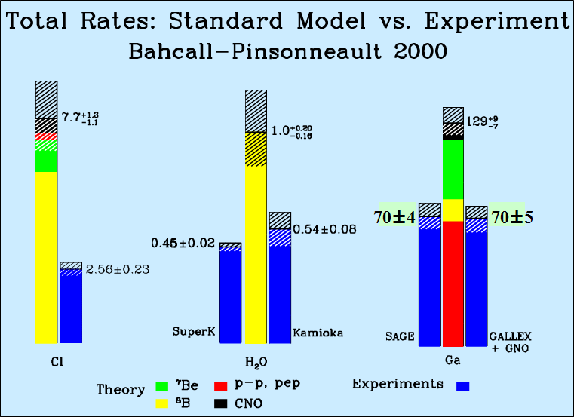
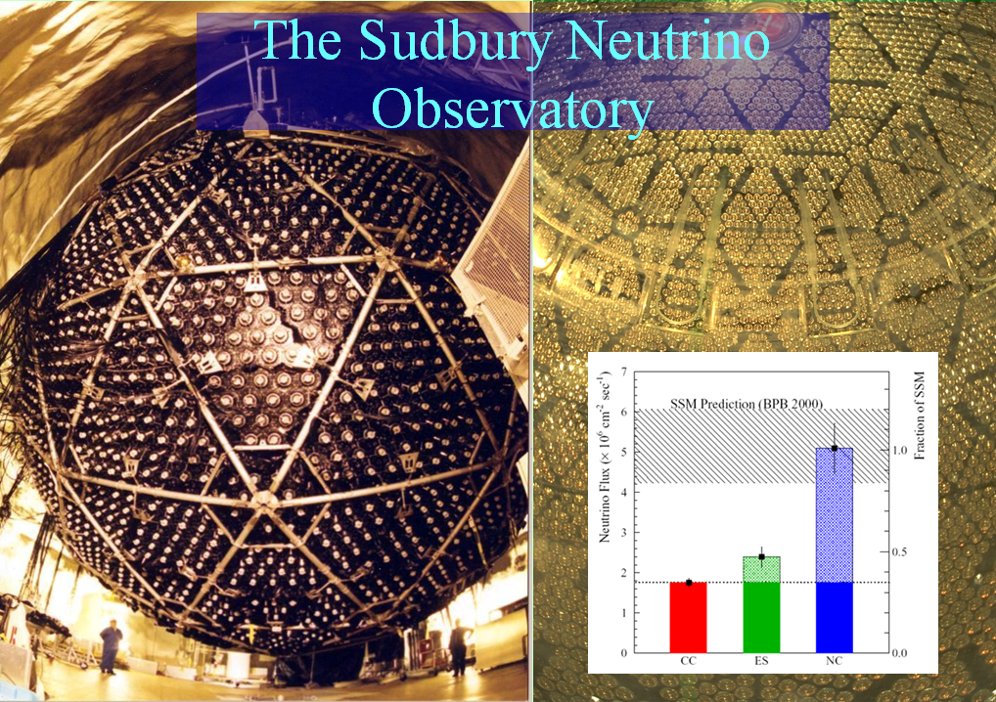
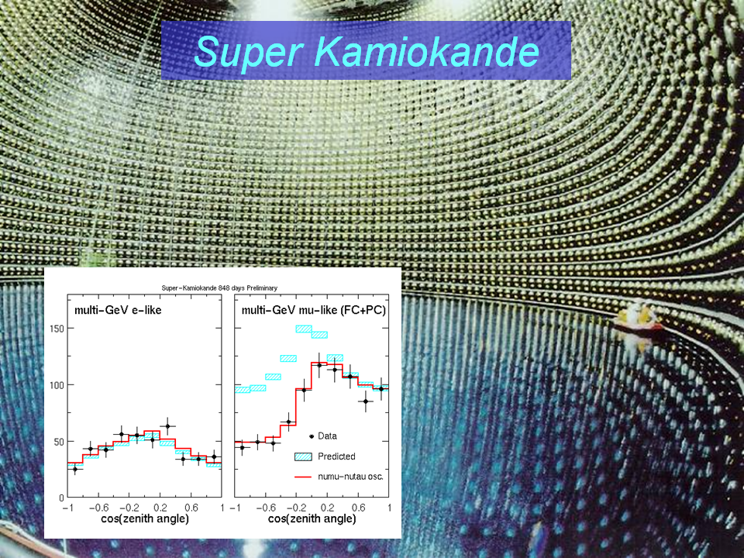
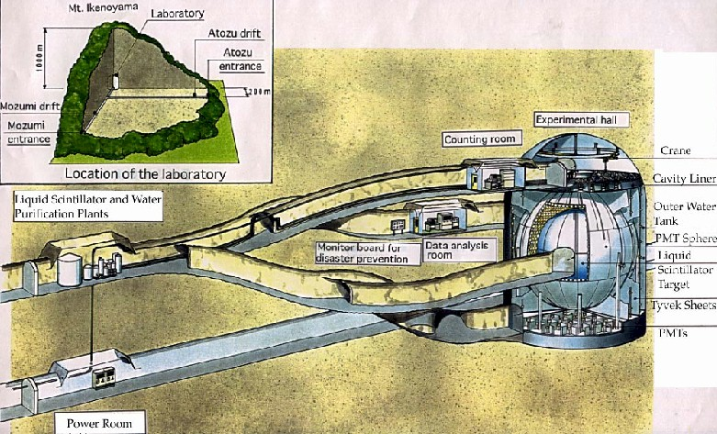


Slide 6
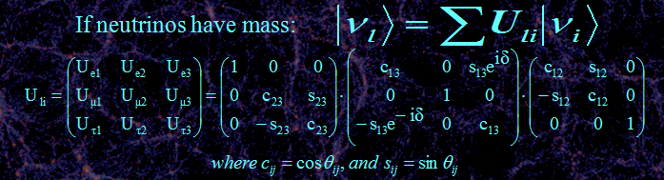
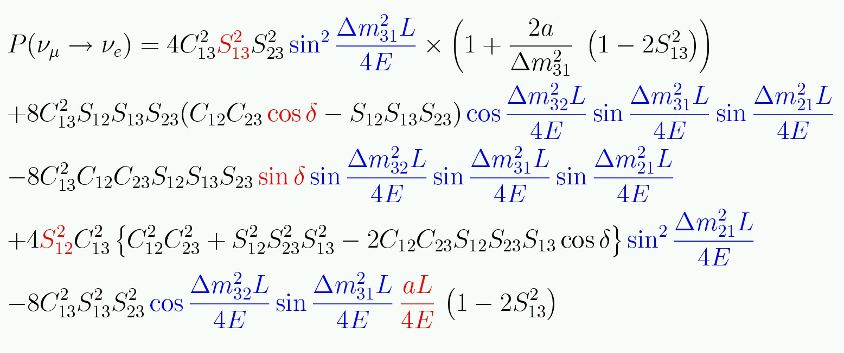
Three neutrino mixing.
Complicated equation means
covariances and degeneracies!
CP sensitivity mainly because this term flips sign for ν and anti-ν
If only two neutrinos contribute:
Need Matter effects to
get the signs of Δm²_{ij}

Slide 7
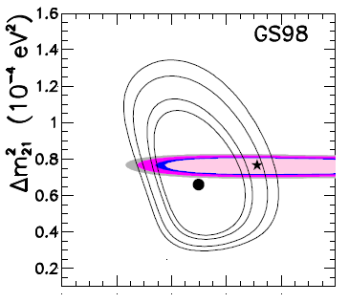
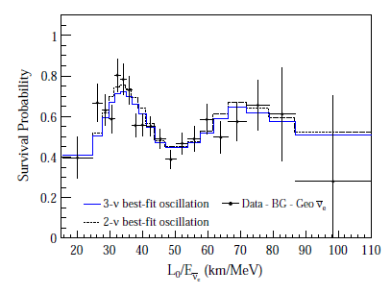

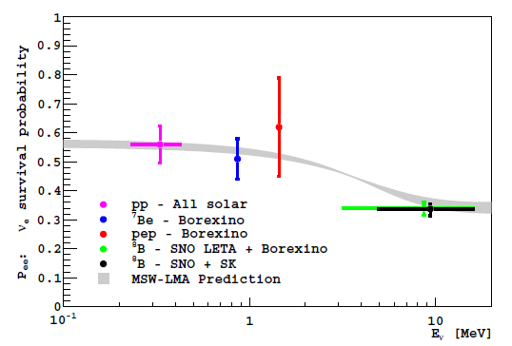
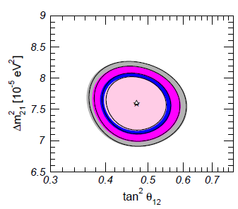

How well do we know θ₁₂?
Gonzalez-Garcia, Maltoni, Salvado

Slide 8
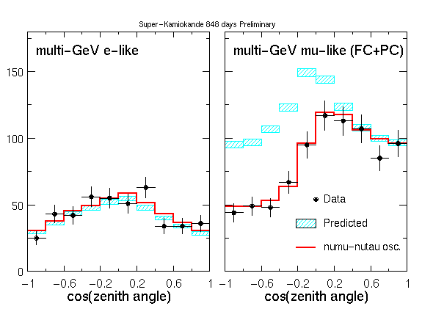
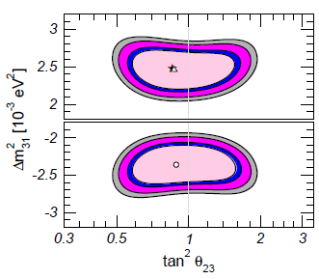
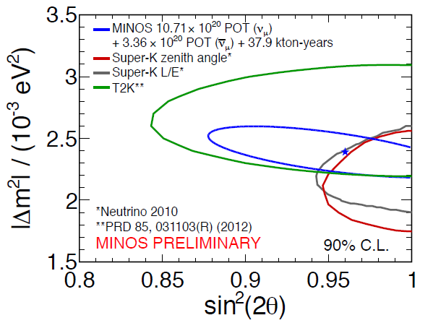
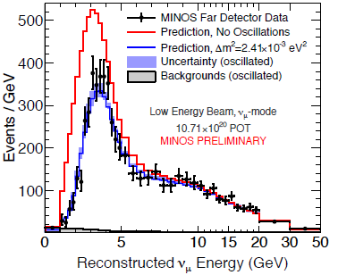
How well do we know θ₂₃?
Gonzalez-Garcia, Maltoni, Salvado

Slide 9
What is the pattern of neutrino masses?
It “probably” looks
something like this
Log m²
m₃
Δm²₂₃ ~ 2.5 x 10⁻³ eV²
m₂
Δm²₁₂ ~ 7.5 x 10⁻⁵ eV²
m₁
ν_{e}
ν_{μ}
ν_{τ}

Slide 10
What is the pattern of neutrino masses?
But it could look like this
Log m²
m₃
m₂
m₁
Some argue that this is “unnatural”
m₂
m₁
m₃
Normal Heirarchy
Inverted Heirarchy
ν_{e}
ν_{μ}
ν_{τ}

Slide 11
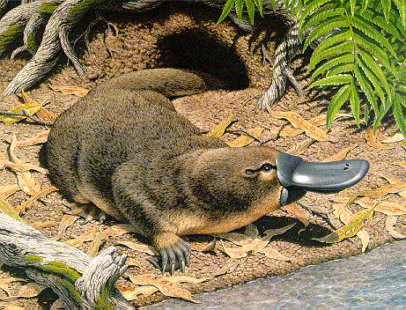
Does this look natural?

Slide 12
This makes a factor of two difference in the
cosmological contribution, but a factor of two
on what?
Log m²
m₃
m₂
m₁
m₂
m₁
m₃
ν_{e}
ν_{μ}
ν_{τ}

Slide 13
Even more significant is the absolute scale.
Log m
1 eV
m₃
This?
m₂
m₁
Or this?
10⁻¹ eV
Neutrino oscillations won’t help
you here, need absolute mass measurements like T₂ endpoint
or 0νββ decay…
m₃
m₂
10⁻² eV
m₁
ν_{e}
ν_{μ}
ν_{τ}

Slide 14

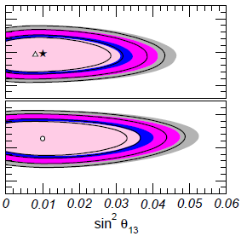
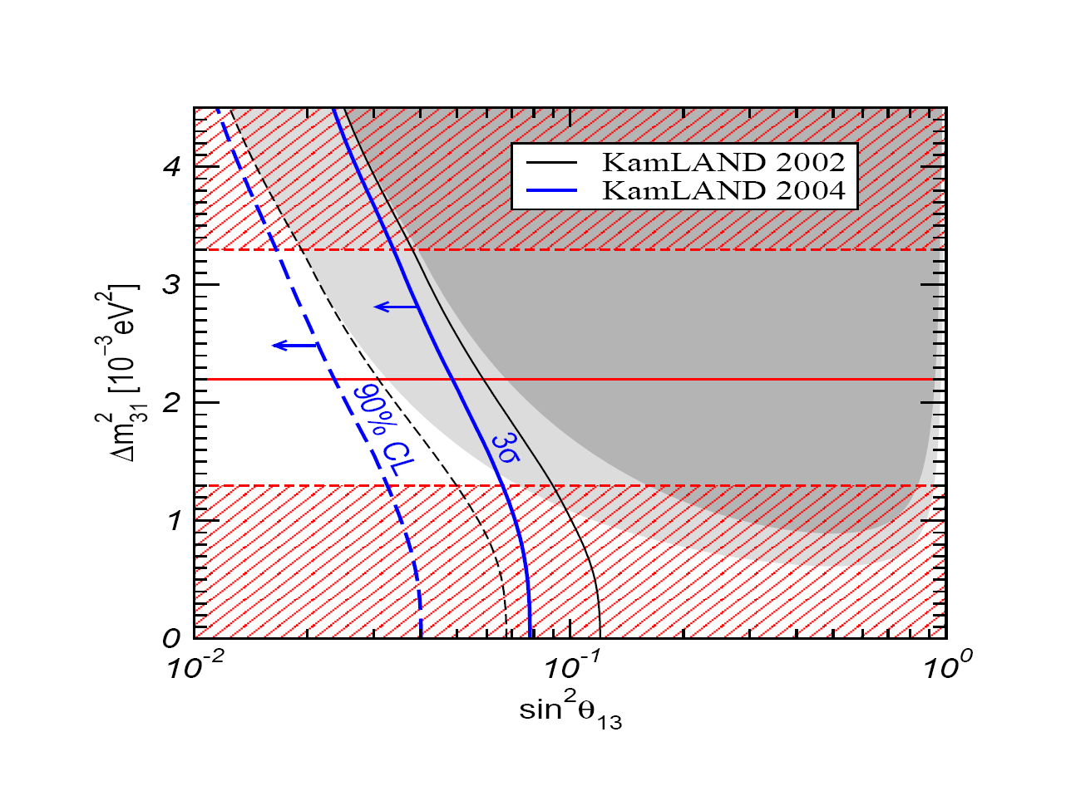
2004 limits on θ₁₃
2011
J.W.F. Valle, hep-ph/0410103
Dave Wark
Imperial College/RAL

Slide 15
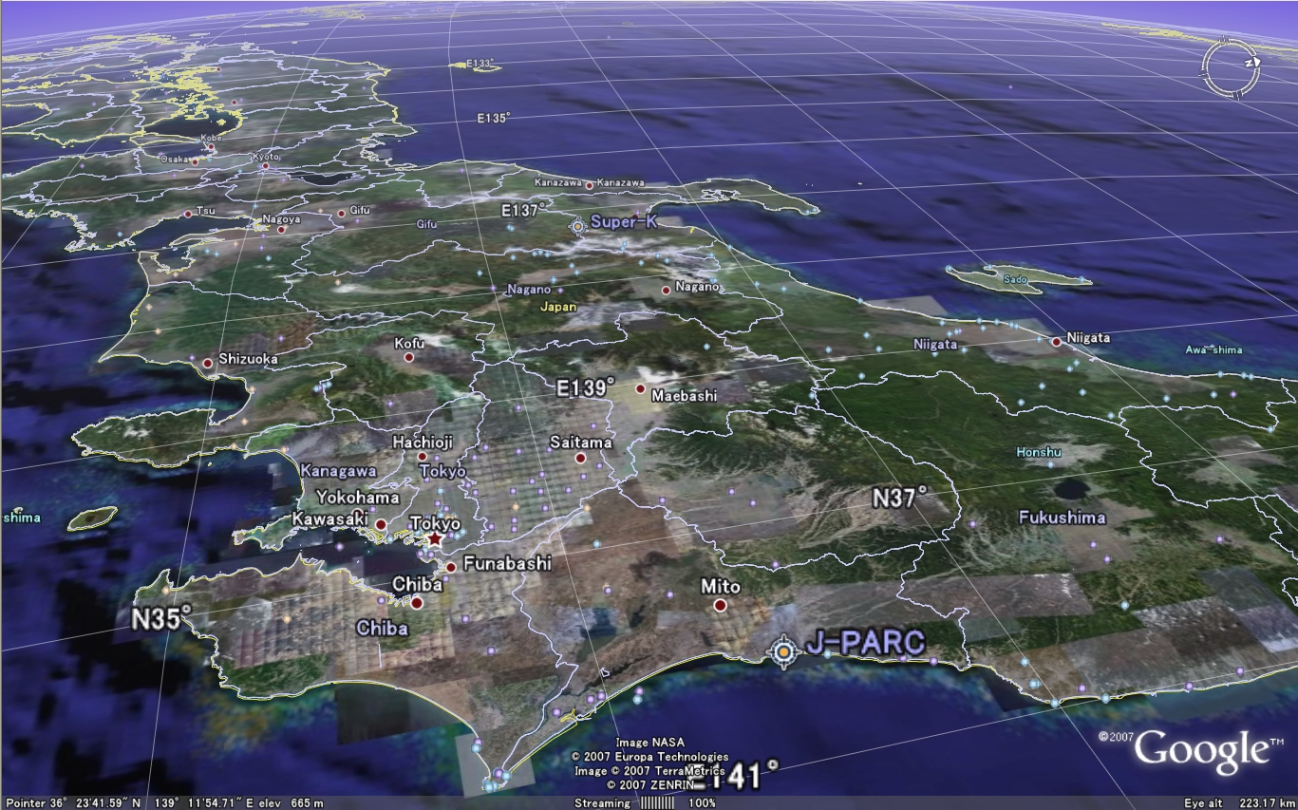

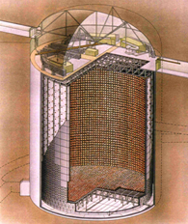
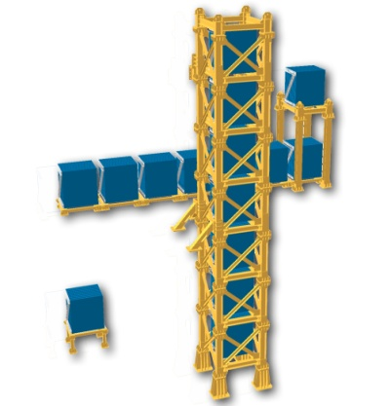
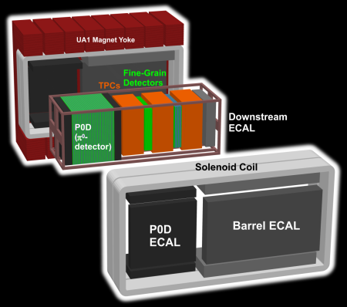
#

Slide 16
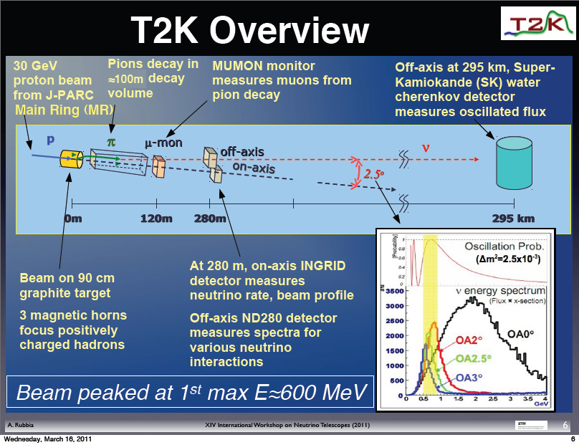

Slide 17
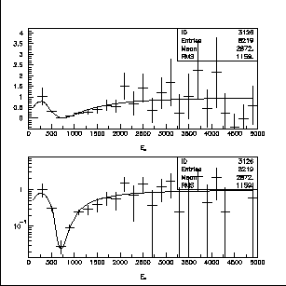
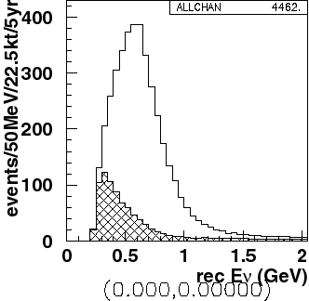
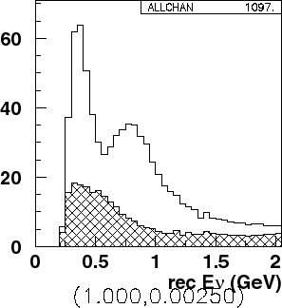
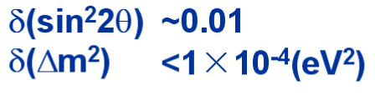
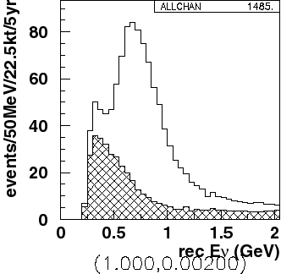
What are we trying to measure?
ν_{μ} disappearance
No oscillation
sin²2θ₂₃
Δm²= 2.5 x10⁻³ eV²
Δm²= 2.0 x10⁻³ eV²
Δm₂₃²
Precision measurements

Slide 18
What are we trying to measure?
ν_{e} appearance
sin²2θ₁₃

Slide 19
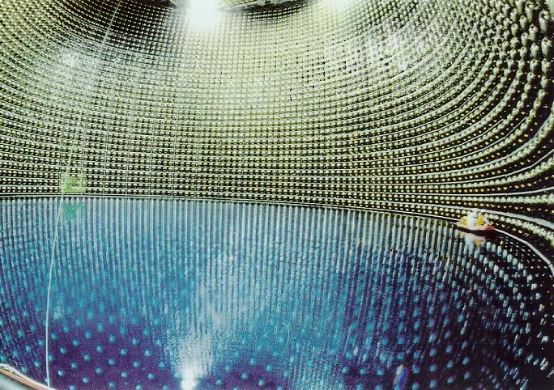
Optimal Far Detector – Super Kamiokande

Slide 20
Background
from NC
interactions
e
ν_{μ}
disappearance
signal
π⁰
ν_{e}
appearance
signal
μ
In this energy range, Super Kamiokande well understood,
Excellent for separating
electrons, μ, π⁰

Slide 21
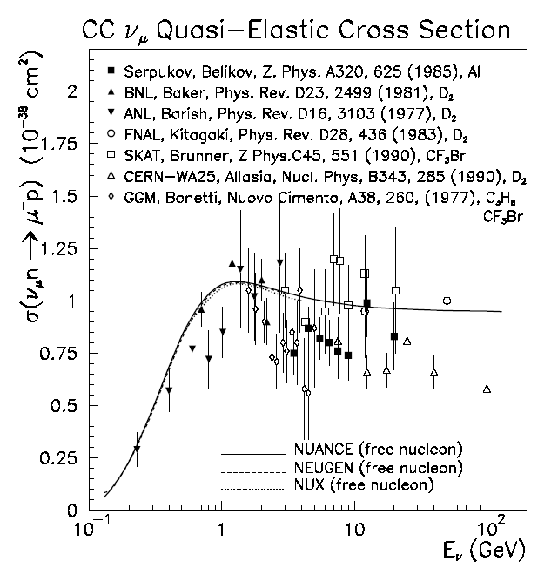
Cross sections are poorly known in range 0.1-10 GeV
Data compiled by G.Zeller, hep-ex/0312061

Slide 22
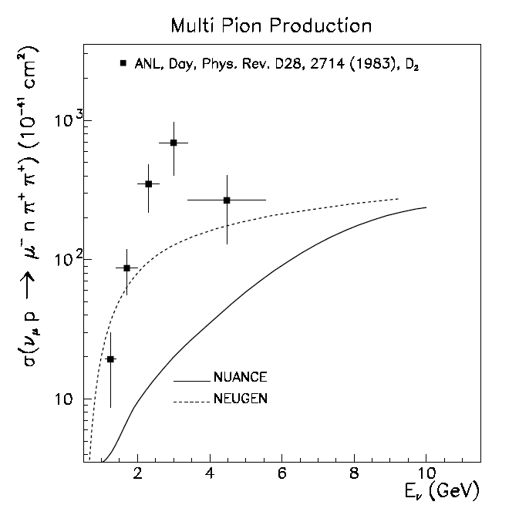
Cross sections are poorly known in range 0.1-10 GeV
Data compiled by G.Zeller, hep-ex/0312061

Slide 23
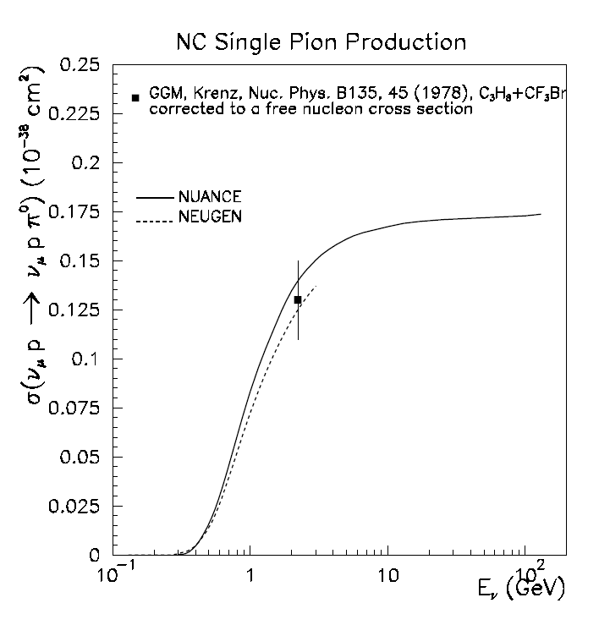
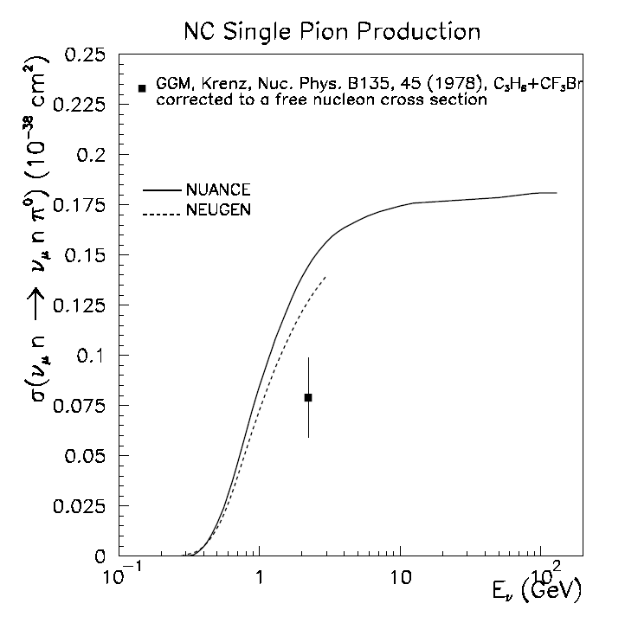
Some are worse than others…
Data compiled by G.Zeller, hep-ex/0312061

Slide 24
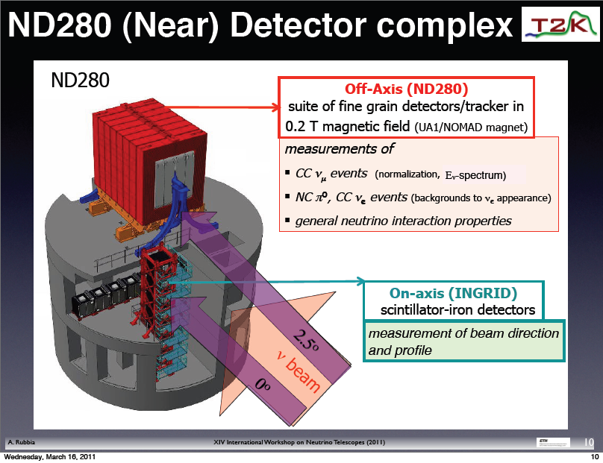
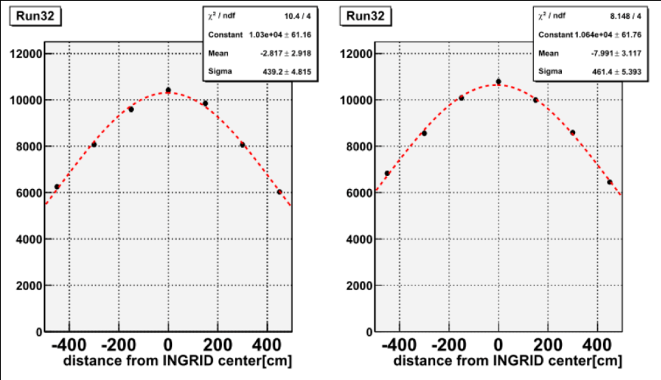
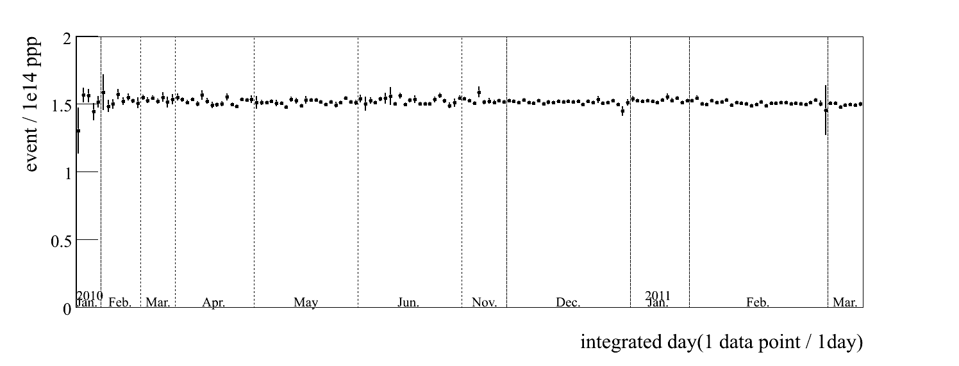

Slide 25
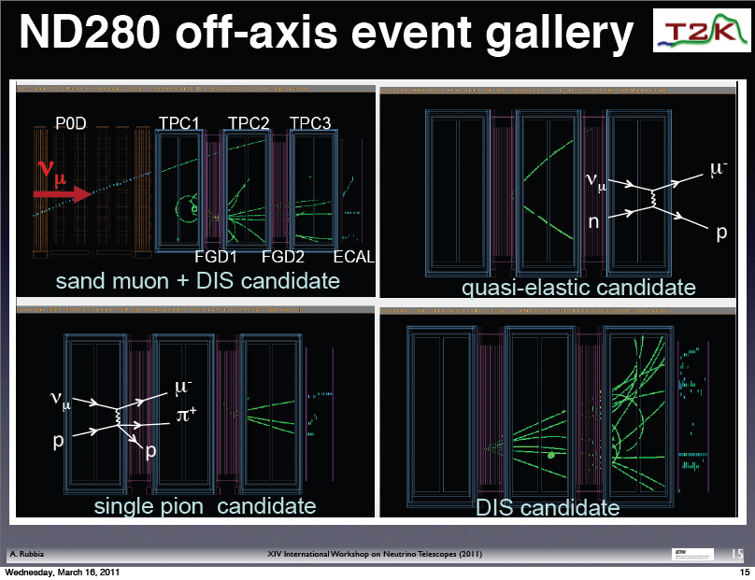

Slide 26
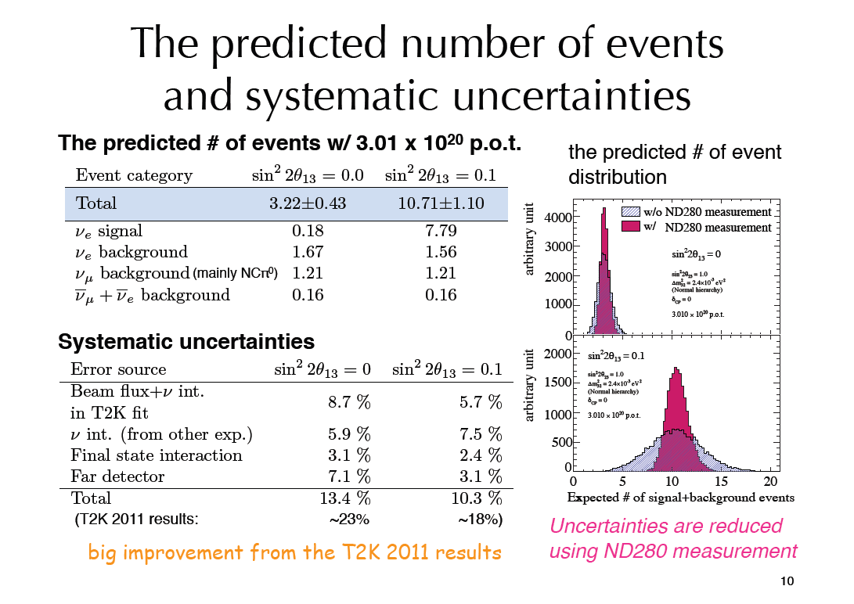
Slides from Sakashita-san’s presentation at ICHEP12

Slide 27
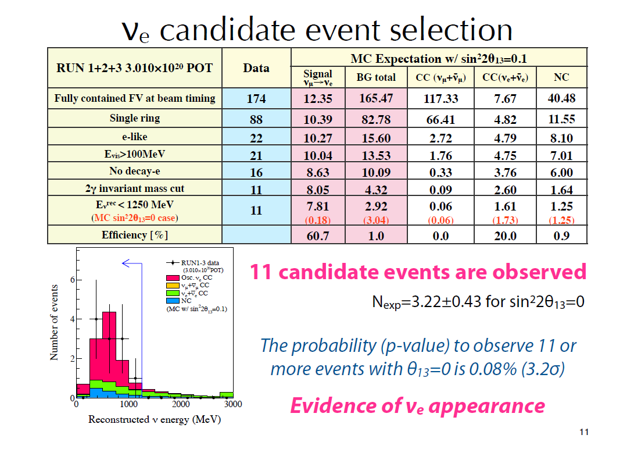
Analysis uses 3.06 x 10²⁰ POT

Slide 28
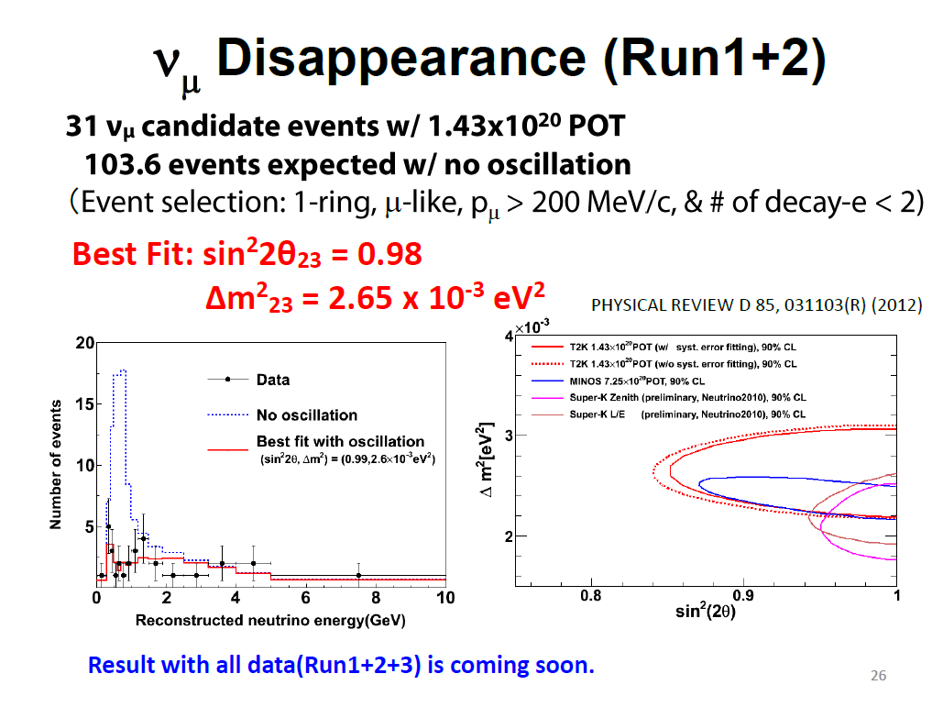
Analysis uses 1.43 x 10²⁰ POT
As of this morning, 4.811 x 10²⁰ POT, more results soon…

Slide 29
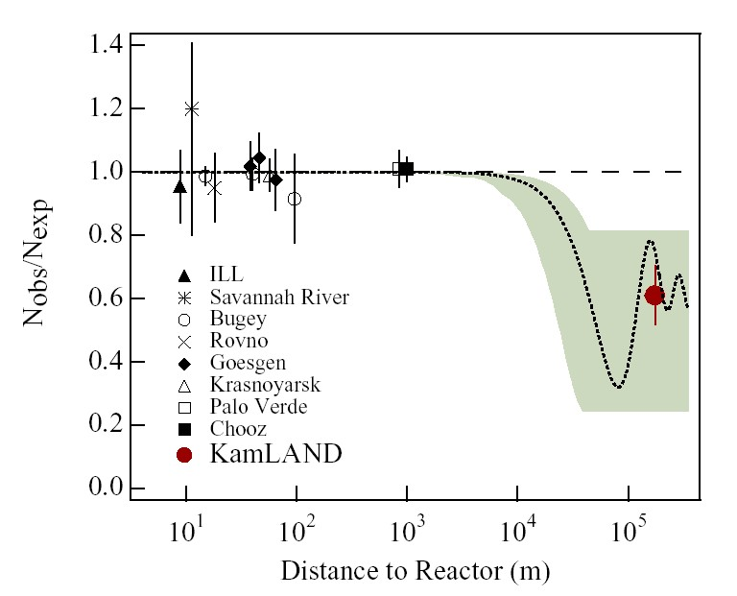
Effect of 3ν on reactor disappearance
Disappearance on very
short baselines –
no MSW, no CP viol
sin²2θ₁₃
Measure this small deficit. Due to Δm²₁₂<Δm²₂₃₍₁₃₎, this is almost pure θ₁₃ measurement
Figure from Josh Klein
Dave Wark
Imperial College/RAL

Slide 30
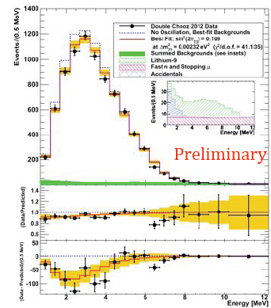
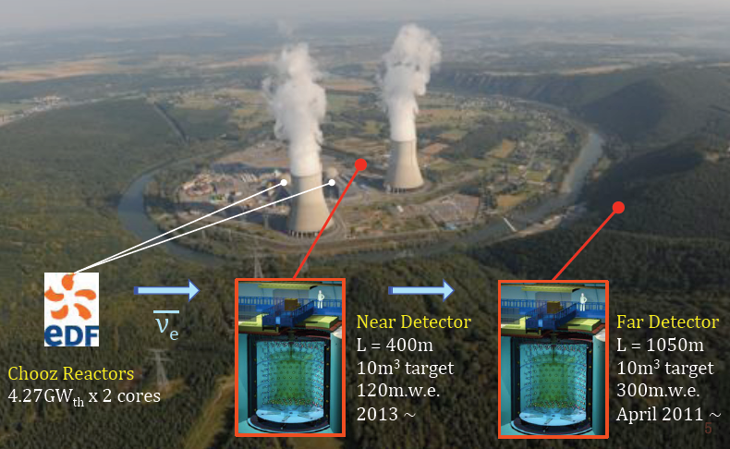
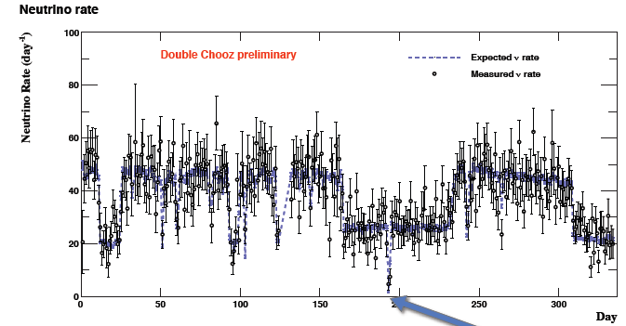
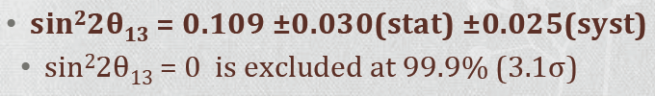
Double Chooz Results
Currently only far detector, so
use Bugey results for norm.

Slide 31
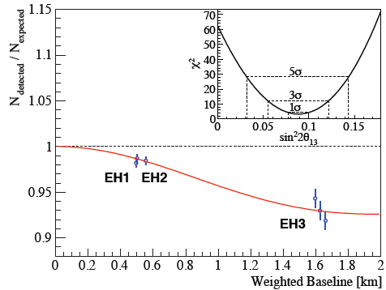
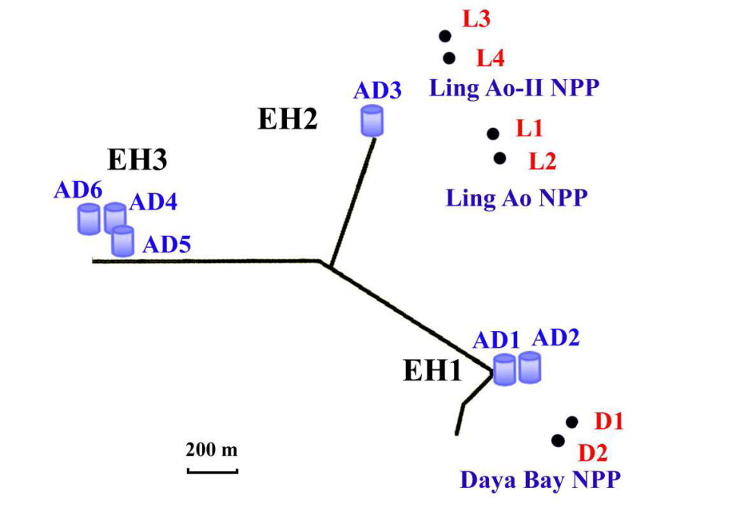
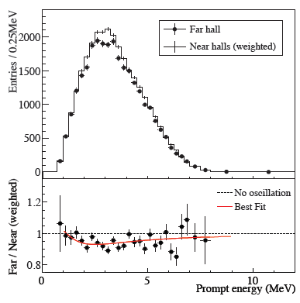

Daya Bay Results!

Slide 32




RENO Results

Slide 33

A word of caution about Global Fits…
Global Solar ν fit
prior
to SNO/KamLAND

Slide 34


These are 99% c.l. contours!
Global Fits do not replace compelling experiments, particularly in ν physics!

Slide 35

What is
the MH?
Is θ₂₃
maximal?
If θ₂₃≠45º
what is
the octant?
What is
δ?
Gonzalez-Garcia,Maltoni,Salvado,Schwetz

Slide 36
What is
the MH?
Is θ₂₃
maximal?
If θ₂₃≠45º
what is
the octant?
What is
δ?
Gonzalez-Garcia,Maltoni,Salvado,Schwetz
The determination of these parameters, including δ, is critical to completing our understanding of the Standard Model.
There is no credible alternative to long-baseline experiments to measure δ.

Slide 37



How will we learn more?
where:

Slide 38


Slide 39


Slide 40


Slide 41


Slide 42

Statistics an issue for all experiments, and systematics
become important once you have enough statistics.

Slide 43

Additional Information from Continuing Long Baseline Experiments - T2K, NOνA (+ reactors)
Indications, hints, guidance – Yes! Discoveries, sadly, no….

Slide 44




The Next Step in Japan
Hyper Kamiokande L=295km OA=2.5deg
J-PARC MR
→~1.0MW
Water Cerenkov selected as the current option.
European involvement almost inevitable
because of the 280m detector, but greater
involvement is being considered..
Interference with ILC in Japan?

Slide 45

T2HK Appearance Spectra
NB: Normal Hierarchy Assumed!
Difference from
δ = 0.
Only 5 yrs running (1.5 ν, 3.5 anti-ν) assumed…

Slide 46



Possible synergy with a NF beam

Slide 47


Slide 48

SPSC feedback very positive, recommends we proceed to a TDR…

Slide 49



Slide 50


Slide 51


Do the Finns want to play ?

Slide 52


Slide 53




US: Long Baseline Neutrino Experiment
CD 0: January 2010
CD 1: December 2012!
1300 km
34 kT of LAr
desired option.
For cost reasons, the project has
been phased to a 10 kT detector
on the surface and no ND.

Slide 54

From Pilar Hernandez’s talk in Kracow…
>5σ in
2 yrs. vs. 10
Near
Detectors?
Other proposals to measure the MH with atm. or reactor ν, hard
to get convincing evidence at 5σ but more work needed.

Slide 55




νStorm
β Beam
ν_{e} σ!
EURONu has considered options and costs and recommends Neutrino Factory
Costs will be high – R&D needed to reduce.
Neutrino Factory

Slide 56
Measuring absolute m_{ν}
Supernovae – Prodigious producers of neutrinos, and measuring time shifts can in principle measure neutrino masses, m_{ν} < ~30 eV.
Kinematic limits: If you believe the oscillation results, all Δm²≪1 eV, therefore only ν_{e} measurements have useful sensitivity → current best is Tritium Beta Decay, m_{ν} < 2.2 eV.
If neutrinos have Majorana masses, then zero-neutrino double-beta decay is allowed → observation of 0νββ decay would be direct evidence for neutrino mass, <m_{ν}> < ~1.3 eV.
Neutrinos are the second most numerous particle in the Universe → even a tiny neutrino mass could have astrophysical implications, Σm_{ν} < 0.28 eV(?)
Dave Wark
Imperial College/RAL

Slide 57
Conclusions
Neutrino oscillations are the first confirmed BSM particle physics.
We still have a lot of work to do to completely characterize the MNSP matrix.
The measurement of “large” θ₁₃ has opened up a whole range of new experiments on a realizable scale.
There is no other way to do this physics than build major projects to measure a few numbers – but we need those numbers!
A strong case exists for at least two long-baseline projects in the near to mid-term.
There is and will (or at least should) be a continuing programme to develop towards a Neutrino Factory.
The sterile neutrino question also needs an answer.
European involvement in T2HK is almost certain if the project proceeds, involvement in LBNE is being considered.
The LAr prototype at CERN is a near-term opportunity, and extensive other R&D is needed (like νStorm).
There is much work to be done!
JOIN US!.
Dave Wark
Imperial College/RAL

Slide 58

Neutrinos in the proposed CERN Strategy…

Slide 59

From M. Shaevitz talk
Could measure ν_{e} cross-sections, critical (?) for 5% systematics?

Slide 60


Slide 61





LSND Starts it all...
Short baselines
(L/E ~ 1)
and Sterile ν.
MiniBooNE says....
No!
Latest…
Yes?
Dozens of proposed experiments to test...

Slide 62



Synergy/Interference with Long-Baseline proposals?

Slide 63


Slide 64

Comments:
  5% systematics! Ambitious….
  What is plotted is E_{ν}, what is measured is the amount of charge in the tubes, true reconstruction needed.
  Sorting of events between classes has energy dependent systematics, needs full reconstruction.
  All based on Monte Carlo (and always will be)....

Slide 65


Slide 66

Further future for reactor experiments.
FT of data –
Does not create
information!
Slide from Nishikawa’s summary.
Assumes 3% energy resolution in a
20 kT organic scintillator!

Slide 68

Slide from Yvonne Wong’s talk at TAUP ‘11

Slide 69

Slide from Yvonne Wong’s talk at TAUP ‘11

Slide 70

Slide from Yvonne Wong’s talk at TAUP ‘11

Slide 71




If you are measuring a mass, you must QUANTIFY the systematics!

Slide 72
SNO Systematic Flux Uncertainties
  Error Source
  Energy scale
  Energy resolution
  Non-linearity
  Vertex shift
  Vertex resolution
  Angular resolution
  High Energy γ’s
  Low energy background
  Instrumental background
  Trigger efficiency
  Live time
  Cut acceptance
  Earth orbit eccentricity
  ¹⁷O, ¹⁸O
  Experimental uncertainty
  Cross-section
  Solar Model
  CC error (%)
  -5.2, +6.1
  ±0.5
  ±0.5
  ±3.1
  ±0.7
  ±0.5
  -0.8, +0.0
  -0.2, +0.0
  -0.2, +0.0
  0.0
  ±0.1
  -0.6, +0.7
  ±0.2
  0.0
  -6.2, +7.0
  3.0
  -16, +20
ES error (%)
-3.5, +5.4
  ±0.3
  ±0.4
  ±3.3
  ±0.4
  ±2.2
  -1.9, +0.0
  -0.2, +0.0
  -0.6, +0.0
  0.0
  ±0.1
  -0.6, +0.7
  ±0.2
  0.0
  -5.7, +6.8
  0.5
  -16, +20
Unless a real error analysis is done
for astrophysical mass “limits” they
cannot really be considered
equivalent to laboratory limits.
In any case, using precious
cosmological data to
constrain m_{ν} would be like
using LEP as a tide gauge.
Return ↑

Slide 74



February 1984
March 8,1987
A supernova
converts
~ 1 M⊙ to ν

Slide 75

Limit from SN1987a is m_{νe} > 23 eV (PDG)
Best you can do is ~5-10 eV, which isn’t good enough
Light and neutrinos got here on the same day after travelling
for ~160k yrs, so |v_{ν}-c|/c < 2×10⁻⁹ at E_{ν} ~ 10 MeV
Return ↑

Slide 77




Tritium β-decay
Fermi theory of β-decay:
observable:
tritium as β emitter:
high specific activity
(half-life: 12.3 years)
low endpoint energy E₀
(18.57 keV)
super-allowed

Slide 78



KATRIN experiment
(KArlsruhe TRItium Neutrino experiment, location: Forschungszentrum Karlsruhe)
70 m
electron transport
CMS at same scale
tritium decay
energy analysis
tritium retention
β-decay rate: 10¹¹ Hz
T₂ pressure: 10⁻⁶ mbar
background rate: 10⁻² Hz
T₂ pressure: 10⁻²⁰ mbar
about 14 orders of magnitude
adiabatic guiding of electrons on meV level

Slide 79

Return ↑

Slide 81

LSND Starts it all...
Short baselines
(L/E ~ 1)
and sterile ν.
MiniBooNE says....
No!
Yes?

Slide 82


Slide 83


Return ↑

Slide 84


In the systematics dominated era
support measurements are essential!
One slide on hadron production

Slide 85





Neutrino interaction properties must
also be measured...
But also need....
Near Detectors....
Return ↑

Slide 87
Dirac ν vs Majorana ν
C
P
T
Lorentz
Boost,
E, B
C
P
T
Dirac
Majorana

Slide 88

ββ decay and neutrino mass
35 isotopes in nature

Slide 89

0νββ: Peak at Q-value of nuclear transition
Sum energy spectrum of both electrons

Slide 90



Slide 91

Each is ±1 if CP conserved, but there
can still be cancellations

Slide 92


Slide 93

KKDC Claim
(best fit 0.32 eV)
Present Cuoricino result
GERDA Target
CUORE Target
With SuperNEMO, SNO+, MAJORANA, many others should reach here in ~ 7-10 yrs.
Need new ideas to reach < 10 meV, but kiloton
scale low background experiments are not impossible!

Slide 94



SuperNEMO
Organic scintillator calorimeter with 4% energy resolution, designed in the UK
Extension to the Frejus laboratory recently approved…

Slide 95



SNO with Nd loaded scintillator (=SNO+)

Slide 96
If oscillations
prove IH
If 0νββ decay
sets a limit here
Then neutrinos are Dirac...
Return ↑

Slide 97


Slide 99
From M. Shaevitz talk
Could measure ν_{e} cross-sections, critical (?) for 5% systematics?

Slide 100
LSND Starts it all...
Short baselines
(L/E ~ 1)
and Sterile ν.
MiniBooNE says....
No!
Latest…
Yes?
Dozens of proposed experiments to test...

Slide 101
Synergy/Interference with Long-Baseline proposals?

Slide 102

How will we learn more?
where:
NH,

Slide 103


Slide 104


Slide 105


Slide 106


Slide 107


Slide 109


Slide 110


Slide 112


Slide 113

Atmospheric Neutrinos

Slide 114




CERN to Super-K?

Slide 115

Atmospheric Neutrinos

Slide 116

Atmospheric Neutrinos

Slide 117
Sterile Neutrinos
LSND Starts it all...

Slide 118

New MiniBooNE Results (from C. Polly’s talk)
LSND Starts it all...

Slide 119


Other Indications of Sterile ν
(or underestimates of systematics)
Gallium Anomaly
Must include all data (CDHS, atmos. ν, MINOS, etc.)

Slide 120

Atmospheric Neutrinos

Slide 121

Atmospheric Neutrinos
Adding more sterile ν’s doesn’t help!

Slide 123

Atmospheric Neutrinos

Slide 124


Slide 125

Atmospheric Neutrinos

Slide 126

We are comparing sensitivities
using a model which is known
to be wrong!

Slide 127


Slide 128


Slide 129


Slide 130


Slide 131


Slide 132


Slide 133


Slide 134


Slide 135


Slide 136


Slide 137


Slide 138


Slide 139


Slide 140


Slide 141

Atmospheric Neutrinos (plots from Itow-san’s talk)

Slide 142

Atmospheric Neutrinos

Slide 143

Atmospheric Neutrinos

Slide 144

Atmospheric Neutrinos

