Slide 1
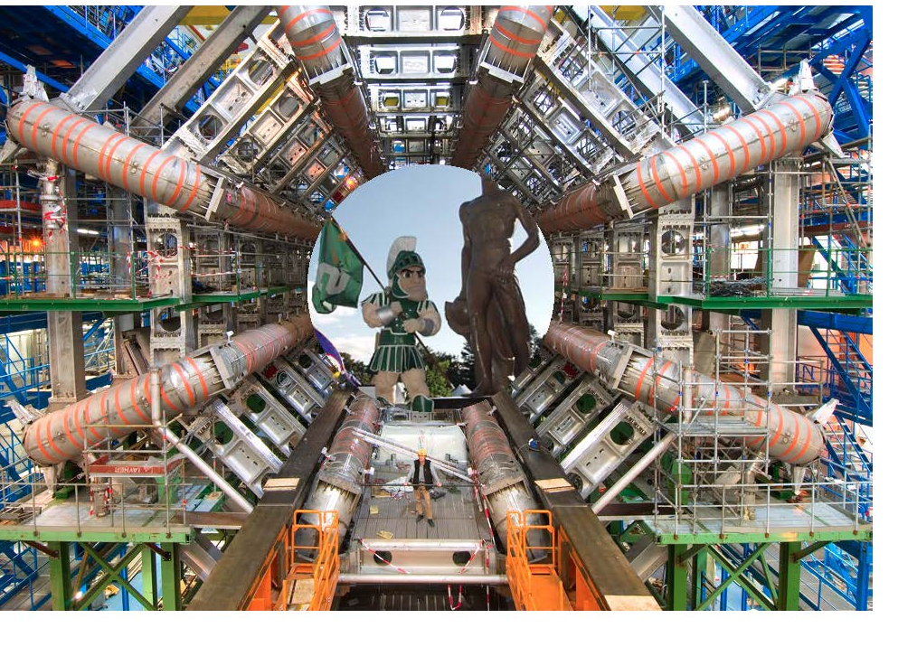
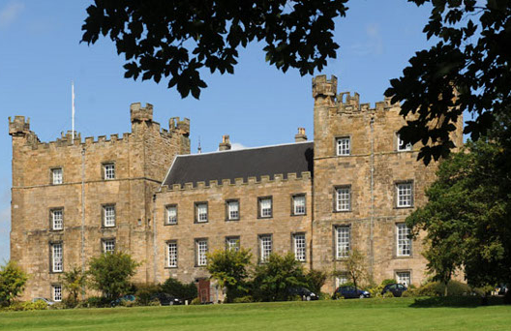
PDFs for Higgs Physics
Joey Huston
Michigan State University/
IPPP Durham
RadCor 2013
PDFs for the LHC
Joey Huston
Michigan State University
XII

Slide 2
First some history: PDF4LHC
In 2010, we carried out an exercise to which all PDF groups were invited to participate
A comparison of NLO predictions for benchmark cross sections at the LHC (7 TeV) using MCFM with prescribed input files
Benchmarks included
W/Z production/rapidity distributions
ttbar production
Higgs production through gg fusion
masses of 120, 180 and 240 GeV
PDFs used include CTEQ6.6, MSTW08, NNPDF2.0, HERAPDF1.0, ABKM09, GJR08

Slide 3
PDF4LHC recommendations(arXiv:1101.0538)
So basically, this is a factor of 2.
At the time of this prescription, neither CTEQ nor NNPDF had NNLO PDFs.

Slide 4
More benchmarking
2 studies in 2011 Les Houches proceedings(1203.6803)
Benchmarking for inclusive DIS cross sections
with S. Alekhin, A. Glazov, A. Guffanti, P. Nadolsky, and J. Rojo
excellent agreement observed
Benchmark comparison of NLO jet cross sections
J. Gao, Z. Liang, H.-L. Lai, P. Nadolsky, D. Soper, C.-P. Yuan
compare EKS results with FastNLO (NLOJET++)
excellent agreement between the two if care is taken on settings for jet algorithm, recombination scheme, QCD scale choices

Slide 5
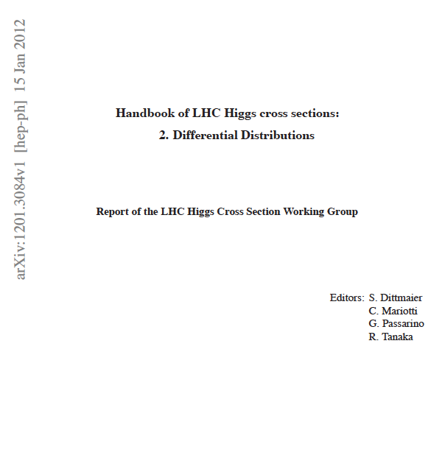
Higgs Yellow Reports
paralleled 2010 PDF4LHC
report
more extensive use of PDF and cross
section correlations

Slide 6
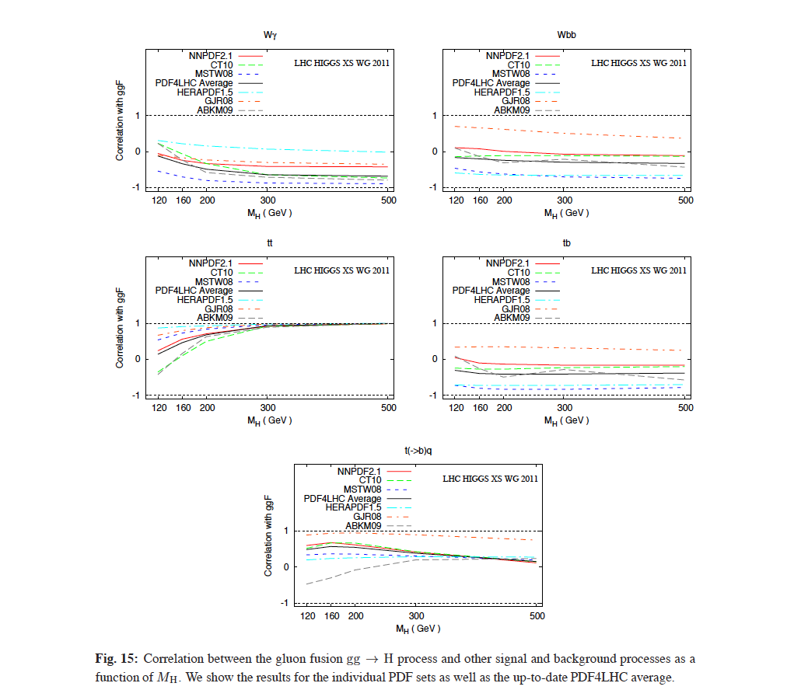
Correlations (of gg fusion production of Higgs to various processes shown) differ between PDFs more than I would have originally suspected
Again, MSTW, CTEQ and NNPDF correlations tend to be similar
tt

Slide 7
Correlations (of gg fusion production of Higgs to various processes shown) differ between PDFs more than I would have originally suspected
Again, MSTW, CTEQ and NNPDF correlations tend to be similar

Slide 8
Followup
Study of NNLO PDFs from 5 PDF groups (no new updates for JR)
drawing from what Graeme Watt had done at NNLO, but now including CT10 NNLO, and NNPDF2.3 NNLO
HERAPDF has upgraded to HERAPDF1.5; ABM09->ABM11
using a common values of α_{s} (0.118) as a baseline; varying in range from 0.117 to 0.119)
including a detailed comparisons to LHC data which have provided detailed correlated systematic error information, keeping track of required systematic error shifts, normalizations, etc
ATLAS 2010 W/Z rapidity distributions
ATLAS 2010 inclusive jet cross section data
CMS 2011 W lepton asymmetry
LHCb 2010 W lepton rapidity distributions in forward region
The effort was led by Juan Rojo and Pavel Nadolsky and has resulted in an independent publication
The results from this paper will be utilized in a subsequent PDF4LHC document(s)
…and are now in YR3

Slide 9
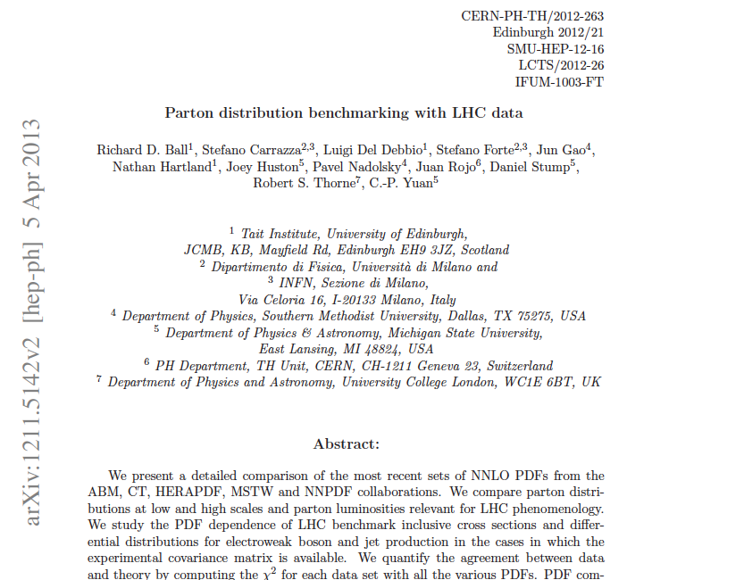
Benchmark paper
Not officially a PDF4LHC document but will be used as input to future recommendations
Comparisons only at NNLO, but NLO comparisons available at http://nnpdf.hepforge.org/html/pdfbench/catalog

Slide 10
PDFs used in the comparison
No updates of JR since 2009.

Slide 11
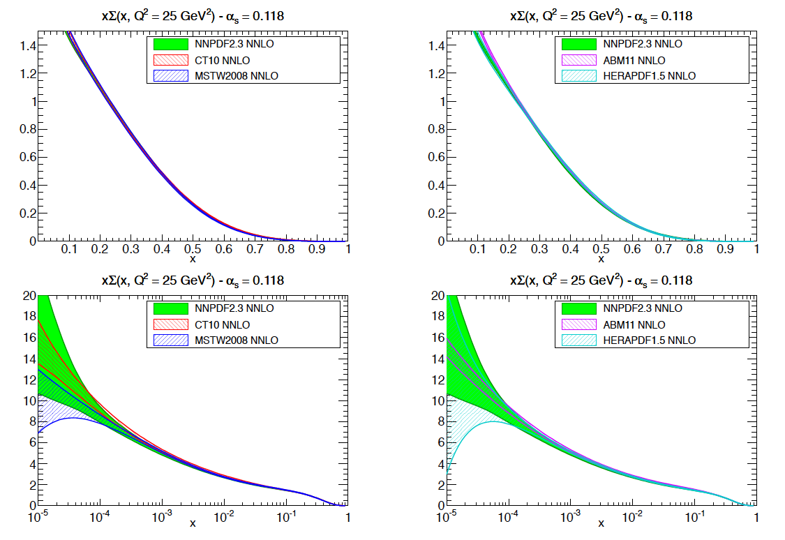
PDF comparisons
quark singlet PDFs
…results for
other values of
α_{s} and at NLO
available on
the HEPFORGE
website
good agreement
for all sets for
quark singlet
distribution

Slide 12
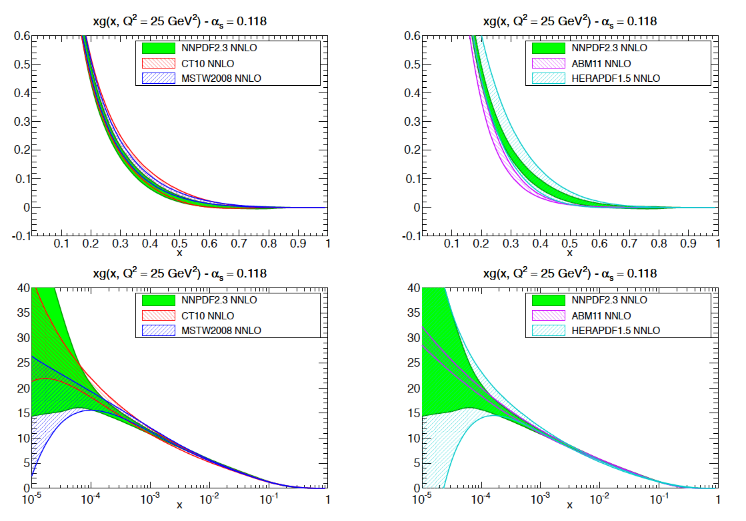
Comparison of PDFs
CT10, MSTW08
and NNPDF2.3
gluon distributions
all in reasonable
agreement
The 1-sigma
uncertainty
bands overlap
for all values of
x
Differences are
larger for ABM11
HERAPDF
uncertainties
somewhat larger
at low x; noticeably
larger at high x due
to lack of collider
jet data
gluon PDF

Slide 13
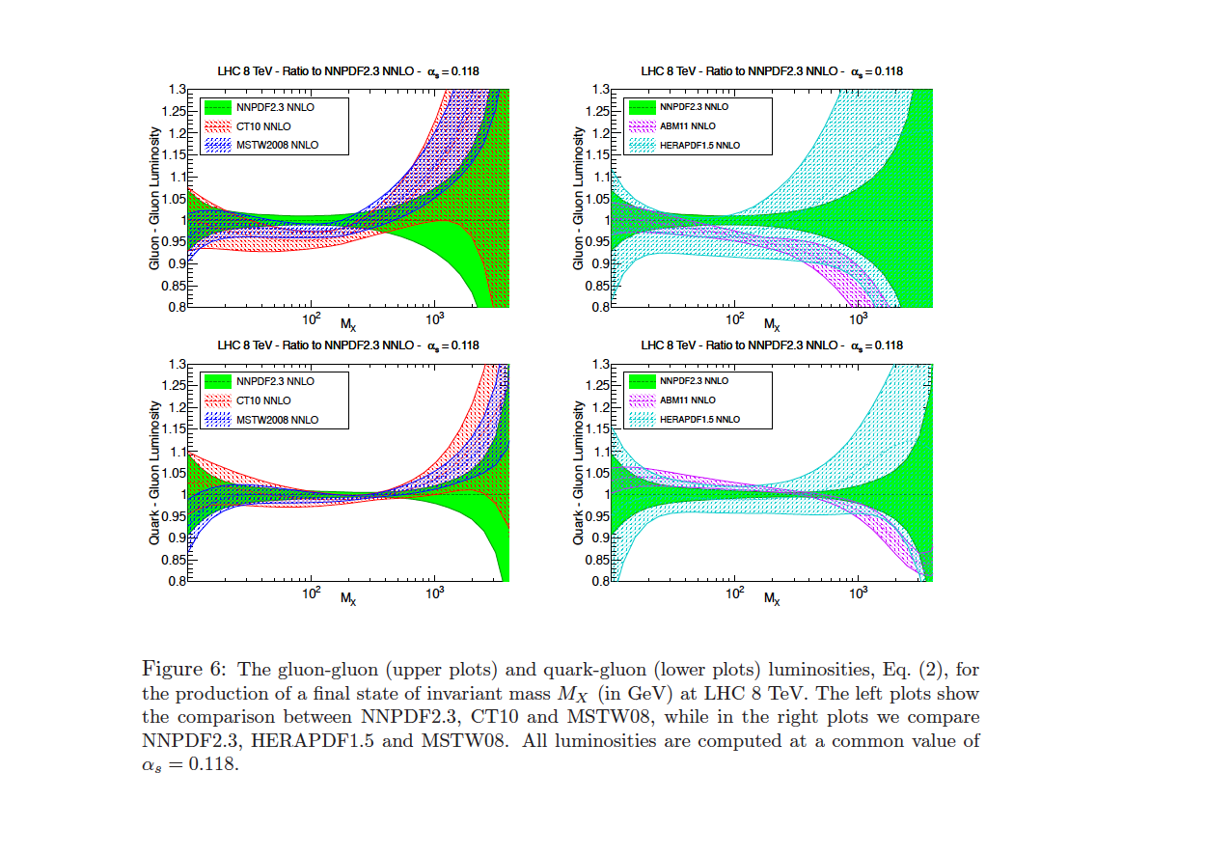
PDF luminosities
gluon-gluon and
gluon-quark
luminosities in
reasonable agreement
for CT10,
MSTW08 and
NNPDF2.3 for full
range of invariant
masses
HERAPDF1.5
uncertainties larger in
general

Slide 14
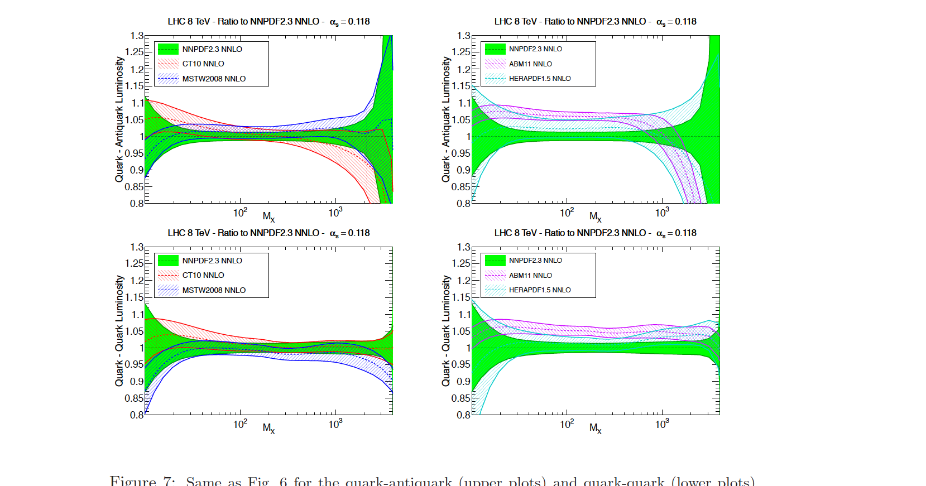
PDF luminosities
quark-quark and quark-antiquark
quark-antiquark
luminosities for
CT10, MSTW08
and NNPDF2.3
overlap almost
100% in W/Z
range
ABM11 systematically
larger at small
mass, then falls
off more rapidly
at high mass
for VH
for VBF

Slide 15
Uncertainties have improved
…with additional data and in going from NLO to NNLO
2010
2012

Slide 16
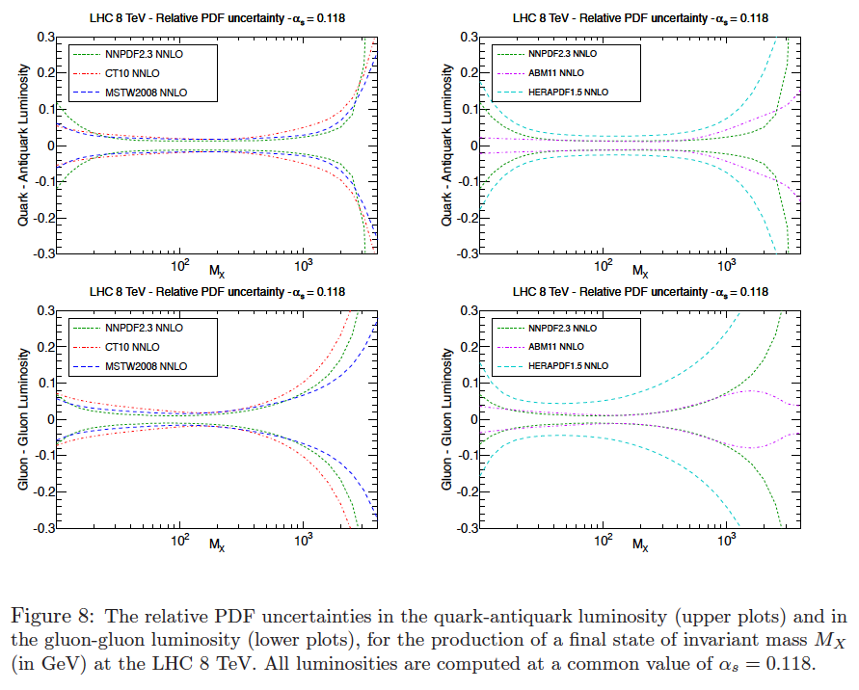
Compare relative luminosity uncertainties
good agreement in
size of uncertainties
between the 3
global PDFs
larger uncertainties
of HERAPDF1.5
apparent
ABM11 uncertainties
smaller at high
mass

Slide 17
NNLO PDF uncertainties
Factor of 2 expansion of MSTW2008 error (previous prescription) basically works for gg initial states (like 125 Higgs)
…but maybe an overestimate for qQ initial states

Slide 18
…but are they good enough?
Can we further improve the gg PDF luminosity uncertainty in the Higgs mass region?
PDF+α_{s} error is now the dominant theory error for ggF
NNPDF2.3 marks the high edge and CT10 the low edge
full gg uncertainty is ~ factor of 2 more than any of the individual group uncertainties
The gluon in this region is determined largely by the HERA combined Run 1 data set, but fixed target (NMC and BCDMS) have big impact as well
There may be issues relating to specific heavy quark schemes/charm quark masses
This was a project that started at Les Houches

Slide 19
PDF Higgs Projects
NNPDF2.3 fit only to collider data leads to a slightly different gluon and a prediction for the gg->Higgs cross section at 8 TeV in better agreement with CT10 and MSTW08
but factor of 2 larger uncertainties; we need BCDMS and NMC
We will re-investigate the impact of BCDMS and NMC data on Higgs cross section predictions
impact is on the order of a few percent, but this is one place where that order of magnitude is critical
so we may be able to improve the PDF
uncertainty but there is still a strong
α_{s}(m_{Z}) dependence

Slide 20
α_{s}(m_{Z})
Right now the Higgs Cross Section Working Group is using a mean value for α_{s}(m_{Z}) of 0.118 with 90% CL error of 0.002 (68%CL error of 0.012), or an inflation of the world average uncertainties; the α_{s} error is added in quadrature with the PDF error
The world average is dominated by lattice results
I was reasonably convinced at Snowmass that the lattice results are robust enough, so that an uncertainty of 0.012 (at 68% CL) may not be fair
So I may try to reduce the Higgs Working Group uncertainty, especially if we’re successful in reducing the PDF uncertainty
variety of different
calculations/groups results
in very compatible
results

Slide 21
8 TeV Higgs cross section predictions
cross sections
calculated at
NNLO
using a scale
of m_{H}
ABM11 and
HERAPDF1.5
predictions
within
error
envelope
NB: ABM11
cross section
would be
lower if
native value
of α_{s} (0.1134)
used
ggF
VBF

Slide 22
More 8 TeV Higgs cross section predictions

Slide 23
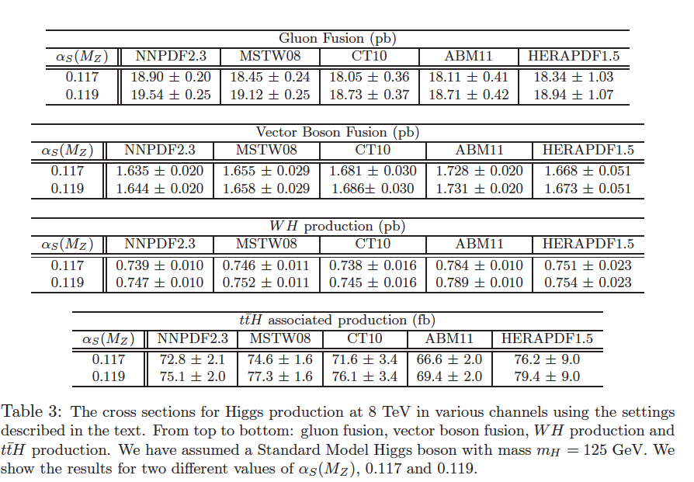
8 TeV NNLO Higgs Cross Section Predictions

Slide 24
Revisit prescriptions (for 8 TeV cross sections)
midpoint
2010
2012
Compare to MSTW08 NNLO value of 18.45 pb
(2010 prescription)
HXSWG 8 TeV NNLO cross section
2012
NNLO+NNLL

Slide 25
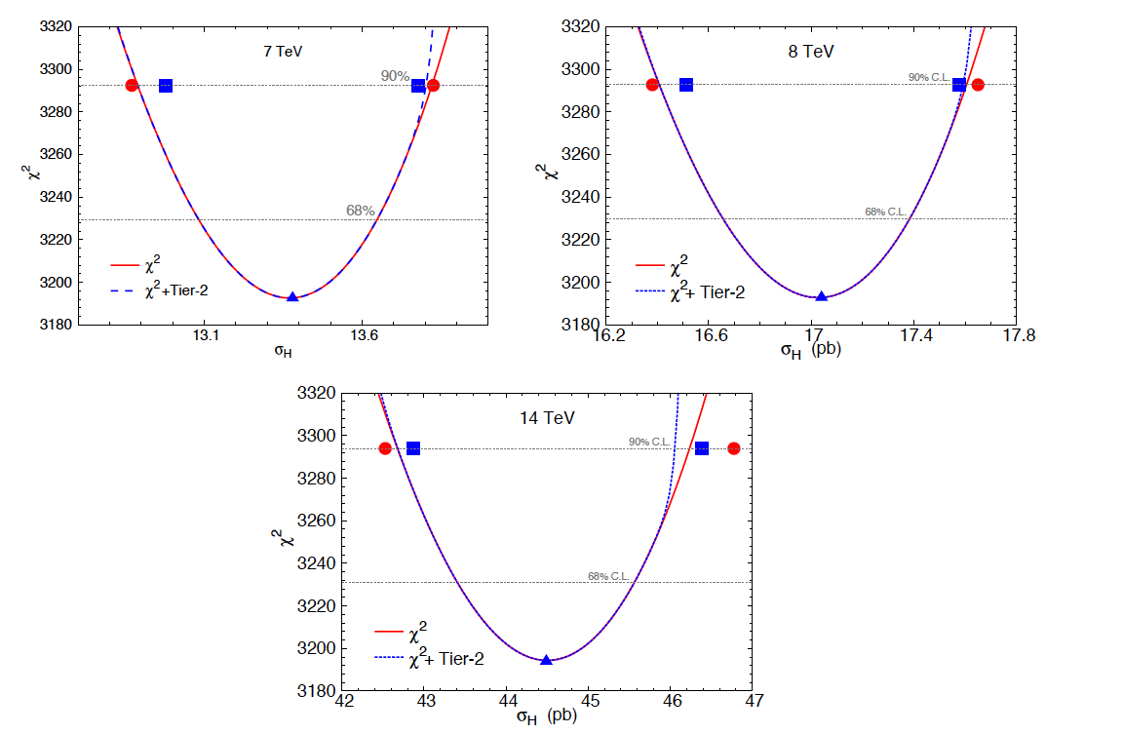
Scaling issues: 90%CL->68%CL
New CT paper dealing with PDF and α_{s} uncertainties for gg->Higgs production, comparing Hessian and Lagrange Multiplier Techniques
LM technique
not dependent
on assumption
of quadratic χ²
behavior, so
more robust than
Hessian
curves are LM calculations
of global fit χ² vs Higgs σ
with (blue) and without (red)
‘Tier 2 penalty’
The blue (red) points are the
Hessian determination of the
of the PDF uncertainty with
(without) the Tier 2 penalty
Tier 2 penalty
prevents the fit
to any one
experiment from
degrading too
Much
all predictions at
NNLO using μ=m_{H}

Slide 26
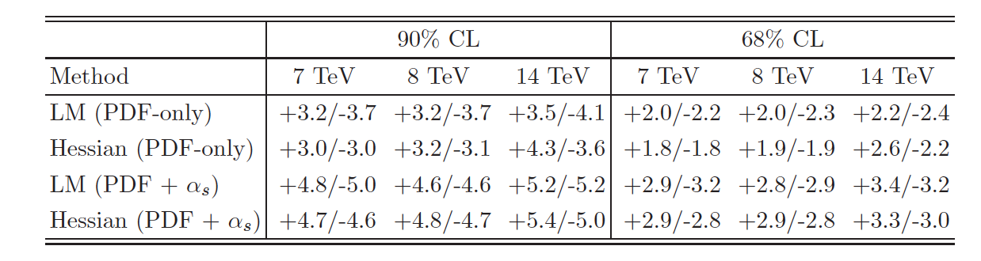
PDF+α_{s} uncertainties
LM estimates of PDF(+α_{s}) uncertainties slightly larger than Hessian determinations, but close, especially for the combined PDF+α_{s} errors
The 68% CL errors agree with the naïve scaling factor of 1.645

Slide 27
Fits of the fits: META PDFs
PDFs from different groups have different physics inputs. But if we only focus on the phenomenological studies at the LHC with the limited x and Q ranges, the idea of META PDF is reasonable and also feasible.
Procedure (for LHC):
1, selecting a specific x-Q range, and a parameterization form to describe all the PDFs at an initial scale above the bottom quark mass;
2, check that the fitted PDFs can well represent the original PDFs at the x-Q range studied;
3, choosing a scheme to combine the PDF measurements of different groups in the new PDF parameter space;
Benefits:
1, A nature way to compare and combine the LHC predictions from different PDF groups independent of the process, works similarly as the PDF4LHC prescriptions but directly in the PDF parameter space;
2, Especially desirable for including results from large number of PDF groups, in this case also minimizing numerical computation efforts for massive NNLO calculations
3. Possible to explore eigenvector directions that saturate the combined uncertainty for important LHC cross sections.
fits to PDFs from global PDF fits
for example, eigenvector directions that
describe the gg->Higgs uncertainty
Jun Gao, Pavel Nadolsky

Slide 28
Jun Gao, Pavel Nadolsky

Slide 29
Meta-PDFs
effect of
tolerance
on impact
of new data
in global
fits needs
to be
better
understood
CTEQ/MSTW
may be
different than
NNPDF?
investigate
for Les
Houches
Writeup
use-cases for
META-PDFS
or
equivalent
Jun Gao, Pavel Nadolsky

Slide 30
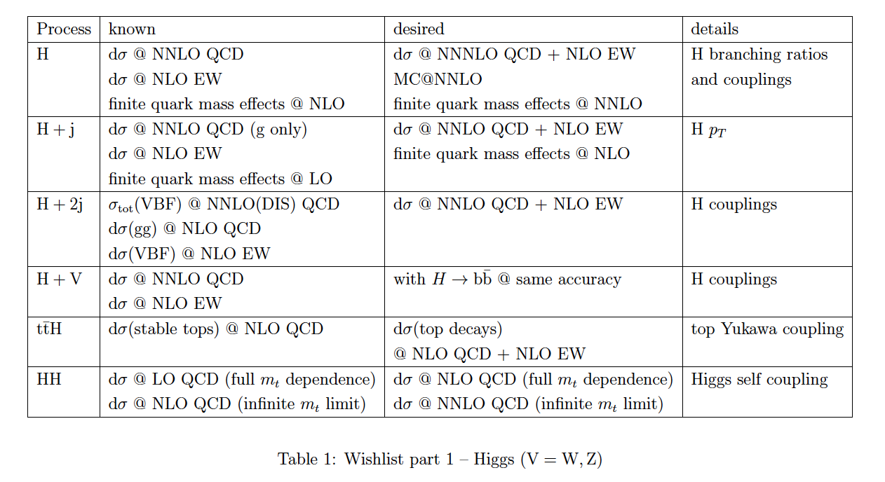
NNLO QCD+NLO EW wishlist
add a column here
for current exp
precision and that
expected at 14 TeV
N. Glover, S. Dittmaier

Slide 31
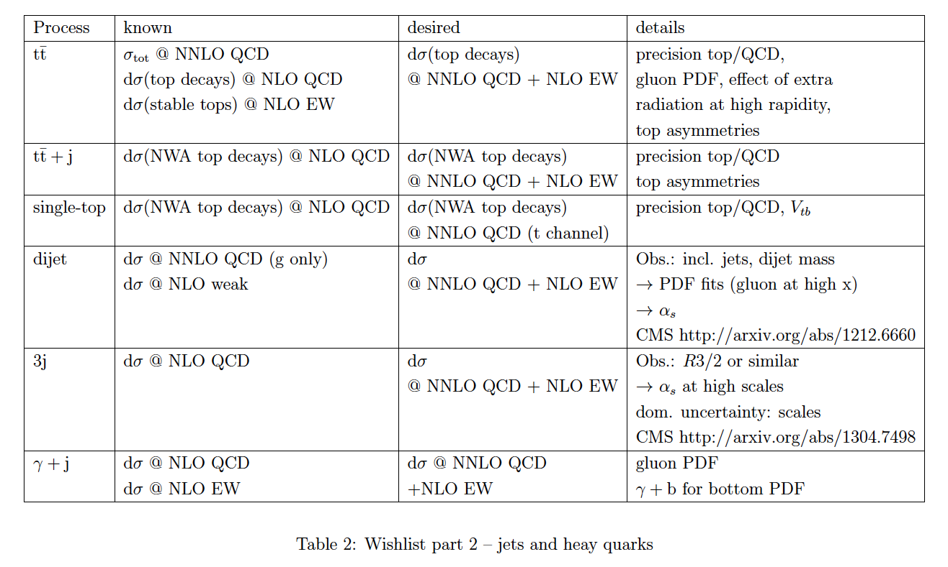
NNLO QCD + NLO EWK wishlist
N. Glover, S. Dittmaier

Slide 32
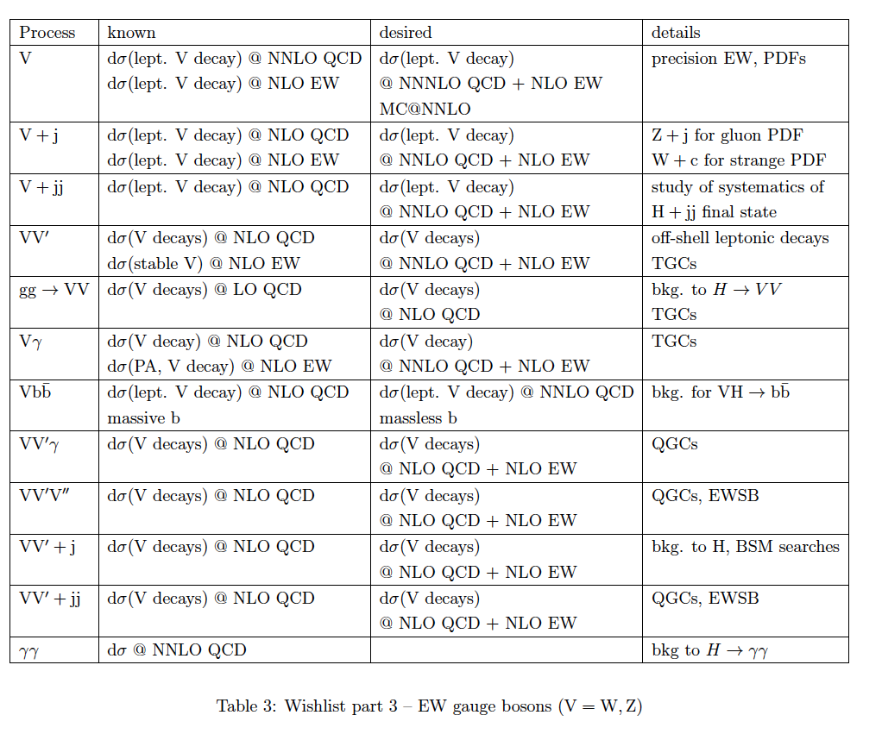
NNLO QCD + NLO EWK wishlist
N. Glover,
S. Dittmaier

Slide 33
The frontier

Slide 34
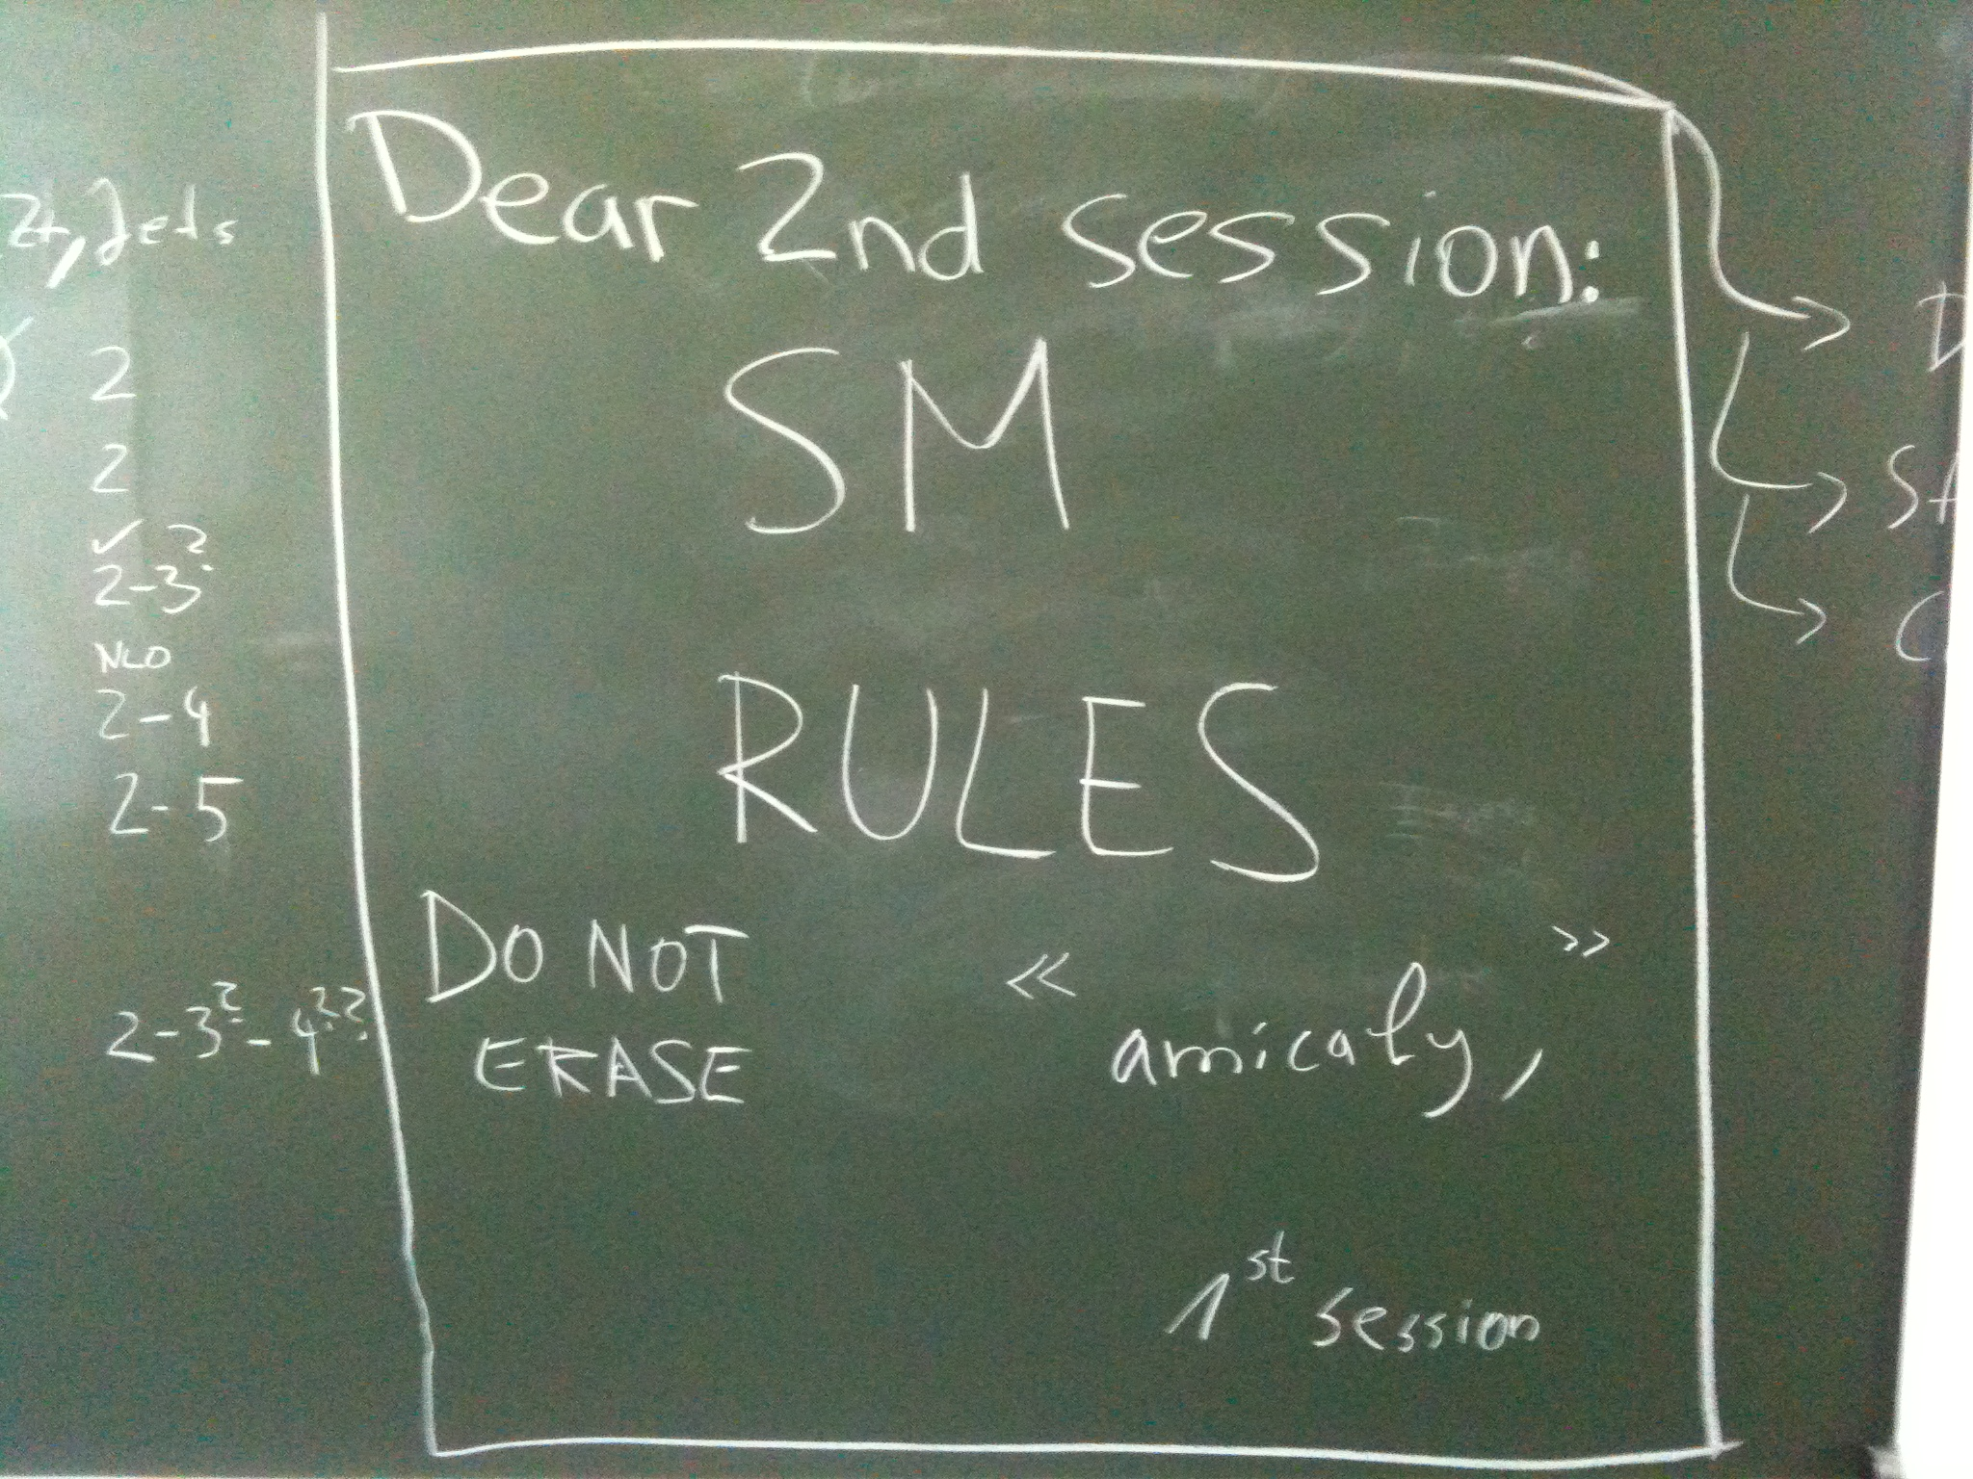
what we left at Les Houches for the BSM session

Slide 35
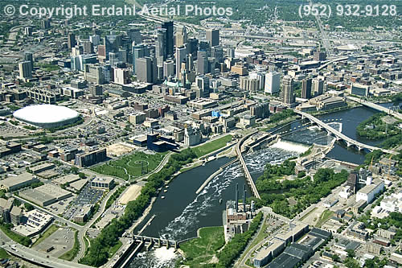
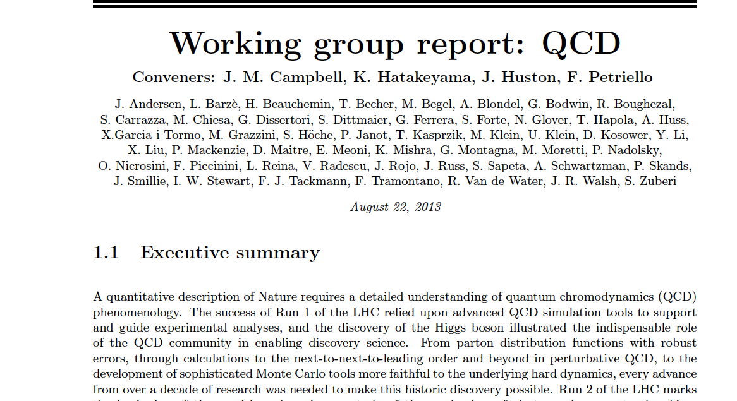
Snowmass
The Snowmass QCD writeup is complete
also deals with hard EWK corrections
Should be on the archive soon
http://www.snowmass2013.org/tiki-index.php?page=Quantum+Chromodynamics+and+the+Strong+Force
It was difficult to get the message across to
the Higgs/BSM etc people the importance
of higher order QCD+EWK calculations, of
the type discussed at this workshop. We
realized afterwords that we should have
presented the message in a simpler fashion.

Slide 36
One theory to rule them all…
QCD
…and in the (infrared) darkness bind them.

Slide 37
Summary
(Relatively) new NLO (and NNLO) PDFs are available: CT10, NNPDF2.3, HERAPDF1.5, ABM11, in addition to MSTW2008
expect new updates for all in the near future
Higgs cross section predictions have been updated using the new NLO and NNLO PDFs
A new prescription based on the same families of PDFs would lead to a central prediction (and uncertainties) similar to what was used in 2010
note that quark-quark luminosity uncertainties have been reduced; gluon-gluon luminosity uncertainties (at least in the 125 GeV range) have not
HERAPDF1.5 NNLO predictions consistent with those of CT10, NNPDF2.3 and MSTW2008 but with larger uncertainties
larger differences with ABM11; may be due to use FFN scheme
Ongoing work on trying to understand the differences among CT10, NNPDF2.3, MSTW08 and HERAPDF1.5 for gg PDF luminosities
A new prescription (somewhat more sophisticated) is being developed; more powerful tools (such as meta-PDFs) will also be used in the near future

Slide 38
Lastly, I was able to get a video of Lance falling in action on Wednesday

Slide 39
Nota bene
For the PDFs to be fully NNLO, we need to use NNLO matrix elements for inclusive jet production, crucial to the determination of the high x gluon
So far, we have them for the gg channel
corrections are sizeable; I would expect them to be smaller for the gq and qQ channels, following the Dixon conjecture
Completion this year? Nigel won’t
take bets any more

Slide 40
The future looks bright
New data from HERA and from the LHC should improve understanding of PDF uncertainties for Higgs cross sections
we should use as input all relevant high-statistics LHC data
e.g. inclusive photon production, photon+jet, W+c, Drell-Yan, single top and top pair production, …
ratios thereof at different center-of-mass energies
this data must be reported with well-understood correlated systematic errors to be understood; also which errors are additive and which are multiplicative
An LHeC will further improve our knowledge of PDFs, at both high and low x, as well as α_{s}

Slide 41
…and
Photon PDFs: photon PDFs can be larger than antiquark distributions at high x; the LHC is a γγ collider->Les Houches project
Both CT and NNPDF are developing photon PDFs + QED corrections (so far only MRST2004QED available)
…plus, at Les Houches, a general re-visitation of QED and EWK corrections for 14 TeV cross sections, especially in the Sudakov Zone

Slide 42
Advertisement
The Snowmass exercise is ongoing (in cooperation/conjunction with Les Houches). Of particular interest to this audience are QCD and EWK, and pQCD computing
If you’re here tomorrow, please come to the meeting shown below

Slide 43
Sheldon tackles 6-loops

Slide 44
Some PDF issues
What is the current (and ultimate) uncertainty of the LHC beam energy, how does it affect uncertainties in cross section comparisons, and how might ratios of cross sections lead to more precise comparisons (taking into account correlations)?
What sort of errors/uncertainties are present in using NNLO PDFs with NNLO+NNLL predictions (i.e. do we need resummed PDFs); what sort of errors/uncertainties wold be present if NNLO PDFs were used with a NNNLO prediction for ggF?
Revisiting theory uncertainties in PDF determination, i.e. scale choice for processes such as inclusive jet production
…as well as issues regarding scale choices in LHC predictions (such as discussed in extra slides)

Slide 45
Back to correlations
A 126 Higgs produced through ggF is strongly correlated with the gluon distribution in the x-range around m_{Higgs}/sqrt(s)
and anti-correlated with the higher x gluon distribution
The correlation is the same whether LO or NLO (or NNLO) matrix elements are used
using CT10NNLO PDFs: Jun Gao and Pavel Nadolsky (preliminary)

Slide 46
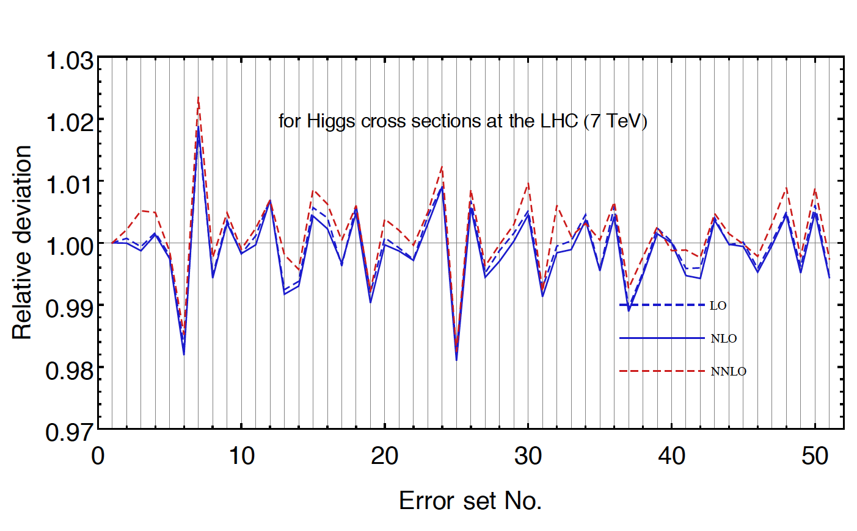
Correlations
The ggF Higgs cross section at 7 TeV depends primarily on a few eigenvectors, presumably relating to the low x gluon distribution
I haven’t had a chance to check yet exactly what the PDF components are
You can also effectively directly probe the PDF direction sensitive to the Higgs cross section using the Lagrange Multiplier technique
study in progress
CT10 NNLO

Slide 47
Correlations with the gluon
Here are the experiments that are most sensitive to the gluon distribution (for CT10 NNLO but should be similar for other PDFs)
HERA and the Tevatron/LHC jet experiments

Slide 48
Correlations between jet data and the gluon
Correlations are shown for each data point for each cross section
As expected, Tevatron jet cross sections are mostly strongly correlated with the high x gluon, LHC jet cross sections with the low x gluon

Slide 49
Currently, the HERA combined data provide the greatest constraint on the low x gluon distribution
LHC jet data can provide a more important role, if the systematic errors can be reduced
The completion of the NNLO inclusive jet cross section calculation is also crucial to reduce the theoretical uncertainty

Slide 50
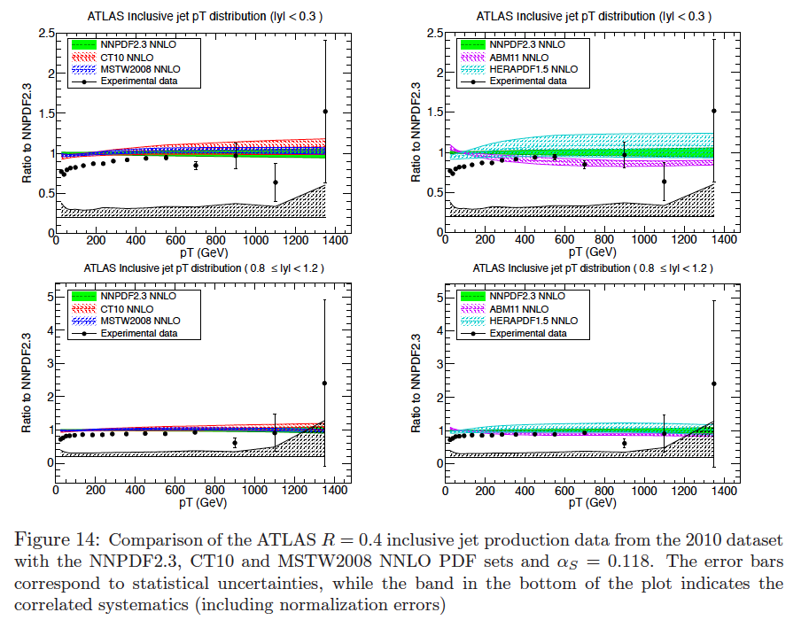
ATLAS 2010 jet data

Slide 51
Systematic error shifts for ATLAS jet data for
CT10 and NNPDF2.3 NNLO
also important to check that no
major systematic errors need large shift
χ² for all PDFs
are good (too good?)
2010 data not
constraining for
PDF fits?

Slide 52
Scale uncertainty
The Higgs cross section depends on the renormalization scale μ_{R} and factorization scale μ_{F}
Consider default values for these two scales, μ_{o,F} and μ_{o,R} and expand around these values
Can write the NLO Higgs cross section (actually any NLO cross section) near the reference scales as
…where the explicit logarithmic dependences have been factorized out; the b and c variables will depend on the kinematics
In general, there will be a saddle point, where the local slope as a function of μ_{R},μ_{F} is zero, i.e. the b’s vanish
Around the saddle point, can write the scale dependence as

Slide 53
Consider inclusive jet cross section at NLO
For c_{F}>0,c_{R}<0 and c_{F},|c_{R}|>>|c_{RF}|, the saddle point axes are aligned with the plot axes, as shown at the top right
At higher p_{T} values, c_{RF}<0 and c_{F},|c_{R}|<<|c_{RF}|, the saddle position rotates by about 45º
The saddle position also depends on jet size and on rapidity (somewhat)
In any case, the perturbative series is well-behaved for inclusive jet production, leading to stable predictions at NLO, using a scale related to the p_{T} of the jet
…except perhaps when you go very far forward

Slide 54
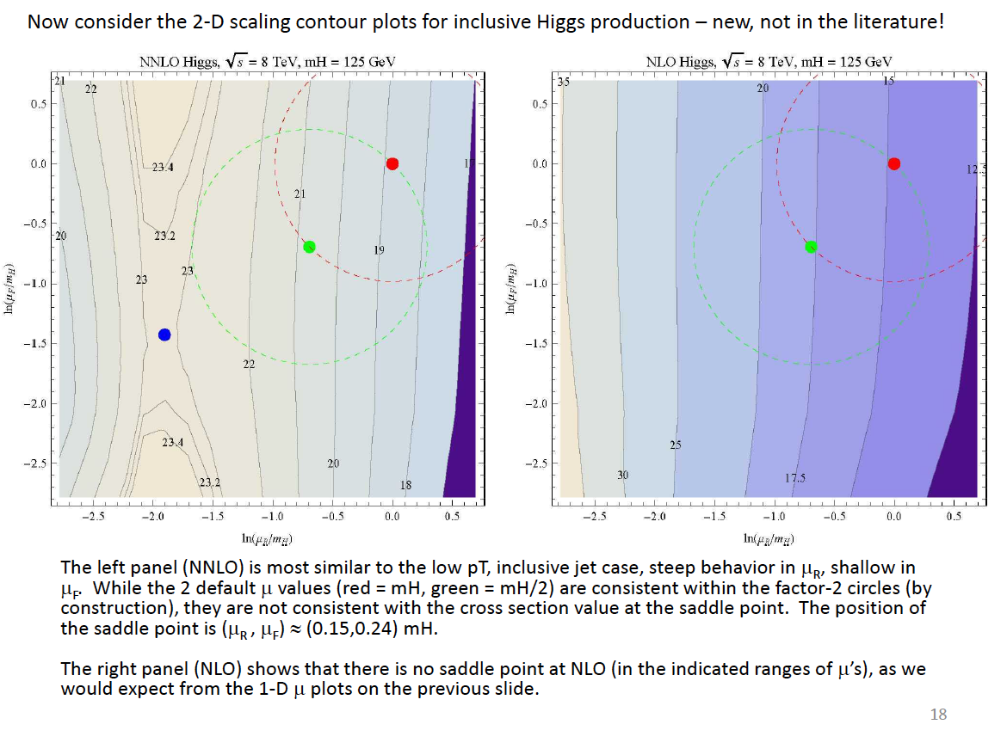
2-D plots for ggF for Higgs
The NNLO scale dependence looks similar to that for low p_{T} inclusive jet production, steep at low values of μ_{R}, shallow in μ_{F}
Note that there is no saddle point at NLO in the range of scales plotted; it looks similar to LO for inclusive jet production
ihixs
Achilleas Lazopoulos and Stephan Buehler, with Steve Ellis

Slide 55
ggF at NNLO
Note that the location of the saddle point is at ~(0.15m_{H},0.24m_{H}), i.e. outside of the range of uncertainties typically taken into account when using a scale of either m_{H} or 0.5 m_{H}
Saddle point ~23.1pb compared to 20.7pb for m_{H}/2
Maybe the saddle point is not magic, but it may be disturbing that it is not included in the uncertainty calculation

Slide 56
ggF at NNLO
Now consider a 450 GeV Higgs produced by ggF
There’s some rotation of the saddle region as you would expect from the jet analysis
Saddle point also moves to smaller μ_{F}

Slide 57
Babis at GGI
Points out that series is not well-behaved and that even NNLO might not be enough for precision predictions
~N³LO prediction peaks near a scale of m_{Higgs}
But normalization has not been determined; likely to have some additional positive corrections
I don’t really understand the ~NNNLO
curve. Very large change in
predicted cross section at low scales.
claims that 5% precision might be
achievable at NNNLO.
good progress in the
calculation, so maybe we don’t have too
long to wait; need Higgs + 1 jet at NNLO

Slide 58
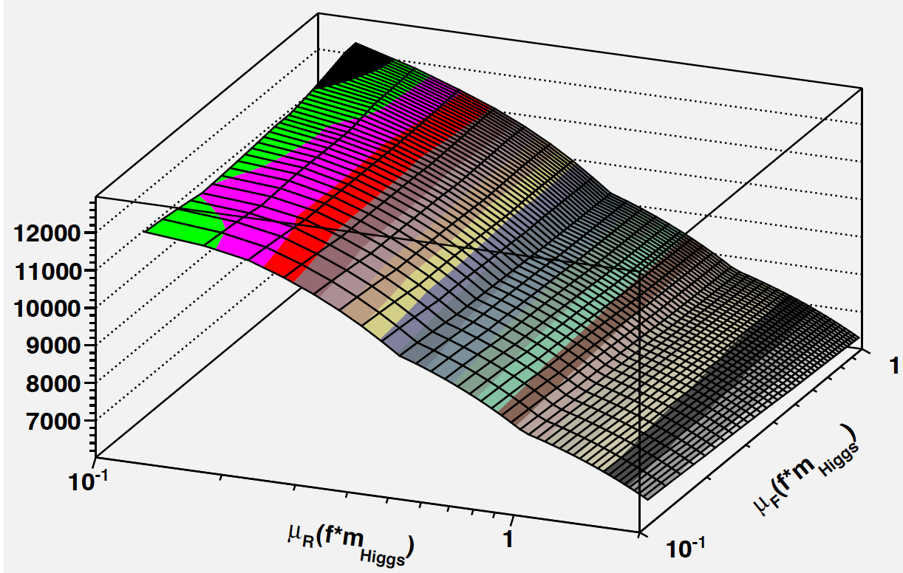
Now look at Higgs+1 jet at NLO
This is for inclusive requiring only a 20 GeV/c cut on the jet; behavior is monotonic and no saddle point is present; scale uncertainties are large and ill-defined
…but better than inclusive Higgs production at NLO
Higgs+1 jet at NNLO in 2013 (N. Glover, private communication)

Slide 59
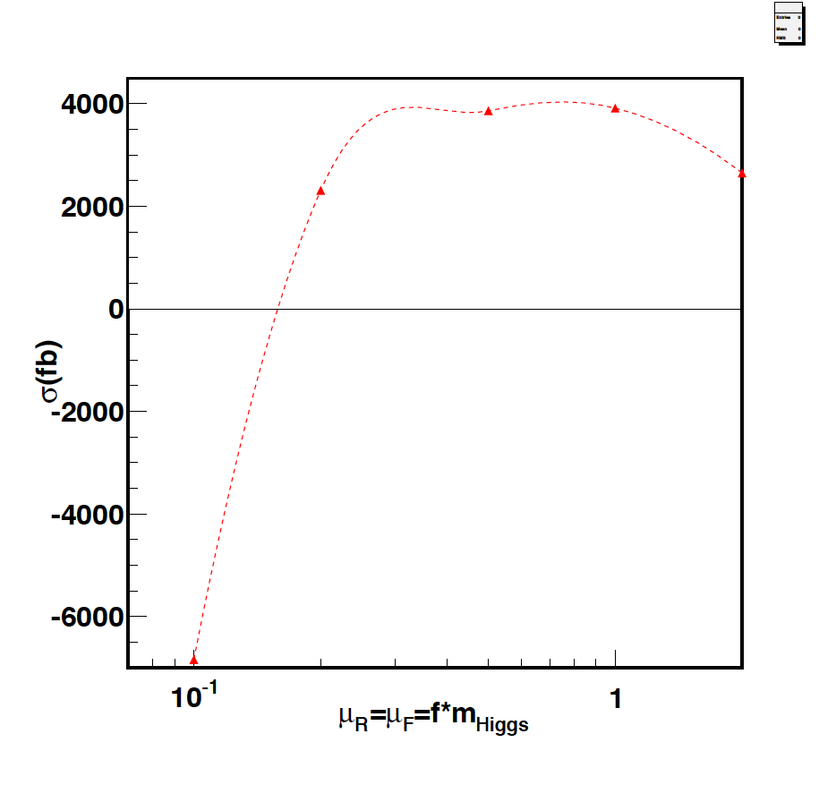
What about Higgs+2 jets?
Better behavior than for either inclusive Higgs or Higgs+1 jet

Slide 60
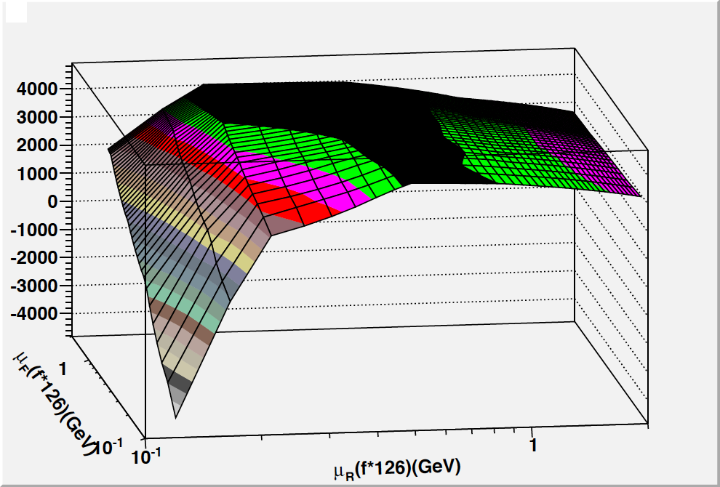
Higgs+2 jets (2D)
x

Slide 61
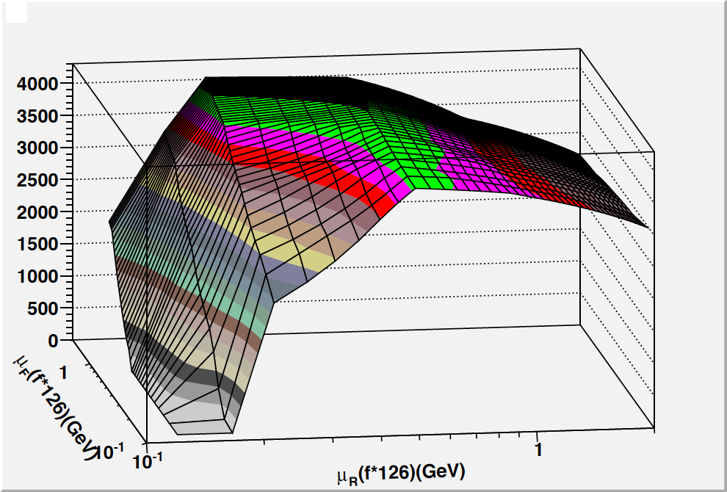
Higgs + 2 jets (positive cross sections)
x

Slide 62
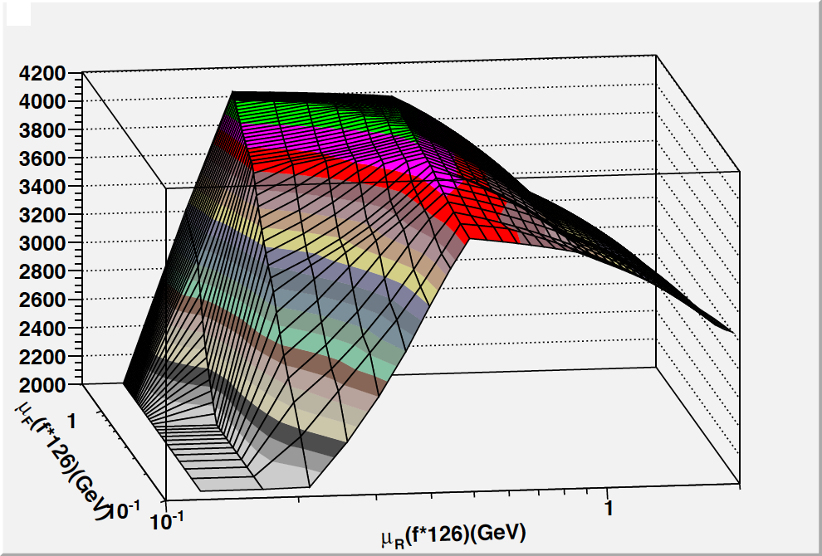
Higgs + 2 jets
x

Slide 63
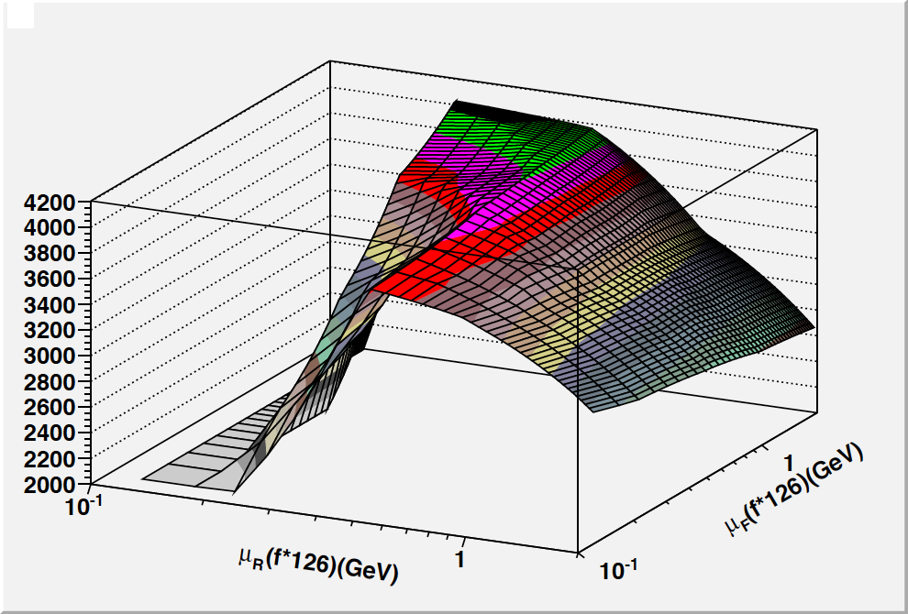
x
Scale of mHiggs
(3360 fb)

Slide 64
μ_{F} dependence
As we have seen, the μ_{F} dependence is much flatter than the μ_{R} dependence for gg->Higgs (+jets)
Mostly because ggF probes the gluon distribution in the region around the inflection point
For the higher x values probed in the VBF region, this will change somewhat

Slide 65
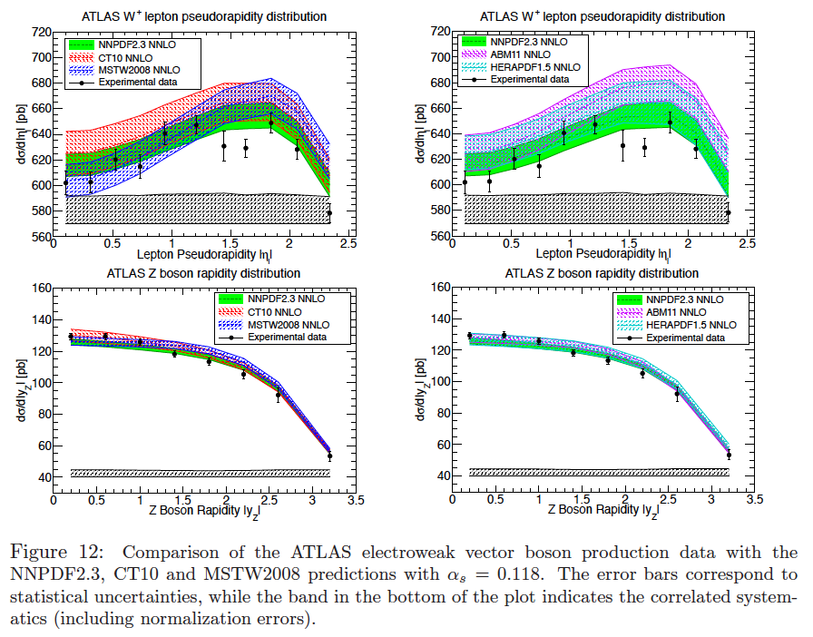
Comparisons to 2011 data

Slide 66
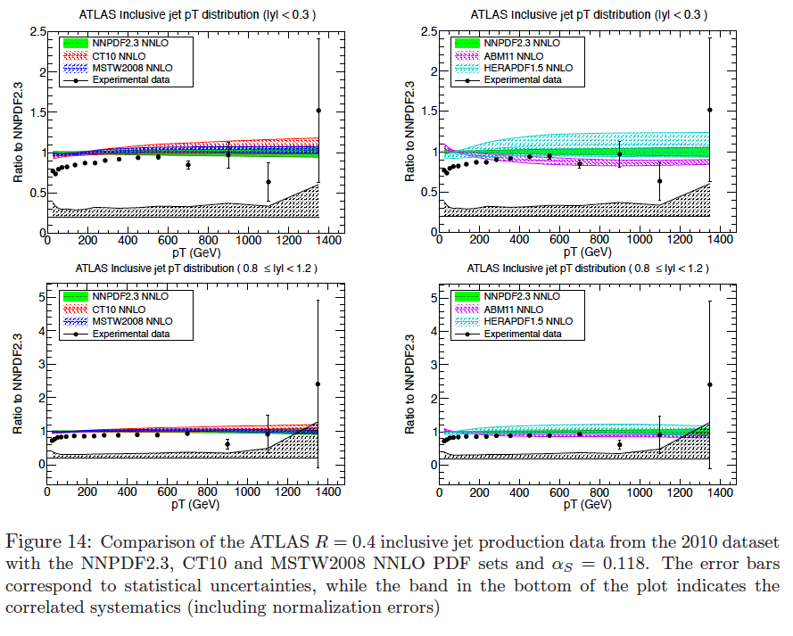
Comparisons to 2011 data

Slide 67
Comparisons to 2011 data

Slide 68
Comparison of jet predictions
agreement
at high p_{T},
some
differences
for
APPLGRID
at low p_{T}
larger
differences
at low p_{T}
if scale
of p_{T}^{jet,max}
is used
note
unshifted
data has
poor
agreement
with theory
scale =p_{T}j^{et}
scale =p_{T}j^{et,max}
scale =p_{T}j^{et,max} in each rapidity bin
ATLAS choice
hatched is FASTNLO
uncertainty band
for p_{T}/2 to 2p_{T}
could we agree on
a common scale,
like p_{T}^{jet}?

Slide 69
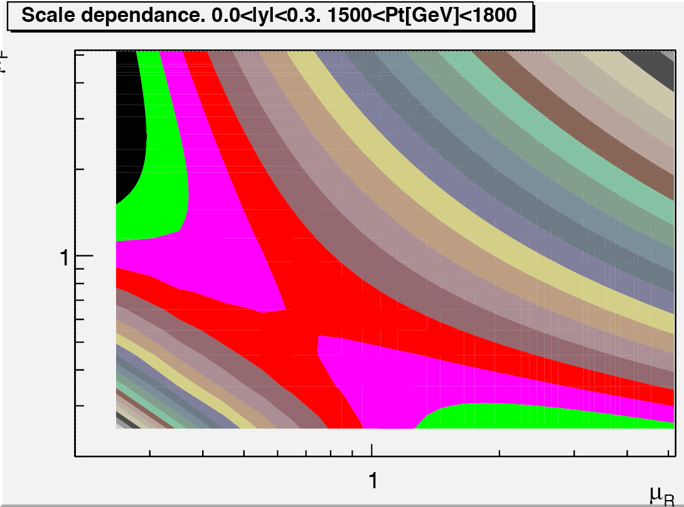
Aside: Scale choices
Take inclusive jet production at the LHC
Canonical scale choice at the LHC is μ_{r}=μ_{f}=1.0*p_{T}
CDF used 0.5p_{T}
CTEQ6.6/CT10 used this scale for determination of PDFs
new CT PDFs use p_{T}
Close to saddle point for low p_{T}
But saddle point moves down for higher p_{T} (and the saddle region rotates)
Our typical scale choices don’t work for all LHC kinematics; more extreme movements for some of measured cross sections
Rather than look for some magic formula, we should try to understand what is going on the kinematic/scale point-of-view
R=0.4
antikT

Slide 70
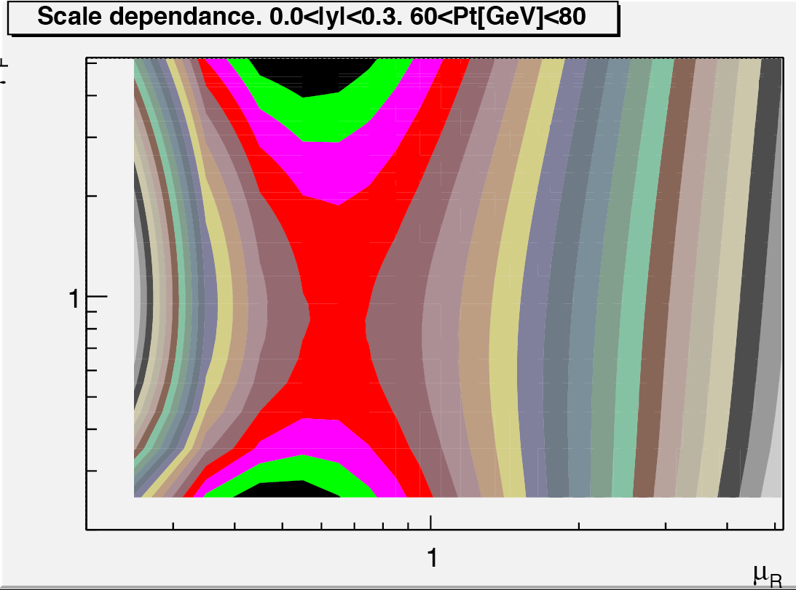
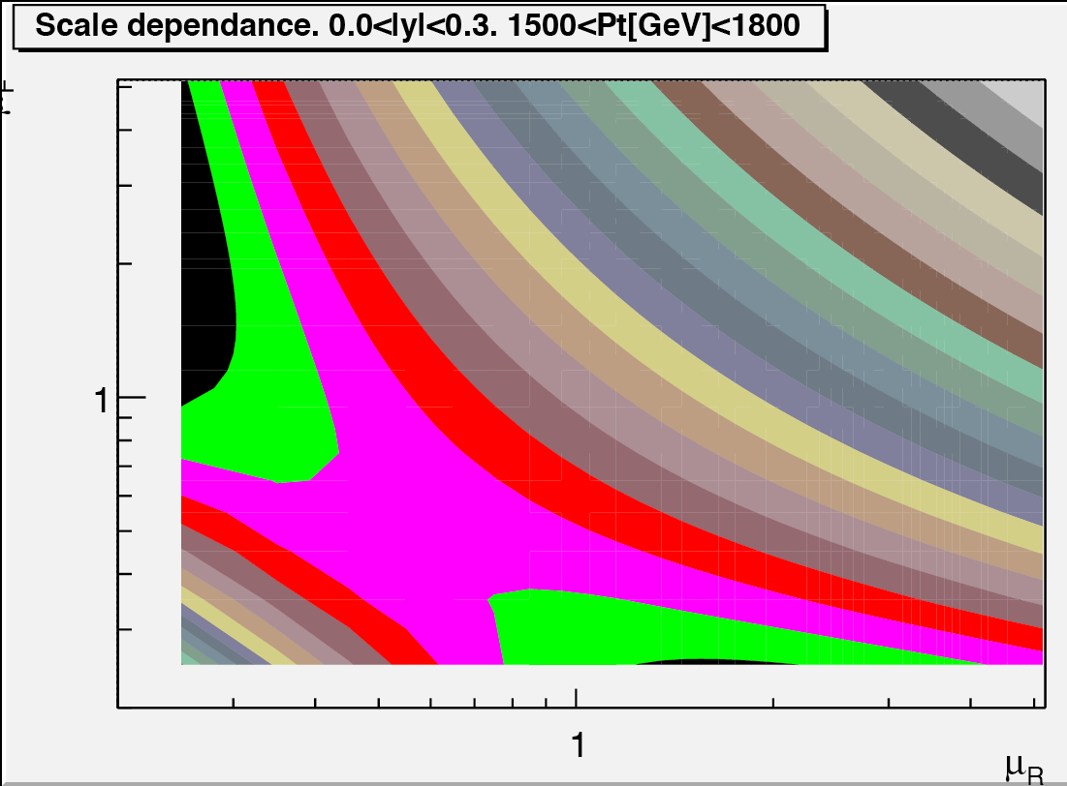
Scale dependence also depends on jet size;
R=0.4
antikT
R=0.6
antikT
NB:Tevatron
inclusive
jet
measurements
with
R=0.7

Slide 71
Calculation of χ²
x

Slide 72
Which χ²?
There are a number of χ² values being quoted that can differ greatly depending on the details of the definition

Slide 73
Sheldon tackles 6-loops

