Slide 1
Black Holes,
Strings and
Entanglement
Herman Verlinde
Durham, 10/11/13
w/ E.Verlinde
L. McCough
J. Heckman
S. Jackson
R. Pourhasan

Slide 2
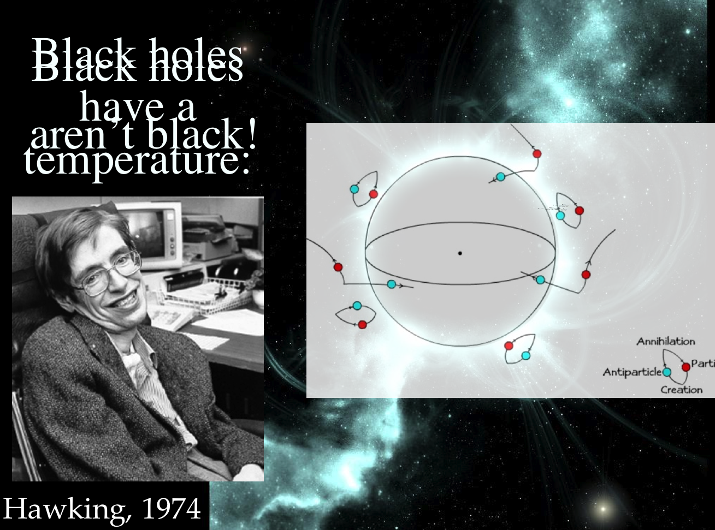
= 8 M
β
π
Η

Slide 3
virtual |ˈvərCHo͞oəl|
Adjective
“almost or nearly as described, but not completely or according to strict definition”
Physics: denoting particles or interactions with extremely short lifetimes and (owing to the uncertainty principle) indefinitely great energies, postulated as intermediates in some processes

Slide 4
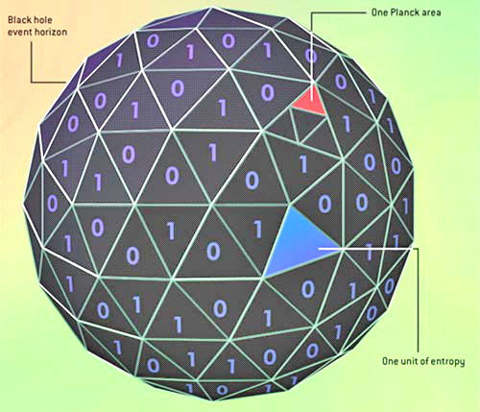
S = Area/4G
BH
N
Bekenstein
Hawking

Slide 5
How to fall into a black hole?
How do black holes store information?
Why is empty space smooth?

Slide 6
Firewall Paradox
AMPS
Almheiri e.a.
B
A

Slide 7
AdS/CFT
Maldacena
GKP-Witten
RG-scale
Finite
=
Temperature
Extra
=
Dimension
Black Hole
‘t Hooft Susskind

Slide 8
Entanglement Entropy
Geometric

Slide 9
Entanglement Entropy
Holographic
S =
Area
EE
4G
d+2
Ryu & Takayanagi

Slide 11
A general entangled state:
A balanced entangled state:

Slide 12
?
local vacuum state?

Slide 13
!

Slide 15
Topological qubit
interior
exterior
γ
γ
γ
γ
1
2
3
4
{ , }=
γ
γ
δ
i
j
ij
Majorana qubit

Slide 16
Space-Time is a
Topologically Ordered Medium
Example 1:
Toric code
(Kitaev)
A =
Π
σ
A
+
y
B =
Π
B
σ
x

Slide 17
Space-Time is a
Topologically Ordered Medium
Example 2:
MERA
(Vidal)
⬄
AdS/CFT
(Swingle)

Slide 18
Topological entanglement entropy
B
A
in 2+1 dim
measures topological long range order

Slide 19
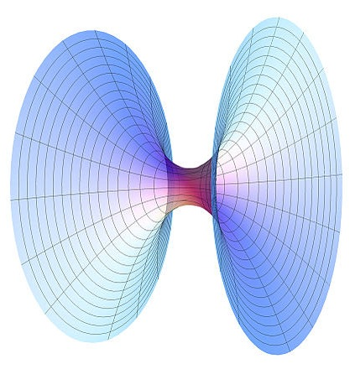
Minimal Geodesic Length: L [Path]
min
A
B
is a Topological Quantum Number of Path

Slide 20
2+1-D Quantum Geometry
U (sl(2,R) x sl(2,R))
q

Slide 21
Topological entanglement entropy
Kitaev-Preskill, Levin-Wen
d = quantum dimensions of anyon excitations
a
a
S = modular S-matrix of CFT conformal blocks
b

Slide 22
Topological entanglement entropy
B
A
a
S = Log S
top
o
a = SL(2,R) x SL(2,R) representation that characterizes the BTZ black hole state

Slide 24
ZZ, 2001
bp =
Minimal Geodesic Length: L [Path]
min
A
B

Slide 26
What is entangled with what?
>
|
=
Typical CFT State with Energy E = M

Slide 27
Residual entropy

Slide 28
Mirror Operators
Papadodimas
& Raju
Mirror Operators

Slide 29
FW removal via Quantum Teleportation:

Slide 30
Einstein gravity is the bookkeeper of
microscopic quantum information.

Slide 31
Geometric RG flow :

Slide 32
Modular Hamiltonian
→
1st Law of Thermodynamics
→
Einstein Equations
Jacobson

Slide 34
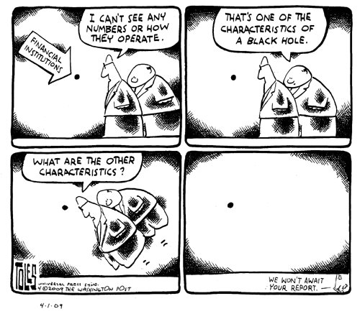
What are the characteristics of a quantum black hole? .

