Slide 1


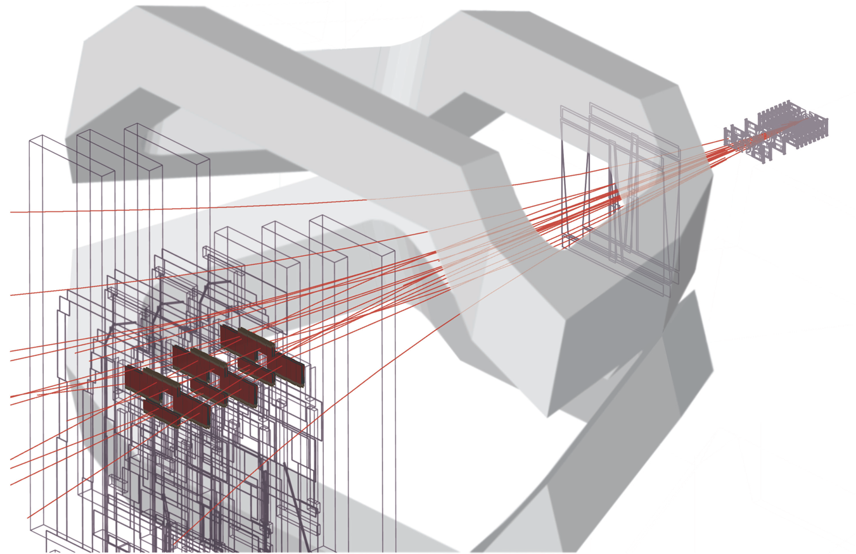
LHCb recent highlights and prospects
M. Needham
PPAP meeting 22nd July 2014
On behalf of LHCb UK

Slide 2
Outline
Introduction
Selected (recent) physics highlights
  CKM measurements
  Charm
  Rare decays
  Exotic spectroscopy
  W production
Run 2 preparation
The upgrade
Tried to focus on analyses/areas
with strong UK participation
Many things not covered

Slide 3
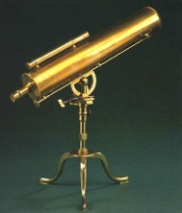
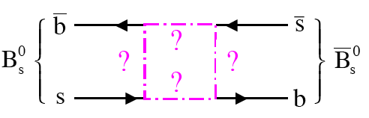
Physics Goals
Standard Model completed
by discovery of Higgs Boson
But many reasons to believe
SM is not final word
e.g. CP violation in SM not
enough to explain absence of
anti-matter in visible universe
Precision indirect searches
provide telescope to scales
of O(100) TeV
Complement direct searches
New
Particles ?

Slide 4
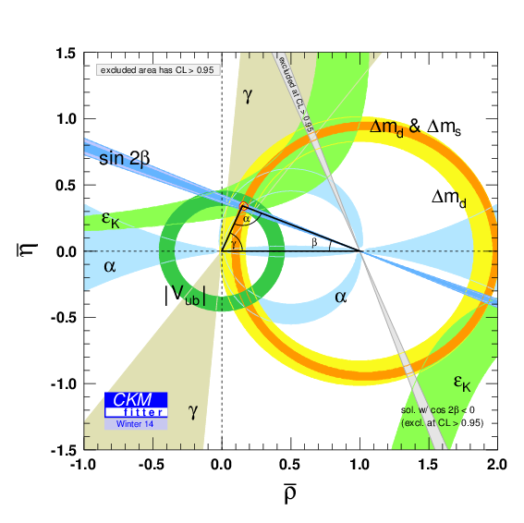
Physics Goals
Search for New Physics and CP violation in rare processes using b and c quark decays
Where did the
Antimatter go ?
arXiv:1309.2293
Equal amounts
Matter/antimatter
No
antimatter

Slide 5
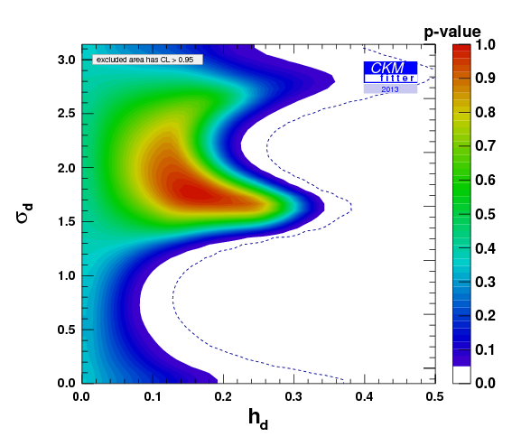
Physics Goals
Despite progress from b factories still room for New Physics amplitude
at level of 10 % in B_{d} mixing (Similar story in B_{s} sector)
Phase New Physics
arxiv:1309.2293
Magnitude New Physics

Slide 6
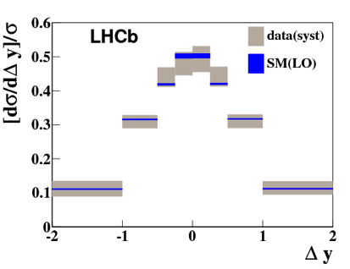
But also….
B_{c} physics
Quarkonia
Spectroscopy
Electroweak
Forward
Physics
pA
Kaons
LFV
BSM

Slide 7

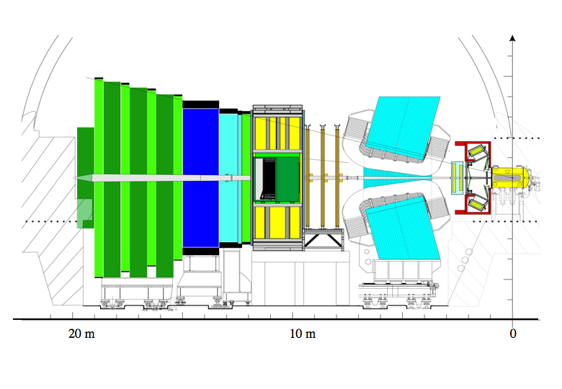
The LHCb Detector
Muon System
RICH Detectors
Vertex Locator
VELO
pp collision Point
~ 1 cm
B
Calorimeters
Tracking System

Slide 8
LHCb-UK
Birmingham, Bristol, Cambridge, Edinburgh, Glasgow,
Imperial, Liverpool, Manchester, Oxford, RAL, Warwick
Collaboration 700 authors, 20 % UK affiliated
New spokeperson from UK (G. Wilkinson)
Two previous physics coordinators from UK
30 % of physics groups convenors from UK
UK led construction and now operation of
Vertex detector + RICH. Current project
leaders both from UK
UK provides appropriate Tier-1 data storage for LHCb

Slide 9
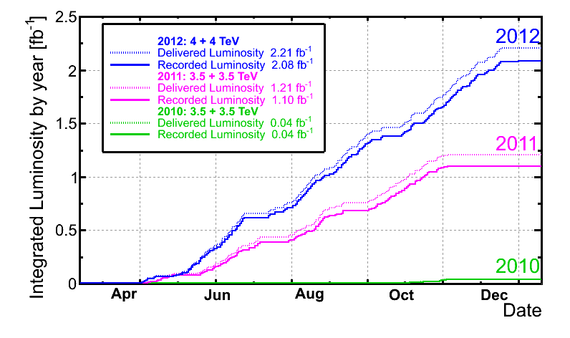
Run 1 Overview
~ 3.3 fb⁻¹ of data collected
Essentially all data physics quality
Also data taken in pA run and also at 2.76 TeV pp

Slide 10
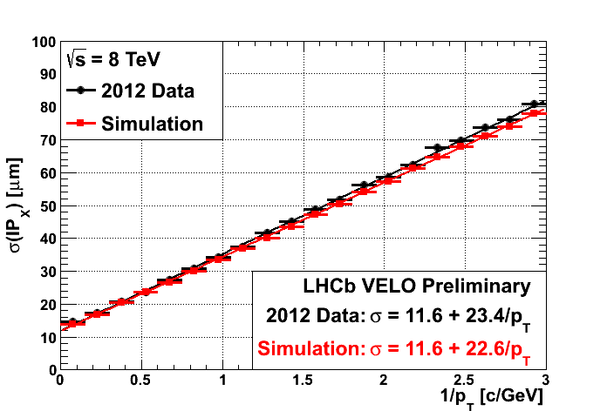
Detector Performance
Detector performance close to design expectations ! Superb foundation
to do good physics
Impact parameter
resolution in
vertex detector
Cherenkov angle for
isolated tracks
UK Led
UK Led

Slide 11
Scientific Output
Already 196 papers submitted or published papers
  200 mark will be reached tommorrow morning
  Harvest of Run 1 data will continue at 1-2 papers per week

Slide 12
The angle γ
UK Led
To uncover New Physics important to overconstrain CKM matrix parameters
Least well directly measured
CKM angle. Uncertainty around
8⁰
Theoretically clean measurement
with B ➔ DK decays
Brod+Zupan arXiv:1308.5663
Key part of LHCb physics program: many analyses ongoing
Many B decay modes to open charm contributing

Slide 13
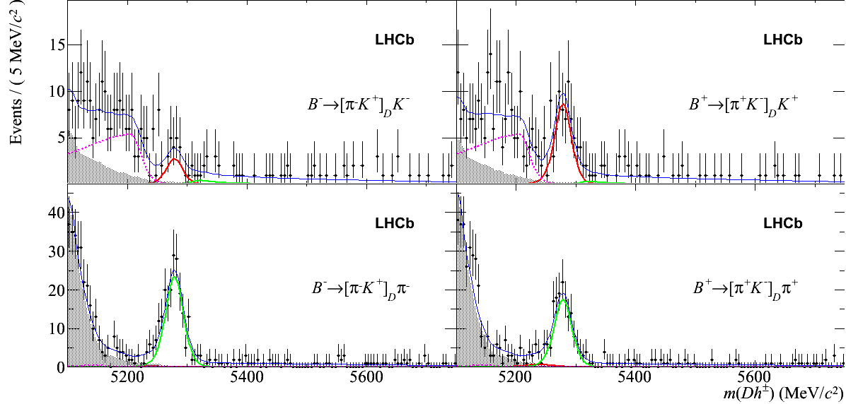
The angle γ
UK Led
Reversed suppression
of the D decays relative
to the B decays results
in much more equal
amplitudes
Matter
Anti-matter
Clean signal
for BR 10⁻⁷
Phys. Lett. B713 (2012) 351
3 fb⁻¹
update
soon

Slide 14
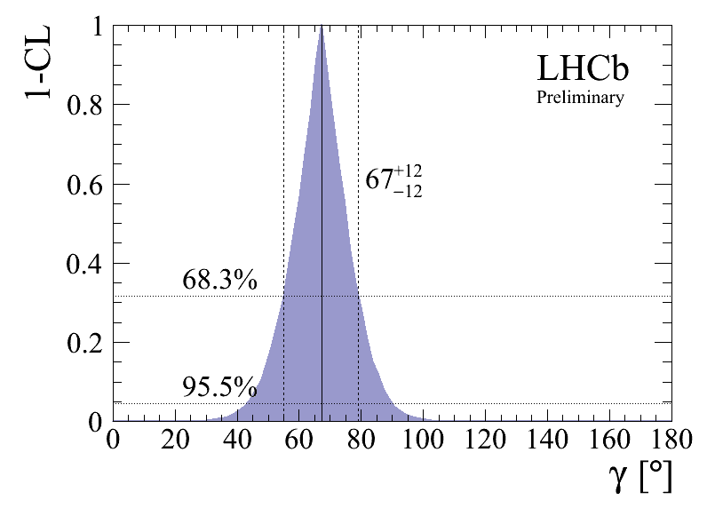
The angle γ
UK Led
LHCb-CONF-2013-006
γ combination
Uncertainty
12º on γ
LHCb-CONF-2013-006
Updates on many measurements with full Run 1 dataset in progress
Further improvement already with Run 1 data ! 4º precision by end Run 2

Slide 15
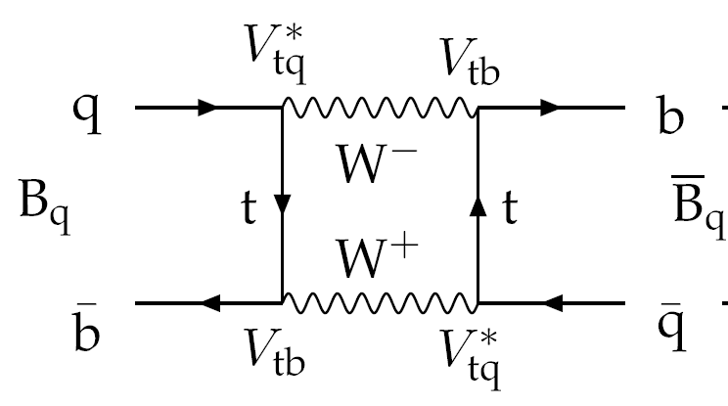
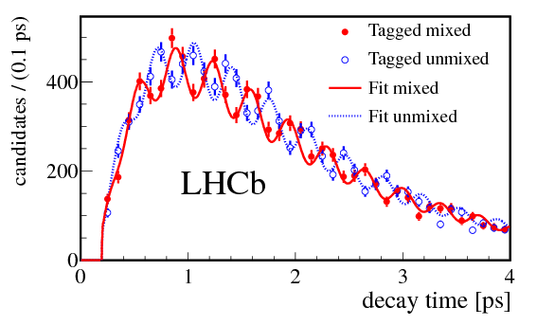
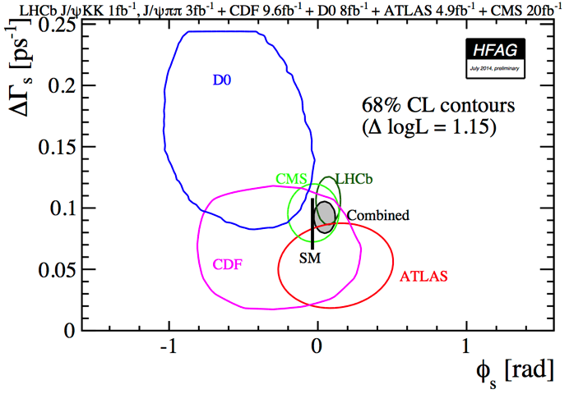
CP violation in B_{s} mixing
UK Led
New J. Phys.15 (2013) 053021
Observable CP violating phase φ_{s} (analogous to sin2β in B⁰ case ): SM expectation φ_{s} ~ -0.036 rad. Can be enhanced in New Physics models
Measured φ_{s} in J/ψϕ ,J/ψππ modes
New measurement in J/ψππ mode
0.070 ± 0.068 ± 0.008 rad (LHCb-Paper-2014-019)
Update in J/ψϕ mode with 3 fb⁻¹ coming soon precision ~ 0.05 rad level
Run 2 precision ~ 0.015 rad

Slide 16
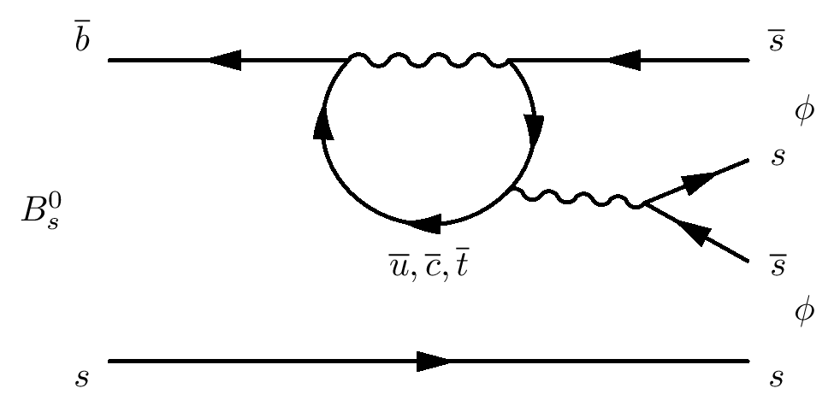
CP violation in B_{s}➔ϕϕ
UK Led
Gluonic penguin decay
Standard Model cancellation
between decay + mixing phases ϕ_{s}^{eff}
is negligible.
Result consistent with Standard Model
Already interesting sensitivity reached for
flagship upgrade precision measurement
LHCB-PAPER-2014-026

Slide 17
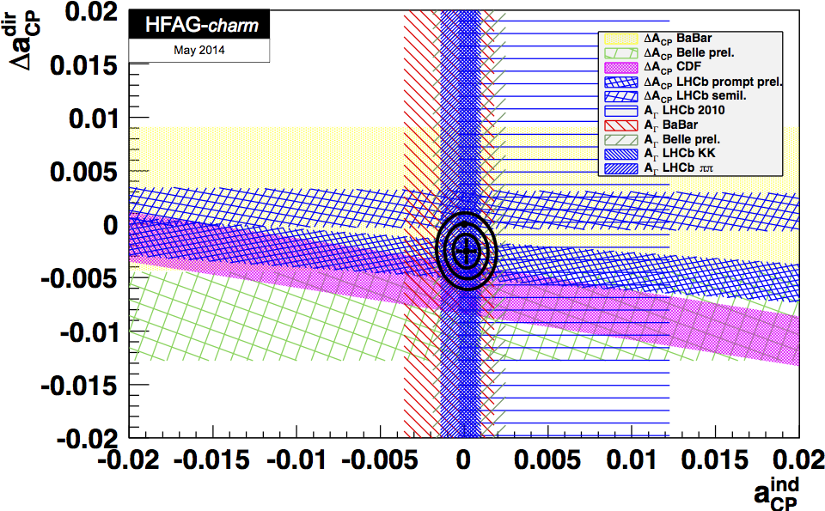
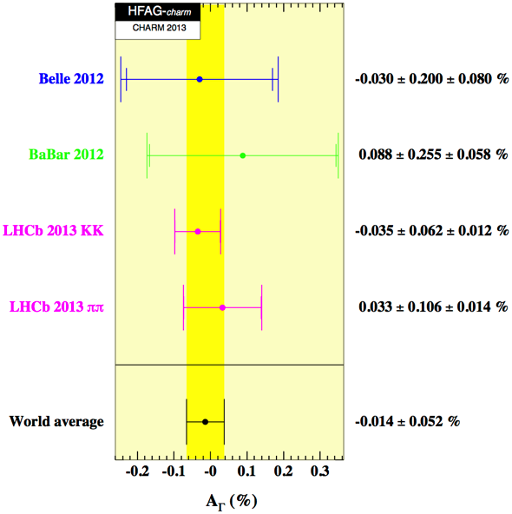
Charm
UK Led
Wide program in charm rare decays and CP violation searches
Huge statistics allowing huge progress e.g. CP violation in Charm mixing
Phys. Rev. Lett.112 (2014) 041801
1fb⁻¹ result. 3fb⁻¹ update to come
LHCb 4 times better than
World average
Run 2: higher cross-section and improved trigger !
Reach interesting precision: SM expect A_{Γ} ~ O(10⁻⁴)

Slide 18
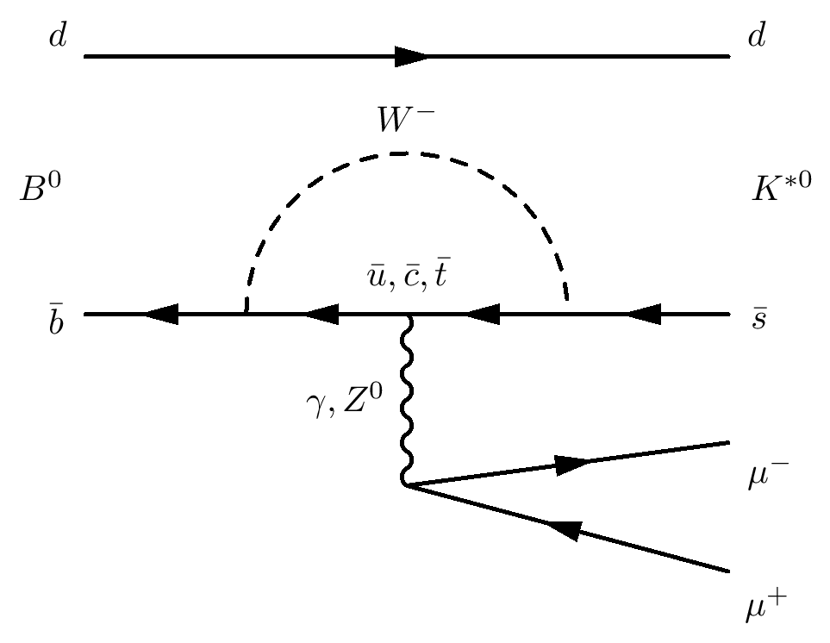
B⁰ ➔K*μ⁺μ⁻ and friends
UK Led
B⁰➔ K*μμ and similar rare decays gives
access to wide range of observables sensitive
each sensitive to different NP effects
Discrepancy for P5’ observable using
1fb⁻¹ of data compared to expectation
3.7 σ local significance (probability
probability that at least one bin
varies by this much is 0.5 %)
Update with 3 fb⁻¹ soon. How
will this evolve with more
data with Run 2 ?
Phys. Rev. Lett.111 (2013) 191801

Slide 19
B⁰ ➔K*μ⁺μ⁻ and friends
Result attracted a lot of theory attention, range of interpretations – QCD related or New Physics
Descotes-Genon et al perform global fit
4.5σ discrepancy from SM ?
[PRD 88 074002 (2013)]
Altmannshofer and Straub 3σ discrepancy.
Flavour changing Z’ boson
[EPJC 74 2646 (2013)]
The size of form factor power corrections is currently under extensive study
within phenomenology community (e.g. Jaeger et al, JHEP05(2013)043)
Zwicky/Lyon (arXiv:1406.0566) Anomaly related to discrepancies
in B⁺ ➔K⁺μμ at high q² ?

Slide 20
R_{K}
UK Led
Wealth of other observables to probe, e.g. R_{K} which should be 1 in SM [lepton universality]
LHCB-PAPER-2014-024
2.6 σ away from SM. Interesting to see how develops with Run 2

Slide 21
Exotic Spectroscopy
Why do quarks come in twos or threes ?
Hot topic in recent years @ b-factories and BES
Many candidates claimed – e.g. X(3872), Z(3900)⁺. But no unambigous candidate
One candidate Z(4430)⁺ claimed by Belle in B⁰ ➔ψ(2S)Kπ decay chain but not seen by Babar.
Charged state, confirmation provides irefutable evidence for four quark states

Slide 22
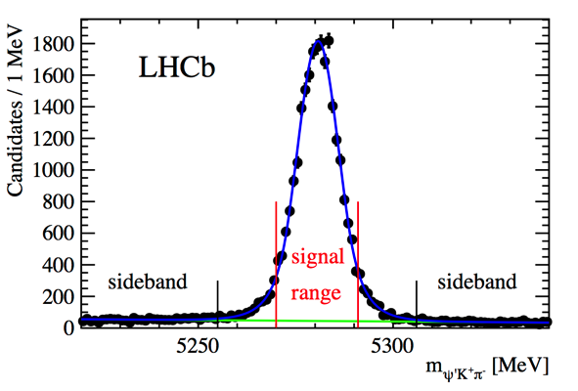
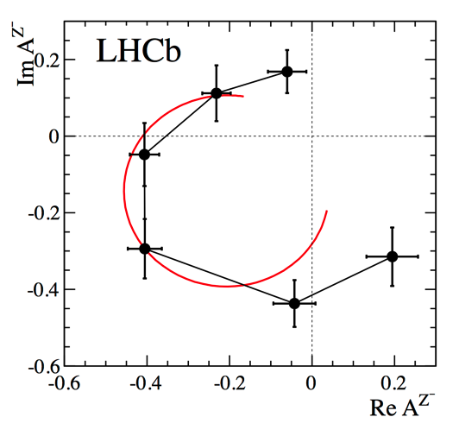
Z(4430)⁺
LHCB-PAPER-2014-014
Phys Rev Lett 112 222002 (2014)
Full angular analysis
J^{P} = 1⁺, rules out cusp interpretation
Phase shift consistent with resonant behaviour
Four quark states exist: elucidate nature with Run 2 data

Slide 23
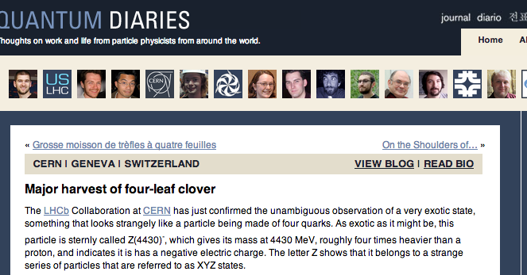
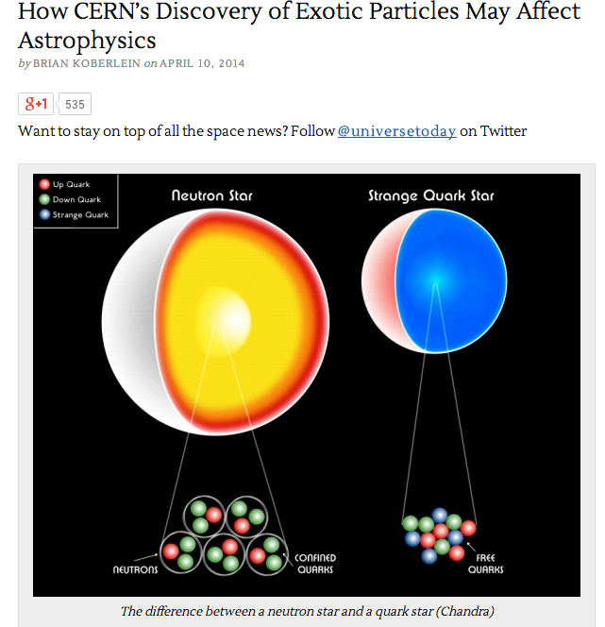
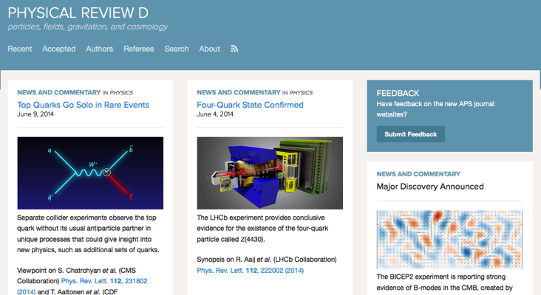
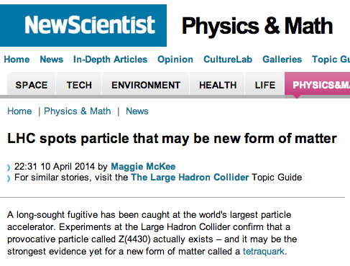
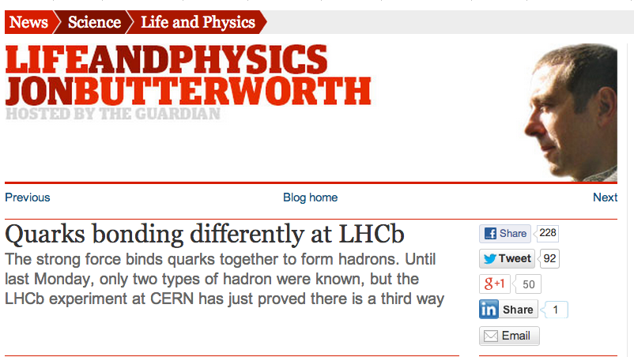
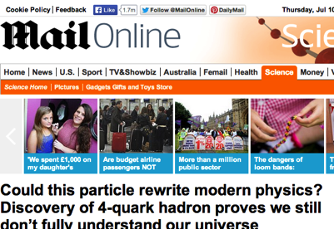
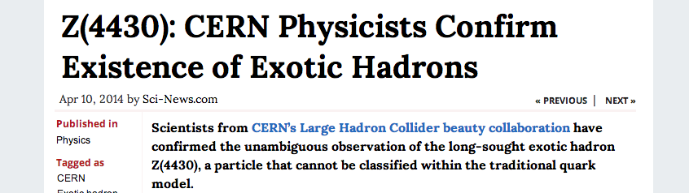
Z(4430)⁺

Slide 24
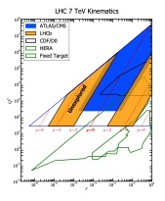
Electroweak Physics
Program of W and Z cross-section
measurements
Unique access to small x-region unexplored
by previous experiments
Test Standard Model and constrain PDF
sets
Measurements complement ATLAS + CMS

Slide 25
W production
UK Led
Measure cross-sections + ratios
805,593 events selected
Purity ~ 77 %
Complementary measurements to
GPDs who go to η ~ 2
Good agreement with NNLO predictions
For variety of PDF
LHCb-PAPER-2014-033
Run 2: New kinematic regime + higher cross-section !

Slide 26
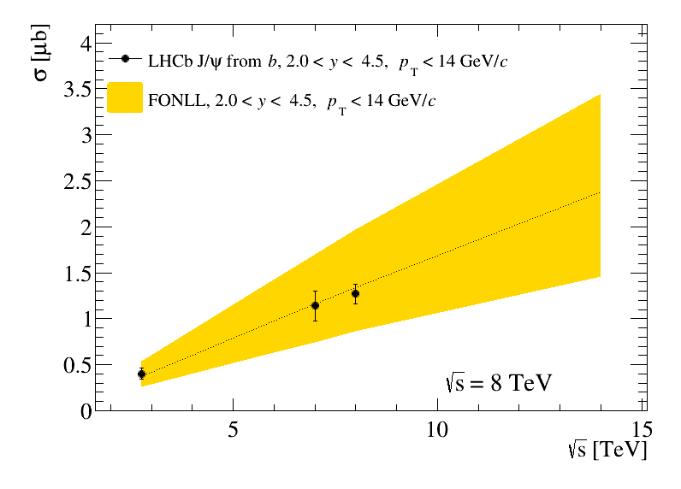
Run II
Detector performed well in Run 1. Work to consolidate this for Run 2
Extend physics program: Herschel forward shower counters
Main challenge:
b cross-section will go up factor
by factor 1.8
Charm always benefits from
more bandwidth
Want to profit from increased
cross-section, and increase the
physics reach
1.8
J/ψ from b
JHEP06(2013)064
More selective trigger, using more RICH information
and data parking strategy needed

Slide 27
Run II: Physics
Collect around 5 - 6 fb⁻¹
Aim for 1 fb⁻¹ already in 2015
Statistical power of data will
more than double !
Phys. Rev. Lett.111 (2013) 101805
Run 1 evidence
for B_{s} ➔μμ
Lots of exciting physics !
Revisit B(d,s) ➔μμ. Is ratio
consistent with SM ?
R_{K} and P5 anomalies in B ➔ K*ll
γ with 4º precision !
Electroweak + exotic searches
arxiv:1309.2293

Slide 28
Run II: Trigger
Data from first part of fill will be buffered in HLT farm allowing time
to perform online calibration and alignment of full detector. Data quality online will be close to offline – trigger selects the events we want
L0
HLT
Turbo stream concept for charm: write out microDST/ntuple for
analysis at trigger level

Slide 29
Run II
UK Led
System being prepared to define how often and when alignment/calibration
triggered
e.g. Velo half alignment stable fill-to-fill
To better than 10 μm

Slide 30
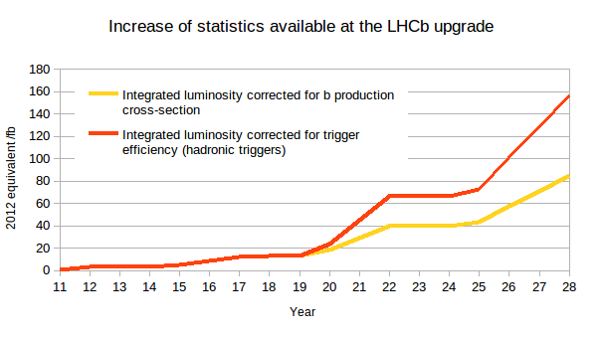
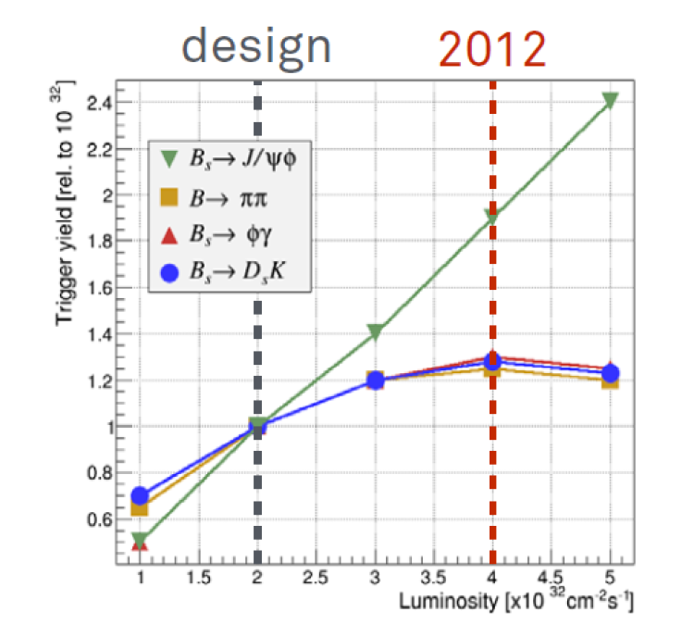
The Upgrade
Beyond LS2 dataset doubling
time lengthens
Detector reaching end of design life
Gain statistics run at higher luminosity (10³³ cm² s⁻¹)
Replace front-end electronics to allow full detector readout at 40 MHz crossing rate
Full software trigger
Limited by L0 hadron trigger
Muon
trigger
Hadronic
trigger

Slide 31
Upgrade Trigger
Readout full detector @ full collision rate, huge rates to disk
New challenges for reconstruction and computing !

Slide 32

Timeline
2011 Letter of Intent
2013-2014 R+D, submission of of TDRs to LHCC
2014-017 Final R+D, production and construction
2019 LS2 Installation and commissioning
NOW
to 2030
10 years running @ luminosity of
10³³ cm⁻²s⁻¹ to collect 50 fb⁻¹

Slide 33

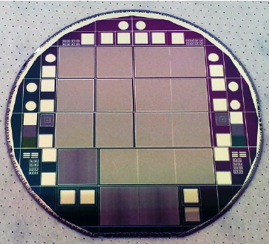
Pixel Detector
UK Led
Most advanced pixel detector ever constructed
55 μm x 55 μm pixels
Radiation dose 10¹⁶ protons/cm²
Detector 5 mm from LHC beam
Microchannel cooling
Superior performance
to current VELO

Slide 34
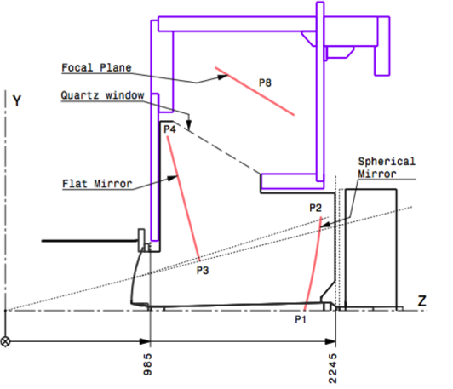
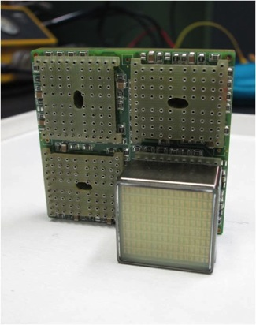
RICH
UK Led
Challenge of high occupancy enviroment
Optimized RICH 1 layout - new mechanics,
mirrors, …
New photodetectors (R11265 from Hammatsu)
New readout electronics

Slide 35

Upgrade Reach
LHCB-TDR-012

Slide 36
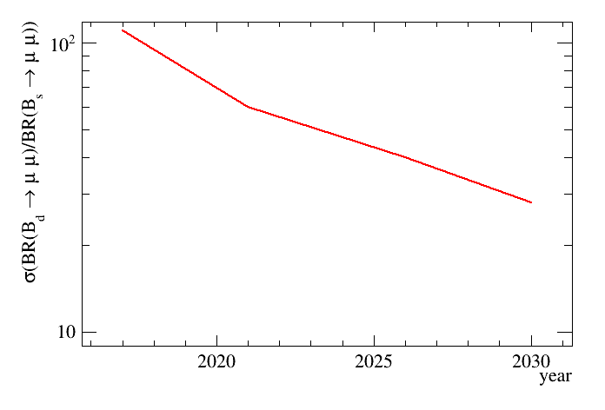
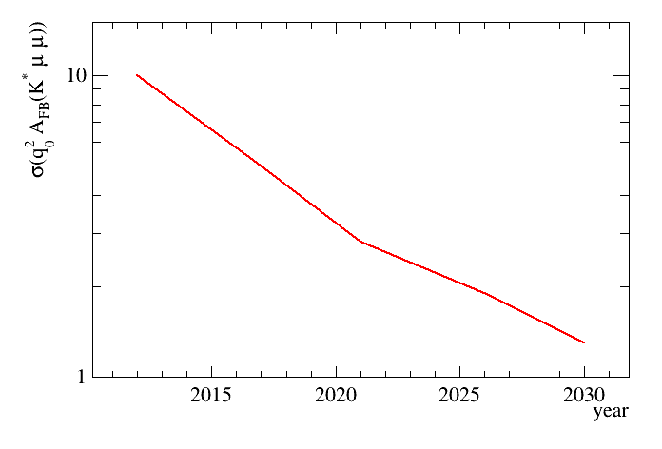
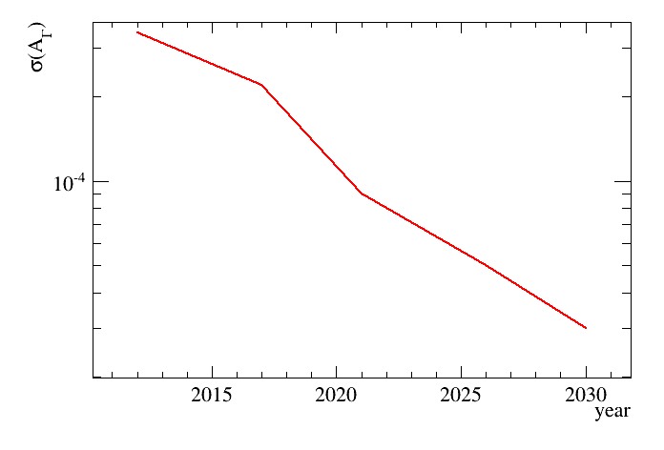
Upgrade Reach
Rare decays
rel B_{d}/B_{s} BR
known to 30 %
Test MFV 0807.5039
Zero crossing
for B ➔ K*μμ
known to 2 %
Upgrade
LS2
Now
Upgrade
LS2
Charm
Charm mixing
A_{Γ} Sensitivity at
SM level (10⁻⁴⁾
50 billon
reconstructed
charm decays !
Challenge SM
predictions
Upgrade
Now
LS2

Slide 37
Upgrade Reach
arXiv:1309.2293
Angle γ
Upgrade
γ ~ 1º
Now
New Physics in B_{s} mixing
Assuming SM
Phase NP
ϕ_{s} ~ 0.2º
Upgrade
Now
Magnitude NP

Slide 38
Summary
LHCb had a very successful Run 1
  197 papers so far across wide range of topics
  More to come updates on a^{f}_{s} , ϕ_{s} , sin2β, γ , ΔA_{CP}, B->K*μμ,…
Looking forward to exciting Run 2
  Collect 5 fb⁻¹ with twice b cross-section
    ~ 12.5 kHz rate to disk, twice Run 1 rate
  Double precision. Do anomalies from Run 1 persist ?
  Online alignment and calibration in real time
Upgrade for Run 3 to collect 50 fb⁻¹ of data
  Running at 10³³ cm² s⁻¹
  Readout of full detector at 40 MHz, 100 kHz to disk
  Order of magnitude increase in precision

Slide 39
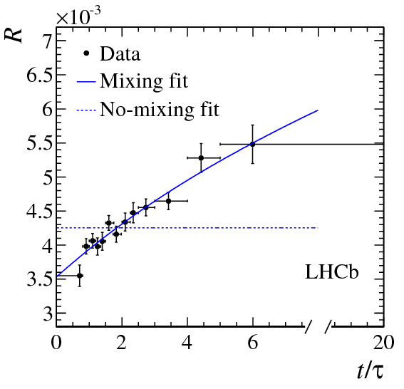
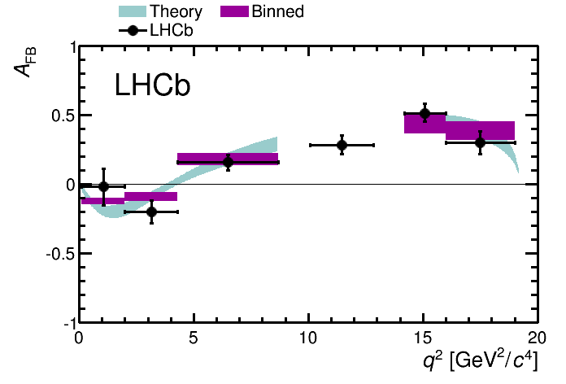
Summary
Best measurements
of Bd/Bs mixing
5σ observation
charm mixing
Evidence for B_{s} ➔μμ
Firm evidence of 4 quark state
Most precise
measurement γ
Best measurement of forward
background symmetry in B
+ observation of several new particles + 50 new decay modes

Slide 40
Backup

Slide 41
Run 1: Trigger

Slide 42
Upgrade
Numbers prepared for ECFA workshop
https://twiki.cern.ch/twiki/bin/view/ECFA/PhysicsGoalsPerformanceReachHeavyFlavour

Slide 43
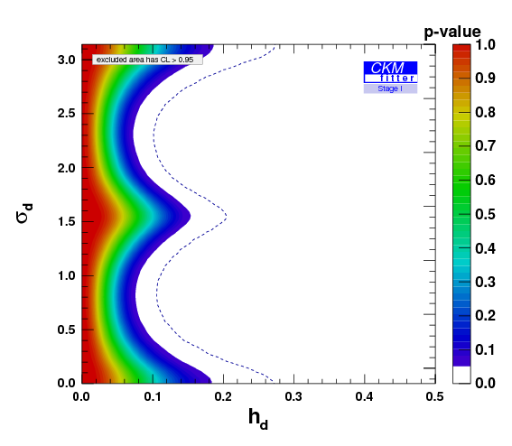
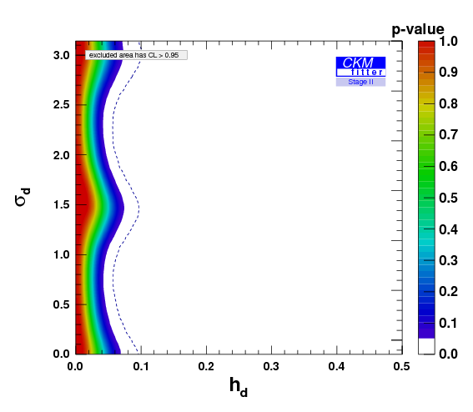
Bd mixing in generic models
Run I era
Run II era

Slide 44
The angle γ
Lots of other beautiful results coming out now or soon, e.g. 3fb⁻¹ update
for B ➔ DK with D ➔ K_{s} π⁺π⁻
K_{s} decay
in VELO
K_{s} decay
after VELO
LHCb-PAPER-2014-041

Slide 45
Upgrade Reach
Upgraded detector will have a rich physics program building on studies
with current detector
Precision tests of CP violation and CKM parameters in b decays
Rare b and c decays
High statistics charm
Spectroscopy and b-hadron measurements
Electroweak
Quarkonia
Exotic searches
Full software trigger. Flexible response to discoveries

Slide 46
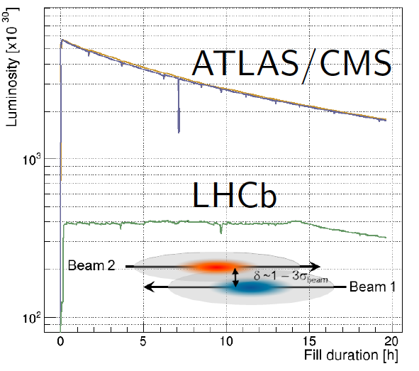
Run II
Assume 1870 colliding bunches at μ ~1.35 (2012 was μ ~ 1.6)
Allowing for increased multiplicity data rates similar to 2012
As in 2012 will level luminosity
Aim to collect 5 fb⁻¹ of data at luminosity of 4 × 10³² cm⁻²s⁻¹

