Slide 1
LHC upgrade: accelerator challenges
LHC machine status,
and plans for HL-LHC
Mike Lamont
Acknowledgements: Lucio Rossi & Oliver Brüning

Slide 2
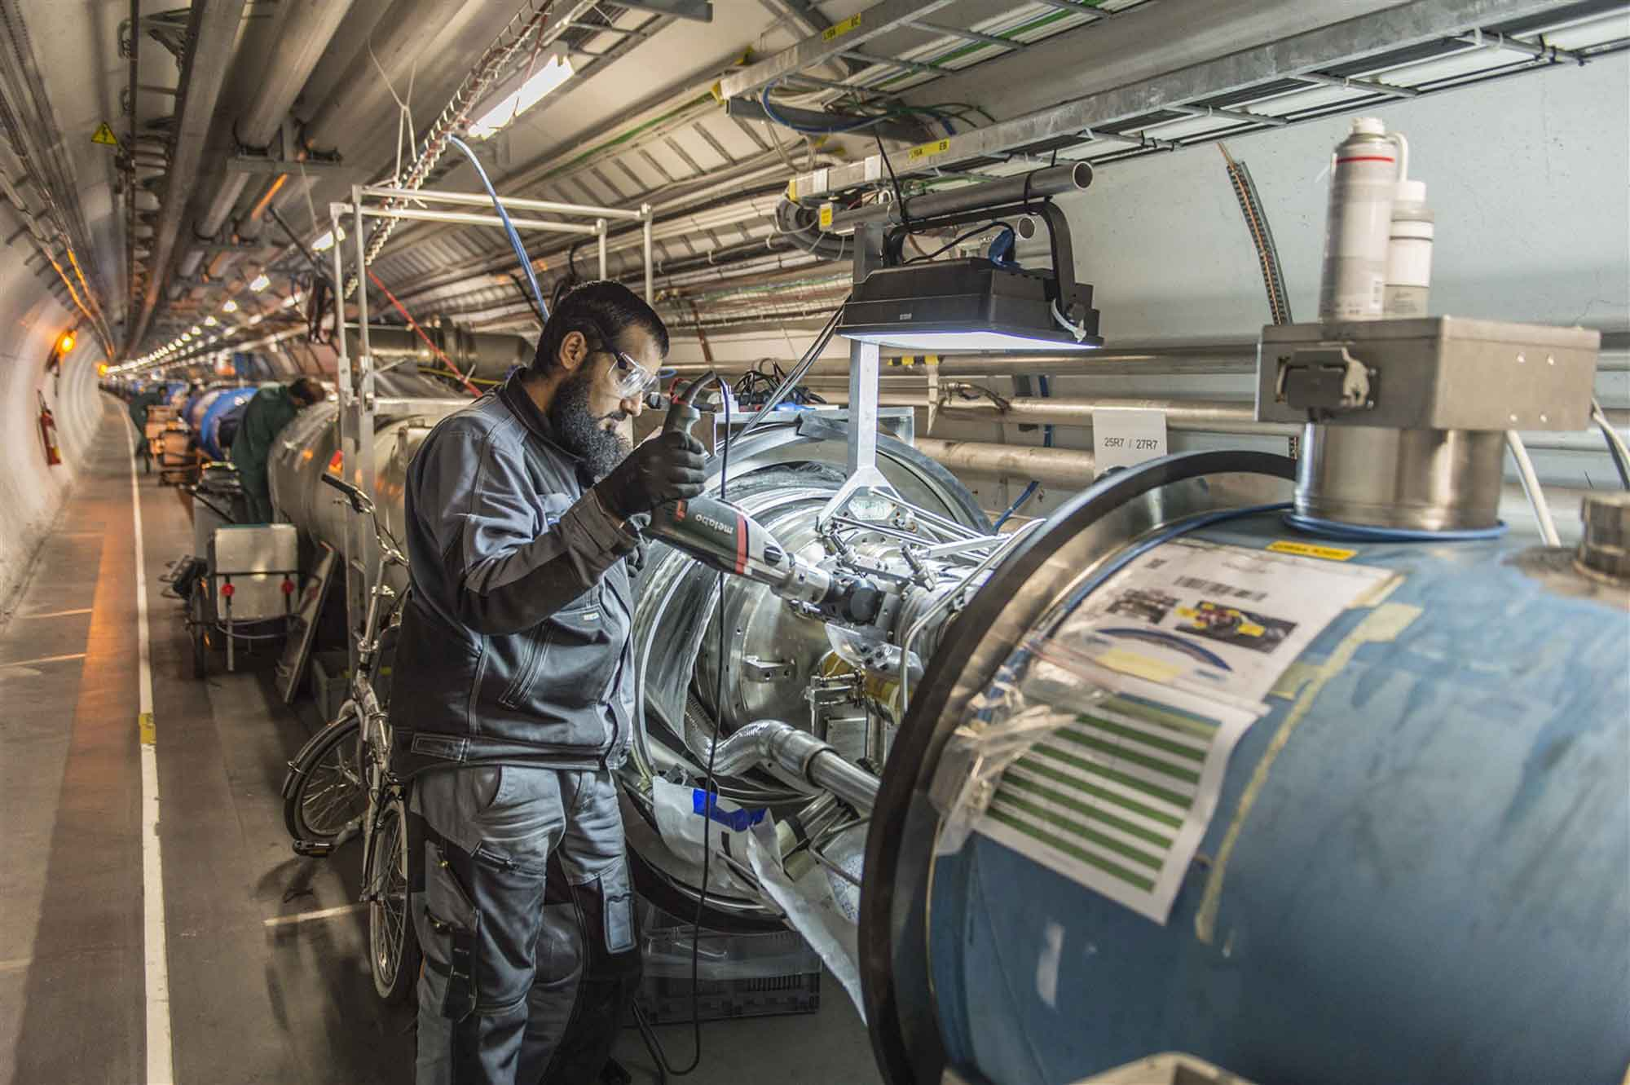
LS1 - descent into the underworld again

Slide 3
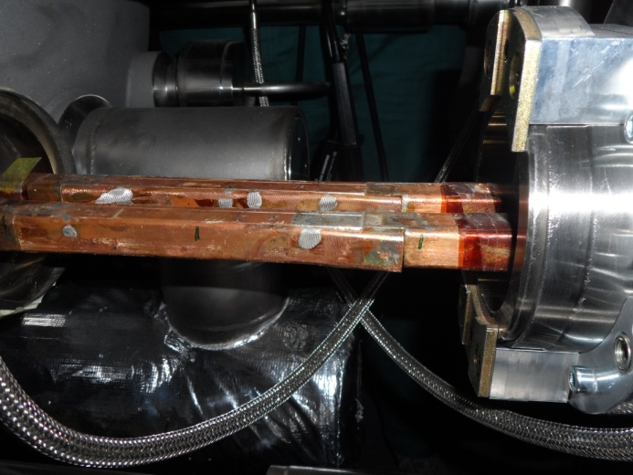
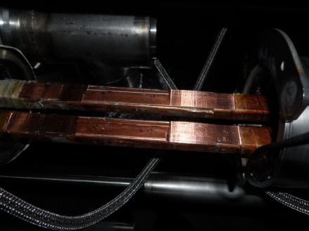
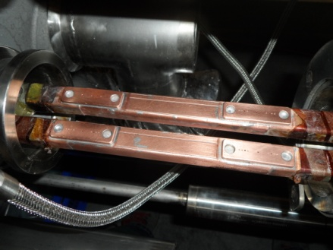
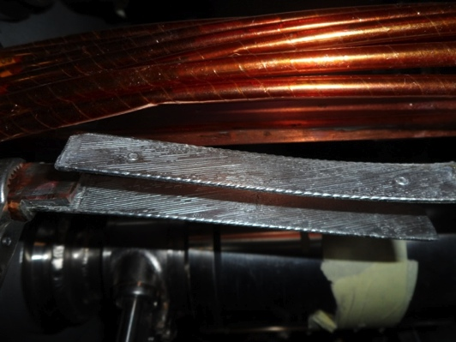
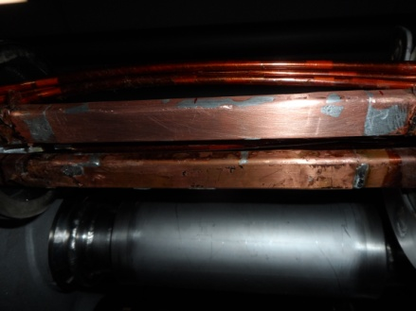
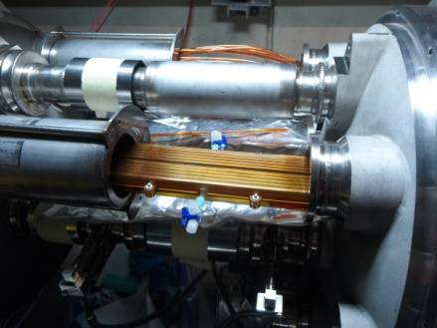
« Old Splice » « Machined Splice » « Consolidated Splice »
« Cables » « New Splice »
Total interconnects in the LHC:
  1,695 (10,170 high current splices)
Number of splices redone: ~3,000 (~30%)
Number of shunts applied: > 27,000
« Insulation box »
And a lot more besides…

Slide 4
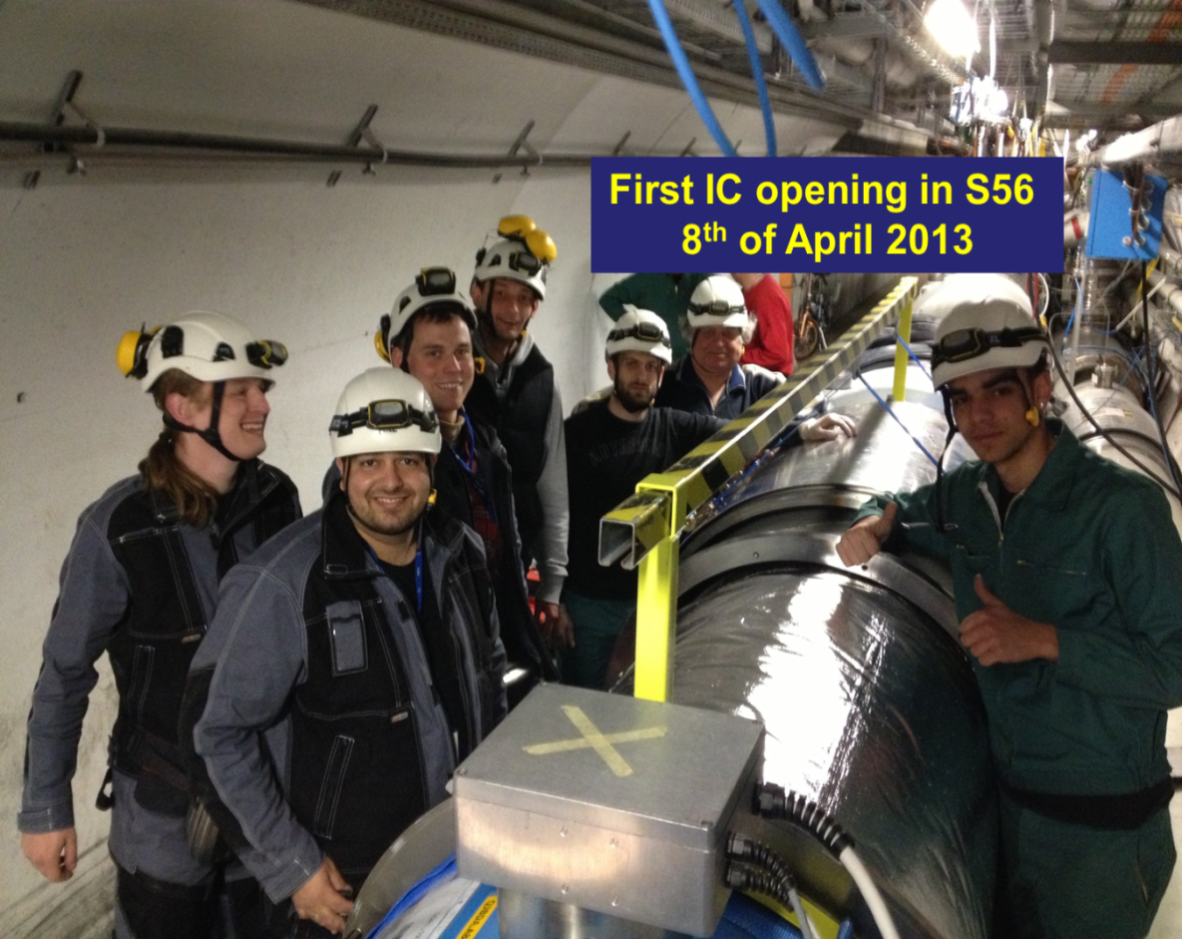
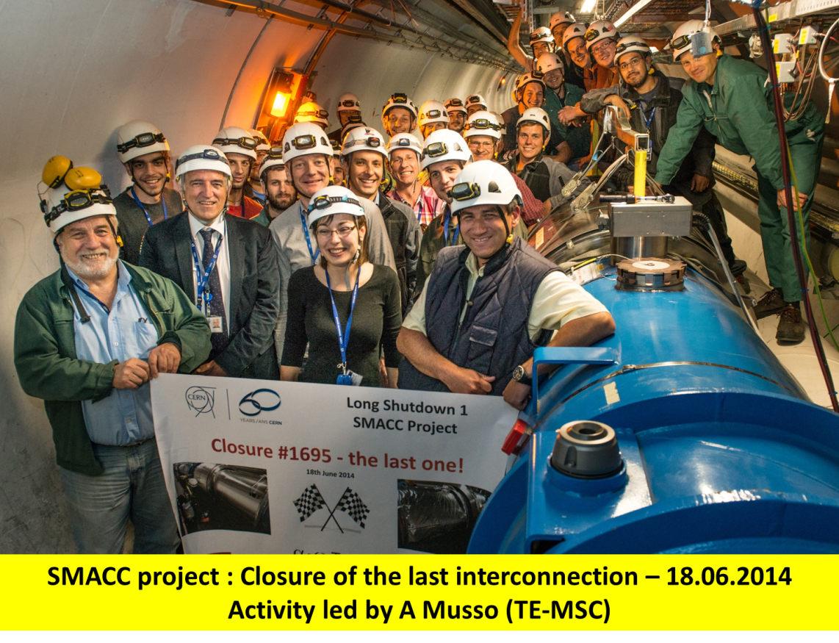
Superconducting Magnets and Circuits Consolidation (SMACC)
Monumental effort
Over 350 persons involved
Including preparation: ~1,000,000 working hours
No serious accidents!
Jean-Philippe Tock
Collaborations with NTUA (Athens), WUT (Wroclaw) and support of DUBNA

Slide 5
Version 4.1
c/o Marzia Bernardini & Katy Foraz
Today
9th March 2015

Slide 6
CSCM (Copper Stabilizer Continuity Measurement)
Fully qualify magnet bypass = copper stabilizer of the bus-bar + diode + diode leads
Bypass contains about 3500 connections/joints per sector!
Connect the two 6 kA/200 V power converters in series
Stabilize the sector 20 K so the magnets and bus are not superconducting.
Apply a current of a few 100 A to open the bypass diodes
Apply a current pulse of 6.5 TeV equivalent and watch carefully

Slide 7
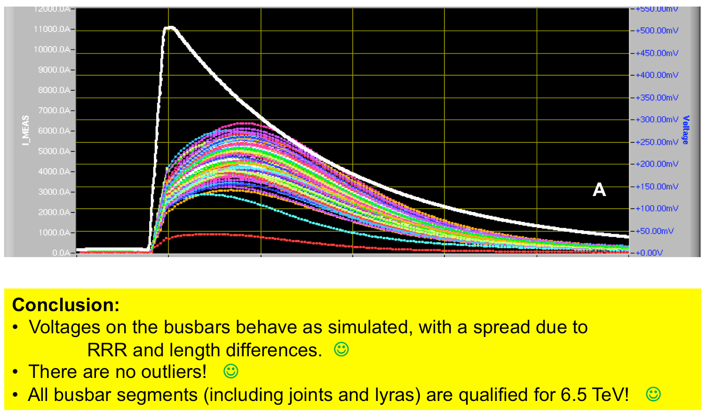
Signals from 11.1 kA run
Sector 67

Slide 8
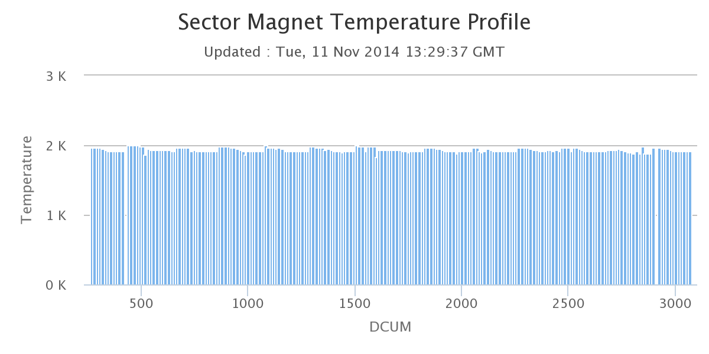
Cool-down - status
Sector 12 | 1.9 K | Prep. for powering tests | CSCM OK
Sector 23 | 20 K |  | CSCM OK
Sector 34 | 26 K | Cool-down
Sector 45 | 20 K | CSCM just starting
Sector 56 | 1.9 K |  | CSCM OK
Sector 67 | 1.9 K | First training quench… | CSCM OK
Sector 78 | 5 K |  | CSCM OK
Sector 81 | 1.9 K | Powering tests started | CSCM OK

Slide 9
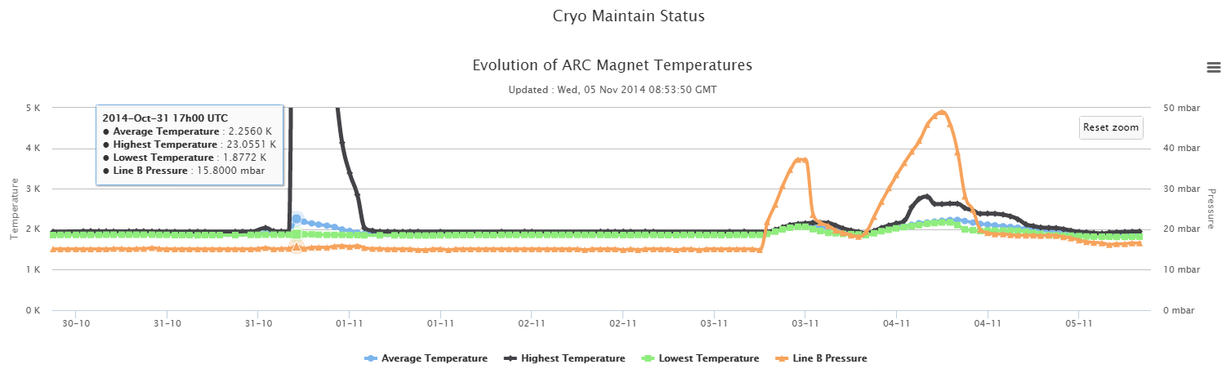
Powering tests
All magnet circuits taken to nominal current (6.5 TeV) one by one
  Rigorous checks of quench protection, energy extraction, interlocks, power converter…
800 lb gorilla is the main dipoles
  100 or so quenches expected to get to 6.5 TeV
  One so far in sector 67 at around 5.8 TeV
S67
1st training quench

Slide 10
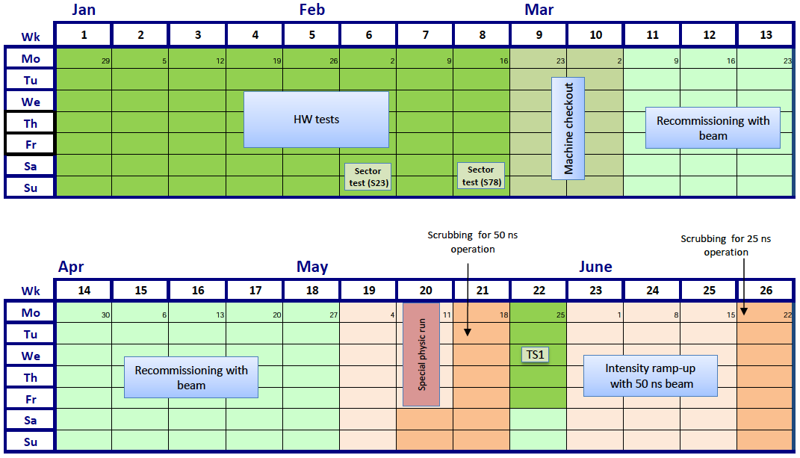
2015 Q1/Q2
FIRST BEAM
9th MARCH
SCRUBBING
FOR 50 ns
SCRUBBING
FOR 25 ns
Official GPD luminosity target for the year: 10 fb⁻¹

Slide 11


Slide 12
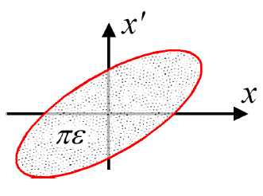
Luminosity
N | Number of particles per bunch
k_{b} | Number of bunches
f | Revolution frequency
σ* | Beam size at interaction point
F | Reduction factor due to crossing angle
ε | Emittance
ε_{n} | Normalized emittance
β* | Beta function at interaction point
Round beams, beam 1 = beam 2

Slide 13
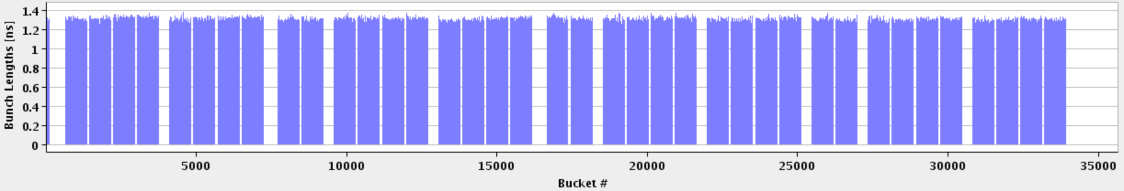
LHC bunch structure - 2015
25 ns bunch spacing
Nominal bunch intensity 1.15 x 10¹¹ protons per bunch
1 PS batch
(72 bunches)
1 SPS batch
(288 bunches)
Abort gap
26.7 km 2800 bunches

Slide 14
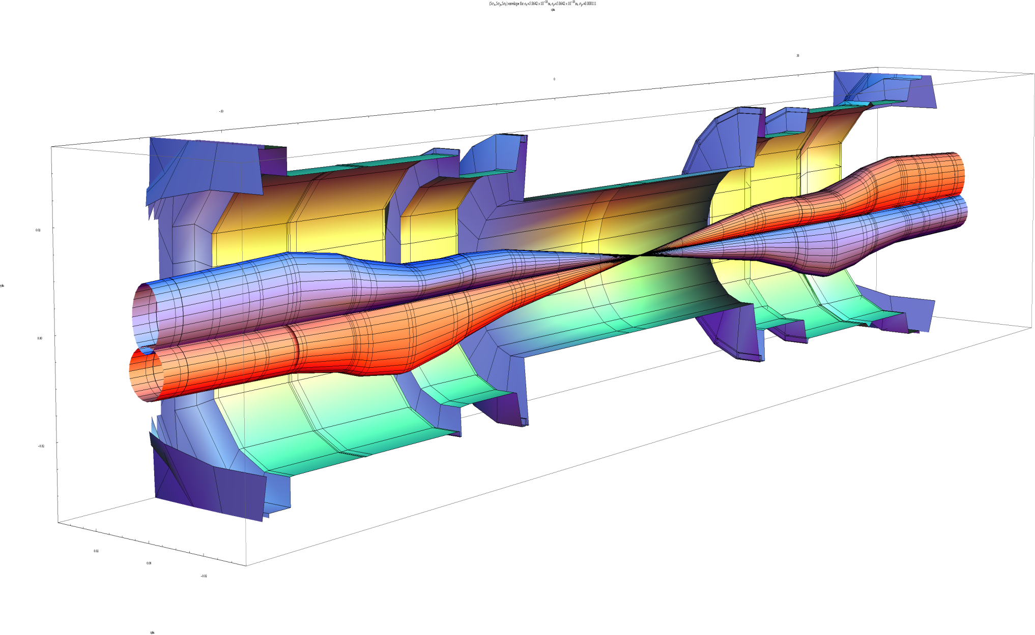
Squeeze in ATLAS
β_{max} ~4.5 km
β* = 55 cm
HL-LHC
β_{max} ~20 km
β* = 15 cm
2.6 mm
7 microns
Image courtesy John Jowett

Slide 15
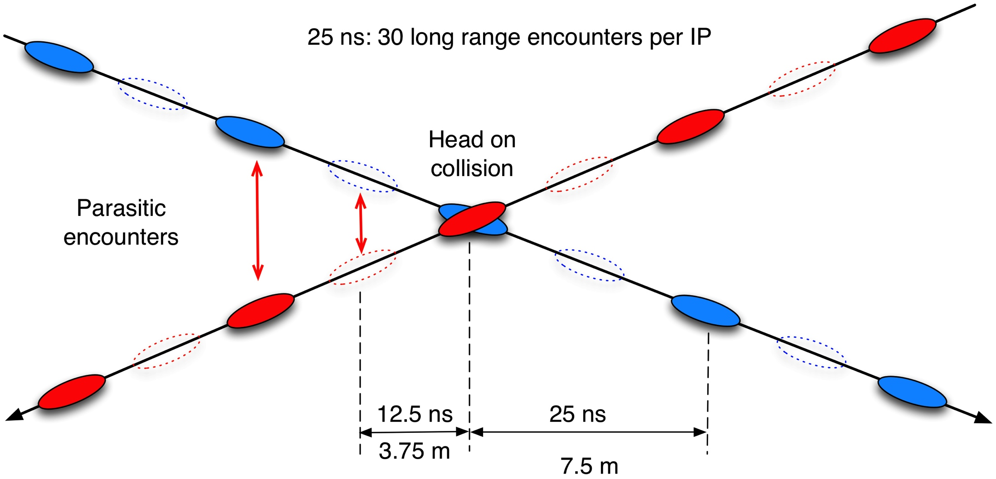
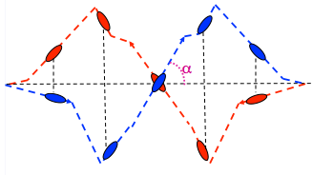
Crossing angle
work with a crossing angle to avoid parasitic collisions.
Separation: 10 -12 σ

Slide 16
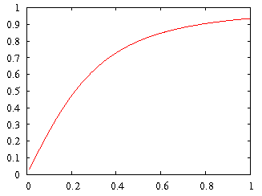
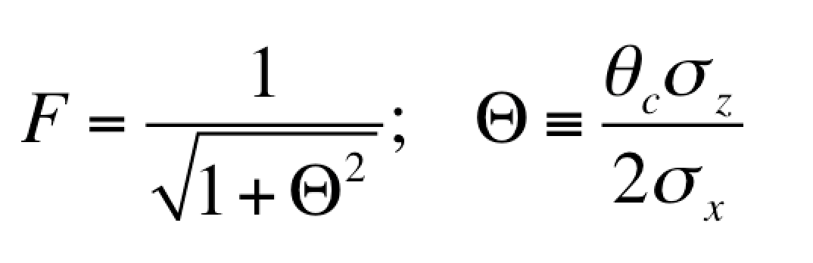
Crossing angle
Large crossing angle:
➔ reduction of long range beam-beam interactions
➔ reduction of beam-beam tune spread and resonances
➔ reduction of the mechanical aperture
➔ reduction of luminous region
➔ reduction of overlap & instantaneous luminosity
geometric luminosity
reduction factor:

Slide 17
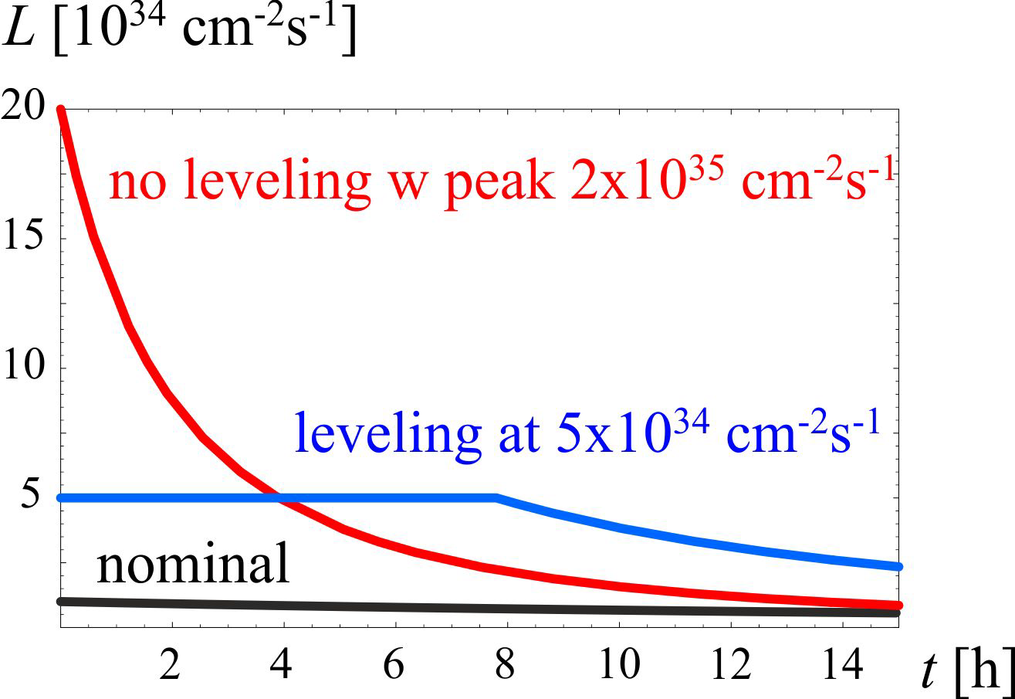
HL-LHC - goals
Prepare machine for operation beyond 2025 and up to 2035
Devise beam parameters and operation scenarios for:
  total integrated luminosity of 3000 fb⁻¹ in around 10-12 years
  an integrated luminosity of 250 fb⁻¹ per year
  mu ≤ 140 (peak luminosity of 5x10³⁴ cm⁻²s⁻¹)

Slide 18
How?
Beam from injectors
  High bunch population, low emittance, 25 ns beam
Lower beta* (~15 cm)
  New inner triplet magnets - wide aperture Nb₃Sn
  Large aperture NbTi separator magnets
  Novel optics solutions
Crossing angle compensation
  Crab cavities
Dealing with the regime
  Collision debris, high radiation
  High machine availability
  Beam

Slide 19
HL-LHC: key 25 ns parameters
Protons per bunch | 2.2 x 10¹¹
Number of bunches | 2750
Normalized emittance | 2.5 micron
Beta* | 15 cm
Crossing angle | 590 microrad
Geometric reduction factor | 0.305
Virtual luminosity | 2.4 x 10³⁵ cm⁻²s⁻¹
Levelled luminosity | 5 x 10³⁴ cm⁻²s⁻¹
Levelled <pile-up> | 140

Slide 20
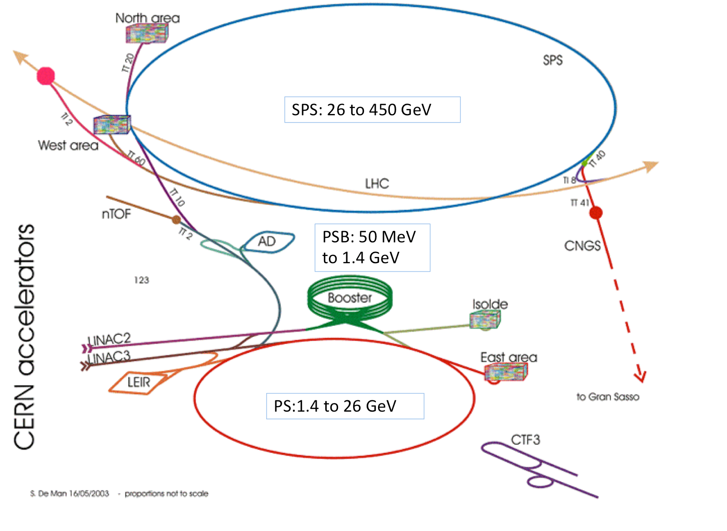
1. Beams from injectors

Slide 21
LIU proton target → HL-LHC beam parameters
25 ns | N (x 10¹¹ p/b) | ε (μm) | B_{l} (ns)
Achieved in 2012 | 1.2 | 2.6 (std) 1.4 (BCMS) | 1.5
HL-LHC | 2.3 | 2.1 | 1.7
Injectors must produce 25 ns proton beams with about double intensity and higher brightness
A cascade of improvements is needed across the whole injector chain to reach this target
Malika Meddahi

Slide 22
BOOSTER: 160 MeV to 2.0 GeV
LINAC4: H- at 160 MeV
PS: 2 GeV to 26 GeV

Slide 23
Main means to achieve the target HL-LHC proton beam parameters
Linac4 in for Linac2 | H⁻ injection into PSB at 160 MeV Expected double brightness for LHC beams out of the PSB
Booster | Increase energy to 2 GeV New (or upgraded) RF system New main power supply
PS | Injection at 2 GeV Beam production schemes (e.g. BCMS) Feedback systems: new wide-band longitudinal feedback; transverse feedback against head-tail and e-cloud instabilities
SPS | Power upgrade of the main 200 MHz RF system (plus double available 800 MHz voltage) Electron cloud mitigation through a-C coating (baseline) or beam induced scrubbing
Many other options plus a full ion upgrade program
Malika Meddahi

Slide 24
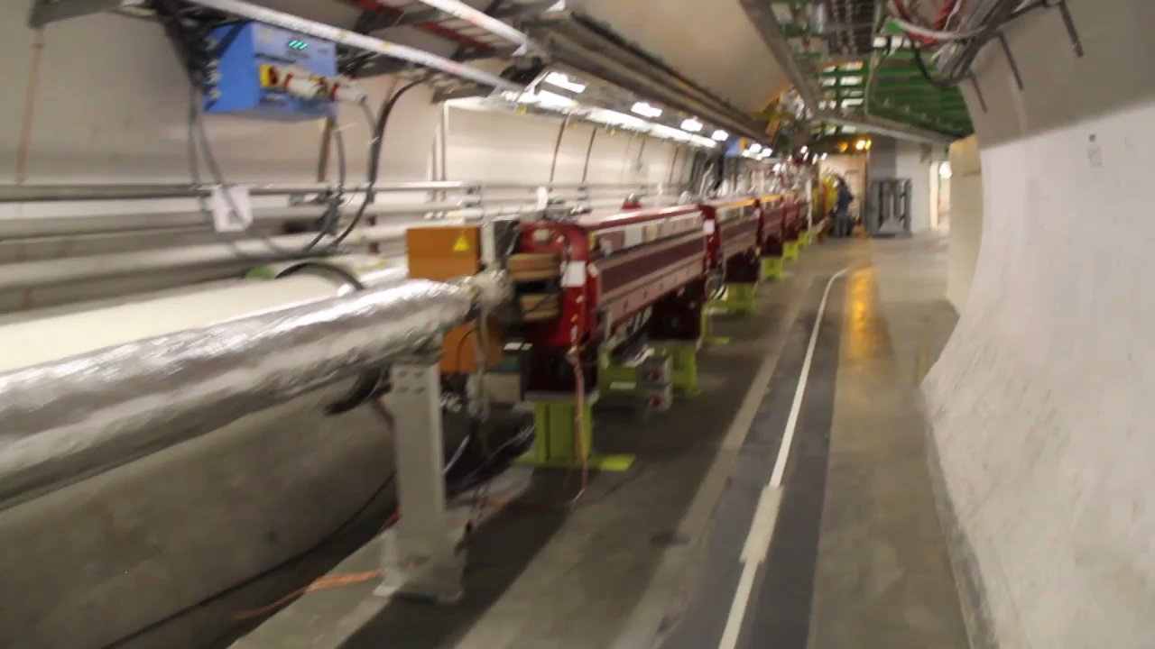
2. LOWER beta*

Slide 25
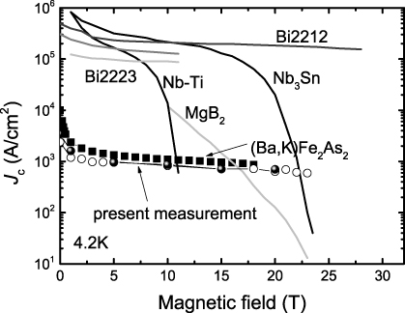
Triplets
Present LHC triplets: 210 T/m, 70 mm coil aperture
  8 T @ coil - approaching limit of NbTi
HL-LHC triplet: 140 T/m, 150 mm coil aperture
  Around 12 T @ coil
  Requires Nb₃Sn technology
1.8K
25 year development for this new magnet technology -
US-LARP/CERN collaboration

Slide 26


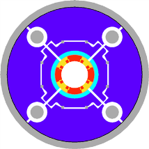
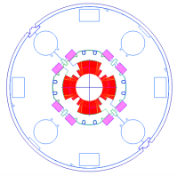
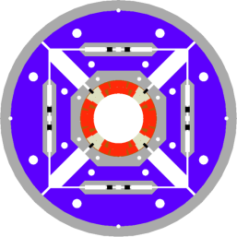
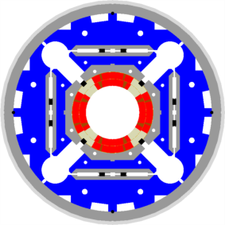

LHC low-β quads: steps in magnet technology from LHC toward HL-LHC
LHC (USA & JP, 5-6 m)
∅70 mm, B_{peak}∼ 8 T
1992-2005
LARP TQS & LQ (4m)
∅90 mm, B_{peak}∼ 11 T
2004-2010
LARP HQ
∅120 mm,
B_{peak}∼ 12 T
2008-2014
LARP & CERN
MQXF
∅150 mm,
B_{peak}∼ 12.1 T
2013-2020

Slide 27
New interaction region layout
New triplets are not enough by themselves
Superconducting separation dipoles (D1)
Corrector package
And beyond…
ATLAS
CMS
LHC
ATLAS
CMS
HL LHC

Slide 28
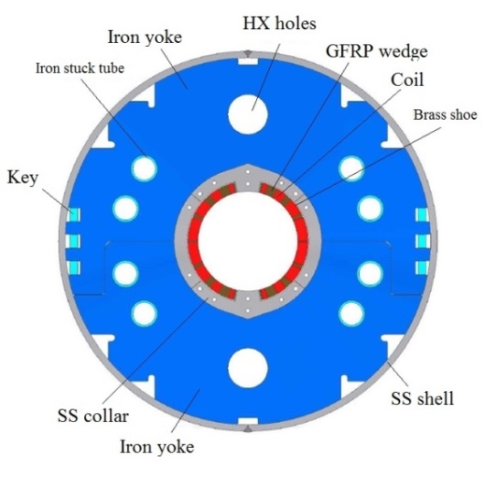
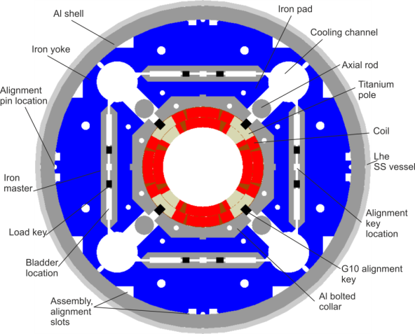
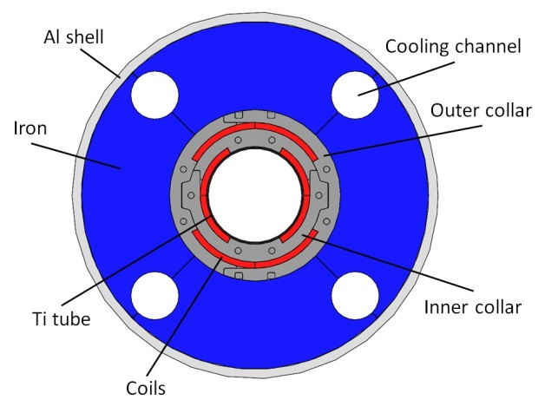
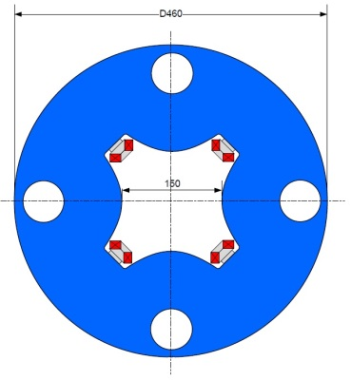
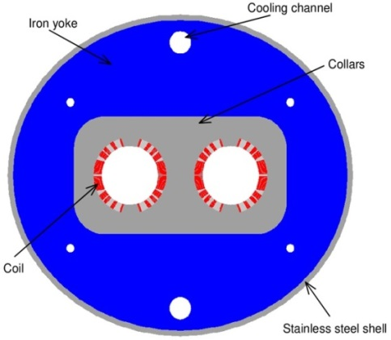
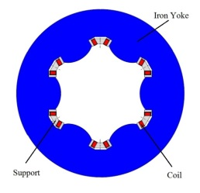
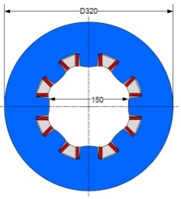
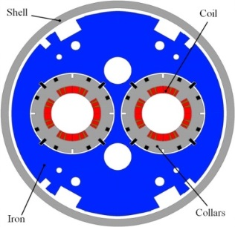
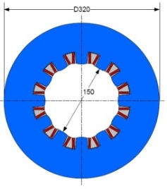
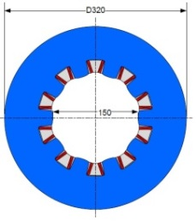
International magnet zoo
Triplet QXF (LARP and CERN)
Orbit corrector (CIEMAT)
Separation dipole D1 (KEK)
Skew corrector (INFN)
Corrector sextupole (INFN)
Corrector octupole (INFN)
Recombination dipole D2
(INFN design)
Q4 (CEA)
Ezio Todesco
Cross-sections in scale
Corrector dodecapole (INFN)
Corrector decapole (INFN)

Slide 29
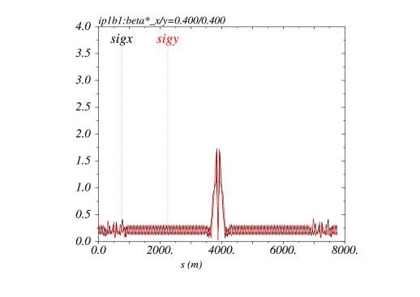
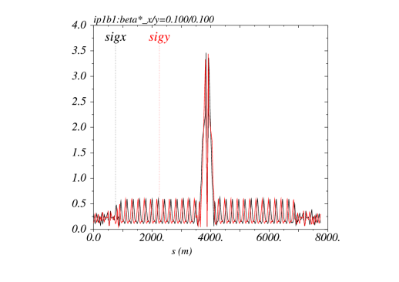
Low beta* optics (ATS)
(S. Fartoukh)
Small β* is limited not only by aperture but : optics matching, chromatic effects...
A novel optics scheme was developed to reach un-precedent β* w/o chromatic limit based on a kind of generalized squeeze involving 50% of the ring
β*= 40 cm
β*= 10 cm
The new IR is sort of 8 km long !
Beam sizes [mm] @ 7 TeV from IR8 to IR2 for typical ATS
“pre-squeezed” optics (left) and “telescopic” collision optics (right)

Slide 30
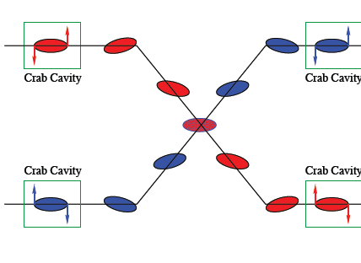
3. Crossing angle compensation

Slide 31
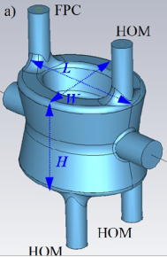
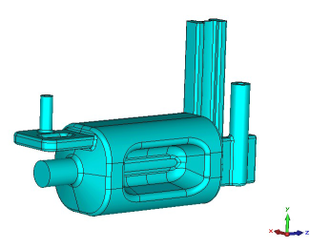
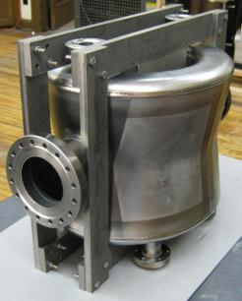
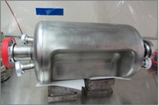
Crab cavity development
Major R&D program
Now concentrate on two designs in order to be ready for test installation in SPS in 2016/2017 TS
Double ¼-wave: coaxial couplers with
hook-type antenna
RF Dipole: waveguide or
waveguide-coax couplers
RF-Dipole Nb prototype [ODU-SLAC]
DQWR prototype (17-Jan-2013) [BNL]

Slide 32

Excellent results: e.g. RF dipole > 5 MV
2 K result
Initial goal was 3.5 MV
however ΔV > 5-6 MV would ease integration
4.2 K result
Quench
JP Delahayen ODU
5

Slide 33
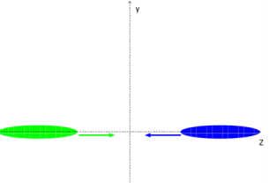
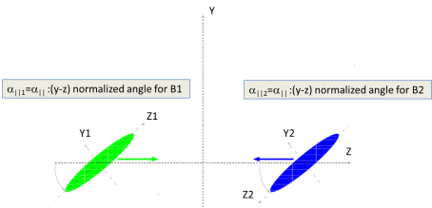
Crab kissing
Aim: lengthen luminous region to reduce pile-up density
Crab-cavities in the separation plane
Usual configuration in the || plane
Kissing Configuration in the || plane

Slide 34
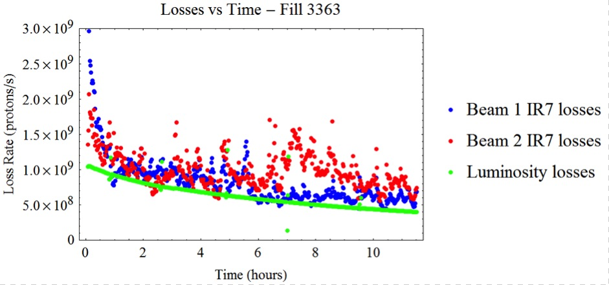
4. DEALING with the regime
Losses in Stable Beams 2012: 50 ns, 1370 bunches, 1.6e11 ppb

Slide 35

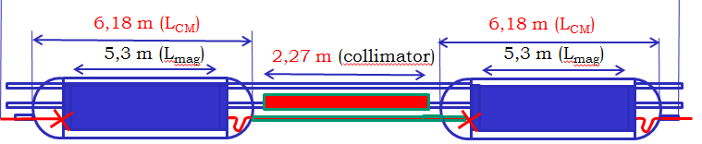
DS collimation
Protecting the dispersion suppressors (DS) from collimation or luminosity debris
Replace a 8.3 T Nb-Ti dipole with two 11 T Nb₃Sn dipoles
  Leaving enough space for a 0.8 m long room temperature collimator
  4 units needed for IP2 in LS2 – first Nb₃Sn seeing a beam!
  8 units needed for IP7 in LS3
  Up to 16 more units could be needed at IP5 and IP1 in LS3
Ezio Todesco – Chamonix 14

Slide 36
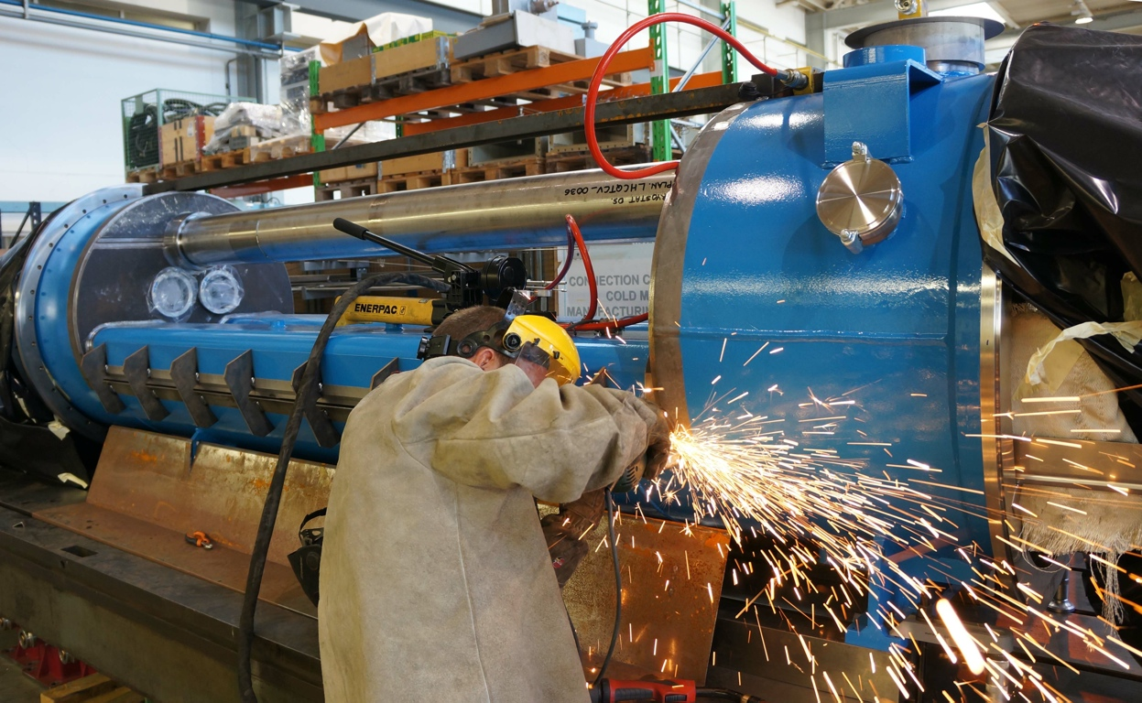
Prototyping of cryogenics bypass
Prototyping of the by-pass crystostat (QTC) for the installation of a warm collimator in the cold dispersion suppressors.
MBHSP02 passed 11 T during training at 1.9 K
with I = 12080A on 5th March 2013!

Slide 37






The critical zones around IP1 and IP5
ATLAS
CMS
3. For collimation we also need to change the DS in the continuous cryostat: 11T Nb₃Sn dipole
2. We also need to modify a large part of the matching section
e.g. Crab Cavities &
D1, D2, Q4 & corrector
New triplet Nb₃Sn
required due to:
-Radiation damage
-Need for more aperture
More than 1.2 km of LHC
Plus technical infrastructure
(e.g. Cryo and Powering)…

Slide 38
Equipment on the Beam | Tunnel equipment | Vert. J | Surface Eq. | Dis.
Interaction Region and MS
IP 1,5
Cryoplant
IP 1,5
P
I
C
BIS
Magnet system
MQXFA MQXFB, MBXF, MBRD, MQYY,
Q5 1.9, Q6 1.9
MCBXFB, MCBXFA, MQSXF, MCTXF, MCTSXF, MCDXF, MCDSXF, MCOXF, MCOSXF, MCSXF,MCSSXF,
MCBRD, MCBYY
Cryo line
CB
Warm compressor and other surface eq.
Alignment
QPS2
EE
TAXS, TAXN
DF(X-M) +
SC Link DSH (X-M)
DFH(X-M) +
Power converters
Collimation (TCTPM, TCL, TCLM, TCTP)
Beam vacuum
Rad-hard electronics for
BLM and BPM
Beam diagnostic
BPMSQW, BMPSQ, BPMSQT, BMLC
RF system
Loads, circulators, RF power, LLRF, HVPS, central LLRR
Crab Cavity cryomodules
CC diagnostic and protection
SC link/
Powering
arc
IP 1,5
DS Collimation pp (TBC RUN II)
IP 1,5
Cryo-bypass+TCLD
DFHA +
Power converters
DFA+
SC Link DSHA
H.F. dipoles
DS Collimation for ion
IP 2
Cryo-bypass+TCLD
H.F. dipoles
Paolo Fessia
SC link/powering
IP 7
DS Collimation pp (TBC RUN II)
IP 7
Hor. SC L. DSH + DFA
Cryo-bypass+TCLD
New DSLM for Q6
H.F. dipoles
Power converters

Slide 39
A few other challenges
Very bright beams, very high bunch population, very high beam current
Beam stability
  New low impedance collimators
Beam lifetime & loss spikes
  Magnet quenches
Machine protection
  Failure scenarios - local beam impact - equipment damage
  Quench protection
Machine availability
  Radiation to electronics (SEUs etc.)…

Slide 40

Powering cold circuits
To avoid radiation to electronics and personnel – move power converters, possibly to surface. High Temperature Superconducting (HTS) links.
L = 20 m
(25×2) 1 kA @ 25 K, LHC Link P7

Slide 41

2010 - 2035
LS3: HL-LHC upgrade – machine and experiments

Slide 42
Conclusions
2015 should be interesting
HL-LHC well established - as is LIU
Good progress on main technological challenges
It will be challenging:
  Ambitious targets
  Big beams, low tolerance to losses, very good operational efficiency required
  Run 2 and 3 are going to provide a lot of useful input

Slide 43
HL-LHC Baseline Summary:
Cryogenic system upgrade (IR1&5 and IR4)
Tungsten shielding for triplet
New large aperture triplet magnets (Nb₃Sn)
New Large aperture Insertion magnets (NbTi)
Crab Cavities for compensation of geom. Reduction
Operation with Luminosity leveling
Collimation upgrade (DS and impedance)
R2E and superconducting link

Slide 44
HL-LHC Options:
Hollow electron lens (halo beam removal)
Long Range Beam-Beam wire compensators (reduction of crossing angle)
Flat beam operation (reduction of crossing angle)
Crab Kissing Scheme
Higher or lower harmonic RF system (bunch profile and beam stability)

Slide 45

10 year plan
Run 2: 13 to 14 TeV c.m. with peak luminosity of ~1.7x10³⁴ cm⁻² s⁻¹
Run 3: 14 TeV c.m. with peak luminosity of ~2x10³⁴ cm⁻² s⁻¹
EYETS ~5 months
Extended year end technical stop (CMS)
LS2: 18 months
Connection of LINAC4
LHC Injectors Upgrade
LS3: 30 months
High Luminosity LHC

