Slide 1


Physics with ATLAS and CMS
at the LHC
Albert De Roeck
CERN, Geneva, Switzerland
Antwerp University Belgium
UC-Davis California USA
IPPP, Durham UK
BUE, Cairo, Egypt
15th December 2014
Durham, UK

Slide 2




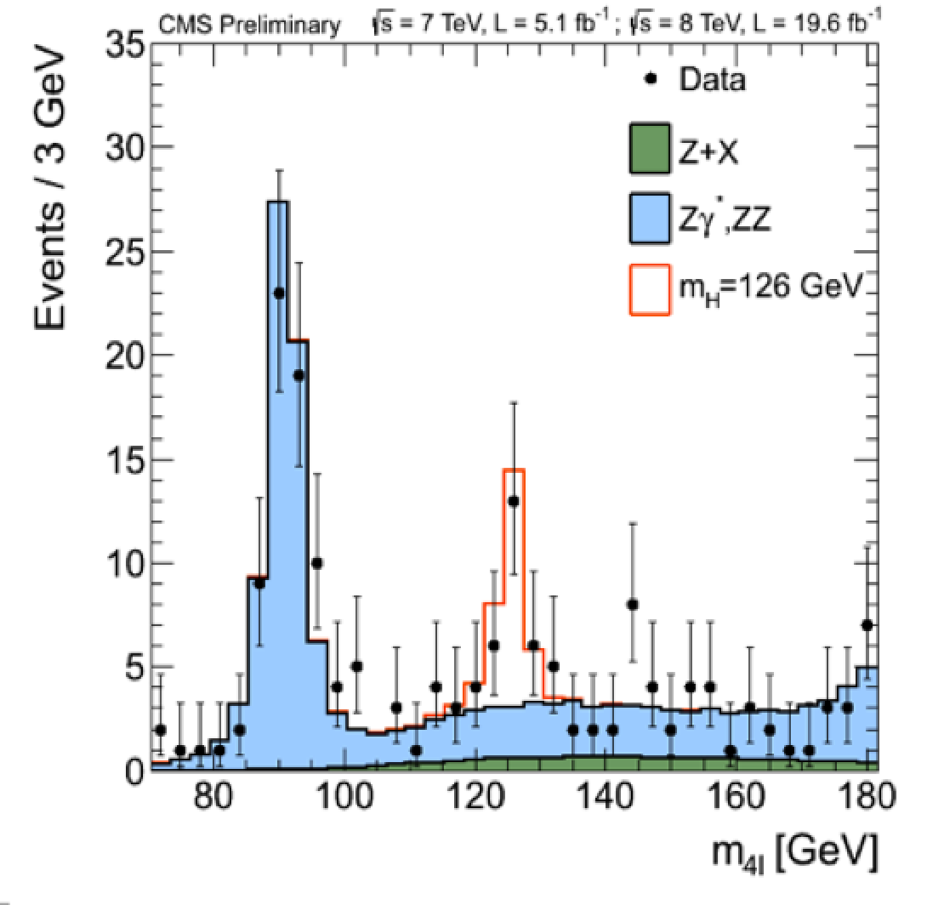


Outline
Introduction
QCD and EWK results
The Higgs particle: overview
of the channels & properties
Direct Beyond the SM Searches
RunII start-up: what to expect
Melbourne 4th July 2012,
late afternoon

Slide 3
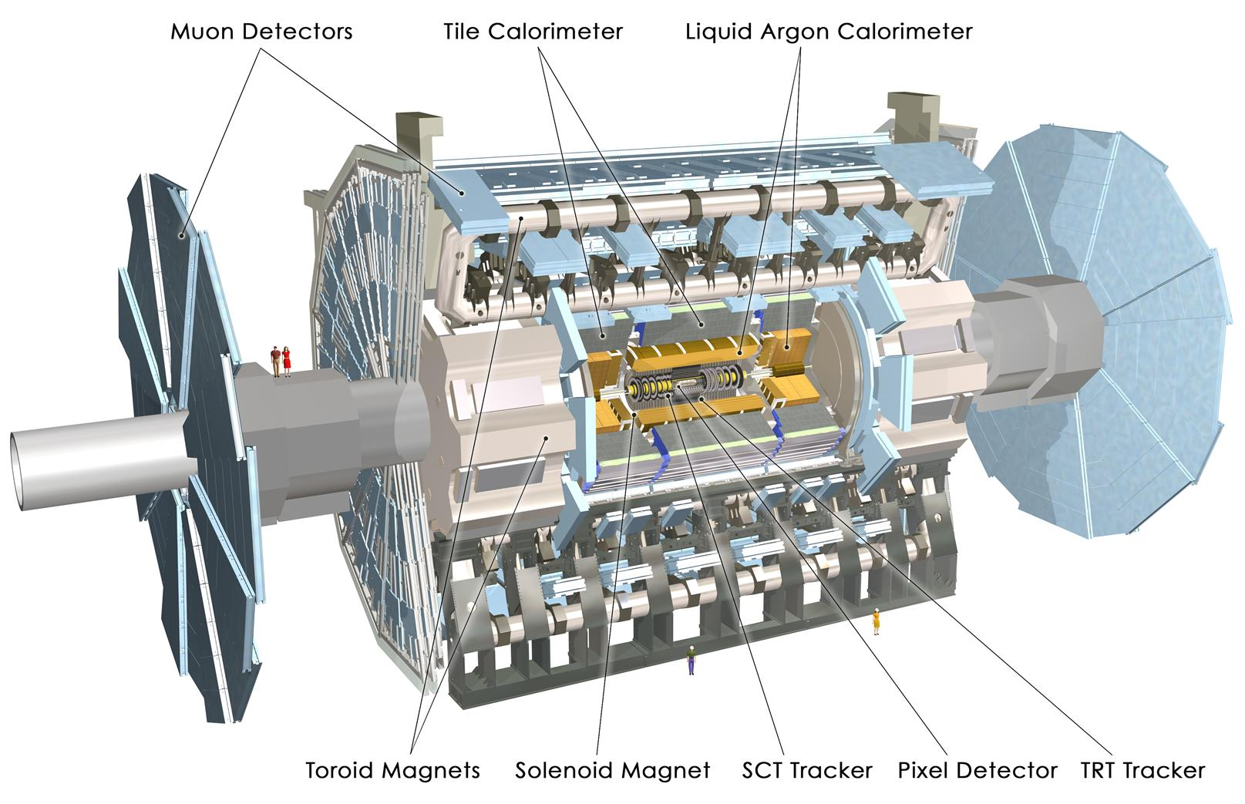
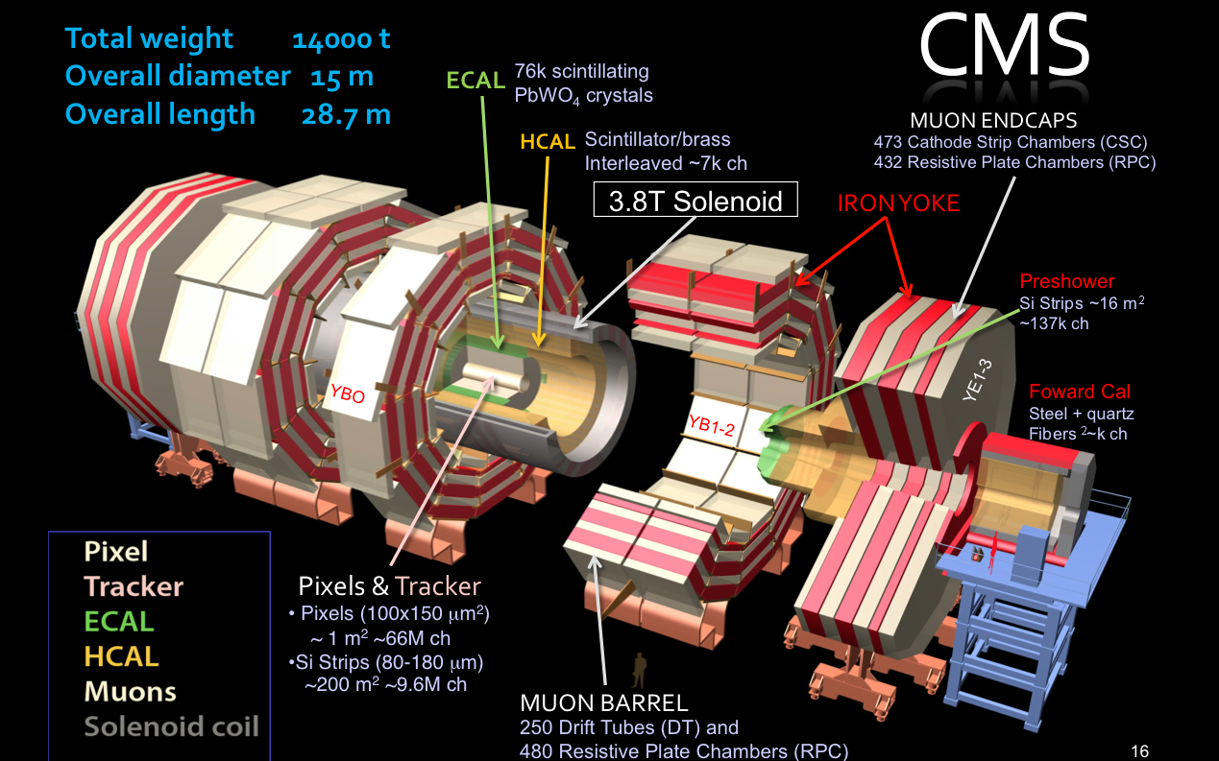
The New Physics Hunters @ the LHC
LHC: pp collisions
Luminosity:
5 fb⁻¹ @ 7 TeV
20 fb⁻¹ @ 8 TeV
The ATLAS experiment
The CMS experiment
Excellent 4π-acceptance
detectors that performed
extremely well in 2010-2013!
LHCb will be discussed later

Slide 4
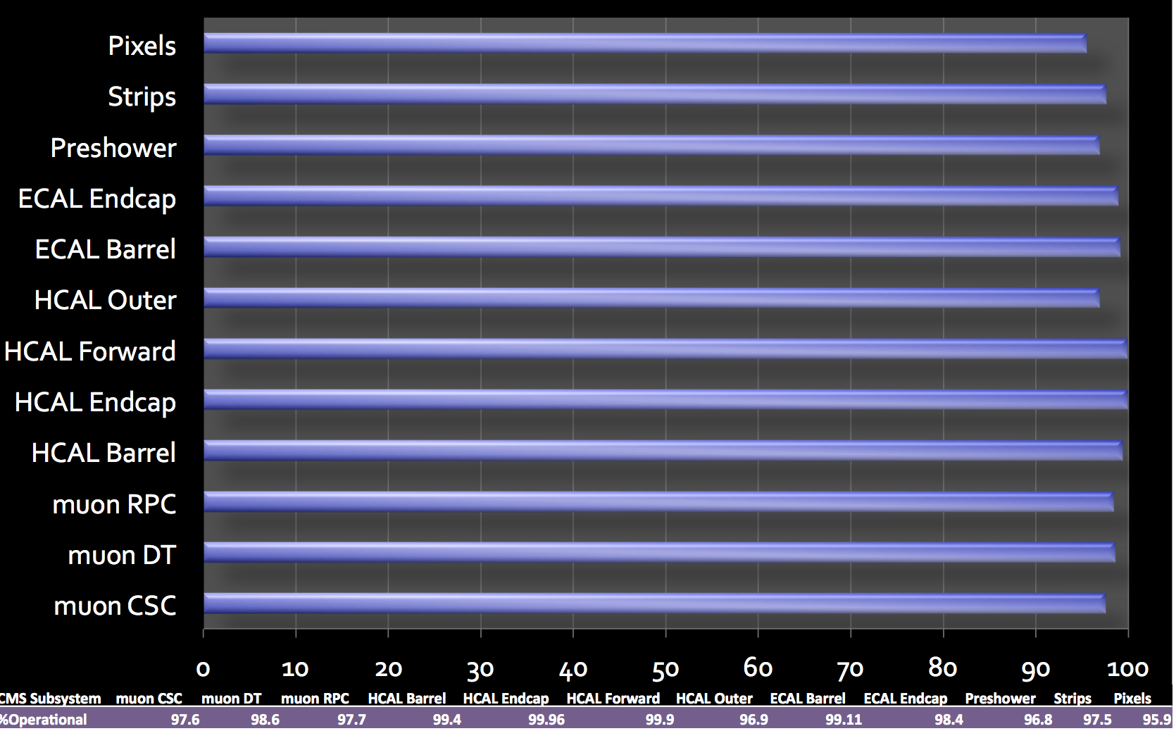
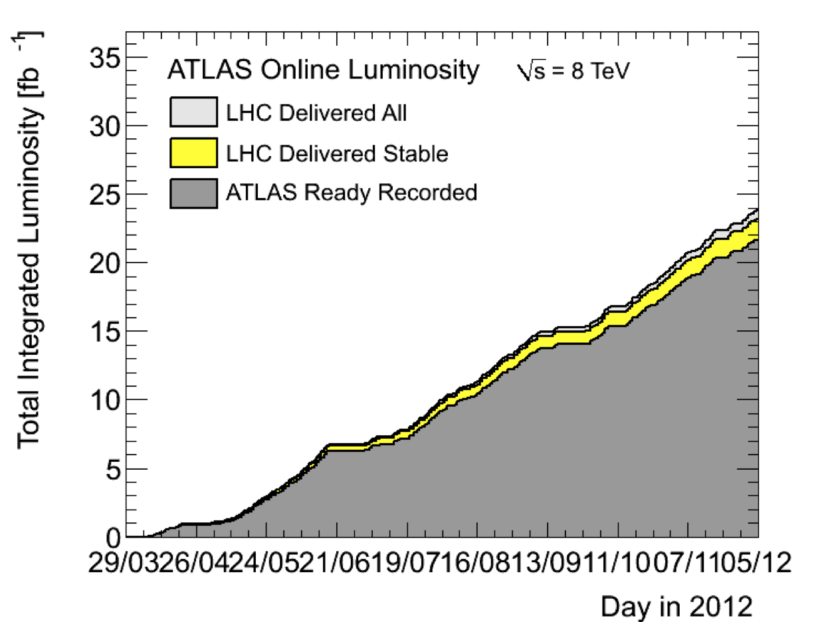
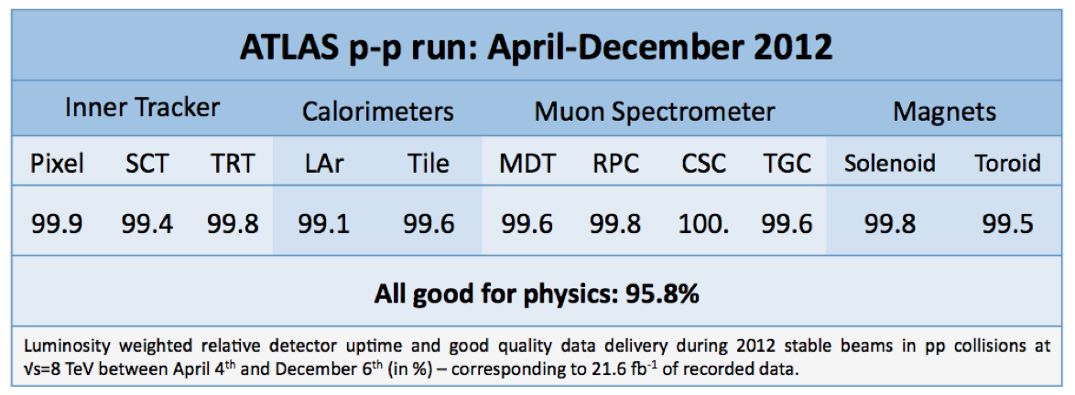
Operation of the Experiments
LHC: pp collisions Luminosity:
5 fb⁻¹ @ 7 TeV
20 fb⁻¹ @ 8 TeV
CMS: sub-detector operation
ATLAS: sub-detector operation efficiency in 2012

Slide 5
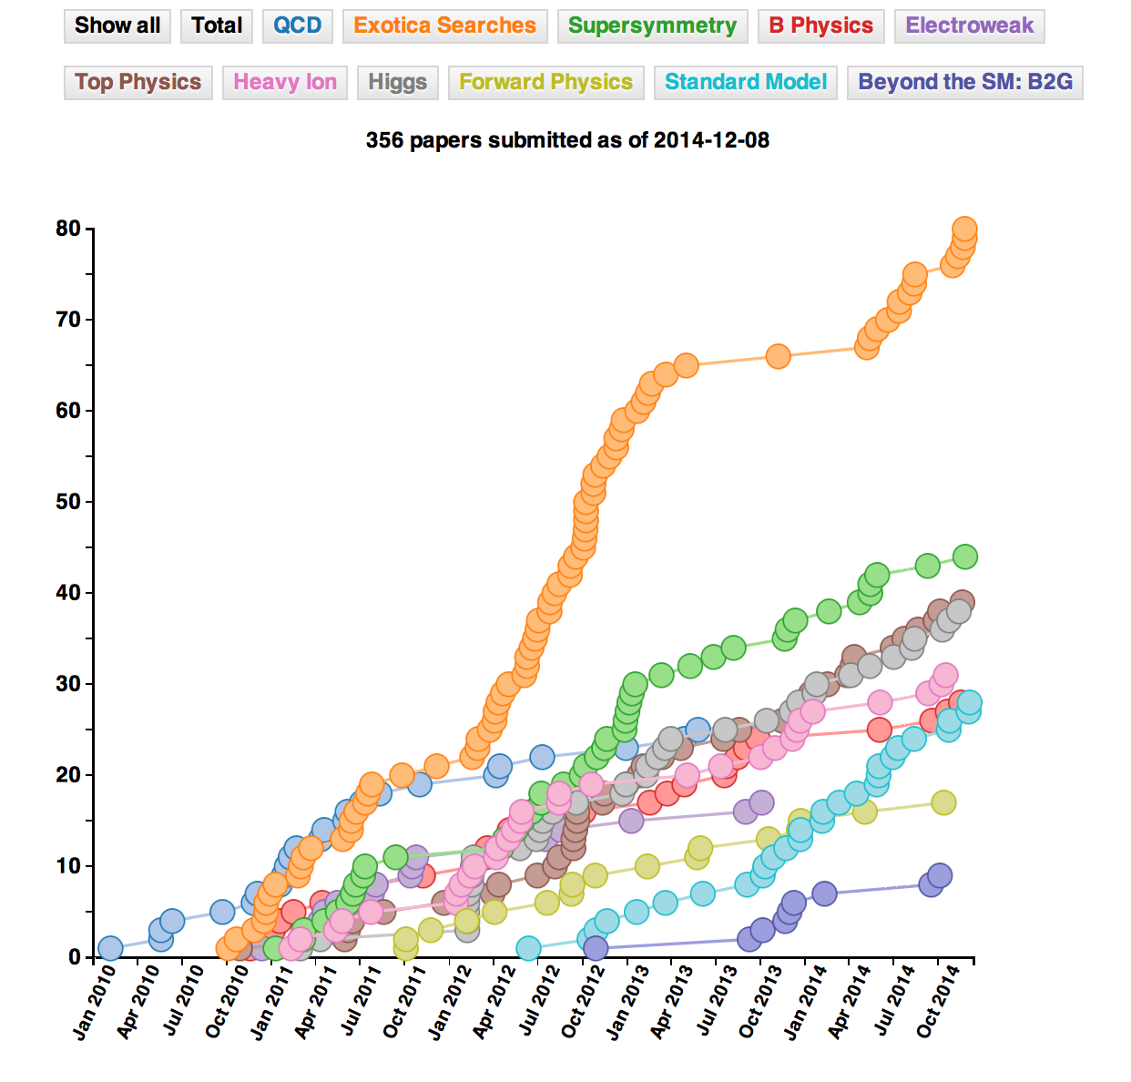
Example: CMS Publications
356 publications on
pp (and pPb/PbPb)
physics since
January 2010
(08/12/2014)
Many on exotica
searches and
supersymmetry
(>130 papers
together)
Similar for ATLAS

Slide 6


Most cited paper so far...
Special Physics Letters B edition with the ATLAS and CMS CMS papers on the Higgs Discovery
Also…
More than 3600 times
cited so far…

Slide 7
Standard Model Studies
The study of the Standard Model at 13/14 TeV will be one of the
first points to tackle at the new energy.
The first QCD and Electroweak Studies can be done with << fb⁻¹
Luminosity profile in 2015 not fixed yet but the LHC is likely to make a careful start with low luminosity for some time, with a stop after ~ the first 1 fb⁻¹

Slide 8
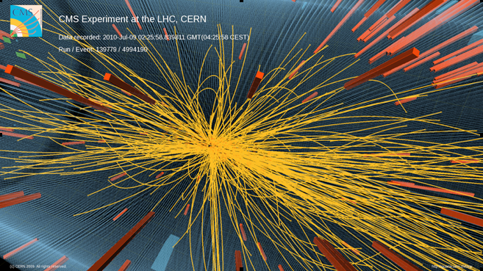
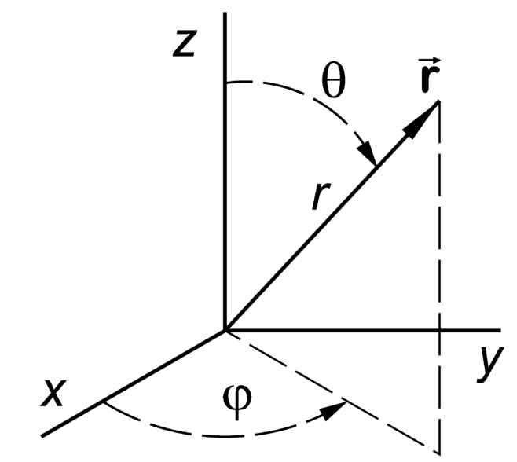
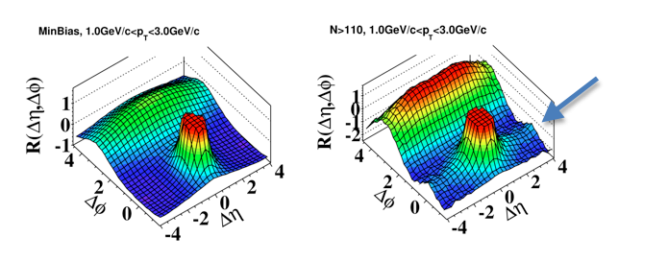
Correlations Between Produced Particles
Min bias collisions
•Select high multiplicity events
•Study the correlation between
two charged particles in the
angles φ (transverse):
Δφ and θ (longitudinal): Δθ
η= -ln tanθ/2
All events
High multiplicity events
A new phenomenon
in the ‘stronge force’?
•Multiple interactions?
•Glass condensates?
•Hydrodynamic models?Still not quant. explained
JHEP 1009 (2010) 091
This was the first (subtle) new effect, in 2010, studying the strong force…
Was first seen in AA, then pp (unexpected) and now also pA (~unexpected)

Slide 9
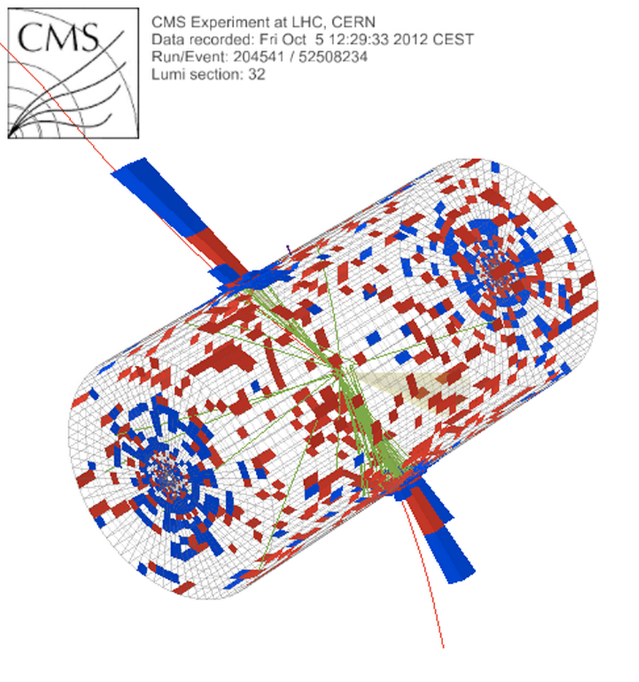
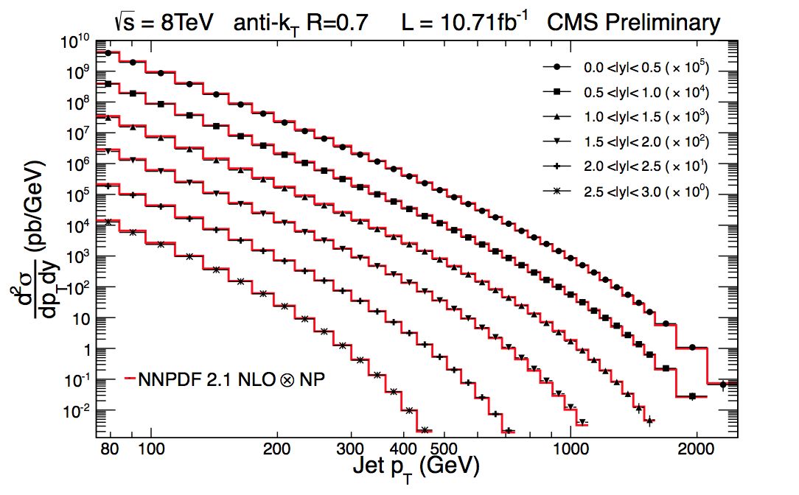
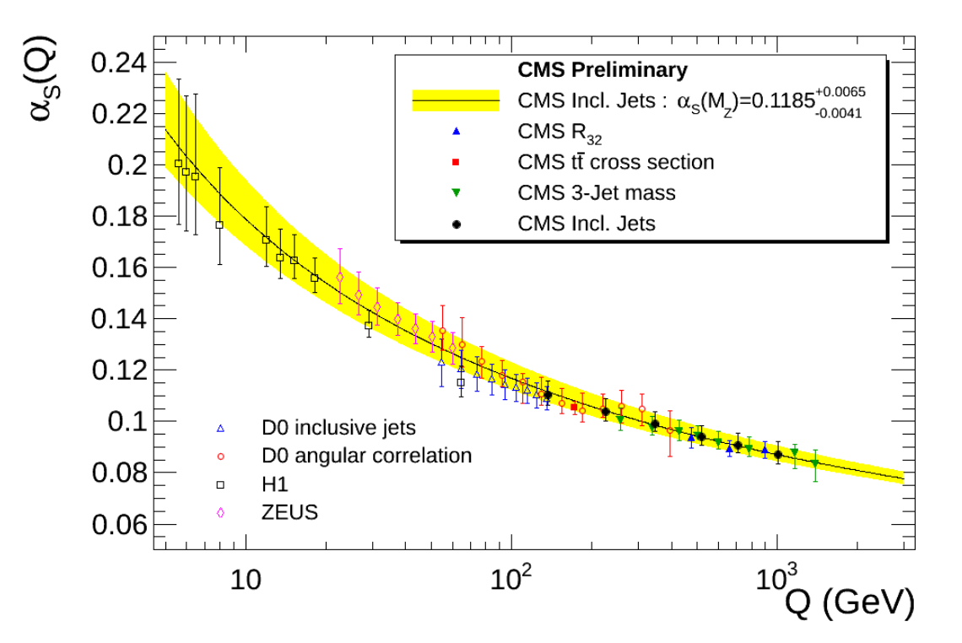
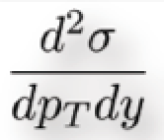


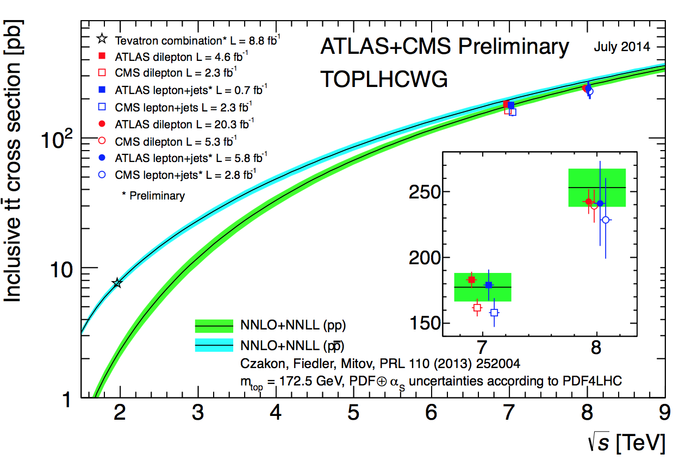
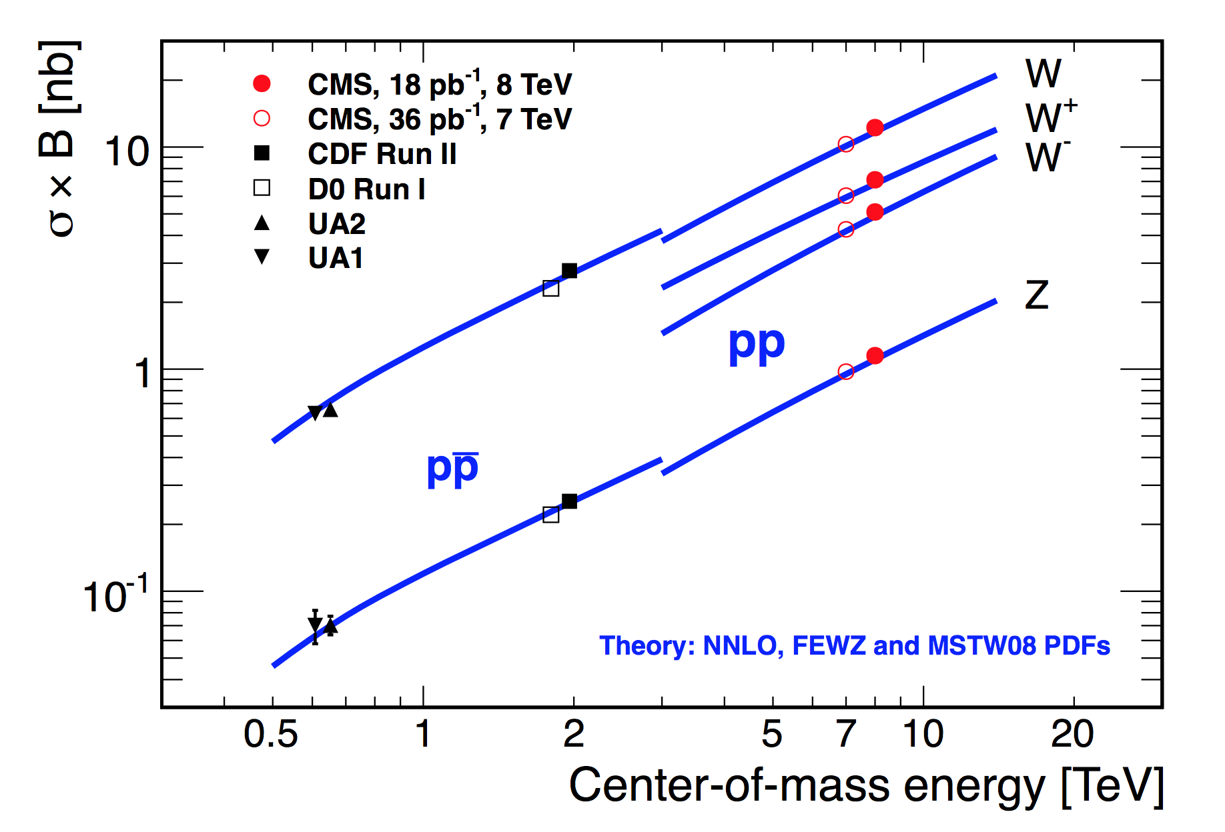
Jets, EWK Bosons, Top…
CMS-PAS-SMP-12-012
Precise measurements can
already be made with ~ 10 pb⁻¹
Di-jet invariant
mass = 5.15 TeV
(R=1.1 jets)
Measurements at 7/8 TeV in agreement with (N)NLO QCD

Slide 10
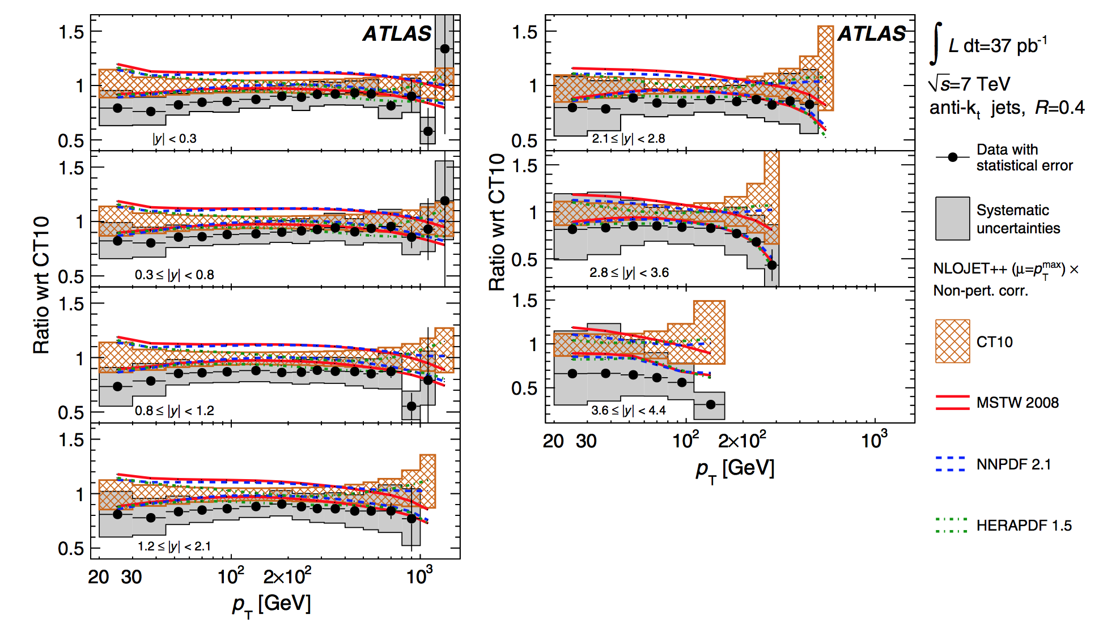
Inclusive Jet Production
Comparison with NLO calculations with the data in some detail,
for different proton structure function parameterizations.
Deviations for highest y range?

Slide 11
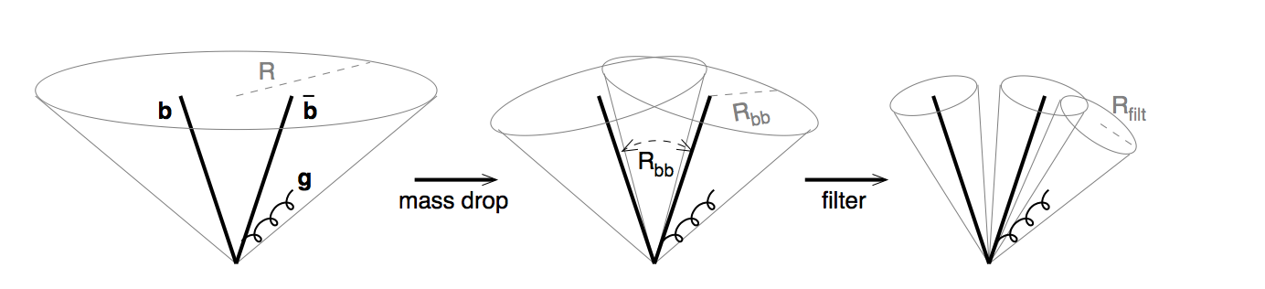
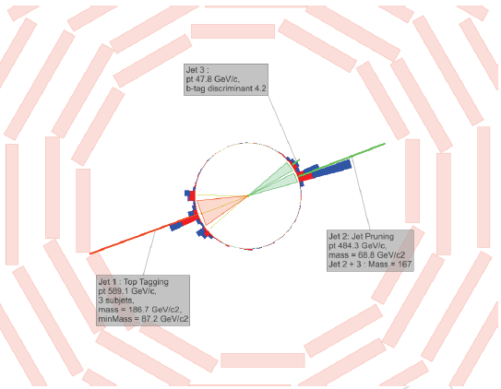
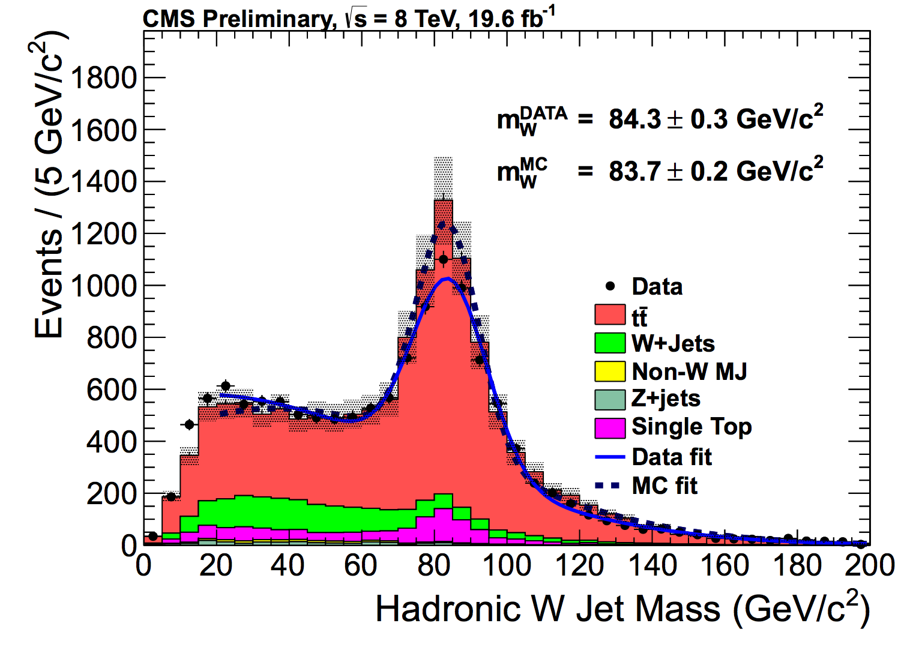
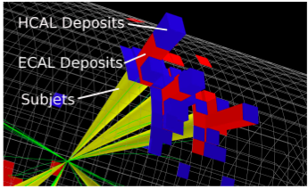
New Directions: Boosted Jets & Substructure
Analyse boosted/merged jets
arXiv:0802.2470
•Start from Cambridge-Aachen FAT jets and apply jet “pruning” to find sub-jets
•Many methods being developed to analyse the jet substructure: grooming->
mass drop filtering, trimming, pruning… (BOOST Workshops…)
Example: Boosted top events with b-jet and two merged jets from the W
New techniques at LHC to study QCD and for searches for New Physics

Slide 12
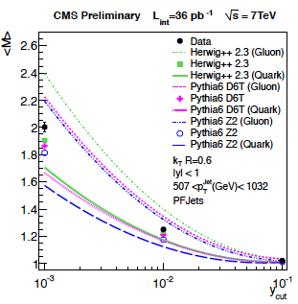
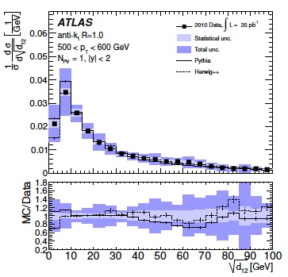
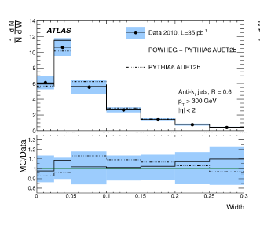
Detailed QCD Jet-structure Studies
Detailed QCD jet studies such as substructure grooming are important to get:
  Deeper insight into pQCD evolution in jets
  To perform searches for New Physics in a new way
CMS-QCD-10-41
arXiv:1203:4606
Subjet multiplicity
k_{T} splitting scale
Jet width
New techniques at LHC to study QCD and for searches for New Physics

Slide 13
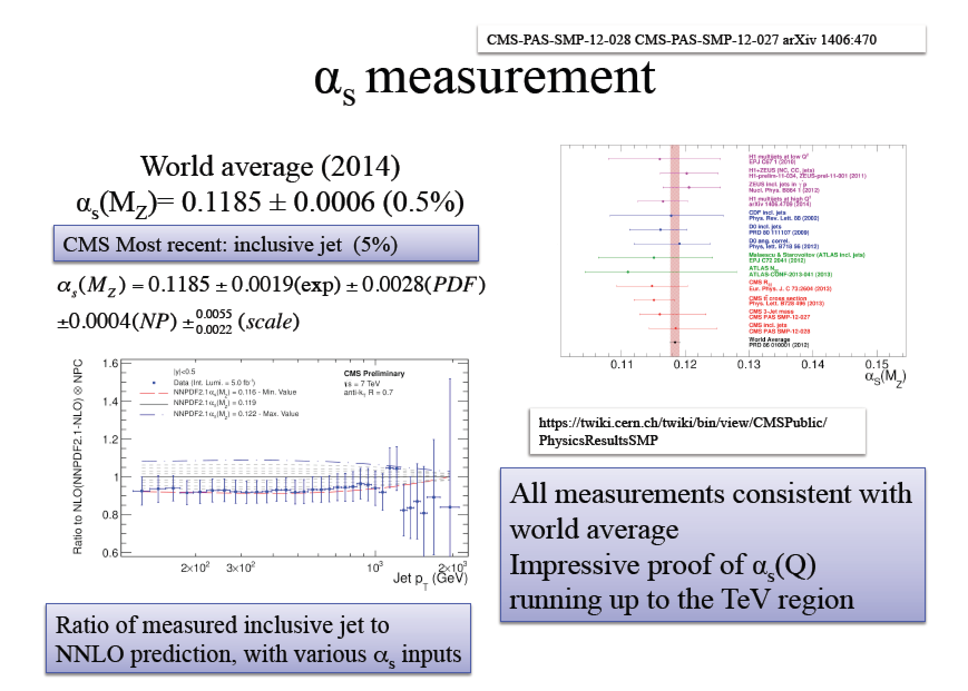
Extracting the Strong Coupling Constant

Slide 14
W and Z Boson Production
Precision of these measurements
is ~3% (luminosity uncertainty)

Slide 15
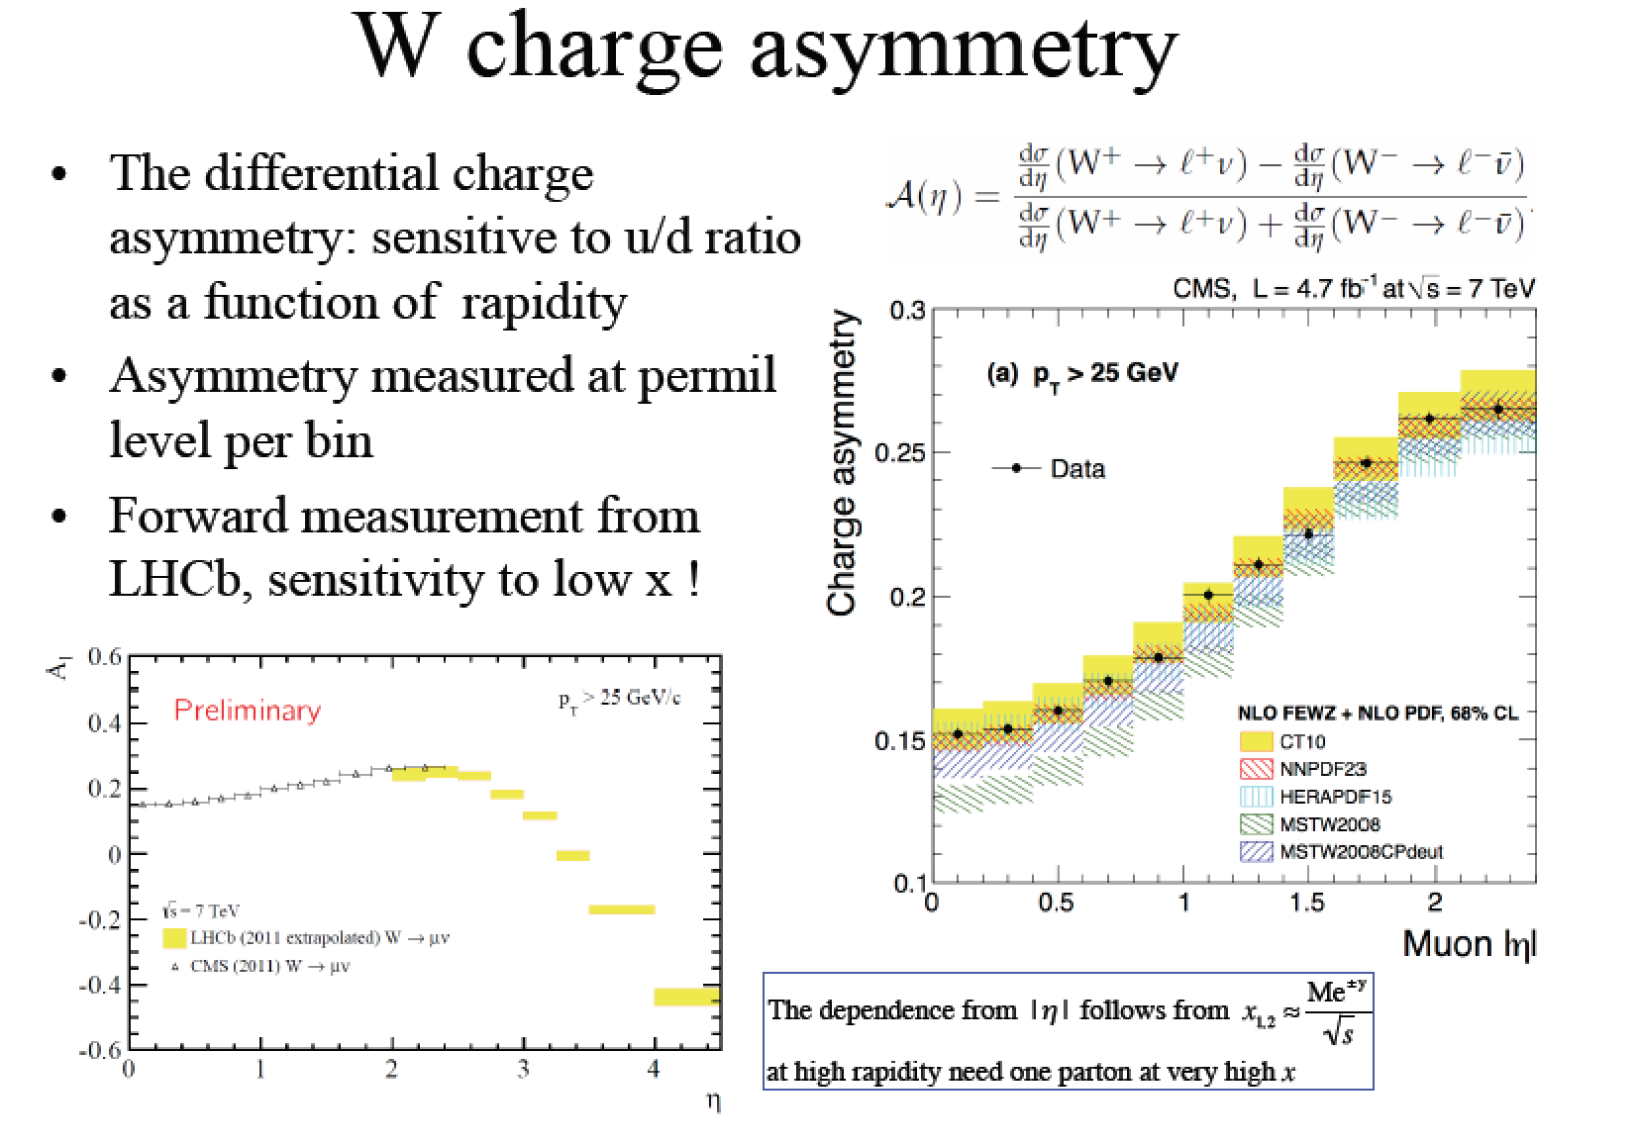
W Boson Production

Slide 16
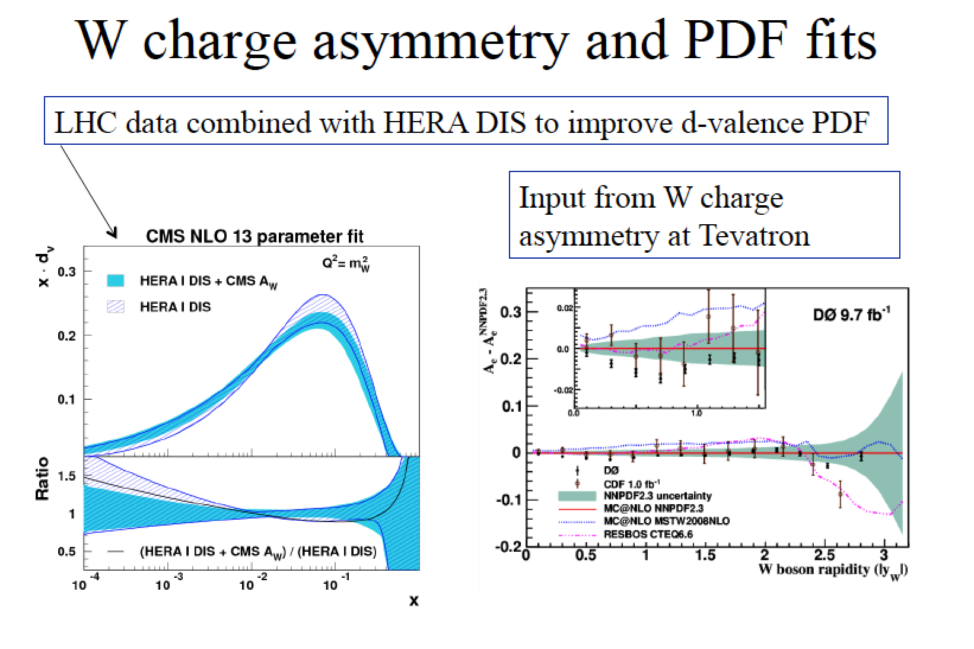
W Boson Production

Slide 17
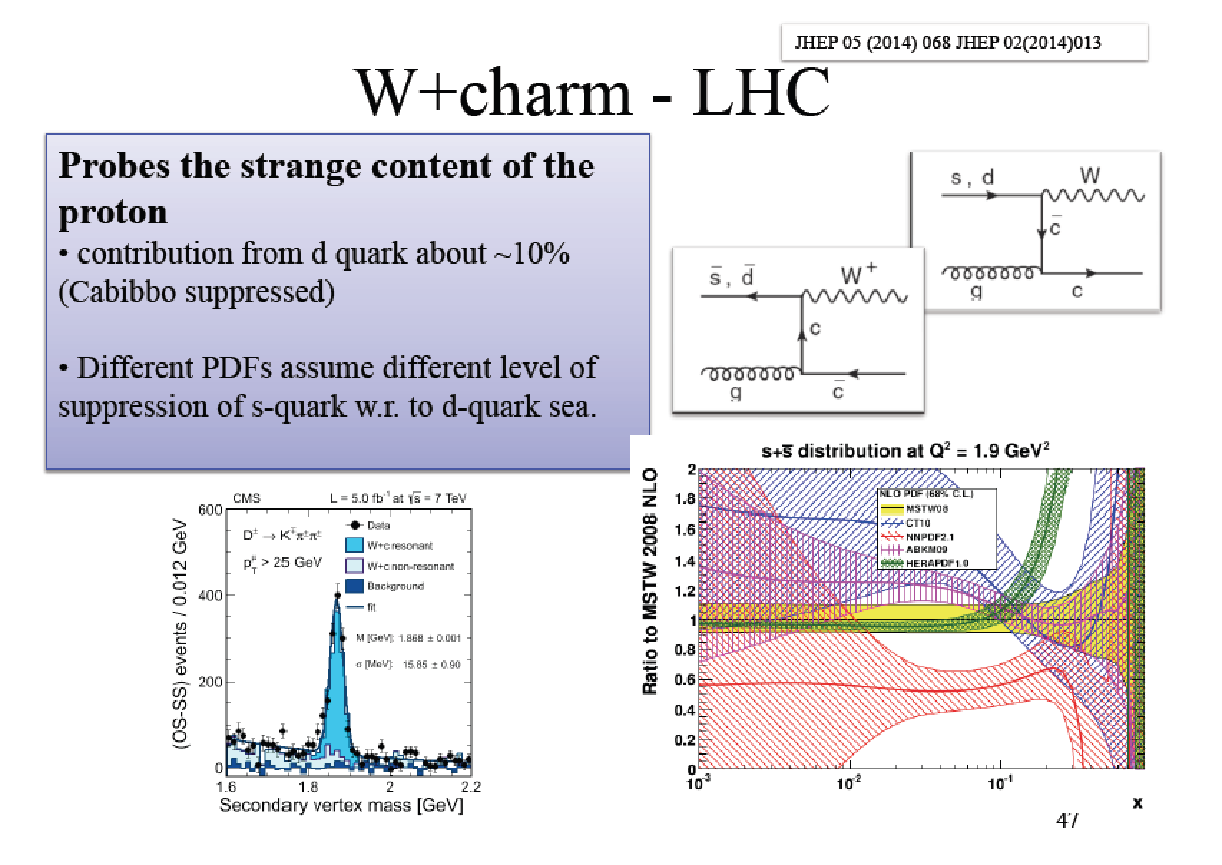
W Boson Production

Slide 18
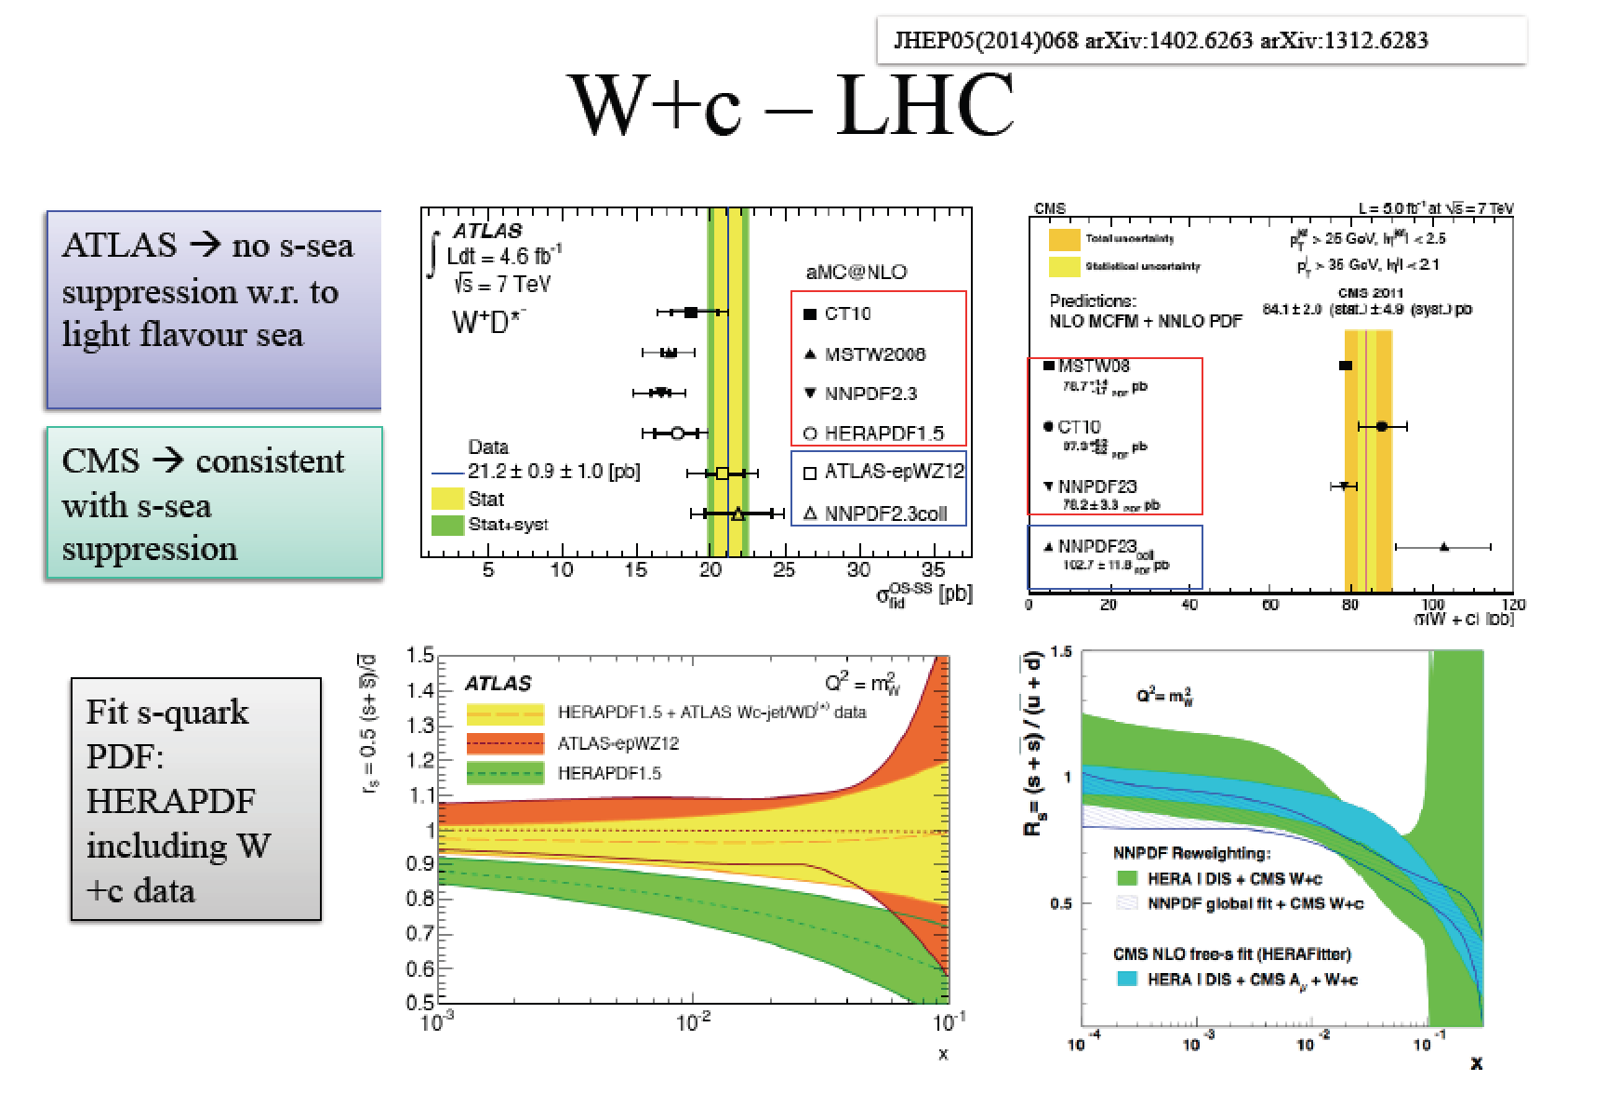
W Boson Production
PDF precision will be crucial for EWK measurements M_{W}, sin²θ etc…

Slide 19
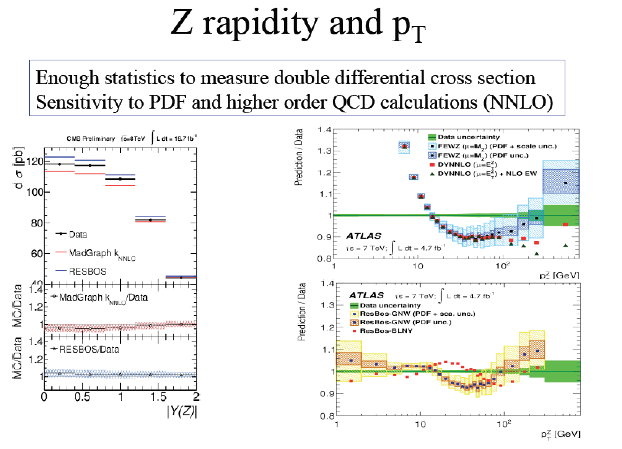
Z Boson Production

Slide 20
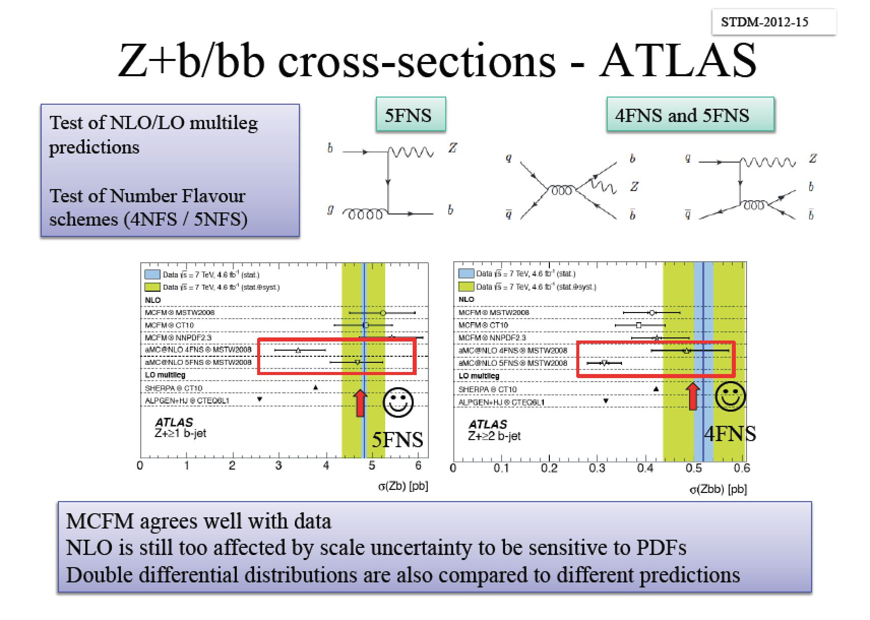
Z Boson Production

Slide 21
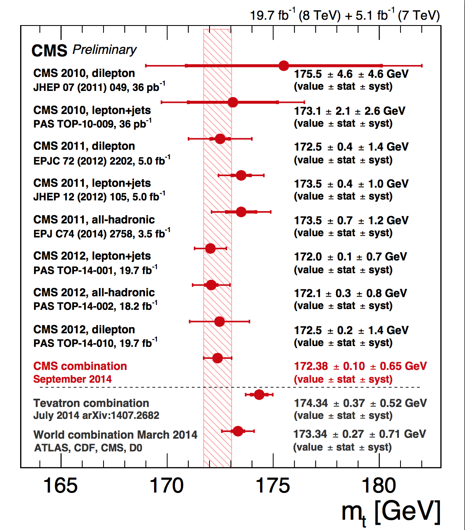
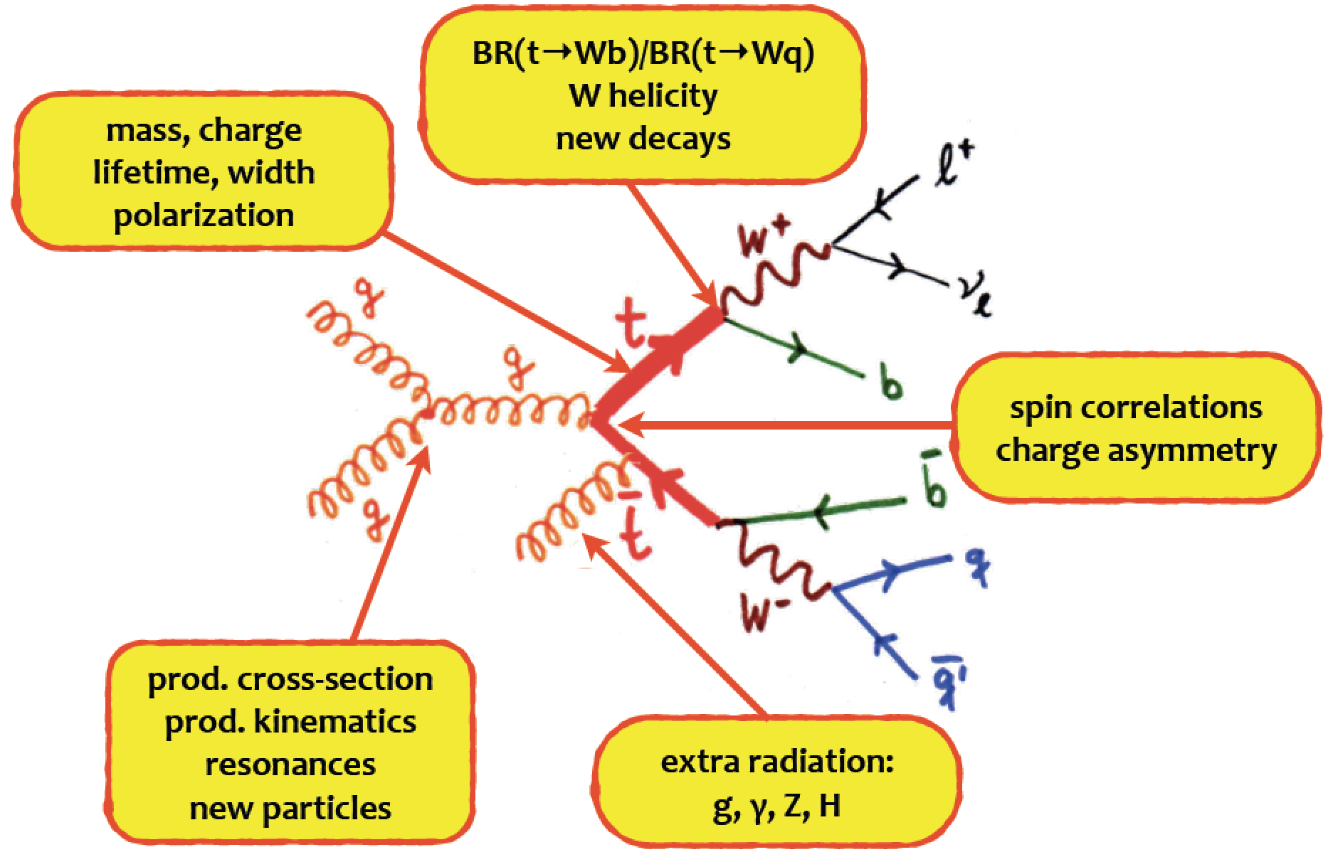

LHC as a Top Factory
Cross section ~ 250 pb (8 TeV)
->• ~5.10⁶ produced tt-pairs (2012)
•a few 10⁵ used in the analyses
Top mass determination
Spring 2014
Using Tevatron and
LHC combination of the
mass measurements
Meanwhile:
CMS update: 172.38±0.10 (stat)±0.65 (syst) GeV
Tevatron update: 174.34 ± 0.64 GeV

Slide 22
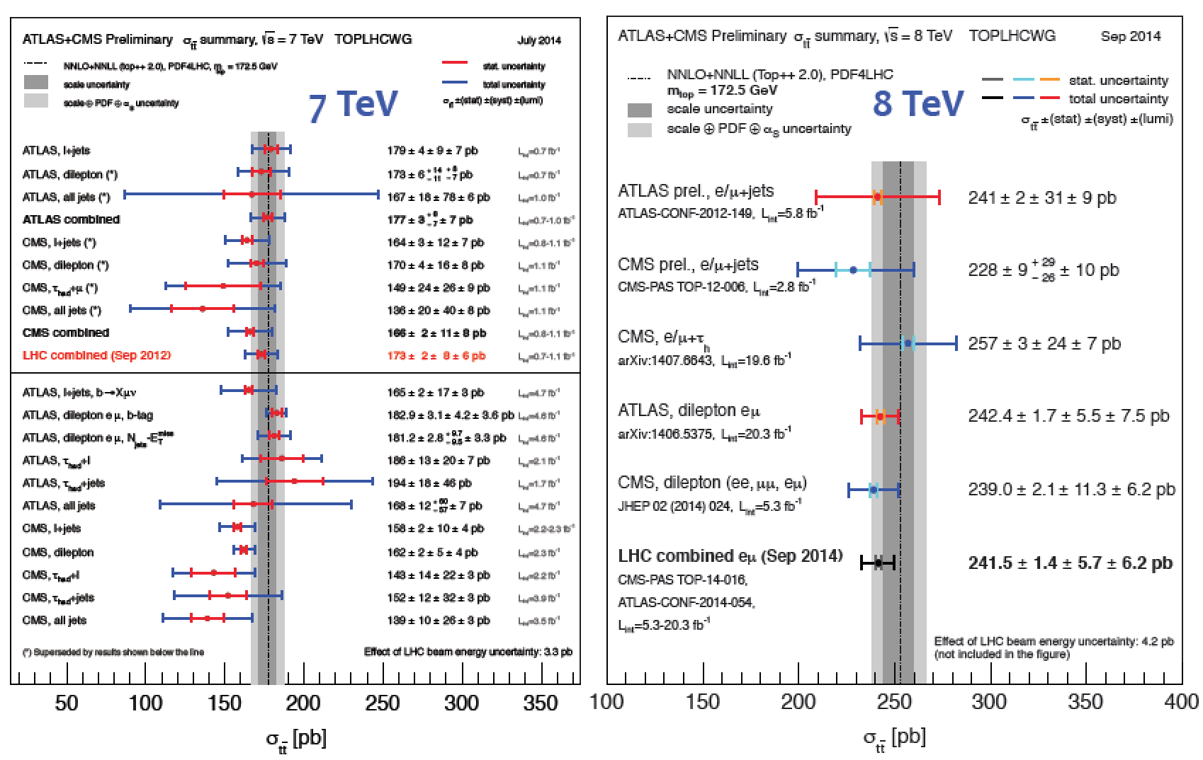
Top Cross Sections Summary
Exp: 3.5%
Th: 5.7%

Slide 23
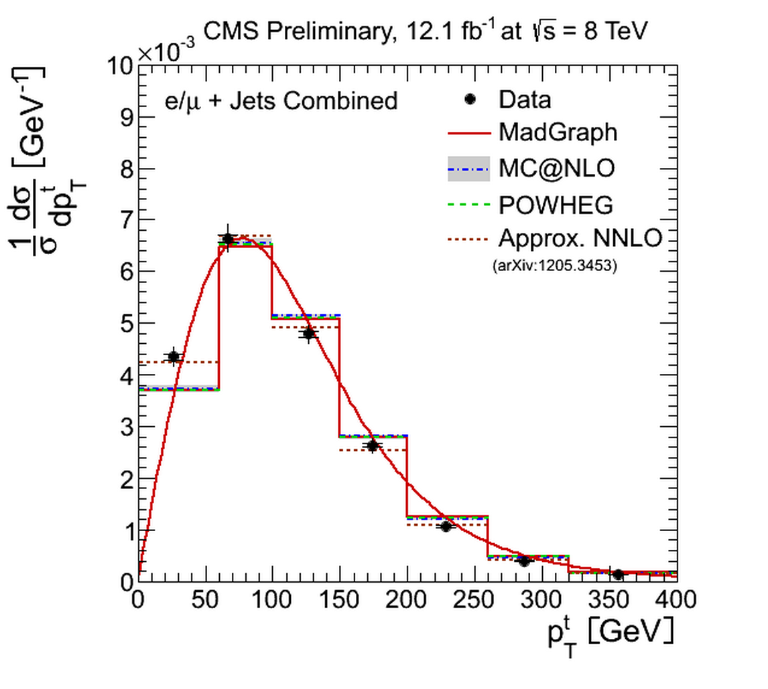
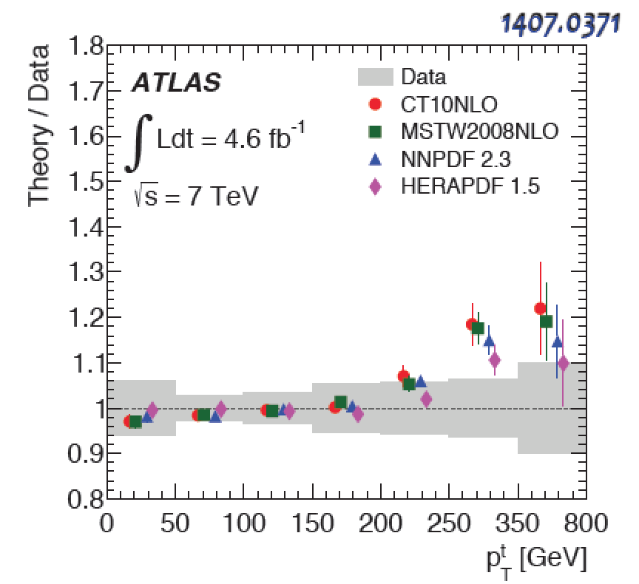
Detailed Top Studies
Large amount of tops at the LHC allows from detailed studies:
Some discrepancies with the MC calculations, eg top p_{T} spectra
MCFM
Experiments reweight the p_{T} distributions…

Slide 24
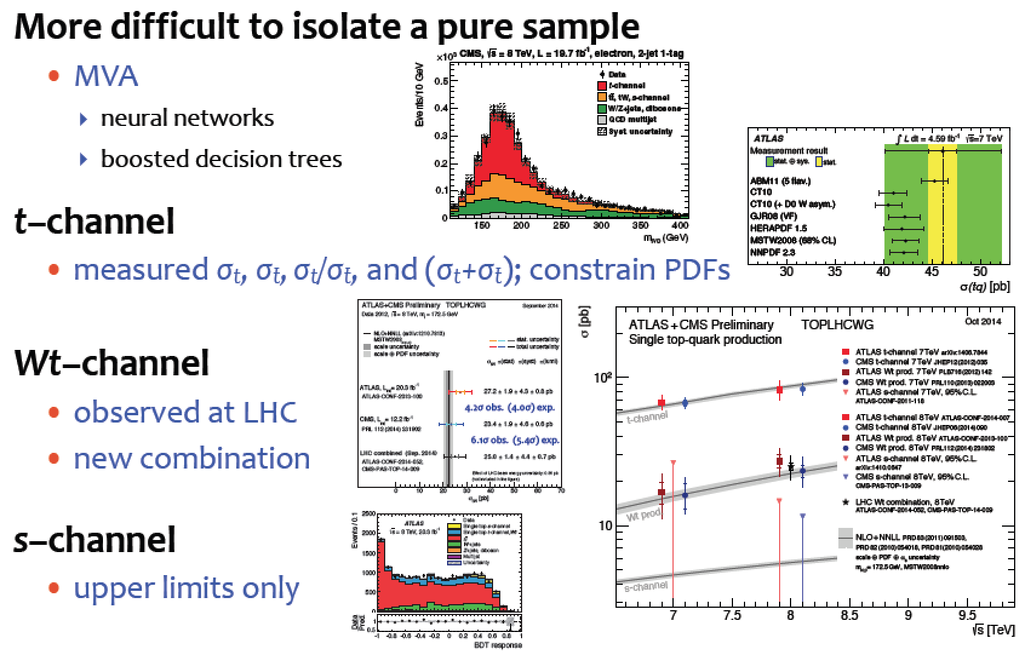
Single Top Results

Slide 25
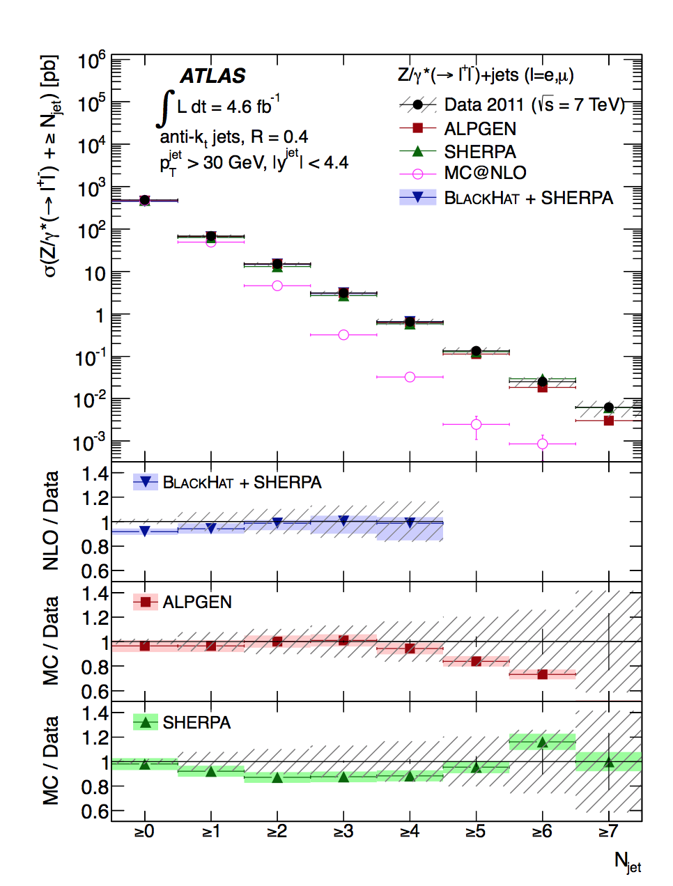
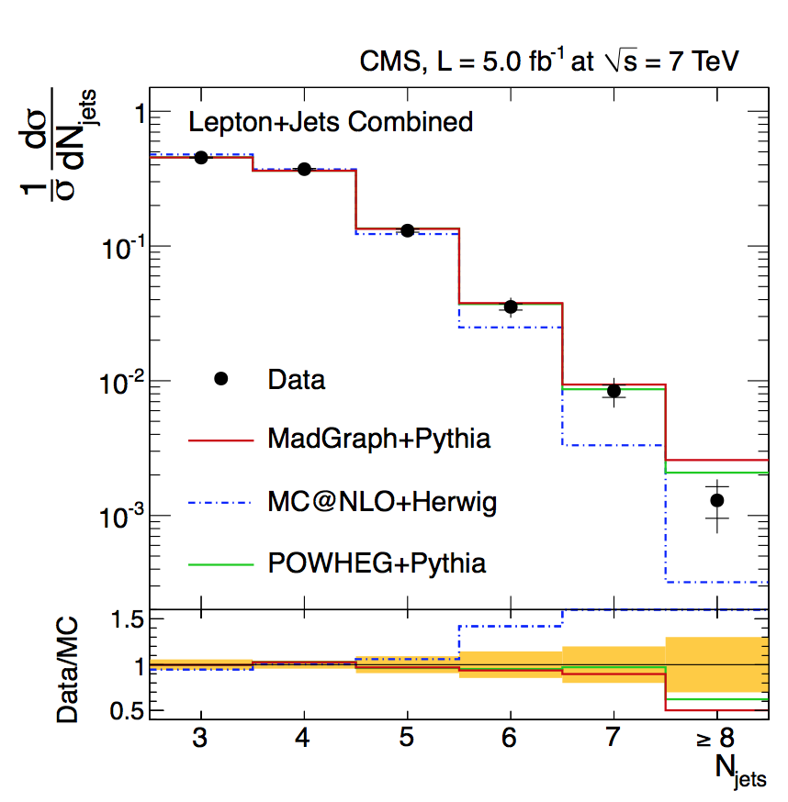
Vector Boson+Jets and Top+Jets
arXiv:1304.7098
High statistics and precision at the LHC
allows for W/Z+jets and top+jets studies
arXiv:1404.3171
top+jets
Z+jets
Good description by theory for both processes
Important backgrounds for searches, eg for SUSY searches

Slide 26
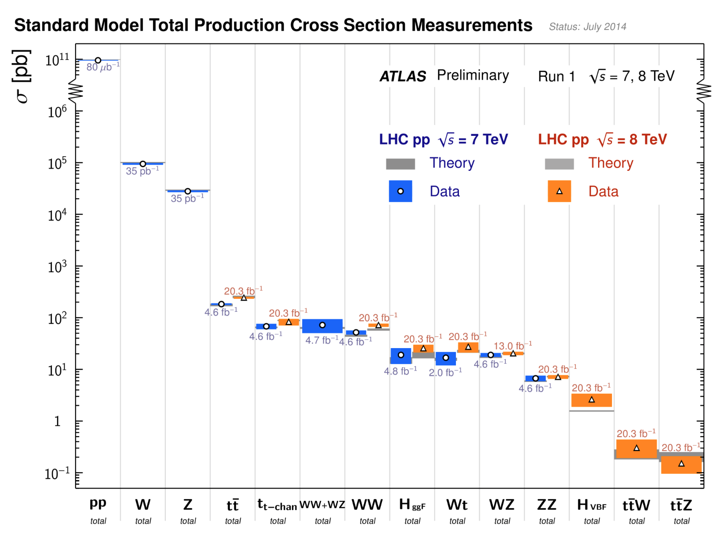
Cross Sections at 7/8 TeV
Measurements in good agreement with the Standard Model predictions

Slide 27
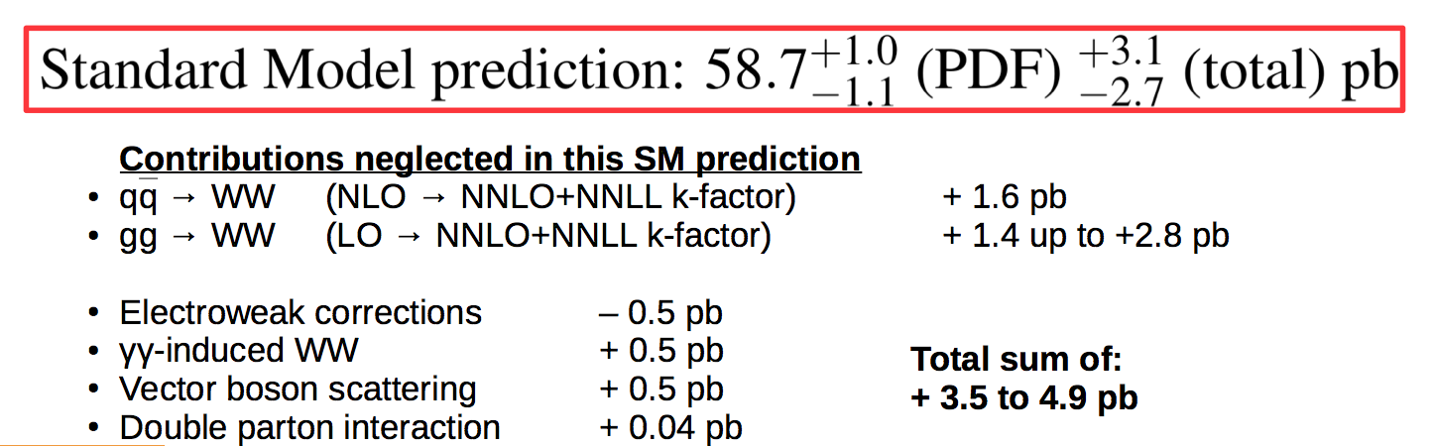
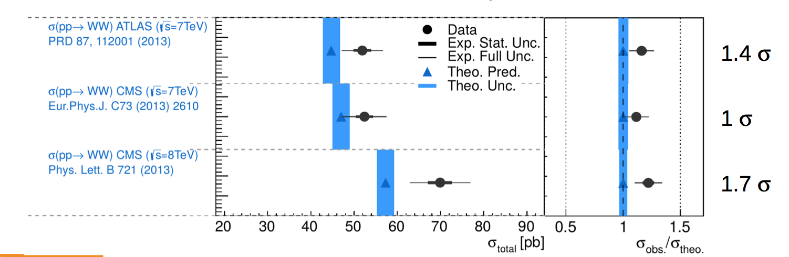

WW Production
Di-boson production: This should not be a problem for theory, no?
8 TeV
Interest/excitement:
Signals for charginos
in SUSY scenarios
with eg light stops:
arXiv:1406.0858
arXiv:1406.0848
arXiv:1407.4912
plus ATLAS 8 TeV:
Bizar: all measurements so far gave a systematically higher value!
Less the case for ZZ and WZ as far as we can see…

Slide 28
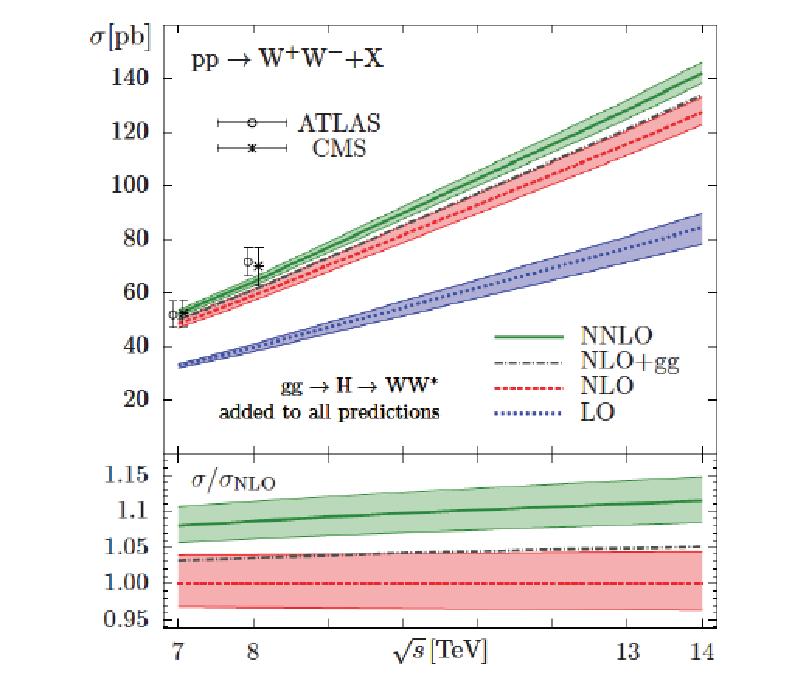
WW Production
Developments: more calculations (full NNLO calculations, discussion on the jet-veto in the selection,…)
Eg Gehrmann et al arXiv:1408.5243 and more (P. Meade et al….)
NNLO gives an increase of ~12% for the cross section.
My take:
•Need to have a careful look at QCD
corrections, effects of the jet veto…
Improved calculations can explain
~50-70% of the effect
Case for new physics is getting
weaker -- if not gone---
•Other measurements in preparation
eg: WW→lνjj, WW+0/1/2 jets…
•Measure it at 13 TeV!

Slide 29
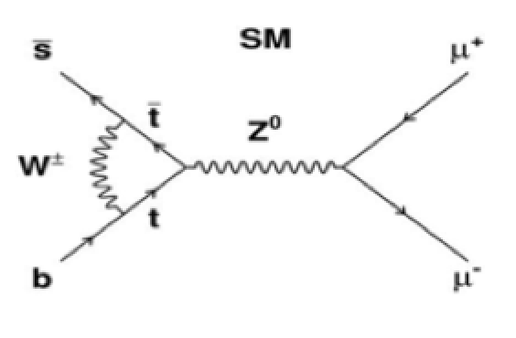
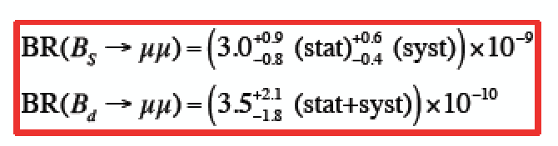
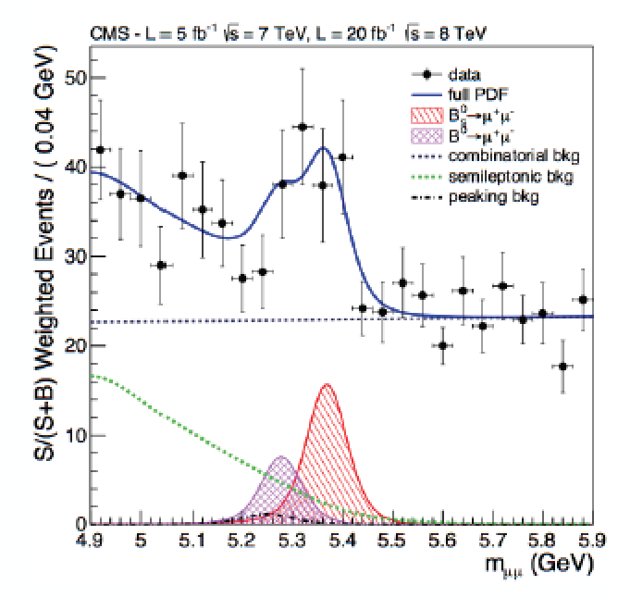
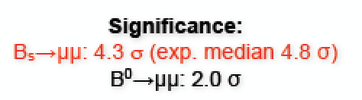

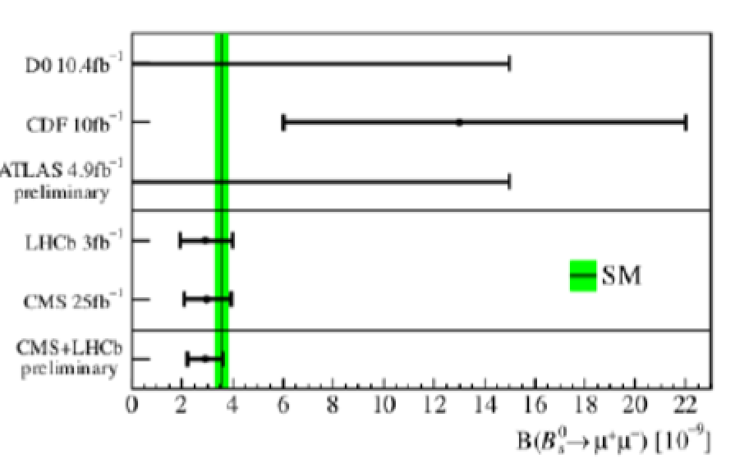
Precision Measurements: B_{s(d)} →μμ
•A B_{s} particle is a particle consisting of a beauty-quark
and strangeness-quark, with a mass of ~ 5.4 GeV
•Three B_{s} particles in a million will decay into two
muons. This decay has been chased since 30 years.
•New physics modifies these Standard Models predictions
PRL 111 (2013) 101804

Slide 30
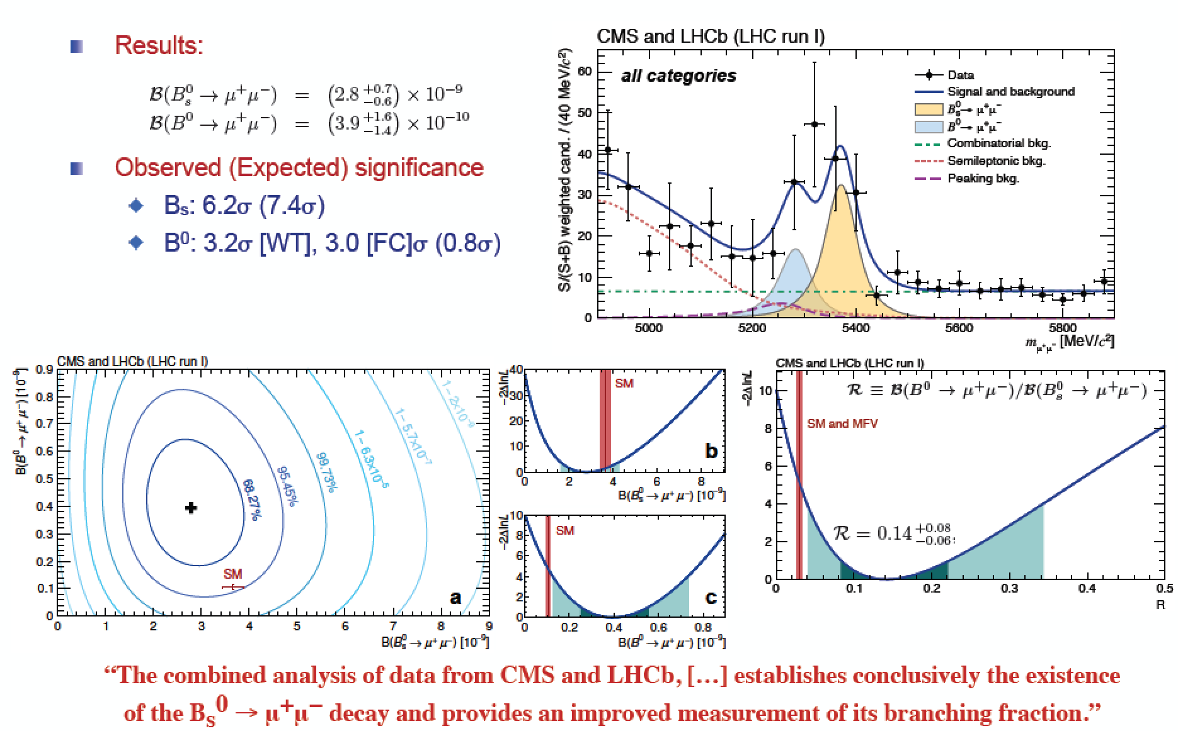
Precision Measurements: B_{s(d)} →μμ
Combined CMS+LHCb analysis submitted to Nature this month month!!
But no sign of New Physics …☹

Slide 31

Higgs!
We discovered a New kind of particle!
December 2013

Slide 32
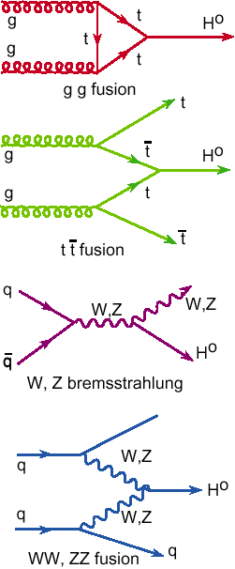



Higgs Production & Decay
Processes
•Gluon fusion
•Vector Boson Fusion
•W/Z associated prod.
•Top associated prod
•B-quark associated prod?
Numbers taken from the
LHC Higgs Cross Section WG
See yellow reports:
YR1: Inclusive cross sections
YR2: Differential cross sections
YR3: Properties

Slide 33








Higgs Hunting: Channel Overview
Processes/decays studied:
Results released In progress
bbH?
Main decay channel characteristics:
+ more exotic channels
“the big five”

Slide 34
Higgs Analyses
•In summer 2012 we called it a “Higgs-like” particle
•In spring 2013 (with 3x more data) we called it a Higgs particle
Spin/parity 0⁺ favored, couplings roughly as in SM for Bosons
What happened Next?
More detailed analyses of the 125 GeV particle, in particular the search for direct decays into fermions, ttH channel,...
More precise measurements of the “signal strength σ/σ_{SM}“ and of the mass of the particle, and the spin (0++), couplings
Searches for Higgs like particles at higher masses
Searches for exotic, non-SM decays (none found so far)
Searches for di-Higgs events (in BSM scenarios, none found so far)
Differential distributions + fiducial volume cross sections
→The experiments have published Run-I legacy papers
The Higgs is the new playground: Room for new experimental/theoretical ideas!!
Remember: we have already ~1 Million Higgses produced at the LHC

Slide 35

CMS: Higgs → γγ
arXiv:1407.0558

Slide 36




ATLAS: Higgs → γγ
arXiv:1408.7084
Significance: Expected 4.6σ Observed 5.2σ
arXiv:1408.7084
For M_{H}=125.4 GeV
Especially new calibrations for electromagnetic showers…

Slide 37




The Decay H → ZZ → 4l
ATLAS: arXiv:1408.5191
CMS: arXiv:1312.5353
•Search for a narrow peak in 4-lepton inv. Mass
•Low statistics & background channel
•Use kinematical discriminators and categories
ATLAS: Expected: 6.0σ Observed: 8.1σ
→ μ = 1.44^{+0.40}_{-0.33}
CMS: Expected: 6.7σ Observed: 6.8σ
→ μ = 0.93^{+0.29}_{-0.24}
Significance is well over 6 standard deviations in this channel

Slide 38

ATLAS: Higgs → ZZ and γγ
Differential distributions (& fiducial cross sections)
H→ ZZ
arXiv:1408.3226
arXiv:1407.4222
H→ γγ
Still limited sensitivity
but shows the potential

Slide 39




The Decay → WW → 2l 2ν
ATLAS: arXiv:1412.2641
CMS: arXiv:1312.1129
•Search for events with 2 leptons and
missing transverse momentum
•Main backgrounds: WW,V+jets,DY,top…
•No mass peak-> broad excess
ATLAS @125.3 GeV: Expected: 5.8σ Obs: 6.1σ
→ μ =1.09^{+0.23}_{-0.21}
CMS @ 125 GeV: Expected: 5.8σ Obs: 4.3σ
→ μ = 0.72^{+0.20}_{-0.18}

Slide 40




The Decay Higgs to Fermions
H-> bb
Associated production
channels: ZH and WH
H-> tau tau
Inclusive and with jets
All tau decay modes used
A (mild) excess seen in
both channels
Poor mass resolution
H→ττ
H→bb
arXiv1401.5041
arXiv1310.3687
CMS @ 125 GeV
H→ττ 3.2σ (obs) 3.7σ (exp)
→ μ = 0.78^{+0.27}_{-0.27}
H→bb 2.1σ (obs) 2.1σ (exp)
→ μ = 1.0 ± 0.5

Slide 41



Higgs → Fermions Combination
•The combined H(ττ) and H(bb) result establishes a strong evidence for
coupling of the Higgs boson to down-type third generation fermions
•Indirect and direct results on ttH coupling also evident for a coupling to
up-type fermions
arXiv:1401.6527 and
Nature Physics 10 (2014)

Slide 42





Higgs → Fermions Combination

Slide 43




ATLAS: Higgs to Fermions
arXiv:1409.6212
H→ττ
H->bb in
WH channel
H→bb
H-> bb:
Expected: 2.6σ
Observed: 1.4σ
→ μ =0.52^{+0.40}_{-0.37}
H->tau tau
Expected: 3.5σ
Observed: 4.5σ
→ μ = 1.42^{+0.44}_{-0.38}
ATLAS-CONF-2014-061

Slide 44


Higgs → μμ (ee)
•Observing H(μμ) decay may be the only way to
show the non-flavor universal couplings
The coupling to charm will be hard to probe
•Requires very large statistics for an observation: a
strong case for the High Luminosity-LHC: HE-LHC
•First searches have been already done
ATLAS: μ < 7.0 (7.2 expected) @ 95% CL
CMS: μ < 7.4 (5.1 expected) @ 95% CL
BR(H→ee) < 1.7x10⁻³ @ 95% CL
CMS-PAS-HIG-13-007
arXiv:1406.7663

Slide 45


High Mass Search: Higgs → γγ
arXiv:1407.6583
No (additional) excess found in
the region from 65 to 600 GeV

Slide 46



High Mass Search: Higgs → ZZ,WW
High mass Higgs searches with SM channels WW, ZZ updated with 2012
statistics
Sensitivity reaches now up to ~ 1 TeV
Interpretation of the data in eg EW-singlet models; Benchmark models proposed by the LHC XS WG
CMS-PAS-13-008
CMS-PAS-13-014
CMS-PAS-12-024
ATLAS-CONF-2013-067
ZZ→4l, 2l2τ, 2l2q, 2l2ν
WW→2l2ν
WW→lν jet

Slide 47



The Decay H→ Zγ
μ< 10 @95% CL (10 exp.)
μ< 18 @95% CL (13.5 exp.)
CMS: arXiv:1307.5515
ATLAS: arXiv:1403.3051
•Z decays into 2 charged leptons. The BR (H → Z γ) is comparable to
BR(Η → γγ) , but BR (Z → ll) reduces sensitivity (factor 15)
•Search for a narrow llγ peak on top of a falling background, as for H → γγ
•No significant excess seen over the entire search region
About a factor 10 above SM sensitivity
In certain models this channel could be largely enhanced via loops

Slide 48




Higgs-Top Associated Production
Various decay modes of the Higgs are considered
arXiv:1408.1682
H→bb,ττ
CMS: μ < 4.5 (1.7 expected) @ 95% CL μ= 2.8±1.0
Improvement H->bb with matrix element methods: μ= 1.2+1.6-1.5 CMS-PAS-HIG-14-010

Slide 49




Single Top + Higgs Production
•Direct coupling to the top quark -> C_{t}=-1 or large cancelations in the SM?
•Cross sections could be surprisingly large if there are deviations from SM
Negative C_{t} gives 15x increased cross section plus 2x Higgs to 2 photons.
•Composite Higgs models heavy t’ -> top + Higgs..
•Study the Higgs decay to two photon decay channel
No events found top + two photon selection
95% upper limit is 4.1 times the expected cross section for C_{t}=-1
CMS-PAS-HIG-14-001
New: single top with Higgs into bb
~7.6 times the cross section for C_{t}=-1 (95%CL)
CMS-PAS-HIG-14-015

Slide 50



The Mass of the New Particle
Determine the mass from ZZ and 2-photon channels which show a peak!
New calibration & strong effort on systematics
CMS
Two-photon and
two Z channel mass
estimates agree
(within 1.6σ)
Mass value is
about 125.0 GeV
with 0.3 GeV
uncertainty
Old value: 125.5 GeV

Slide 51



The Mass of the New Particle
ATLAS
ZZ:
γγ:

Slide 52



The Total Width of the Higgs
Direct width limits so far 3.4 GeV in ZZ and 6.9 GeV in two-photon decays (95% CL) from the resonance peak measurement
→Dominated by experimental resolution
New in 2014
arXiv:1405.3455
•Until recently it seemed unlikely the LHC could
measure the total Higgs width (~4.2 MeV in SM)
•In 2012 it was noted that 7.6% of the Higgs to
ZZ cross section is above 180 GeV arXiv:1206.4803
•The off-shell contribution is independent of the
total width!
•The ratio of on-shell to off-shell can thus provide
information on the width
•Interference of the signal with ZZ continuum is
important and must be taken into account
2012/13: Kauer, Passarino; Caola, Melnikov; Campbell, Ellis, Williams …

Slide 53



The Total Width of the Higgs
•Study Higgs → ZZ in the 4 charged lepton and 2 charged lepton + 2ν decay
•Determine the total Higgs width in the two channels separately
•Use a kinematic discriminant and m_{T} distributions to reduce ZZ continuum
= 5.4 •ΓSM
ICHEP: ATLAS!
ATLAS-CONF-2014-042
Issue with the Theory??

Slide 54


Spin/Parity Studies
Combined study of H→ZZ and H→WW
•Tested using all diboson channels
•Hypotheses comparison O⁺/other states
CMS-PAS-HIG-14-014
O⁺ hypothesis is
always favoured
in the comparison
All “exotic” scenarios excluded scenarios excluded with 99.9% CL
Also CP studies of J=0 state → Results consistent with SM

Slide 55

Spin-0 Amplitude in H→VV

Slide 56

Spin-0 Amplitude in H→ZZ→4l
arXiv:1411.3441
The state is compatible with a 0++ state
More details in the backup

Slide 57
Searches for BSM Higgs
MSSM neutral Higgs searches
Charged Higgses (single, double…)
Associated production
Double Higgs production
2HDM searches
FCNC tests
Unusual decays (LFV, others…)
No significant signal reported so far.

Slide 58




Invisible Higgs Decay Channel
Search for invisible Higgs decays using
Z+H → 2 leptons + missing E_{T}
VBF H → 2 jets + missing E_{T}
Possible decay in Dark Matter particles
(if M<M_{H}/2): Higgs Portal Models
Combined result from the three channels
BR(H→invisible)<58%(44% exp) at 95% CL.
for a Higgs with a mass of 125 GeV
arXiv:1404.1344
arXiv:1402.3244

Slide 59

MSSM Neutral Higgs → tau tau
arXiv:1408.3316
•Study of the Neutral Higgs
h/H/A to tau tau
•Include channels with associated
b-quark production
•No excess found so far
–> exclusions (95% CL)
m_{h}^{max} scenario;
m_{h}^{mod+} and m_{h}^{mod+}
scenarios
with modified
stop mixing
(arXiv:1302.7033)

Slide 60


Search for LFV Decays: H →μτ
CMS-PAS-HIG-14-005
On public demand
from our theory
friends ☺

Slide 61

Search for LFV Decays: H →μτ
Mild excess giving a 2.5σ effect… To be watched!!!

Slide 62

ATLAS: hh → γγbb
•No signal expected with the present collected luminosity for this channel
•Select events with 2 b jets and 2 photons. (non-resonant channel)
•5 events within bin of Mγγ±2σ_{Mγγ} and 1.5 expected
which is about 2.4σ significance…
arXiv:1406.5053

Slide 63
Higgs Combined analysis

Slide 64




Coupling Measurements
CMS-PAS-HIG-14-009
•New update of overall
combination since spring 2013
for CMS
•ATLAS update to be released
Combination of ATLAS & CMS
being discussed

Slide 65

All Channels in Overview (CMS)
Overall strength was 0.82 ± 0.15 before ICHEP14 (spring 2013)

Slide 66

Significance of the 4 Prod. Channels

Slide 67

Coupling Modifiers

Slide 68



ATLAS: Strength and Couplings
New results in preparation… (M. Kado ICHEP 2014)

Slide 69

Generic Model Tests

Slide 70





Brief Higgs Summary
We know already a lot on this Brand New Higgs Particle!!
Width =
A: < 24 MeV
C: < 22 MeV
(95%CL)
Mass =
A: 125.4 ±0.4 GeV
C: 125.0 ±0.3 GeV
Couplings are
within 20% of
the SM values
Spin =
0⁺ preferred
over 0⁻,1,2
SM-like behaviour for most properties, but we continue look of course for
anomalies, i.e. unexpected decay modes or couplings, multi-higgs production…

Slide 71


The Future: Studying the Higgs…
Higher Energy in 2015!
LHC lumi upgrade !
Experiment upgrades!!
(Other/new machines?)
Many questions are still unanswered:
•What explain a Higgs mass ~ 126 GeV?
•What explains the particle mass pattern?
•Connection with Dark Matter?
•Where is the antimatter in the Universe?
•…

Slide 72

Direct Searches
Searches for Supersymmetry
Precise measurements
of the top quark and
first measurements of the
Higgs mass
New Physics inevitable?
But at which scale/energy?

Slide 73




Beyond the Higgs Boson
Supersymmetry: a new symmetry in Nature?
Candidate particles for Dark Matter
⇒ Produce Dark Matter in the lab
“One day all these trees will
be SUSY phenomenology papers”
SUSY particle production at the LHC
Picture from Marusa Bradac

Slide 74

SUSY Searches: No signal yet to date…
•So far NO clear signal of
supersymmetric particles
has been found
•We can exclude regions
where the new particles
could exist.
•Searches will continue for
the higher energy in 2015
allowed
excluded
Plenty of searches ongoing: with jets, leptons, photons, W/Z,
top, Higgs, with and without large missing transverse energy
Also special searches for contrived model regions
CMS-SUS-11-015

Slide 75

Constrained MSSM: Various Studies
•So far NO clear signal of
supersymmetric particles
has been found
•We can exclude regions
where the new particles
could exist.
•m_{1/2}: universal gaugino
mass at GUT scale
•m₀: universal scalar
mass at GUT scale
allowed
excluded
Plenty of searches ongoing: with jets, leptons, photons, W/Z,
top, Higgs, with and without large missing transverse energy
Also special searches for contrived model regions
CMS-SUS-11-015

Slide 76





Limits on Squarks and Gluinos
Results depend on the topologies studies, assumed mass of the LSP etc.
Popular presentation of data:
Simplified ModelS (SMS)
Examples
Combined limits typically > 1-1.5 TeV on sparticle masses

Slide 77

Electroweakino Searches

Slide 78

Searches in ATLAS and CMS
Searching for SUSY
  Recently special attention to “Natural SUSY” and more difficult scenarios eg. compressed scenarios
Searching for Exotica
  New gauge bosons
  New partners of the fermions
  Mono-objects for extra dimension and dark matter searches
  Resonances with boosted techniques, eg for top-antitop
  Unusal topologies…
  Unusual signals in the detectors (heavy particles, ionization…)
  ….
Some 2-3 σ effects are seen (and expected!)
Many (all?) of these are expected to be statistical fluctuations but are worth checking in Run-II

Slide 79


Natural SUSY?
Low mass stops?
Searches for stop quarks are pushing limits now to 700 GeV

Slide 80

Top in SUSY

Slide 81


Summary of SUSY Searches
In short: no sign of SUSY with the data collected so far
https://twiki.cern.ch/twiki/bin/view/CMSPublic/PhysicsResultsSUS
Work ongoing on eg compressed spectra, extended incl. searches, Scharm…

Slide 82

Summary of SUSY Searches
ATLAS Results

Slide 83
Searches for Exotica
>100 papers/ experiment!
Only a few examples here…

Slide 84

Beyond the SM Signatures

Slide 85



New Gauge Bosons: Z’, W’
Z’
W’
W,’ Z’ Limits are now around 3 TeV

Slide 86





Di-jet Searches
CMS-EXO-12-059
arXiv:1407.1376

Slide 87




Exotica Searches: Top/Bottom Partners
VLQs: Relevant eg in composite Higgs models

Slide 88





Dark Matter: The Next Challenge !?!
Astronomers found that most of the matter in the Universe must be invisible Dark Matter
‘Supersymmetric’ particles ?
Vera Rubin ~ 1970
F. Zwicky 1898-1974

Slide 89






The Generic Dark Matter Connection
Searches for mono-jets and mono-photons can be used to search for
Dark Matter (DM)
Use effective theory or better simplified models to relate measurements to Dark Matter studies

Slide 90





Mono-object Searches in CMS
Mono-jets: Generally the most powerful
Mono-photons: First used for dark matter Searches
Mono-Ws: Distinguish dark matter
couplings to u- and d-type of quarks
Mono-Zs: Clean signature
Mono-Tops: Couplings to tops
Mono-Higgs: Higgs-portals
Higgs Decays?
Effective Field Theories for DM
interpretation are under scrutiny!
Alternatives such as SMS proposed…
arXiv:1407.8257
arXiv:1411.0535
Example Monojets
arXiv:1410.8812
arXiv:1408.3583
Dark Matter?

Slide 91

Mono-Object Searches
These give also
limits on eg
ADD extra
dimensions
Limits around
4 TeV for n=3
(mono-jets)

Slide 92
Searches for Unusual Particles
Heavy stable charged particles with unit charge traversing the detector
Heavy stable charged particles with multiple charge traversing the detectors
Heavy stable charge particles with fractional charge traversing the detector
Heavy new particles decaying in the detector
Heavy new particles stuck in the material in or before the detector

Slide 93

Hidden Valey

Slide 94

Stopped Gluinos
Data taken in between accelerator fills!!
Limits up to
800 GeV on
R-hadrons

Slide 95


Heavy Stable Charged Particles
Limits from
0.2 to 1.3 TeV

Slide 96

Summary of Exotica Searches
ATLAS Results

Slide 97

Summary of Exotica Searches

Slide 98
Searches at the LHC
LHC searches for NP right now: Nothing significant found at present!
However most discoveries start with a hint i.e. less than 3 sigma (standard deviations), or evidence with more than 3 sigma before they become an observation or discovery (more that 5 sigma, like the Higgs)
Any 2-3 sigma effects are of interest to follow up with additional data or check with other channels. They will either grow with luminosity (possible real signal) or get less significant (statistical fluctuation). But no excitement yet…
Some examples ➔
--because this is (almost) Christmas!

Slide 99




Search for Heavy Neutrinos and W_{R}
Left-right symmetric extension of the Standard Model
arXiv:1407.3683
Select events with
2 leptons and 2 jets
Large exclusion range
in mass of the W_{R} and
heavy neutrino
Observe a 2.8 sigma
excess in the electron
channel around 2 TeV
W_{R} mass

Slide 100

More Searches to Watch…
Global CMS statistical analysis (MUSIC) on all channels ongoing

Slide 101


ATLAS SUSY: Lepton Channels
Study of single and double leptons + jets + MET
•19 channels studies
•One channel has 7 events with expectation
1.6±1.0. Significance is ~ 2.3σ
Two muons with 6<p_{T}<25 GeV, 2 jets +MET
ATLAS-CONF-2013-062
…Also used in the WW anomaly interpretation…

Slide 102

Are we looking at the right place?
…you tell us!

Slide 103




A Global View!
Model independent search
•Divide events into exclusive classes
•Study deviations from SM predictions
in a statistical way
CMS-EXO-10-021
ATLAS-CONF-14-006
ATLAS for 20fb⁻¹
Probability distribution as expected
for 35 pb⁻¹ for CMS
→muons, electrons, photons, (b)jets, MET

Slide 104
The Future

Slide 105

The LHC Schedule

Slide 106


LHC @ 2015
S. Bertolucci
1/12/2014
Kruger meeting

Slide 107


SUSY Prospects @ 2015/2016
Expect ~ 10-20 fb⁻¹ in 2015 & 40 fb⁻¹ in 2016 (present estimates)
Now: 2014 typical values
2015-2016
More results & details later at this meeting
0.5-1 fb⁻¹ would be enough for first analyses entering new territory
We expect that have such a sample by Summer 2015!!

Slide 108
What we can measure in Run II…
Many couplings to a precision of ~ 5% (b to 10%)
Top Yukawa couplings to 15-20%
Higgs to mumu to about 30%
Higgs to Zgamma? Maybe combining ATLAS & CMS
Access to more difficult channels such as VBF with H->bb
Constrain invisible decay width to 20 %
Total width of the Higgs if the theory follows data precision
No access to triple Higgs coupling so far. With LH-LHC? Unless we have some new ideas!!
Note: we will produce ~ 25 Million Higgses in run-II @ LHC Better experimental methods to use more than a few per mille? New Theoretical ideas to extract information from the data? New Theoretical precision? This is the job description

Slide 109

Summary
Run-I delivered many measurements of Standard Model processes, eg on the top quark, EWK and in QCD. Some features of multiparticle production are not yet understood
A prime goal for the LHC is to look for New Physics. The Run-I data have cut strongly in the phase space of NP eg: Supersymmetry, putting Constrained and Natural models “in trouble”. 13/14 TeV data can be conclusive…
Understanding Dark Matter is the next big challenge! Generic studies with MET are a high priority. Maybe dark matter couples to the Higgs directly?
With one to a few fb⁻¹ of 2015 data, the LHC will overtake the run-I searches. 2015-2016 could well be very crucial – and very exciting years!!!
And maybe soon…

Slide 110
Backup

Slide 111


Slide 112

LHC 2015
F. Zimmerman, 12/9/14

Slide 113

Higgs Cross Sections @ 14 TeV
With 100 fb⁻¹ approx 10 x more signal (8 x more background) than run-I
ttH approx 20 x more signal

Slide 114




Search for Micro Black Holes
Nice events, eg a 10 jet event
Extra Dimensions!
Planck scale
a few TeV?
arXiv:1202.6396
Look for the decay producs
of an evaporating black hole
•Define S_{T} to be the scalar
sum of all high p_{T} objects
found in the event
•Look for deviations
at high S_{T}
Black hole masses excluded in range below ~5 TeV depending on assumptions

Slide 115


Slide 116


Slide 117

Global Electro-Weak Fits

Slide 118





New Physics in WW Cross Sections?
Both these phenomenology papers appeared on June 3rd …
Da
arXiv:1406.0858
arXiv:1406.0848
Interpretation in the two papers
(Overall analyses of WW, and
available SUSY searches):
→ Stop pair production -- with m_{stop}
~ 200 GeV– plus decay to chargino
leading to the WW excess
Da Costa
ICHEP14
•Tests in other channels?
ATLAS already excluded this point?
•WW excess at 13 TeV?

Slide 119

Top Asymmetry
New Results from D0 in pp: Effect at the Tevatron disappearing?

