Slide 1
Theory Town Meeting
STFC Update
Grahame Blair
Executive Director, Programmes
Durham, 17 December 2014

Slide 2

CONTENTS
Science highlights
Corporate update
Particle Physics Programme
Discussion

Slide 3
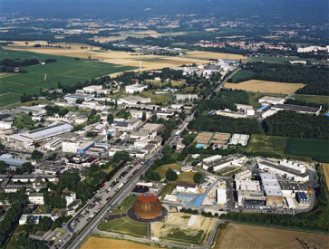
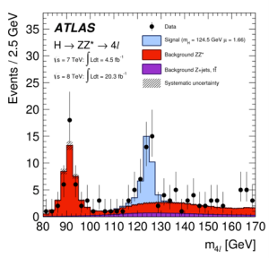
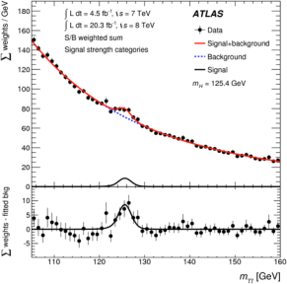
CERN
LHC experiments very active
  ATLAS has 360 papers published in learned journals, including 70 in last six months
Detailed analysis of Higgs boson properties
  Is it the standard model Higgs or something else?
  Is it really responsible for giving particles mass?
  How does it connect to what we know from cosmology (inflation, dark matter, dark energy)?
Preparing for LHC start-up in 2015
  Long shutdown work has gone extremely well
  Next run will be at double the energy and much higher collision rate
  Key objectives – better measurement of Higgs properties, search for new particles that may explain Dark Matter

Slide 4
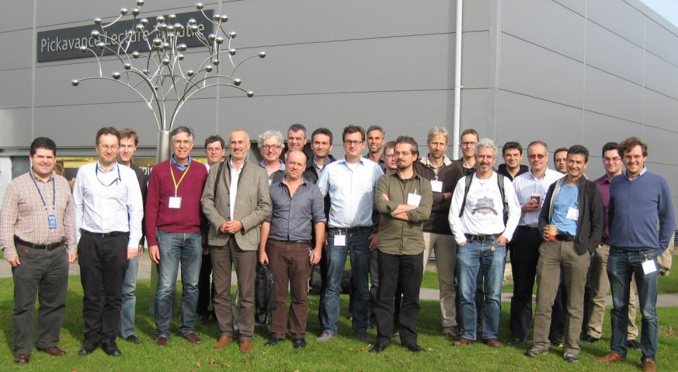
RD53 Collaboration General Meeting
16-17 October
New research and development collaboration to address the challenges of making readout microelectronics for the phase 2 pixel detector upgrades of ATLAS and CMS

Slide 5
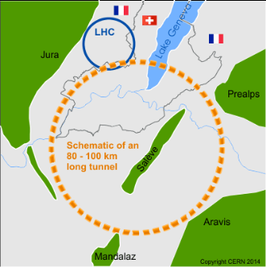
Even bigger colliders?
STFC Accelerator Science and Technology (ASTeC), with the University of Dundee, developed laser
manipulation process to generate low
secondary electron yield (< 1) for
metal surfaces
Solves a problem that will be critical
for LHC upgrades and for future higher
energy machines
Collaboration with industry supported
by STFC proof of concept grant
High performance, low cost and rapid atmospheric treatment
Joint patent application filed in July

Slide 6
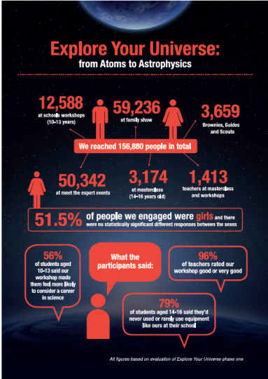
Inspiring future generations
Through our engagement
programmes in 2013, we reached
18,000 teachers, 334,000 students
and 1.1 million public
We have invested £22.4 million in
postgraduate training in particle
physics, nuclear physics and
astronomy
  Current cohort of 766 PhD students
  Trained in high-end scientific, analytical and technical skills, which drive the knowledge economy
STFC provided 14,200 training days to students (30% increase on last year)

Slide 7
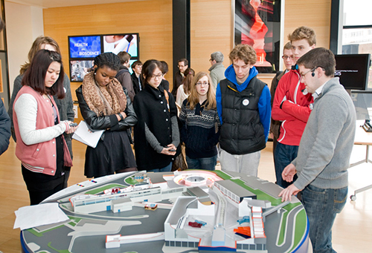
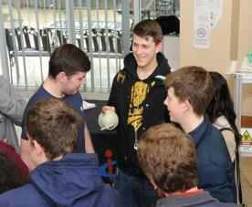
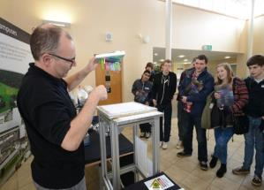
Particle Physics Masterclasses
In March, STFC hosted seven days of Particle Physics Masterclasses for over 1,000
A-level students, giving them a unique insight into the real world of particle physics research

Slide 8
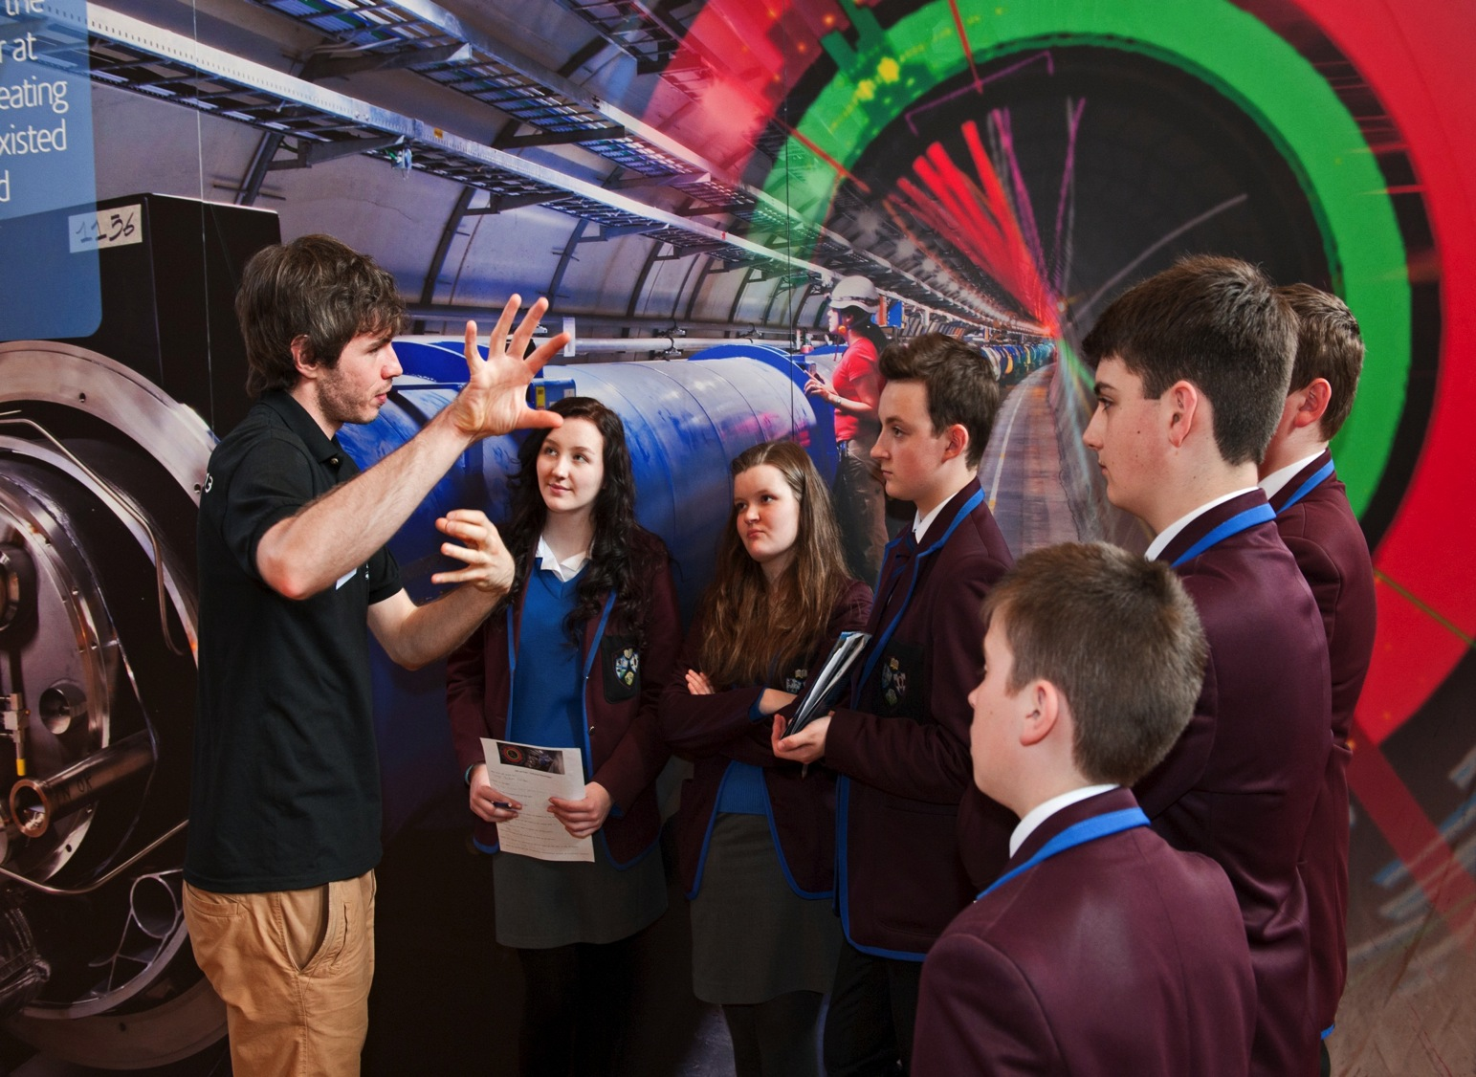
7% increase in applications to physics degree courses. 64% increase between 2008 and 2013
84 million members of the public reached through four STFC mass media initiatives between 2009 and 2014

Slide 9
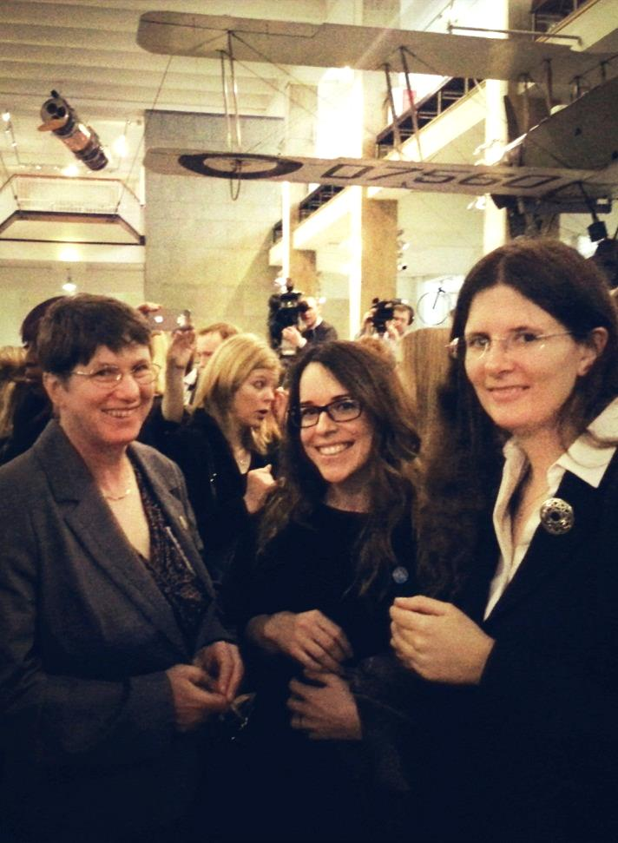
Pledge to get more women into science and technology
STFC has answered Government’s call to action by pledging support for its ‘Your Life’ campaign
Launched in May 2014, the campaign aims to encourage more women to take up careers in science, technology, engineering and maths (STEM)

Slide 10
Public Engagement Highlights
Past – Levitation demonstration on Qi reaches 1.89M viewers on the night
Present – Illuminating Atoms photo exhibition at the Royal Albert Hall
Future – ‘Dark Matter Garden’ is accepted for Chelsea Flower Show 2015

Slide 11
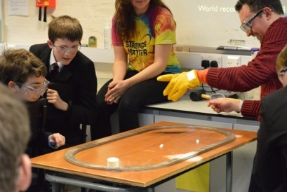

Slide 12
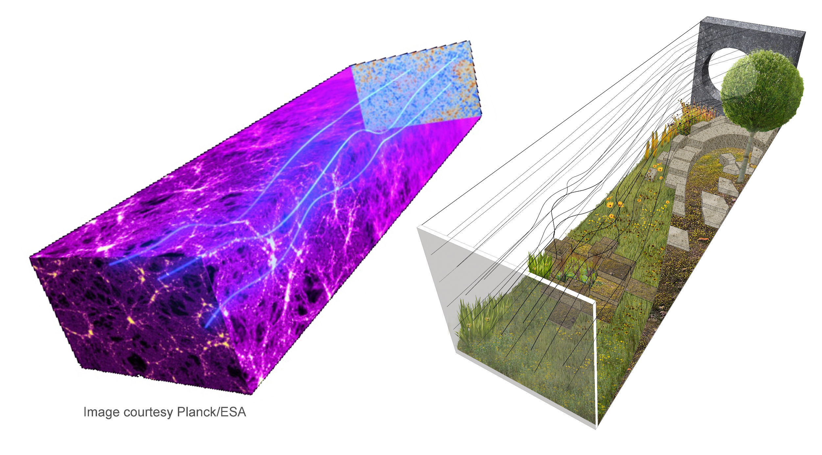

Slide 13
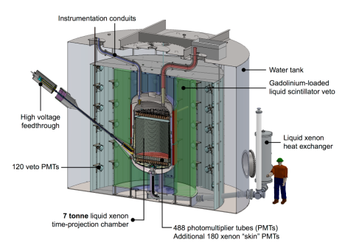
Refreshing our Science Programme
  Implementing the Programmatic Review
  Cherenkov Telescope Array
  Dark Matter
  Long Baseline Neutrino Experiments
  Large Synoptic Survey Telescope
  Budgets for 2015/16 allocated in accordance with this plan

Slide 14

Nuclear Physics
Support for
ALICE Upgrade
  Central trigger processor and tracking
ISOL-SRS
  Internal and external spectrometers
Jefferson Laboratory Upgrade
  SuperBigBite spectrometer and forward trigger for CLAS
AGATA
  First in-beam test successful, experiment early 2015
New nuclear physics theory group at the
University of York
  STFC-funded theory chair and PhD studentship with
  university funding for additional lecturer

Slide 15
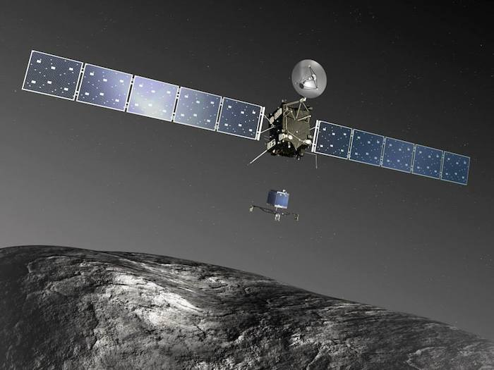
Rosetta and Philae
Lander reached comet in November 2014 - a first for science!
STFC Technology designed four application-specific integrated circuits for the mission. They control the mass spectrometers and provide key telemetry functions on the orbiter and lander
RAL Space led the development of the lander primary payload

Slide 16
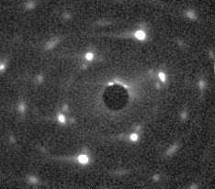
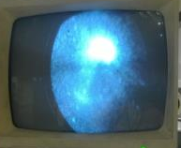
Accelerator Science and Technology
First electron diffraction demonstrated on VELA
Result has huge scientific potential, enabling
atomic scale measurement of fundamental
processes in determining mechanical, electrical,
catalytic and optical properties of matter
Technique complements the structural science
capability of the next generation, large X-ray
Free Electron Lasers
UED pattern from Au crystal obtained with multiple shot, 4 MeV electrons
First electron beam for wastewater treatment
Part of a CLASP-funded collaboration with Oxford/Bristol/Lancaster universities
and Siemens

Slide 17
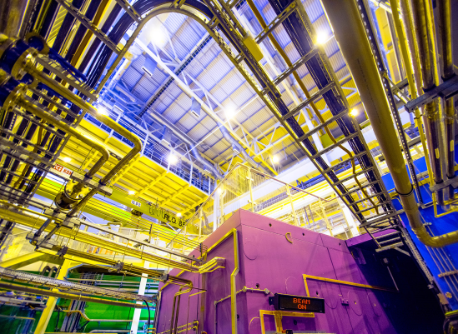
30 years of neutrons at ISIS
This week we are celebrating 30 years of neutrons at ISIS:
  24,000 proposals
  114,000 days of neutron and muon instrument time requested
  60,000 experiment days delivered
  13,000 separate experiments
  30,000 Gb of data
  Over 10,000 publications
STFC Photowalk 2014 Winner:
‘The Polref instrument in ISIS Target Station 2 takes centre stage’ by John Willoughby

Slide 18
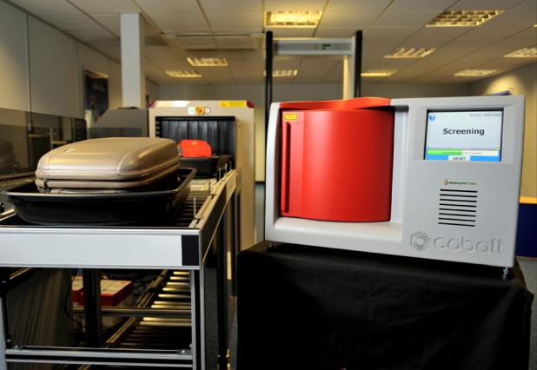
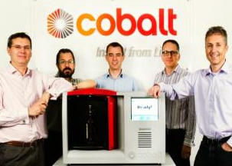
Keeping airports and passengers safe
STFC spin-out Cobalt Light Systems has now sold its unique liquids scanners to 65 European airports
Identifies, within seconds, the
chemical composition of liquids
sealed within non-metallic
containers without opening them
Presented with the prestigious
2014 MacRobert Award for
engineering innovation
Could end hand
luggage restrictions

Slide 19

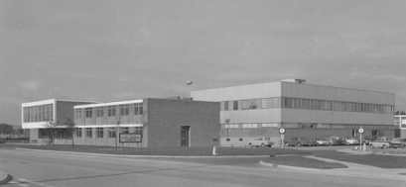
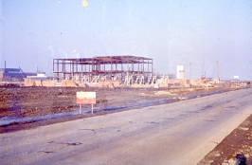
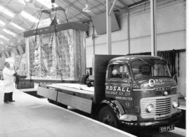
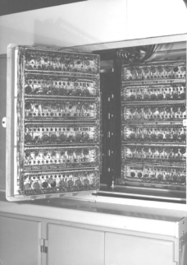
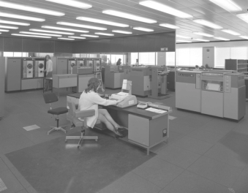

50 years of STFC scientific computing
ATLAS computer laboratory 1964
Ferranti ATLAS
0.350 MIPS
(A5 chip in an iPhone 4S
= 1,256 MIPS)

Slide 20
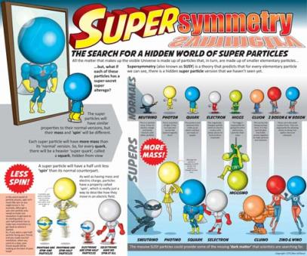
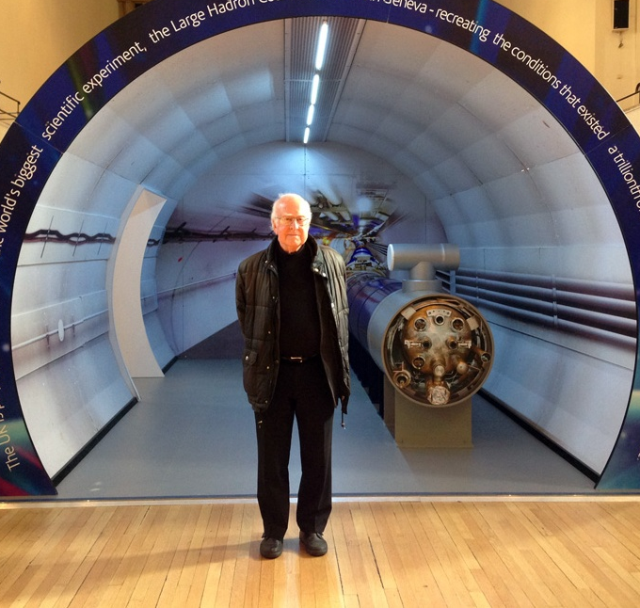
Raising the profile of science
New graphics commissioned
  to help explain key LHC concepts
Return of the LHC tunnel
  LHC Roadshow Version 2 to engage public around LHC restart
Lasers Roadshow for International Year of Light 2015
  STFC leading, working with EPSRC and other Research Councils supporting, for national tour

Slide 21
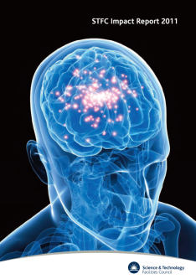

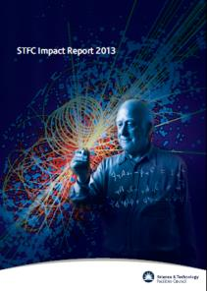
Impact Report 2014
Our research remains amongst the best in the world as measured by citation impact
  We consistently outperform other areas of physical sciences in the UK in terms of research quality
  Over 4,000 peer-reviewed papers published across our entire funding portfolio
Our research produces significant impacts, for example this year…
  We have detected the earliest stages of eye disease, made a breakthrough in the race to solve antibiotic resistance, and supporting carbon capture to help UK meet its greenhouse gas emissions target

Slide 22
CONTENTS
Science highlights
Corporate update
Particle Physics Programme
Discussion

Slide 23
STFC’s role
Our mission is to maximise the impact of our knowledge, skills, facilities and resources for the benefit of the United Kingdom
and its people. We deliver our mission through three distinct
but interrelated long-term, strategic programmes:
Supporting University-based research and skills development
in astronomy, particle physics and nuclear physics
Providing access to world-leading, large-scale research facilities for UK researchers and industry
Building national Science and Innovation Campuses around our national laboratories to promote academic and industrial collaboration

Slide 24

Our Strategy
  World Class Research - Sustaining the UK’s position as one of the world’s leading research nations
  World Class Innovation - realizing the innovative capacity of STFC’s science and research facilities to support the growth of a high-tech UK economy
  World Class Skills - Delivering the scientific and technically skilled workforce that will sustain the UK as one of the world’s leading research nations

Slide 25
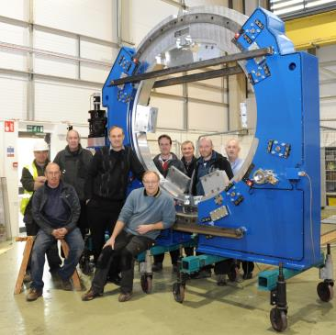


Investing in our people
“Following the IiP assessment there is no doubt in our minds that the whole workforce at STFC are totally committed to the core goal of delivering world leading scientific research and the technology to achieve it.”
Dave Pegler, Investors in People Specialist
TheJobCrowd has recognised STFC as the
‘Best Graduate employer within Science, Research and Development (recruiting less than 30 graduates)’
STFC is also included in the list of top 100 companies for graduates to work for!

Slide 26
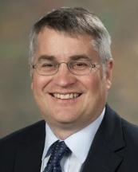
Management update
Neil Phimister - new Executive Director, Finance
Joined STFC in February 2014
Member of Executive Board
Brings experience from the high-technology sector
Extensive experience in all aspects of corporate financial operations
Played a leading global role in implementing process and system initiatives

Slide 27
Light Touch Review
  Highlighted two areas for specific consideration, including science strategy
  Consultation showed support for change in this area
    While acknowledging that current system has worked pretty well, through the commitment of everyone involved
  STFC Council and Science Board are happy with proposed way forward
  Conclusion
  We will set up a new central strategy and planning function to bring together these activities across all of STFC
  If setting STFC up from scratch we would have done this at the start
  Promotes and strengthens ‘one STFC’

Slide 28
CONTENTS
Science highlights
Corporate update
Particle Physics Programme
Discussion

Slide 29

Particle Physics News

Slide 30
Dark Matter Search – LUX-ZEPLIN
Following prioritisation in the STFC Programmatic Review, and its down select in the US P5 for dark matter experiments earlier this year
A full proposal for UK participation in LUX-ZEPLIN construction has been invited by STFC for peer review
  If UK-participation is approved, funding will need to begin in Apr 15 to fit current DOE project schedule (bridging funding has been awarded for critical support meantime)
  Assurances required from DOE on US commitment before funds released

Slide 31
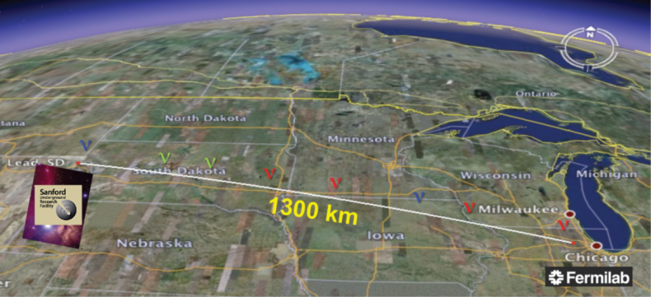
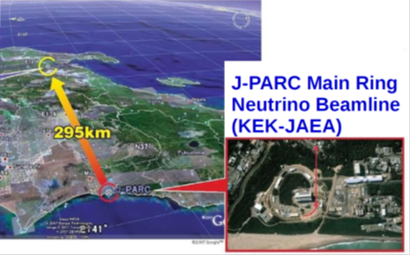
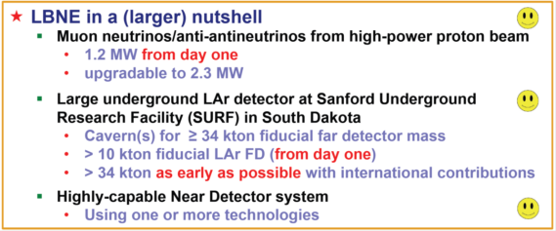
Neutrino Physics
Next generation long baseline neutrino experiments will search for CP violation, and measure mass differences to higher precision
  Secondary science includes proton decay, supernova neutrino physics, dark matter, neutrino tomography
3 year preparatory phase programme getting underway focusing on LBNE and Hyper-K physics and detector studies and LiAr detector technology
  involve 13 UK groups and substantial international support
  Total STFC funding approx. £6M over 3 years (including existing CG support)

Slide 32
LHCb Upgrade – Beyond the Energy Frontier
UK participation in the LHCb Upgrade endorsed by Science Board in the summer and awards to 11 UK research groups, including RAL PPD, being finalised for approval.
  STFC funding approx. £14M over 6 years
  upgraded experiment to be installed during LHC’s second long shutdown (LS2), with commissioning and renewed data taking starting in 2020.
Main role of LHCb is to search for new physics beyond the Standard Model through precision tests of matter/anti-matter asymmetries (CP violation) and rare decays in heavy-quark flavour physics.
UK groups play a primary role in the RICH (Ring imaging Cherenkov) and VELO (Vertex Locator) detectors of LHCb.

Slide 33
PP Theory Consolidated Grants
UK PP Theory consolidated grants programme for Oct 14 – Sep 17 announced in the summer.
  20 groups supported but announcement delayed by the 2015 Spending Review.
  Further complication was subsequent need to restrict grants funding to flat cash (rather than constant volume as recommended by Programmatic Review).
Unfortunately, meant not possible to award number of RAs originally recommended
  reduction from 29.67 RA FTE to 28 RA FTE, a loss of five RA years
  ensures all groups will be able to recruit some RA effort over the duration of the grant (where RA effort requested)
Also includes funding for Isaac Newton Institute, at a level of £100k per annum (£400k total) agreed under Cross Council Funding Agreement.

Slide 34
Consolidated Grants Mechanism Review
Review of the Consolidated Grants Mechanism this year
  Looked at implementation and areas for improvement
  Meeting with Grantholders in September to discuss recommendations
Key changes
  No overlapping grants
  3-year awards with review dates brought forward to preserve long-term planning and security for core posts
  Scope for a no-cost extension of up to one year
  Improvements to operating effectiveness (e.g. simplifying grants processing)
Not a significant change for PPGP(T) or Astronomy who already work in this way
Bigger effect for the next PPGP(E) CG round 2015

Slide 35
Review of Computing
A Working Group has been set up to develop an STFC Computing Strategy.
  identify current and future requirements of STFC’s scientific and industrial user communities
  recommend how STFC can best support the provision of these needs
  identify the relation to the wider UK and international settin
  consider how to maximise the impact of STFC e-infrastructure both for science and for industrial engagement.
CAP are fully involved and consultation will be through the advisory panels and representatives of projects such as DIRAC

Slide 36
DIRAC
The annual DiRAC conference was held in Durham on 22 Sept. There are now over 450 registered users.
A review to determine the optimal level of recurrent costs for DiRAC for financial years 2014/15 2016/17 has concluded. Grants should be issued shortly.
The 5th call for proposals for computer time on DiRAC closed on 3 Sep. 14 proposals have been received: 3 particle physics projects and 11 astronomy/cosmology projects. The peer review process is underway.

Slide 37
COMPUTING ADVISORY PANEL
The Computing Advisory Panel (CAP) met on 24 June 2014.
CAP discussed possible models for the next phase of PRACE (the European HPC infrastructure); reviewed the CAP submission to the BIS capital consultation exercise.
CAP has a new Chair: Dr Stephen Fairhurst, Cardiff University

Slide 38
Phenomenology Review
Mid-Term Review of Institute for Particle Physics Phenomenology (IPPP) in March 2013
  Noted IPPP has had a very positive impact
  UK phenomenology programme grown considerably and landscape transformed by new experimental results (e.g. LHC)
STFC to undertake a strategic review of UK Phenomenology
  Enable future STFC funding of Phenomenology (including IPPP) to be tensioned against the rest of the PP programme
  allow sufficient time for implementation of recommendations before the next IPPP grant review (e.g. feed into Theory (2016) and Experimental (2018) PP grant reviews)
  Aim to initiate review in early 2015 - to be completed by end 2015

Slide 39
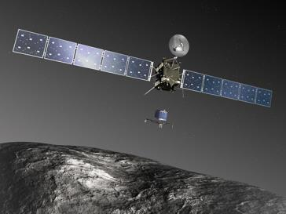
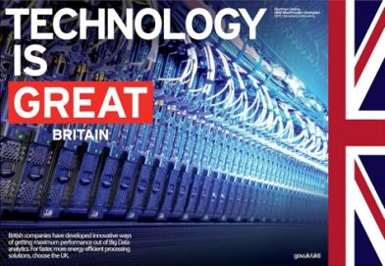
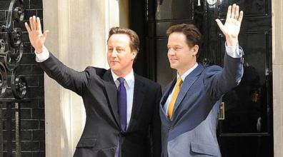

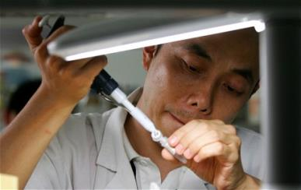
Comprehensive Spending Review

Slide 40


Hartree – Connecting with Industry
Building on our growing success
Autumn Statement contained
funds to establish STFC-IBM
international research centre
on big data in the UK
£115 million from UK, matched
by £200 million from IBM
Linked to SKA, the Turing Centre and Manchester’s new materials science institute

Slide 41
Likely timeline for Spending Review
Civil service discussions for Spending Review underway now
  Initial data request likely March 2015?
Autumn Statement - Dec 2014
  Capital allocation for 16/17 to 19/20
  Science and Innovation Strategy
Election – May 2015
  New Government, Chancellor, Ministers?
  Departmental reorganisation?
Spending Review - June to December 2015
  Resource funding for 2016/17 to 2019/20
  If coalition re-elected, Spending Review may be delayed as 2015/16 resource already agreed
  If minority Government, it may be a one year roll-over followed by second election

Slide 42
STFC Town Meeting
4th Feb 2015.
BP Theatre, British Museum, London.
To provide an overview of current funding scenarios, and answer community questions about what role they may play in arguing for science funding, before the election.

Slide 43
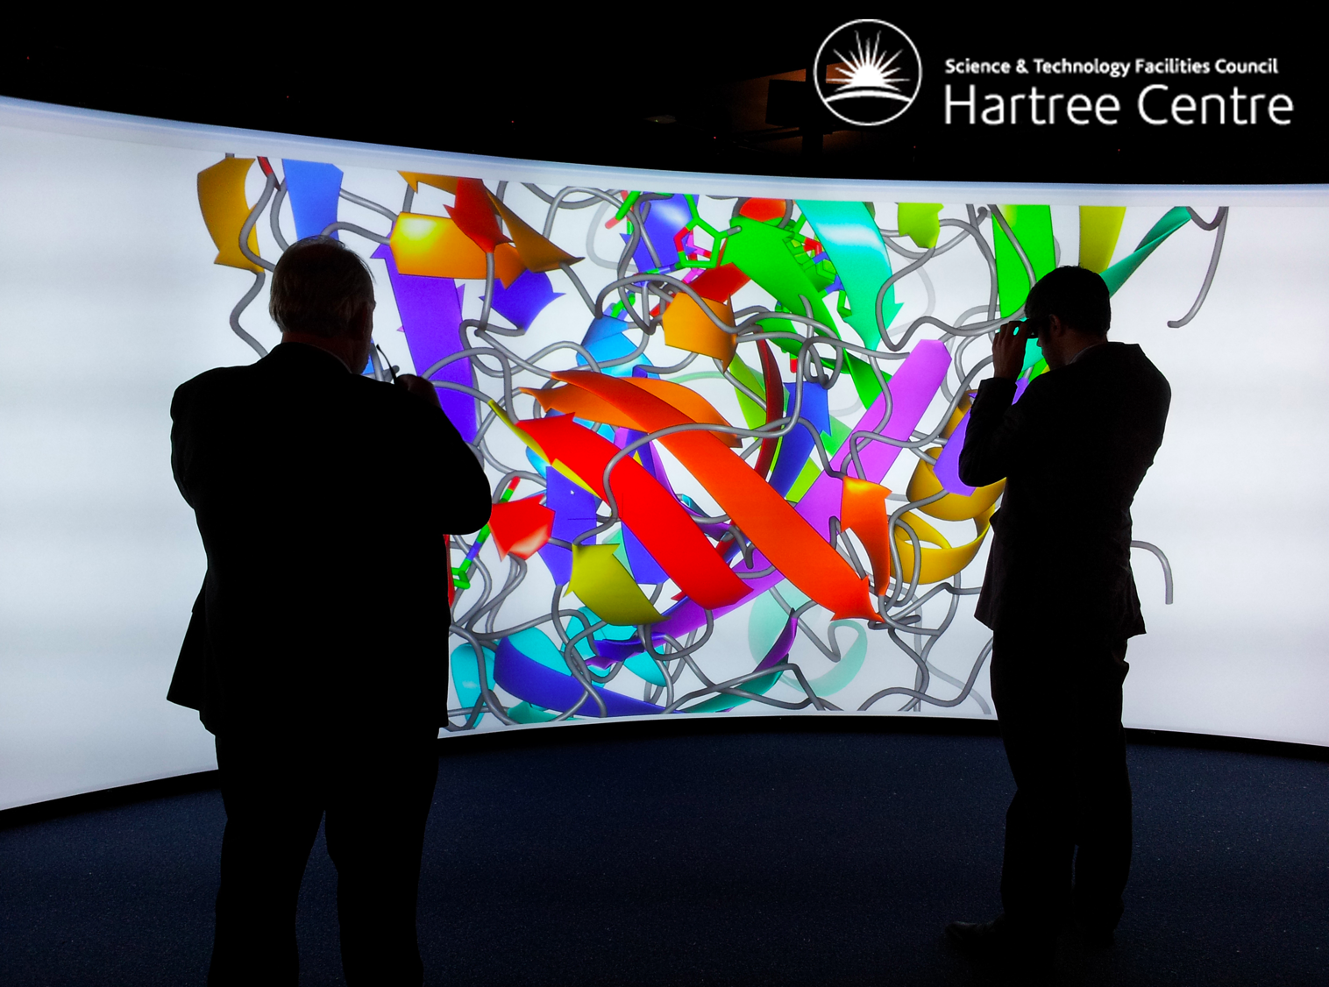
Discussion

