Slide 1
INSPIREHEP … and data
Sünje Dallmeier-Tiessen (CERN)
for many collaborators in GS-SIS and IT-CIS

Slide 2
Outline
INSPIRE
What we do with “data”
Future plans
Other platforms relevant to “data”
Analysis Preservation Framework
Open Data Portal
www.inspirehep.net
www.opendata.cern.ch
www.data.cern.ch

Slide 3
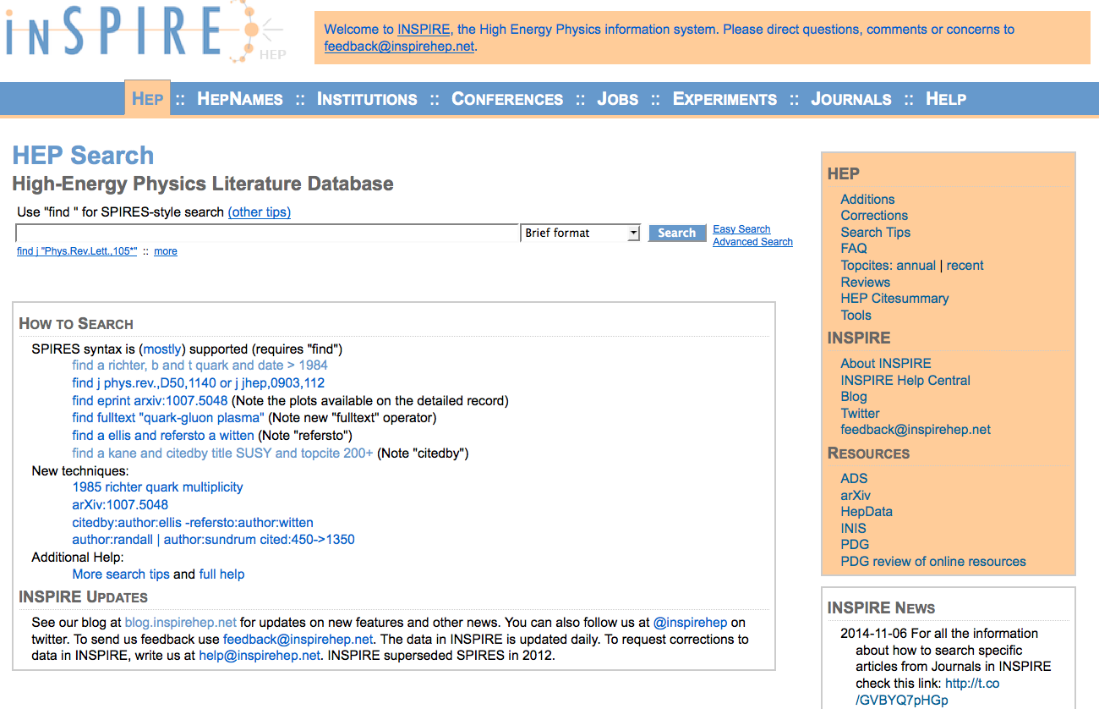

Slide 4
An aggregator

Slide 5
INSPIREHEP
Publi-cations
Authors
Datasets
Based on Invenio
An information hub:
Pre-prints
Published papers
Authors
Data
And institutions, conferences, journals
Job offers…
Linked!

Slide 6
Citability of data

Slide 7
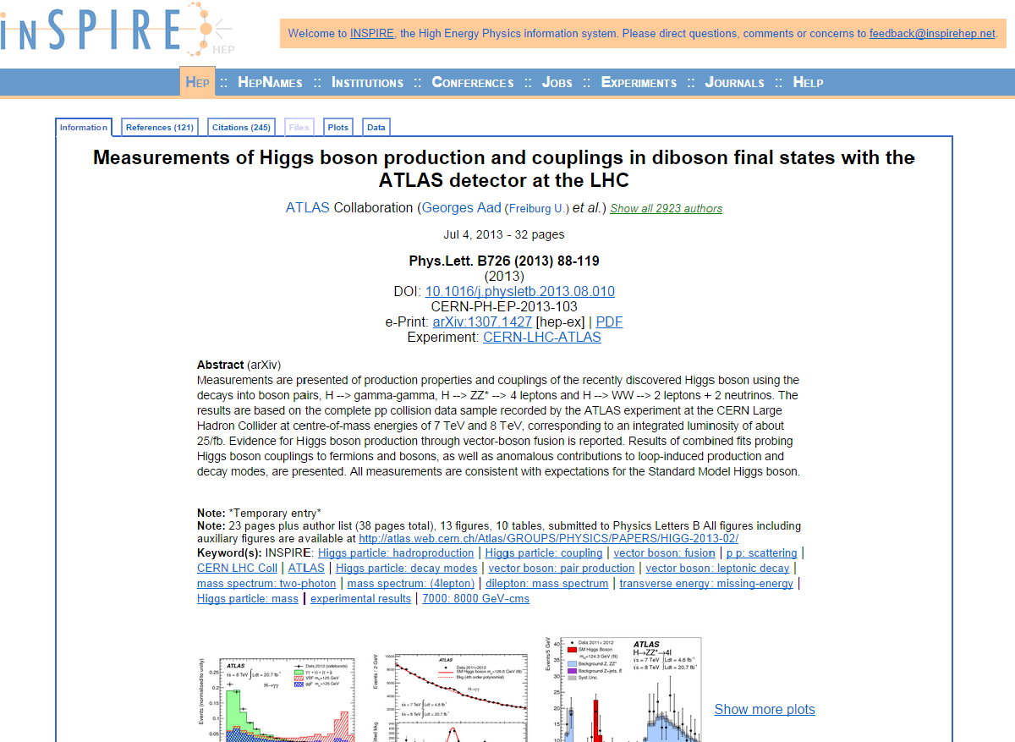
HEPdata on INSPIRE: starting from the paper

Slide 8
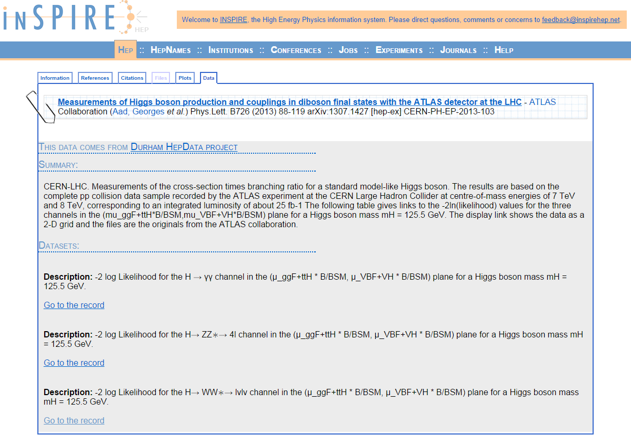
The underlying datasets (HEPdata)

Slide 9
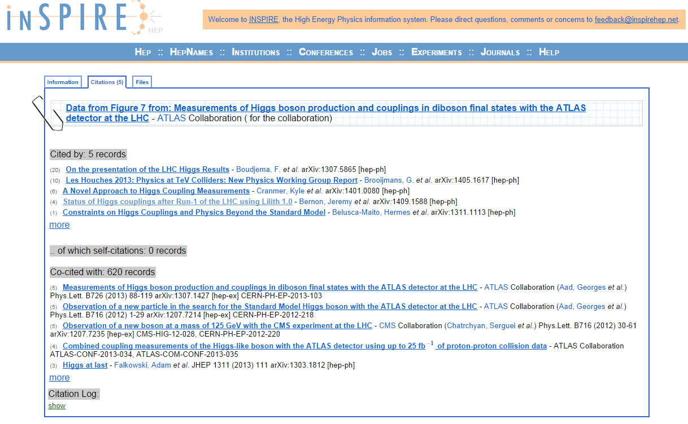
Data Citation and Tracking

Slide 10
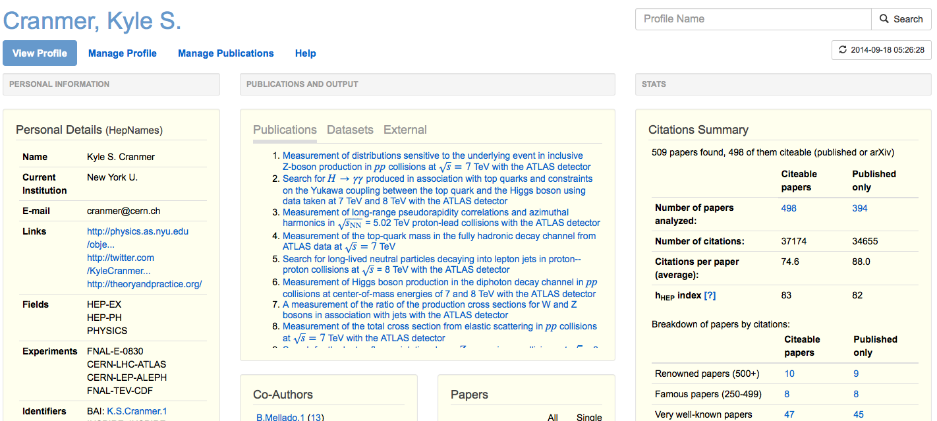
Author profile on INSPIRE feat. data

Slide 11
Searchable?
Discoverable?

Slide 13
Focusing on reproducibility and reuse
Two new tools at CERN

Slide 14
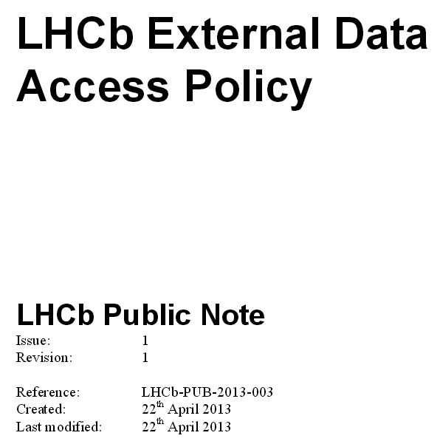
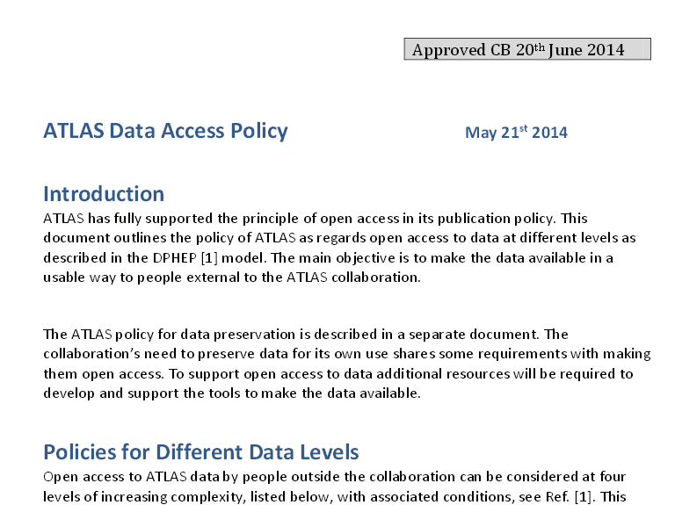
Services needed to support the policies

Slide 15
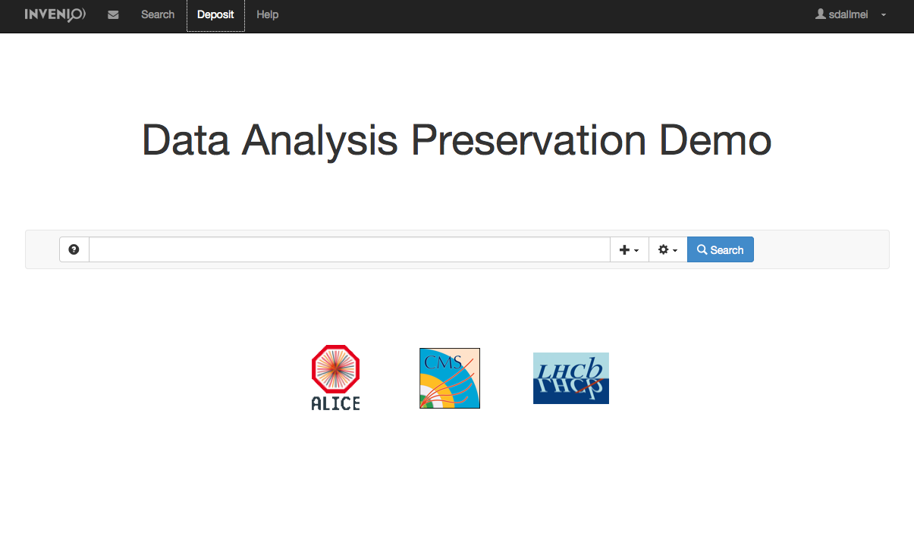
Capturing the complexity: Analysis Preservation Framework

Slide 16
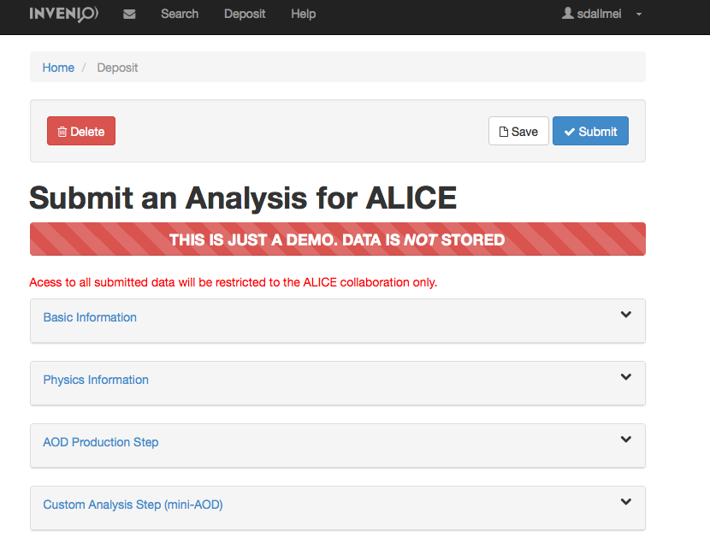
Capturing the complexity: Analysis Preservation Framework

Slide 17
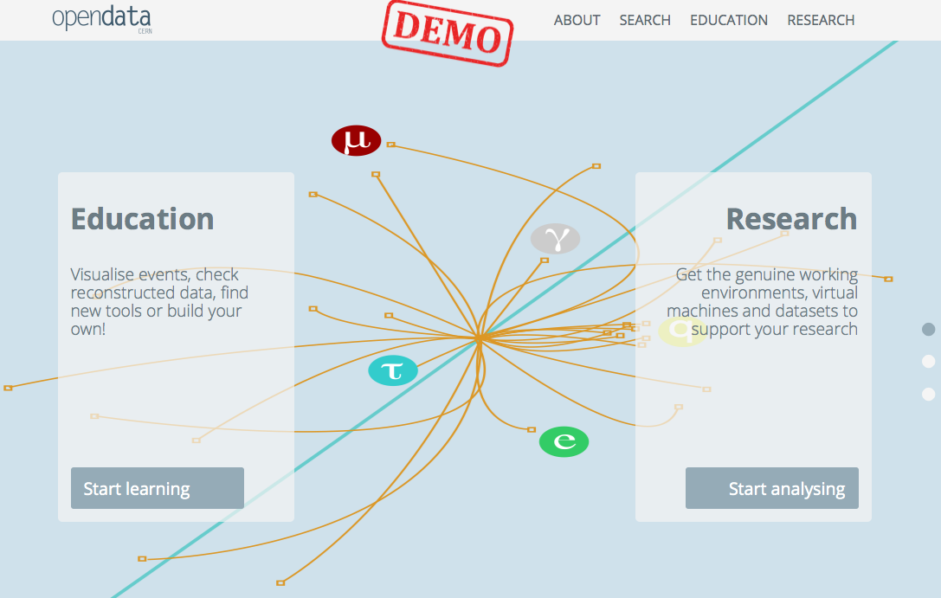
Open it up: CERN Open Data Portal
www.opendata.cern.ch

Slide 18
Research and Education

Slide 19
Two portals: hand in hand
1. Preserve in a safe and “closed” environment
2. Push it out into the “open” whenever needed
To the Open Data Portal
INSPIRE
CDS
Can be plugged into the “normal” workflows within the experiments
Complex metadata
Including documentation, software, discussions/reviews, presentations, notes, preprints
Each of them could become a citable object, or the package

Slide 20
Standards emerge
DOI
Licenses
Article – Data Linking
Data Citation
Metadata (?)
Outreach formats (?)
The portals are Invenio based

Slide 21
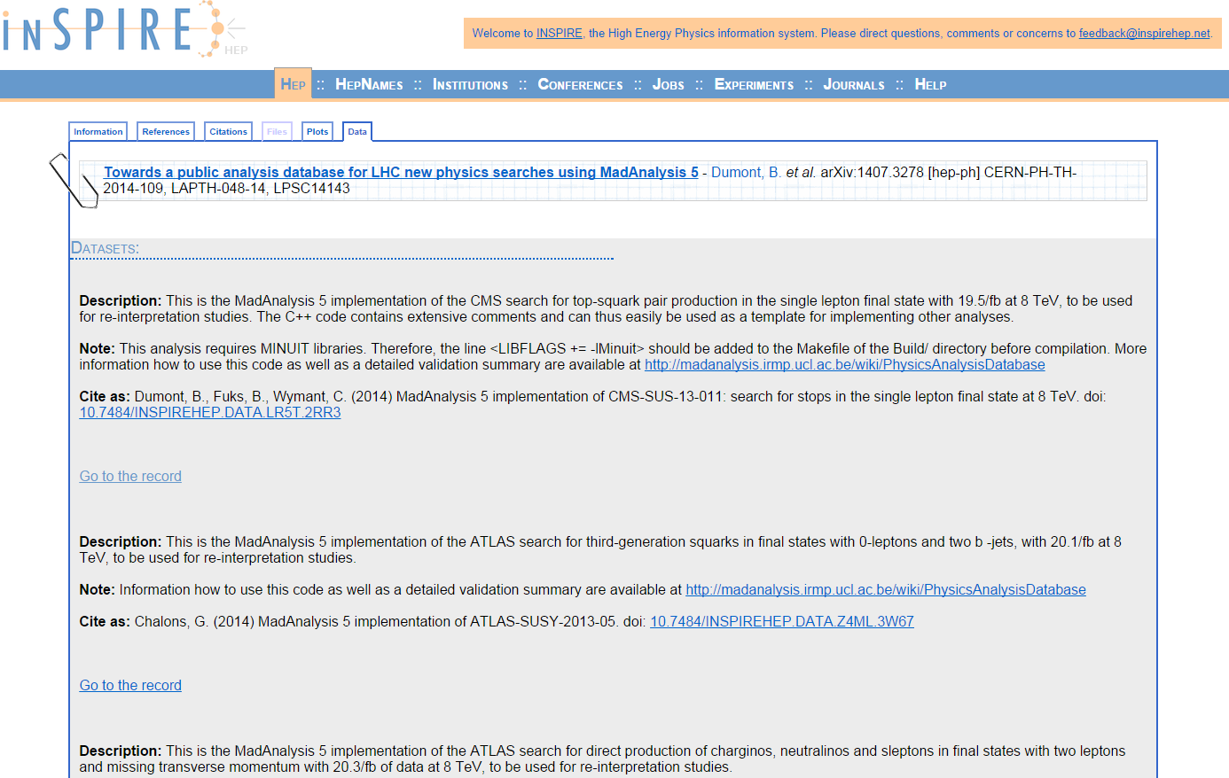
We need to expand the discussion: code snippets

Slide 22
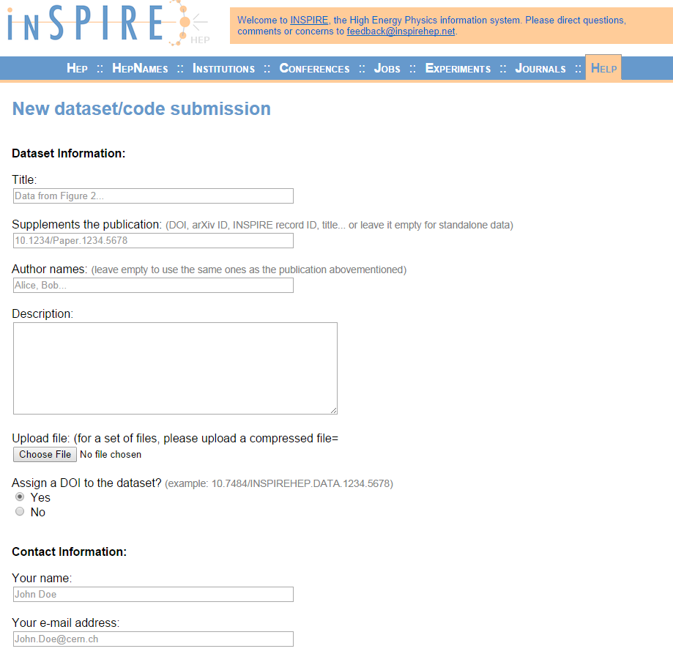
Code snippets

Slide 23
Next steps
Give data more visibility
Extend coverage to “software”/code options
What are the plans for Rivet and HEPforge?
Widespread assignment of DOIs
Explore solutions for the “counts” of data reuse
Improve the understanding of user requirements
Metadata
Search
Citation
➔ Organize joint HEPData – INSPIRE workshop

Slide 24
INSPIRE’s future

