Slide 1
Novel Acceleration
Dr G Burt
Lancaster University, Cockcroft Institute

Slide 2
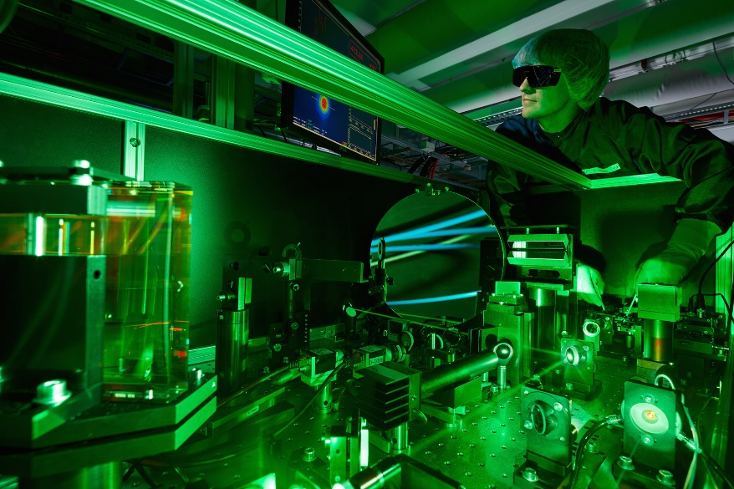
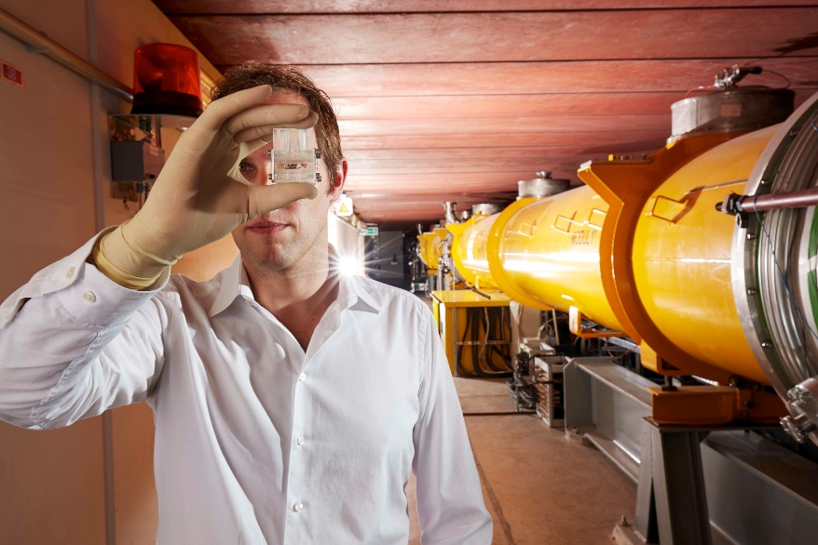
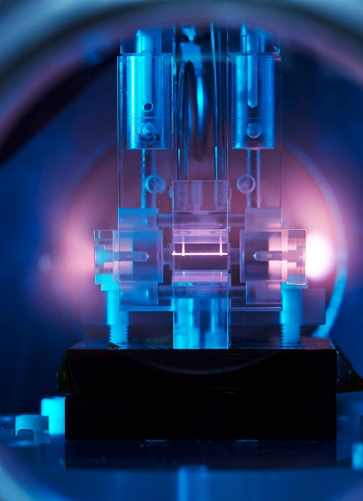
Novel or Advanced Accelerators
Laser-Plasma-based electron and hadron accelerators:
  Driven by lasers (for both e- and hadron) e-: Multi-GeV beams have been achieved → beam energy sufficient for applications → applications around the corner?!
  Hadrons: ion beams have been produced and transported
  Activities at many centers in Europe (as well as US and Asia)
  This dominates the novel acceleration arena

Slide 3
An Engineers view of Laser Plasma Accelerators
Efficiency is at least one or two order of magnitude less than conventional sources. For a 1 TeV collider at CERN the required power would dwarf the rest of Geneva and would potentially require several new dedicated power stations. Work on increasing to 50% by combining billions of fibre lasers is sfar from realised.
The lasers and power supplies are very large so the gradient is often overstated. In conventional sources we have two numbers active length and total length. LPWA have a small active length but the total length is still significant. Still smaller than linacs but not by as much as implied.
The laser stability coupled with the sensitivity to the laser parameters means every shot is different and most have poor beam quality. Reported results are typically the best shot from the run NOT the average. ]
Multiple stages is a challenge yet to be solved.

Slide 4
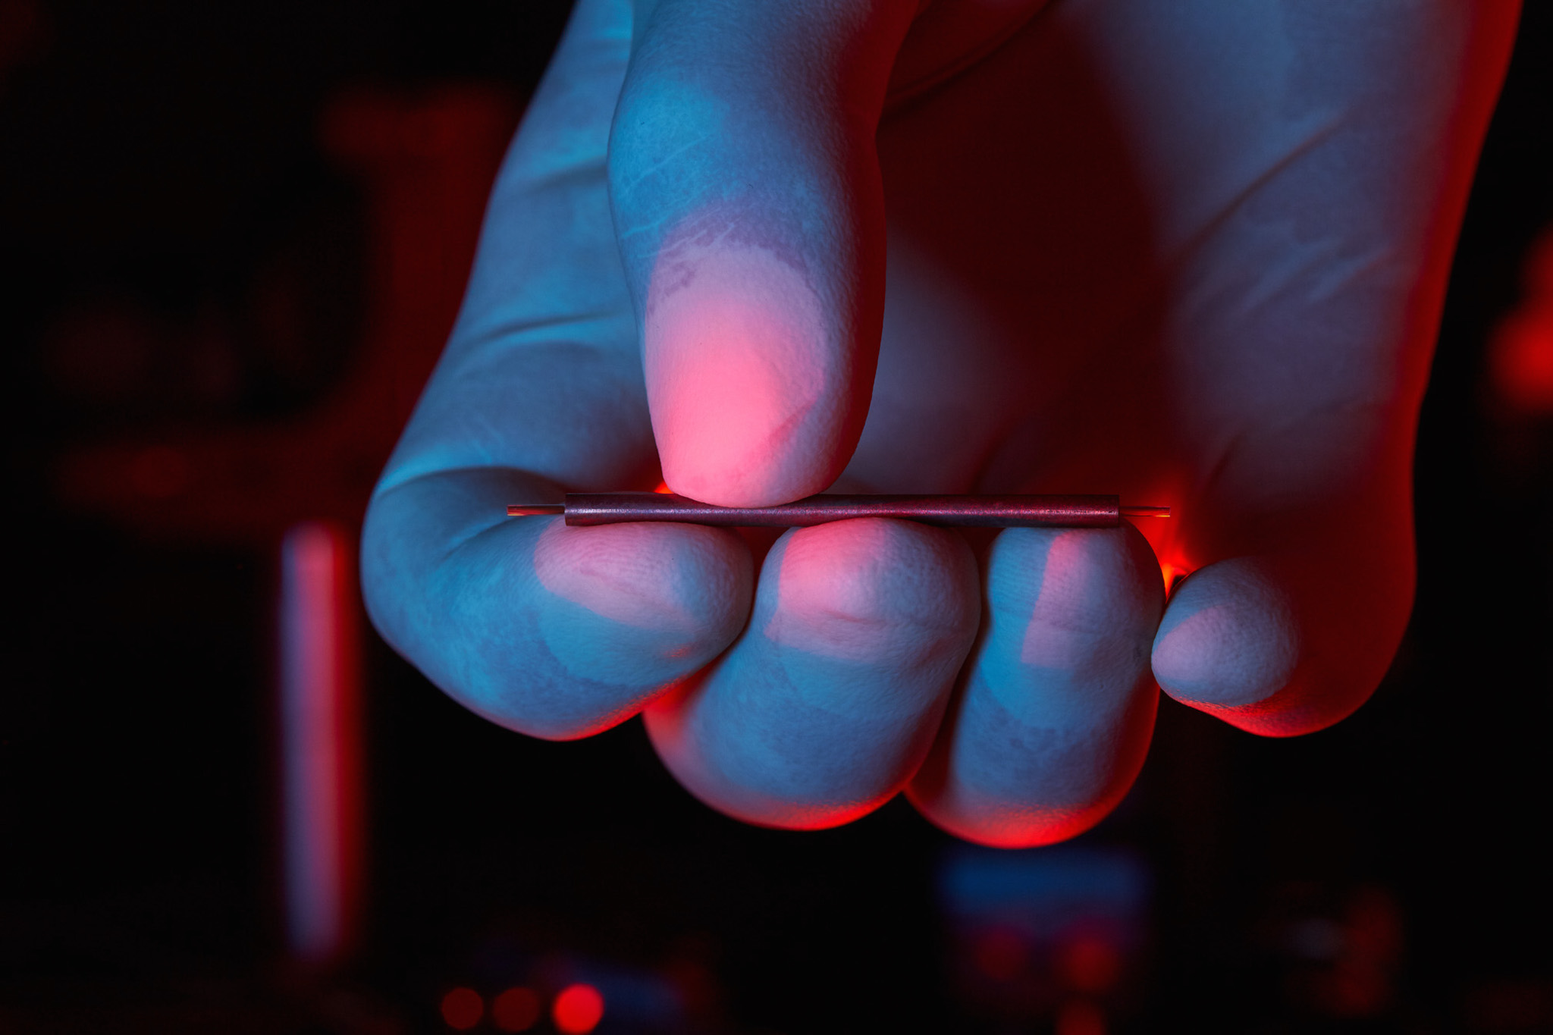

Are there other options or are we stuck with conventional accelerators?
YES!!!!
Lasers could be used with dielectrics to overcome the stability issues and reach similar gradients to plasmas. Using THz lasers/vacuum tubes significantly increases beam quality over shorter wavelength sources in dielectrics. Efficiency still is an issue at present. Good for medical linacs and light source replacements. Good potential for higher efficiency THz vacuum tubes (harmonic gyrotrons, BWO’s) or wakefield driven could allow path to TeV colliders.
You could drive the plasma with a proton or electron beam as opposed to a laser. The drive beam would be a highly efficient high current beam (such as the LHC proton beam). This would be far more efficient and stable than a laser plasma accelerator. Likely the most viable option for a novel multi-TeV collider other than traditional accelerators.

Slide 5
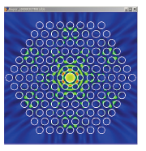
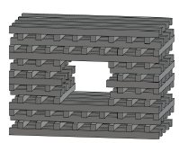
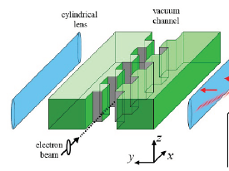
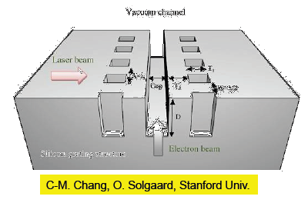
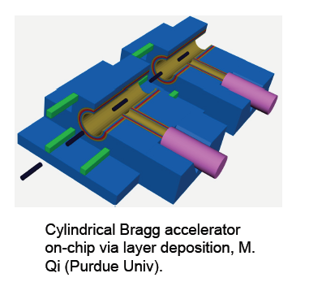
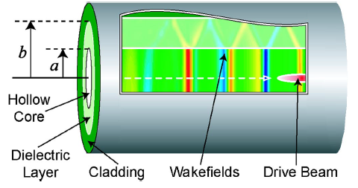
Dielectric Accelerators
Types
Photonic structures
Dielectric Wakefield Accelerators (like CLIC but with dielectric)
Dielectric RF Linacs (replace RF structure with dielectric)
Dielectric Wall Accelerators (high voltage switches)
THz/Laser driven dielectric accelerators (high frequency linacs)
Why?
Dielectrics can have very high gradients if the right material is used (5.5 GV/m shown in experiments but not with acceleration yet)
They can operate at high frequencies, THz or higher (smaller)
Can potentially have lower long-range wakefields (for photonic structures)
Simpler to manufacture (in some cases)

Slide 6
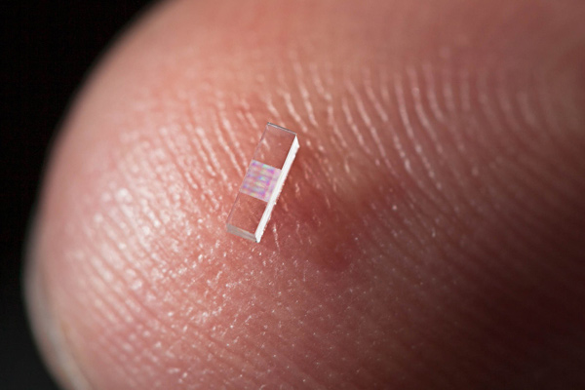
Laser-driven dielectric structures
  1 GeV/m demonstrated but low absolute energies achieved so far (emerging field)
  At present led by DESY-MIT (THz) and UCLA-SLAC (optical) collaborations
  Field is excited by either a high current beam or a laser
  Wave velocity is matched to the beam velocity using a dielectric structure
  Lots of parameter space to explore still lots of opportunity for UK to get involved and lead.
  Easy to use multiple stages unlike plasma.

Slide 7
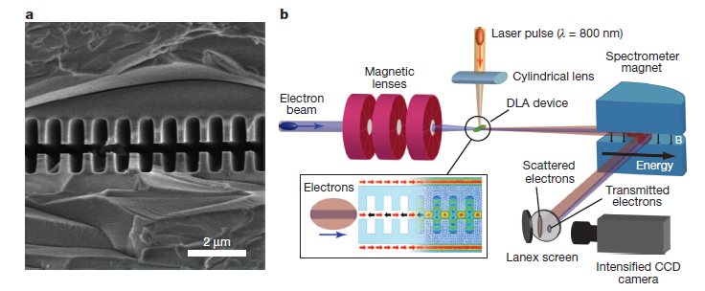
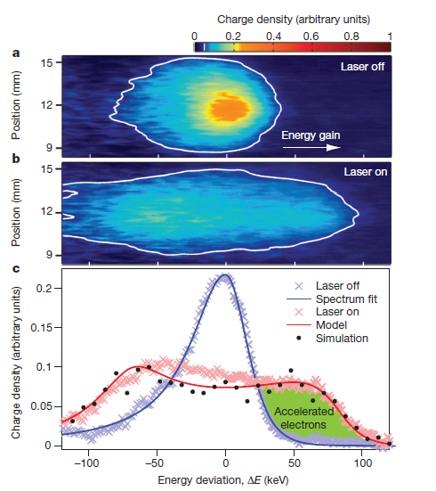
Stanford, SLAC, UCLA results

Slide 8
THz vs optical
Optical
THz
RF
As a bunch is normally a few hundred microns long the energy spread introduced by an optical acceleration is large. Some electrons are decelerated.
At THz the spread is smaller and all are accelerated

Slide 9
THz dielectric acceleration
A simple fibre can replace a corrugated metallic cavity.
THz is generated by the beam or from the interaction of a laser with a non-linear crystal.
Work is ongoing on efficient THz sources for many other applications.
Can have a larger aperture than at optical frequencies (longer wavelength). This makes optics much easier and reduces effect of unwanted wakes.
A simple structure can reach >1 GV/m (demonstrated at SLAC for a single shot)

Slide 10

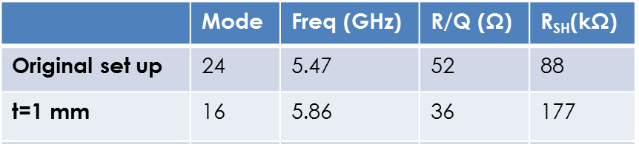
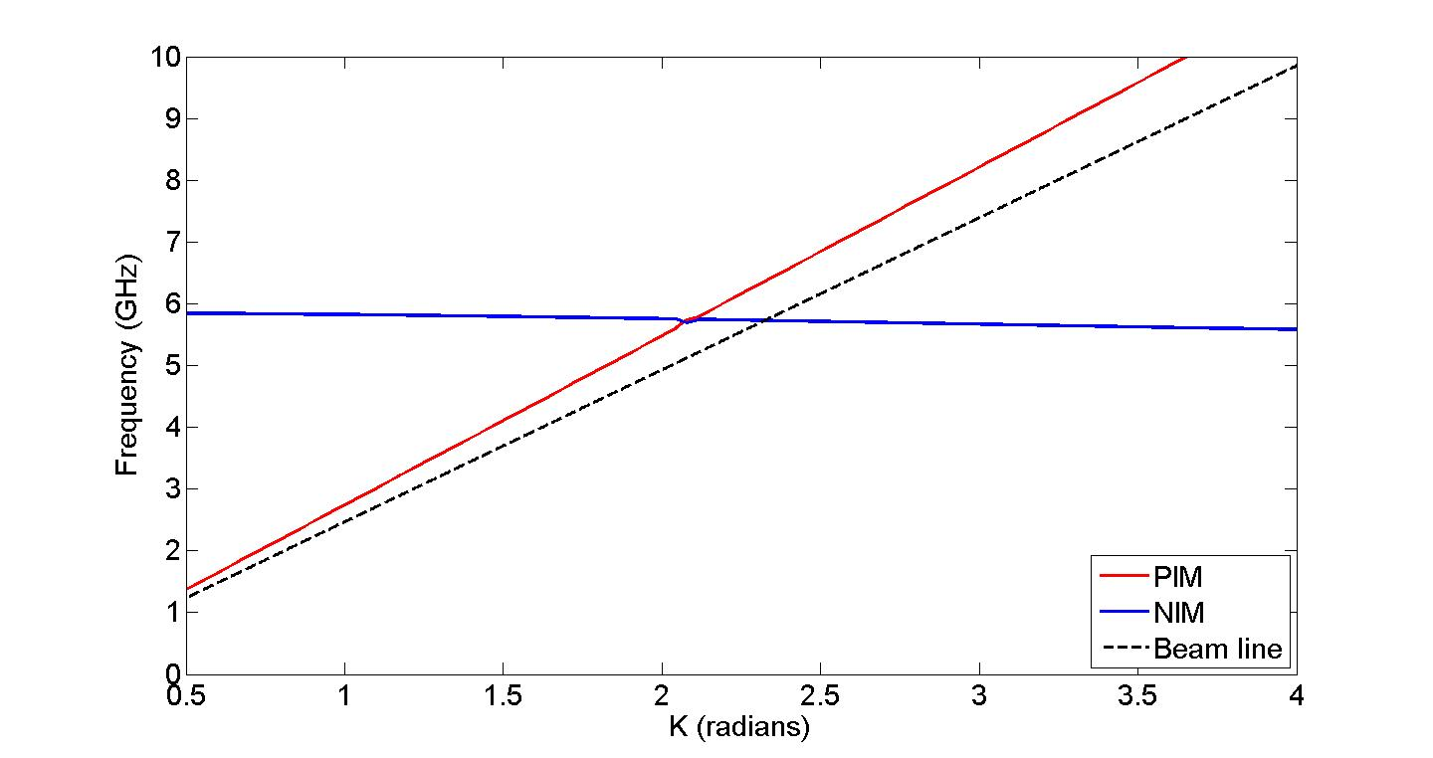
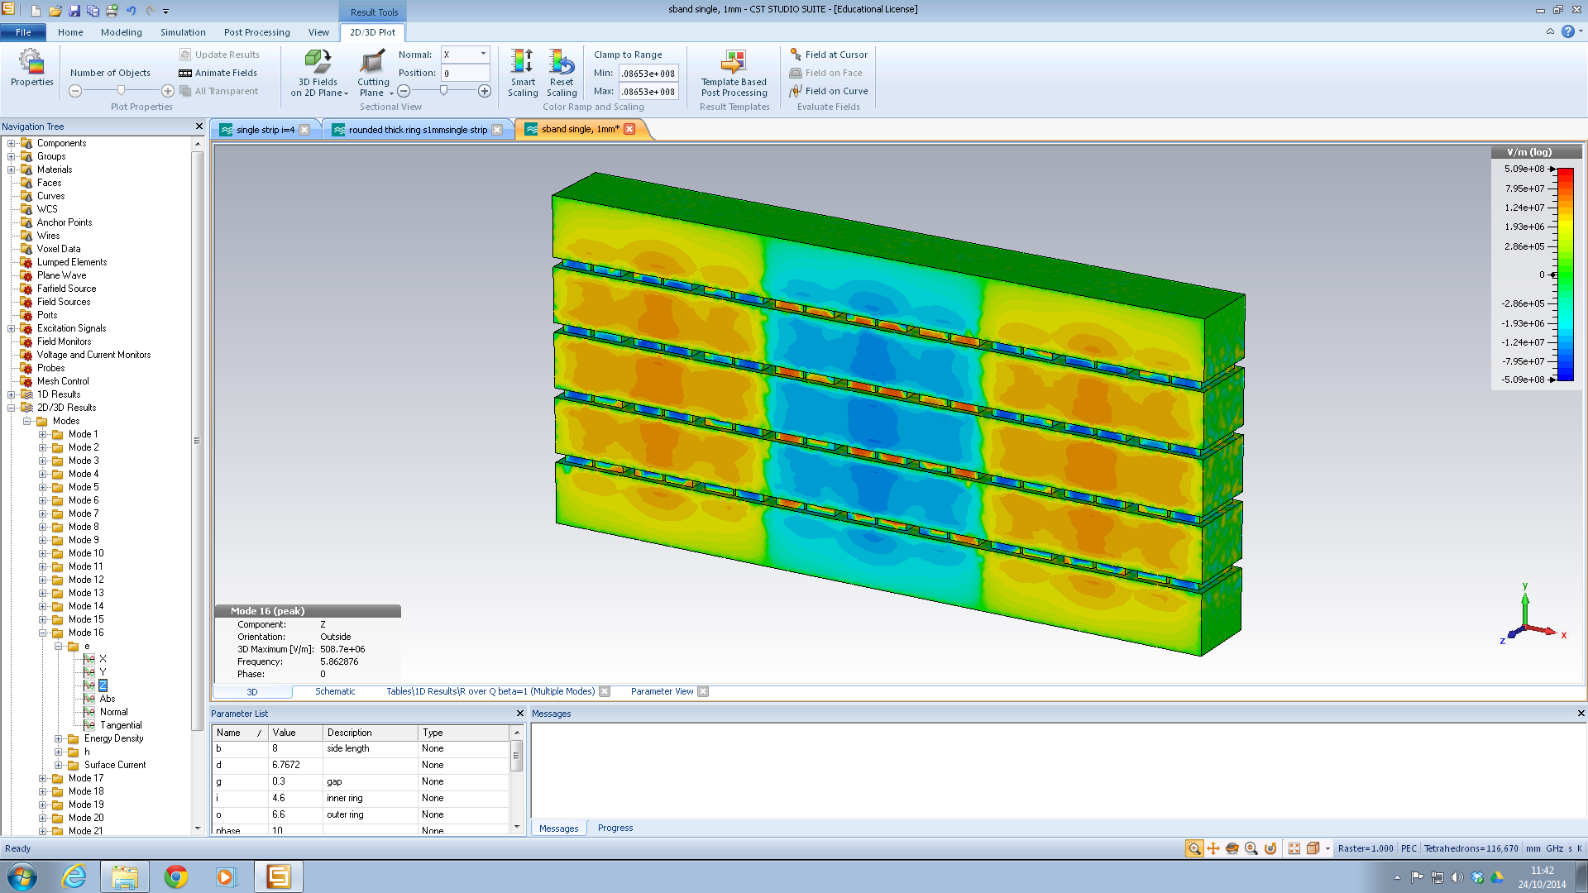
MTM-loaded waveguide
Suitable TM mode for pencil beam of diameter ~ 5-10 mm
Width | 8 mm
Outer ring slot length | 6.6 mm
Slot width | 0.8 mm
Inner ring slot length | 4.6 mm
Split width | 0.3 mm
Thickness | 1 mm
R_{SH}~30 MΩ/m
E-field on axis
E-field of TM-like NIM mode at 6 GHz
[E. Sharples, R. Letizia, Journal of Instrumentation, 2014]

Slide 11
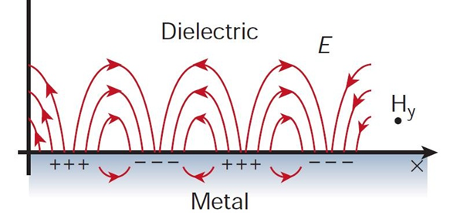
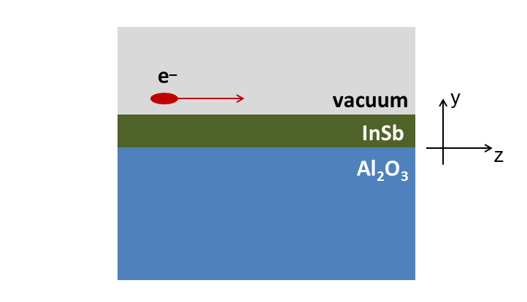
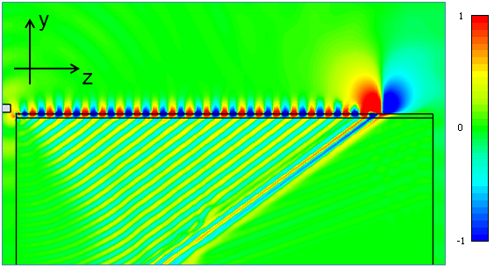


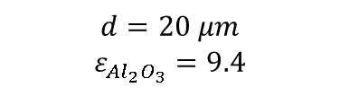



Beam excitation of THz Surface Plasmon modes
Intersection at
$$f≈1.84 THz$$
threshold
$$θ$$
InSb as plasmonic material at THz
Energy (keV)
$$d$$
$$I_{N_{e}}\left(ω\right)=I_{1}\left(ω\right)\left[1+\left(N_{e}−1\right)f\left(ω\right)\right]$$
Ɵ
$$d=20 μm$$
$$ε_{{Al}_{2}O_{3}}=9.4$$
$$f\left(ω\right)∝e^{−{\left(kσ_{z}\cos{θ_{b}}\right)}^{2}}e^{−{\left(kσ_{x}\sin{θ_{b}}\right)}^{2}}$$
[R. Letizia, E. Stoja, Proc. of UCMMT (2014)]]
11

Slide 12
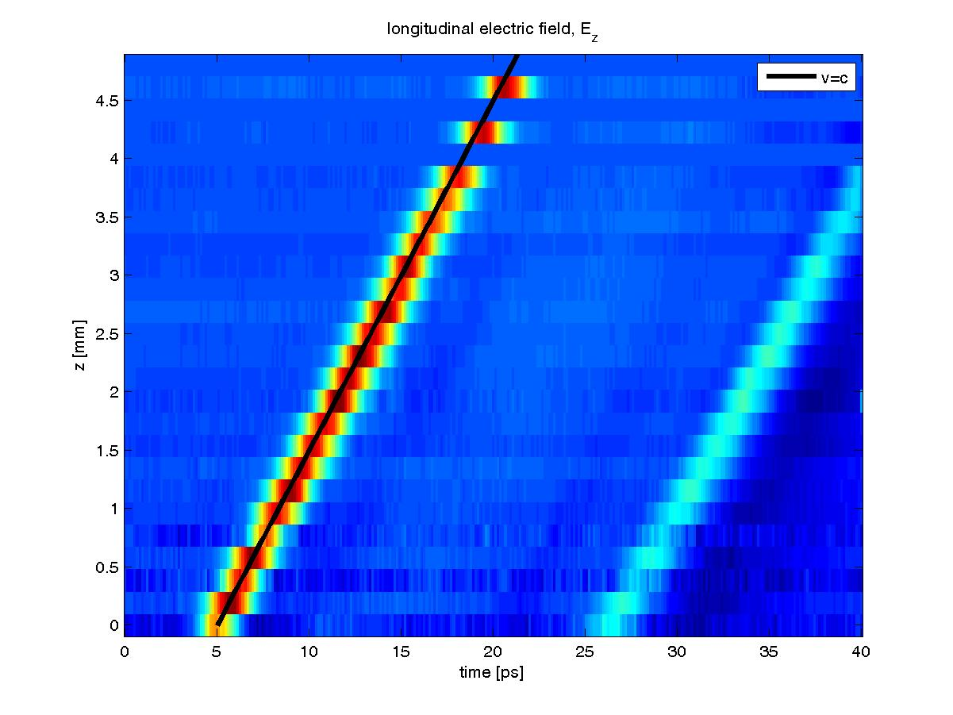
Direct THz acceleration
Laser group arrival time tuneable to give effective source velocity < c
Local conversion to THz - effective phase velocity tuned to match electron beam
Results for phase velocity 0.91 – 1.10c
velocity tuneable from optics
Separate measurements: 50kV/cm with ~20% of laser power

Slide 13
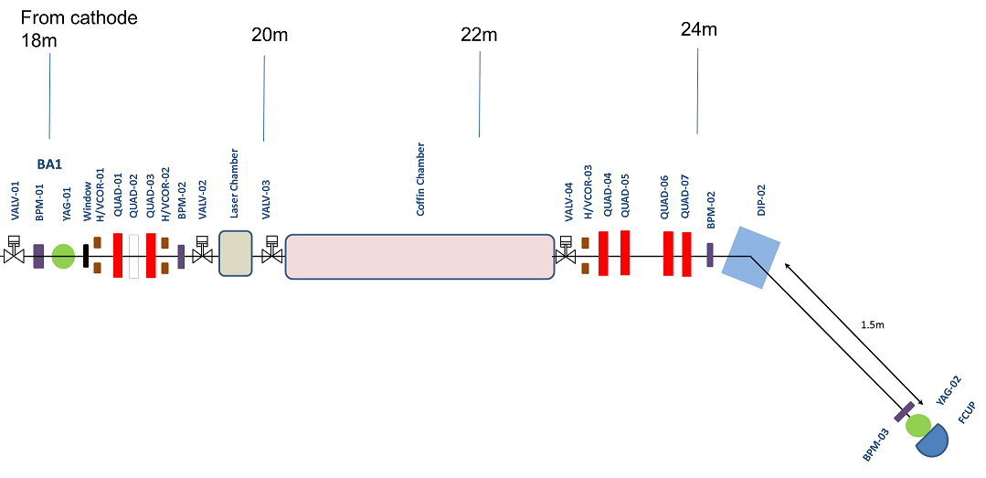
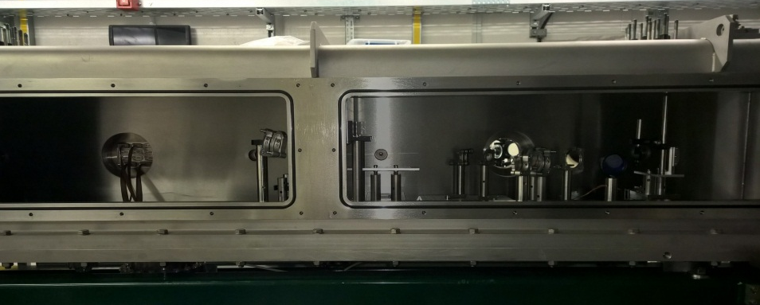
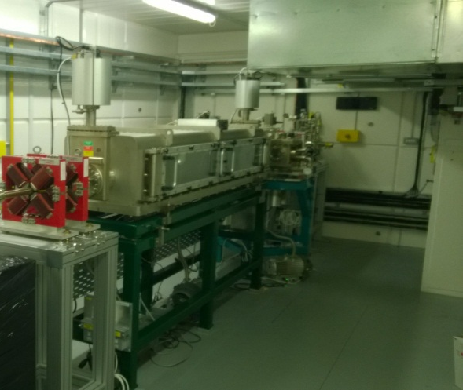
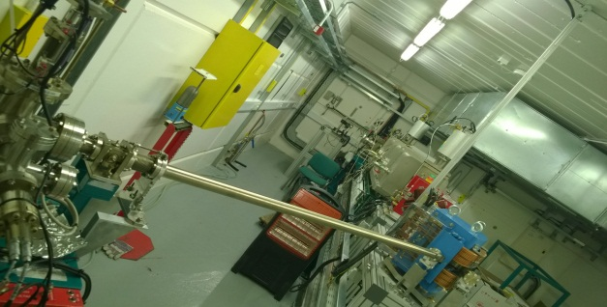
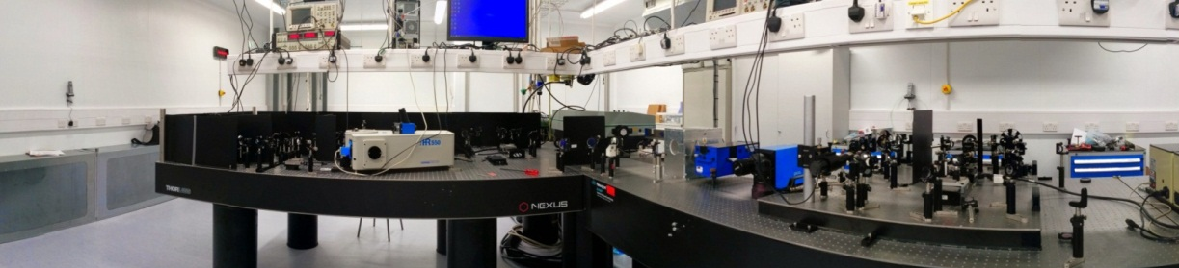

Flexible user station on VELA - first experiments completed July/August 2015
Now: 5MeV, <1pC-200 pC, 2-5ps
Now+12months; 50MeV, 100fs,
120m² laser lab
Multiple lasers, up to 20TW laser
Coupled to VELA user station

Slide 14
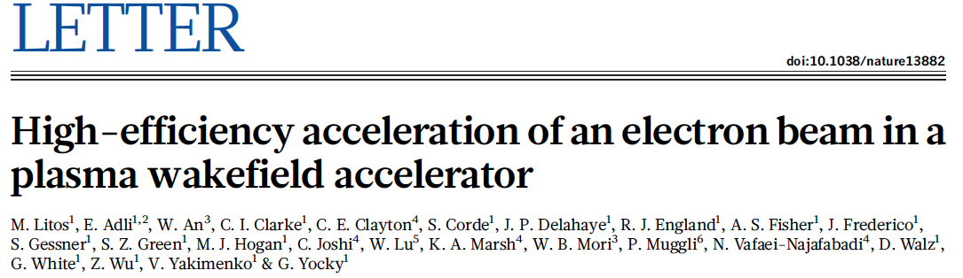
FACET two-bunch experiment
Accelerating gradient 4.4 GeV/m
Final energy spread of trailing bunch:0.7%

Slide 15
Beam-Driven Wakefield Acceleration Worldwide
Facility | Where | Drive (D) beam | Witness (W) beam | Start | End | Goal
AWAKE | CERN, Geneva, Switzerland | 400 GeV protons | Externally injected electron beam (PHIN 15 MeV) | 2016 | 2020+ | Use for future high energy e-/e+ collider. Study Self-Modulation Instability (SMI). Accelerate externally injected electrons. Demonstrate scalability of acceleration scheme.
SLAC-FACET | SLAC, Stanford, USA | 20 GeV electrons and positrons | Two-bunch formed with mask (e⁻/e⁺ and e⁻-e⁺ bunches) | 2012 | Sept 2016 | Acceleration of witness bunch with high quality and efficiency Acceleration of positrons FACET II proposal for 2018 operation
DESY-Zeuthen | PITZ, DESY, Zeuthen, Germany | 20 MeV electron beam | No witness (W) beam, only D beam from RF-gun. | 2015 | ~2017 | Study Self-Modulation Instability (SMI)
DESY-FLASH Forward | DESY, Hamburg, Germany | X-ray FEL type electron beam 1 GeV | D + W in FEL bunch. Or independent W-bunch (LWFA). | 2016 | 2020+ | Application (mostly) for x-ray FEL Energy-doubling of Flash-beam energy Upgrade-stage: use 2 GeV FEL D beam
Brookhaven ATF | BNL, Brookhaven, USA | 60 MeV electrons | Several bunches, D+W formed with mask. | On going |  | Study quasi-nonlinear PWFA regime. Study PWFA driven by multiple bunches Visualisation with optical techniques

Slide 16

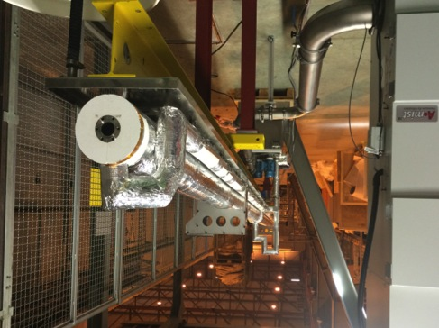
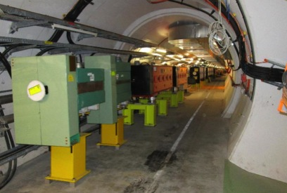
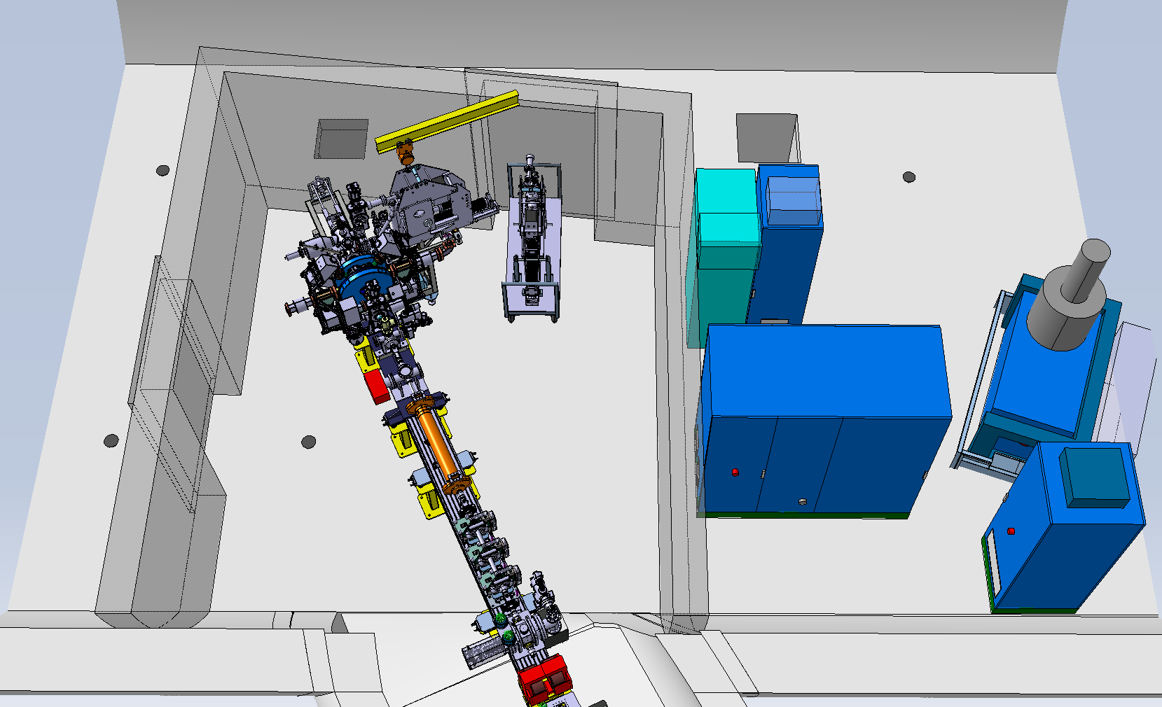
AWAKE
The AWAKE experiment is a proof of principle experiment using protons from the SPS to drive a large wake (>1GV/m) in a 10 m long plasma to accelerate an electron beam from 20 MeV to several GeV.
There is strong UK involvement in diagnostics and the electron injector.
A 450 m plasma driven by the LHC beam would reach 600 GeV in a single pass.
Obviously this system is very efficient

Slide 17
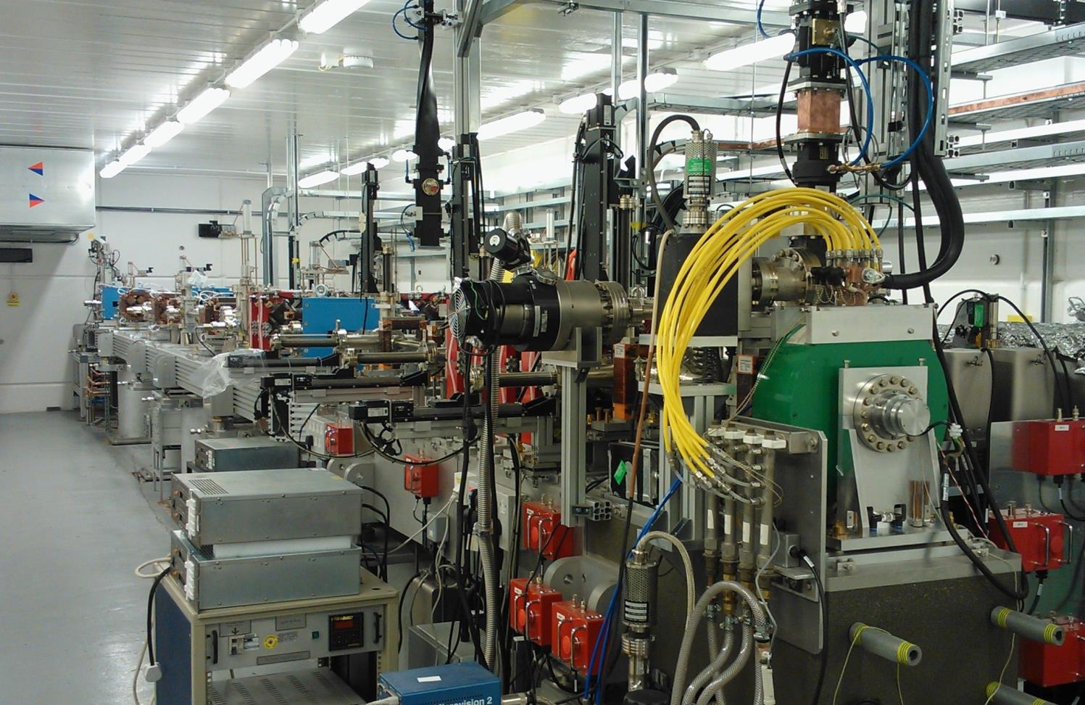
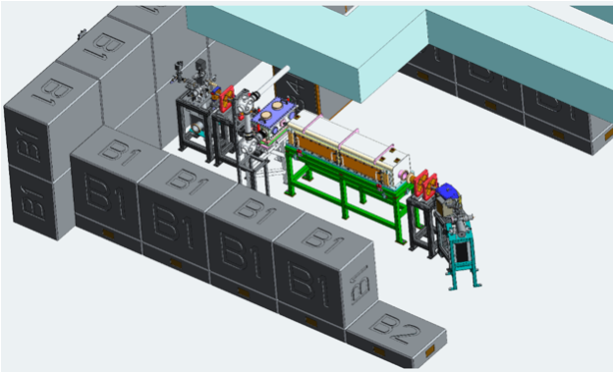
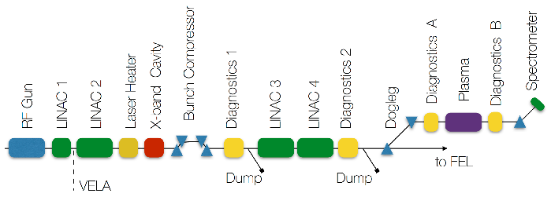
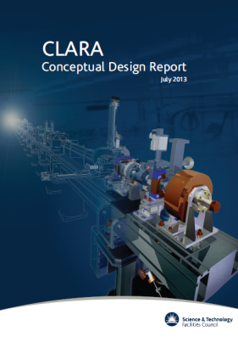
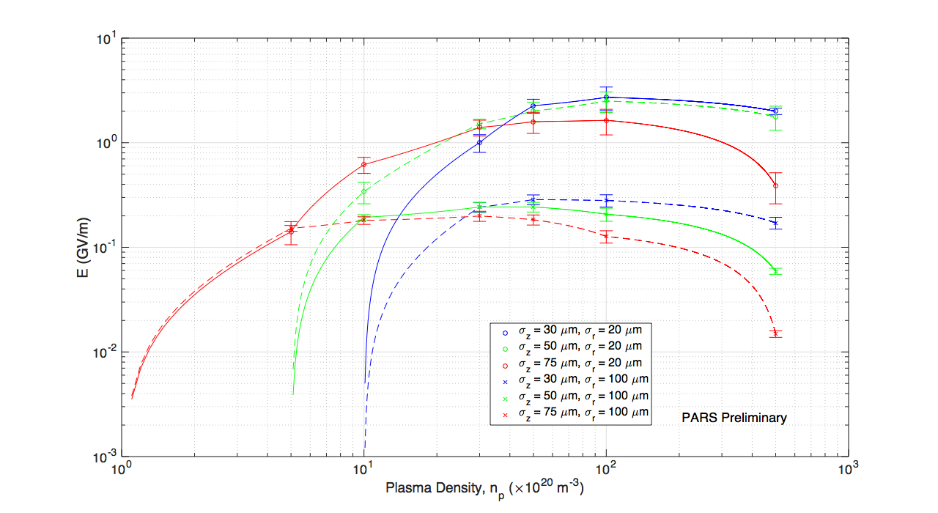
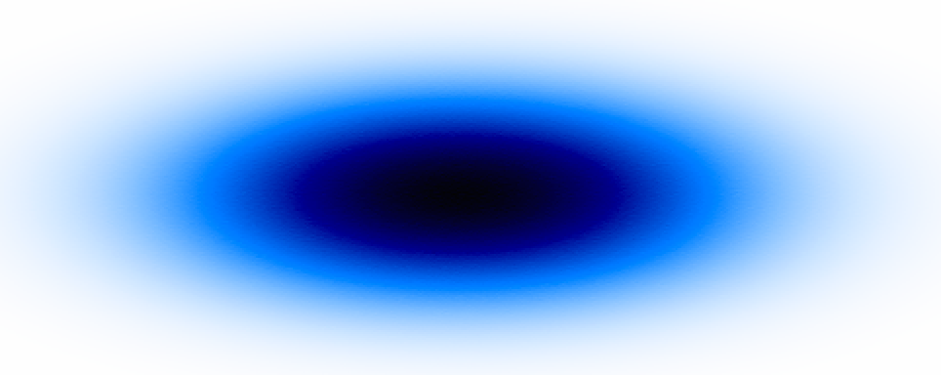
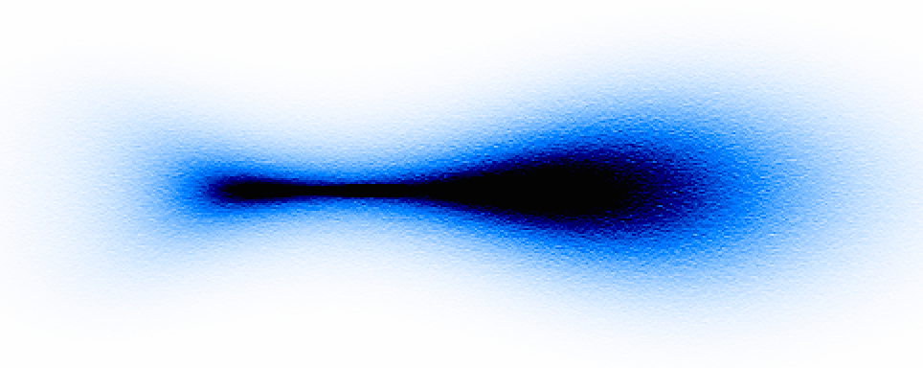
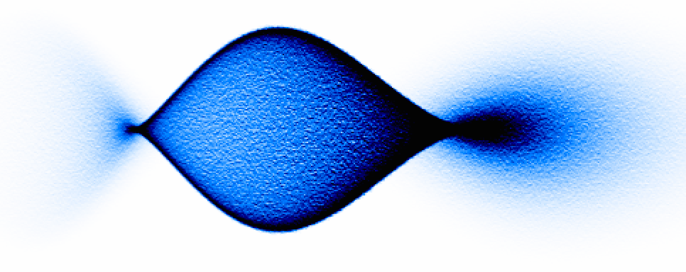
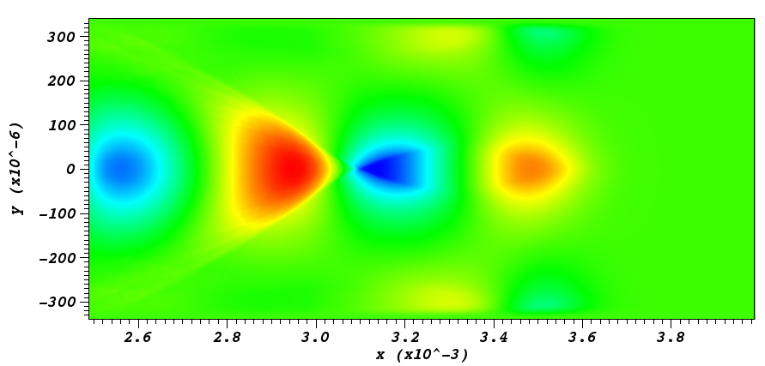
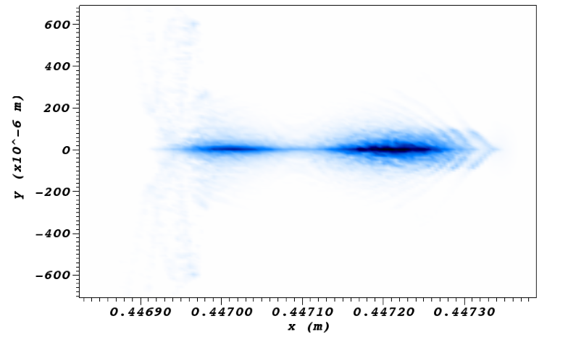
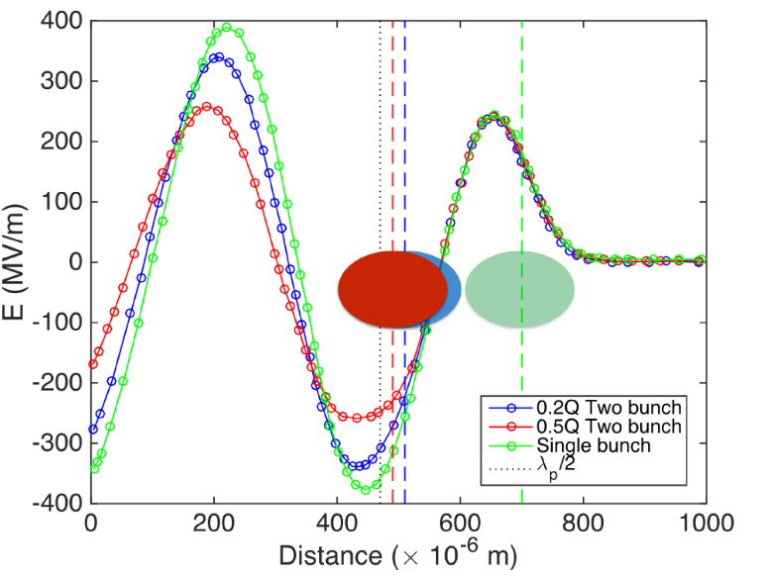
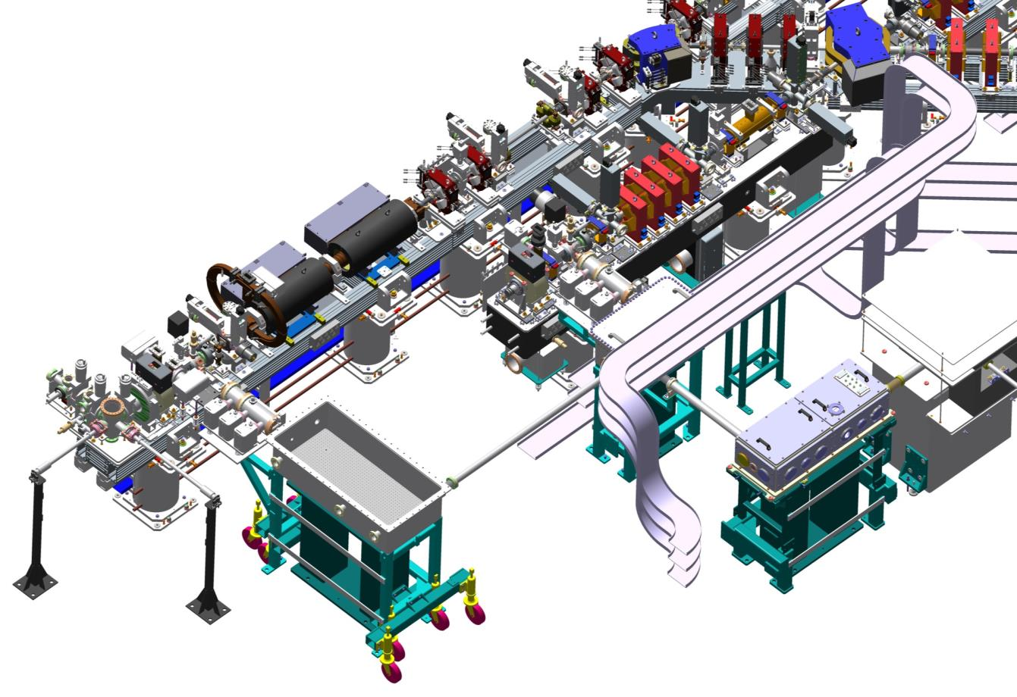
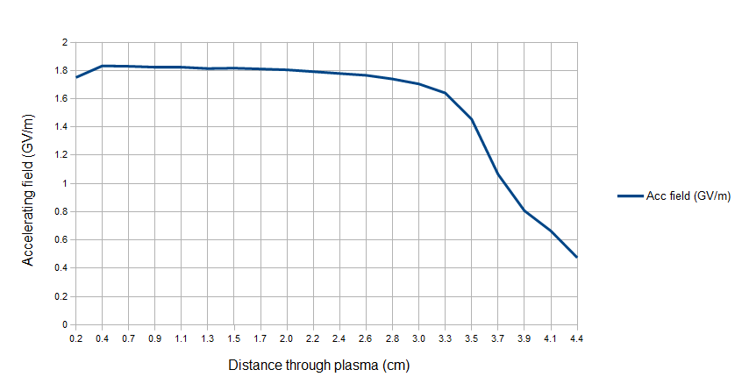
PWFA at Cockcroft Institute
PWFA at VELA user station in 2015
PWFA at CLARA in 2020
High beam quality preservation, ultrahigh brightness e- production, e.g. plasma photocathode
First experiment on plasma lens started in August 2015
E=4.8 MeV
Q=250 pC
σz = 3.3 mm
σr = 0.45 mm
focusing gradient of 10 T/m
E=250 MeV, Q=250 pC
E_{acc}~ 3 GV/m
PWFA at CLARA front end in 2016
Demonstration of high acceleration gradient ~ GV/m
Two bunch acceleration for high quality beam production
E=50-150 MeV
Q=250 pC
σz = 20-100 μm
σr = 50 μm
acc. gradient
~GV/m
acc. grad. 1.8 GV/m
Guoxing Xia et al.

Slide 18
New “Conventional” breakthrough's
High field dipole magnets allowing projects like FCC.
N-doped, Nb3Sn and Multilayer SRF provides higher Q, higher temperature and higher fields.
High gradient X-band still going strong and replacing old S-band technology

Slide 19
Conclusions
LPWA is not the only fruit of novel accelerators
Plasma’s can be driven with beams to provide far better beam quality (in theory) and efficiency.
Laser’s can excite dielectric structures which are more stable
THz can drive dielectrics to provide better beam quality and there is continuing development of high efficiency sources.
Beams can drive dielectrics to provide efficiency AND beam quality.
“Conventional” sources are also breaking new barriers

