Slide 1


Double Beta Decay
Jeanne R Wilson
25 – 9 – 2015
Remit: Present the UK program on Double Beta decay and put it in context with world-wide efforts.
Thanks to: D.Waters, S.Biller, S. Soldner-Rembold, P.Guzowski

Slide 2

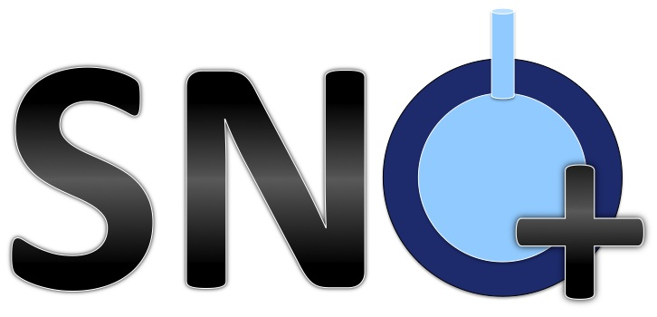
Contents
Double Beta Decay in brief
UK Experiments
  SNO+
  SuperNemo
World-wide activity
  ⁷⁶Ge: GERDA, Majorana
  ¹³⁰Te: CUORE
  ¹³⁶Xe: KamLAND-Zen, EXO
Notes:
OK – I’ll give a brief intro and motivation and try to put things in context by summarising the other leading expiirments world-wide, but this talk will focus heavily on the two double beta experiments, SNO+ and superNEMO that we have significant input on in the UK.

Slide 3
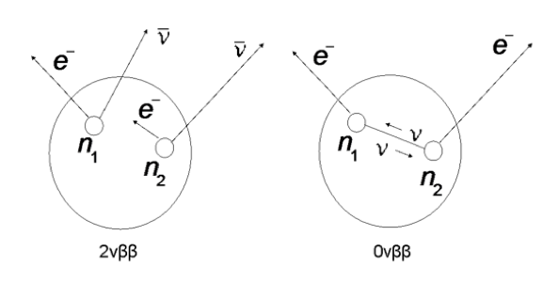
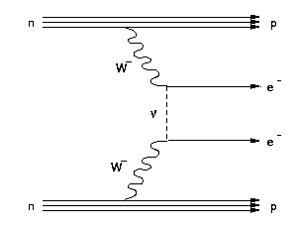
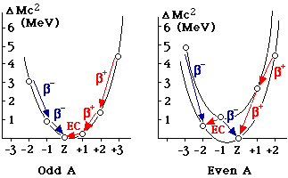
Double Beta Decay
(A,Z) → (A,Z+2) + 2 e⁻ + 2ν_{e}
(A,Z) → (A,Z+2) + 2 e⁻
Only Observed if Majorana Neutrinos
  GUTs and leptogenesis
Rate proportional to absolute Neutrino Mass Scale
Notes:
So this is beta decay – neutron to electron plus anti-neutrino, and this is double beta decay when two decays occur at the same time in the same nucleus. This process emitting 2 neutrinos is a second order process in the standard model that occurs for a small selection of even-even nuclei where the splitting of the mass curves makes the single decay energetically unfavourable but the double decay allowed.
But what we are really interested in it neutrinoless double beta decay – the mode where no neutrinos are emitted.
This is interesting because it can only occur if the neutrino is majorana type such that the neutrino can flip helicity. This allows explanation of the low neutrino masses through the see-saw mechanism and is favoured by many grand unified theories and models to explain leptogenesis
Furthermore, the rate of this process, if observed is proportional to the absolute neutrino mass scale, which we would like to know, since oscillations only tell us mass differences.

Slide 4

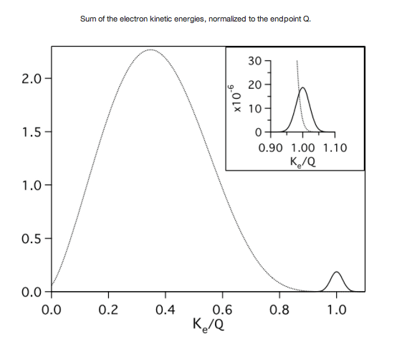
Neutrinoless Double Beta Decay
Phase space
Nuclear Matrix Element
Experiment options
Select isotopes with favourable phase space
Select isotopes with favourable matrix elements
  Beware large uncertainty / differences between models
Select isotopes with large abundance or good enrichment opportunity
Good energy resolution
Low Backgrounds in region of interest (ROI)
Notes:
The rate of neutrinoless double beta decay is governed by the phase space factor, the nuclear matrix element – which we cannot calculate exactly and is subject to large uncertainties – and the neutrino mass squared over the mixing matrix.
To maximise our potential for this measurement we need to select isotopes with favourable phase space – high for neutrinoless double beta decay and lower for the accompanying 2 neutrino mode, and favourable matrix elements.
Then because the signal is a peak at the Q-value, which is the exact endpoint of the 2nu spectrum, we need good energy resolution to minimise the contribution of the 2 neutrino background, and of course, low backgrounds in this region of interest.

Slide 5
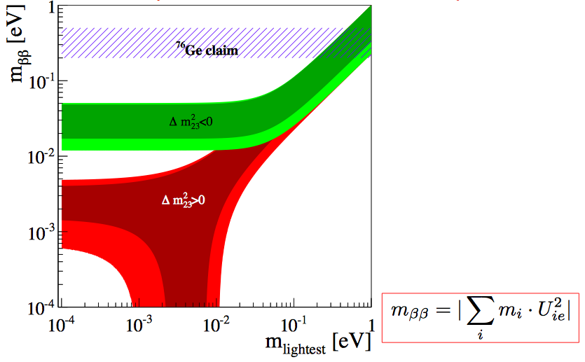
Experimental Sensitivity
~10kg
~100kg
~1000kg
~10000+kg!
Degenerate
Inverted
Normal
Notes:
This is the classic plot for neutrinoless double beta decay sensitivity – the double beta mass – a sum of the mass states over the MNS matrix, against the lightest neutrino mass – the structure comes from the different mass heirarchy models – degenerate, inverted and normal - and the restrictions we already have from oscillation measurements.
The heidelberg moscow experiment claimed to have observed a signal in an experiment of order 10kg germanium, but that has been largely refuted and current experimental limits are pretty much ruling this out now. The right hand side here gives an idea of the isotope mass you need to to test these different regions and I’ll show how the experiments I’m going to talk about fit into this later.

Slide 6
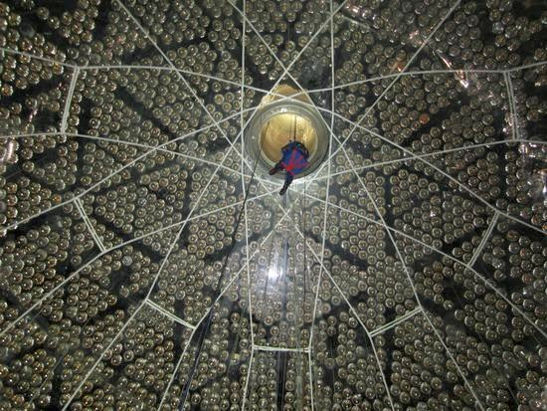
Massive detector provides self shielding from external backgrounds
¹³⁰Te
: Large natural isotopic abundance (34%), so no enrichment needed to deploy tonne-scale of isotope
: High half-life of 2ν mode (7.0x10²⁰yr) relative to possible 0ν transition compared to other isotopes
Liquid scintillator
: Can be purified on-line
: Loading can be changed, scalable
: Fast timing allows rejection of several time-correlated radioactivity backgrounds
SNO+
Notes:
Firstly SNO+: built on the SNO detctor which provides self-shielding from external backgrounds
130Te is the chosen isotope since it has high natural abundance so you don’t need to enrich to get large quantities and it has a favourable 2nu : 0nu half-life ratio compared to most other isotopes.
The Tellurium is loaded into liquid scintillator that can be purified to remove natural decay chains. Then there is fast timing to reject the remaining time-correlated radioactive decay backgrounds.
One advantage of loading your isotope is that you can scale the loading or change to a different isotope.

Slide 7
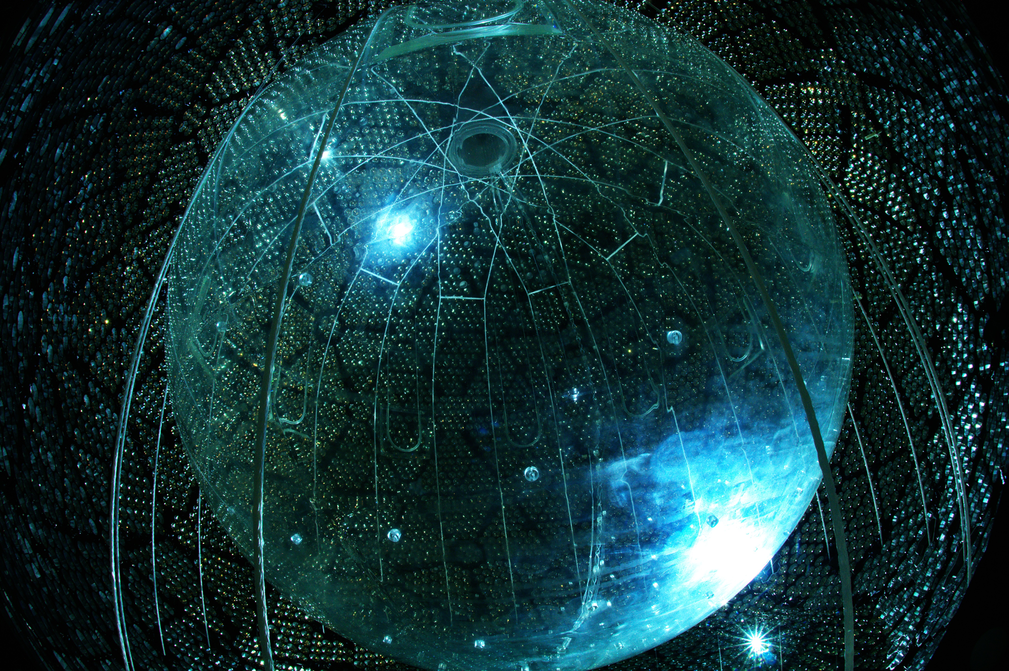
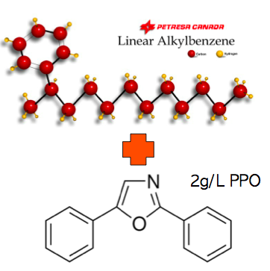
SNO+ Detector
12m diameter Acrylic Vessel Hold down rope net
780 tonnes scintillator
+ Telluric acid
+ H₂0 + surfactant + WLS
7ktonnes water shielding
~9300 8inch PMT array
Notes:
Key features of the detector – the 12m diameter acrylic vessel that holds the scintillator, loaded with the telluric acid, surfactant and wavelengthshifter. We have installed this hold-down net to counteract the bouyancy of the scintillator wrt the surrounding water shielding. Scintillation light is detected by the array of over 9k PMTs.

Slide 8

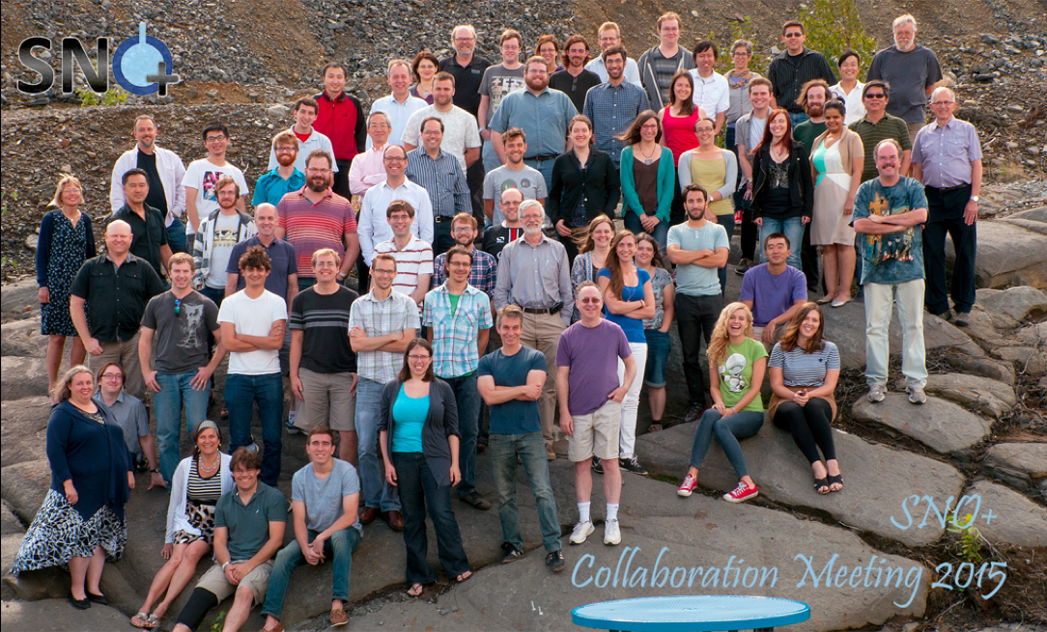
90 members, 6 countries, 23 institutions
Backgrounds co-coordinator
Scintillator Development
coordinator
Lancaster
Liverpool
Oxford
QMUL
Sussex
11 academics
4 postdocs
14 phds
Analysis Co-coordinator
Calibration coordinator
Processing coordinators
Software co-cordinator
Notes:
SNO+ collaboration is fairly small, about 90 members, but a large UK fraction from 5 institutes, and we hold many leading roles within the collaboration.

Slide 9
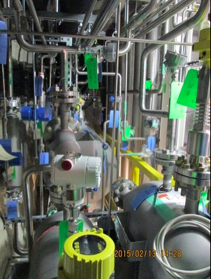
SNO+ Status
Milestones
  Scintillator plant main installation complete
  Helium Leak checking complete
  Cleaning and passivation ~done
  Successfully tested loading on AV hold-down ropes
  Electronics upgrades and PMT repairs
  In-situ optical fibres for calibration (LED and laser)
  JINST Vol. 10, P03002 (2015)
  Te loading and purification methods developed, can now all be accomplished underground
  S. Hans et al., NIMA795 (2015)
  First tonne Te purchased, “cooling down” in SNOLAB (0.13% loading)
  Additional Canadian funding will now allow us to go up to 0.5% loading in Phase I
  New loading approach developed at Oxford is now being seriously considered - promises higher light yield, lower backgrounds, likely easier to implement.
    Possible route to Phase II with PMT upgrade.
Notes:
We have made a lot of progress in the past year
The scintillator plant main installation is complete and all the pipes and vessels have been helium leak checked, cleaned and passivated with citric acid- we are just rinsing the final few loops now, The hold-down rope system has been successfully tested, we’ve installed electronics upgrades to cope with the higher event rates and had a good success rate repairing PMTs that failed during SNO operation.
We’ve designed and installed most of the in-situ optical calibration system – see later slide
Developments in the te loading and purification methods mean we can now do this all underground which is big win for reducing backgrounds from radioactive isotopes created by cosmic muon interactions.
As is the fact that the first tonne of tellurium we have already purchased with STFC funding and its stored 2km underground in SNOlab
We have secured more Canadian funding so we can go to 0.5% loading, rather than 0.3% in the first phase and are also investingating new loading techniques that I’ll mention in a moment

Slide 10
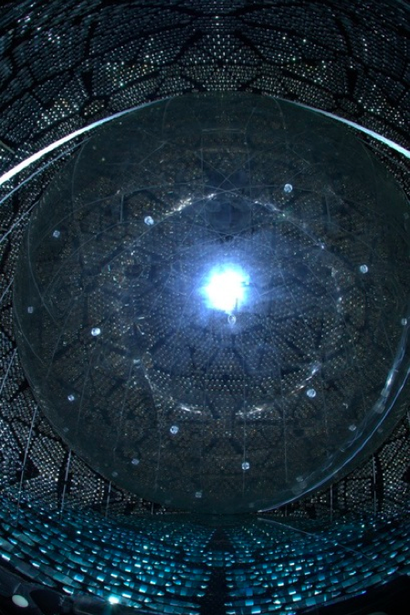
SNO+ Status
Set-backs
  Significant cavity water leak – currently lowering water level to identify and fix problem
Next Steps:
  Commissioning detector with water
    Optics, detector backgrounds
    Nucleon decay, solar axions, anti-ν
  Scintillator plant safety review and commissioning
    Scintillator fill ~1 year from now
    Calibrations, Background studies
    Solar neutrino sensitivity, Supernova, Reactor, Geoneutrinos
  Start Te deployment early 2017
    0νββ, Supernova, Reactor, Geoneutrinos
Notes:
Leak: It’s a solvable problem, it isn’t currently impacting the schedule for isotope deployment, but it’s impacting some commissioning activities, water-phase physics, sapping resources and is currently our number one priority.
4 tonnes / day at 30foot -> 26tonnes /day @ 85foot
Once the leak is sorted, we will fill with water – priorities for water fill are to characterise optics and non-scintillator backgrounds but there is also interesting physics that can be done.
Concurrently, the scintillator plant work continues – safety reviews and commissioning with the aim to be ready for scintillator fill in about a years time. So worst case we have a year to fix the leak and fill.
Likewise, work continues on the tellurium purification systems aiming for isotope deployment early 2017.

Slide 11
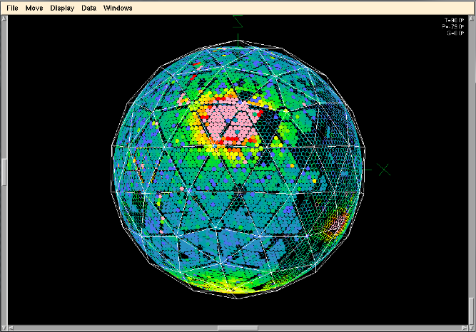
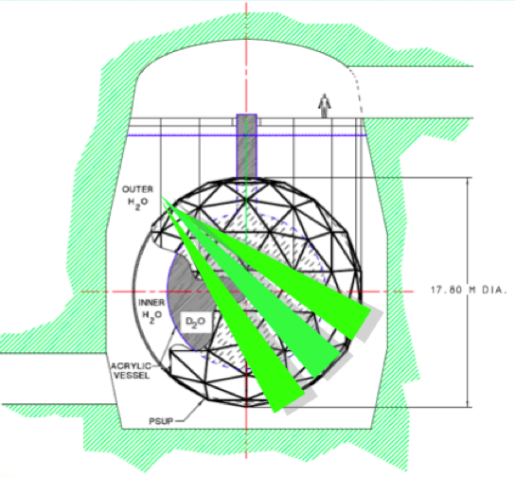
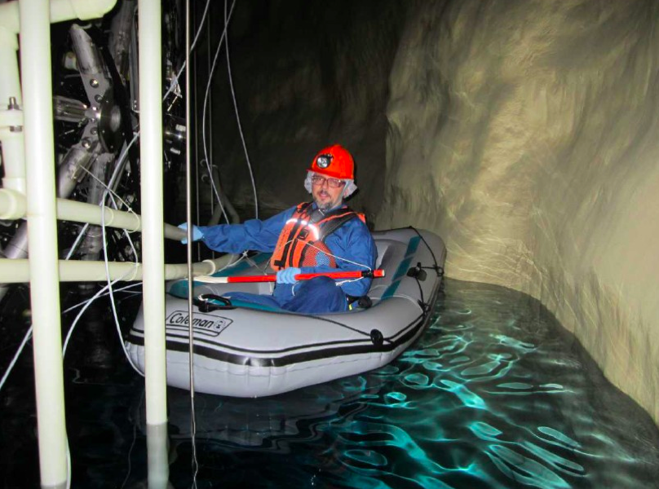
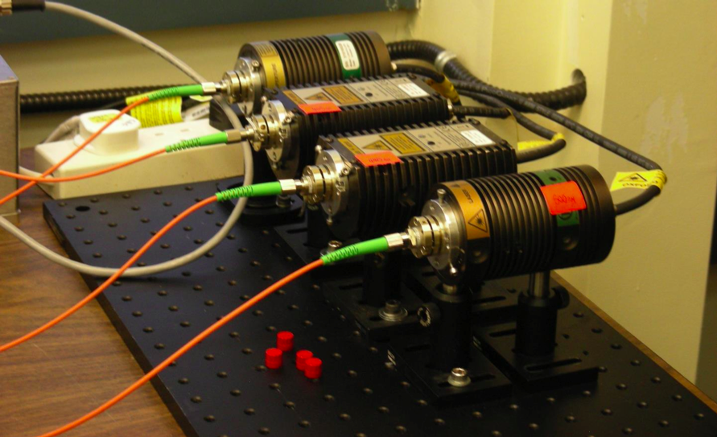
Calibrations
ELLIE light injection system (UK + Portugal)
  PMT timing calibration (TELLIE) LEDs
  In-situ scattering measurement (SMELLIE) Lasers
  Attenuation monitoring (AMELLIE) LEDs
>100 fibres mounted on PMT support structure allows regular, non-invasive calibration (2/3 installed by boat)
Notes:
I wanted to mention the light injection calibration system that has been designed and built for SNO+, predominantly with UK effort. This allows calibration of PMT timing, optical scattering and attenuation monitoring without deploying sources into the scintillator volume and risking contamination.
About 2/3 of the 100+ fibres are already installed and the systems have been tested and characterised.

Slide 12
SNO+ (¹³⁰Te)
T_{½} > 3.9 × 10²⁵ y (1 year,0.3%)
T_{½} > 9.0 × 10²⁵ y (5 year,0.3%)
http://arxiv.org/abs/1508.05759
Notes:
This is the predicted sensitivity for 5 years running of SNO+ with 0.3% loading of natural Tellurium. The signal shown on this plot is a 200meV neutrino ie consistent with the HM claim – for assumptions on matrix elements etc used I refer you to this SNO+ review paper.
The backgrounds are dominated by 8B solar neutrinos – essentially flat in the ROI and not much we can do about them, the second largest background is the 2nu – which could be reduced with better light yield and hence narrower energy window.
So for phase 1 – with 0.3% loading we should get to 4 10^25 in 1 year and nearer 10^26 in 5 years.
`Summary plot of all backgrounds and a hypothetical $0\nu\beta\beta$ signal
corresponding to a mass approximately $m_\beta\beta = 200$ meV. Events are
shown in the FV of 3.5 m and for 0.3% natural Te loading.`
IBM-2 model
200hits/MeV

Slide 13
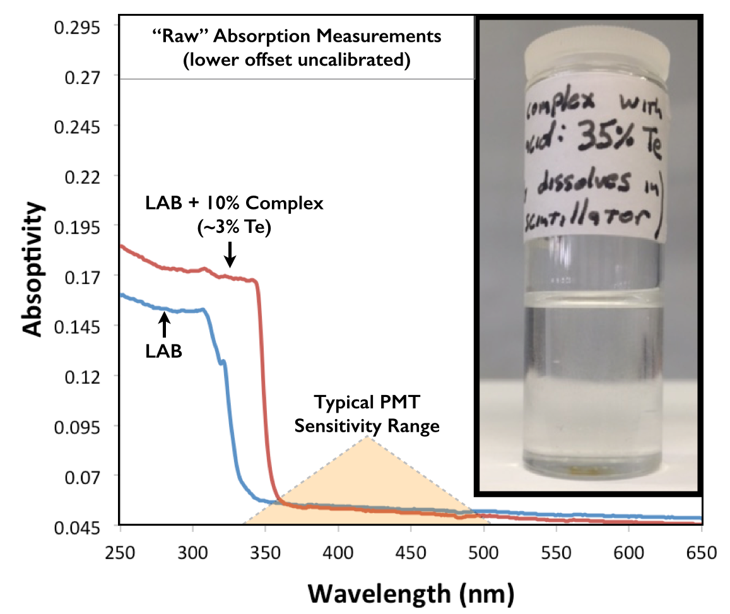
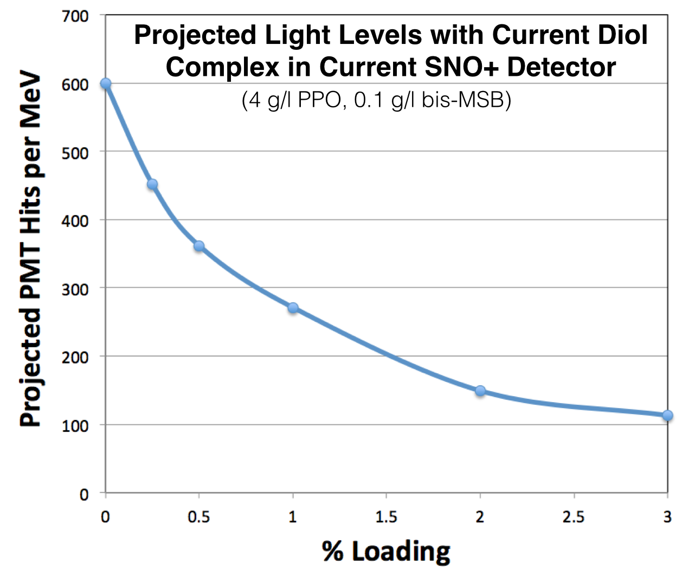
Diol Complexes
Promises higher light yield, lower backgrounds, likely easier to implement.
Quenching at ~% level but possible route to Phase II with PMT upgrade.
Notes:
And R&D is continuing on the loading method – recently a new idea is being developed by the Oxford group using Diols which seem to have low absorption in our sensitive wavelength range and offer an easy implementation route to high light yield and low background

Slide 14
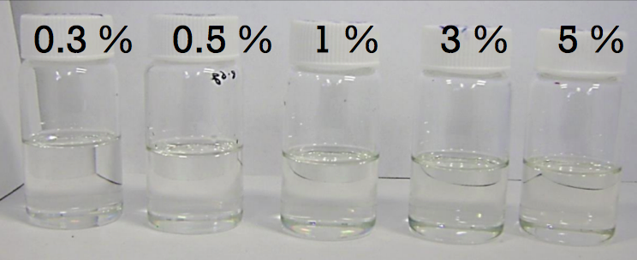
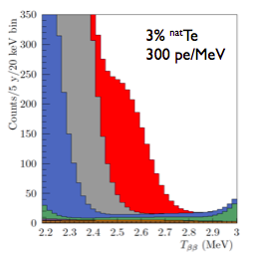
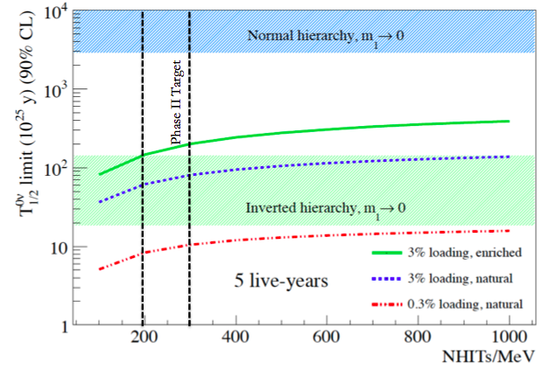
SNO+ future
 | T^{½}_{0ν} sensitivity
0.3% Te, 1 yr | 3.9 × 10²⁵ yr
0.3% Te, 5 yr | 9 × 10²⁵ yr
3% Te, HQE PMTs | 7 × 10²⁶ yr
3% ^{nat}Te
450 pe/MeV
3% ^{nat}Te
300 pe/MeV
3% loading,
450 nhit/MeV
R&D into surfactant + Cocktail developments to increase light yield, new surfactants, diols …
Investigate bag to contain Te-loading to fiducial volume
Upgrade to High QE PMT array
Notes:
And there is further R&D for higher loading for future SNO+.
The name of the game is high light yield and high loading – the lines on this 5year half-life sensitivity plot guide your eye to see how well we do increasing loading from 0.3 to 3% for 200 and 300 PMT hits / MeV.
And our routes to higher light yield include cocktail developments – new surfactants, diols etc., a bag to contain the tellurium within a central fiducial volume, and upgrades to a high QE PMT array.

Slide 15








SuperNEMO
Imperial, Manchester, UCL, UCL-MSSL, Warwick
7 academics, 6 RAs, 4 PhD
The goals of SuperNEMO :
Build on the experience of the extremely successful NEMO-3 experiment.
Use the power of the tracking-calorimeter approach to identify and suppress backgrounds. This will yield a zero-background experiment in the first (Demonstrator Module) phase.
Prove that a 100 kg scale experiment can reach the inverted mass hierarchy (~50 meV) domain.
In the event of a discovery by any of the next-generation experiments, demonstrate that the tracking-calorimeter approach is by far the best one for characterising the mechanism of 0νββ decay.
Notes:
The other major UK double beta effort is SuperNEMO, which builds on experience from the NEMO-3 experiment. Again, a strong UK involvement from 5 institutions.
This is a very different approach – a tracking calorimeter is used to identify and suppress backgrounds – and since you are tracking the electrons out of the decay in thin target foils, this means that, in the event of observation, you can start to probe the characteristics- energy ratio of the electrons and angle between them - and hence the mechanism for the double beta decay.

Slide 16
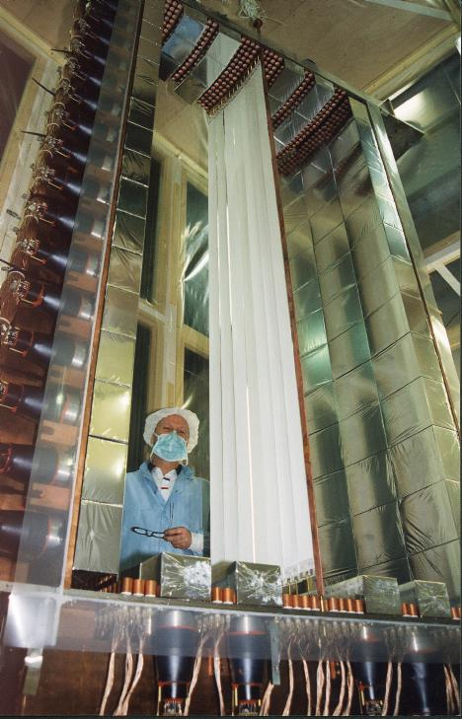
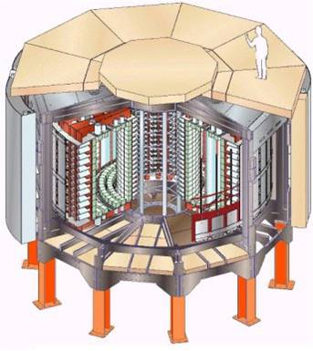
NEMO-3 Overview
Tracking-calorimeter detector.
Situated in Laboratoire Souterrain de Modane (LSM) : 4800 M.W.E.
Ran from 2003 – 2011
Decommissioned to make space for the Demonstrator Module
Notes:
This was NEMO3 – located in the Modane laboratory in France – it ran till 2011 with this cheese wedge structure with various source foils sandwiched between trackers and calorimeters.

Slide 17
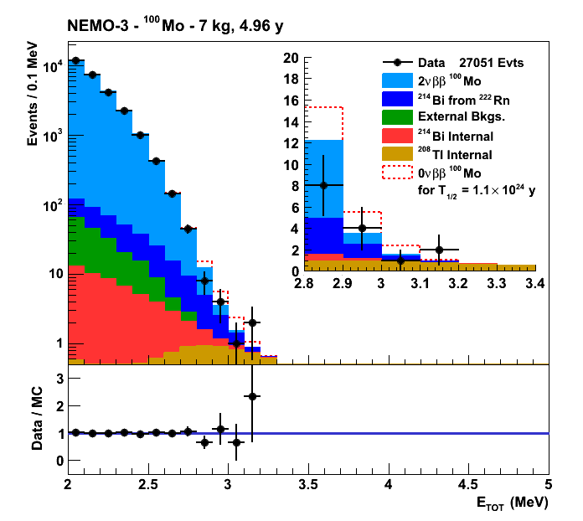
Recent NEMO-3 Results: All Have Major Involvement
Final result with ¹⁰⁰Mo – 7kg
For the Majorana mass mechanism :
Also limits on RHC, R_{P} SUSY etc.
Phys.Rev. D89 (2014) 11, 111101
arXiv:1506.05825
Final analyses of NEMO-3 data currently being published : more than 50% are UK led.
Two PhDs completed since the last PPAP meeting in 2014.
preliminary
preliminary
⁴⁸Ca
¹⁵⁰Nd
Notes:
And here are a selection of recent NEMO-3 results – the final leading limit from 7kg of 100Mo of 1.1 10^24 years.
And there is more analysis to come – with strong UK involvement.

Slide 18
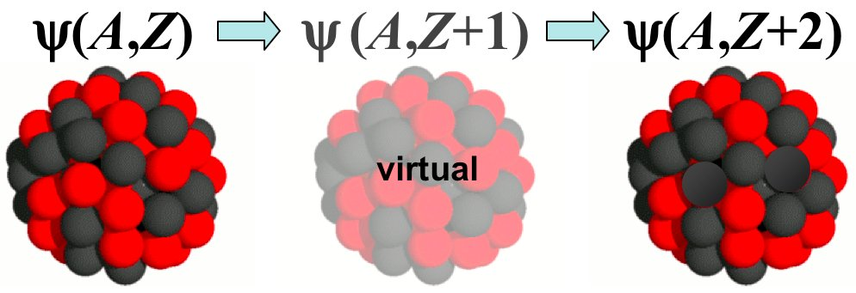
World’s Best Limits
EXO-200
80 kg ¹³⁶Xe (fiducial)
[141 kg total]
[ KamLAND-Zen ]
290 kg ¹³⁶Xe total (off-scale)
Sensitivity vs. Isotope Mass (area of rectangle)
NEMO-3 :
Competitive with small M_{isotope}
Best for probing signal mechanism in event of discovery.
Width due to uNclear Matrix Elements
GERDA
18 kg ⁷⁶Ge
INVERTED
MASS
HIERARCHY
NEMO-3
7 kg ¹⁰⁰Mo
Notes:
Just to illustrate – this tracking gives you a lot of sensitivity so the NEMO-3 limits are a similar order of magnitude to the world leading results from EXO/Kamland and GERDA despite a much smaller mass.

Slide 19
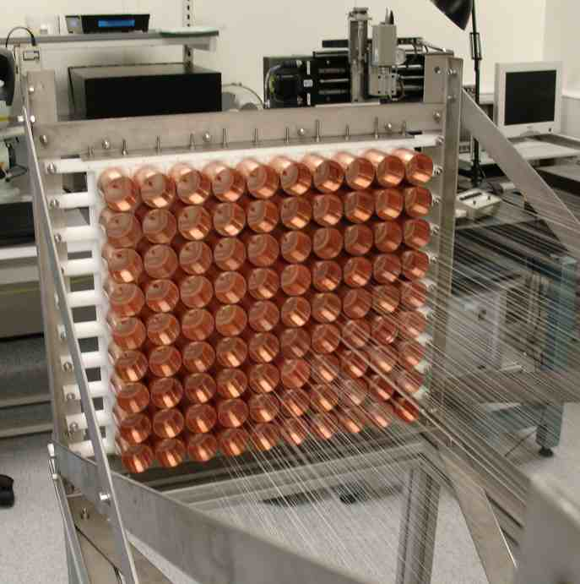
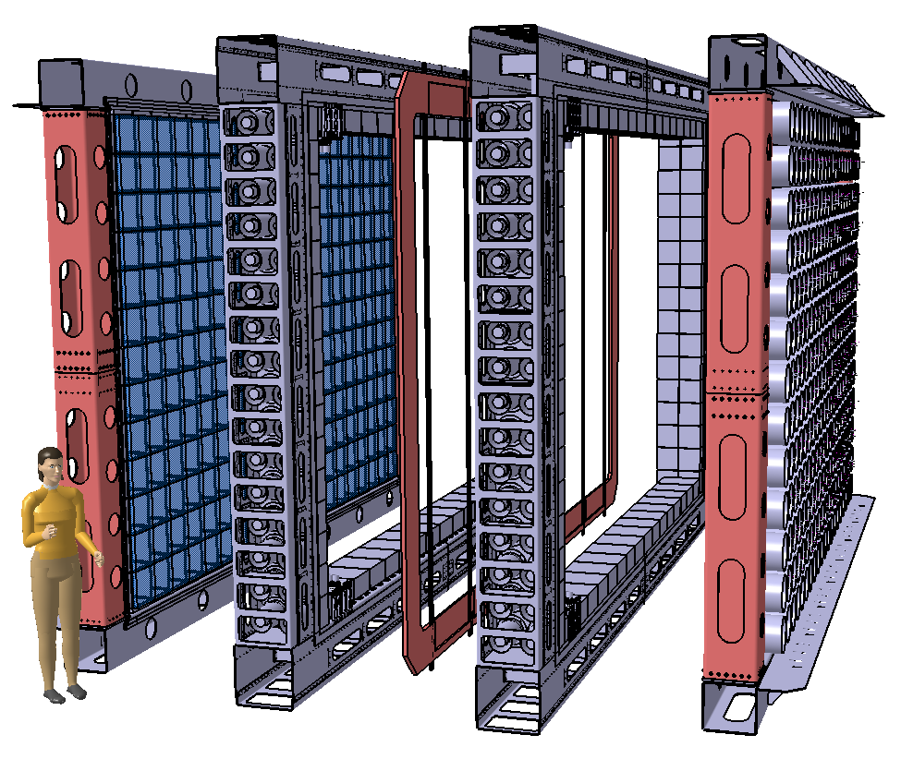
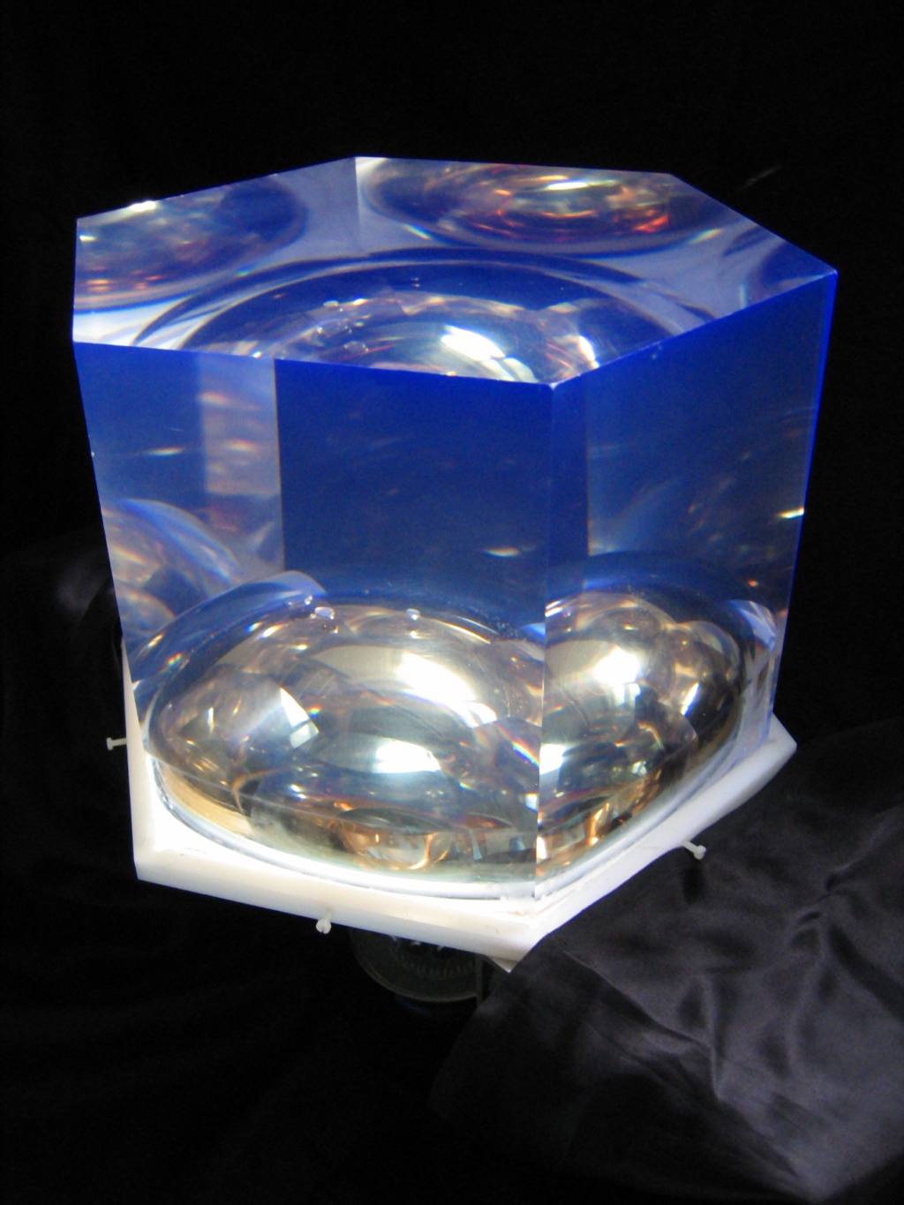
SuperNEMO Demonstrator Module: Overview
Tracker Prototype
Prove Mass Production
~700 calorimeter channels
2000 tracker cells
Change isotope ¹⁰⁰Mo ⁸²Se (longer )
²¹⁴Bi and radon reduced by a factor of 30.
²⁰⁸Tl reduced by a factor of 50.
Halve the calorimeter resolution to 4% at Q_{ββ}.
Improved efficiency, calibration etc.
6-7 kg source foil
UK R&D
Calorimeter R&D
Demonstrate FWHM~7% @ 1 MeV
Demonstrator Module
Notes:
SuperNEMO is a similar principle to NEMO3 but more square and bigger and better : with reduced backgrounds and better calorimeter resolution . The selected isotope is 82Se due to the more favourable 2nu half-life.
It starts with one demonstrator module containing 6-7kg of source on this central foil
The UK is responsible for production of the tracker modules and also calorimeter R&D
4 C-sections to tracker cells

Slide 20
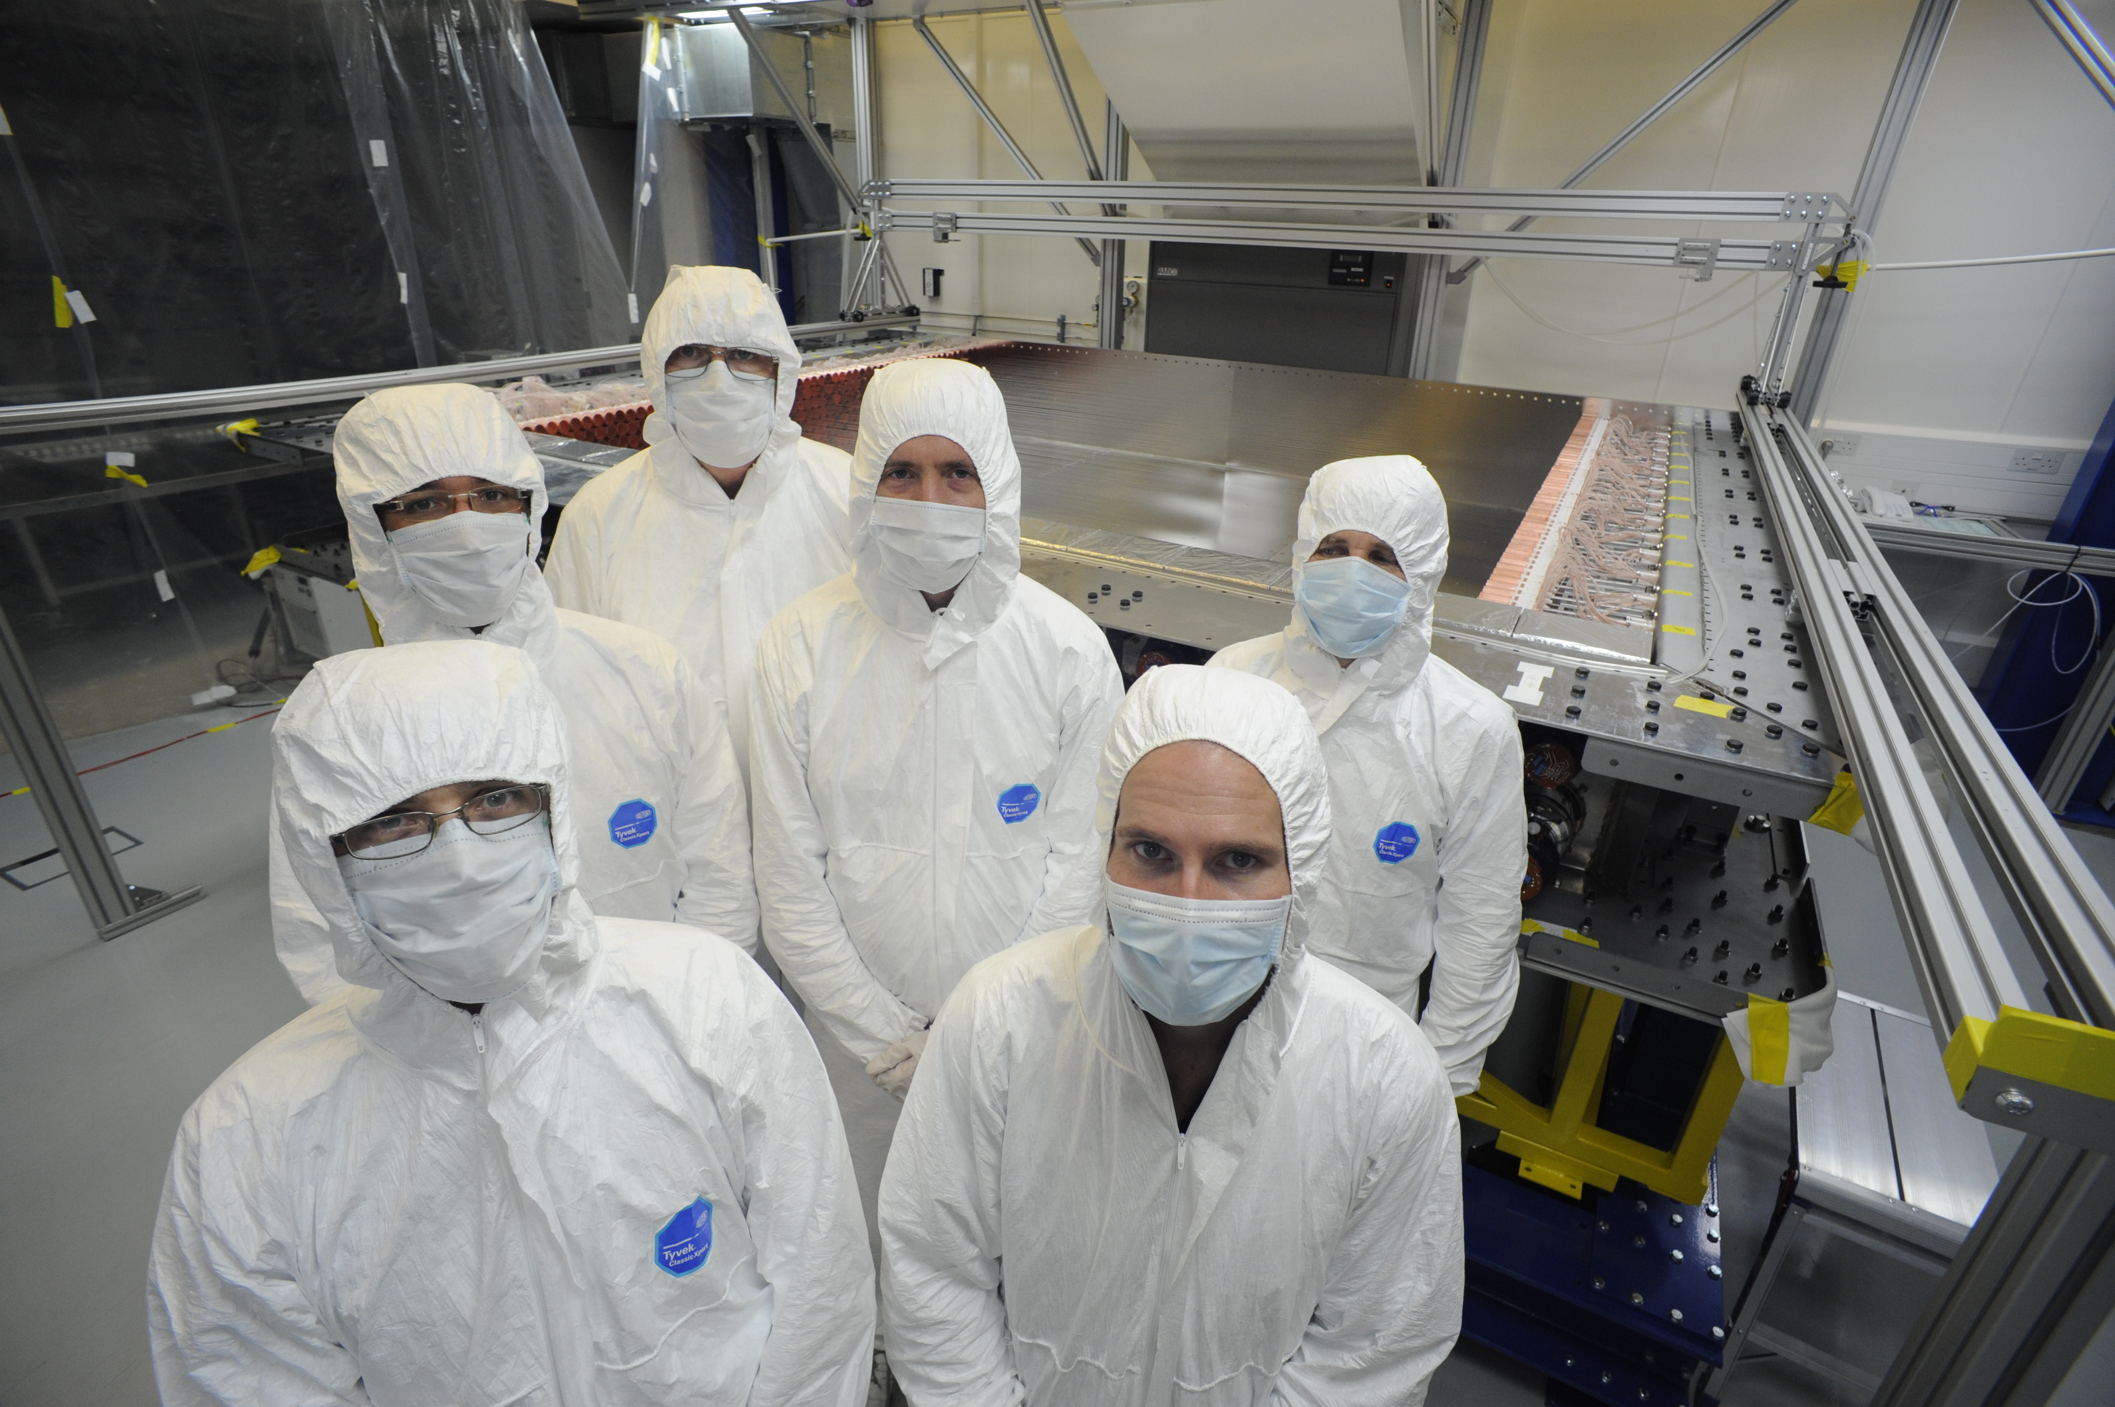
SuperNEMO Construction Status
First tracker module completed October 2014.
Fully tested and commissioned with cosmics : > 98% good channels.
Meets background (radon) requirements.
Notes:
The first of 4 tracker modules for the demonstrator was completed in October last year and has since been tested and comissioned with cosmics and it satisfied radon requirements.

Slide 21
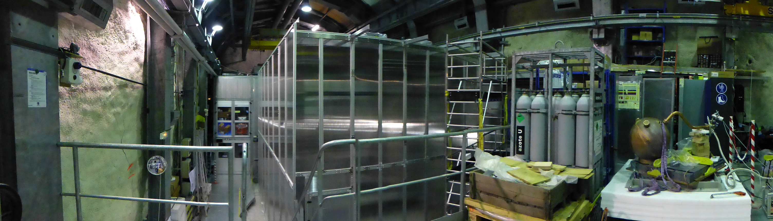
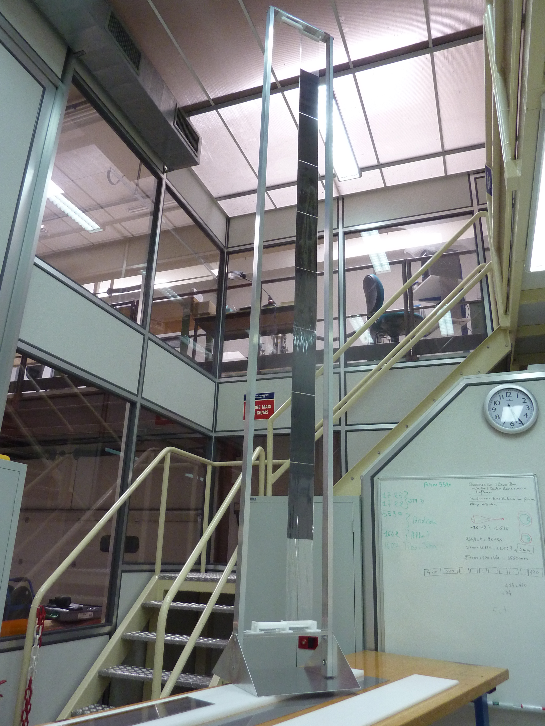
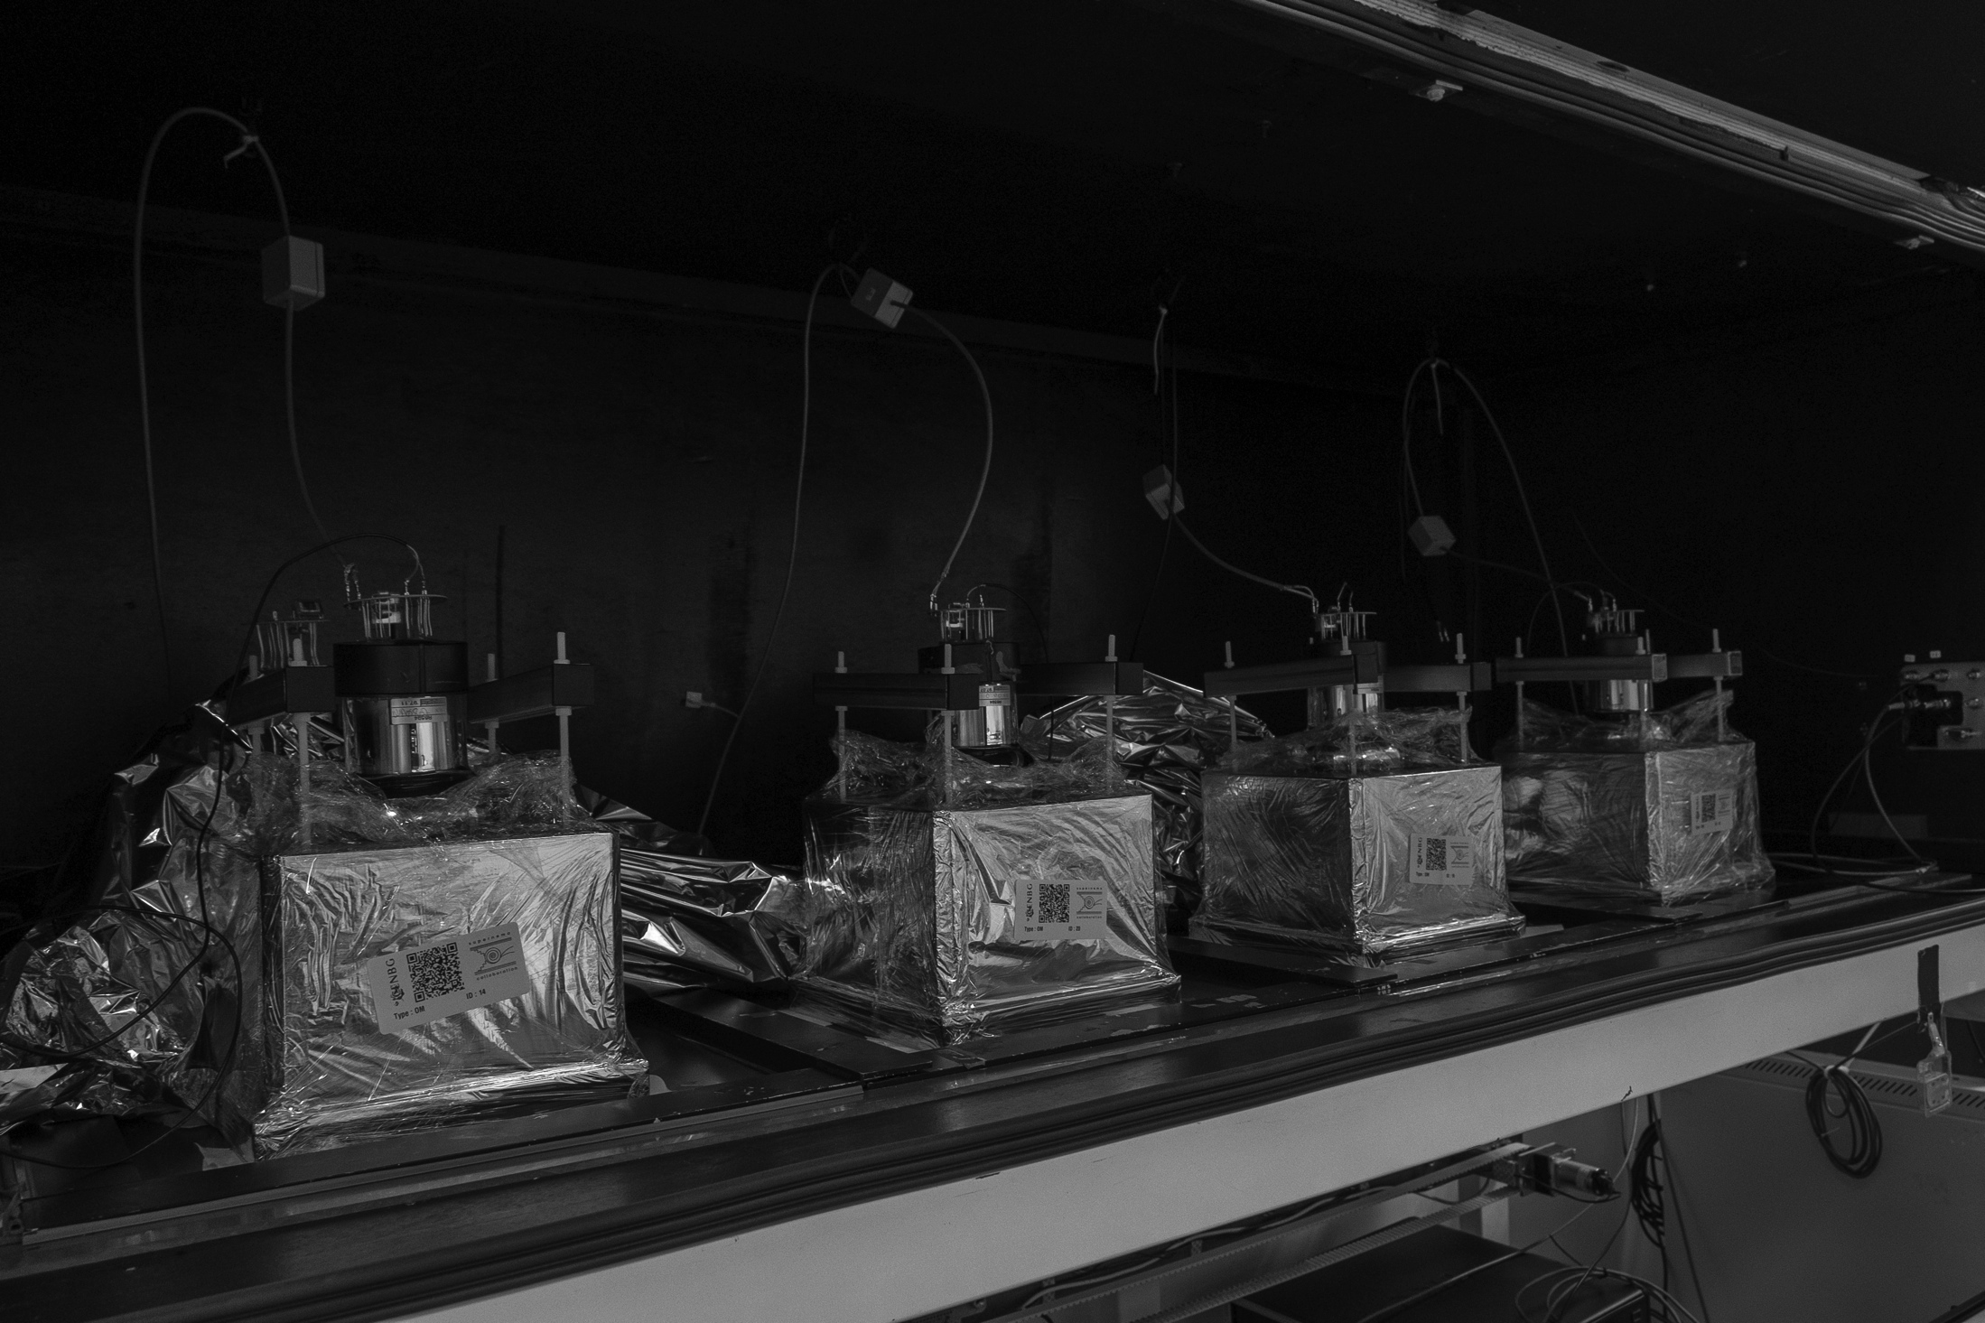
SuperNEMO Construction Status
Support Structure & Clean-Tent at LSM
New !
Full Size Source Foil Mock-up
Calorimeter Module Production
Notes:
Meanwhile, the support structure, clean tent have been constructed at Modane and source foils and calorimeter production is in swing in France.

Slide 22
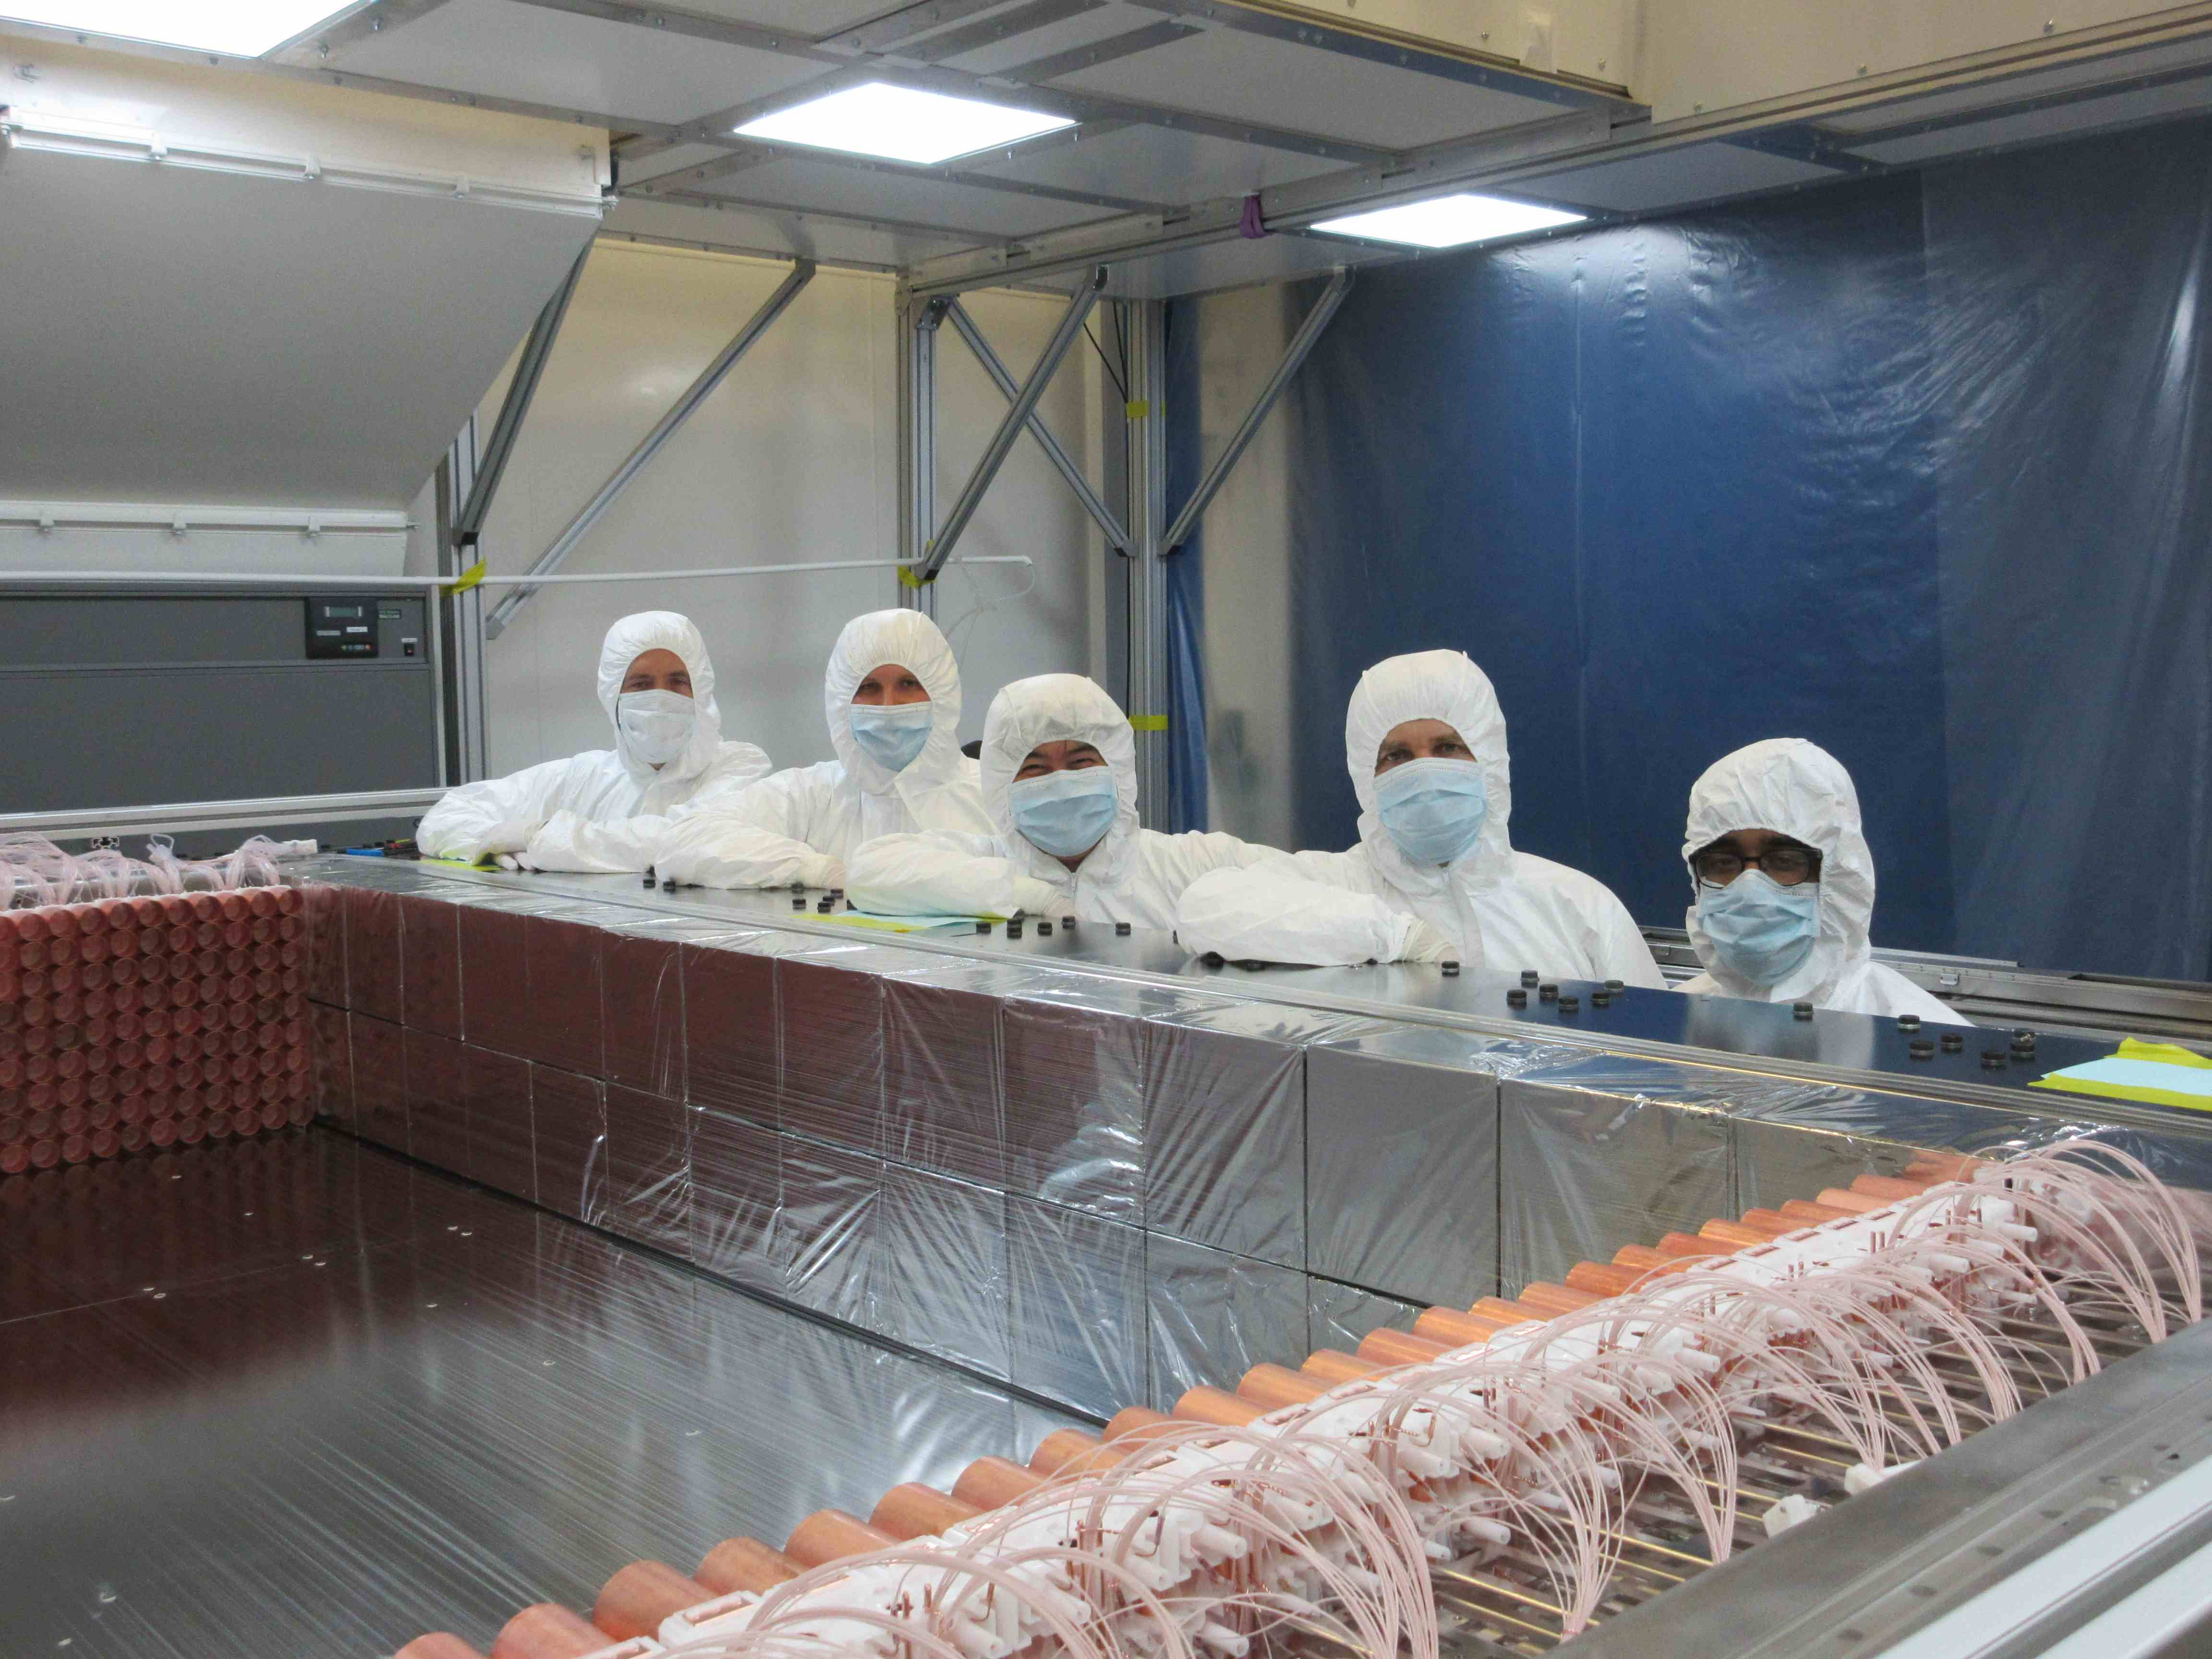
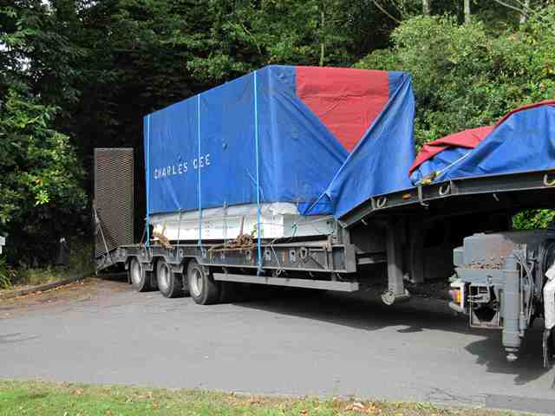
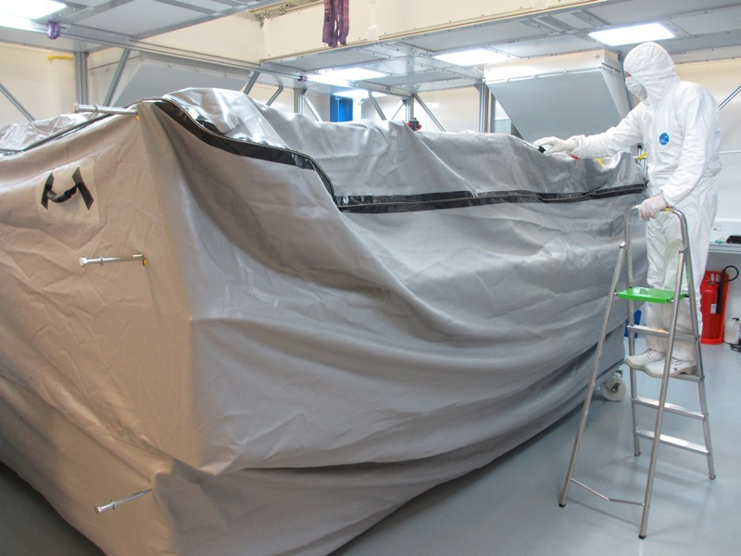
SuperNEMO Construction Status
Transport Container
Transport Clean Bag
Second module completed June 2015, 3rd / 4 underway
  -> construction of trackers for demonstrator more than 50% complete.
The first module is leaving for the LSM tomorrow !
On track to complete the Demonstrator Module construction & assembly in 2016.
Notes:
The first Tracker module is actually shipping out to LSM tomorrow, the second is completed and the third is underway so things are on track for assembly o f the demonstrator next year.

Slide 23


Timescales
Demonstrator Phase Complete; Further Module Construction
First results from Demonstrator
Construction in UK, France, US
Installation in LSM
Full SuperNEMO
2012
2013
2014
2015
2016
2017
2018
2019
2020
2020+
Water Fill?
Liquid Scintillator Fill
Future SNO+ Phases
First Isotope Deployment
First Results with Loaded-LS
Notes:
This summarises the time-frames of the two experiments – so in both cases things should be really moving in the next 2 years.

Slide 24
Other Experiments
¹³⁰Te
CUORE:
TeO crystal Bolometers
(Cuoricino -> CUORE-0 -> CUORE -> CUPID)
¹³⁶Xe
KamLAND-Zen:
Enriched ¹³⁶Xe loaded LS in Bag
EXO:
¹³⁶Xe liquid TPC (EXO-200 -> nEXO)
⁷⁶Ge
GERDA:
HPGe array, Lar cryogenic shield
Majorana:
HPGe, high purity Cu shield
Notes:
To put things in context, I’m just focusing on the experiments I think are seen as the fore-runners for the near future of double beta decay – these, including SNO+ and SuperNEMO are the ones being considered in the USA NSAC downselect process for example.
I’ve split them by isotope, and tried to give an idea of the experiment evolution.
CUORE uses Tellurium 130 in tellurium oxode crystal bolometers, based on years of experience with cuoricino, CUORE-0 has recently produced results and is the first step towards a full 200+kg CUORE, and there are ideas on the horizon for a future CUORE with PID – CUPID.
The two leading Xenon experiments are KamlandZEN – a similar approach to SNO+ though their isotope is enriched and they use a bag to contain it to a central FV. And EXO is a liquid xenon TPC concept.
There are two Germanium experiments under consideration – both classic HPGe detectors – GERDA in Gran Sasso and Majorana in the states. The main differences being the shielding options.

Slide 25
Summary Table
Experiment | Isotope/Method | T^{½}_{0ν}Limits (90% CL) Predicted / Solo / combined | Future | Predicted Sensitivity (5 years)*
SNO+ | ¹³⁰Te liquid scintillator | 3.9 × 10²⁵ y (0.3% loading, 1 year) | SNO++ (3% loading, HQE PMTs) | 7 × 10²⁶ y
NEMO-3 SuperNEMO | ¹⁰⁰Mo ⁸²Se Source foils and tracking | 1.1 × 10²⁴ y 6.5 × 10²⁴ y (7kg demonstrator) | Full 100kg | 1 × 10²⁶ y
GERDA | ⁶⁸Ge HPGe | 2.1 × 10²⁵ y 3.0 × 10²⁵ y | Future ⁷⁶Ge | 3.2 × 10²⁷ y
Majorana | ⁶⁸Ge HPGe | 1 × 10²⁵ y (30kg.y) | “ | “
Cuoricino CUORE-0 CUORE | ¹³⁰Te bolometers | 2.8 × 10²⁴ y 2.7 × 10²⁴ y 4.0 × 10²⁵ y | CUPID | (2-5) × 10²⁷ y (*10 years)
KamLAND-Zen | ¹³⁶Xe liquid scintillator | 2.6 × 10²⁵ y | KamLAND2-Zen | 10²⁶- 10²⁷ y (*20meV)
EXO200 | ¹³⁶Xe TPC | 1.1 × 10²⁵ y | nEXO | 6.6 × 10²⁵ y
Notes:
So this table sumarises the sensitivities – limits for the current / near future expreiments in this column – I’ve used green where they are only predictions. And this last column is for future – where possible for comparison these are 5 year limits.
So we are basically at the stage of probing 10^25 year half-lives and the next generation pushes to the next order of magnitude.

Slide 26
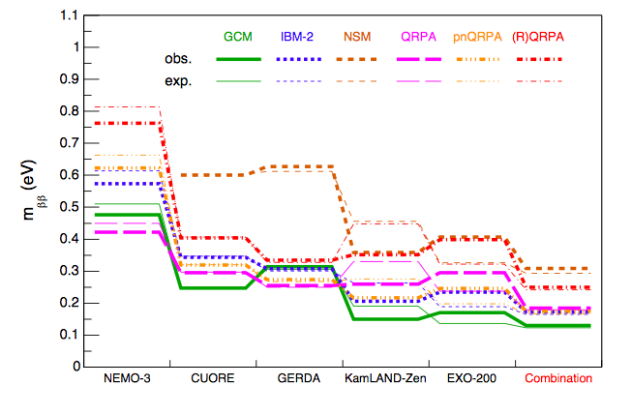
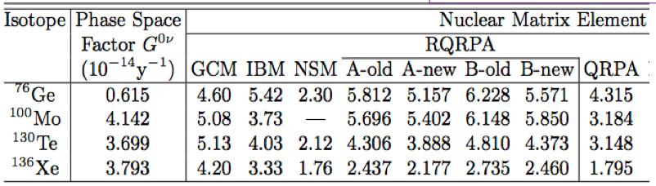
Combining Results
Phys Rev D 92, 012002, & P Guzowski, TAUP2015
Experiments measure half-life
Combined limits on m_{ββ} dependent on NME
Notes:
I show sensitivity in half-life as that is what we measure, but to compare between experiments using different isotopes we need to consider mass sensitivity, and that depends on the Matrix elements. This table gives the matrix element calculations of various theory groups for the four isotopes in question – note there is a fair range in values due to different methods and assumptions in the calculations. The Manchester group have started to combine existing experimental limits in this paper per matrix element calculation as shown here to reach improved combined upper limits on neutrino mass.

Slide 27
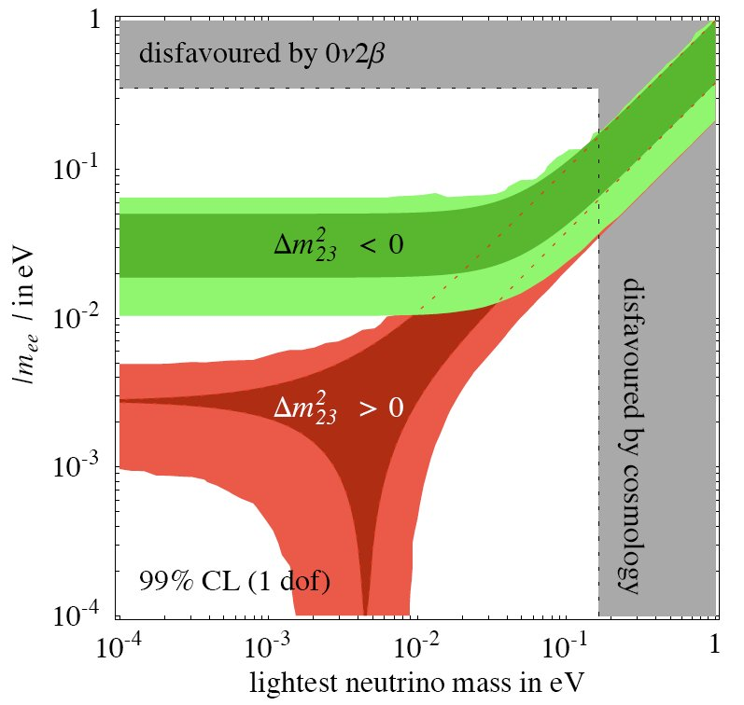
Timescales & Sensitivity
Best Current Limits
(EXO, KLZ, Gerda, NEMO-3)
KKDC Claim (⁷⁶Ge)
Degenerate
Current Target Level
(SNO+ Phase 1, CUORE, EXO+, GERDA+, KLZ+, Full SuperNEMO)
Inverted
Hierarchy
Inverted Hierarchy Explorers
(SNO+ Phase 2/3 (?) nEXO (?), Super-KLZ (?))
Effective Neutrino Mass (eV)
Normal
Hierarchy
There Be Dragons …
Or maybe enormous LS or bolometer detectors.
There Be Dragons…..
Biller, Physical Review D,
071301R
Lightest Neutrino Mass (eV)
Notes:
Back to the phase space plot we can draw roughly where the existing measurements, current running / nearly running experiments and proposed future experiments sit, but bare in mind from the range of that last slide, these regions are suitably fuzzy.
So the bottom of the inverted hierarchy looks feasible within my career – but the normal hierarchy is challenging – you need 10s, 100s, thousands of tonnes of isotope with low backgrounds in a big detector. I haven’t got time to go into the challenges people are thinking about this

Slide 28
Summary
UK heavily involved in two major 0νββ experiments
Different isotopes, Different methodologies
Enriched ⁸²Se
Tracking -> Zero Background
Probe Mechanism
Large Mass -> Scalability
natural Te loading (¹³⁰Te)
Notes:
So to summarise, the UK is involved in two major neutrinoless double beta experiments employing different isotopes and very different complementary technologies. If we get lucky with the mass hierarchy then the next decade could be very interesting times in this field and its important that we keep up our strong UK programme to stay in the action.

Slide 29
Backups

Slide 30
76 Germanium

Slide 31
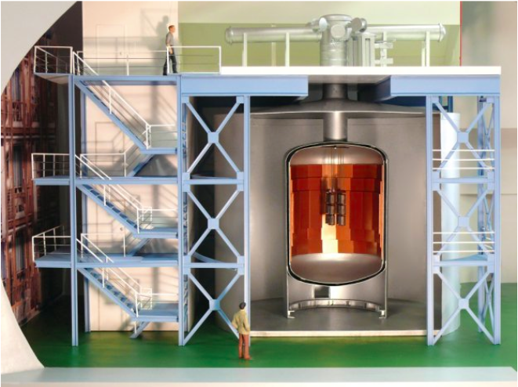
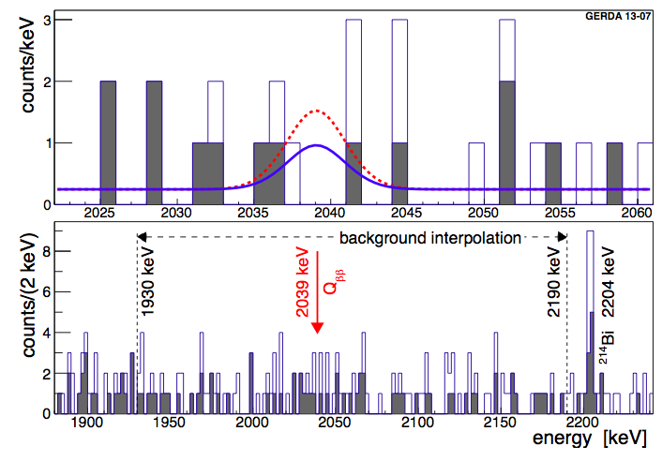
GERDA
Phys. Rev. Lett 111 (2013) 122503
arXiv:1307.4720
Enriched HPGe array
LAr active cryogenic shield
18 kg of enriched 76Ge (Phase I)
40 kg of enriched 76Ge (Phase II)
Phase 1 results
21.6 kg·yr exposure
0.01 cts/(keV·kg·yr) after pulse shape discrimination
T^{½}_{0ν} > 2.1 · 10²⁵ yr (90 % CL)
+IGEX+HM = T^{½}_{0ν} > 3.0·10²⁵ yr (90 % CL)

Slide 32
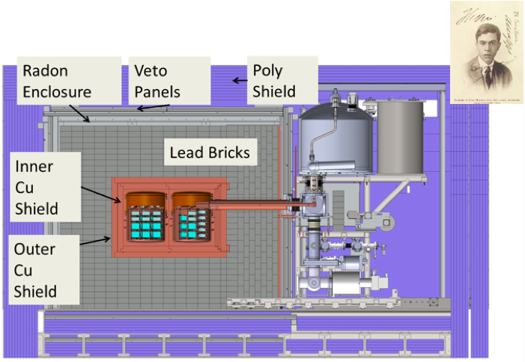
Majorana
Demonstrator:
30kg (87%)enriched ⁷⁶Ge
15kg natural Germanium
Sandford lab
High-purity electroformed
Cu shield (compact)
arXiv:1501.03089
Require <3 count/tonne/year in 4meV ROI
➔<1count/tonne year in ROI for tonne-scale experiment
Need 30 kg.y exposure to test HM claim
Notes:
thanks to various effects such as self-shielding and longer time for cosmogenic backgrounds such as 68Ge to decay

Slide 33
Future ⁷⁶Ge
Majorana + GERDA ➔single international ⁷⁶Ge 0νββ Collaboration
Tentative down-select 2017
Stepwise implementation towards 1000kg
5 year 90% CL sensitivity T^{½}_{0ν} > 3.2×10²⁷ yr
http://science.energy.gov/~/media/np/nsac/pdf/docs/2014/NLDBD_Report_2014_Final.pdf

Slide 34
130 Tellurium

Slide 35
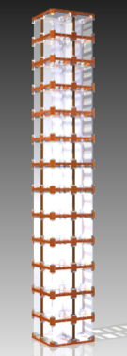
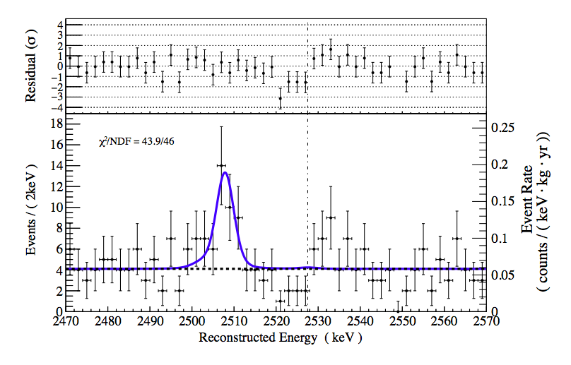
CUORE-0
1 tower
52 crystals
10.9kg ¹³⁰Te
T^{½}_{0ν}>2.7 × 10²⁴ yr (90 % CL) arXiv:1504.02454 (PRL)
11kg ¹³⁰Te operating 2013-2015 TeO₂ Cryogenic bolometers
Energy resolution = 5.1 ± 0.3 keV (FWHM)
Background = 0.058 ± 0.004 (stat.) ± 0.002(syst.) counts/(keV·kg·yr)
In combination with Cuoricino: T^{½}_{0ν} > 4.0×10²⁴ yr (90% CL)

Slide 36
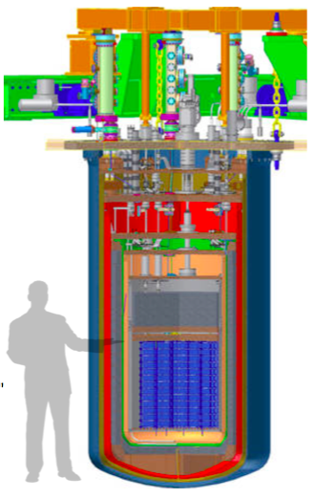
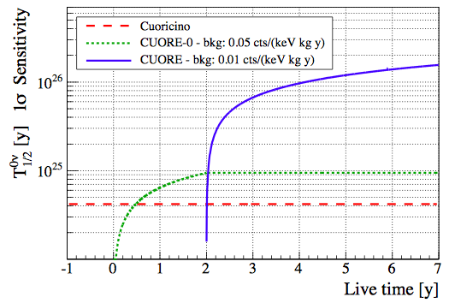
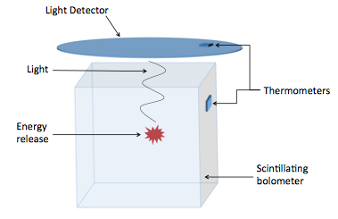
CUORE future
2015 – 2020, 206kg ¹³⁰Te in array of 988 crystal bolometers.
All towers assembled and underground
Cryostat and dilution unit under commissioning (reached 6mK base T)
Expect to start operations by end of year
5 year sensitivity: T^{½}_{0ν}>9.5×10²⁵yr
2020++: CUPID (Eur.Phys.J. C74, 3096 (2014))
CUORE with PID
10 year sensitivity
T^{½}_{0ν}>2-5×10²⁷yr

Slide 37
136 Xenon

Slide 38
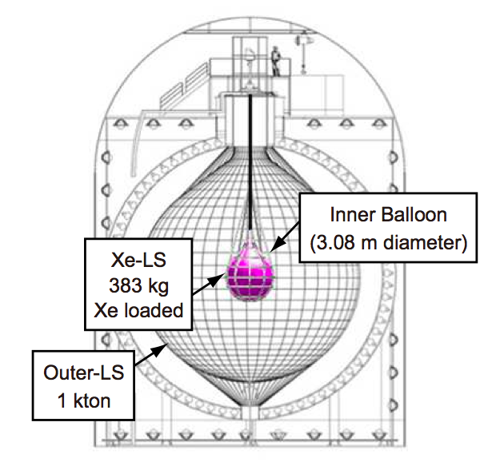
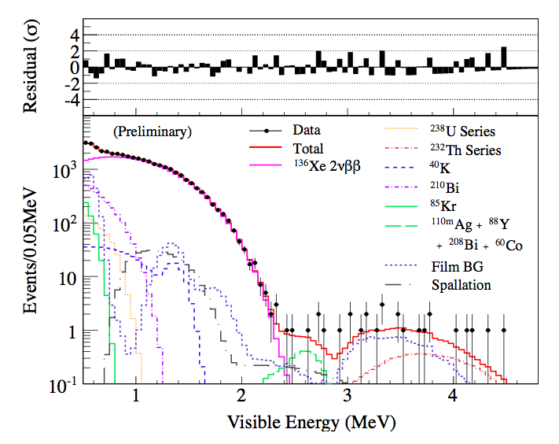
KamLAND-Zen
arXiv: 1409.0077
114.8 live days ➔27.6 ¹³⁶Xe kg-yr
^{110m}Ag reduced > factor of 10
T^{½}_{0ν} > 2.6 × 10²⁵ years (90%CL)

Slide 39
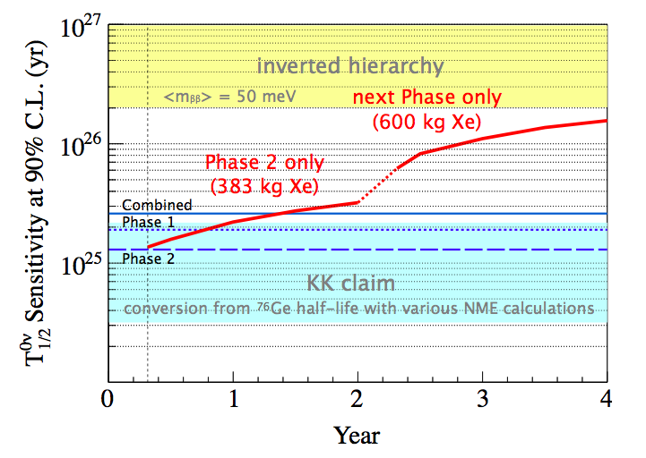
KamLAND-Zen next generation
….to reach <m_{ββ}> ~20meV in 5 years running ➔ KamLAND2-Zen
Increase light yield ➔Energy Resolution <2.5% at Q-val (from 4.0%)
  Iight collective mirrors (×1.8 light yield)
  Brighter LS (×1.4 light yield)
  High QE PMTs (×1.9 light yield)
Increase mass ➔ 1000kg ¹³⁶Xe
  Enriched Xe

Slide 40
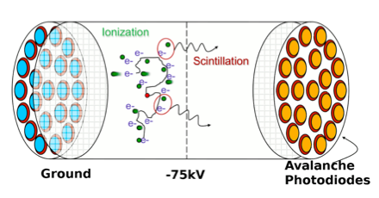

EXO-200
Single site
Multi site
Nature 510, 229-234, arXiv: 1402.6956
T^{½}_{0ν} > 1.1 × 10²⁵ yr (90% CL)
200kg Single phase liquid Xenon Detector (enriched 80.6% ¹³⁶Xe)
100kg-yr ¹³⁶Xe exposure
Energy resolution = σ/E = 1.53%
Notes:
Events in the detector are classified as single-site (SS) or multi-site (MS) ac- cording to the number of detected charge deposits. 0νββ events are predominantly SS whereas γ backgrounds are mostly MS. For each event, the energy is determined as a linear combination of charge and scintillation, while a “standoff distance” (SD) is defined as the distance be- tween a charge deposit and the closest material that is not LXe, other than the cathode.
EXO-200 has been described in detail elsewhere [15]. Briefly, the detector is a cylindrical liquid xenon (LXe) time projection chamber (TPC), roughly 40 cm in di- ameter and 44 cm in length. Two drift regions are separated in the center by a cathode. The LXe is en- riched to 80.6% in 136Xe, the 0νββ candidate (Q = 2457.83 ± 0.37 keV [16]). The TPC provides X-Y-Z co- ordinate and energy measurements of ionization deposits in the LXe by simultaneously collecting the scintillation light and the charge. Charge deposits spatially separated by about 1 cm or more are individually observed and the position accuracy for isolated deposits is a few mm. Avalanche Photodiodes (APDs) measure the scintillation light.

Slide 41
EXO next Generation
5 tonnes enriched ¹³⁶Xe
nEXO 5yr 90% CL sensitivity: T^{½}_{0ν}> 6.6×10²⁷yr
LXe homogeneous imaging TPC similar to EXO200:
  baseline: install at SNOLAB (cosmogenic background reduced wrt EXO200)
  simultaneous measurement: energy, spatial extent, location, particle ID
  Multi-parameter approach improves sensitivity: strengthens proof in case of discovery
  inverted hierarchy covered with a well proven detector concept
  possible later upgrade for Ba retrieval/tagging: start accessing normal hierarchy

Slide 42

Next Generation ¹³⁶Xe
NEXT: electroluminescent high-pressure xenon gas TPC filled with 100 kg of enriched Xe
Energy resolution better than 1% at Q_{ββ}
Topological information gives signal: background rejection
NEXT (Spain)
  100kg detector ~2017
PANDA-X III (China)
  200kg detector ~2017
Notes:
signal events (a twisted track of about 10 cm long, with two energy depositions at both ends) from background events (single electrons with only one blob at the end and most of the time accompanied by an X-ray

Slide 43

SNO+ Water Leak

Slide 44

SNO+: What if we see a Bump?

Slide 45

Global Landscape (USA Perspective)

