Slide 1

LHC Run 2 Prospects: Experimental Overview
YETI 2016
Sinéad Farrington
12th January 2016

Slide 2
Outline
What I will cover:
  Recap the goals of the LHC
  Look at how the LHC experiments are designed
  Summarise what was achieved in Run 1
  Describe the upgrades done in the shutdown between Run 1 & 2
  Summarise some of the Physics prospects for Run 2
  Look at some early hints from Run 2
What I will not cover:
  Details of any given Physics topic
    In the next days you will have 2 hours dedicated to individual topics, with a detailed look at the theory and experiment behind each topic
    This talk is an overview of many topics so touches on them briefly
Final caveat:
  I’m on ATLAS so may use it to describe things more often than CMS simply because I’m more familiar with it – there is no intended bias

Slide 3

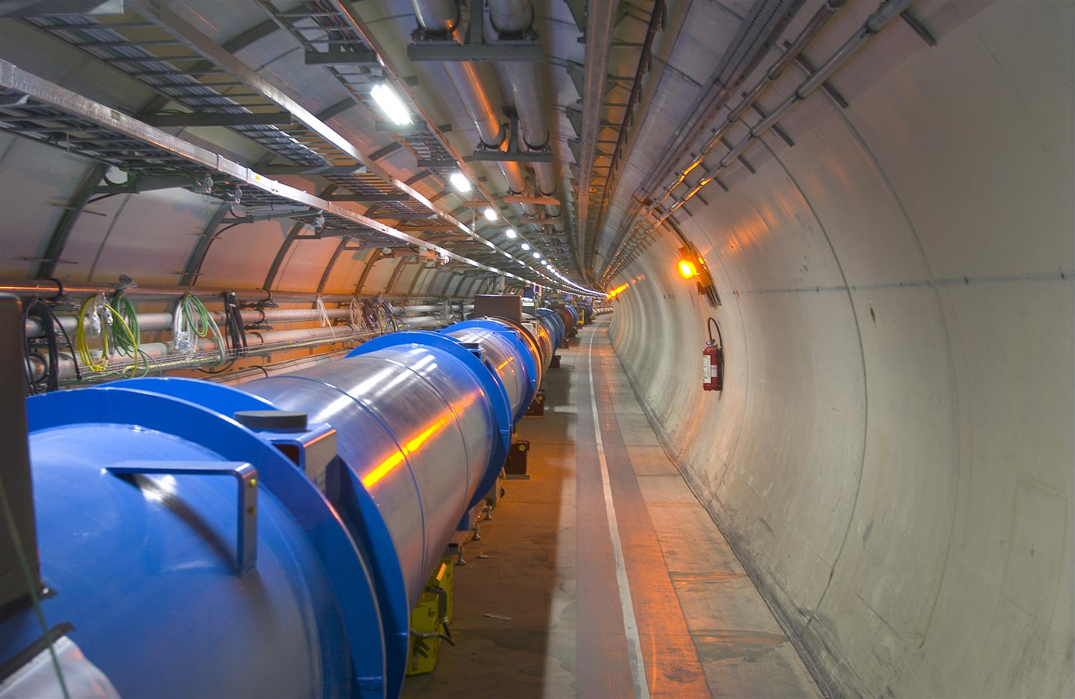
The Large Hadron Collider
p
p
Collisions of proton bunches travelling at high energy
Superconducting dipole magnetic field 8.3 Tesla
2808 bunches, 10¹¹ particles in each
  99.9999991% x speed of light, 11000 revolutions per second
  Interactions between beams every 25 nanoseconds

Slide 4


Particle Collisions
Two particles collide at very high energy
New particles are produced which we detect and study
?

Slide 5
Why?

Slide 6
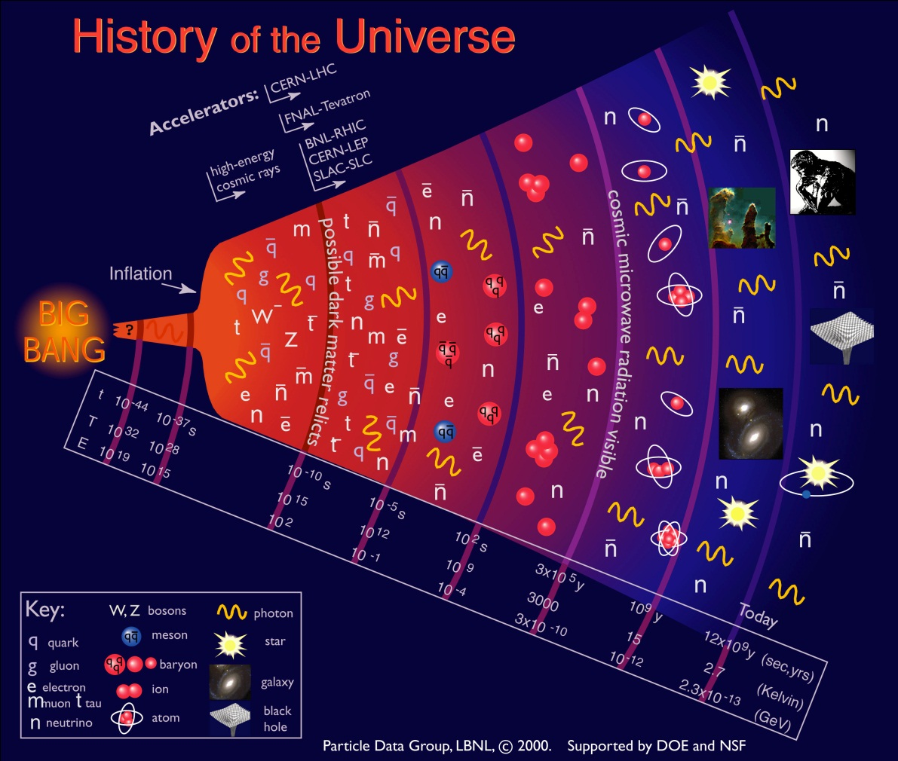
Understanding the Universe
Big Bang
now
Older ….. larger … colder ….less energetic

Slide 7
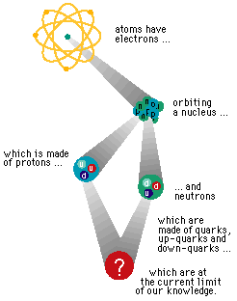
How do we do it?
To probe the conditions of the early universe we smash particles together
J. Ellis

Slide 8
The Energy Frontier
Size of structure we can probe with a collider like LHC
= h / p (de Broglie, 1924)
h = Planck’s constant = 6.63 x 10⁻³⁴ Js
p = momentum of protons
The larger the momentum (energy), the smaller the size probed
AND E=mc²

Slide 9
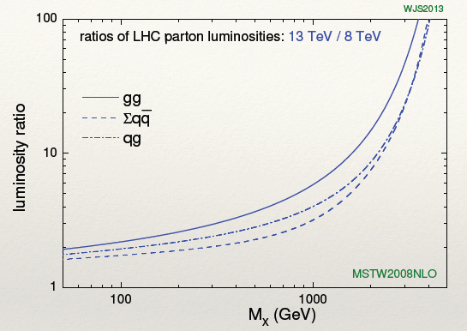
Run 1 to Run 2 Energy Increase
Linear relation between energy of collision and mass of particles that can be produced
But the extra luminosity is not shared equally among parton-pair interactions, so the reach depends on production
mechanism

Slide 10
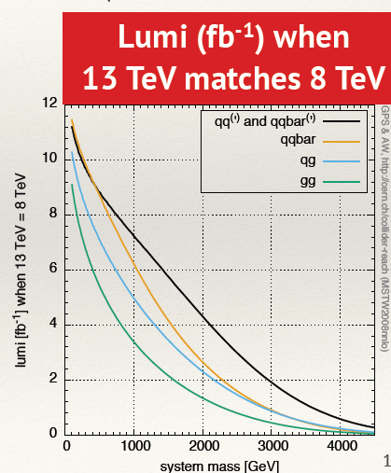
Integrated lumi comparison
(From G. Salam talk)

Slide 11
Goals of the LHC
Understanding the generation of mass
Understanding origin of CP violation
  In quantities large enough to explain CP asymmetry of universe
Searching for new phenomena to rule in or out new theories
Searching for whatever is out there
Joining up our understanding of the very large (galaxies) with the very small: what is dark matter?

Slide 12
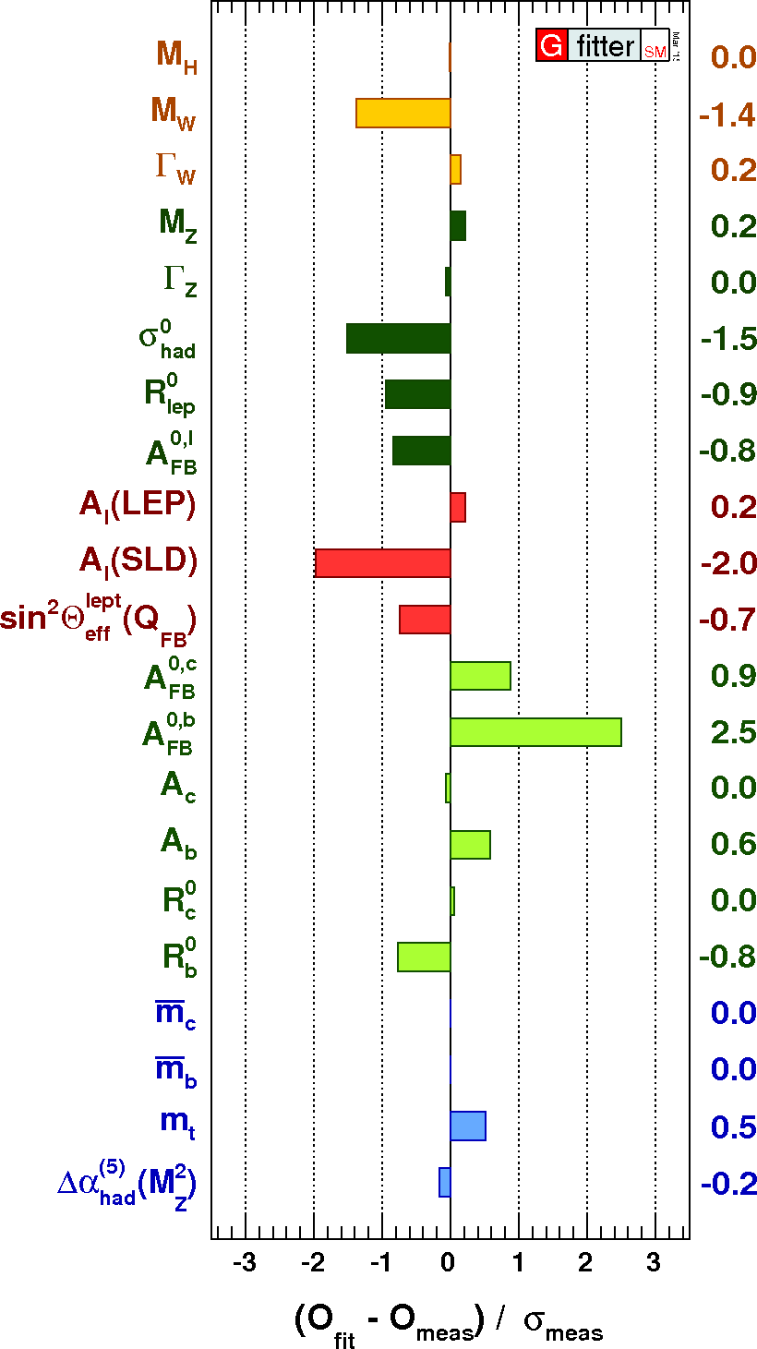
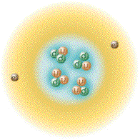
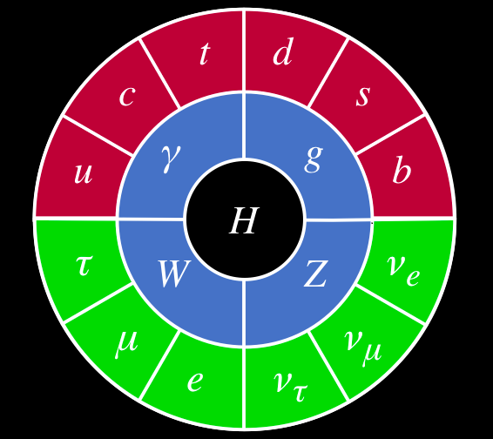
Probe the Standard Model and look for processes beyond it
Strong, weak and Electromagnetic
forces
Describes interaction of matter
particles by the means of
force carrier particles

Slide 13
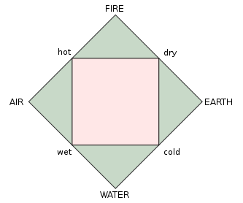
Probe the Standard Model and look for processes beyond it
Strong, weak and Electromagnetic
forces
Describes interaction of matter
particles by the means of
force carrier particles
Greeks

Slide 14
Goals of the LHC
How do we, as experimentalists, go about achieving those goals?
How far did we get in Run 1?

Slide 15
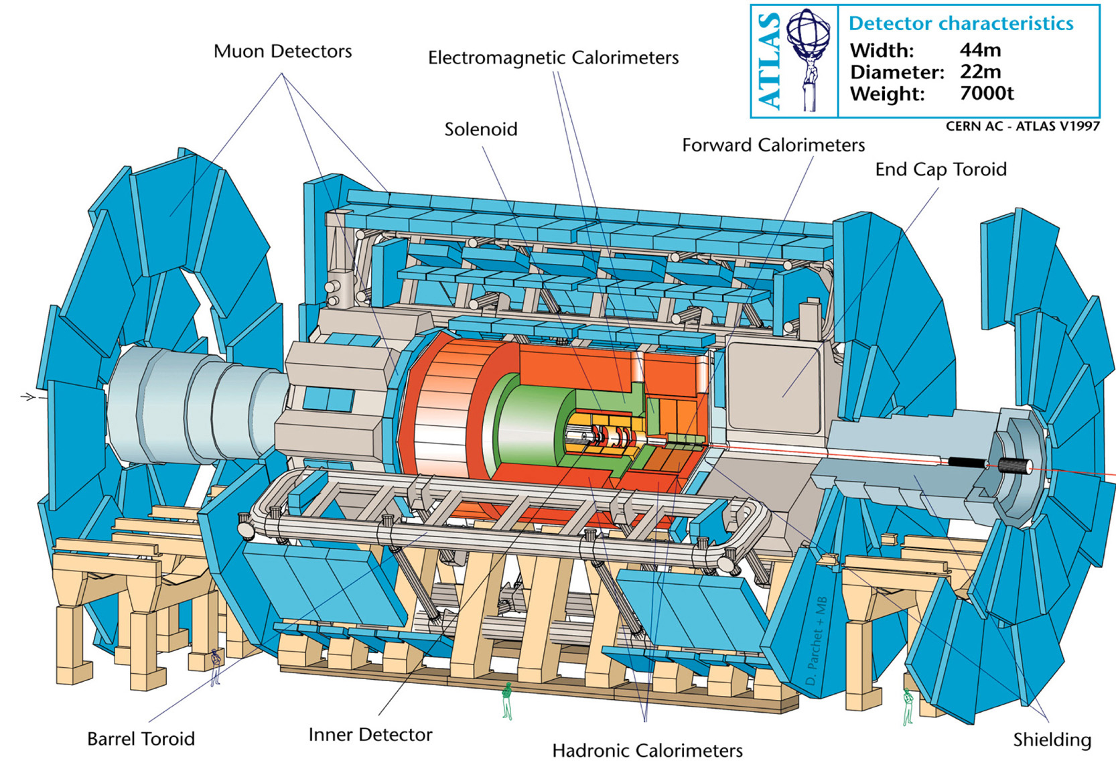
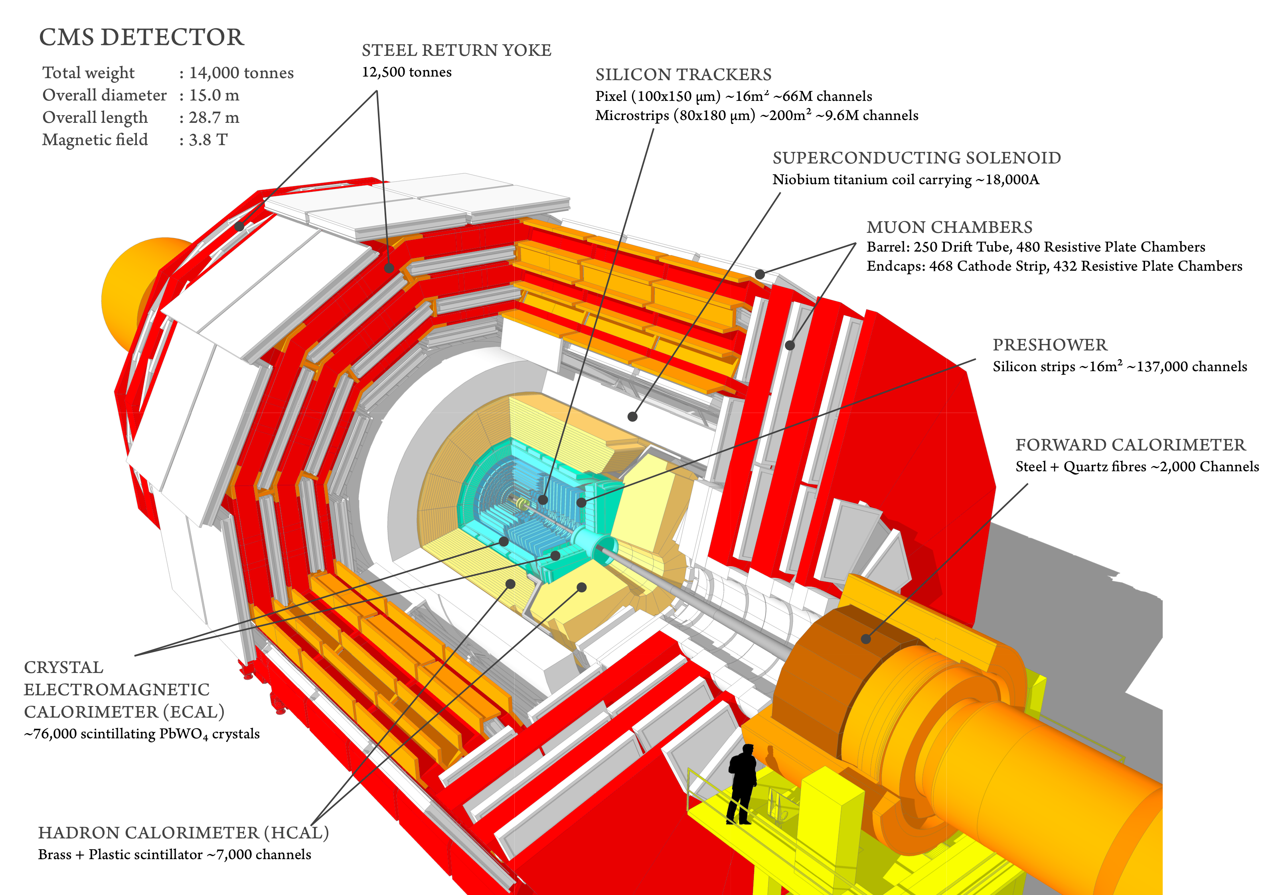
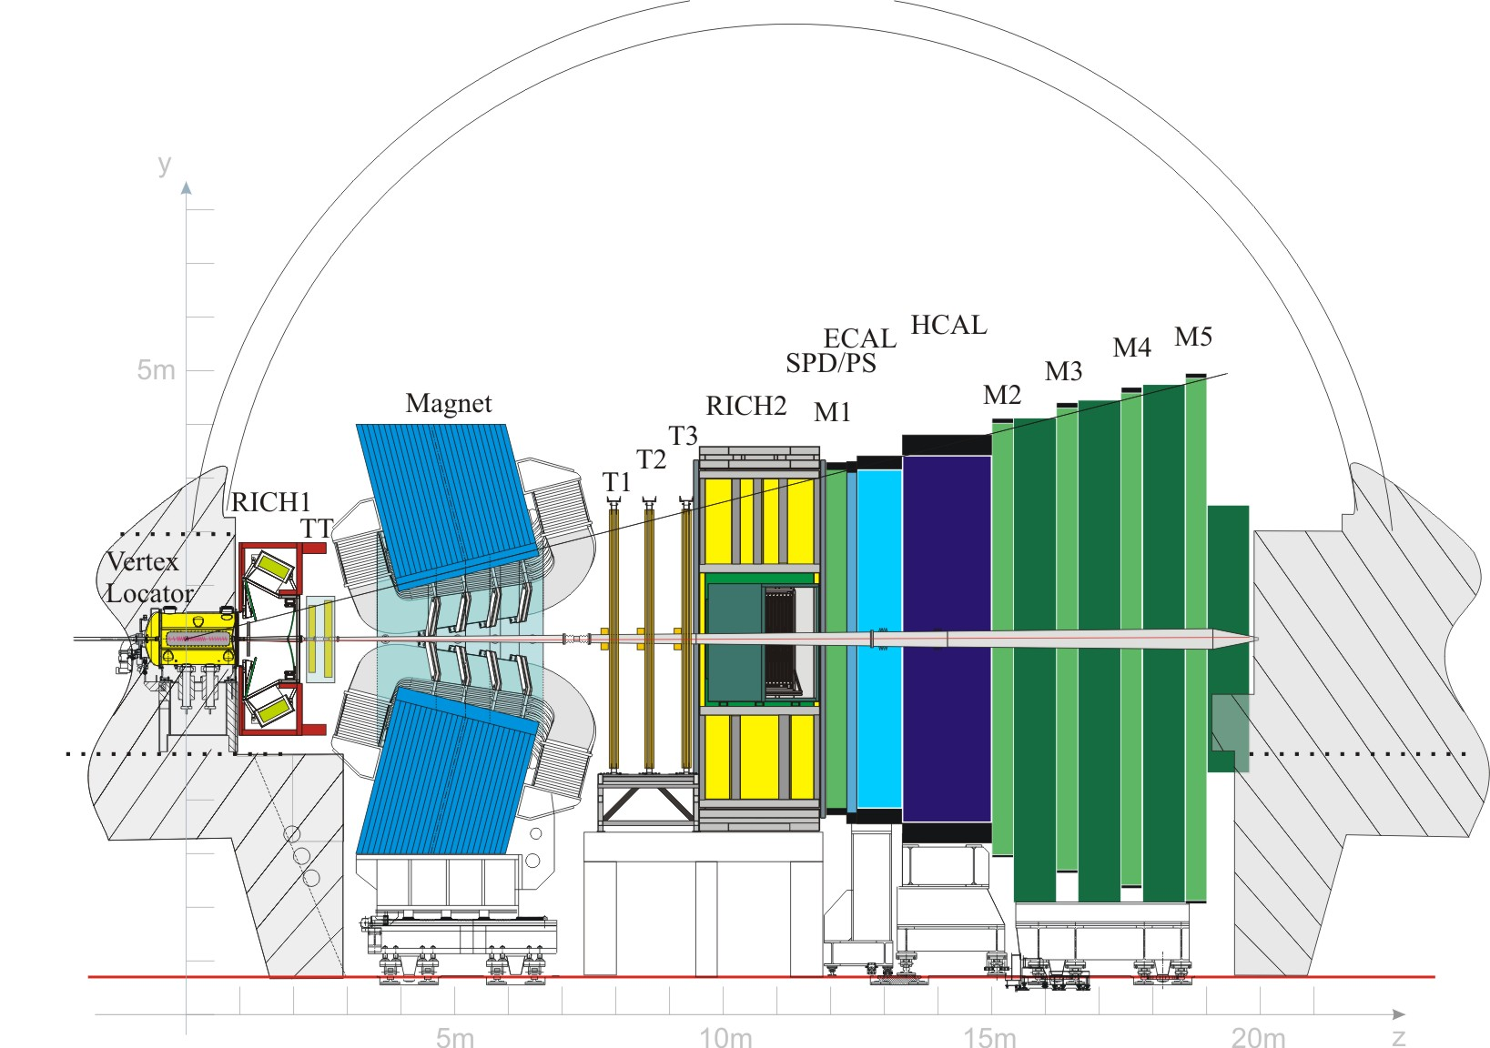
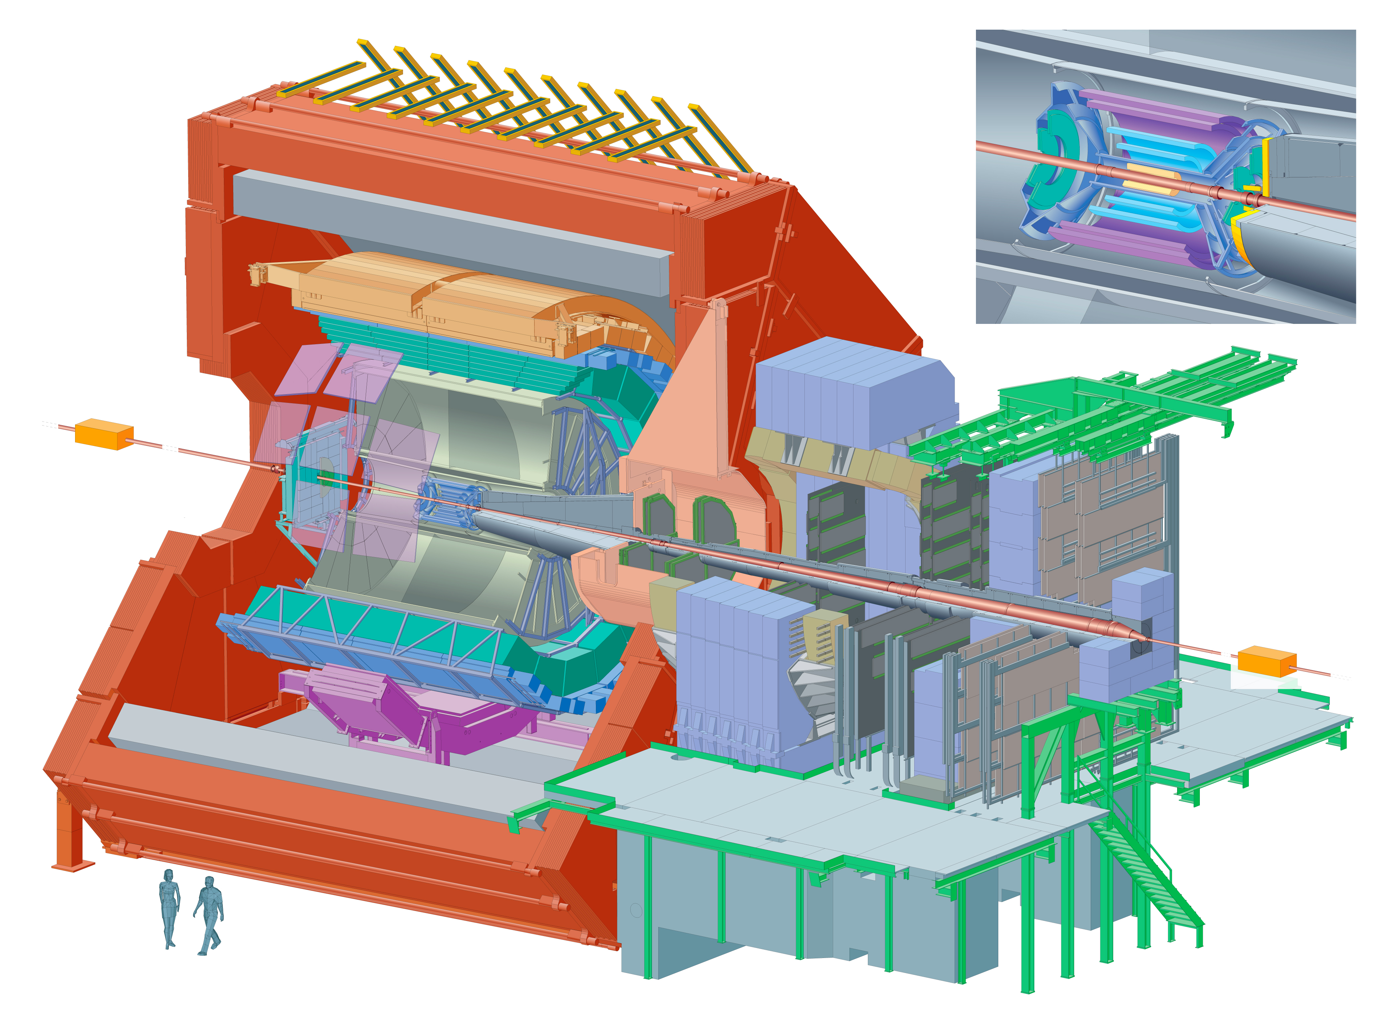
LHC Experiments
To achieve LHC goals, there are two approaches, built using the same detector principles
  General purpose detectors (ATLAS and CMS)
  Dedicated experiments for flavour physics (LHCb) and Heavy Ion (ALICE) – I will not cover ALICE detector or Physics

Slide 16
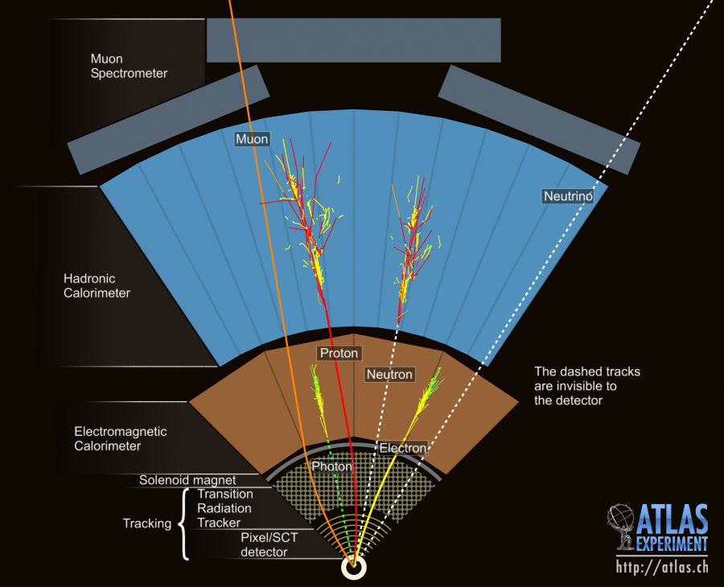
ATLAS Detector
“Onion shell” structure enables reconstruction of particles
Use this capability to reconstruct particle interactions of
special interest

Slide 17
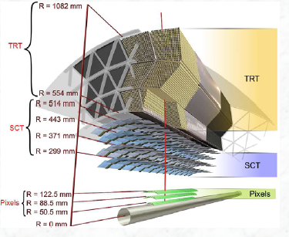
ATLAS Tracker
Silicon strips and pixels (~62m² of silicon)
  In 2 Tesla field
  High granularity and resolution for charged particle trajectories
Transition Radiation Tracker
  Continuous tracking of charged particles – Xe-filled tubes
  Less material
  than silicon tracking

Slide 18
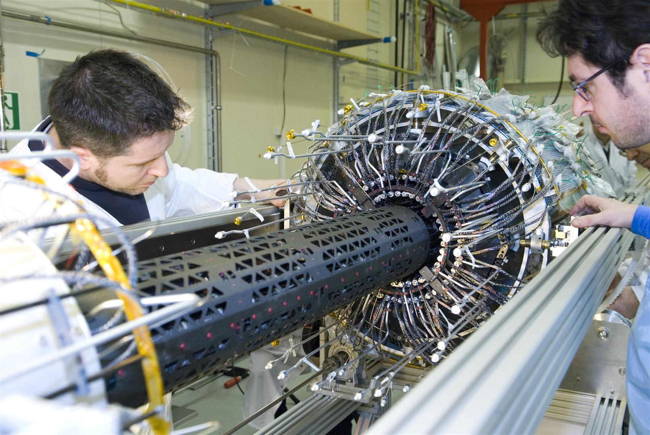
The ATLAS experiment

Slide 19
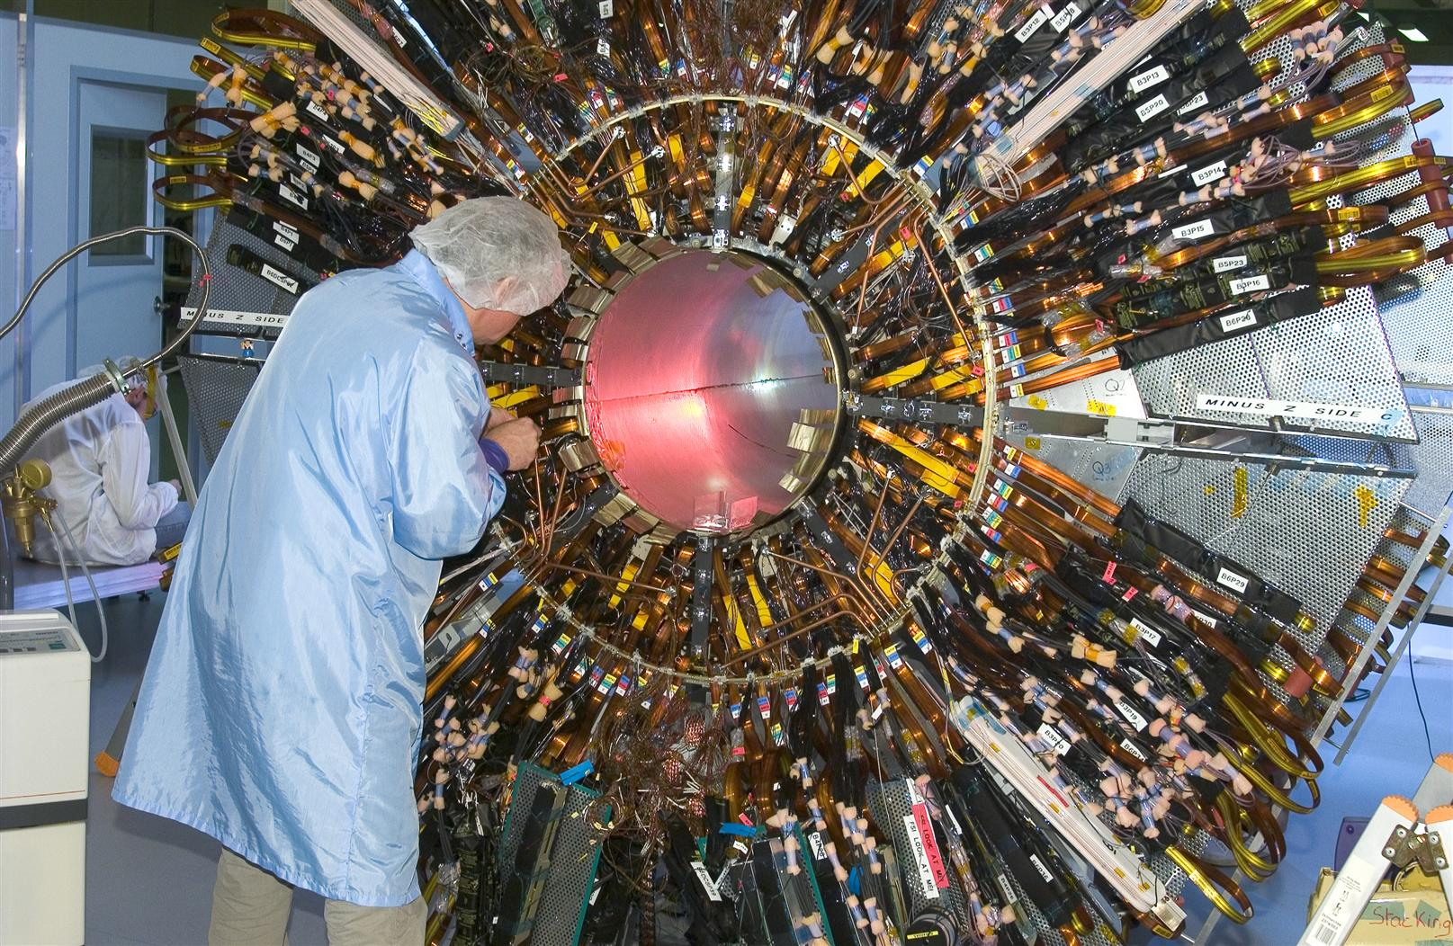
The ATLAS experiment

Slide 20
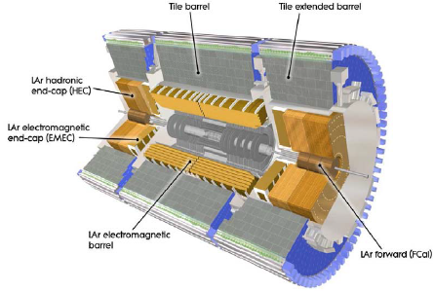
ATLAS Calorimeters
Liquid Argon calorimeter
  Barrel Electromagnetic calorimeter and end-cap of Hadronic calorimeter
  Fast response time, fine “granularity”
Tile
  Barrel of Hadronic Calorimeter
Outside B-field

Slide 21
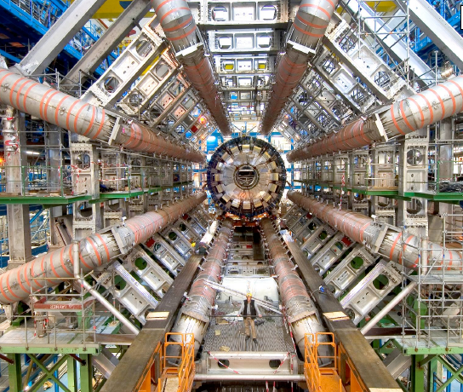
ATLAS Muon Chambers
ATLAS=A ToroidaL ApparatuS

Slide 22
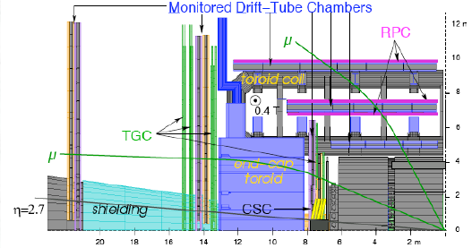
ATLAS Muon Chambers
Independent muon spectrometer
  Standalone capabilities
  Monitored Drift Tube chambers measure momentum and position of muons

Slide 23
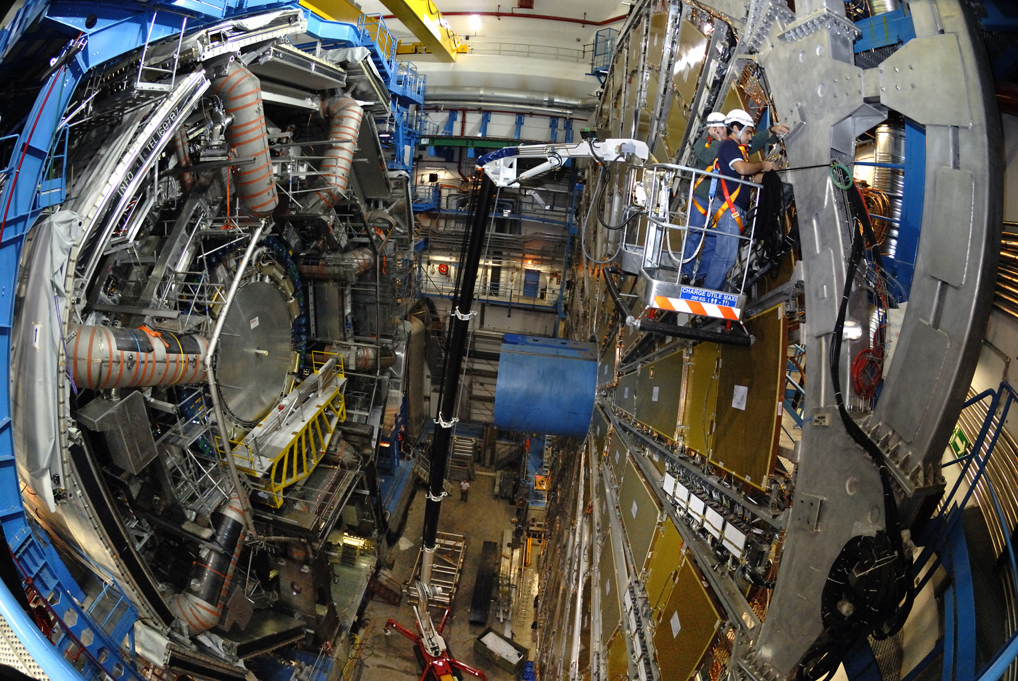
The ATLAS Experiment

Slide 24
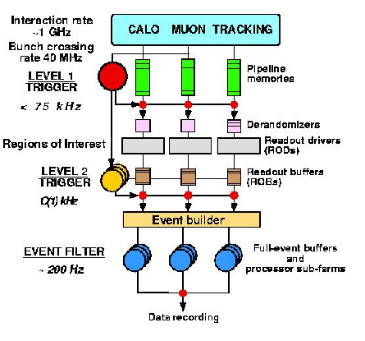
ATLAS Trigger
Three distinct levels during Run 1
Reduce rate from bunch crossing ~40 MHz to output rate of order 1 kHz

Slide 25
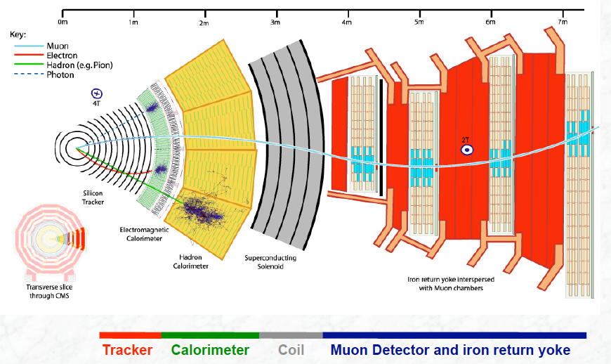
CMS Detector

Slide 26
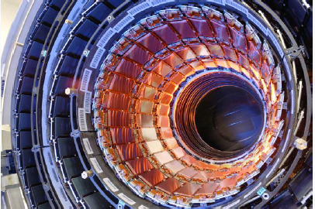
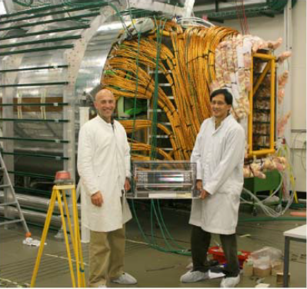
CMS Tracker
200m² of silicon detector
4 Tesla magnetic field

Slide 27
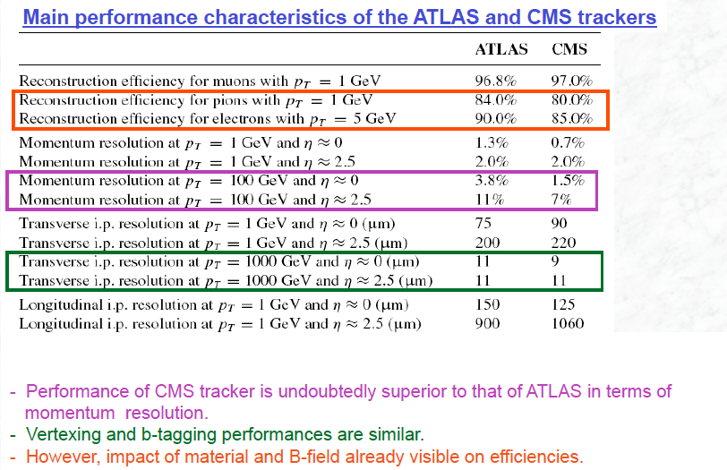
ATLAS/CMS Comparison
From K. Jakobs

Slide 28
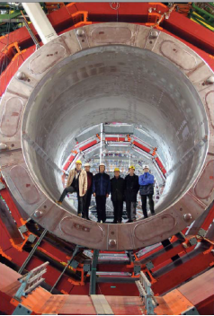
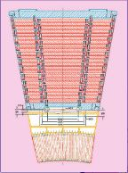
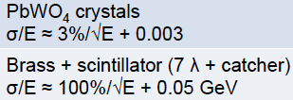
CMS Calorimeters
Electromagnetic calorimeter and part of hadronic calorimeter are inside the solenoid coil and form its return yoke

Slide 29
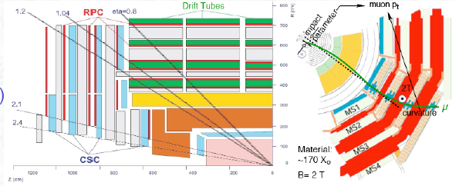
CMS Muon Chambers
Excellent momentum resolution combined with tracking detector in central region
  Less good standalone, making muon triggering a bit more challenging e.g. unprescaled thresholds

Slide 30
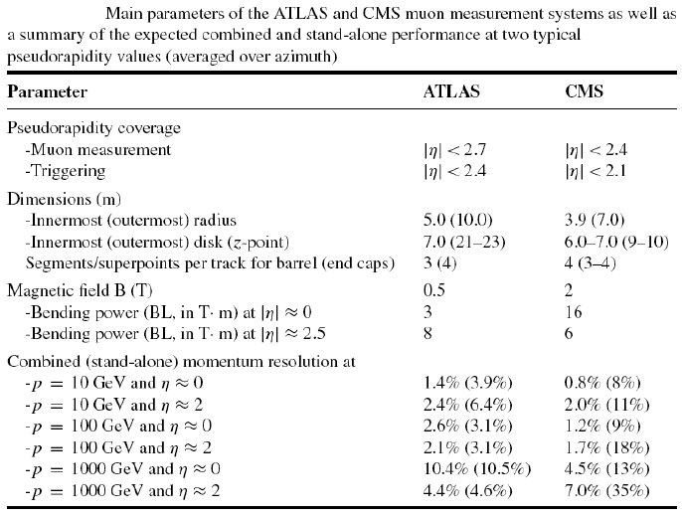
ATLAS/CMS muon chambers

Slide 31
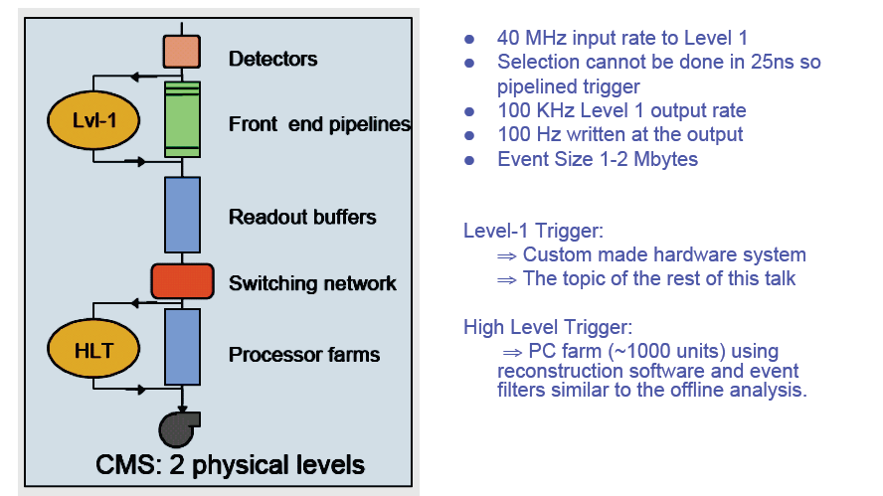
CMS Trigger

Slide 32
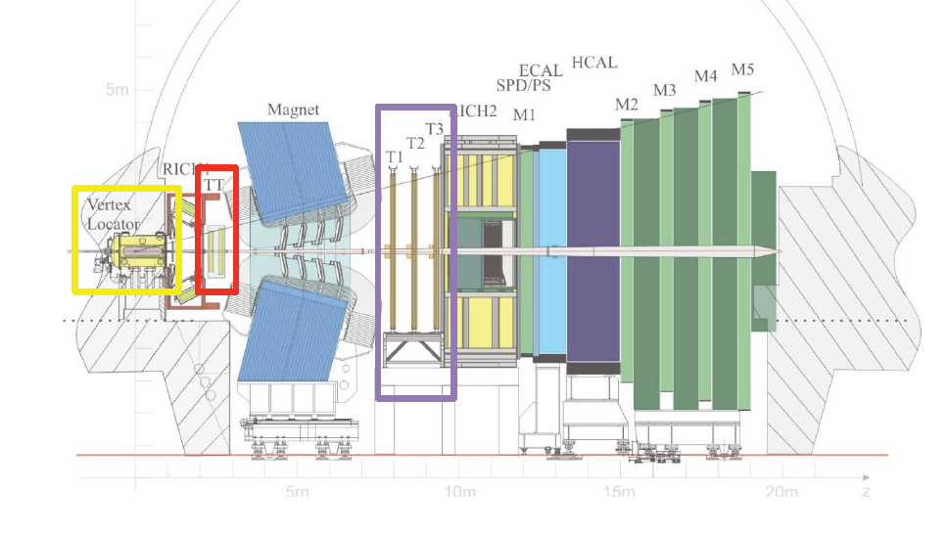
LHCb Detector

Slide 33
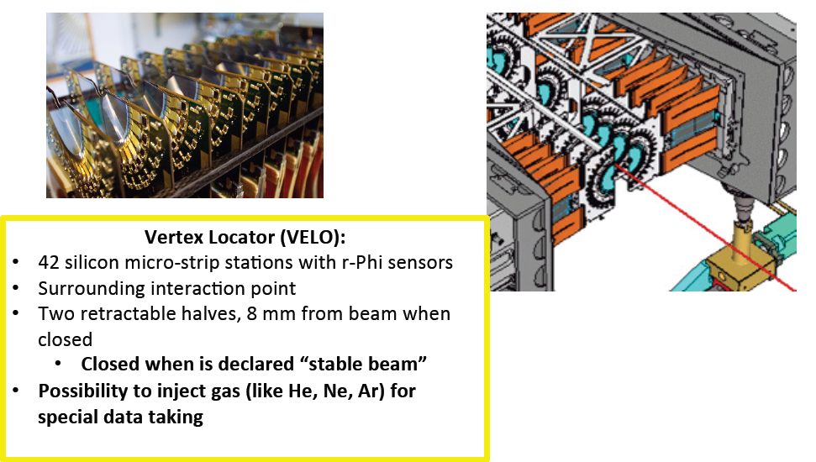
LHCb Tracker
From B. Storaci

Slide 34
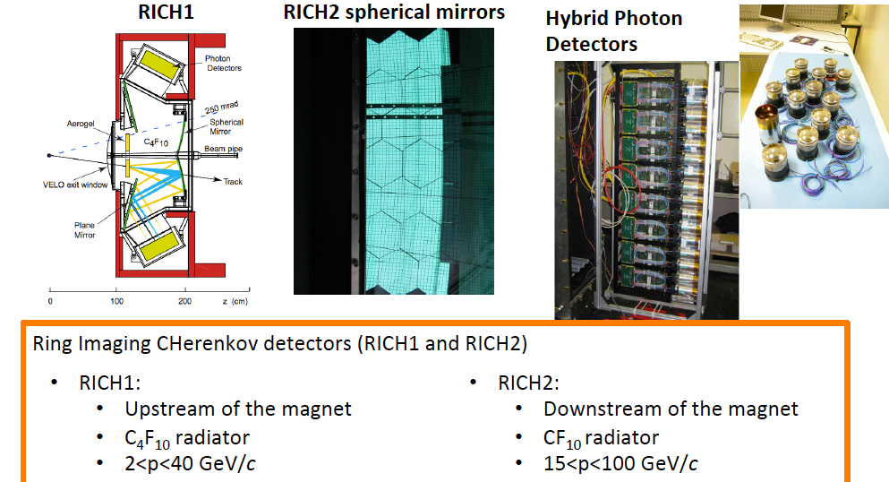
LHCb Particle Identification
From B. Storaci

Slide 35
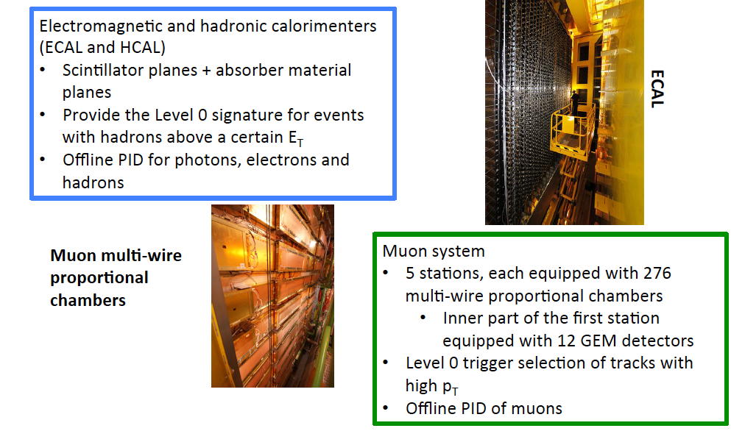
LHCb Calorimeter, Muon Chambers
From B. Storaci

Slide 36
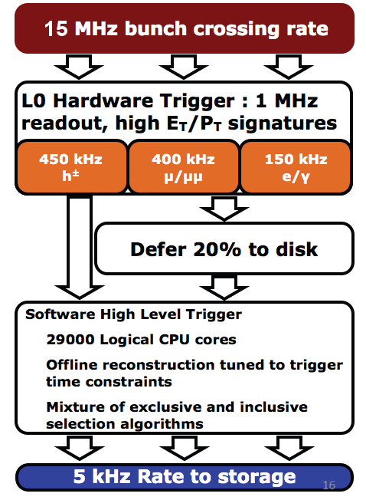
LHCb Trigger
In Run 1:

Slide 37
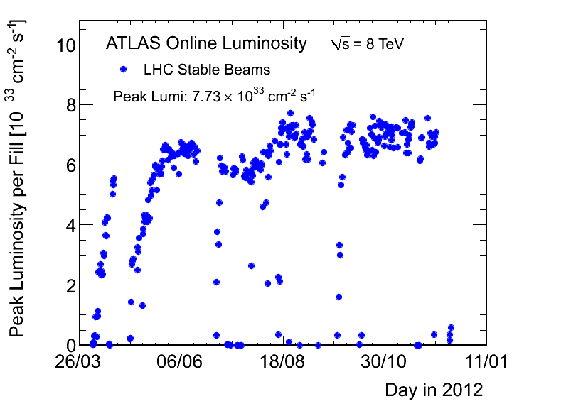
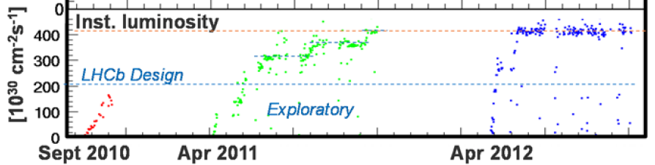
Run 1 Dataset
7/8 TeV centre of mass collisions
Instantaneous luminosity:
  ATLAS/CMS: ~7x10³³cm⁻²s⁻¹, event pile-up ~ 20.7
  LHCb luminosity levelling: ~4x10³² cm⁻²s⁻¹, event pile-up ~ 1.7 events
    Much harder to resolve vertex structure of b decays with pile-up

Slide 38
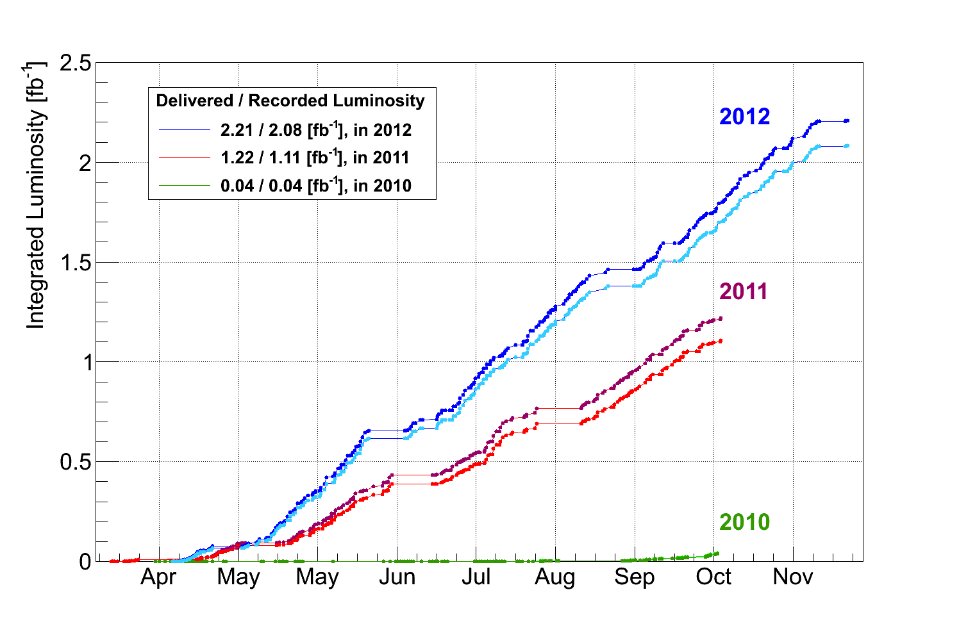
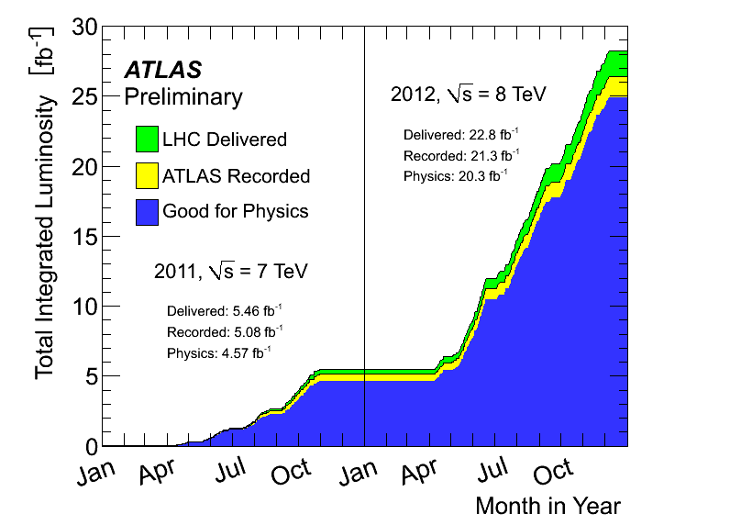
Run 1 Dataset
7/8 TeV centre of mass collisions
Integrated luminosity:
  ATLAS/CMS: ~4fb⁻¹ at 7 TeV, 20 fb⁻¹ at 8 TeV
  LHCb:~1fb⁻¹ at 7 TeV, ~2fb⁻¹ at 8 TeV

Slide 39
Run 1 Analysis Highlights
Impossible to summarise Run 1 in a couple of slides
  But I’m going to try…
  Selecting highlights
Lumping ATLAS and CMS together
  In general they search for and measure the same physics (though not always)

Slide 40
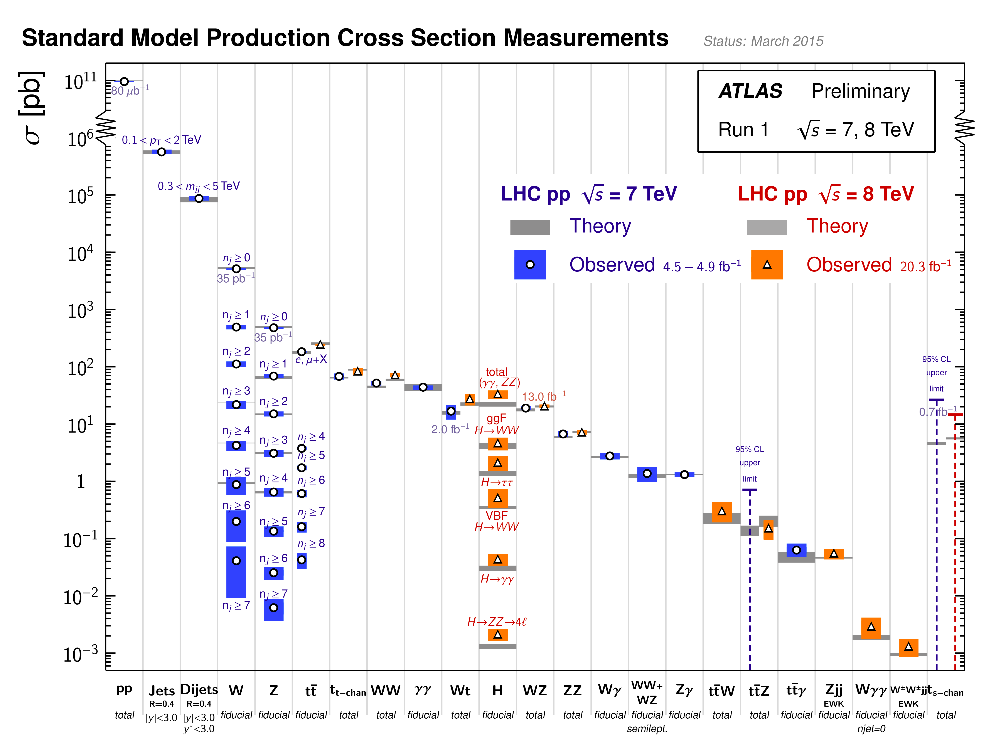
Run 1 Dataset
Copious production of SM particles and the Higgs

Slide 41
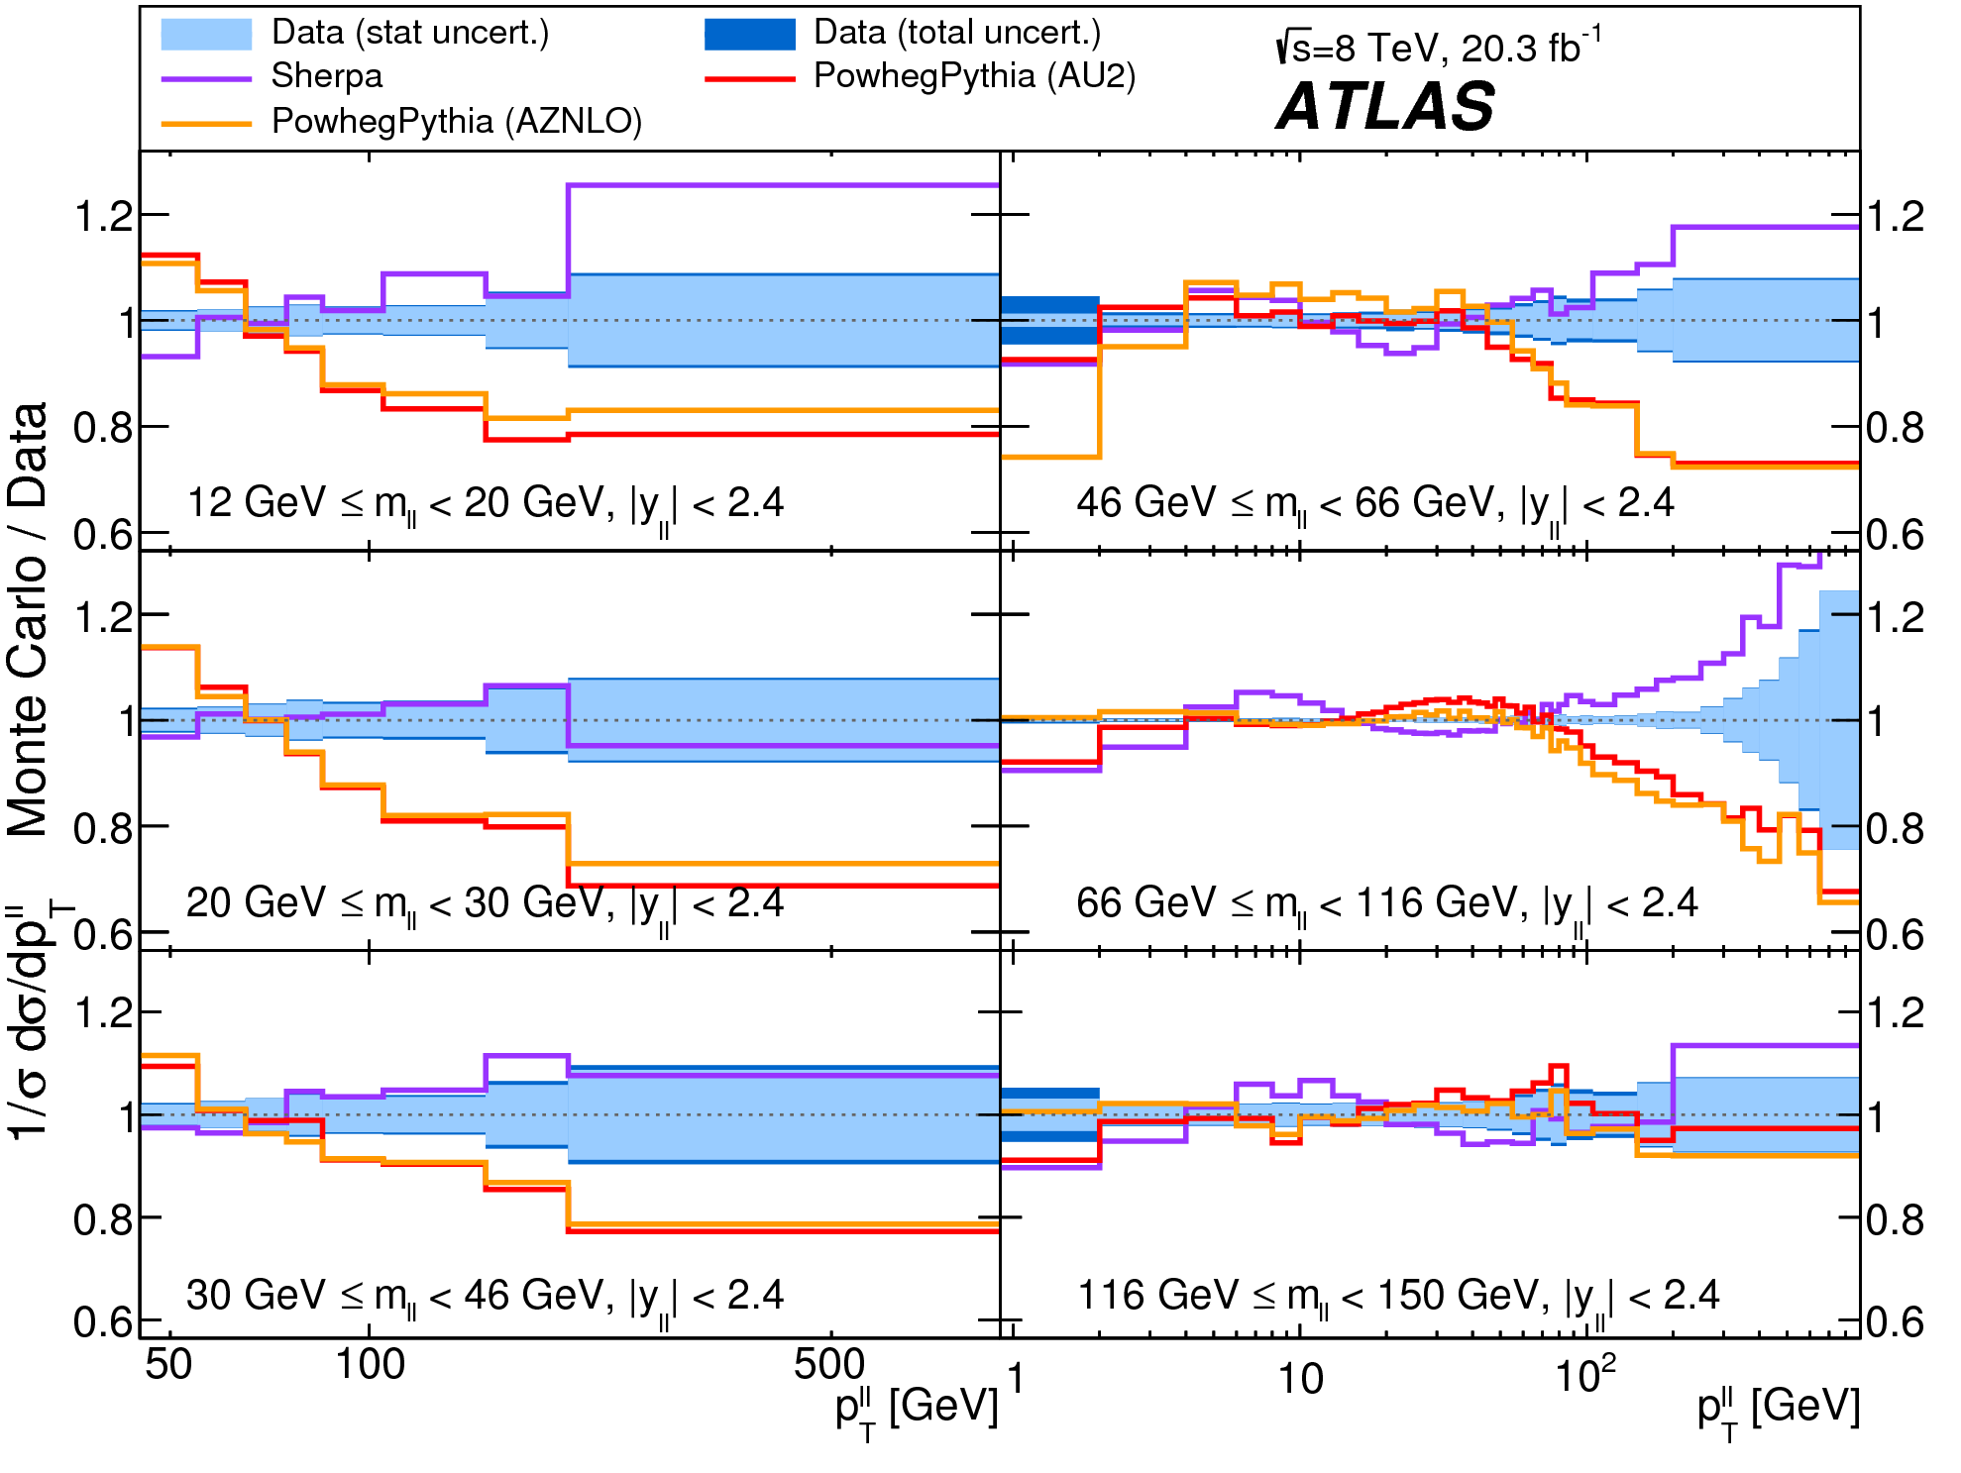
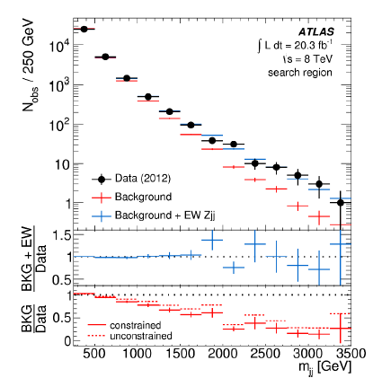
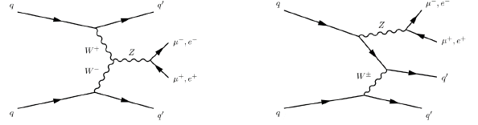
Run 1 Achievements: ATLAS/CMS
Standard Model
  Large range of results
  Some (re)establish e.g.
  boson production and
  give momentum
  distributions to pin down
  Monte Carlo tunings
  Some are first observations of new phenomena (or are stronger than previous signals at Tevatron thus allowing probing of their kinematics)

Slide 42
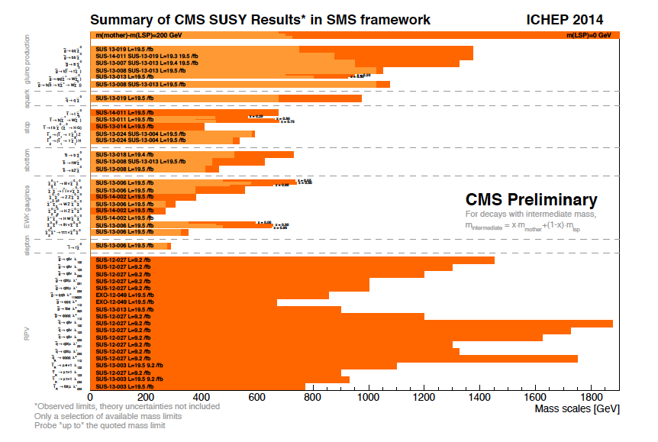
Run 1 Achievements: ATLAS/CMS
Supersymmetry Searches
  CMS summary of limits and final states
  Prolific searches and honing of techniques but no evidence (yet)

Slide 43
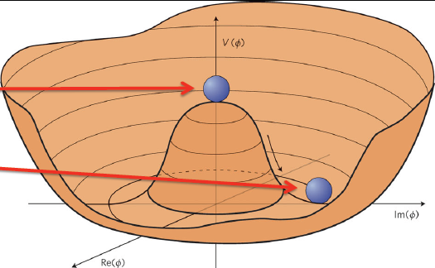
Higgs Boson
Introduced to give mass to W and Z bosons
  Requires a new potential to be added to the Standard Model
  Introduction of “complex doublet” implies 4 new degrees of freedom, 3 of which are the W⁺, W⁻ Z boson mass
  Fourth is the Higgs boson itself
Massless
bosons
Spontaneous
symmetry
breaking

Slide 44
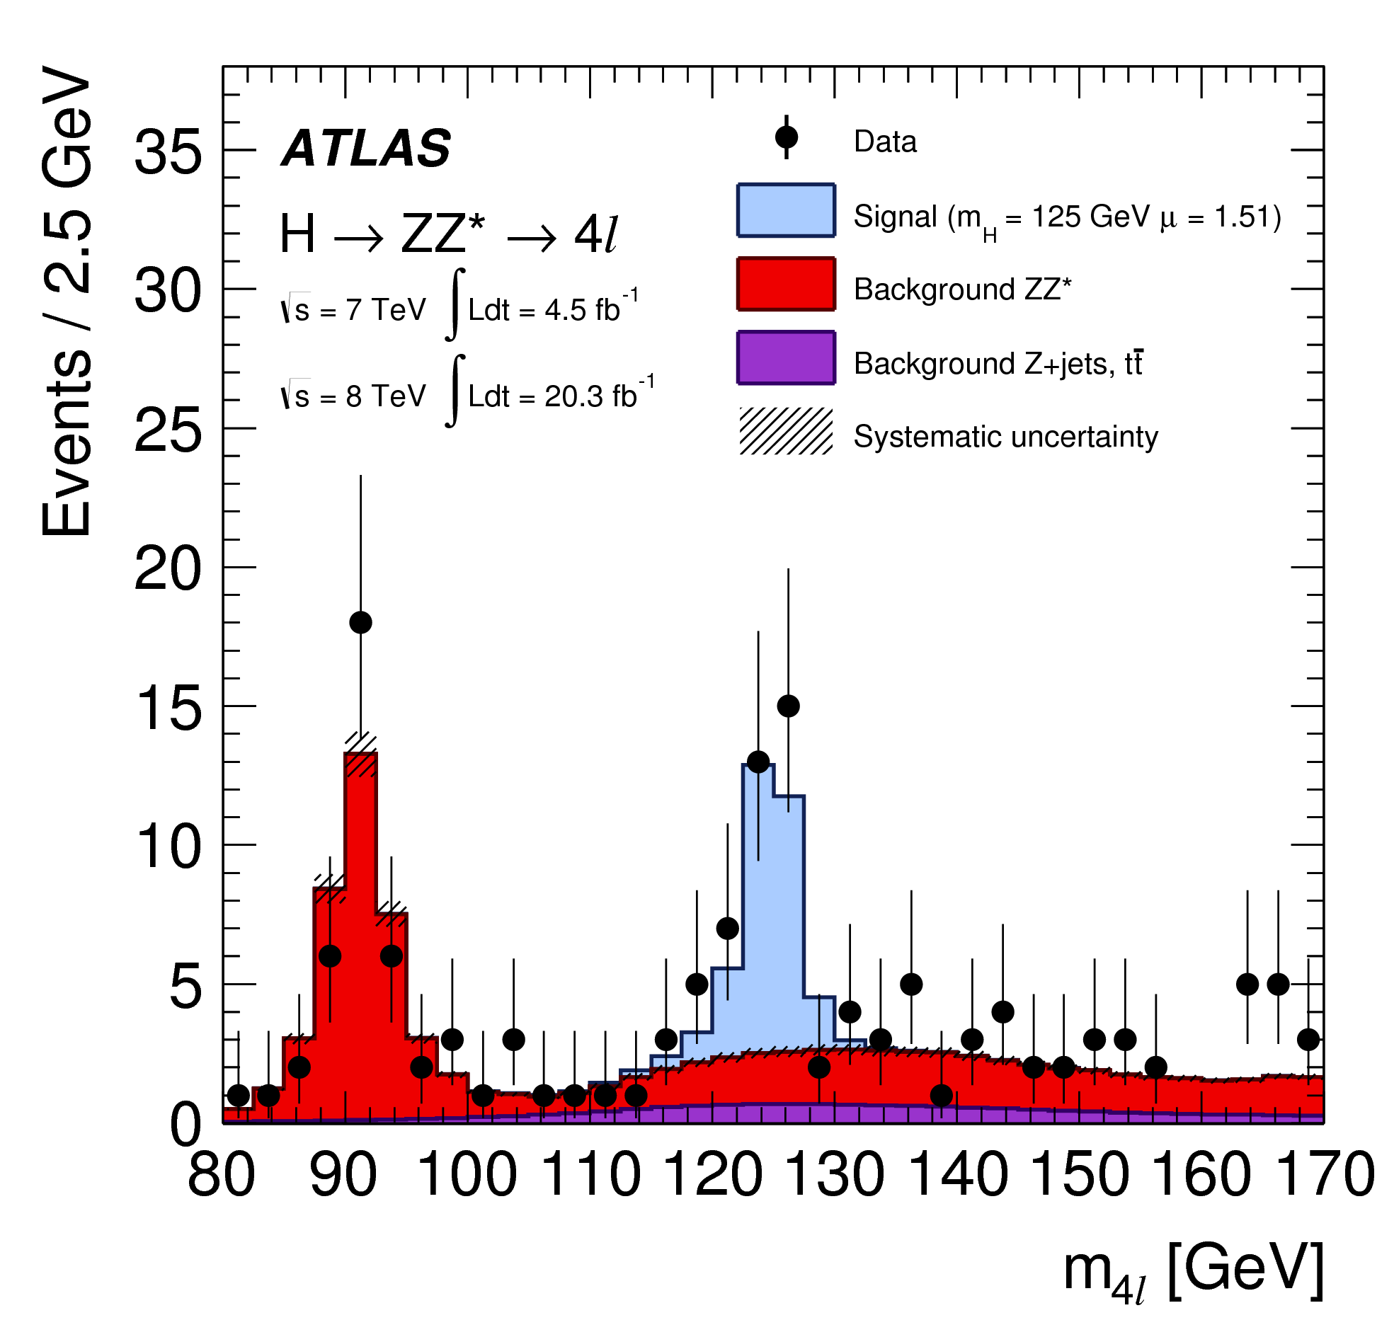
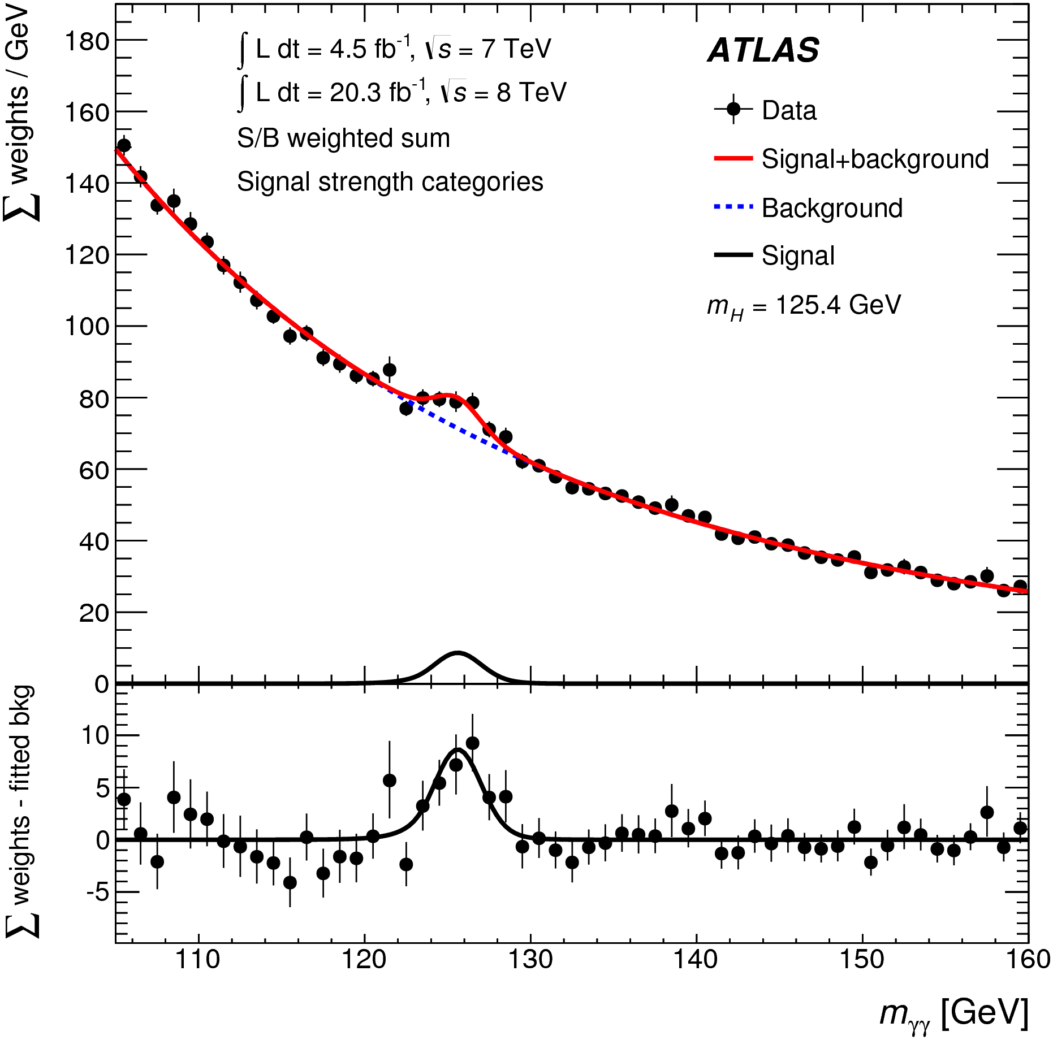
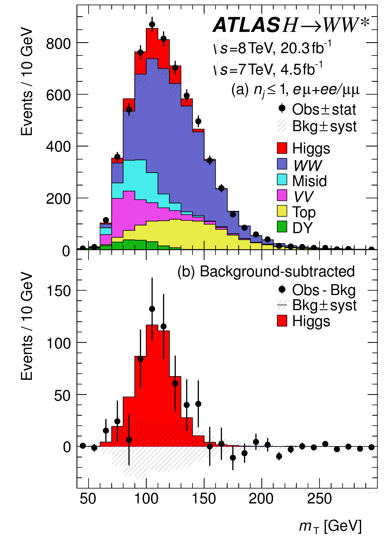



Higgs Decaying to Bosons
EPJC 74(2014) 3076, PRD 92 012006(2015),PRD 91 012006(2015), PRD 90 112015(2014), JHEP 01 (2014) 096, PRD 89 (2014) 092007
Observation in γγ ZZ* WW*
ATLAS
obs(expected)
significance
5.2(4.6)
8.1(6.2)
6.5(5.9)
CMS
5.6(5.3)
6.5(6.3)
4.7(5.4)

Slide 45


Higgs Decaying to Fermions
Tau leptons
σ Observed (Expected)
4.5 (3.4) 3.2 (3.7)
JHEP 04 (2015) 117
JHEP 05 (2014) 104

Slide 46



Higgs Decaying to Fermions
b quarks
σ Observed (Expected)
1.8 (2.8) 2.6 (2.7) 2.2(1.4)
JHEP01(2015)069
arXiv:1506.01010
PRD 88, 052014 (2013)

Slide 47


Run 1 Achievements: LHCb
Probed rare decays and found some interesting discrepancies
Observed B to mumu
(BR ~10⁻⁹)

Slide 48


Run 1 Achievements: LHCb
From K. Miyabayashi

Slide 49

Upgrades for Run 2
Long Shutdown 1: 14th Feb 2013 – 23rd March 2015
LHC work: 10,000 high-current splices between LHC magnets opened and consolidated
Experiments also installed new detectors and performed maintenance during this time

Slide 50

LHC in the Shutdown
From M. Lamont

Slide 51


ATLAS in the shutdown
4th silicon pixel detector layer (IBL)
  Innermost Pixel detector layer at R=3.3 cm from beam

Slide 52


IBL silicon layer
Improved tracking performance (impact parameter resolution)
Extra material demands a new geometry for ATLAS:

Slide 53

ATLAS in the shutdown
Trigger improvements
  New Topological L1 trigger, new central trigger processor, coincidence between Tile and muons, merge of high-level trigger, new Fast TracK Trigger (FTK), improved L1 calorimeter trigger

Slide 54
ATLAS in the Shutdown
Infrastructure:
  New beampipe, improvements to magnet & cryogenic system
Detector consolidation
  Muon chambers completion (|η|=1.1-1.3) and repairs, improved readout of various systems (L1 rate 100 kHz), repair of pixel modules and calorimeter electronics, new pixel services, new luminosity detectors, new MBTS detector
Software improvements to simulation, reconstruction, grid and analysis software

Slide 55
CMS in the shutdown
Level 1 Trigger:
  Upgraded calorimeter trigger – better isolation and pile-up subtraction
Added a muon chamber
Run tracker colder (strips at -15 C, pixels at -10 C)
  Detector suffers less radiation damage at cooler temperatures
HCAL new calibration strategies

Slide 56

CMS in the Shutdown
From W&C seminar Olsen, Malgeri

Slide 57

CMS in the Shutdown
From W&C seminar Olsen, Malgeri

Slide 58

CMS in the Shutdown

Slide 59

LHCb in the shutdown
From CERN seminar B. Storaci

Slide 60

LHCb in the Shutdown
Challenging to perform calibration and alignment in real time, but has been successful e.g.
From CERN seminar B. Storaci

Slide 61


Prospects for Run 2
Expected performance in 2016:
For a full overview of the public Run 2 results see the talks at the CERN seminars for CMS and ATLAS: https://indico.cern.ch/event/442432/

Slide 62


Prospects for Run 2: ATLAS and CMS
Some hardware challenges
ATLAS
CMS
Slides from LHCC open session

Slide 63
A few slides
Following few slides attempt to give the briefest of highlights of what will be discussed in the next three days
  I am sure to miss out many people’s favourite topics, so take this as a sketch!

Slide 64


Higgs: What precision is necessary?
SM couplings can be modified by new physics
Modifications can be small depending on the BSM scenario (Snowmass report)
  For new physics at the 1TeV mass scale:
  Higher scales imply smaller effects
arXiv:1310.8361

Slide 65
Higgs: Prospects for ATLAS and CMS
Full measurement of the key properties of this new boson will take some time to establish
  The Higgs-fermion sector is relatively unknown but Run 2 will close in on it
Key to characterising this particle are
  Production and decay rates (to greater precision)
    Original discoveries of order 10-20% uncertainties
    Run 2 will take us to order 5-7% uncertainties and theory predictions improving all the time too
    Probe fermion sector not only with higher statistics but with new mechanisms e.g. ttH, Look for Higgs to mumu
  Intrinsic quantum numbers
Switch from search mode to precision physics
  Emphasis on publishing what we measure in pure form (think about EFT, simplified cross-section)

Slide 66

Top/Searches prospects for Run 2
Top
  Measure cross-section and properties more accurately, especially single top
Searches
Standard Model
CMS wine and cheese, Olsen and Malgeri

Slide 67

Prospects for Run 2: LHCb
Will go impressively further into precision SM measurements
Statistical uncertainties for Run 2

Slide 68

Hints from Early Run 2
Diphotons
  See 2 σ bump around 750 GeV
    But two sigma effects come and go… (e.g. dijets excess was 2.5 σ in run 1 and has gone in run 2)

Slide 69


Final Remarks
LHC continues to live up to its role as the energy frontier collider and deliver results that constitute
  - Precision measurements -Powerful searches (with relatively small amounts of data)
The next couple of days here at YETI will be very interesting
  Impossible to predict which sector will yield the interesting results
Thanks to Tim Gershon (LHCb) and Sam Harper (CMS) for help finding material

Slide 70
Discussion Topics
What sets the scale of the detectors?
Why have a dedicated flavour physics detector?
Why is LHCb a forward-only detector (and why only one arm?)?
What sets the lifetime of the detectors?
What constitutes a useful measurement (from a theorist perspective)?

Slide 71


Matter Particles
We see three generations
  Undergoing similar interactions
  Mass hierarchy
  Each has an antiparticle

Slide 72

Forces
In the Standard Model, we depict (and calculate) forces as the exchange of a force-carrier boson, between particles

