Slide 1
Muon Colliders:
Physics and Accelerator Technology
Mark Palmer
February 17, 2016
Higgs-Maxwell Particle Physics Workshop
Royal Society of Edinburgh

Slide 2
Acknowledgements
MAP Collaboration
IDS-NF Collaboration
MICE Collaboration
Of special note: A. Blondel, J-P. Delahaye,
E. Eichten, P. Janot, …

Slide 3
Outline
Introduction: Why Muons?
Physics with a Muon Collider
The Feasibility of Building a Muon Collider
Conclusion

Slide 4
Introduction: Why Muons?

Slide 5
Why Muons?
Physics
Frontiers
Intense and cold muon beams a unique physics reach
Precision sources of neutrinos
Colliders
Opportunities
Collider Synergies
High intensity beams required for a long-baseline Neutrino Factory
are readily provided in conjunction with a Muon Collider Front End
Tests of Lepton Flavor Violation
Anomalous Magnetic Moment (g-2)
Next generation lepton collider
s-channel production of scalar objects
Strong coupling to particles like the Higgs
Reduced synchrotron radiation a multi-pass acceleration feasible
Beams can be produced with small energy spread
BUT accelerator complex/detector must be able to handle the impacts of μ decay
Beamstrahlung effects suppressed at IP
Such overlaps offer unique staging strategies to guarantee physics
output while developing a muon accelerator complex capable of
supporting collider operations

Slide 6
High Energy Muon Accelerator Capabilities
Long Baseline NF

Slide 7
Why a Muon Collider?
First – why a lepton collider?
  In proton (or proton-antiproton) collisions, composite particles (hadrons), made up of quarks and gluons, collide
    The fundamental interactions that take place are between individual components in the hadrons
    These components carry only a fraction of the total energy of the particles
    For p-p collisions, the effective interaction energies are O(10%) of the total center-of-mass (CoM) energy of the colliding protons
    Thus a 14 TeV CoM energy at the LHC probes an energy scale
    E < 2 TeV
  Electrons (and positrons) as well as muons are fundamental particles (leptons)
    Leptons are point-like particles
    Their energy and quantum state are well understood during the collision
    When the leptons and anti-leptons collide, the reaction products probe the full CoM energy
    Thus a few TeV lepton collider can provide a precision probe of the full energy range of fundamental processes that are discovered at the LHC

Slide 8
Muon Collider Features
Beamstrahlung
Effect of ISR and
beamstrahlung at the
IP for 3 TeV CoM
energy
Typical metric
developed for e⁺e⁻
LCs is the fraction of
luminosity within 1%
of E_{CM}

Slide 9
μ⁺μ⁻ Colliders vs e⁺e⁻ Colliders
s-Channel Production
  When 2 particles annihilate with the correct quantum numbers to produce a single final state. Examples:
  e⁺e⁻ g Higgs OR μ⁺μ⁻ g Higgs
  The cross section for this process scales as m² of the colliding particles, so:
  Thus a muon collider offers the potential to probe the Higgs resonance directly
    The luminosity required is not so large
    A precision scan capability is particularly interesting in the case of a richer Higgs structure (eg, a Higgs doublet)

Slide 10
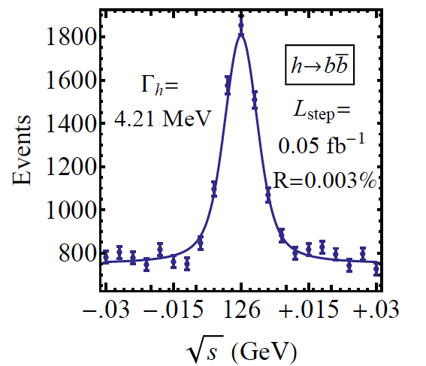
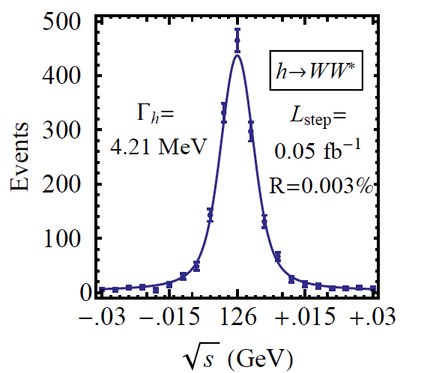
Muon Collider Features
Energy Resolution
Muon beams enable colliding
beams with very small energy
spread
Of particular significance for a
Higgs Factory if there were signs
of a non-standard Higgs
  Ability to directly probe the width and
  structure of the resonance
Specific Cases:
δE_{b}/E_{b}~4×10⁻⁵ @ Higgs
δE_{b}/E_{b}~10⁻⁴ to 10⁻³ @ Top
δE_{b}/E_{b}~1×10⁻³ @ TeV-scale
Han & Liu

Slide 11
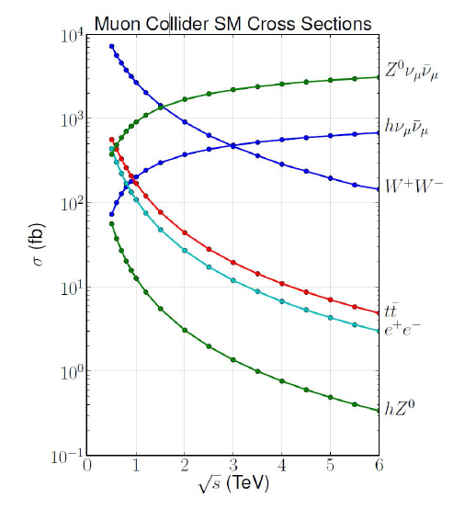
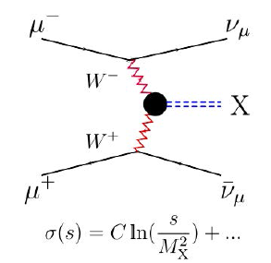
Muon Collider Features
High Energy Collisions
At √s > 1 TeV: Fusion processes dominate
  An Electroweak Boson Collider
  A discovery machine complementary to very high energy pp collider
At >5TeV: Higgs self-coupling
resolution <10%

Slide 12
Synchrotron Radiation and Energy Reach
Synchrotron Radiation
  In a circular machine, the energy loss per turn due to synchrotron radiation can be written as:
  where ρ is the bending radius
  If we are interested in reaching the TeV scale, an e⁺e⁻ circular machine is not feasible due to the large energy losses
  Solution 1: e⁺e⁻ linear collider
  Solution 2: Use a heavier lepton – eg, the muon

Slide 13
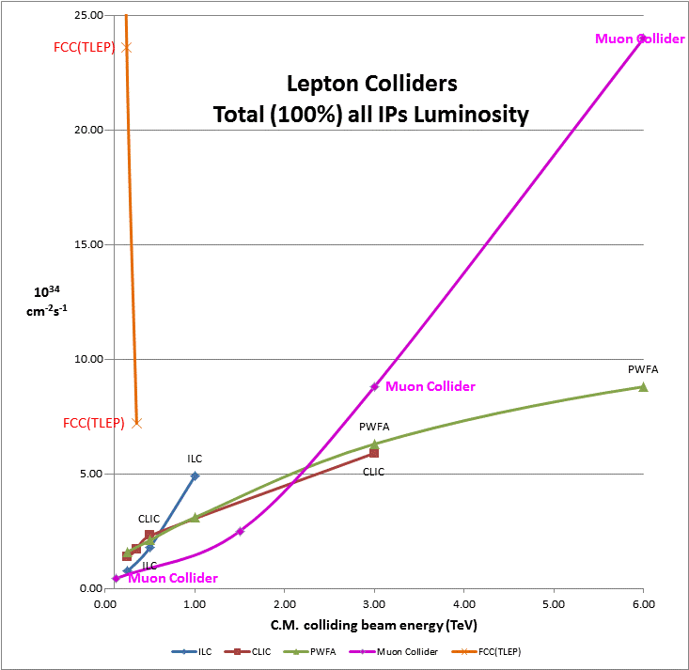
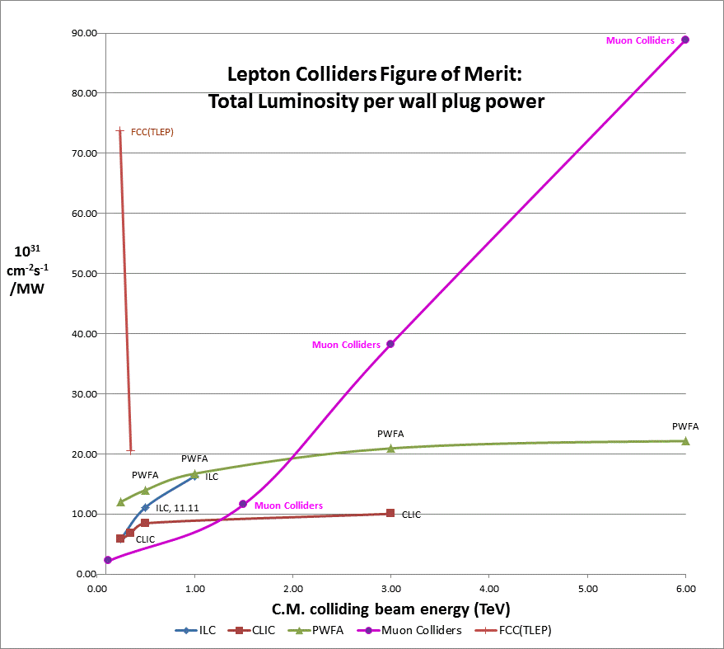
Muon Colliders –
Efficiency at the multi-TeV scale
Circular
Circular
Muons
Muons
Linear
Linear
Efficiency of multi-pass acceleration

Slide 14
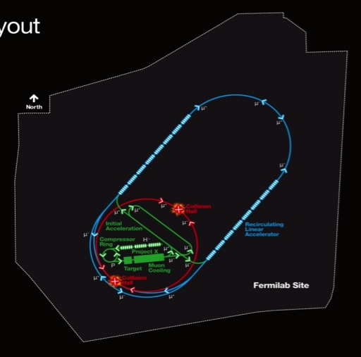
Muon Collider Parameters
Exquisite Energy Resolution
Allows Direct Measurement
of Higgs Width
Success of advanced cooling concepts
a several × 10³² [Rubbia proposal: 5×10³²]

Slide 15
The Scale of a Multi-TeV Collider shown on the Fermilab Site
A TeV-Scale
Accelerator
System
SC Linac

Slide 16
Physics with a Muon Collider

Slide 17
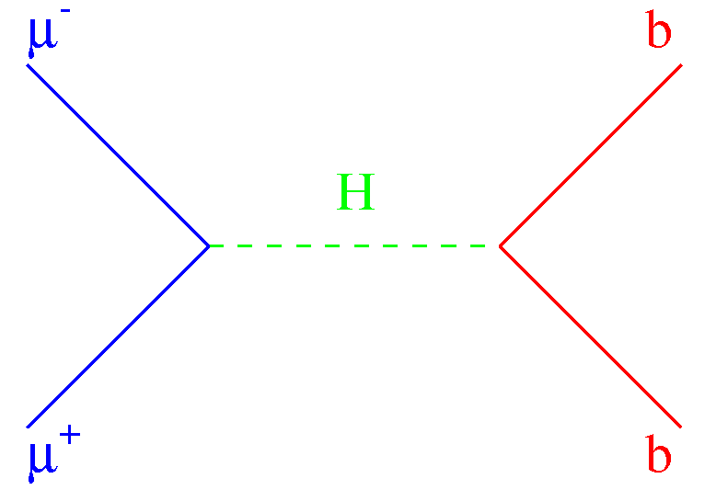
A Higgs Factory
Direct s-channel production
of the Higgs
  σ(μ⁺μ⁻ → H) ~
  σ(e⁺e⁻ → H) x 40,000
  Expect ~14K Higgs/yr
  with MAP baseline
  luminosity
  Advanced cooling as
  assumed in the Rubbia
  plan would provide
  another factor of ~5
X
(1): with ISR
(2): δE/E = 3×10⁻⁵
(3): δE/E = 6×10⁻⁵
X
S. Jadach, R.A. Kycia
arXiV:1509.02406
√s (GeV)

Slide 18
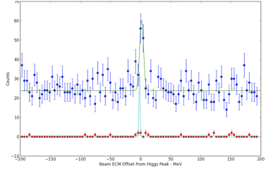
A Higgs Factory
With a beam energy spread of 0.004%, a Higgs Factory has unique operating features
  Requires excellent machine energy stability
  Would utilize a “g-2” technique to monitor the beam energy (Rana and Tollestrup)
    Electron calorimeter to monitor
    the decay electrons as the
    beam polarization precesses
    in the dipole field of the ring
    Precision measurement of the
    oscillation frequency provides
    the energy
  An initial energy scan
  campaign required to
  locate the resonance
    Presently know m_{H} to ±250 MeV
    ~2 orders of magnitude smaller
    with a muon collider
A. Conway, H. Wenzel
arXiV:1304.5270
2 pb⁻¹/pt

Slide 19
A Higgs Factory
Direct production combined
with precise energy resolution
  Ability to probe detailed structure in the region of the resonance
  A full line-shape measurement probes:
    The Higgs mass, m_{H}
    The Higgs width, Γ_{H}
    The branching ratio into μ⁺μ⁻,
    BR(H → μμ) [and hence g_{Hμμ}]
  But also to look for new physics features
    Ex: Higgs doublet model
Snowmass 2013
arXiV:1308.2143

Slide 20
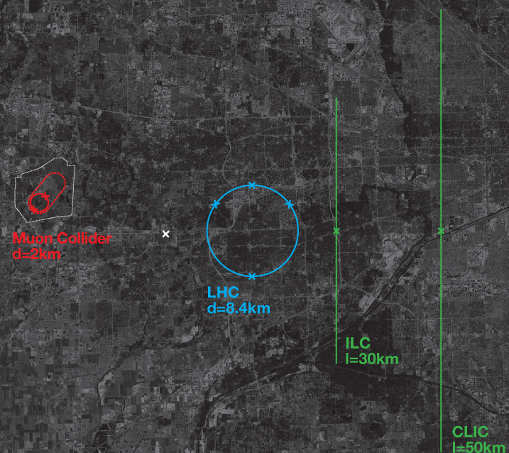
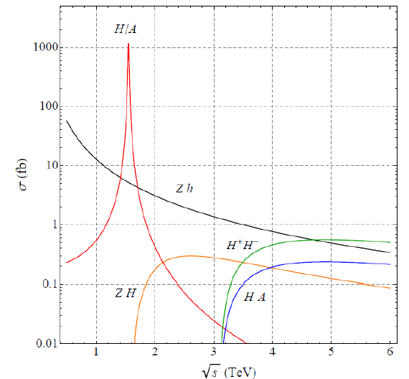
Higher Energy Colliders
A multi-TeV lepton collider will be required for a thorough exploration of Terascale physics
Muon colliders come into their own at energies >2 TeV
  Absolute luminosity
  Luminosity per input wall-plug power
  Compact rings
Their excellent energy resolution can disentangle closely spaced states
  Example: Extended Higgs
  Sector and the H/A resonance

Slide 21
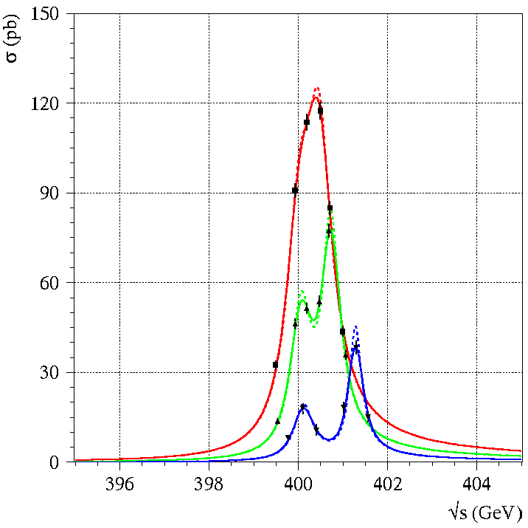
H/A Examples
Can be applied to heavier H and A in 2HDM (e.g., from SUSY)
  Example 1: m_{A} = 400 GeV Example 2: m_{A} = 1.55 TeV
  Best performance is ultimately obtained by optimizing the ring for operation
δE/E = 0.1%
δE/E = 0.1%
P. Janot (1999)
tanβ = 10
E. Eichten, A. Martin
PLB 728 (2014)125
tanβ = 20
tanβ = 8
tanβ = 6
Background

Slide 22
Additional Higgs bosons (3)
One way to proceed
Automatic mass scan with radiative returns in μμ collisions
  Go to the highest energy first
    √s = 1.5, 3 or 6 TeV
  Select event with an energetic photon
    Check the recoil mass m_{Recoil} = [s – 2E_{γ}√s]^{1/2}
  Can “see” H and A
    If tanβ > 5
  Build the next collider
    At √s ~ m_{A,H}
N. Chakrabarty et al.
PRD 91 (2015)015008
tanβ

Slide 23
Summary
Muon colliders offer great potential for exploration of the Terascale
  May offer the only cost-effective route to a lepton collider operating in the several TeV range
There are technical challenges
  Muon cooling technology
  Detector backgrounds from μ decays
  Let’s take a quick look at some of the technology issues
And, further work is desirable to understand the detailed physics reach given the proposed solutions to those challenges

Slide 24
Accelerator Technology

Slide 25
High Energy Muon Accelerator Capabilities
Long Baseline NF

Slide 26
Luminosity
The principle parameter driver is the production of luminosity at a single collision point
where
N is the number of particles per bunch (assumed equal for all bunches)
f_{coll} is the overall collision rate at the interaction point (IP)
σ_{x} and σ_{y} are the horizontal and vertical beam sizes (assumed equal for
all bunches)
H_{D} is the luminosity enhancement factor
Ideally we want:
  High intensity bunches
  High repetition rate
  Small transverse beam sizes
Linear Collider Form
Notes:
Disruption enhancement factor has a value around 1.5 for the ILC

Slide 27
ILC Parameters at the IP
The parameters at the interaction point have been chosen to
provide a nominal luminosity of 2×10³⁴ cm⁻²s⁻¹. With
  N = 2×10¹⁰ particles/bunch
  σ_{x} ~ 640 nm ⇔ β_{x}* = 20 mm, ε_{x} = 20 pm-rad
  σ_{y} ~ 5.7 nm ⇔ β_{y}* = 0.4 mm, ε_{y} = 0.08 pm-rad
  H_{D}~ 1.7
An average collision rate of ~14kHz is required.
Beam sizes at the IP are determined by the strength of the final focus magnets and the emittance (phase space volume) of the incoming bunches.
  A number of issues impact the choice of the final focus parameters. For example, the beam-beam interaction as two bunches pass through each other can enhance the luminosity, however, it also disrupts the bunches. If the beams are too badly disrupted, safely transporting them out of the detector to the beam dumps becomes quite difficult. Another effect is that of beamstrahlung which leads to significant energy losses by the particles in the bunches and can lead to unacceptable detector backgrounds. Thus the above parameter choices represent a complicated optimization.

Slide 28
Muon Collider Luminosity
For a muon collider, we can write the luminosity as:
For the 1.5 TeV muon collider design, we have
  N = 2×10¹² particles/bunch
  σ_{x,y} ~ 5.9 μm  β* = 10 mm, ε_{x,y}(norm) = 25 μm-rad
  n_{turns}~1000
  f_{bunch}=15 Hz (rate at which new bunches are injected)
But this is optimistic since we’ve assumed N is constant for ~1000 turns when it’s actually decreasing. The anticipated luminosity for this case is ~1.2×10³⁴ cm⁻²s⁻¹.

Slide 29
Challenges for a μ⁺μ⁻ Collider
Create pions from a MW-scale proton beam
striking a target
To avoid excessive power requirements, must efficiently capture the produced pions
  Capture of both forward and backward produced pions loses polarization
The phase space of the created pions is very large!
  Transverse: 20π mm-rad
  Longitudinal: 2π m-rad
Emittances must be cooled by factors of ~10⁶ to be suitable for multi-TeV collider operation
  ~1000x in the transverse dimensions
  ~40x in the longitudinal dimension
  The muon lifetime is 2.2 μs lifetime at rest

Slide 30
Cooling Options
Electron/Positron cooling: use synchrotron radiation
a For muons ΔE~1/m³ (too small!)
Proton Cooling: use
  A co-moving cold e- beam
  a For muons this is too slow
  Stochastic cooling
  For muons this is also too slow
Muon Cooling: use
  Use Ionization Cooling
  a Likely the only viable option
  Optical stochastic cooling
  Maybe, but far from clear

Slide 31
Key Feasibility Issues
Proton Driver
Target
Front End
Cooling
Acceleration
Collider Ring
Collider MDI
Collider Detector
High Power Target Station
Capture Solenoid
Energy Deposition
RF in Magnetic Fields
Magnet Needs (Nb₃Sn vs HTS)
Performance
Acceptance (NF)
>400 Hz AC Magnets (MC)
IR Magnet Strengths/Apertures
SC Magnet Heat Loads (μ decay)
Backgrounds (μ decay)

Slide 32
Characteristics of the Muon Source
Overarching goals
  NF: Provide O(10²¹) μ/yr within the acceptance of a μ ring
  MC: Provide luminosities >10³⁴/cm⁻²s⁻¹ at TeV-scale (~n_{b}²)
  Enable precision probe of particles like the Higgs
How do we do this?
  Tertiary muon production through protons on target (followed by capture and cooling)
    Rate > 10¹³/sec n_{b} = 2×10¹²

Slide 33
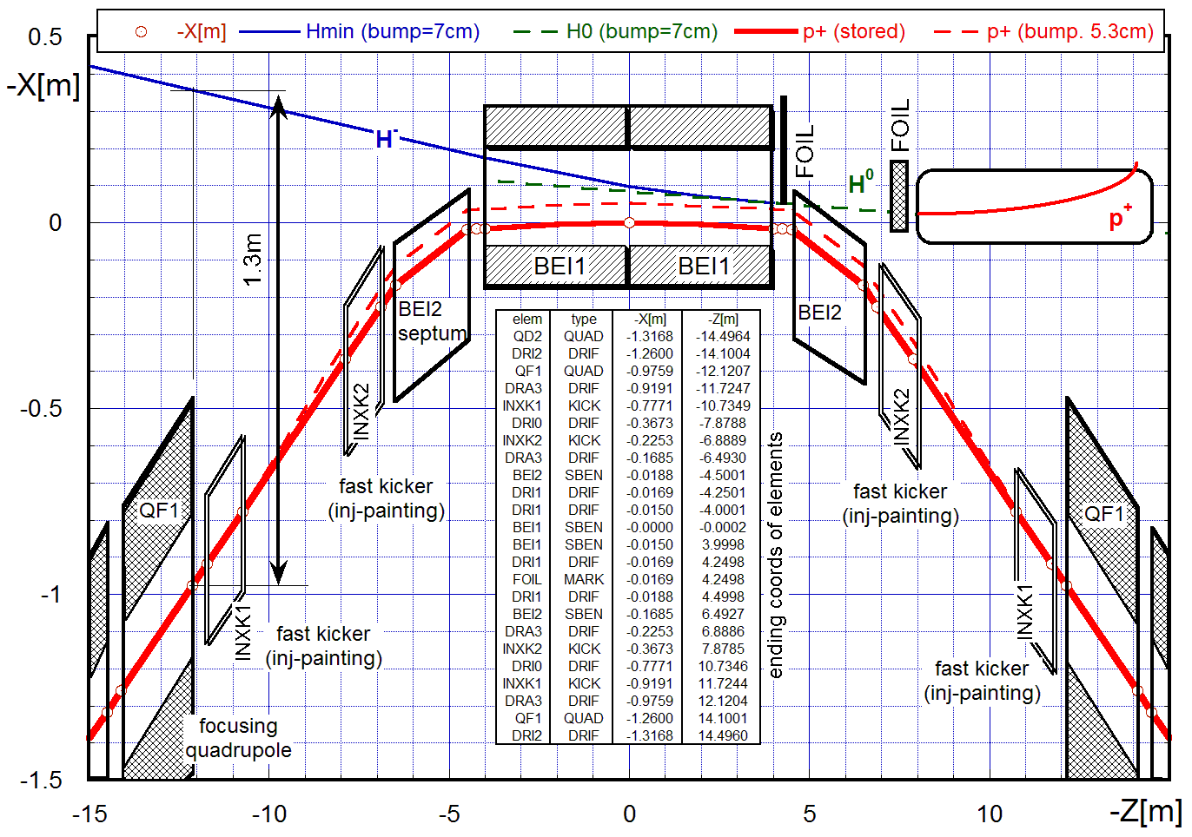
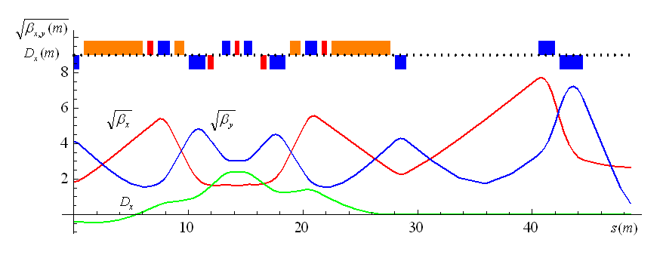
Proton Driver
H⁻ beam
Accumulator Ring
Layout & Injection Orbits
(Alexahin, Kapin)
3.87 MHz RF V=11 kV
kicker for vertical extraction
Optics:
½ staight +
1 arc cell
Based on 6-8 GeV Linac Source
Accumulator & Buncher Ring Designs in hand
H- stripping requirements same as those established for Fermilab’s Project X
Buncher Ring
Layout & Optics
(Alexahin)

Slide 34
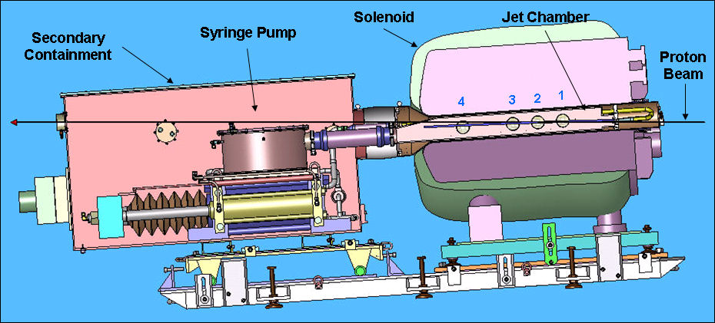

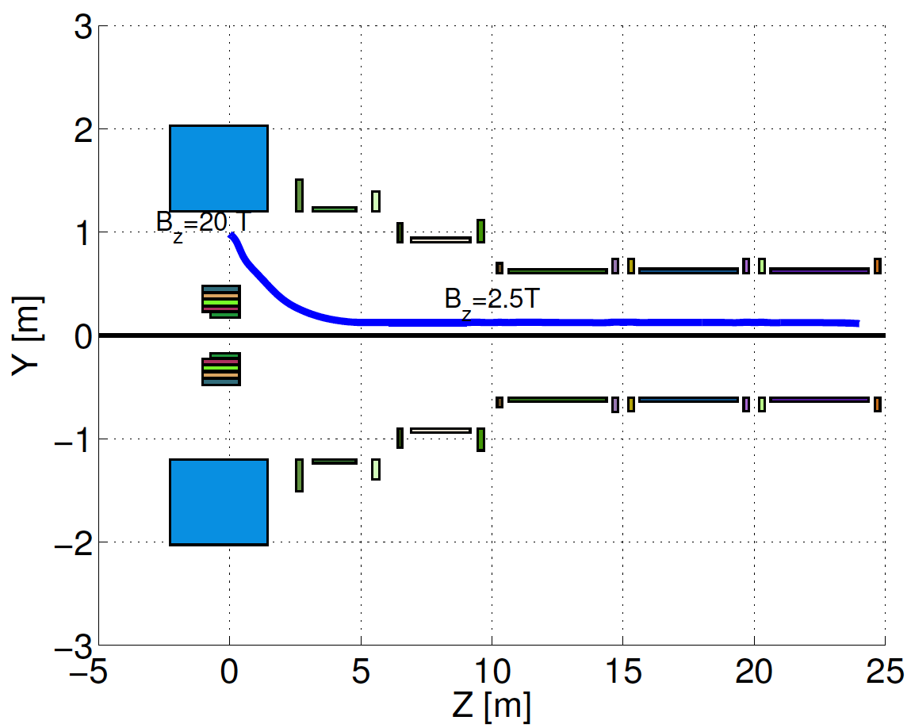
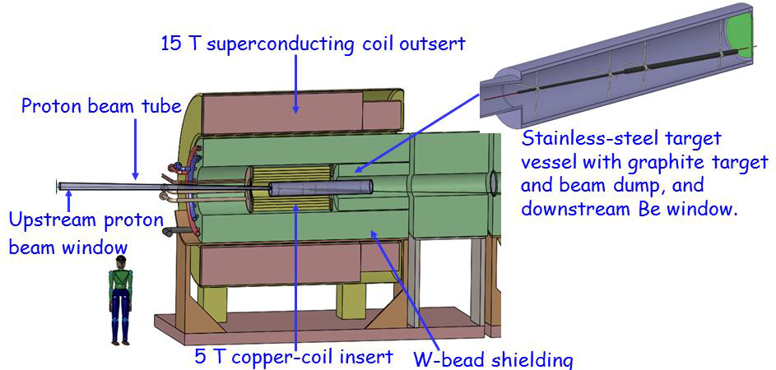
High Power Target
MERIT Expt:
  LHg Jet in 15T
  Capability: 8MW @70Hz
MAP Staging aims at 1-2 MW a C Target
Improved Compact Taper Design
  Performance & Cost
MERIT
@CERN
1 cm
Compact
Taper Design
C Target
Option

Slide 35
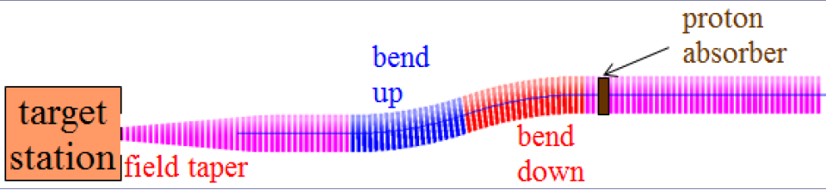
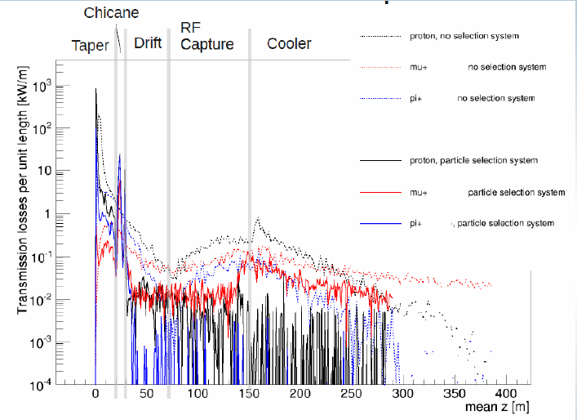
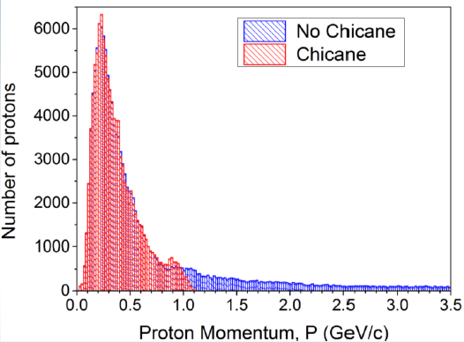
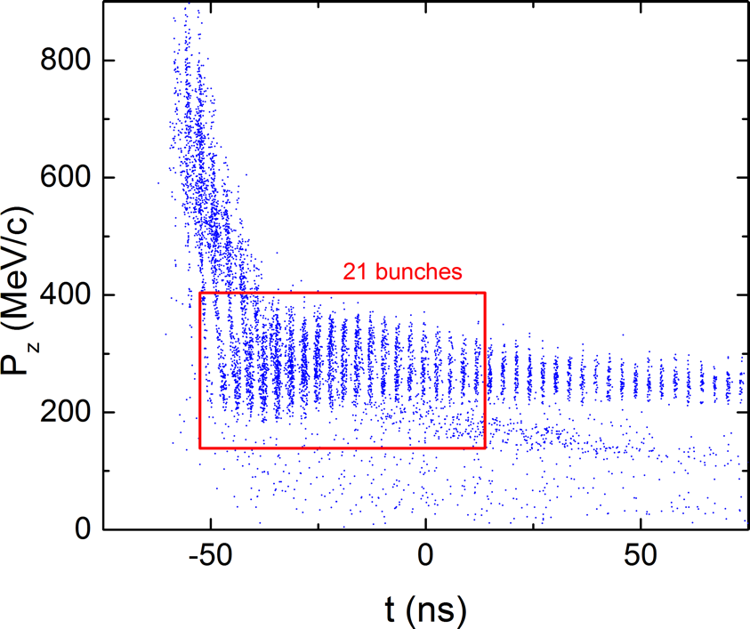
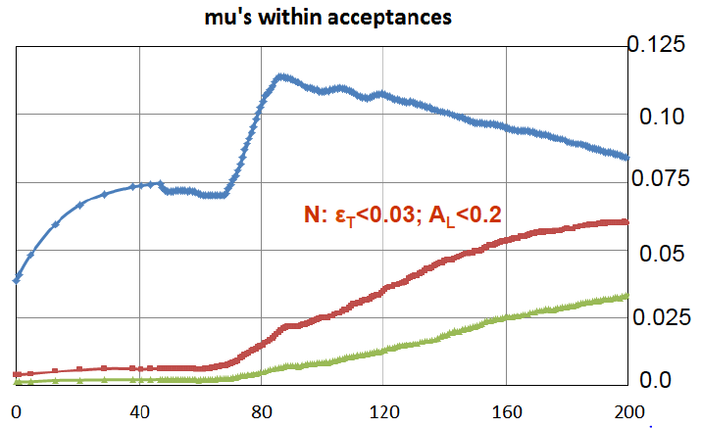
Front End
Control of FE Energy Deposition
Energy Deposition
Full 325 MHz RF Design
Validation of gas-filled RF cavity performance
FE Energy
Deposition
35
CERN SPC Working Group on Future Colliders
Buncher and Phase
Rotator Matched to a
325 MHz Initial Cooling
Channel
Validation of FE
performance
with gas-filled
cavities

Slide 36
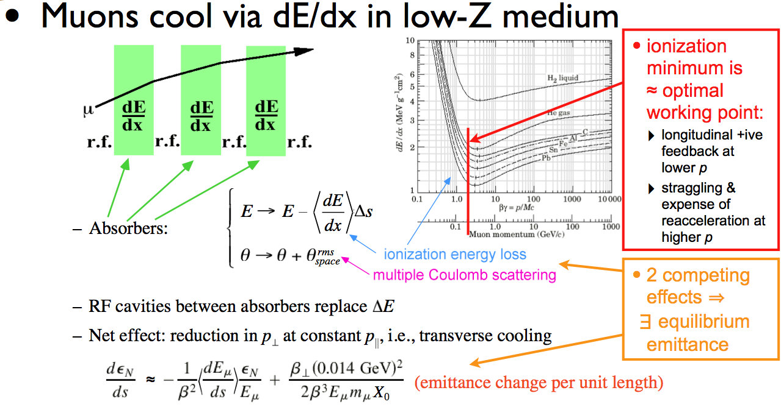
Cooling Methods
The unique challenge of muon cooling is its short lifetime
  Cooling must take place very quickly
  More quickly than any of the cooling methods presently in use
  a Utilize energy loss in materials with RF re-acceleration
Muon Ionization Cooling
Kaplan

Slide 37
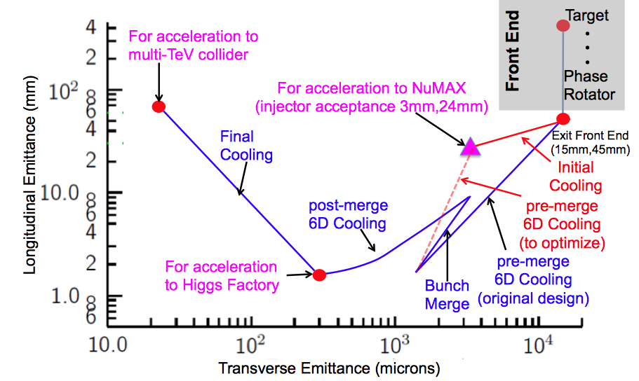
Muon Ionization Cooling
Advanced techniques a
Improved HF Luminosity
Simplified Final Cooling requirements
MAP Higgs
Factory Target
PIC assumed in Carlo
Rubbia’s Proposal

Slide 38
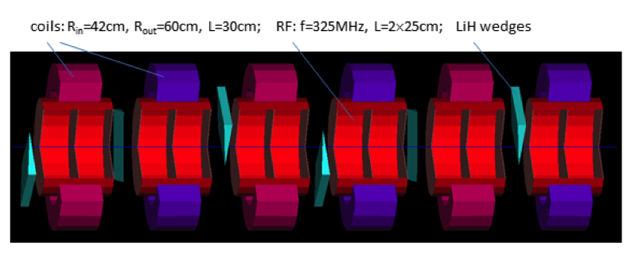
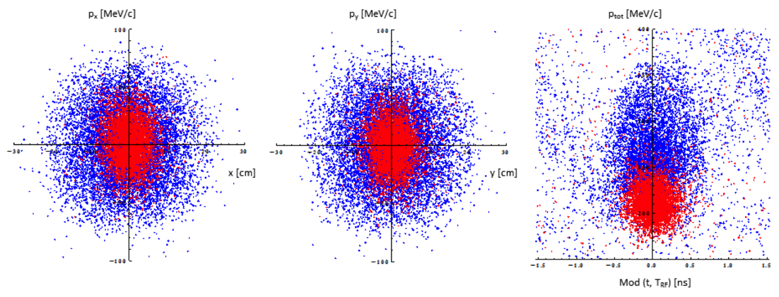
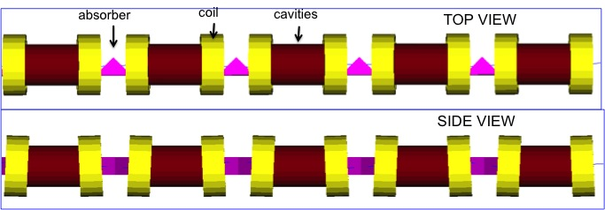
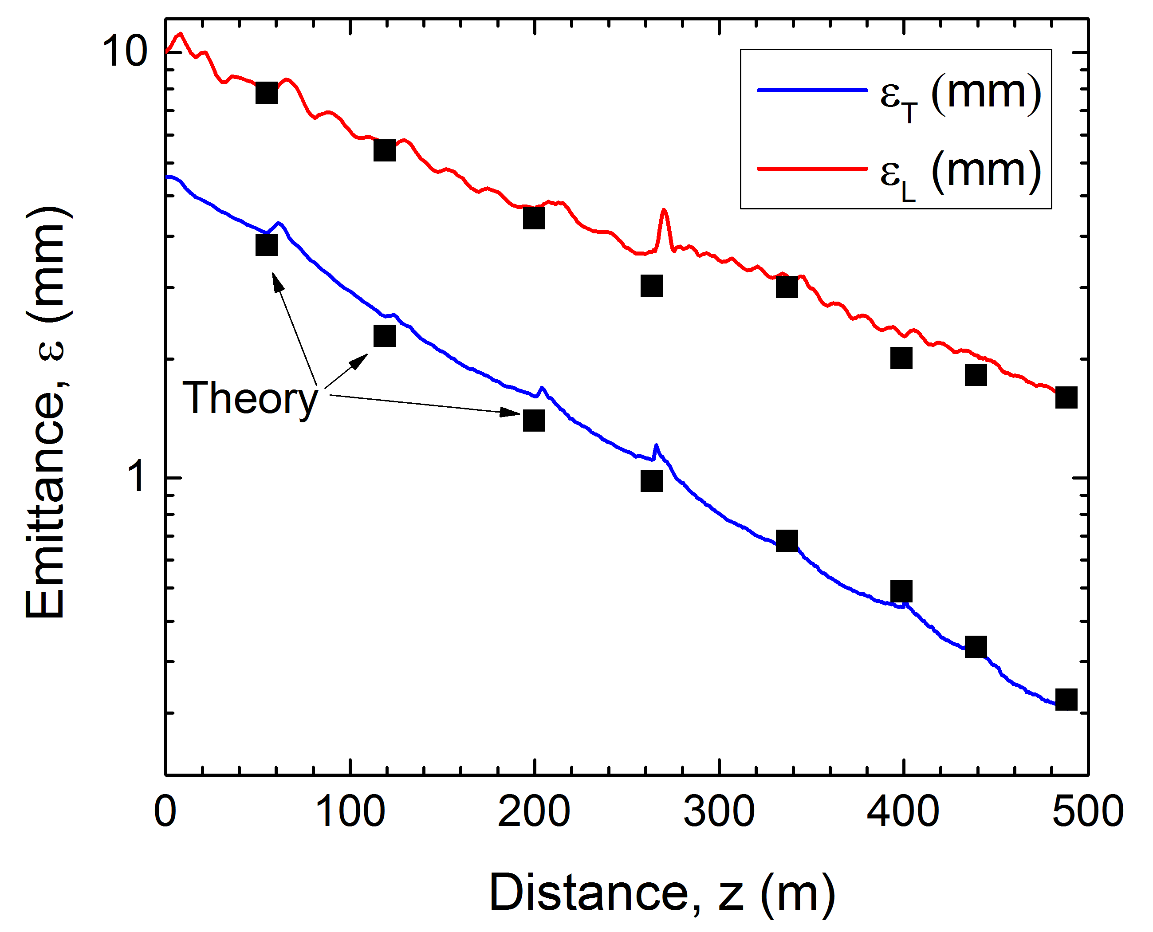
Muon Ionization Cooling (Design)
Initial 6D Cooling: ε_{6D} 60 cm³ a ~50 mm³; Trans = 67%
6D Rectilinear Vacuum Cooling Channel (replaces Guggenheim concept):
ε_{T} = 0.28mm, ε_{L} = 1.57mm @488m
Transmission = 55%(40%) without(with) bunch recombination

Slide 39
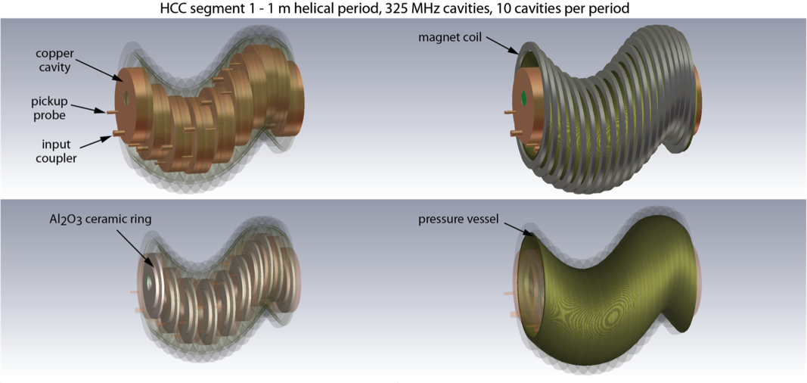
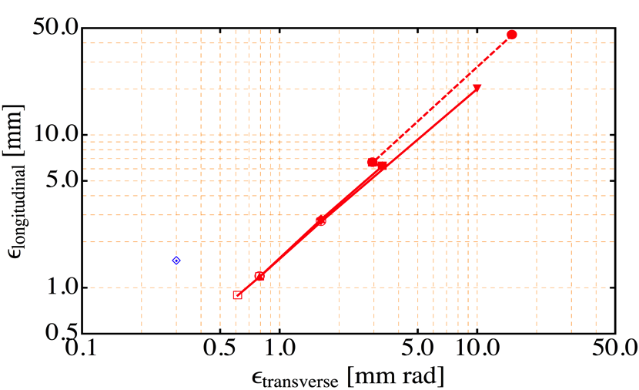
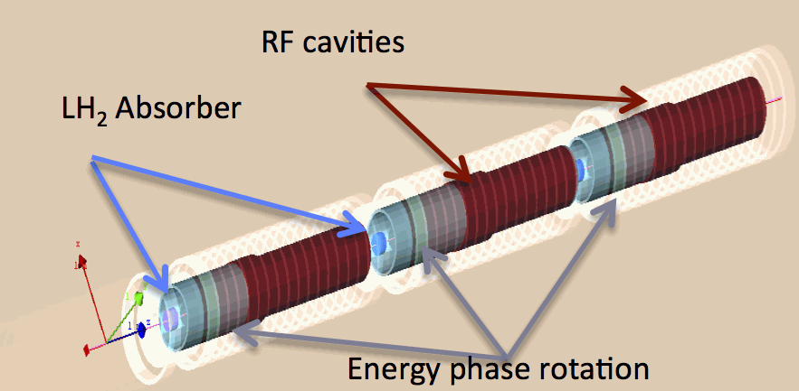
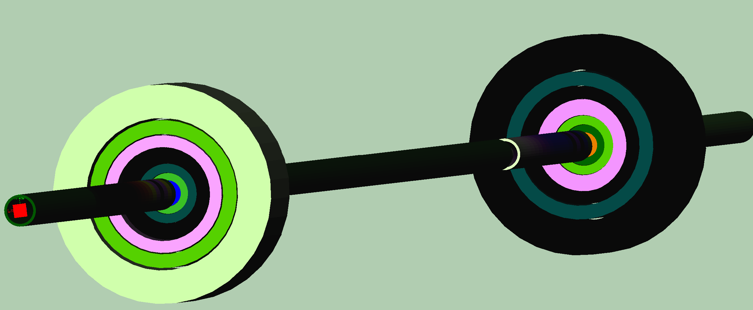
Muon Ionization Cooling (Design)
Initial 6D cooling
Matching
325 MHz cooling
650 MHz
Helical Cooling Channel (Gas-filled RF Cavities):
ε_{T} = 0.6mm, ε_{L} = 0.3mm
Late Stage w/ Induction Linac
Final Cooling with 25-30T solenoids (emittance exchange):
ε_{T} = 55μm, ε_{L} = 75mm

Slide 40
Muon Ionization Cooling (Design)
Longitudinal Merge
Bunch Merge
MAP Baseline Designs offer
  Factor >10⁵ in emittance reduction
Alternative and Advanced Concepts
  Hybrid Rectilinear Channel
  (gas-filled structures)
  Parametric Ionization Cooling
  Alternative Final Cooling
  One example:
  a Early stages of existing scheme
  a Round-to-flat Beam Transform
  a Transverse Bunch Slicing
  a Longitudinal Coalescing
  (at ~10s of GeV)
  a Considerable promise to exceed our original target parameters
Higgs Factory
Bunch
Merge
Transverse Merge
ε_{T}
Trans
σ_{t}

Slide 41
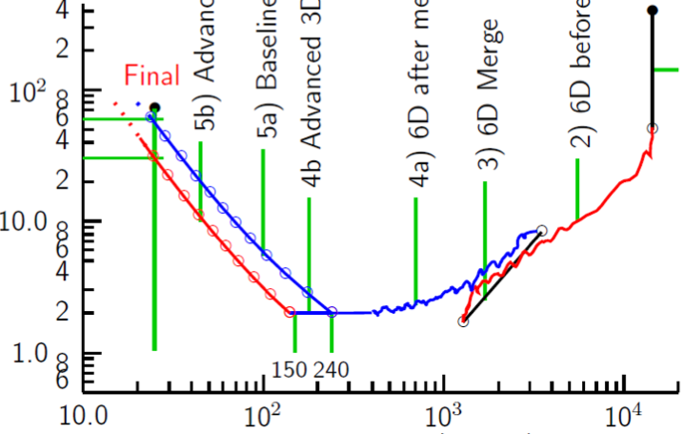
Cooling: The Emittance Path
Target
Y
Specification Achieved (simulations)
•
•
•
For acceleration to
multi-TeV collider
Front End
For acceleration to NuMAX (325MHz injector acceptance 3mm,24mm)
Phase
Rotator
Final
Exit Front End
(15mm,45mm)
Initial Cooling
Longitudinal Emittance (mm)
Initial
(X)
Initial
(Y)
Final
Cooling
post-merge 6D Cooling
pre-merge
6D Cooling (original design)
For acceleration
to Higgs Factory
HCC
Bunch
Merge
VCC &
Hybrid
Transverse Emittance (microns)

Slide 42
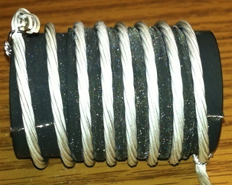
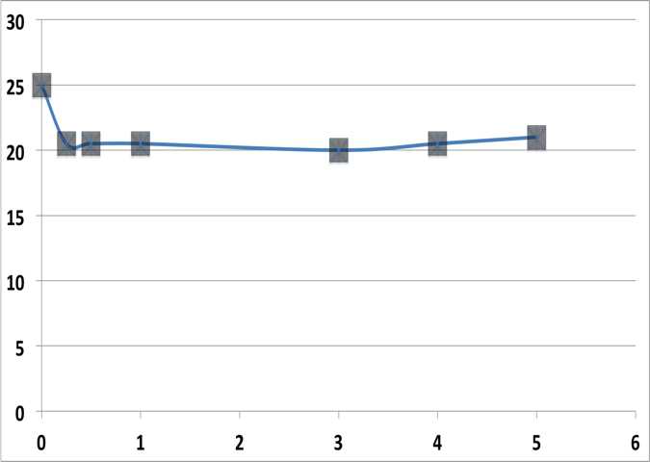
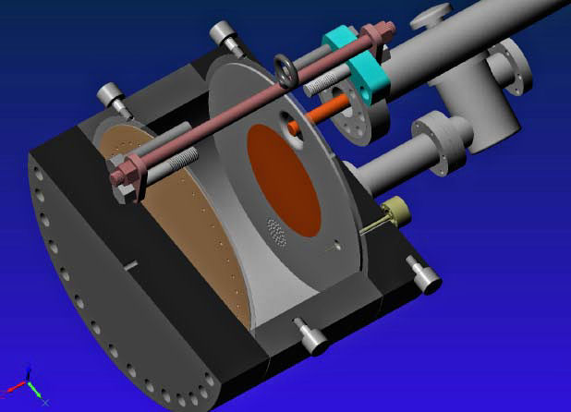
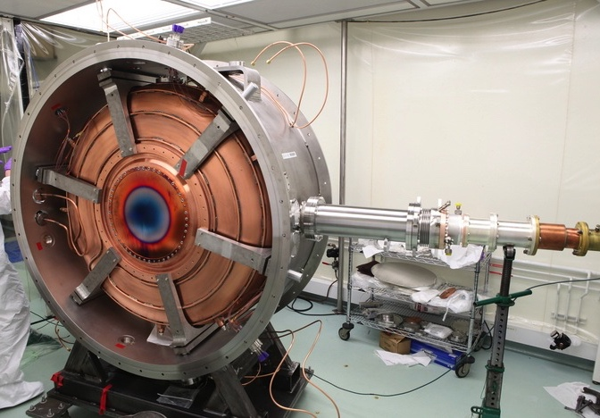
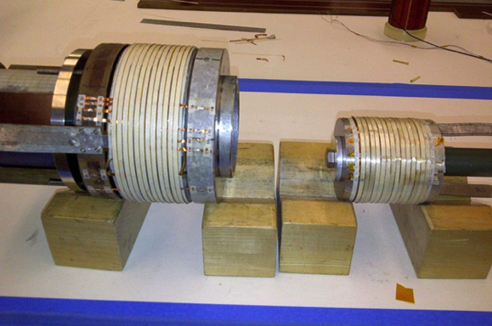
Cooling Technology R&D
>20MV/m operation
in up to 5 T B-field
Successful Operation of 805 MHz “All Seasons” Cavity in 5T Magnetic Field under Vacuum
MuCool Test Area/Muons Inc
Demonstration of High Pressure RF Cavity in 3T Magnetic Field with Beam
Extrapolates to required
μ-Collider Parameters
MuCool Test Area
Breakthrough in HTS Cable Performance with Cables Matching Strand Performance
FNAL-Tech Div
T. Shen-Early Career Award
World Record HTS-only Coil
15T on-axis field (16T on coil)
R. Gupta
PBL/BNL
MICE 201 MHz RF Module –
MTA Acceptance Test in B-field Complete
11MV/m in Fringe of 5T Lab-G Solenoid
<4×10⁻⁷ Spark Rate (0 observed)
1% Dry Air (0.2% O₂) in GH₂
Pure GH₂
1% Dry Air
(0.2 % O₂)
in GH₂ at
B = 3T
~50X reduction in
RF power dissipation
E₀ = 25 MV/m

Slide 43
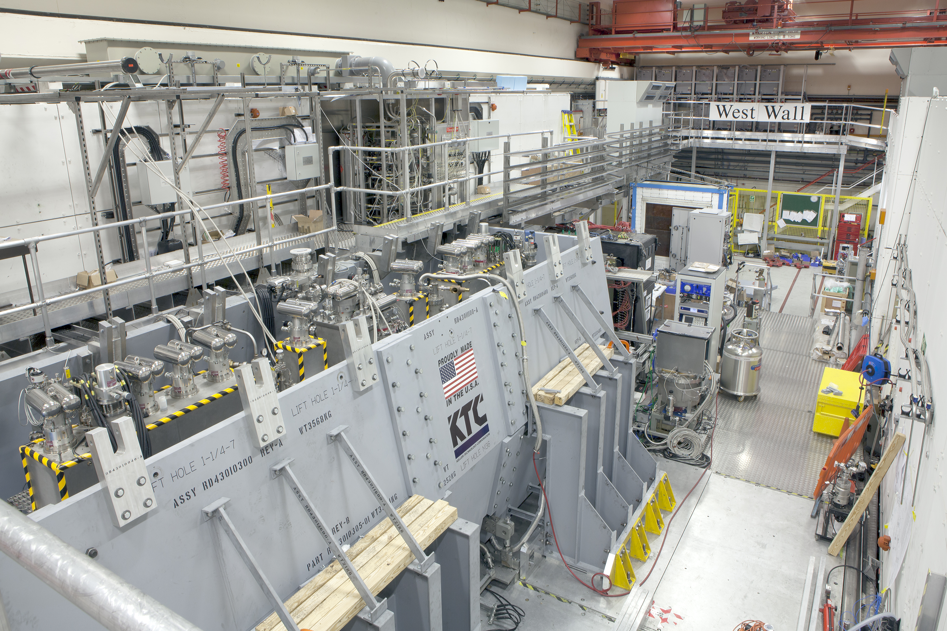
Muon Ionization Cooling Experiment
Cooling Channel Commissioning Underway for MICE Step IV

Slide 44
Ionization Cooling Summary
6D Ionization Cooling Designs
  Designs in hand that meet performance targets in simulations with stochastic effects
  Ready to move to engineering design and prototyping
  Able to reach target performance with Nb₃Sn conductors (NO HTS)
RF operation in magnetic field (MTA program)
  Gas-filled cavity solution successful and performance extrapolates to the requirements of the NF and MC
  Vacuum cavity performance now consistent with models
  MICE Test Cavity significantly exceeds specified operating requirements in magnetic field
MICE Experiment now in commissioning phase
Final Cooling Designs
  Baseline design meets Higgs Factory specification and performs within factor of 2.2× of required transverse emittance for high energy MC (while keeping magnets within parameters to be demonstrated within the next year at NHMFL).
  Alternative options under study

Slide 45
Acceleration Requirements
Key Issues:
  Muon lifetime a ultrafast acceleration chain
  NF with modest cooling a accelerator acceptance
  Total charge a cavity beam-loading (stored energy)
  TeV-scale acceleration focuses on hybrid Rapid Cycling Synchrotron a requires rapid cycling magnets
  B_{peak} ~ 2T f > 400Hz

Slide 46
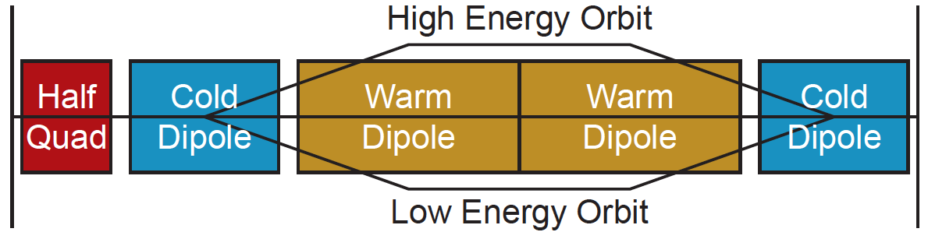
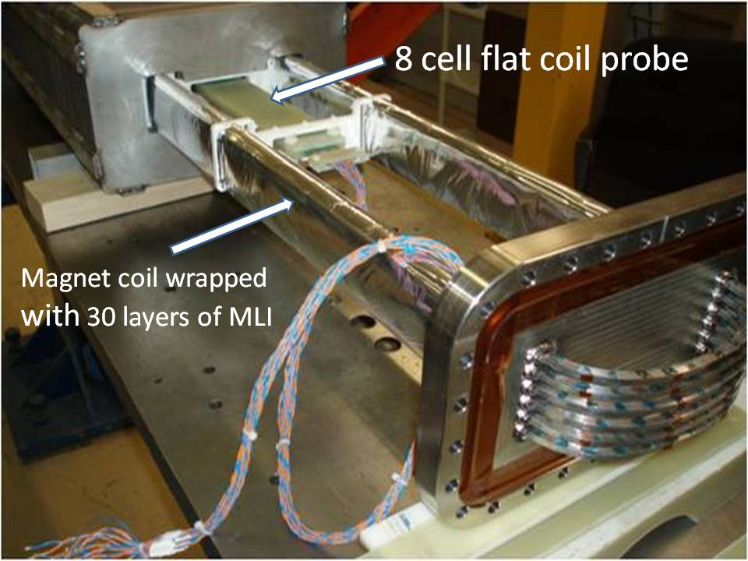
Acceleration
Technologies include:
  Superconducting Linacs (NuMAX choice)
  Recirculating Linear Accelerators (RLAs)
  Fixed-Field Alternating-Gradient (FFAG) Rings
  (Hybrid) Rapid Cycling Synchrotrons (RCS) for TeV energies
Hybrid RCS
  RCS requires
  2 T p-p magnets
  at f > 400 Hz
  (U Miss & FNAL)
EMMA – FFAG
Design concepts in hand
Magnet R&D indicates parameters achievable

Slide 47
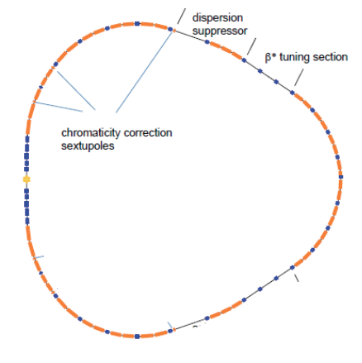
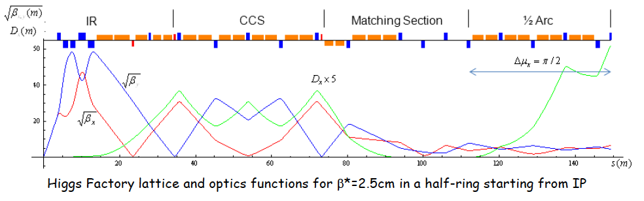
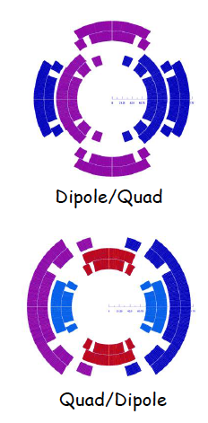
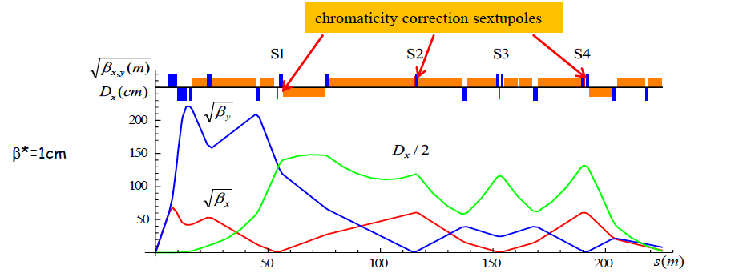
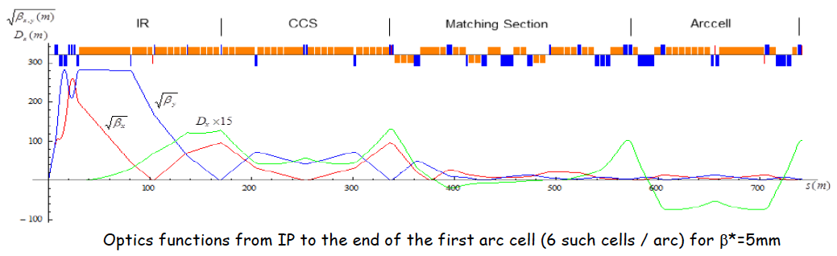
Collider Rings
Detailed optics studies for Higgs,
1.5 TeV, 3 TeV and now 6 TeV CoM
  With supporting magnet designs
  and background studies
Higgs Ring (single IR)
Higgs, 1.5 TeV CoM and 3 TeV CoM Designs
  With magnet concepts
  Achieve target parameters
Preliminary 6 TeV CoM design
  Key issue is IR design and impact on luminosity
  Utilizes lower power on target
Higgs
1.5 TeV
3 TeV

Slide 48
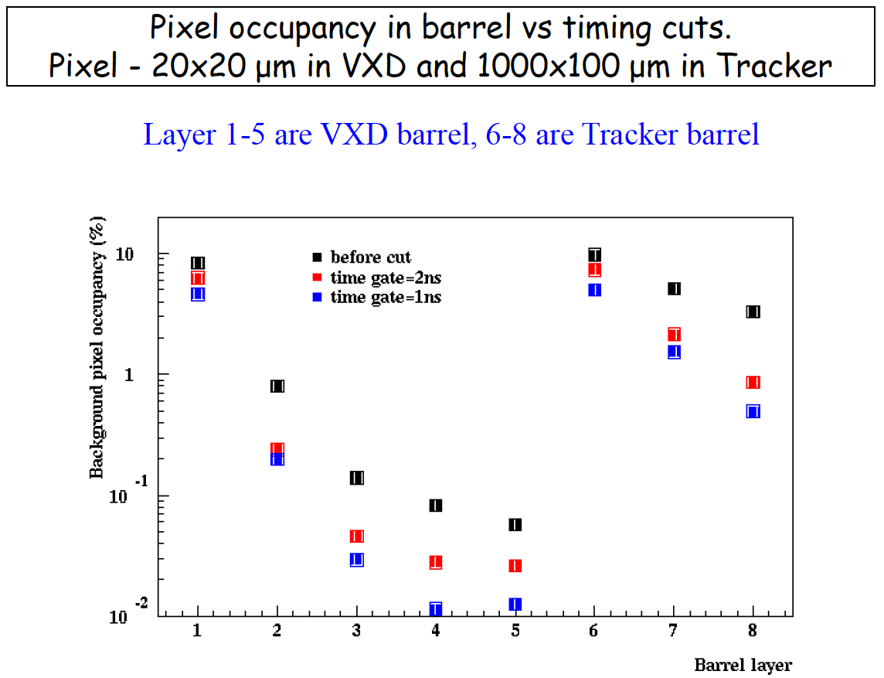
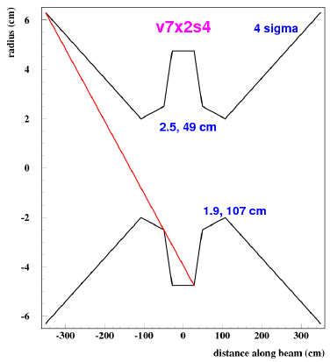
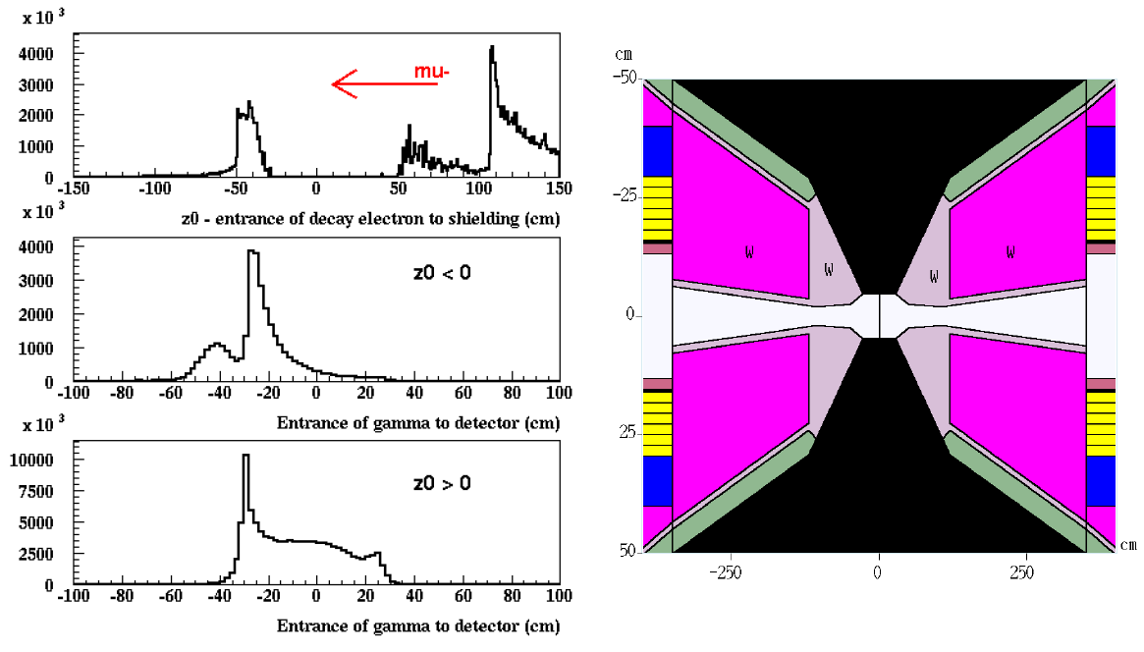
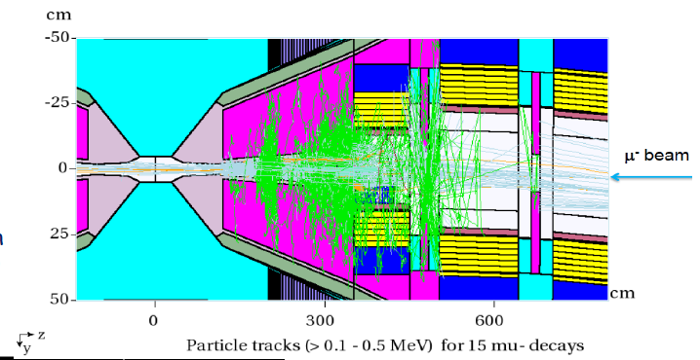
Machine Detector Interface
Backgrounds appear manageable with suitable detector pixelation and timing rejection
Recent study of hit rates comparing MARS, EGS and FLUKA appear consistent to within factors of <2
  a Significant improvement in our confidence of detector performance

Slide 49




Detector Backgrounds & Mitigation
Trackers: Employ double-layer structure with 1mm separation for neutral background suppression
Single layer hit efficiency
Single layer bkgd occupancy
Preliminary detector study promising
  Real progress requires dedicated effort, which MAP was not allowed to fund
1st pass setup:
Further
improvements
anticipated
MARS Bkgds a ILCRoot Det Model

Slide 50
Conclusion
Multi-TeV MC a potentially
only cost-effective route to
lepton collider capabilities with
E_{CM} > 5 TeV
Capability strongly overlaps
with next generation neutrino
source options, i.e., the
neutrino factory
Key technical hurdles have
been addressed:
  High power target demo (MERIT)
  Realizable cooling channel designs with acceptable performance
  Breakthroughs in cooling channel technology
  Significant progress in collider & detector design concepts
Muon collider capabilities offer unique potential for the future of high energy physics research

