Slide 1
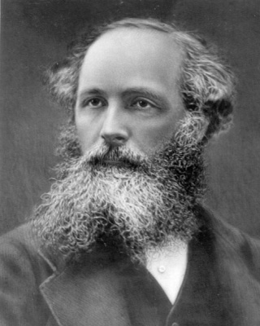
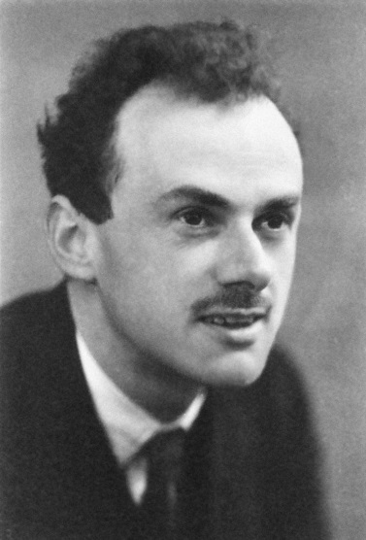
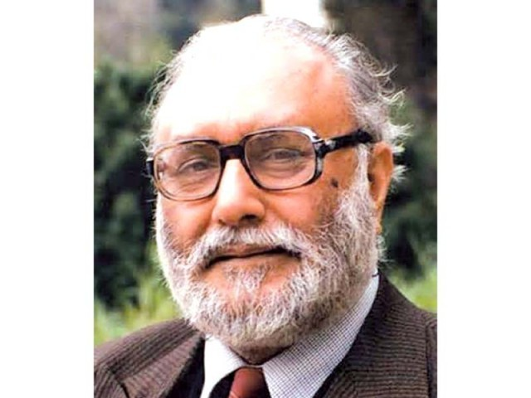
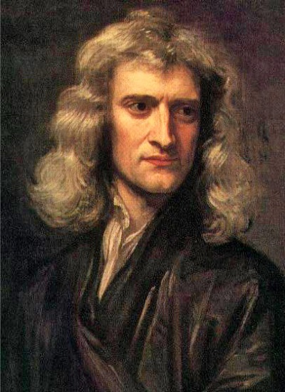
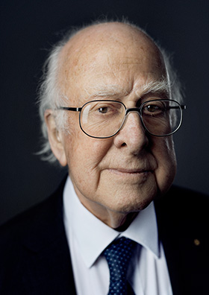
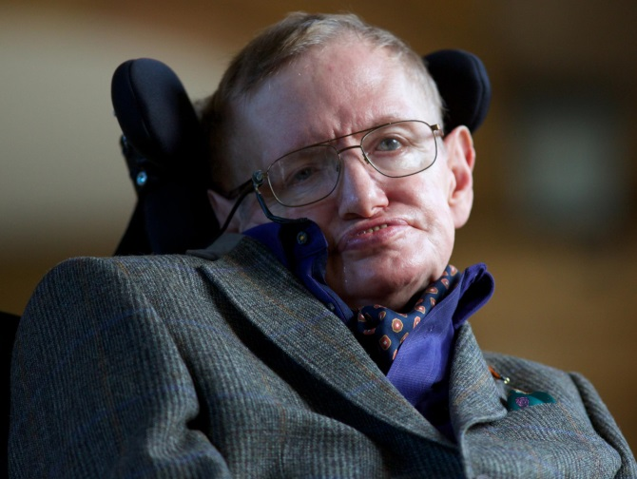
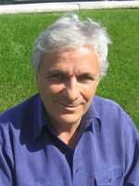
Formal Theory Nick Evans (University of Southampton)
.. sets the ground rules for particle physics… in the UK… to this day…

Slide 2
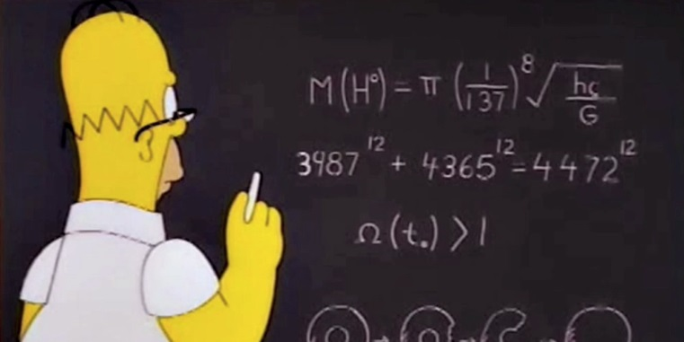
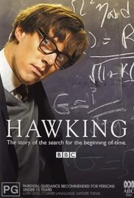
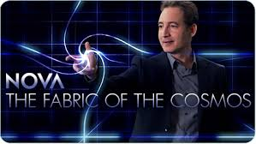
Formal Theory
… has a brand… that is crucial to physics recruitment… and undergraduate teaching…

Slide 3
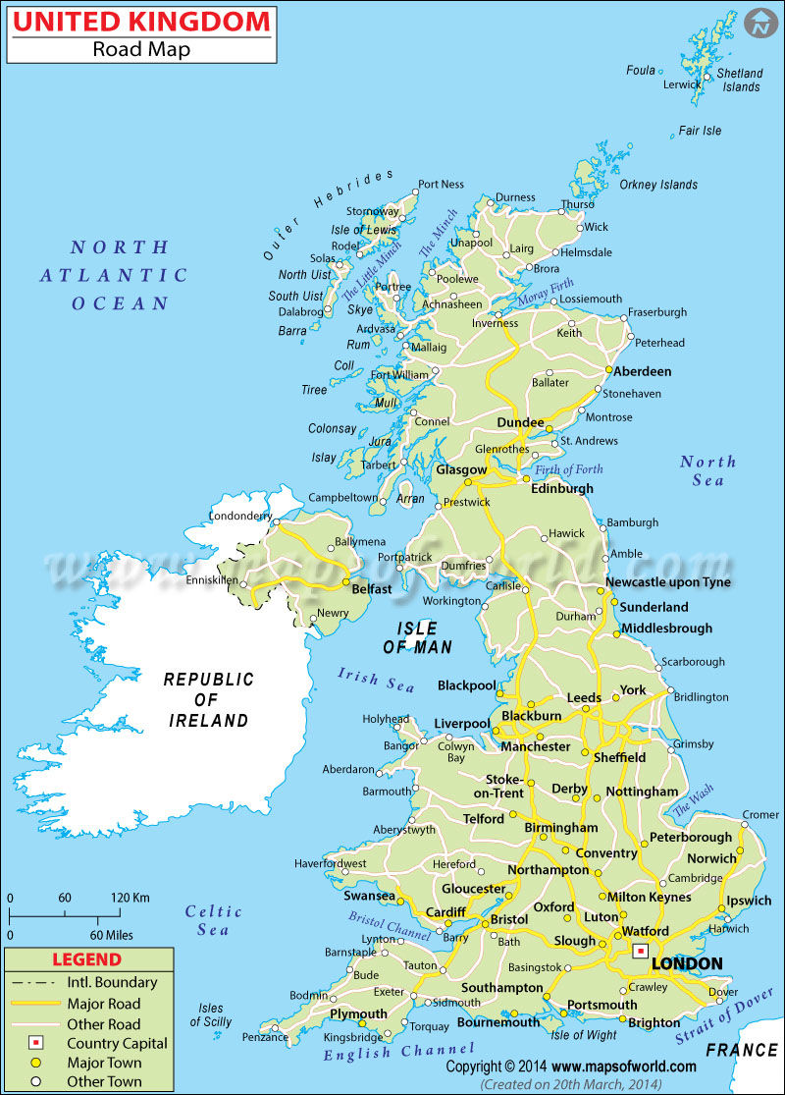
13 UK Groups
(Formal = theorists – pheno – lattice)
~110 staff
Durham, Maths
11 staff
Edinburgh/Heriott Watt 8 staff
Nottingham
9 staff
Liverpool
5 staff
DAMTP
11 staff
Swansea
8 staff
Queen Mary
12 staff
Oxford
5 staff
Kings, Maths
8 staff
Southampton, STAG
9 staff
Surrey
6 staff
Sussex
2 staff
Imperial
15 staff

Slide 4
Experiment is still busy confirming the Standard Model – 1960s & 70s theory…
So what are formal theorists up to?
Answer: what they should be doing!
* understanding field theory, the structure that underlies the SM
* understanding strong coupling ala QCD
* thinking about quantum gravity where we know we must go
eventually
* pursuing anomalies from the SM from astronomy – dark matter, dark
energy

Slide 5
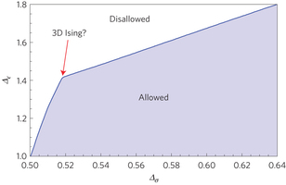
Innovations in Field Theory
* Supersymmetric gauge theories
* Conformal theories (IR fixed points and UV asymptotic safety)
* Integrable models eg N=4 SYM – large sectors have been exactly solved even at
strong coupling
* Bootstrap methods in integrable models
* Amplitude methods – escaping Feynman Diagrams and efficient computation
Spin Offs: MHV techniques for LHC cross-sections beyond LO

Slide 6
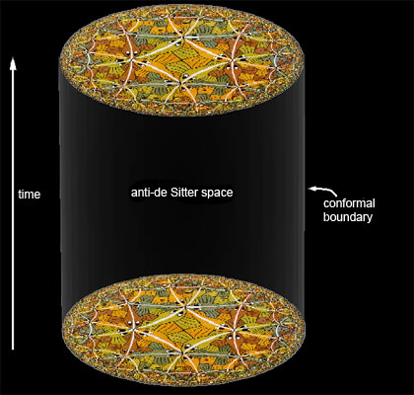
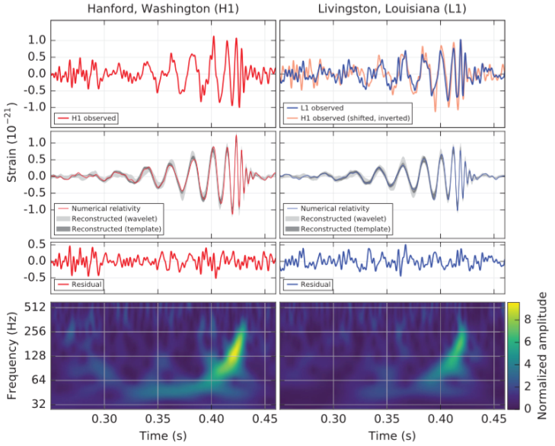
Gauge/Gravity Duality
* Gauge Theory and Quantum Gravity are the same thing!
* Black Hole information loss accessible (if not solvable yet)
* Holographic models of QCD & BSM physics
* A first theory description of the quark gluon plasma at strong coupling – new
understandings of transport properties and links to fluid mechanics & CM
* new cosmologies of the singularity
Spin Offs: TeV scale gravity & brane world
Remember: 10 solar mass black hole collisions
is now experimental physics!

Slide 7
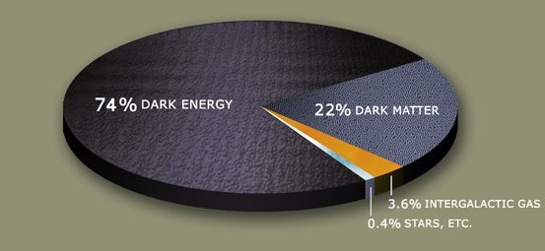
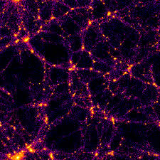
Dark Theory
* WIMPS, axions, etc & their signals
* Dark energy & fine tuning
* Cosmological scalars, inflation mechanisms
and models
* Modified gravity in the IR eg massive gravity
* String phenomenology

Slide 8
World Leading?
ESF Holograv – UK contributed 5%
spent 20%...
21 ERC, STFC RF, RS URF
QM – 2 Edin - 1
KCL – 2 Nottingham - 3
Cambridge – 1 IC – 2
Swansea – 1 Southampton - 5
Oxford – 3
Surrey – 1
STFC RA Funding
13 1/3 postdocs across 110 academics….

Slide 9
Outlook
Formal theorists are a core element of our Universities’ recruitment and teaching excellence
The SM will break and then we need innovative and flexible theorists and the ideas they have in the bag already
UK is competing globally on very limited funding

Slide 10
Lattice Gauge Theory – DiRAC3 review

