Slide 1
A High Granularity CMOS Technology Strategy for Particle Physics and STFC
Particle Physics Advisory Panel
27th July 2016
University of Birmingham

Slide 2
Outline
Background and development.
Cosener’s House 10th March 2016 meeting.
Outcomes and Strategy Proposal.
Only one slide on the HR/HV CMOS technology.
No slides on projects/experiments (e.g. STAR/RHIC, Beam-line telescopes, mu3e, ALICE ITS upgrade, LHC upgrades LS2 and LS3, ALICE vertex, LC, FCC, + others).
No slides on international collaborations (e.g. AIDA-2020, STREAM, RD50, RD53, …)

Slide 3
You know this…
Silicon is at the heart of vertex and tracking detectors in HEP.
Very few experiments that don’t need 2D/3D reconstruction in some form.
Beginning to be proposed for other purposes:
Digital Calorimetry.
Fast timing for vertex separation in colliders.
Charge detection in Drift and Time Projection Chambers.
SiPM/APDs instead of phototubes.
85% of $38 billion sensor market uses CMOS and growing.
It takes about 10-15 years of continuous development to implement the technology into a detector.
How do we position the UK to do this?

Slide 4
In other words…
How do we scale up from 0.25 mm² sensors (Industry) to 1 hectare (FCC/LC calorimetry) and meet all the requirements?

Slide 5
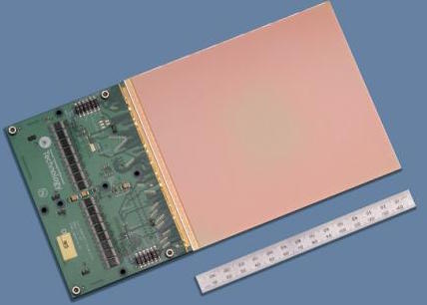
High Voltage (HV)/High Resistivity (HR) CMOS
Small feature size (1μm), thin material (20μm), high speed (80 MHz), timing resolution (<1ns), low-power (20 mW/cm²), high radiation hardness (>100 Mrads), high dynamic range, low noise (< 1e⁻), wafer scale, higher yield, low cost ($0.3/cm²), intelligent, …
Institutes/STFC have track record, capabilities, and potential in this area.
Already have success with Newton Fund and HR/HV CMOS.
Enables institutes and STFC to access Global Challenges Research Fund.

Slide 6
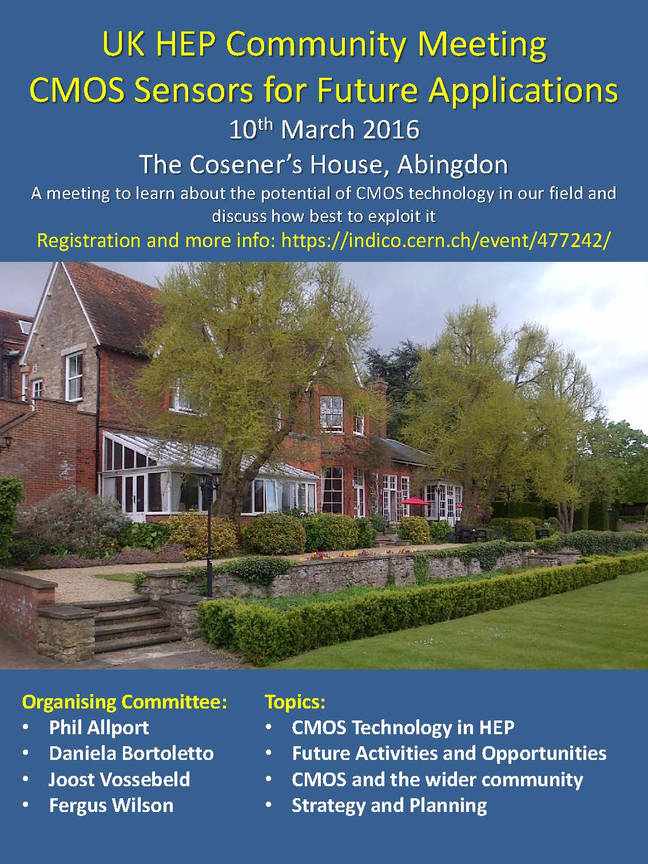
55 attendees from 11 UK institutes + OU + CERN + DESY + Heidelberg + STFC. We organised 14 talks on HEP + planning session. Talks on wider context (mass spectroscopy, space, astronomy, medical, proton therapy, x-ray, electron microscopy,…) Concentrated on HEP needs but looked at synergies with STFC facilities and other programmes. All talks available on indico site

Slide 7
Outcomes - Feedback
Only source of STFC funding for institutes are Project R&D (PRD) grants:
Example costs: 1 year of design effort £70k; 1 engineering run can cost £200k.
No follow-on funding so projects have no momentum.
Grant awards:
How to choose between competing proposals?
How to/Whether to fund follow on proposals?
As Technology is not a roadmap/strategy for STFC, institutes can not ask for posts in their consolidated grant.
Strong technology R&D stream leads to success at the project level.
Recognition that technology R&D needs a strategy in the same way that experiments/projects do.
Avoid duplication, avoid segmentation, avoid silo mentality, create networks, improved planning, invest to save, amplify outcomes, expand horizons, higher profile, ….

Slide 8
Outcomes – Competition/Benchmarking
Other countries (e.g. France/Germany) have continuous funding which ensures they can constantly improve their technology, often producing new sensors every 3 months.
They have full time designers.
Building long-term relationships with foundries is essential (design rules, NDA’s, …)
Concern that UK is at a disadvantage when bidding for high-profile, advanced technology projects
Projects go to groups/countries that have a consistent track record
We have examples where UK led the world but lost the race.
Concern that a lot of our expertise is being transferred out of UK.

Slide 9
Outcomes - Message from meeting
Many of the problems HEP are trying to solve have overlaps with other facility and programme needs.
Stop-Start funding doesn’t work. Long term consistent funding is the key to progress.
Desire by institutes to bring together their people to make R&D more coherent and national.
Desire to put a UK flag on CMOS technology R&D (again!).
Full-time sensor and ASIC designs/designers vital.
Incremental submission of designs key to progress.
Acknowledgement that UK shouldn’t do everything.

Slide 10
Outcomes - The Challenges and Road Map
Today | Short-term | Long-term
Radiation Tolerance
Timing Resolution and High Rate Capability
Pixel Size Granularity and Position Resolution
Radiation Length and Collection Thinness
Device Area (Cost) and Power
10¹⁵ n_{eq}/cm²
10¹⁶ n_{eq}/cm²
10¹⁸ n_{eq}/cm²
10-20 ns
< 100 ps
< 1ns
25-100 µm
10-25 µm
1-5 µm
150-100 μm
~50 μm
≤20 μm
100m²
1,000m²
10,000m²

Slide 11
Outcomes - HEP Performance Drivers
Darker colours indicate increased importance

Slide 12
Outcomes - STFC Technology Strategy
HEP not the only users of CMOS within STFC remit:
Photon Science (e.g. XFEL, LCLS, DLS).
Astronomy and Space Science (Earth Observation).
Nuclear Physics (CBM@FAIR, R3B).
High Speed Imaging (commercialisation).
X-ray Imaging.
Fluorescent Lifetime Imaging (FLIM, Single Photon APDs).
Transition Electron Microscopy.
Mass Spectroscopy.
Medical Imaging.
Hadron Therapy.
Global Challenges (Technology for Health, Agriculture).
Overlap between HEP needs and other STFC programmes
STFC Technology Department is carrying out its own CMOS review now.

Slide 13
Outcomes - Input to PPAP document
Document available on the PPAP Community Meeting 2016 page.
Current status of UK and UK desires for the future
Review of Technological Challenges
Roadmap
Proposal
Provided as input to TD strategy planning.
Presented to STFC facility representatives and National Labs director

Slide 14
Executive Summary of Strategy
We have the basis to be world leaders in HV/HR CMOS technology.
Comparison with international activities shows that key to a successful R&D programme is long-term continuity of funding to allow rapid submission of incremental designs and testing.
Encourage STFC to adopt a long-term approach to strategic technology R&D areas and support the R&D needed to make HV/HR CMOS technology as (one of its) strategic technology priorities;
UK groups to create a national HV/HR CMOS R&D consortium that, working closely with international partners, will develop applications of this technology in the near future and carry out the required R&D to meet the most challenging performance requirements of HEP applications in the long-term future;
UK groups to prepare a bid requesting a sustained funding line that would establish a core team of designers in the UK and allow for the regular submission of prototypes.

