Slide 1
Dark Matter Effective Field Theory Scattering analysis in the XENON100 detector
Ran Itay, Weizmann Institute of Science
on behalf of the XENON Collaboration.
Benjamin Farmer, Stockholm University
Dark Matter Interpretations for Direct Detection, August 2016

Slide 2
21 Institutes from 10 countries.
The XENON Collaboration
10 countries
21 Institutes
130 Scientists

Slide 3
Detection Principle
Top PMT array
4.4 kV
E _{extraction}
Anode
gXe
E _{drift}
LXe
Cathode
-16 kV
Bottom PMT array

Slide 4
Detection Principle
Top PMT array
4.4 kV
E _{extraction}
Anode
e⁻
e⁻
E _{drift}
LXe
e⁻
Cathode
-16 kV
Bottom PMT array

Slide 5
Detection Principle
Top PMT array
4.4 kV
E _{extraction}
Anode
γ
e⁻
γ
γ
e⁻
E _{drift}
LXe
γ
e⁻
γ
Cathode
-16 kV
Bottom PMT array

Slide 6
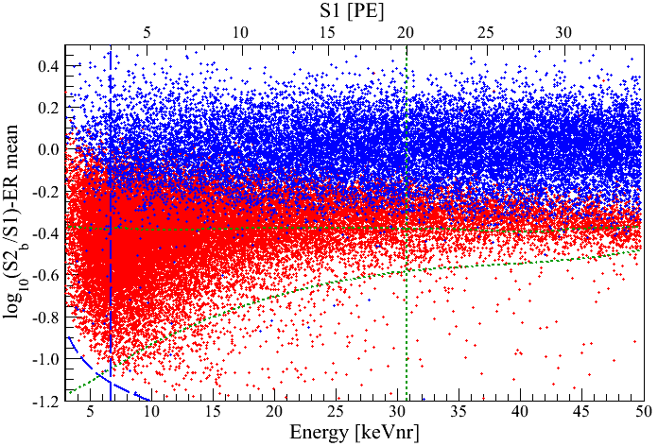
Detection Principle
Top PMT array
4.4 kV
E _{extraction}
e , γ – background
Anode
γ
γ
γ
γ
γ
γ
WIMP, N – signal
e⁻
e⁻
E _{drift}
LXe
e⁻
Cathode
-16 kV
Bottom PMT array

Slide 7
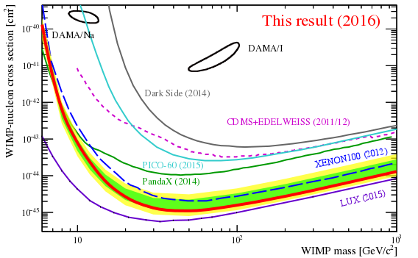
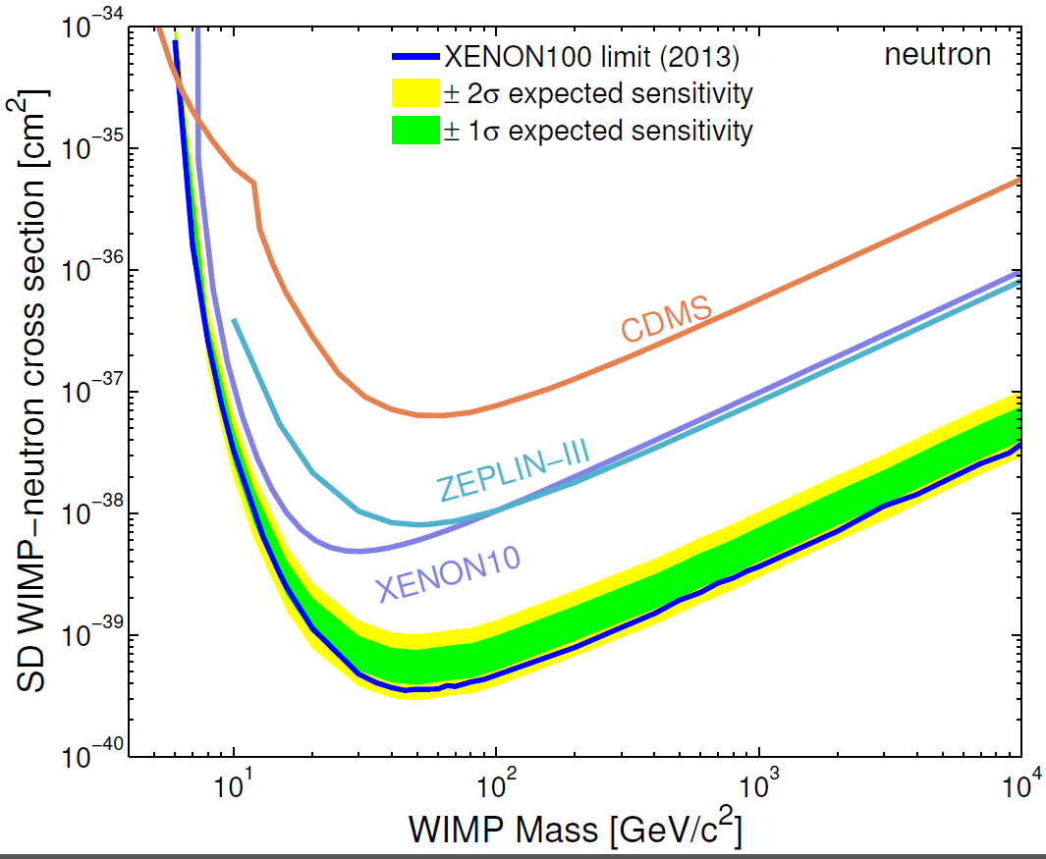
Standard Interactions
Spin Independent
Spin Dependent
Preliminary
arXiv: 1301.6620

Slide 8
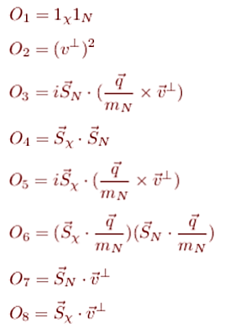
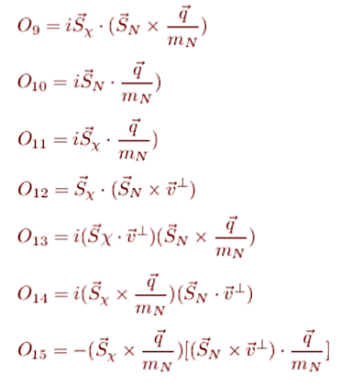
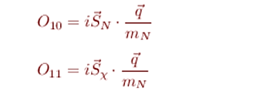
EFT Interactions
$$L_{int}=c{ Ψ}_{χ}^{∗}{\hat{O}}_{χ}ψ_{χ}ψ_{N}^{∗}{\hat{O}}_{N}ψ_{N}= \sum_{α=p,n}{\sum_{i=1}^{15}{c_{i}^{α}{\hat{O}}_{i}^{α} }}$$
SI
Cannot be obtained at leading order
SD
Fitzpatrick et al. arXiv:1203.3542
Anand et al. arXiv: 1308.6288

Slide 9
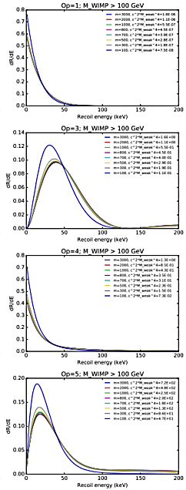
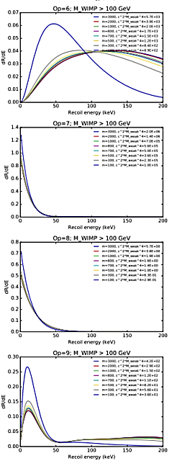
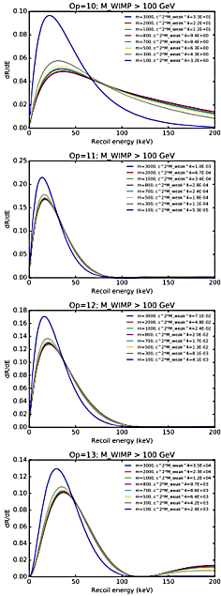
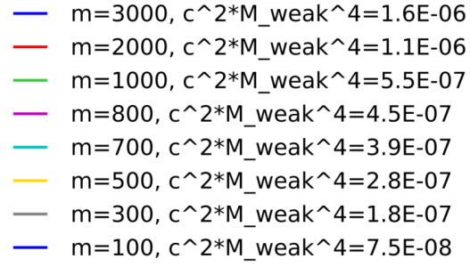
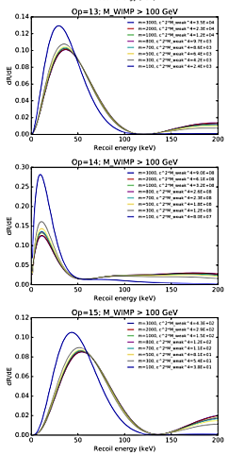
SI
SD

Slide 10
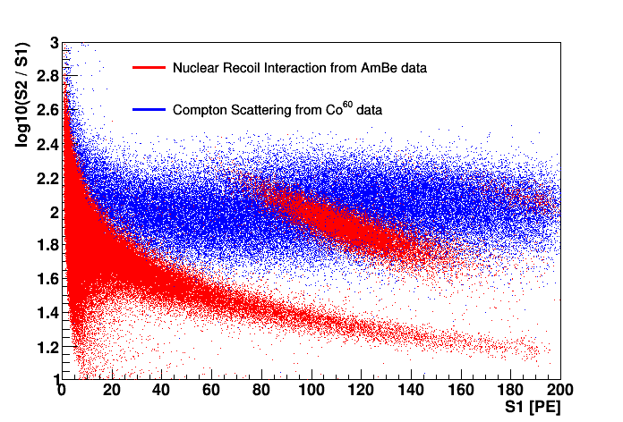
Strategy
Blind analysis, data of Run 2, 28.2.11 – 31.3.12 (34*225.6 kg*day)
Treat each operator separately
Signal region divided into 2 energy regimes.
Low Energy (3-30PE),
“standard” analysis.
Signal Model – MC based
Detector acceptance
Background Model(fit)
Profile Likelihood(pdf in S1)
High Energy (30-180PE),
This work.
Signal Model – calibration based
Detector acceptance
Background Model
(calibration data)
Profile Likelihood (binned S1)
40 keV line
Blind
Likelihood combination

Slide 11
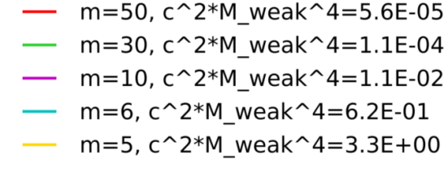
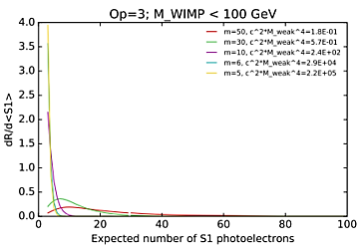
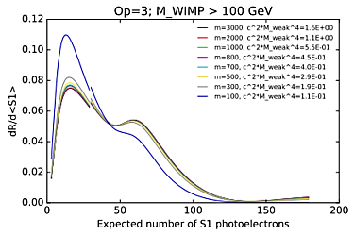
High Energy (30-180 PE)
Signal Model
Spin-orbit.
$${\hat{O}}_{3}= i{\vec{S}}_{N}⋅(\frac{\vec{q}}{m_{N}}×{\vec{v}}^{⊥} )$$

Slide 12
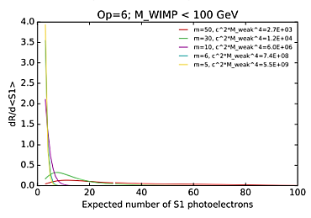
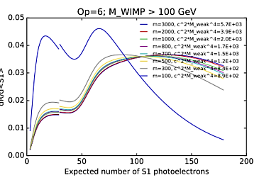
High Energy (30-180 PE)
Signal Model
SD( longitudinal only ).
$${\hat{O}}_{6}={(\vec{S}}_{χ}⋅\vec{q}){(\vec{S}}_{N}⋅\vec{q})$$

Slide 13
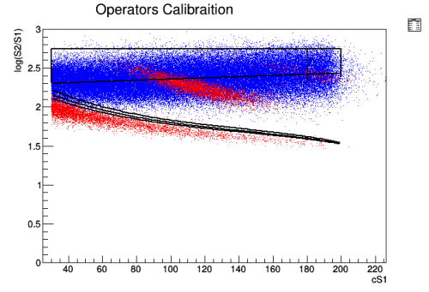
High Energy (30-180 PE)
Background Model
Data Driven Method
Use ER calibration runs (Co + Th) to estimate background
Define signal-free control region
Estimate scaling factor using control region $τ=\frac{N_{DM}^{CR}}{N_{Co \& Th}^{CR} }$
Scale ER calibration in signal region
Control region
Signal region
NR acceptance quantiles
e , γ – background
WIMP, N – signal

Slide 14
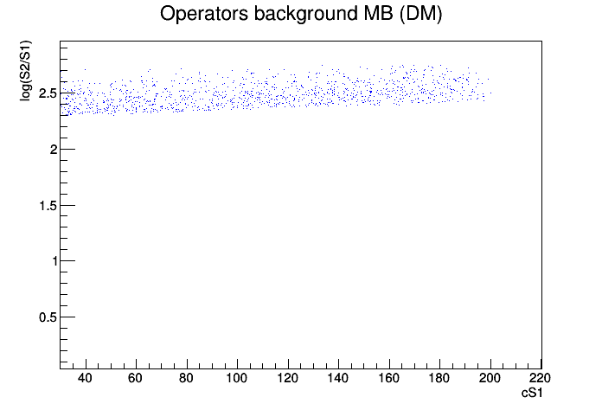
High Energy (30-180 PE)
Background Model
Total number of events in calibration Sample – 49468
Total number of events in DM Sample – 1163
τ = (2.35 ± 0.07)${×10}^{−2}$
systematic uncertainty to be evaluated
Control region
Blind
Preliminary

Slide 15
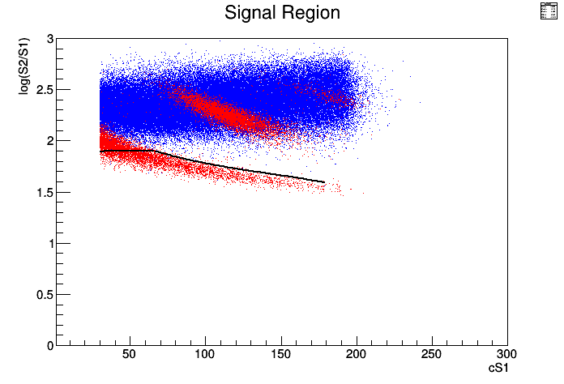
High Energy (30-180 PE)
Likelihood analysis will include “full” region.
Benchmark area, shown here for preliminary sensitivity
Signal region
e , γ – background
WIMP, N – signal
95% NR acc & 99.9% ER rej
Expected background: 1.4
Total signal acc ~60%
Notes:
9.6 bck 95% – 5.7 limit
1.4 bck 60% – 5.2 limit
2.35 bck 50% sig– 7.1 lim

Slide 16
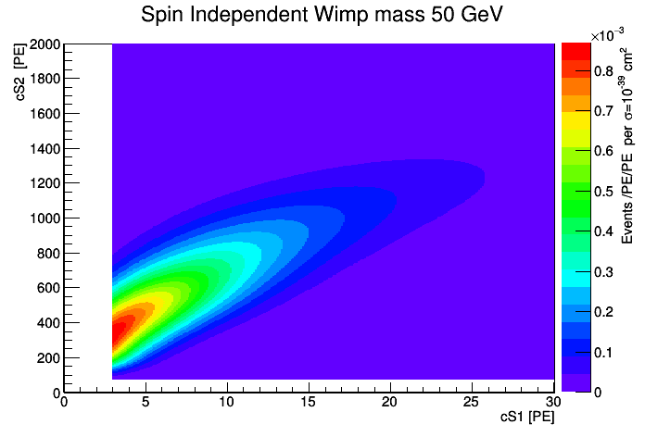
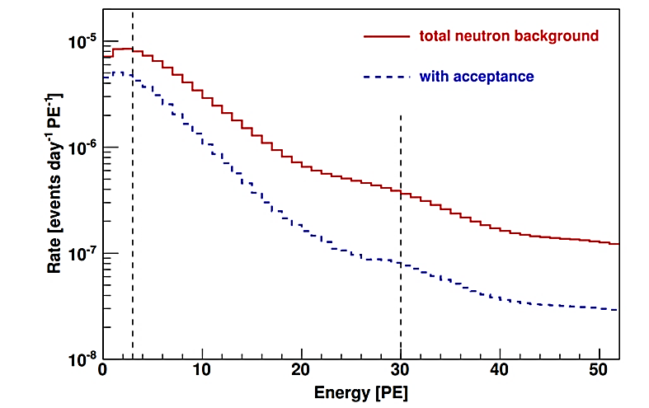
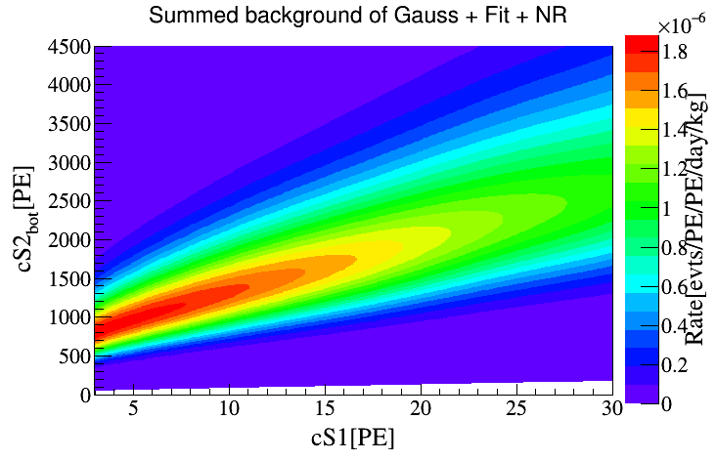
Low Energy (3 - 30 PE)
Similar and improved to arXiv: 1207.5988
Signal model
Background model
Expected background: 1.7
Preliminary
$${0.46}_{−0.17}^{+0.34}$$
Preliminary

Slide 17
Sensitivity
Very preliminary.
Currently based on Feldman-Cousins counting approach
All CDMS results taken from K. Schneck et al. PRD 91, 092004 (2015) .

Slide 18
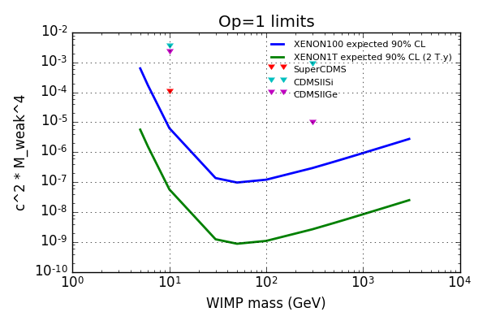
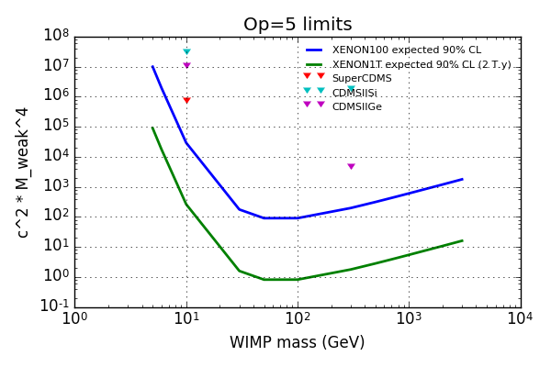
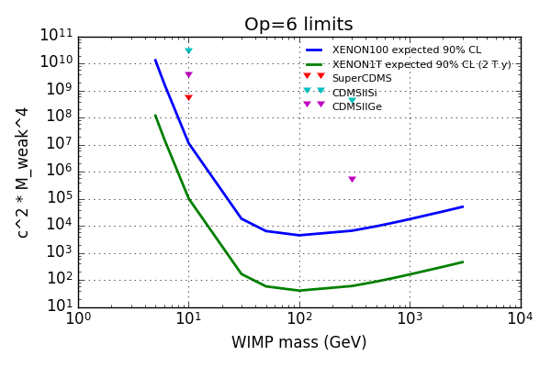
Estimated Sensitivity
$${\hat{O}}_{1}=1_{χ}⋅1_{N}$$
$${\hat{O}}_{5}={i\vec{S}}_{χ}⋅(\frac{\vec{q}}{m_{N}}×{\vec{v}}^{⊥})$$
Preliminary
$${\hat{O}}_{4}={\vec{S}}_{χ}⋅{\vec{S}}_{N}$$
$${\hat{O}}_{6}={(\vec{S}}_{χ}⋅\vec{q})⋅{(\vec{S}}_{N}⋅\vec{q})$$
Notes:
M_weak = 246.2 GeV

Slide 19
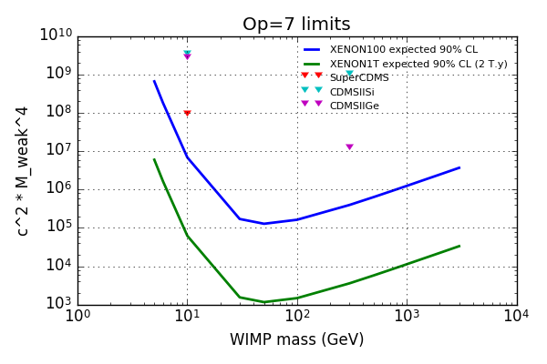
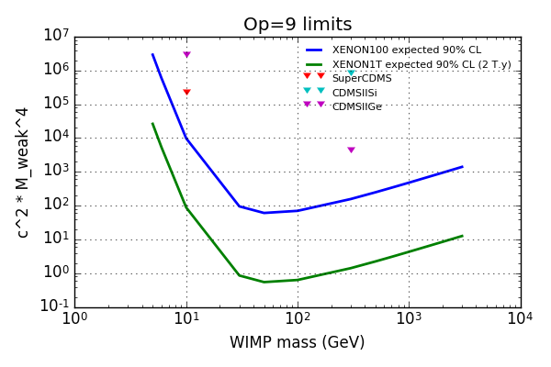
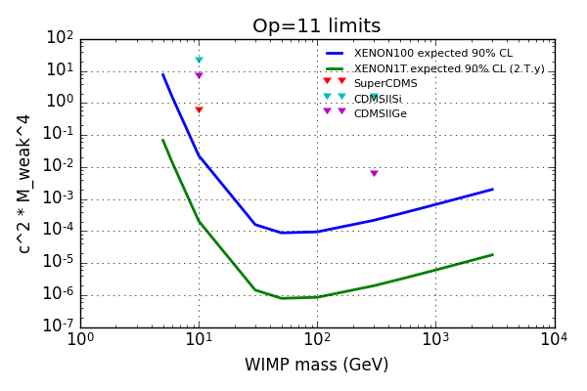
Estimated Sensitivity
$${\hat{O}}_{7}={\vec{S}}_{N}⋅{\vec{v}}^{⊥}$$
$${\hat{O}}_{10}={i\vec{S}}_{N}⋅\frac{\vec{q}}{m_{N}}$$
Preliminary
$${\hat{O}}_{9}={i\vec{S}}_{χ}⋅({\vec{S}}_{N}×\frac{\vec{q}}{m_{N}})$$
$${\hat{O}}_{11}={i\vec{S}}_{χ}⋅\frac{\vec{q}}{m_{N}}$$

Slide 20
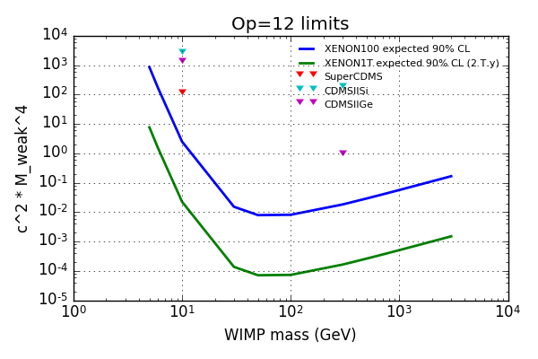
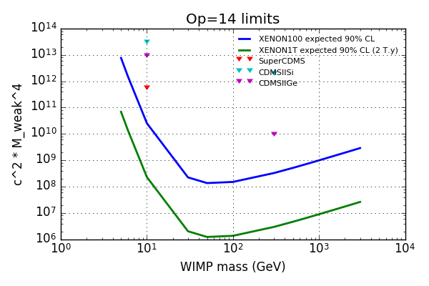
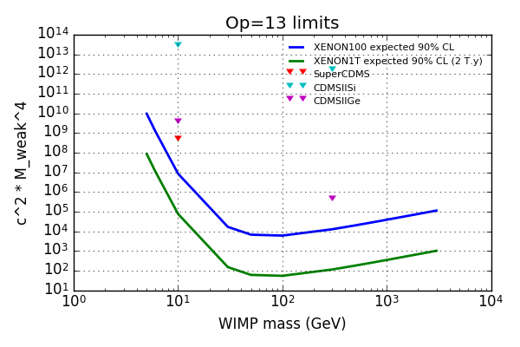
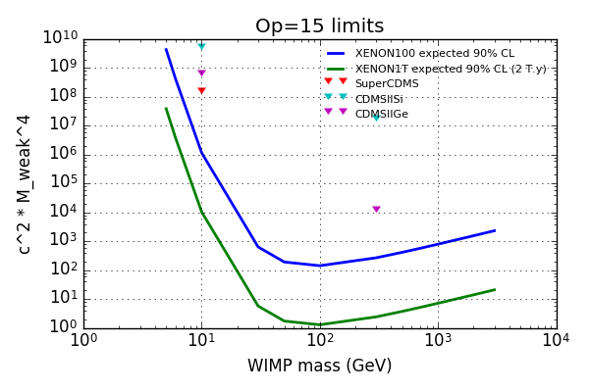
Estimated Sensitivity
$${\hat{O}}_{12}={\vec{S}}_{χ}⋅({\vec{S}}_{N}×{\vec{v}}^{⊥})$$
$${\hat{O}}_{14}={i(\vec{S}}_{χ}×\frac{\vec{q}}{m_{N}})({\vec{S}}_{N}⋅{\vec{v}}^{⊥})$$
Preliminary
$${\hat{O}}_{13}={i(\vec{S}}_{χ}⋅{\vec{v}}^{⊥})({\vec{S}}_{N}×\frac{\vec{q}}{m_{N}})$$
$${\hat{O}}_{15}=−({\vec{S}}_{χ}×\frac{\vec{q}}{m_{N}})[\left({\vec{S}}_{N}×{\vec{v}}^{⊥}\right)⋅\frac{\vec{q}}{m_{N}}]$$

Slide 21
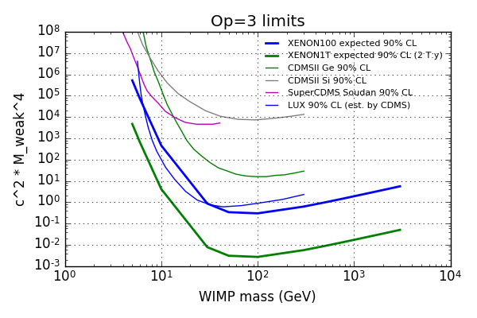
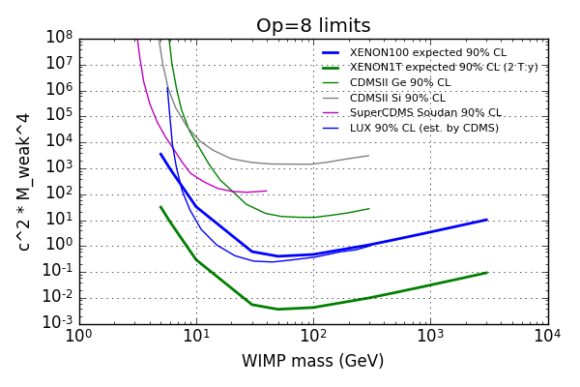
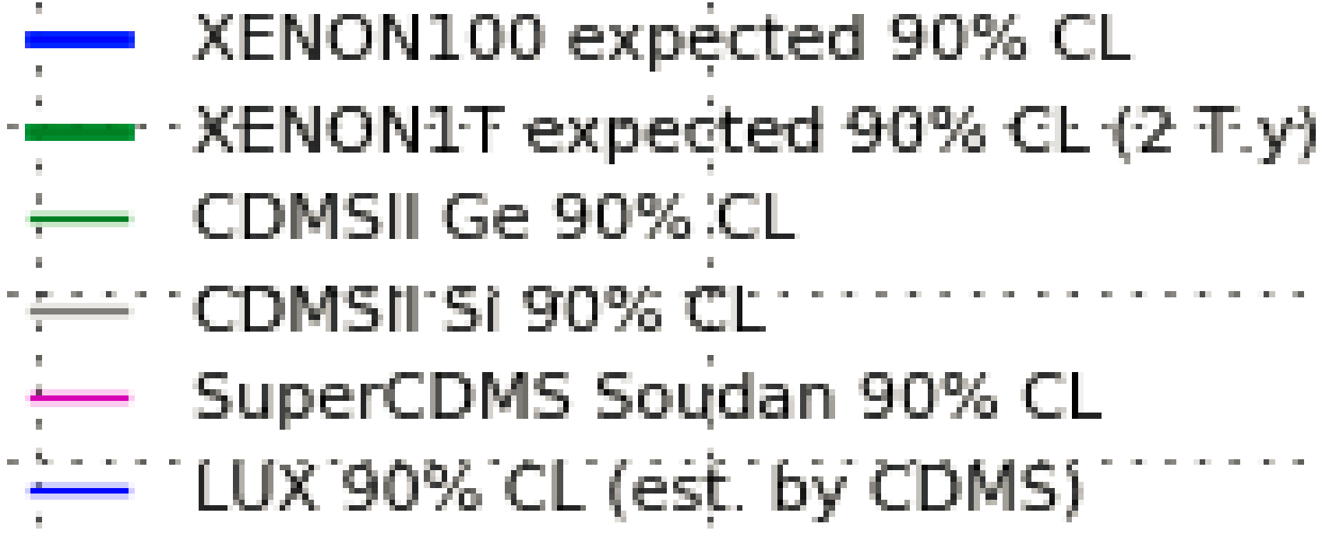
Estimated Sensitivity
$$O_{3}=i{\vec{S}}_{N}⋅(\frac{\vec{q}}{m_{N}}×{\vec{v}}^{⊥})$$
$${\hat{O}}_{8}={\vec{S}}_{χ}⋅{\vec{v}}^{⊥}$$
Preliminary

Slide 22
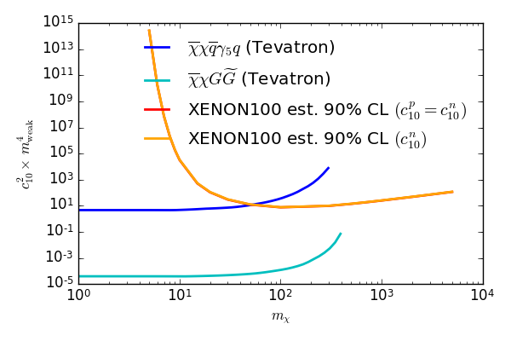
Estimated Sensitivity
Reduction from Relativistic operators
Limits on majorana fermions
Preliminary
$${\hat{O}}_{2}^{R}=i\overline{χ}χ\overline{N}γ_{5}N$$
$${\hat{O}}_{10}^{NR}=i{\vec{S}}_{N}⋅\frac{\vec{q}}{M_{N}}$$
Goldman et al. arXiv:1005.1286
Panci et al. arXiv:1307.5955

Slide 23
Summary
Ongoing analysis on EFT operators in XENON100.
Energy range extended to 180PE (240 keVnr), previously up to 30PE (43 keVnr)
Estimated sensitivity promising.
Comparison to Relativistic operators in Tevatron presented.
Future - XENON1T, stay tuned!

Slide 24
Questions

Slide 25
Backup Slides

Slide 26
High Energy (30-180 PE)
Statistical Inference
Log Likelihood ratio.
$$L= \prod_{i}{L_{1}×L_{2}×L_{3}}$$
$$L_{1}=Poisson\left(n_{i}^{obs} \right|{ε^{b}τN}_{i}^{Cal}+{ε^{s}N}_{i}^{s})$$
$$L_{2}= Gauss\left(L_{eff}\right)×Gauss\left(τ\right)×Gauss\left(Acc\right)$$
$$L_{3}= Poisson\left(N_{i}^{cal}\right|N_{Tot}^{cal} ∗ε_{i}^{b}) ×Poisson\left(N_{i}^{cal}\right|N_{Tot}^{cal} ∗ε_{i}^{s})$$
$$ε_{i} −expected fraction of events in bin i$$
$$N_{i}−Total number of calibration events in bin i$$
$$τ −scaling factor$$

Slide 27
Low Energy (3-30 PE)
Statistical Inference
Log Likelihood ratio.
$$L= \prod_{i}{L_{1}×L_{2}×L_{3}×L_{4}}$$
$$L_{1}=Poisson\left(n_{i}^{obs} \right|{ε^{b}τN}_{i}^{Cal}+{ε^{s}N}_{i}^{s})$$
$$L_{2}= Gauss\left(L_{eff}\right)×Gauss\left(Acc\right)$$
$$L_{3}= Poisson\left(N_{i}^{cal}\right|N_{Tot}^{cal} ∗ε_{i}^{b}) ×Poisson\left(N_{i}^{cal}\right|N_{Tot}^{cal} ∗ε_{i}^{s})$$
$$L_{4}=\prod_{j=1}^{n^{i}}{\frac{ε_{s}^{i}N_{s}f_{s}\left(S1\right)+ε_{b}^{i}N_{b}f_{b}\left(S1\right)}{ε_{s}^{i}N_{s}+ε_{b}^{i}N_{b}}}$$
$$ε_{i} −expected fraction of events in bin i$$
$$N_{i}−Total number of calibration events in bin i$$
$$f\left(S1\right)−p of data coming from s/b$$

Slide 28
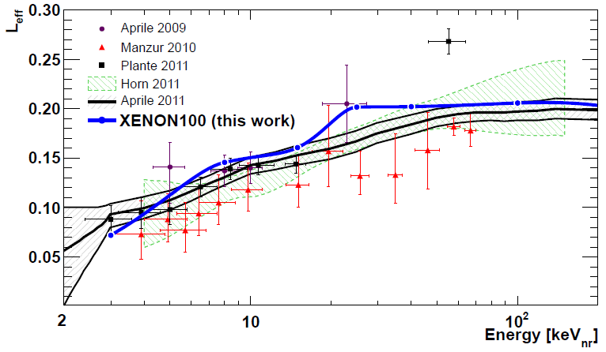

Slide 29
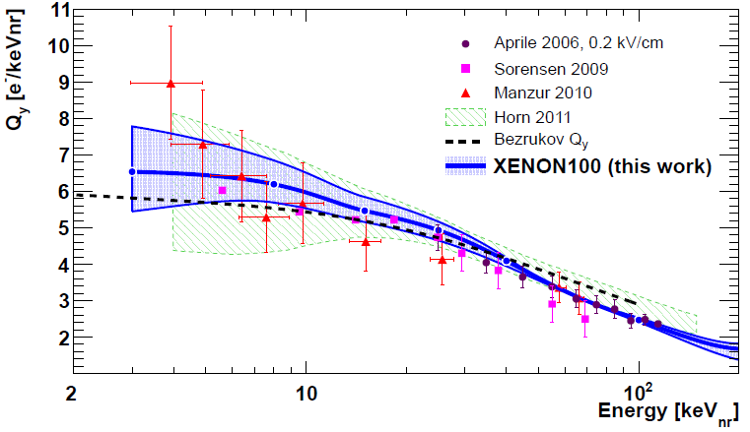

Slide 30
e , γ – background
WIMP, N – signal
95% NR acc
Expected background: 9.6

