Slide 1
Planning for UKRI: STFC town meeting Durham, December 2016
Brian R Bowsher
Chief Executive

Slide 2
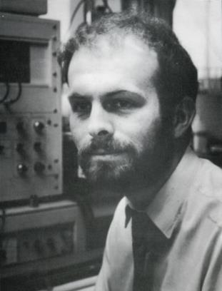
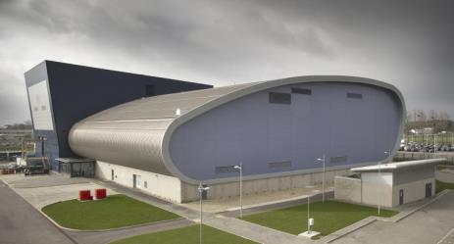
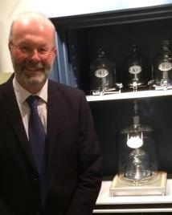
Brian Bowsher
A brief history

Slide 3
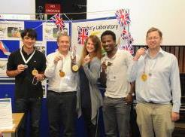
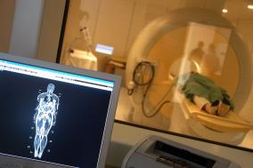
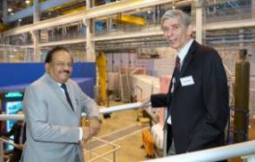
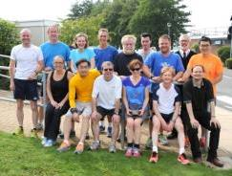
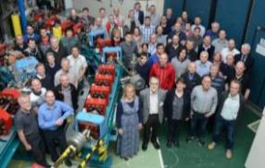
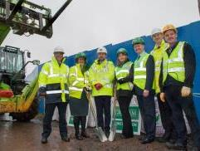
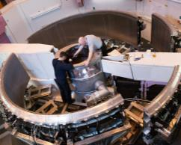
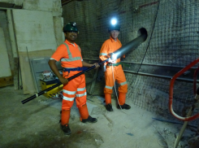
First impressions
Science excellence
Impact
Partnership/collaboration
Inclusive environment

Slide 4
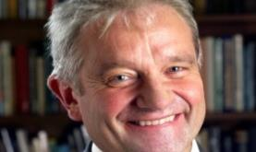
But change coming….
Brexit
Department for Business, Energy and Industrial Strategy (BEIS)
Merger of BIS and Department of Energy and Climate Change
UK Research and Innovation (UKRI)
New UKRI CEO

Slide 6
UK Research and Innovation
Single research and innovation funding body
Seven research councils, HEFCE’s research and knowledge exchange (known in future as Research England) and Innovate UK to merge into UKRI
Existing Royal Charters revoked, and all staff, assets, agreements, etc. legally transferred into UKRI
UKRI expected to start on 1 April 2018
Councils, Research England and Innovate will continue “in name” as UKRI committees
Budgets for each set separately by SoS
Each committee will produce Delivery Plan within the context of the overall UKRI strategy

Slide 7
Establishment and transition
Current stage
Higher Education and Research Bill
Schedule based on Royal Assent in the Spring
UKRI interim Chair appointed – Sir John Kingman
CEO – appointment process underway
Aiming for April 2017 start
Shadow body to be established in 2017

Slide 8
UKRI - a great opportunity
Further enhance excellent reputation for science
Increase synergies/multi-disciplinary work
Increase impact
“The whole is more than the sum of its parts”

Slide 9
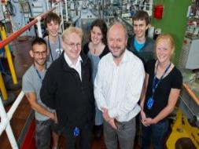
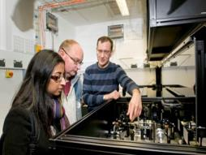
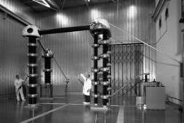
Some challenges
Must ensure academic partners continue to be provided with the long-term support they need for world-leading research
Requirement for scientists and facilities to be retained within STFC
Uncertainties in support services
Single culture across all RCs, Innovate and HEFCE?
STFC, NERC, MRC, BBSRC more than grants
9,000+ scientists across UKRI family
Critical national science infrastructure
Flexibility to grow

Slide 10
Brexit

Slide 11
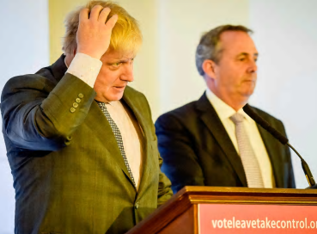
Where we are now
Little clarity in the five months since the referendum
Changes in Government - new Departments for Exiting the European Union and International Trade
Government says it will invoke Article 50 by end March 2017
Parliamentary committees are scrutinising the impacts on universities and research
Legal challenges

Slide 12
Areas of potential impact
10% of STFC staff are non-UK EU or EEA nationals
80% of our EU staff are in SET roles
Large facility usage by non-UK EU academics
Foreign exchange rate fluctuations:
International subscriptions variation covered by BEIS
Loss of EU funding for university groups
Seven years of flat cash and loss of EU = real trouble for some

Slide 13
What next?
Brexit may happen, but it’s outside our control
Better to engage not complain
We can only influence the “how” if we’re listened to
Focus on providing high quality data and analysis to Government
We want Ministers to understand the impact so they can plan to mitigate in advance, e.g. funding
There are opportunities from the Government’s desire for UK to remain a world-class research nation
New funding? More support and engagement?

Slide 14
Funding

Slide 15
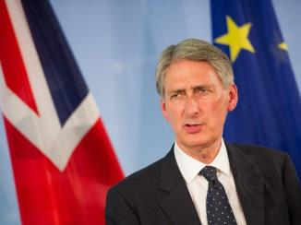
Public finances
In his Autumn Statement, Philip Hammond said UK will need to increase its borrowing by £122bn over the next five years
Brexit will blow a £59bn hole in the public sector finances
Equivalent to the tax and duties on fuel, tobacco, alcohol, gambling, cars and air travel

Slide 16
Autumn Statement
£2bn p.a. for science and innovation by 2020/21
Funding far larger than anticipated
All for RCs, IUK and HEFCE
Will ramp up to full amount
BEIS will consult on spending priorities
Industrial Strategy Challenge Fund
Research and Innovation Capacity
Perhaps some Injection to QR?
Allocations
Funding for 2017/18 resolved by BEIS by March 2017
UKRI CEO involved in mini spending review next summer

Slide 17
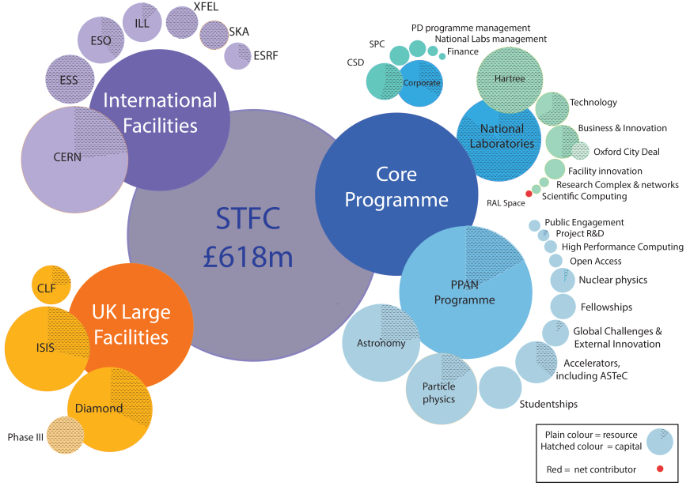
Financial summary

Slide 18
Key points
£17.6m gap between capital budget & requirement each year
£12.3m gap between resource budget & requirement each year
Core capital budget
Global Challenges Research Fund
Core resource budget
We told government that “constant volume” (flat-cash plus inflation) would avoid the need to withdraw from significant projects
But our allocation was flat
Capital cut of 40% from 2019/2020 in our indicative allocation

Slide 19
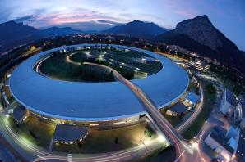
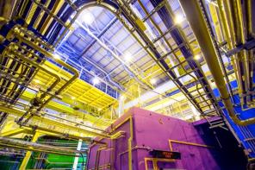
Immediate pressures
International Facilities
Annual funding gap of £21m p.a. due to foreign exchange risk BEIS WILL COVER
Large Facilities
Allocation assumes a ‘savings target’ of £1.8m for 2016/17, rising to £7.8m in 2019/20
Core Programme
Impact of 7th year of flat-cash
Funding gaps in both resource and capital by 2020/21 if we do nothing

Slide 20
Some of our arguments for more
Large Facilities
ISIS and CLF have not operated in full for many years - full operations would require an additional £26m p.a. by 2019/20
Core Programme
Astronomy success rates decreased from 44% in 2013 to 30% in 2016
Can only fund half of astronomy depts
PP Experimental funds reduced by 30% since 2007 – send fewer physicists to CERN (6%) than Germany (11%) or Italy (15%)
PhD studentships decreased by 25% since 2008 – we could treble
Etc . . .

Slide 22
Balance of Programmes Objectives
To review what science and funding has changed since the last programmatic review (2012-13)
To review the PPAN current and planned programme for the next five years
To review any changes to the strategic priorities of the science roadmaps and the subsequent impact
To consider any potential future changes in the programme or funding landscape
To review any critical decision points identified by STFC and their implications
To review the appropriate balance between subject areas and between R&D, construction and exploitation

Slide 23
BoP timeline
July 2016 | 5-6 July - Science Board - kicks off BoP exercise Extranet site set up and start of compilation of relevant documentation 25 July - Questions sent to Advisory Panel chairs 28 July- Telecon with Advisory Panel chairs | Information Gathering Phase
Aug 2016 | 15 August – First BoP Panel telecon (14:00 – 16:00)
Sep 2016 | 17-18 September - Initial report to STFC Council 21 September - Second BoP Panel telecon (14:00-16:00) 23 September- AP chairs input to BoP Panel
Oct 2016 | 17-18 October – First BoP Panel meeting (Swindon) | Assessment Phase
Nov 2016 | 28-29 - Second BoP Panel meeting (Swindon)
Dec 2016 | 12-13 – Science Board (Swindon)
Feb 2017 | Report findings to first Science Board meeting of 2017

Slide 24
Panel Membership
Prof Richard Harrison (Chair), RAL Space
Prof Tara Shears (Deputy Chair), University of Liverpool
Prof Gary Barker, University of Warwick
Prof Stewart Boogert, RHUL
Prof Peter Clarke, University of Edinburgh
Prof Antonella De Santo, University of Sussex
Prof Janet Drew, University of Hertfordshire
Prof Simon Hands, University of Swansea
Prof David Ireland, University of Glasgow
Prof Bob Nichol, University of Portsmouth
Prof Alberto Vecchio, University of Birmingham

Slide 25
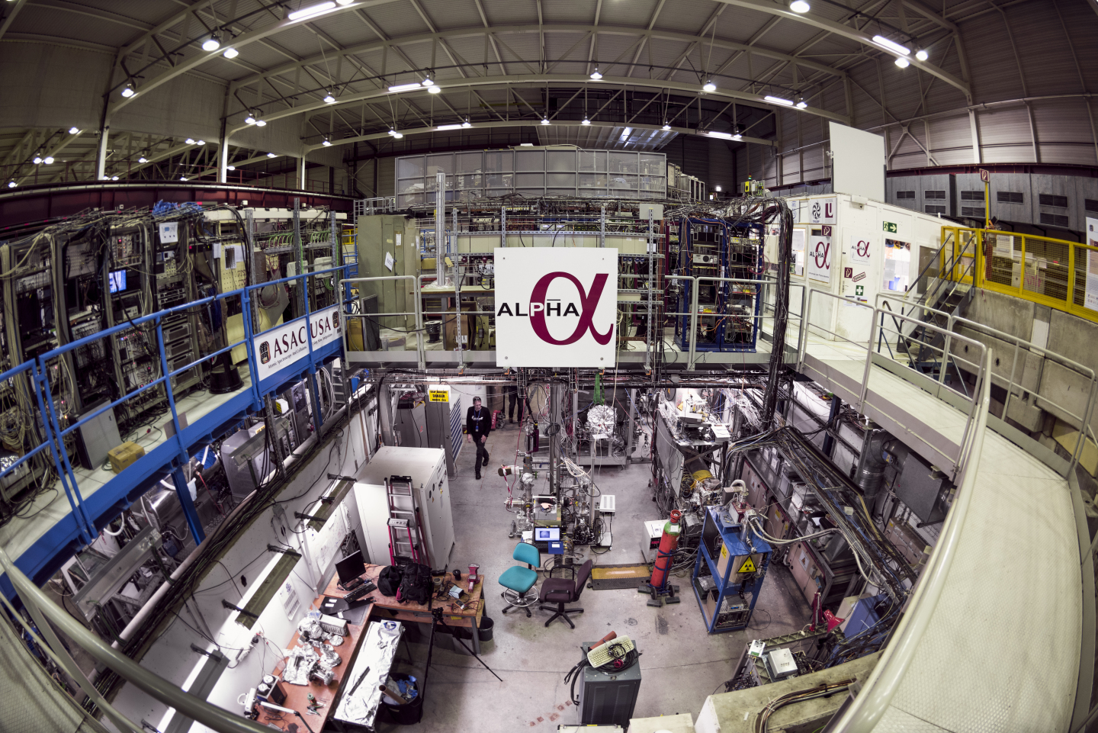
Programme Highlights

Slide 26
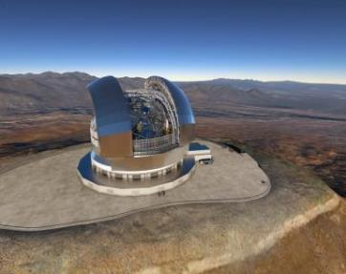
European Extremely Large Telescope
The world’s largest optical-IR telescope – 39m segmented mirror
ESO has let the main contracts for the construction of E-ELT phase 1
First light is scheduled for 2024 – this will help ensure the E-ELT is timely, competitive with other ELTs, and stabilises costs.
Work towards HARMONI and METIS instruments is advancing in the UK (led by the UKATC, Durham and Oxford)

Slide 27
Square Kilometre Array
SKA HQ Campus Construction starts December at Jodrell Bank
Formal convention negotiations set to complete early 2017
Matching design to cost cap, and seeking additional partners
Construction set to begin in 2018
Pathfinders starting to deliver science at both sites

Slide 28
A society that values STEM
New STFC public engagement strategy outlines five key aims:
Showcasing STFC science & technology
Building the right partnerships
Developing & supporting STEM influencers
Improving our reach with diverse audiences
Delivering high quality public engagement activities and outcomes
Underpinned by new evaluation framework and supported by specific communications campaigns

Slide 29
Studentships and Fellowships
Doctoral training partnership studentship allocations are set to be announced by Christmas
Applications for a centre for doctoral training in data intensive science will be assessed on 26 January 2017. It will involve five STFC-funded students per year for three years with at least another two per year funded from other sources
153 applications for this year’s Ernest Rutherford Fellowship round have been received. Interviews will be held in February

Slide 30
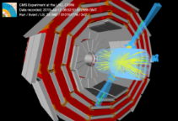
CERN
Highest PP priority is to fully exploit LHC investment at CERN
Funding and leadership in ATLAS, CMS and LHCb (also ALICE)
Performance over RUN 2 has been outstanding
LHC experiment upgrades strongly supported
ATLAS and CMS Phase-1 upgrades construction and R&D for Phase-2 funded and on track
Phase-2 scoping documents presented to Funding Agencies
Strategic review on future UK investment underway (see later)
LHCb upgrade construction funded and on track

Slide 31
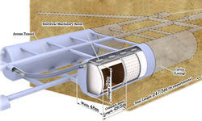
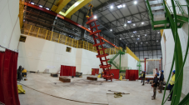
Neutrinos
Strongly supporting long baseline neutrino experiments
T2K exploitation at KEK in Japan
R&D programme towards future participation in DUNE (USA) and Hyper-K (Japan) underway
UK participation in protoDUNE at CERN approved in 2016
Strategic Review underway on future UK investment

Slide 32
Particle Physics Reviews
Strategic Reviews for high priority next generation experiments
LHC Phase 2 Detector Upgrades (ATLAS & CMS)
Long-Baseline Neutrino experiments (DUNE & Hyper-K)
Will include input from:
PR 2013 and BOP 2016
Recent developments in the programmes
implications for future funding of flat cash
Critical decision points in 2018 and 2019 for the projects
Outcomes were reported to Science Board in December 2016 and will feed back into BoP

Slide 33
Consolidated Grants
Particle Physics Theory (PPT) consolidated grants announced in November
Announcement delayed to ensure clarity over impact of flat cash on wider STFC financial position
Real terms reduction in the volume of research means recommended programme is not considered optimal
Particle Physics Experimental (PPE) grants capital equipment call closed at the end of October
Final part of the PPE 2015 consolidated grants round
Proposals encouraged for more strategic investments to sustain international UK leadership and enhance UK technology capability

Slide 34
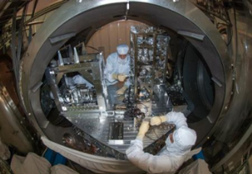
Particle astrophysics
Strong support for vibrant UK gravitational waves community
GW programme is highest priority in Particle Astrophysics
UK had critical development role in first LIGO detection
BOP considering the need to maintain UK leadership and fully exploit the new field of gravitational waves astronomy
Direct dark matter searches with LUX-ZEPLIN
UK participating in construction phase of US-led project
Successfully passed the DOE CD 2/3b review (April 16)

Slide 35
Nuclear physics
Support for UK groups exploiting wide variety of international facilities
ISOLDE, Jyvaskyla, JLAB, GANIL etc.
Experiment support for AGATA and ALICE
Outcome of next NP Consolidated Grants round due in July 2017
Support for new NP theory group at York
Several NP projects funded to help broaden programme:
Includes major contribution to NuSTAR construction programme at FAIR (largely completed)

Slide 36
Summary
Some challenging times ahead
Balancing the programme under flat cash
Preparing for UKRI
Preparing for the next CSR
Opportunities in all of these
Government recognises your value and doesn’t intend harm
UKRI should deliver more coherent funding approach allowing excellence to shine
CSR is an opportunity to return to stability

Slide 37
Questions

