Slide 1
Constraining BSM (Simplified) models with SM measurements
Jon Butterworth, David Grellscheid (IPPP),
Michael Krämer (Aachen), David Yallup
UK HEP Forum “Into the Unknown with LHC13”
3 Nov 2016

Slide 2
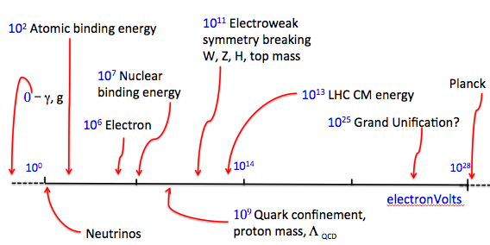
The Standard Model

Slide 3
The Standard Model
Into the unknown…

Slide 4

The Standard Model
Into the unknown…
  Tread carefully
  High energies, high luminosities, model independence…
Here be dragons

Slide 5
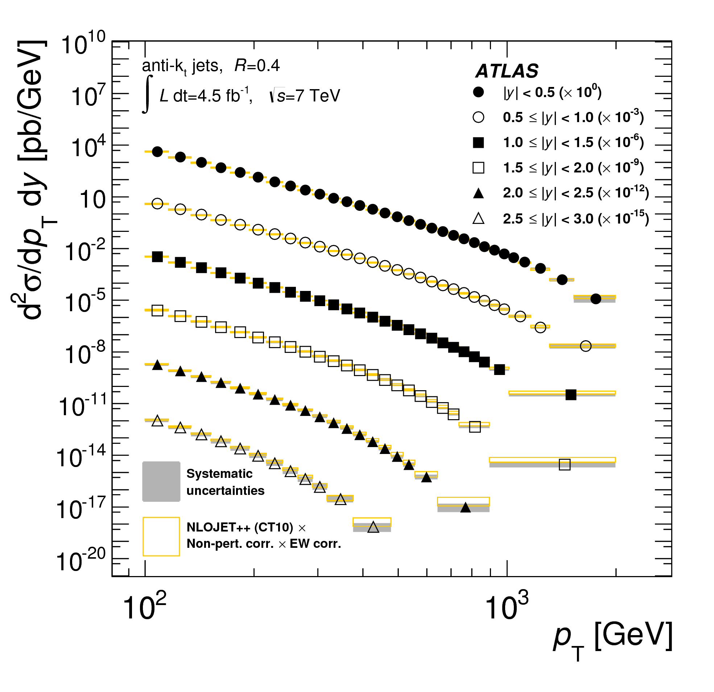
Precision ‘Standard Model’ Measurements
They should not (and mostly do not) assume the SM
They agree with the SM

Slide 6
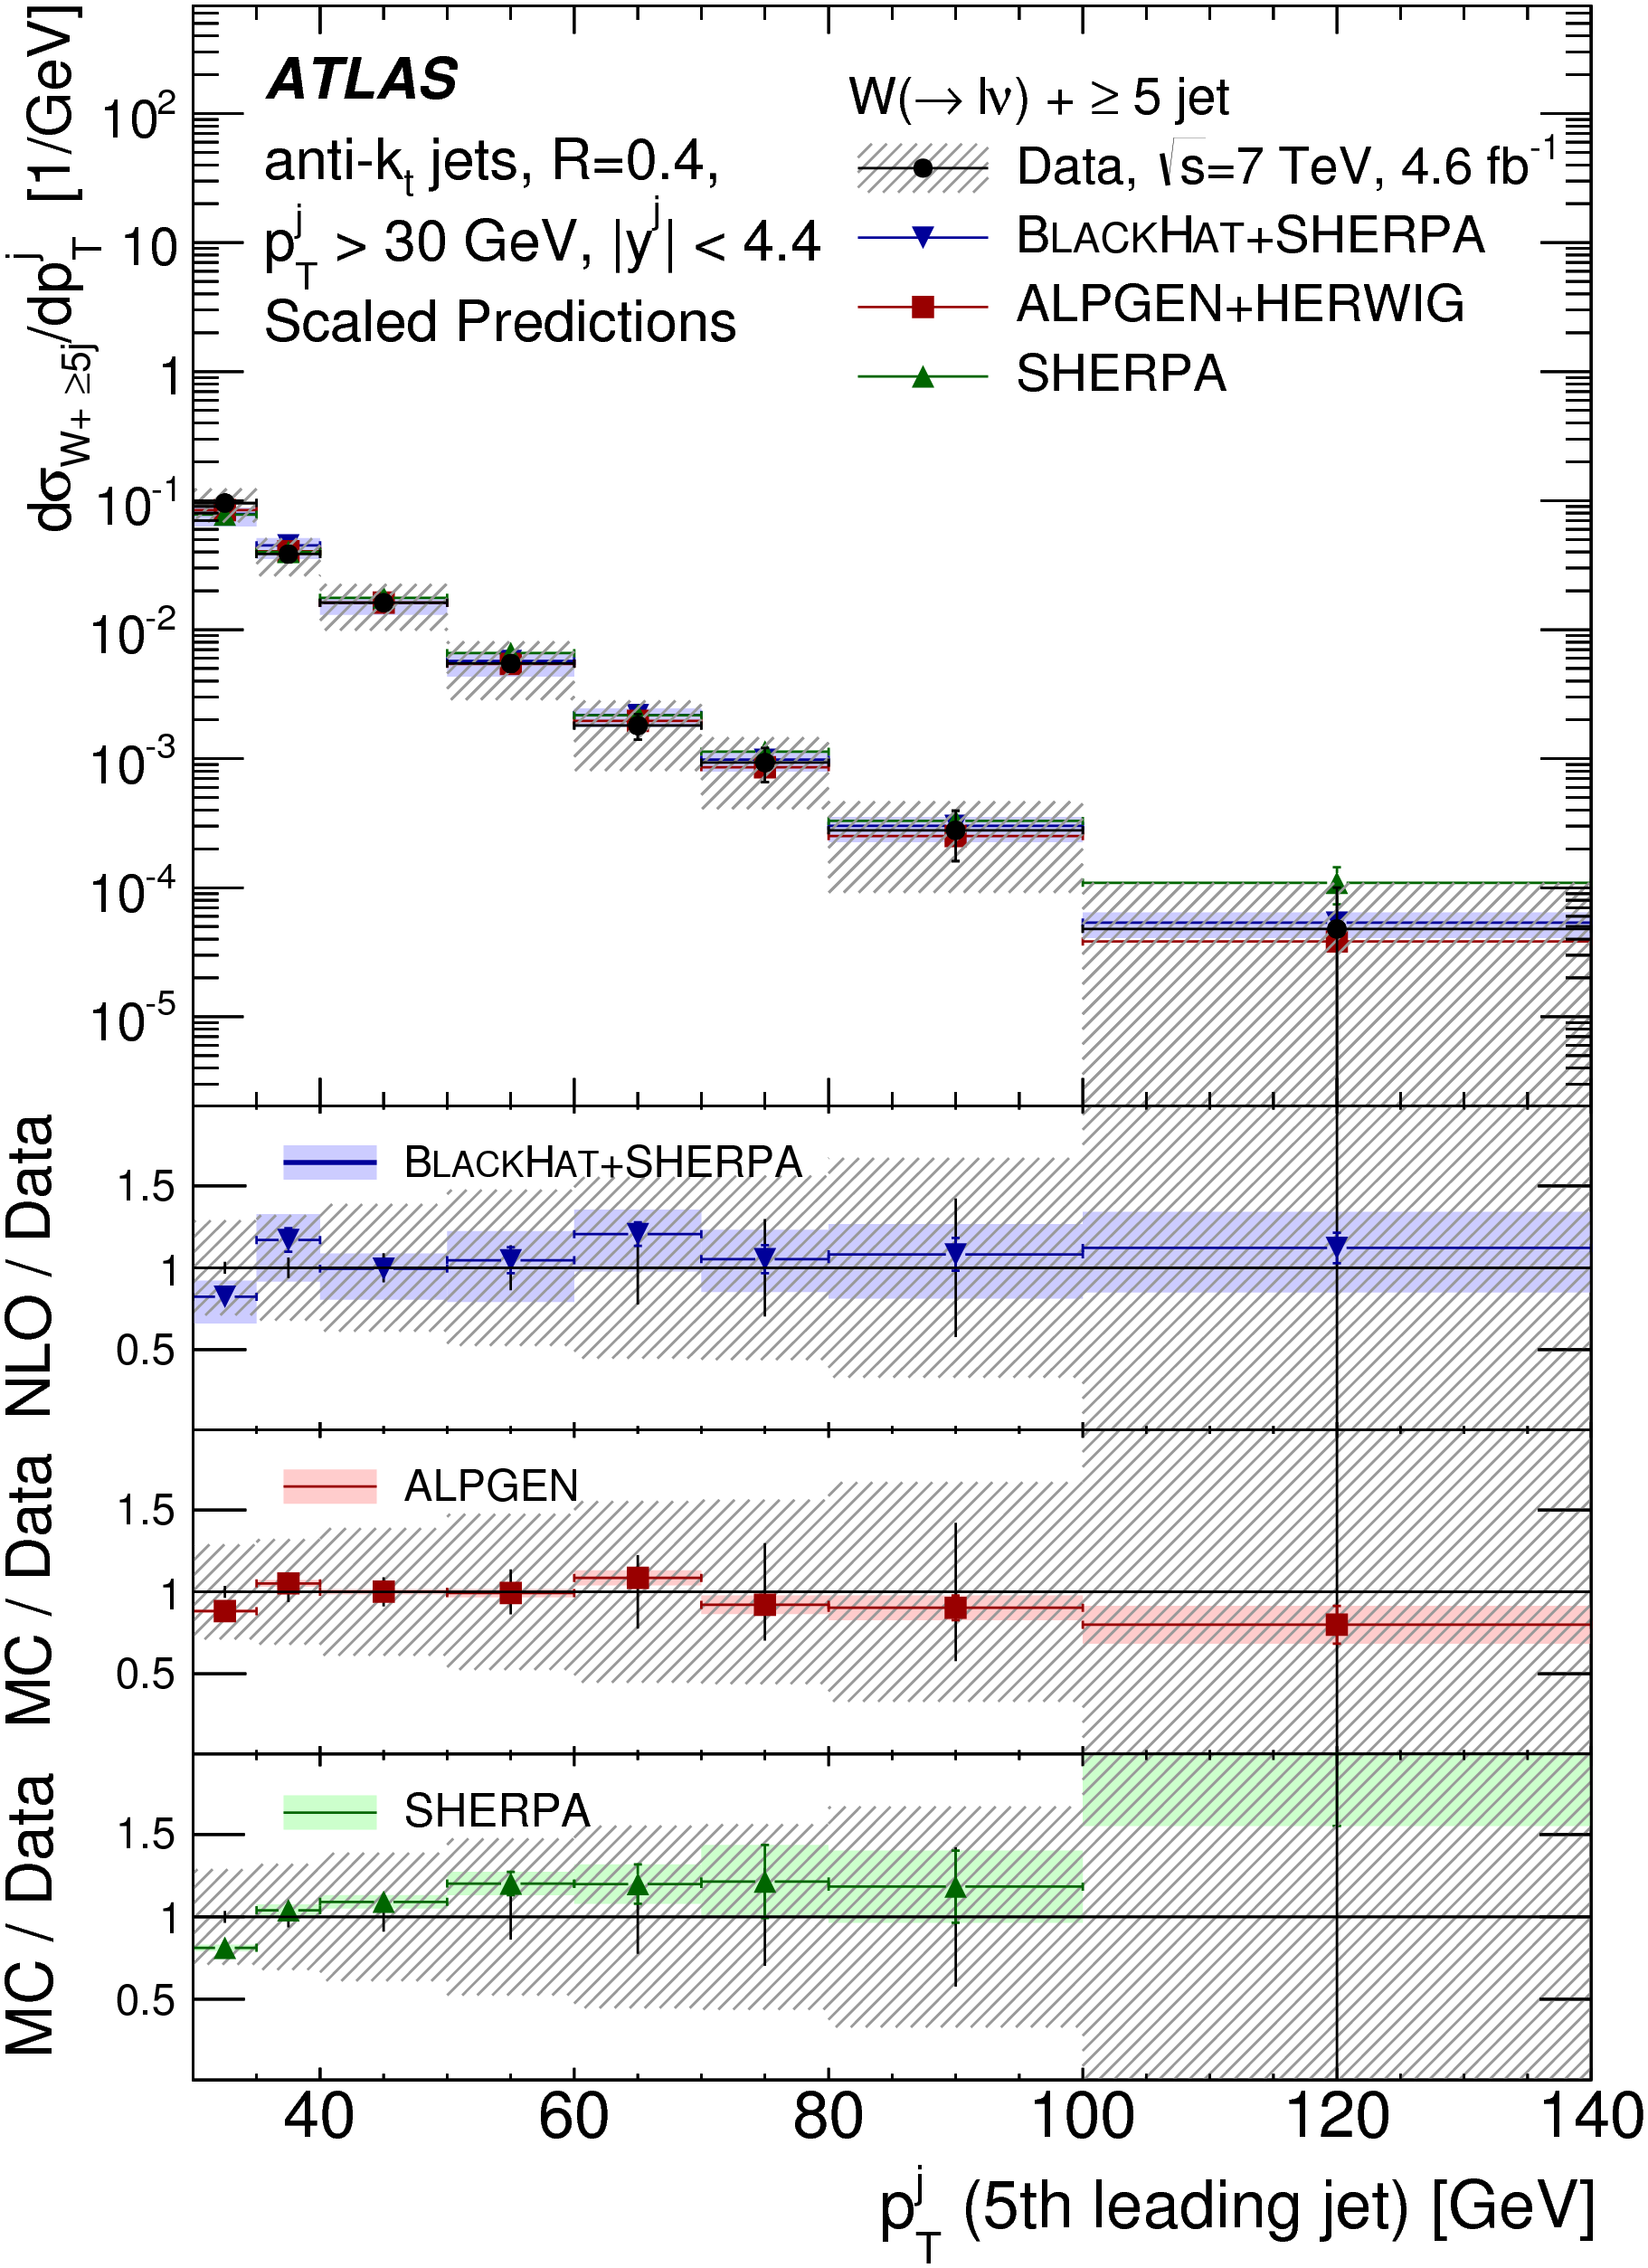
Precision ‘Standard Model’ Measurements
They should not (and mostly do not) assume the SM
They agree with the SM
Thus they can potentially exclude extensions

Slide 7
Precision ‘Standard Model’ Measurements
They should not (and mostly do not) assume the SM
They agree with the SM
Thus they can potentially exclude extensions

Slide 8
Simulation and Experiment
Particle Four-Vectors
MC Event Generator
Digitized Readout
Detector & Trigger Simulation
Data for Analysis
Event Reconstruction

Slide 9
Simulation and Experiment
Particles
Collider!
Digitized Readout
Detector & Trigger
Data for Analysis
Event Reconstruction

Slide 10
Simulation and Experiment
Particle Four-Vectors
MC Event Generator
Digitized Readout
Detector & Trigger Simulation
Data for Analysis
Event Reconstruction
Unfolding & Data Correction: Test and evaluate

Slide 11
Simulation and Experiment
Particles
Collider!
Digitized Readout
Detector & Trigger
Data for Analysis
Event Reconstruction
Unfolding & Data Correction: Make the measurement!

Slide 12
What do we actually measure?
The final state!
  Quantum mechanics says so
Clearly we can’t, even in principle, tell the difference between amplitudes with identical final states
If your measurement can’t be defined in such terms, you should worry!
  Model dependence
  Physical meaning!

Slide 13
What is your final state?
Quarks, gluons? (top?)
W, Z, H?
Taus?
Hadrons? (lifetime cut? Do they propagate in B-field? In material?)
Jets (what are the input objects?)
Neutrinos? All of them? From hadronic decays too?Missing E_{T}
Photons? Isolated photons? From hadronic decays too?
Electrons, muons? From hadronic decays too? What about QED FSR?

Slide 14
Important considerations (for searches too)
What is your final state?
  A common choice is place a lifetime cut at 10ps, and where necessary to draw further distinction, draw the line at hadronisation.
  Stable objects (hadrons, leptons, photons) can be combined algorithmically to give well-defined objects (jets, dressed leptons, isolated photons, missing E_{T}…)
  Remember, this is about defining “truth”, i.e. what we correct back to within some systematic uncertainty

Slide 15

Unfold

Slide 16


Slide 17
Increase acceptance

Slide 18
Increase acceptance

Slide 19
Extrapolate

Slide 20
Extrapolate

Slide 21
But how reliably?

Slide 23
Concept of a “fiducial” cross section
Defines a region in which acceptance is ~100%
Implies that some kinematic cuts must be implemented in whatever theory the data are compared to (easy for MC, less so for some high-order calculations)

Slide 24
Inaccessible. Removed by kinematics cuts, and not part of the fiducial cross section

Slide 25
Concept of a “fiducial” cross section
Defines a region in which acceptance is ~100%
Implies that some kinematic cuts must be implemented in whatever theory the data are compared to (easy for MC, less so for some high-order calculations)
Ideally of course, build an experiment which covers all the phase space of interest…

Slide 26

Simplified Model(s)
Effective lagrangian including minimal new couplings and particles
Our starter example: leptophobic Z’ with vector coupling to u,d quarks, axial vector to a DM candidate ψ.

Slide 27
Key tools:
UFO interface
BSM Model in FeynRules
Final State Particles
New processes in Herwig7
Exclusion
Rivet, and data from HepData

Slide 28
Strategy
Use measurements shown to agree with the Standard Model
  Not a search! Guaranteed not to find anything
  Will be slower, but more comprehensive and model independent
  Assume the data = the background!

Slide 29
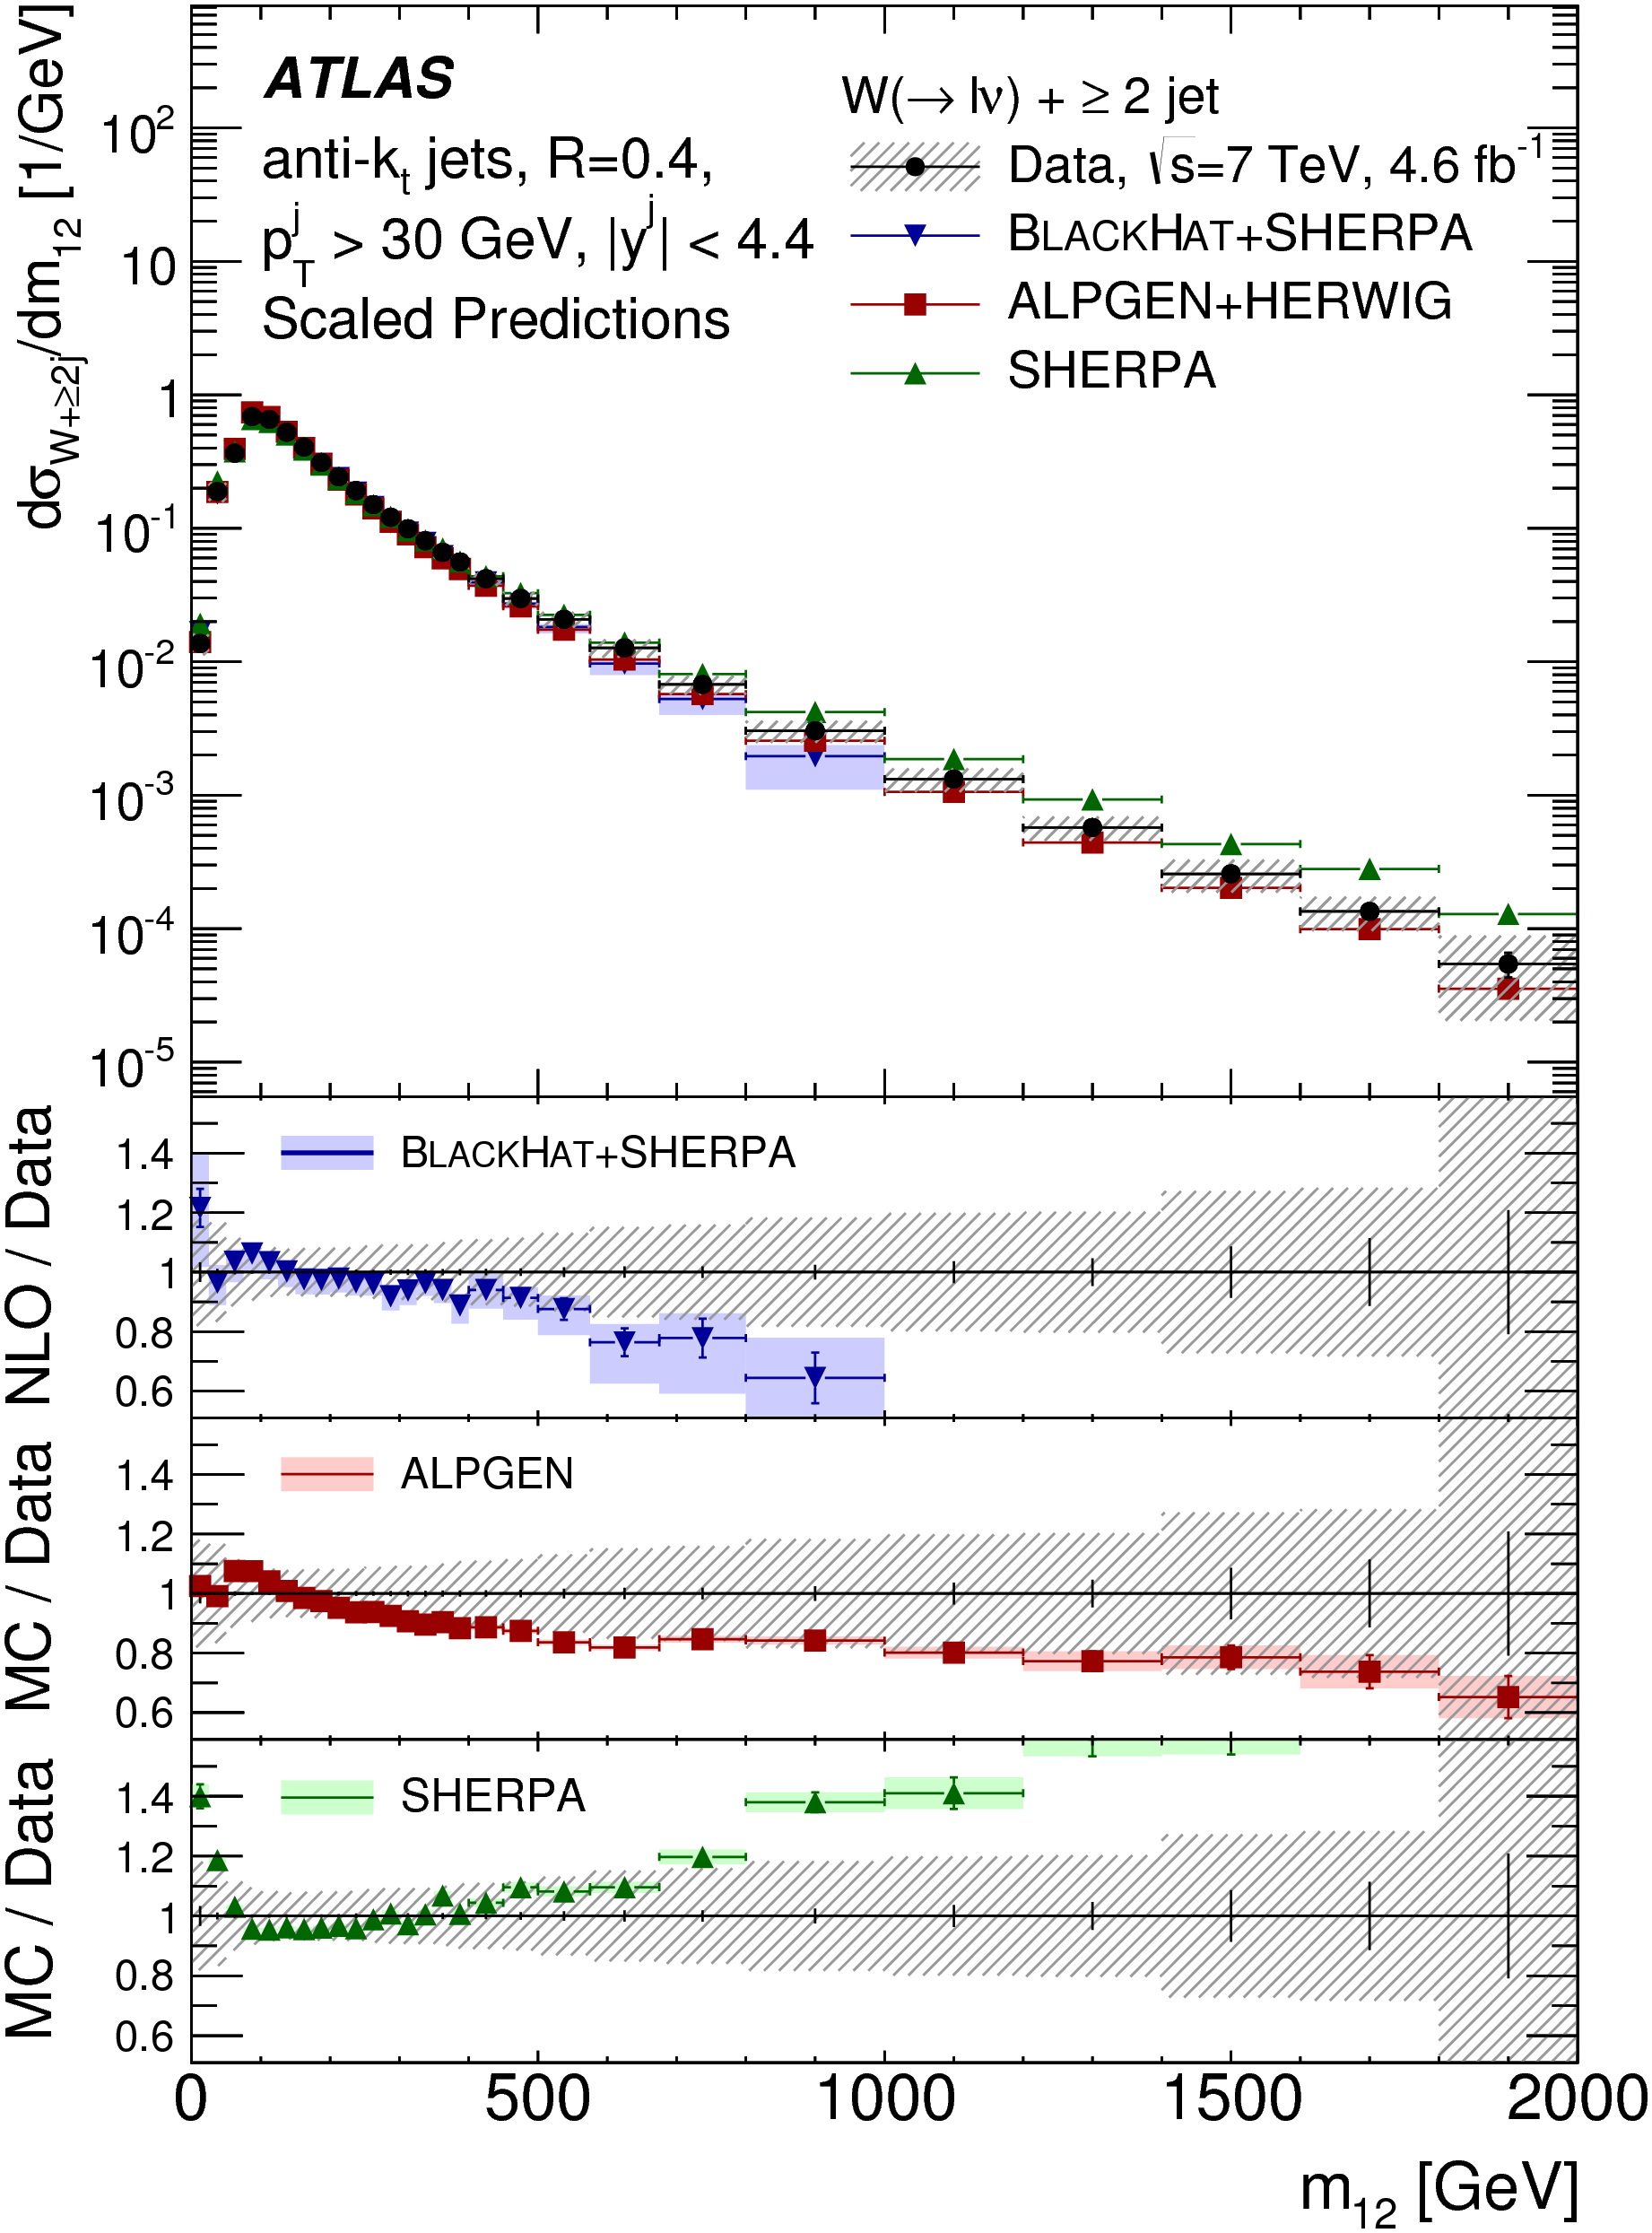
Will miss this kind of thing…

Slide 30
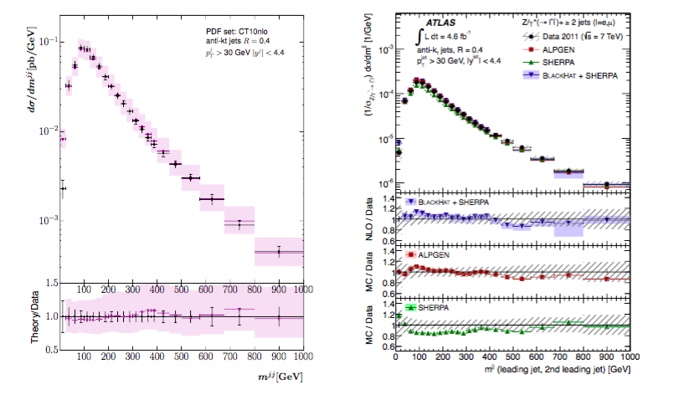
Although we probably want to miss it…
J. Andersen, J. J. Medley, J. M. Smillie, JHEP 1605 (2016) 136, arXiv:1603.05460 [hep-ph]

Slide 31
Strategy
Use measurements shown to agree with the Standard Model
  Not a search! Guaranteed not to find anything
  Will be slower, but more comprehensive and model independent
  Assume the data = the background!
Key for constraining new models if there is a signal (unintended consequences)
Key for constraining scale of new physics if there is no signal

Slide 32
Statistics
Construct likelihood function using
  BSM signal event count
  Background count (from central value of data points)
  Gaussian assumption on uncertainty in background count, from combination of statistical and systematic uncertainties
  BSM signal count error from statistics of generated events (small!)
Make profile likelihood ratio a la Cowan et al (Asimov data set approximation is valid)
Present in CL_{s} method (A. Read)
Systematic correlations not fully treated - take only the most significant deviation in a given plot (conservative)

Slide 33
Dynamic data selection
SM measurements of fiducial, particle-level differential cross sections, with existing Rivet routines
Classify according to data set (7, 8, 13 TeV) and into non-overlapping signatures
Use only one plot from each given statistically correlated sample
Jets, W+jets, Z+jets, γ (+jets), γγ, ZZ, W/Z+γ
Sadly no Missing E_{T}+jets, not much 8 TeV, no 13 TeV yet, though much is on the way… Also can use suitably model-independent Higgs and top measurements in future.
Most sensitive measurement will vary with model and model parameters

Slide 34
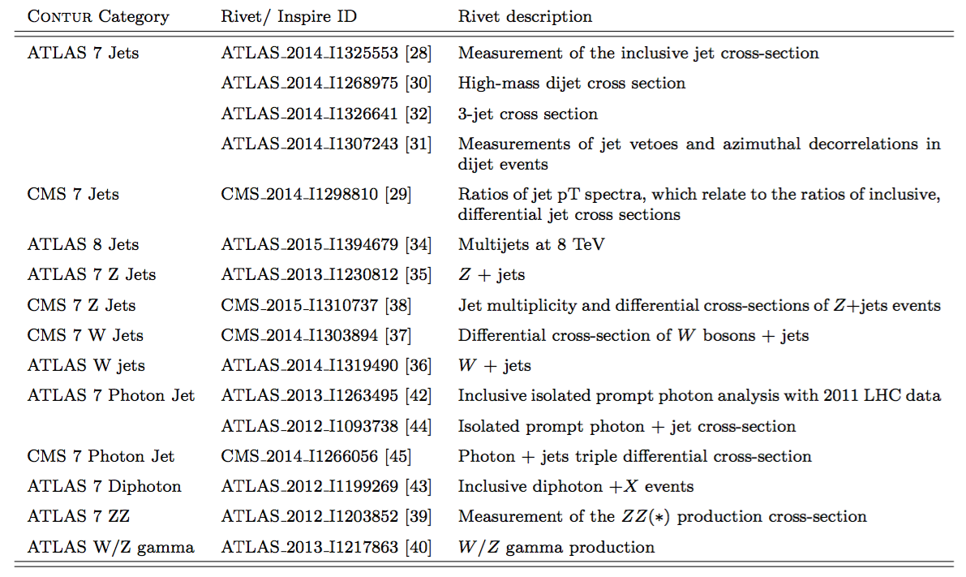

Slide 35
Key tools:
Constraints On New Theories Using Rivet
UFO interface
BSM Model in FeynRules
Final State Particles
New processes in Herwig7
Exclusion
Rivet, and data from HepData

Slide 36
Key tools:
Constraints On New Theories Using Rivet
UFO interface
BSM Model in FeynRules
Final State Particles
New processes in Herwig7
Exclusion
Rivet, and data from HepData
C O N T U R
https://contur.hepforge.org/
https://contur.hepforge.org/

Slide 37
Parameter Choices
Scan in M_{DM} and M_{Z’}
Four pairs of couplings:
  Challenging: g_{q} = 0.25; g_{DM} = 1
  Medium: g_{q} = 0.375; g_{DM} = 1
  Optimistic: g_{q} = 0.5; g_{DM} = 1
  DM-suppressed g_{q} = 0.375; g_{DM} = 0.25

Slide 38
Data Comparisons

Slide 39
Data Comparisons

Slide 40
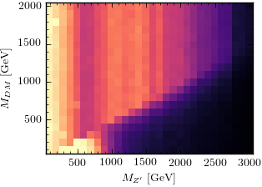
Heat Maps
Heatmap for g_{q}=0.25, g_{DM}=1 (Challenging scenario)

Slide 41
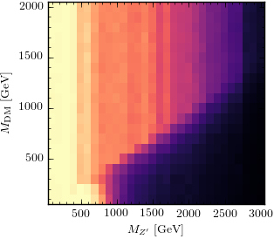
Heat Maps
Heatmap for g_{q}=0.25, g_{DM}=1 (Challenging scenario)

Slide 42
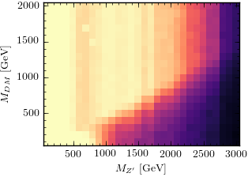
Heat Maps
Heatmap for g_{q}=0.375, g_{DM}=1 (Medium scenario)

Slide 43
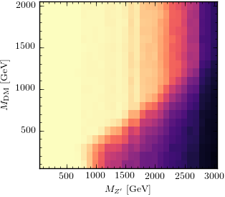
Heat Maps
Heatmap for g_{q}=0.375, g_{DM}=1 (Medium scenario)

Slide 44
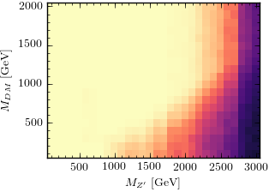
Heat Maps
Heatmap for g_{q}=0.5, g_{DM}=1 (Optimistic scenario)

Slide 45
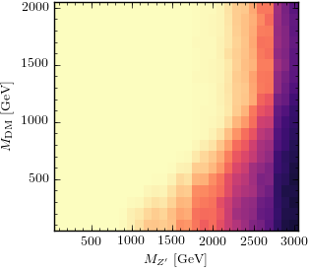
Heat Maps
Heatmap for g_{q}=0.5, g_{DM}=1 (Optimistic scenario)

Slide 46
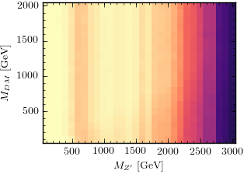
Heat Maps
Heatmap for g_{q}=0.375, g_{DM}=0.25 (DM suppressed)

Slide 47
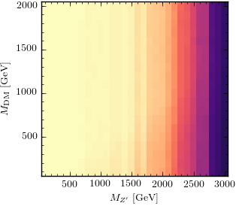
Heat Maps
Heatmap for g_{q}=0.375, g_{DM}=0.25 (DM Suppressed)

Slide 48
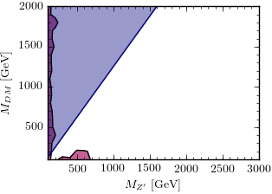
95% CL_{s} Contour
Heatmap for g_{q}=0.25, g_{DM}=1 (Challenging scenario)

Slide 49
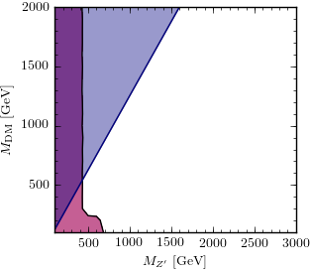
95% CL_{s} Contour
Heatmap for g_{q}=0.25, g_{DM}=1 (Challenging scenario)

Slide 50
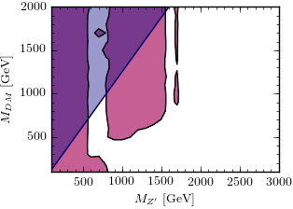
95% CL_{s} Contour
Heatmap for g_{q}=0.375, g_{DM}=1 (Medium scenario)

Slide 51
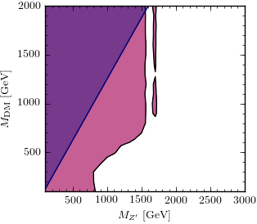
95% CL_{s} Contour
Heatmap for g_{q}=0.375, g_{DM}=1 (Medium scenario)

Slide 52
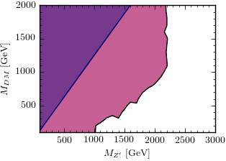
95% CL_{s} Contour
Heatmap for g_{q}=0.5, g_{DM}=1 (Optimistic scenario)

Slide 53
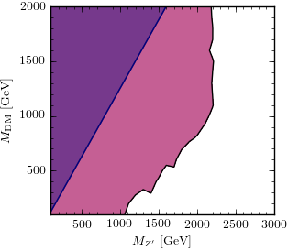
95% CL_{s} Contour
Heatmap for g_{q}=0.5, g_{DM}=1 (Optimistic scenario)

Slide 54
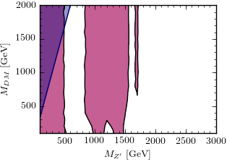
95% CL_{s} Contour
Heatmap for g_{q}=0.375, g_{DM}=0.25 (DM suppressed)

Slide 55
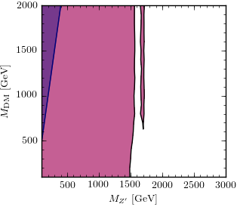
95% CL_{s} Contour
Heatmap for g_{q}=0.375, g_{DM}=0.25 (DM Suppressed)

Slide 56
Conclusions
Particle-level measurements not only measure what is happening in our collisions, they constrain what is not happening.
Limit-setting procedure developed; even with conservative treatment of correlations, limits are competitive with those from dedicated searches using comparable data-sets
General framework developed:
  consider all new processes in a given (simplified) model
  consider all available final states. (e.g. V+jet shows previously unexamined sensitivity to the model considered)
Highly scaleable to other models & new measurements – plan continuous rolling development
See arXiv:1606.05296 (and references therein), and hepforge.org/contur

