Slide 1
Current and Future Status of Heavy Ion Physics
O. Villalobos Baillie
University of Birmingham

Slide 2
Prologue
The field of ultrarelativistic heavy ion physics began about 30 years ago, when developments with the beams at BNL (AGS) and CERN (SPS) allowed the acceleration of heavy ion beams
  c. 1986 Si/O/S beams
  1994 Au beams (BNL) and Pb beams (CERN)
  2000 RHIC Au-Au collider (√s = 200 GeV) starts at BNL
  2010 LHC collides Pb ions at √s = 2.76 TeV
Initially, the aim was to find out whether a phase transition to a deconfined phase of matter, the QGP, occurred; subsequently, it has become a systematic study of the properties of this phase.
What has been achieved, and what are the next steps?

Slide 3
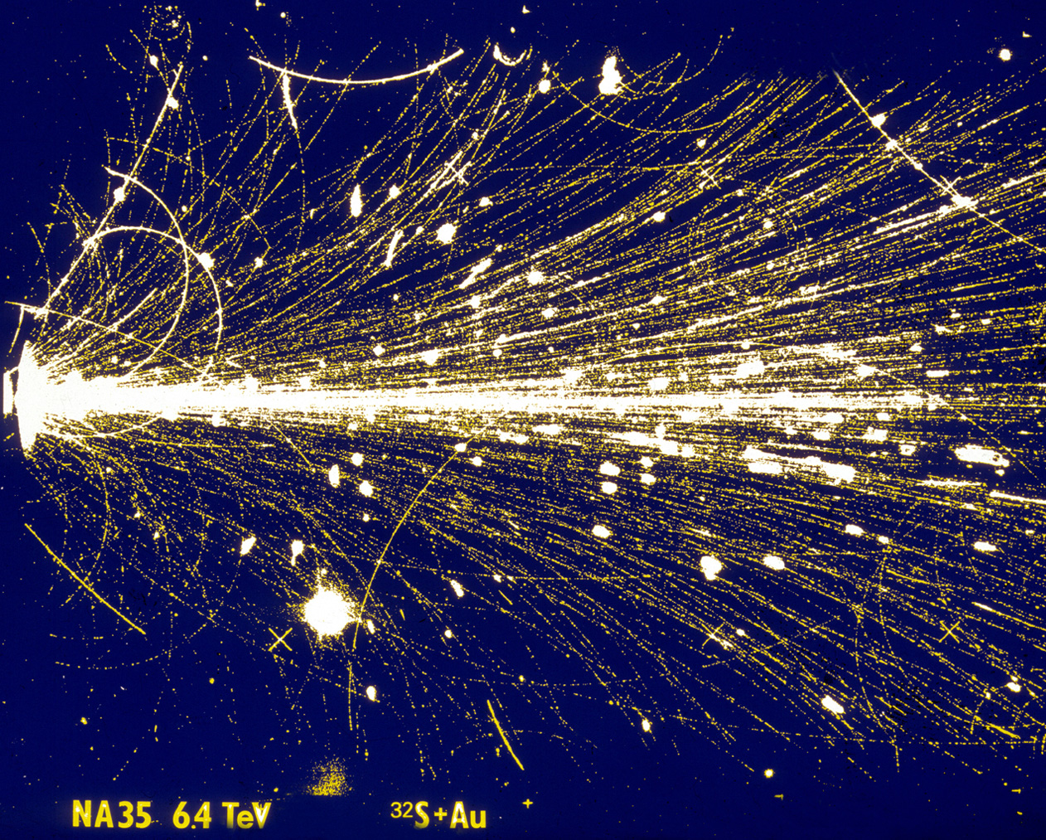
Prologue
The field of ultrarelativistic heavy ion physics began about 30 years ago, when developments with the beams at BNL (AGS) and CERN (SPS) allowed the acceleration of heavy ion beams
  c. 1986 Si/O/S beams
  1994 Au beams (BNL) and Pb beams (CERN)
  2000 RHIC Au-Au collider (√s = 200 GeV) starts at BNL
  2010 LHC collides Pb ions at √s = 2.76 TeV
Initially, the aim was to find out whether a phase transition to a deconfined phase of matter, the QGP, occurred; subsequently, it has become a systematic study of the properties of this phase.
What has been achieved, and what are the next steps?

Slide 4
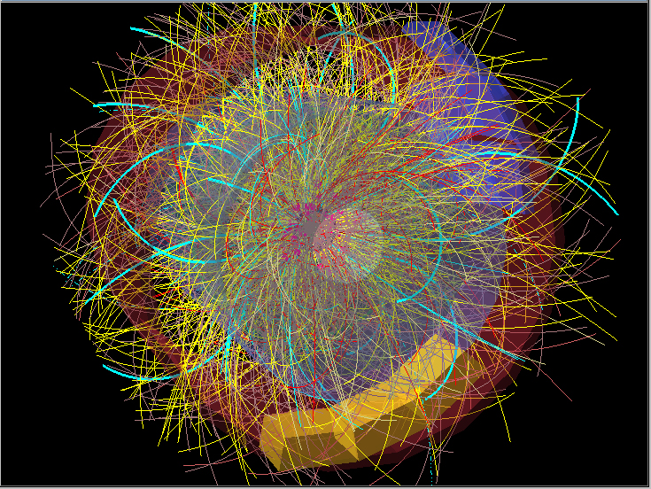
Prologue
The field of ultrarelativistic heavy ion physics began about 30 years ago, when developments with the beams at BNL (AGS) and CERN (SPS) allowed the acceleration of heavy ion beams
  c. 1986 Si/O/S beams
  1994 Au beams (BNL) and Pb beams (CERN)
  2000 RHIC Au-Au collider (√s = 200 GeV) starts at BNL
  2010 LHC collides Pb ions at √s = 2.76 TeV
Initially, the aim was to find out whether a phase transition to a deconfined phase of matter, the QGP, occurred; subsequently, it has become a systematic study of the properties of this phase.
What has been achieved, and what are the next steps?
© CERN

Slide 5
Plan of Talk
Development of a Heavy ion collision
Initial Stages
Formation of a Quark-Gluon Plasma
Interaction of partons with the medium
Freeze-out
What can be done with more statistics at LHC?

Slide 6
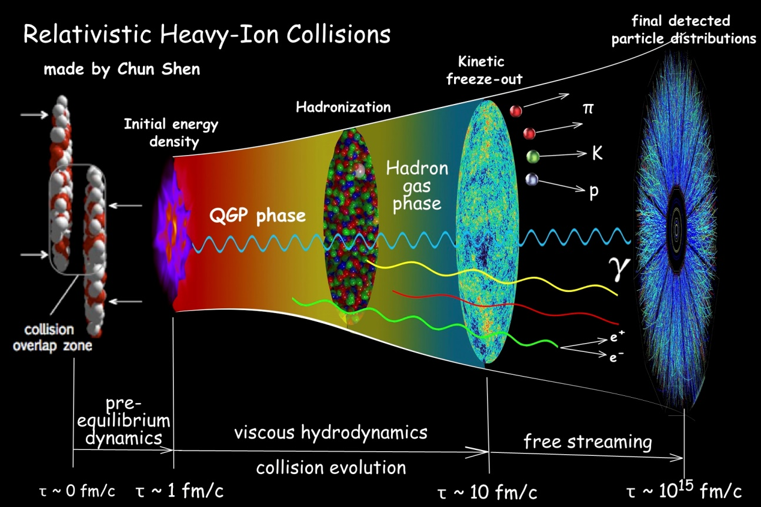
Stages in a Heavy Ion Collision
Initial state of nuclei, dependent on nuclear pdfs
First hard collisions, quickly leading to formation of QGP
Expanding QGP, with shape and momentum distribution conditioned by fluid hydrodynamics
Cooling and freeze-out, technically in two stages: chemical and thermal freeze-out

Slide 7
Initial Stages
Ultra-Peripheral Collisions, where the two nuclei do not overlap, but only interact electromagnetically, producing a vector meson, can probe the gluon structure function of the nucleus.
Comparison with models, using a variety of different structure function sets, indicates that “moderate” shadowing is taking place.

Slide 8
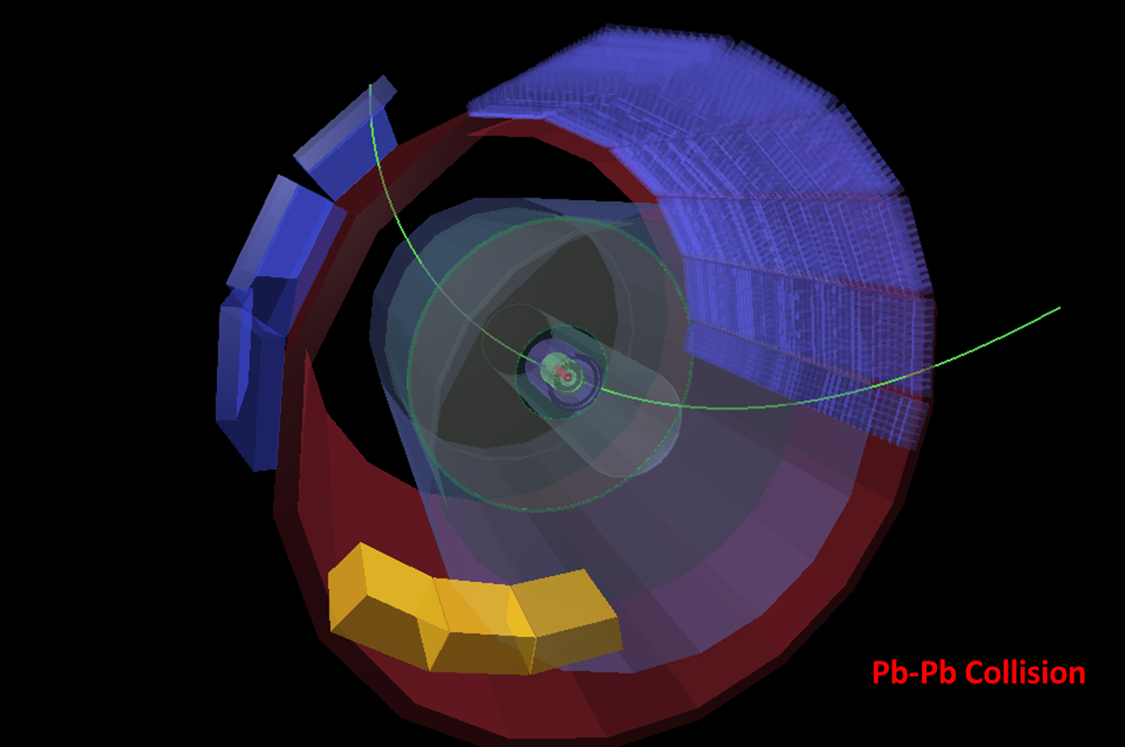
Mid-rapidity J/ψ

Slide 9
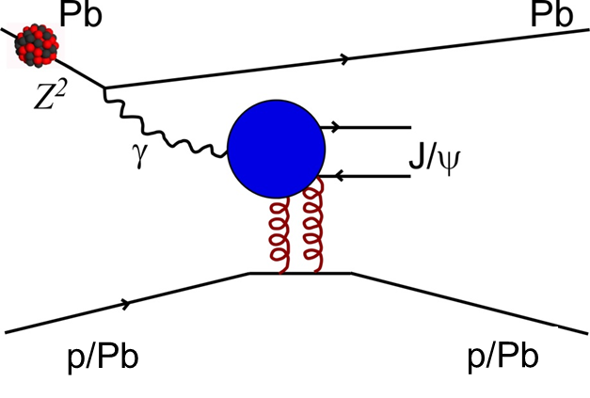
Exclusive Vector Meson Production
E. Abbas et al., Eur. Phys Journal C73 (2013) 2617
LEADING ORDER
First analyses from ALICE and CMS, using Run 1 data, point to moderate shadowing in the nucleus. Run 2 analyses, currently underway, will already yield a very large increase in statistics (e.g. factor 50 for ALICE in the forward region) allowing more detailed differential studies to be made.

Slide 10
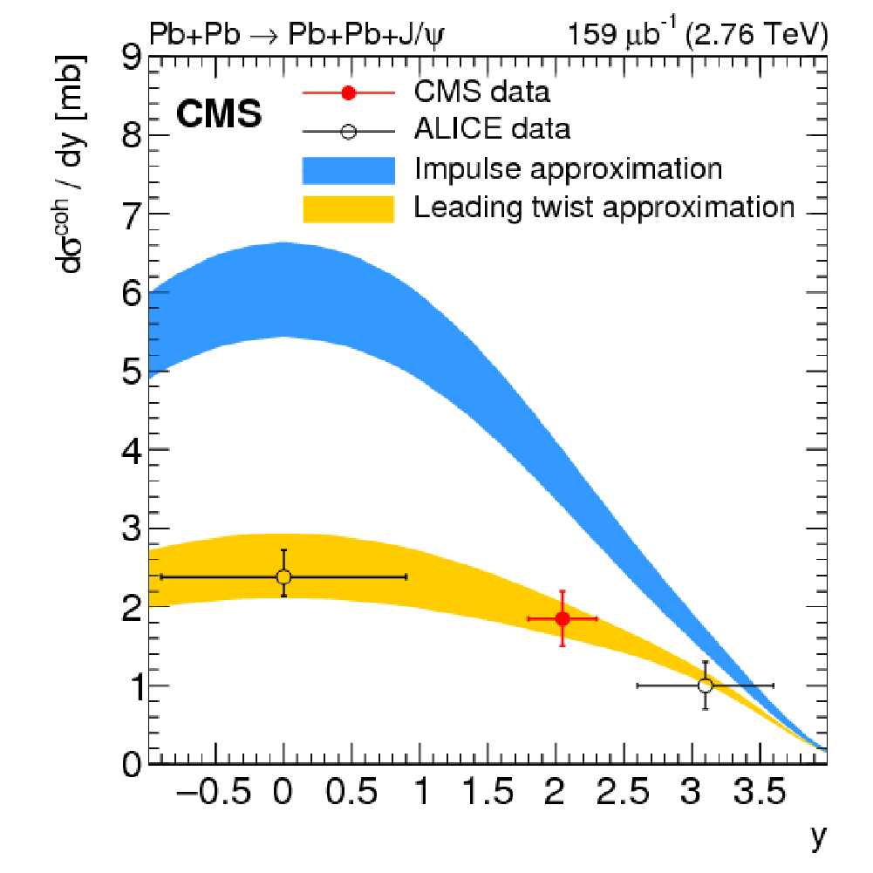
Exclusive Vector Meson Production
LEADING ORDER
ArXiv:1605.06966
First analyses from ALICE and CMS, using Run 1 data, point to moderate shadowing in the nucleus. Run 2 analyses, currently underway, will already yield a very large increase in statistics (e.g. factor 50 for ALICE in the forward region) allowing more detailed differential studies to be made.

Slide 11
Dijet Production
√s = 5.02 TeV
Precision measurements of η_{dijet} = (η1+η2)/2∝0.5 log(x_{p}/x_{Pb}) + ηCM
Sensitive to (n)PDFs. Allows access to Q² dependence
No PDF set satisfactory over whole range. Authors claim EPS09 does better than most.

Slide 12
Temperature via Direct Photons
Measurement of photons radiating from the plasma
Backgrounds from meson decays and hard processes
Important to characterise collisions. Need more differential measurements.

Slide 13
Production of Heavy Flavour
B⁺ →J/ψ K⁺
CMS PAS HIN-16-011
Interaction of heavy particles with medium measured using R_{AA}.
Also sensitive to nPDF
ArXiv:1509.06888
D⁰, D⁺, D*

Slide 14
Quarkonium:Two effects
Two separate effects are expected for quarkonium
  Suppression because of Debye colour screening. The amount of suppression depends on the “size” of the meson. The larger the effective radius, the more the suppression
  Warning: other descriptions exist.
  Regeneration (if temperature high enough) because of thermal production)
    At LHC, for the first time, temperature is high enough that regeneration of charmonium could be significant
    Should be small or negligible for Upsilon states.

Slide 15
Quarkonium Production

Slide 16
Quarkonium Production

Slide 17
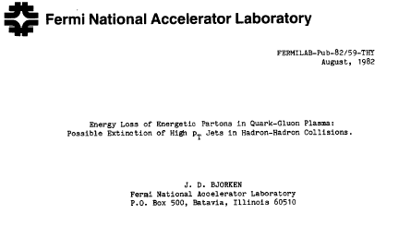
Jet Production
In 1982 Bjorken wrote a preprint (never published) proposing two ideas
QGP might be formed in high multiplicity pp collisions.
In a QGP, jets might undergo substantial quenching.

Slide 18
Jet Production
In 1982 Bjorken wrote a preprint (never published) proposing two ideas
QGP might be formed in high multiplicity pp collisions.
In a QGP, jets might undergo substantial quenching.

Slide 19
Jet Production in AA collisions
STAR √s = 200 AGeV AuAu
Phys.Rev.Lett.91:072304,2003
First evidence seen at RHIC. Looking at particles above pt cutoff, the away side jet signal disappears in Au-Au, but not in pp

Slide 20
Fully reconstructed Jets
Ratio of fragmentation functions shows a substantial increase in low-z production in central events with respect to peripheral events.
Similar effect in different rapidity intervals.
ATLAS

Slide 21
Jet Masses in pPb and PbPb
pPb
PbPb

Slide 22
Jet Masses pPb and PbPb
Ratio of jet masses Pb-Pb/pPb shows PbPb has a shift towards lower jet masses, not reproduced in current quenching models.
Related to virtuality of jets.

Slide 23
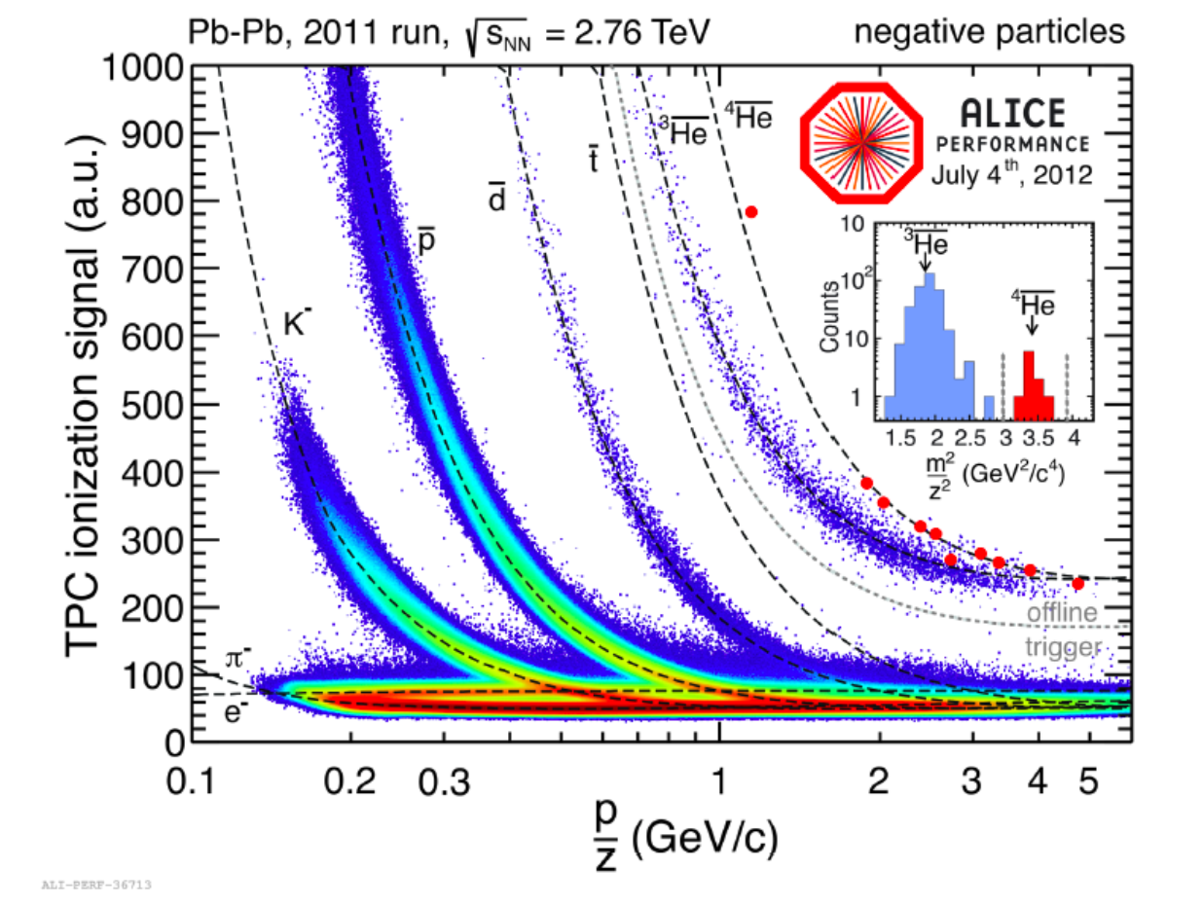
ALICE PID by dE/dx

Slide 24
Particle Production
Abundances of particles can be described in terms of just two parameters in Pb-Pb.
Current status is that there is more than one model. Internal assumptions of the models are different, predictions have become very similar.
Models assume chemical equilibrium. In one case equilibrium achieved in hadronic phase (THERMUS), in the other in QGP phase followed by hadronization (SHARE).

Slide 25
Particle Production
Abundances of particles can be described in terms of just two parameters in Pb-Pb.
Current status is that there is more than one model. Internal assumptions of the models are different, predictions have become very similar.
Models assume chemical equilibrium. In one case equilibrium achieved in hadronic phase (THERMUS), in the other in QGP phase followed by hadronization (SHARE).

Slide 26
Strangeness Production in Small Systems
Strangeness production in pPb and even in pp increases with multiplicity, and becomes comparable to Pb-Pb at the same multiplicity
Not reproduced by models.
ArXiv:1606.07424

Slide 27
Strangeness Production in Small Systems
Strangeness production in pPb and even in pp increases with multiplicity, and becomes comparable to Pb-Pb at the same multiplicity
Not reproduced by models.
First indications of “anomalous behaviour=“ in high multiplicity pp came from CMS who reported a ridge structure in η similar to shat is observed in AA collisions in high multiplicity pp at 7 TeV
ArXiv:1606.07424

Slide 28
Future running
CMS
Data taking in Runs 2 and 3 will make a huge improvement in statistics, allowing detailed studies of processes currently barely detectable.
ATLAS and CMS will focus on high p_{T} studies, covering both jets and heavy flavour production
ALICE will focus on lower p_{T} jets and heavy flavour, while continuing detailed studies of soft variables.

Slide 29
Detector Upgrades
Upgrades for ATLAS and CMS are driven by pp and will be familiar to the audience
In particular improved inner tracker and upgraded DAQ systems will be important
ALICE has more substantial upgrade for Run 3, driven specifically by new higher rates for Pb-Pb operation (~8 kHz interaction rate → 50 kHz)

Slide 30
ALICE upgrade
ALICE will undergo a substantial upgrade during LS2, so as to be ready for new higher luminosity ion-ion running in run 3
  New TPC readout, using GEM technology
  New 7 layer ITS (instead of current 6 layer) using monolithic ALPIDE pixels.
    Higher allowed occupancy and increased precision
  New muon chamber readout, new muon detector before muon absorber to improve tracking
  New forward detectors
  Redesign of DAQ and trigger to allow continuous readout of principal detectors. Events will be picked out of the datastream by the reconstruction program.

Slide 31
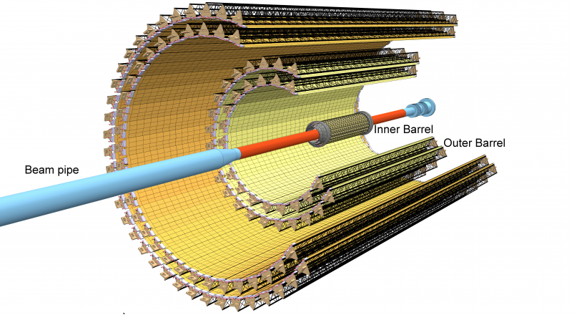
New ALICE ITS
The ALICE inner tracker (ITS) will be completely rebuilt with a new all-pixel tracker, using monolithic pixels (ALPIDE).
The inner layer is significantly closer to the beam line, giving improved vertexing precision for heavy flavour decays.

Slide 32
New ALICE ITS
Benchmark Λ_{C} → pKπ. Not accessible with current ITS.
The ALICE inner tracker (ITS) will be completely rebuilt with a new all-pixel tracker, using monolithic pixels (ALPIDE).
The inner layer is significantly closer to the beam line, giving improved vertexing precision for heavy flavour decays.

Slide 33
New TPC
The ALICE TPC will have new readout modules, using GEM technology, so as to allow continuous readout without substantial space-charge buildup
First part should be ready for 2017.

Slide 34
Trigger and DAQ
Not all detectors will upgrade, so new system will be hybrid.
Continuous readout detectors will have readout split into “frames”, separated by a heartbeat trigger
Triggering detectors identify bunch crossings in which collisions occur
Potential for substantial use of HLT in event filtering

Slide 35
Upgrade Summary
Upgrades will allow far more detailed studies than currently possible of the properties of a QGP
Focus on hard probes, currently still very much limited by statistics.
Also great interest in “small systems”. High multiplicity collisions in pp very interesting.

Slide 36
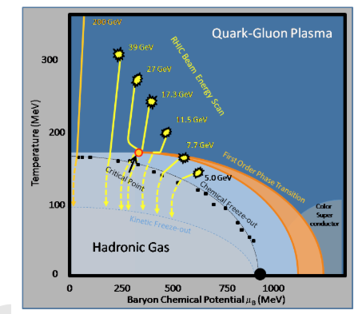
What else is going on?
RHIC is focussing on large increase in statistics in a scan of lower energies, to try to find the onset of the QGP
If energy low enough, this may be studied even better in very high luminosity collisions at FAIR (GSI)
Aim is to re-equip PHENIX with upgraded detectors to make new detector aimed at jets and electromagnetic probes at higher luminosity.
Complementarity between two programmes.

Slide 37
Summary
Ultrarelativistic Heavy ion collisions have come a very long way over the last 30 years.
Focus has changed from establishing whether a QGP might exist to a detailed study of its properties.
Detailed “Standard Model” for heavy ions still does not exist.
  Some features (e.g. hadron abundances) now quite well understood.
LHC energies allow many probes to be used, especially in the hard probes sector.
Huge energies also allow investigation of high multiplicity small systems, where surprises may lie.

Slide 38
BACKUP

Slide 39
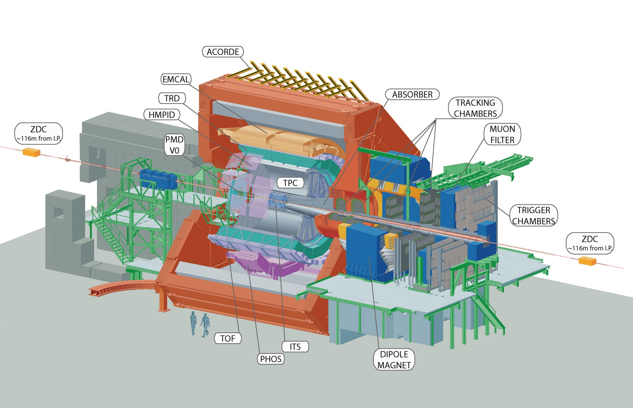

ALICE Apparatus
A-SIDE
C-SIDE
VZERO-A: 2.8<η<5.1
VZERO-C: -3.6<η<-2.6

Slide 40
ALICE Apparatus
FORWARD TRIGGER
A-SIDE
C-SIDE
(ZDC)
VZERO-A
DIMUON ARM
(ZDC)
VZERO-C
VZERO-A: 2.8<η<5.1
VZERO-C: -3.6<η<-2.6

Slide 41
ALICE Apparatus
CENTRAL TRIGGER
A-SIDE
C-SIDE
(ZDC)
VZERO-A
SPD
(ZDC)
VZERO-C
TOF
VZERO-A: 2.8<η<5.1
VZERO-C: -3.6<η<-2.6

