Slide 1






Searches for black holes, sphalerons and magnetic monopoles
NICK E. MAVROMATOS
KING’S COLLEGE LONDON
UK HEP FORUM:
Into the Unknown with LHC13
3-4 November 2016
The Cosener's House
Abindgon, UK

Slide 2

OUTLINE
Black Holes, sphalerons & magnetic monopoles: Theory Background
Experimental searches :
(i) in space
(ii) @ colliders
((iii) as analogues in condensed matter Labs)
The MoEDAL LHC experiment
Experiment specifically designed for:
Detection of highly ionising, long-lived massive particles predicted in a plethora
of BSM models such as SUSY
Detection of solitonic defects:
(i) Generic Monopole-like structures if in TeV mass range, Model independent searches
(ii) specific Electroweak Monopoles rather than GUT monopoles, with TeV masses
CONCLUSIONS & OUTLOOK

Slide 3
OUTLINE
Black Holes, sphalerons & magnetic monopoles: Theory Background
Experimental searches :
(i) in space
(ii) @ colliders
((iii) as analogues in condensed matter Labs)
The MoEDAL LHC experiment
Experiment specifically designed for:
Detection of highly ionising, long-lived massive particles predicted in a plethora
of BSM models such as SUSY
Detection of solitonic defects:
(i) Generic Monopole-like structures if in TeV mass range, Model independent searches
(ii) specific Electroweak Monopoles rather than GUT monopoles, with TeV masses
CONCLUSIONS & OUTLOOK
First bounds (on masses) for monopoles
with spin-0, spin ½ and magnetic charge q_{m}=g_{D,} ..., 6g_{D} from 8 TeV LHC run 2012

Slide 4

Black Holes
1
Solutions of Einstein’s equations , physically arise from collapsing matter

Slide 5



Types of Black Holes
Schwarzschild (non rotating, mass M )
Reissner-Nordstrom (non-rotating, mass M, charged (Q))
Kerr-Newmann (rotating (angular momentum J), mass M, charged (Q))

Slide 6
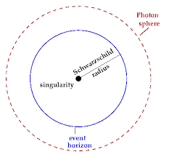
Black-Hole Geometries
Schwarzschild (non rotating, mass M )
(a spherical boundary of
zero thickness in which
photons that move
on tangents to that
sphere would
be trapped in a circular
orbit about the black hole)

Slide 7
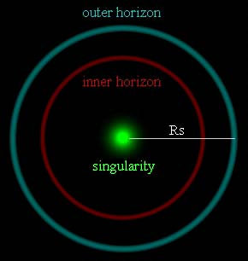
Black-Hole Geometries
Reissner-Nordstrom (non-rotating, mass M, charged (Q))

Slide 8
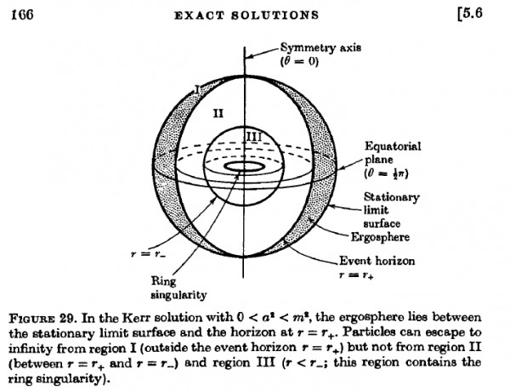
Black-Hole Geometries
Kerr-Newmann (rotating (angular momentum J), mass M, charged (Q))
inner
horizon
(outer)

Slide 9

Black Hole with some Hair
No hair conjecture/theorem : Black holes can only be characterised by
their mass, angular momentum and charge.
Evasion of no-hair theorem (violation of its assumptions) :
Black Holes with scalar hair
Einstein Yang-Mills –Higgs systems
String-inspired GR with higher-curvature (Gauss Bonnet) terms & dilatons
Einstein-Maxwell-axion systems
Modified Gravity models
........
Hair may be
secondary i.e.
non trivial scalar fields
outside horison but
corresponding charge
may be a function
of primary hair eg mass

Slide 10
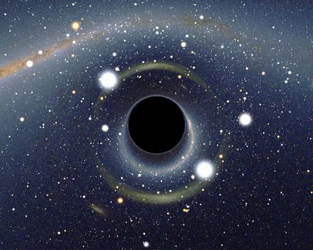
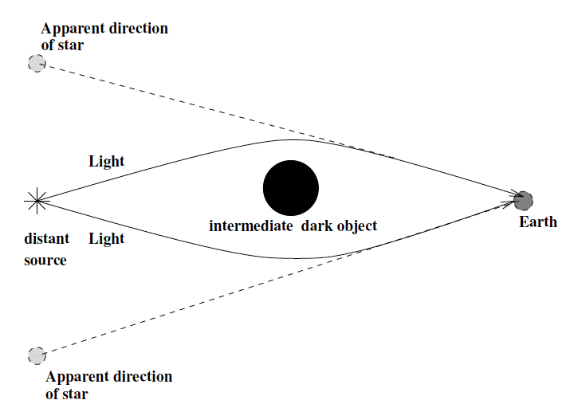
Astrophysical Detection
Gravitational lensing
Simulated view of a black hole in front of the Large Magellanic Cloud. Note the gravitational lensing effect, which produces two enlarged but highly distorted views of the Cloud. Across the top, the Milky Way disk appears distorted into an arc.

Slide 11


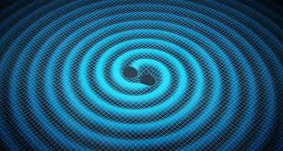
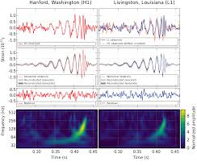
in 2016:
DETECTION
OF Gravitational Waves
(GR IMPORTANT PREDICTION)
ARE ANNOUNCED BY
VIRGO-LIGO Colls
(signal GW150914 in 2015 &
GW151226)
Signals interpreted/fitted very well by
assumption that GW were produced during
merging of two spiralling
black holes onto a larger black hole

Slide 12
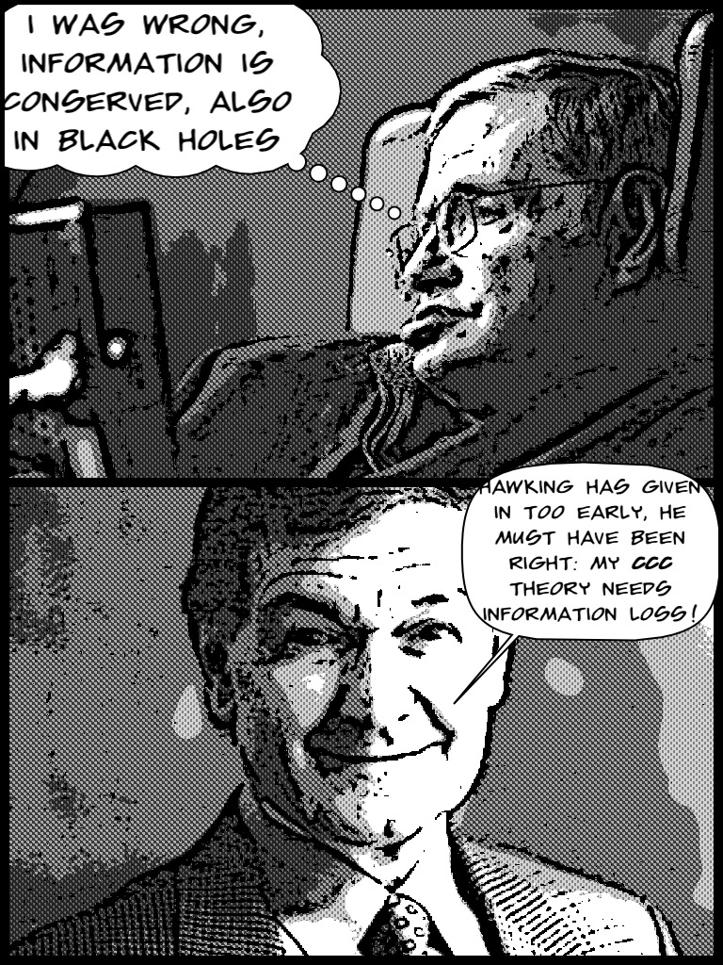
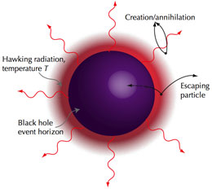
(Quantum) Black Hole Evaporation & Information Loss ``paradox’’
start from pure QM state → end up in ``thermal’’ states described by density matrix ?
for observers asymptotically far from BH horizon
Black body
...still debatable despite
holographic AdS-CFT
correspodence ...etc
Image credit: The Extreme Light Infrastructure European Project.

Slide 13
(Quantum) Black Hole Evaporation & Information Loss ``paradox’’
start from pure QM state → end up in ``thermal’’ states described by density matrix ?
for observers asymptotically far from BH horizon
Hawking radiation
@ Horizon of BHs:
Effective two-dimensional
field theory with
phase-space
area-preserving
W∞ symmetries →
particle in such near
BH horizon geometry is
described by
completely integrable
field theory
+ in string theory :
W - gauge symmetries
infinite dimensional
gauge hair →
information retention?
Black body
Bonora et al.
Image credit: The Extreme Light Infrastructure European Project.
Ellis, NEM, Nanopoulos

Slide 14
(Quantum) Black Hole Evaporation & Information Loss ``paradox’’
start from pure QM state → end up in ``thermal’’ states described by density matrix ?
for observers asymptotically far from BH horizon
Hawking radiation
@ Horizon of BHs:
Effective two-dimensional
field theory with
phase-space
area-preserving
W∞ symmetries →
particle in such near
BH horizon geometry is
described by
completely integrable
field theory
+ in string theory :
W - gauge symmetries
infinite dimensional
gauge hair →
information retention?
Black body
Bonora et al.
also Infinity of BMS
states on horizon
Strominger + ... +
Hawking, Perry
not relevant to
coherence?
Image credit: The Extreme Light Infrastructure European Project.
Ellis, NEM, Nanopoulos

Slide 15
TeV Black Holes in Large Extra Dimensional Models
In standard GR, the Planck scale M_{P} is the scale at which quantum gravity
phenomena are expected to set in
In String theory with extra space dimensions, the quantum gravity scale
is the string scale M_{s} = 1/ √α’ = 1/ (minimal string length). This is
disconnected from the Planck scale, as there is the following relation
where V is the compactification volume and D number of space-time dimensions.
Depending on the size of V one may have
M_{s} = O(TeV) << M_{P}
This has implications in having Black Hole solutions in string theory with mass
of order of the string scale M_{s} << M_{P ,} producable at colliders such as LHC.

Slide 16
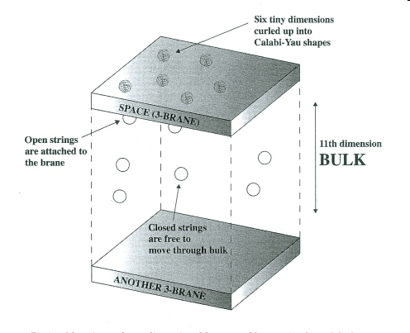
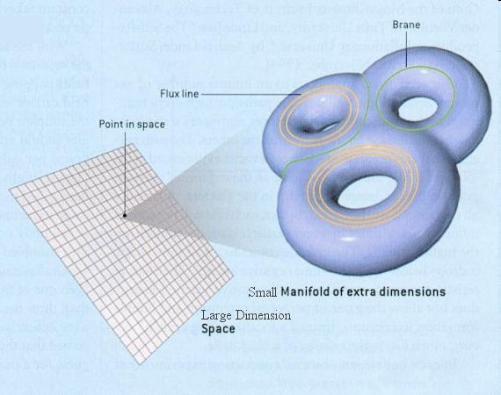
Large Extra dimension models motivated by string theory
Arkani-Hamed
Dimopoulos, Dvali
(string models)
Randall Sundrum
(brane models)
Both relevant
for providing
resolution of
the hierarchy
problem
in field theory
Stringy effects @ low
scales (TeV ) possible

Slide 17
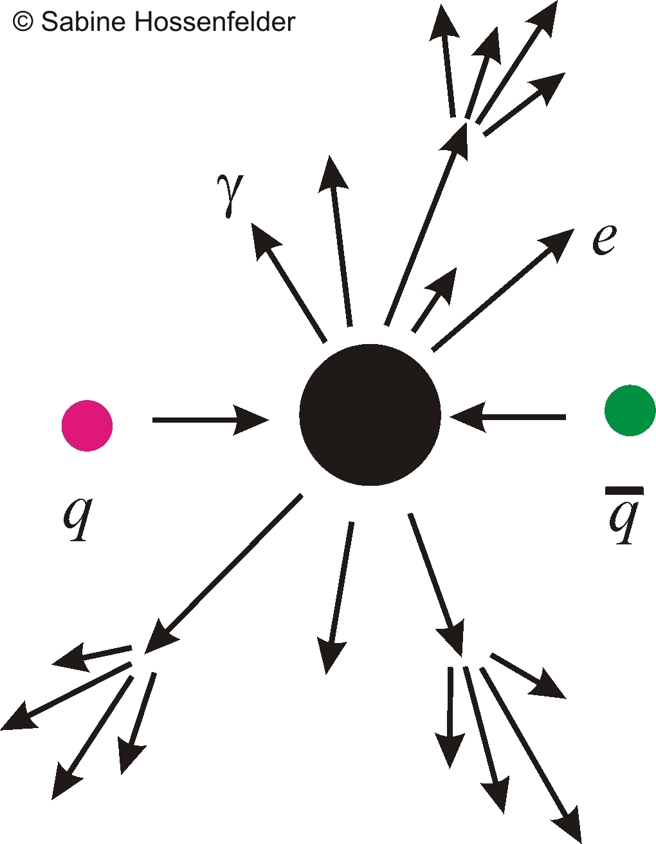
Large Extra dimension models motivated by string theory
Arkani-Hamed
Dimopoulos, Dvali
(string models)
Randall Sundrum
(brane models)
Both relevant
for providing
resolution of
the hierarchy
problem
in field theory
gravitons
propagate
in bulk
as well as
brane
Stringy effects @ low
scales (TeV ) possible
Dimopoulos, Landsberg
Formation of TeV Black Holes (BH) by high energy SM particle Collisions

Slide 18
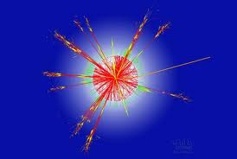
Large Extra dimension models motivated by string theory
Arkani-Hamed
Dimopoulos, Dvali
(string models)
Randall Sundrum
(brane models)
Both relevant
for providing
resolution of
the hierarchy
problem
in field theory
gravitons
propagate
in bulk
as well as
brane
Stringy effects @ low
scales (TeV ) possible
Dimopoulos, Landsberg
Formation of TeV Black Holes (BH) by high energy SM particle Collisions
BH produced in proton-proton collisions can carry electric charge
Charged BH Hawking evaporate but not completely → certain fraction of final
BH remnants carry charge (BH±)

Slide 19

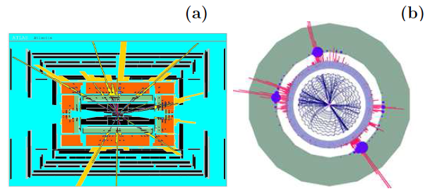
Collider Production of TeV Black Holes
If colliding particles with TeV energies @ LHC are closer than Schwarzschild radius
of (quantum) TeV black holes → formation of (unstable) black holes
Hawking (thermal) evaporation , spectacular signal @ LHC of emission of particles
n= number of
extra dims
mini BH life time
τ < 10⁻²⁶ s
Event as would be seen by ATLAS
CHARYBDIS generator
Event as would be seen by CMS
TRUENOIR gemerator

Slide 20
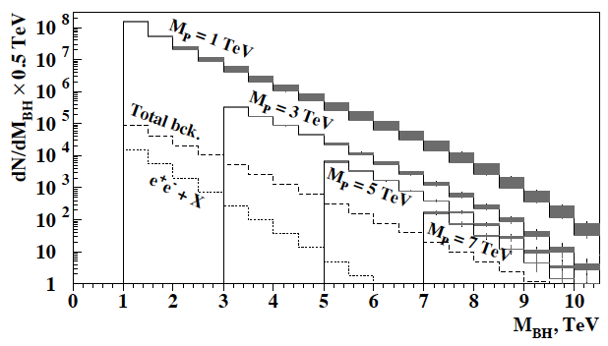
Theoretical predictions in electron or photon channels with 100 fb⁻¹ ∫ L
Landsberg arXiv:0607297
2 ≤ n ≤ 7
Multiplicity of emitted particles of given spin depends on gray body factors
– detailed studies in higher dimensional GR

Slide 21
Theoretical predictions in electron or photon channels with 100 fb⁻¹ ∫ L
Landsberg arXiv:0607297
2 ≤ n ≤ 7
NO MINI BH effects
HAVE BEEN DETECTED
SO FAR ....
Multiplicity of emitted particles of given spin depends on gray body factors
– detailed studies in higher dimensional GR

Slide 22
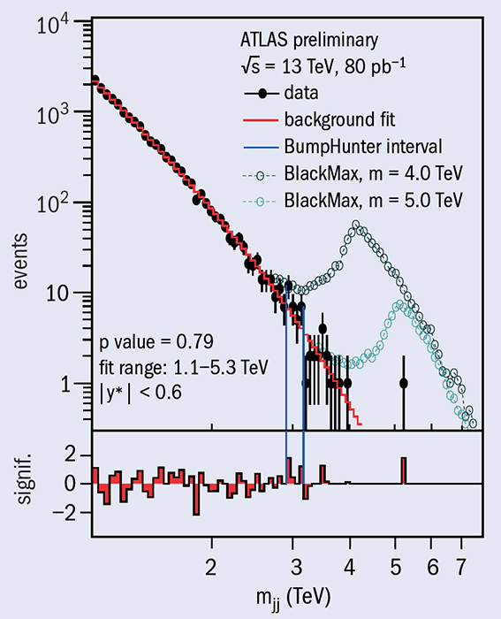

The dijet mass distribution
(filled points)
for selected events,
together with predictions
from BlackMax for two
quantum-black-hole signals, normalized to the predicted cross-section.
The bottom panel shows
the bin-by-bin significance of the difference between data and fit, considering statistical uncertainties only.
CERN Courier 2015/9

Slide 23
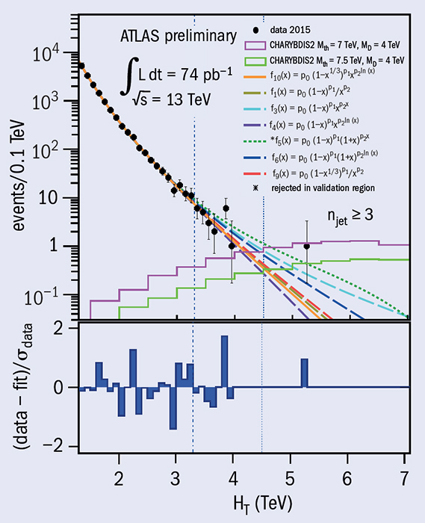
If micro BH exist will Hawking decay
to a large number of SM particles
Scalar sum of jet transverse
momenta (HT) in high-multiplicity
events fitted by the baseline
function (solid line) and
six alternatives (dashed lines).
Examples of
simulated signals are also shown.
The bottom panel shows
the bin-by-bin significance
of the difference
between the data and the fit,
where the fit prediction is taken from the baseline function.
CERN Courier 2015/9

Slide 24

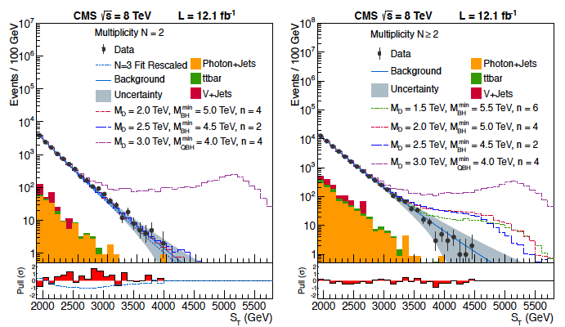
CMS Coll: 1303.5338
N

Slide 25
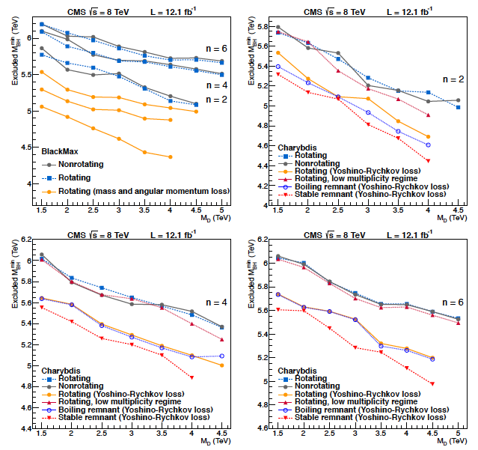
area
below
a curve
excluded

Slide 26
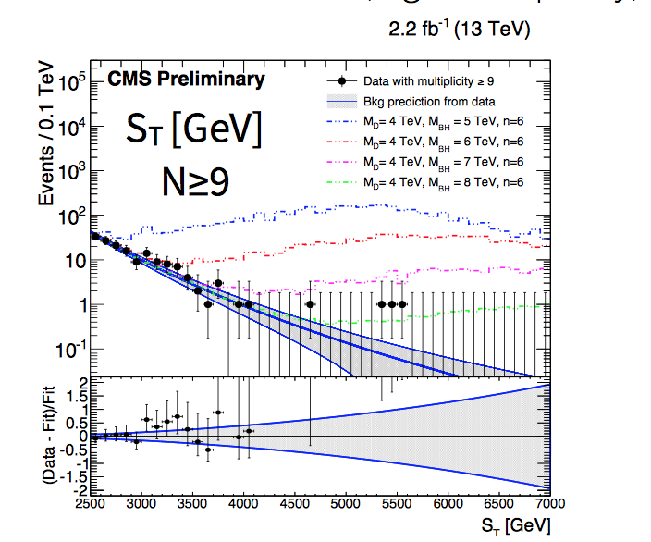
Black Hole Masses
< 8-9 TeV excluded,
depending on models
and assumptions
A de Roeck
SUGRA @ 40 (2016)

Slide 27
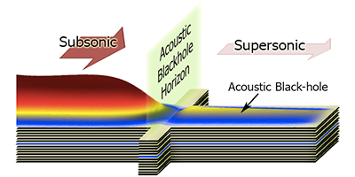
Analogue (Sonic or Acoustic) Black Holes in Condensed matter
Phonons (sound perturbations) unable to escape from a fluid flowing
faster than the speed of sound → analogies with light trapped in BH horizons:
surface of sonic black hole at which the flow speed changes from being
greater than the sound speed to being less than then sound speed is called
the Horizon analogue (frequency of phonons approaches zero). Phononic version of
Hawking radiation at the horizon → useful analogues for drawing conclusions on
astrophysical black holes?
First predicted by Unruh in 1981 ,
elaborated further by Visser 1997,
demonstrating
the existence of Hawking
radiation phononic analogue.
First experimental demonstration in rubidium Bose-Einstein condensate in 2009
O. Lahav, A. Itah, A. Blumkin, C. Gordon & J. Steinhauer,
arXiv:0906.1337 (2009).
First Self-amplifying phononic Hawking radiation (analogue BH laser) observed in 2014
J. Steinhauer, Nat Phys doi:10.1038/nphys3104 (2014).

Slide 28
SPHALERONS

Slide 29
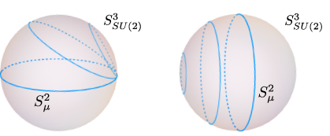

SPHALERONS:
Static unstable solutions of Electroweak theory playing an important role for Baryo/Leptogenesis
Euclidean
instanton solutions
imply SU(2) Vacua
labelled by n → Minkowski
gauge & scalar fields
S² maximum size at μ=π/2 (sphaleron-unstable), S² shrinks → 0 @ μ=0, π
A sphaleron may convert baryon to antileptons and antibaryons t leptons →
(i) wipe out any baryon asymmetry generated before the electroweak symmetry breaking (when sphalerons were abundant) (ii) a baryon net excess can be created during the EW breaking but it can be preserved if the breaking is first order
They also preserve B-L so they can communicate Lepton number violation to Baryonic sector in some theories of Leptogenesis, which is then transformed
to Baryogenesis

Slide 30
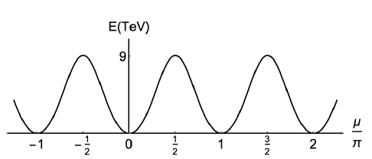





sphaleron
potential
barrier
Manton (1983)
= V(Q)
periodic
sphaleron
potential in
EW theory
vacuum
vacuum
Effective one-dim
Schroedinger eq.
For SM values
Tye & Wong (2015)
Solution for the Bloch wave function → baryon-lepton number
violating processes can occur without tunnelling suppression
Interesting Phenomenology @ colliders: B+L violating processes
any number of W± , Z
E₁ + E₂ ≥ E _{sph} NO SUPPRESSION

Slide 31
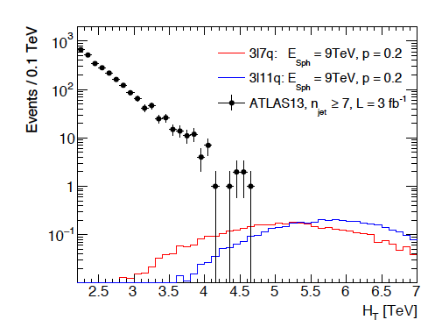



Searches @ LHC
Ellis, Sakurai 1601.03654
parametrize cross section
of parton-parton collisions
parton luminosity function of
colliding quarks a and b
DATA POINTS :number of events with n_{jet} ≥ 3
RED histogram: Δn=-1 sphaleron process
(3 antileptons, 7 antiquarks in final state)
BLUE histogram: Δn=+1 process
(3 leptons, 11 quarks in final state)
centre of mass
energy of pp collision

Slide 32
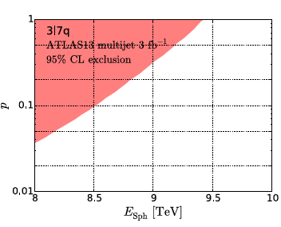
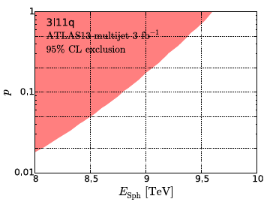
Searches @ LHC
Ellis, Sakurai
DATA POINTS :number of events with n_{jet} ≥ 3
RED histogram: Δn=-1 sphaleron process
(3 antileptons, 7 antiquarks in final state)
BLUE histogram: Δn=+1 process
(3 leptons, 11 quarks in final state)
exclusion region: recast 13 TeV ATLAS data
for microscopic BH at 3 fb⁻¹

Slide 33
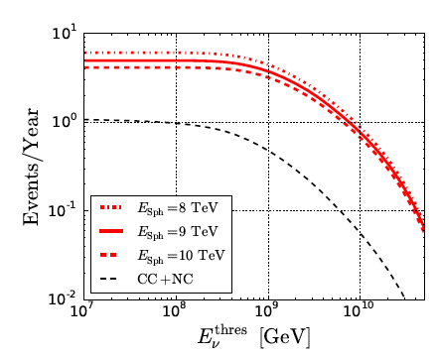


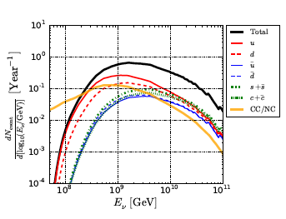

Searches in ICECUBE
Ellis, Sakurai, Spannowsky
1603.06573
parametrize
sphaleron-induced
neutrino-quark
collision
sphaleron-event rate in ICECUBE

Slide 34
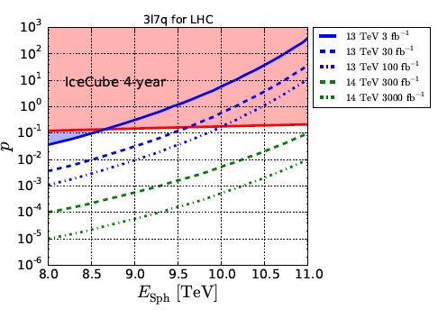
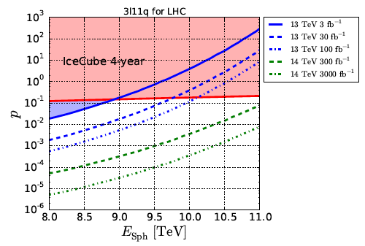
COMPARISON ICECUBE-LHC
Ellis, Sakurai, Spannowsky
1603.06573
solid blue: recast of an
ATLAS search for microscopic
Back holes at 3 fb⁻¹
Conclusion: ICECUBE
advantageous for high sphaleron
energies E_{sph ,}
LHC for small E_{sph}

Slide 35
MONO
POLES

Slide 36

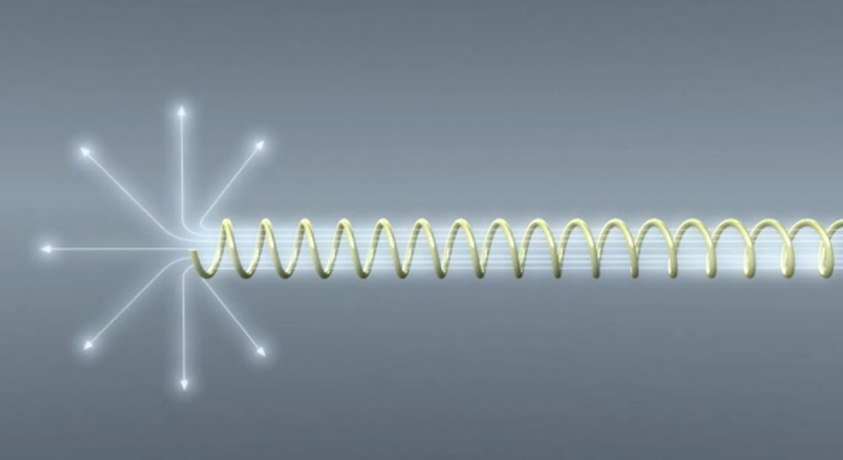
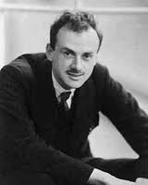
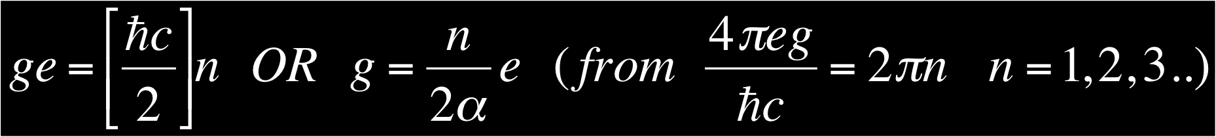
Dirac’s Monopole
In 1931 Dirac hypothesized that the Monopole exists as the end of an infinitely long and thin solenoid - the “Dirac String”
Requiring that the string is not seen gives us the Dirac Quantization Condition & explains the quantization of charge!

Slide 37
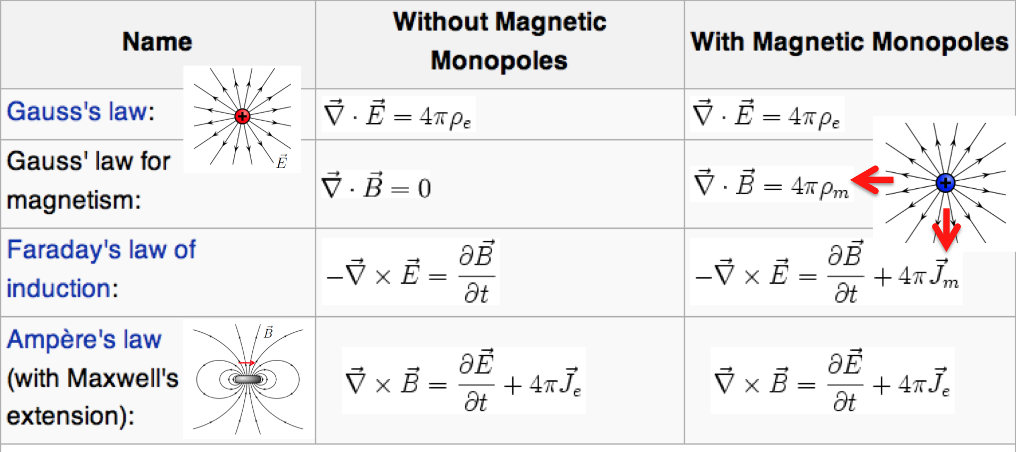




Dirac’s Monopole symmetrizes Equations
For Dirac monopole

Slide 38
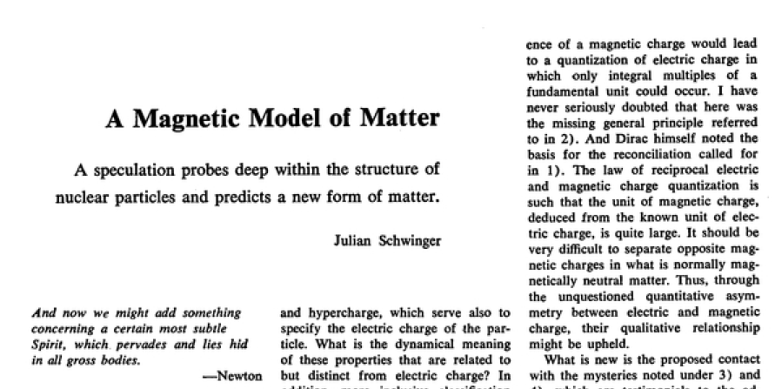
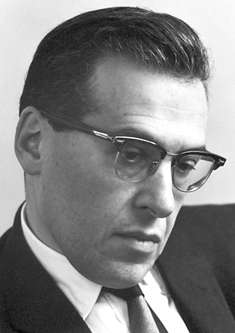
Schwinger’s Dyon
Postulated a “dyon” that carries electric & magnetic charge
Quantisation of angular momentum with two dyons (q_{e1},q_{m1}) and (q_{e2},q_{m2}) yields
(q_{e1} ,q_{m1}) - (q_{e2} ,q_{m2}) = 2nh/m₀ ( n is an integer)
  Fundamental magnetic charge is now 2g_{D} (g_{D} = Dirac’s magn. charge)
  If the fundamental charge is 1/3 (d-quark) as the fundamental electric charge then the fundamental magnetic charge becomes 6g_{D}

Slide 39


The ‘t Hooft-Polyakov Monopole
Alexander Polyakov
GUT monopole
Gerard t’Hooft
In 1974 ‘t Hooft and Polyakov found that many (non-Abelian) Grand Unified gauge theories predict Monopoles
  Such monopoles are topological solitons (stable, non dissipative, finite energy solutions) with a topological charge
  The topology of the soliton’s field configuration gives stability e.g. a trefoil knot in a rope fixed at the ends (boundary conditions)
Produced in the early Universe at G.U.T. phase transition a GUM is a tiny replica of the Big Bang with mass ~ 0.02 μg

Slide 40
Important Connection of `t Hooft-Polyakov Monopole with
spontaneous symmetry breaking → Higgs-like excitations
Assume appropriate GUT non-abelian group (eg SU(5))
admitting monopoles → spontaneously broken
φ = 0
φ = η ≠ 0 (r → ∞ )
symmetry
broken
Assume mass concentrate
inside the core of size L
Outside the core
f ≈ 1 → χ^{α} χ^{α} → η²
V → 0 (non trivial minimum)

Slide 41
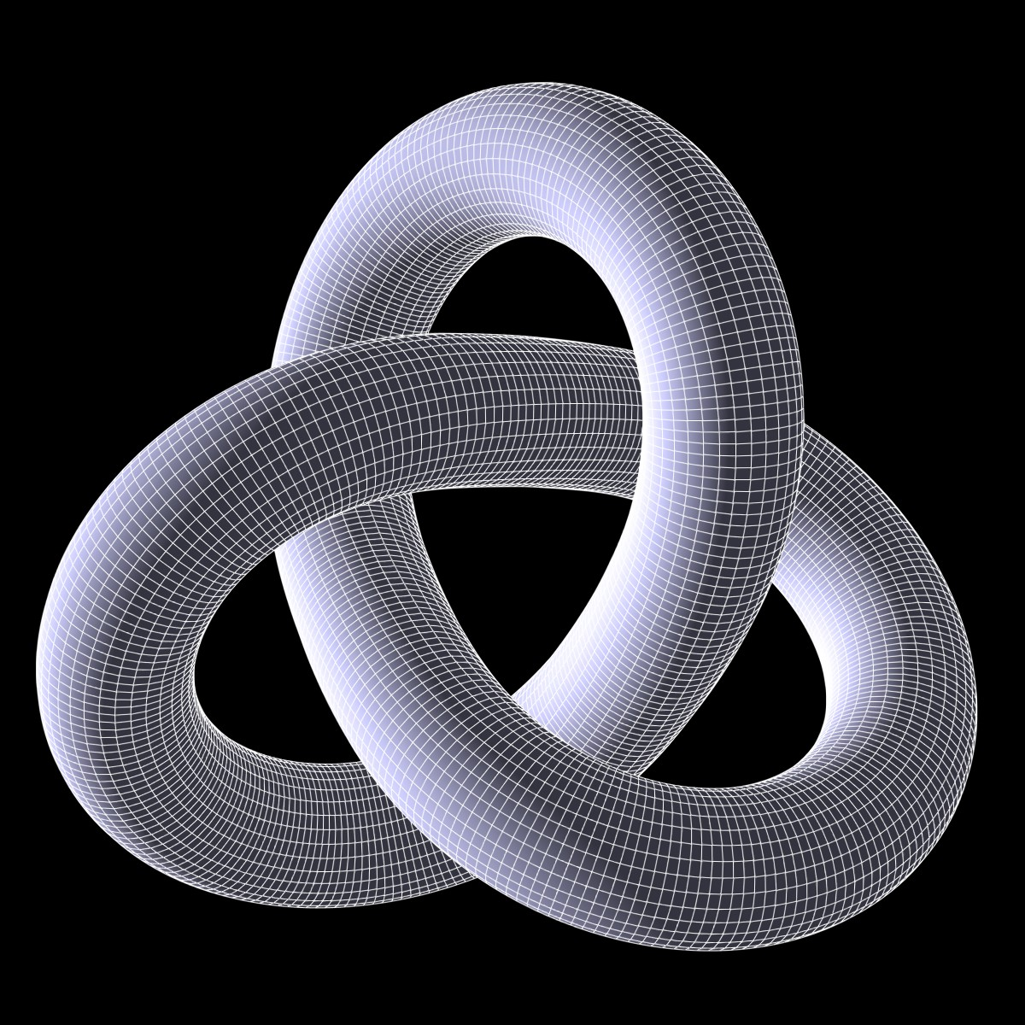
The ‘t Hooft-Polyakov Monopole
Alexander Polyakov
GUT monopole
Gerard t’Hooft
In 1974 ‘t Hooft and Polyakov found that many (non-Abelian) Grand Unified gauge theories predict Monopoles
  Such monopoles are topological solitons (stable, non dissipative, finite energy solutions) with a topological charge
  The topology of the soliton’s field configuration gives stability e.g. a trefoil knot in a rope fixed at the ends (boundary conditions)
Produced in the early Universe at G.U.T. phase transition a GUM is a tiny replica of the Big Bang with mass ~ 0.02 μg

Slide 42
The ‘t Hooft-Polyakov Monopole
Alexander Polyakov
GUT monopole
Gerard t’Hooft
In 1974 ‘t Hooft and Polyakov found that many (non-Abelian) Grand Unified gauge theories predict Monopoles
  Such monopoles are topological solitons (stable, non dissipative, finite energy solutions) with a topological charge
  The topology of the soliton’s field configuration gives stability e.g. a trefoil knot in a rope fixed at the ends (boundary conditions)
Produced in the early Universe at G.U.T. phase transition a GUM is a tiny replica of the Big Bang with mass ~ 0.02 μg

Slide 43
The ‘t Hooft-Polyakov Monopole
Alexander Polyakov
GUT monopole
Gerard t’Hooft
In 1974 ‘t Hooft and Polyakov found that many (non-Abelian) Grand Unified gauge theories predict Monopoles
  Such monopoles are topological solitons (stable, non dissipative, finite energy solutions) with a topological charge
  The topology of the soliton’s field configuration gives stability e.g. a trefoil knot in a rope fixed at the ends (boundary conditions)
Produced in the early Universe at G.U.T. phase transition a GUM is a tiny replica of the Big Bang with mass ~ 0.02 μg
10¹⁵⁻¹⁶ GeV

Slide 44
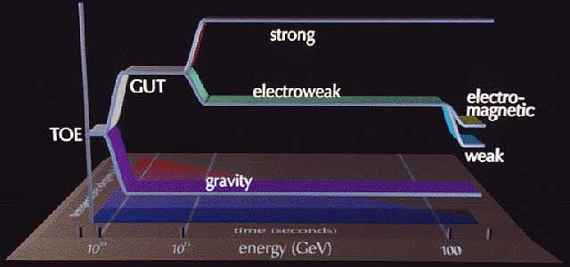
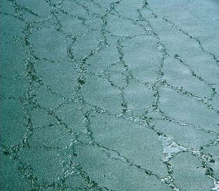
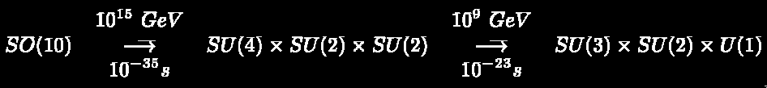
The GUT Monopole (GUM)
Water freezing to ice
The GUT transition
GUT monopole
A symmetry-breaking phase transition caused the creation of topological defects as the universe froze out at the GUT trans.
  The GUM is a tiny replica of the Big Bang with mass ~ 0.02 μg (10¹⁶ GeV
  GUT monopoles should comprise 10¹¹ x ρ_{critical} of the Universe !!
  Guth introduced the inflationary scenario to dilute the monopoles to an acceptable level and also solve the horizon and flatness problems.
Lighter “Intermediate Mass Monopoles” can be produced at later Phase Transitions – mass 10¹⁰ GeV or lower

Slide 45

GUT Monopole Catalysis of p-Decay
Illustration of monopole catalysis of proton decay via the Rubakov-Callan Mechanism via super heavy gauge bosons that mediate baryon number violation
The central core of the GUT retains the original symmetry containing the field of the superheavy “X” all quarks and leptons are here essentially indistinguishable
  Protons can be induced to decay with x-section ofo σ_{B}β ~ 10⁻²⁷ cm²- giving a line of catalyzed proton decays on the trail of the monopole
One can search for non relativistic monopoles at water/ice detectors (IceCube, KamioKande, etc.) using catalysis

Slide 46

But… GUT monopoles not alone in market
Other monopole states predicted in
theories beyond the standard model,
like strings (Wen & Witten) may have
sufficiently low-masses
(if string scale is low @ TeV)
to be falsifiable at LHC energies

Slide 47
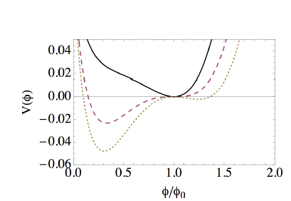

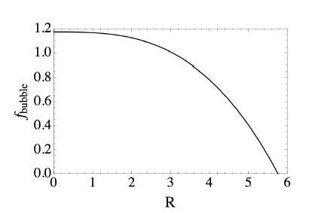
Vacuum instabilities & light GUT monopoles?
MOeDAL review : ArXiv:1406.7662
A. Rajantie
Contemp.Phys. 53 (2012) 195-211;
arXiv:1204.3073
Monopole Energy density
@ GUT scales
ε=1, μ=0.48
Original Higgs vacuum decays
to a new true vacuum via bubble
formation : true vacuum inside bubble
of radius R (new scale) containing
monopole, bubble surrnounded by
false vacua. Monopole decays
vacuum bubble radius

Slide 48
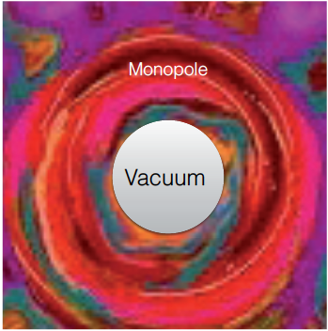
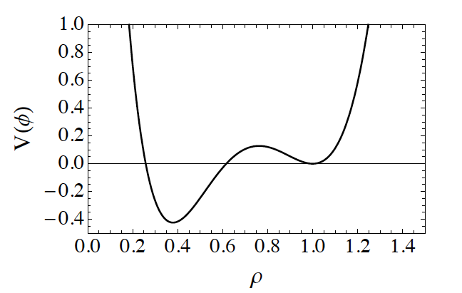
Vacuum instabilities & light GUT monopoles?
Courtesy: Vicente Vento (Valencia)
Work in progress on description of monopole structure & study of possible consequences.
Modifications of Georgi-Glashow (MGG) model
towards smaller monopole masses BUT ALSO stable monopoles
relevance to MoEDAL
Monopole structure in
MGG model:
Bag model: core: true
quasi empty vacuum
outside: a monopole tail
The bigger the core
the smaller the mass

Slide 49

But ...there may already be...
several, light monopoles in the ...air

Slide 50
Electroweak Magnetic Monopole?
Y.M. Cho and D. Maison,
Phys. Lett. B391, 360 (1997).
Cho – Maison in 1997 envisioned a new type of spherically symmetric Electroweak Standard Model dyon, with:
  Magnetic charge 2g_{D}
  Mass in the range 4→7 TeV/c² → Cho et al. arXiv: 1212.3885 [hep-ph]
This monopole is a non-trivial hybrid between the abelian Dirac monopole and the non-abelian ‘t Hooft-Polyakov monopole
Cho-Maison monopole would be produced → detected/falsified @ LHC if its mass lies in the predicted range

Slide 51

Electroweak Magnetic Monopole?
Y.M. Cho and D. Maison,
Phys. Lett. B391, 360 (1997).
Important role of U_{Y} (1) for SM
admitting monopole solutions
SU(2) x U_{Y} (1) / U_{em} (1) → CP¹ structure
π₂(CP¹) = Z , Higgs doublet as CP¹ field
→ non trivial topology (knot - like soliton)
Cho – Maison in 1997 envisioned a new type of spherically symmetric Electroweak Standard Model dyon, with:
  Magnetic charge 2g_{D}
  Mass in the range 4→7 TeV/c² → Cho et al. arXiv: 1212.3885 [hep-ph]
This monopole is a non-trivial hybrid between the abelian Dirac monopole and the non-abelian ‘t Hooft-Polyakov monopole
Cho-Maison monopole would be produced → detected/falsified @ LHC if its mass lies in the predicted range

Slide 52
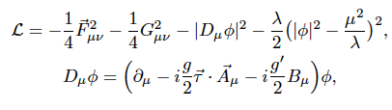
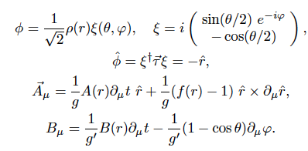
The Cho-Maison Magnetic Monopole
Y.M. Cho and D. Maison,
Phys. Lett. B391, 360 (1997).
The Standard Model provides naturally
the non-trivial topological framework
for the existence of a ``monopole-like’’ state
NB: incorrect conjectures
in the past that E/W model
does not have monopoles
SOLUTION
NB: apparent string-like
singularity in ξ, Β
is gauge artefact, can be
removed by making U(1)
non-trivial → e/w Dyon

Slide 53

The Cho-Maison Magnetic Monopole
Y.M. Cho and D. Maison,
Phys. Lett. B391, 360 (1997).
The Standard Model provides naturally
the non-trivial topological framework
for the existence of a ``monopole-like’’ state
NB: incorrect conjectures
in the past that E/W model
does not have monopoles
But...POINT-SINGULARITY OF CHO-MAISON MONOPOLE MAKES ESTIMATE OF MASS CLASSICALLY IMPOSSIBLE →
Need to find FINITE-ENERGY Solutions
SOLUTION
NB: apparent string-like
singularity in ξ, Β
is gauge artefact, can be
removed by making U(1)
non-trivial → e/w Dyon

Slide 54

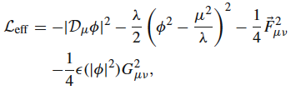
Recent Model of Cho for finite dyons
Cho, Kim, Yoon , arXiv:1305.12.1699
Eur.Phys.J. C75 (2015) 2, 67
Finiteness is obtained if one
modifies U_{Y}(1)-part of SM lagrangian:
weak interactions
gauge bosons
hypercharge ``photon’’

Slide 55


Recent Model of Cho for finite dyons
Cho, Kim, Yoon , arXiv:1305.12.1699
Eur.Phys.J. C75 (2015) 2, 67
Finiteness is obtained if one
modifies U_{Y}(1)-part of SM lagrangian:
Assume Higgs field
affects U_{Y}(1) permittivity
of vacuum
e.g. due to quantum
(loop) corrections
ε(|φ|²) → 1
r → ∞
→ ``running’’
→

Slide 56


Recent Model of Cho for finite dyons
Cho, Kim, Yoon , arXiv:1305.12.1699
Eur.Phys.J. C75 (2015) 2, 67
Finiteness is obtained if one
modifies U_{Y}(1)-part of SM lagrangian:
For finite energy of Cho-Maison Dyon we need

Slide 57
Theoretical requirement for
finiteness of energy
OPEN ISSUES: Examine potential effects of Higgs-dependent `dielectric constant’ modification ε(φ) of U_{Y}(1) vacuum in electroweak data
→ Bounds on n Ellis, NEM, You PLB 756, 25 (2016)
The price of a finite energy electroweak monopole (dyon)

Slide 58
The price of a finite energy electroweak monopole (dyon)
Ellis, NEM, You PLB 756, 25 (2016)
Cho et al. 2015

Slide 59
The price of a finite energy electroweak monopole (dyon)
Ellis, NEM, You PLB 756, 25 (2016)
Excluded by LHC data on
H → γ γ
Cho et al. 2015

Slide 60

The price of a finite energy electroweak monopole (dyon)
Ellis, NEM, You PLB 756, 25 (2016)
Excluded by LHC data on
H → γ γ
Cho et al. 2015
Dim 6 operators
complete EFT analysis
Ellis, Sanz, You JHEP 1503 (2015)
Global fit to LHC data

Slide 61
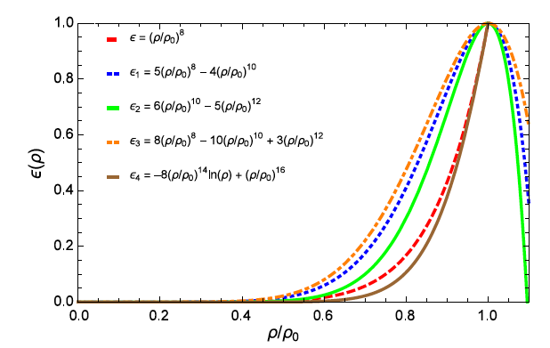

Try more general (phenomenological) function of ε(φ φ⁺)
LHC-data incompatible
Require Maximal
Entropy

Slide 62
Try more general (phenomenological) function of ε(φ φ⁺)
LHC-data incompatible
Require Maximal
Entropy
non polynomial

Slide 63
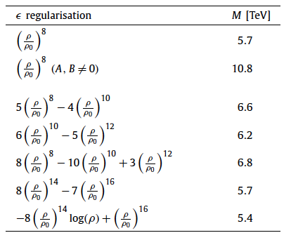
Modified Monopole Masses
Ellis, NEM, You PLB 756, 25 (2016)

Slide 64
Modified Monopole Masses
Ellis, NEM, You PLB 756, 25 (2016)
Gravitation can reduce the mass further
Cho, Kim, Yoon , arXiv:1605.08129

Slide 65

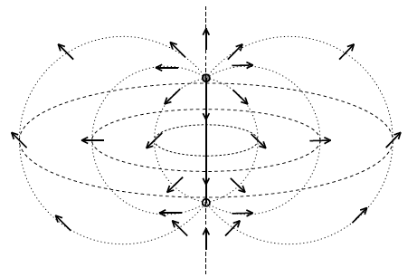





Other Monopole-like EW structures
Review:
Achucarro & Vachaspati
Phys Repts 327 (2000)
Electroweak Strings (Nambu’s Dumb-bell configurations)
Yang’s singular monopole in electroweak SU(2) Yang-Mills
Higgs field zeroes
monopole
antimonopole
NB: Yang’s monopole has IR infinities → regularised if embedded in gravity in even space-time dimensions:
Cebeci, Sarioglu, Tekin
Phys.Rev. D78 (2008) 125016
Reissner-Nordstrom
Black Hole (BH)
If TeV BH produced @ LHC → could have TeV mass Yang monopoles as well?

Slide 66

Other Monopole-like EW structures
Rosy They,Ban-Loong Ng & Khai-Ming Wong
arXiv: 1406.0978
``Half Monopole AXISYMMETRIC Solution in Weinberg-Salam Model:
electromagnetic potential is singular along, say, z axis
with half the magnetic charge of Cho-Maison monopole, g = 2π/e
In U(1) magnetic field: solution is a finite-length line magnetic charge from r=0
In SU(2) ‘t Hooft’s magnetic field: is a point magnetic charge located at r=0
has magnetic dipole moment that decreases exponentially with increasing
Higgs self-coupling λ^{1/2} @ sin²θ_{W} = 0.23
IMPORTANT: FINITE TOTAL ENERGY proportional to (1/2) Log λ

Slide 67

Other Monopole-like EW structures
Rosy They,Ban-Loong Ng & Khai-Ming Wong
arXiv: 1406.0978
``Half Monopole AXISYMMETRIC Solution in Weinberg-Salam Model:
electromagnetic potential is singular along, say, z axis
with half the magnetic charge of Cho-Maison monopole, g = 2π/e
In U(1) magnetic field: solution is a finite-length line magnetic charge from r=0
In SU(2) ‘t Hooft’s magnetic field: is a point magnetic charge located at r=0
has magnetic dipole moment that decreases exponentially with increasing
Higgs self-coupling λ^{1/2} @ sin²θ_{W} = 0.23
IMPORTANT: FINITE TOTAL ENERGY proportional to (1/2) Log λ
Sphaleron Inside Look
Hindmarsh & James (94)
CAN EXIST EITHER AS ISOLATED MAGNETIC LINES OR IN
MONOPOLE-ANTIMONOPOLE PAIRS
CONNECTED BY A Z⁰ FLUX TUBE INSIDE SPHALERONS

Slide 68
Other Monopole-like EW structures
Rosy They,Ban-Loong Ng & Khai-Ming Wong
arXiv: 1406.0978
``Half Monopole AXISYMMETRIC Solution in Weinberg-Salam Model:
electromagnetic potential is singular along, say, z axis
with half the magnetic charge of Cho-Maison monopole, g = 2π/e
In U(1) magnetic field: solution is a finite-length line magnetic charge from r=0
In SU(2) ‘t Hooft’s magnetic field: is a point magnetic charge located at r=0
has magnetic dipole moment that decreases exponentially with increasing
Higgs self-coupling λ^{1/2} @ sin²θ_{W} = 0.23
IMPORTANT: FINITE TOTAL ENERGY proportional to (1/2) Log λ
Sphaleron Inside Look
Hindmarsh & James (94)
helical magnetic field
CAN EXIST EITHER AS ISOLATED MAGNETIC LINES OR IN
MONOPOLE-ANTIMONOPOLE PAIRS
CONNECTED BY A Z⁰ FLUX TUBE INSIDE SPHALERONS

Slide 69

Other Monopole-like EW structures
Similar sphaleron-related solutions with
screened magnetic field have been discussed in
D. G. Pak, P. M. Zhang, and L. P. Zou
arXiv: 1311.7567v3
Helical screened magnetic field
Energy Density → FINITE TOTAL ENERGY
Estimated by a variational
method to be ≥ 4.3 TeV

Slide 70

Other Monopole-like EW structures
Similar sphaleron-related solutions with
screened magnetic field have been discussed in
D. G. Pak, P. M. Zhang, and L. P. Zou
arXiv: 1311.7567v3
Helical screened magnetic field
But such sphaleron
related solutions
are unstable….
could they be
stabilised ? →
relevant @ LHC
& MoeDAL?
Energy Density → FINITE TOTAL ENERGY
Estimated by a variational
method to be ≥ 4.3 TeV

Slide 71
Magnetic Monopole
Properties
– behaviour
in matter

Slide 72


Magnetic Monopole Properties
Magnetic charge = ng = n68.5e
(if e→1/3e; g→3g)
HIGHLY IONIZING
Coupling constant = g/Ћc ~ 34. Spin ½?
Breaks chemical
bonds eg in
Plastics of
Nuclear Track
detectors
Energy acquired in a magnetic field =2.06MeV/gauss.m = 2TeV in a 10m, 10T LHC magnet
The monopole mass is not predicted within the Dirac’s theory.

Slide 73
Magnetic Monopole Properties
Magnetic charge = ng = n68.5e
(if e→1/3e; g→3g)
HIGHLY IONIZING
Coupling constant = g/Ћc ~ 34. Spin ½?
Energy acquired in a magnetic field =2.06MeV/gauss.m = 2TeV in a 10m, 10T LHC magnet
Dirac Monopole
is singular
Mass cannot
be predicted
classically
needs regularization
The monopole mass is not predicted within the Dirac’s theory.

Slide 74


The Ways to get High Ionization
Electric charge - ionization increases with increasing charge & falling velocity β (β=v/c) – use z/β as an indicator of ionization
Magnetic charge - ionization increases with magnetic charge and decreases with velocity β – a unique signature
  The velocity dependence of the Lorentz force cancels 1/β² term
The ionization of a relativistic monopole is (ng)² times that of a relativistic proton i.e 4700n²!! (n=1,2,3…)
74

Slide 75


Monopoles in Nuclear Track Detectors (NTDs)
The highly ionizing particle leaves a cylindrical trail of damage in the plastic NTDs
ETCHING PROCESS:
Tracks are revealed as conical etch pits . Charge resolution ~0.05e . Spatial resolution ~ 10 microns/pit – pointing to the IP
J PINFOLD

Slide 76

Monopole Energy Losses in plastic
Nuclear Track Detectors (NTD)
Detection
thresholds of CR39
used in MACRO Expt

Slide 77




Induction Experiments
Cabrera’s Event
A monopole traversing a SQUID coil
Data from Cabrera’s apparatus taken on St Valentine’s day in 1982 (A=20 cm²).
  The trace shows a jump – just before 2pm - that one would expect from a monopole traversing the coil.
In August 1985 a groups at ICL reported the:“observation of an unexplained event” compatible with a monopole traversing the detector (A= 0.18 m²)
SAME TECHNOLOGY IS UTILIZED BY MoEDAL
ICL
Event

Slide 78
Searching for
High Mass (> 10 TeV)
(primordial) Magnetic Monopoles

Slide 79

Primordial Monopoles
Primordial Monopoles:
  GUT monopoles - m~10¹⁷ GeV
  IM Monopoles– made in later phase transitions of early universe m ~ 10⁹ GeV
Monopoles accelerate to relativistic speeds in galactic B-fields → ~10²⁰ eV
Parker Bound is an upper limit on the density of magnetic monopoles based on the existence of a galactic B- field.
  This bound can be evaded if monopole anti-monopoles pairs are bound
Extended Parker Bound - a more stringent limit.
  Based on the survival of the small seed field of the protogalaxy
F< 10⁻¹⁵ cm⁻² s⁻¹ sr⁻¹ for β<3 x 10⁻³
B-field in spiral galaxies is ofo 10 μG (microGauss) ( Earth’s field ofo 0.1G)

Slide 80





Major Cosmic Monopole Searches
IceCube (Antarctica: -2.4km) -
Cerenkov emission& catalyzed p-decay
MACRO (Gran Sasso: -1400m) –
high ionization
SLIM (Chacaltaya: +5200m ) –
high ionization
Super-K (Kamioka: -1000m ) –
catalyzed p-decay

Slide 81


Cosmic Monopole Flux Limits
A. Rajantie,
L. Patrizii

Slide 82

Cosmic Bounds
Rajantie,
L. Patrizii

Slide 83
Searching for
Low Mass ( O(10 TeV) )
Magnetic Monopoles @ LHC

Slide 84

Monopole Production at Colliders
CDF excluded MM pair production at the 95% CL for cross-section < 0.2 pb and monopole masses 200 < m_{M}< 700 GeV/c²

Slide 85
Monopole Energy Losses in plastic
Nuclear Track Detectors (NTD)
Detection
thresholds of CR39
used in MACRO Expt

Slide 86




THE SEARCH FOR MONOPOLIA
Dirac or other monopoles
(e.g. Cho-Maison monopole)
may not be free states but
BOUND states → MONOPOLIUM
(MM) → produced at colliders?
M
Monopole-
antimonopole
binding
interaction
M
Epele, Fanchiotti, Garcia-Canal,
Mitsou, Vento,
EPJPlus 127 (2012), 60

Slide 87

THE SEARCH FOR MONOPOLIA
Dirac or other monopoles
(e.g. Cho-Maison monopole)
may not be free states but
BOUND states → MONOPOLIUM
(MM) → produced at colliders?
Production cross
section @ LHC, 7 TeV
M
monopole mass
Binding energy fixed BE = 2m/15 , e.g.
for m=750 GeV, binding energy = 100 GeV
→ monopolium mass M= 1400 geV
V. Vento
in MOeDAL Physics Review
arXiv:1405.7662
→

Slide 88



Relevance to LHC & MoEDAL Expts
Monopolium is neutral in its ground state & thus if produced in such a state is
difficult, probably impossible, to detect in LHC (ATLAS, CMS) or MoeDAL (since
damage to plastics from SM background could be higher )
BUT…it may be produced in an excited state, which could be a magnetic multiple
→ highly ionizing.
Its decay via photon emission will produce a peculiar trajectory, if the decaying states are also magnetic multipoles,
the process will generate a peculiar trajectory in the medium.
Monopolium
might break up
in the medium
of MoEDAL into
highly-ionizing
Dyons
V. Vento
in MOeDAL Physics Review
arXiv:1405.7662
Moreover, In presence of magnetic fields huge polarizability

Slide 89



Monopoles & Diphoton events
Epele, Fanchiotti, Garcia-Canal,
Mitsou, Vento, EPJPlus 127 (2012), 60
monopole-
antimonopole
annihilation
characteristic
signal of
monopolium
production
ΝΒ: ordinary monopoles: Dirac coupling too large to reproduce the 750 γγ res, with Γ_{tot} = 45 GeV,

Slide 90

Monopoles & Diphoton events
Epele, Fanchiotti, Garcia-Canal,
Mitsou, Vento, EPJPlus 127 (2012), 60
characteristic
signal of
monopolium
production
X
ΝΒ: ordinary monopoles: Dirac coupling too large to reproduce the 750 γγ res, with Γ_{tot} = 45 GeV,

Slide 91

ATLAS-LHC Search @ 8 TeV pp collisions
Atlas Coll.Phys.Rev. D93 (2016) no.5, 052009
∫ L = 7.0 fb⁻¹
Search for magnetic monopoles as highly ionizing particles (HIP):
particle produces high ionization region in Transition Radiation Tracker (TRT),
slows down and stops in e/m calorimeter
Negligible bremsstrahlung for HIP → narrower energy deposit in e/m calorimeter
than electrons, protons which induce e/m shower
No events found in the signal region → exclude
masses 200 GeV ≤ m ≤ 2 500 GeV for magnetic charge 0.5g_{D} < |g| < 2.0g_{D}

Slide 92
Interpretation of Results-Monopole Simulations
Atlas Coll.Phys.Rev. D93 (2016) no.5, 052009
Model-dependent and model-independent interpretation of results require magnetic
monopole simulation using Drell-Yan & single monopole production
Leading DY process: pp → q –anti q → virtual photon → Monopole antimonopole Pairs
Use MADGRAPH5 MONTE CARLO EVENT GENERATOR for spin ½, and spin 0 monopoles

Slide 93

Interpretation of Results-Monopole Simulations
Atlas Coll.Phys.Rev. D93 (2016) no.5, 052009
Model-dependent and model-independent interpretation of results require magnetic
monopole simulation using Drell-Yan & single monopole production
Leading DY process: pp → q –anti q → virtual photon → Monopole antimonopole Pairs
Use MADGRAPH5 MONTE CARLO EVENT GENERATOR for spin ½, and spin 0 monopoles
NB: DY processes not reliable
perturbatively

Slide 94



spin 1/2
spin 0

Slide 95















International Collaboration
> 65 Physicists from
21 Participating Institutions
UNIVERSITY OF ALBERTA
INFN & UNIVERSITY OF BOLOGNA
UNIVERSITY OF BRITISH COLUMBIA
CERN
UNIVERSITY OF CINCINNATI
INPPS CRACOW
CONCORDIA UNIVERSITY
CZECH TECHNICAL
UNIVERSITY IN PRAGUE
UNIVERSITÉ DE GENÈVE
GANGNEUNG-WONJU
NATIONAL UNIVERSITY
DESY
HELSINKI UNIVERSITY
IMPERIAL COLLEGE LONDON
KING'S COLLEGE LONDON
KONKUK UNIVERSITY
UNIVERSITY OF MÜNSTER
NORTHEASTERN UNIVERSITY
NATIONAL UNIVERSITY OF SCIENCE & TECHONOLOGY (MISiS) MOSCOW
INSTITUTE FOR SPACE SCIENCES, ROMANIA
TUFT'S UNIVERSITY
IFIC VALÈNCIA

Slide 96

The MoEDAL Experiment Revealed
J PINFOLD

Slide 97
The MoEDAL Experiment Revealed
Beam
Beam

Slide 98
The MoEDAL Experiment Revealed
Beam
Beam

Slide 99

The MoEDAL Detector – a Tour
LHCb
MoEDAL
DETECTOR SYSTEMS
The TDR NTD array
(Z/β > ~5)
The Very High Charge Catcher NTD array (Z/β > ~50)
The Monopole Trapping detector
The TimePix radiation background monitor
MoEDAL is unlike any other LHC experiment:
  The largest deployment of passive Nuclear Track Detectors (NTDs) at an accelerator
  The 1st time trapping detectors will be deployed as a detector
J PINFOLD

Slide 100
The MoEDAL Detector – a Tour
The highly ionizing particle leaves a cylindrical trail of damage in the plastic NTDs
DETECTOR SYSTEMS
The TDR NTD array
(Z/β > ~5)
The Very High Charge Catcher NTD array (Z/β > ~50)
The Monopole Trapping detector
The TimePix radiation background monitor
ETCHING PROCESS:
Tracks are revealed as conical etch pits . Charge resolution ~0.05e . Spatial resolution ~ 10 microns/pit – pointing to the IP
J PINFOLD

Slide 101

The MoEDAL Detector – a Tour
DETECTOR SYSTEMS
The TDR NTD array
(Z/β > ~5)
The Very High Charge Catcher NTD array (Z/β > ~50)
The Monopole Trapping detector
The TimePix radiation background monitor
Aluminium good trapping
material with its large
magnetic moment

Slide 102


The Physics Principle of MMTs
SQUID magnetometer (ETH- Zuerich)
We deployed (~ 1 ton) trapping volumes in the MoEDAL/VELO Cavern to trap highly ionizing particles
  The binding energies of monopoles in nuclei with finite magnetic dipole moments are estimated to be hundreds of keV
After exposure the traps are removed and sent to:
  The SQUID magnetometer at ETH Zurich for Monopole detection
  SNOLAB (2km underground) to detect decays of MSPs

Slide 103
Complementarity of MoEDAL
ATLAS+CMS
MoEDAL
The main LHC detectors are optimized for the detection of singly (electrically) charged (or neutral) particles (Z/β~1) moving near to the speed of light (β > 0.5)
Typically a largish statistical sample is needed to establish a signal
MoEDAL is designed to detect charged particles, with effective or actual Z/β > 5.
As it has no trigger/ electronics slowly moving (β < ~5) particles are no problem
One candidate event is enough to establish the signal (no Standard Model backgrounds)
  MoEDAL is complementary to the main LHC experiments and expands the physics reach of LHC

Slide 104



MoEDAL Sensitivity
✔
✔
✔
✔
✔
NTDs
only!
NTDs
only!
Cross-section limits for magnetic (L) and electric charge (R) (from arXiv:1112.2999V2 [hep-ph]) assuming:
  Only one MoEDAL event is required for discovery and ~100 events in the other (active) LHC detectors
@ 20 fb⁻¹ (assumed)

Slide 105

The MoEDAL Physics Program
Search for magnetic Monopole/Dyon with mass up to ~7 TeV & magnetic charge (ng) of n=1-9
CHAMPS
Search for exotic, massive long-lived, single or multiply charged particles with Z/β ≥ 5 & mass up to 7 TeV & charge as high as ~400

Slide 106
MoEDAL Physics: this talk
Search for magnetic Monopole/Dyon with mass up to ~7 TeV & magnetic charge (ng) of n=1-9
Global Monopoles
Global Monopoles
Global Monopoles
Global Monopoles
Monopolia
Search for exotic, massive long-lived, single or multiply charged particles with Z/β ≥ 5 & mass up to 7 TeV & charge as high as ~400
Global Monopoles
Global Monopoles

Slide 107

MoEDAL Physics: this talk
Search for magnetic Monopole/Dyon with mass up to ~7 TeV & magnetic charge (ng) of n=1-9
Global Monopoles
Global Monopoles
Global Monopoles
Global Monopoles
Monopolia
Search for exotic, massive long-lived, single or multiply charged particles with Z/β ≥ 5 & mass up to 7 TeV & charge as high as ~400
Global Monopoles
Global Monopoles

Slide 108

THE PHYSICS of MoEDAL on paper
Review paper: the Physics of MoEDAL
arXiv: 1405.7662 - Int.J.Mod.Phys. A29 (2014) 1430050
FIRST PAPER ON BOUNDS OF MONOPOLE MASSES FOR THE 2012 LHC RUN @ 8 TeV,
in integrated luminosity 0.75 fb^{-1,} arXive:1604.06645 JHEP 1608 (2016) 067
No magnetic charge is detected in any of the samples and the results
are interpreted for monopoles in the mass range 100 GeV ≤ m ≤3500 GeV
and in the charge range 1g_{D} ≤ |g| ≤ 6g_{D}, where g_{D} is the Dirac charge in quantization
condition
Stay tuned for 13 TeV run data bounds

Slide 109

First MoEDAL
Monopole Searches in
2012 @ 8 TeV LHC Energies,
and L = 0.75 fb ⁻¹

Slide 110


MoEDAL First Monopole Searches @ 8 TeV, L = 0.75 fb ⁻¹
Test Monopole Trapping
Detector (MTD)
The MoEDAL Coll, arXiv:1604.06645
The 2012 MoEDAL trapping detector prototype was an aluminium volume comprising 11 boxes each containing 18 cylindrical rods of 60 cm length and 2.5 cm diameter.
The physics principle of Monopole Detection: if monopole is present in MTD then persistent current exist: difference
(jump) in current before and after passage
of the sample through sensing coil
Candidate events: if persistent current
is different from zero by more than 0.25 g_{D}
Magnetometer response profile for a
typical aluminium sample of the MTD

Slide 111

MoEDAL First Monopole Searches @ 8 TeV, L = 0.75 fb ⁻¹
The MoEDAL Coll, arXiv:1604.06645
No non-trivial result
for the 2012
Measurements
in the 2012 MTD

Slide 112

The MoEDAL Coll, arXiv:1604.06645

Slide 113
Interpretation of Results-Monopole Simulations
The MoEDAL Coll, arXiv:1604.06645
Model-dependent and model-independent interpretation of results require magnetic
monopole simulation using Drell-Yan & single monopole production
Leading DY process: pp → q –anti q → virtual photon → Monopole antimonopole Pairs
Use MADGRAPH5 MONTE CARLO EVENT GENERATOR for spin ½, and spin 0 monopoles

Slide 114
Interpretation of Results-Monopole Simulations
The MoEDAL Coll, arXiv:1604.06645
Model-dependent and model-independent interpretation of results require magnetic
monopole simulation using Drell-Yan & single monopole production
Leading DY process: pp → q –anti q → virtual photon → Monopole antimonopole Pairs
Use MADGRAPH5 MONTE CARLO EVENT GENERATOR for spin ½, and spin 0 monopoles
NB: DY processes not reliable
perturbatively

Slide 115


MoEDAL Limits on Monopole Production
The MoEDAL Coll, arXiv:1604.06645
spin ½
spin 0
Cross section
upper limits
@ 95% C.L. for
DY processes

Slide 116


MoEDAL Limits on Monopole Production
The MoEDAL Coll, arXiv:1604.06645
spin ½
spin 0
Cross section
upper limits
@ 95% C.L. for
DY processes

Slide 117

The MoEDAL Coll, arXiv:1604.06645
LOWER BOUNDS ON MONOPOLE MASSES
FROM MoEDAL @ 8 TeV LHC , L = 0.75 fb⁻¹
NB: DY processes not reliable
perturbatively

Slide 118
The MoEDAL Coll, arXiv:1604.06645
LOWER BOUNDS ON MONOPOLE MASSES
FROM MoEDAL @ 8 TeV LHC , L = 0.75 fb⁻¹
For the first time
@ LHC , surpass
previous collider
results

Slide 119

Summary for Production Cross sections @ Colliders
A. Rajantie
Phys. Today

Slide 120
MoEDAL Physics: this talk
Search for magnetic Monopole/Dyon with mass up to ~7 TeV & magnetic charge (ng) of n=1-9
Global Monopoles
Global Monopoles
Global Monopoles
Global Monopoles
Monopolia
Search for exotic, massive long-lived, single or multiply charged particles with Z/β ≥ 5 & mass up to 7 TeV & charge as high as ~400
Global Monopoles
Global Monopoles

Slide 121
Black-Hole
Remnants in Large extra dimensions

Slide 122
Large Extra dimension models motivated by string theory
Arkani-Hamed
Dimopoulos, Dvali
(string models)
Randall Sundrum
(brane models)
Both relevant
for providing
resolution of
the hierarchy
problem
in field theory
gravitons
propagate
in bulk
as well as
brane
Stringy effects @ low
scales (TeV ) possible
Dimopoulos, Landsberg
Formation of TeV Black Holes (BH) by high energy SM particle Collisions
BH produced in proton-proton collisions can carry electric charge
Charged BH Hawking evaporate but not completely → certain fraction of final
BH remnants carry charge (BH±)

Slide 123
Large Extra dimension models motivated by string theory
Arkani-Hamed
Dimopoulos, Dvali
(string models)
Randall Sundrum
(brane models)
Both relevant
for providing
resolution of
the hierarchy
problem
in field theory
gravitons
propagate
in bulk
as well as
brane
Stringy effects @ low
scales (TeV ) possible
Dimopoulos, Landsberg
Formation of TeV Black Holes (BH) by high energy SM particle Collisions
BH produced in proton-proton collisions can carry electric charge
Charged BH Hawking evaporate but not completely → certain fraction of final
BH remnants carry charge (BH±)

Slide 124
BH formed from proton-proton collisions are formed from interactions of
valence quarks (carry largest available momenta of partonic system) →
BH average charge 4/3 → after evaporation to stable remnants, some
accumulated net charge
Most of BH remnants carry charge zero or one (in units of electron charge)
smaller but non negligible fraction carry multiple charges → highly ionizing,
relevant to MoEDAL
Estimated number of BH remnants vs charge using PYTHIA event generator
& CHARIBDIS program for BH decay

Slide 125

TeV
remnant

Slide 126


Slide 127
Conclusions - Outlook
PROSPECTS LOOK GREAT FOR LHC Expts
HIGGS(like) Discovery in 2012, → more measurements to come during > 2015 RUN II may unveil
the nature of the Boson & possibly New Physics – machine operates fine @ 13 TeV collisions
We discussed Black Holes (BH), both astrophysical and mini (in extra dimensional
theories) and their searches in space and at colliders.
Large Astrophysical BHs: plethora of evidence (including GW) they exist .
Mini BHs (extra dimensions): producible @ colliders ...no current evidence @ LHC
We discussed prospects of Sphaleron-induced processes @ ICE CUBE & LHC:
unsuppressed tunneling processes for ≥ 9 TeV (= E_{sph} ) total quark collision energies
We discussed TeV-mass scale (``electroweak’’ and other types) monopoles and their
current searches @ LHC, in particular MoEDAL *
FUTURE LOOKS BRIGHT FOR MoEDAL – ROLE AS A PROBE OF
THE TOPOLOGICAL AVATARS BEYOND THE SM ….
MAY DETECT NOT ONLY MONOPOLES BUT OTHER EXOTICS AS
WELL (INCLUDING BRANE/STRING THEORY HIP DEFECTS)
probably exclusively …
…Surprises may be
around the corner...
EVEN FOR THEORISTS
...Carry on Searching …

Slide 128




*
Cannot be the property of ordinary matter
If magnetic monopole exists should be a
NEW elementary particle !
This is what Particle Physics Experiments at LHC
such as MoeDAL are currently searching
U. Alberta-IC-KCL-Langdon School Collaboration

Slide 129

Conclusions - Outlook

Slide 130
SPARES

Slide 131





Spin Ice Monopole-like Quasiparticles
The arrangement of hydrogen atoms (black circles) about oxygen atoms (open circles) in ice
The arrangement of spins (black arrows)
in a spin ice – material tetrahedra of ions
with non-zero spin
Monopole-like quasiparticles (excitations):
These excitations
are NOT describing
a fundamental particle
unlike the real monopole.
C. Castelnovo, R. Moessner,
S. L. Sondhi
Nature 451, 42-45 (2008)
They account for
phase transition
of spin ice in a
magnetic field

Slide 132
Magnetic frustration
leads to ``monopole-like’’
quasiparticle excitations
in spin ice :
sp[in d.o.f. magnetic dipoles
fractionalise into decpnfined
pairs of magntic monopole-like
configurations
The magnetic moments
were shown to align in the
spin ice into interwoven
tube-like bundles
resembling Dirac strings.
At the defect formed by the
end of each tube,
the magnetic field looks
like that of a monopole.
Use of applied
magnetic field (break the symmetry
of the system) can control the
density and orientation of
these strings
Dr C Castelonovo
https://www.royalholloway.ac.uk/cmt/research/frustratedmagnetism.aspx

Slide 133
Magnetic frustration
leads to ``monopole-like’’
quasiparticle excitations
in spin ice :
sp[in d.o.f. magnetic dipoles
fractionalise into decpnfined
pairs of magntic monopole-like
configurations
BUT I STRESS AGAIN ...THIS IS NOT THE
REAL ELEMENTARY MAGNETIC MONOPOLE
WE ARE SEARCHING FOR IN PARTICLE PHYSICS
The magnetic moments
were shown to align in the
spin ice into interwoven
tube-like bundles
resembling Dirac strings.
At the defect formed by the
end of each tube,
the magnetic field looks
like that of a monopole.
Use of applied
magnetic field (break the symmetry
of the system) can control the
density and orientation of
these strings
Dr C Castelonovo
https://www.royalholloway.ac.uk/cmt/research/frustratedmagnetism.aspx

Slide 134




Expand around the Higgs v.e.v
observed
X

Slide 135
Try more general (phenomenological) function of ε(φ φ⁺)
Require Maximal
Entropy

Slide 136

Ellis, NEM, You PLB 756, 25 (2016)
Modified Finite-Energy Electroweak Monopole

Slide 137

Ellis, NEM, You PLB 756, 25 (2016)
Modified Finite-Energy Electroweak Monopole

