Slide 1



Higgs Properties at the LHC
Kathryn Grimm
Lancaster University
on behalf of the ATLAS and CMS collaborations
HEFT 2017, Lumley Castle

Slide 2
Outline
The newest and best measurements for Higgs couplings, cross sections, and m_{H}
  → Spring 2017 results from both ATLAS and CMS in the most sensitive channels, H→γγ and H→ZZ→4l
  Many results now presented using Simplified Template Cross Sections (STXS), PseudoObservables, fiducial cross sections.
Overview of other couplings and properties measurements: H-Fermion (tau, mu, top),HWW, self-coupling, CP measurements
Review of the Run 1 ATLAS+CMS Combination
  The Kappa framework and cross section ratios
Lancaster University, HEFT 2017

Slide 3
Latest Higgs Measurements
Measurement |  | H→ZZ | H→γγ | H→WW | H→ττ | H→bb
Coupling | CMS | April 2017 35.9 fb-1 CMS-PAS-HIG-16-041 | Aug. 2016 CMS-PAS-HIG-16-020 | June 2016 2.3 fb-1 CMS-PAS-HIG-15-003 | May 2017 CMS-PAS-HIG-16-043 | Run 1 VH Phys. Rev. D92 (2015), no. 3, 032008, Run 2 VBF CMS-PAS-HIG-16-003
 | ATLAS | June 2016 ATLAS-CONF-2016-079 | Aug 2016 13.3 fb-1 ATLAS-CONF-2016-067 | Nov 2016 ATLAS-CONF-2016-112 5.8 fb-1 | Run 1JHEP 05 (2014) 1041 | Aug 2016 L = 13.2 fb⁻¹ ATLAS-CONF-2016-080 ATLAS-CONF-2016-091
Cross Section | CMS | April 2017 35.9 fb-1 CMS-PAS-HIG-16-041 | Mar. 2017 CMS-PAS-HIG-17-015 | Nov 2016. 5.8 fb-1 ATLAS-CONF-2016-112
 | ATLAS | May 2017 36.1 fb-1 HIGG-2016-25 | Aug. 2016 13.3 fb-1 ATLAS-CONF-2016-067 | Nov. 2016 Production XS ATLAS-CONF-2016-112
Mass | CMS | April 2017 35.9 fb-1 CMS-PAS-HIG-16-041 | Run 1 Phys. Rev. Lett. 114, 191803
 | ATLAS | Run 1 Phys. Rev. Lett. 114, 191803 | Run 1 Phys. Rev. Lett. 114, 191803
Notes:
VBF Hbb atlas VBF ATLAS-CONF-2016-063
May 2017
First ATLAS WW (coupling) results, June 2016 :
First CMS WW results June 2016: https://cds.cern.ch/record/2161793 http://inspirehep.net/record/1471048
Run 1 CMS Htautau: JHEP 04 (2015) 117

Slide 4
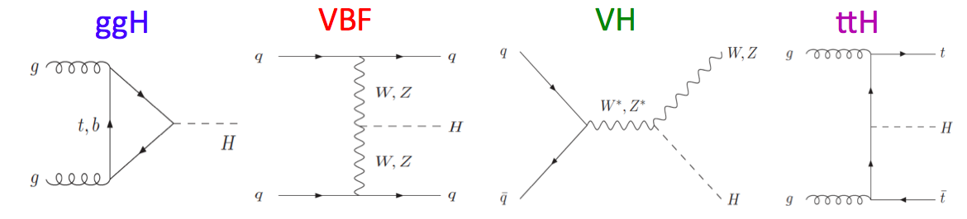
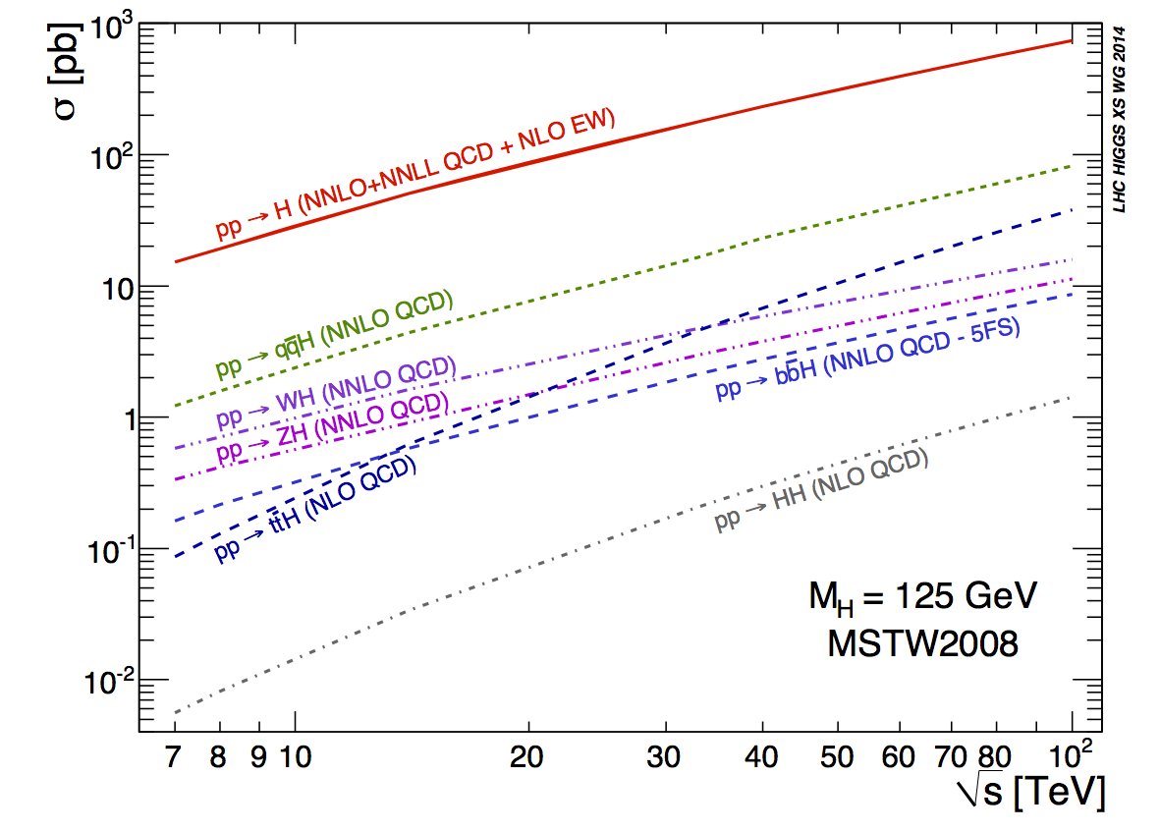
Higgs Production
ggH
VBF
VH
ttH
Observed at 5σ
✔
✔
Notes:
Wouters talk has a lot more info about the bottom less important productions. They are not searched for directly

Slide 5
Higgs Decays
H→ZZ
>6σ✔
H→ττ
5σ✔
H→bb
H→WW
5σ✔
2.6σ
H→γγ
>5σ✔
Lancaster University, HEFT 2017
m_{H}= 125.26 ± 0.20 (stat) ± 0.08 (syst) GeV
Notes:
Powerful test of nature of Higgs boson: SM, or subtly different?

Slide 6
Latest H→ZZ→4l and H→γγMeasurements
Lancaster University, HEFT 2017

Slide 7
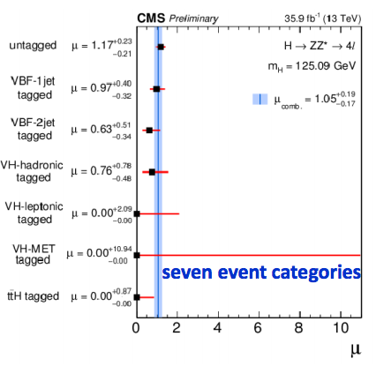
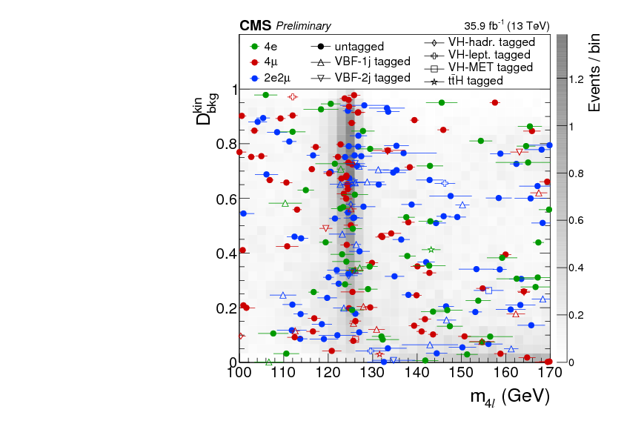

H→ZZ→4l
Higgs Signal Strength
CMS-PAS-HIG-16-041
April 2017; L= 35.9 fb⁻¹
Signal signature:
  4 isolated leptons
  Fully reconstructed mass peak
  Large S/B ratio
Events split into 7 categories according to Higgs production modes to increase sensitivity, based on number of leptons, number of bjets, missing energy, kinematic discriminants
Test against SM Higgs signal with m_{H}= 125.09GeV
Experimental and Theoretical uncertainties of similar magnitude
Lancaster University, HEFT 2017
Notes:
http://inspirehep.net/record/1518828/plots

Slide 8
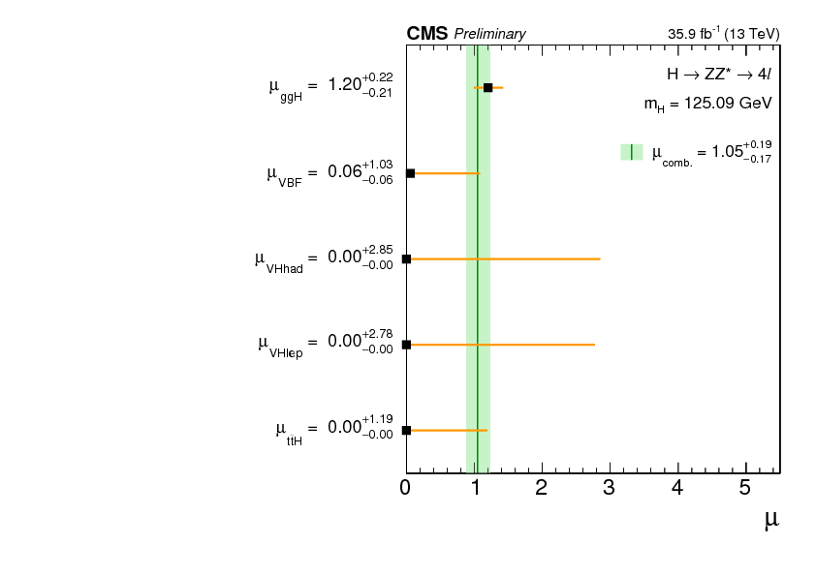
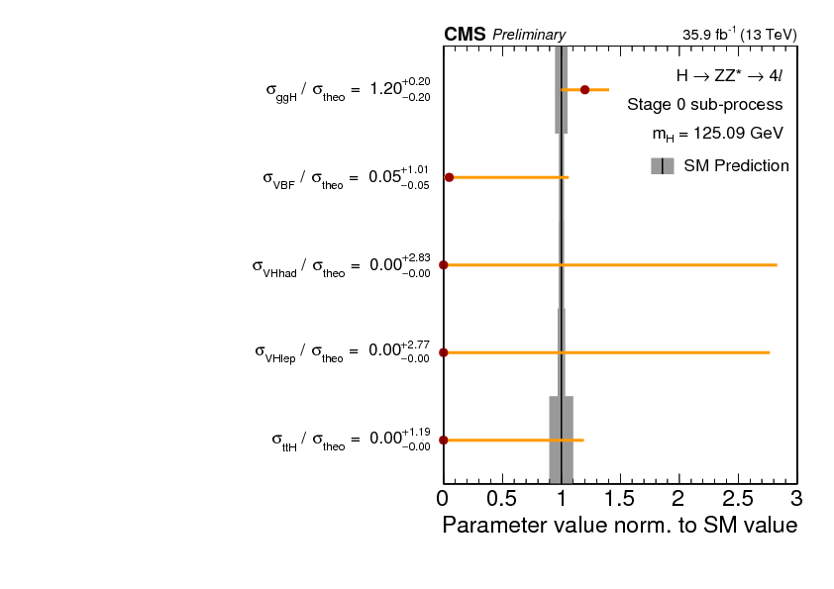
H→ZZ→4l
Higgs Signal Strength
CMS-PAS-HIG-16-041
Signal strength by production mode μ_{ggH}μ_{VBF}μ_{VH}μ_{ttH}
Simplified template cross sections
excess in the untagged category leads to higher signal strength for gg → H and lower strength of vbf/VH(had) modes

Slide 9
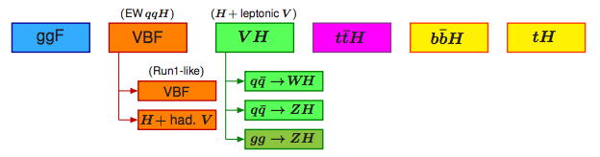
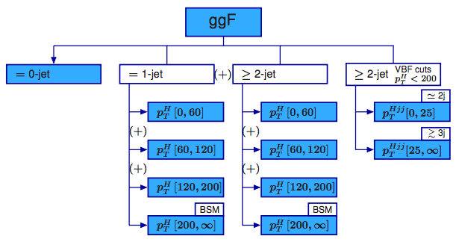
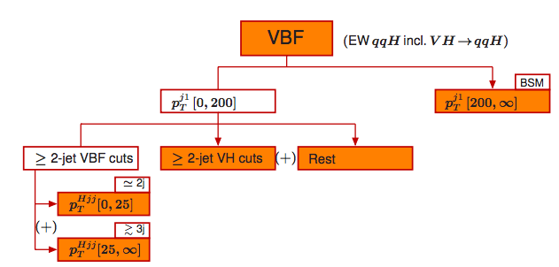
Simplified Template Cross Sections
Defined in the CERN Yellow Report 4
Define a common binning system for reporting results:
Stage 0:
Stage 1:

Slide 10
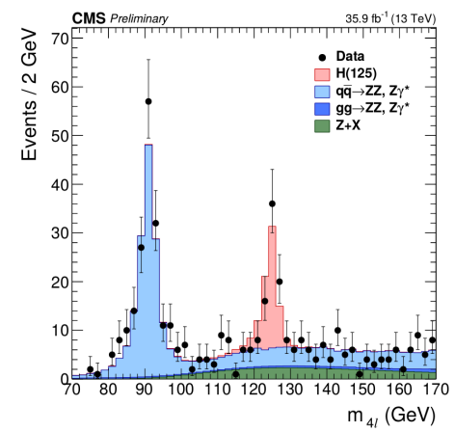
H→ZZ→4l
Higgs Mass Measurement
CMS-PAS-HIG-16-041
Run 1 ATLAS+CMS Combination: (Phys. Rev. Lett. 114, 191803)
𝑚_{𝐻} = 125.09 ± 0.21 (stat) ± 0.10 (syst) GeV
New 4-lepton invariant mass from H→ZZ→llll (CMS-PAS-HIG-16-041)
125.26 ± 0.20 (stat) ± 0.08 (syst) GeV
3D fit to L(m_{4l},D_{mass}, D_{bkg})
Kinematic fit using a constraint on the intermediate Z mass
For each event, the likelihood is maximized and the refitted transverse momenta are used to recalculate the four-lepton mass and mass uncertainty. These distributions are then used to build the likelihood used to extract the Higgs boson mass.
Notes:
Read the note to understand what they did
See Moriond summary: https://indico.in2p3.fr/event/13763/session/17/contribution/117/material/slides/1.pdf
https://indico.in2p3.fr/event/13763/session/2/contribution/67/material/slides/1.pdf
Systematic uncertainty dominated by uncertainty in the lepton
momentum scale

Slide 11
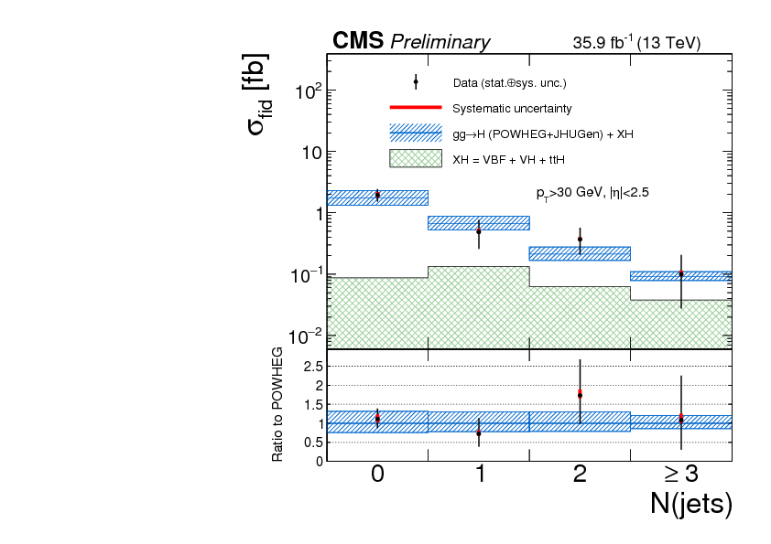
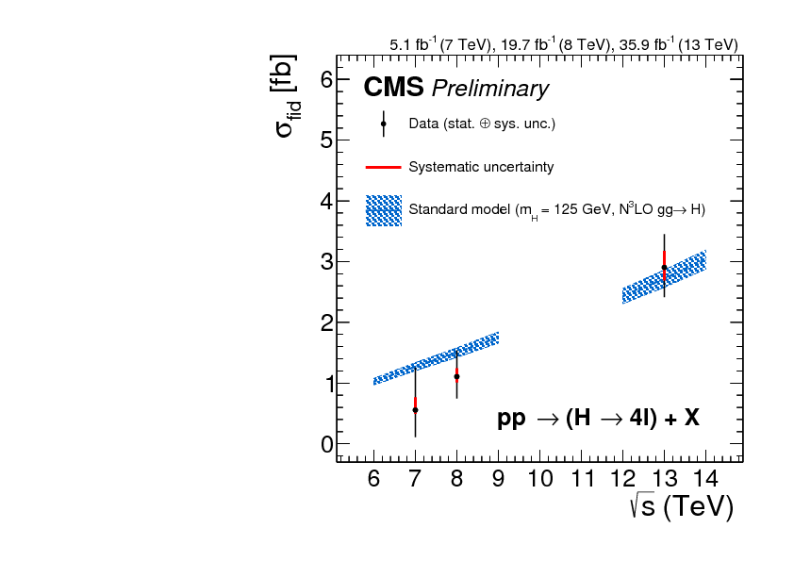
H→ZZ→4l
Higgs Cross Section
CMS-PAS-HIG-16-041
Measured: σ_{fid} = 2.90^{+0.48}_{−0.44}(stat.)^{+0.27} _{−0.22}(sys.) fb.
SM expectation: σ_{fid} = 2.72 ± 0.14 fb.
Cross sections measured in fiducial phase space to minimize model dependence.
Differential cross section for N(jets), Also measured for p_{T}(jet) and p_{T}(H)
Measured Fiducial σ_{fid} vs √s

Slide 12
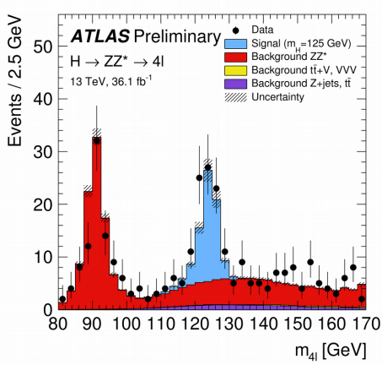
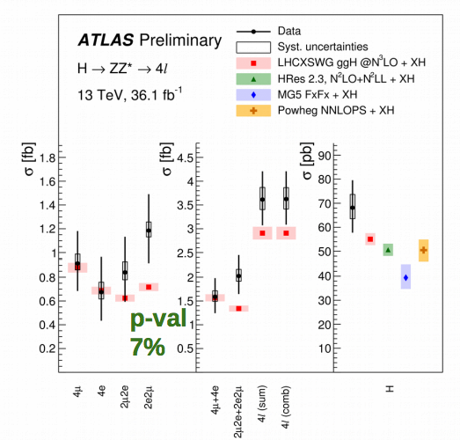
H→ZZ→4l
ATLAS-CONF-2017-032
New at LHCP: 36.1 fb⁻¹
Measurement of the Higgs fiducial cross sections
Correct for detector efficiency and resolution
Signal extraction: fit the 4l invariant mass
56 Expected Higgs events
Notes:
4x more higgs events compared to 8TeV analysis
Significantly larger gains are expected in the regions of the differential dis-
48 tributions that probe higher momentum and energy scales due to increased parton-parton luminosities.
The total cross section is also compared to the cross sections predicted by NNLOPS,
399 HRes, and MG5_aMC@NLO_FxFx (see Section 3). It can be seen that the MG5_aMC@NLO_FxFx
400 cross section is lower than the other predictions, as its accuracy in the 0-jet bin is only NLO in QCD. All
401 generators predict cross sections that are lower than the N3LO calculation

Slide 13
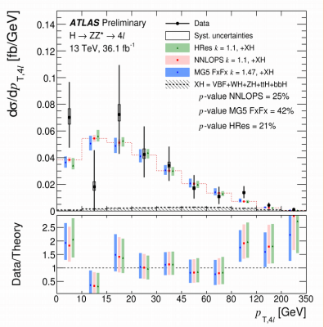
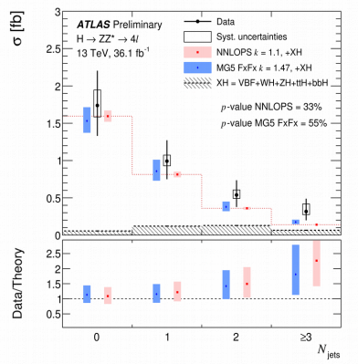
H→ZZ→4l
ATLAS-CONF-2017-032
New at LHCP: 36.1 fb⁻¹
Differential cross section distributions in jet and pT bins

Slide 14
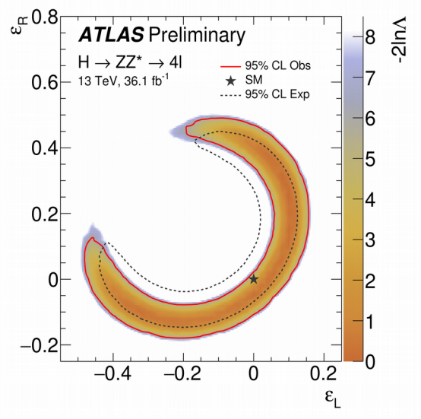
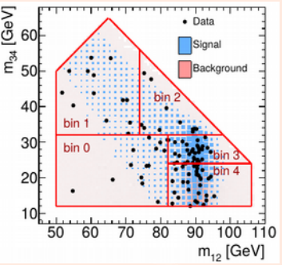
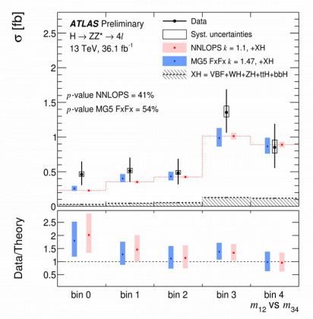
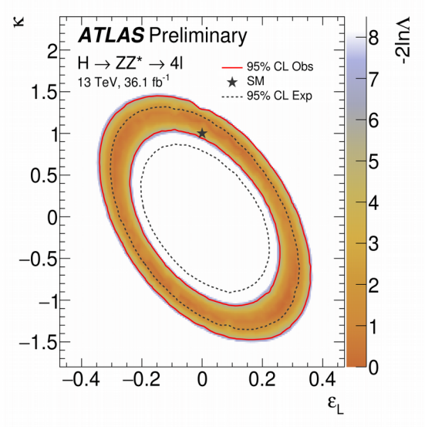
H→ZZ→4l
ATLAS-CONF-2017-032
New at LHCP: 36.1 fb⁻¹
Eleni Mountricha @ LHCP
Use differential fiducial cross sections to look for BSM modified H interactions using pseudo-observables (PO). PO = form factors parametrizing amplitudes of physical processes. Calculate the contribution to the double differential decay rate: m12 vs m34
Double differential m12 vs m34 decay rate
Limits on modified contact terms between H and L/R-handed leptons. (Lepton universality imposed)
Limits on ε_{L} and modified coupling to Z-boson
^{PseudoObservables:} ^{Eur. Phys. J. C (2015) 75:128}
& YR4
Notes:
https://indico.cern.ch/event/517784/contributions/2558843/attachments/1459283/2253857/lhcp_17_05_15.pdf
https://atlas.web.cern.ch/Atlas/GROUPS/PHYSICS/CONFNOTES/ATLAS-CONF-2017-032/

Slide 15
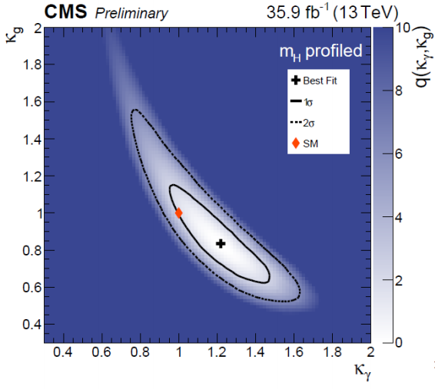
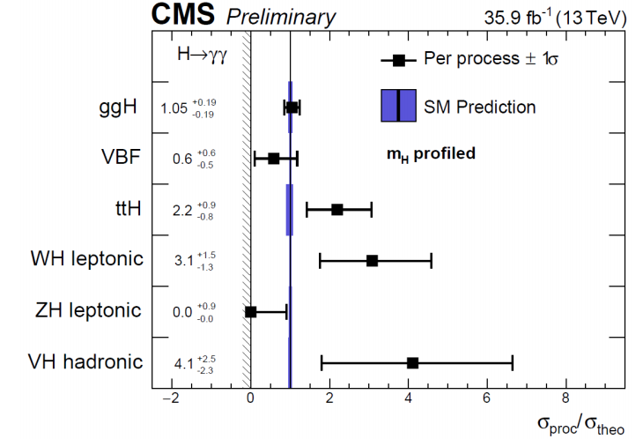
H→γγCoupling
CMS-PAS-HIG-16-40
May 2017 35.9 fb-1
Events separated into 14 categories depending on H production, kinematics
Cross section ratios measured for each process in the STXS framework
Coupling modifiers for vector bosons, fermions, photons, gluons
Most likely values of coupling modifiers κ_{g} and κ_{γ}
*

Slide 16
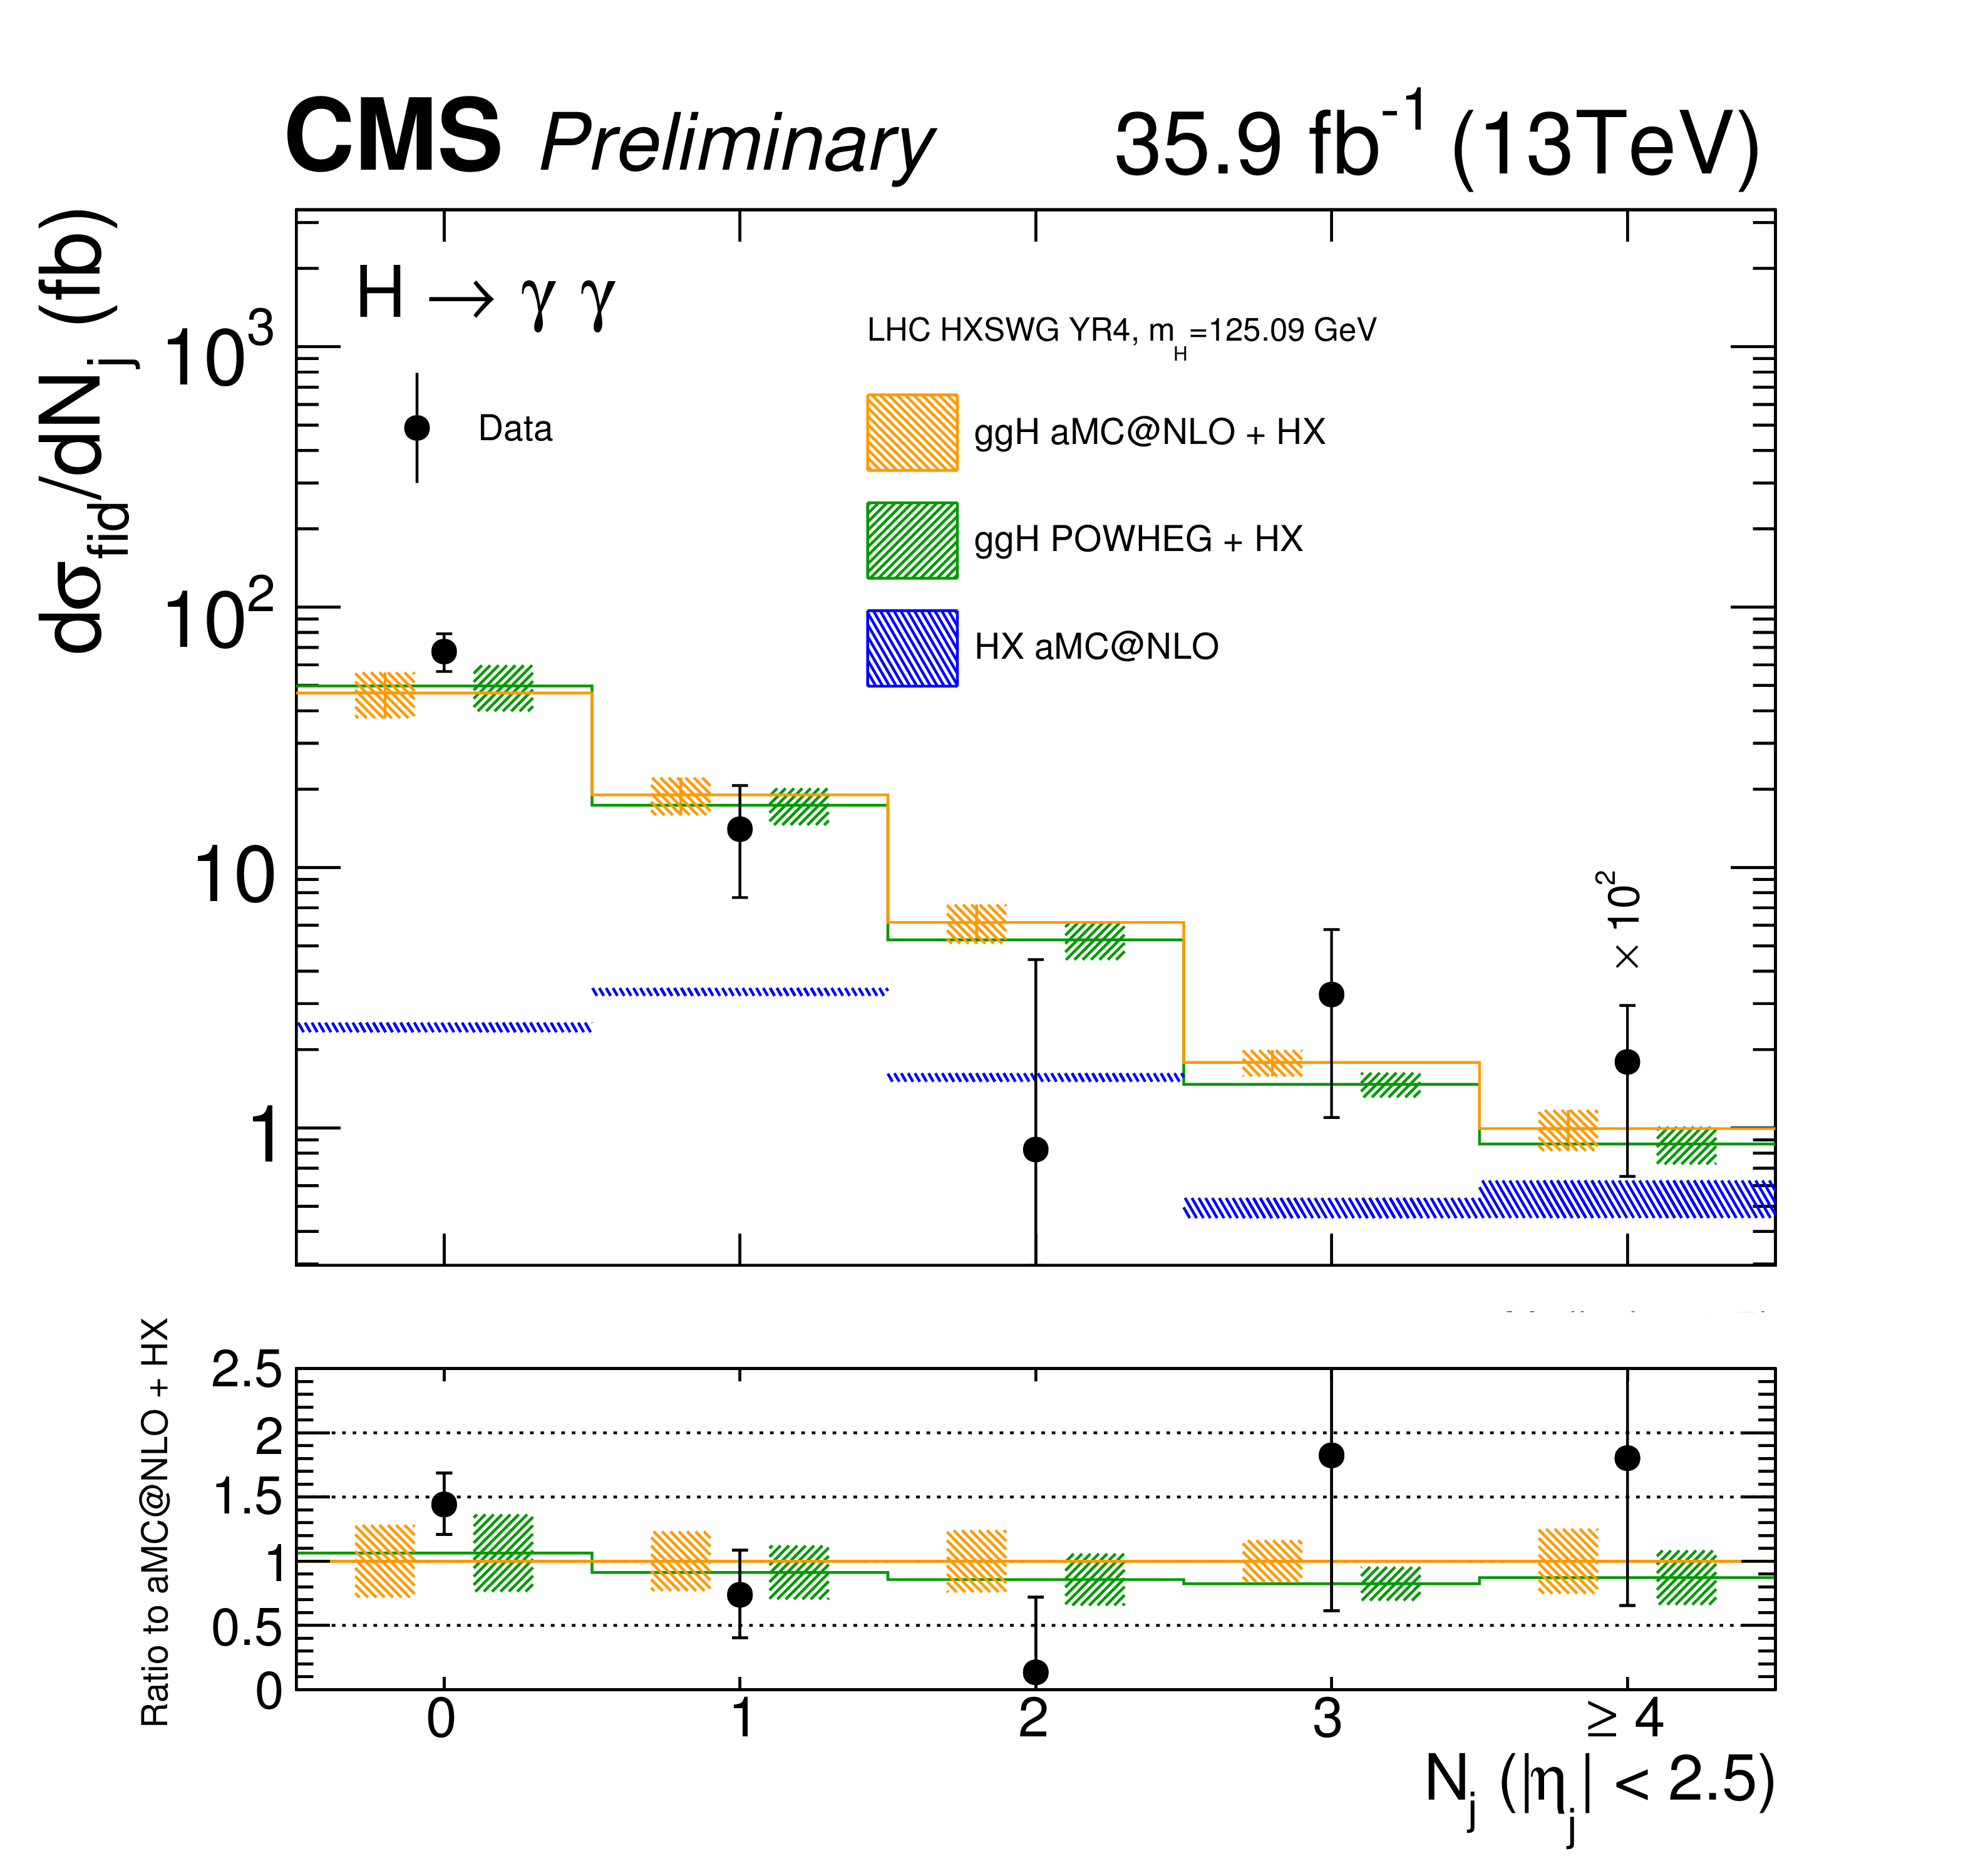
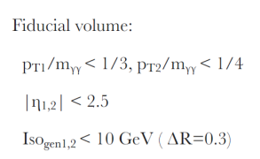
Higgs Cross Section Measurement: H→γγ
CMS-PAS-HIG-17-015
CMS March 2017; 34.5 fb⁻¹
3 untagged event categories based on expect mass resolution
Fiducial cross sections consistent with SM predictions. σ_{fiducial}= 84 ± 11 (stat) ± 7 (syst) fb
Lancaster University, HEFT 2017
Differential cross sections for N(jets), pT(H)
Notes:
://cms-results.web.cern.ch/cms-results/public-results/preliminary-results/HIG-17-015/index.html
Total (ATLAS) and fiducial (CMS) cross sections are consistent with N3LO QCD calculation with NLO electroweak corrections.
Fiducial cross section:
σ_{fiducial}= 84 ± 11 (stat) ± 7 (syst) fb

Slide 17
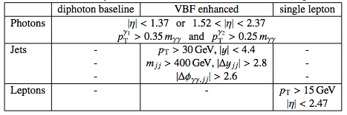
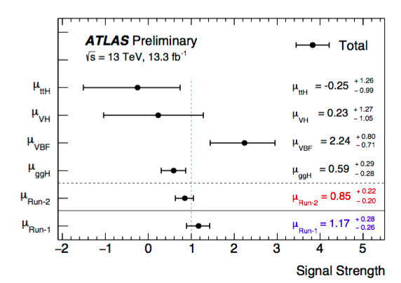
Higgs Cross Section Measurement: H→γγ
Aug 2016: ATLAS-CONF-2016-067
Couplings measurement
Simplified template cross sections
Fiducial & total-production x-sections
  Use 3 fiducial phase space regions.
Notes:
https://atlas.web.cern.ch/Atlas/GROUPS/PHYSICS/CONFNOTES/ATLAS-CONF-2016-067/
LHCP talk:
https://indico.cern.ch/event/517784/contributions/2558844/attachments/1459271/2253512/CMS_Higgs_HighResolution_JTaoIHEP.pdf
slide 15 : the CONF note presented in this slide also has coupling results in addition to the fid/diff results shown here (e.g. Fig. 14 in the note, more complete that the CMS one on slide 14!) which would be good to mention. Might also be good to give the ATLAS CONF note reference and not just the CDS link.

Slide 18
H→γγ+ H→ZZ Combo
ATLAS-CONF-2016-081
      Aug 2016
Run 2 Combo:
Stage-0 simplified template cross sections
Fiducial Cross Section
Products of Higgs boson production cross sections of process i and branching ratios to the final state f :
σ_{i} · B^{f}
reported for |y(H) | < 2.5
Notes:
Approval: https://indico.cern.ch/event/559982/contributions/2260743/attachments/1319353/1978050/Higgs_Combination_Approval_2.pdf
https://indico.cern.ch/event/632454/contributions/2557683/attachments/1455239/2245749/STXS-20170508.pdf
https://cds.cern.ch/record/2206272/files/ATLAS-CONF-2016-081.pdf
“aiming for stage 1 in next round”
slide 16 : maybe highlight here the switch from μ to STXS, which is one of the novelties of Run 2 and removes the dependence on the SM prediction (you could also point out somewhere that the Run 1 and Run 2 μs are not directly comparable since the ggF cross-section in the denominator changed from NNLO to N3LO...)

Slide 19
Results from H→ττ, H→μμ, H→WW, ttH, HH
Lancaster University, HEFT 2017

Slide 20
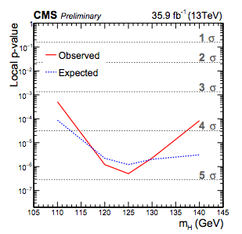
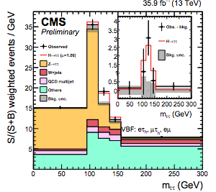
H→ττ
CMS-PAS-HIG-16-043
May 2017 35.9 fb-1
Signal significance of 4.9 σ(4.7 expected)
Signal strength: μ= 1.06 ±0.25

Slide 21
H→μμ
ATLAS-CONF-2017-014
May 2017 36.1 fb-1
Clean analysis with well measured backgrounds
No significant excess observed. Higgs couplings to fermions are not universal
Observed (expected) upper limit on XS*BR is 3.0 (3.1) times the SM.
When combined with √s=7 TeV and √s=8 TeV, the observed (expected) upper limit is 2.8 (2.9) times the SM
Lancaster University, HEFT 2017
Notes:
https://atlas.web.cern.ch/Atlas/GROUPS/PHYSICS/PAPERS/HIGG-2016-10/

Slide 22
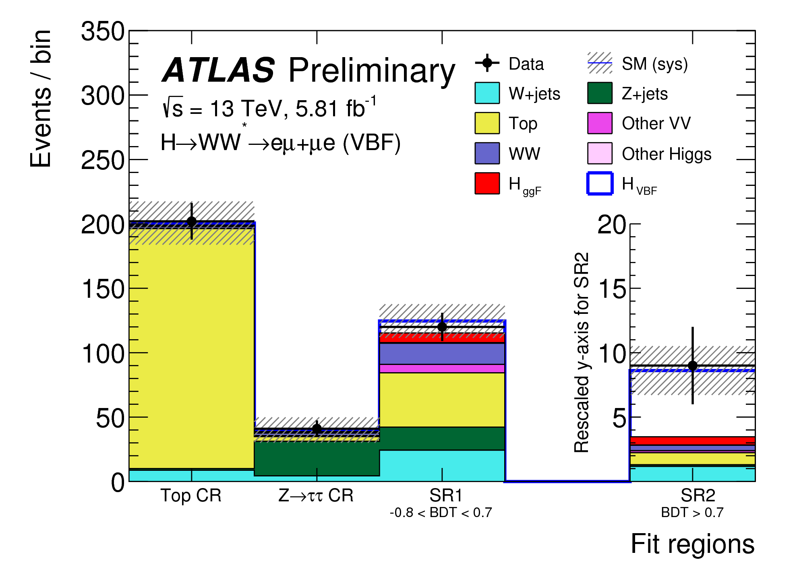
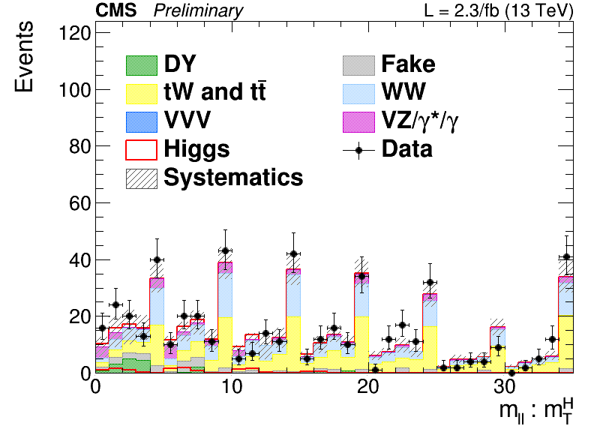


H→WW
ATLAS-CONF-2016-112
Nov 2016. 5.8 fb-1 @13TeV
CMS-PAS-HIG-15-003
June 2016. 2.3 fb-1 @13TeV
Exp (obs) significance for VBF at 13TeV: 1.9σ (1.2σ)
Exp (obs) significance for VH at 13TeV: 0.77σ (0.24σ)
Exp (obs) significance at 13TeV: 0.7σ (2.0σ)
Lancaster University, HEFT 2017
Notes:
ALTAS https://atlas.web.cern.ch/Atlas/GROUPS/PHYSICS/CONFNOTES/ATLAS-CONF-2016-112/
ATLAS https://cds.cern.ch/record/2231811
CMS https://cds.cern.ch/record/2161793 Just reestablishing HWW at 13TeV

Slide 23
ttH(ZZ,WW, ττ)
March 2017
CMS-PAS-HIG-17-004
Leptonic decay channels
(2, 3, 4+ leptons
and a bjet)
The observed (expected) best fit ttH yield is 1.5±0.5 (1.0^{+0.5}_{−0.4}) times the SM prediction, corresponding to a significance of 3.3σ (2.5σ).
Lancaster University, HEFT 2017
Notes:
http://cms-results.web.cern.ch/cms-results/public-results/preliminary-results/HIG-17-004/index.html

Slide 24
ttH(ϒϒ,multilepton,bb)
ATLAS-CONF-2016-068
Aug 2016 13.3 fb-1
Combination of 3 decay channel analyses
The ratio of the prod xs to the SM ttH prediction is 1.8±0.7, corresponding to a significance of 2.8σ (1.8σ expected).
Lancaster University, HEFT 2017
Notes:
https://atlas.web.cern.ch/Atlas/GROUPS/PHYSICS/CONFNOTES/ATLAS-CONF-2016-068/

Slide 25
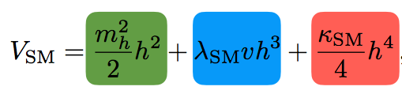
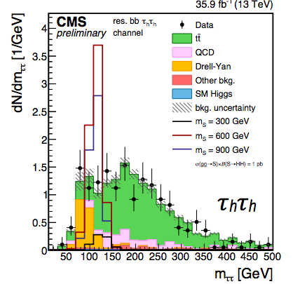
Di-Higgs Production
Searches from ATLAS & CMS in final states bbbb, bbττ, bbWW, bbγγ, γγWW
Effective Lagrangian used to model BSM effects: anomalous λ_{HHH} and y_{t} couplings and 3/4 new contact interactions
Projections to High-Luminosity LHC: Expected l
CMS-PAS-HIG-17-002
ATLAS-CONF-2016-049
no syst (with syst)
ATL-PHYS-PUB-2016-024
HH -> bbbb
Limit set at 29* SMσ_{HH}
(σ_{HH} ×BR < 330fb)
Best HH limit so far
Lancaster University, HEFT 2017
Limit set at 28* SMσ_{HH}
Notes:
Search for modification of σ_{HH}
talk at Moriond that sets range bounds on lamba/lamba SM https://indico.in2p3.fr/event/13763/session/0/contribution/37/material/slides/0.pdf
CMS bbbb CMS-PAS-HIG-16-026
bbWW CMS-PAS-HIG-17-006
CMS bbtautau CMS-PAS-HIG-17-002

Slide 26





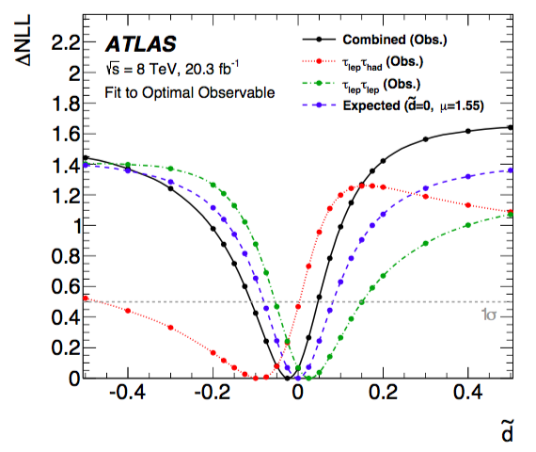
Higgs CP constraints from VBF H→ττ
Most sensitivity for H→ττcomes from the VBF channel; large sensitivity to VBF prod. from H→ττchannel
Constrain CP-odd Bosonic operators in EFT
Parametrize CP violation in VBF:
HZZ and HWW terms controlled by d~.
d~ = 0 means no CP-odd term.
At 68% conf level find that d~ is within [-.11,0.05]
EPJC 76 (2016) 658
Notes:
The blue is the SM. in the SM d~ vanishes.
cite sinead and chris hays
at 68% conf level find that d~ is within [-.11,0.05]
EPJC 76 (2016) 658

Slide 27
Additional measurements
Spin and parity are consistent with the SM Higgs:
  H→ZZ: CMS-PAS-HIG-17-011
  H→ZZ: ATLAS-CONF-2016-079
  ATLAS Collaboration, Evidence for the spin-0 nature of the Higgs boson using ATLAS data, Phys. Lett. B 726 (2013) 120, arXiv: 1307.1432 [hep-ex].
Higgs width measurements:
  Many assumptions necessary. See talk at Higgs Coupling 2016
BSM A/H→tautau
  ATLAS-CONF-2016-085; CMS-PAS-HIG-16-006
Notes:
Conf https://indico.cern.ch/event/477407/contributions/2197205/attachments/1369152/2075606/HiggsCouplings2016_MassWidthCombinations.pdf

Slide 28
ATLAS+CMS Run 1 Higgs Combination
Lancaster University, HEFT 2017

Slide 29
The Run 1 ATLAS+CMS Higgs Combination
LHCP, St Petersburg,1 Sept 2015,
Revised and sent to JHEP Sep 2016 https://arxiv.org/abs/1606.02266
Thesis:
The production cross sections and decay branching ratios (BR) of the Higgs boson can be precisely calculated once the mass is known.
  Also Assume there is only one Higgs boson with Spin Parity 0⁺ and with a narrow width such that production and decay are decoupled
Combing ATLAS and CMS adds a factor of almost √2 = 1.4 in precision (when signal theory systematics do not dominate)
The ATLAS+CMS coupling combination results include:
  1) Fits of signal strengths (global, by production, by decay) relative to the SM
  2) Fits in the κ-framework, measuring coupling modifiers
  3) Generic parameterizations based on ratios of XS and BR and on coupling modifier ratios
Run 1: M_{H} = 125.09 ± 0.24 GeV= ± 0.21 (stat.) ± 0.11(syst.)
Lancaster University, HEFT 2017
Notes:
At the LHC there is direct sensitivity to the couplings of the Higgs boson to W, Z bosons and to τ, b and t fermions, And indirectly to gluons and γ
maybe give some motivation for searching for BSM in the couplings?
Signal strengths (σ, BR) results relative to the SM
Coupling modifiers
Generic fits based on Xs and BR and on coupling modifier ratios
WE WANT TO ASSESS THE COMPATIBILITY WITH THE SM PREDICTIONS

Slide 30
Coupling Combination:
Signal Strengths
i →H →f
Most precisely measured H coupling and also most constrained parameterization: Assume all production and decay scale together: the SM predictions of signal yields in all categories are scaled by a global signal strength μ.
A fit to the combined ATLAS and CMS data at √s = 7 and 8 TeV with μ as the parameter of interest results in the best-fit
μ= 1.09 ^{+0.11} _{-0.10} = 1.09 ^{+0.07} _{-0.07} (stat) ^{+0.04} _{-0.04} (expt) ^{+0.03} _{-0.03} (thbgd)^{+0.07} _{-0.06} (thsig)
total systematic uncertainty:^{+0.09} _{-0.08}
Lancaster University, HEFT 2017
Notes:
Since σ_{i} and BR^{f} cannot be separately measured without additional assumptions, only the product of μ_{i} and μ^{f} can be extracted
experimentally, leading to a signal strength μ_{i}^{f} for the combined production and decay:
“Characterize the Higgs Yields”
This global signal strength is the most precisely measured H coupling related observable but this simple parameterisation is very model dependent since all H production and decay are combined with the assumption that their ratios are the same as in ths SM

Slide 31
Coupling Combination:
Signal Strengths
Production signal strengths
Assume SM BRs
Decay signal strengths
Assume SM Cross Sections
SM p-value 25%
SM p-value 60%
Notes:
look at the pieces that make up the total
total ttH is 2.3σ effect

Slide 32
Coupling Combination:
Signal Strengths
Comparing likelihood of the best-fit with no signal: μ_{prod}=0 and μ^{decay}=0 :
> 5 σ
> 5 σ
First established VBF and H→ττat 5 σ
ggF, H→γγ, H→ZZ, H→WW already at 5 σ before the combination
Lancaster University, HEFT 2017

Slide 33
Coupling Combination:
Signal Strengths
Fit the bosonic and fermionic productions separately per decay
μ_{VBF+VH}/μ_{ggF+ttH}= 1.06 ^{+ 0.35} _{– 0.27}
No assumption on the BRs is needed in the combination of the μ_{VBF+VH}/μ_{ggF+ttH} ratio (benefit of the ratio)
Lancaster University, HEFT 2017
Notes:
Why isnt the combined fit shown?

Slide 34
Coupling Combination:
The κ Framework– Coupling modifiers
i →H →f
Scale Higgs boson couplings by modifiers, κ, factorizing production and decay
Individual coupling modifiers, correspond to tree-level H couplings to the different particles: κ_{W}, κ_{Z}, κ_{t}, κ_{b}, κ_{τ}, κ_{μ}
BR_{BSM} includes invisible + undetected H decays
or
Lancaster University, HEFT 2017
Notes:
here, by construction, the SM cross sections and branching ratios themselves include the best available higher-order QCD and EW corrections, as shown in Tables 1 and 2. This higher-order accuracy is not necessarily preserved for κj values different from unity, but the dominant higher-order QCD corrections factorise to a large extent from any rescaling of the coupling strengths and are therefore assumed to remain valid over the whole range of κ j values considered in this paper.
κ_{c}, κ_{s}

Slide 35
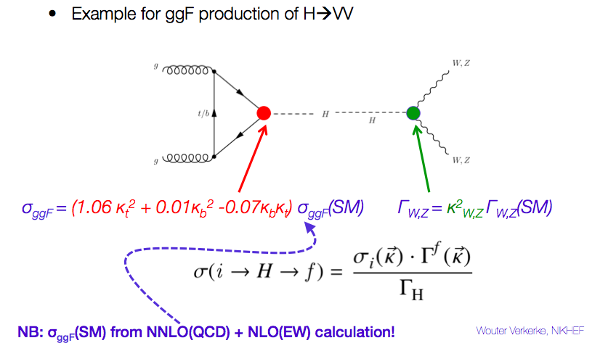
Coupling Combination:
Disentangle Branching Ratios and Cross Sections
Example
Notes:
by construction, the SM cross sections and branching ratios themselves include the best available higher-order QCD and EW corrections, as shown in Tables 1 and 2. This higher-order accuracy is not necessarily preserved for κj values different from unity, but the dominant higher-order QCD corrections factorise to a large extent from any rescaling of the coupling strengths and are therefore assumed to remain valid over the whole range of κ j values considered in this paper.

Slide 36
κ-Parameterization
Lancaster University, HEFT 2017
Notes:
For example, the first line corresponds to the diagrams on the previous page. [I THINK]You can express the coupling as either Kgluon or as the sum or the top and bottom particles

Slide 37
κ-Parameterization
Constraints on H couplings
Split coupling modifier by fermion flavor and by W/z
Assume only SM physics in loops, no invisible or unseen BSM Higgs decays
Fit for scaling parameters for Higgs couplings to W, Z, b, t, τ, μ
Low measured value of κ_{b} reduces total H width: all κ_{j} measured low
Within current precision Higgs couplings scale with particle masses
Notes:
kappa mu is compatible with 0. Most are below 1. this is because Hbb is bring down the total width.

Slide 38
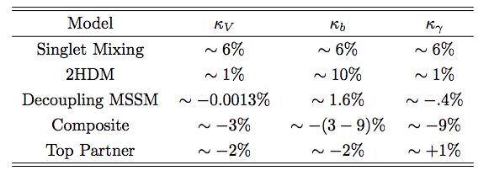
What precision is necessary?
Snowmass report (2013) gives precision necessary for observing NP at 1TeV mass scale
^{arXiv:1310.8361}
Lancaster University, HEFT 2017

Slide 39
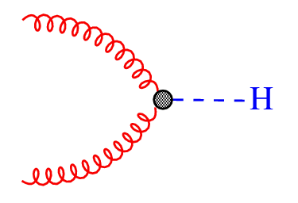
κ-Parameterization
Allowing for BSM contributions
Results shown so far have assumed no invisible BSM Higgs decays or BSM contributions to loops. Now drop these assumptions.
1) Represent loop processes (ggF, H→ϒϒ) with effective parameters (κ_{g},κ_{ϒ})
2) Allow for invisible/undetected BSM Higgs decays to increase the Total H width
g
g
1.06κ_{t}² +0.01κ_{b}² -0.07κ_{t}κ_{b}
κ_{g}²
Lancaster University, HEFT 2017
Notes:
3 rd option: ATLAS also used the off-shell analysis to constrain the total width in the combination and give limits on BSM decay. Depending on your time budget, you could add this as 3rd option.
If BR_BSM is >0 it would lower observed cross sections by a common factor
3) Constrain Γ_{H} with off-shell +on-shell coupling strengths. (Not used in combination.) arXiv:1507.04548.

Slide 40
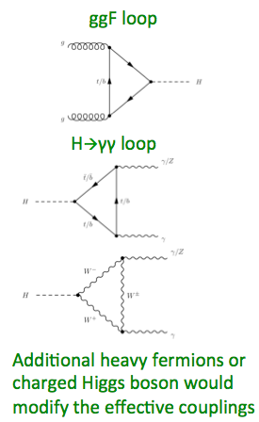

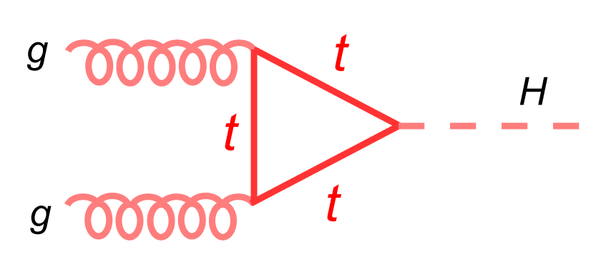
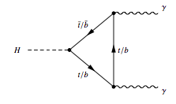
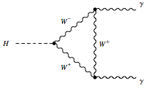
κ-Parameterization
Allowing for BSM contributions
1.
Probe potential BSM contributions to loops. Fix all tree-level Higgs couplings to SM (κ_{W},κ_{Z},κ_{b},κ_{t},κ_{μ},κ_{τ}=1) and BR_{inv}=0 , and only allow modifications to the two main loops of ggF and Hγγ

Slide 41

κ-Parameterization
Allowing for BSM contributions
2.
Constraints on Higgs couplings allowing BSM physics in loops & decays
Keep all 6+2 coupling parameters floating, but assume either BR_{BSM} = 0 orκ_{W},κ_{Z}≤1
p-value for data-SM prediction 11%
Notes:
κW ≤ 1 and κZ ≤ 1 means BSM>0. The W,Z couplings less than 1 are motivated by BSM models

Slide 42
κ-Parameterization
Allowing for BSM contributions
2.
Constraints on Higgs couplings allowing BSM physics in loops & decays
Keep all 6+2 coupling parameters floating, but assume either BR_{BSM} = 0 orκ_{W},κ_{Z}≤1
Notes:
κW ≤ 1 and κZ ≤ 1 means BSM>0. The W,Z couplings less than 1 are motivated by BSM models

Slide 43

Parameterization using ratios of cross sections and branching ratios
Take gg→H→ZZ as a reference because of its small systematic uncertainties
Then use ratios of σand BR:
The combined fit results can be presented as a function of nine parameters of interest: one reference cross section times branching ratio, σ(gg → H → ZZ), four ratios of production cross sections, σ_{i}/σ_{ggF} and four ratios of branching ratios, BR^{f} /BR^{ZZ.}
The ratios are independent of the theoretical predictions on the Inclusive cross sections and BR’s
Lancaster University, HEFT 2017
Notes:
Parameterization of ratio of observables with minimal dependence on theory predictions
• Results remain valid when theory predictions are updated

Slide 44
Parameterization using ratios of cross sections and branching ratios
Results generally agree with SM
The p-value of the compatibility between the data and the SM predictions is 16%
Largest difference is seen in BR_{bb}/BR_{ZZ}, at the level of 2.4 σ
  Effect mainly coming from large ZH and ttH (both ratios σ_{i}/σ_{ggF} ~ 3) because Hbb does not contribute to the observed excesses.
theory uncert
very small
Notes:
• Results are in general agreement with the SM
• Largest difference is seen in BRbb/ BRZZ, at the level of 2.4 σ
where the fit result for each parameter is normalised to the corresponding SM prediction. Also shown in Fig. 7 are the theory uncertainties on
the SM predictions for the fitted parameters (they are very small, and therefore barely visible, for the ratios of branching ratios). In the various fits, the combination of 7 and 8 TeV data is carried out under the assumption that the ratios of the production cross sections with respect to the SM predictions are the same at 7 and 8 TeV. The total relateive uncert on xS ggHZZ is approx 19% with its main contribution coming from the statistical uncertainty. The total relative systematic uncertainty is only ∼ 4%. Table 18 and Fig. 26 in Appendix A show the results obtained when choosing the H → WW channel as an alternative reference process. This yields a somewhat smaller total uncertainty of approximately 15% on σ(gg → H → WW), but with a much larger contribution of ∼ 11% from the systematic uncertainties. The ratio of cross sections σVBF/σggF and the ratios of BRs, BRWW/BRZZ and BRγγ /BRZ Z , are measured with a relative uncertainty of approximately 30%, while the BRττ /BRZ Z ratio of BRs is measured with a relative accuracy of approximately 40%.

Slide 45
Overview & Conclusions
The Run 1 ATLAS+CMS Combination represents a baseline measurement for Higgs properties. Presented in terms of μ’s,κ’s and cross section ratios.
More and more precise Higgs measurements are being made in Run 2. The form of those results is evolving, to more EFT friendly Simplified Template Cross Sections, Pseudo observables
No significant deviations from the SM Higgs seen yet!
Lancaster University, HEFT 2017

Slide 46
Backup
Notes:
Run 1 and Run 2 μs are not directly comparable since the ggF cross-section in the denominator changed from NNLO to N3LO

Slide 47

Extracting parameters of interest
Measure parameters of interest,
signal strengths (μ),
coupling modifiers (κ),
production cross sections,
branching ratios,
or ratios of these quantities,
with Profile likelihood ratio. A maximum-likelihood fit is performed on all categories simultaneously to extract the parameters of interest
set of nuisance parameter
values that maximize the
likelihood for a given
best fit values for nuisance parameters and parameters of interest
Lancaster University, HEFT 2017
Notes:
Construct a profile likelihood. A maximum-likelihood fit is performed on all categories simultaneously to extract the parameters of interest ( signal strength, μ). The test statistic is the 1 Log of the formula shown (captial lamba)
For each likelihood evaluation, all systematic uncertainties (nuisances) are varied to maximize the profile likelihood (profiled)

Slide 48
Monte Carlo
ATLAS H->ZZ
  ggF: N3LO in QCD. NLO EW corrections
    Alternative: MG5_MC@NLO: NLO accuracy in QCD for 0, 1, 2 extra jets, merged with the FxFx scheme using the NNPDF30_nlo_as_0118 PDF set
  VBF: NLO QCD and EW corrections + approx NNLO QCD corrections
  VH: NNLO in QCD, NLO EW
  ttH: NLO in QCD
CMS H->ZZ
  Signal samples: ggF, VBF, VH, ttH: generated at NLO in perturbative QCD (pQCD) with POWHEG 2.0.
  For WH and ZH the MINLO HVJ [23] extension of POWHEG 2.0 is used.
  The default parton distribution function (PDF) used in all simulations is NNPDF30_nlo_as_0118. The decay of the Higgs boson to four leptons is modeled with JHUGEN.
Notes:
FxFx is fixed order merged and matched
CMS: https://cds.cern.ch/record/2256357/files/HIG-16-041-pas.pdf

Slide 49
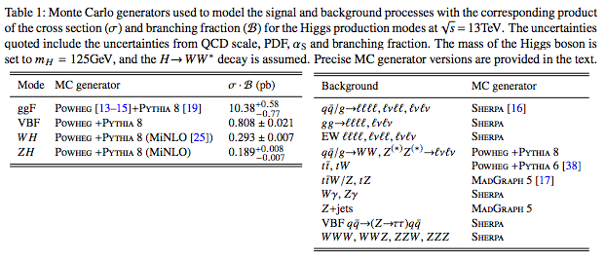
Monte Carlo
ATLAS H->WW. ATLAS-CONF-2016-112
Notes:
FxFx is fixed order merged and matched

Slide 50
κ-Parameterization
Constraints for H couplings to fermions, bosons
Expanding parameter ranges to include negative couplings
Positive WW contour reduced due to preferred negative solution
Negative κ_{F} disfavored in combination
Sensitivity to the (relative) sign of k_V and k_F only comes from the interference of 2 prod or decay modes
The negative ϒϒ contour is completely incompatible with the negative WW contour, for example.
Notes:
sensitivity to the (relative) sign of k_V and k_F only comes from the interference of 2 prod or decay modes?
Negative couplings would change sign of interferences.
Almost 5 sigma exclusion of KF<0
The other two quadrants are symmetric with respect to (00) all physics quantites only depend on a product of two K’s

Slide 51
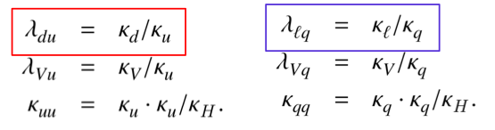
κ-Parameterization
Up/down fermion and lepton/quark symmetries
Several BSM physics models (notably 2HDM), predict asymmetries in couplings between up-type and down-type fermion couplings, and between lepton and quark couplings
p-value 67%
Probing Up-type: ggF, γγ,ttH
Probing Down-type: bb, tautau
Probing Quark coupling: ggF, γγ, bb, ttH
Probing lepton coupling: tautau

Slide 53
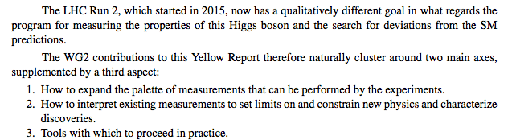
Yellow Report 4
arXiv:1610.07922v2 [hep-ph] 15 May 2017
x

Slide 54
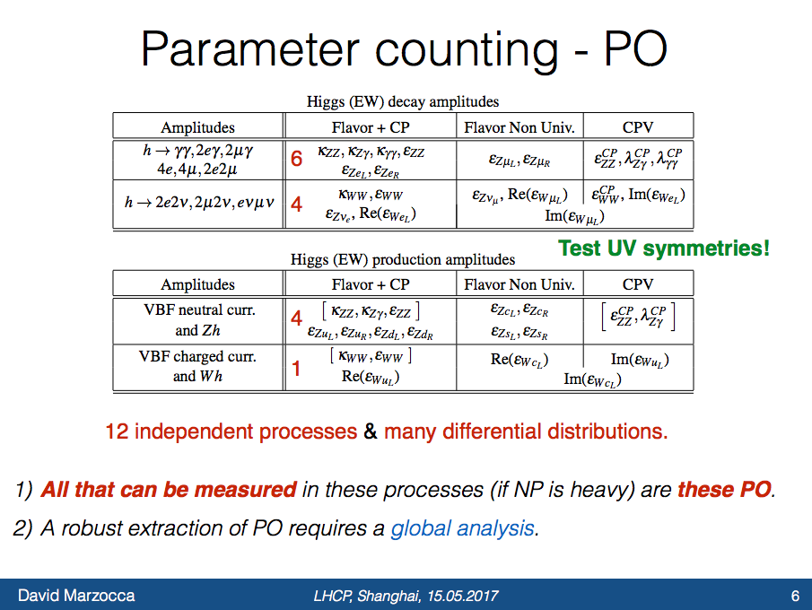
x

Slide 55
