Slide 1
Neutron and electron electric dipole moments
Ben Sauer
PPRP July 21, 2017

Slide 2
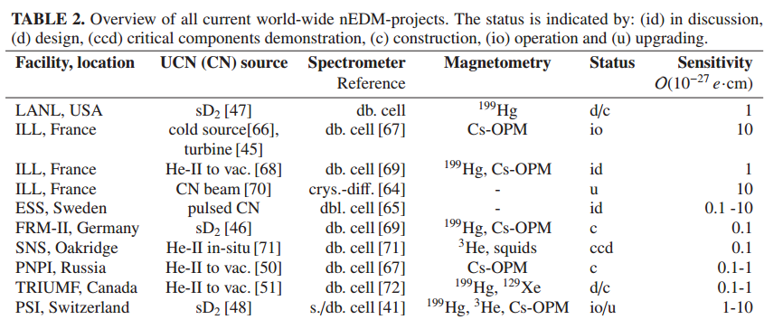
World neutron EDM experiments
P. Schmidt-Wellenburg
The quest for an electric dipole moment of the neutron
http://dx.doi.org/10.1063/1.4955363 (2016)

Slide 3
Status of neutron EDM
Latest limit is 3×10⁻²⁶ e.cm (90% c.l.) from reanalysis of 2006 ILL data.
Involved new understanding of systematic effects.
UK (Sussex) group led reanalysis of ILL results, now key part of PSI experiment

Slide 4
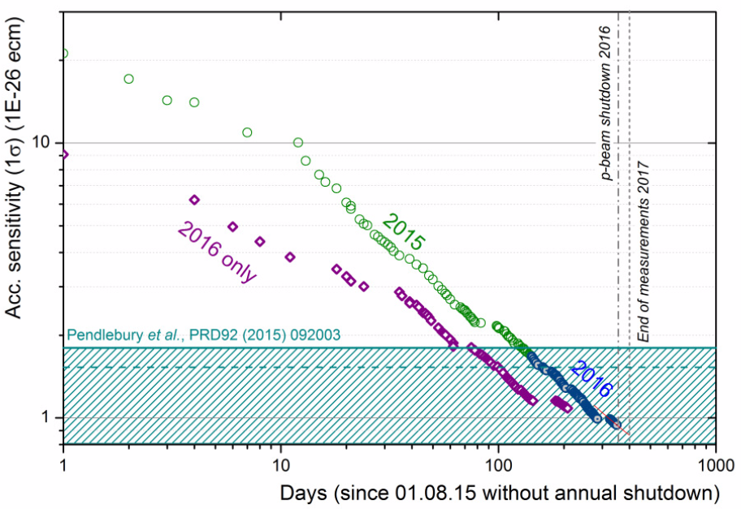
nEDM at PSI
PSI currently has best sensitivity in the world
One month left of data collection before upgrade
Expect limit of about 2×10⁻²⁶ e.cm based on current data

Slide 5
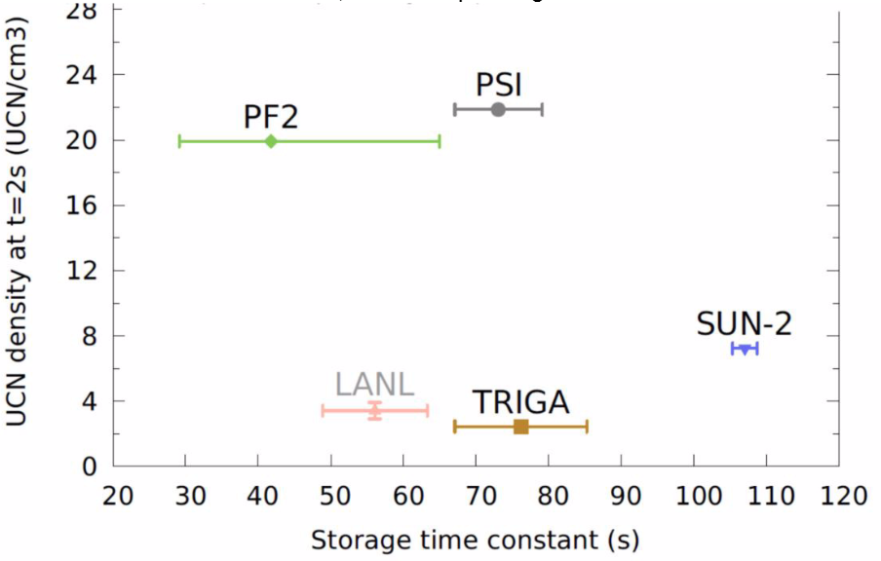
PSI is world’s best UCN source

Slide 6
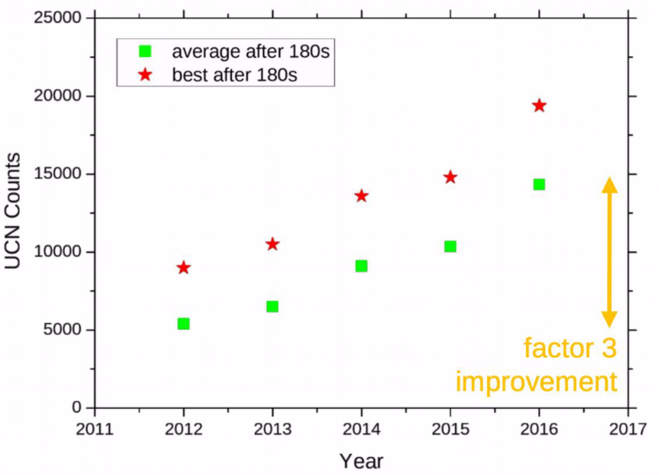
PSI UCN source is still improving

Slide 7
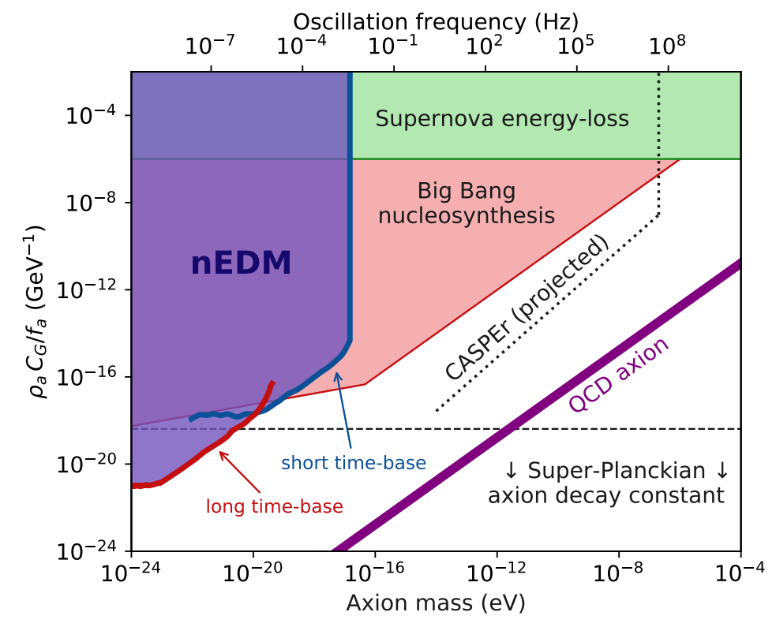
nEDM limits to axion-like dark matter
First laboratory constraints placed on the coupling of axion dark matter to gluons

Slide 8
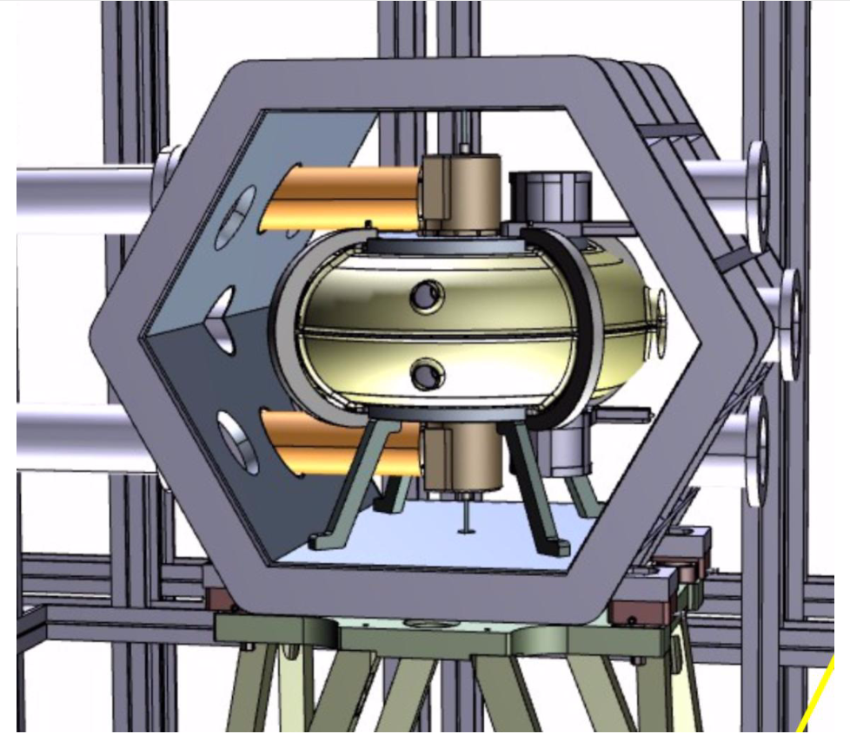
The future of neutron EDM at PSI
PSI planning/building n2EDM
Known technology
Commissioning 2020, expect to reach low 10⁻²⁷ e.cm
Double chamber allows measurement of both E field directions at once, reduces systematics by order of magnitude.
France, Switzerland, Poland, Germany, Belgium, UK (Sussex)

Slide 9
Future: US cryogenic nEDM
To run at Oak Ridge SNS
Commissioning planned for 2022
Aim is 5×10⁻²⁸ e.cm measurement
Many technical issues will need to be resolved

Slide 10
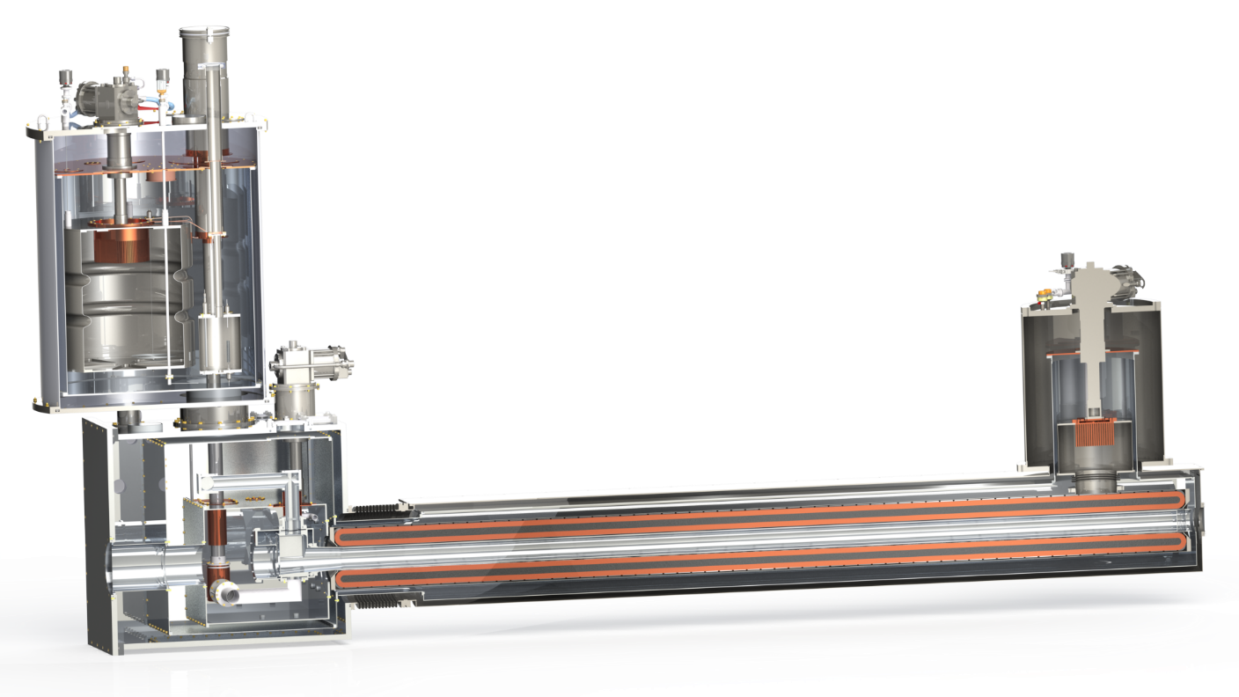
Future: Cryogenic nEDM R&D at ILL
PanEDM – two stage programme towards a cryogenic nEDM (ILL/TUM/RAL)
Working towards a next generation nEDM experiment following the room temperature era
Super-thermal UCN source coupled to nEDM:
room temperature proof-of-principle – from end 2018
cryogenic experiment – five years beyond
Cryostat assembly SuperSUN

Slide 11
Cryogenic nEDM R&D
Higher neutron densities
Higher electric field
PanEDM
Infrastructure built for dedicated beamline at ILL
Beamline call for tender released
One cryostat received, others on order
EDM components (Ramsey chamber, magnetic shielding, …) manufactured
UCN technologies being advanced at RAL – transport optimisation

Slide 12
The electron EDM
Experiments use paramagnetic atoms or molecules
Enhancement factor (combination of relativistic effects and orbital structure)
polarization
effective electric field (GV/cm)
Most recent results have come from molecules
YbF: Imperial College London
ThO: ACME collaboration (Harvard/Yale)
HfF⁺: JILA (Boulder, Colorado)

Slide 13
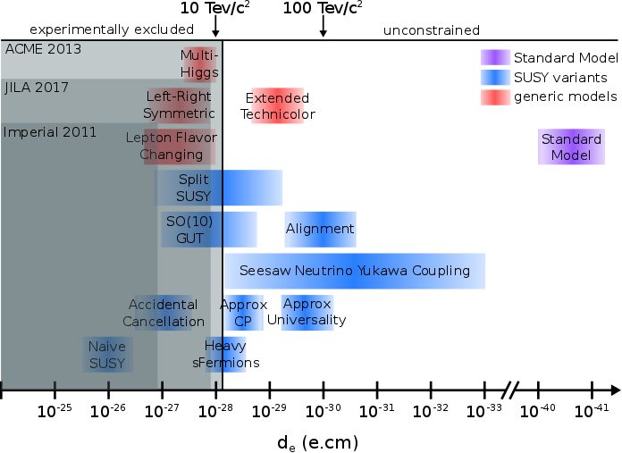
Electron EDM world limits
Imperial: Nature 473 493 (2011),
ACME: Science 343 269 (2014),
JILA: arXiv:1704.07928v1 (2017).

Slide 14
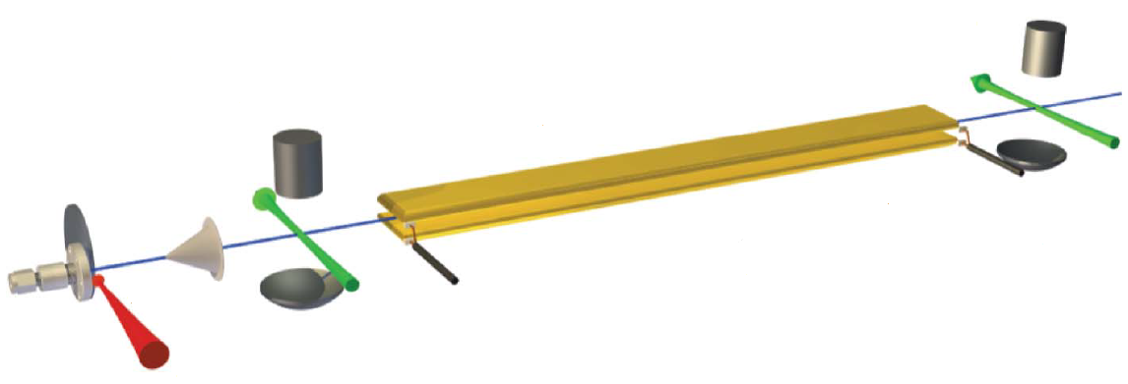
Sensitivity of eEDM experiments
molecule number
polarization/ enhancement
coherence time

Slide 15
Limits of eEDM experiments
YbF: 50% polarization (requires large E field), T limited by transit time.
ThO: good polarization, T limited (metastable state)
HfF⁺: T very long (ion trap), N very limited (next generation to switch to ThF⁺).

Slide 16
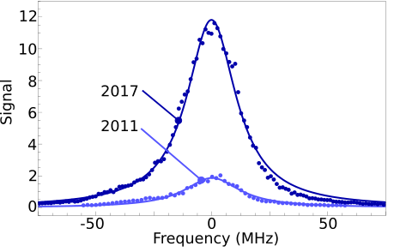
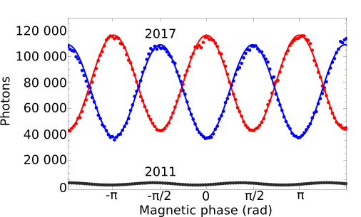
YbF Electron EDM, generation II
Put more molecules into the
initial state
Detect the molecules better at the final stage
2011:
~1000 molecules detected per shot
2017:
~200,000 molecules detected per shot, with both quadratures detected
2011 to 2017:
6x more molecules prepared in the initial state
Total signal increase: 200
Notes:
Edit figure, years
population

Slide 17
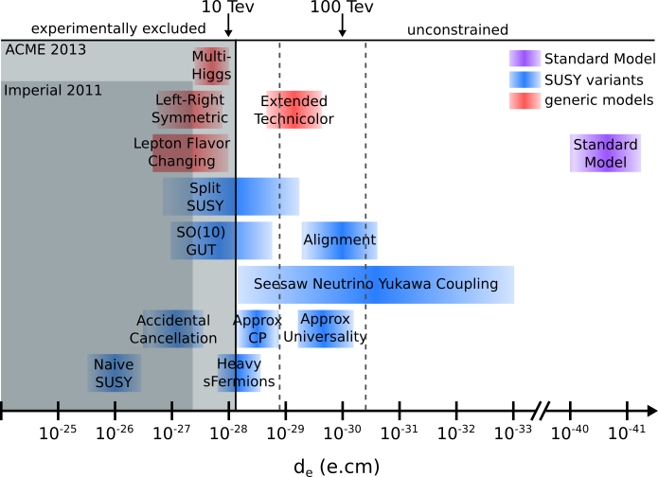
Electron EDM measurements
Constraining T-violating physics
Imperial Generation I
(2011)
Generation II experiments
(2017- taking data now)
Imperial Generation III

Slide 18
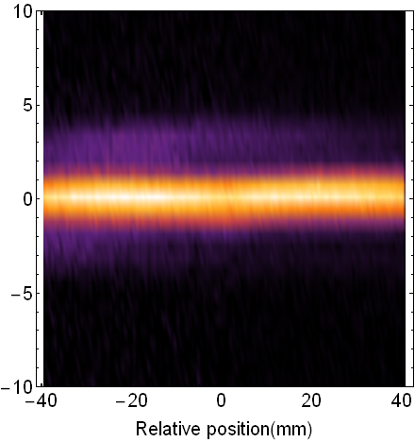
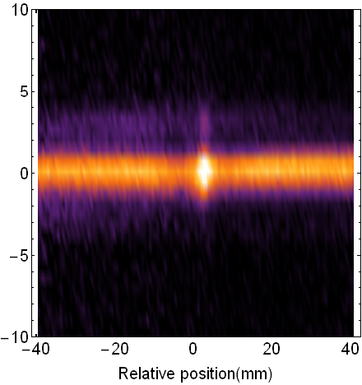
Imperial YbF generation III
No cooling
Slow YbF beam (long coherence time), 600m/s → 120m/s.
2d transverse laser cooling, 50μK, gives high brightness beam.
Should probe eEDM at 10⁻³⁰ e.cm or better.
Science complete, funded by ERC.
Now searching for funding mechanism for construction.
Blue molasses
transverse T ≅ 50 μK
Probe laser
Camera
Transverse cooling
20cm
552 nm
568 nm 565nm
YbF source

