Slide 1
Detecting a Dark Sector Phase Transition in the Early Universe
Presenter: Alastair Wickens
Supervisor: Malcolm Fairbairn

Slide 2
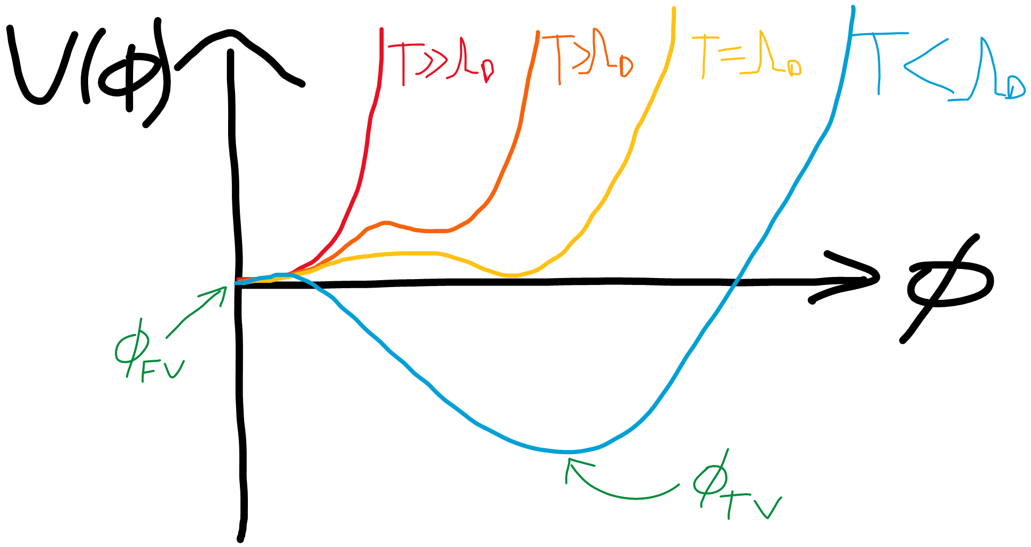
Cosmological Phase Transitions
Electroweak
QCD
Pure SU(N) Dark Sector?
At $T=Λ_{Dark}$: Dark Gluons → Dark Glueballs
Requirement for detectability: First Order

Slide 3
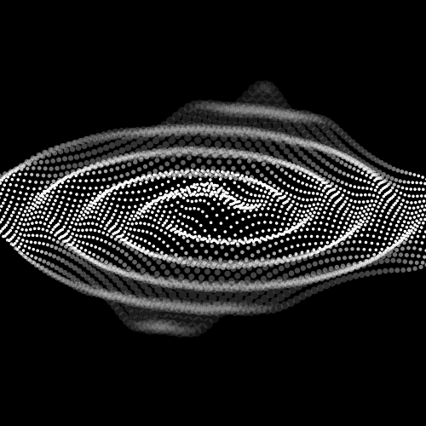
The stages of a First Order Phase Transition
Dark Gluon Plasma
Phase Transition
Dark Glueball Plasma
Homogenous False Vacuum
Bubbles of True Vacuum Nucleate
Bubbles Collide
Homogenous True Vacuum
A bubble of true vacuum per horizon

Slide 4
Gravitational Wave Sources from a First Order Phase Transition
Bubble wall collisions
Acoustic sounds waves in plasma
Turbulent flows in plasma

Slide 5
Know in great detail about the evolution of the universe in visible sector.. B provides a map from the dark sector temperature (which tells us little about the time scales of the universe) to the visible sector.
Model Parameters
Dark Sector
Visible Sector
$T_{Dark}$
Degree of gauge group: N
At $T_{Dark}=Λ_{Dark}$:
Dark Gluons →Dark Glueballs
Hubble expansion
Age of Universe
$T_{visible}$
$$B=\frac{T_{Dark}}{T_{Visible}}$$

Slide 6
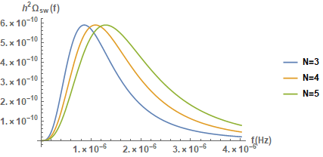
Dark Sector Phase Transition for $Λ_{Dark}=0.1GeV$ Preliminary Results
Gravitational Wave Power Spectrum - Acoustic Sound Waves
Increasing Temperature
Horizon radius
Dark Sector
Visible Sector
$T_{visible}$ (N=5)
$T_{visible}$ (N=4)
Age of Universe
_{B}
$T_{visible}$ (N=3)
$$Λ_{Dark}=0.1GeV$$

Slide 7
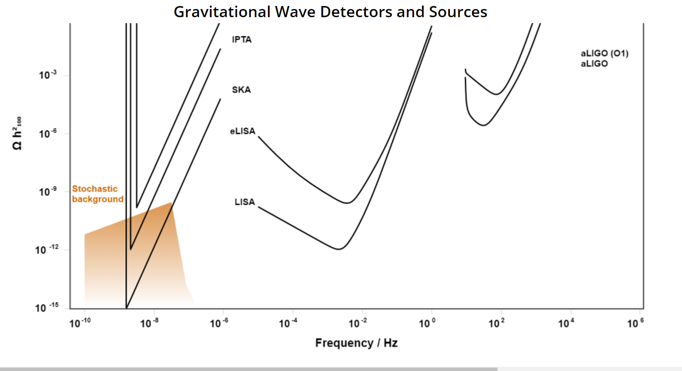
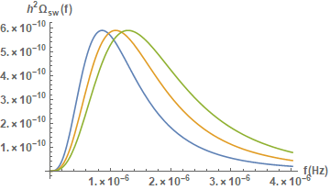

Slide 8
Thanks for listening!

