Slide 1
Evolution of Universes in Causal Set Cosmology
YTF 10, January 2018
Stav Zalel
Imperial College London
R Sorkin, D Rideout gr-qc/9904062,
R Sorkin gr-qc/0003043, R Sorkin et al. gr-qc/0009063,
F Dowker, SZ 1703.07556

Slide 2
Causal sets: an approach to quantum gravity
Spacetime is discrete and dynamical
Spacetime is a causal set, $(C,\text{≺}\text{)}$.
Hasse diagram
Spacetime grows by accretion, or “birth”, of new elements.
The growth is a physical process. The passage of time is a manifestation of this growth.
The growth is governed by stochastic dynamics.
The order relation, $\text{≺}$, is transitive: $x\text{≺}y, y\text{≺}z⇒x\text{≺}z.$
Causal set elements are spacetime atoms.
The partial order gives the causal structure of spacetime.
$$z$$
$$y$$
$$w$$
$$x$$

Slide 3
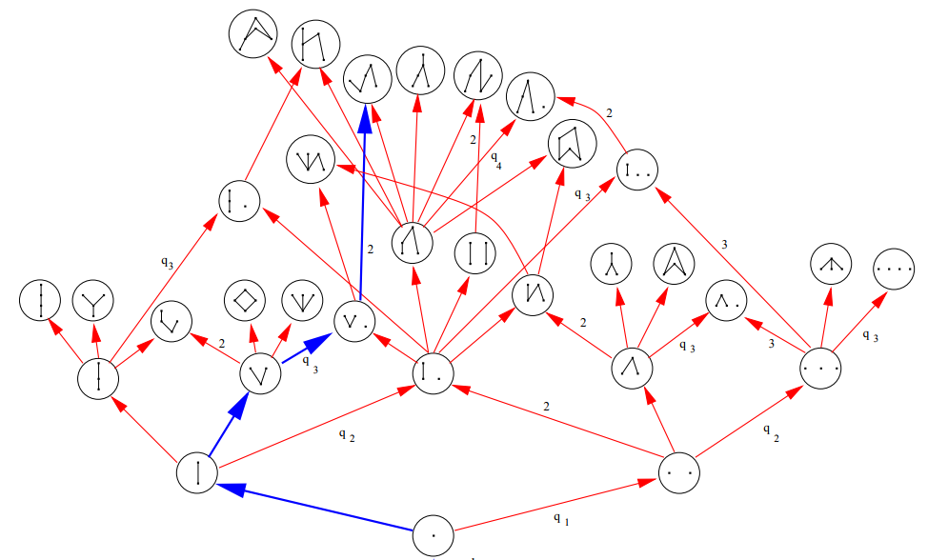
Poscau
Figure from: arXiv:gr-qc/9904062

Slide 4
Classical Sequential Growth Models
A generic class of stochastic causet growth models, derived from physically motivated conditions. (Sorkin, Rideout, arXiv:9904062).
$$P\left(C^{n}→C^{n+1}\right)=\frac{λ(π,m)}{λ(n,0)}$$
$$λ\left(π,m\right)= \sum_{k=m}^{π}{\left(\begin{matrix}π−m \\ π−k\end{matrix}\right)}t_{k}$$
Each CSG model is specified by a countable set of coupling constants
$\left\{t_{k}\right\}= \left\{t_{0},t_{1},t_{2},…\right\}$ , defined up to an overall constant, with
$t_{0}>0 , t_{k}≥0 ∀ k>0$.

Slide 5
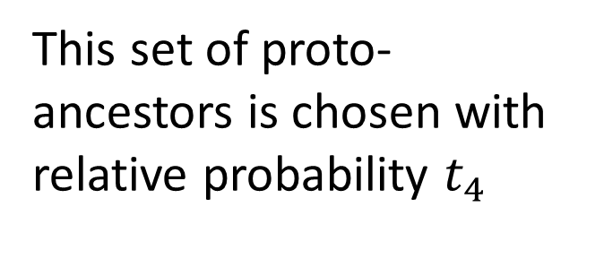




Interpreting the $t_{k}$‘s
$t_{k}$ is the relative probability for the new elements to choose a particular subset of cardinality $k$ to form relations with. We call the chosen elements proto-ancestors.
This set of proto-ancestors is chosen with relative probability $t_{4}$
$$n=11$$
$$k=4$$
$$m=2$$
$$π=9$$

Slide 6

Classical Sequential Growth Models
$$P\left(C^{11}→C^{12}\right)=\frac{λ(9, 2)}{λ(11, 0)}$$
$$m≤k≤ π$$

Slide 7
CSG Cosmologies
Causal immortality: every element has an element to its future.
Past-finite, future-infinite.
Dust universe
$$\{t_{0}=1,t_{k}=0 ∀ k>0\}$$
Big-bang universe.
Originary model.
Forest universe
$$\{t_{0}=t_{1}=1, t_{k}=0 ∀ k>1\}$$
Cycles of cosmic collapse and expansion
Transitive percolation $\{t_{k}=t^{k}$}

Slide 8
Bouncing cosmology
A post is an element which is related to every other element in the set.
The current era is the set of elements to the future of the post.
The past of the post (or “the past”) is the set of elements to the past of the post.
current era
post
past
Big-crunch – Big-bang
arXiv:gr-qc/0003043, arXiv:gr-qc/0009063

Slide 9
Bouncing cosmology
A post is an element which is related to every other element in the set.
The current era is the set of elements to the future of the post.
The past of the post (or “the past”) is the set of elements to the past of the post.
current era
post
past
Big-crunch – Big-bang

Slide 10
Bouncing cosmology
The growth of the causet is governed by a CSG dynamics, $\left\{t_{k}\right\}.$
$P\left(C^{n}→C^{n+1}\right)=\frac{λ(π,m)}{λ(n,0)}$
$λ\left(π,m\right)= \sum_{k=m}^{π}{\left(\begin{matrix}π−m \\ π−k\end{matrix}\right)}t_{k}$
current era
post
past
$$\left\{t_{k}\right\}$$

Slide 11
Effective dynamics
The growth of the current era is governed by an effective CSG dynamics, $\left\{{\tilde{t}}_{k}\right\}.$
$P\left(C^{n}→C^{n+1}\right)=\frac{\tilde{λ}(π,m)}{\tilde{λ}(n,0)}$
$\tilde{λ}\left(π,m\right)= \sum_{k=m}^{π}{\left(\begin{matrix}π−m \\ π−k\end{matrix}\right)}{\tilde{t}}_{k}$
current era
$$\left\{{\tilde{t}}_{k}\right\}$$

Slide 12
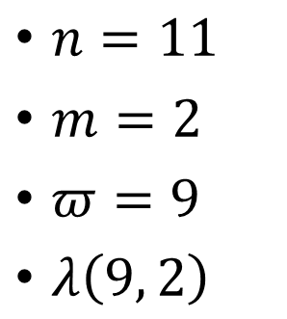
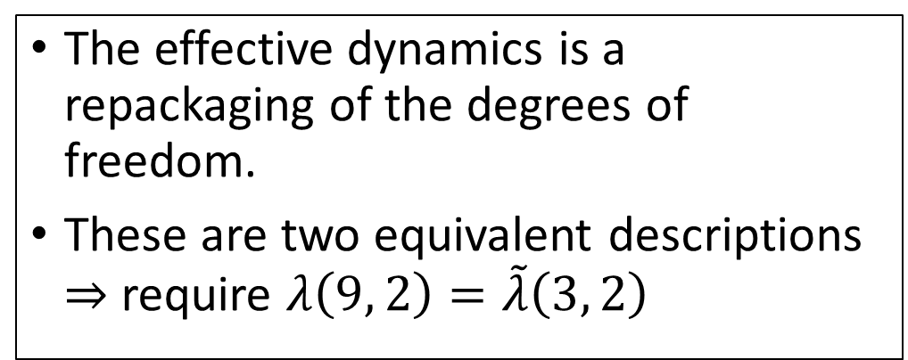
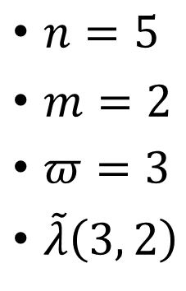
Effective dynamics
$n=5$
$m=2$
$π=3$
$\tilde{λ}\left(3, 2\right)$
$n=11$
$m=2$
$π=9$
$λ\left(9, 2\right)$
$$\left\{{\tilde{t}}_{k}\right\}$$
The effective dynamics is a repackaging of the degrees of freedom.
These are two equivalent descriptions $⇒$ require $λ\left(9, 2\right)=\tilde{λ}\left(3, 2\right)$
$$\left\{t_{k}\right\}$$

Slide 13
Effective dynamics
The effective couplings in the current era after a post with $N$ ancestors:
$${\tilde{t}}_{0}=\sum_{l=1}^{N+1}{\left({N \atop l−1}\right)t_{l}}$$
$${\tilde{t}}_{k}=\sum_{l=0}^{N+1}{\left({N+1 \atop l}\right)t_{k+l}}, ∀ k>0$$
arXiv:1703.07556

Slide 14
Evolutionary cosmology
Explaining homogeneity and isotropy
Fine tuning of parameters in underlying theory.
Evolutionary model in which parameters are renormalised at each evolutionary stage.
Linear cyclic model
Branching model

Slide 15
Branching universes
arXiv:1703.07556

Slide 16
What’s next for causal set cosmology?
Analysis of partial breaks.
Analysis of RG flow.
Studying CPT invariance in CSG dynamics.

Slide 17
Thanks for listening

