Slide 1
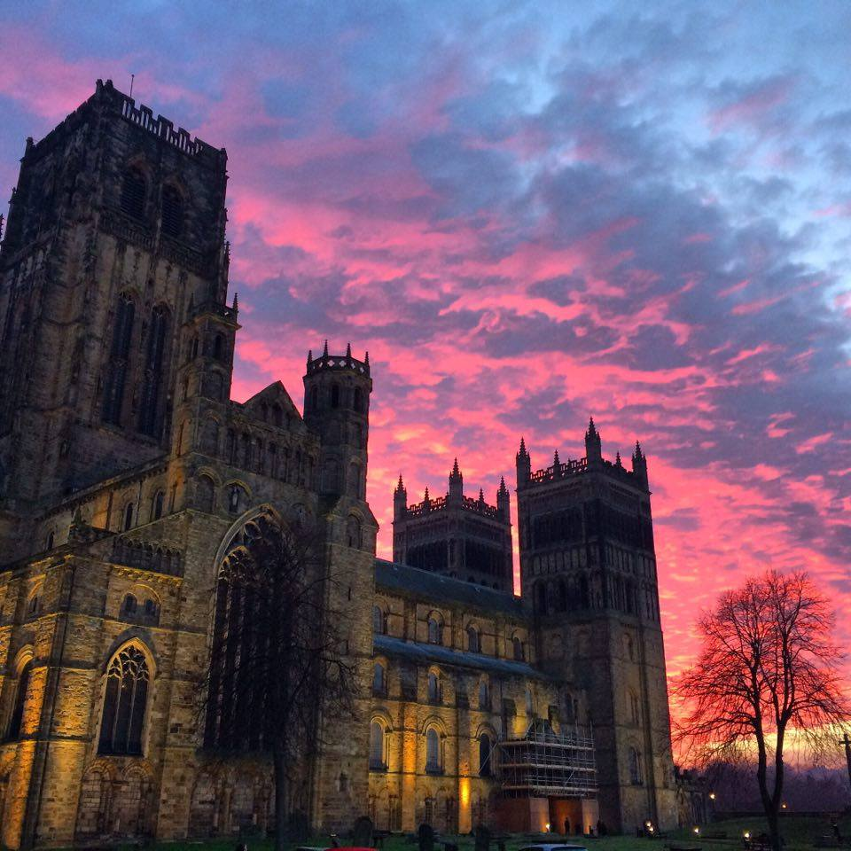
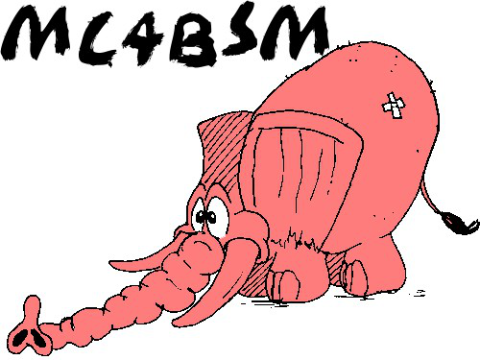
(In)elastic (Boosted) Dark Matter Searches and Monte Carlo Simulation
Doojin Kim
Monte Carlo Tools for Physics Beyond the Standard Model
Institute for Particle Physics Phenomenology,
Durham University, United Kingdom, April$18$th, $2018$

Slide 2
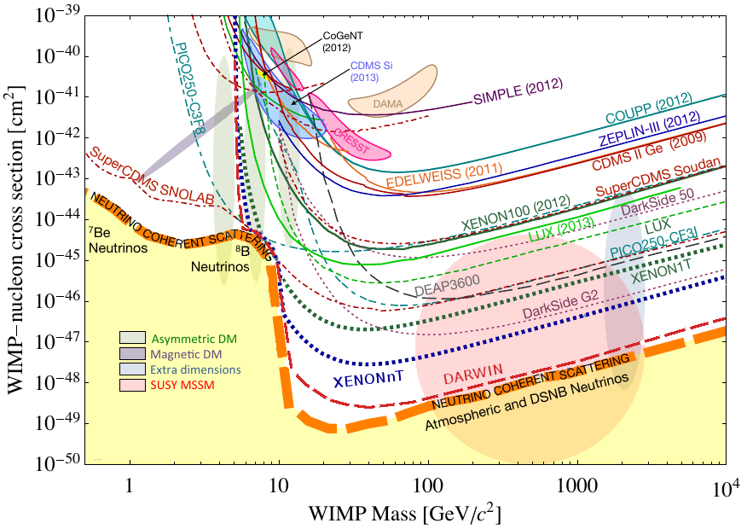
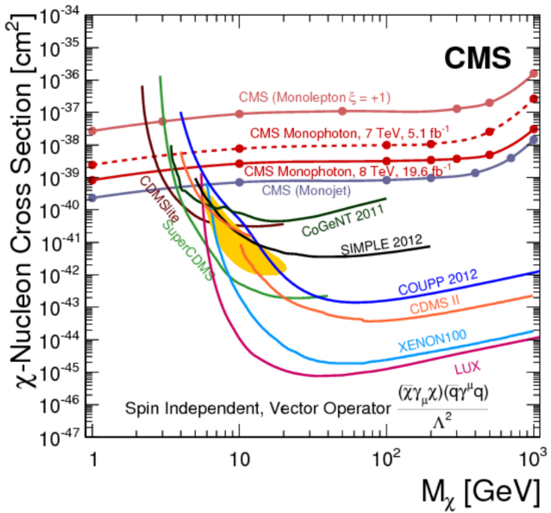
Current Status of Dark Matter Searches
No observation of DM signatures via non-gravitational interactions while many searches/interpretations designed/performed under WIMP/minimal dark-sector scenarios ⇒ merely excluding more parameter space in dark matter models
[Cushman, Calbiati, McKinsey ($2013$); Baudis ($2014$)]
[CMS mono-photon search ($2014$)]
Time to change our approach?!

Slide 3
Conventional vs. Nonconventional Approaches
Conventional/traditional approaches for DM searches;
Weak-scale mass
Weakly coupled
Minimal dark sector
Elastic scattering
Non-relativistic
Nonconventional/modified approaches for DM searches;
Other mass scales, e.g., sub-GeV, MeV, keV, …
Weaker connection to the SM, e.g., vector portal (dark photon), scalar portal, …
“Flavorful” dark sector, e.g., more DM species, unstable heavier dark-sector states, …
Inelastic scattering
Relativistic
Nonconventional/modified approaches for DM searches;
Other mass scales, e.g., sub-GeV, MeV, keV, …
Weaker connection to the SM, e.g., vector portal (dark photon), scalar portal, …
“Flavorful” dark sector, e.g., more DM species, unstable heavier dark-sector states, …
Inelastic scattering
Relativistic
Inelastic boosted/relativistic DM searches

Slide 4
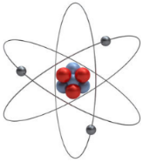
Inelastic “Relativistic”/Boosted Dark Matter
Generic model framework [DK, Park, Shin $(2016)$]
$χ_{1}$: undetected
Probing heavier dark-sector states
Target recoil (like in typical DM direct detection exp.) + secondary visible signatures ⇒ more handles, (relatively) background-free (no secondary signatures in usual backgrounds)
Complementary to standard DM direct searches
$χ_{1}:"boosted"$DM
Detector
$χ_{2}$: heavier
dark sector state:
unstable
Fixed target:
$e^{−}, p,$ etc.
Secondary signatures:
some are visible
Target recoiling:
visible

Slide 5
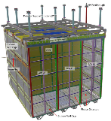
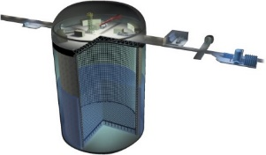
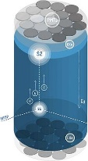
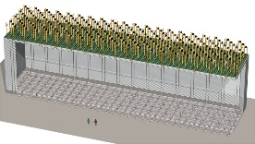
Boosted/Relativistic Dark Matter: Cosmic Frontier
Signals coming from the universe today, nontrivial model building required
Semi-annihilation in e.g., $Z_{3}$ models [D’Eramo, Thaler (2010)]
Fast-moving DM via induced nucleon decays [Huang, Zhao (2013)]
“Assisted” freeze-out [Belanger, Park (2011)], Tw0-component DM models [Agashe, Cui, Necib, Thaler (2014)]
Incoming flux of boosted DM is typically small.
Surface-based detectors, e.g., ProtoDUNE, SBN Program [Chatterjee, DK, et al. (2018); DK, Kong, Park, Shin in progress]
Earth surface
Underground large-volume detectors, e.g., Super/Hyper-K, DUNE [Agashe, Cui, Necib, Thaler (2014); Huang, Zhao (2013); Necib, Moon, Wongjirad, Conrad (2016); Berger, Cui, Zhao (2014); Kong, Mohlabeng, Park (2014); Alhazmi, Kong, Mohlabeng, Park (2016); DK, Park, Shin (2016)]
Conventional WIMP detectors (with some model variation), e.g., Xenon, Lux-Zeplin [Giudice, DK, Park, Shin (2017)]

Slide 6
Boosted/Relativistic Dark Matter: Intensity Frontier
Signals coming from colliders, additional model building not always necessary
If dark sectors (containing dark matter) are more “weakly” connected to the SM sector, high intensity experiments are also motivated, e.g., fixed target experiments.
BDX, NA64, MicroBooNE, SeaQuest, LDMX, T2HKK, DUNE, SHiP, and many more
Shielding
Detector
Target
(thick/thin)
$e/p$ beam
Quite a few phenomenological studies/proposals in the context of dark photon decays, elastic/inelastic scattering of DM, etc. [LoSecco et al. (1980); Bjorken, Essig, Schuster, Toro (2009); Batell, Pospelov, Ritz (2009); deNiverville, Pospelov, Ritz (2011); Izaguirre, Krnjaic, Schuster, Toro (2014); Izaguirre, Kahn, Krnjaic, Moschella (2017); Berlin, Gori, Schuster, Toro (2018); Bonivento, DK, Park, Shin in progress, and many more]

Slide 7
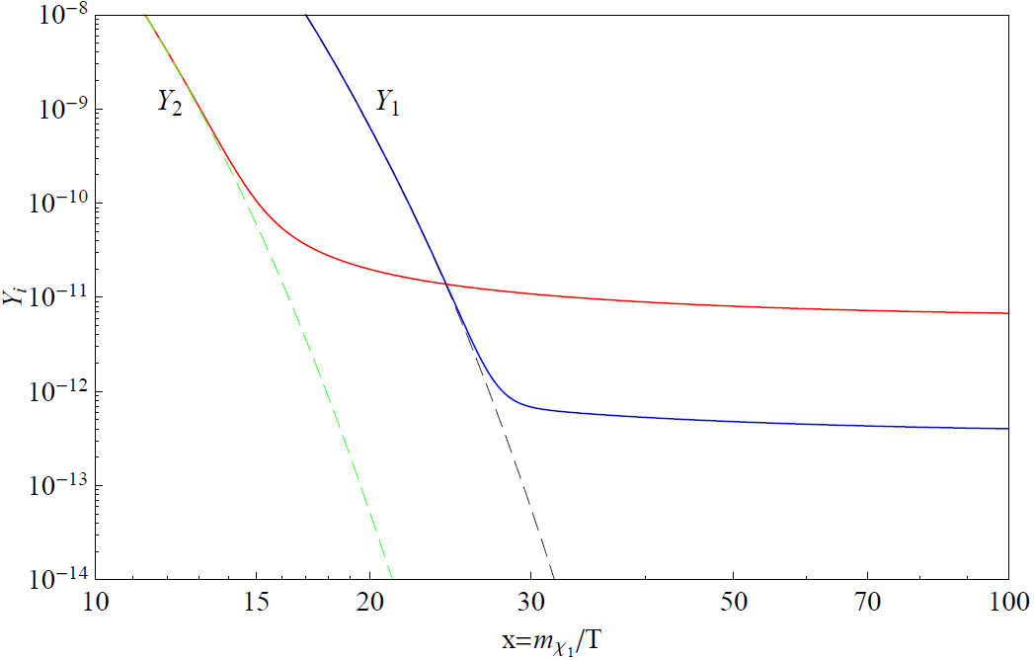
Two-component Boosted DM Scenario
A possible relativistic source: BDM scenario (cosmic frontier), stability of the two DM species ensured by separate symmetries, e.g., $Z_{2}⊗Z_{2}^{′}, U\left(1\right)⊗U{\left(1\right)}^{′}, etc.$
Dominant relic
$$χ_{0}$$
$$χ_{1}$$
SM
$$χ_{0}$$
$$χ_{1}$$
SM
Freeze-out first
Freeze-out later
Negligible, non-relativistic relic
$$Y_{1}$$
$$Y_{0}$$
$$Y_{1}$$
“Assisted” freeze-out mechanism
[Belanger, Park ($2011$)]

Slide 8
“Relativistic” Dark Matter Search
$$χ_{0}$$
$$χ_{1}$$
SM
$$χ_{0}$$
$$χ_{1}$$
SM
Heavier relic $χ_{0}$: hard to detect it due to tiny/negligible coupling to SM
Lighter relic $χ_{1}$: hard to detect it due to small amount
$$χ_{0}$$
$$χ_{1}$$
$$χ_{1}$$
becomes boosted,
hence relativistic!
($γ_{1}=m_{0}/m_{1}$)
$$χ_{0}$$
$$χ_{1}$$
(Galactic Center at the universe today)
(Laboratory)
[Agashe, Cui, Necib, Thaler ($2014$)]

Slide 9
Boosted DM Detection
Flux of boosted $χ_{1}$ near the earth
Setting ${\left\langle σv\right\rangle }_{χ_{0}χ_{0}→χ_{1}χ_{1}}$ to be $\sim {10}^{−26} {cm}^{3}s^{−1}$ and assuming Navarro-Frenk-White DM halo profile, a standard profile, one finds
$$ℱ_{χ_{1}}∝(interaction strength)×{(χ_{0} number)}^{2}$$
$\sim 0.8×{10}^{−7}{cm}^{−2}s^{−1}\left(\frac{{\left\langle σv\right\rangle }_{χ_{0}χ_{0}→χ_{1}χ_{1}}}{{10}^{−26}{cm}^{3}s^{−1}}\right){\left(\frac{20 GeV}{m_{0}}\right)}^{2}$
from DM number density
$$ℱ_{χ_{1}}\sim {10}^{−7}{cm}^{−2}s^{−1}$$
For WIMP mass-range $χ_{0}$[e.g., $𝒪$($20$ GeV)]
No sensitivity in conventional dark matter direct detection experiments ⇒ large-volume (neutrino) detectors motivated
Super-/Hyper-Kamiokande (SK/HK)
Deep Underground Neutrino Experiment (DUNE)
SKY
DUNE
SK/HK

Slide 10
Benchmark Model
Vector portal (e.g., “dark photon” scenario) [Holdom ($1986$)]
Fermionic DM
$χ_{2}$: a heavier (unstable) dark-sector state
Flavor-conserving interaction ⇒ elastic scattering (can be suppressed or even vanishing)
Flavor-changing interaction ⇒ inelastic scattering
$$ℒ_{int}∋−\frac{ε}{2}F_{μν}X^{μν}+g_{11}{\overline{χ}}_{1}γ^{μ}χ_{1}X_{μ}+g_{12}{\overline{χ}}_{2}γ^{μ}χ_{1}X_{μ}+h.c.+(others)$$
$$γ$$
$$X$$
SM
⊗
Dark
$$ε$$
$$χ_{2}$$
$$X$$
•
$$g_{12}$$
$$χ_{1}$$
Not restricted to this model: various models conceiving BDM signatures
BDM source: galactic center, solar capture, dwarf galaxies, assisted freeze-out, semi-annihilation, fast-moving DM etc. [Agashe et al. (2014); Berger et al. (2015); Kong et al. (2015); Alhazmi et al. (2017); Super-K (2017); Belanger et al. (2011); D’Eramo et al. (2010); Huang et al. (2013)]
Portal: vector portal, scalar portal, etc.
DM spin: fermionic DM, scalar DM, etc.
iBDM-inducing operator: two chiral fermions, two real scalars, dipole moment interactions, etc. [Tucker-Smith, Weiner ($2001$); Giudice, DK, Park, Shin ($2017$)]

Slide 11
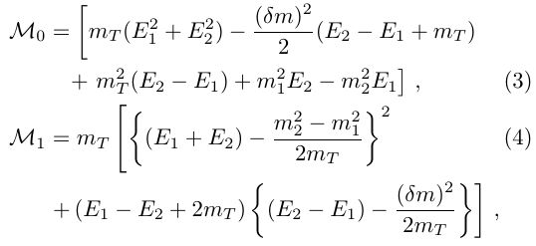
Inelastic BDM (iBDM) at Large-Volume Detectors
$$χ_{1}$$
$$χ_{2}$$
[DK, Park, Shin (2016)]
$$χ_{1}$$
$$X$$
$$X$$
•
$$e^{−}$$
$$(T=e^{−}, p)$$
•
$$e^{+}$$
$$T$$
$$T$$
$$≡s$$
($F_{1}=1, F_{2}=0$ for electron)
$θ$ (roughly) determines angular separation between the primary (target recoil) and the secondary ($e^{+}e^{−}$ pair) signals.

Slide 12
Discovery Potential with e-scattering
$$χ_{1}$$
$$χ_{2}$$
[DK, Park, Shin (2016)]
$$χ_{1}$$
$$X$$
$$X$$
•
$$e^{−}$$
•
$$e^{+}$$
$$e^{−}$$
$$e^{−}$$
GeV/sub-GeV mass and sizable boost factor of dark-sector particles preferred by kinematics
$e$-scattering preferred $←$ smaller threshold energy, $e^{−}$ as a fundamental particle
$e^{+}e^{−}$ from the secondary: highly collimated (not separable in most favored parameter region)
$e^{−}$ from the primary: collimated, but separable with detectors of good angular resolution
High chance to observe two separable charged tracks

Slide 13
Discovery Potential with p-scattering
$$χ_{1}$$
$$χ_{2}$$
[DK, Park, Shin (2016)]
$$χ_{1}$$
$$X$$
$$X$$
•
$$e^{−}$$
•
$$e^{+}$$
$$p$$
$$p$$
GeV/sub-GeV mass and decent boost factor of dark-sector particles preferred by kinematics
(Typically) Larger threshold energy, $p$ could be broken apart, atomic form factor
$e^{+}e^{−}$ from the secondary: separated
$p$ from the primary: separated from the secondary particles
High chance to observe three separable charged tracks

Slide 14
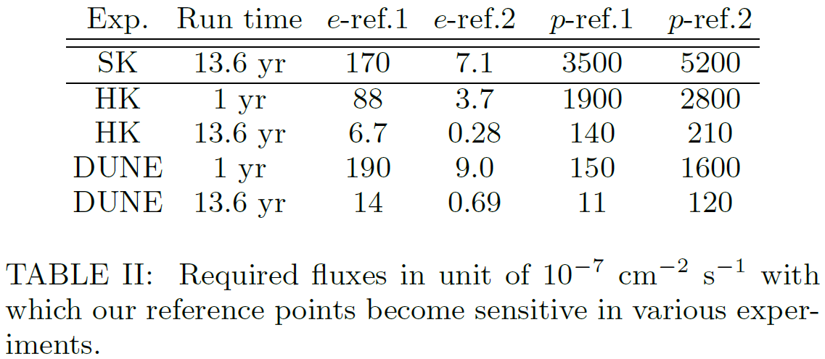
Results
 | $$m_{1}$$ | $$m_{2}$$ | $$m_{X}$$ | $$γ_{1}$$
$e$-ref$1$ | $$0.4$$ | $$0.5$$ | $$0.06$$ | $$250$$
$e$-ref$2$ | $$0.1$$ | $$0.14$$ | $$0.03$$ | $$200$$
$p$-ref$1$ | $$0.4$$ | $$0.9$$ | $$0.2$$ | $$15$$
$p$-ref$2$ | $$0.1$$ | $$1.0$$ | $$0.5$$ | $$50$$
$ε^{2}={(3×{10}^{−4})}^{2}$ and $g_{12}=0.5$ for all reference points
$γ_{1}$: boost factor of boosted DM $χ_{1}$
“Zero” background assumed
Every mass in GeV
[DK, Park, Shin (2016)]
Recall, in a minimal boosted DM scenario, if flux over the whole sky is $𝒪\left({10}^{−7}\right){ cm}^{−2}s^{−1}$, it is promising and achievable!
Comparable/better signal sensitivity at DUNE! ⇒ More investigation needed! [De Roeck, DK, Moghaddam, Park, Shin, Whitehead, in progress]

Slide 15
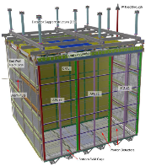
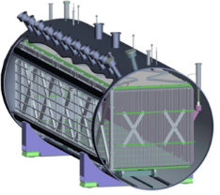
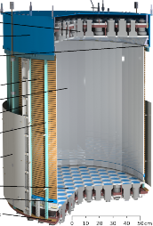
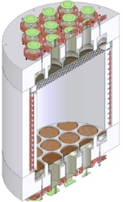
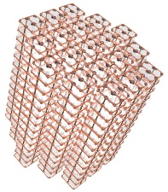
More Applications
SKY
Similar physics opportunities at surface-based detectors, e.g., NO$v$A, SBN Program, ProtoDUNE, etc.
Challenge: enormous cosmic-origin backgrounds (typically from muons)
Solution
Many signal features of iBDM [Chatterjee, DK et al. (2018)]
“Earth Shielding” for elastic BDM (at the cost of half statistics) [DK, Kong, Park, Shin in progress]
Surface
Similar physics opportunities at conventional WIMP detectors or (small-volume) neutrino detectors, e.g., Xenon, DarkSide, CUORE, etc.
Challenge: “small” volume w.r.t the flux of boosted DM
Solution: model modification to increase the flux
$$ℱ_{χ_{1}}∝m_{0}^{−2}$$
Good resolution, sensitivity to low-energy (MeV-range) signals
Phenomenological study at WIMP detectors with their detector specifics considered [Giudice, DK, Park, Shin (2017)]

Slide 16
(In)elastic BDM Searches in Various Experiments
Energy of
boosted DM
100 GeV
10 GeV
Hyper-K
Hyper-K
Super-K
Super-K
DUNE
DUNE
1 GeV
SBN Program, ProtoDUNE
SBN Program, ProtoDUNE
100 MeV
Borexino
Borexino
10 MeV
CUORE
Xe-1T, LZ, DarkSide
Xe-1T, LZ, DarkSide
CUORE
1 MeV
small
(Fiducial) volume
large
poor
Angular/position res.
good
Detectors are complementary to one another rather than superior to the others!

Slide 17
Event Simulation for Cosmic-frontier Searches
Boosted/relativistic DM injection
Parton-level
Calculation
Event
Generation
Detector
Response
(Usually) boosted DM comes with a fixed boost factor
Phase-space gen.
Standard parton-level calculators
Standard event generators
GENIE
LArSoft
GEANT4
Electron scattering: good enough with standard parton-level calculators (or even phase-space generator) to describe leading behaviors of BDM-initiated events
Proton scattering: several effects even before detector responses, e.g., atomic form factor, deep inelastic scattering (DIS of iBDM [DK, Machado, Park, Shin, in progress]), $Δ$-resonances regime, nucleon effects etc.
GENIE (see also Berger’s talk for more details)
The above-mentioned effects are fully considered.
Resonance model in [Rein, Sehgal (1981)] (inputs from lattice QCD needed?)
Elastic BDM has been implemented, iBDM is being implemented.

Slide 18
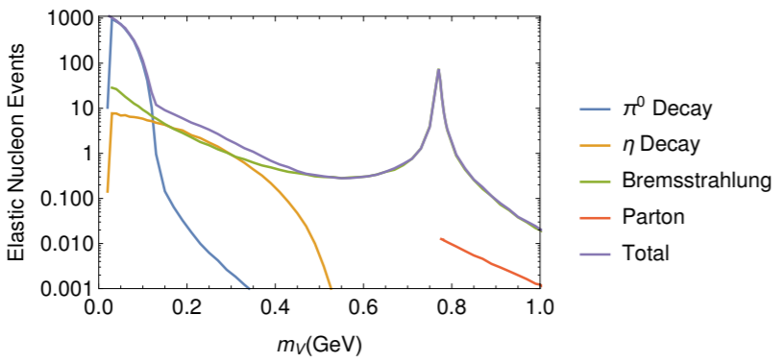
Event Simulation for Intensity-frontier Searches
Boosted/relativistic DM injection
Parton-level
Calculation
Event
Generation
Detector
Response
Ex) vector portal
Meson ($π/η$) decays
Bremsstrahlung
Drell-Yan
Phase-space gen.
Standard parton-level calculators
Standard event generators
GENIE
LArSoft
GEANT4
BdNMC [deNiverville (2017)],
All production mechanisms are considered.
Target and detector characteristics can be set.
Pre-simulated data is used.
[deNiverville, Chen, Pospelov, Ritz (2017)]
Fixed target experiments with the latest MadGraph

Slide 19
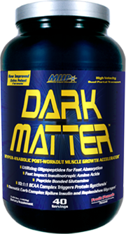
Conclusions
Boosted/relativistic dark matter searches at the cosmic/intensity frontier are promising.
They may provide an alternative avenue to explore dark sector physics (including dark matter).
B
TED
OOS
Theoretical/phenomenological studies have been actively conducted and in progress.
There are many ongoing/projected experiments in which they can be tested/probed.
Many existing MC tools can be utilized for boosted/relativistic DM physics, and an increasing amount of effort to develop dedicated MC tools has been made.
More active interactions with MC-tool community are highly expected/encouraged!

Slide 20
Thank you!

Slide 21
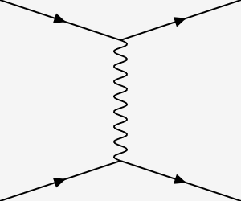
Background Considerations
Potential sources
Cherenkov radiation (CR) by electron/muon is distinguished from that by proton.
Electron-preferred scenarios:
Proton-preferred scenarios: opening angles among recoil proton, decayed electrons are large enough to resolve
$$ν_{ℓ}$$
$$ν_{ℓ}$$
$$ν_{ℓ}$$
$$ℓ$$
$$ν_{ℓ}$$
$$ν_{ℓ}$$
$$ν_{ℓ}$$
$$ℓ$$
$$Z$$
$$W$$
$$Z$$
$$W$$
$$e$$
$$e$$
$$e$$
$$ν_{e}$$
$$p$$
$$p$$
$$n$$
$$p$$
: CR by an N.C.
electron
: CR by a C.C.
electron/muon/tau
: CR by an N.C.
proton unless broken
: CR by at least, a C.C.
proton unless broken

Slide 22
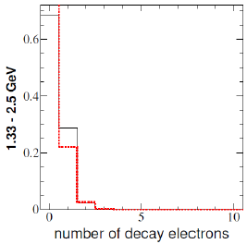
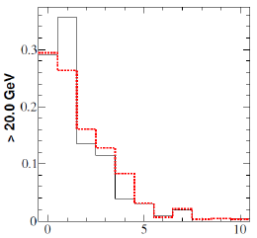
Background Considerations
More challenging cases: broken nuclei
Similar expectations for neutral currents
(Dedicated study in progress)
$$ν_{ℓ}$$
$$ℓ$$
$$W$$
$$π$$
$$p/n$$
$$π$$
$$π$$
$$π^{+}→μ^{+}ν→e^{+}ννν$$
Super-K ($2012$)

Slide 23
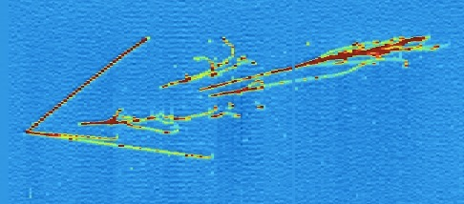
Background Considerations
More challenging cases: broken nuclei
Expecting again that (quality) track-based particle identification allows us to distinguish multi-track background events from signal ones
A dedicated study is needed
$$ν_{ℓ}$$
$$ℓ$$
$$W$$
$$π$$
$$p/n$$
$$π$$
$$π$$
Particle tracks created by a neutrino interaction in liquid argon in the ArgoNeuT
e.g. $π^{+}→μ^{+}ν→e^{+}ννν$

Slide 24
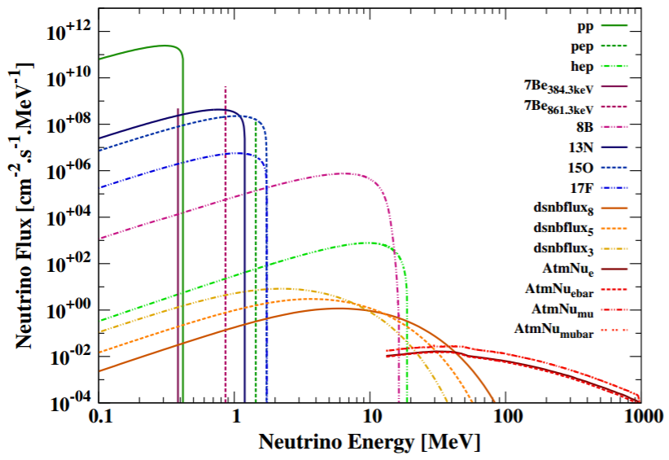
Flux of Neutrino
[Ruppin et al., ($2014$)]

