Slide 1
How Not To Miss a Discovery: Optimal Parameter Space Scans with Cluster Analysis
Durham, April 3-6 2018
Tommaso Dorigo
INFN Padova
(Based on work done in collaboration with
A. Carvalho, M. Dall'Osso, F. Goertz, C. Gottardo, M. Tosi)

Slide 2
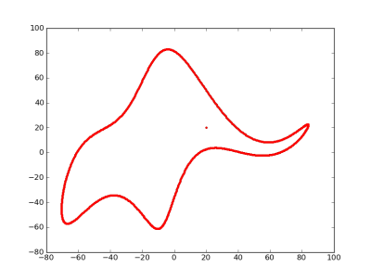
Introduction
import numpy as np
import pylab
# elephant parameters
p1, p2, p3, p4 = (50 - 30j, 18 + 8j, 12 - 10j, -14 - 60j )
p5 = 40 + 20j # eyepiece
def fourier(t, C):
f = np.zeros(t.shape)
A, B = C.real, C.imag
for k in range(len(C)):
f = f + A[k]*np.cos(k*t) + B[k]*np.sin(k*t)
return f
def elephant(t, p1, p2, p3, p4, p5):
npar = 6
Cx = np.zeros((npar,), dtype='complex')
Cy = np.zeros((npar,), dtype='complex')
Cx[1] = p1.real*1j
Cx[2] = p2.real*1j
Cx[3] = p3.real
Cx[5] = p4.real
Cy[1] = p4.imag + p1.imag*1j
Cy[2] = p2.imag*1j
Cy[3] = p3.imag*1j
x = np.append(fourier(t,Cx), [-p5.imag])
y = np.append(fourier(t,Cy), [p5.imag])
return x,y
x, y = elephant(np.linspace(0,2*np.pi,1000), p1, p2, p3, p4, p5)
pylab.plot(y,-x,'.')
pylab.show()
The vast majority of proposed hypotheses for theories that extend the Standard Model are composite – they rely on the value of free parameter(s) to describe the phenomenology they predict
Famously, John von Neumann once nailed it thus: "With four parameters I can fit an elephant, and with five I can make him wiggle his trunk."
Less famously, a paper explains how four (complex) parameters are indeed enough for the task [J. Mayer, K. Khairy, and J. Howard, Am. J. Phys. 78, 648 (2010)]

Slide 3
A Few Examples
Supersymmetry comes to mind: with over 120 free parameters, the space of possible theories to investigate is huge
A general SUSY scan is beyond anybody's powers, so phenomenologists have devised clever strategies to reduce the problem, noting that one can restrict to a study of only five parameters in minimal models (MSSM), or a few more in slightly more elastic versions (e.g. 19 in the pMSSM)
The risk that by concentrating on these for experimental hypothesis testing (SM vs X) one misses a discovery is however always present
The Heavy vector triplet model (HVT), one of the simplest SM extensions, posits a new gauge group generating W' and Z' bosons, with four main parameters g_{v}, c_{f}, c_{h}, M_{v}
EFT frameworks that extend the SM by spelling out higher-dimension operators with associated strength parameters, like e.g. anomalous coupling Higgs Lagrangians (see below)
In the face of the large LHC datasets and the concrete possibility that NP hides in some non-obvious corner of the parameter space, one feels the need of some rigor in the definition of a scanning strategy of theories such as those mentioned above.

Slide 4
Higgs Lagrangian in EFT
The example I will focus on in this talk is the hypothesis of anomalous couplings of the Higgs boson, which give rise to modifications in the properties of the final state of pp→hh+X : considering up to dimension-6 operators we have in general the coupling parameters k_{λ}, k_{t}, c₂, c_{g}, c_{2g}:
In the SM k_{λ}=k_{t}=1, and c₂, c_{g}, c_{2g} are null. The space spanned by these 5 parameters affects the kinematics of the final state, but leaves unaffected the signature of Higgs pair production
Single Higgs production observables already constrain some of these parameters, so that the range of investigation is rather well defined. We are looking in a 5-dimensional box of limited size.

Slide 5
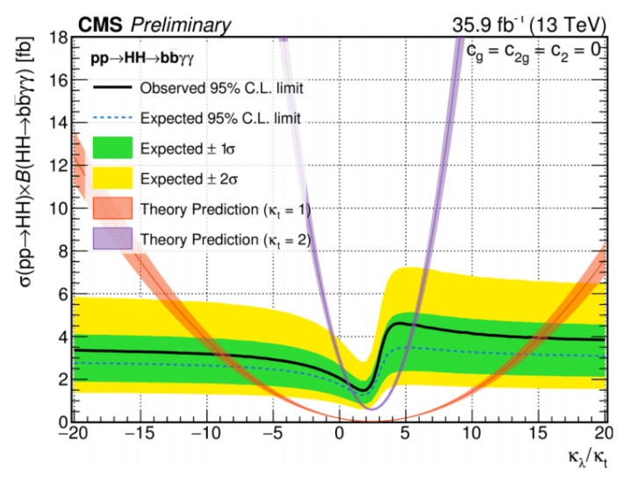
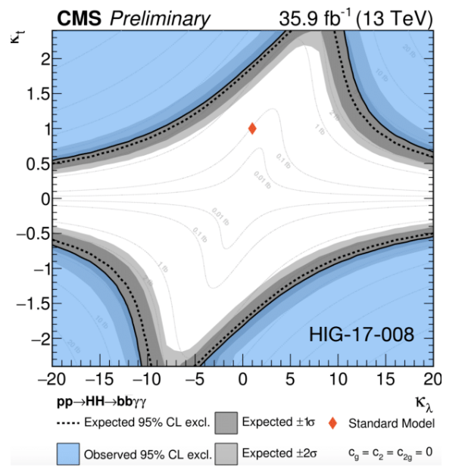
Constraints on EFT coupling modifiers
A strong effort is under way by ATLAS and CMS to study non-resonant hh production in a number of final states. SM production is not at reach yet, but some combinations of anomalous couplings would make the signal detectable
The absence of a signal is turned into cross section limits, from which bounds in the parameters are derived

Slide 6
Higgs Pairs at LO: Two Variables
pp→hh+X can be described at LO using the two four-momenta of the Higgs bosons
but if we remove ISR/FSR effects, which are the same irrespective of the value of the five couplings, we have two Higgs bosons back-to-back in azimuth → 4 variables
The azimuthal angle φ is irrelevant → 3 variables
The boost along the z axis enshrines all PDF effects; by boosting the hh system to the CMS we remove it → 2 variables
Hence we can fully describe a pair-production process by two variables. We take them to be the cosine of the emission angle of a Higgs boson in the hh rest frame, |cos θ*|, and the hh system invariant mass, M_{hh}.
We can then imagine each point of the 5-dim space (k_{λ},k_{t}, c_{g},c_{2g},c₂) to correspond to a 2D probability density describing the hh kinematics
h
φ
h
θ*
h
h

Slide 7
Two-Sample Tests
We can study the kinematics resulting from arbitrary parameter space points with generator-level simulations
These are obtained with MadGraph
20,000-event samples, one for each of 1500 different points chosen in a custom-shaped grid in the 5D space
We need to define a "degree of similarity" between the distributions, to partition the space in regions where the kinematics are similar
Such a measure can be used to define homogeneous regions, as well as identify representative points of each region in the 5D space

Slide 8
Constructing the TS
To compare (M_{hh}, |cosθ*|) distributions with 20,000 entries each we use a binned likelihood ratio TS
Distributions are divided in 50 x 5 bins
If distributions 1 and 2 have the same parent, the probability to observe n_{i,1} and n_{i,2} events in bin i can be written as
where the expectation values are
Now a useful decomposition can be used:
The Poisson term on the RHS has no information on the agreement!
It is an ancillary statistic we can neglect. All the information is in

Slide 9
The Likelihood Ratio
Now we consider the saturated hypothesis that distributions 1 and 2 are exactly equal: for it, the binomial term has the form
Putting this at the denominator, we may construct a likelihood ratio TS as
The good thing of this TS is that it is distributed as a chisquared [Baker and Cousins, NIM 221 (1984) 437]. We may then use it directly as an ordering parameter in defining the distance of parameter space points in our clustering procedure.
In other words, we expect that if samples i and j are "more similar" to each other than are samples j and k, then TS(ij) > TS (jk)

Slide 10
Clustering Procedure - Definitions
The sample comparison is pairwise → for 1500 points we perform 1500*1499/2 tests
The procedure requires two definitions:
D1) For each pair of clusters: with index i running on elements of the first cluster and j running on all elements of the second, define cluster-to-cluster similarity as
D2) Identify the benchmark sample within a cluster as the element k with the highest value of TS^{min}_{k} = min_{i}(TS_{ki}) between the clustered samples, where i runs on all elements of the cluster except k
i
TS_{ij}
j
k

Slide 11
The Procedure: 1-2-3
Once we know what similarity and benchmark are, we can define the clustering procedure:
Start by identifying each element as a 1-element cluster
Find among all the possible pairs of clusters the pair with the highest value of TS^{min}; merge the two clusters into one, and compute the resulting benchmark
Repeat step 2 above until N_{clus} clusters are left

Slide 12
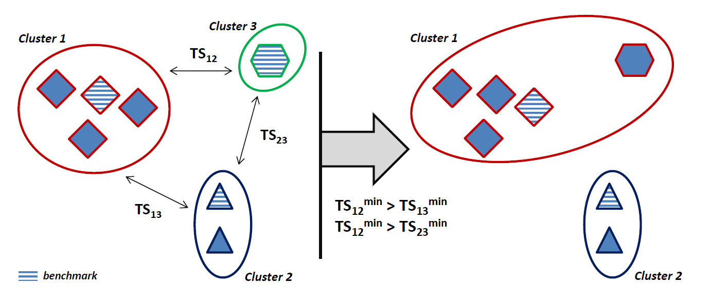
Graphical Illustration
The clustering procedure we designed has several attractive features: it always yields a well-defined "representative point" in each cluster (what we call a benchmark point), and it privileges intra-cluster homogeneity over average homogeneity.

Slide 13
What We Get
By partitioning the parameter space into regions where the phenomenology is homogeneous we solve the problem of exploring it with a finite number of searches
By having identified a well-defined benchmark in each region we know what topology to target in order to have the maximum impact on the full cluster
one can in fact show that by training a classifier using the benchmark, one obtains the best separation for all elements of the cluster

Slide 14
Where To Stop ?
The only parameter in the procedure is the number of clusters one wants. In alternative, one may define the smallest value of TS allowed for a pair of elements of the same cluster.
Of course one may also choose to run the procedure until one cluster is left, then compare results for different N_{clus} and decide a posteriori the wanted configuration based on arbitrary criteria
A larger number of clusters (and benchmarks) guarantees higher homogeneity → stronger inference, small loss of information in extrapolating a search tuned for the benchmark to all the cluster
This has to be weighted against the effort to perform a larger number of independently optimized searches

Slide 15
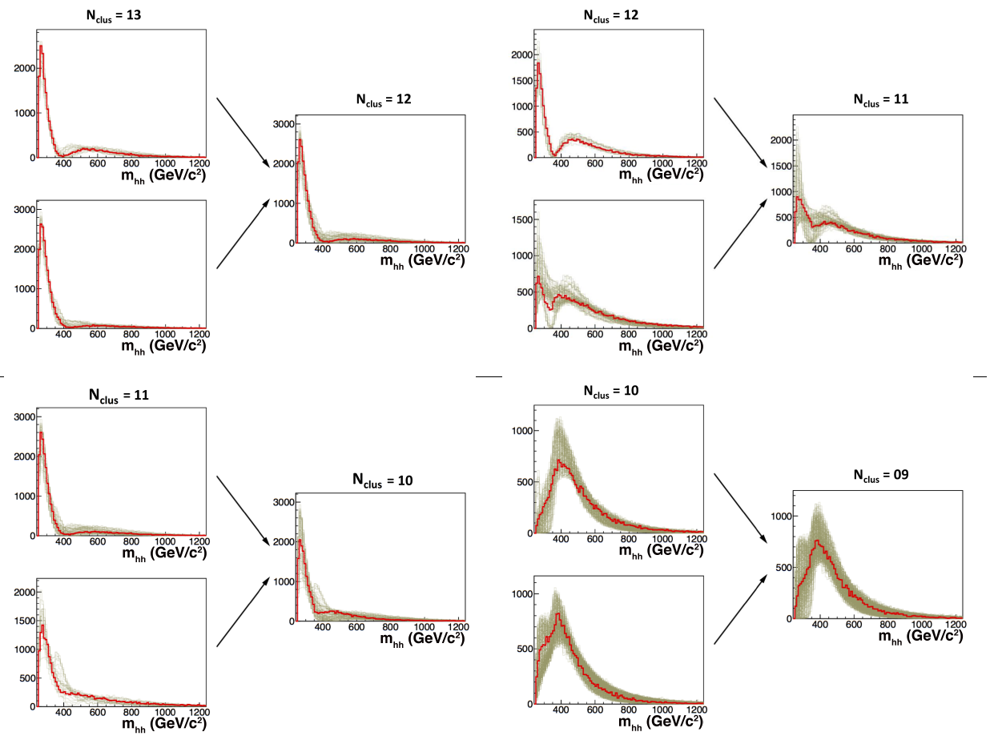
Application to hh Production: M_{hh} View

Slide 16
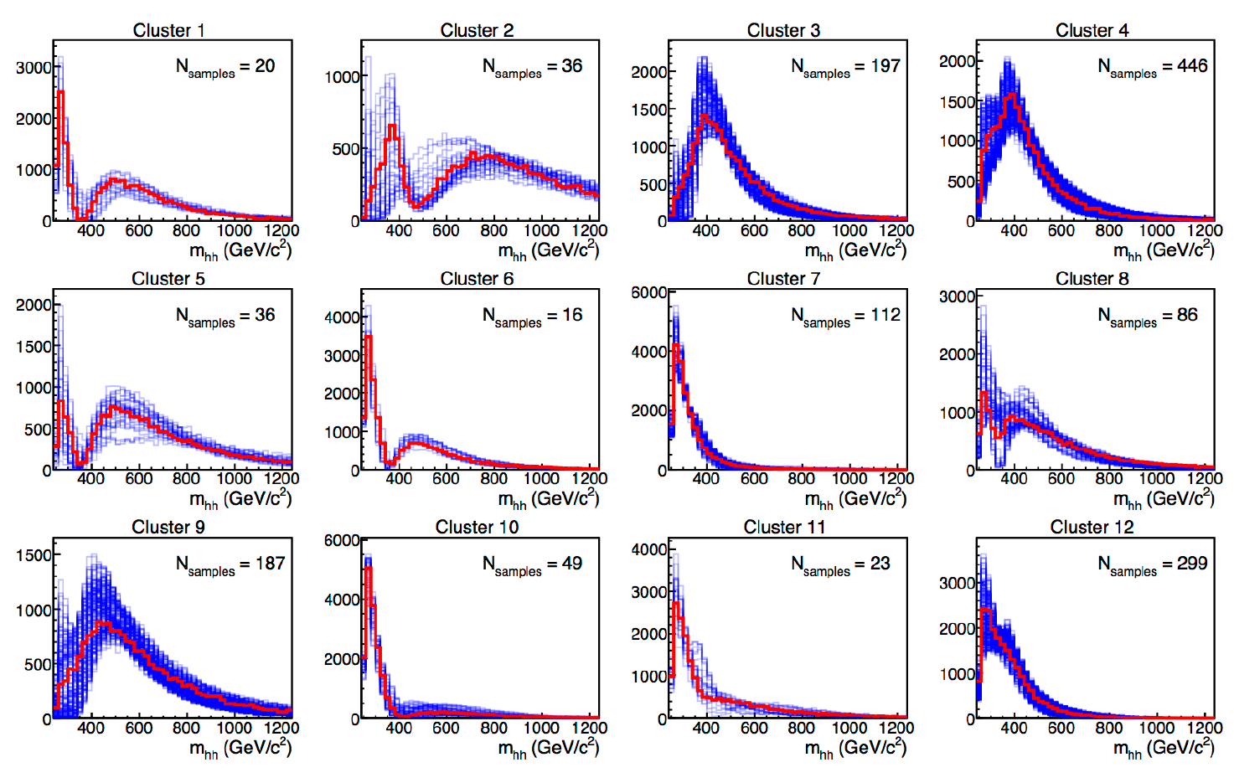
The 12 Chosen Clusters: M_{hh}

Slide 17
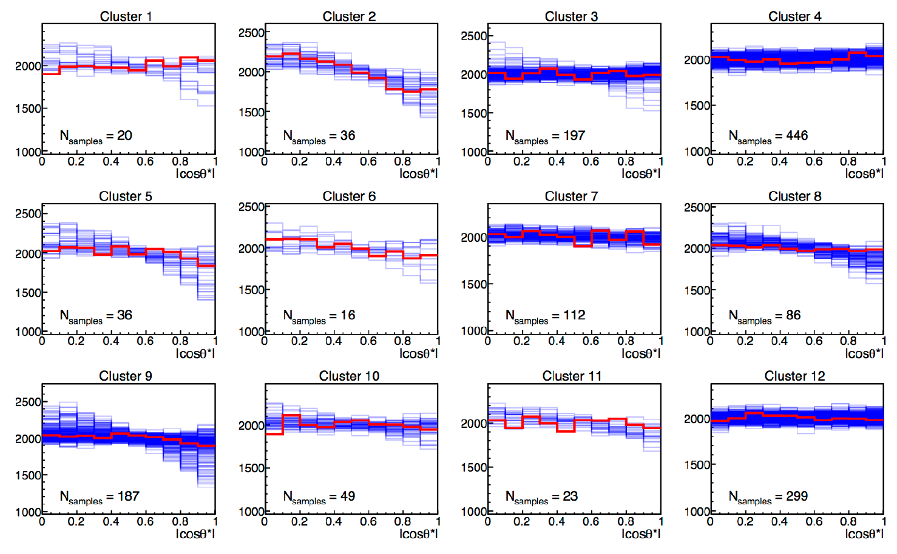
The 12 Chosen Clusters: |cos θ*|

Slide 18
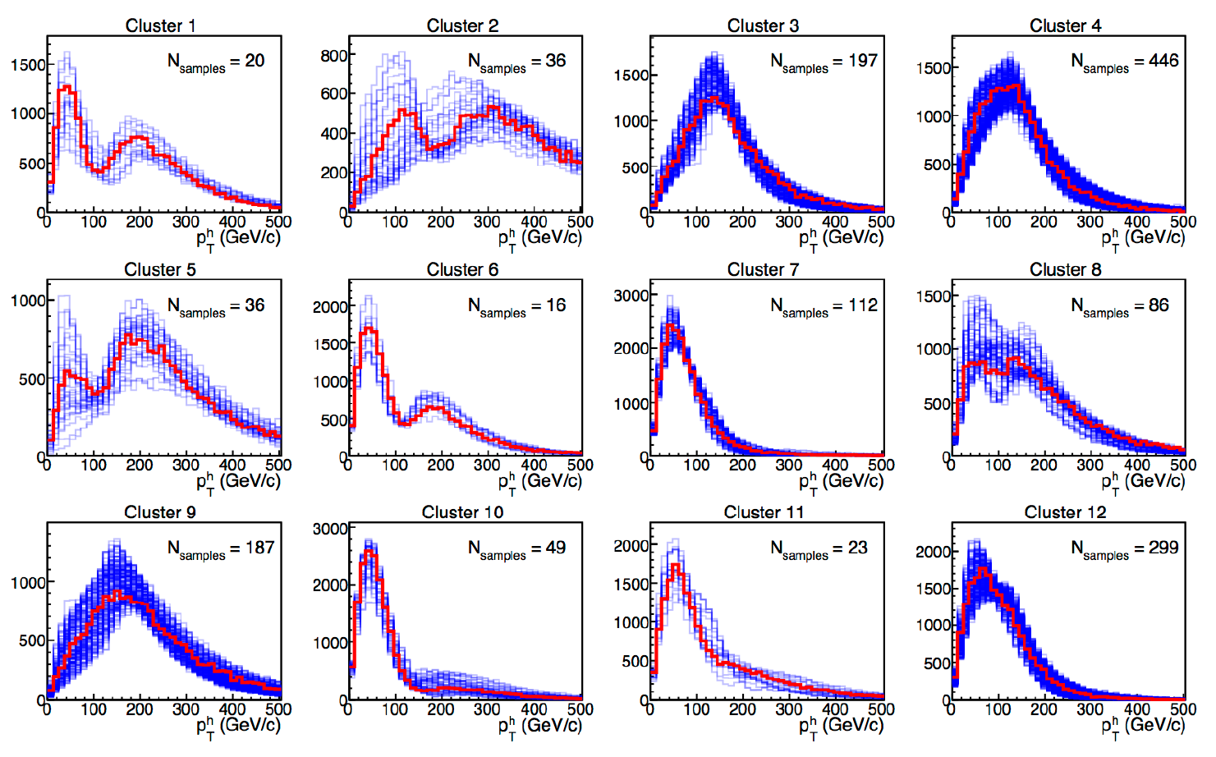
Other Variables: P_{T,h}

Slide 19
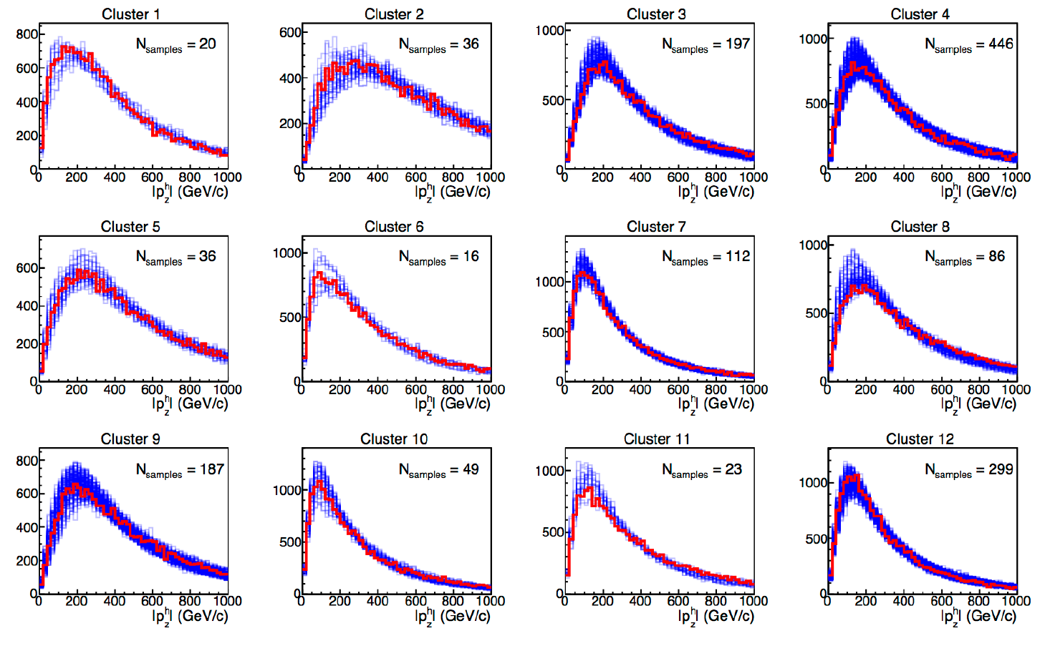
Other Variables: P_{z,h}

Slide 20
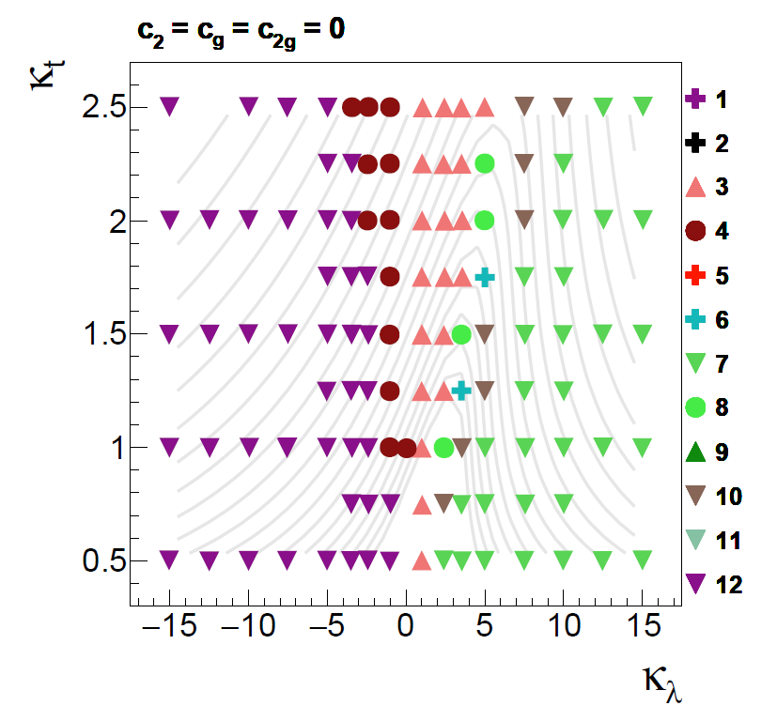
Clusters in (k_{λ}, k_{t}) Space

Slide 21
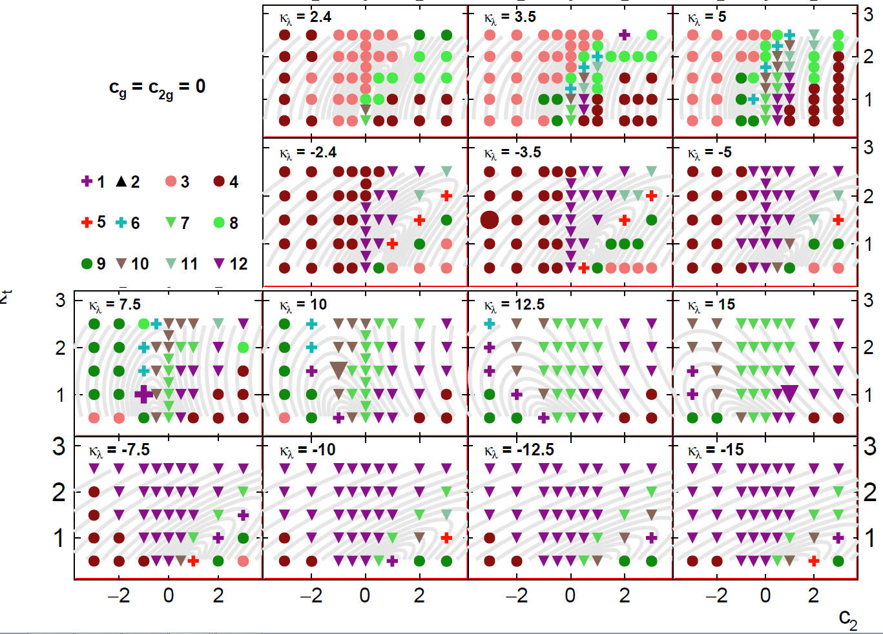
Clusters in (k_{t}, c₂) Space

Slide 22
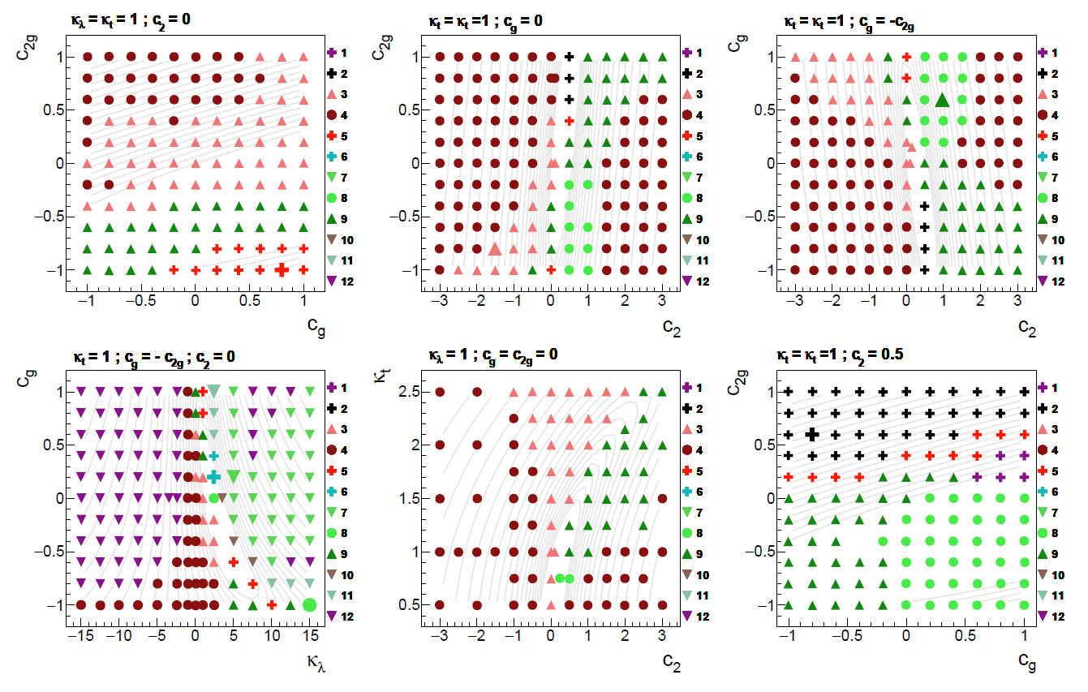
Clusters in (c_{2g}, c_{g}) Space

Slide 23
Conclusions
New physics theories live in multi-D parameter spaces, whose direct and exhaustive experimental investigation is impossible
One then focuses on simplified models, or defines benchmarks which represent the "typical" features of the new phenomena
A systematic approach is highly desirable. This can be achieved with a clustering procedure, which guarantees that the analysis time required to study a finite number of theories is optimally spent
We have shown how to best define benchmarks for the investigation of the EFT Higgs Lagrangian with anomalous couplings. The resulting 12 theories are now the ones of reference in di-Higgs searches.
This technique can be advantageously employed in a number of other NP searches
For details see A.Carvalho et al., "Higgs Pair Production: Choosing Benchmarks with Cluster Analysis", JHEP 4 (2016) 126, arXiv:1507.02245

