Slide 1
Particle Identification European Strategy Update meeting - Durham
Antonis Papanestis
RAL – STFC

Slide 2
Outline
Particle ID techniques:
Time of flight
Cherenkov radiation
RICH detectors
DIRC detectors
Transition radiation
dE/dx

Slide 3
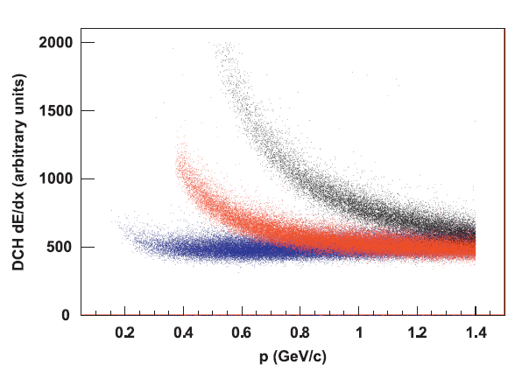
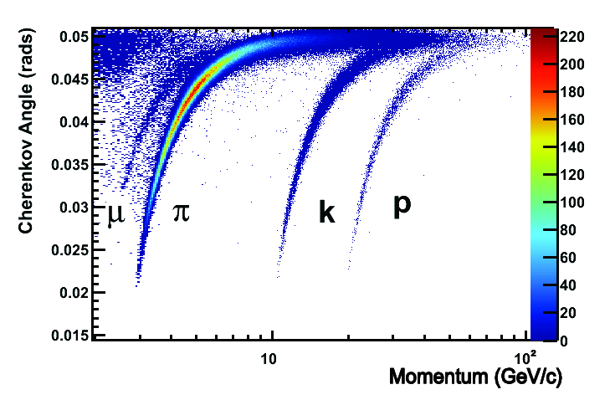
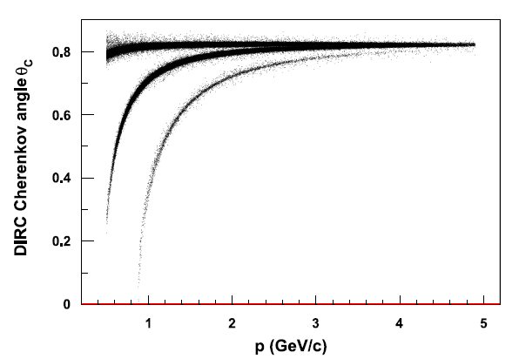
Trends
Higher energy colliders, higher luminosity
More tracks in the detectors, higher momentum tracks
LHCb particle ID
Babar particle ID

Slide 4
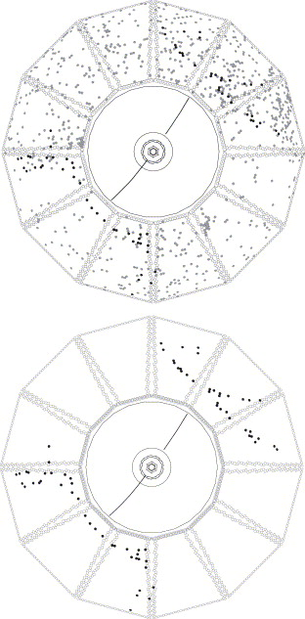
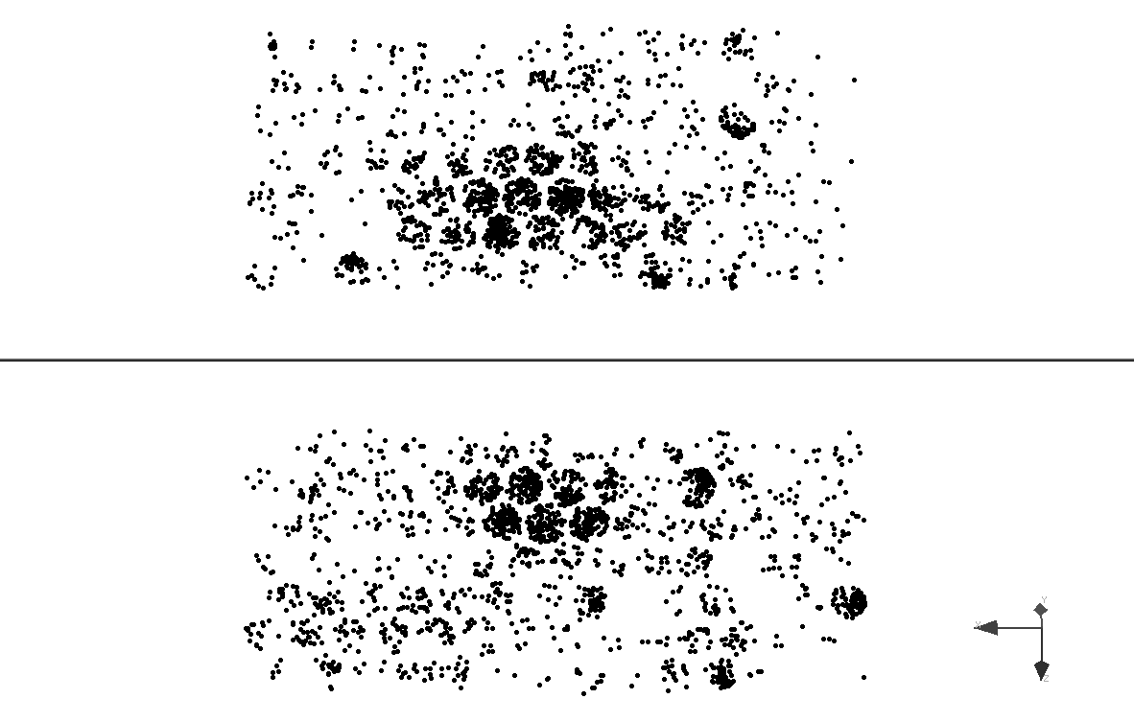
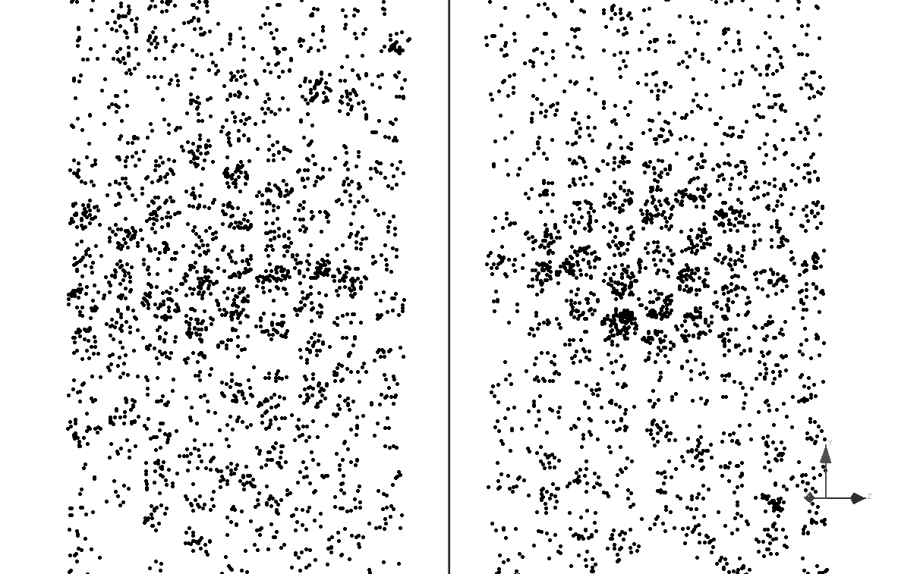
Increased hit multiplicity
Babar DIRC
LHCb RICH 1/2
Before time window
About 1000 hits per box
After time window

Slide 5
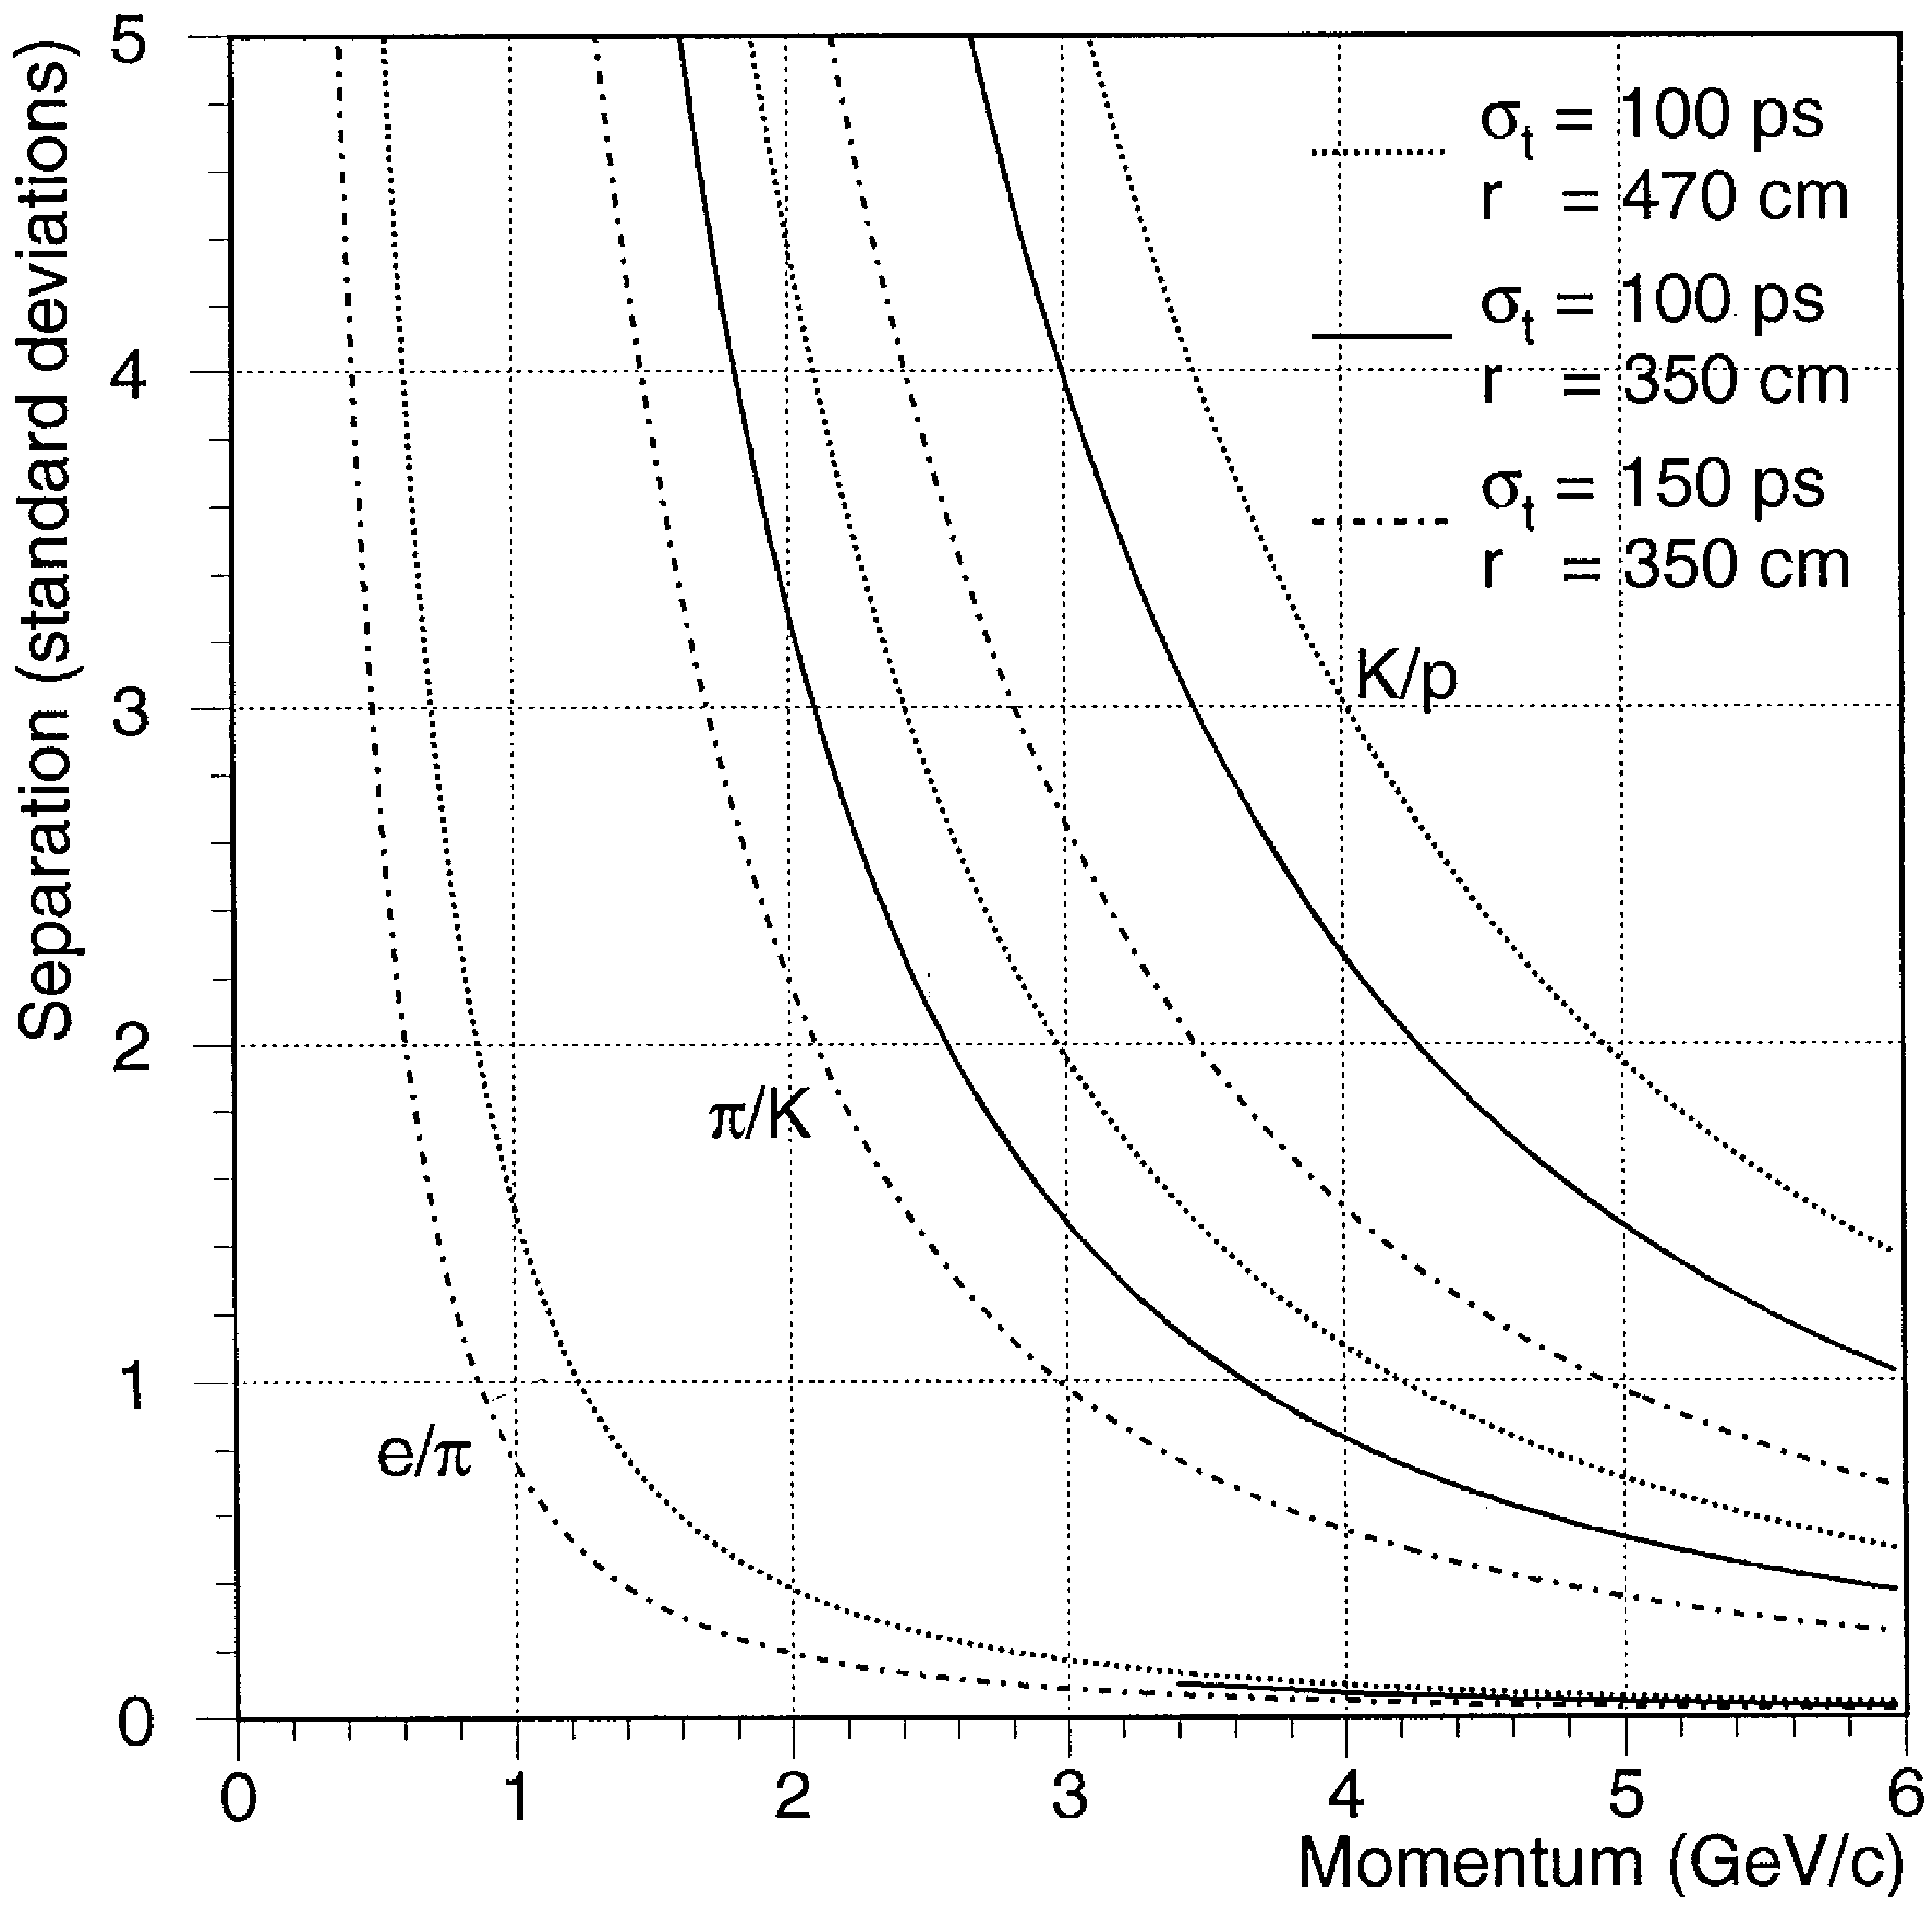
Time of flight
Better time resolution, better particle ID
Faster detectors
Desired for all detector technologies
As an extra dimension to reduce complexity
Expected PID performance for various path lengths and time resolutions

Slide 6
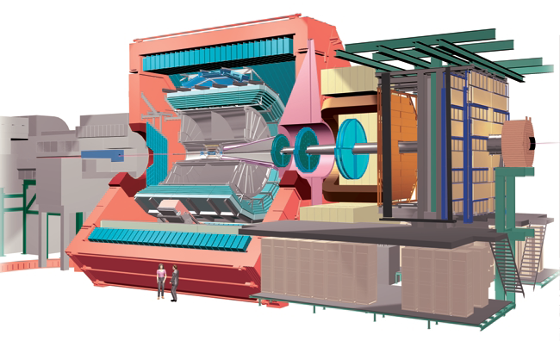
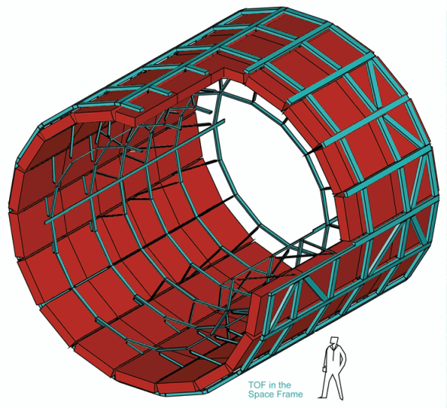
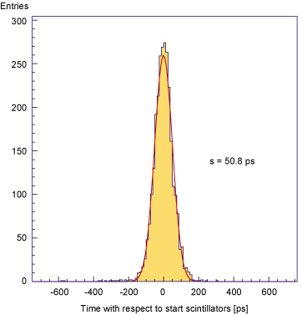
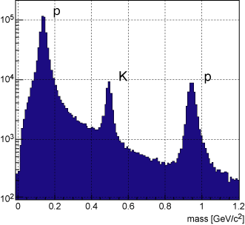
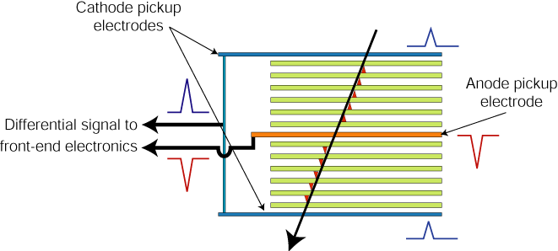
TOF: ALICE experiment
http://aliceinfo.cern.ch/Public/en/Chapter2/Chap2_TOF.html
Resistive plates made of glass.
2 X5 gaps : 250 mm
Readout by HPTDC chip (High Performance Time to Digital Converter)
σ=50.8ps
3σ π/K separation up to 2.2 GeV/c and K/p separation up to 4 GeV/c.

Slide 7
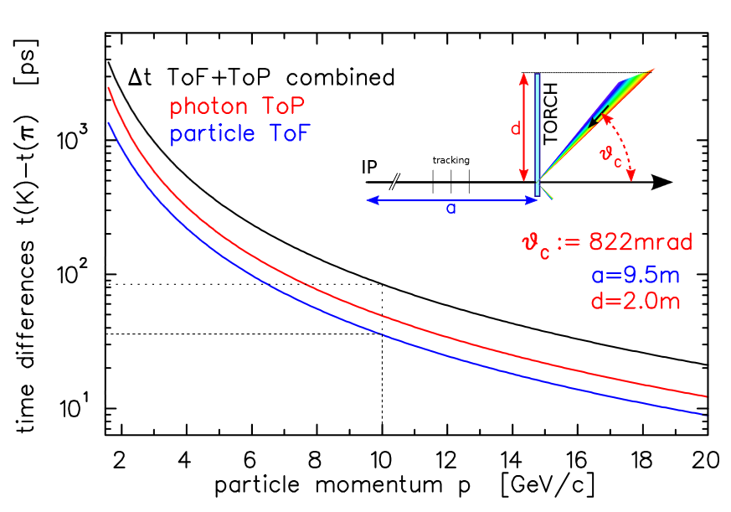
TORCH
The focusing unit converts angles to positions allowing the measurement of propagation time
Multiple photons from the same track can improve the time accuracy

Slide 8
RICH detectors
Performance parameters:
Cherenkov angle resolution
Number of photons
Complexity of the event
Detector occupancy
Increasing the number of photons:
Improved mirror reflectivity
Better detector geometrical coverage
Improved detector Quantum efficiency

Slide 9
Cherenkov angle resolution
Chromatic error
For a given radiator the refractive index depends on the photon wavelength
Work in the area where the refractive index is flat: optical
Loss of photons
Detectors with high QE in the optical
Aberrations from the optical system
Move mirrors to desired positions for smallest possible “emission point error”
If inside the detector acceptance, low material budget (composite) mirrors are needed
Detection point error
Smaller pixel
Helps with occupancy
More channels
Improve tracking and add timing

Slide 10
Photon detectors
Multi-Anode PMTs
To be installed in the LHCb RICH Upgrade
Much improved since 2005
MCPs (Micro Channel Plate detectors)
LAPPD Large Area Picosecond Photon Detectors
SiPMs (Silicon Photo Multipliers)
Arrays of Avalanche Photo-Dodes
HPDs (Hybrid Photon Detectors)
Currently in use by LHCb RICH

Slide 11
Ideal photon detector
Pixel size 1mm²
SiPM, MCP
Low dead area (tiles)
?? Possibly all
Radiation hard
MaPMT
Insensitive to magnetic fields
SiPM, MCP
Good QE at visible (~50%)
SiPM
Durability
SiPM, MaPMT
Low dark counts
MCP, MaPMT
Fast
MCP
Possibly SiPM
Cheap ☺

Slide 12
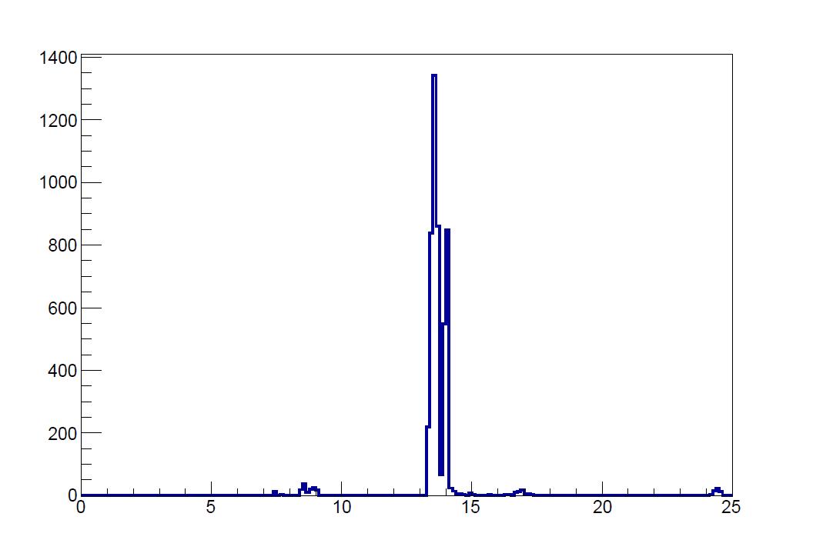
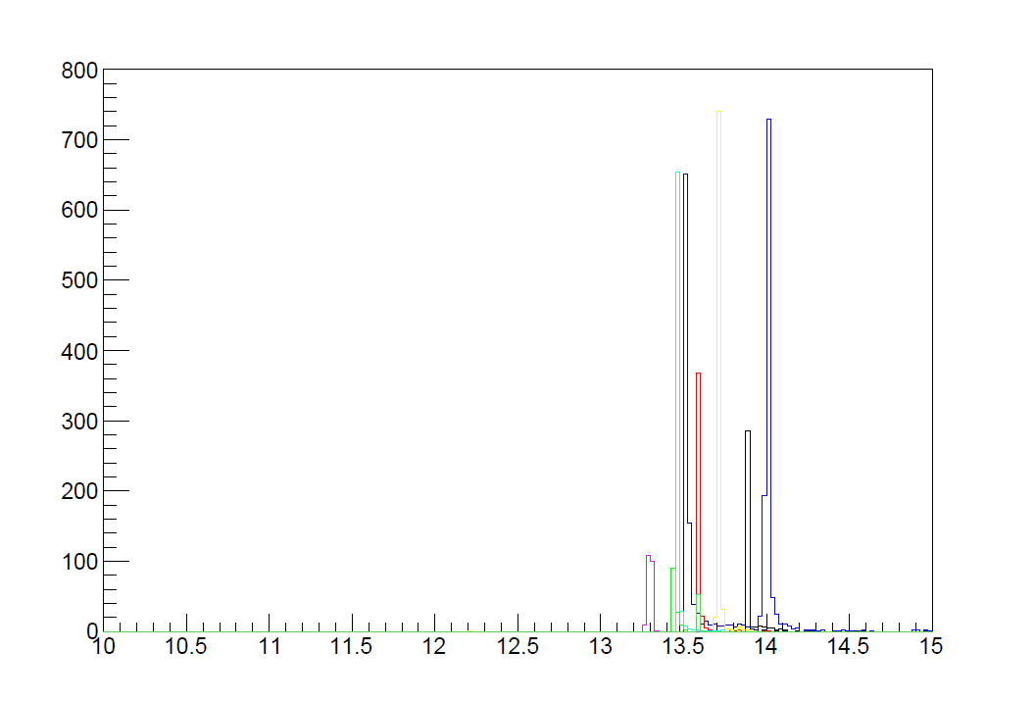
Timing
Timing can reduce event complexity by association of photons to tracks/vertices
Can be used as an extra dimension
Benefits start at ~100 ps
ns
LHCb event with 9 primary vertices seen by the RICH detectors with 125 (left) and 25 (right) ps resolution

Slide 13
Summary
RICH and TOF techniques have proved very successful for particle ID
The LHCb RICH, and the RICH for the LHCb Upgrade show what is possible to do at the moment
New photon detectors will be needed in the next generation experiments (LHCb Upgrade II)
Can we find other applications to speed up their development?
SiPMs promising, but currently suffer from radiation damage
LAPPDs a viable alternative
Is timing below 100 ps possible?
Good quality, large area, cheap mirrors from composite materials could be a key factor in the new generation RICH detectors

