Slide 1
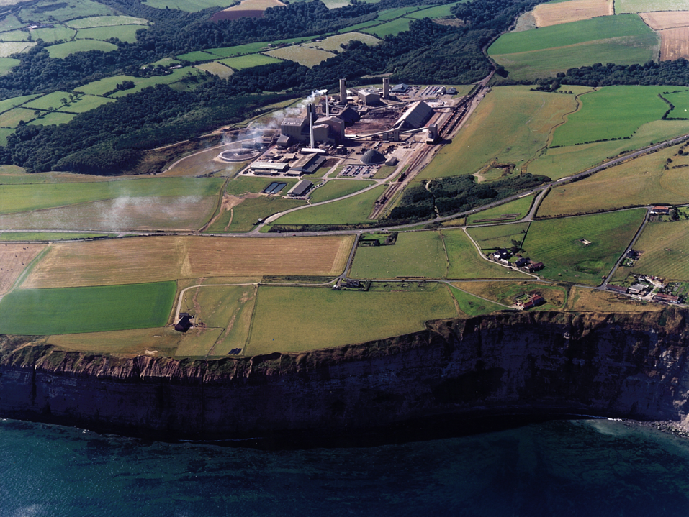

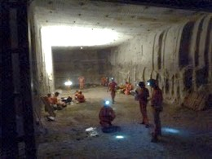
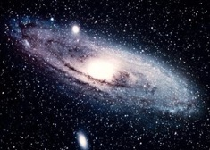
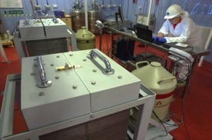
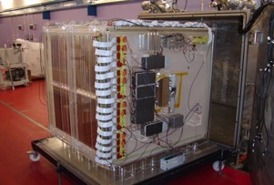
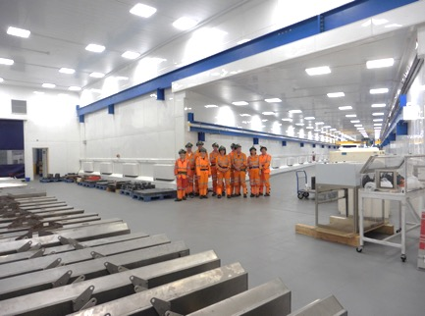
Paul Scovell
STFC Boulby Underground Science Facility
Boulby Science – the search for Dark Matter & Beyond
Hartlepool Nuclear Power Station
Multi-disciplinary studies: geology, climate, the environment, life on earth & elsewhere
Boulby Underground Laboratory:
Multi-disciplinary deep underground science. From astroparticle physics to studies of geology/geophysics, life on Earth and beyond.
New Underground lab @ Boulby

Slide 2


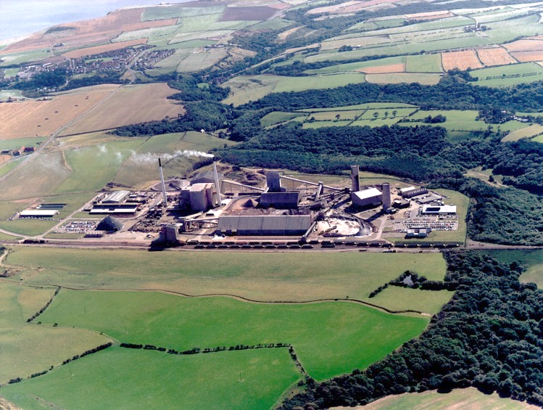
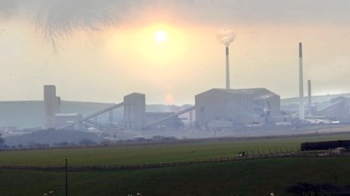
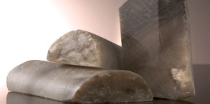
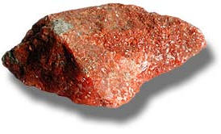
Boulby Mine
A working polyhalite and rock-salt mine on the North East of England.
Owned by Israel Chemicals Ltd. (ICL-UK)
Major local employer - ~700 direct and 3000 indirect employment.
Middlesborough
Staithes
Whitby
Deepest mine in Britain: 1100m
York
Polyhalite
Potash (KCl)
View from Staithes

Slide 3

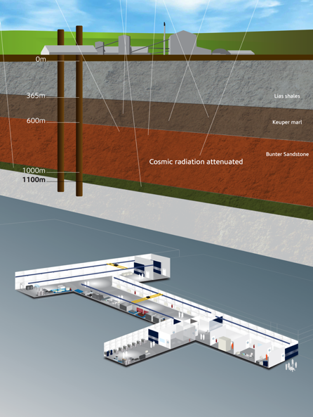
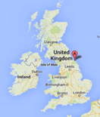


Boulby Underground Laboratory
The UK’s deep underground science facility operating in a working potash and salt mine.
1.1km depth (2805 mwe). With low background surrounding rock-salt
Operated by the UK’s Science & Technology Facilities Council (STFC) in partnership with the mine operators ICL
New Lab open since 2017
Permian Evaporites
Factor ~10⁶ reduction in cosmic ray flux
vs. surface
A QUIET place in the Universe

Slide 4
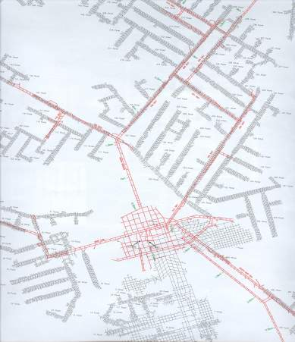
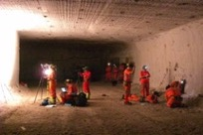
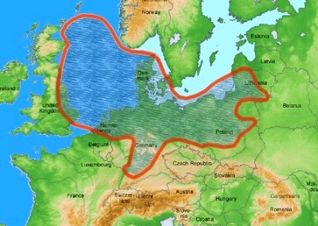
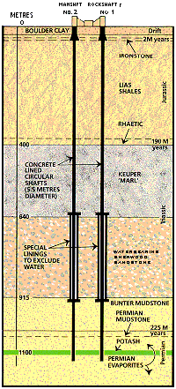




Boulby Geology & Mining
Excavations are in Salt (NaCl) & Potash (KCl) Permian evaporite layers left over from the Zechstein Sea.
Over 40 kms of tunnel mined each year (now >1,000kms in total), the long-lived roadways being cut in the lower NaCl layer.
Typical Boulby Salt Roadway
U: 67 ± 6 ppb
Th: 125 ± 10 ppb
Low γ & n backgrounds
Low Rn (<3 Bqm⁻³)
Zechstein Sea
Potash
Mine Shafts
Rock-Salt
New Lab
(2017)
Polyhalite
Boulby Geology
sean.paling@stfc.ac.uk

Slide 5


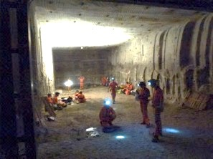
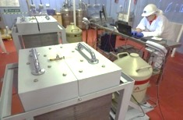

Underground Science @ Boulby Mine
DRIFT: Directional Dark Matter Search
BUGS: Ultra-low background material screening
(for LUX-ZEPLIN and Super-K-Gd and more)
ERSaB: Environmental gamma spectroscopy
Deep Carbon: Muon Tomography for CCS (etc)
SELLR: Life in Low background radiation
BISAL: Geomicrobiology / Astrobiology studies
MINAR: Space Exploration Tech. Development
Misc. Geology / Geoscience
Etc... (More to come).
DRIFT-II
A busy & growing multi-disciplinary science programme: from astrophysics (Dark Matter) to studies of geology, climate, the environment, life on Earth & beyond.

Slide 6

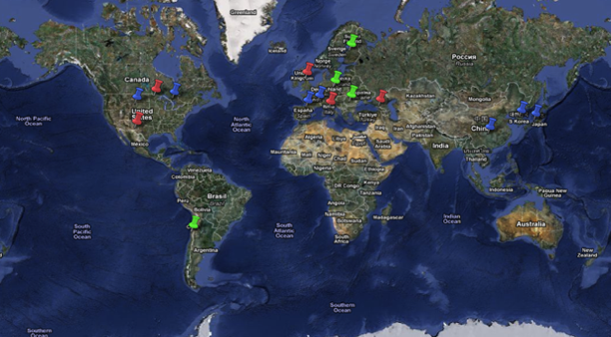


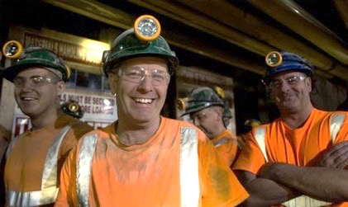






Boulby Facility Details…
• The UK’s deep underground science facility. One of 4 in EU. ~10 in the world.
• Supports work of 9 collaborative projects (astrophysics to climate, geology, environment etc), 20 institutions, > 70 scientists and students.
Facility funded and operated by the Science and Technology Facilities Council (STFC).
The World’s Underground labs
Operations, H&S & science programme managed by 4(+3) onsite staff and supported by Rutherford Appleton Lab (PPD).
Mine operators ICL-UK provide wide-ranging operational & higher level support.
How does Boulby Compare?
Lowest Radon levels (3 Bq/m³)
Most diverse science prog.
Science and Industry partnership

Slide 7
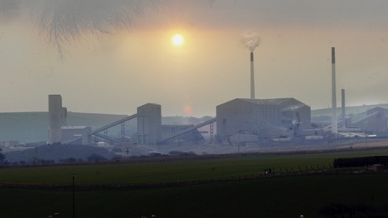
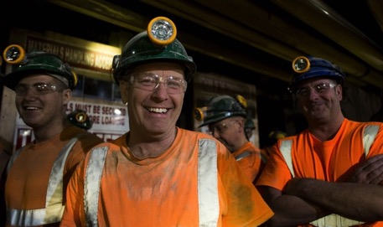
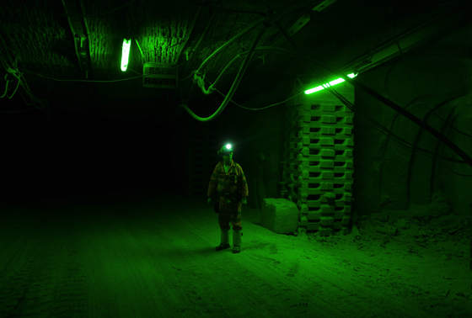
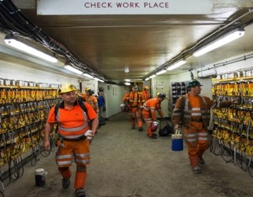
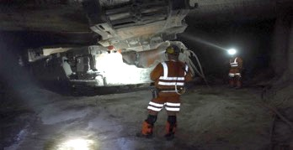
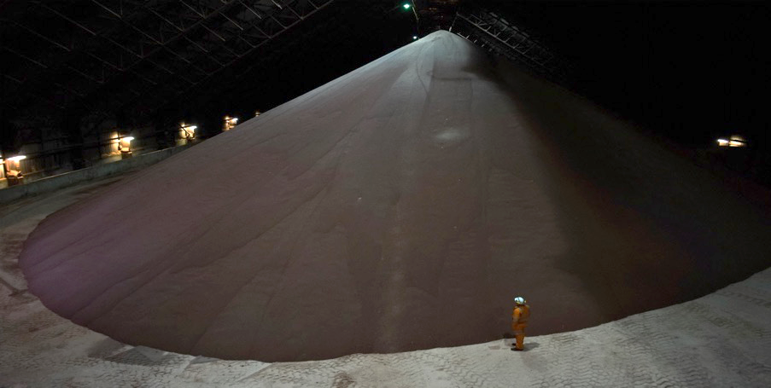
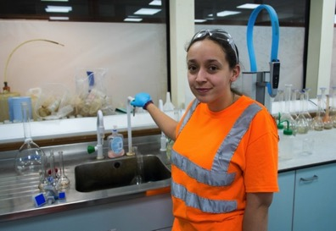

Working alongside
mining at Boulby…
Our responsibility:
Safety
Operations Impact
Outreach & Media
CPL/ICL support us:
Keep the mine operating and safe
Emergency H&S
Materials transportation
Misc. Facility maintenance

Slide 8
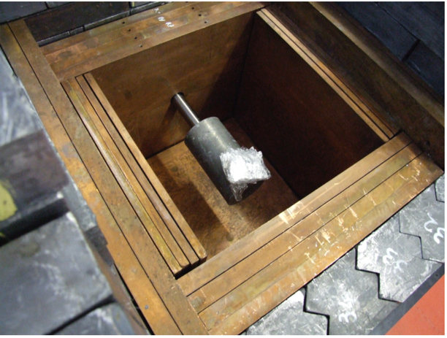
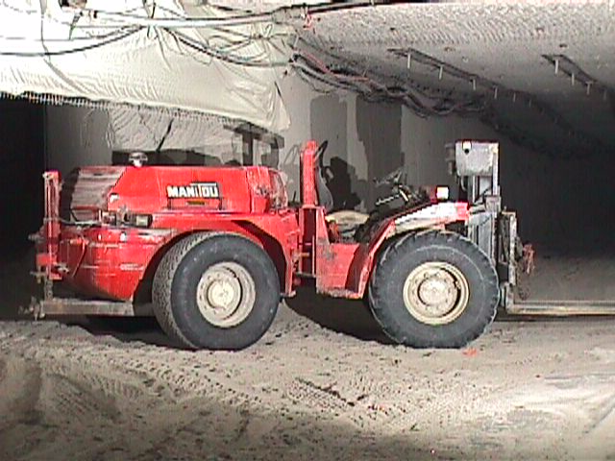
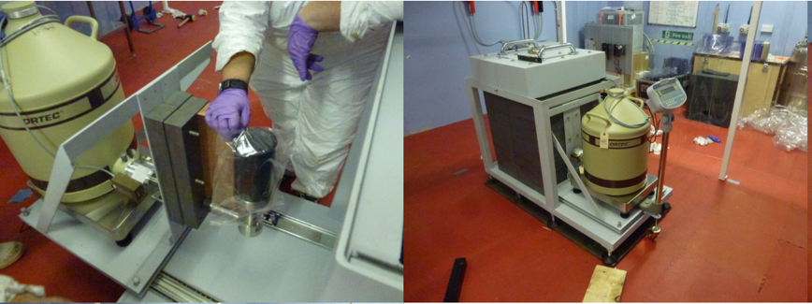
Low Background Screening
Ambitious programme to reboot and expand UK screening facilities launched in 2013
Starts with refurbishment of existing p-type coax – renamed Lunehead
Complemented by purchase of BEGe type detector
  First facility (I think!) to use this type of detector for low-background particle physics material assay
2014
c. 2009

Slide 9
Background Improvements

Slide 10
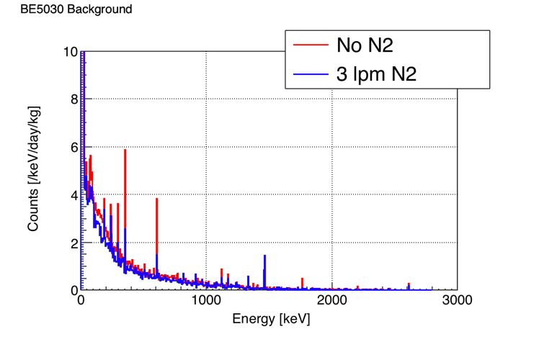
Background Improvements

Slide 11
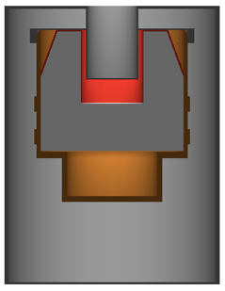
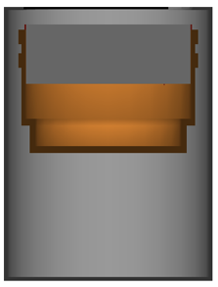
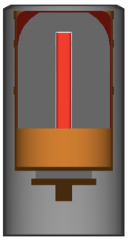
Backgrounds

Slide 12
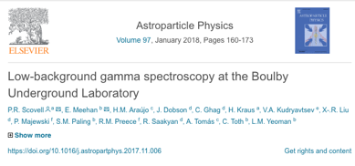
Detector Characterisation
All detectors are characterised using IAEA385 standard sample
Irish Sea sediment characterised at a large number of counting facilities using multiple techniques

Slide 13
Detector Sensitivity
PTFE
Copper
Chaloner has great reach in the low energy regime particularly for low energy lines
Also outperforms Lunehead in higher energy lines for denser material
This would not be the case with a newer p-type

Slide 14
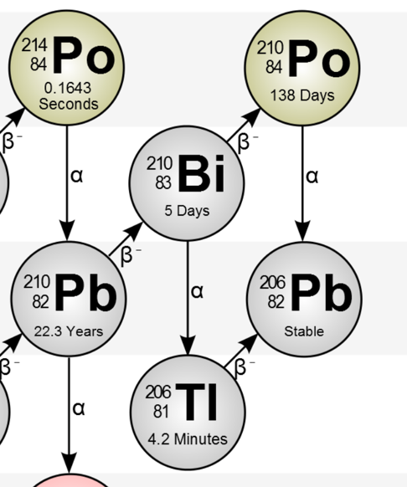
Detector Sensitivity
5.3 MeV
We see that the low energy reach of the BEGe type detector opens sensitivity to information not accessible using a p-type
This impacts the background model for low-background detectors

Slide 15
Comparing Background
 |  | Counts/day
 |  | Gator | GE-MPI | Chaloner | Lunehead | Lumpsey
Energy (keV) | Isotope | 2.2 kg | 2.2 kg | 0.8 kg | 2.0 kg | --
46.5 | ²³⁸U/²¹⁰Pb | -- | -- | 6.4(9) | -- | 18(2)
63.2 | ²³⁸U/²³⁴Th | -- | -- | 4.1(8) | -- | 13(1)
239 | ²³²Th/²¹²Pb | <0.5 | -- | 6.2(9) | 23(1) | 240(6)
911 | ²³²Th/²²⁸Ac | <0.5 | <0.2 | 0.7(3) | 5.0(7) | 52(3)
352 | ²³⁸U/²¹⁴Pb | 0.7(3) | <0.5 | 15.7(1.5) | 17(1) | 150(5)
609 | ²³⁸U/²¹⁴Bi | 0.6(2) | 0.5(5) | 11.7(1.3) | 16(1) | 80(3)
662 | ¹³⁷Cs | 0.3(1) | -- | 0.9(4) | <1.0 | <3.0
1173 | ⁶⁰Co | 0.5(1) | 0.6(4) | 2.1(6) | 4.4(6) | 3.9(7)
1332 | ⁶⁰Co | 0.5(1) | 0.4(3) | 2.0(6) | 3.8(6) | 2.8(6)
1461 | ⁴⁰K | 0.5(1) | 0.6(4) | 7.9(1.1) | 17(1) | 13(1)
2615 | ²³²Th/²⁰⁸Tl | 0.2(1) | -- | 0.7(3) | 6.1(8) | 21(2)

Slide 16
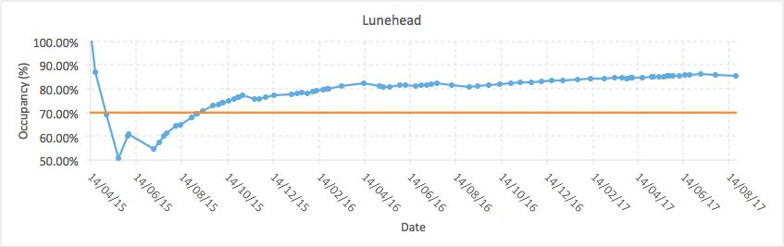
Improving Sensitivity
The two detectors have performed admirably for LZ screening
Over 80% occupancy on both Chaloner and Lunehead
240 Assays complete
For next generation low-background detectors we want to push further
Suite complemented by the addition of three S-ULB detectors

Slide 17
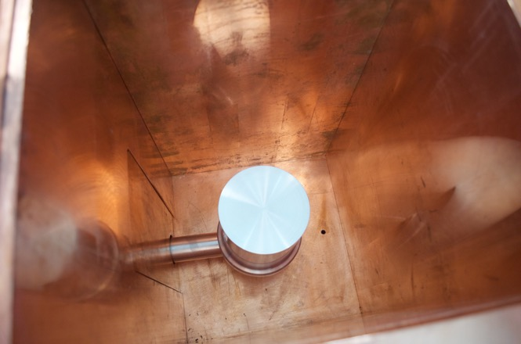
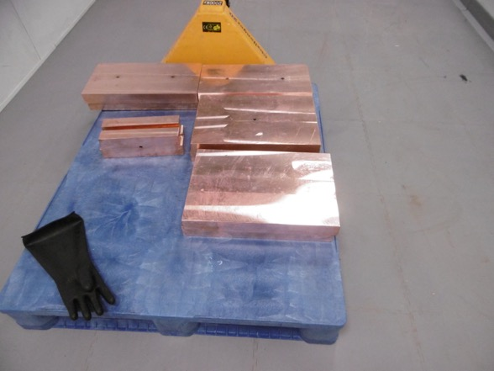
New S-ULB detectors
Developed with Canberra Lingolsheim
100% p-type (Merrybent)
160% p-type (Belmont)
55% BEGe (Roseberry)

Slide 18
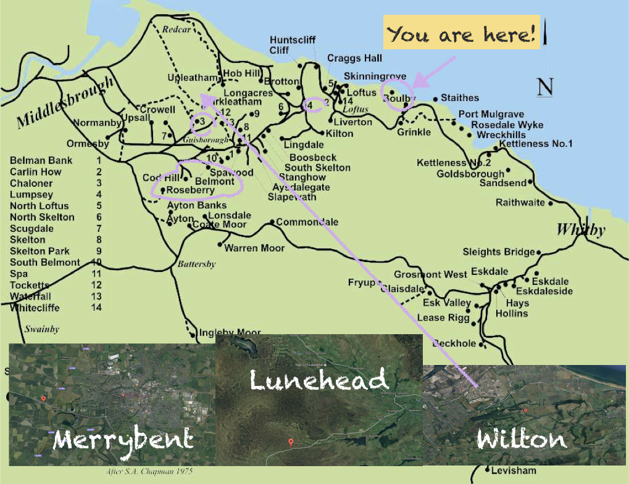

Slide 19
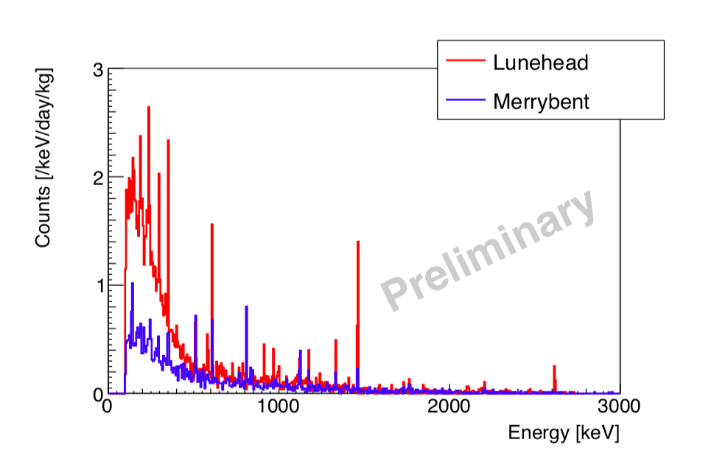
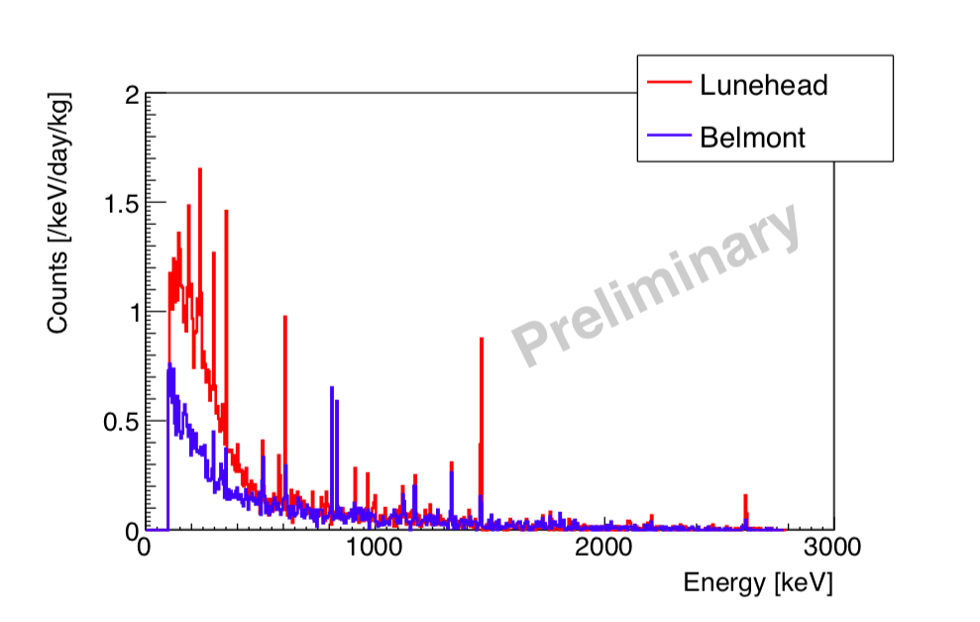
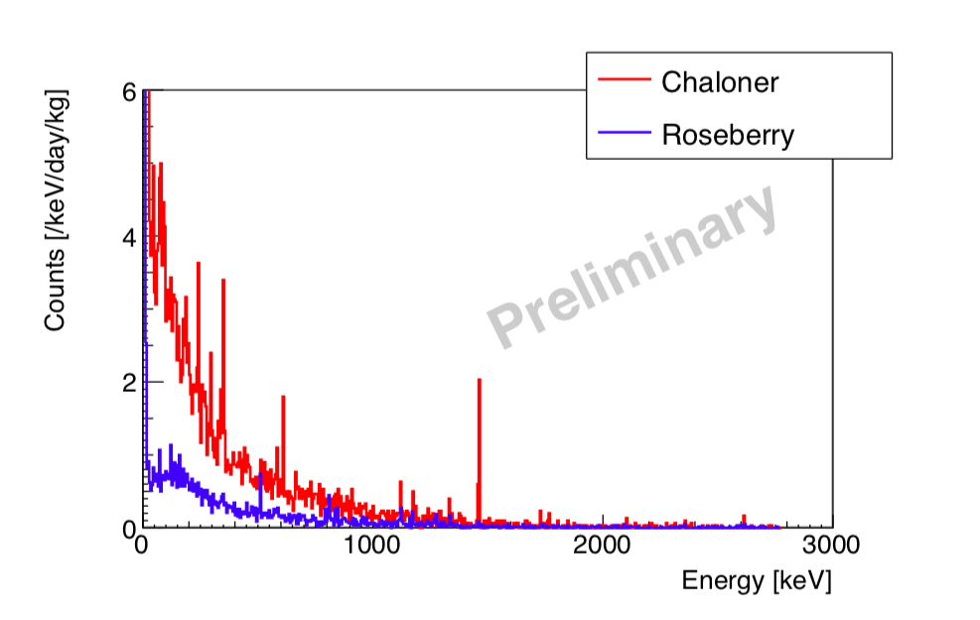
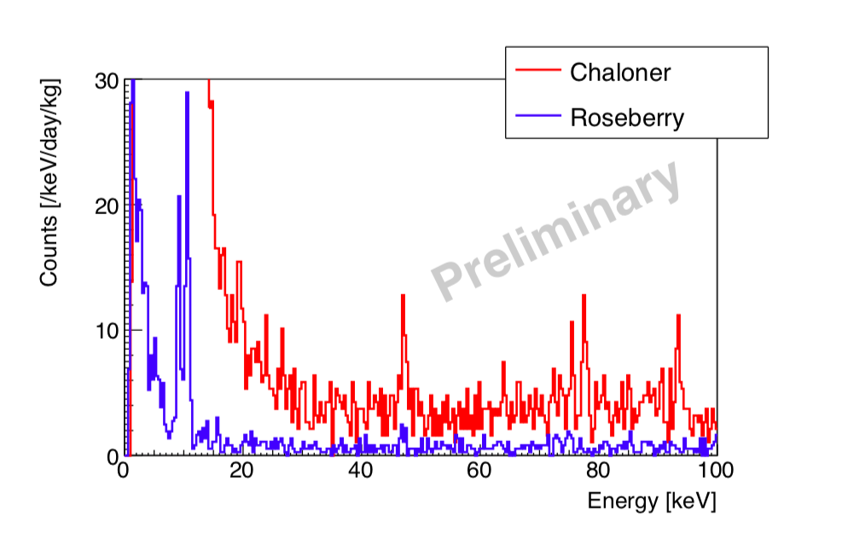
New S-ULB detectors

Slide 20
Sensitivity Improvements
 |  | Counts/day
 |  | Gator | GE-MPI | Roseberry | Merrybent | Belmont
Energy (keV) | Isotope | 2.2 kg | 2.2 kg | 0.9 kg | 2.0 kg | 3.2 kg
46.5 | ²³⁸U/²¹⁰Pb | -- | -- | 0.9(2) | -- | --
63.2 | ²³⁸U/²³⁴Th | -- | -- | <0.2 | -- | --
239 | ²³²Th/²¹²Pb | <0.5 | -- | <0.2 | <0.3 | <0.3
911 | ²³²Th/²²⁸Ac | <0.5 | <0.2 | <0.2 | <0.3 | <0.3
352 | ²³⁸U/²¹⁴Pb | 0.7(3) | <0.5 | 0.5(2) | 9(1) | 11(1)
609 | ²³⁸U/²¹⁴Bi | 0.6(2) | 0.5(5) | 0.5(2) | 6(1) | 12(1)
662 | ¹³⁷Cs | 0.3(1) | -- | <0.2 | <0.3 | <0.3
1173 | ⁶⁰Co | 0.5(1) | 0.6(4) | 0.7(2) | 2.0(6) | 6.8(9)
1332 | ⁶⁰Co | 0.5(1) | 0.4(3) | 0.9(2) | 2.1(6) | 4.8(7)
1461 | ⁴⁰K | 0.5(1) | 0.6(4) | 0.5(2) | 3.6(7) | 2.3(5)
2615 | ²³²Th/²⁰⁸Tl | 0.2(1) | -- | <0.2 | 0.9(3) | 0.8(3)
Compare count rates in new detectors with old
Compare with GATOR and Ge-MPI

Slide 21
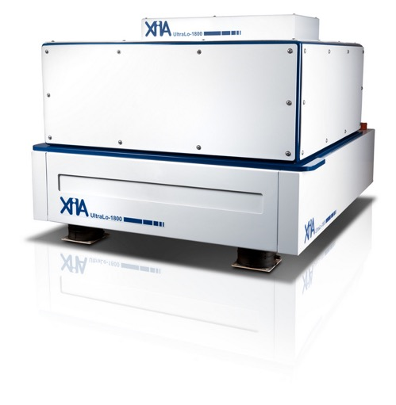
XIA
BUGS further expanded
The UltraLo-1800 is a low-background surface alpha counter with electronic background suppression
<0.0001 alphas/cm²/hour
This combines with the new generation of BUGS detectors to expand screening capability for next gen low background experiments
Not only to reduce backgrounds but to measure contaminations
  Feed to background models
Currently developing the technique at Boulby but have some interesting samples in the pipeline

Slide 22
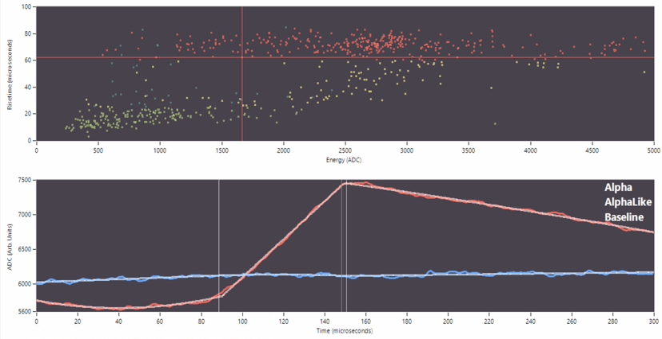
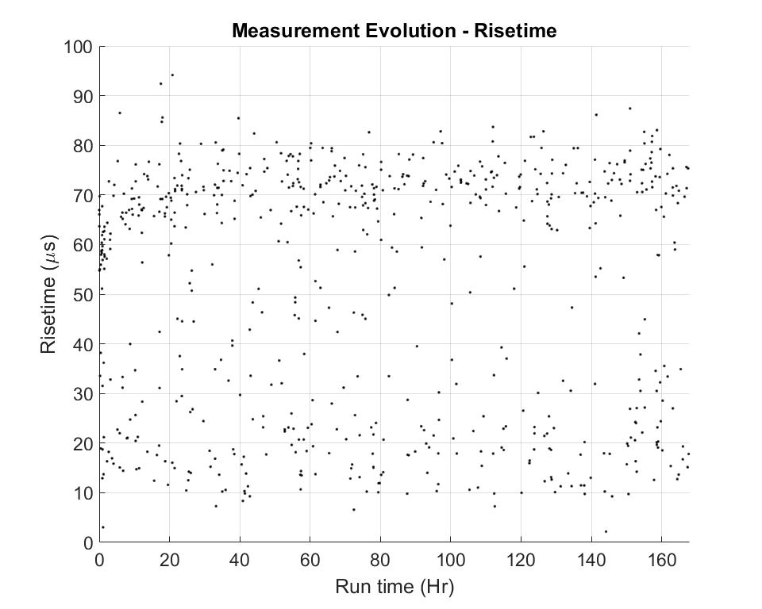
XIA
Location | Depth | Alphas | Ceilings | MidAirs | Rounds
XIA | 0 m | 100 | 76 | 99 | 308
Stanford | -17 mwe | 100 | 79 | 27 | 31
Soudan UL | -2060 mwe | 100 | 64 | 60 | 3
LSM | -4800 mwe | 100 | 130 | 44 | 14
ASTEP | 2552 m | 100 | 110 | 275 | 700
Boulby UL | -2805 mwe | 100 | 30 | 51 | 10

Slide 23
Looking Forwards
Screening continues apace for LZ
We have also started in Super Kamiokande Gd screening
We look to place Boulby as *the* place to do low background screening
Wish to establish BUGS as a center of excellence for screening and cleanliness
We hope to eventually expand further
  Rn emanation
  Microscopy
  ICP-MS??
Watch this space!

