Slide 1
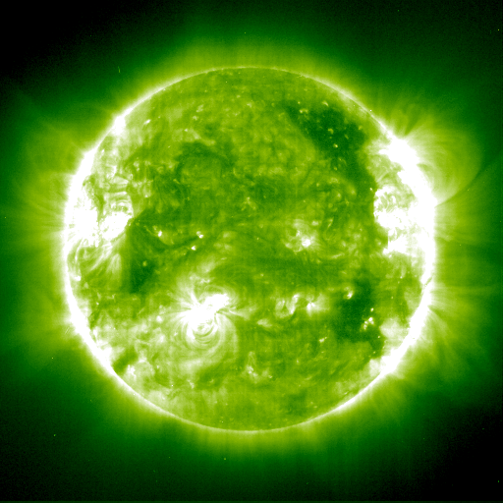
C N O
Clearly
Now (an)
Opportunity
MALCOLM FAIRBAIRN
Kings College London

Slide 2
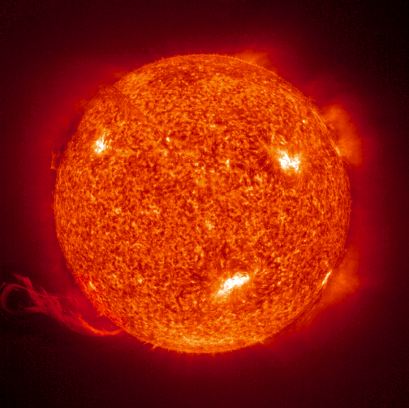
Outline:-
Solar Metallicity Problem
CNO neutrinos via electron recoils
CNO neutrinos via nuclear recoils
based on
Cerdeno, Davis, Fairbairn and Vincent arXiv:1712.06522

Slide 3


Slide 4
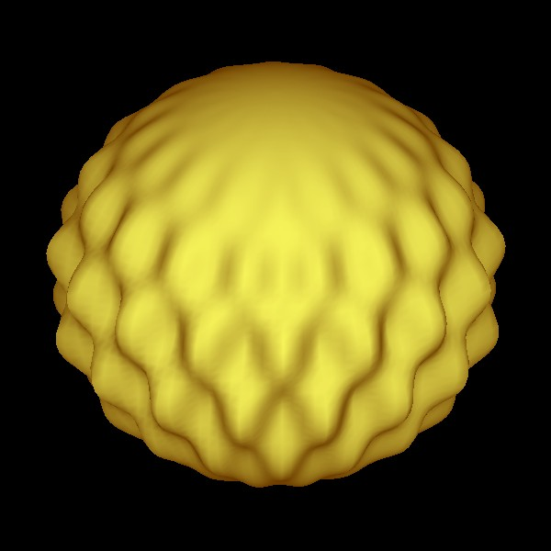
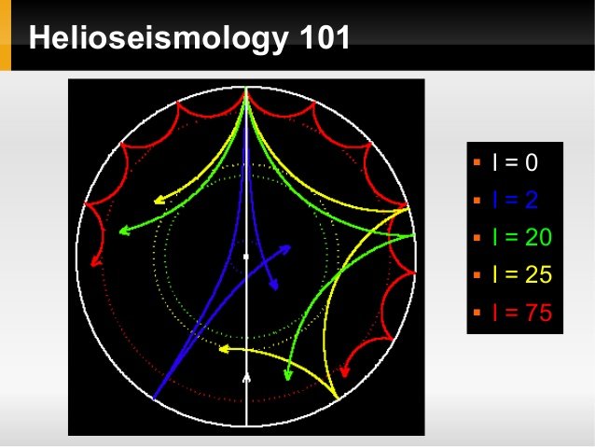
Helioseismology – vibrational modes of the Sun
By its very nature it samples the speed of sound in the Sun at different depths

Slide 5
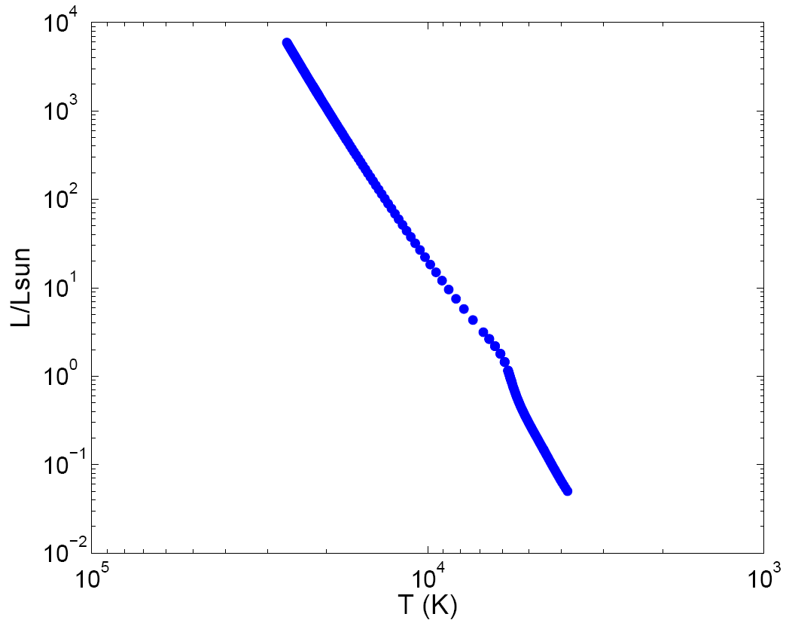
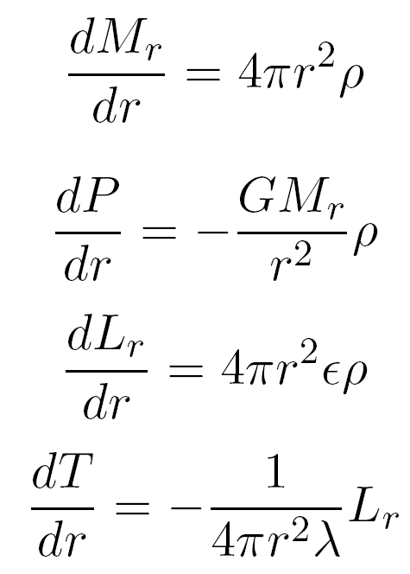
Equations of stellar structure have solutions which are stars

Slide 6
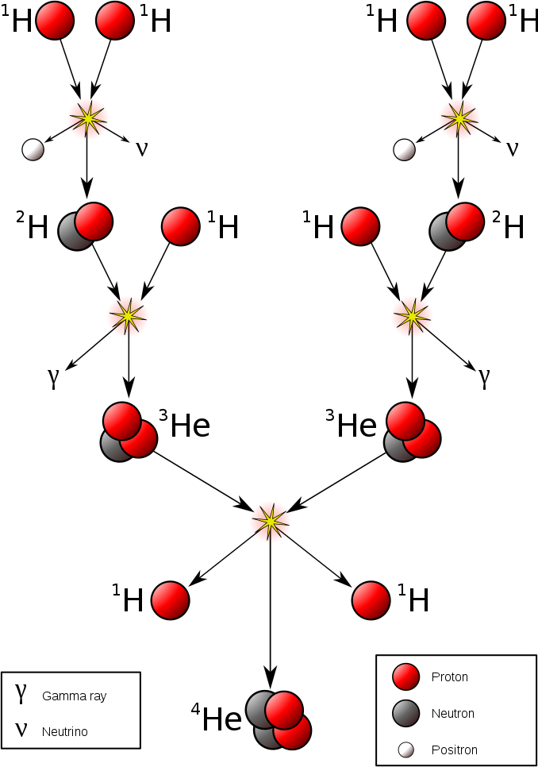
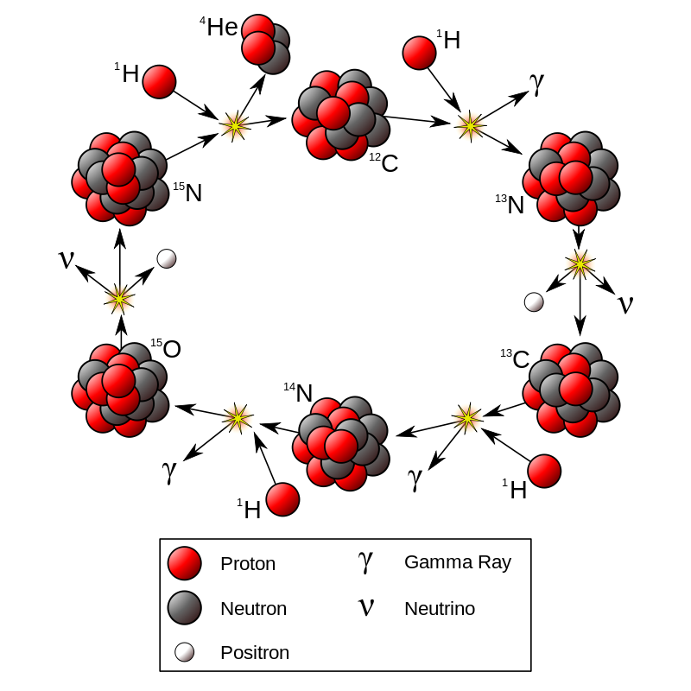
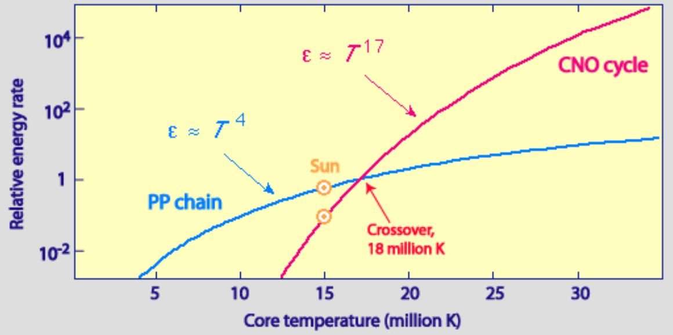
PP-chain
CNO-cycle
DEPENDS ON METALLICITY Z

Slide 7
Equations of Stellar Structure have Solutions which are Stars
This kink partially result of
change between CNO
and PP cycle

Slide 8
Solar Spectral Abundance
This is taken from Asplund, Grevesse, Sauval and Scott 2009

Slide 9
Observed abundances are not consistent with Solar Models which match Helioseismology constraints on speed of sound.
Z
As we make conclusions about DM and DE using stars should worry about this.

Slide 10
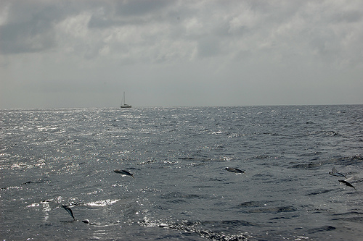
Equations of stellar structure have solutions which are stars
Scattering of dark matter can reduce opacity

Slide 11
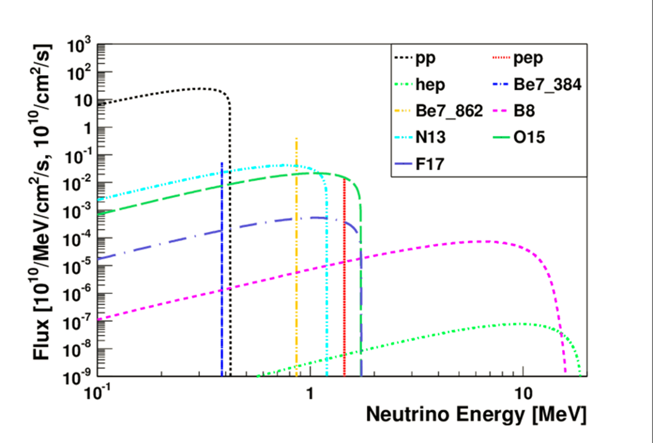
One way to get a better hold on this is by measuring CNO neutrinos

Slide 12
Electron Recoils from CNO neutrinos
Let us estimate the sensitivities of some upcoming experiments
Harnik, Kopp
& Machado 2009

Slide 13
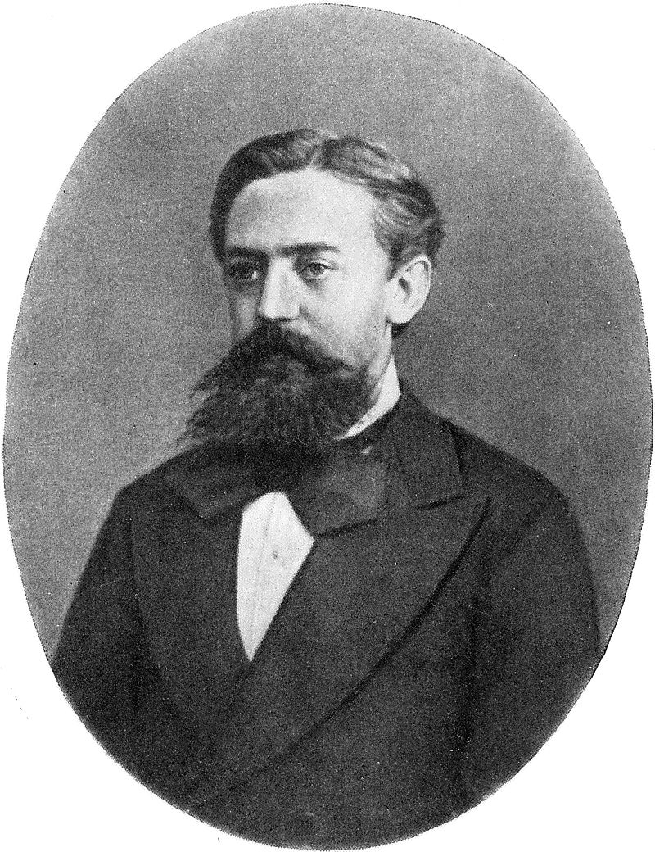
Our Statistical Analysis in the work
We do Monte Carlo Markov Chains MCMC
Some of our (Gaussian) priors based on actual measurements and their errors
Other priors are based on expected backgrounds and the accuracy with which experiments will be able to measure these backgrounds
We compare the spectra of the different sources with simulated data
Each chain has one simulated data set, normalisations of the various spectra are allowed to vary within their priors
We run 50 chains (50 fake experiments) for each situation
Andrey Markov

Slide 14
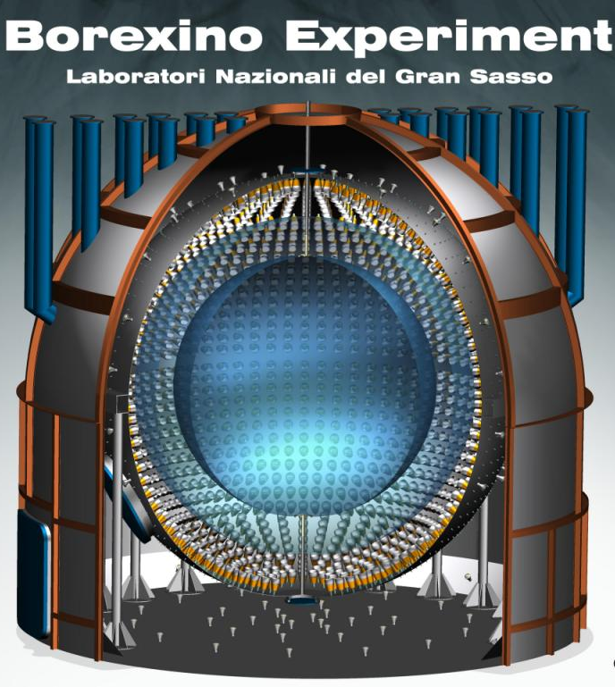
Liquid scintillator with 71 tons fiducial mass located in Gran Sasso Laboratory.
The liquid is a doped aromatic hydrocarbon.

Slide 15
Borexino CNO recoil spectrum and relevant backgrounds
CNO flux is rather similar to ²¹⁰Bi flux
This is a problem, however Borexino hope to be able to measure ²¹⁰Bi flux
through observation of daughter nuclei.
They may be able to do this at 10% level.

Slide 16
Borexino
Pessimistic (realistic) error
Estimate, assumes Borexino
Can measure ²¹⁰Bi flux to 10%
THIS IS AFTER 10 YEARS OF RUNNING.
DASHED LINE IS HI-Z CNO FLUX.
PROBABLY UNREALISTIC:-
BOREXINO WILL HAVE DIFFICULTY MEASURING CNO
Optimistic (unrealistic?) error
Estimate, assumes Borexino
Can measure ²¹⁰Bi flux to 1%

Slide 17
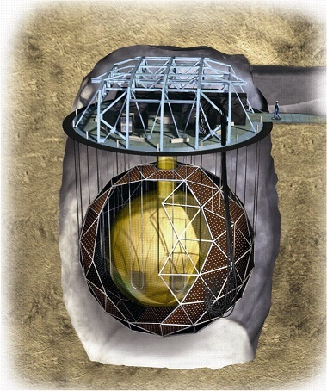
SNO+
Also has backgrounds but more importantly it is
Starting it’s run with ¹³⁰Te for 0νββ

Slide 18
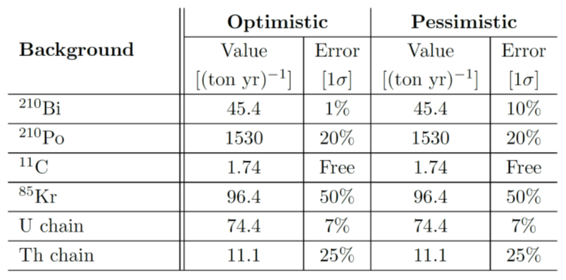
SNO+ runs without ¹³⁰Te
Six months running of SNO+ with pessimistic errors
Three years running of SNO+ with pessimistic errors
HOWEVER – currently SNO+ plans to run with
¹³⁰Te in order to look for neutrinoless double beta decay

Slide 19
As it stands, SNO+ MAY detect CNO at low significance IF it decides to run without ¹³⁰Te for several years and they understand their backgrounds as well as they hope to.
However, they probably won’t be able to discriminate between low and high metallicities.

Slide 20
What about Dark Matter detectors?
CNO neutrinos give rise to
MeV electron recoils (above pp)
&
keV nuclear recoils (below 8B)
Lets start with electron recoils.

Slide 21

start with electron recoils

Slide 22
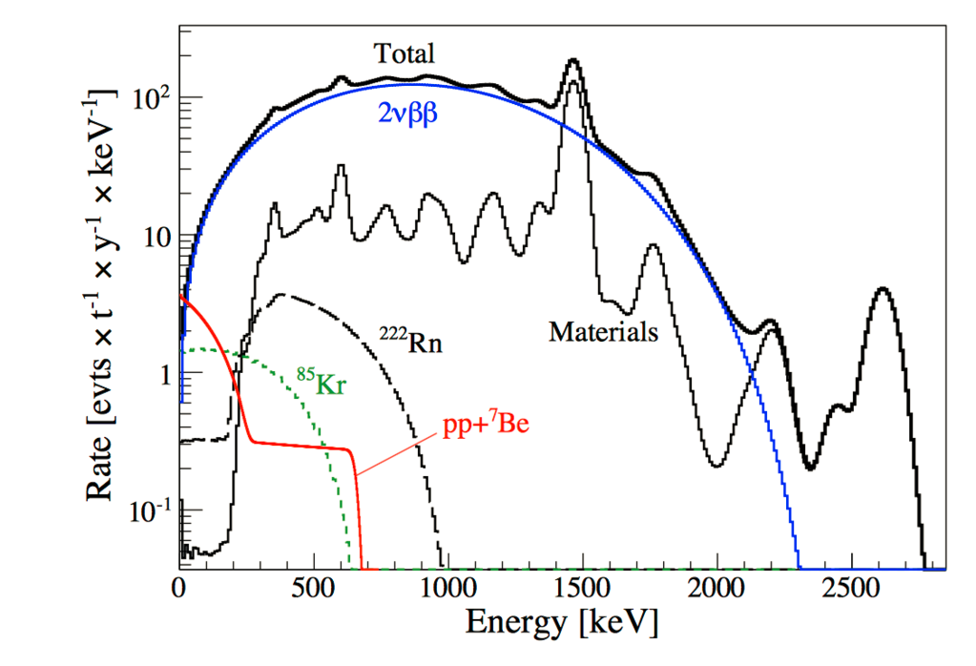
FUTURE XENON EXPERIMENTS (e.g. Darwin)
CNO neutrinos would be very difficult for a Xenon like experiment…
Electron recoils are in a region with a lot of background…

Slide 23
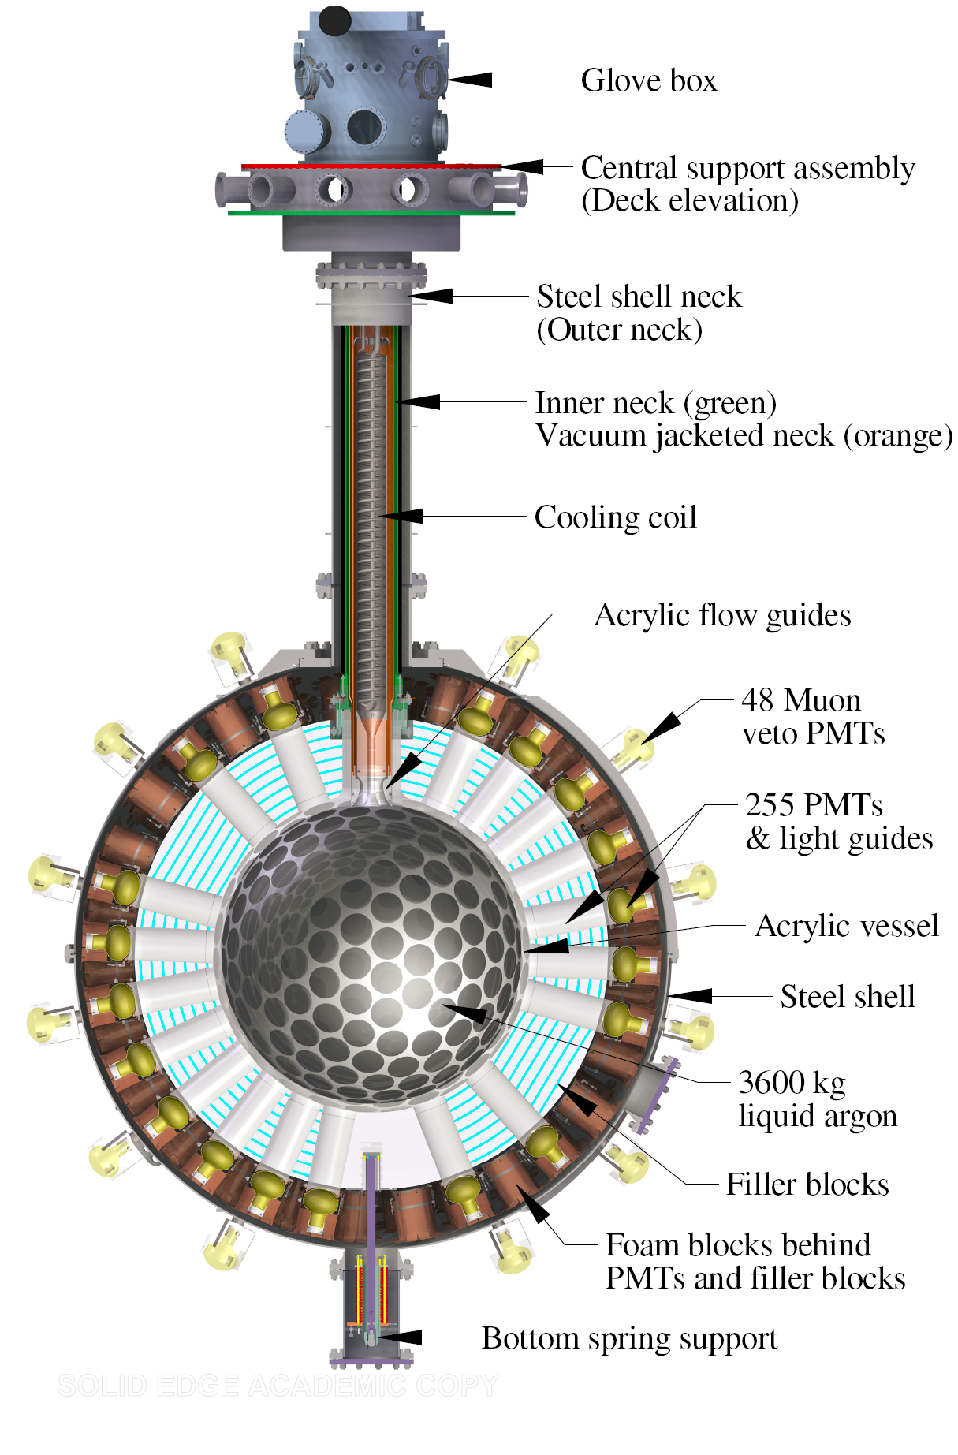
FUTURE ARGON EXPERIMENTS
e.g. Deap 3600, already exists
Darkside 20 tons
will probably happen.
Located at Gran Sasso
Argo 100 tons ????

Slide 24
Backgrounds in Liquid Argon Experiment

Slide 25
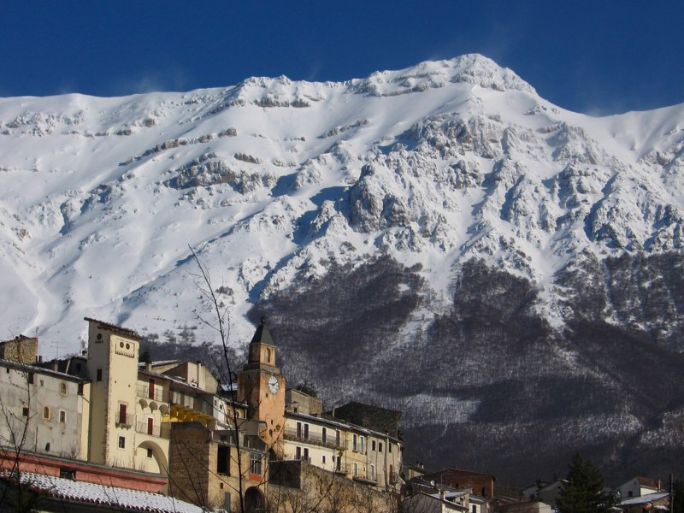
Gran Sasso mountain

Slide 26
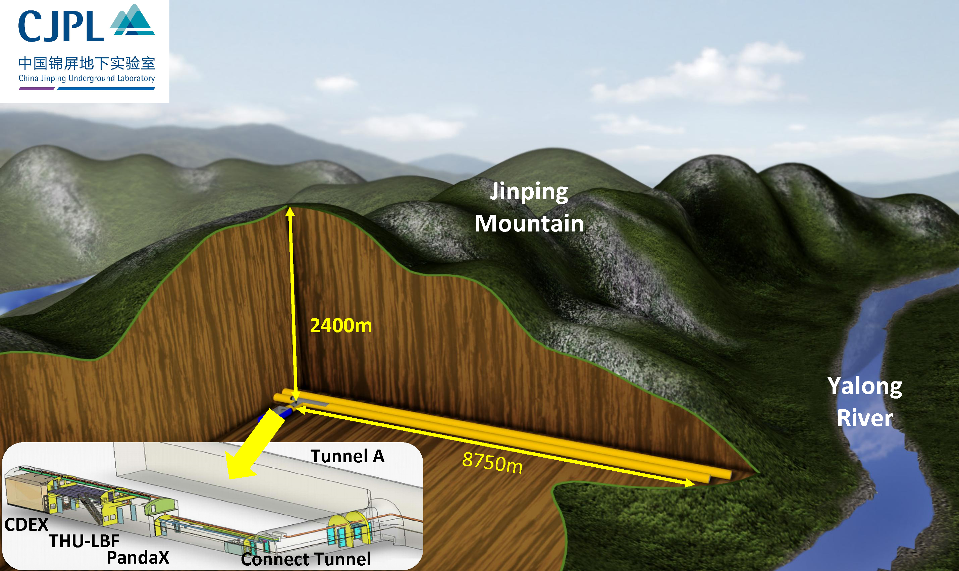
Jinping Laboratory

Slide 27
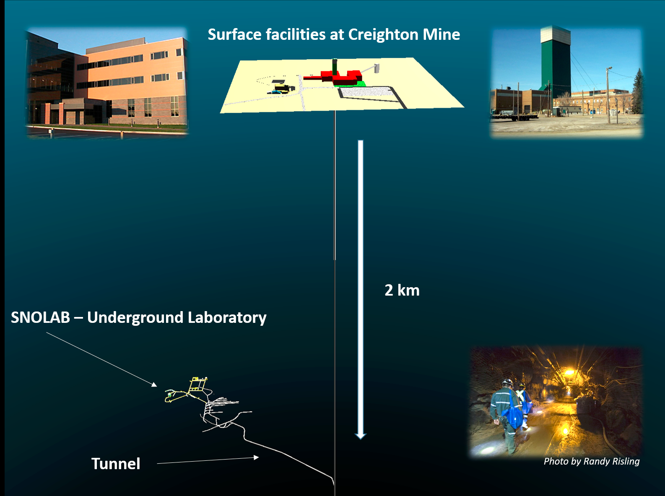

Slide 28
Gran Sasso
Radon chain
Unmeasured
Radon Chain
Known at 10%
1000 ton-yrs
liquid argon
SNOLAB or Jinping
Radon chain
Unmeasured
Radon Chain
Known at 10%

Slide 29
Summary of Electron Recoil Results

Slide 30
What about Nuclear recoils?

Slide 31
CNO Nuclear Recoil Energy Spectrum

Slide 32
CNO Nuclear Recoil Sensitivity requirements
Required combination of high target mass and VERY low threshold is challenging!

Slide 33



Conclusions
Current experiment looking for CNO probably can’t see it (Borexino)
Experiment which might be able to see it isn’t looking (SNO+)
Future large argon experiments will be able to see it if they can understand their backgrounds
If current low threshold nuclear recoil experiments could be improved and scaled up they might also see it.
PEOPLE SHOULD TRY HARDER TO LOOK FOR CNO NEUTRINOS
THE DARK MATTER COMMUNITY MIGHT ONE DAY GET INVOLVED

Slide 34
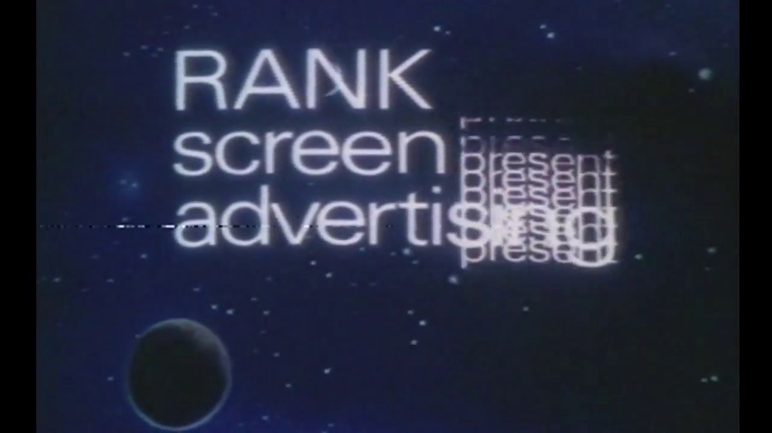

Slide 35
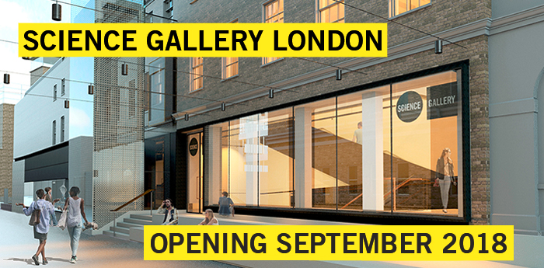

Slide 36
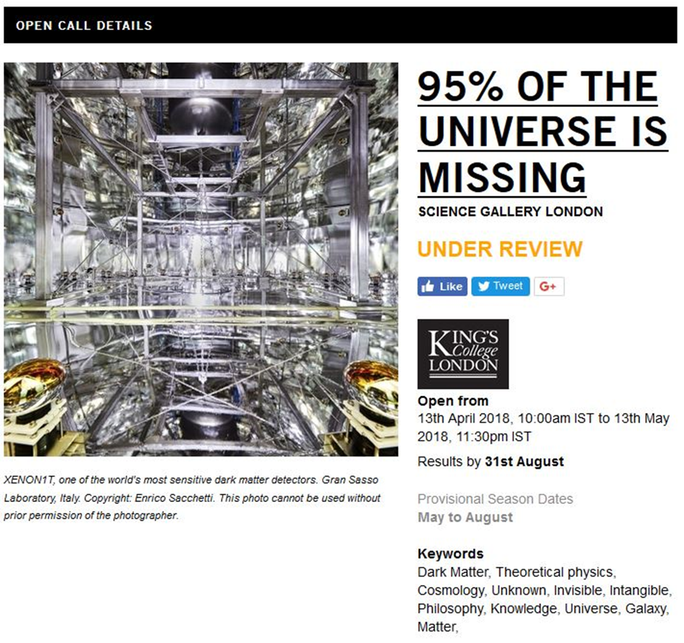
Exhibition should run late May 2019 for about 3 months.

Slide 37

This is an art exhibition, it is not a season at the science museum
We will be running constant events evening/lunchtime talks
Would love to come up with some interactive activities
Also need to exhibit parts of old experiments (anything pretty)
We are open to suggestions, less didactic, more playful!!!
I am VERY happy to hear from any of you!!!

