Slide 1
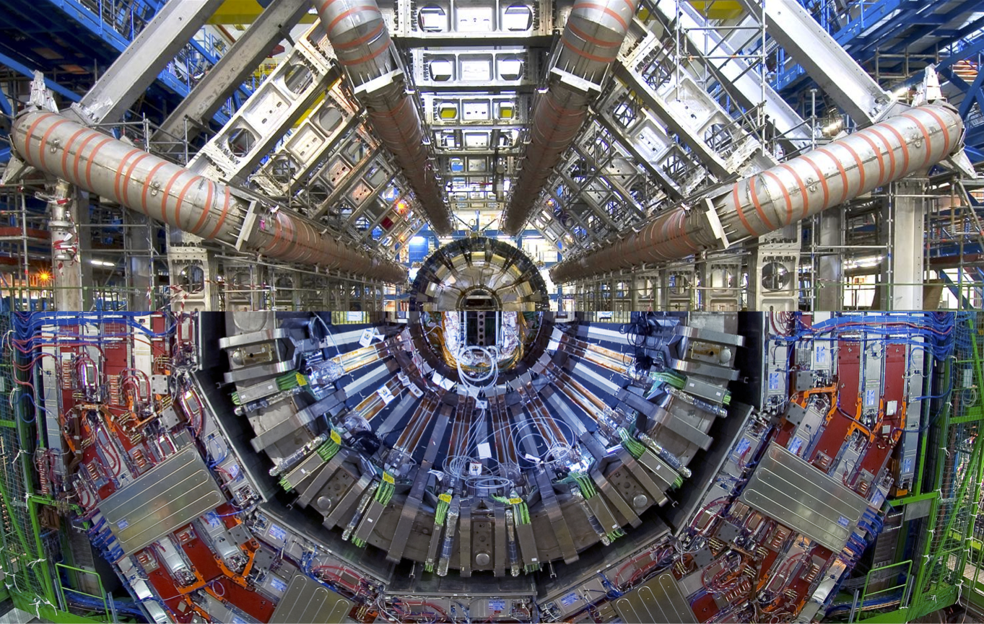








Low-mass diphoton searches in ATLAS and CMS
based on:
CMS-PAS-HIG-17-013 *
PRL 113 171801 (2014)
Run 1 (2012): 19.7 fb-1
Run 2 (2016): 35.9 fb-1
+combination
ATLAS-CONF-2018-025
* Supersedes
CMS-PAS-14-037
Run 1 (2012): 20.3 fb-1
Run 2 (2016+2017): 80 fb-1
Suzanne GASCON-SHOTKIN
IPN Lyon (IN2P3-CNRS)/Université Claude Bernard Lyon 1
Run 1 (2012): 19.7 fb-1
IRN Terascale
IPPP Durham (UK)
September 6, 2018

Slide 2
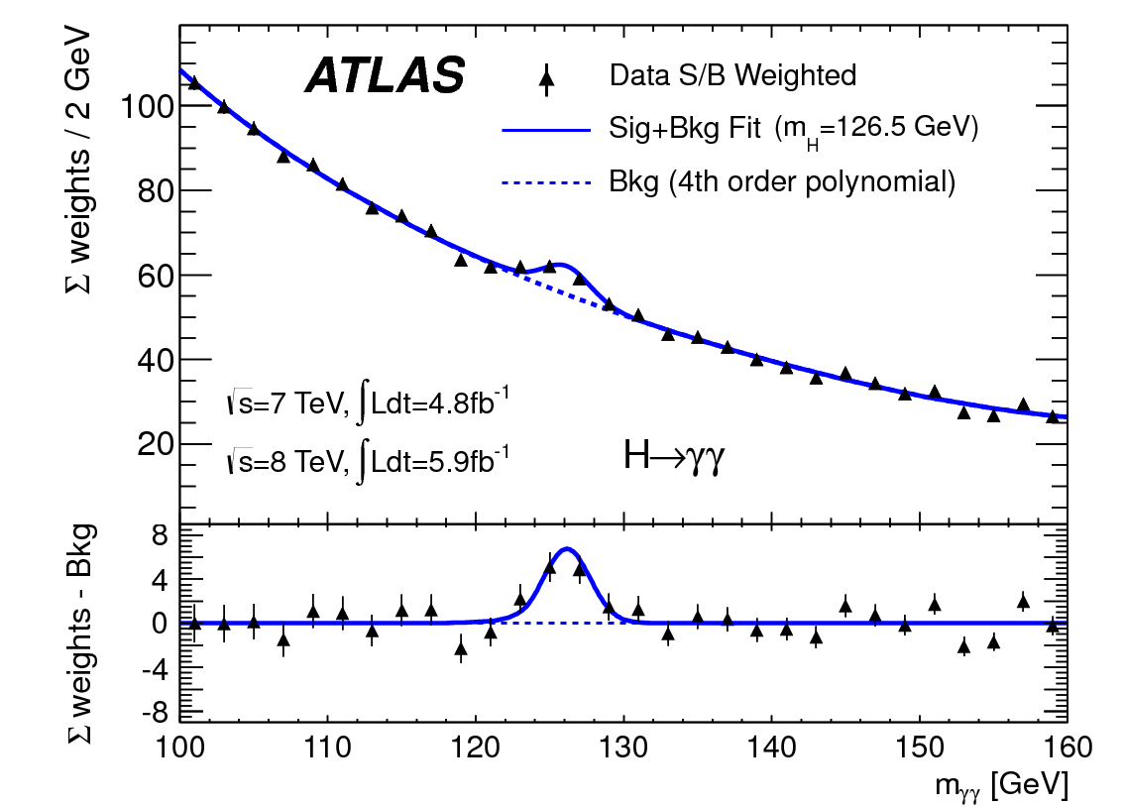
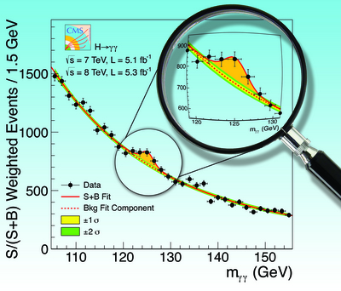
Outline
Motivation
General analysis strategy
Triggering and search zone
Photon Identification
Event selection & Classification
Signal modeling
Background Modeling
Systematic Uncertainties
Presentation of Results
Results
Summary/Conclusions
Acknowledgements
Phys. Lett. B 716 (2012)
2

Slide 3
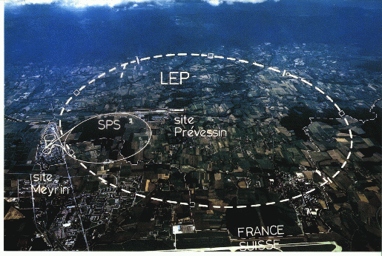
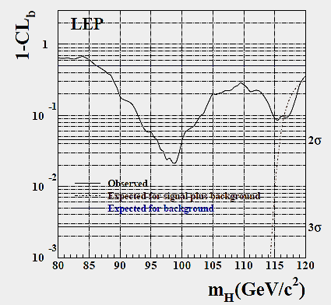
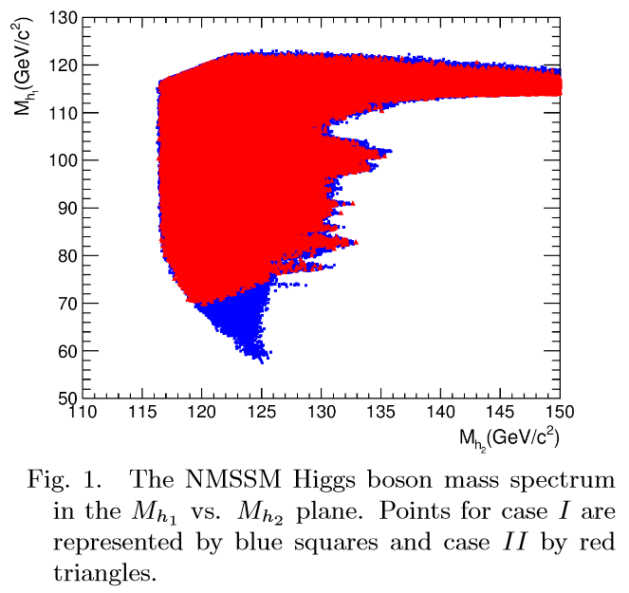
Motivation for low-mass diphoton searches
Final LEP SM Higgs boson search results: >2σ excess at mH= 98 GeV. Has contributed to sustained interest by both theorests and experimentalists in the possibility of additional low-mass (pseudo-) scalars
Much theoretical activity since then: Many BSM models allow a resonance with m<125 GeV coexisting with the Higgs boson discovered in 2012 GeV (generalized 2HDM, NMSSM…)
LEPHWG, Phys. Lett. B565:61-75,2003
J. Fan et al., Chinese Phys. C 38 073101

Slide 4
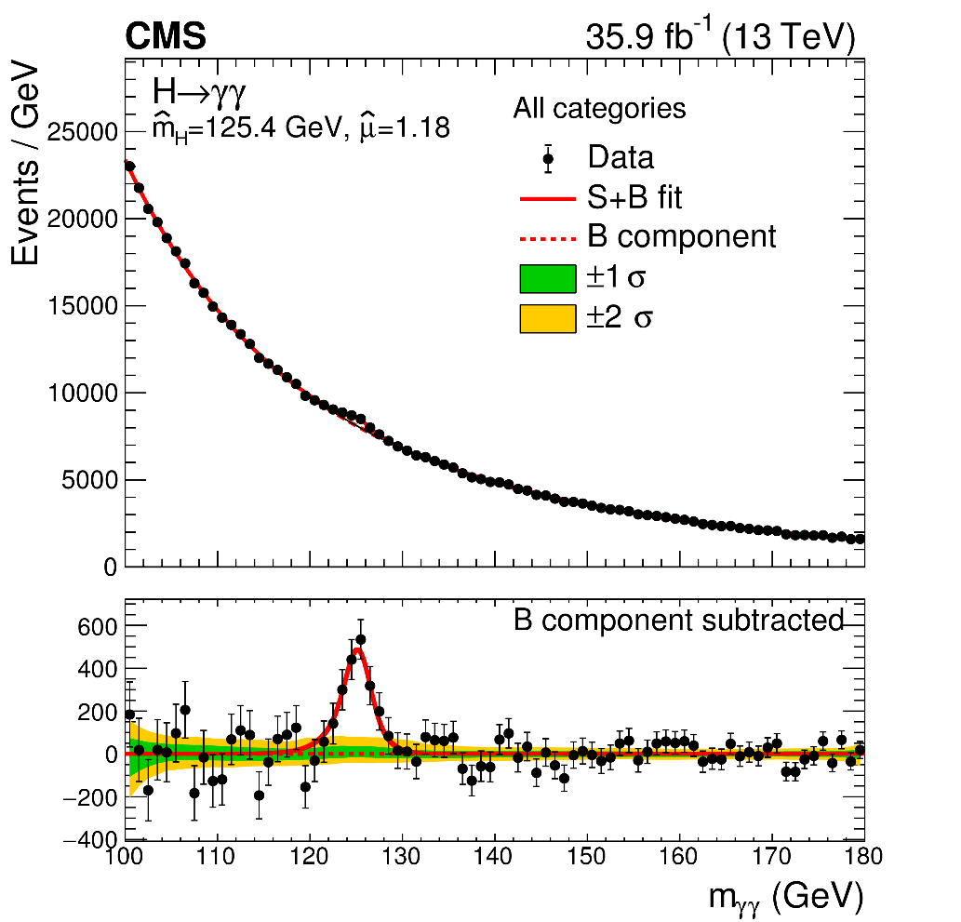
General Analysis Strategy: Std. vs low-mass H→γγ analysis
arXiv:1804.02716,
Subm. JHEP
Search for a narrow signal peak over a smoothly-falling background
Lower limit of search range limited by triggering capabilities
Relic dielectron→diphoton background from Z→ee, decreased sensitivity around m_{Z}
Inherit many analysis elements from standard H→γγ analysis (photon and event reconstruction/selection, signal modeling and part of background modeling techniques..)

Slide 5
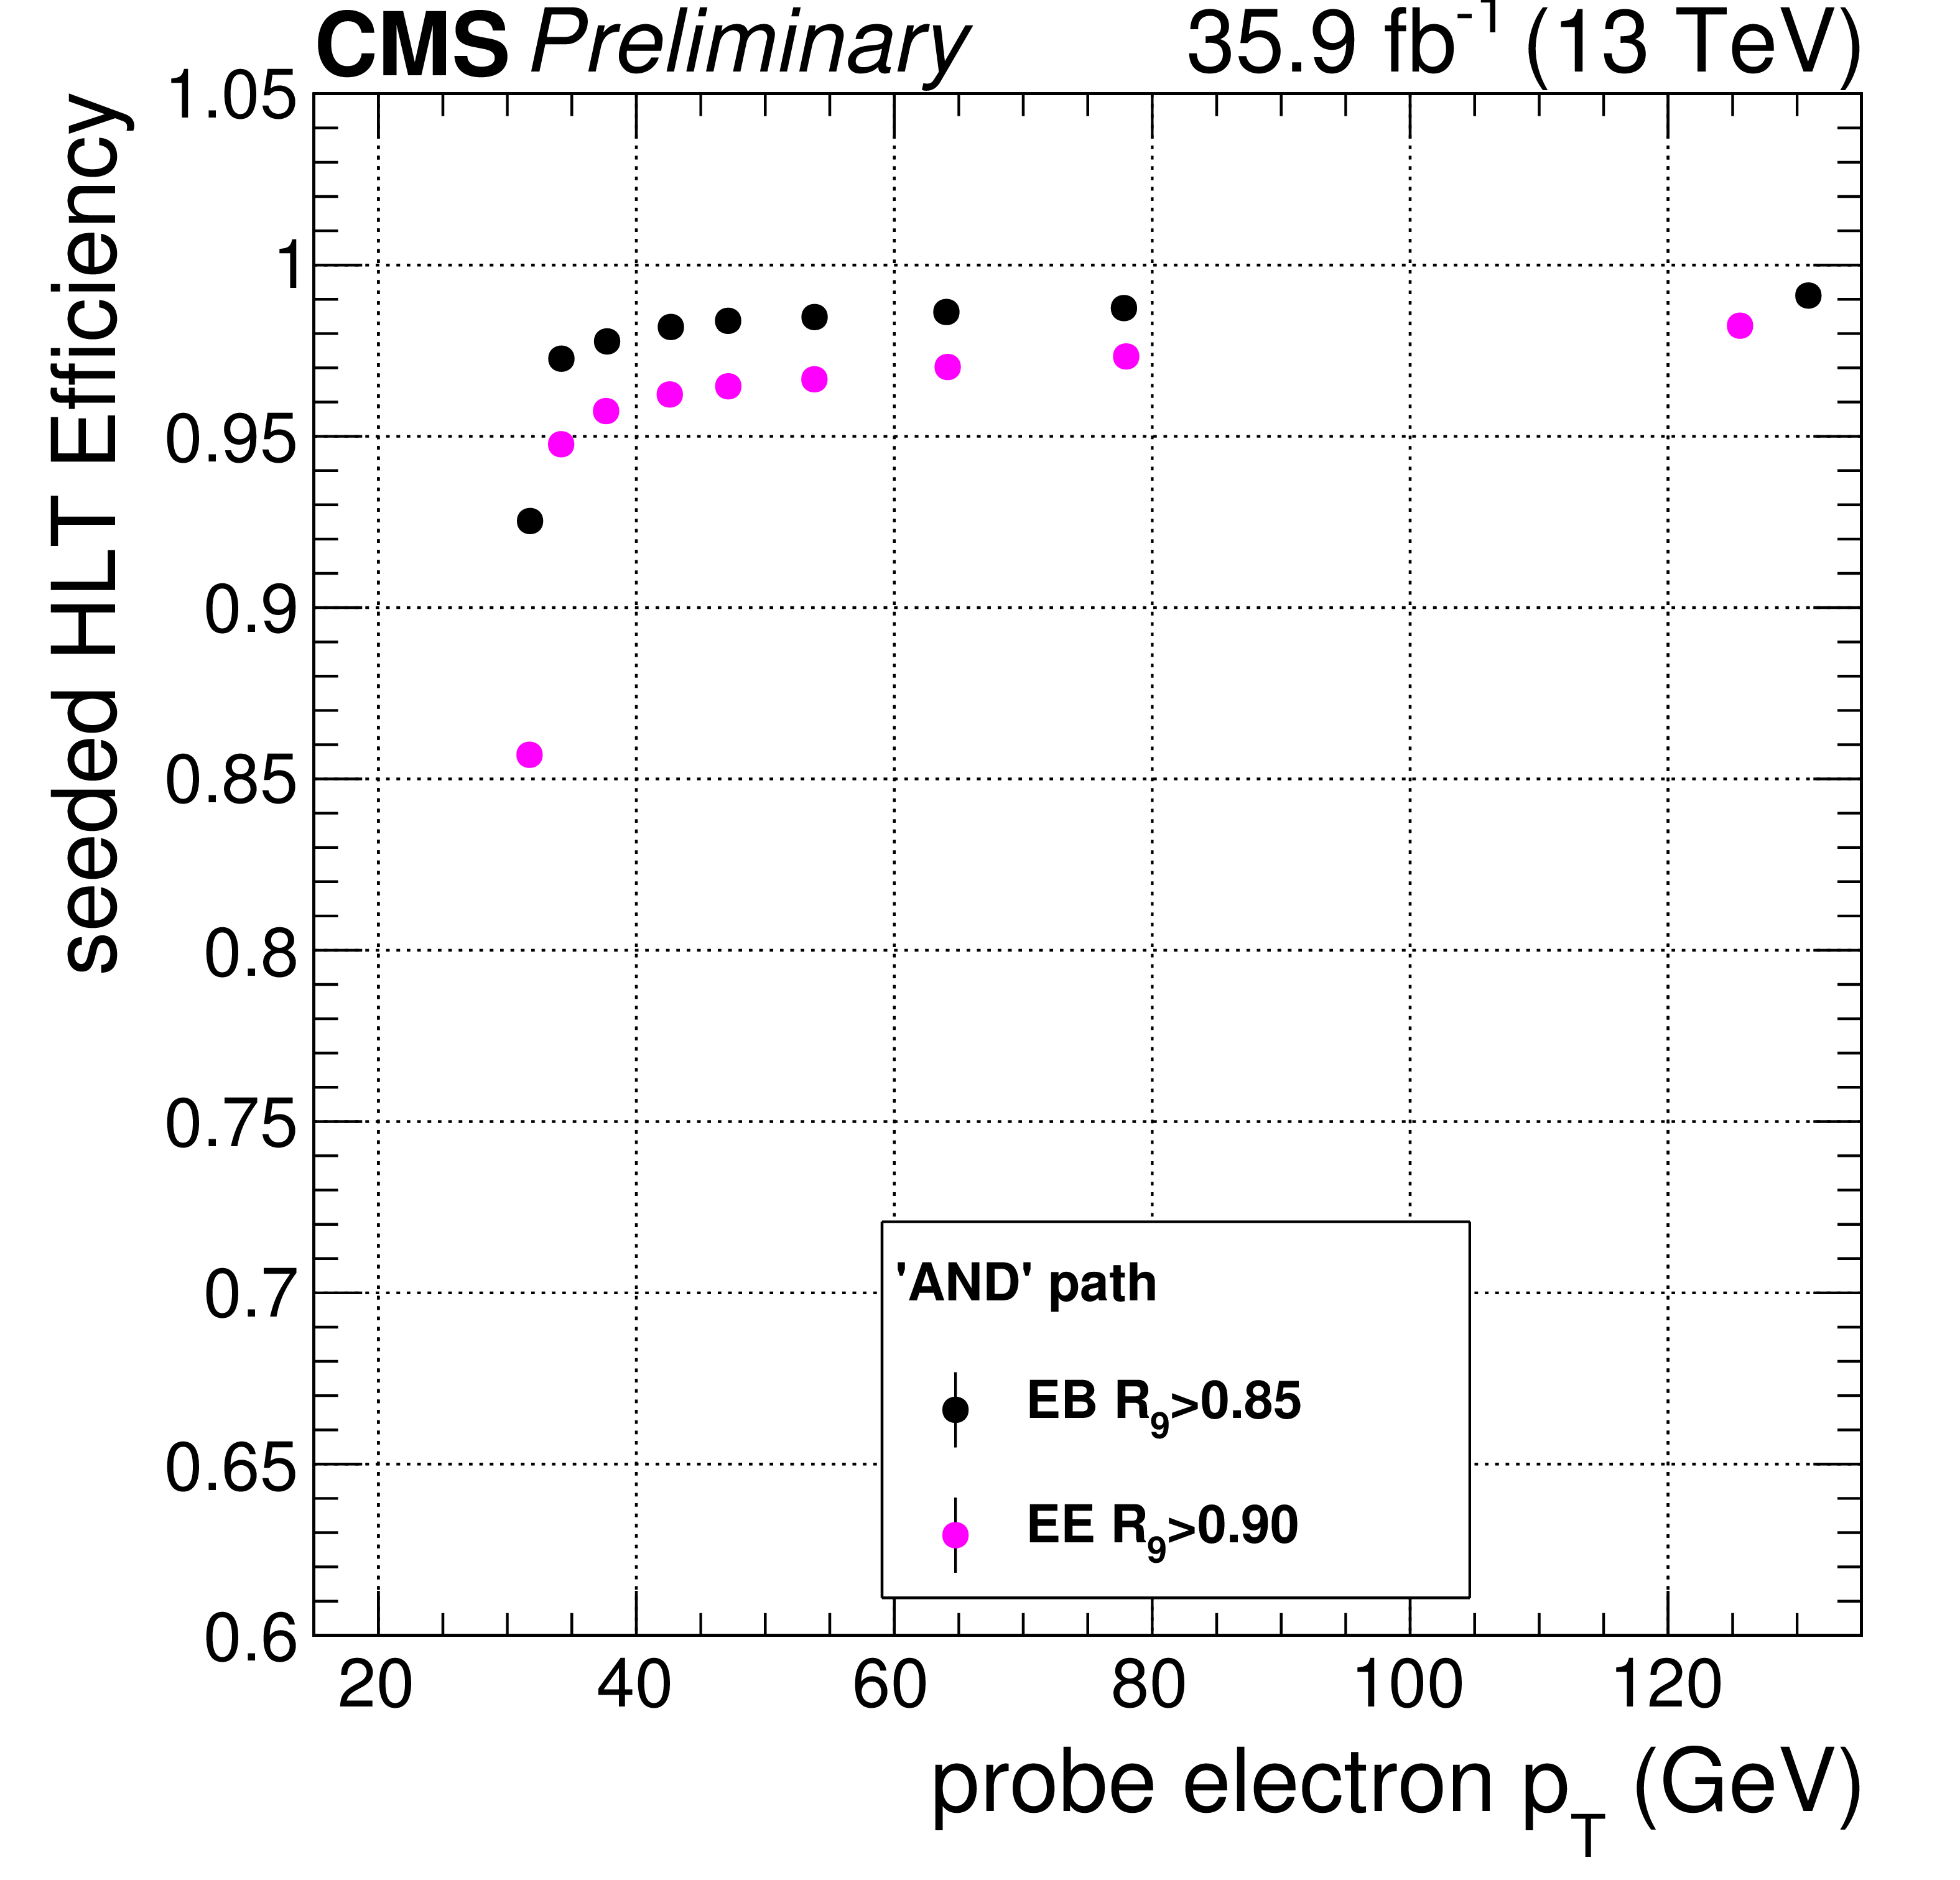
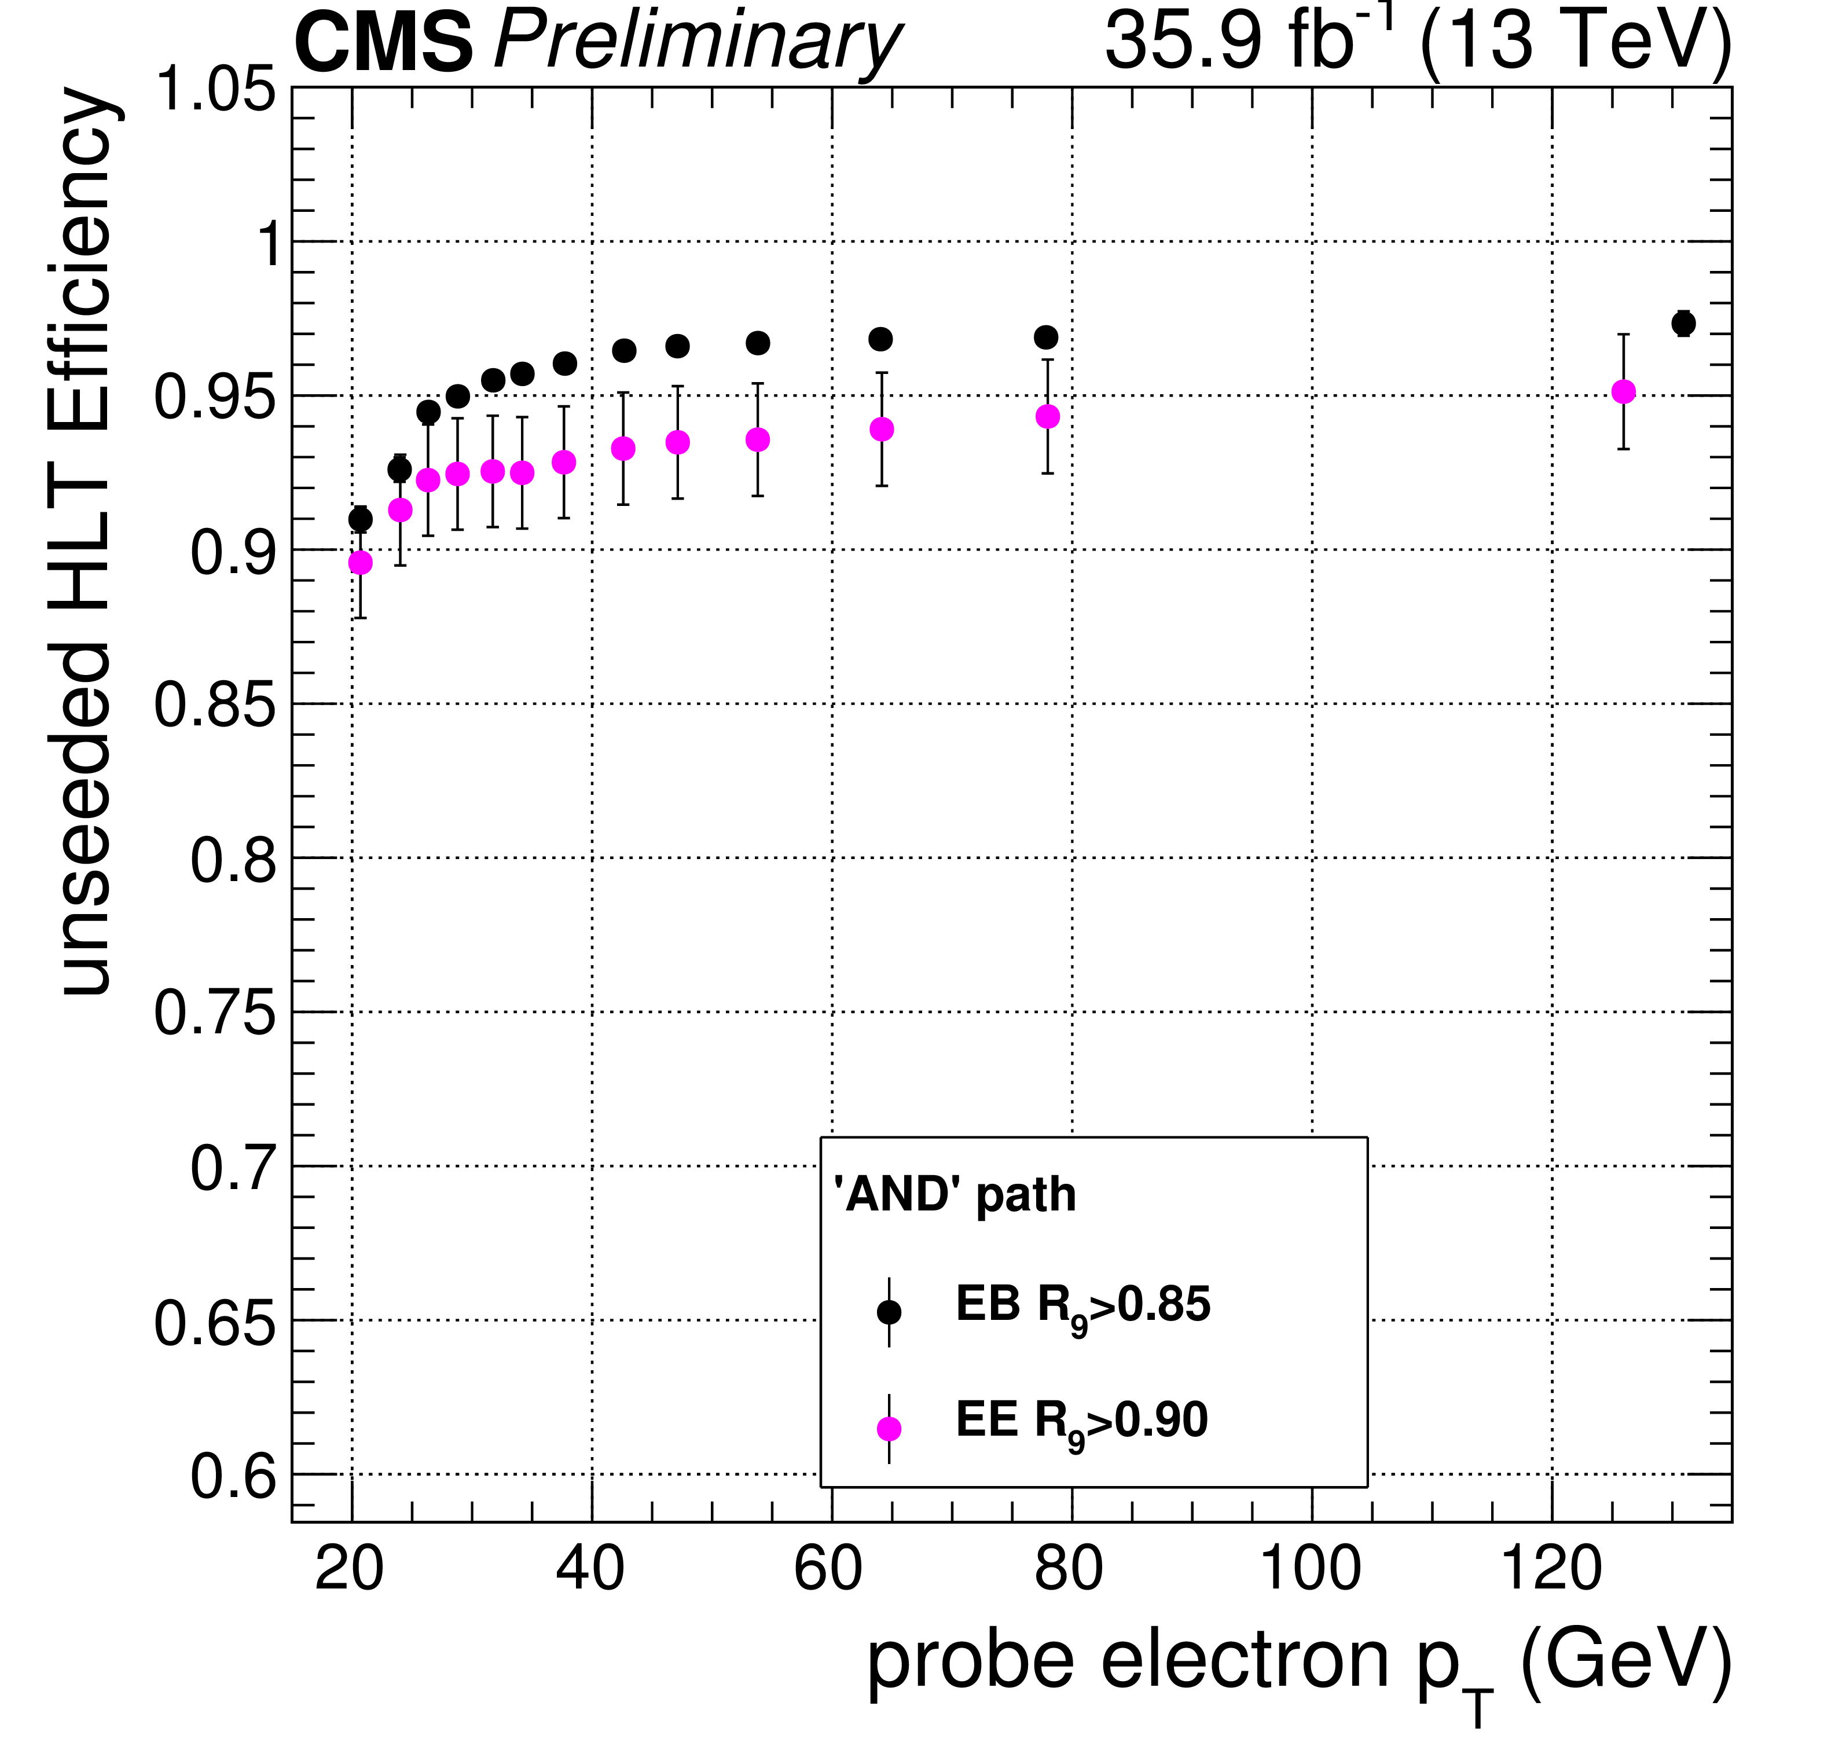
Triggering and search zone
CMS PAS HIG-17-013
2012: p_{Tγ} >{26,18} GeV, requirements on ratio of hadronic/electromagnetic energy, either EM shower shape or isolation energy, m_{γγ} >60 or 70 GeV➔search zone: 80 GeV<m_{h}<110 GeV
2016: p_{Tγ} >{30,18} GeV, requirements on ratio of hadronic/electromagnetic energy, veto if hits in pixel detector, stricter EM shower shape and isolation energy requirements, m_{γγ} >55 GeV➔search zone: 70 GeV<m_{h}<110 GeV
PRL 113 171801 (2014)
ATLAS-CONF-2018-025
2012: p_{Tγ} >{20,20} GeV, 2016-2017: p_{Tγ} >{20,20} then >{22,22} then >{20,20} GeV
Requirements on EM shower shape, then isolation energy (2017)
Search zone: 65 GeV<m_{h} <110 GeV

Slide 6
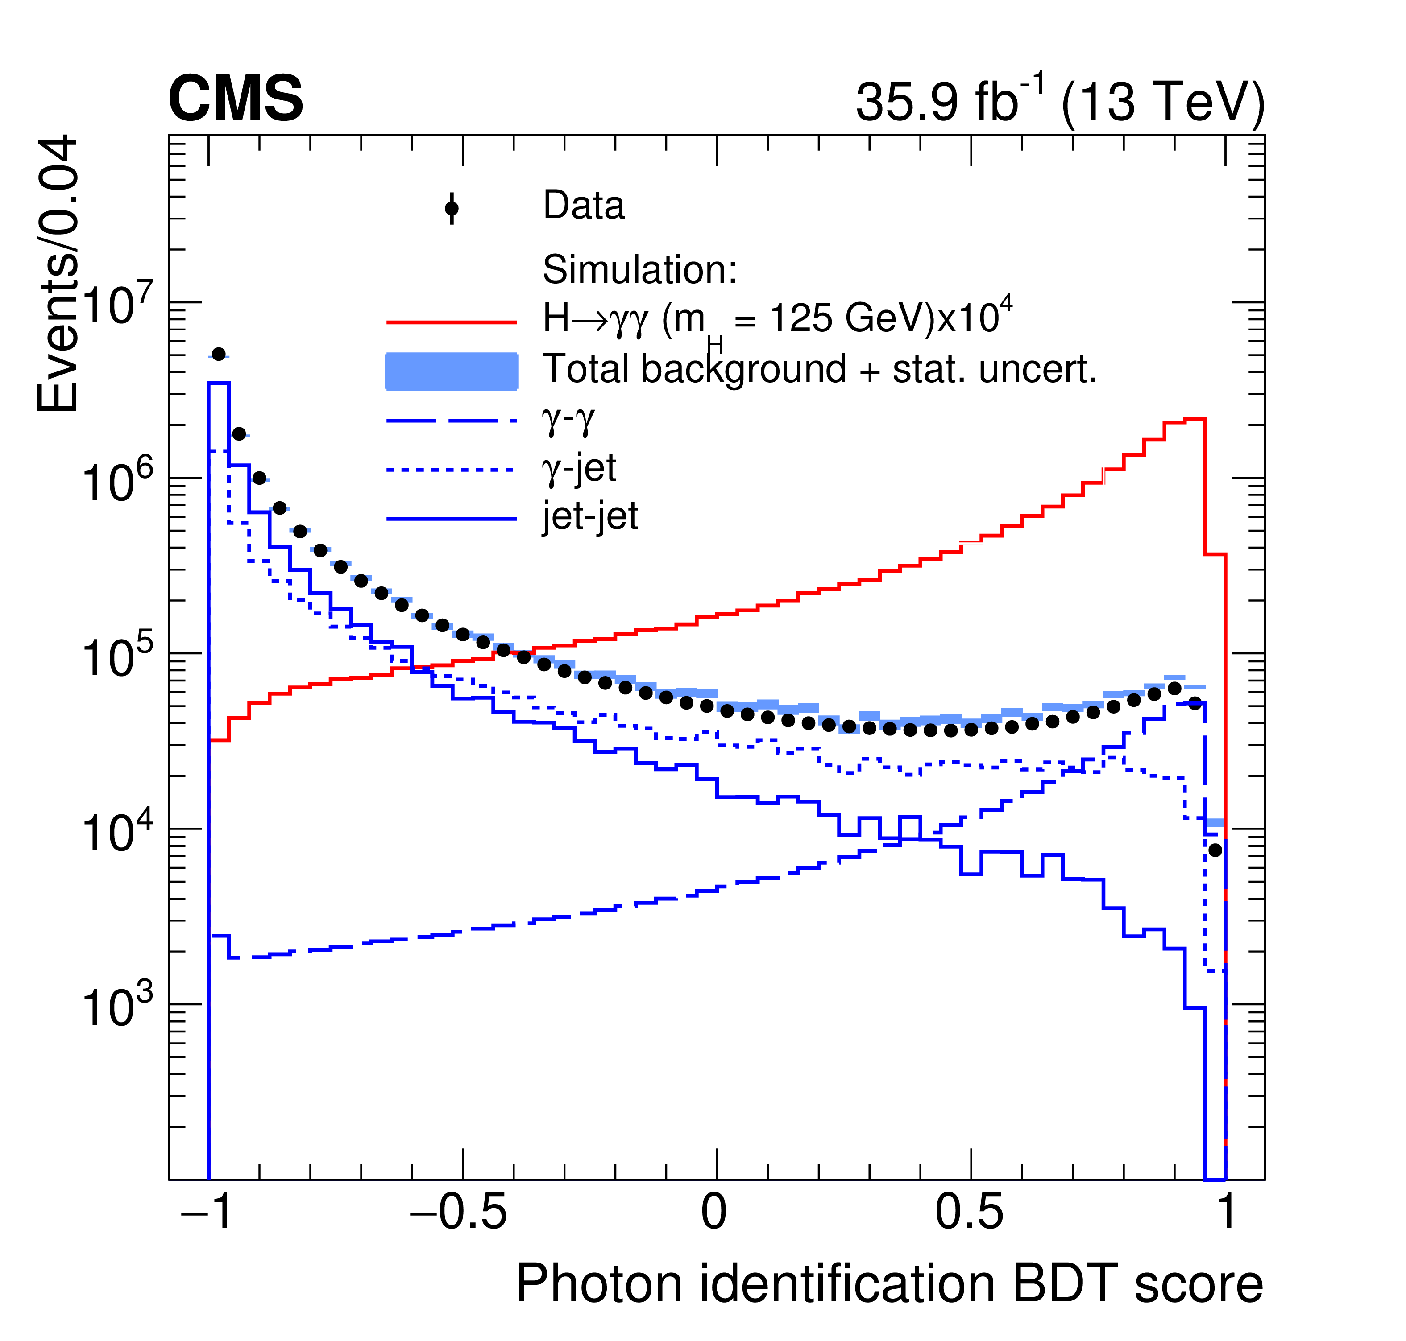
Photon Identification
Fight reducible background, mostly from π⁰
Photon ID BDT: shower shape, ‘particle flow’ isolation sums (photon, charged hadron), energy-density coeff. ρ, η
Minimum score required, otherwise score input to diphoton BDT (next slide)
Veto photon candidates associated with pixel detector hits
PRL 113 171801 (2014)
Cut-based shower shape criteria
Cut-based calorimeter and tracking isolation sum criteria
Photon conversion identification: Association with 2 conversion-compatible tracks or 1 track with no hit in innermost layer of inner tracking detector
arXiv:1804.02716,
Subm. JHEP
Both experiments correct isolation sums for pileup and underlying-event contributions.

Slide 7
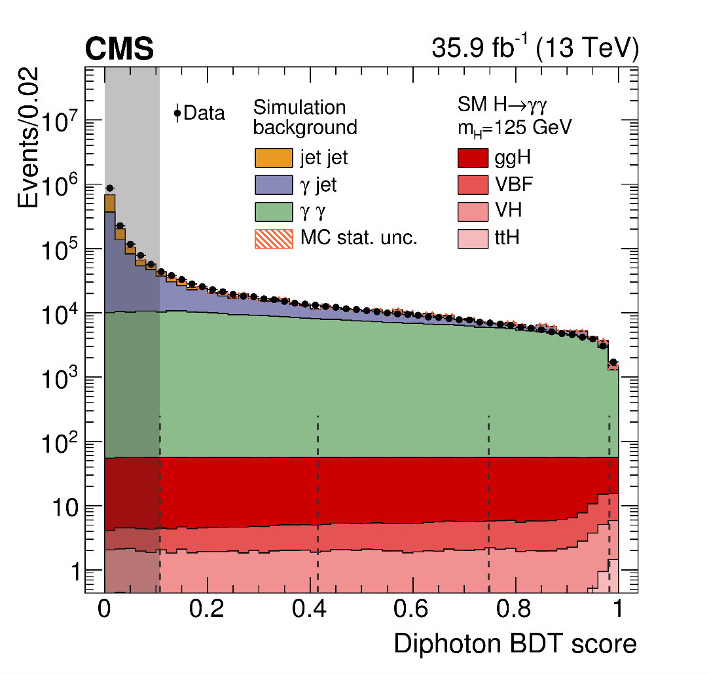
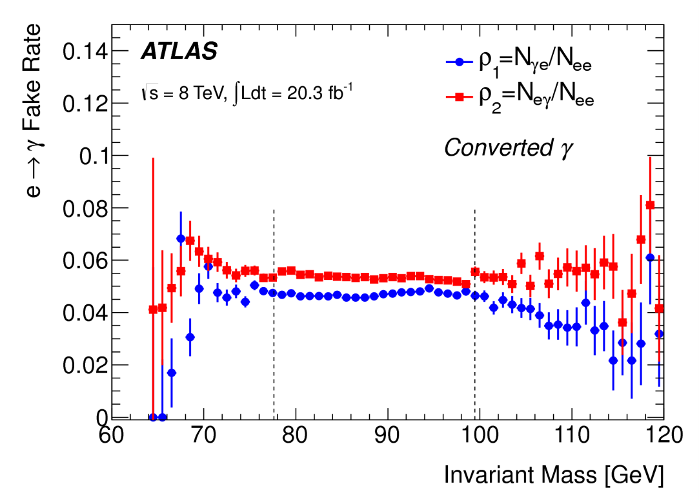
Event selection & Classification
arXiv:1804.02716, Subm. JHEP
PRL 113 171801 (2014)
Diphoton BDT: pt/m_{γγ}, η , cos(φ1−φ2), both PhotonID BDT outputs, mass resolution wrt correct and incorrect vertices, vertex probability
4 (3) inclusive classes for 2012 (2016)
Requirements on p_{Tγ}/m_{γγ} to avoid m_{γγ} sculpting
3 classes: conversion status (UU,UC,CC)
Requirements on p_{Tγ} , model m_{γγ} sculpting

Slide 8
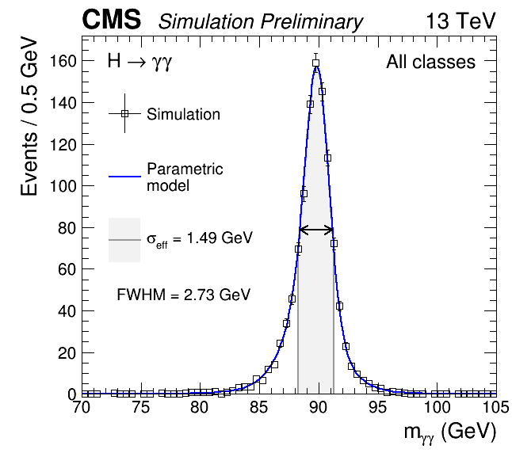
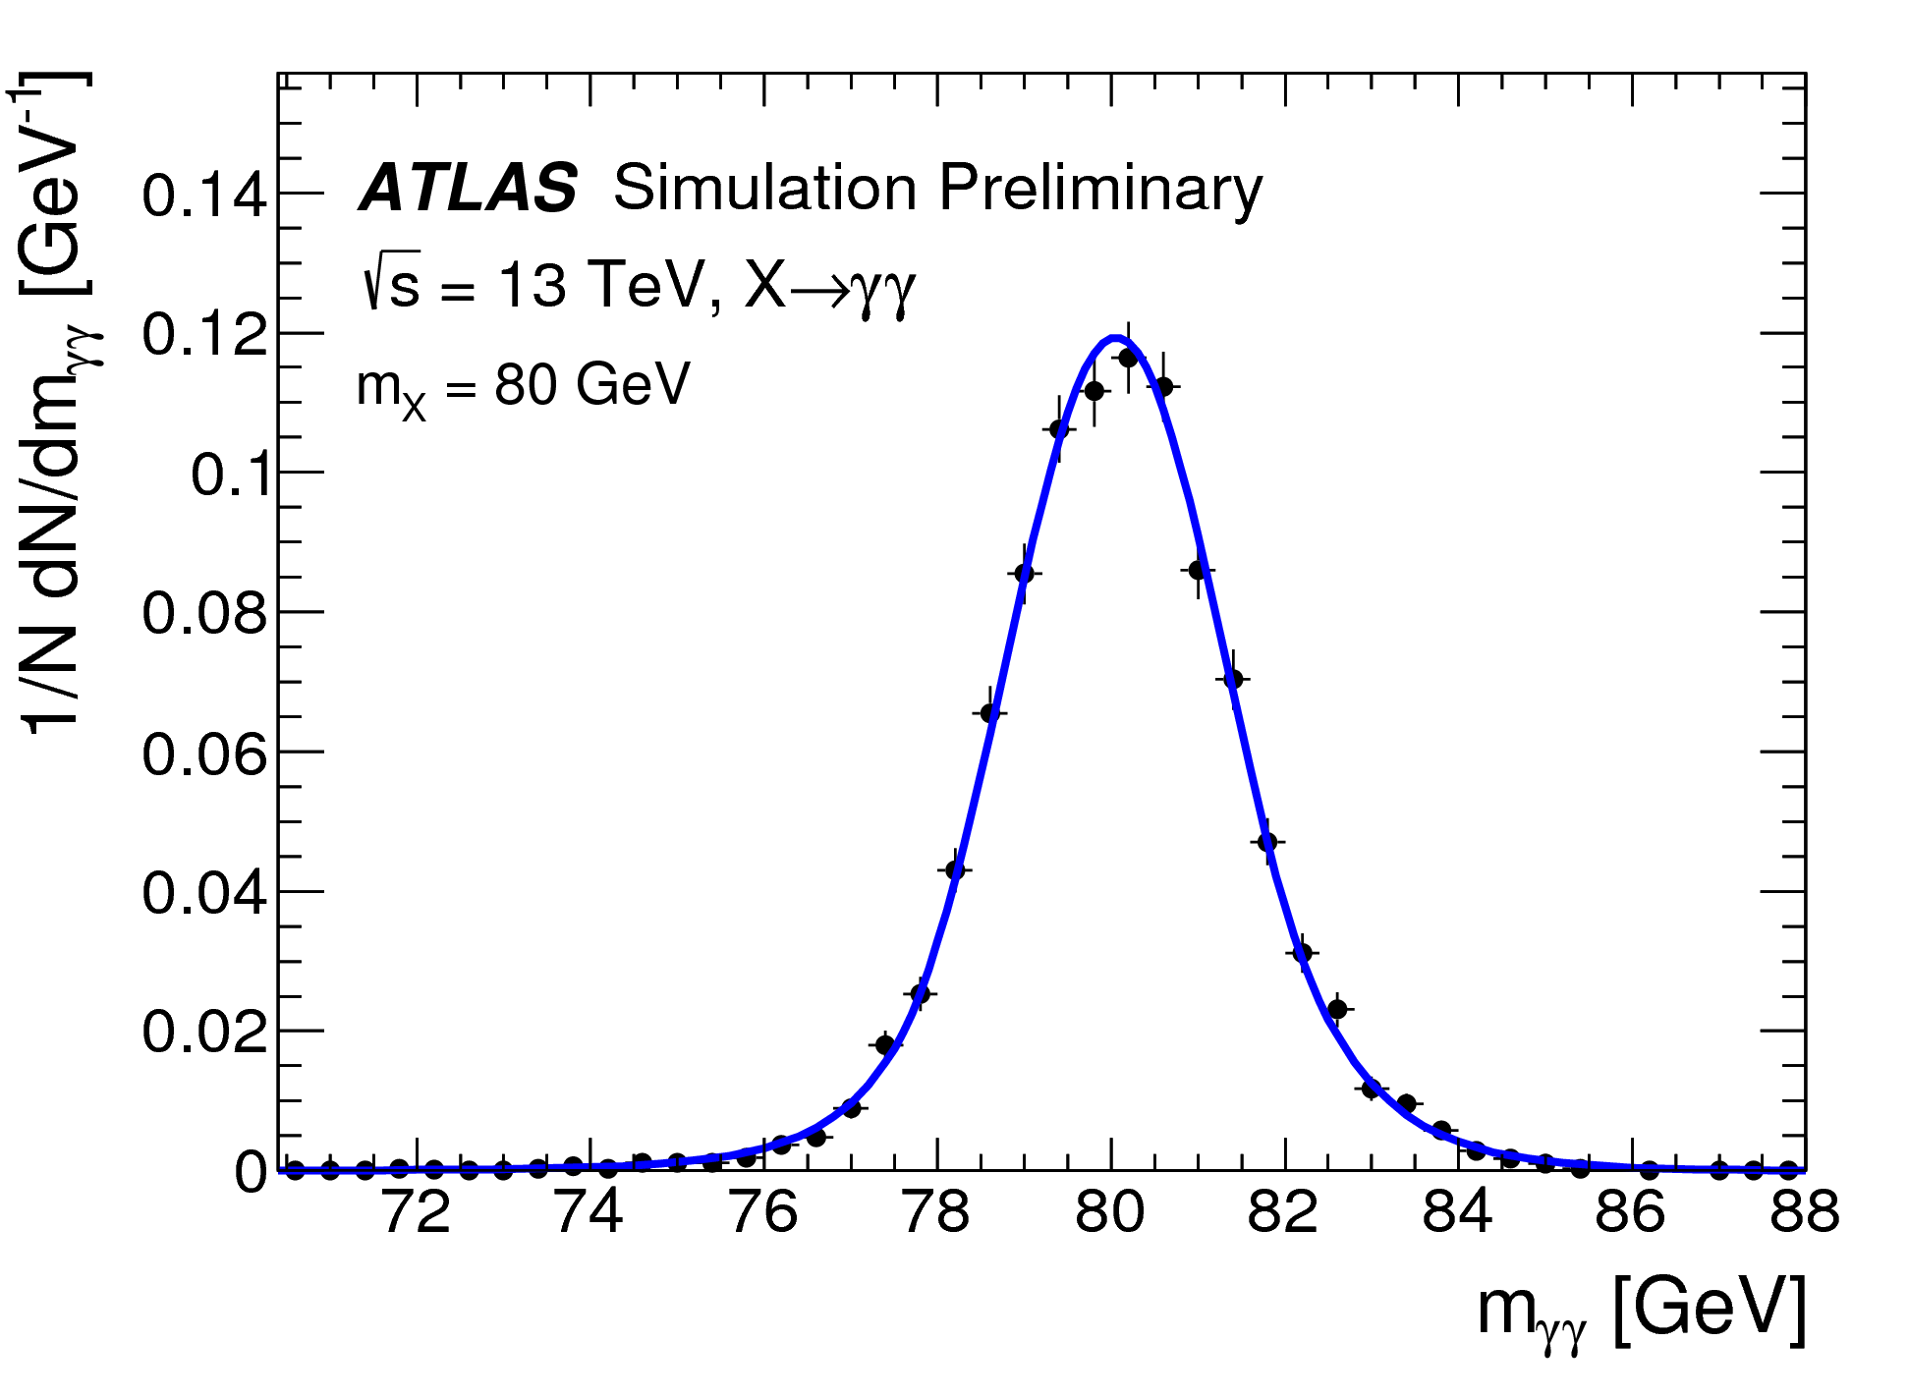
Signal modeling
CMS PAS HIG-17-013
ATLAS-CONF-2018-025
Signal model: Sums of Gaussian functions
MC ggH, ttbarH, VBF, VH production processes present in SM proportions, ‘SM-like’ xs from LHCHXSWG
Signal model: Double Crystal Ball (DCB) function (UU shown)
MC ggH production process nominal, ttbarH, VBF, VH processes used for systematic uncertainty estimation

Slide 9
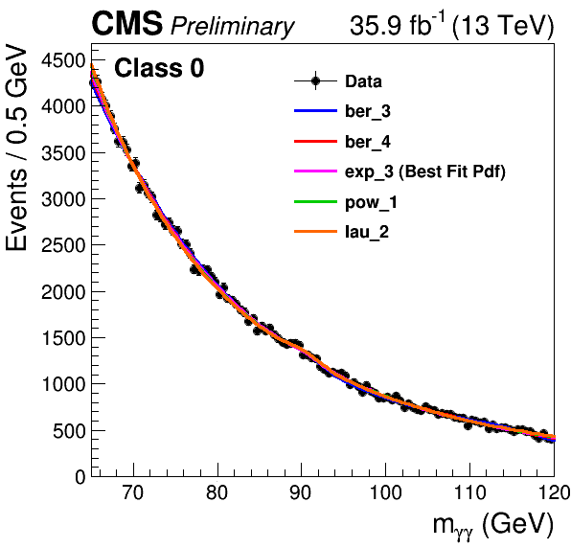
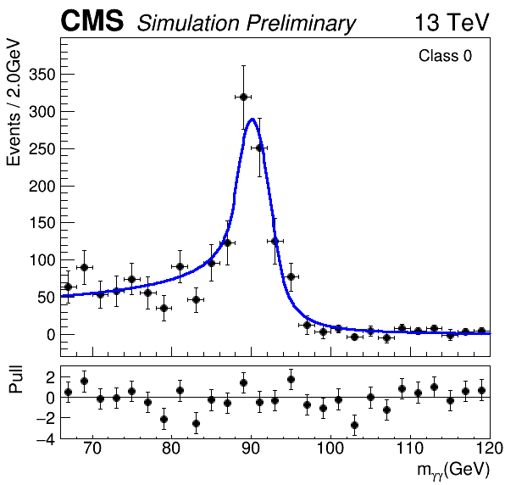
Background Modeling
CMS PAS HIG-17-013
Background Model: Sum of polynomial (chosen from 4 families) + double Crystal Ball (DCB) function for relic Z→ee
Chosen polynomials: 2012: 4th (5th) order Bernstein polynomial for class 0 (1-3), 2016: 3d order sum of exponentials (classes 0,2), 1st-order power law (class1)
DCB: shape parameters from MC ‘double-fake’ events, syst. uncertainty from ‘single-fake’ events, normalization floating

Slide 10
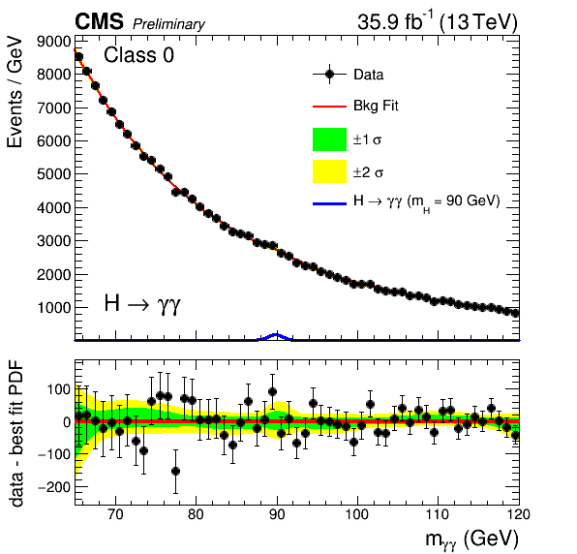
Background Modeling
CMS PAS HIG-17-013
Background Model: Sum of polynomial (chosen from 4 families) + double Crystal Ball (DCB) function for relic Z→ee
Chosen polynomials: 2012: 4th (5th) order Bernstein polynomial for class 0 (1-3), 2016: 3d order sum of exponentials (classes 0,2), 1st-order power law (class1)
DCB: shape parameters from MC ‘double-fake’ events, syst. uncertainty from ‘single-fake’ events, normalization floating
2012: Explicit test to determine if model bias acceptable (pull of μ <0.14) 2016: Choice of background function is discrete parameter in lh fit to data, systematic error associated with each possible choice (discrete profiling or ‘envelope’ method)

Slide 11
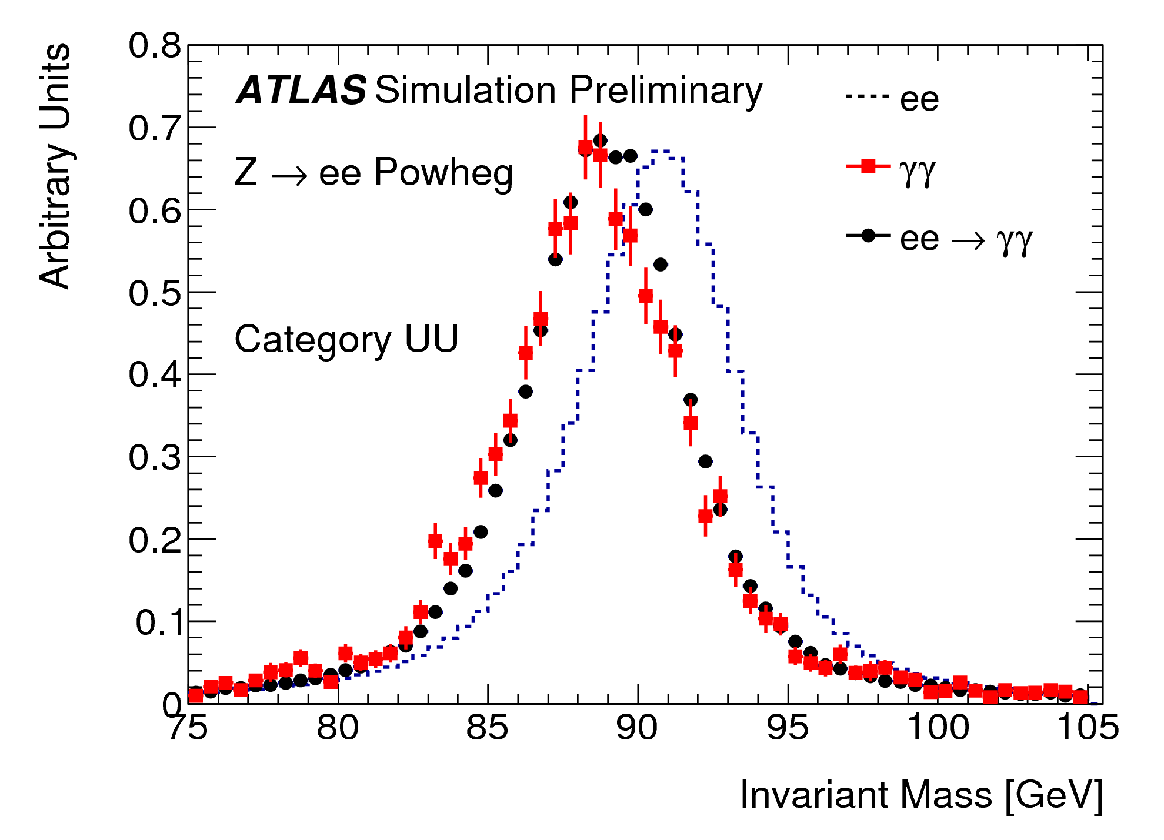
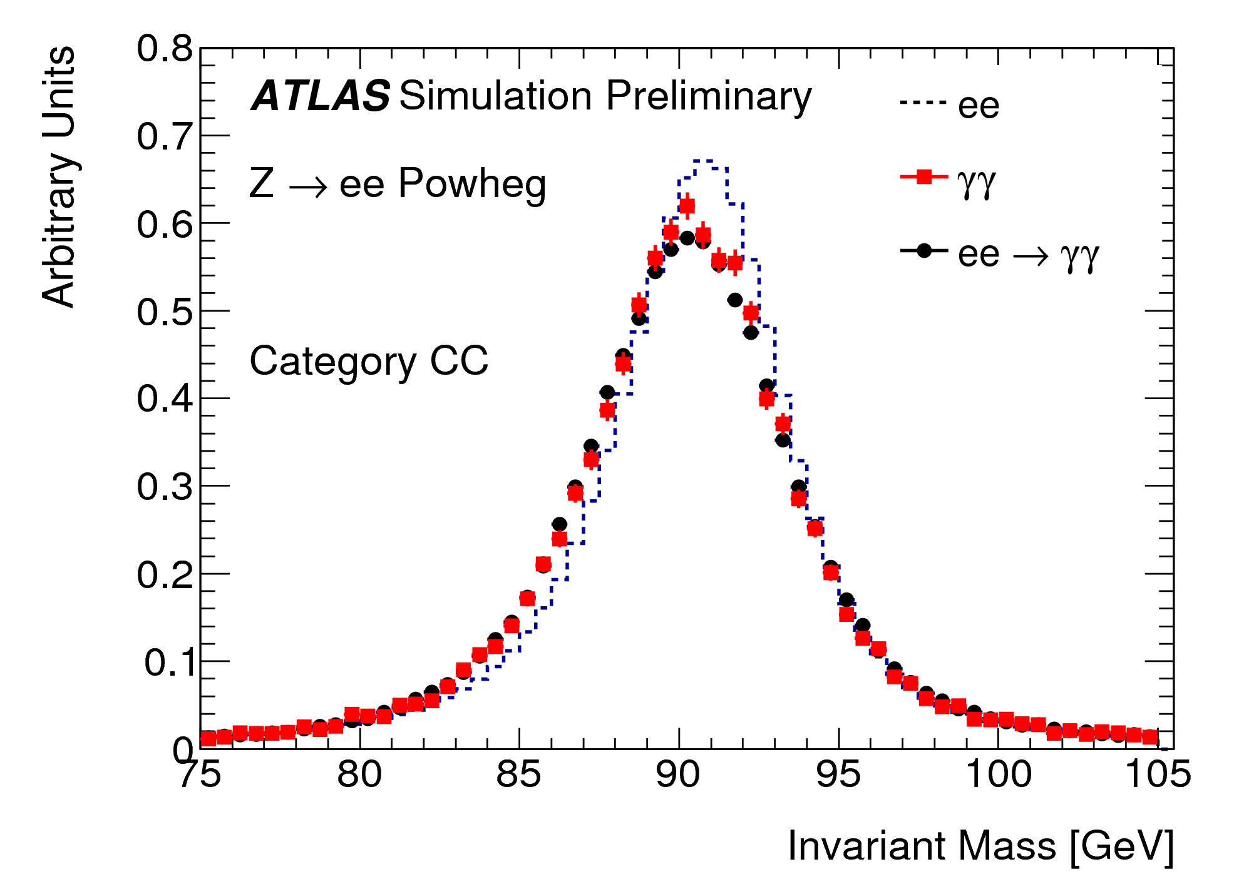
Background Modeling
ATLAS-CONF-2018-025
Background Model: Sum of polynomial ( 2012: Landau + exp; 2016-2017: chosen from Fermi-Dirac, Bernstein, Landau, Landau + exp) + double Crystal Ball (DCB) function for relic Z→ee component
DCB shape: Transformation (2012: Smirnov on E_{T}, φ, 2016-2017: Smirnov on m_{ee}) applied to generic Zee MC events→match ‘double-fake MC events, resulting template fit to Zee data to extract shape parameters
DCB normalization fixed from fake rates (eγ/ee pairs) in Zee data for γ_{1,2} in each class, reactualized for Run 2
PRL 113 171801 (2014)

Slide 12
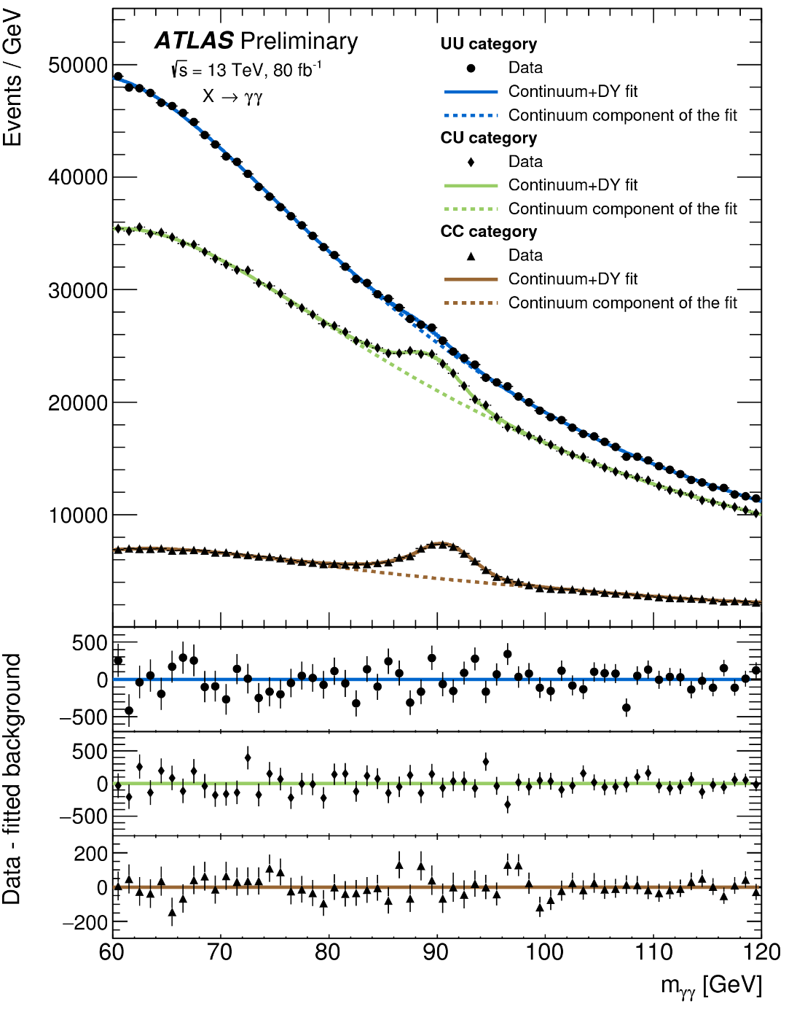
Background Modeling
ATLAS-CONF-2018-025
Background Model: Sum of polynomial ( 2012: Landau + exp; 2016-2017: chosen from Fermi-Dirac, Bernstein, Landau, Landau + exp) + double Crystal Ball (DCB) function for relic Z→ee component
Chosen polynomials: 2012: Landau + exp; 2016-2017: Landau + exp (UU,CU), 5th order Bernstein (CC), fitted on data with normalization and function parameters free
2012: Require signal yield bias <20% stat uncertainty on fitted signal yield for background-only spectrum
2016-2017: Choose model with smallest spurious signal in signal+background fit to background-only template with components from MC; fractions determined from a 2D sideband method (developed for diphoton xs measurements)

Slide 13
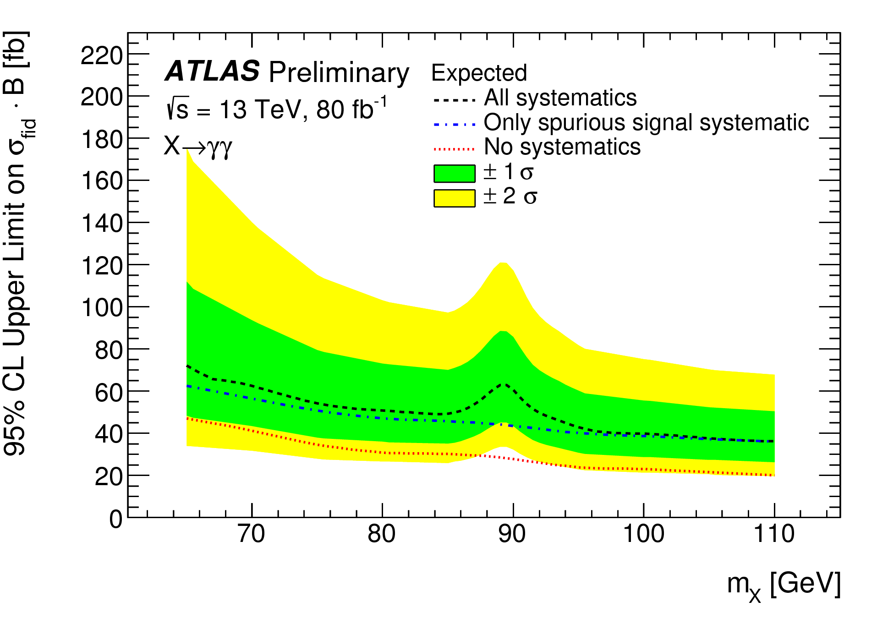
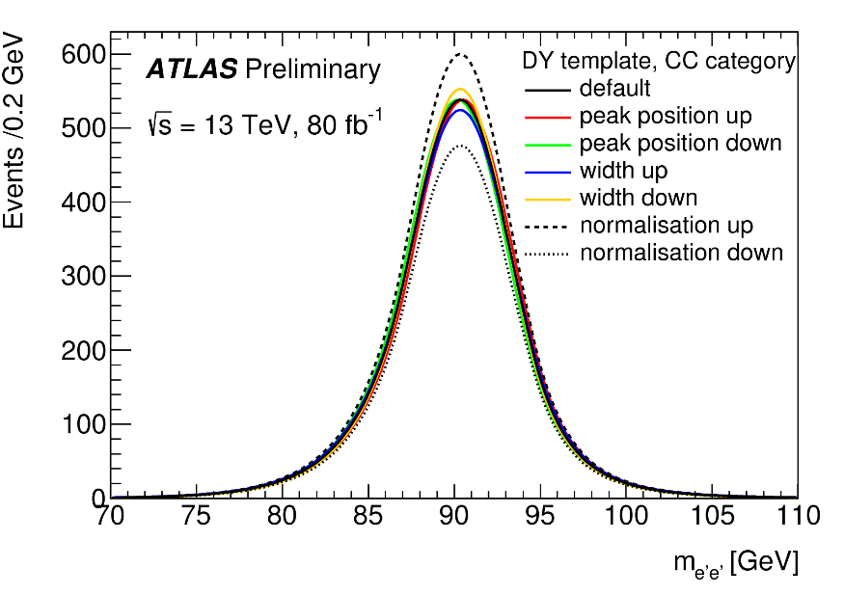
Systematic Uncertainties
ATLAS-CONF-2018-025
Spurious signal systematic dominant except in nbd of m_{Z}
DCB systematics dominated by normalization uncertainty (9-21%)
Signal yield unc. from production mode: 2.4-25%
CMS PAS HIG-17-013
Uncertainties in DCB shape parameters μ , σ
Uncertainties in shape of photon id BDT distribution, per-photon energy resolution: variations in signal efficiencies <15%
Uncertainties in signal acceptance from scale variations <8%

Slide 14
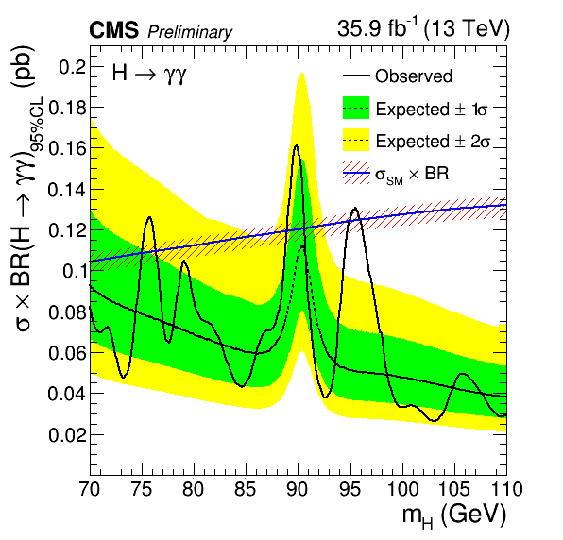
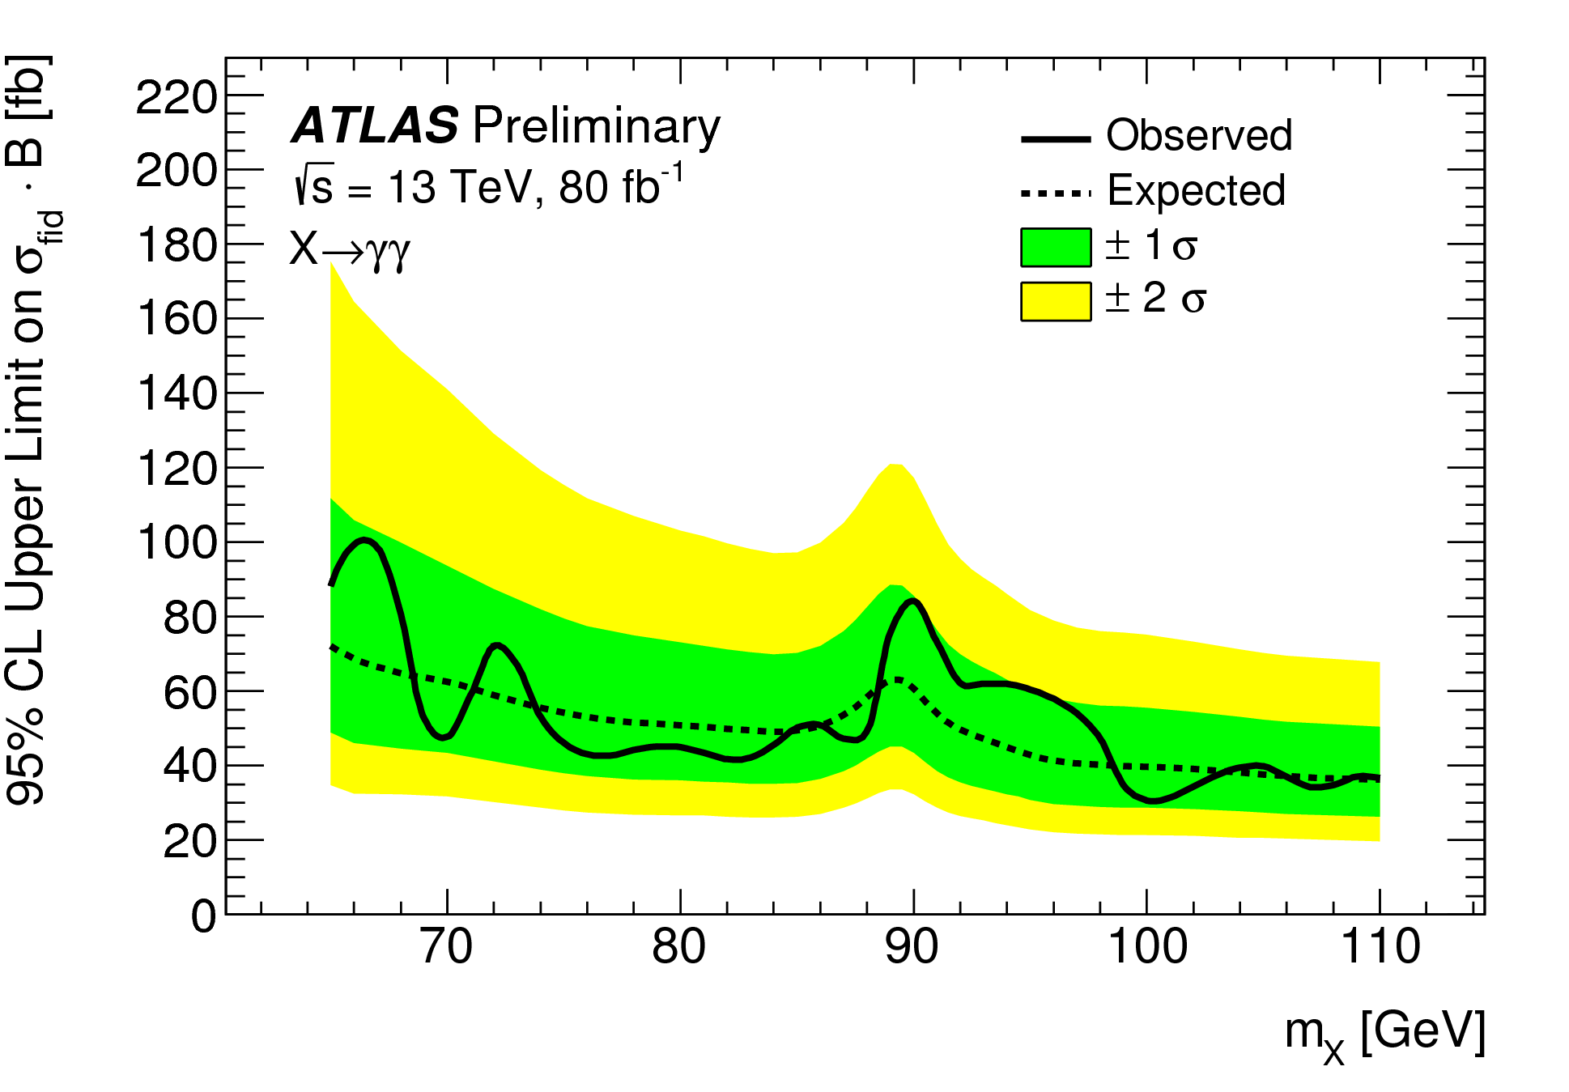
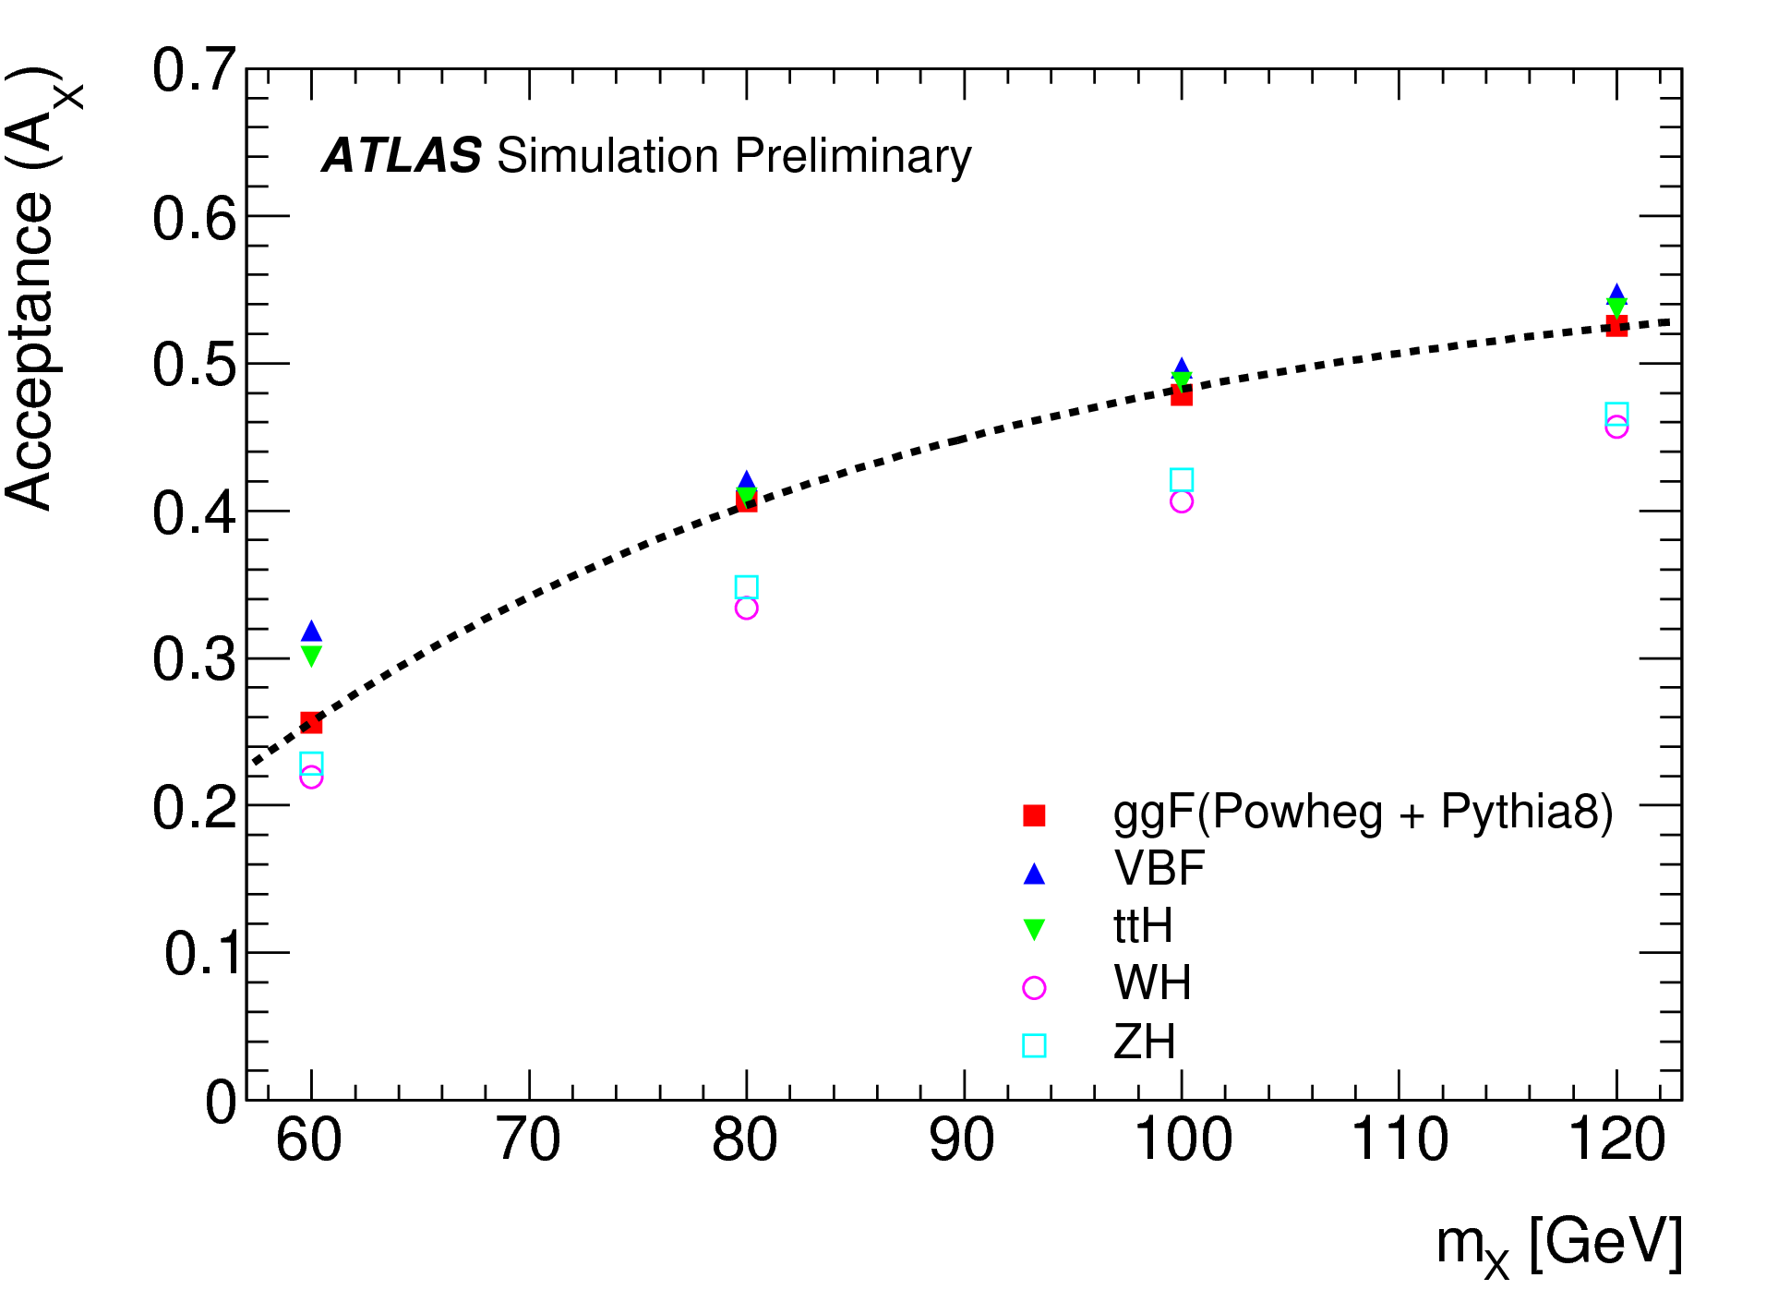
Presentation of Results
CMS PAS HIG-17-013
ATLAS-CONF-2018-025
CMS: Limit on total cross section X B
ATLAS: Limit on fiducial cross section X B

Slide 15
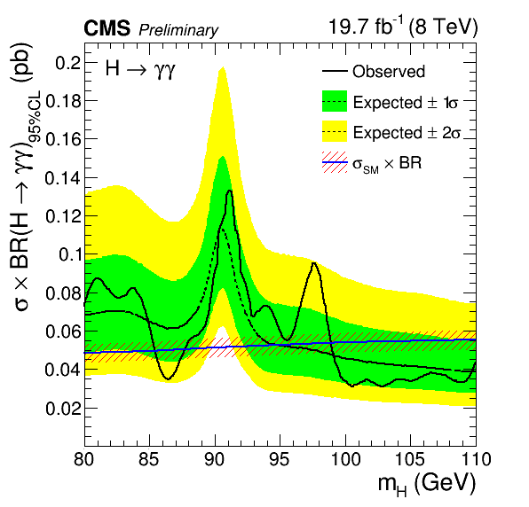
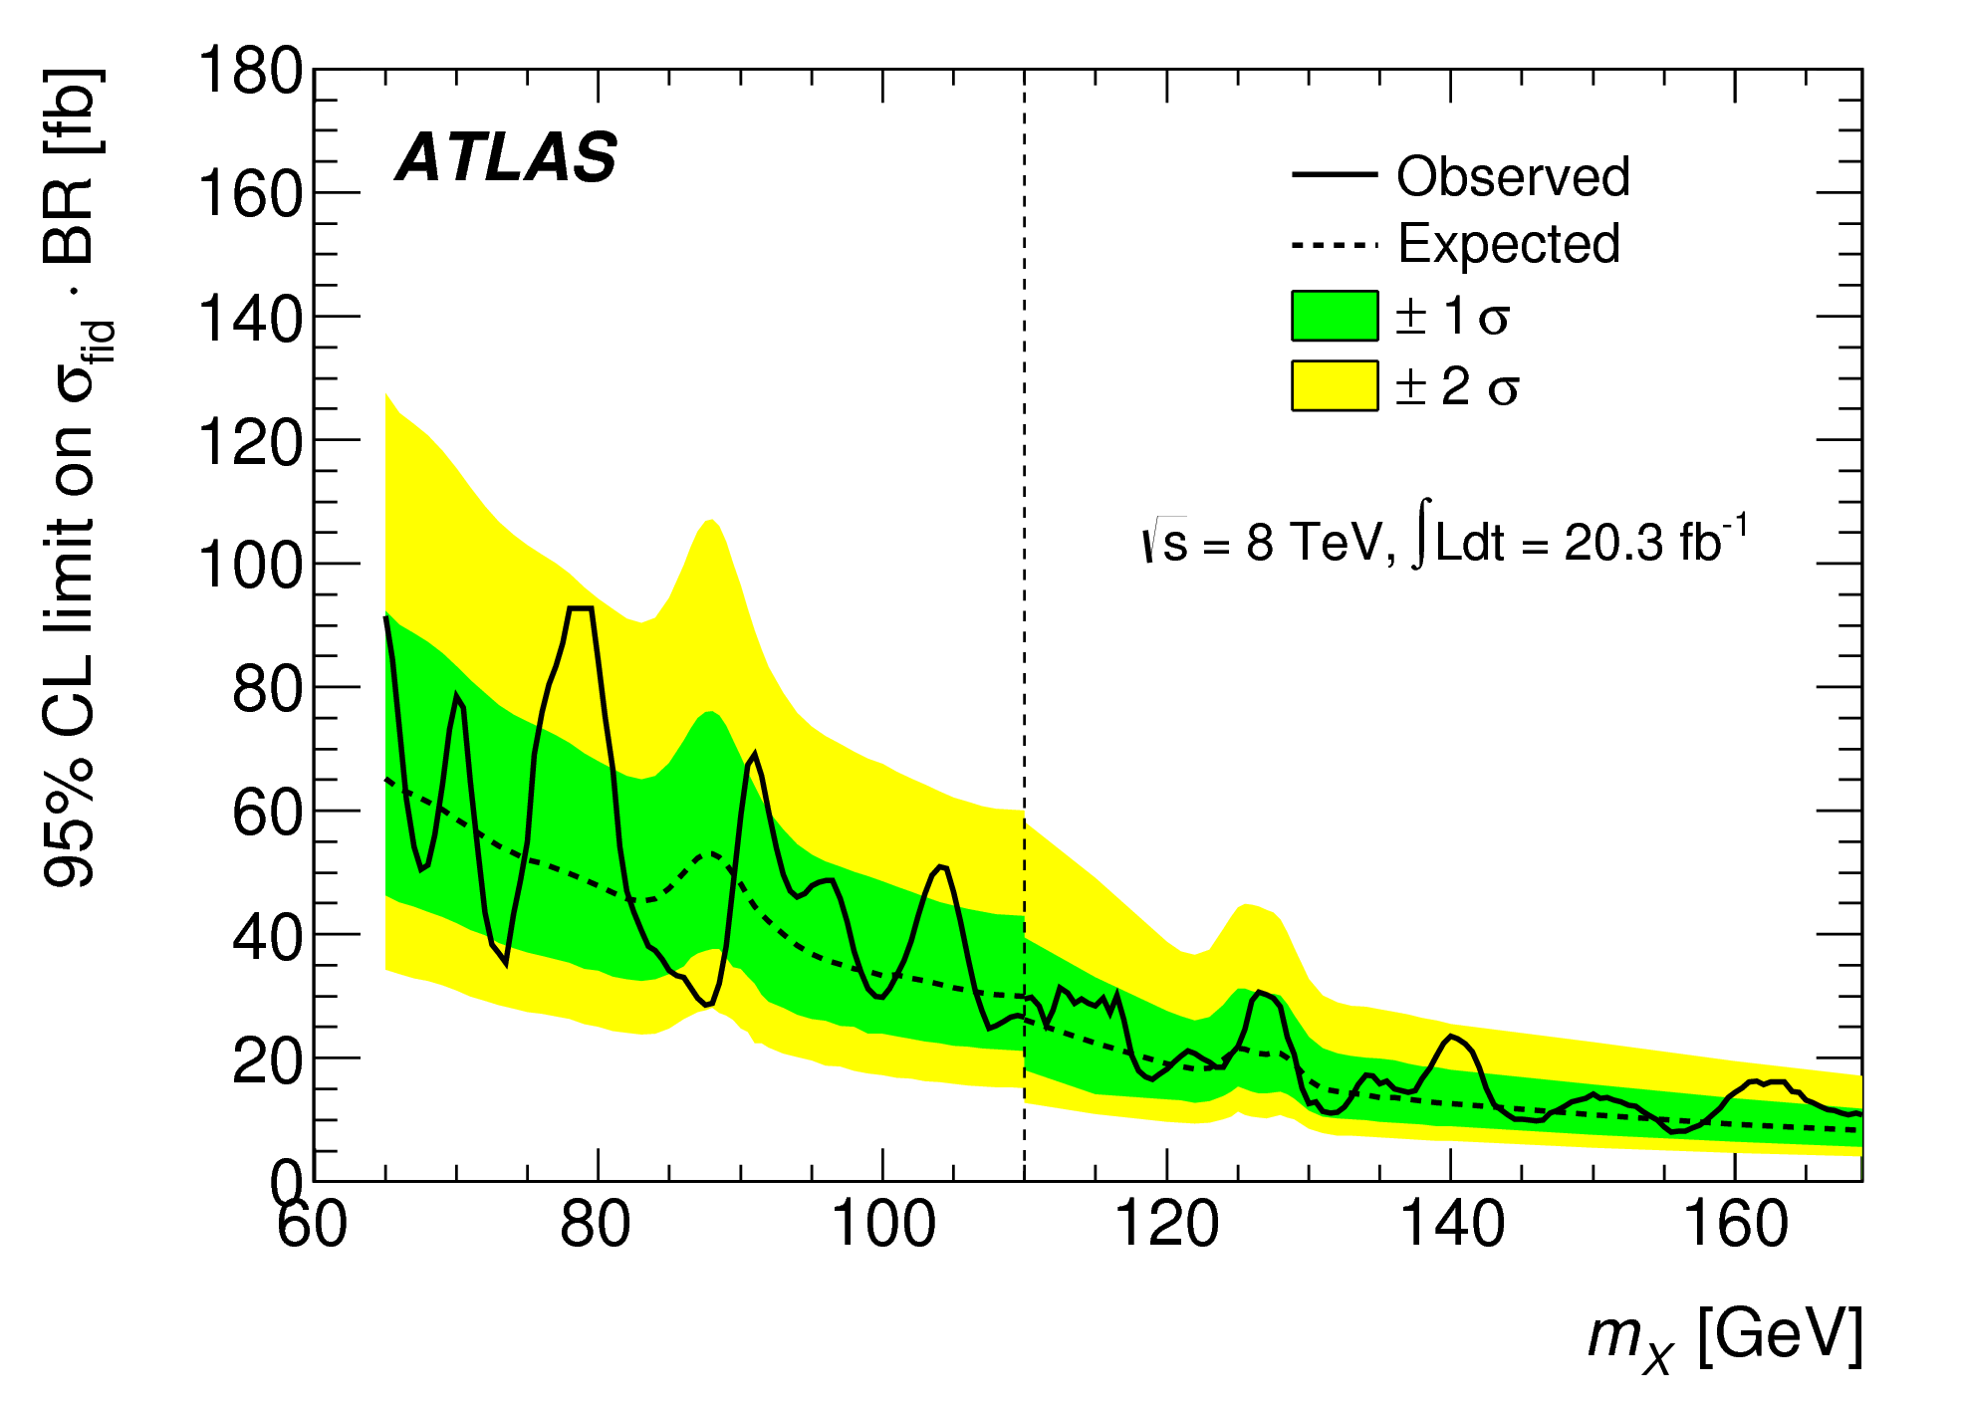
Results: Run 1
PRL 113 171801 (2014)
CMS: minimum(maximum) limit on σ X Br : 31(133) fb at m=102.8(91.1)GeV
ATLAS: limit on σ_{fid} X Br: 90 fb for m=65 GeV
CMS PAS HIG-17-013
No significant excesses with respect to expectations
~2σ excursion @~97.5 GeV
~2σ excursion @~80 GeV

Slide 16
Results: Run 2
CMS: minimum(maximum) limit on σ X Br : 26(161) fb at m=103.0(89.9)GeV
ATLAS: minimum(maximum) limit on σ X Br : 30(101) fb
ATLAS-CONF-2018-025
CMS PAS HIG-17-013
Notes:
”

Slide 17
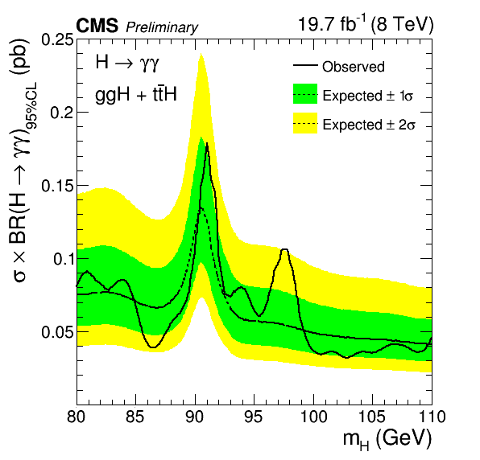
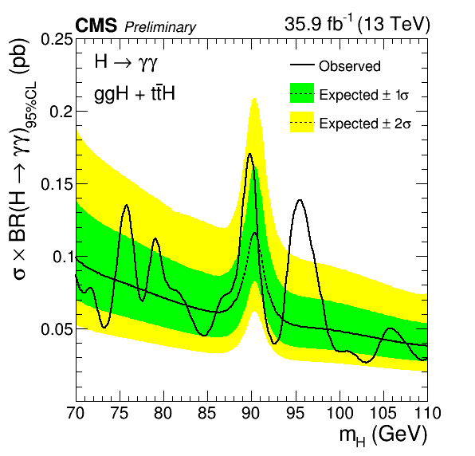
Results: Runs 1+2 g-induced
CMS PAS HIG-17-013
Per-process limits on σ X Br assuming 100% gluon-induced processes (ggH, ttbarH in SM proportions)

Slide 18
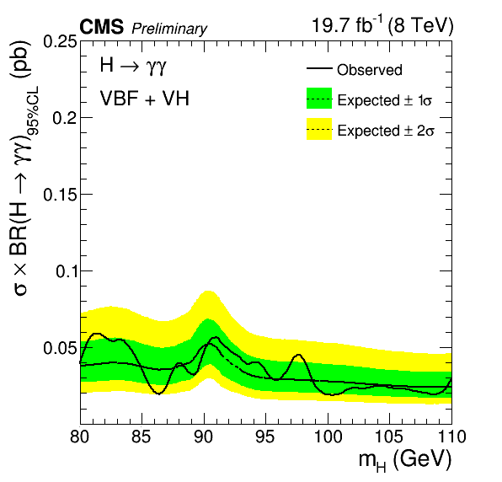
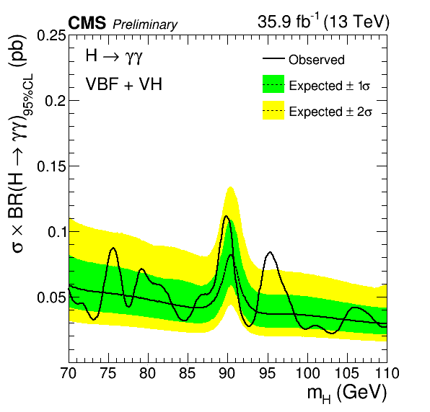
Results: Runs 1+2 f-induced
CMS PAS HIG-17-013
Per-process limits on σ X Br assuming fermion-induced processes (VBF, VH in SM proportions)

Slide 19
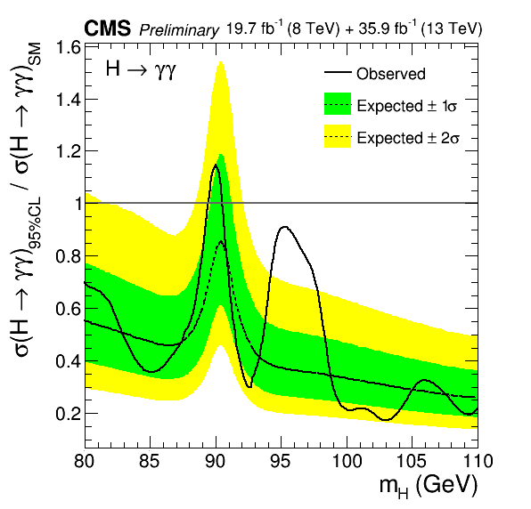
Results: Runs 1+ 2 Combination
CMS PAS HIG-17-013
All experimental + theoretical systematic uncertainties assumed uncorrelated except for those on signal acceptance due to scale variations + those on production cross sections (assumed 100% correlated).
8 TeV+13 TeV: minimum(maximum) limit on (σ X Br)/ (σ X Br)_{SM} : 0.17(1.15) at m=103.0(90.0)GeV
Combined 8 TeV+13 TeV σ X BR limit normalized to SM expectation (production processes assumed in SM proportions ).

Slide 20
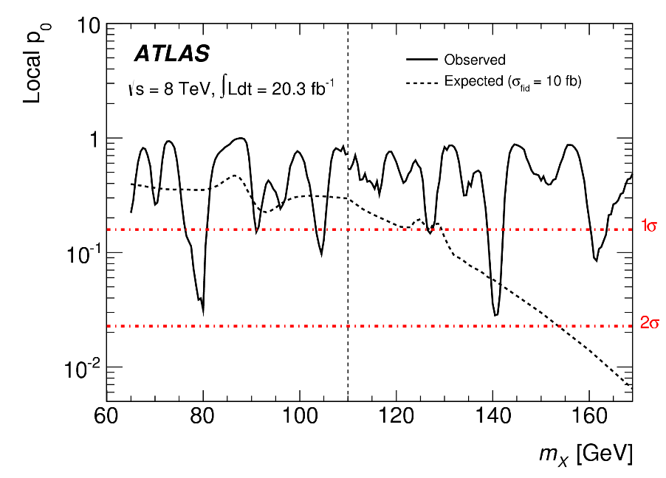
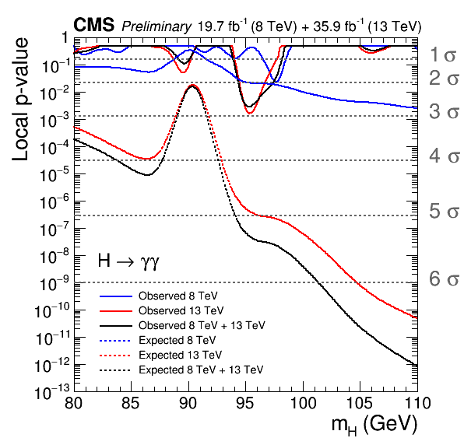
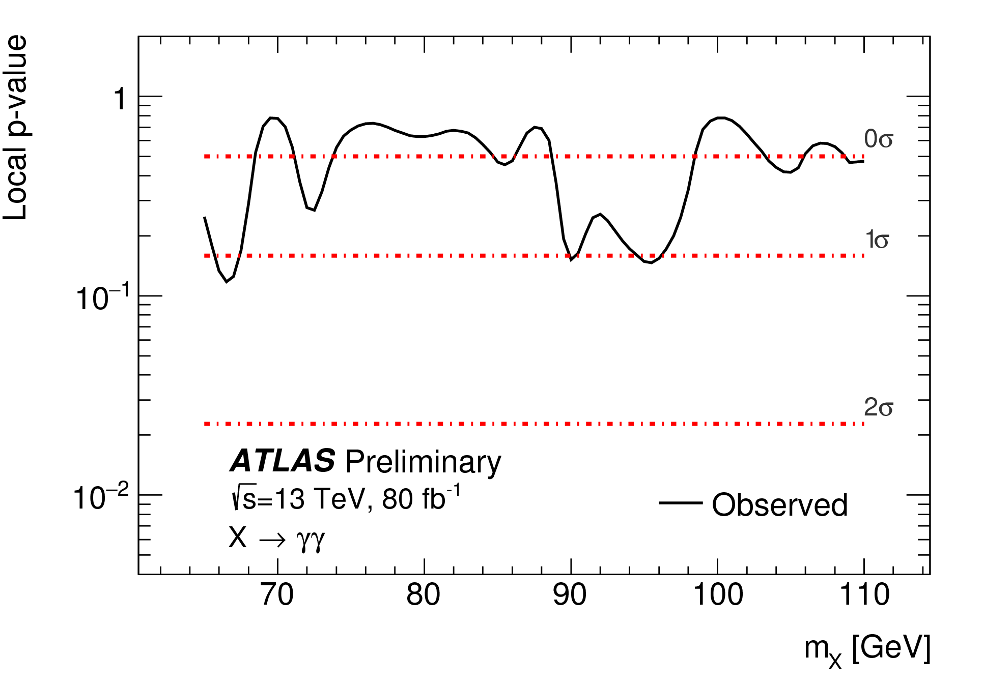
Results: p-values
PRL 113 171801 (2014)
8 TeV: Excess with ~2.0 σ local significance at m=97.6 GeV
13 TeV: Excess with ~2.9 σ local (1.47 σ global) significance at m=95.3 GeV
8TeV+13 TeV: Excess with ~2.8 σ local (1.3 σ global) significance at m=95.3 GeV
More data are required to ascertain the origin of this excess
ATLAS-CONF-2018-025
CMS PAS HIG-17-013
Expected and observed local p-values for 8 TeV, 13 TeV and their combination
8 TeV, 13 TeV: No excess>2σ

Slide 21
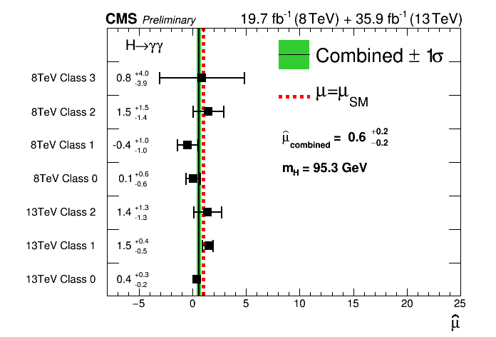
Runs 1+2
CMS PAS HIG-17-013
Excess here mostly driven by class 1 (&2) at 13 TeV
χ² probability for the seven individual values to be compatible with a single signal hypothesis: 41%
‘Signal’ strengths for the 7 event classes and overall, in the 8 TeV+13TeV combination, fixing m_{H}=95.3 GeV
More data are required to ascertain the origin of this excess

Slide 22
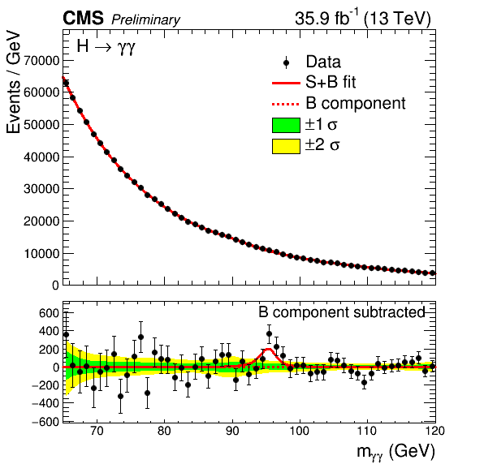
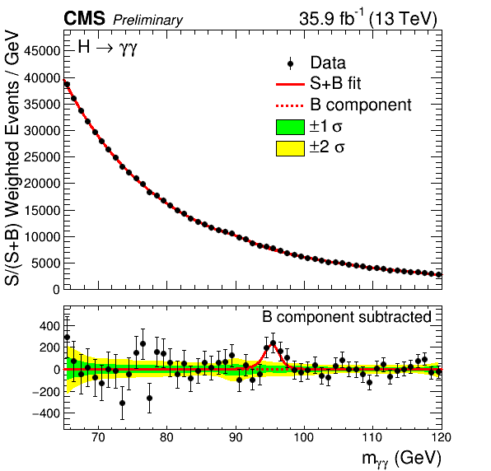
Run 2
CMS PAS HIG-17-013
Fits of S+B model over all event classes, for best-fit m=95.3 GeV
Bands include uncertainties on fit function choice/fitted parameters (from toys).
Left: unweighted, Right: each event weighted by the ratio S/(S+B) for its event class

Slide 23

Summary and Conclusion
PRL 113 171801 (2014)
CMS PAS HIG-17-013
ATLAS: Has individual results from 2012 (20.3fb-1) and 2016-2017 (80 fb-1), no combination
CMS: Has individual and combined results from 2012 (19.7fb-1) and 2016 (35.9 fb-1)
ATLAS-CONF-2018-025

Slide 24
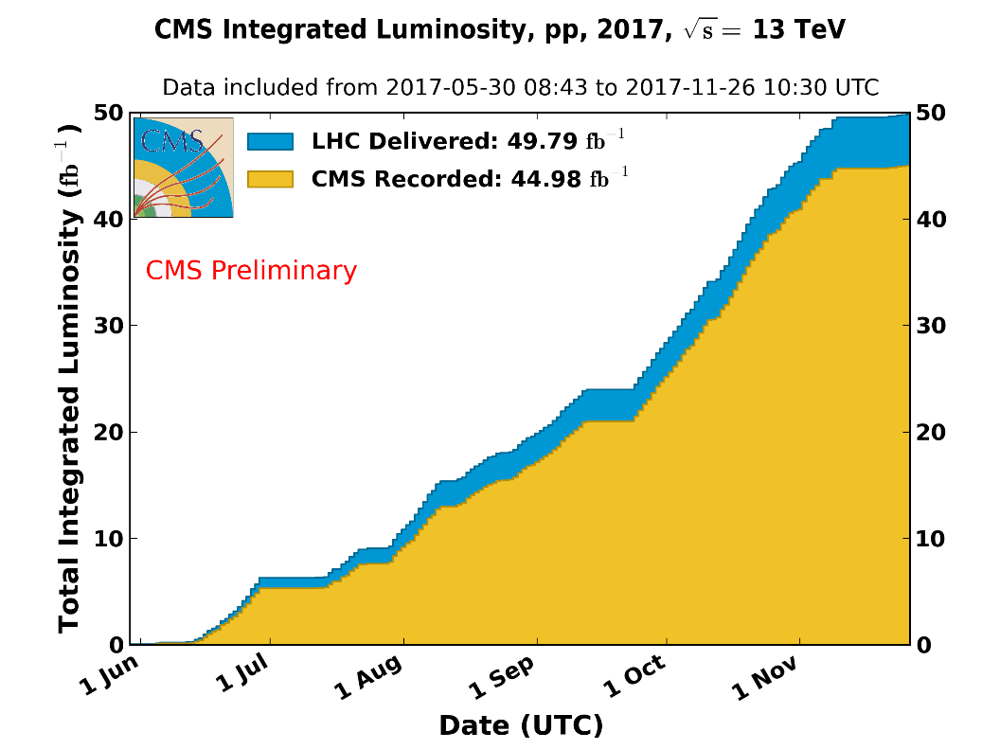
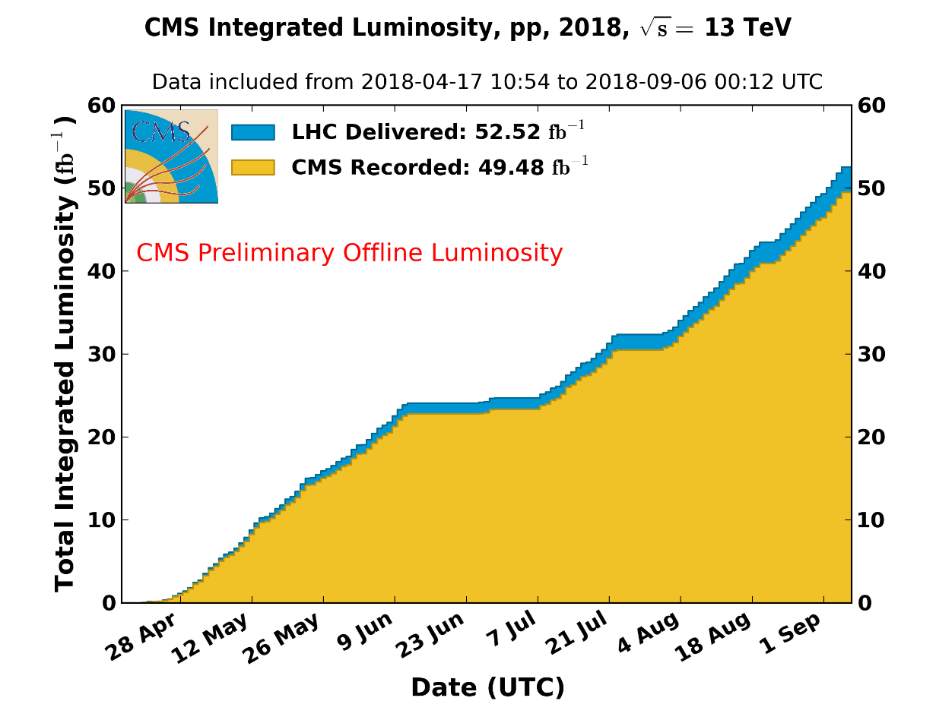
Summary and Conclusion
The CMS analysis of the 2017 data (in progress) and the excellent performance of the LHC in 2018 (already as much data recorded as in 2017, with ~5 weeks of p-p datataking remaining) should enable ATLAS and CMS to significantly advance on low-mass diphoton searches
https://cms-service-lumi.web.cern.ch/cms-service-lumi/publicplots/int_lumi_per_day_cumulative_pp_2017OnlineLumi.png
https://cms-service-lumi.web.cern.ch/cms-service-lumi/publicplots/int_lumi_per_day_cumulative_pp_2018NormtagLumi.png

Slide 25
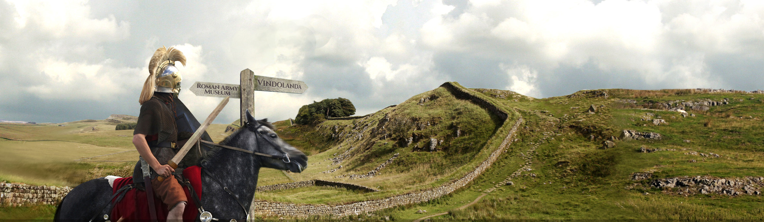

Acknowledgements
Thank you for the invitation and thank you for your attention
Special thanks to: L. Finco, L. Roos, R. Lafaye, M. Lethuillier, J. Tao, L. Finco, B. Courbon,, S. Zhang, K. Mondal, A. Purohit, P. K. Rout, S. Bhattacharya, C. Camen, A. Lesauvage
….and the super organization!!

Slide 26
Backup

Slide 27
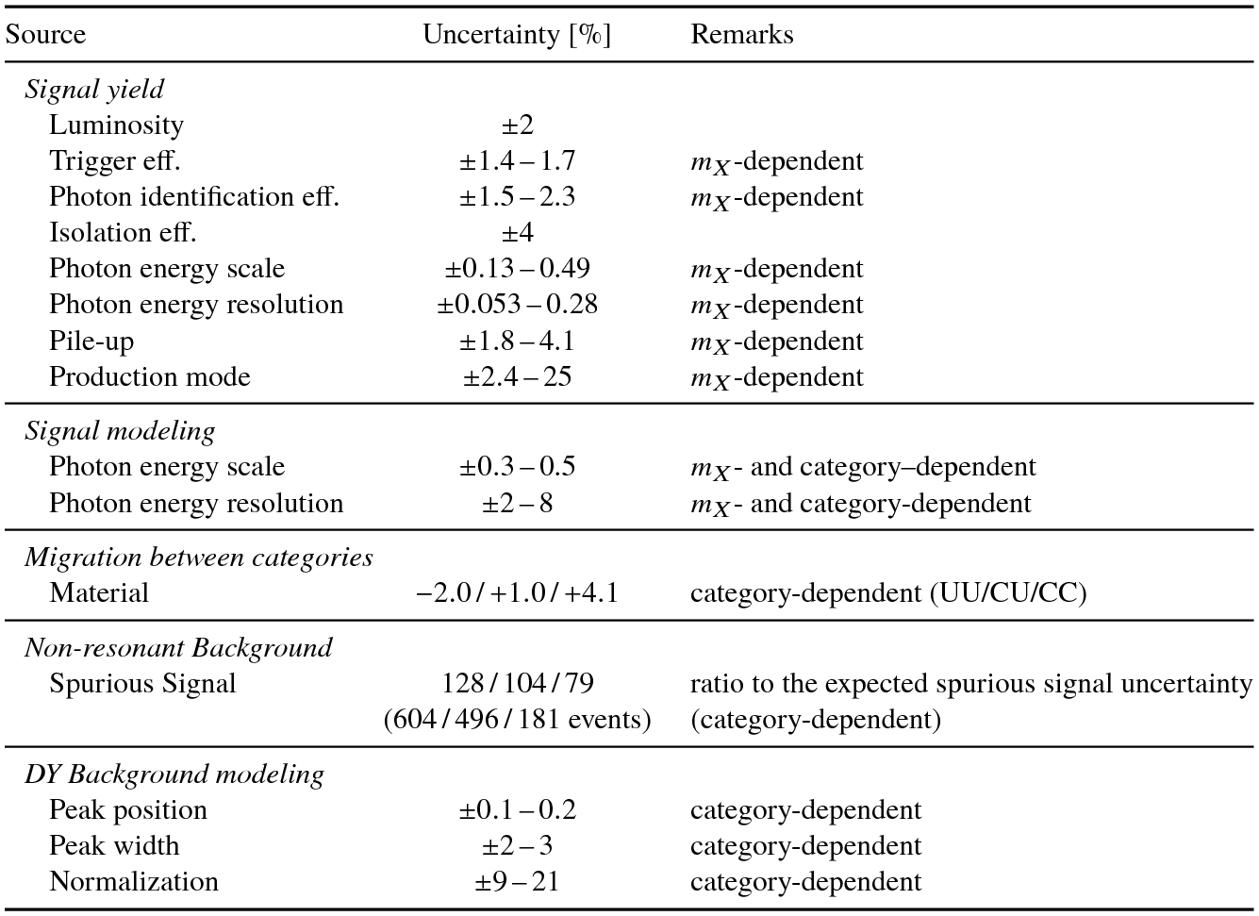
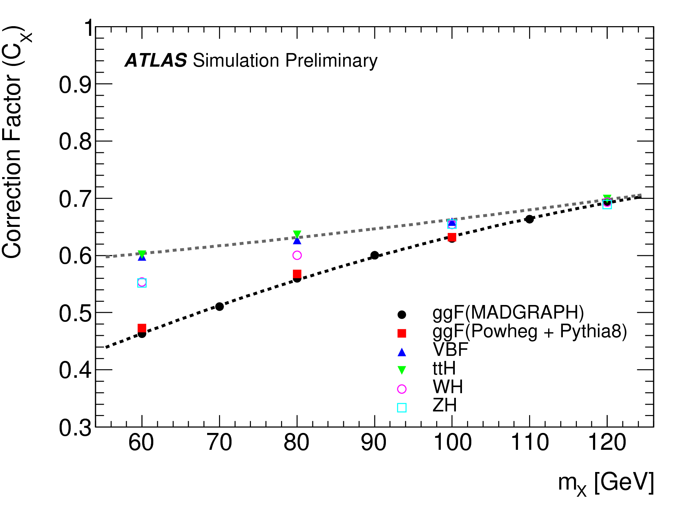
Backup
ATLAS-CONF-2018-025

Slide 28
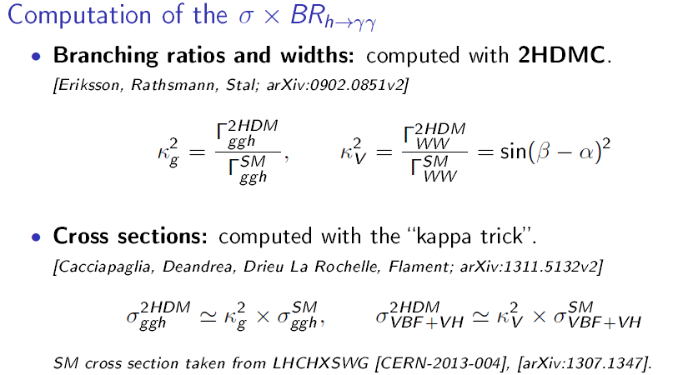
h-->γγ (65-110GeV): 2HDM Interpretation of CMS Run 1 results
arXiv:1607.08653, subm. JHEP
(Cacciapaglia , Deandrea, G-S, Le Corre, Lethuillier , Tao)
Cross-checked with SusHi [Harlander, Liebler, Mantler; sushi.hepforge.org/manual/SusHi150.pdf] for gluon fusion mode, agreement at ~3% level

Slide 29

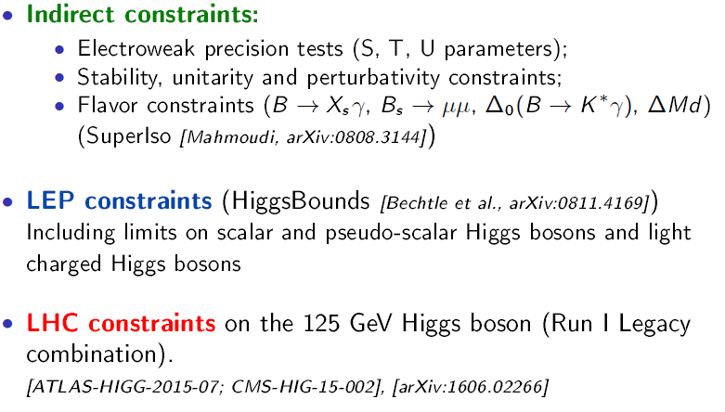
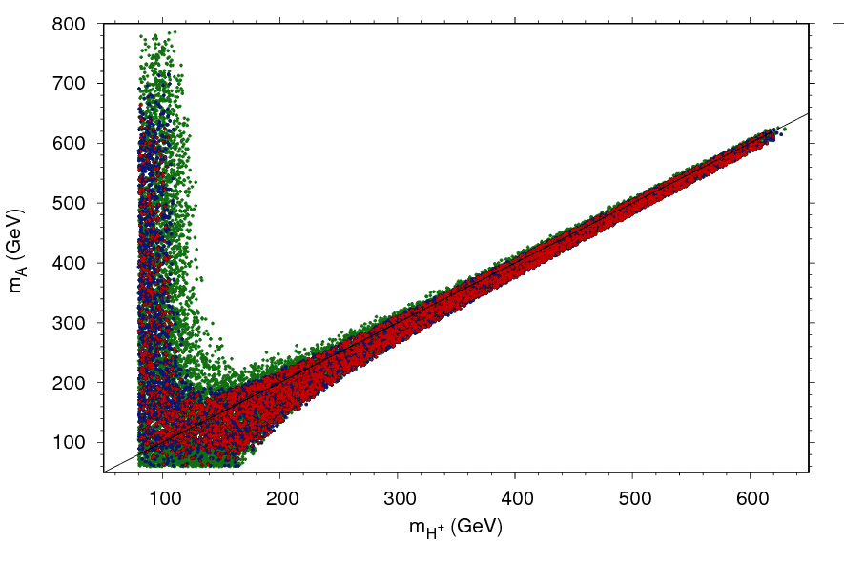
h-->γγ (65-110GeV): 2HDM Interpretation of CMS Run 1 results
arXiv:1607.08653, subm. JHEP
(Cacciapaglia , Deandrea, G-S, Le Corre, Lethuillier , Tao)
Initial 1M-point scan, apply cumulative constraints:
Type 1

Slide 30



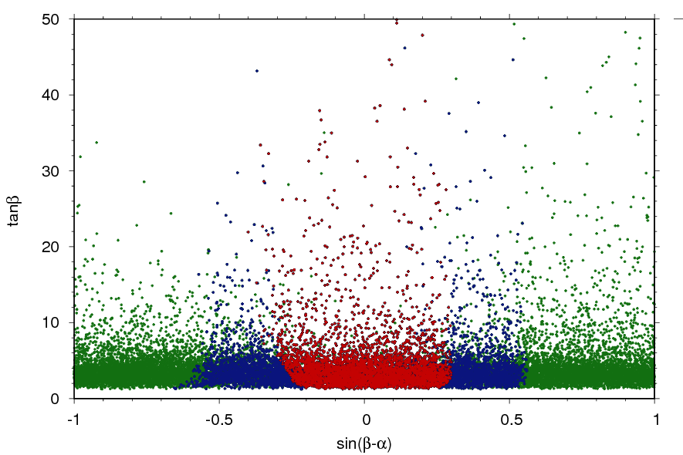
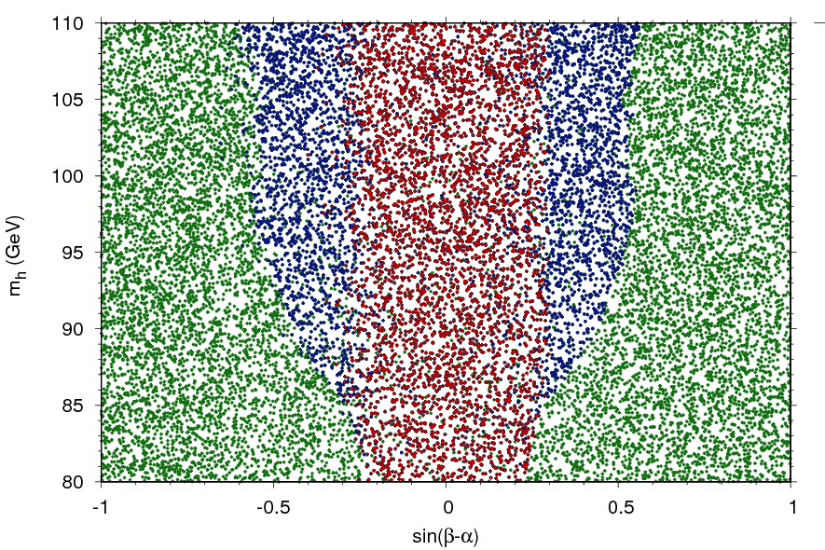
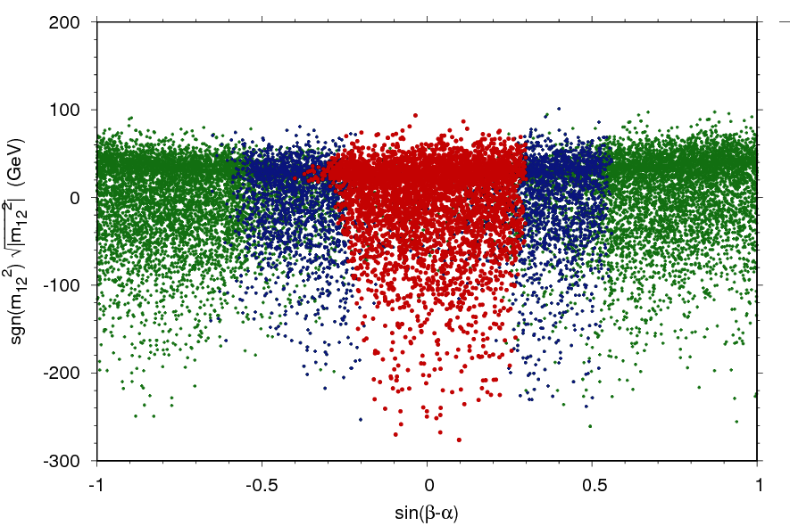
h-->γγ (65-110GeV): 2HDM Interpretation of CMS Run 1 results
arXiv:1607.08653, subm. JHEP
(Cacciapaglia , Deandrea, G-S, Le Corre, Lethuillier , Tao)
Initial 1M-point scan, apply cumulative constraints to refine ranges (shown: Type 1):

Slide 31

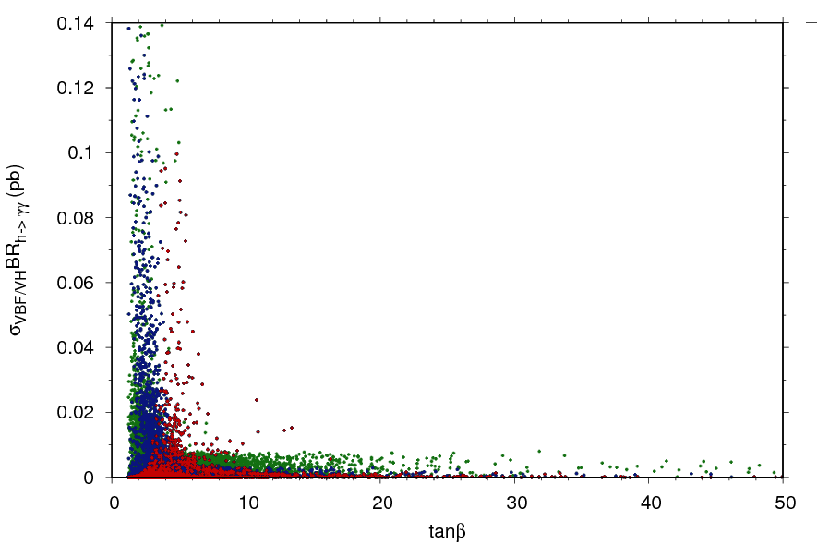




h-->γγ (65-110GeV): 2HDM Interpretation of CMS Run 1 results
arXiv:1607.08653, subm. JHEP
(Cacciapaglia , Deandrea, G-S, Le Corre, Lethuillier , Tao)
Initial 1M-point scan, apply cumulative constraints:
Gluon fusion
VBF+VH
Further refine ranges targeting points within ‘shooting distance’ of CMS maximal sensitivity (>0.01pb)

Slide 32



h-->γγ (65-110GeV): 2HDM Interpretation of CMS Run 1 results
arXiv:1607.08653, JHEP12(2016)068
Gluon fusion
VBF+VH
Results of new 1M-point scan with new ranges: Some exclusion possible with VBF + VH, m_{h} ~<105 GeV
Notes:
Add authors’ names!

Slide 33



h-->γγ (65-110GeV): 2HDM Interpretation of CMS Run 1 results
arXiv:1607.08653, JHEP12(2016)068
Projections of red points on previous slide→orange if σXBR>CMS observed limit←→excluded (violet otherwise) [but caveat…]

Slide 34




h-->γγ (65-110GeV):Interpretation of CMS Run 1 results
Les Houches 2017, very preliminary
(A. Angelescu, G. Moreau, S. Fichet,
SGS, L.Finco, S. Zhang)
⏀
⏀ = light Higgs, radion, dilaton, axion…
Using generic (EFT) parameters so that
any BSM model can be constrained :
CP even ⏀
= Z
Excluded by CMS-HIG-14-037 (VBF+VH)
CP odd ⏀
Excluded by CMS-HIG-14- 037

Slide 35





φV-->γγV(65 ~20-110GeV): Future ideas for probing lower di-γ masses
Les Houches 2017, very preliminary
(A. Angelescu, G. Moreau, S. Fichet,
SGS, L.Finco, S. Zhang)
⏀
⏀ = light Higgs, radion, dilaton, axion…
Using generic (EFT) parameters so that
any BSM model can be constrained :
= Z
SM Background
CP odd ⏀
= Z
CP even ⏀
possible discrimination
m⏀ = 20 GeV
m⏀ = 70 GeV
For (pseudo-) scalars below m~ 70-80GeV
decay: ZZ* kin. closed and difficult (trigger)
ggFusion mechanism not promising
take advantage of the Z→l⁺l⁻ from pp→Z⏀
P_{T} distribution

