Slide 1
STFC: activities, issues & ambitions
Professor Mark Thomson
STFC Executive Chair
19 December 2018

Slide 2
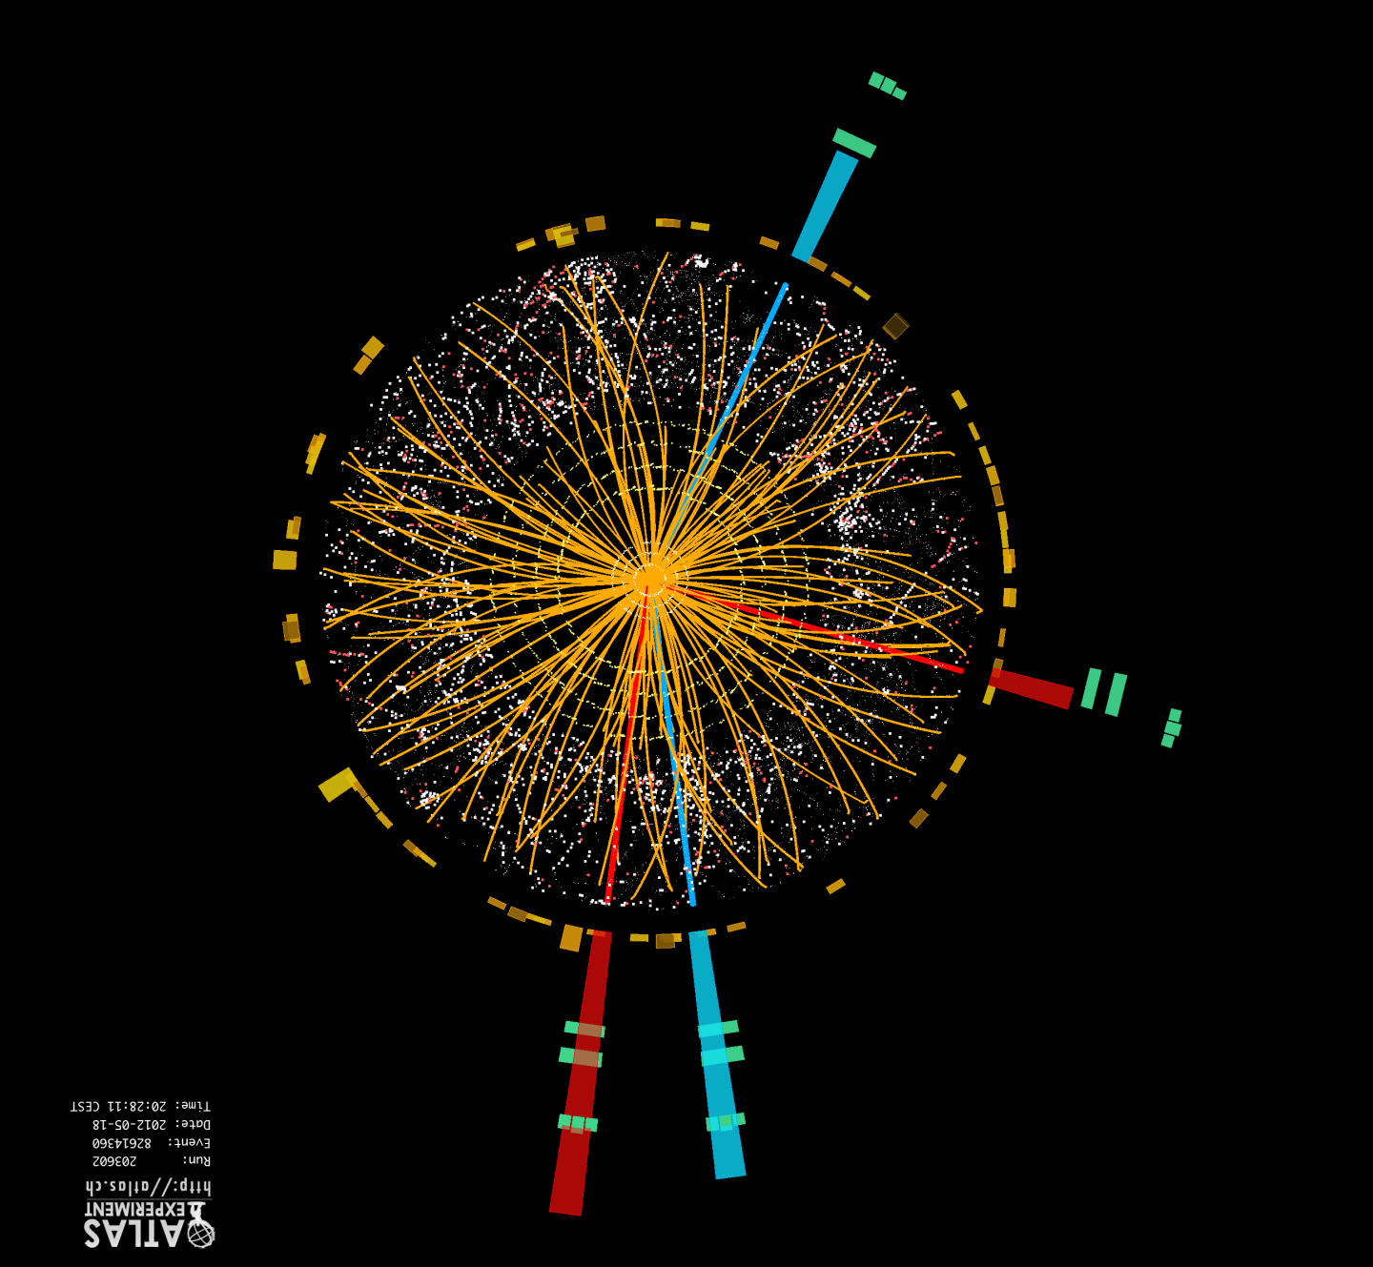
Contents
Contents
UK Research and Innovation
STFC as Part of UKRI
UKRI Funding Opportunities
Particle Physics Update
Spending Review 2019
Infrastructure Roadmap
Closing Remarks

Slide 3
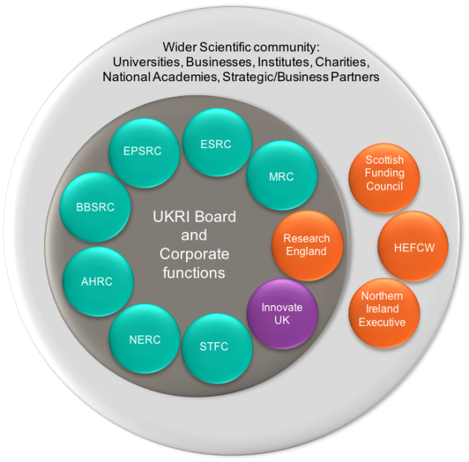
UK Research and Innovation
UK Research and Innovation (UKRI) formed on 1 April 2018 as the new funding organisation for research and innovation in the UK
It brings together the seven UK Research Councils, Innovate UK and a new organisation Research England
Strengthens the connections between research disciplines
STFC is part of a larger organisation but will retain much of its identity:
    Delegated budget remains unchanged
    Culture already aligned with UKRI

Slide 4
UK Research and Innovation
Brings many advantages and opportunities:
Strengthened strategic approach to future challenges
Unified voice for the UK’s research and innovation system
Improved quality of evidence on the UK’s research and innovation landscape
Amongst the immediate priorities:
    Engaging stakeholders to create a well informed roadmap to reaching 2.4% of GDP investment in R&D by 2027
In addition, enables a more coherent cross-discipline approach to R&I

Slide 5
UKRI Strategic Prospectus
The Vision is:
  Benefiting everyone through knowledge, talent and ideas
The Mission is:
  Push the frontiers of human knowledge and understanding
  Deliver economic impact
  Create social and cultural impact by supporting society to become enriched, healthier, more resilient and sustainable
Underpinned by:
  Foundations for excellent research and innovation
  Best environment for research and innovation

Slide 6
Contents
UK Research and Innovation
STFC as Part of UKRI
UKRI Funding Opportunities
Particle Physics Update
Spending Review 2019
Infrastructure Roadmap
Closing Remarks

Slide 7

Strategy for STFC
  We are developing STFC’s first “Strategic Delivery Plan” as part of UKRI
  Publication expected in April 2019
  New format of priority areas and strategy for the next ~10 years
  Also Delivery plan for FY’19
  STFC is developing a “bold and ambitious” forward-looking plan
  There is a lot of change around us, including the additional resources associated with the formation of UKRI and the government’s Industrial Strategy
  I believe this is a unique opportunity for STFC and the other councils of UKRI
Credit: STFC/Timothy Mills

Slide 8

STFC’s Priorities
  Key priorities for STFC’s SDP:
  Fully engage with new frontier science opportunities to drive development of novel technologies
  Use our inspiring high-tech facilities (in UK and overseas) as a training ground for skills in engineering, technology and computing for the UK
  Create a strategic pipeline for developing our world-leading National facilities and to keep them world class
  Grow our stewardship of the R&I ecosystem at the Harwell and DL Campuses
  Strengthen strategic partnerships with other councils, e.g. EPSRC

Slide 9
STFC: Change and refresh
  We’re continuing to work through the division of responsibilities within UKRI between the Councils and the central team, and between UKRI and BEIS
  We need to deliver a more efficient process and service for you, for government, for staff and for the public
  The UKRI Transformation Programme is underway, and will lead to internal changes – e.g. HR, Finance already centralised teams, opportunities to reduce red tape etc
  STFC also experiencing some change
  Executive Board retirements and departures has allowed a refresh at the top level, including better representation of our lab-based activities
  We’re also conducting a targeted review of the Consolidated Grants process

Slide 10

Equality, Diversity and Inclusion
  E,D&I is a very high priority for STFC and UKRI
  Jennifer Rubin (Executive Chair, ESRC) is the UKRI E,D&I champion
  UKRI Board made strong public commitments
  STFC now has a dedicated EDI team and is establishing an high-level Advisory Body chaired by a Council member (Sheila Rowan), and an internal Implementation Group
  Physics community has taken some positive steps
  But the Strumia case demonstrates we cannot be complacent, cannot simply assume we are doing “OK”
  There needs to be an increased focus on E,D&I across all of activities

Slide 11
Contents
Contents
UK Research and Innovation
STFC as Part of UKRI
UKRI Funding Opportunities
Particle Physics Update
Spending Review 2019
Infrastructure Roadmap
Closing Remarks

Slide 12
UKRI Funding Opportunities
  Autumn Statement 2016 uplift to research and innovation budget:
  Industrial Strategy Challenge Fund (ISCF) – Wave 2 challenges underway, launch of Wave 3 expected
  Global Challenges Research Fund (GCRF) – large amounts still unallocated
  Strategic Priorities Fund (SPF) – £560 million over three years, bids from UKRI Councils and BEIS PSREs
  Talent Fund – £300 million over three years
  Commercialisation Fund – £108 million
  Strength in Places Fund – £115 million over three years for collaborative bids between research organisations and business to support regional growth
  Fund for International Collaboration (FIC) – £110 million over three years

Slide 13
STFC and the new funds
  The STFC community was not as successful with round one of GCRF as hoped:
  We accepted the need to improve our bids, and for closer working with other councils, departments and industry
  In the last year there has been significant progress:
  Received funding for National Satellite Test Facility at Harwell from ISCF
  Now expecting several major projects to be confirmed in coming weeks from SPF and FIC
  Recently (since April) adopted a new approach:
  Target highest-priority ideas from STFC’s communities
  Our job is to align these highest priority ideas with the new funding opportunities

Slide 14
New ideas and reviews of old
  The Developing a World Class Programme exercise in summer has provided 51 “proposals” now reviewed by STFC Council, Executive Board and Science Board
  It wasn’t a prioritisation, but instead the collection of new ideas with which to bid for the new UKRI-wide funding streams – the list is on our website
  The list is already being used to help inform bids for Fund for International Collaboration, Strategic Priorities Fund.
  We continue our regular reviews of our programmes
  Completing programme evaluations of computing, nuclear physics and particle astrophysics

Slide 15
Contents
Contents
UK Research and Innovation
STFC as Part of UKRI
UKRI Funding Opportunities
Particle Physics Update
Spending Review 2019
Infrastructure Roadmap
Closing Remarks

Slide 16
Particle Physics Programme Evaluation
PP Evaluation to be completed by May 2019
  Will feed into next Balance of Programme exercise
Consider current and future balance of the programme.
Inter-dependencies between areas to be managed (e.g. PA and PP).
Each review will explore the consequence of + 10% funding over the next 5 years.
2017 Review of Theory will be an input to the evaluation
PP Theory Review
Q4 2017
PP Programme Evaluation
Q3 2018
BoP2
2019

Slide 17
Review of Consolidated Grants
CG Review is underway, due to report in early 2019.
  Chaired by Alison Davenport (former chair of Science Board).
Will consider options for grants delivery mechanisms for PP Experiment and Theory, Astronomy and Nuclear Physics.
Will need to meet the needs of STFC and its communities and offer flexibility to meet the different needs of the programme.
But should also be administratively straightforward and efficient in line with UKRI processes and TRAC methodology.

Slide 18
Particle Physics Update
The 2018 Particle Physics Experiment consolidated grants round, £60M~ for 2019-2022 now awaiting final approval
  Huge funding pressures due to continued flat cash, magnified by changes in TRAC methodology, and LHC commitments
  Resulting programme smaller but relatively balanced between groups and experiments. Carries significant risks to UK deliverables and physics
  Mitigation being finalised by STFC but outcome will be sub-optimal
New major project investments:
  ALIGO+ (£11M over 4 years) – assumes securing UKRI directed funds
  ATLAS Phase 2 Upgrade construction (£32M over 6 years) approved and underway
  CMS Phase 2 Upgrade construction (£11M over 5 years) approved and grants being prepared for announcement

Slide 19
Particle Physics Update
DiRAC Computing – Efforts continue to find funding for DiRAC-3 needed to help underpin STFC’s frontier science programme
  core component, together with GridPP, of National e-Infrastructure provision
LBNF/DUNE
  Proposals for the DUNE and PIP-II SRF sub-projects with PPRP for peer review
  working with US DOE on governance and framework for international agreements.
CTA – reached critical decision points ahead of construction phase
  Only one SST design at observatory to reduce complexity - review underway
  Legal negotiations ongoing to establish CTAO as an ERIC
LSST UK community building up involvement in US-led project
  STFC has committed to the operational phase of this facility to allow almost all major UK groups to have early access to the data

Slide 20
Skills and Engagement
11 Ernest Rutherford Fellowships to be awarded in 2019
220 students awarded in 2018 on Doctoral Training Partnerships
Data Intensive Science Studentships
  another 27 students awarded to the 8 centres in 2018 + 22 match funded students
UKRI Future Leader Fellowships – launched in 2018
  3rd round closing date of 2nd May for mandatory outline proposals
Other schemes awarded in 2018
  Innovation Fellowships, Innovation Placements, Alan Turing Artificial Intelligence Students, Industrial CASE students
Hawking Fellowships
  new scheme to be launched in 2019 in the areas of maths, physics and computer sciences, up to 10 per year for the next five years

Slide 21
Skills and Engagement
  Ten summer schools supported in 2018 with over 450 students attending
  Summer school for CDT students held at UCL in July
  CDT event held in Edinburgh for 2018 cohort of students to participate in training sessions including careers sessions with non-academic partners
  Immediate employment of students in diverse sectors of the UK economy:
  53% University,
  5% Public Sector
  28% Private Sector
  10% Teaching, study or self-employed
  Over 70% of those employed in private sector are employed in software development, data analysis, engineering and finance

Slide 22
Contents
Contents
UK Research and Innovation
STFC as Part of UKRI
UKRI Funding Opportunities
Particle Physics Update
Spending Review 2019
Infrastructure Roadmap
Closing Remarks

Slide 23
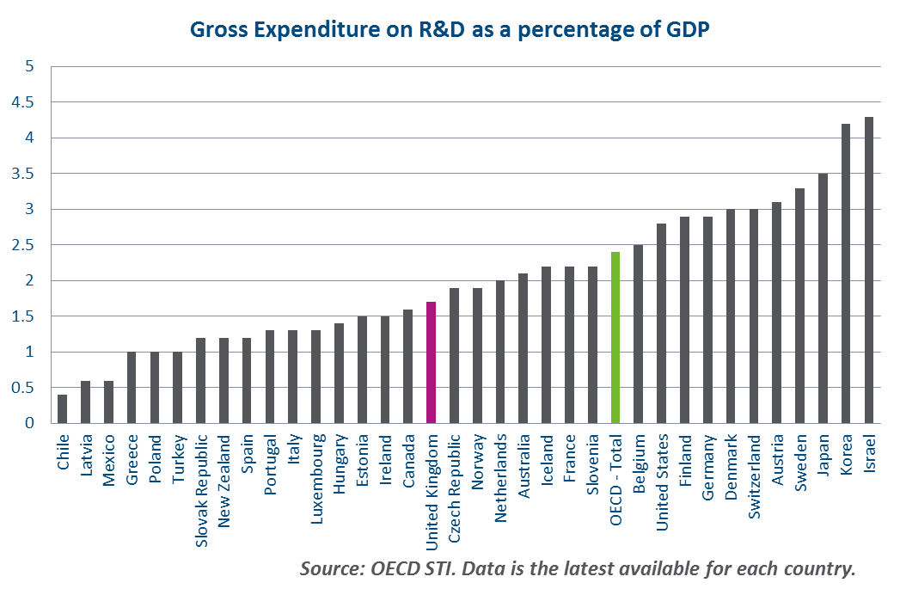

Spending Review 2019
  Government announced intention to hold a full Spending Review in 2019
  Precise timing not confirmed, nor
  is the period of time it will cover
  Will be challenging as public finances remain tight, despite the “end of austerity” message
  Brexit remains an unknown
  But … commitment to raise total investment in research and development to 2.4% of Gross Domestic Product by 2027
Gross Expenditure on R&D as a % of GDP

Slide 24
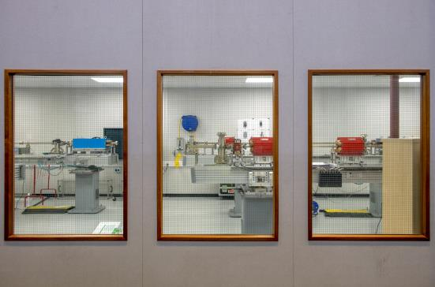
CSR Preparations
  UKRI requested scenarios for lower, unchanged and higher budgets to inform their bid to BEIS
  Options for infrastructure projects
  STFC also provided an optimum scenario of the benefits from increasing our:
  Core Programme
  Skills and Talent
  Science Estate / ”well found” labs
  Innovation
  Technology
Credit: STFC/Martin Malies

Slide 25
Contents
Contents
UK Research and Innovation
STFC as Part of UKRI
UKRI Funding Opportunities
Particle Physics Update
Spending Review 2019
Infrastructure Roadmap
Closing Remarks

Slide 26
Infrastructure Roadmap
  This is an exciting time for UK science:
  Government’s Industrial Strategy highlights the importance of Research and Innovation to the UK economy
  Significantly increased investment in Research and Innovation
  Goal of 2.4% of GDP by 2027
  Currently developing the “UK Research and Innovation Infrastructure Roadmap”
  Work led by STFC on behalf of UKRI
  First exercise of its type in the UK
  Will provide an evidence base of current research infrastructures and future research needs out to 2030

Slide 27

Infrastructure Roadmap
  Main Outputs:
  Interim Reports
  Summary of landscape analysis (December)
  Themes within sectors (planned early 2019)
  Final Report (May/June 2019) covering
  Landscape (what we have got)
  Future capability needs (what the research
  and innovation community needs)
  Options for meeting future needs with narrative
  Not a prioritisation exercise
Factual resource that may be used to inform policy

Slide 28
Contents
Contents
UK Research and Innovation
STFC as Part of UKRI
UKRI Funding Opportunities
Particle Physics Update
Spending Review 2019
Infrastructure Roadmap
Closing Remarks

Slide 29
What keeps me awake at night ?
  1) Pressure on STFC’s core programme:
  Over last years, flat cash has squeezed core programme
  Unable to join/lead new world-class scientific projects (except through one-off interventions)
  Missing many opportunities to develop new and novel technologies
  Ultimately, this will stifle innovation
Reduced contribution: CERN, Lux Zeplin, Gravitational waves, CTA, SuperNEMO neutrinoless double beta decay, LHC upgrades, academic time for particle physics, reducing experimental programme
Currently Unable to pursue: Simons Observatory, nEDM, no early stage R&D programmes, iceCube, DiRAC 3, Liverpool telescope 2, European Solar Telescope, ELI, …
  2) Staff recruitment and retention:
  Particularly acute for STEM staff at Harwell
  If not addressed, there is a real risk of not being able to operate efficiently our National facilities

Slide 30

Questions

