Slide 1
Belle II Results
Bostjan Golob
University of Ljubljana/
Jozef Stefan Institute
&
Belle/Belle II Collaboration
Introduction
Status
(plan, accelerator, detector)
Phys. program
Prospects
(Example of measurements:
E_{miss})
University
of Ljubljana
“Jozef Stefan”
Institute
UK HEP Forum
„The Spice of Flavour“
Abingdon
27-28 November 2018

Slide 2
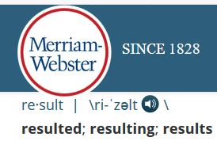
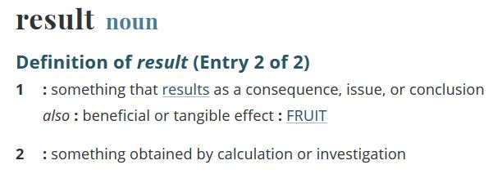
Introduction
Disclaimer:
„Results“ in the title is to be
understood in a very broad sense
…as a consequence of planning, R&D for accelerator
and for detector modules

Slide 3
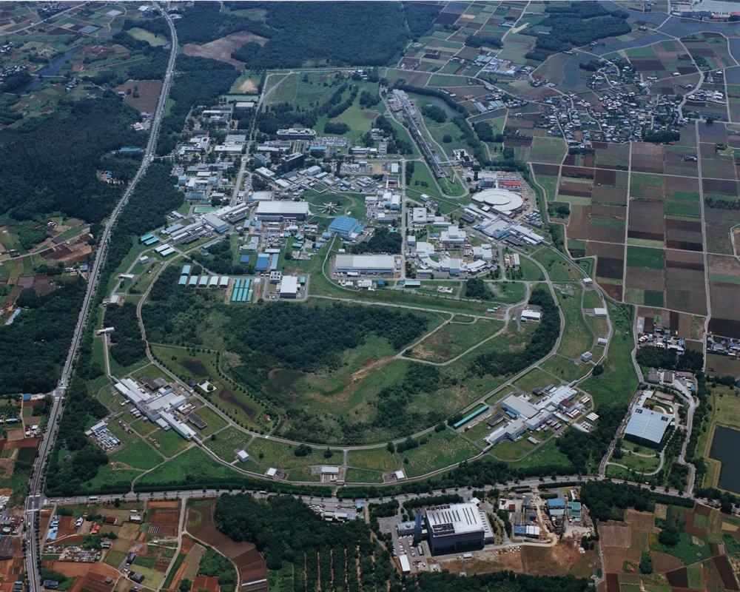
Introduction
Accelerator
“SuperKEKB”
Tokyo (40 mins by Tsukuba Exps)
SuperKEKB:
e⁻ (HER): 7.0 GeV
e⁺ (LER): 4.0 GeV
E_{CMS}=M(Υ(4S))c²
(→BB)
[M(Υ(1S))c² ,M(Υ(6S))c²]
dN_{f} / dt = σ(e⁺e⁻→f)L
L =8x10³⁵ cm⁻² s⁻¹
LER
HER
e⁻
Belle 2
e⁺

Slide 4
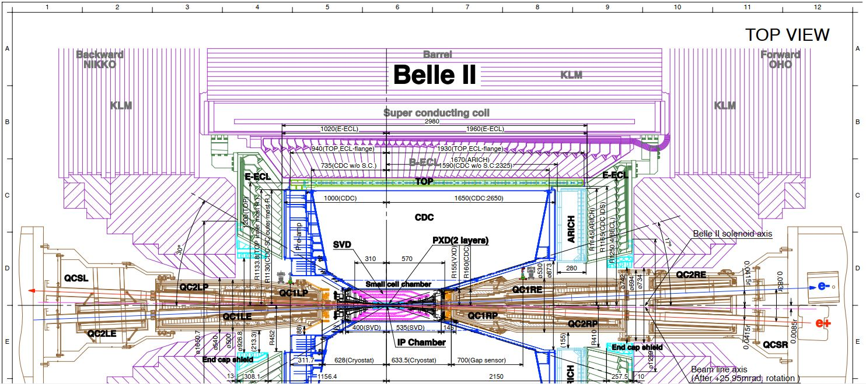
Introduction
Detector Belle II
KL and muon detector:
Resistive Plate Counter (barrel outer layers)
Scintillator + WLSF + MPPC (end-caps , inner 2 barrel layers)
EM Calorimeter:
CsI(Tl), waveform sampling (barrel)
Pure CsI + waveform sampling (end-caps)
Vertex Detector
2 layers DEPFET + 4 layers DSSD
Central Drift Chamber
He(50%):C2H6(50%), small cells, long lever arm, fast electronics
Particle Identification
Time-of-Propagation counter (barrel)
Prox. focusing Aerogel RICH (fwd)
3m

Slide 5
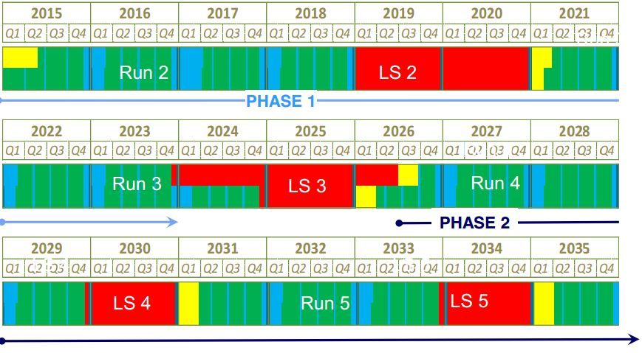
Introduction
Super KEKB luminosity planning
~6 ab⁻¹
~ 1 ab⁻¹
~15 ab⁻¹
Phase 1
Phase 2
Phase 3 →
Phase 1:
w/o QCS
w/o Belle 2
Phase 2:
w/ QCS
w/ Belle 2
(no VXD)
Phase 3:
full Belle 2
QCS, Belle 2
VXD
~ 25 ab⁻¹
~ 40 ab⁻¹
LHCb LS2
LHCb LS3
HL LHC

Slide 6
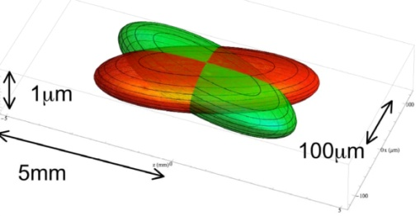
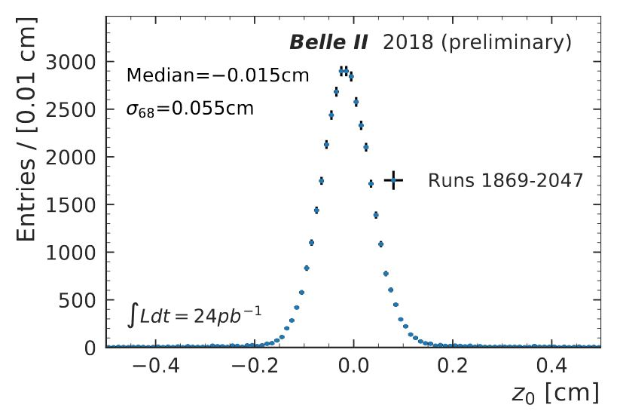
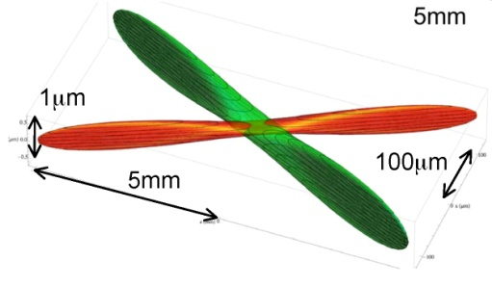
Phase 2 Accelerator
Phase 2: accelerator and detector commissioning, physics collisions
validation of Nano beam scheme
March 22nd – July 17th 2018
KEKB:
Belle: σ ~ 1 cm
σ_{x}~100μm,σ_{y}~2μm
SuperKEKB:
z₀ of single tracks
from primary vtx
N. Braun et al., BELLE2-NOTE-PL-2018-008
σ_{x}~10μm,σ_{y}~60nm

Slide 7
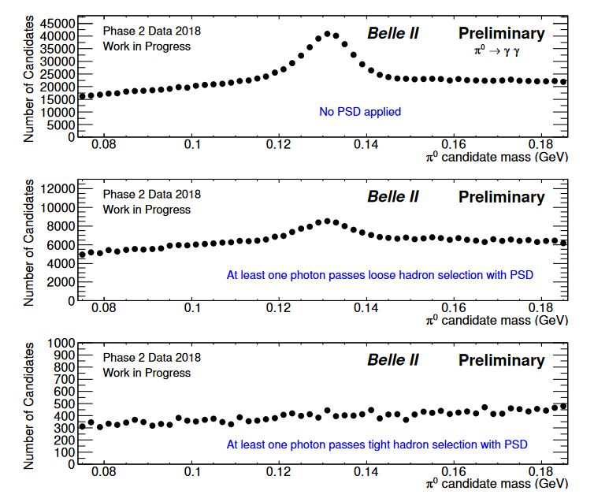
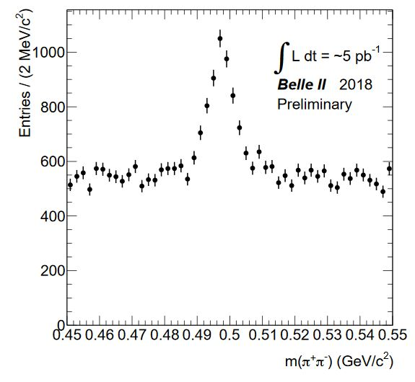
Phase 2 Detector
Phase 2: accelerator and detector commissioning, physics collisions
S. Longo, J.M. Roney, BELLE2-NOTE-PL-2018-027
B. Fulsom, BELLE2-NOTE-PL-2018-006
π⁰ → γγ
no requirement on γ
at least one γ passing loose PSD
K_{S} → π⁺π⁻
at least one γ passing tight PSD
Beam bkg rejection (high mult.),
vtx fit, CDC
hadron veto in ECL using
Pulse Shape Discrimination

Slide 8
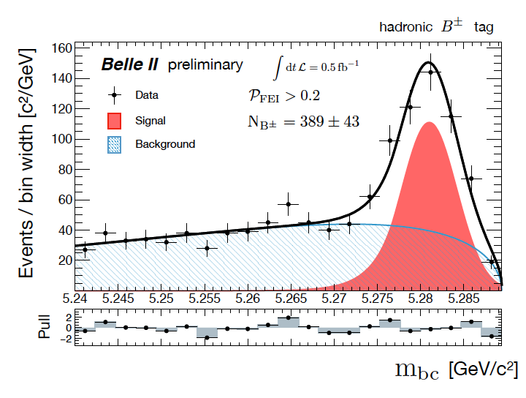
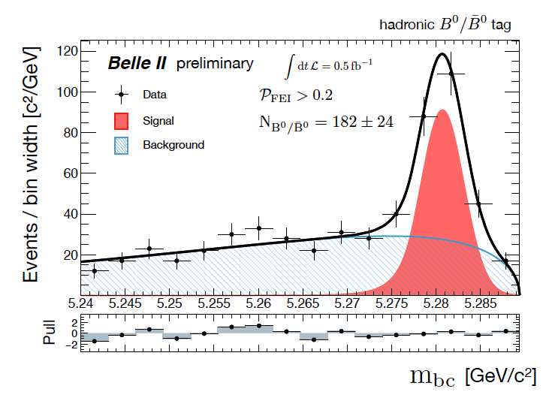
Phase 2 Physics
Phase 2: accelerator and detector commissioning, physics collisions
reconstruction of B mesons (Full Event Interpretation)
B⁺
B⁰
W. Sutcliffe, F. Bernlochner, B2NOTE-2018-031-1

Slide 9
Phase 3 Topics
Methods and processes where Belle 2 can provide
important insight into NP complementary to other experiments:
E_{miss}:
B→ τν, B → X_{c}τν, B → hνν, B → X_{u} l ν, D_{s} → τν, ...
(Semi)Inclusive:
B → sll , B → sγ, B → dγ, ...
Neutrals:
B → K_{S}π⁰γ, B → η’ K_{S}, B → K_{S}K_{S}K_{S}, τ → μγ, D⁰ → h⁰h⁰, D⁰ → Vγ, B_{s} → γγ, ...
N.B.: at the intensity frontier both, exp. and th. accuracy must
~match in order to be able to spot deviations from SM;

Slide 10
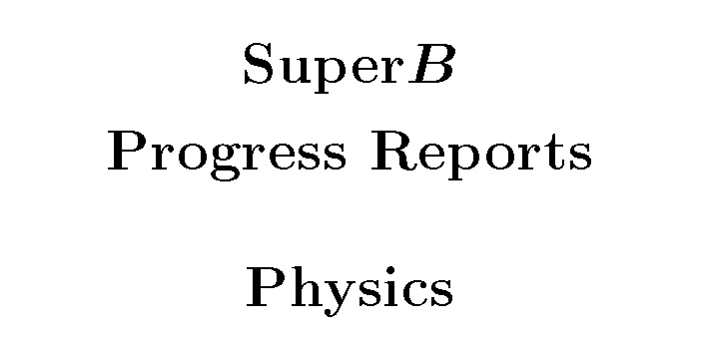
Phase 3 Topics
Methods and processes where Belle 2 can provide
important insight into NP complementary to other experiments:
Detailed description of physics program at Belle 2 in:
Physics of B Factories
Impact of Belle II on Flavor Physics
A.G. Akeroyd et al., arXiv: 1002.5012
B.G.,, K, Trabelsi, P. Urquijo,
BE LLE2-NOTE- PH-2015-002
Comparison between Belle II and
LHCb Physics Projections
B. O’Leary et al., arXiv: 1008.1541
P. Urquijo, BE LLE2-NOTE- PH-2015-004
Ed. A.J. Bevan, B. Golob, Th. Mannel,
S. Prell, and B.D. Yabsley,
Eur. Phys. J. C74 (2014) 3026
The Belle II Physics Book
(report of B2TiP)
~700 p.
~900 p.
E. Kou, P. Urquijo eds.,
to be published in Prog. Theor. Exp. Phys.
New!

Slide 11
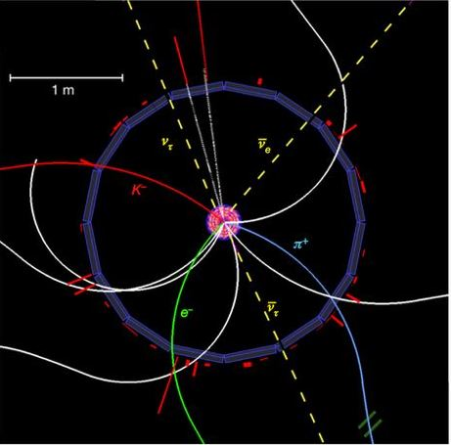
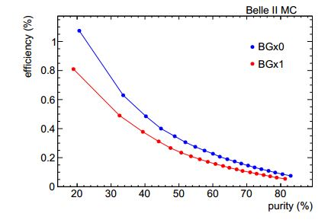
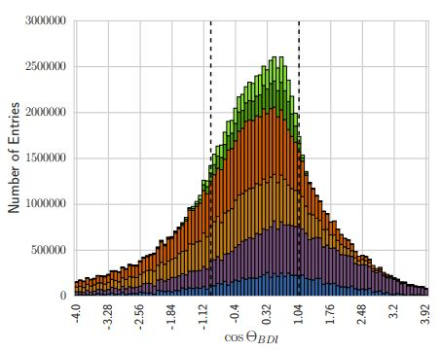
Phase 3 FEI
FEI: Full Event Interpretation
fully (partially) reconstruct B_{tag};
reconstruct h± , γ fromB_{sig} ;
ν‘s: no additional energy in EM calorim.;
signal at E_{ECL}~0;
reconstruction of B mesons with
invisible particles in final state;
FEI performed using MVA,
ε_{had} ~ 0.4%, P_{had}~40%
ε_{sl}~ 2x ε_{had} , P_{sl}~0.5 xP_{had}
e⁺
B_{tag} B_{sig}
ε_{had} =N_{b}^{rec}/N_{BB}
P_{had}=N_{b}^{sig}/(N_{b}^{sig}+ N_{b}^{bkg})
√(εP) drops by a factor of
0.5-0.8 for each level of beam
bkg.
e⁻
E. Kou, P. Urquijo eds., The Belle II Physics Book
to be published in Prog. Theor. Exp. Phys.

Slide 12
Phase 3 E_{miss}
B → D⁽*⁾τν
R(D⁽*⁾)= B(B → D*τν) / B(B → D* l ν)
R(D)_{SM}= 0.300 ±0.008
R(D*)_{SM} = 0.252 ±0.003
had. tag; τ → l νν , fit to M²_{miss} , multivariate classifier (E_{ecl}, p_{l} , ...)
l =e,μ Test of Lepton
Flavor Universality (LFU)
H. Na et al., Phys.Rev.D 92, 054410 (2015)
S.Fajfer et al., Phys.Rev.D85(2012) 094025
Belle, PRD92, 072014 (2015), 700 fb⁻¹
Low
M²_{miss} :
D* l ν ,
fit M²_{miss}
high
M²_{miss} :
mult.
miss.
Particles,
fit O_{NB}
N_{sig}=503 D*τν
N_{sig}=320 Dτν
R(D)= 0.375 ±0.064 ±0.026 R(D*) = 0.293 ±0.038 ±0.015

Slide 13
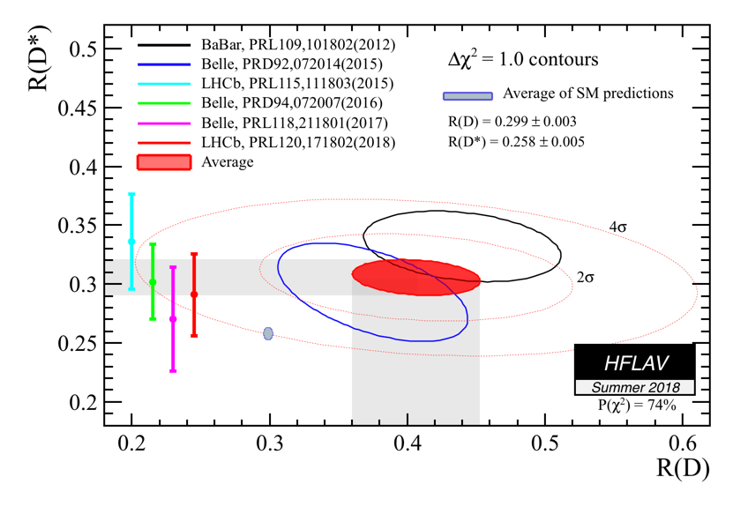
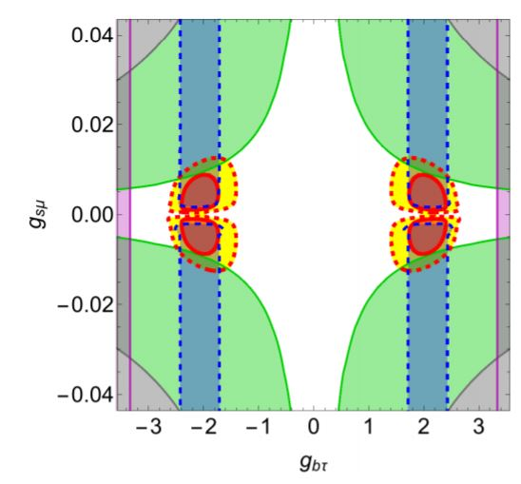
Phase 3 E_{miss}
B → D⁽*⁾τν
Average of measurements
if discrepancy
Data/SM confirmed
with larger accuracy
⇒ interpretation
l
b
c
b
Central value
(1σ)
W⁻
LQ
Average
l
c
4σ
SM
SM
ν
ν
NF
Preferred region R(D⁽*⁾) &
B → K⁽*⁾ l l
forbidden region B → Kνν
forbidden region t → Bτν
LQ coupling constants
S. Fajfer, N. Košnik, Phys.Lett. B755, 270 (2016)

Slide 14
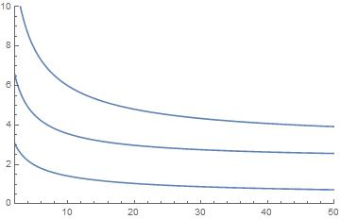
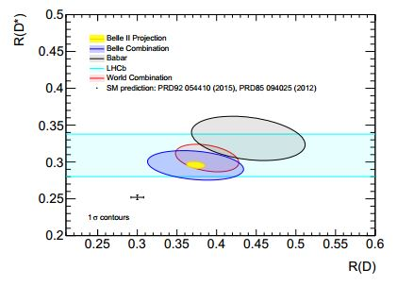
Phase 3 E_{miss}
B → D⁽*⁾τν
expected accuracy Belle II:
~2021
6.0%
E. Kou, P. Urquijo eds., The Belle II Physics Book
to be published in Prog. Theor. Exp. Phys.
σ(R_{D})/R_{D} [%]
3.6%
σ(R_{D*})/R_{D*} [%]
0.14
σ(P_{τ}) [x10]
∫L dt
[ab⁻¹]
WA
Belle II
(50 ab⁻¹)
SM

Slide 15
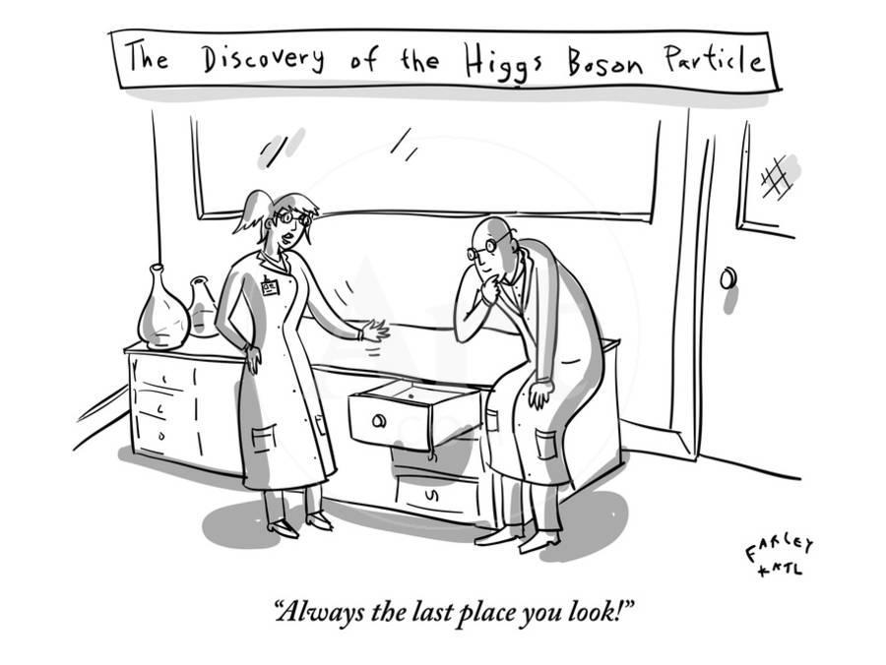
Summary
Lepton flavour universality is a corner stone SM
potential LFU violation is one of ~O(5) relatively significant
data / SM discrepancies in flavour physics
In few years with Belle II data we should be able to provide
much more accurate meas‘s of these discrepancies
Only with combination of measurements (LHC, SuperKEKB, …)
and in compArison to theory predictions, we may hope for
answers re NP
„The most exciting phrase to hear in science, the one that heralds new
discoveries, is not 'Eureka!' (I found it!) but 'That's funny ...‚“
Isaac Asimov (1920-1992)

