Slide 1
PPAP Community Meeting 2018
Introduction

Slide 2
Objectives for this meeting
Overview of UK PP programme
Input to Particle Physics Programme Evaluation
Roadmap update
Answers to questions from STFC (not yet formally received)
Discussion session on Tuesday
Input to European strategy for Particle Physics process
Discussion today plus possible use of time tomorrow
Identification of “Big Ideas”

Slide 3
Process for input to European Strategy
Today wide discussion.
Hope at least to narrow down options to put forward.
Produce start of draft writeup.
Further meeting scheduled for 20th Sept. At B’ham.
Meeting style & content to be influenced by today’s discussion.
Initial draft available prior to meeting in time for comment before 20th.
Scope for additional meetings if we decide useful today.
Deadline for submission 18 December 2018
Today wish to record discussion. (need your agreement)
Enable those not able to come to send in comments.

Slide 4
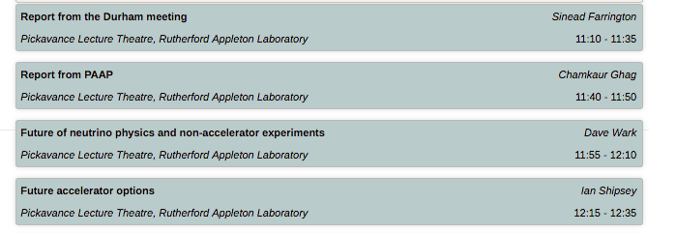
Morning session talks to raise questions for discussion this afternoon.

Slide 5
Documents
Report from meeting in Durham
https://conference.ippp.dur.ac.uk/event/661/
Attached today’s indico page (and 2017 page)
Output from process in 2013
PPAP input to last process

Slide 6
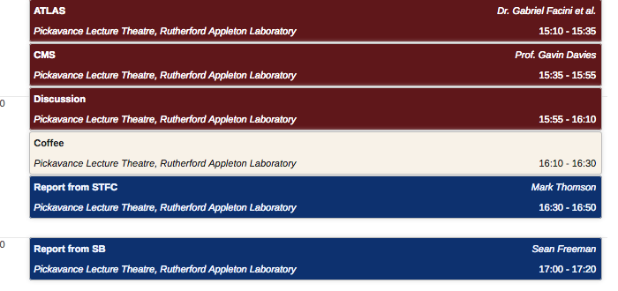
Programme after lunch

Slide 7
Priority projects
Aim: To develop an ambitious portfolio of outline business cases for priority projects that relate to our strategic scientific and research infrastructure objectives
Position STFC to make strong bids to the ‘challenge led’ funds, Spending Review and other opportunities as they arise
Four projects large (> 50M), medium and small.
Projects to be able to start within the next 5 to 6 years.
Identify projects by 31st July. Business case by 7th September.
Project lead to write business case.

Slide 8
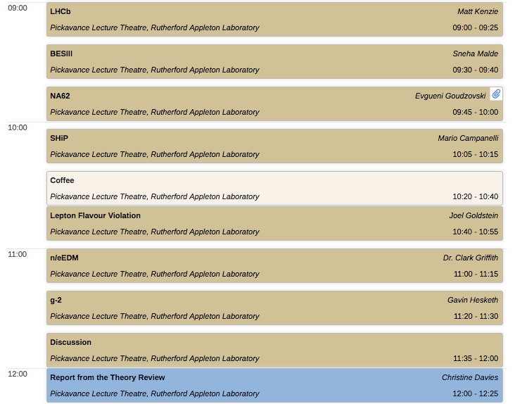
Tuesday - Flavour

Slide 9
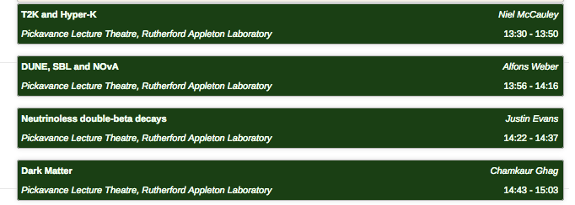
Tuesday Neutions & Non-accelerator

Slide 10
Practical information
Lunch provided next to lecture theatre.
Dinner left to you. List of local pubs available.
Committee will have dinner together (Hart of Harwell). People who would like to join us are very welcome. Around 10 places possible. Transport can be arranged.
WiFi. Eduroam available. If need other register at https://visitorwifi.stfc.ac.uk/Default.aspx to use guest. Please put in Gill Birch (gill.birch@stfc.ac.uk) as approver.

