Slide 1
Summary of the IPPP European Strategy Update Workshop IPPP 16-18 April 2018
Justin Evans, Sinead Farrington,
Evgueni Goudzovski, Mitesh Patel,
Michael Spannowsky
16th July 2018

Slide 2
IPPP European Strategy workshop
Gather a broad spectrum of UK academics, with a brief to engage “mid career” academics
Nucleated around a list of mid-career academics provided by group leaders, and in addition had an open registration call
Aimed to kick off thinking about the UK input
Ask ourselves what science we want to be doing in 20 years
Science-, not politics-, focused
Speakers covered wide range of technology/physics questions in open-minded way
Was not aiming to be a town meeting
PPAP 16/17 July RAL; Town meeting 20 Sept Birmingham
Compiled a workshop summary document
The UK final submission must take care to access the very latest projections, our write-up is just a snapshot and based on speakers’ expertise and personal views

Slide 3
This talk
Highlights from the sessions (of course I cannot be exhaustive, so apologies for omissions)
Theory
Technology
Leptons
Quark Flavour
Higgs
Exotics
Standard Model/Top
Dark Matter
Astroparticle/Gravitational waves
Summarise the workshop conclusions
Consensus on some practical issues
Open questions/sticking points
https://conference.ippp.dur.ac.uk/event/661

Slide 4
Theory
Valya Khoze

Slide 5
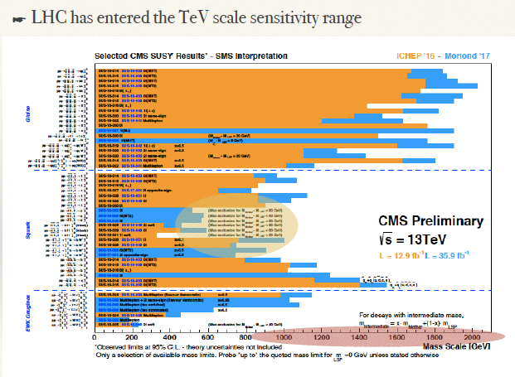
Theory
Report from future colliders working groups
But constraints can be avoided in non-minimal scenarios
So “best bet” are Higgs precision measurements – must form part of any future program
C. Englert

Slide 6
Physics Beyond Colliders
C. Burrage

Slide 7
Technology
Accelerators
New capabilities are being – and should be - developed, no matter what we do next (e.g. laser)
Silicon
Reported on developments in CMOS/MAPS
Drew attention to lack of access to wafer processing/dicing – challenging for small scale R&D
Trigger/DAQ
Multivariate method developments
Smaller experiments driving DAQ developments
Possibilities growing to process data on-detector
Computing
Recognise role of High Performance Computers
Need for career path / role for software engineers
S. Gibson, V. Boisvert, D. Costanzo, J. Vossebeld

Slide 8
Leptons
S. Peeters
Neutrinoless beta decay
Insights on nature of neutrinos; sensitive to new physics
(UK document on future strategy being
submitted to STFC)

Slide 9
Neutrinos
Blake,
J. Nowak

Slide 10
Neutrinos
Blake,
J. Nowak

Slide 11
Muon Physics
G. Hesketh

Slide 12
Quark Flavour
M. Vesterinen

Slide 13
Quark Flavour Anomalies
K. Petridis

Slide 14
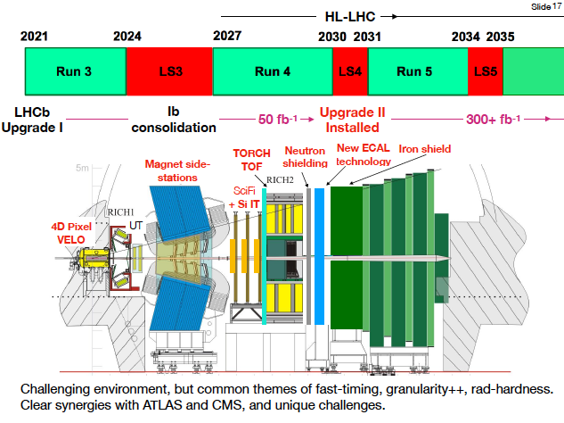
Quark Flavour
K. Petridis

Slide 15
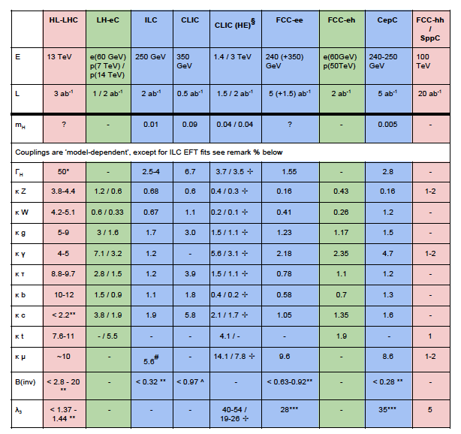
Higgs
N. Wardle,
V. Martin,
C. Englert,
T. Scanlon
Width
Couplings
(see write-up
for footnotes)
Self-couplings

Slide 16
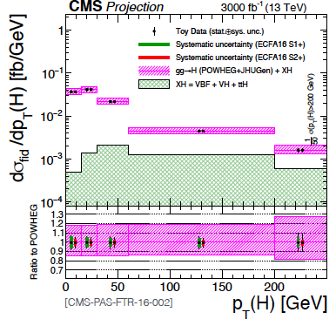
Higgs
N. Wardle
V. Martin

Slide 17
Exotics
M. D’Onofrio

Slide 18
Exotics
M. D’Onofrio

Slide 19
Exotics
M. D’Onofrio

Slide 20
Standard Model/Top
A. Buckley

Slide 21
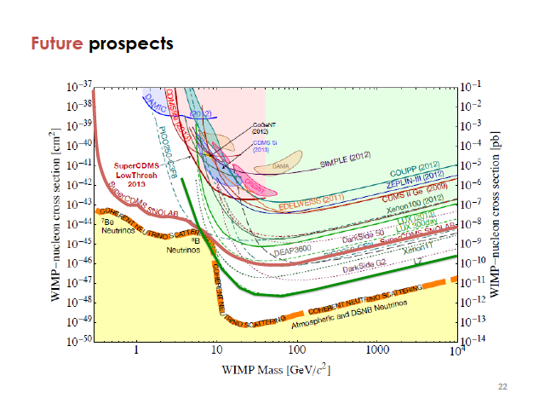
Dark Matter
D. Cerdeno

Slide 22
Dark Matter
D. Cerdeno

Slide 23
Astroparticle
R. Nichol

Slide 24
Astroparticle
R. Nichol

Slide 25
Open Questions (order not significant!)
1) It was a clear outcome from the talks that the extensions to current sensitivities provided by the High Luminosity LHC (HL-LHC) provide important constraints to many SM parameters and search capability for BSM physics. The commissioning and exploitation of the HL-LHC should therefore be one of the highest priorities for European Particle Physics in the 2020s.
2) What is the possible scale of new physics? To what extent could insights be delivered by flavour physics anomalies on the timescale of the ES update? While some hints will be available it is not clear if an energy scale could be identified, such that it could inform a choice of future collider.
3) Related to (2) Is there a consensus among theorists on a collider CoM energy at which null observations would definitively tell us something about the way in which the SM is broken?

Slide 26
Open Questions
4) There was strong enthusiasm for a future collider. The physics cases for FCC and CLIC are clearly both strong but there are resource implications in pushing both R&D programs forward during the 2020s. The last UK ES submission said that
“a timely decision should be taken on optimal next-generation collider facilities for exploitation of LHC discoveries”. The final 2013 ES update document said "to stay at the forefront of particle physics, Europe needs to be in a position to propose an ambitious post-LHC accelerator project at CERN by the time of the next Strategy update, when physics results from the LHC running at 14 TeV will be available".
It is the recommendation of the organisers of this workshop that it should be considered, in a UK community meeting, whether a decision can now be made on a definitive UK recommendation. If a consensus cannot be reached, then it could be debated in the community meeting whether to put forward to the ES process that its committee makes a definitive recommendation by 2020.
5) Which program(s) can best engage a generation of physicists over the next decades such that expertise is retained in operating experiments/accelerators and analysing data, rather than witnessing a brain drain while waiting for the next large project?
6) In relation to (5) the importance of smaller, non-collider experiments was agreed both for their own strong science objectives and as training grounds for the field in general.

Slide 27
Omissions
Some topics were raised in addition to the program of the meeting, and these could be addressed at the UK community meetings:
Should a deep-underground-facility be part of a future ES?
Axion experiments
Availability of satellite data for astroparticle physics - it has been so far fortuitous that this is public, can we rely on this in future?
Contact should be increased between collider experiment efforts to search for dark matter and direct detection experiments
The SHIP experiment was not discussed and should be addressed in future discussions.
How to fit into the outside-Europe perspective

Slide 28
Practical Suggestions
— Technical:
1) The positive benefits of RD collaborations were discussed and it was suggested that these could be extended to cover more areas and to have a more open structure, for example envisaging RD’s on Trigger and DAQ; silicon work across Europe on producing wafers/dicing.
2) It was noted that the role of physicist programmer underpins experimental particle physics and should be supported appropriately with a better defined career path across European institutes and labs.

Slide 29
Practical Suggestions
— Theory:
1) A concerted approach to theory combinations may be of use e.g. to combine
EDM’s;
2) global fits with neutrinos were suggested;
3) greater engagement of nuclear theorists with neutrino research would be of
benefit. This could be developed by the CERN theory division as part of the
CERN Neutrino Platform, the existence of which was strongly appreciated
by the workshop attendees.

Slide 30
Summary
Workshop a success in engaging broad range of interested physicists, discussing the science
Write-up intended to be of use as a briefing document giving snapshots of the science and project status (and noting omissions in the workshop program)
Practical suggestions were gathered

Slide 31
Technology: Accelerators
Accelerators: novel acceleration is needed whatever the future decisions are
S. Gibson

Slide 32
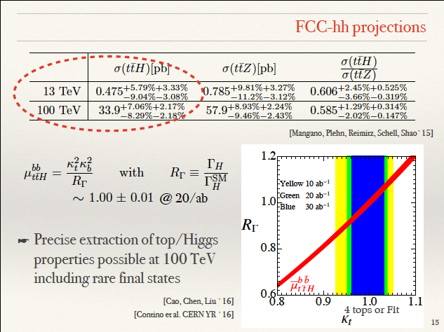
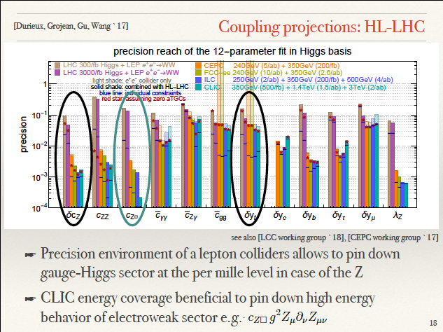
Coupling projections FCChh/CLIC
C. Englert

Slide 33
Technology: Accelerators
Accelerators: novel acceleration is needed whatever the future decisions are
S. Gibson

Slide 34
Technology: Computing
D. Costanzo

Slide 35
Technology: Silicon
Significant R&D in Monolithic Array Pixel Sensors (MAPS), for example pushing time resolution:
J. Vossebeld

Slide 36
Higgs at LHeC

Slide 37
Exotics
M. D’Onofrio

Slide 38
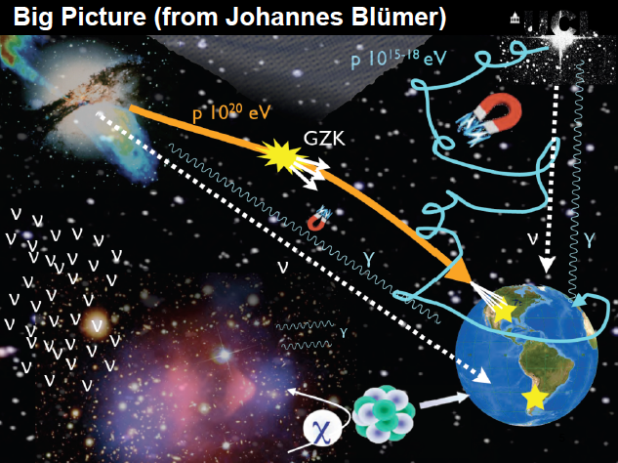
Astroparticle/Gravitational Waves

Slide 39
Gravitational Waves
T. Sumner

Slide 40
Gravitational Waves
T. Sumner

Slide 41
Astroparticle/Gravitational Waves

Slide 42
Exotics
M. D’Onofrio

Slide 43
Technology: Silicon
J. Vossebeld

Slide 44
Technology: Trigger/DAQ
V. Boisvert

Slide 45
Technology: Computing
D. Costanzo

Slide 46
Dark Matter
D. Cerdeno

